Slide 1
Energy Upgrades of a Linear Higgs Factory
2024 International Workshop on Future Linear Colliders
Emilio Nanni
July 8th, 2024

Slide 2
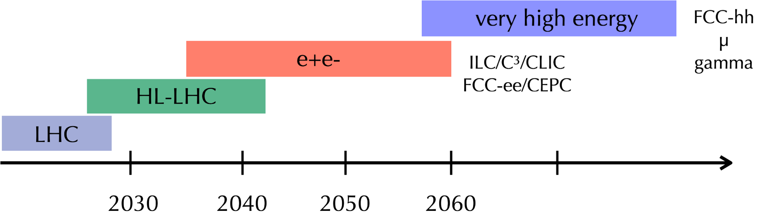
What’s Next for the Energy Frontier?
Wish list beyond HL-LHC:
1. Establish Yukawa couplings to light flavor ⟹ needs precision
2. Establish self-coupling ⟹ needs high energy
Decades Long Program of Higgs Physics and Discovery
LCWS 2024

Slide 3
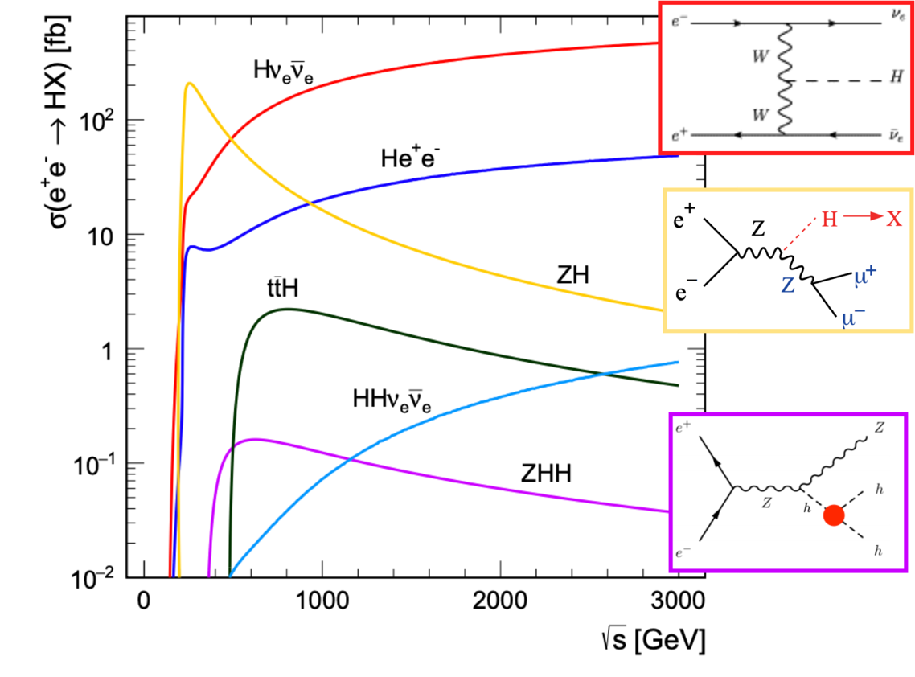
Higgs Production at e⁺e⁻
ZH is dominant at 250 GeV
Above 500 GeV
Hvv dominates
ttH opens up
HH production accessible with ZHH
Global Vision for a Linear Collider Facility:
Mon July 8th
16:00-17:20 Ito Hall
Full Higgs Factory Program
91 GeV to TeV scale
BSM reach 100 TeV
LCWS 2024

Slide 4
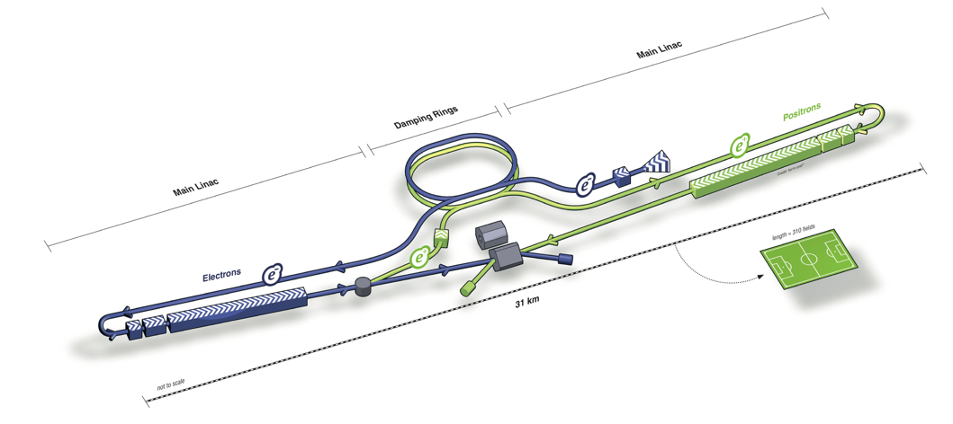
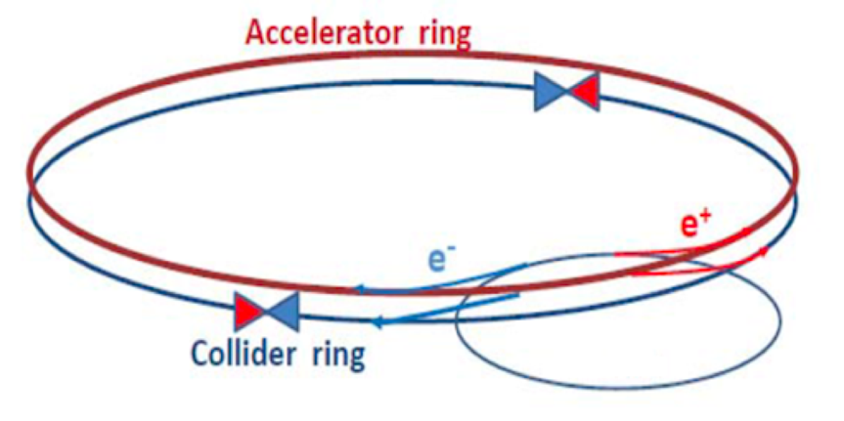
Linear vs. Circular
Linear e⁺e⁻ colliders: ILC, C³, CLIC
Reach higher energies (~TeV), and can use polarized beams
Relatively low radiation
Collisions in bunch trains
Circular e⁺e⁻ colliders: FCC-ee, CEPC
Highest luminosity collider at Z/WW/ZH
limited by synchrotron radiation above 350 – 400 GeV
Beam continues to circulate after collision
Infrastructure, Technology and People Provide a Pathway for Future Discovery
LCWS 2024

Slide 5
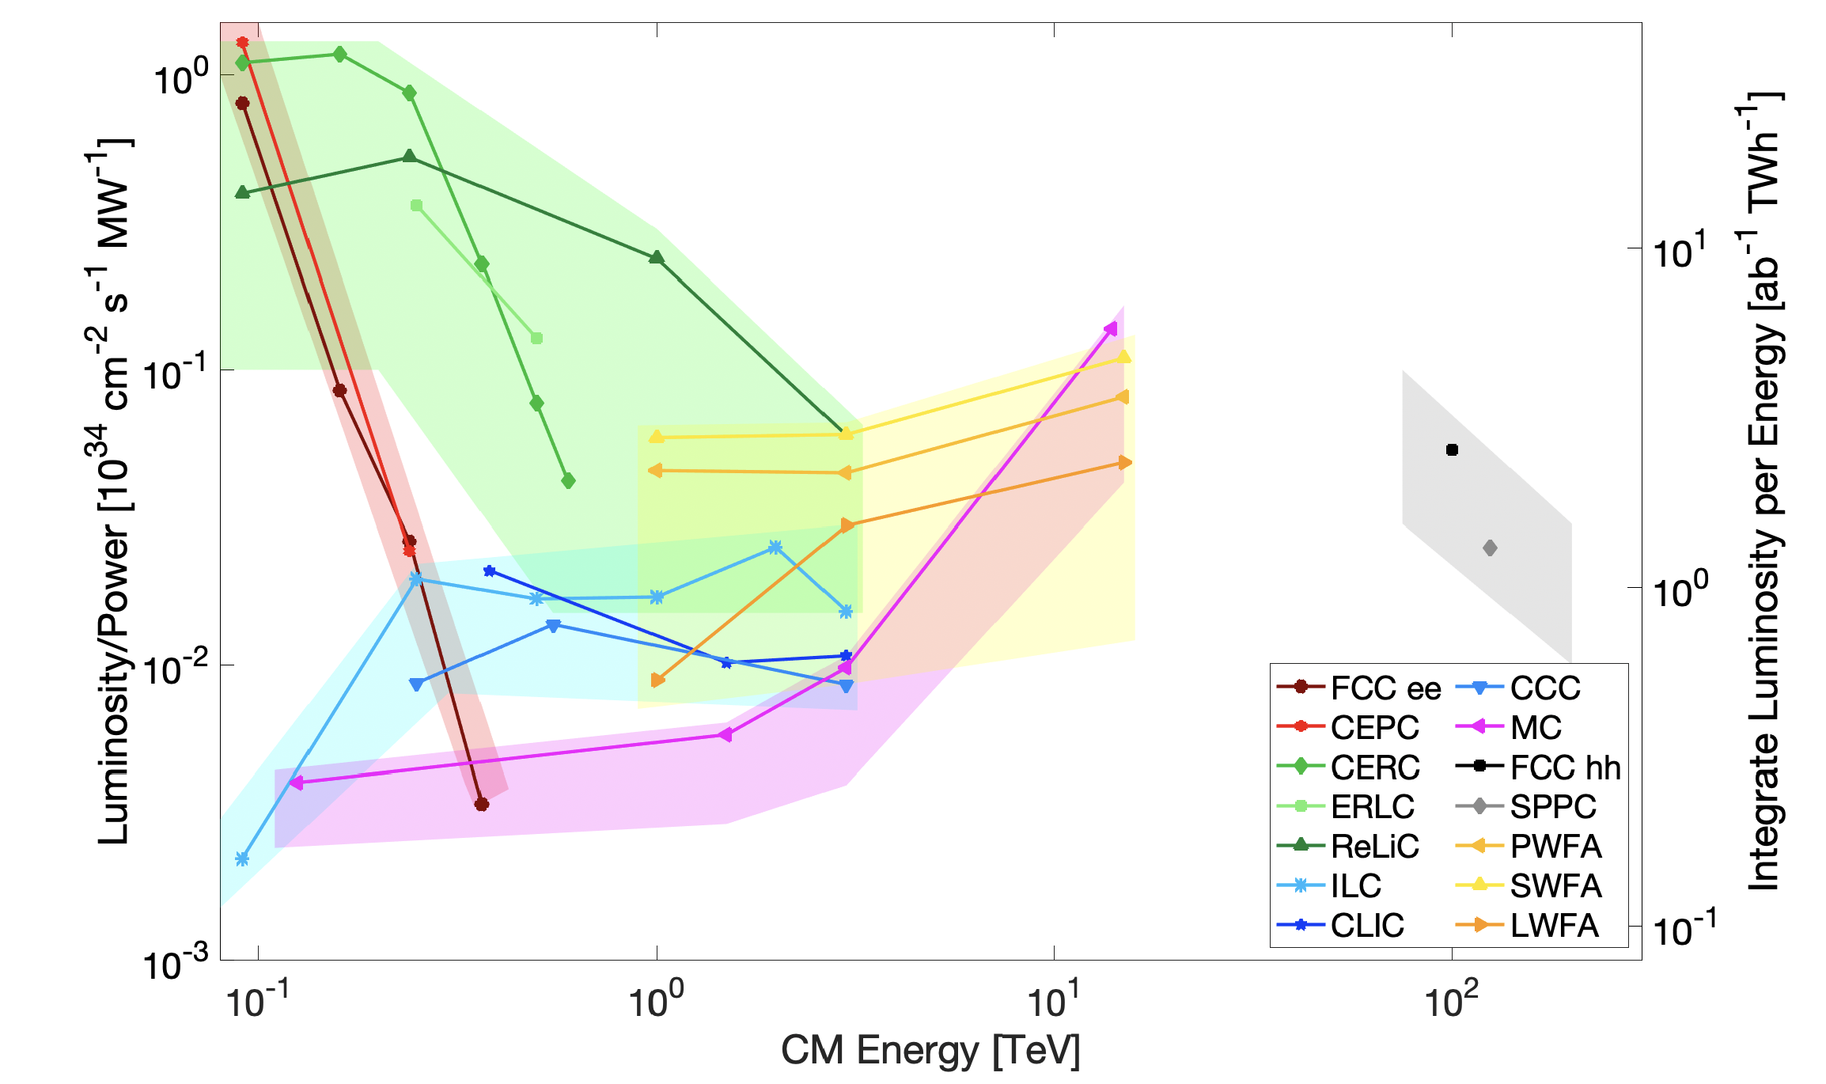
Sustainable Scaling with Energy
Linear colliders maintain power efficiency with energy
Snowmass ITC comparison of collider parameters
Inputs from 2021
Sustainability is an increasing focus of our community
Need community updates for EPPSU
Sustainability Session LCWS 2024:
Tuesday July 9th
15:45 - 17:45 Ito Hall https://agenda.linearcollider.org/event/10134/sessions/5589/#20240709
Note: Includes proven and early-stage technologies
LCWS 2024

Slide 6
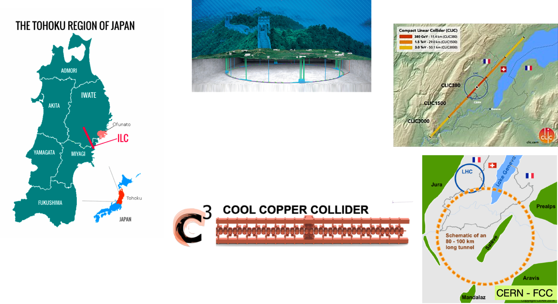

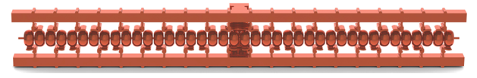
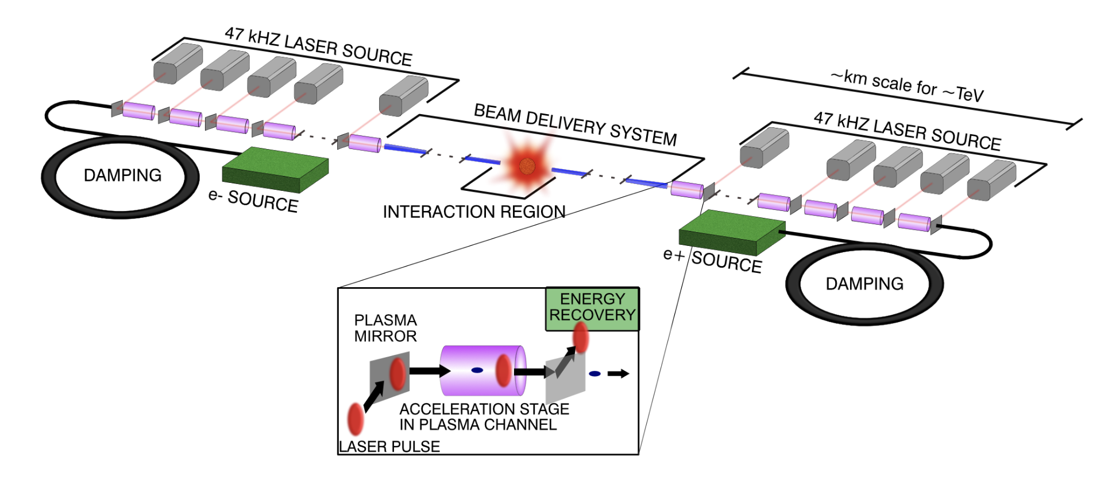
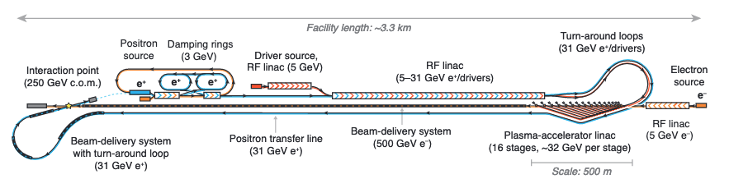

Linac Proposals or Technologies for Future Upgrades?
CLIC 380/1000/3000 GeV
250/550 GeV
… > TeV
ILC
250/500 GeV
Wakefield Accelerators
Recirculating
Linacs
LCWS 2024

Slide 7
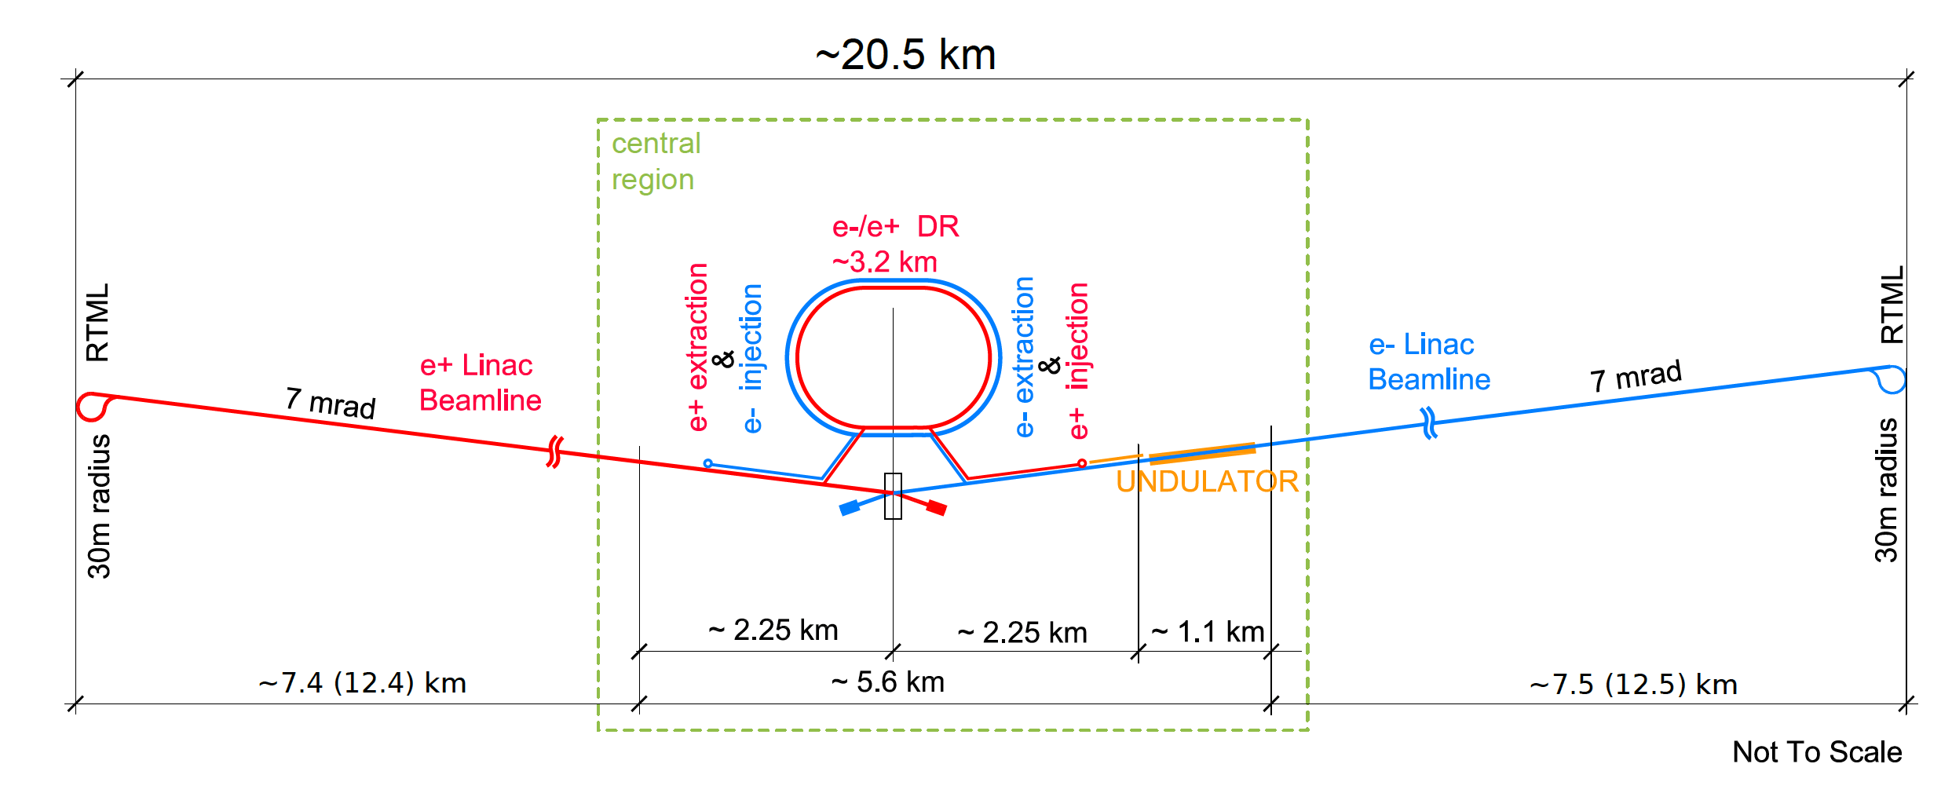
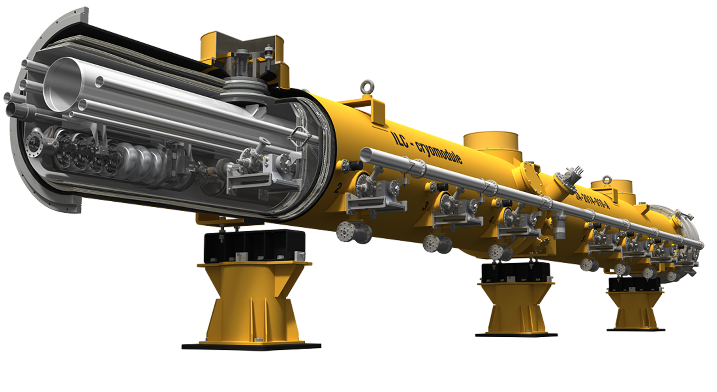
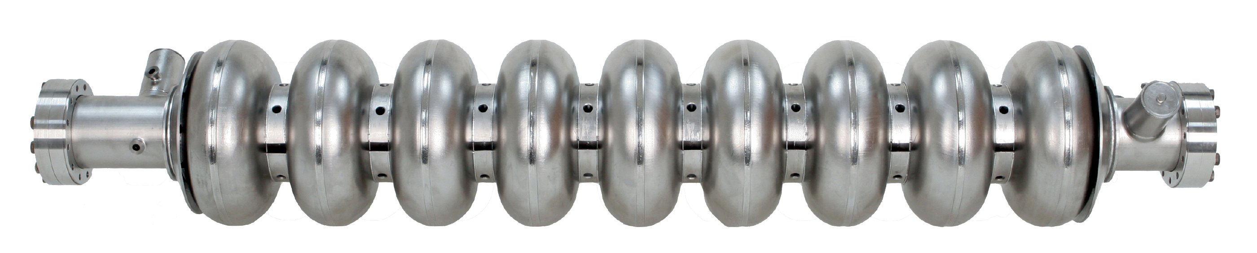
ILC Baseline
250 GeV Center of Mass Superconducting RF Linear Accelerator
Established technology for main linac
Reusable Infrastructure:
  2X 7.4 km large bore tunnel
  Electron and positron sources
  Damping rings
  Cryogenics
  Beam transport & turn arounds
  Beam delivery & final focus – upgradable or replaced
Existing HW reutilized (e.g. FELs)
DESY-22-045, “The international linear collider: Report to snowmass 2021”
Why change technology? Energy Reach or Efficiency/Luminosity
LCWS 2024

Slide 8
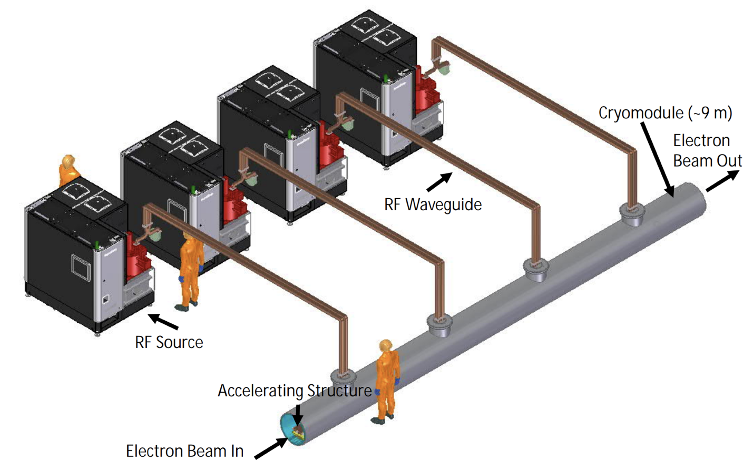
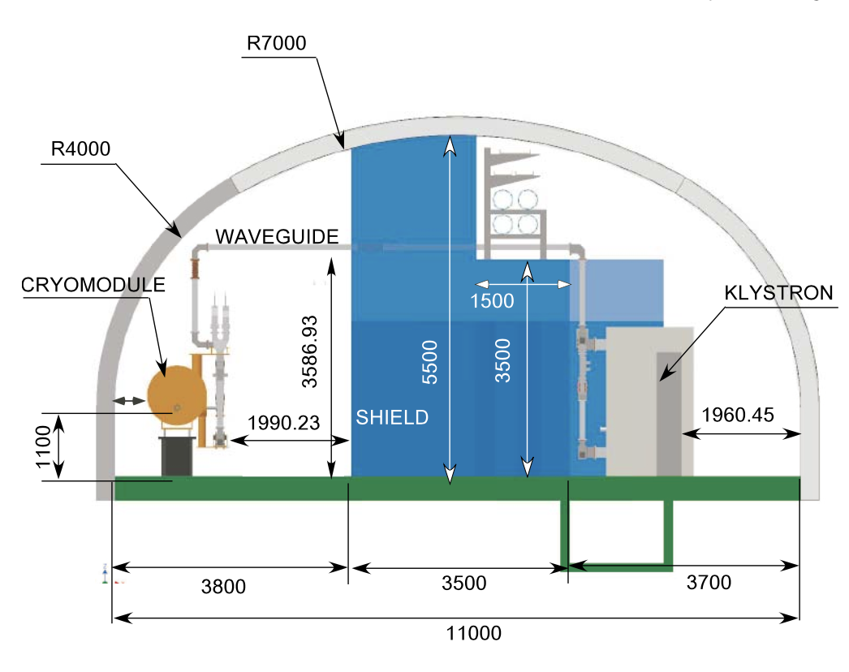
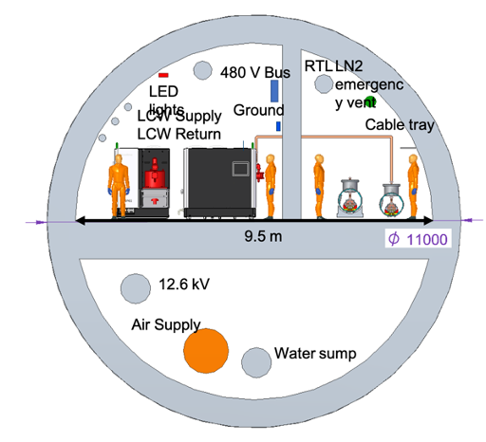
Constrain Imposed by Tunnel Dimensions
ILC provides a large tunnel suitable for multiple technologies
ILC
Usable Tunnel Width - 11 m
C³
Usable Tunnel Width - 9.5 m
Cryomodule Unit - 9 m
(630 MeV/1 GeV )
LCWS 2024

Slide 9
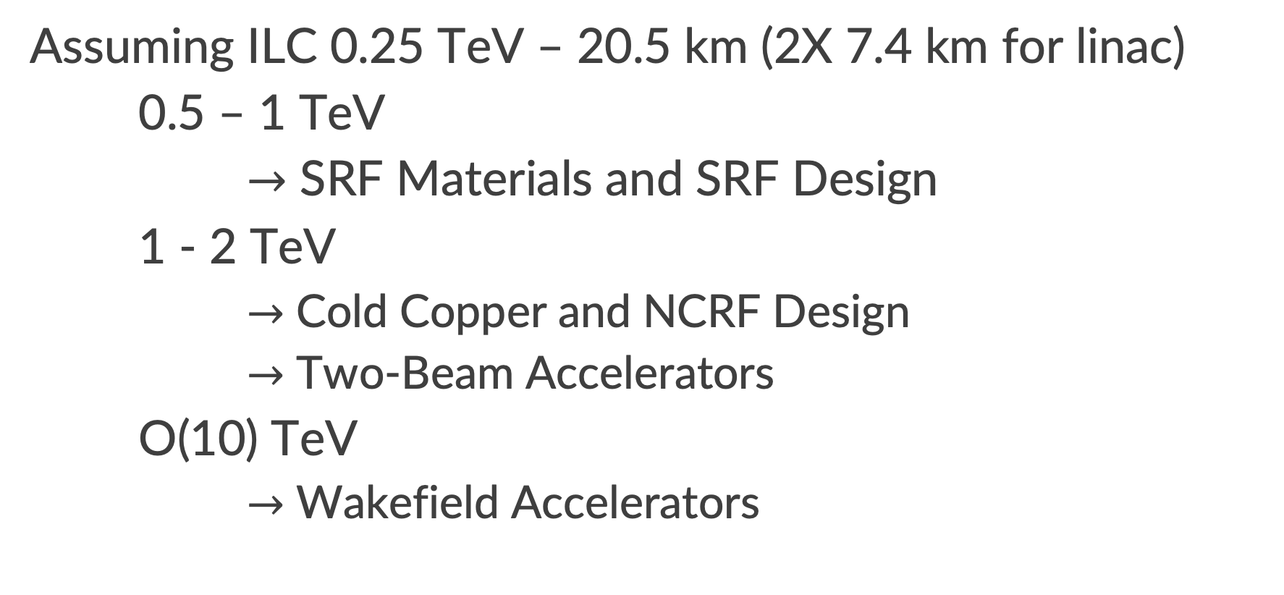
Pathways to Higher Energy
Assuming ILC 0.25 TeV – 20.5 km (2X 7.4 km for linac)
0.5 – 1 TeV
$→$ SRF Materials and SRF Design
1 - 2 TeV
    $→$ Cold Copper and NCRF Design
    $→$ Two-Beam Accelerators
O(10) TeV
    $→$ Wakefield Accelerators
LCWS 2024

Slide 10
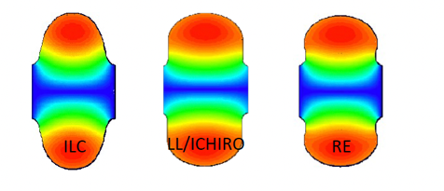
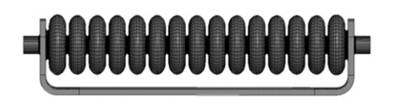
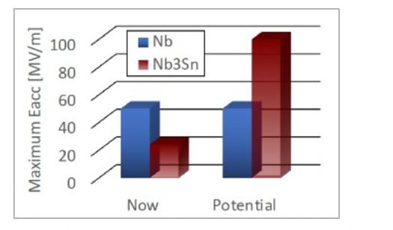
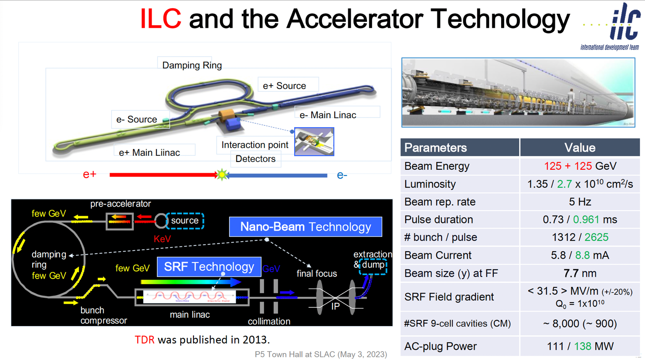
SRF technology for ILC-250 beyond present limits
Advanced shape standing wave SRF cavities – Low Loss (LL), ICHIRO,
Reentrant (RE) – increase peak quench magnetic field by 10-20%, potentially bringing accelerating gradient limit to ≲ 60 MV/m
Traveling wave (TW) SRF offers better cryogenic efficiency and higher accelerating gradient up to ~ 70 MV/m – possible application: ILC energy upgrade, HELEN collider, ACE at Fermilab
Advanced SRF materials – Nb3Sn cavities can potentially reach ~ 90 MV/m

Slide 11

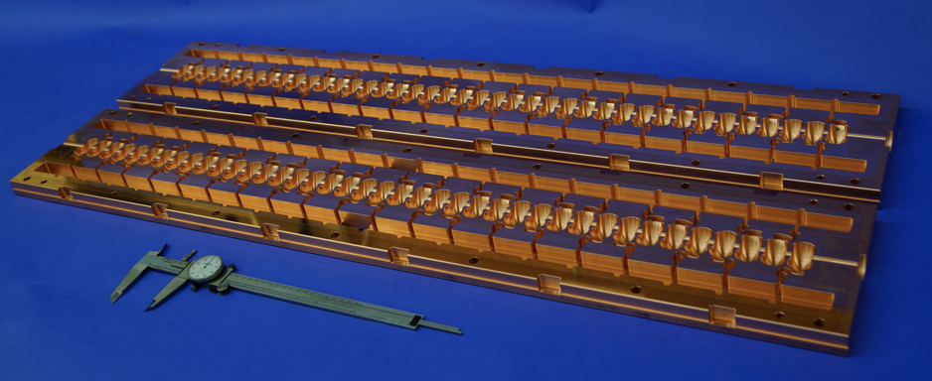
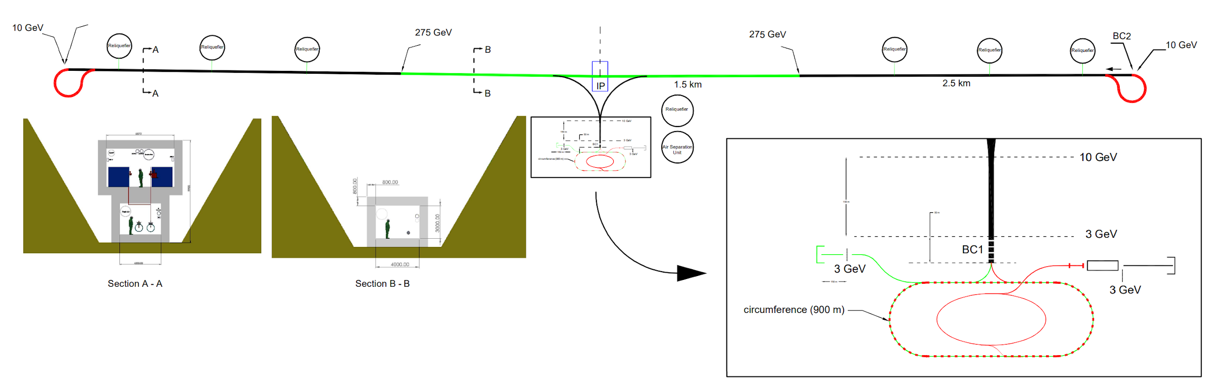
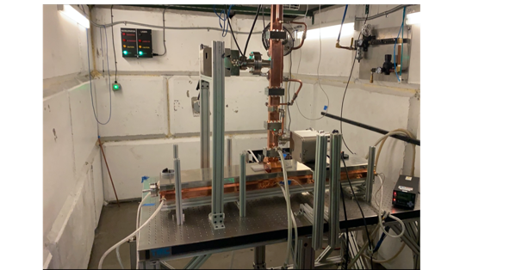
C3 Cool Copper Collider
C³ Prototype One Meter Structure
C³ is based on a new rf technology
Dramatically improving efficiency and breakdown rate
Distributed power to each cavity from a common RF manifold
Operation at cryogenic temperatures (LN₂ ~80-K)
Potential for High gradient: 155 MeV/m
Scalable to multi-TeV operation
C³ - 8 km Footprint for 250/550 GeV
High power Test at Radiabeam
HEP Seminar

Slide 12
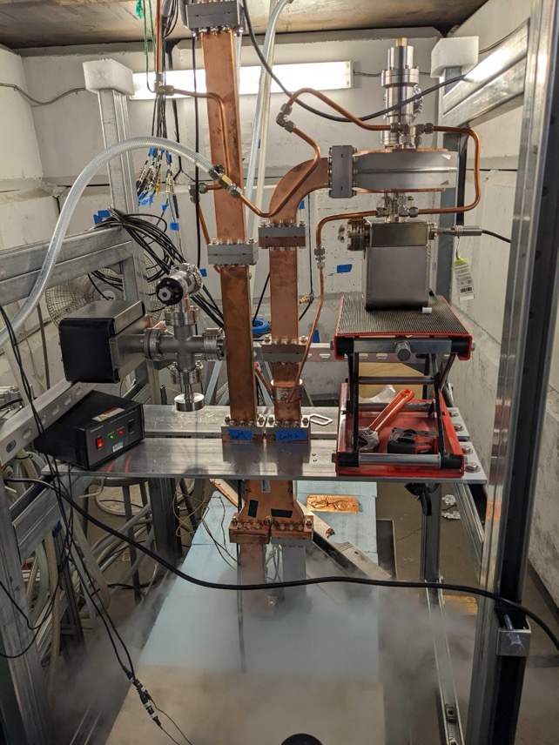
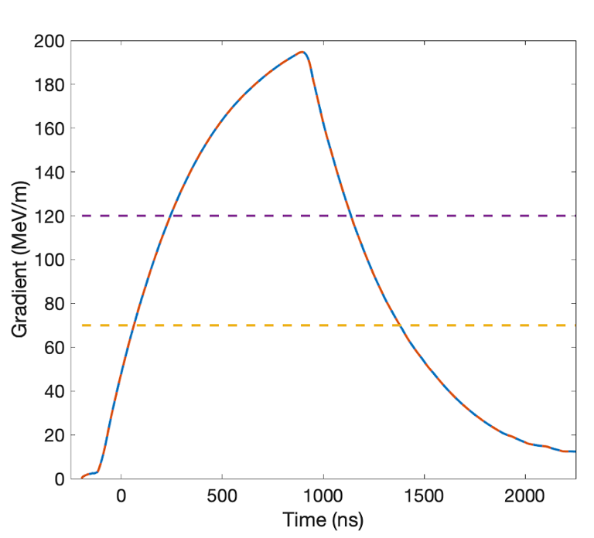
Exceeding Gradients and Pulse Lengths Required for C³
Measured and modeled response for single cell cavity
C³ - 2000
200 ns
C³ - 550
250 ns
C³ - 250
700 ns

Slide 13
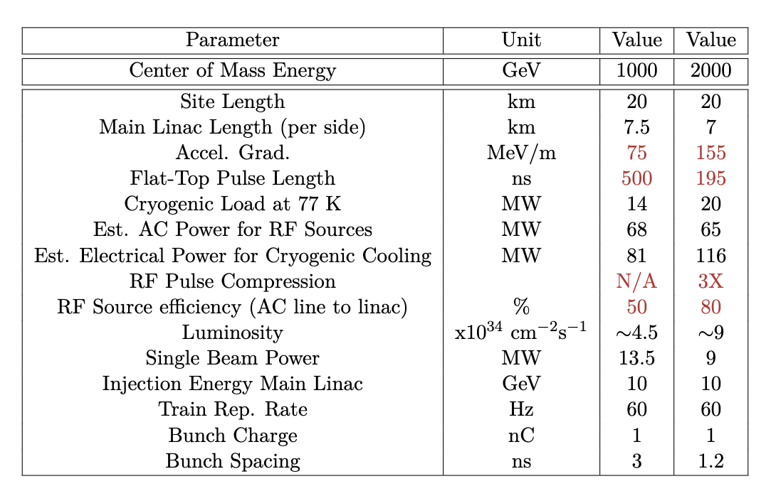
Energy Upgrade of ILC 250
Cryoplants replaced or modified
Injectors and damping rings reusable with fast kickers and extraction of bunch trains
Sustainability: Adoption of lower repetition rate, higher beam loading will improve power consumption
B. Bullard - Sustainability Session: Tuesday 16:15
LCWS 2024

Slide 14
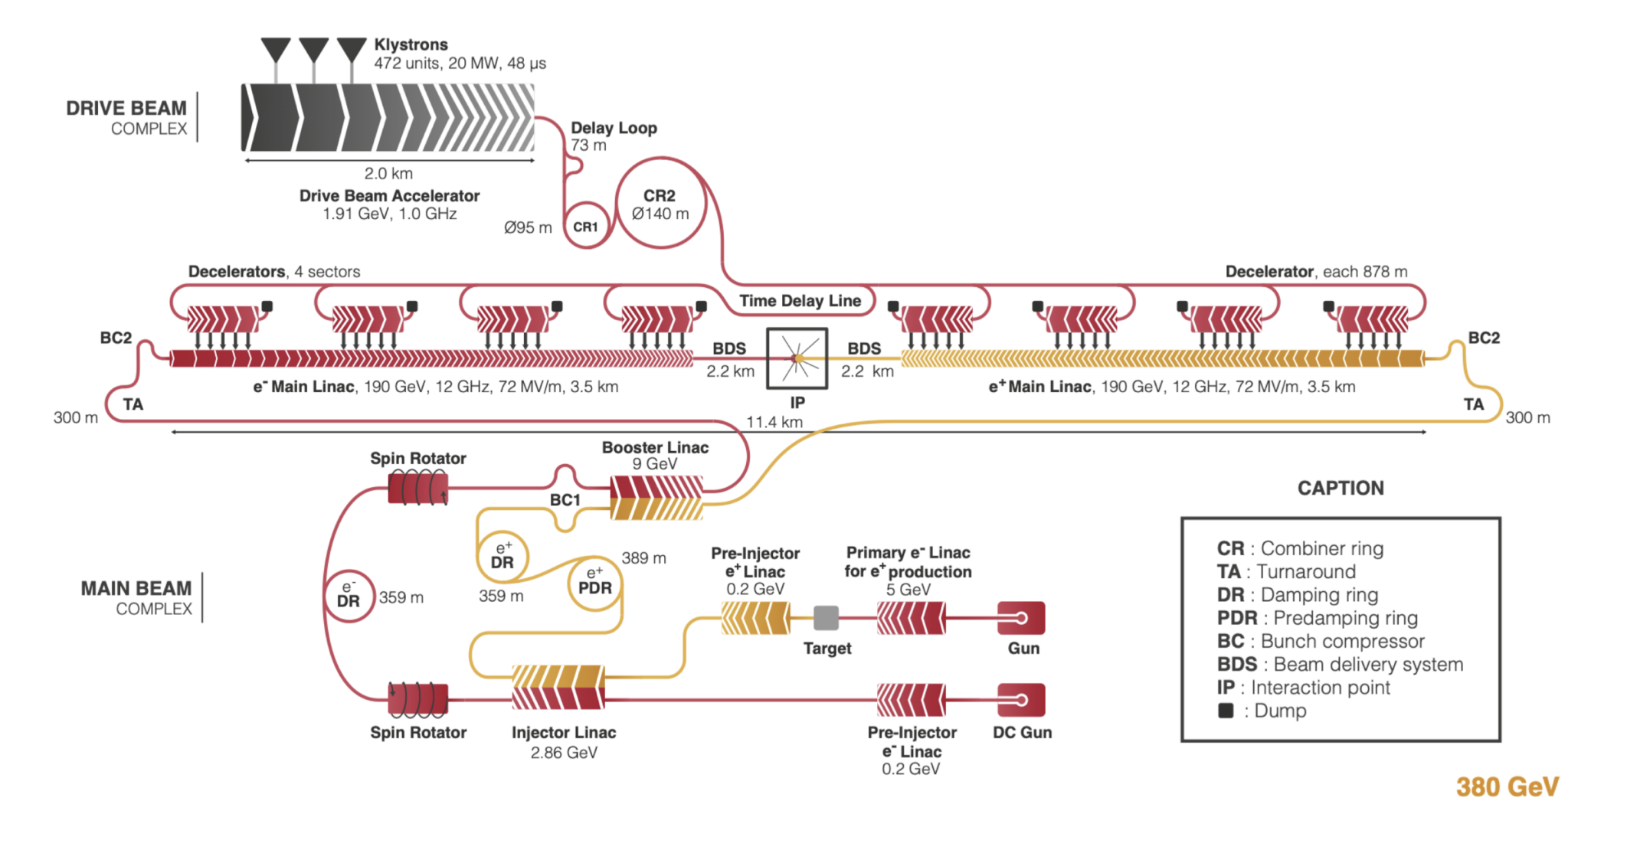
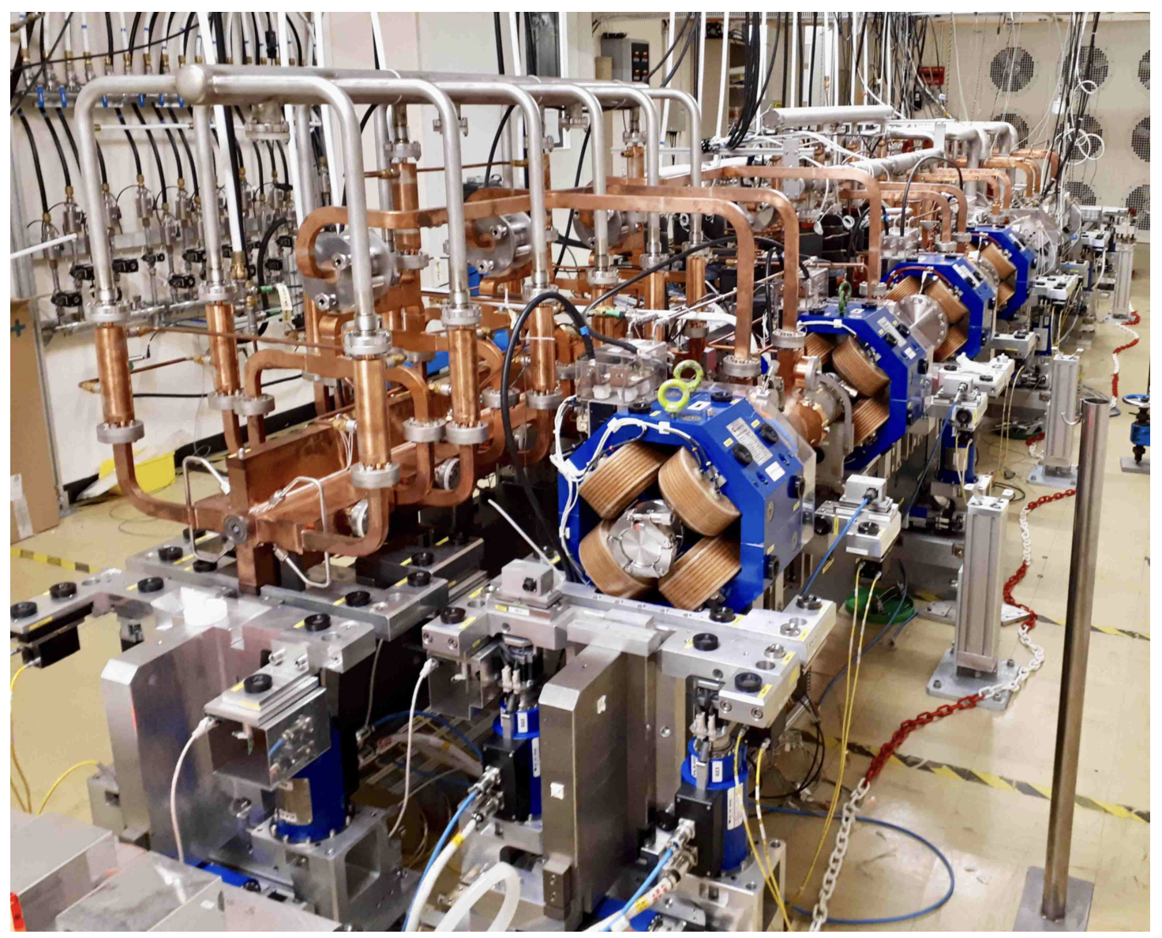
CLIC Two Beam Acceleration
High gradient achievable with CLIC accelerator technology
Efficient high power and low energy drive linac
Power extraction parallel to the main linac
LCWS 2024
arxiv.org/pdf/2203.09186

Slide 15
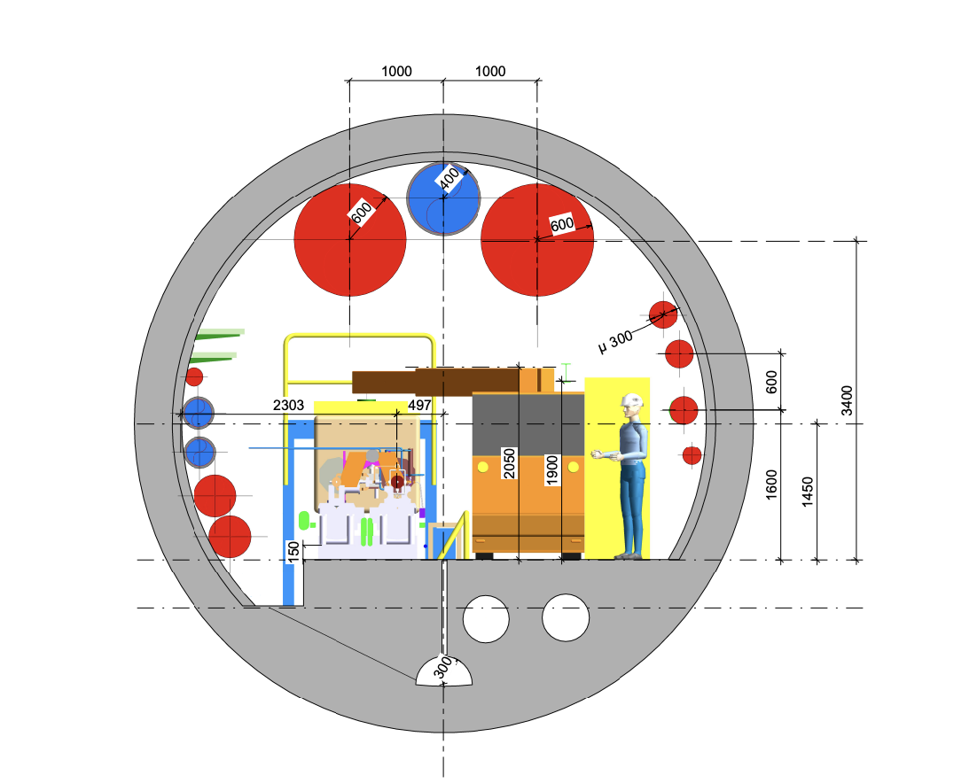
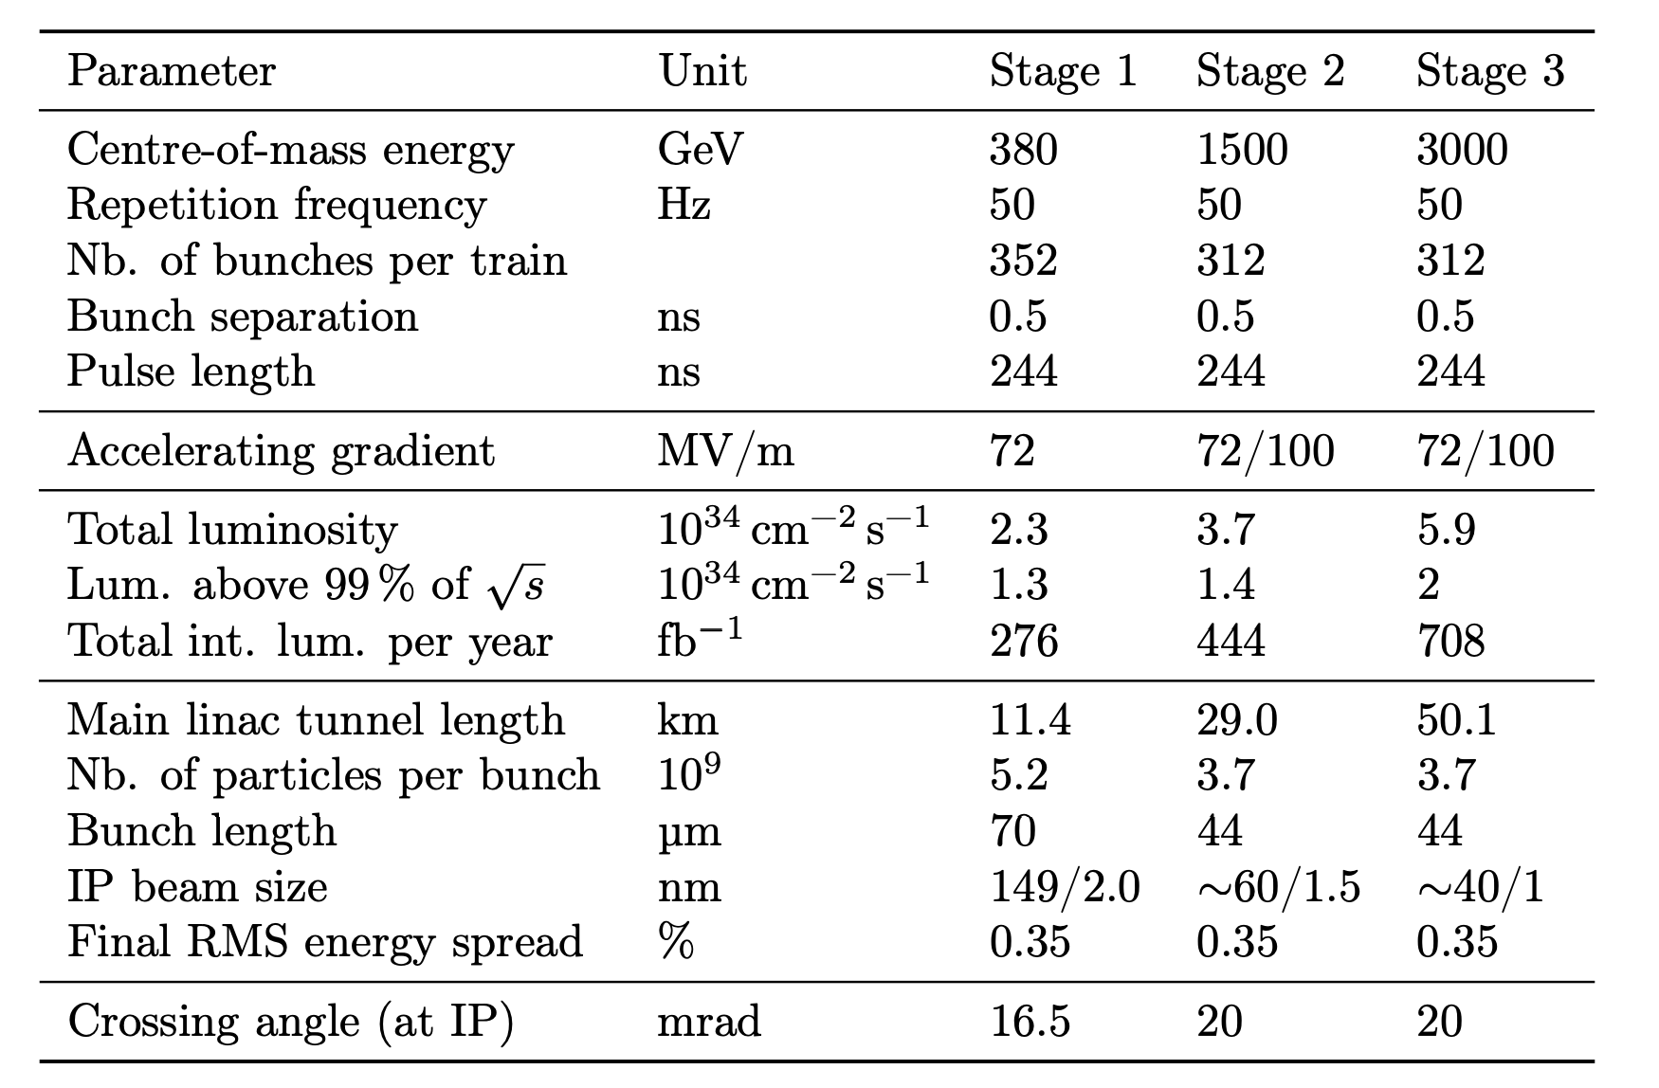
CLIC Gradients for TeV Upgrade
CLIC modules operate at 100 MeV/m and fit easily in ILC main linac tunnel
Additional drive beam turnaround one possible complication
Nominal CLIC Parameters
LCWS 2024
arxiv.org/pdf/2203.09186

Slide 16


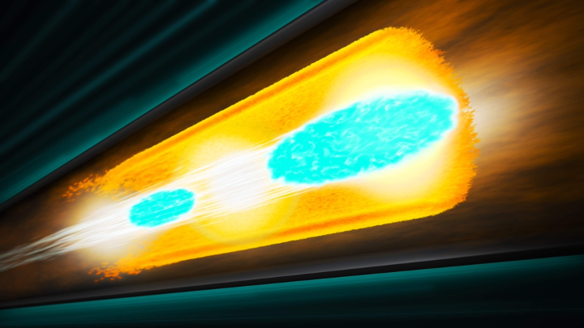

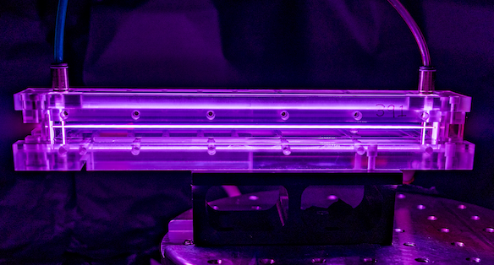
Wakefield Accelerator Technologies
S. Gessner, P5 Town Hall 2023
Structure Wakefield Accelerators @
Argonne, SLAC, and LBNL are the stewards of SWFA, PWFA, and LWFA technology in the US, with university participation.
Beam Driven Plasma @
Laser Driven Plasma @
Key advantages:
Ultra-large gradients (1-100 GeV/m)
Ultra-short bunches (suppress beamstrahlung)
Notes:
Show capillary

Slide 17
The Path to 10+ TeV
S. Gessner, P5 Town Hall 2023
2025 | 2030 | 2035 | 2040 | 2045 | 2050 | 2055 | 2060 | 2065 | 2070 | 2075
250 GeV Higgs Factory
500+ GeV Upgrade
SRF or NCRF Linear Collider
Integrated Design Study, BDS Study, Demo facility Study
CDR
TDR
Design Studies
High-Power R&D,
0.5 GeV Demo, 3 GeV Demo
Structure Wakefield Collider
Beam-Driven Plasma Collider
Positron PWFA, Staging,
Energy Recovery
Demonstrator Facility with BDS System
15 TeV Wakefield Collider
Operating 2060 and Onward
Laser-Driven Plasma Collider
Staging, Energy Recovery,
kHz repetition, Positron LWFA
NLQED, FEL R&D, IP R&D
𝛾𝛾-Plasma Collider
Wakefield Accelerators can be developed in parallel with the operation of Linear Collider Higgs Factories to provide a staged upgrade path to the energy frontier.
ACC Sessions at LCWS 2024 https://agenda.linearcollider.org/event/10134/sessions/5585/#20240709
Notes:
WRE

Slide 18
Conclusions
Fundamental strength of a linear collider facility is the ability to increase energy
Achievable with the same technology and extension of length
Achievable improvement or replacement of main linac technology
e.g. ILC 250 GeV with 20 km footprint can reach 2 TeV with C³ technology
Vigorous Accelerator R&D needed to unlock this potential
Please Attend and Participate in the “Global Vision for a Linear Collider Facility”
https://agenda.linearcollider.org/event/10134/contributions/55143/
LCWS 2024

