Slide 1
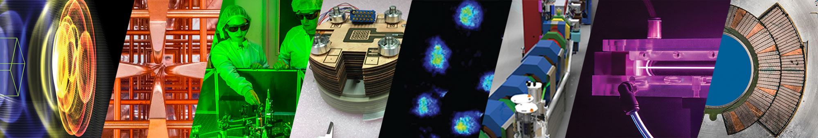
Jean-Luc Vay, Arianna Formenti, Marco Garten, Axel Huebl, Remi Lehe,
Chad Mitchell, Ji Qiang, Olga Shapoval, Edoardo Zoni
A next generation, integrated community toolset
for the modeling of linear colliders
International Workshop on Future Linear Colliders, LCWS2024
July 8-11, 2024 – The University of Tokyo, Japan
Advanced Modeling Program

Slide 2
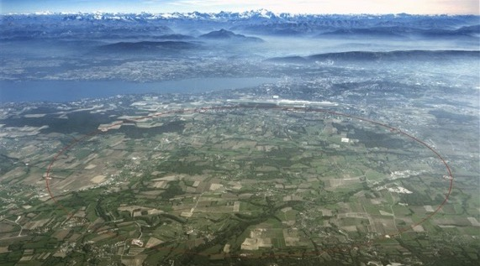
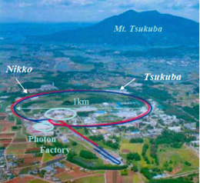
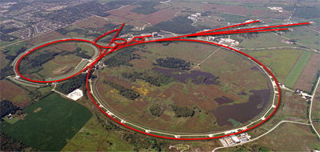
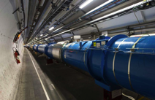
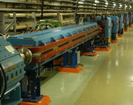
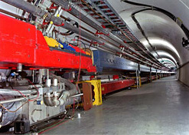
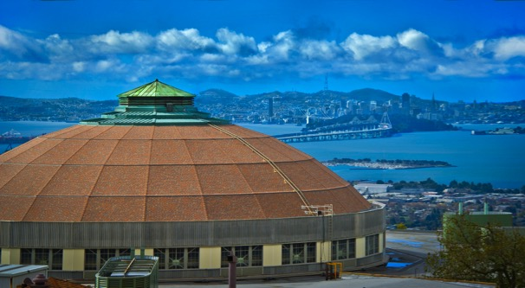
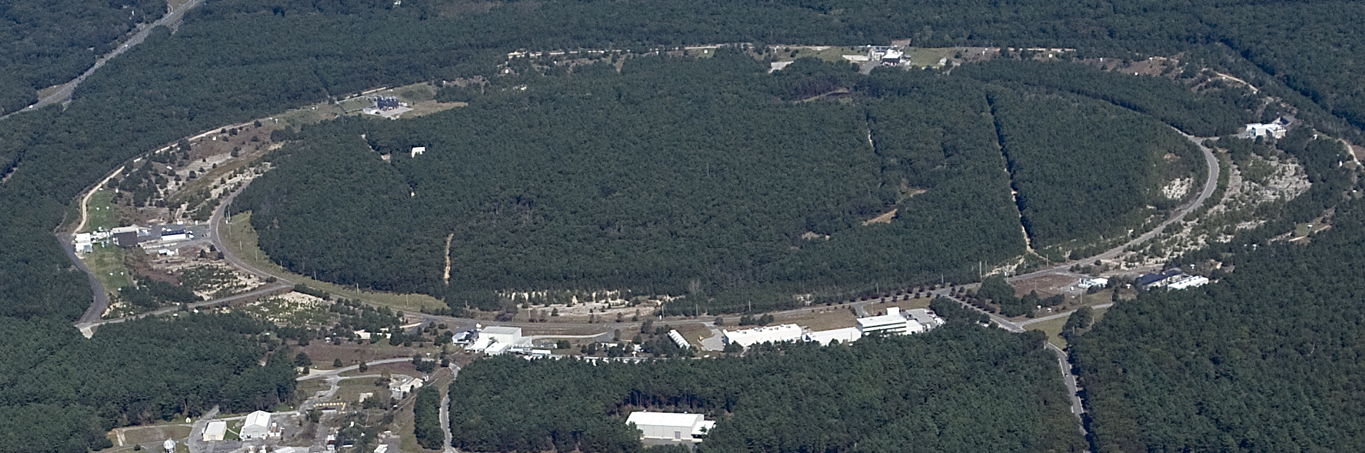
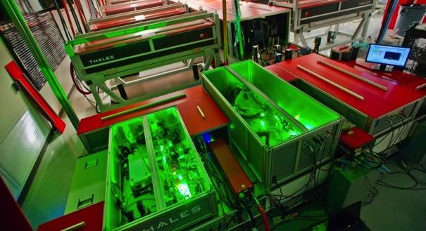
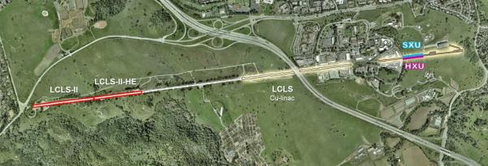
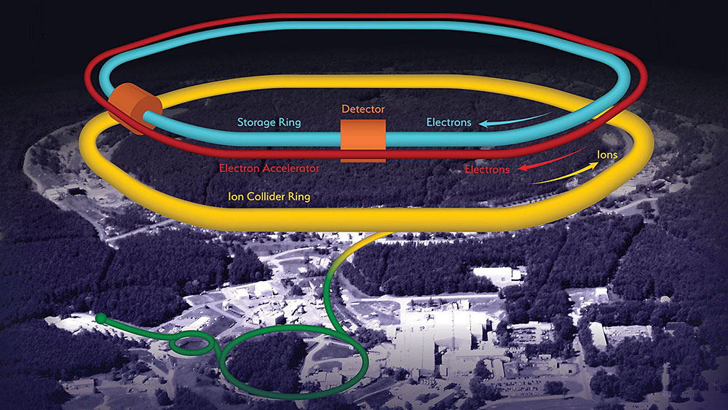
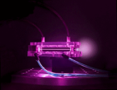
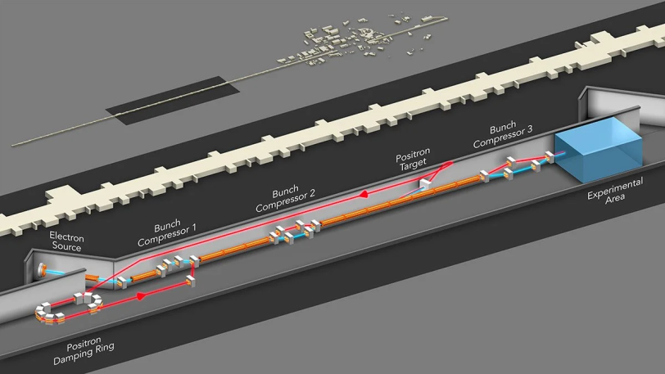
Berkeley Lab has long been home
to state-of-the-art modeling of particle accelerators
CERN (HL-)LHC, PS, SPS
KEK KEKB
FNAL Tevatron, PIP-=II, IOTA, …
LBNL ALS(-U),
BELLA
BNL RHIC, EIC
SLAC LCLS(-II-HE), FACET(-II)
Sample of applications
Notes:
LBNL has a long history of state-of-the-art modeling of light sources, storage rings, and colliders.
Here are a few facilities to which LBNL has been involved in modeling or design.
Our high-fidelity tools have been validated against experimental measurement.
And drive international collaborations.

Slide 3
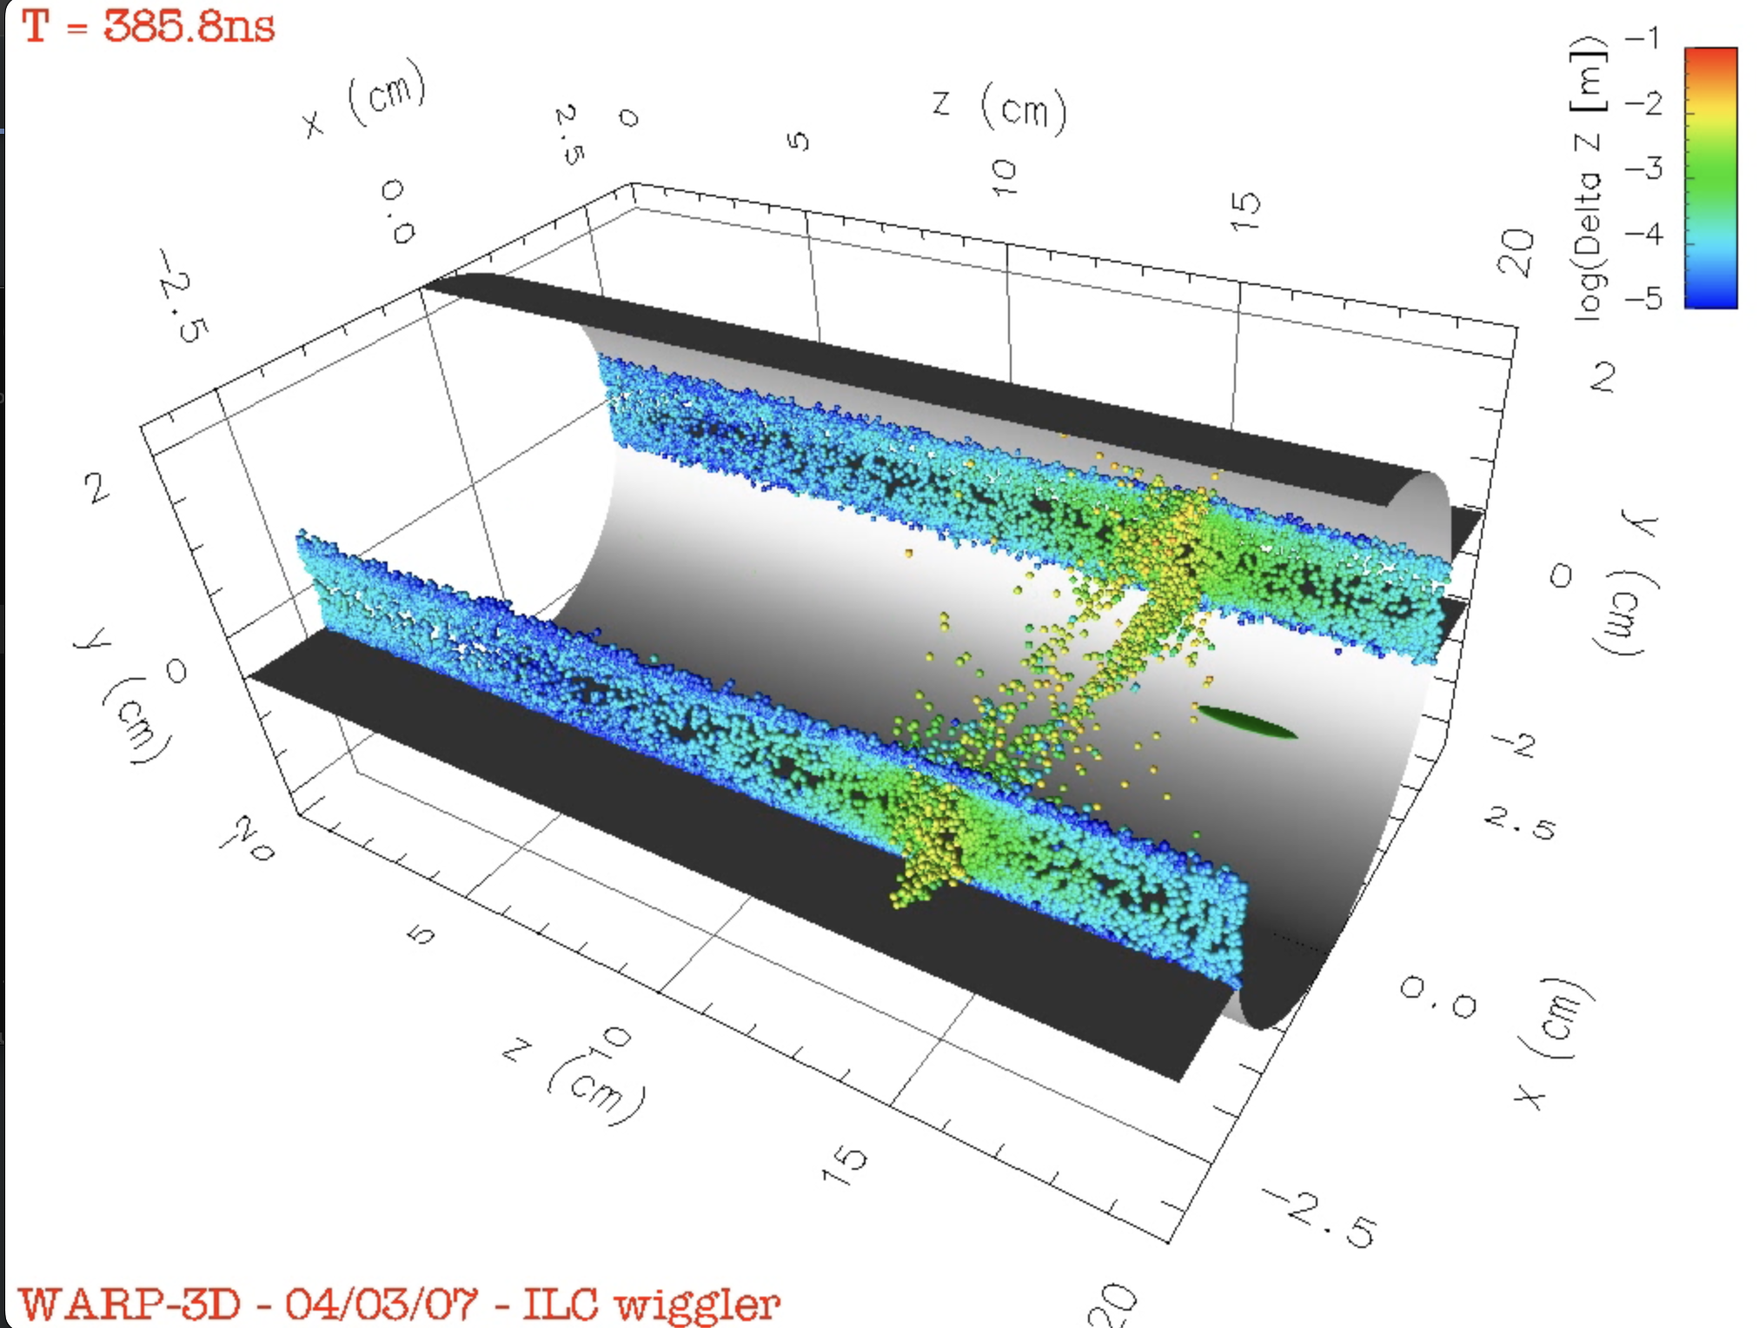
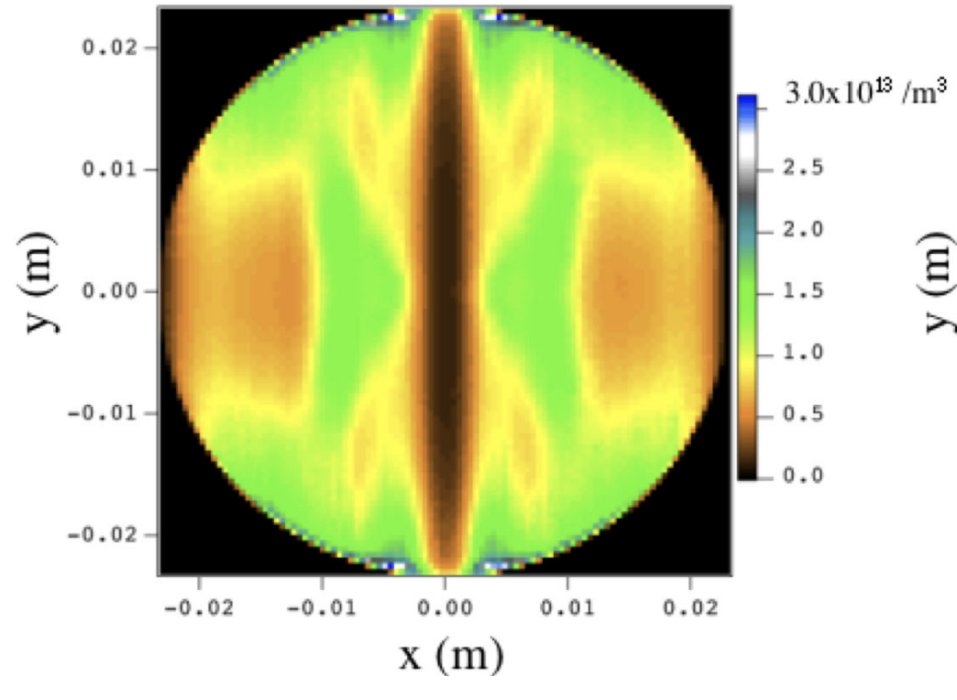
Berkeley Lab has long been home
to state-of-the-art modeling of particle accelerators
Warp+Posinst
Posinst
PIC calculations of the e-cloud in the ILC positron damping ring wigglers
Electron cloud cyclotron resonances in the presence of a short-bunch-length relativistic beam
C. M. Celata, M. A. Furman, J.-L. Vay, D. P. Grote, Proc. PAC07 (2007)
C. M. Celata, M. A. Furman, J.-L. Vay, D. P. Grote, Proc. ECLOUD07 (2007)
C. M. Celata, M. A. Furman, J.-L. Vay, J. W. Yu, PRAB 11, 091002 (2008)
Notes:
LBNL has a long history of state-of-the-art modeling of light sources, storage rings, and colliders.
Here are a few facilities to which LBNL has been involved in modeling or design.
Our high-fidelity tools have been validated against experimental measurement.
And drive international collaborations.

Slide 4
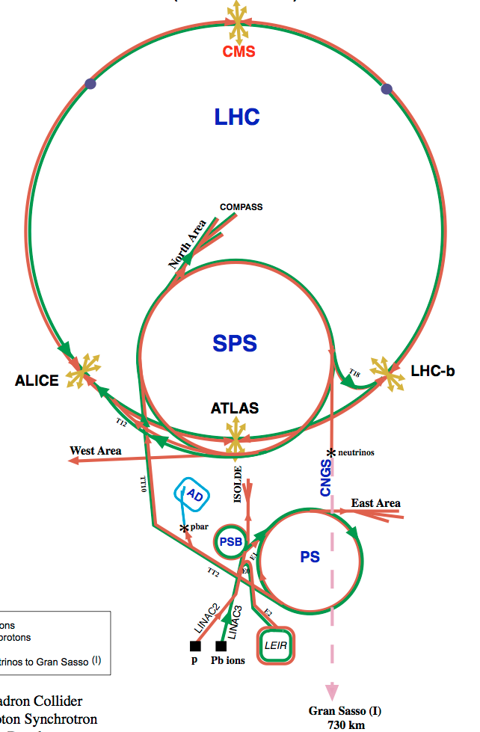
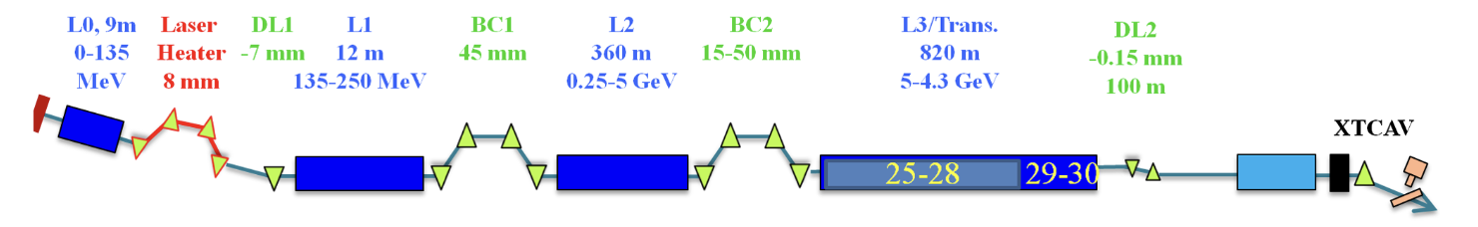
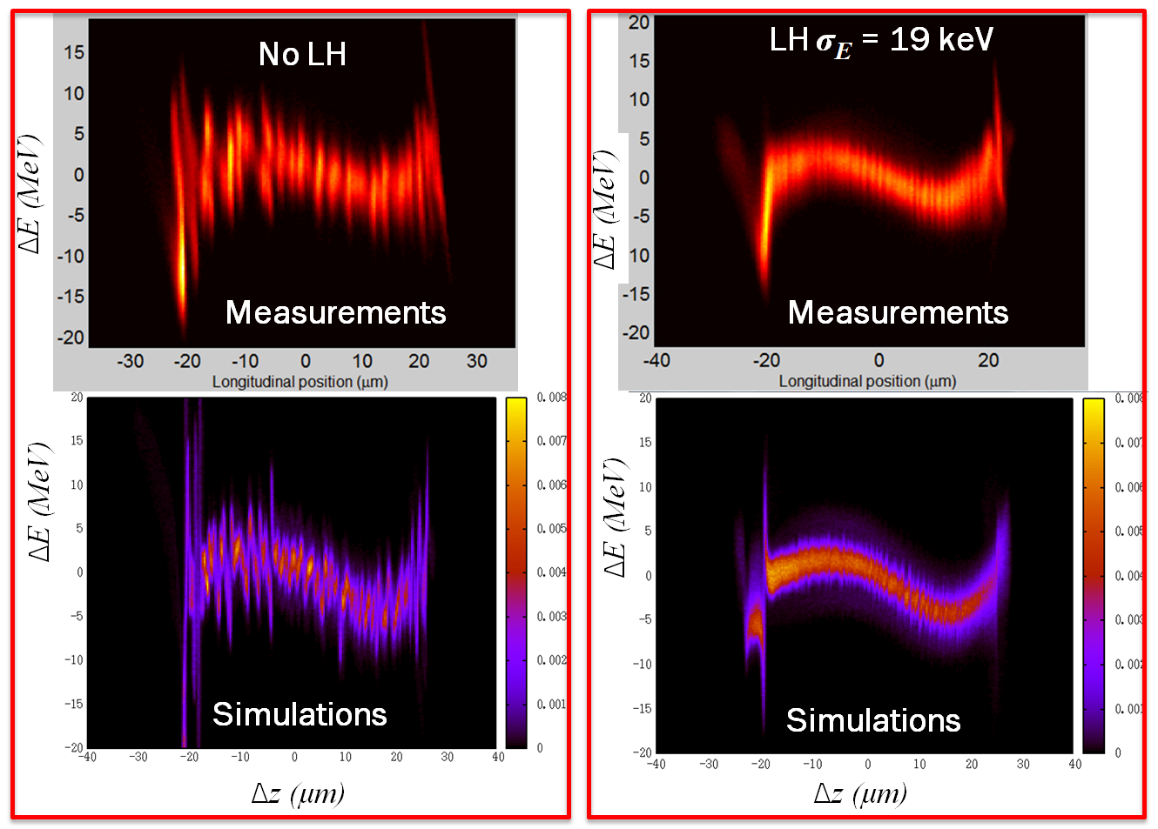
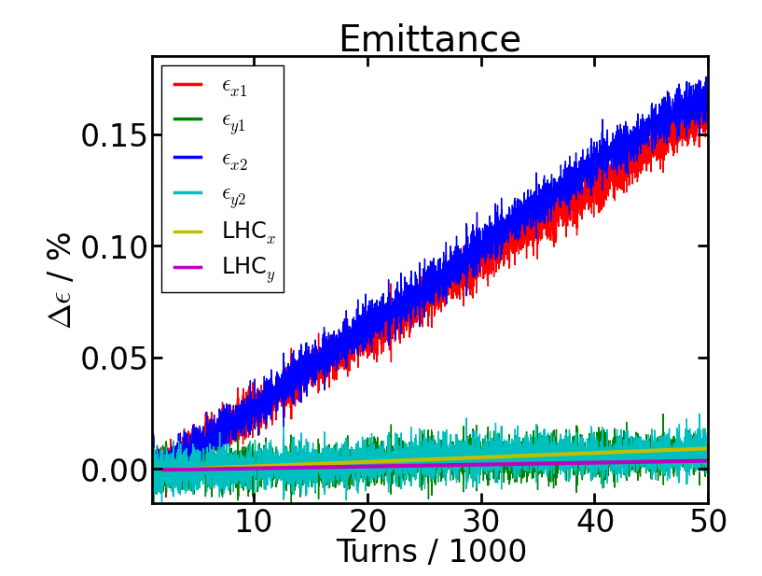
Berkeley Lab has long been home
to state-of-the-art modeling of particle accelerators
BeamBeam3D
Impact-T + Impact-Z (+ Genesis)
Emittance growth due to
crab cavity RF noise.
Strong beam-beam simulation of
interactions in the LHC upgrade.
Start-to-end, one-to-one modeling reproduces
microbunching in the LCLS X-ray FEL.
J. Qiang et al., Proc. IPAC 2015, Richmond, VA (2015).
J. Qiang et al., Phys. Rev. Accel. Beams 20, 054402 (2017).
Notes:
LBNL has a long history of state-of-the-art modeling of light sources, storage rings, and colliders.
Here are a few facilities to which LBNL has been involved in modeling or design.
Our high-fidelity tools have been validated against experimental measurement.
And drive international collaborations.

Slide 5



The Berkeley Lab Accelerator Simulation Toolkit
was created to coordinate Berkeley Lab codes
blast.lbl.gov
Open Source
2014
Codes:
- BeamBeam3D
- Impact-T, Impact-Z
- Marylie/Impact
- Posinst
- Warp
Applications:
Start-to-end accelerators
- beams, plasmas, lasers, structures
- rings, linacs, sources, injectors
- RF, plasma, dielectric acceleration
- conventional & plasma-based focusing
- e-cloud
- CSR
- cooling
- collisions
- beam-beam @ IP
- …
Codes were successfully used by accelerator community on major projects but:
coordination of development was limited by legacy
amount of duplication was growing
number of additional physics modules, codes & contributions (from various institutions) was increasing
need to modernize codes for increasing number of levels of parallelism and GPUs
➔ new (more inclusive) name & coordination of codes development.
5

Slide 6










The Beam, pLasma & Accelerator Simulation Toolkit
followed to better coordinate & modernize codes
blast.lbl.gov
Open Source
2024
Codes:
- BeamBeam3D
- Impact-T, Impact-Z
- Marylie/Impact
- Posinst
- Warp
- FBPIC
- HiPACE++
- ImpactX
- LW3D
- Wake-T
- WarpX
Applications:
Start-to-end accelerators
- beams, plasmas, lasers, structures
- rings, linacs, sources, injectors
- RF, plasma, dielectric acceleration
- conventional & plasma-based focusing
- e-cloud
- CSR
- cooling
- collisions
- beam-beam @ IP
- QED effects
- …
Plasma & fusion devices
and more (astrophysics,
thermionics, microelectronics,
…)
…
Codes were successfully used by accelerator community on major projects but:
coordination of development was limited by legacy
amount of duplication was growing
number of additional physics modules, codes & contributions (from various institutions) was increasing
need to modernize codes for increasing number of levels of parallelism and GPUs
➔ new (more inclusive) name & coordination of codes development.
Standards:
data
input
BLAST is a unique suite of interoperable codes & a multi-institutional international collaboration (>80 contributors, incl. from private sector).
lasers
optimization
6

Slide 7




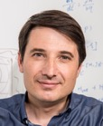











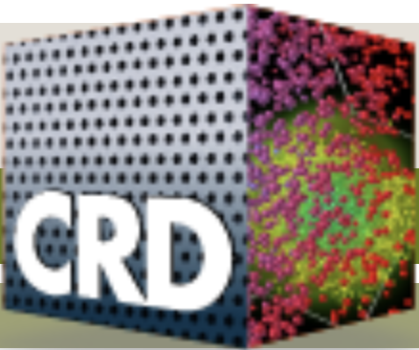










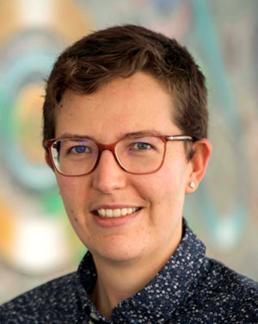



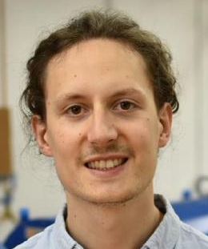
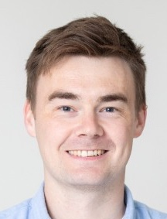






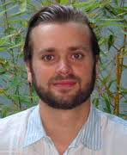




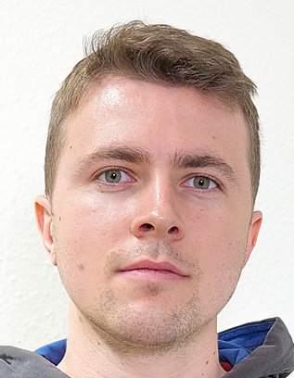



Developed by an international, multidisciplinary team physicists + applied mathematicians + computational scientists
+ software engineers
Jean-Luc
Vay
Ji
Qiang
Arianna Formenti
Marco Garten
Axel
Huebl
Rémi
Lehe
Chad
Mitchell
Ryan
Sandberg
Olga Shapoval
Edoardo
Zoni
over 80
contributors,
incl. from the
private sector
Ann
Almgren
Kevin
Gott
Junmin
Gu
Revathi
Jambunathan
Andrew
Myers
Weiqun
Zhang
David
Grote
Justin
Angus
Kale Weichmann
AM
Germany
Maxence Thévenet*
Severin
Diederichs
Alexander
Sinn
Ángel
Ferran Pousa
Rob
Shalloo
France
Igor
Andriyash
Lorenzo
Giacomel
Lixin
Ge
Switzerland
Henri
Vincenti*
Luca
Fedeli
Thomas
Clark
Pierre
Bartoli
Franz
Poeschel
Roelof Groenewald
France
7

Slide 8

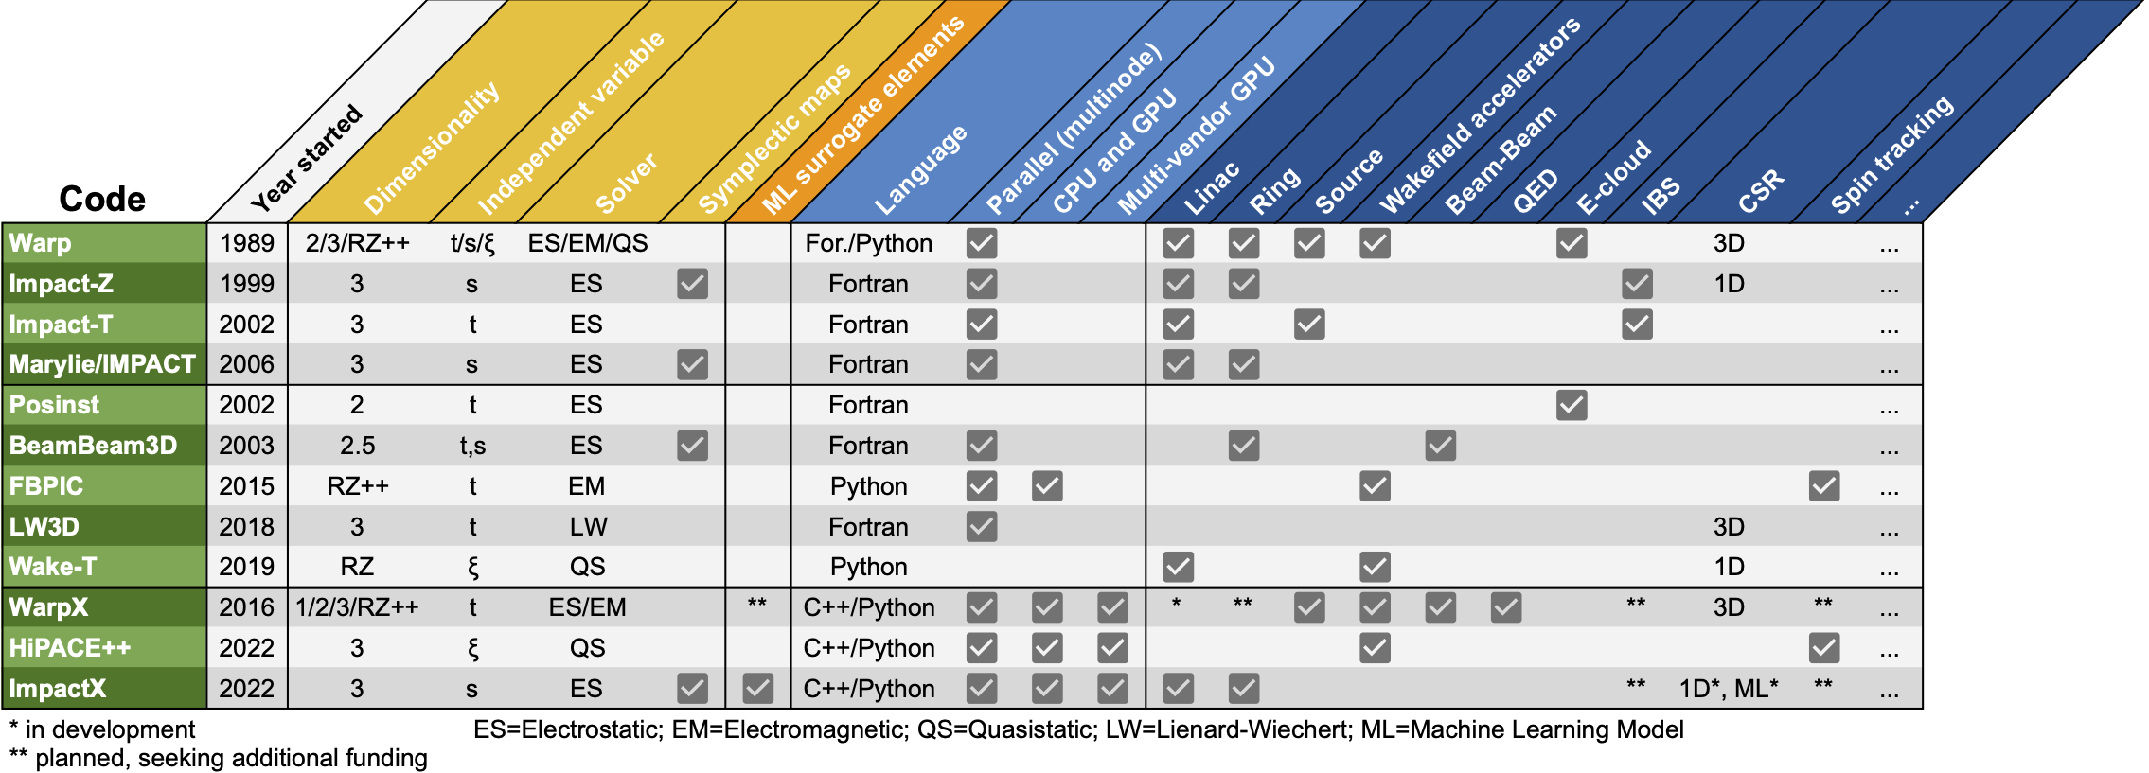





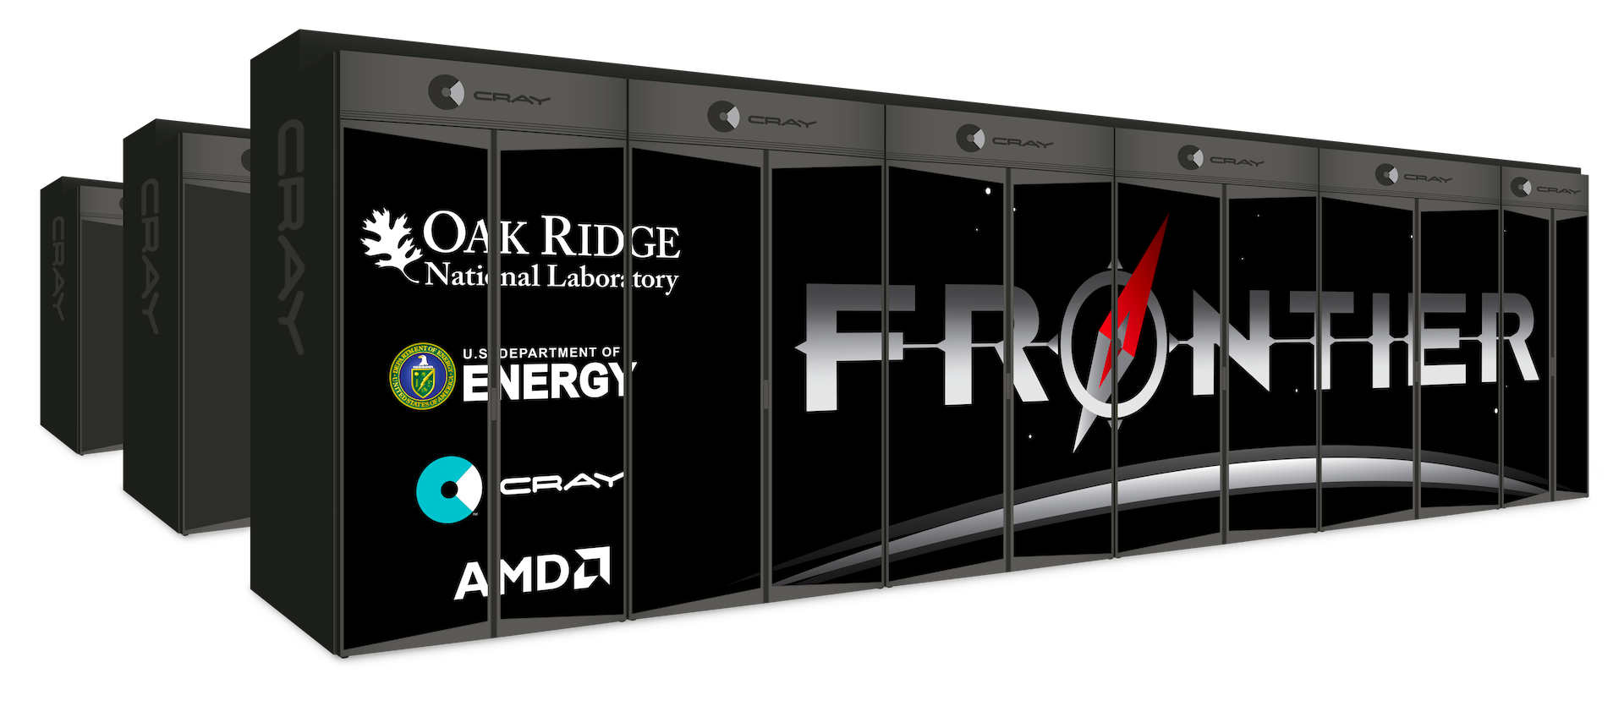
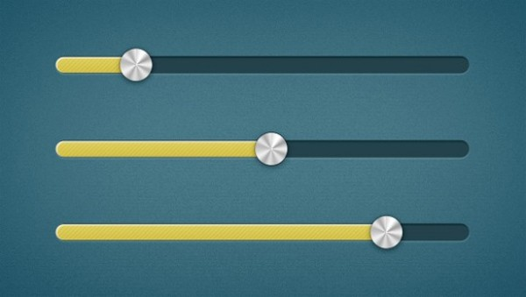
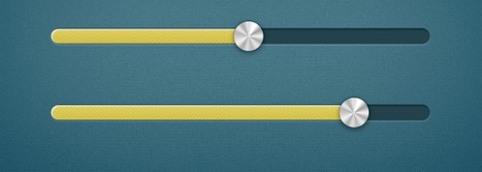
BLAST: a cutting-edge open-source simulation toolkit
for end-to-end accelerator modeling
blast.lbl.gov
standards & workflows
Data
Input
Lasers
Optimize
General purpose
(legacy)
Specialized
New codes are integrated around a common high-performance infrastructure w/CPU+GPU+ML support
New
integrated
all types of colliders: Higgs factory, 10 TeV parton, muon, plasma-based, …
Quasistatic
Fast
&
as
accurate
as
possible
Reduced models
ML
surrogates
Full
PIC
First principles
Accurate
&
as
fast
as
possible
tunability from fast modeling to detailed physics studies for collider design.
Speed
Idealized beam
profiles
Experimental
beam profiles
Fidelity
Reduced physics
Full physics
1D-1V
3D-3V
E.g., for a plasma-based collider:
ML surrogate ➔ Wake-T ➔ HiPACE++➔WarpX
Low resolution
High resolution

Slide 9





AMP leverages the ECP technology (E4S) underpinning WarpX
➔high-performance, integrated suite for particle accelerator modeling (& more)
user-steering, customization, workflows, AI/ML Frameworks (PyTorch, Tensorflow, …)
E4S is unique in the world:
➔ advantage of unparallel performance & portability.
Python interface:
Modular approach pioneered by Warp 20+ years ago
Coupling to other codes (e.g., Posinst, ICOOL, …)
Access to powerful AI/ML tools
pyAMReX
WarpX
t-based PIC
ImpactX
s-based PIC
HiPACE++
quasi-static
…
ARTEMIS
microelectronics
ABLASTR: shared PIC
PICSAR
QED Modules
AMReX
Containers, Communication,
Portability, Utilities
openPMD
diagnostics
Math
FFTs,
lin. alg.
Extreme-Scale Scientific Software Stack
Laboratory Directed Research & Development
CUDA, OpenMP, SYCL, HIP
MPI
➔ Propose to leverage for faster & larger scale modeling for colliders (all types) R&D

Slide 10
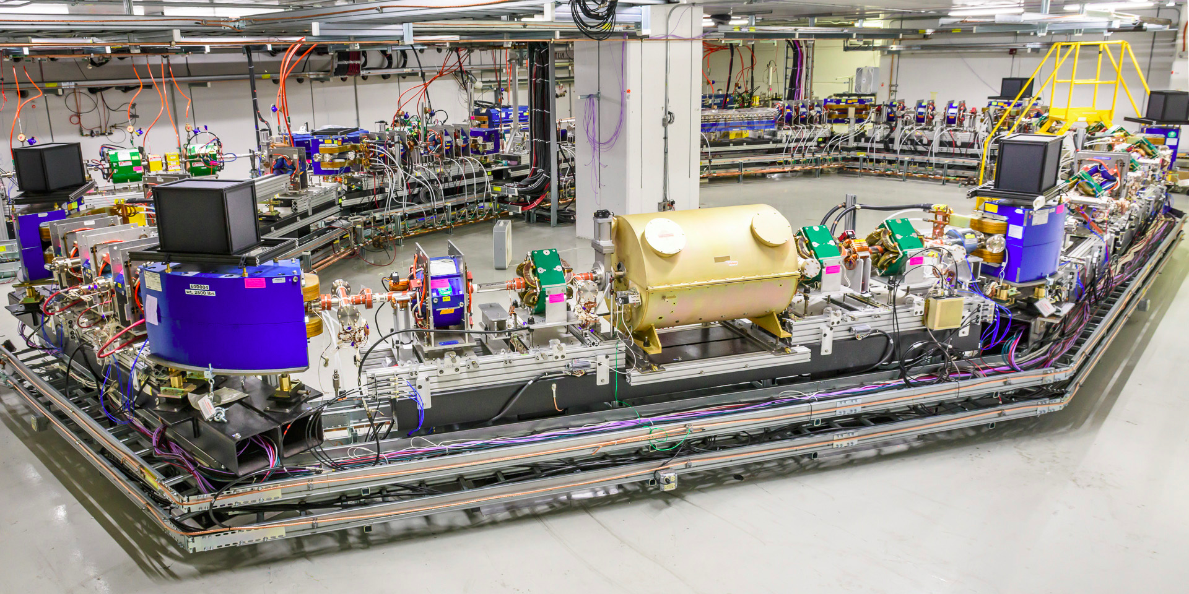
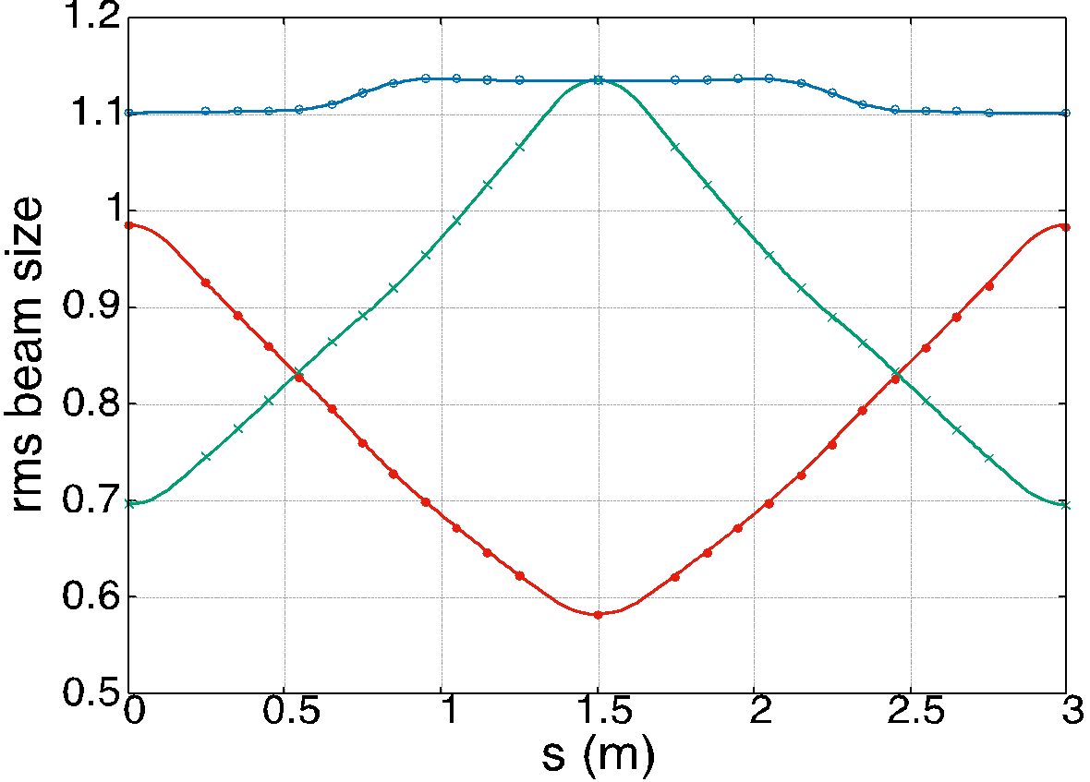

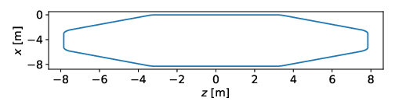
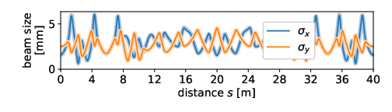


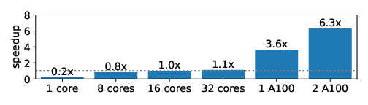
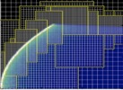

ImpactX aims at high(er) performance modeling
of RF Accelerator Modeling
Beam-Dynamics in Linacs, Rings, Colliders
intense beams, long-term dynamics
HEP colliders: Higgs factory, 10 TeV parton, ee, hh, γγ, muons, …
Example of benchmark against
Impact-Z on IOTA ring beam dynamics
Benchmarks & Validations
86 continuously run benchmarks
code-to-code comparisons
250 MeV proton bunch
focusing quad
700 MHz RF
defocusing quad
rms beam size (mm)
(Lines) ImpactX
(Points) IMPACT-Z
Advanced Numerics
based on IMPACT suite of codes, esp. IMPACT-Z and MaryLie
Performance
order-of-magnitude perf.↗ from GPUs
Triple Acceleration Approach
GPU support
Adaptive Mesh Refinement
AI/ML & Data Driven Models
C Mitchell et al., HB2023, THBP44 and TUA2I2 (2023); A Huebl et al., NAPAC22 and
AAC22 (2022); J Qiang et al., PRSTAB (2006); RD Ryne et al., ICAP2006 ICAP2006 (2006)
LDRD

Slide 11
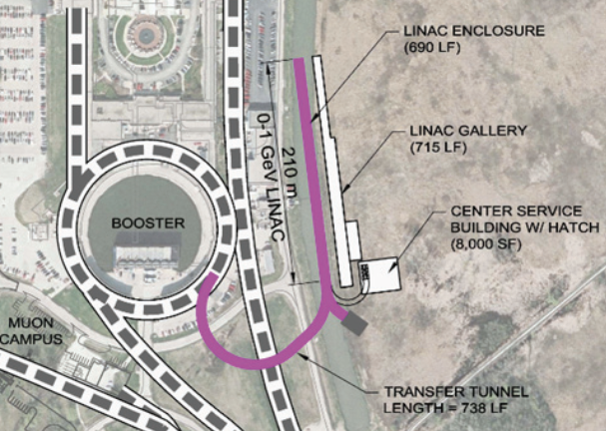
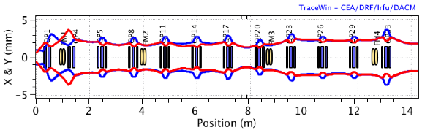

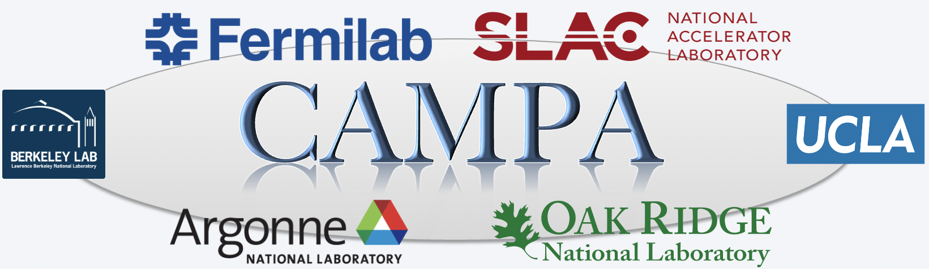
ImpactX being applied to (& benchmarked on) high intensity beams in PIP-II
Proton Improvement Plan II (Fermilab)
5 mA beam modeling of the PIP-II linac
Beam envelopes MEBT transport section
Synergia
ImpactX
Goal:
start-to-end modeling
and design tuning
(virtual test stand)
ImpactX- LBNL
to Synergia for
modeling the Booster
X & Y (mm)
Position (m)
- Now: Benchmark against existing results using new
parallel GPU-capable tools (ImpactX) for validation.
- Goal: Higher speed, resolution, and fidelity modeling.
Notes:
We are transition to a new generation of AMP codes, such as ImpactX.
This is partly supported by an AMP-led SciDAC project.
The goal of the RF modeling is to develop a virtual test stand of the PIP-II beamline

Slide 12
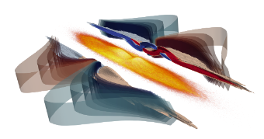


Samples of ongoing engagement in using next-generation BLAST tools
to model future HEP colliders
Collider interaction point modeling using WarpX:
collaboration with SLAC, CEA Saclay
benchmarked against GUINEA-PIG
Exploring gap transport designs using ImpactX:
collaboration with HALHF group (Univ. Oslo)
apochromatic transport concept
transversely-tapered plasma lens concept
WarpX simulation of
beam-beam crossing
at the interaction point
of the ILC
ImpactX apochromatic transport
Initial 1% energy spread
Emittance growth:
See next talk by A. Formenti
Beam transport challenges for a laser plasma acceleration collider:
Focusing of beams with large energy spread
Compact transport plasma lenses for focusing
Preservation of beam emittance (100’s of stages)
Insensitivity to beam jitter and pointer errors
ImpactX provides support for accelerator gap transport difficult to model using, e.g., ELEGANT
C. Lindstrom and E. Adli, Phys. Rev. Accel. Beams 19, 071002 (2016)
C. Lindstrom, EuroNNAc Special Topics Workshop 2022 (2022)
C. Lindstrom et al incl. A. Huebl & C. Mitchell, paper in preparation
See talks on HALHF at this workshop
See Advanced Accelerator Concepts 2 session: this afternoon
Notes:
AMP’s activities in LPA collider modeling have relevance to this talk through their implications for beam transport and focusing.
We have a collaboration with the HALHF group that involves implementing new capabilities in ImpactX and using them to explore proposed gap transport designs to control emittance growth
due to chromatic effects.
Our group has also actively developed capabilities in the code WarpX for modeling beam-beam effects at the interaction point...

Slide 13
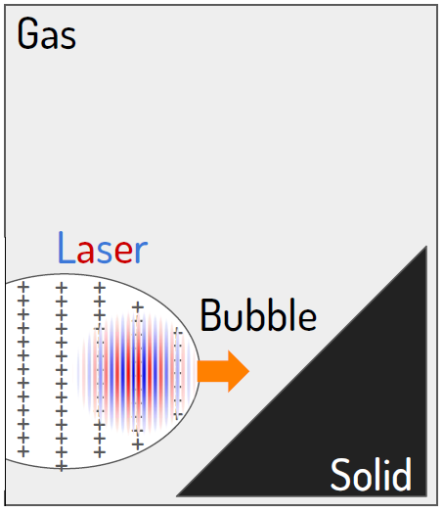
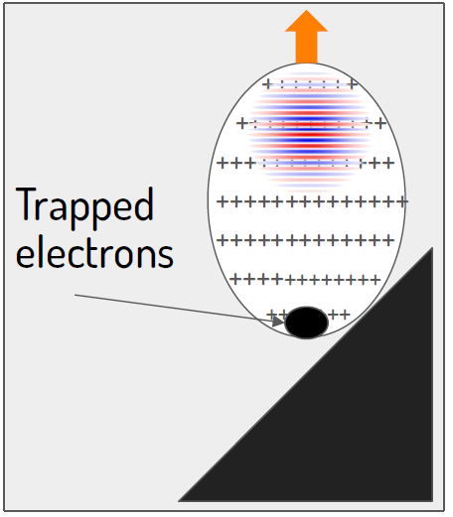
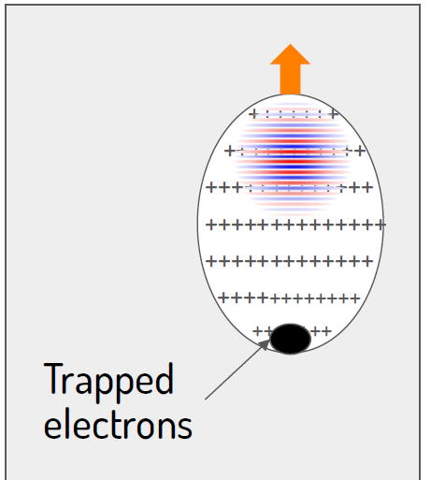

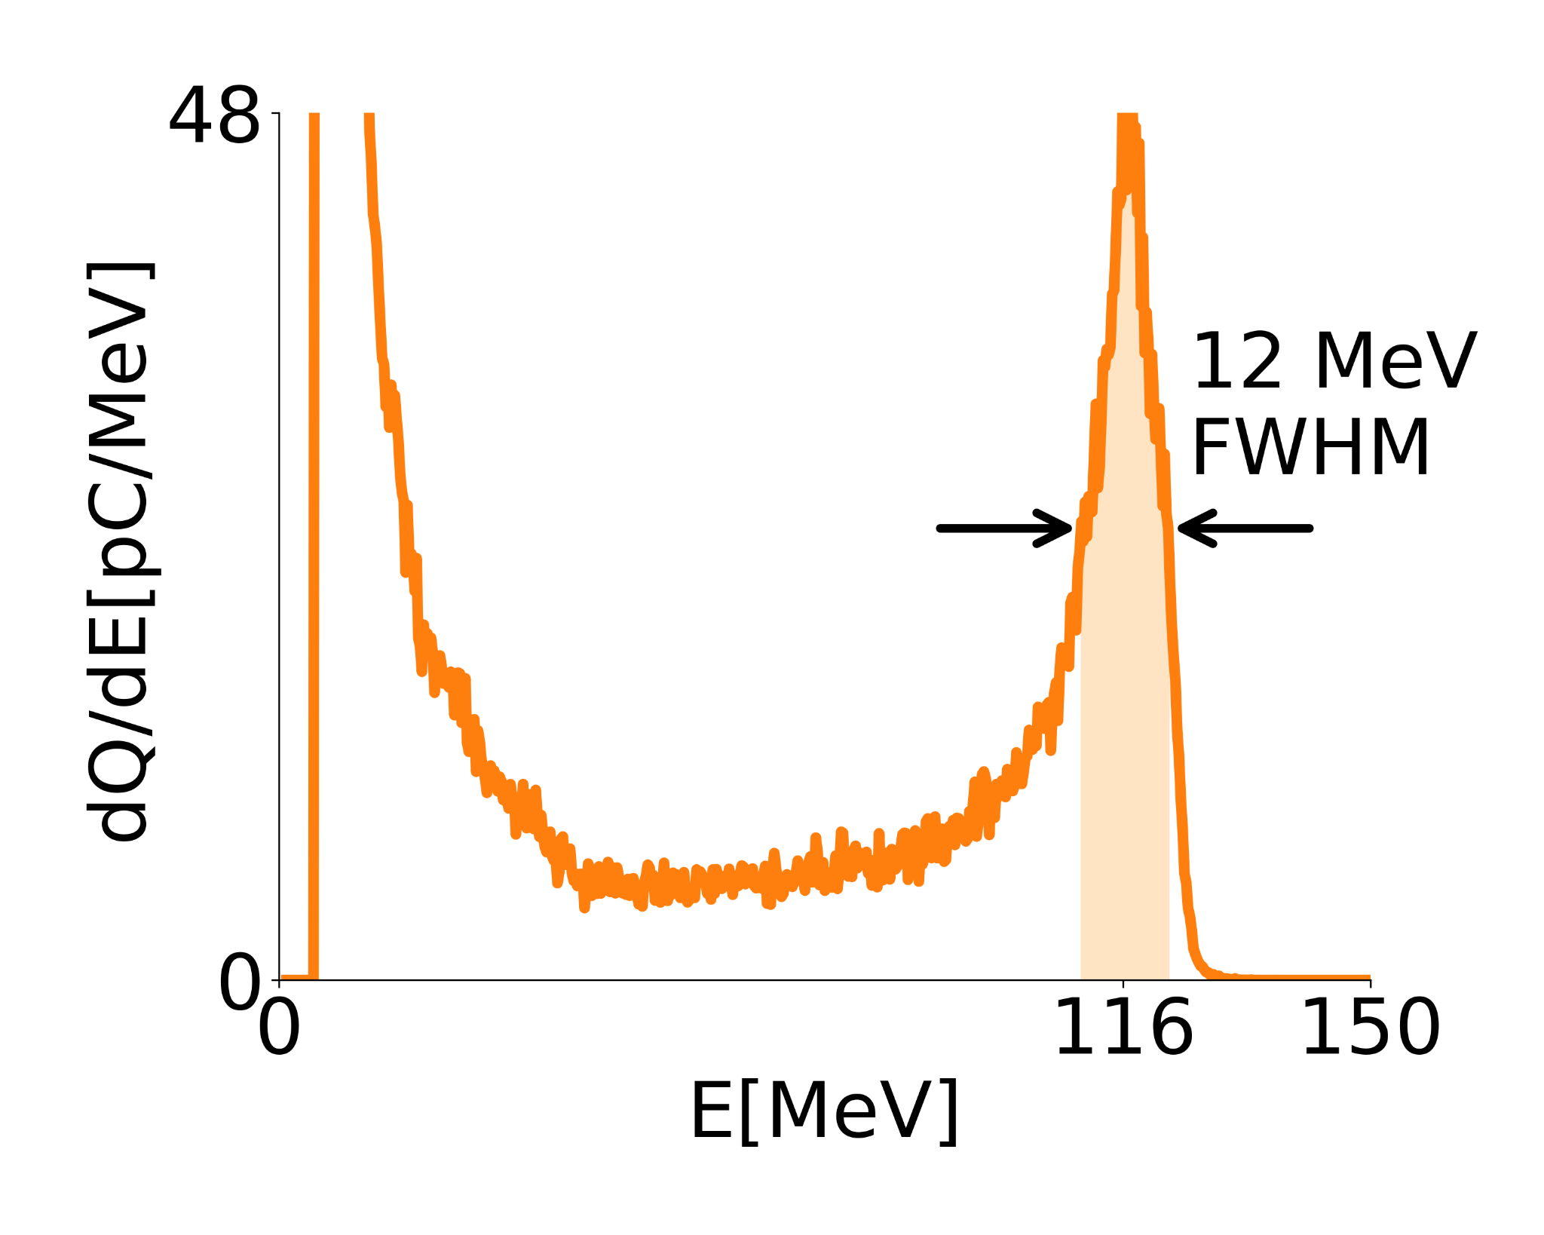

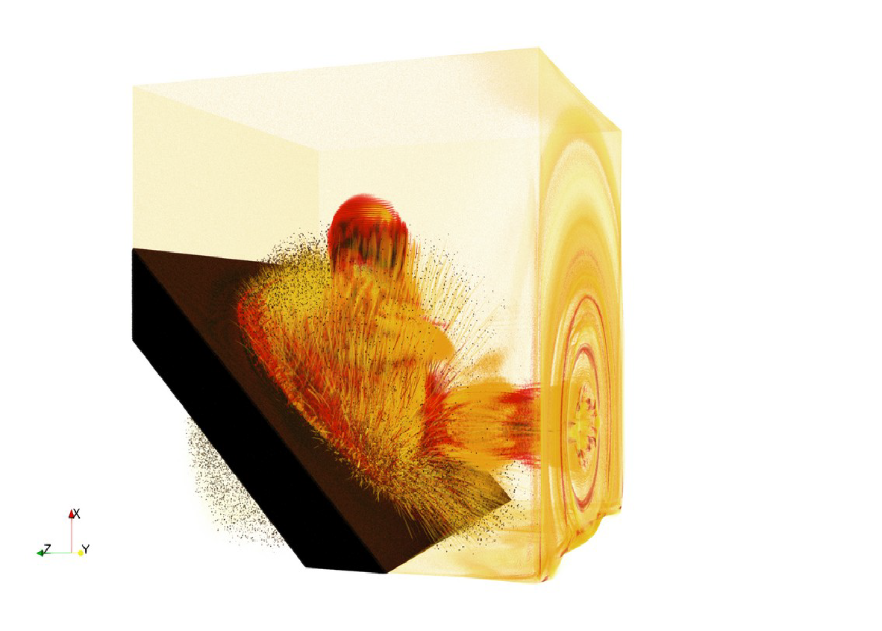





BLAST codes also cover plasma-based collider
modeling from source to interaction point
…
…
Generation
Acceleration & Transport
Interaction Point
Two-stage injection+acceleration
w/ plasma mirror
1
2
3
1st stage
Interaction with the plasma mirror
2nd stage
0.5 nC (peak)
1.7 nC (total)
A success story of a multidisciplinary, multi-institutional team!
L Fedeli, A Huebl et al., SC22, ACM Gordon Bell Prize for WarpX (2022)

Slide 14
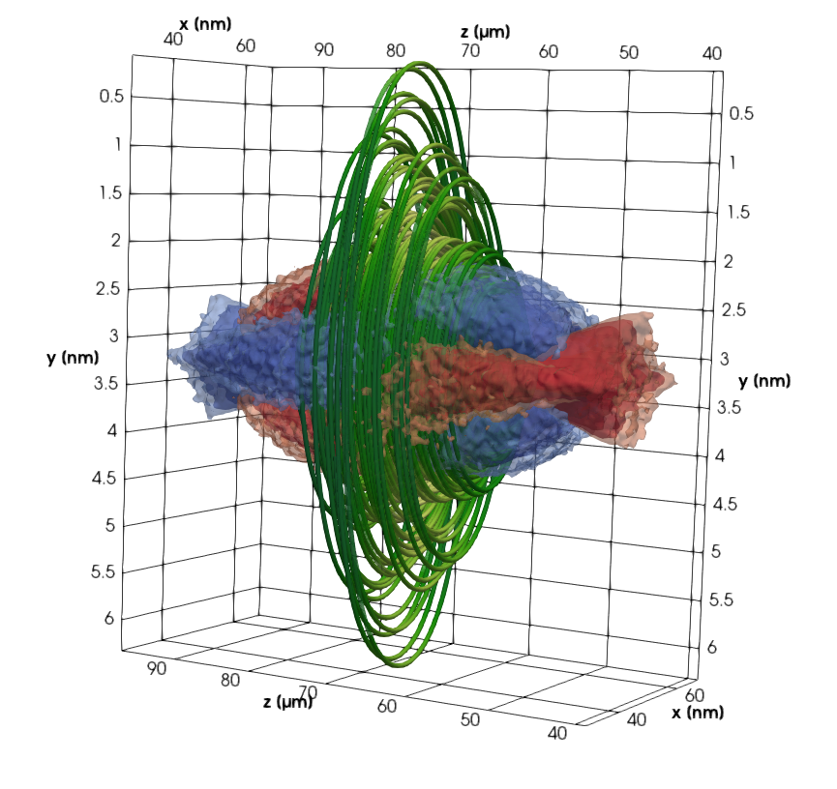
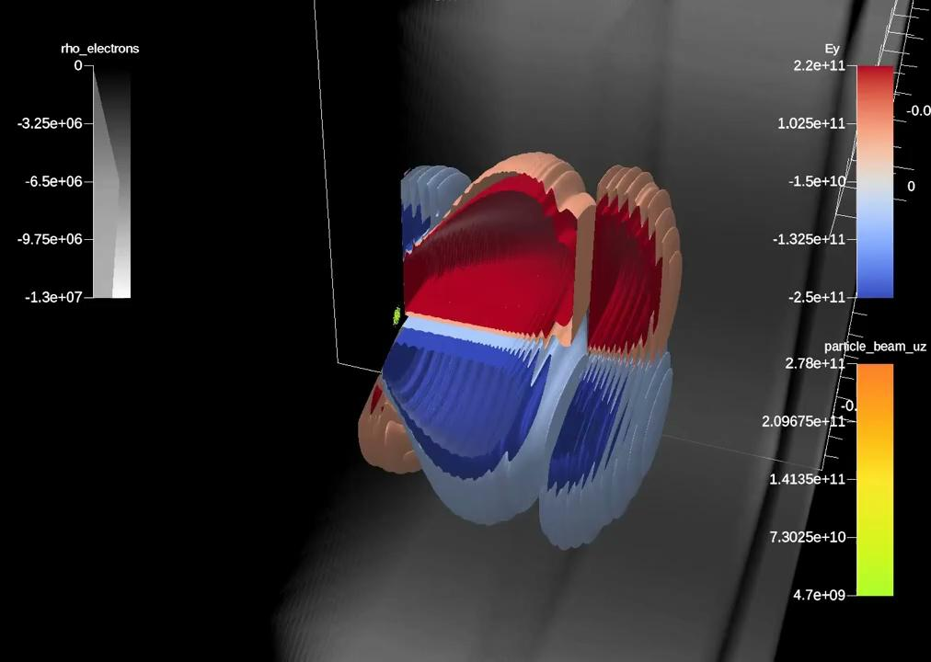
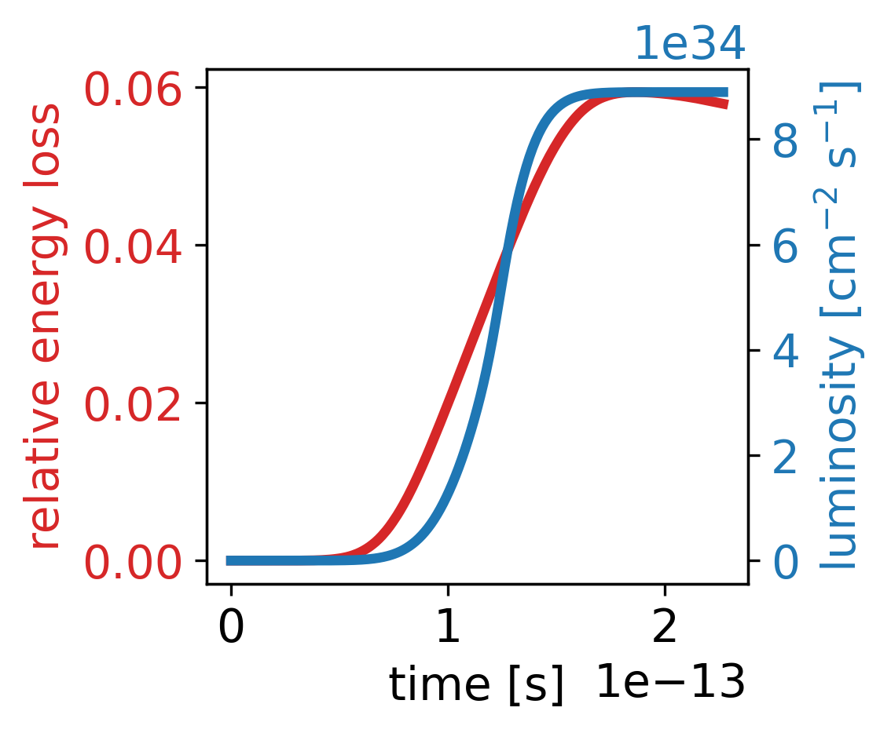
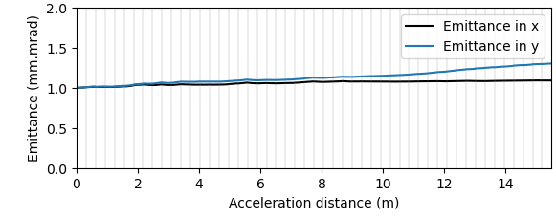
BLAST codes also cover plasma-based collider
modeling from source to interaction point
…
…
Generation
Acceleration & Transport
Interaction Point
Two-stage injection+acceleration
w/ plasma mirror
50 Multi-GeV LPA Stages in 3D
10 TeV COM e–e⁺
Ascent VTK-m In Situ Visualization of the first 15 stages:
1
2
3
preliminary!
1st stage
Interaction with the plasma mirror
2nd stage
0.5 nC (peak)
1.7 nC (total)
1
10
stage number
WarpX can now simulate flat, spherical, round and asymmetric beams in linear colliders:
ILC, C³, wakefield, HALHF, …
Next are more QED physics & circular colliders: FCC-ee, Muons
20
30
40
50
WarpX also studies: flat ILC beams @250 GeV COM, spherical, round and asymmetric beams …
Relative energy spread:
flat at 0.005% after few stages
P5 Report: Exploring the Quantum Universe (2023)
J-L Vay et al., ISAV20 Keynote (2020) & PoP 28.2, 023105 (2021)
L Fedeli, A Huebl et al., SC22, ACM Gordon Bell Prize for WarpX (2022)
WarpX ECP MS FY23.1 & FY23.2 (2023); T Barklow et al., JINST (2023)
A Ferran Pousa et al., IPAC23, TUPA093 & PRAB (2023); CB Schroeder et al., JINST (2023)
1 fC
On the fly focusing lens tuning using e- beam Twiss parameters enables emittance preservation.
See next talk by Arianna Formenti

Slide 15



We also explore the training of ML surrogate models to speed-up simulations
In a given lattice, some elements can be more computationally-expensive to model.
Extreme example: laser-plasma acceleration stages
plasma
stage 1
Drift
Focusing
Drift
plasma
stage 2
Focusing
few pC
e- beam
WarpX
(full EM-PIC)
ImpactX
(tracking code)
WarpX
(full EM-PIC)
Under certain conditions (here: negligible collective effects, specific range of parameters),
computationally-expensive elements can be replaced by ML models, trained over past simulations.
plasma
stage 1
Drift
Focusing
Drift
plasma
stage 2
Focusing
WarpX-trained
neural network
WarpX-trained
neural network
Simulation time: (with full geometry/physics)
hrs <sec
on several GPUs on 1 GPU
ImpactX
(tracking code)

Slide 16





We Exploit our High-Quality HPC Data for ML-Boosted Collider Design
Central BLAST Code Interoperability: Combine Plasma & RF Accelerator Elements for start-to-end modeling
high-quality, first-principle WarpX data used for ImpactX ML surrogate training
LPA + Transport Optimization
with 1000s of evaluations
WarpX start-to-end
simulation
256 GPUs
1 simulation / 5.1 hours
tightly-coupled LPA-neural networks inside ImpactX
ImpactX with WarpX-trained NNs
1 GPU
2-4 simulations / sec
Neural network
Neural network
RT Sandberg et al., IPAC23, DOI:10.18429/JACoW-IPAC2023-WEPA101 (2023)
RT Sandberg et al., PASC24 Best Paper (2024)

Slide 17
Summary & Outlook
Berkeley Lab has a long history in high performance modeling of particle accelerators
We are leading the Beam, pLasma & Accelerator Simulation Toolkit (BLAST)
  a coordinated effort that develops an integrated suite for start-to-end modeling of colliders
  80+ multidisciplinary team of contributors from labs, universities & private sector
  leverages unique technology from the US DOE Exascale Computing Project that enables codes to be built on a common core that enables efficient simulations on CPUs and GPUs
  common Python front-end enables user steering and direct coupling with optimization & AI/ML
We are offering to use the new set of tools in support of the modeling of any type of future collider: Higgs factory, 10 TeV parton, muon, plasma-based, …
Feel free to use and contribute: https://blast.lbl.gov/

Slide 18
Questions?

Slide 19






We are fostering interoperability across open-source optimization software.
Several open-source optimization frameworks are being used in the accelerator community
(each with their respective strengths)
Xopt
github.com/ChristopherMayes/Xopt
optimas
github.com/optimas-org/optimas
rsopt
github.com/radiasoft/rsopt
Optimization algorithms
Optimization algorithms
Optimization algorithms
powered by libensemble
github.com/Libensemble/libensemble
Ongoing efforts by the developers to standardize optimizers and foster interoperability.
Notes:
Xopt: very interactive, GUI
Optimas: facilitates running on CPU/GPU supercomputers
rsopt: easy interface for existing common accelerator simulation codes

Slide 20









Even tighter ML integration can be achieved with differentiable simulations
Regular simulation code
Differentiable simulation code
Input
Output
Input
Output
Simulation
code
Simulation
code
$$f(X)$$
$$X$$
$$f(X)$$
$$X$$
$$\frac{∂f}{∂X}(X)$$
Example:
Output:
final beam emittance
Input:
accelerator parameters

Slide 21

Differentiable codes have several advantages.
Sensitivity studies
$\frac{∂f}{∂X}$ quantifies how sensitive the output is to the input.
Optimization in high-dimensional space (e.g. of accelerator designs)
$\frac{∂f}{∂X}$ can be used in gradient-based optimizers, which often converge faster
Allows training of a neural network that is combined with a differentiable code
Traditional training of neural network
Training of neutral network combined with a code
Neural
network
Differentiable simulation code
Neural
network
Input/output pairs, from a data set
Example: R. Roussel et al., Phase Space Reconstruction from Accelerator Beam Measurements Using Neural Networks and Differentiable Simulations, PRL (2023)

Slide 22









We are exploring frameworks for differentiable codes.
Several algorithms are available to make a code differentiable. e.g.
J. Qiang, Differentiable self-consistent space-charge simulation for accelerator design, PRAB (2023)
Several efforts to build differentiable accelerator simulation codes,
based on auto-differentiation frameworks.
  pytorch
  Cheetah: accelerator code based on pytorch
  github.com/desy-ml/cheetah
  Julia
  Bmad-Julia: proposal to implement Bmad algorithms in Julia
  github.com/bmad-sim
  Enzyme AD
  Takes existing C++ code and makes it auto-differentiable at compile time.
  Could be leveraged to make BLAST codes (ImpactX, WarpX, …) differentiable.

