Slide 1

Introduction of CEPC Industry Promotion Consortium (CIPC)
Jinlin Gao
2024.7.9 Tokyo
Notes:
Hello everyone! Thank you for the invitation from the LCWS organizing committee. It is a great opportunity to be here and give a presentation about CEPC Industrial promotion Consortium（CIPC）from China. My name is Qinyan Pan, I represent Chairman Gao Jinlin, that come from Beijing Sinoscience FULLCRYO Technology Co., LTD of China.

Slide 2
Contents
1
Background and Target
2
CIPC Organization
3
Enterprise introduction
4
Summary
Notes:
The report outline mainly includes the following content

Slide 3
Background And Target
Significance of CEPC large-scale Scientific Engineering
The CEPC is an important part of the world plan for high-energy physics research. It will support a comprehensive research program by scientists throughout the world.
The CEPC is a giant leap for China from the BEPC-II, the presently operating e+e collider at IHEP in Beijing. It will bring China to the forefront of world high-energy physics, and push a wide range of advanced technologies to an extent never imagined before.
Notes:
Firstly, As we know, The CEPC is an important part of the world plan for high-energy physics research. It will support a comprehensive research program by scientists throughout the world. According to a report by Nature on June 17th local time, China would start building world’s biggest particle collider in 2027. The US$5 billion facility would be cheaper,bigger,and fastter to build than a similar one proposed by European scientists.

Slide 4
Background And Target
Who is the CIPC?
That is CEPC Industry Promotion Consortium (CIPC).
Many Relevant Enterprises that participating in the research and industrialization of key technologies related to the CEPC .
What does the CIPC to do?
To support and organize relevant enterprises participating in the industrialization CEPC.
Enhance the technology level of our own enterprises, expand business channels and obtain achievements transfer to enterprises.
Supporting the Strategic Landing of Made in China 2030 and Promoting the Leap Development of China's Industry.

Slide 5
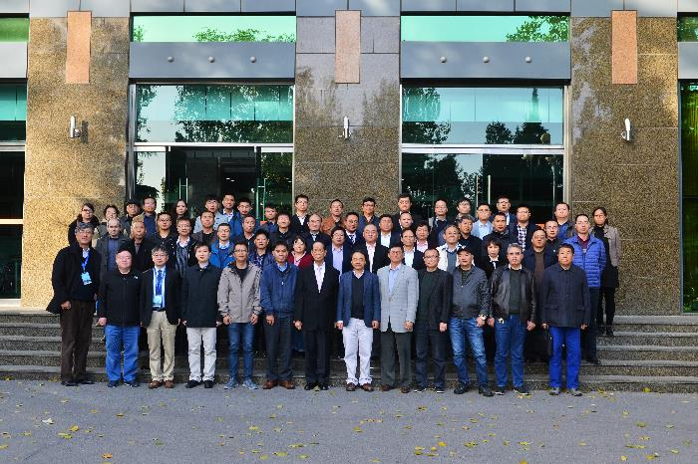
CEPC Industrial Promotion Consortium (CIPC)
As the world’s most advanced accelerator,CEPC put forward the following directions:
1) Superconduting materials (for cavity and for magnets)
2) Superconductiong cavities
3) Cryomodules
4) Cryogenics
5) Klystrons
6) Magnet technology
7)Vacuum technologies
8) Mechanical technologies
9)Electronics
10) SRF
11) Power sources
12) Civil engineering
13) Precise machinery
.....
More than 100 companies joined
in first phase of CIPC，
Established in Nov. 7 , 2017
CEPC will present unprecedented demands to the industry and drive enterprises to master the most advanced technology. Many key technologies of CEPC are inevitable for the future development of accelerators
Notes:
环形正负电子对撞机-超级质子质子对撞机（CEPC-SppC）项目是中国高能物理学界于2012年提出的面向未来的大型粒子对撞机项目，是以高亮度、环形正负电子对撞机起始，未来升级到超级强子对撞机的战略规划项目。CEPC是中国独立提出的新一代世界前沿加速器，其设计、建造将大力推动系列科技创新和高技术发展，将成为我国高能加速器物理发展的首选。
As the world's most advanced accelerator, CEPC will present unprecedented demands to the industry and drive enterprises to master the most advanced technology. Low temperature, precision machinery, vacuum, electronics, radiation resistant chips, automatic control, computers and other cutting-edge technologies with strategic significance will achieve international leadership.
作为世界上最先进的加速器，CEPC将对工业界提出前所未有的需求并推动企业掌握最先进的技术。CEPC很多关键技术是未来加速器发展的必然。低温、精密机械、真空、电子、抗辐照芯片、自动控制、计算机等具有战略意义的前沿技术将实现国际领先。
CIPC的成立，能够统筹汇聚科学界、企业界的力量开展设计、关键技术预研和产业化，全面推动高能物理学科发展与技术进步。CIPC是企业未来发展的重要机遇和平台。通过参与CEPC大科学工程建设，企业不断提升技术创新和工业制造能力，突破并达到国际先进水平，将成为国际著名的设备供应商，最终实现合作共赢协同发展。

Slide 6
Contents
1
Background and Target
2
CIPC Organization
3
Enterprise introduction
4
Summary

Slide 7
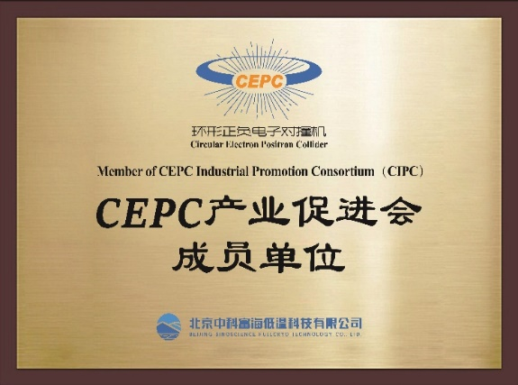
CIPC Organization
CIPC Working group meetings were held on Nov. 24,2017 and Mar. 14 2018. The Executive Committee was established, and the CIPC charter has been drafted and adopted.
CEPC Committee
CEPC Industry Promotion Consortium（CIPC）
CIPC working group
Executive Committee
Member
（>100 Enterprises）
CIPC Logo on the plaque
Notes:
That is CIPC Organization. Under the guidance of the CEPC Committee, we have established the CEPC Industry Promotion Consortium(CIPC), which includes the CIPC working group and Executive committee. More than 100 companies joined the CIPC now.
The CIPC charter has been drafted and adopted. And we all designed the CIPC emblem/Logo on the plaque.

Slide 8
The representatives of CIPC
序号 | 姓名 | 单位 | 职务 | 备注
1 | 高金林 Gao Jinlin | 北京中科富海低温科技有限公司 Beijing Sinoscience Fullcryo Technology Co., Ltd. | 总经理 GM | 主席 Chairman
2 | 薛华实 Xue Huashi | 上海上创超导科技有限公司 Shanghai creative superconductor technology Co., Ltd. | 总经理 GM | 副主席 vice chairman
3 | 李 明 Li Ming | 中国瑞联集团控股有限公司 China RuiLian Group Ltd. | 主席 Director | 副主席 vice chairman
4 | 黄 浩 Huang hao | 昆山国力电子科技股份有限公司 Kunshan national power electronic Technologies Inc. | 总经理 GM | 副主席 vice chairman
5 | 刘大炜 Liu Dawei | 成都飞机工业集团有限责任公司 Chengdu aircraft industry Group Ltd. | 厂长/高工 Director | 副主席 vice chairman
Five representatives of entrepreneurs form the CIPC working group.
Notes:
There are five representatives of entrepreneurs form the CIPC working group,
Including one chairman and four vice chairmen. Jinlin Gao General Manger is the chairman.

Slide 9
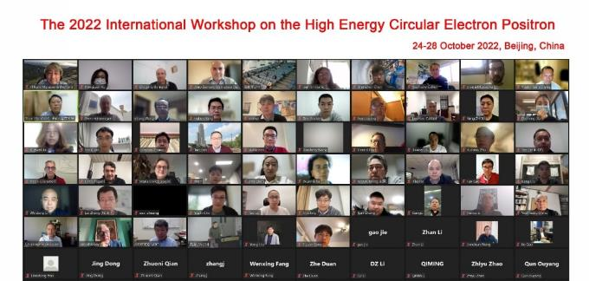
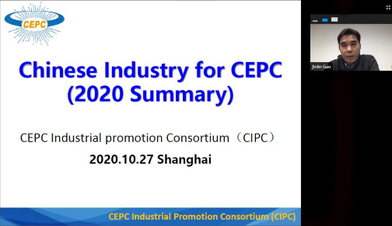
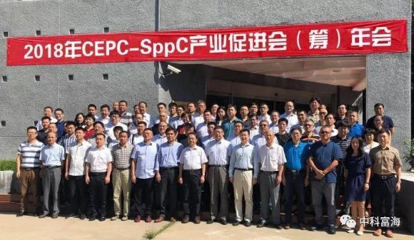
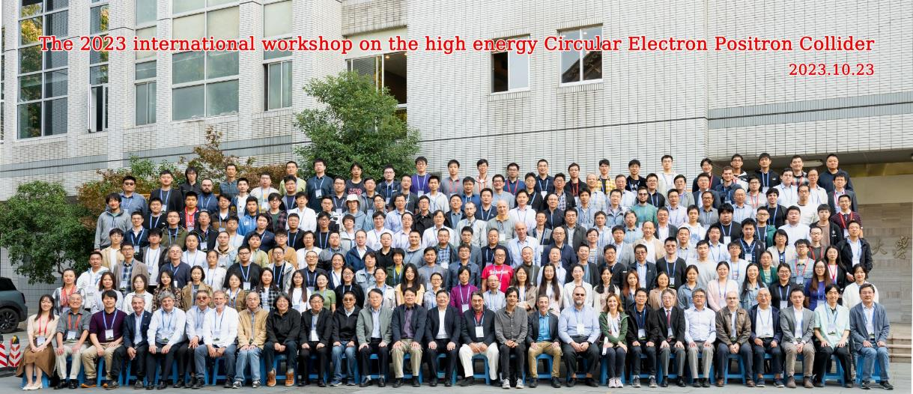
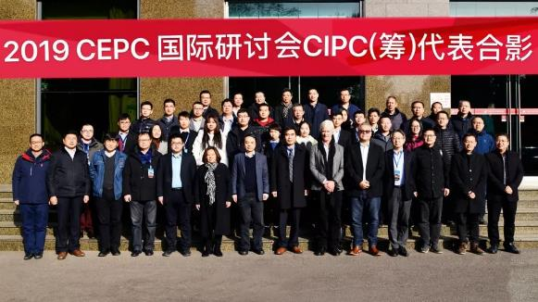
Milestones in CIPC Progress
Notes:
自2017年CIPC产业促进会成立以来，每年聚集数十家企业参加召开研讨会议，与CEPC国际研讨会议同步举行，在产业分会中充分交流研讨核心技术与产品应用问题。
﻿中科院高能所王贻芳院士，CEPC机构委员会副主席主席高杰教授多次出席会议并与企业家进行深入交流。
Since the establishment of the CEPC Industrial promotion Consortium（CIPC）in 2017, dozens of enterprises have gathered to participate in conferences , which are held simultaneously with the CEPC International Seminar. CEPC core technologies and product application issues are fully discussed in the industry session.
Academician Wang Yifang from the IHEP, Chinese Academy of Sciences, and Professor Gao Jie, Vice Chairman of the CEPC Institutional Committee, have attended meetings and deeply communicated with entrepreneurs.

Slide 10
Contents
1
Background and Target
2
CIPC Organization
3
Enterprise introduction
4
Summary

Slide 11

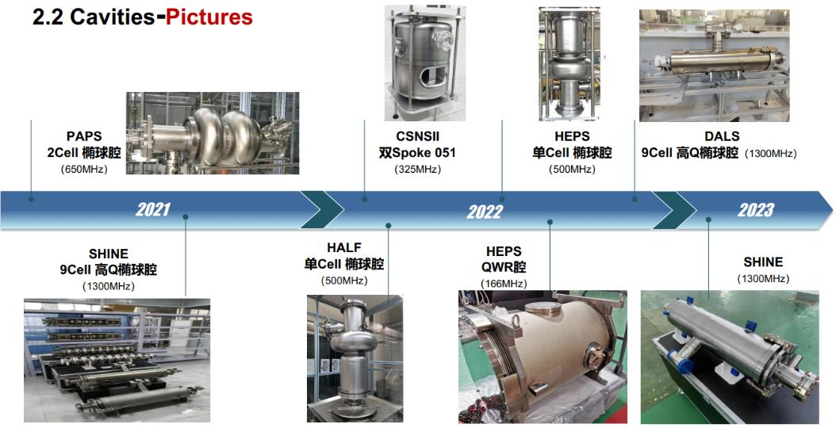
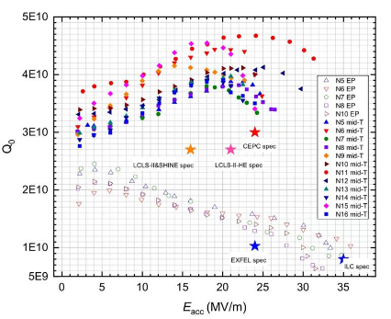
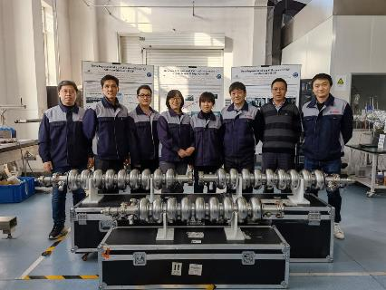
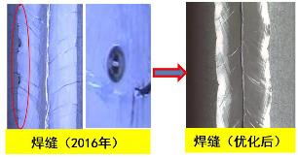
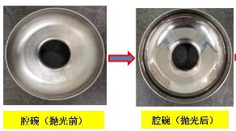
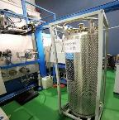
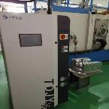
Superconducing Cavities
High performance 1.3GHz 9 Cell cavity
9cell cavities test results
（Jiyuan Zhai）
Technical Team （HERT）
Cavities-High performance 1.3GHz 9 Cell cavity
A. Improve welding quality--- Eacc
★Single cavity: 45MV/m；
★ 9cell cavity: 24MV/m to 30-35MV/m；
B. Improve surface quality--- Ra1.6 to Ra0.4；
C. Update equipment to increase efficiency---
General welding，3days to 1.5 days/cavity；
N2 Cooling
system
Cryotrap
北京高能锐新科技有限责任公司
Beijing HE-Racing Technology Co., Ltd
Notes:
北京高能锐新科技有限责任公司（前身为中国科学院高能物理研究所实验工厂） 是国内外知名的大科学装置关键设备生产企业， 也是大科学装置产品与技术涉及面最广的制造商之一。
依托国内外大科学装置建设以及长期的高能物理合作积累的技术和经验， 创建了一支强大的技术队伍和生产队伍， 拥有完备的生产和测试条件。 产品涵盖磁铁、 加速结构、 电真空器件与超导腔等， 可提供加速器设备设计、 加工、 测试、 安装、 运维等全链条服务体系
Beijing HE-Racing Technology Co., Ltd. (formerly known as the Experimental Factory of the IHEP, CAS) is at home and abroad
Beijing HE-Racing Technology Co., Ltd. (HERT) is a well-known manufacturer for large scientific devices, covering magnets, acceleration structures, electric vacuum devices and superconducting cavities, etc., and can provide a full-chain service system for accelerator equipment design, processing, testing, installation, operation and maintenance.
Here is the latest high-performance 1.3GHz 9 cell cavity produced by HE-RACEING TECHNOLOGY.
A. Improve welding quality--- Eacc
B. Improve surface quality--- Ra1.6 to Ra0.4；
C. Update equipment to increase efficiency--- General welding， 3days to 1.5 days/cavity；

Slide 12
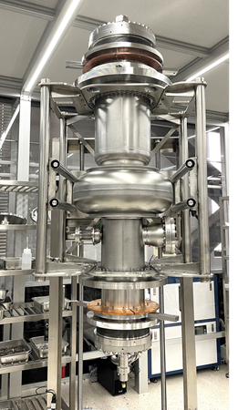
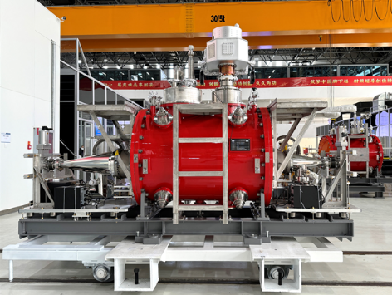
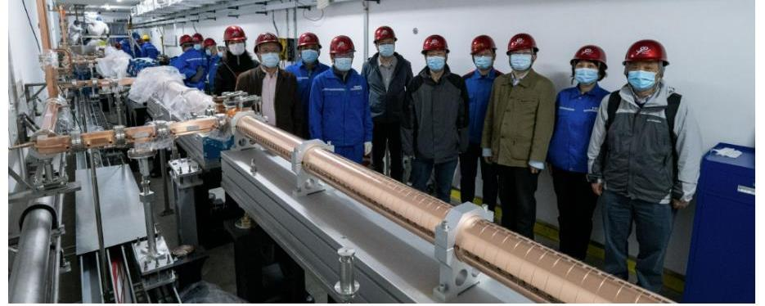
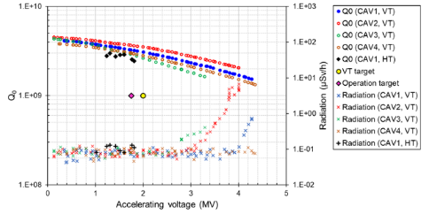
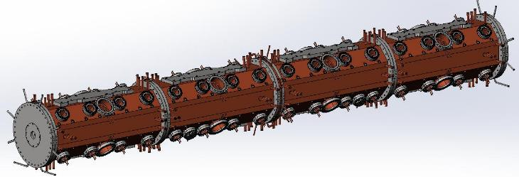
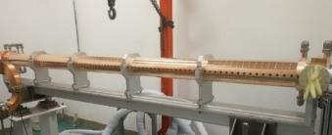
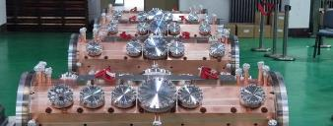
Superconducting Cavities
Group photo of the on-site acceptance of the accelerated structure
The first 500 MHz superconducting module manufactured by Beijing HE-Racing Technology Co., Ltd. successfully completed the horizontal and high-power test at low temperatures, and the test results were better than the design indicators of HEPS
北京高能锐新科技有限责任公司
Beijing HE-Racing Technology Co., Ltd
Notes:
The first 500 MHz superconducting module manufactured by HERT has successfully completed high-power test at low temperatures, and the test results were better than the design indicators of HEPS(High Energy Photon Source)
HEPS linear accelerated structure , Passed the on-site acceptance, meeting the target and the design requirements.

Slide 13
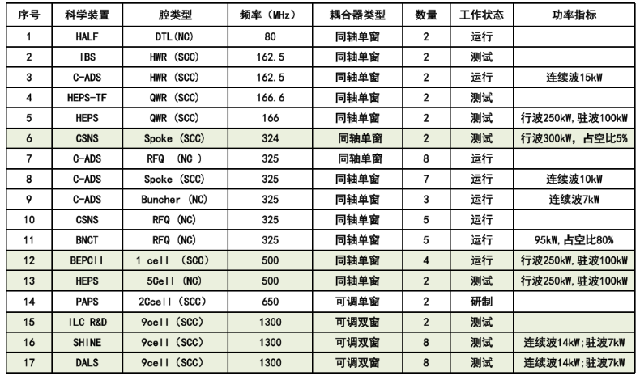
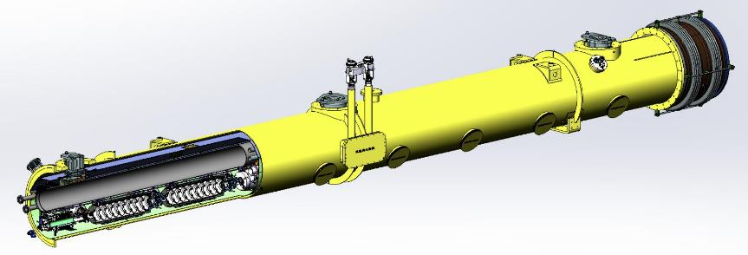
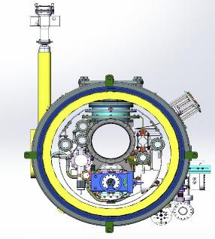
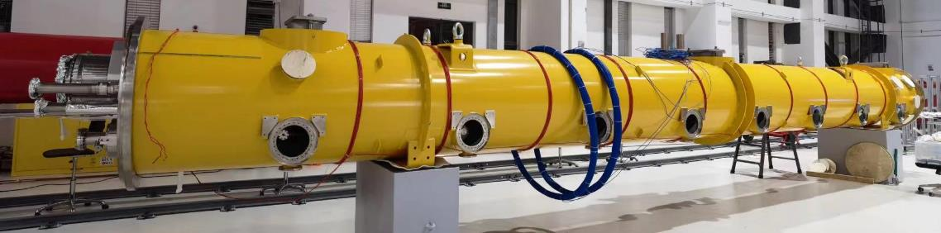
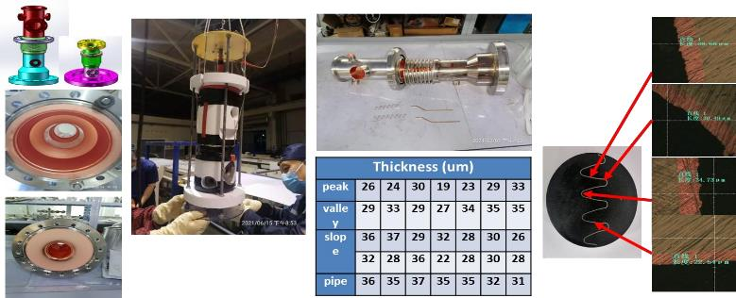
Couplers /Cryomodules
The 1.3GHz cryogenic module was developed and assembled and delivered
HERT full with the experience for accelerator key technology and components R&D and manufacture.
HERT has Successfully developed the several prototype for SRF cavities and Couplers.
Copper Plating
北京高能锐新科技有限责任公司
Beijing HE-Racing Technology Co., Ltd
Notes:
北京高能锐新生产的Couplers在HALF、IBS、C-ADS、HEPS-TF、HEPS、CSNS、C-ADS、BNCT、BEPCⅡ\HEPS、PAPS、ILC R&D、SHINE、DALS项目均有使用
北京高能锐新生产的1.3GHz低温模组研制组装完成并交货。
Couplers produced by HERT are used in HALF, IBS, CADS, HEPS, CSNS, BEPCⅡ, PAPS, ILC R&D, SHINE and DALS projects
The 1.3GHz Cryomodules produced by HERT has been developed and assembled and delivered.

Slide 14

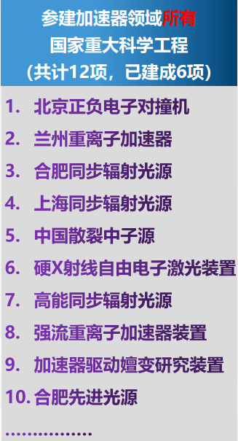
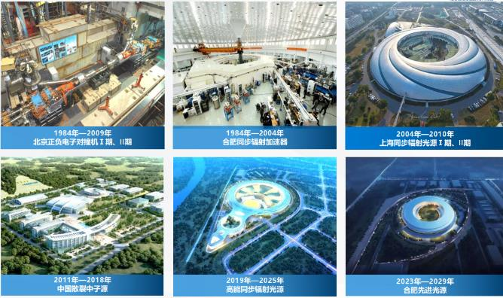
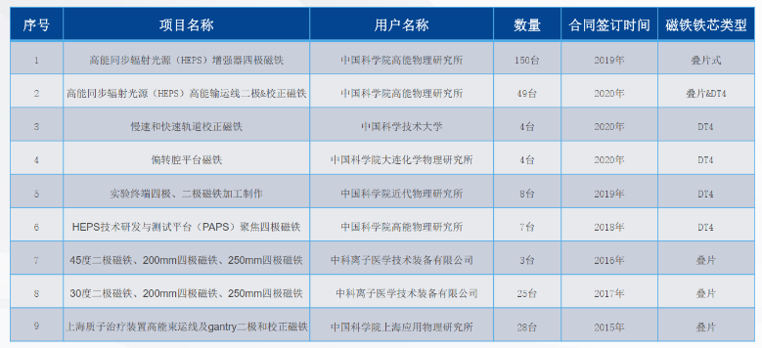
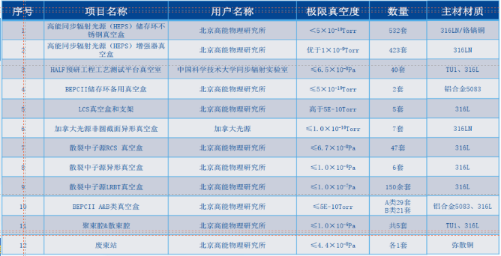
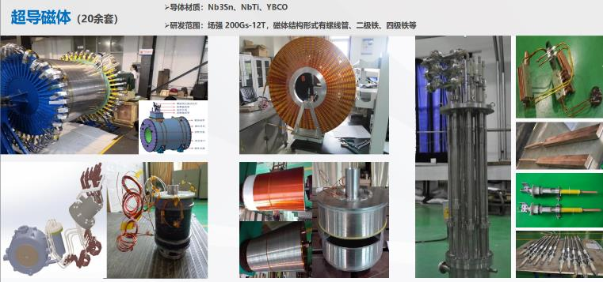
Superconducting magnets
List of magnet class items
List of items in the vacuum chamber and vacuum system category
合肥聚能电物理高技术开发有限公司
Introduction of Hefei Juneng Electric Physics High Technology Development Co., LTD
Notes:
合肥聚能电物理高技术开发有限公司专业从事电物理装置的设计及研制，是国内外重要的电物理设备研制基地。凭借雄厚的技术研发实力和丰富的生产制造经验，我们成功参与了EAST全超导托卡马克、北京正负电子对撞机、上海第三代同步辐射光源、稳态强磁场实验装置、同步辐射加速器、中国散裂中子源、欧洲X射线自由电子激光（EXFEL）波荡器、德国GSI加速器、美国普林斯顿大学Flux coil磁体等诸多电物理装置的研制。
Hefei Juneng Electro physics High-tech Development Co., Ltd. specializes in the design and development of electrophysics devices.They have successfully participated in the development of many electrophysical devices such as EAST superconducting tokamak, Beijing Positron Collider, Shanghai third-generation synchrotron radiation light source, steady-state strong magnetic field experimental device, CSNS（China Spallation Neutron Source）, EXFEL (European X-ray free electron laser) oscillator, German GSI accelerator, Flux coil magnet of Princeton University in the US, etc.

Slide 15
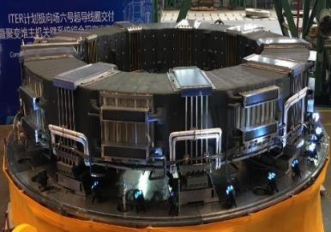
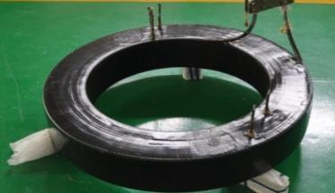
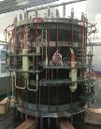
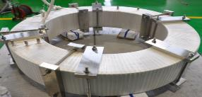
Superconducting magnets
Superconducting magnet related projects
International Thermonuclear Experimental Reactor (ITER) Polar Field 6 magnet
EAST Nb3Sn superconducting experimental magnet
Steady-state strong magnetic field experimental device 40T hybrid magnet external superconducting magnet.
International Thermonuclear Experimental Reactor (ITER) polar field 6
Outside diameter | Φ10.2m | CICC type onductors | 316L
Inner diameter | Φ7.1m | Superconducting material | NbTi
height | 1.13m | The operating current | 48/52kA
Weight | 265t | Magnetic field strength | 7.8T
Key technical indicators
Coil A: CICC superconducting
conductor, armor material 316L,
superconducting material Nb3Sn, operating current 14.1/13.4kA, maximum field strength 12.7T
Coil B: CICC superconducting conductor, armor material 316L, superconducting material Nb3Sn, operating current 14.1/13.4kA, maximum field strength 11.3T
Coil C: CICC superconducting conductor, armor material 316L, superconducting material Nb3Sn, operating current 14.1/13.4kA, maximum field strength 10T
Coil D: CICC superconducting conductor, armor material 316L, superconducting material NbTi, operating current 14.1/13.4kA, maximum field strength 7.7T
A+B+C+D central magnetic field 11.5T
Key technical indicators
Cross-sectional size of Nb3Sn superconducting cable (10.4mm*13.2mm)
Winding withstand voltage and leakage rate detection: pressure 5MPa, for 10 minutes, leakage rate < 1.3E10 Pa m/s.
Withstand Voltage Detection:
Inter-turn insulation withstand voltage: before glue filling, 15V per turn, AC, for 1 minute.
Terminal voltage, 2000V before glue filling, AC, for 1 minute.
Voltage to ground±5000V, DC, for 5 minutes.
Withstand voltage detection to the ground, withstand voltage value 5000V, DC, for 5 minutes
合肥聚能电物理高技术开发有限公司
Introduction of Hefei Juneng Electric Physics High Technology Development Co., LTD
Notes:
Superconducting magnet related projects
➢International Thermonuclear Experimental Reactor (ITER) Polar Field 6 magnet
➢EAST Nb3Sn superconducting experimental magnet
➢Steady-state strong magnetic field experimental device 40T hybrid magnet external superconducting magnet.
Key technical indicators
➢

Slide 16

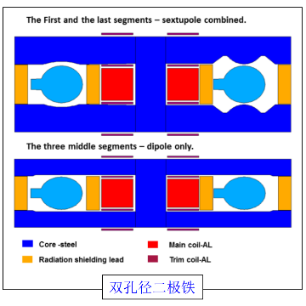
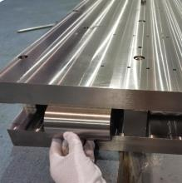
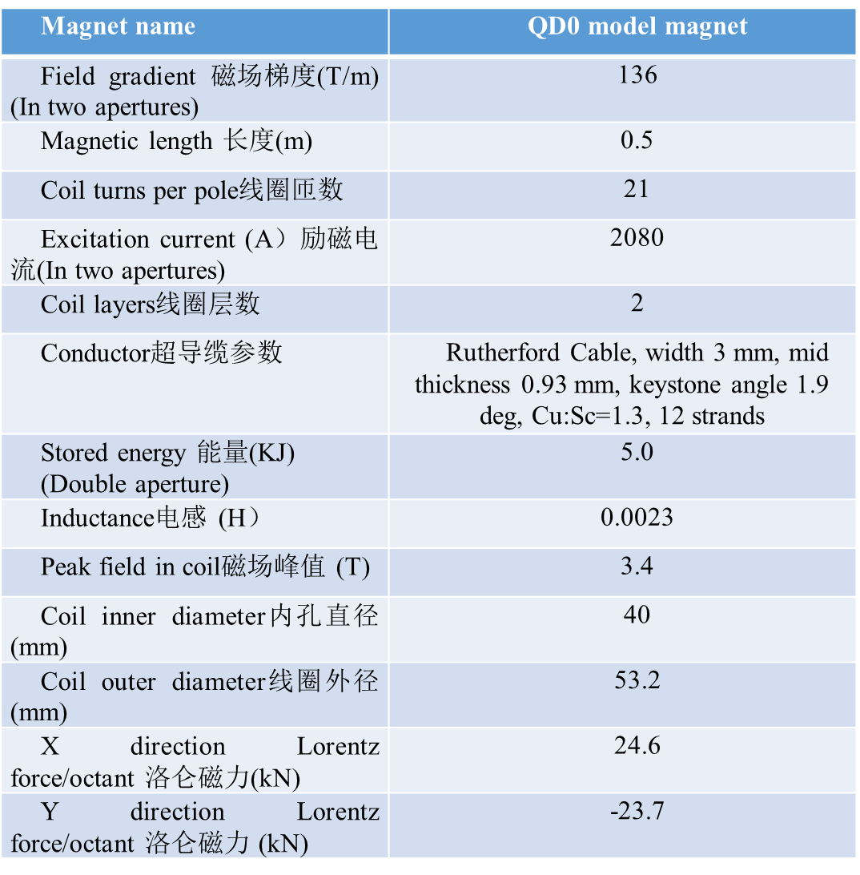
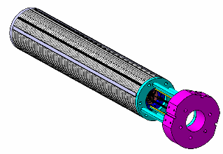
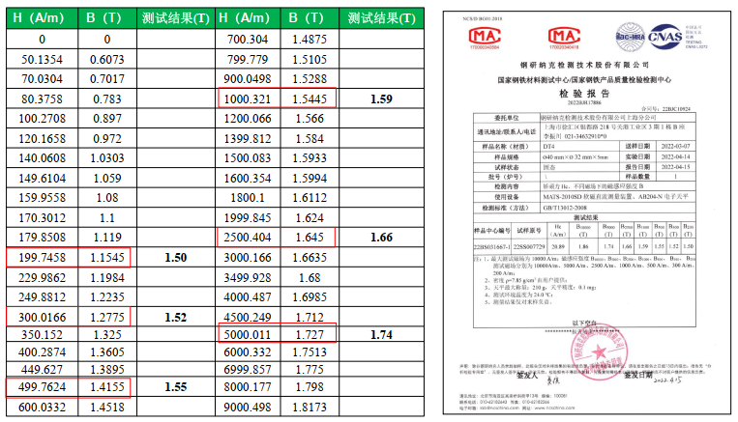
SC and normal conducting magnets
Normal conducting magnet
The QD0 superconducting quadrupole magnet is a cos2θ type double-aperture superconducting magnet with an iron core, and the centerlines of the two aperture are not parallel, and the angle is 33mrad.
Single-aperture superconducting quadruple experimental magnet
合肥科烨电物理设备制造有限公司
Hefei Keyie Electrophysical Equipment Manufacturing Co., Ltd
Notes:
合肥科烨电物理设备制造有限公司成立于2007年1月，主要从事电物理、真空机械及各类通用机械产品的设计制造，先后为HT-6B、HT-6M、HT-7及EAST受控核聚变实验装置完成了主抽气系统、DCN激光干涉仪、离子回旋低杂波天线、内置冷凝泵阀箱、内部部件等大量装置的研制和安装，并负责EAST超导托卡马克核聚变试验装置改造工程的部件研制及加工。
Hefei Keye Electro physical Equipment Manufacturing Co., Ltd. mainly engaged in the design and manufacture of electro physics, vacuum machinery and various general mechanical products, and has provided equipment for HT-6B, HT-6M, HT-7 and EAST controlled nuclear fusion experimental devices.
The company's current research and development focus on QD0 superconducting quadrupole magnet , a single-aperture superconducting quaternary experimental magnet，and Normal conducting magnet

Slide 17

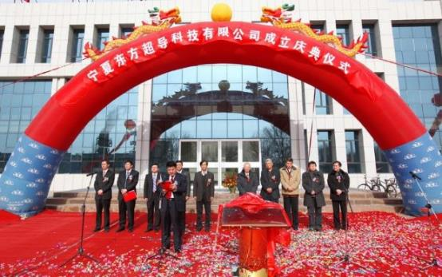
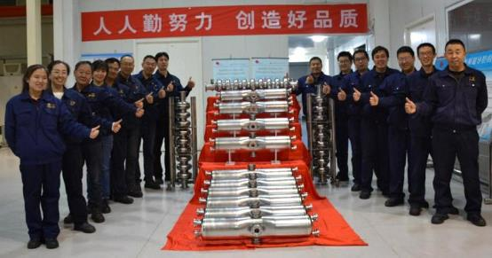
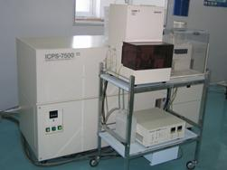
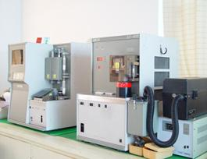
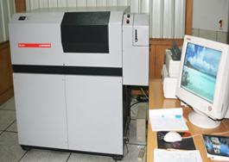
CEPC main ring (650MHz) and
Booster (1.3GHz) SC high frequency
Ningxia Oriental Superconducting Technology Co., LTD., founded in 2010, belongs to OTIC. It is mainly engaged in the manufacturing, welding and post-processing of SRF cavity, a key equipment in particle accelerators of large science facilities.
The core component of the RF superconducting accelerator is the superconducting accelerating cavity. RF superconducting cavity, X-ray free electron laser, radionuclide physics research device are the key component of collider.
宁夏东方超导科技股份有限公司
Ningxia Oriental Superconducting Technology Co., LTD.
Notes:
宁夏东方超导科技有限公司成立于2010年，隶属于OTIC（东方钽业）。主要从事大型科研设施粒子加速器关键设备SRF型腔的制造、焊接和后处理射频超导加速器的核心部件是超导加速腔。射频超导腔、X射线自由电子激光器、放射性核素物理研究装置是对撞机的关键部件。
Ningxia Oriental Superconducting Technology Co., LTD., founded in 2010, belongs to OTIC. It is mainly engaged in the manufacturing, welding and post-processing of SRF cavity, a key equipment in particle accelerators of large science facilities
The core component of the RF superconducting accelerator is the superconducting accelerating cavity. RF superconducting cavity, X-ray free electron laser, radionuclide physics research device are the key component of collider.

Slide 18
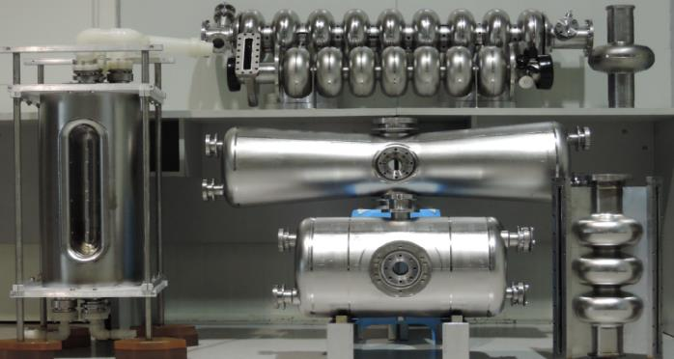
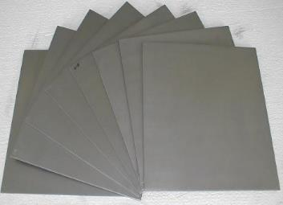
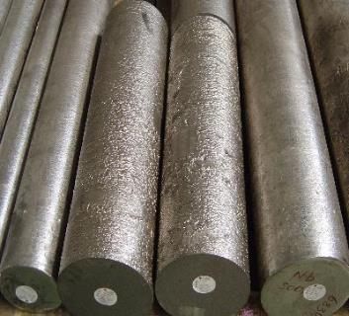
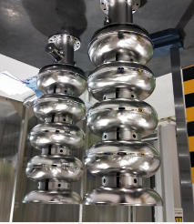
CEPC main ring (650MHz) and
Booster (1.3GHz) SC high frequency
2011 DESY - XFEL
RRR300 Nb: 8 tons, 30% of the project
2012 Michigan State University - FRIB
RRR250 Nb: 8.5 tons, 70% of the project
2014 Fermilab - LCLS II
RRR300 Nb: 5 tons, 50% of the project
2017 INFN and STFC - ESS
RRR300 Nb: 12.5 tons, 100% of the project
2019 IBS - RISP, CERN - HL-LHC, Fermilab - PIP-II, Shanghai - SHINE
RRR300 niobium material procurement in progress
We had built the business relationship with many great customers such as DESY, MSU, Fermilab, JLAB, INFN, STFC, CERN, TRIUMF, RI, ZANON, IHEP, IBS, RRCAT etc.
High RRR Nb sheet
High RRR Nb sheet
宁夏东方超导科技股份有限公司
Ningxia Oriental Superconducting Technology Co., LTD.
Notes:
高RRR值（残余电阻率）铌材射频超导腔实现产业化
所研制的1.5GHz单Cell大晶粒、1.5GHz7Cell细晶粒等2种类型的射频超导腔加速梯度性能达到国际先进水平。建设并形成了30-50只/年射频超导腔的生产能力，实现了项目的产业化目标。
High RRR (residual resistivity) NB RF superconducting cavity is commercialization. The acceleration gradient performance of two types that RF superconducting cavities (1.5GHz single cell large grain and 1.5GHz 7 cell fine grain) has reached the international advanced level.
The production capacity of 30-50 /per-year RF superconducting cavity has been built.
The users they supply such as DESY, MSU, Fermilab, JLAB, INFN, STFC, CERN, TRIUMF, RI, ZANON, IHEP, IBS, RRCAT etc.

Slide 19
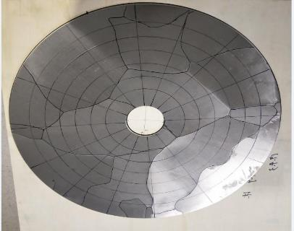



CEPC main ring (650MHz) and
Booster (1.3GHz) SC high frequency
The large grain niobium circular plate (RRR300) produced by OTIC can meet the manufacturing requirements of 1.3GHz-9Cell superconducting cavity.
At present, the company has provided a number of large grain 1.3GHz-9Cell SRF cavities for the Shanghai Hard X-ray Large Science Facility.
SRF Cavity built by Ningxia OSTEC
宁夏东方超导科技股份有限公司
Ningxia Oriental Superconducting Technology Co., LTD.
Notes:
The large grain NB(niobium 铌）circular plate (RRR300) produced by OTIC can meet the manufacturing requirements of 1.3GHz-9Cell superconducting cavity.
At present, the company has provided a number of large grain 1.3GHz-9Cell SRF cavities for the Shanghai Hard X-ray Large Science Facility.

Slide 20






The second generation
high-temperature SC tapes
Superconducting wires
Monolith（NbTi）
Wire in Channel（NbTi）
Nb₃Sn
MgB₂
Name | MgB2 | Monolith（NbTi) | Wire in Channel（NbTi） | Nb₃Sn
Specifications | 1.0mm~1.5mm | 0.5mm~1.6mm (round wire) | 1.6*1.1mm~3.4*2.0mm | 0.65mm~1.65mm
Copper ratio range | 0.15 | 0.6~10 | 4~20 | 1.0
Critical current | (@3T, 20K): 200A~500A | (@4T, 4.2K): 150A~1100A | (@4T, 4.2K): 400A~2000A | (@12T, 4.2K): 200A~800A
Western Superconducting Materials Technology Co., Ltd. was established in Xi'an Economic and Technological Development Zone in 2003, and has built the world's only full-process production enterprise of niobium-titanium (NbTi) rods, superconducting wires and superconducting magnets, realizing the "zero breakthrough" in the industrialization of superconducting wires and applications in China.
西部超导材料科技股份有限公司
Western Superconducting Technologies Co.,Ltd
Notes:
西部超导材料技术有限公司有限公司2003年成立于西安经济技术开发区，建成了世界上唯一的铌钛棒、超导线材、超导磁体全流程生产企业，实现了我国超导线材产业化和应用“零突破”。
Western Superconducting Materials Technology Co., Ltd. has built the world's only full-process production enterprise of niobium-titanium (NbTi) rods, superconducting wires and superconducting magnets, realizing the "zero breakthrough" applications in China.

Slide 21





The second generation high-temperature SC tapes
1.2-km 35 kilovolt superconducting power cable transmission line
Length: 1.2 km
Loading Current: 2.2 kA
Loading Voltage: 35 kV
HTS Materials: 2G tapes from SCSC & SST
Cable Structure: Three-phase integrated
Total area: Save 70% of underground pipegallery space
The superconducting layer produced by Shangchuang Superconductor has a production capacity of wider tapes of 20-40mm; double-lane design; Multiple production Yields up to 400 km/year
Coating and Low-temperature pyrolysis
High-temperature crystallization
上海上创超导科技有限公司（SCSC）
Shanghai creative Superconductor Technologies Co., Ltd.
Notes:
上海上创超导科技有限公司生产的超导层具有20-40mm宽带的生产能力；双车道设计；多次生产产量高达400公里/年。
它还将建造一条1.2公里的35千伏超导电缆传输线，这可以节省70%的地下管道廊道空间
The superconducting layer produced by Shangchuang Superconductor has a production capacity of wider tapes of 20-40mm; double-lane design; Multiple production Yields up to 400 km/year.
It’s also build a 1.2km 35 kilovolt superconducting power cable transmission line, which can Save 70% of undergroundpipe gallery space

Slide 22





high efficiency klystron direction
Preliminary mechanical design
forUHFKP8001
Kunshan National Research Institute has successively developed 650MHz/800KW klystron sample tubes, 650MHz/800KW high-efficiency klystron sample tubes, 648MHz pulse klystron tubes, 650MHz/800KW multi-injection klystron beam tubes, and the latest 324MHz pulse klystron tubesElectro vacuum products for 50 years. Provide high power thyristor of GL1536A in batches for BEPCII in 2012.
昆山国力电子科技股份有限公司
Kunshan GuoLi Electronic Technology Co., Ltd
Notes:
Kunshan National Research Institute has successively developed 650MHz (Megahertz) /800KW klystron/high-efficiency klystron/multi-injection klystron beam tubes, 648MHz pulse klystron tubes, the latest 324MHz pulse klystron tubes Electro vacuum products for 50 years. Provide high power thyristor of GL1536A in batches for BEPCII in 2012.
昆山国家研究院近年来先后开发了650MHz（兆赫）/800KW速调管样品管、650MHz/800KW高效速调管采样管、648MHz脉冲速调管、650MHz/800KW多注速调管束管和最新324MHz脉冲速管电子真空产品。2012年为BEPCII批量提供GL1536A大功率晶闸管。

Slide 23








high efficiency klystron direction
324MHz Mechanical design of klystron tubes
324MHz cavity, output window and collector of the klystron tube
Kunshan National Research Institute 's research and development of 324MHz klystron has completed mechanical design, component processing, cavity welding, tuning and focusing coil integration
324MHz Focusing coil system for klystrons
昆山国力电子科技股份有限公司
Kunshan GuoLi Electronic Technology Co., Ltd
Notes:
324MHz速调管机械设计
324MHz速调管的腔体、输出窗及收集极等部件
昆山国研324MHz速调管的研制完成了机械设计、元器件加工、腔体焊接、调谐和聚焦线圈集成
Kunshan 's research and development of 324MHz klystron has completed mechanical design, component processing, cavity welding, tuning and focusing coil integration

Slide 24












Vacuum technologies
Anhui East China Optoelectronic Technology Research Institute Co., Ltd. specializes in special microwave and microelectronics, special light sources, special displays and other electronic components, and has established a R&D, design and simulation platform covering microwave, millimeter wave, terahertz and other professional directions, R&D and process test equipment and software.
安徽华东光电技术研究所有限公司
Anhui East China Optoelectronic Technology Research Institute Co., Ltd
Notes:
安徽华东光电技术研究所有限公司专业承担特种微波
与微电子、特种光源、特种显示等电子元器件，建立了覆盖微波、毫米波、太赫兹等多个专业方向的研发设计仿真平台，研发与工艺试验设备及软件
Anhui East China Optoelectronic Technology Research Institute Co., Ltd. specializes in special microwave and microelectronics, special light sources, special displays and other electronic components.
They have established a R&D, design and simulation platform covering directions such as microwave, millimeter wave, terahertz, etc. as as well as R&D and process testing equipment and software.

Slide 25






Vacuum technologies
Microwave Vacuum Passive Devices - Product Demonstration of large Scientific Devices
参数名称 | 指标
工作频率 | 162.5MHz
传输损耗 | ≤0.2dB
传输功率 | ≥14kw（CW）
真空漏率 | 优于1E-9mbar*L/s
材料磁导率 | ≤1.05
冷却方式 | 风冷
装配结构 | 陶瓷金属焊接
陶瓷镀膜 | TiN
微波面镀膜 | 镀铜15-30微米
RRR∈ | 30,80
1.5GHz high-mode
absorber
BNCT-RFQ coupler
162.5MHz Dual-window coupler
Cold-hot dual-window coupler
650MHz High power input coupler
1.3GHz Dual-window coupler
Anhui East China Optoelectronic Technology Research Institute Co., Ltd. has created a variety of products for large scientific projects, such as cold-hot double-window coupler, 162.5MHz double-window coupler, 1.3GHz double-window coupler, 650MHz high-power input coupler, 500MHz high-power input coupler, overweight RFQ coupler and other key equipment.
安徽华东光电技术研究所有限公司
Anhui East China Optoelectronic Technology Research Institute Co., Ltd
Notes:
安徽华东光电技术研究所有限公司为大科学工程打造过多种产品，冷-热双窗耦合器、162.5MHz双窗耦合器、1.3GHz双窗耦合器、650MHz高功率输入耦合器、500MHz高功率输入耦合器、超重RFQ耦合器等关键设备
They have created a variety of products for large scientific projects, such as cold-hot double-window coupler, 162.5MHz double-window coupler, 1.3GHz double-window coupler, 650MHz high-power input coupler, 500MHz high-power input coupler, overweight RFQ coupler and other key equipment.

Slide 26









Attracted the attention of International known industrial company
Zanon is located in Schio, North-East of Italy,
1 hour from Venice, where the mother company SIMIC has its main workshop.
Working closely for more than 30 years with the most important Physics Research Institutes in the world, from prototyping to series production.
HIGH TECHNOLOGY PRODUCTS
▪ RF Cavities
▪ Tuners
▪ Cryomodules
▪ Vacuum Chambers
▪
MAIN SECTORS
▪ Scientific Research
▪ Fusion Energy
▪ Aerospace
▪ Industry
▪ Medical
▪ Cryostats
▪ Antennas
▪ Collimators
▪ Special parts
Zanon team visited China in Oct.23-27, 2023, attended CEPC conference and exchanged ideas
Notes:
Zanon is located in Schio, North-East of Italy,
1 hour from Venice, where the mother company SIMIC has its main workshop.
Working closely for more than 30 years with the most important Physics Research Institutes in the world, from prototyping to series production.

Slide 27



Attracted the attention of International known industrial company
Zanon working with Research Institutes fro early ’80.
▪ R&D phase and Production of 45 cryomodules for TESLA Test Facility and XFEL Project at DESY-Hamburg
Zanon participated with aninternational consortium
to produce the Ion Source prototype for ITER beam
injectors.
Zanon’s scope comprised:
▪ Vacuum vessel
▪ Beam source support frame
▪ Beam source electrostatic shields
▪ Beam source handling tool
Notes:
Zanon working with Research Institutes from early ’80.
Focus on R&D phase and Production of 45 cryomodules for TESLA Test Facility and XFEL Project at DESY-Hamburg.
Zanon participated with aninternational consortium to produce the Ion Source prototype for ITER beam injectors.
Zanon从80年代初开始在研究机构工作。
专注于TESLA测试设施和汉堡DESY XFEL项目的45个低温模块的研发阶段和生产。
Zanon与一个国际财团合作，为ITER束流注入器生产离子源原型。

Slide 28






Attracted the attention of International known industrial company
SIMIC is among the Leaders in the Fusion Energy sector and is among the main contributors to ITER project. Working in Fusion Energy for more than 15 years.
ITER PROTOTYPES & SERIES PRODUCIONS
▪ VACUUM VESSEL PROTOTYPE
▪ DIVERTOR PROTOTYPES and SERIES
▪ MAGNETS SYSTEM (70 Radial Plates and 10 TFCoils – very large and complex projects)
Weight of TF COIL - 320 tons/ each
SIMIC is working with CERN & many other Research Institutes for more than 20 years.
SIMIC is among the main contributors of LCH Project, at CERN.
ENDCAP CRYOSTAT FOR ATLAS
Material: Alluminium AL 5083
Diam: 5.500 mm
Thk: 160 mm
Weight: 40.000 kg Cryogenic Tests at 90K Super Insulation Leak Test <1X10⁻⁸ mbar. l/s
250 CRYOMODULES FOR LHC
Material: AISI 304 L, Aluminium, Cu-Ni
Weigth: 2000 Kg
Length: 6.650 mm Pressure test up to 25 bar; He Leak test < 1x10⁻⁸ mbar.l/s 3D Dimensional inspection, Instrumentation test
Notes:
SIMIC is working with CERN & many other Research Institutes for more than 20 years.
SIMIC is among the main contributors of LCH Project, at CERN.
SIMIC is among the Leaders in the Fusion Energy sector and is among the main contributors to ITER project. Working in Fusion Energy for more than 15 years.
SIMIC与欧洲核子研究中心和许多其他研究机构合作了20多年。
SIMIC是欧洲核子研究中心LCH项目的主要贡献者之一。
SIMIC是聚变能源领域的领导者之一，也是ITER项目的主要贡献者之一。在Fusion Energy工作超过15年。

Slide 29






Integrated Radiation Monitoring System
Gamma Detector:
Through the energy compensation method, the low energy segment of 50KeV~250KeV is realized
Accurate and real-time response (obtaining a third-party test report) solves industry problems
Neutron detector:
Successfully developed the first set of strong pulse neutron detector in China
 Real-time measurement of strong pulse neutron flux/dose
 Wide-energy region measurement: Thermal neutron 0.025 eV - high-energy neutron GeV Neutron measurement in the energy region
 High time resolution: Effective observation of accelerator pulsed neutron bundles ns
Terminal information system
1. Upgrade the digital board and readout, to 1: N mode (1 central console, N devices)
There is no need for secondary instruments, and it truly realizes long-distance transmission and large-scale deployment
2. Based on the B/S architecture, access to the EPICS system to connect the radiation protection monitoring data with
Accelerator control and other data paths, so that any terminal in the network can access
北京高能新技术有限公司
Beijing High Energy New Technology Co., Ltd
Notes:
Beijing High Energy New Technology Co., Ltd. focuses on the nuclear detection industry.
Based on the company's existing Gamma Detector and Neutron detector, the company engaged infocuses on research and development, production and promotion.
北京高能新技术有限公司专注于核探测行业。公司在现有伽马探测器和中子探测器的基础上，专注于研发、生产和推广。

Slide 30









Large-scale cryogenic refrigeration
& liquefaction equipment
Helium Liquefier | FHL-40 | FHL-70 | FHL-100 | FHL-140 | FHL-180 | FHL-240 | FHL-280 | FHL-400
Liquefaction Rate(L/h) | 40~70 | 70~100 | 100~140 | 140~180 | 180~240 | 240~280 | 280~310 | 310~420
Rated Power of Compressor(kW) | 75~90 | 90~132 | 132~160 | 160~200 | 200~250 | 250~315 | 315~355 | 355~425
Helium Refrigerator | FHR-40 | FHR-70 | FHR-100 | FHR-140 | FHR-180 | FHR-240 | FHR-280 | FHR-400
Cooling Power(W) | 160 ~250 | 250~320 | 320~450 | 450 ~580 | 580~750 | 750 ~900 | 900 ~1000 | 1000 ~1800
Rated Power of Compressor(kW) | 75~90 | 90~~132 | 132~160 | 160~200 | 200~250 | 250~315 | 315~355 | 355~425
北京中科富海低温科技有限公司
Beijing Sinoscience Fullcryo Technology CO.，Ltd.
Notes:
Fullcryo was established by the Institute of TIPC,CAS.
Provides advanced cryogenic equipment ranging from 20K to 2K, hydrogen liquefaction units, LNG-BOG helium extraction equipment, and separation and purification equipment for rare gases .
The Helium liquefaction rate is 40L/h-400L/h; the cooling power is 200W-4kW@4.5K.
The turbine efficiency is greater than 70%, and the technical indicators are internationally advanced.
We have been successfully applied in major basic scientific facilities such as linear superconducting accelerators, Circulator-2M (HL-2M) Tokamak in China, the Southern Light Source, CIADS (accelerator driven subcritical transmutation system), and the Songshan Lake National Superconducting Laboratory for cryogenic systems.
中科富海拥有20K-2K核心关键技术，是具有自主知识产权的集大型低温制冷装备设计、制造，低温系统工程与民族工业气体供应商，核心产品包括氦制冷机/液化器、LNG-B0G提氦装置、氢液化器和低温工程配套装置等大型低温制冷设备和产品，以及由低温技术驱动的氢能应用系统解决方案、高纯稀有气体、工业气体和气体工程等服务。在低温装备领域，中科富海首次在国内成功开发40L/h -400L/h，200W-4kW系列大型氢氦制冷机与液化装备产品，透平效率大于70%，技术指标国际先进，成功应用于直线超导加速器、中国环流器二号M装置（HL-2M）托卡马克装置、南方光源、CIADS加速器驱动次临界嬗变系统、松山湖国家超导实验室等重大基础科学装置低温系统中。

Slide 31




Large-scale cryogenic refrigeration
& liquefaction equipment
Hydrogen liquefaction system
The 1.5TPD hydrogen liquefaction
The 5TPD hydrogen liquefaction
Hydrogen liquefaction rate | Liquid hydrogen's parahydrogen content | Liquefaction energy consumption | Turboexpander efficiency
3070.2L/h | 98.66% | 12.98KWh/kg | 80%
The 5TPD hydrogen liquefaction
北京中科富海低温科技有限公司
Beijing Sinoscience Fullcryo Technology CO.，Ltd.
Notes:
We have developed a series of large-scale hydrogen liquefaction equipment with a capacity of 1.5-10 TPD. The turbo-expanders' adiabatic efficiency exceeded 80%.
我们开发了1.5-10吨/天大型氢液化装置系列, 其核心透平膨胀机的绝热效率高达81.4%。1.5吨/天氢液化装置电耗12.1kW·h/kg 液氢，综合单位能耗为15.1kW·h/kg 液氢（包括液氮预冷折合能耗。
The First 5TPD large-scale hydrogen liquefaction equipment, co-developed by the TIPC of CAS and Fullcryo. ,has successfully operated. It ran stably for 8.5 hours at full load and 73 hours at low load. At full load, the liquefaction rate was 3070.2 L/h (5.17 tons/day), the liquid hydrogen's parahydrogen content was 98.66%, the energy consumption is 12.98 kW·h/kg liquid hydrogen (including liquid nitrogen loss). These conditions align the unit's performance with international advanced standards.
5吨/天大型氢液化装置，由中国科学院理化所联合中科富海公司共同研发、设计并集成制造，实现了大型氢液化装置国产化。按照任务书指标要求，系统满负荷稳定运行8.5小时，低负荷稳定运行73小时。在满负荷运行条件下，氢气液化率3070.2 L/h （约5.17吨/天），液氢产品的仲氢含量98.66%，液化系统能效比12.98 kW·h/kg液氢（含液氮损耗），透平膨胀机绝热效率均超过80%，装置总体性能达到国际先进水平。

Slide 32


Large-scale cryogenic refrigeration
& liquefaction equipment
国内首台4kW氦制冷机项目通过专家出厂验收
First 4kW helium refrigerator in China
passes inspection
中科富海4000W@4.5K氦制冷机产品通过专家组鉴定，完成出厂验收
Fullcryo 4000W@4.5K helium refrigerator passed the expert inspection, completing factory acceptance
2023年11月29日，中科富海为先进能源科学与技术广东省实验室高能量密度测试平台提供的4000W@4.5K氦制冷机产品顺利通过用户及专家组现场验收，达到出厂要求，为超导腔和超导磁体提供必要的低温工作环境，保障各项研究测试的顺利进行。
On November 29, 2023, the 4000W@4.5K helium refrigerator provided by Fullcryo for the high Energy Density test platform of Guangdong Advanced Energy Science and Technology Laboratory passed the site acceptance by the user and experts, meeting the factory requirements, and was applied in the superconducting cavity and superconducting magnets.
北京中科富海低温科技有限公司
Beijing Sinoscience Fullcryo Technology CO.，Ltd.
Notes:
Our first 4kW@4.5K(with cooling power 4000W@4.5K) helium refrigerator in China passes inspection on November 29, 2023,
Meeting the factory requirements, and was applied in the superconducting cavity and superconducting magnets.

Slide 33


Large-scale cryogenic refrigeration
& liquefaction equipment
国内首台18kW氦制冷机项目通过专家出厂验收
First 18kW helium refrigerator in China
passes inspection
由中国科学院理化所研发设计，中科富海集成制造
It was developed by the Institute of TIPC,CAS, and integrated and manufactured by Fullcryo.
该长度28m、直径4.2m的超大型卧式冷箱实现超高真空、极微泄漏目标，是能够将氦气从常温降低至-269℃的必备条件。
The super large horizontal cold box with a length of 28m and a diameter of 4.2m achieves ultra-high vacuum and extremely low leakage.
验收意见：该系统超目标完成。
现场测试：1.内部各通道打压气密性测试，压力降为0，优于目标值0.02 bar；2.整体真空氦检，集合漏率为
9.1×10⁻¹⁰Pa.m³/s，优于目标值1×10⁻⁷Pa.m³/s。
The horizontal cold box system has exceeded the set targets.
On-site testing: 1. The airtightness test of each internal channel revealed a pressure drop of 0, surpassing the target value of 0.02 bar. 2. The overall leakage rate is 9.1×10⁻¹⁰ Pa.m³/s, surpassing the target value of 1×10⁻⁷ Pa.m³/s.
整套大型低温系统可实现三种工况调节模式： 氦制冷机等效制冷量大于18kW@4.5K；超流氦温区制冷量大于 4kW@2K
Expected goal：Achieving 3 operational mode adjustments:
The liquefaction capacity≥3,000L/h; the cooling capacity ≥ 18kW@4.5K; the cooling capacity in the superfluid helium temperature range ≥4kW@2K.
北京中科富海低温科技有限公司
Beijing Sinoscience Fullcryo Technology CO.，Ltd.
Notes:
2024年5月7日，由中国科学院理化所研发设计，中科富海集成制造 国内首台18kW氦制冷机项目通过专家出厂验收。
该长度28m、直径4.2m的超大型卧式冷箱实现超高真空、极微泄漏目标，是能够将氦气从常温降低至-269℃的必备条件。
整套万瓦级卧式冷箱系统是全国乃至世界上最大的冷箱系统，标志着中国液氦/超流氦温区的大型低温制冷设备研发和制造能力迈上新台阶。
整套大型低温系统可实现三种工况调节模式： 氦液化大于≥3,000L/h；氦制冷机等效制冷量大于18kW@4.5K；超流氦温区制冷量大于 4kW@2K
The First 18kW helium refrigerator in China passes inspection on May 7, 2024，which was developed by the Institute of TIPC,CAS, and integrated and manufactured by Fullcryo.
The super large horizontal cold box with a length of 28m and a diameter of 4.2m achieves ultra-high vacuum and extremely low leakage.
The overall leakage rate is 9.1×10⁻¹⁰ Pa.m³/s, surpassing the target value of 1×10⁻⁷ Pa.m³/s.
The horizontal cold box at Superfluid helium -level is the largest of its kind in China and even in the world.
We can achieve three operating modes for entire system:
the liquefaction capacity≥3,000 liters per hour；the cooling power capacity ≥ 18kW@4.5K; the cooling capacity in the superfluid helium temperature range ≥4kW@2K.

Slide 34
Contents
1
Background and Target
2
CIPC Organization
3
Enterprise introduction
4
Summary

Slide 35
Summary
Driven by the great scientific project of CEPC, CIPC members will participate in pre-research, industrialization and construction, and achieve breakthroughs on key-technologies, equipment manufacturing and industrialization. Comprehensively promote the development and technological progress of high-energy physics.
CIPC is an important opportunity and platform for the future development of enterprises. By participating in the CEPC, CIPC members continuously improves its technological innovation and industrial manufacturing capabilities, breaks through and reaches international advanced levels, ultimately achieving win-win cooperation.
If China starts building the world's largest particle collider in 2027, this great project will attract more scientific and industrial communities around the world to participate in the future.
Notes:
CIPC的成立，能够统筹汇聚科学界、企业界的力量开展设计、关键技术预研和产业化，全面推动高能物理学科发展与技术进步。
CIPC是企业未来发展的重要机遇和平台。通过参与CEPC大科学工程建设，企业不断提升技术创新和工业制造能力，突破并达到国际先进水平，将成为国际著名的设备供应商，最终实现合作共赢协同发展。
The establishment of CIPC can coordinate and gather the forces of the scientific and business communities to carry out design, key technology pre research and industrialization, and comprehensively promote the development and technological progress of high-energy physics.
CIPC is an important opportunity and platform for the future development of enterprises. By participating in the CEPC, CIPC members continuously improves its technological innovation and industrial manufacturing capabilities, breaks through and reaches international advanced levels, ultimately achieving win-win cooperation.
If China starts building the world's largest particle collider in 2027, this great project will attract more scientific and industrial communities around the world to participate in the future.
如果中国2027年开始建造世界上最大的粒子对撞机，这个伟大的项目未来将吸引全世界更多的科学界和产业界参与其中。

Slide 36
Acknowledgements:
Thanks go to companyies who have kindly provided there information:
Beijing HE-Racing Technology Co., Ltd
Introduction of Hefei Juneng Electric Physics High Technology Development Co., LTD
Hefei Keyie Electrophysical Equipment Manufacturing Co., Ltd
Ningxia Oriental Superconducting Technology Co., LTD.
Western Superconducting Technologies Co.,Ltd
Shanghai creative Superconductor Technologies Co., Ltd.
Kunshan GuoLi Electronic Technology Co., Ltd
Anhui East China Optoelectronic Technology Research Institute Co., Ltd
Zanon
SIMIC
Beijing High Energy New Technology Co., Ltd
Beijing Sinoscience Fullcryo Technology CO.，Ltd

Slide 37
Thank you for your kind attention
Contact information:
CEPC Committee: Jie Gao, IHEP, China
CIPC Working group: Jinlin Gao, Beijing Sinoscience FULLCRYO Technology Co., LTD
CIPC Executive Committee:
Qinyan Pan, Beijing Sinoscience FULLCRYO Technology Co., LTD
E-mail: qypan@fuhaicryo.com
Tel: +86 10 86468866

