Slide 1


https://ivi.huhep.org
https://ivi-en.huhep.org
Tohru Takahashi
Hiroshima University/ILC Vanguard Initiative
July 9 2024 LCWS2024
Notes:
"Good afternoon
Today, I will be talking about the ILC Vanguard Initiative, or IVI.

Slide 2


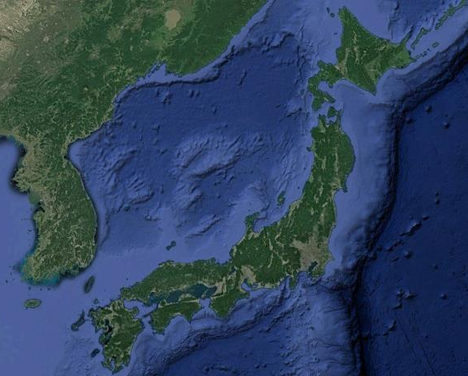
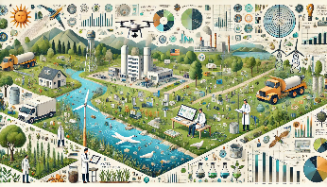
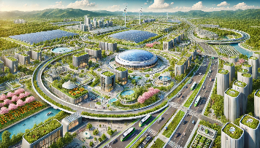
ILC Vanguard Initiative (IVI)
to facilitate and accelerate preparatory tasks for the ILC in Japan
No official decision for the ILC in Japan yet, however ,,,,,,
A lot of works to do in
Management planning
City development design
with local communities
time consuming
Environmental assessment
Notes:
The scientists have chose ILC site more than 10 ago, but we still do not have official approval.
Nevertheless, there is much work to be done by collaboration with communities in mind, such as management, environmental surveys, and city planning.
These efforts are time-consuming and require proactive and efficient organization.
This is why we established the ILC Vanguard Initiative, to facilitate and accelerate these preparatory tasks for the ILC in Japan."

Slide 3
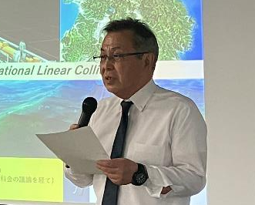
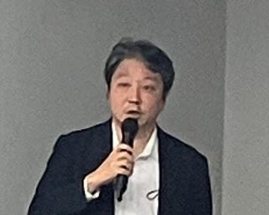
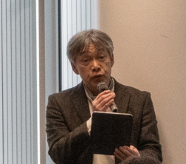
Organization
General incorporated foundation Geosystem Research Institute
ILC Vanguard Initiative（IVI)
Chair：Yuzo Ohnishi
Vice-chair, Advisors
Executive Committee
Public Relations Office
Project Management
Working Group
Next-Generation City Development
Working Group
Environmental Issues
Working Group
Construction Issues
Working Group
Notes:
"The IVI is organized as a group in a general incorporated foundation the Geosystem Research Institute.
Our chair is Professor Yuzo Ohnishi, a professor emeritus of Kyoto University.
Our vice-chair is Professor Satoru Yamashita.
I am the chair of Public Relations Office.
We have several working groups focusing on different aspects such
as project management,
next-generation city development,
environmental issues, and construction."

Slide 4





























Membership
Individual Participation from Universities and Companies
～40 from Academia /Industries
Notes:
We have about 40 members who participate individually from various universities and companies.
Our members come from leading Japanese industries, including construction and telecommunications,
as well as academic institutions.

Slide 5



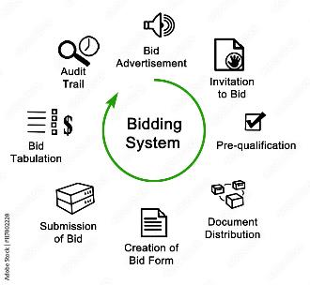
Project Management Working Group
to discuss/propose models for
Governance/Organization
Work sharing
Time scale
Bidding
Notes:
The Project Management Working Group discusses and proposes models for governance, work sharing, timelines, and bidding methods.
This group is crucial in ensuring that our project runs smoothly and on schedule.

Slide 6
Construction/Work sharing Model
Preparation
Construction
Operation
Site
(Surface)
City planning, construction
Environment
and Land Study
Environment assessment
Land acquisition negotiation
Land development planning
Land development
Facility
(Underground)
Tohoku
facility
design
Facility construction
preparation office
Facility const. org.
International
Laboratory
geo. survey
Detector construction
Accelerator Equipment
Acc. tunnel
Access tunnel
IP holl
Technology
(International)
ITN
ILC Pre-Lab
(Acc. Technology)
International
Laboratory
Notes:
A recent out come from the discussion in the management group is a construction /work shaing model.
The construction work is divided into different aspects.
Th site (surface) includes regional environment, city planning which are closely related with local community
The underground facilities, accelerator construction, excavating IP hall .
Technical development is conducted internationally, now conducting by ITN
The IVI concentrates these two activities.
We have making detailed plan that covers everything from land acquisition to city planning and facility construction."

Slide 7
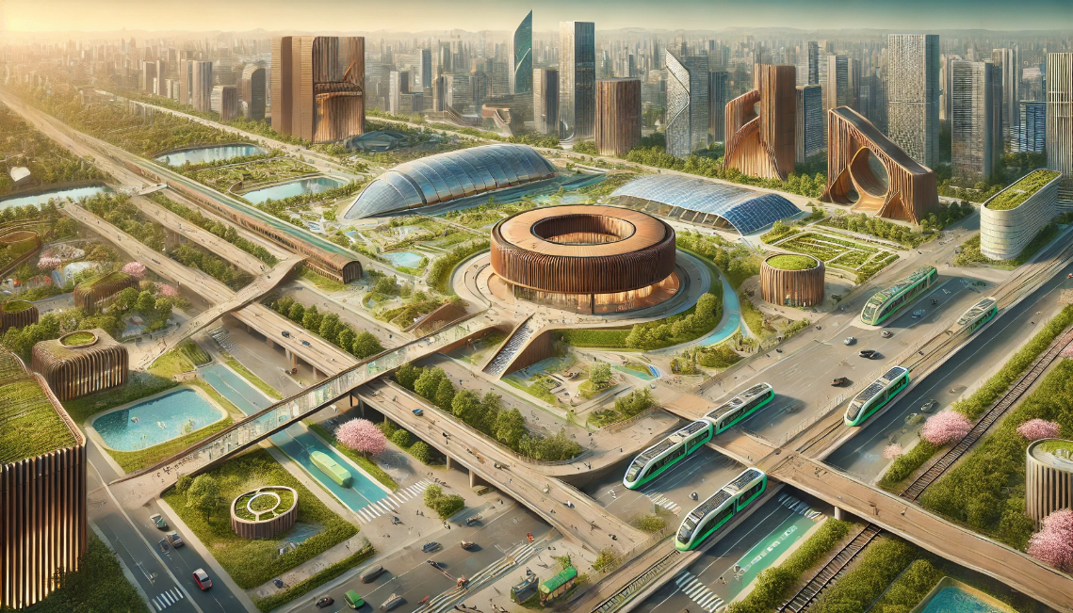
Next-Generation City Development
Working Group
GPT-4o image of city with ILC global lab.
Close cooperation with the surrounding municipalities
that bring extensive and diverse value to the region.
To Demonstrate these initiatives contribute to addressing
social challenges faced by the Tohoku, Japan and global society
Notes:
The Next-Generation City Development Working Group aims to demonstrate
how our initiatives can address social challenges faced by Tohoku, Japan, and the global society.
We work closely with surrounding municipalities to bring extensive and diverse value to the region.

Slide 8
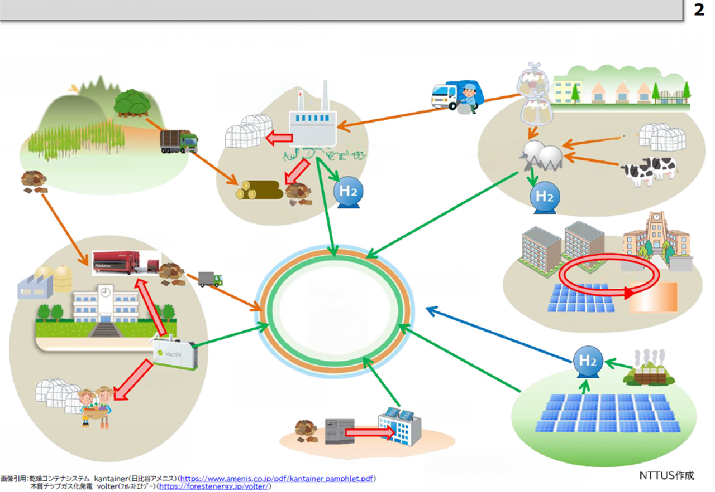
Low-Carbon City Development
electricity
resource
hot water
Utilization of
Forest Resources
Utilization of
Waste Heat
Utilization of
Waste
Food scraps
Forest Resources
Waste Vegitables
Waste
Treatment Plant
Utilization of
Abandoned Farmland
Methane Fermentation
Manure
Drying of Wood Chips
District Circulation
Drying of Wood Chips
Power Network
Hydrogen
Distribution Network
District Heating
Low-Carbon City Development
Large Scale Solar Heat
and Thermal Storage
Wood Chip
Distribution Network
Utilization of
Waste Heat
Solar Panels
Large Scale Solar Plant
Utilization of Idle Facilities
Utilization of
Renewable Energy
Utilization of Existing Facilities
Notes:
This is a example of the discussion in the city development, a concept of Low-Carbon City development.
A low-carbon city, utilizing resources such as electricity, hot water, forest resources, and waste treatment.
This includes the use of renewable energy sources like large-scale solar plants and district heating systems.
Using these resources we could make Low-Carbon, sustainable city
Biomass Renewable, organic resources of biological origin, excluding fossil resources

Slide 9
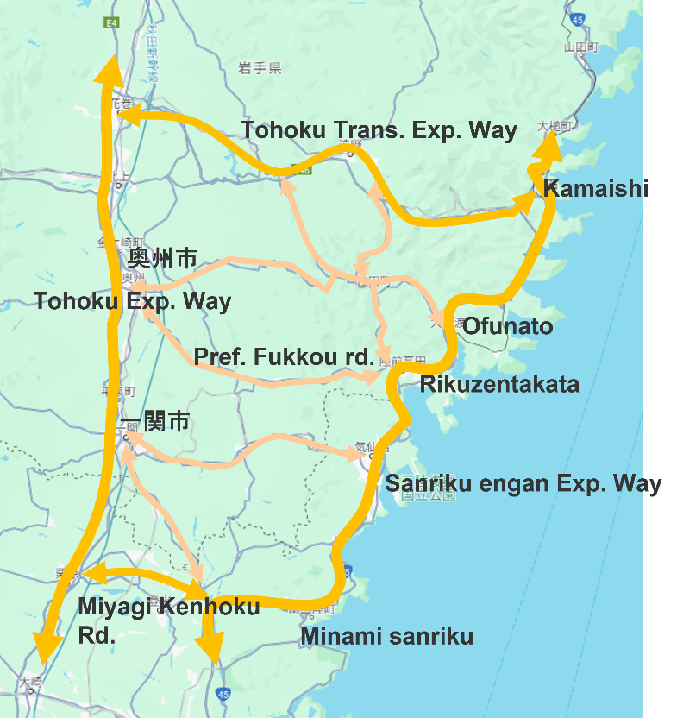
Green ILC Residential Environment Concept
Satoyama
Area
Mid town
Area
Mid town
Area
Satoyama
Area
Gate Way
Area
Main
Campus
IP
Campus
Satoumi
Area
Satoyama
Area
Mid town
Area
Satoyama
Area
Stn. front Rural Area
utilizing existing urban areas and rsatoyama (sea) area
connecting them with cutting-edge lifestyle infrastructure (shopping, medical care, education, and transportation).
Satoyama: a concept of a landscape
sustainable human activities and nature coexist
Notes:
ぁconcept of green ILC residential environment,
utilizing the residential environment of existing urban areas and rich satoyama (sea) villages,
connecting them with cutting-edge lifestyle infrastructure (shopping, medical care, education, and transportation).
a traditional Japanese concept of a landscape where sustainable human activities and nature coexist

Slide 10

Environmental Issues Working Group
GPT-4o image of an environmental assessment
Environmental Assessments:
Complicated and taking time
Need close communication and collaboration with local community
Notes:
The Environmental Issues Working Group handles a broad range of environmental assessments, which are complex and time-consuming.
Close communication and collaboration with the local community are essential to successfully addressing these issues."

Slide 11



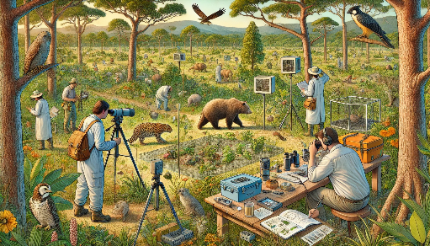
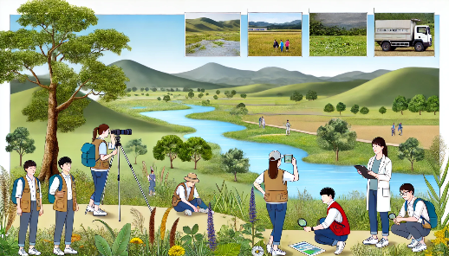
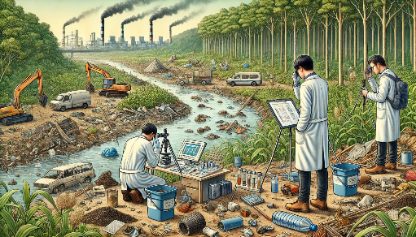
Atmospheric
air quality
noise
vibration
stench
Water
water quality
sediment
ground water
Soils
topography and Geology
ground level
soil contamination
Animals
Plants
Ecosystem
Scenery
people and nature
Waste
Greenhouse gases
illustrations by GPT-4o
Notes:
As you can see, there are many items to consider in environmental assessments,
including air quality, water quality, soil contamination, ecosystems, and greenhouse gases.
Establishing specific methods and processes for these assessments is crucial."

Slide 12
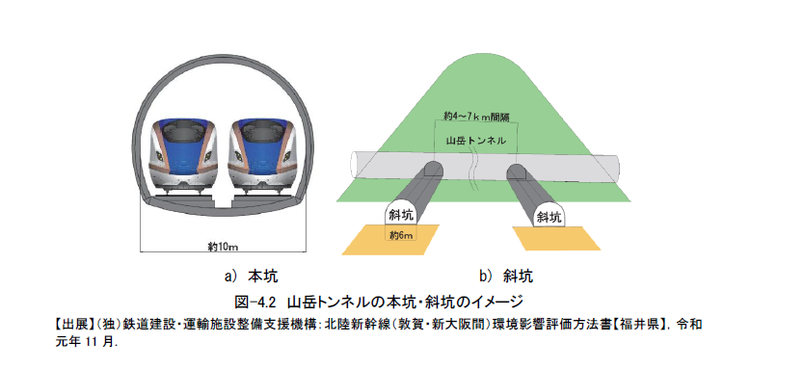
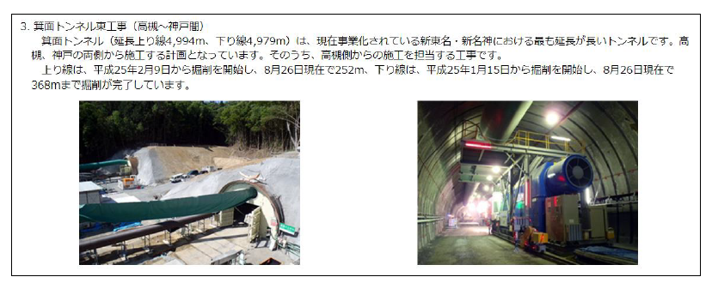


Lessons from previous construction projects
Environmental Issues Working Group
Shinkansen Tunnel
Express way Tunnel
IVI members have been players in these projects
Notes:
We can learn from previous construction projects like the Shinkansen Tunnel and expressway tunnels.
Many IVI members have direct experience with these projects, which provides valuable insights into managing our current efforts."

Slide 13


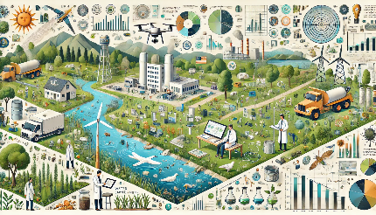
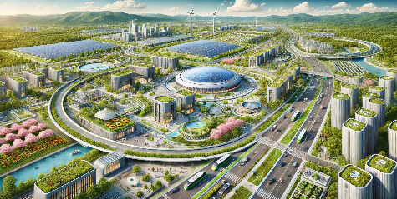
Since its organization in August 2023;
IVI has been very active to study in the areas of
Management
Want to be prepared
whenever it is approved
Environment
→Construction
City Development
Stay Tuned
https://ivi.huhep.org
https://ivi-en.huhep.org
Notes:
"In conclusion, the IVI is dedicated to advancing management, environmental, and city development tasks to prepare for the ILC in Japan.
Our goal is to be ready for when the ILC is officially approved, ensuring a smooth and efficient transition to construction and operation.
Thank you for your attention, and please stay tuned for further developments."

Slide 14
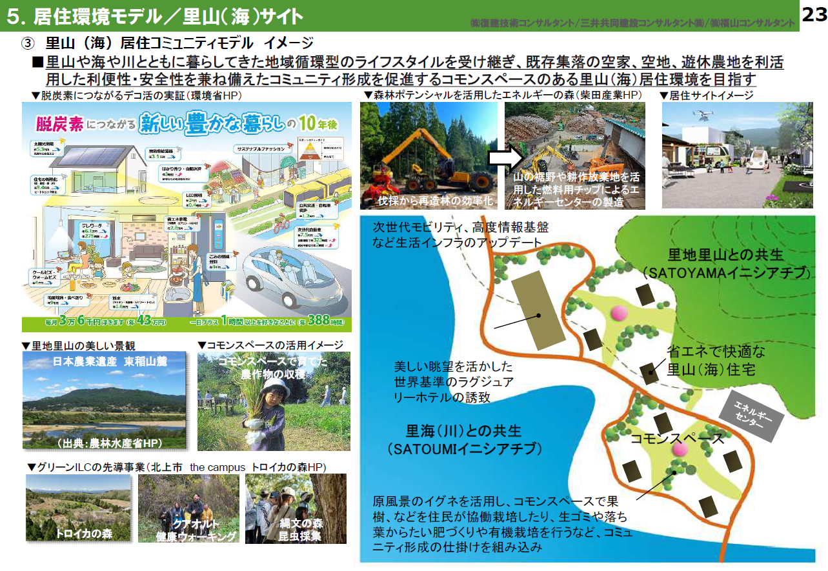

Slide 15
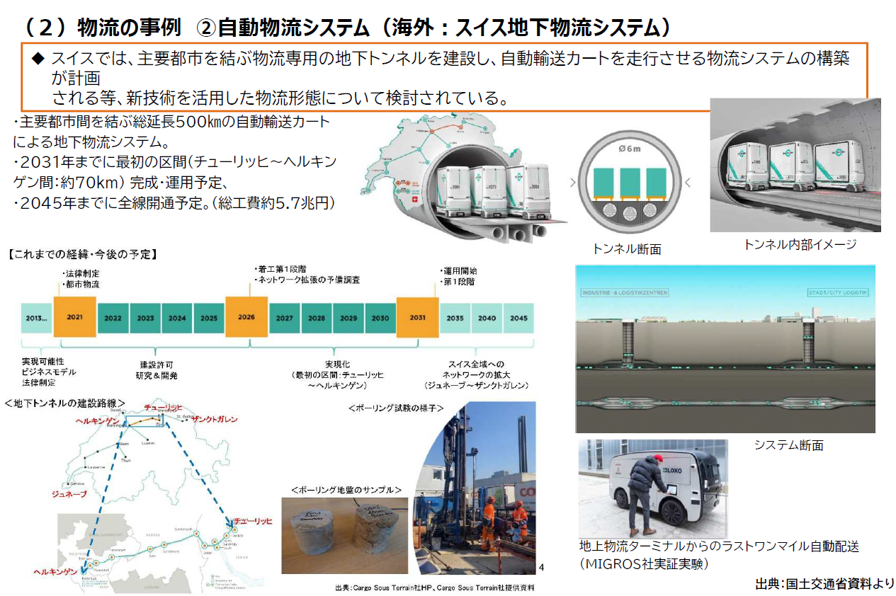

Slide 16
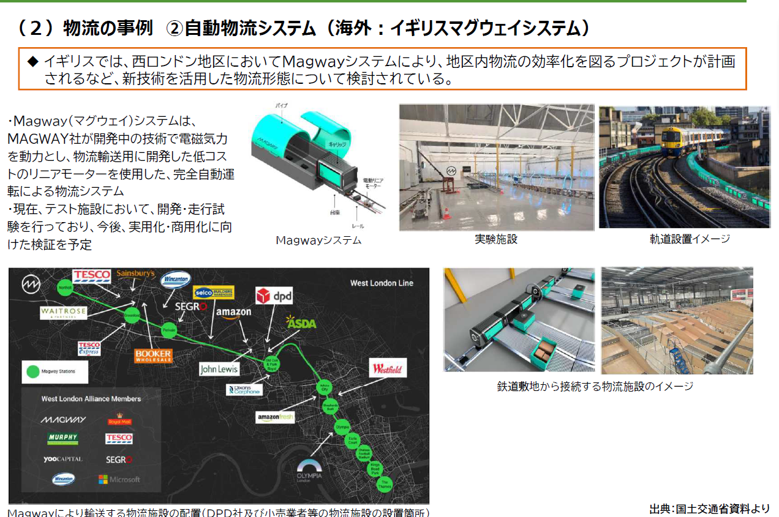

Slide 17
