Slide 1
Efforts toward a Green ILC in Japan
Masakazu Yoshioka, Iwate/Iwate prefectural University
July 9 2024
Argument from the start : why global warming is accelerating?
My naive view point, or rather than a very personal philosophy
Before the Industrial Revolution, CO₂ emitted by human activities and CO₂ absorbed and accumulated by the natural world were in balance and the global cold/warm cycle was a natural phenomenon.
To begin with, CO₂ is stored in forests, soil, oceans, and atmosphere.
After the Industrial Revolution, carbon liberation due to the rapid increase in fossil fuels has caused a loss of that balance, and atmospheric CO₂ concentrations are increasing.
In addition, human activities, especially agricultural land expansion and concentration of specific crops, also impair nature's ability to absorb and store CO₂.
In other words, what we need to do today is clear: (1) make efforts to reduce the excessive emissions of greenhouse gases and (2) work to restore nature's ability to absorb CO₂.

Slide 2
What HEP researchers should do in the first place?
HEP researchers should try to achieve the highest possible performance per power consumption from the design phase of research facilities.
HEP researchers should strive to increase the power efficiency of accelerators, detector components, computing, etc.
HEP researchers should also strive to bring the facilities' availability close to 100% by increasing MTBF (mean time between failure) and shortening MTTR (mean time to repair).
Recover low-grade thermal energy emitted from accelerator and research facilities and return it to society.
These efforts are the natural obligation of the researcher and should be discussed and implemented in great detail.
I personally believe that this is not enough, as I suggested in LCWS2023.
I believe that researchers should also help to restore the resilience of nature that humanity is destroying!

Slide 3
Researchers should further work with the community on the following issues:
To cooperate in increasing the renewable energy rate of local electricity and to operate research facilities with green electricity as much as possible.
Understanding and, where possible, cooperating with efforts by steel, cement, and other GHG emitting companies to reduce their emissions (including CCS/CCUS).
Despite those industry's efforts, CO₂ that cannot be fully zero-emitted will eventually be fixed in the deep underground.
Incorporating these industry efforts, researchers should strive to reduce CO₂ emissions during the ILC construction period.
Cooperate with local efforts to restore forests (green carbon) and oceans (blue carbon), which are inherent to the natural environment.
CCS: “Carbon dioxide Capture and Storage”
CCUS: “Carbon dioxide Capture, Utilization and Storage”

Slide 4
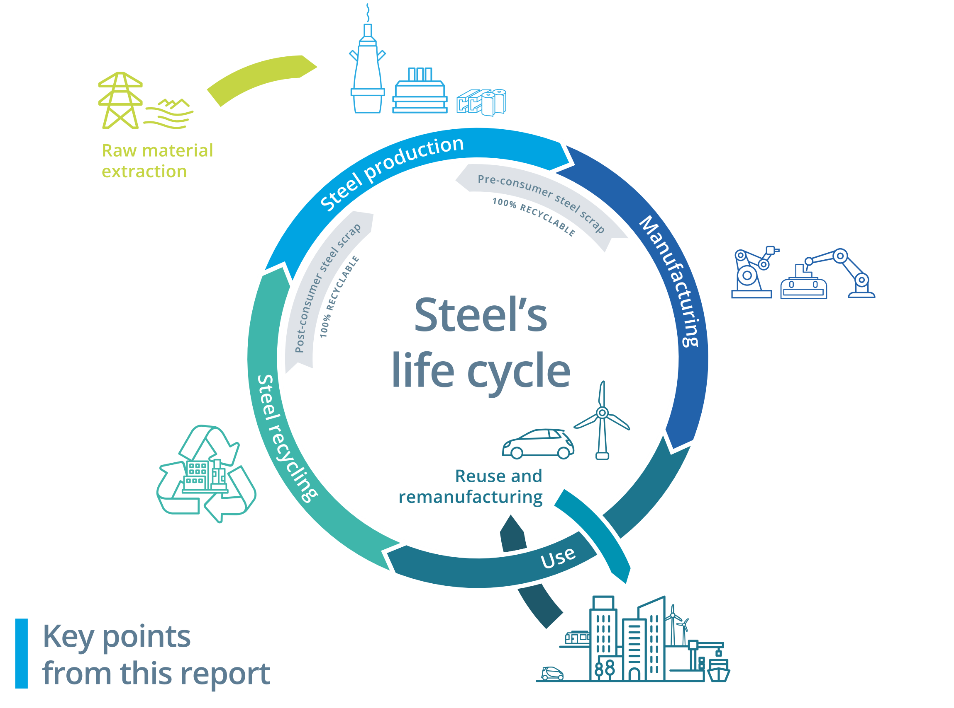
One example of an industrial effort, the steel industry
Efforts are being made in the steel industry to introduce hydrogen reduction instead of relying on coke for reduction reactions.
In addition, efforts are being made to increase the recycling rate of iron and to utilize electric furnaces.
However, it is not easy to achieve zero CO₂ emissions because the hydrogen reduction reaction is an endothermic reaction and recycled iron contains impurities.
Technology has already been developed to separate and compress the remaining CO₂ emissions and seal it in deep underground for a long period of time.

Slide 5
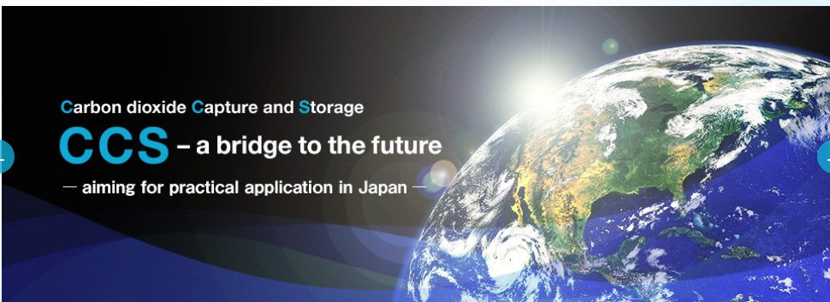
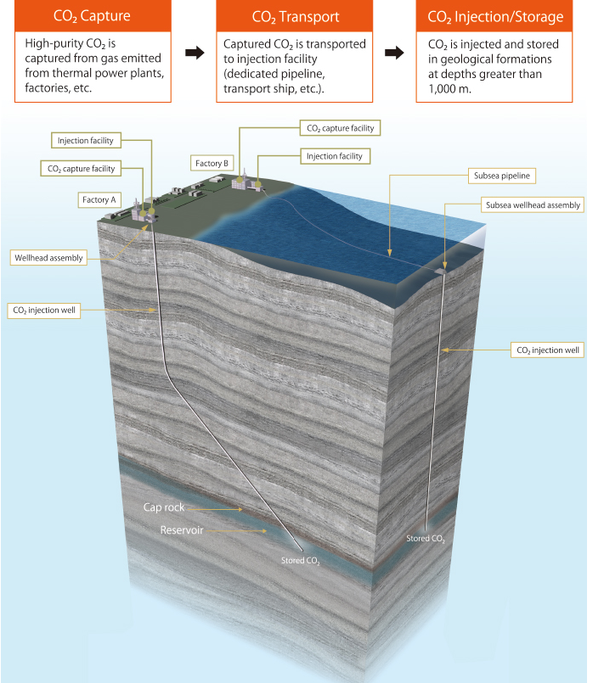
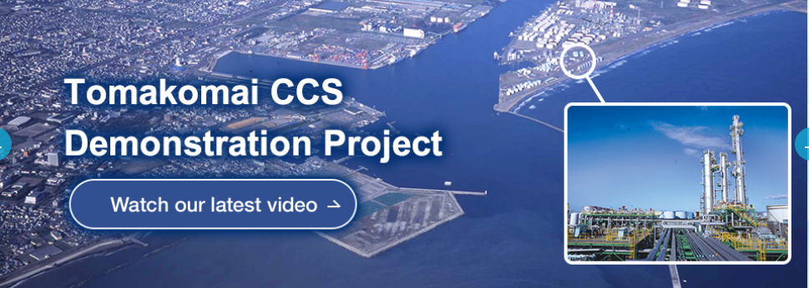
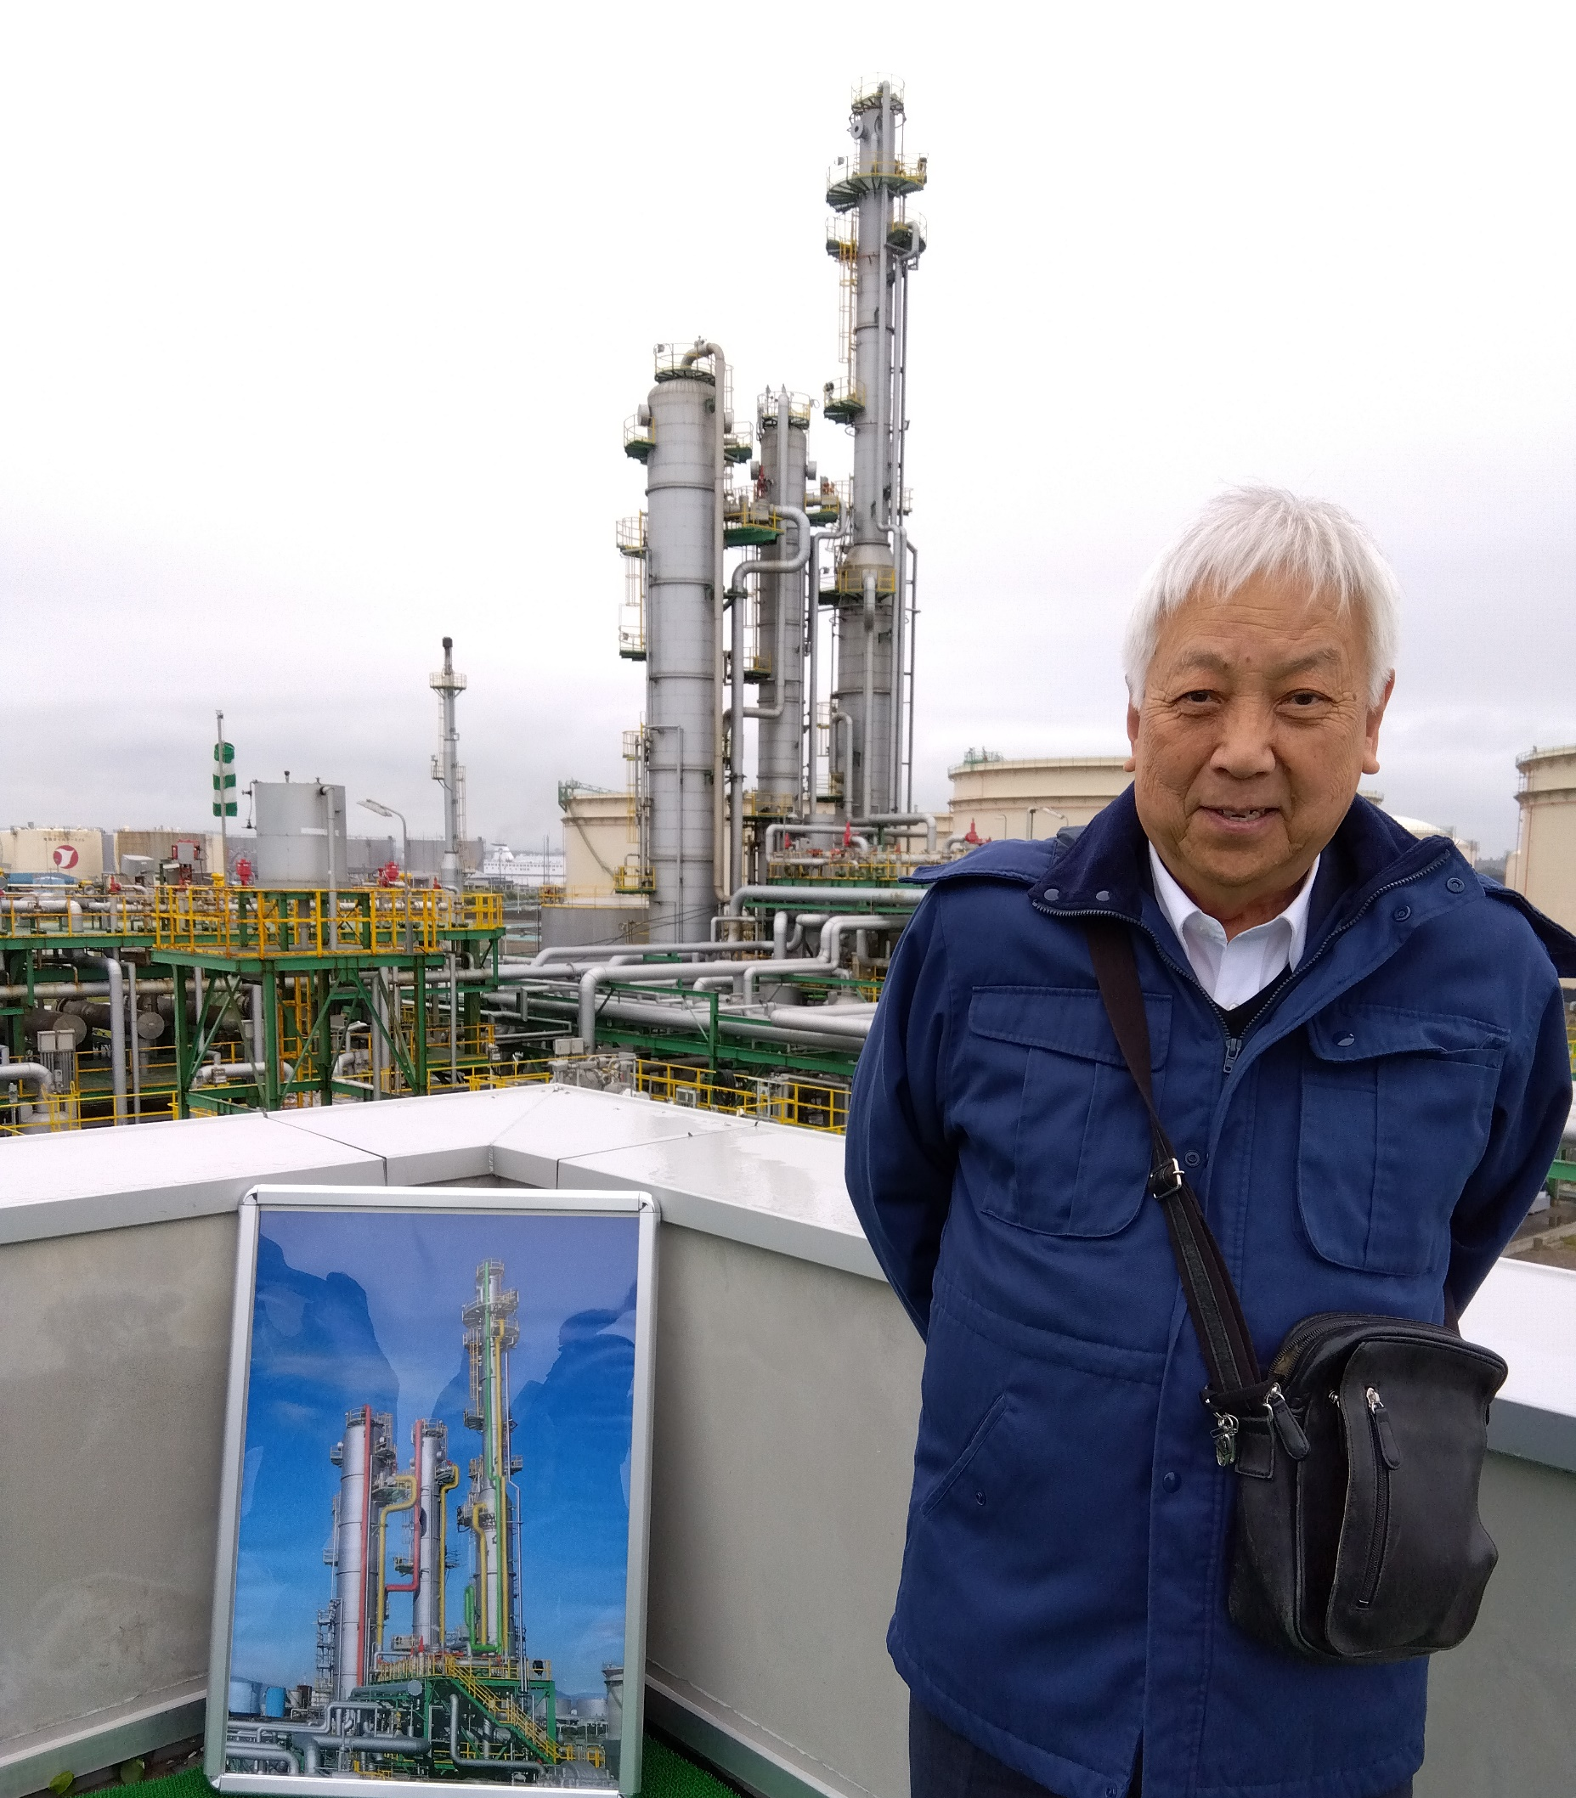
We went to Hokkaido to observe a large scale field trial of CCS
June 5, 2024 @ Tomakomai city in Hokkaido
Industrial trials of CCS are being conducted around the world, and it has already been established as an elemental technology.
Japan, an earthquake-prone and volcanic country with four colliding plates, has achieved 300 k-ton of deep underground storage, which is almost at the practical stage. The issue of cost remains to be addressed.

Slide 6
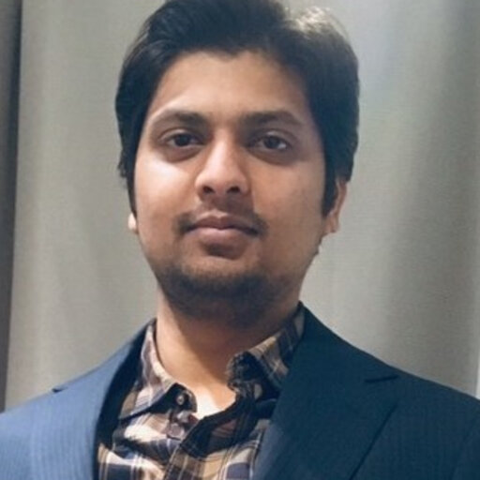
Another example of industry's decarbonization efforts
Development of decarbonized cement
Presentation by Kumar Avadh (Kajima)

Slide 7
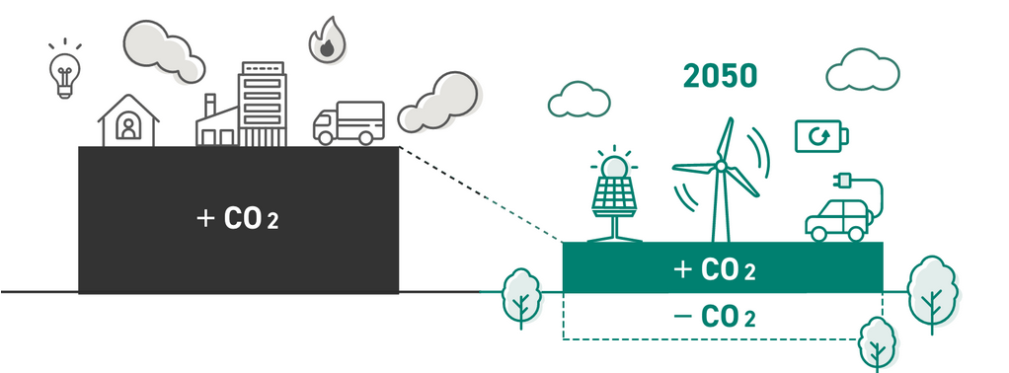

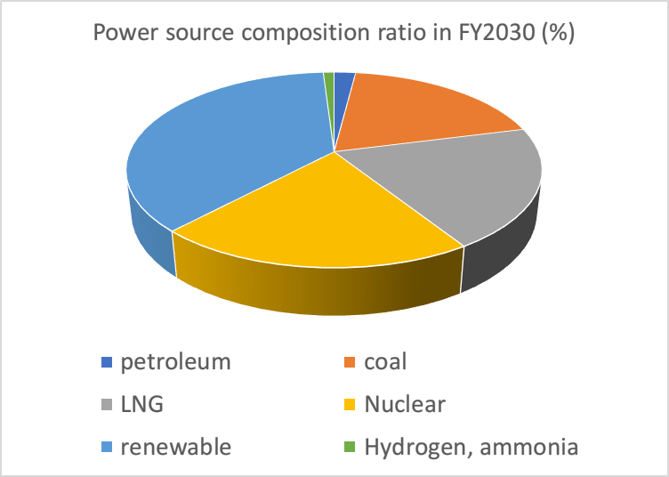
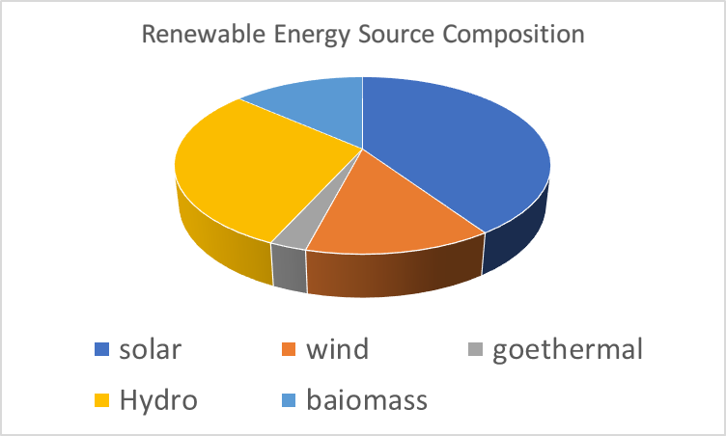
Japan's 2050 Decarbonization Policy
The law now states "a decarbonized society by 2050."
https://www.enecho.meti.go.jp/en/
2030 Interim Target by

Slide 8
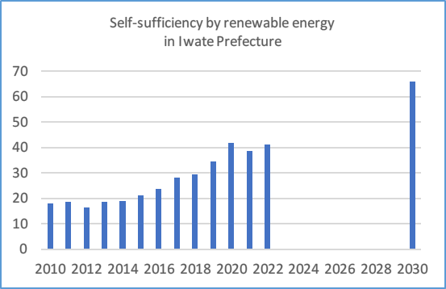
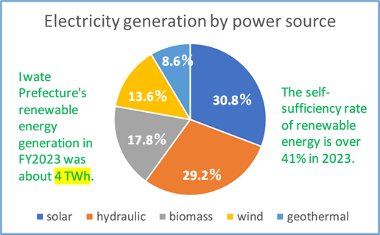
Iwate Prefecture, where the ILC candidate site is located, has a very high self-sufficiency rate in renewable energy in Japan:
Iwate Prefecture has a higher percentage of renewable electricity and future potential than the average for Japan as a whole due to its natural advantages.
Target for FY2030
Impact of the Great East Japan Earthquake
Iwate's current self-sufficiency rate for renewable energy is 41%, twice the national average, and is aiming for 66% in FY2030.
Iwate Prefecture's renewable electricity is characterized by a diverse range of power sources, including solar, hydro, biomass, wind, and geothermal.

Slide 9
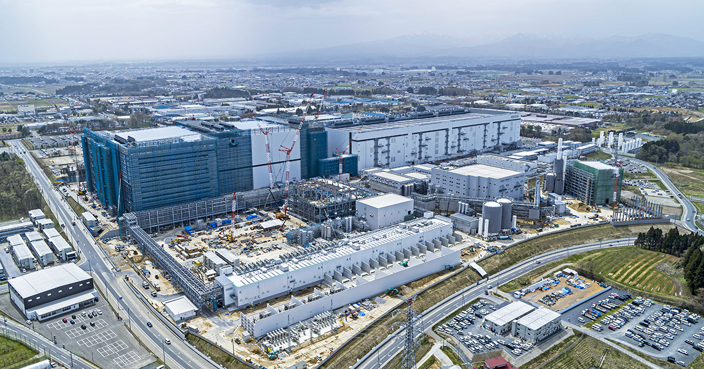
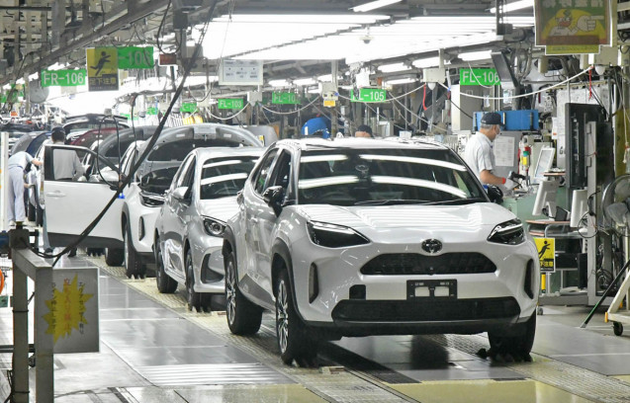
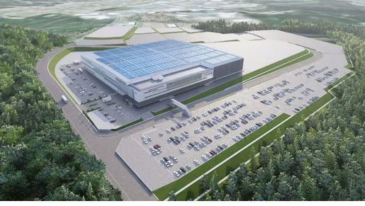
Large manufacturing plants continue to locate in Iwate Prefecture, and there will be competition for green power
Large-scale factories in Iwate Prefecture, including semiconductor related, automobile factories and etc., are located, and it is expected that there will eventually be a "competition" for green power.
Therefore, the HEP community needs to cooperate with electric power companies to further increase green power generation.
Kioxia Iwate Kitakami Plant produces NAND flash
Toyota Motor East Japan Iwate Plant
One of the manufacturing bases in the Tohoku region
Tokyo Electron Technology Solutions Tohoku Plant engaged in semiconductor manufacturing equipment

Slide 10
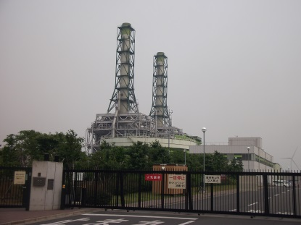
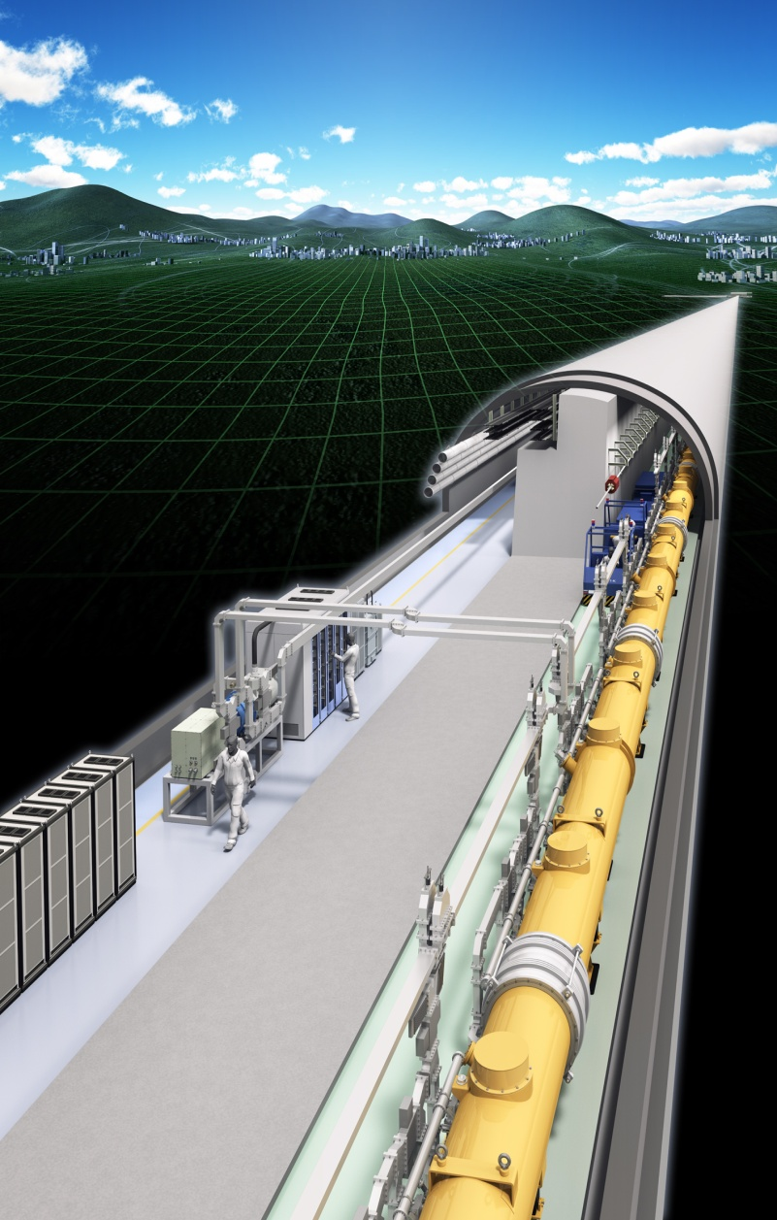
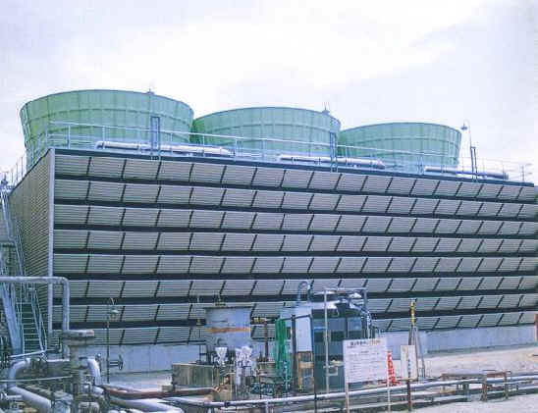
The low-grade waste heat emitted from accelerators should be recovered as much as possible and returned to society.
Cooling water temperature is below 100°C in the cooling tower stage, making it unsuitable for recovering thermal energy
Energy flow:
Power plant ➔ accelerator ➔ cooling tower

Slide 11
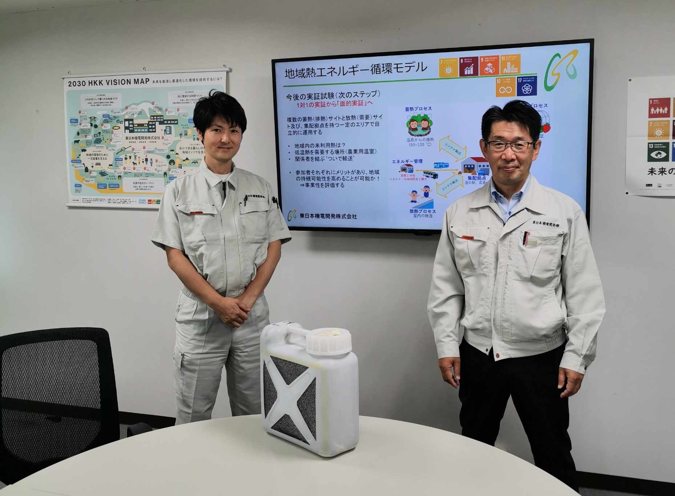
The low-grade waste heat emitted from accelerators should be recovered as much as possible and returned to society.
Since LCWS2016 @ Morioka, this development has been continued and is on the verge of commercialization.
➔ Presentation by Yuichi Kouno (Higashi Nihon Kiden Kaihatsu)
Plan is being developed with the goal of recovering 20% of low-grade waste heat emitted from ILC.
Basic field tests have been completed and larger scale tests are being planned.

Slide 12


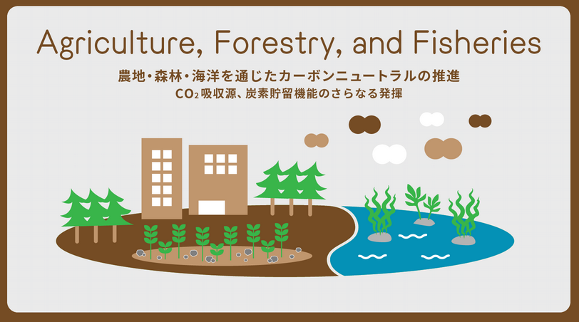
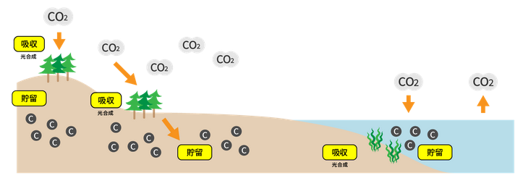
I believe that researchers should also help to restore the resilience of nature that humanity is destroying!
https://green-innovation.nedo.go.jp/article/agriculture/
Plants such as crops and trees, and algae such as seaweed absorb CO₂ and fix it as carbon (organic matter) in the process of photosynthesis.
The amount of CO₂ absorbed by agricultural lands and forests amounted to 47.6 million tons per year (in FY2021).
The carbon fixed by plants and algae is stored as plant matter while they are alive (most notably in trees) and is also stored in large amounts in agricultural land, forest soil or on the ocean floor after they die.
The same is true for the soil and seabed in agricultural lands and forests.
Therefore, the management and conservation of farmlands, forests, and oceans themselves are linked to protecting these huge sinks of greenhouse gases and carbon storage sites.

Slide 13
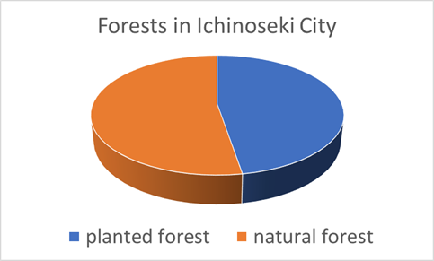
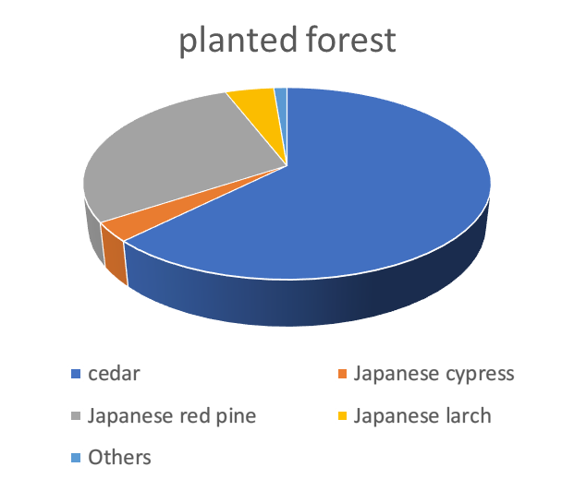
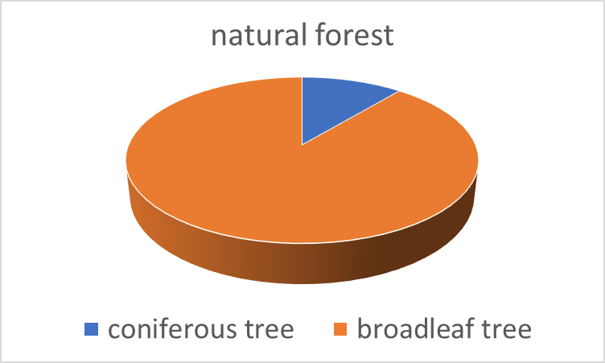
Evaluation of CO₂ absorbed by the forests of Ichinoseki City, Iwate Prefecture, where the ILC candidate site is located.
47% Planted Forest: 31465 ha
53% Natural Forest: 34895 ha
Total 66363 ha
Natural forests are mostly broadleaf tree.
In planted forests, cedar is the most abundant species, followed by red pine.
Estimation by Hiroshi Kikuchi, advisor to the Ichinoseki City Agricultural Land and Forestry Department:
The entire Ichinoseki forest absorbs 303.53 kilotons of CO₂ per year.
The average annual CO₂ absorption per unit area is 4.57 t/year/ha.
It should be mentioned that the Ichinoseki forest will absorb more CO₂ every year than the CO₂ emitted during the construction of the ILC (266 k-ton) over a 10-year period.
The power of nature is that great!

Slide 14
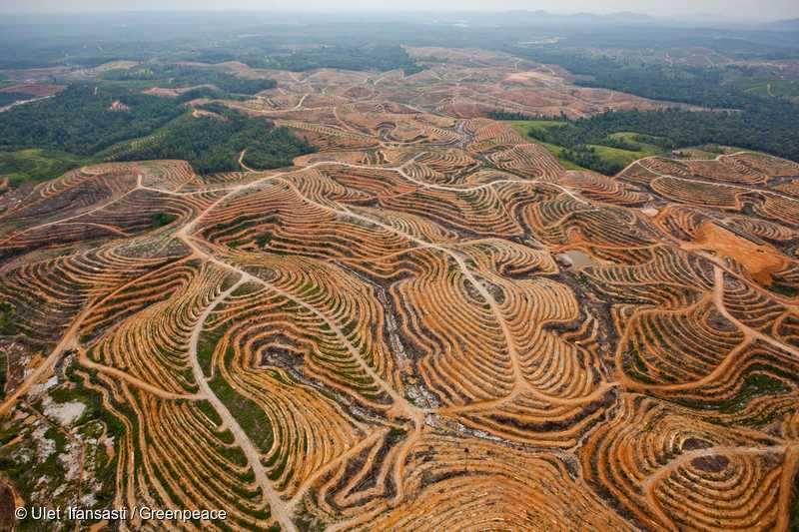
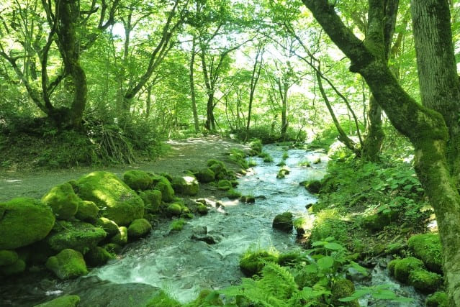
Forests not only absorb CO₂ during the growing season, but also play important roles as (1) a source of CO₂ accumulation in the soil and (2) a green dam to conserve water resources.
Deforestation in the Brazilian Amazon rainforest is often done to create soybean fields and pastures for cattle and other livestock feed. Particularly problematic is the development of these areas for "industrialized livestock farming," which supports mass production and mass consumption in developed countries.
Forests should regain their power to conserve water resources

Slide 15
Summary
Why Global Warming is Accelerating
Before the Industrial Revolution, CO₂ emitted by human activities and CO₂ absorbed and accumulated by the natural world were in balance.
CO₂ is stored in forests, soil, oceans, and atmosphere.
After the Industrial Revolution, that balance has been lost, and the concentration of CO₂ in the atmosphere is increasing.
Furthermore, human activities have also damaged the ability of nature to absorb and store CO₂, in other words, they are causing double damage to nature.
What HEP Researchers Should Do
To save energy in the accelerator and other research facilities and give back to society the technology developed for this purpose.
Recover thermal energy emitted from accelerators and research facilities and return it to society.
Efforts to be made in cooperation with the local community
To cooperate in increasing the renewable energy rate of local electricity and to operate research facilities with green electricity as much as possible.
Understanding and, where possible, cooperating with efforts by steel, cement, and other GHG emitting companies to reduce their emissions (including CCS/CCUS).
Cooperate with local efforts to restore forests (green carbon) and oceans (blue carbon), which are inherent to the natural environment.

Slide 16
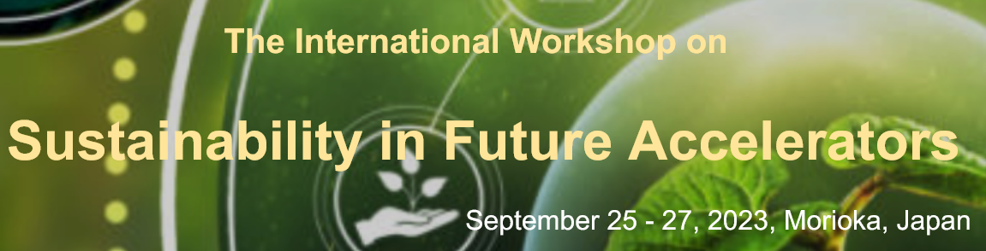
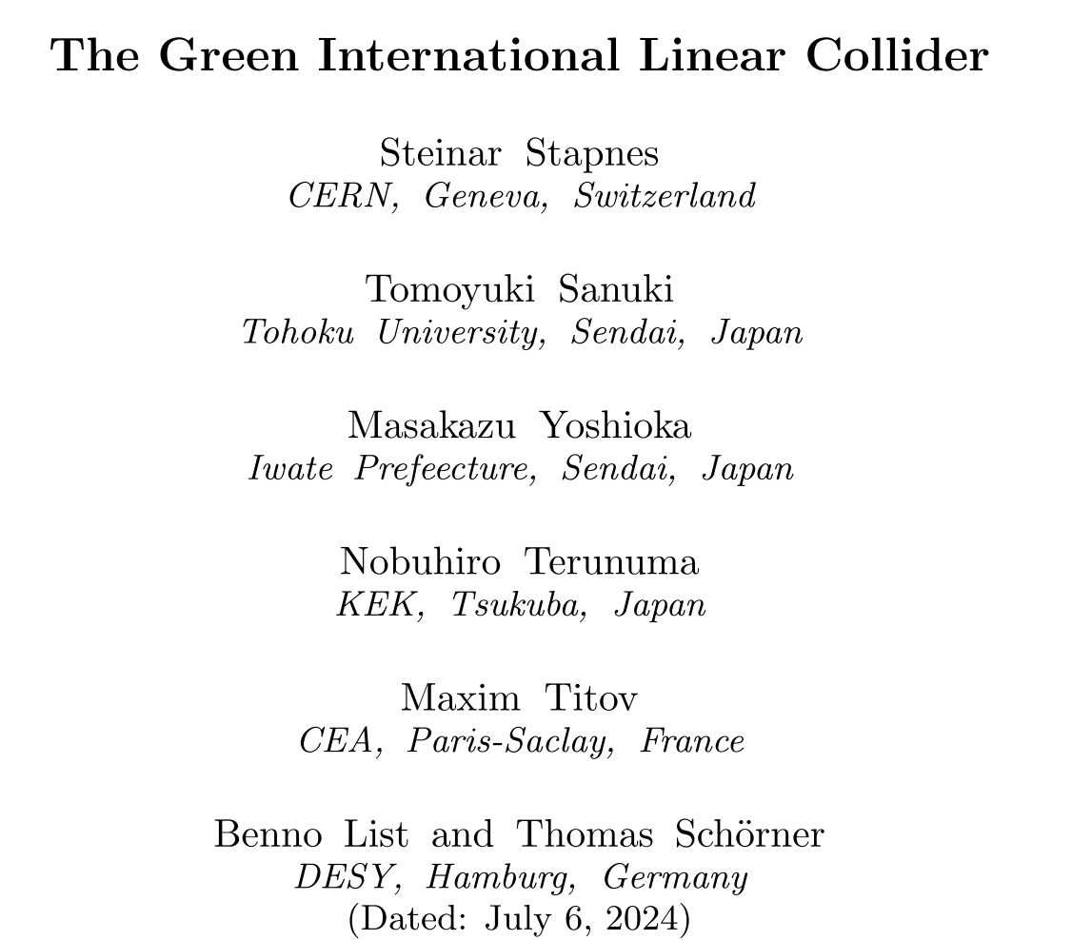
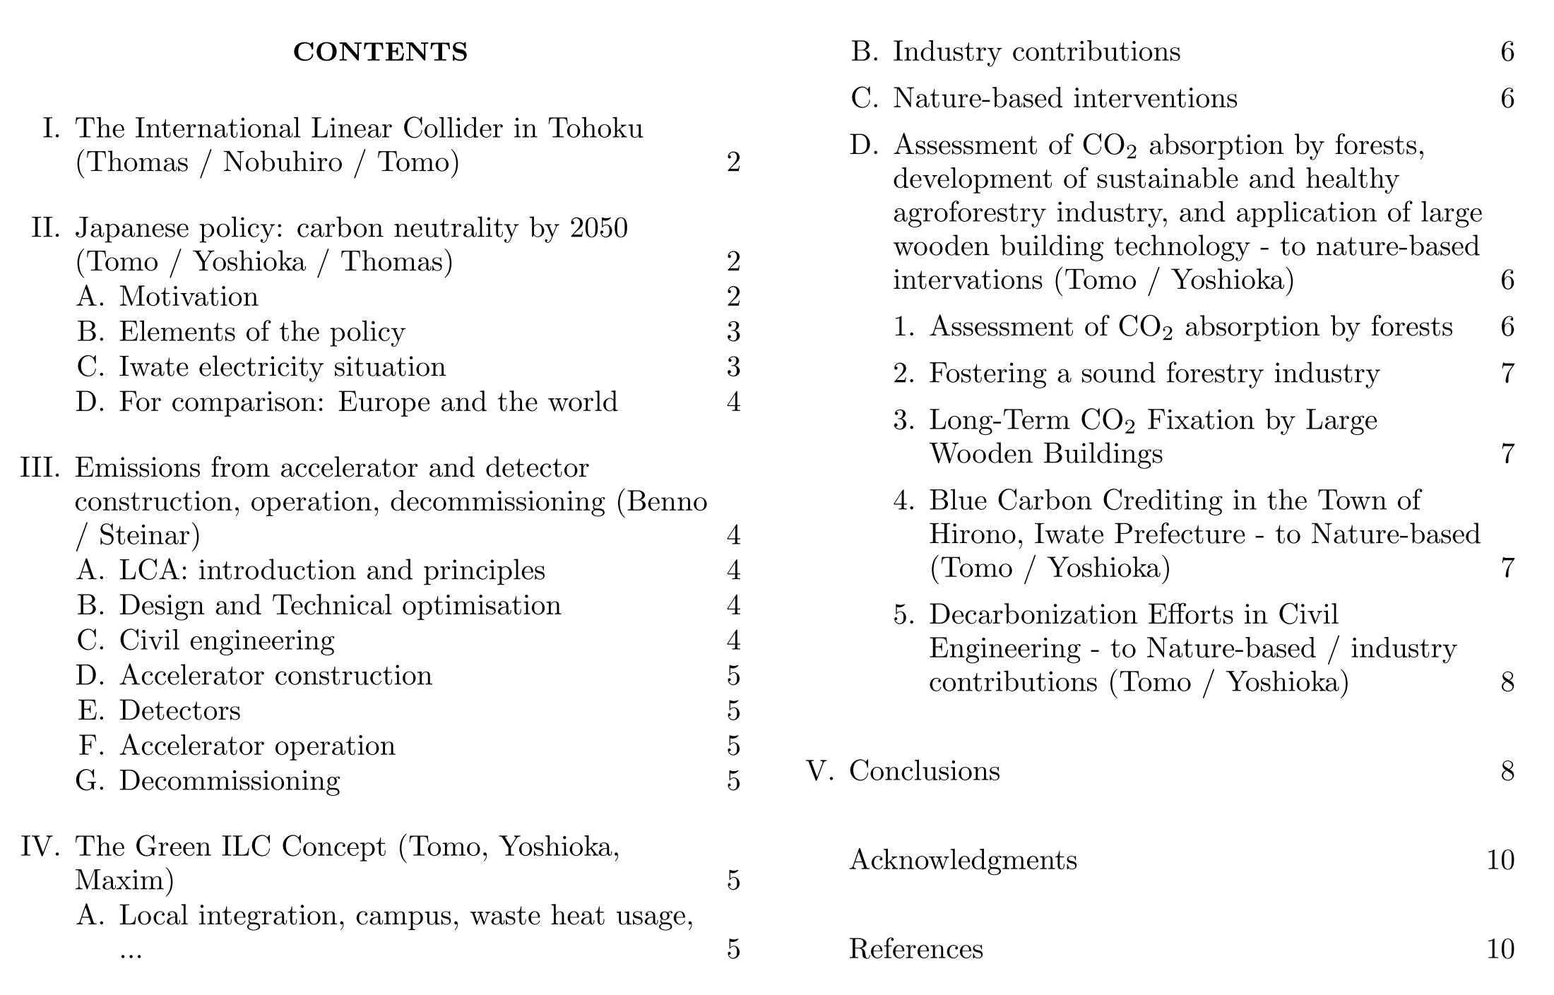
After the WSFA2023 held in Morioka last September, a report on Green ILC is being prepared by the members shown left.
An editorial meeting was held last Friday and the following structure and responsibilities were decided.
The next step will be to hold a second editorial meeting on August 29 next month.

Slide 17
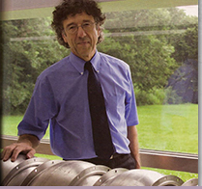
Acknowledgments
This presentation is the responsibility of Yoshioka, based on the results of joint research with the following institutes and organizations
KEK, High Energy Accelerator Research Organization
AAA (Association for the Promotion of Advanced Accelerator Science and Technology)
IVI (ILC Vanguard Initiative)
Tohoku ILC Project Promotion Center
Iwate University
Iwate Industrial Promotion Center
Cooperation from many other companies and organizations
In addition, the presentations in LCWS2023 and WSFA2023 were very informative!
For all of the above, I would like to express my deepest gratitude
I would like to add that I have recently noticed that my work
on Green ILC has been influenced by the late Denis Perret-Gallix (1949~2018,LAPP/IN2P3.CNRS)
Thank you very much for your kind attention!

