Slide 1



CEPC Green Accelerator Technology Development
Rui Ge
Institute of High Energy Physics, CAS
On behalf of CEPC accelerator team
International Workshop on Future Linear Colliders, LCWS2024, July. 8~11th, Tokyo, Japan

Slide 2
Content
Brief introduction of Green Particle Accelerator
Approaches to a green accelerator
Summary

Slide 3
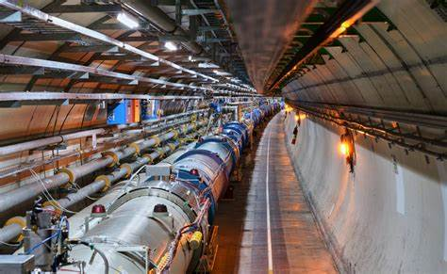
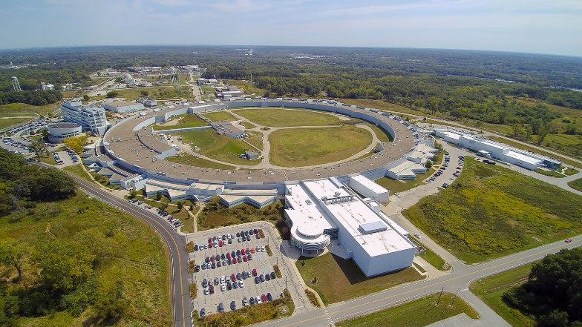
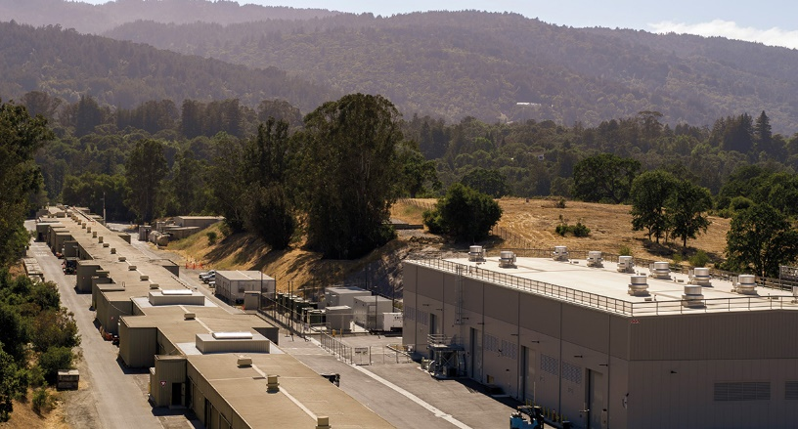

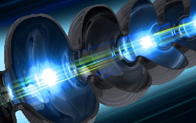
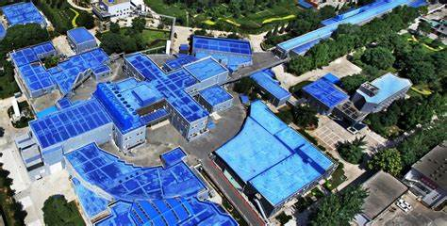
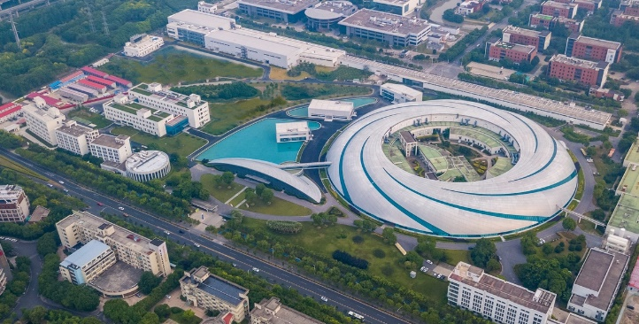
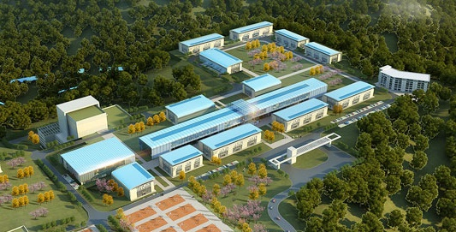
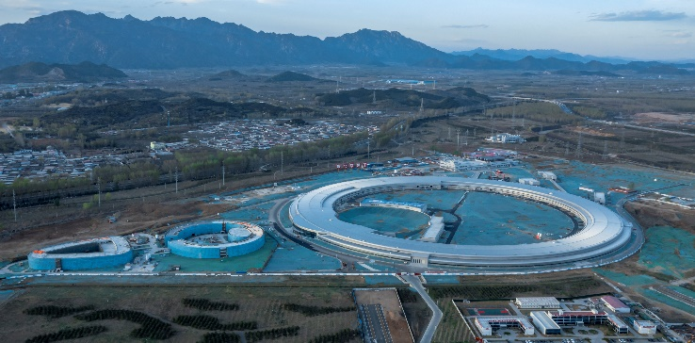
Green Particle Accelerator：issues and challenges
China is reducing energy pollution, promoting green accelerator and boosting unit energy GDP (China dual carbon strategy: achieve peak CO2 emissions before 2030 and carbon neutrality before 2060)
Huge energy is needed for modern large colliders such as LHC, ILC, CEPC…Huge energy means huge cost and huge pollution.
Most of electricity has been converted into the waste heat, which is emitted directly to the environment through the cooling water;
If this part of waste heat is utilized effectively, it is of great significance to the energy gradient utilization and saving power.
Saving power=lower pollution=lower operation cost
LCLSII 照片
功率 200MW
LHC 照片
功率 200MW
APS 照片
功率 125MW
LHC
Power 200MW
APS
Power 125MW
LCLSII
Power 200MW
Super KEKB
Power 90MW
BEPCII 照片
功率 ？MW
上海光源 照片
功率 ？？W
CiADS 照片
功率 7MW
HEPS
Power 38MW
BEPCII
Power 6.5MW
SSRF
Power 10MW
CiADS
Power 7MW
HEPS 照片
功率 ？MW

Slide 4
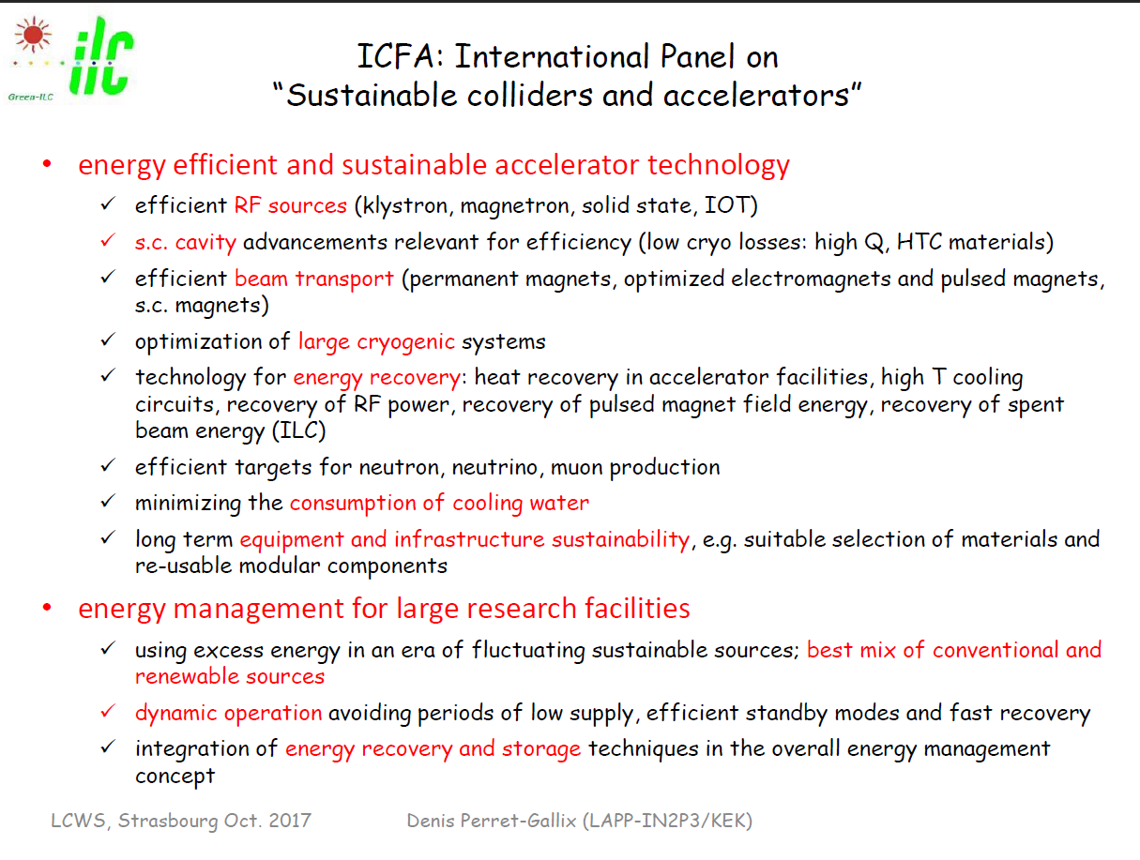
Key factors of green accelerators

Slide 5
Approaches to a green CEPC accelerator
Improving the key technology energy efficiency
  Superconducting technology: High Q SRF cavity and cooling system; HTS magnets
  High performance & efficiency RF source
  Novel magnets: dual aperture magnet, permanent magnet
  ……
Clean energy implement and utility
  Solar panel
  ……
Energy/non-renewable resource recovery
  Helium recovery
  Waste energy recovery from cooling water and utility in civilization
  ……

Slide 6
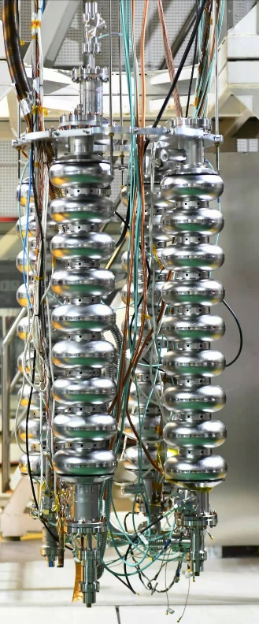
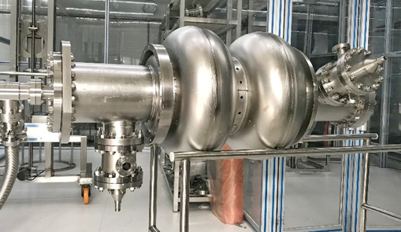
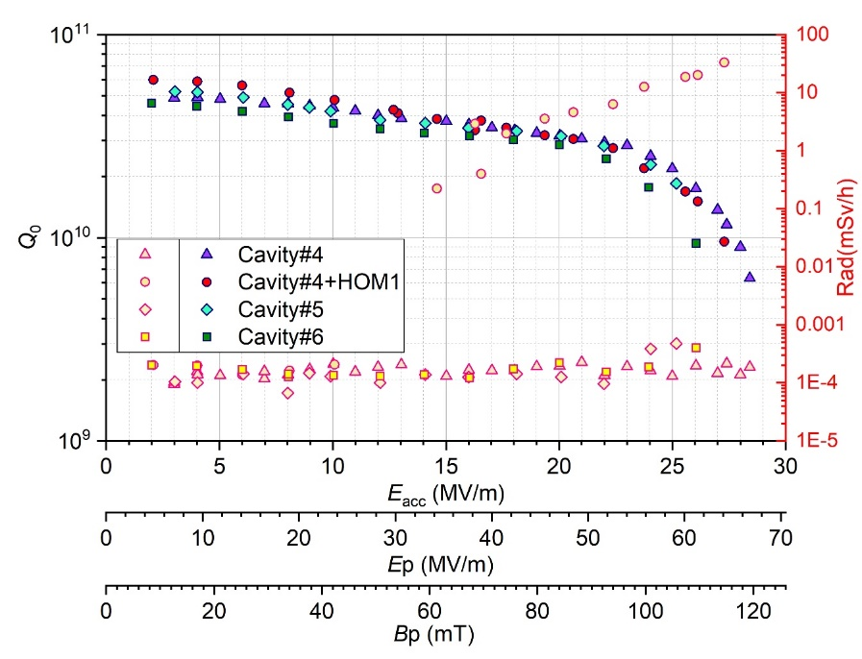
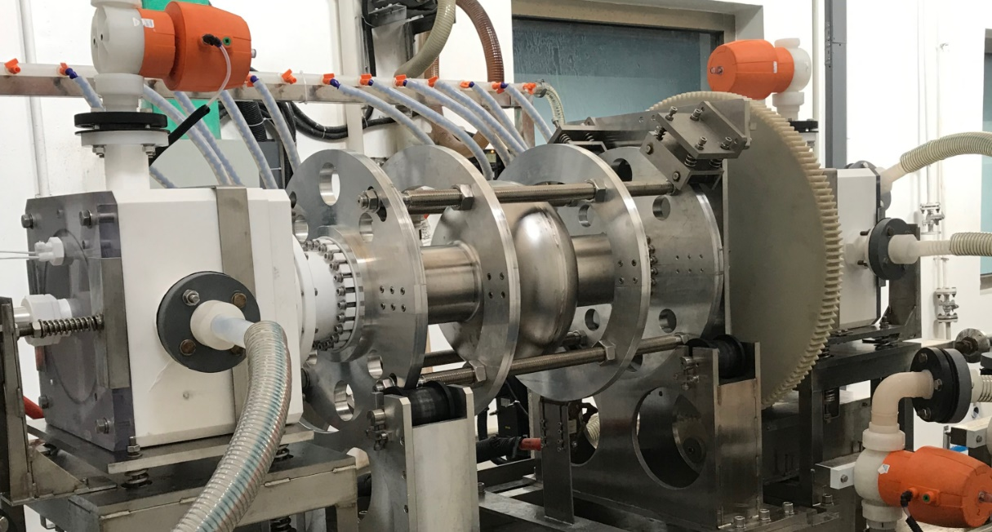
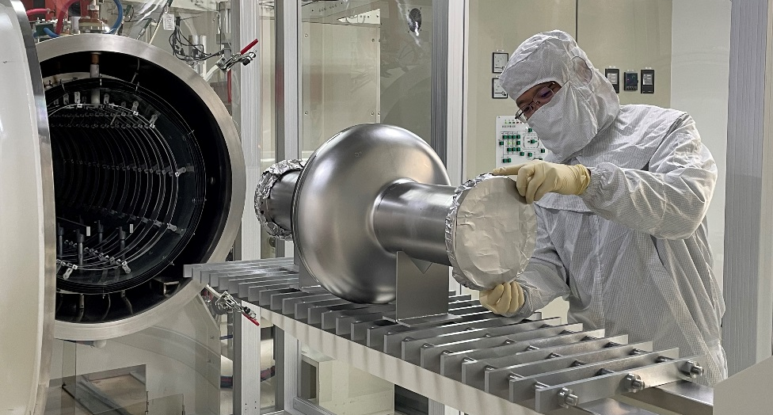
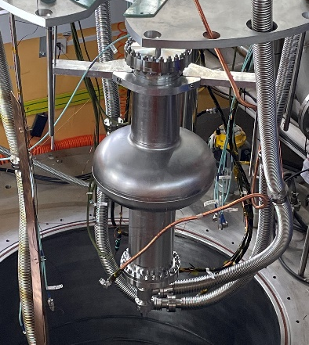
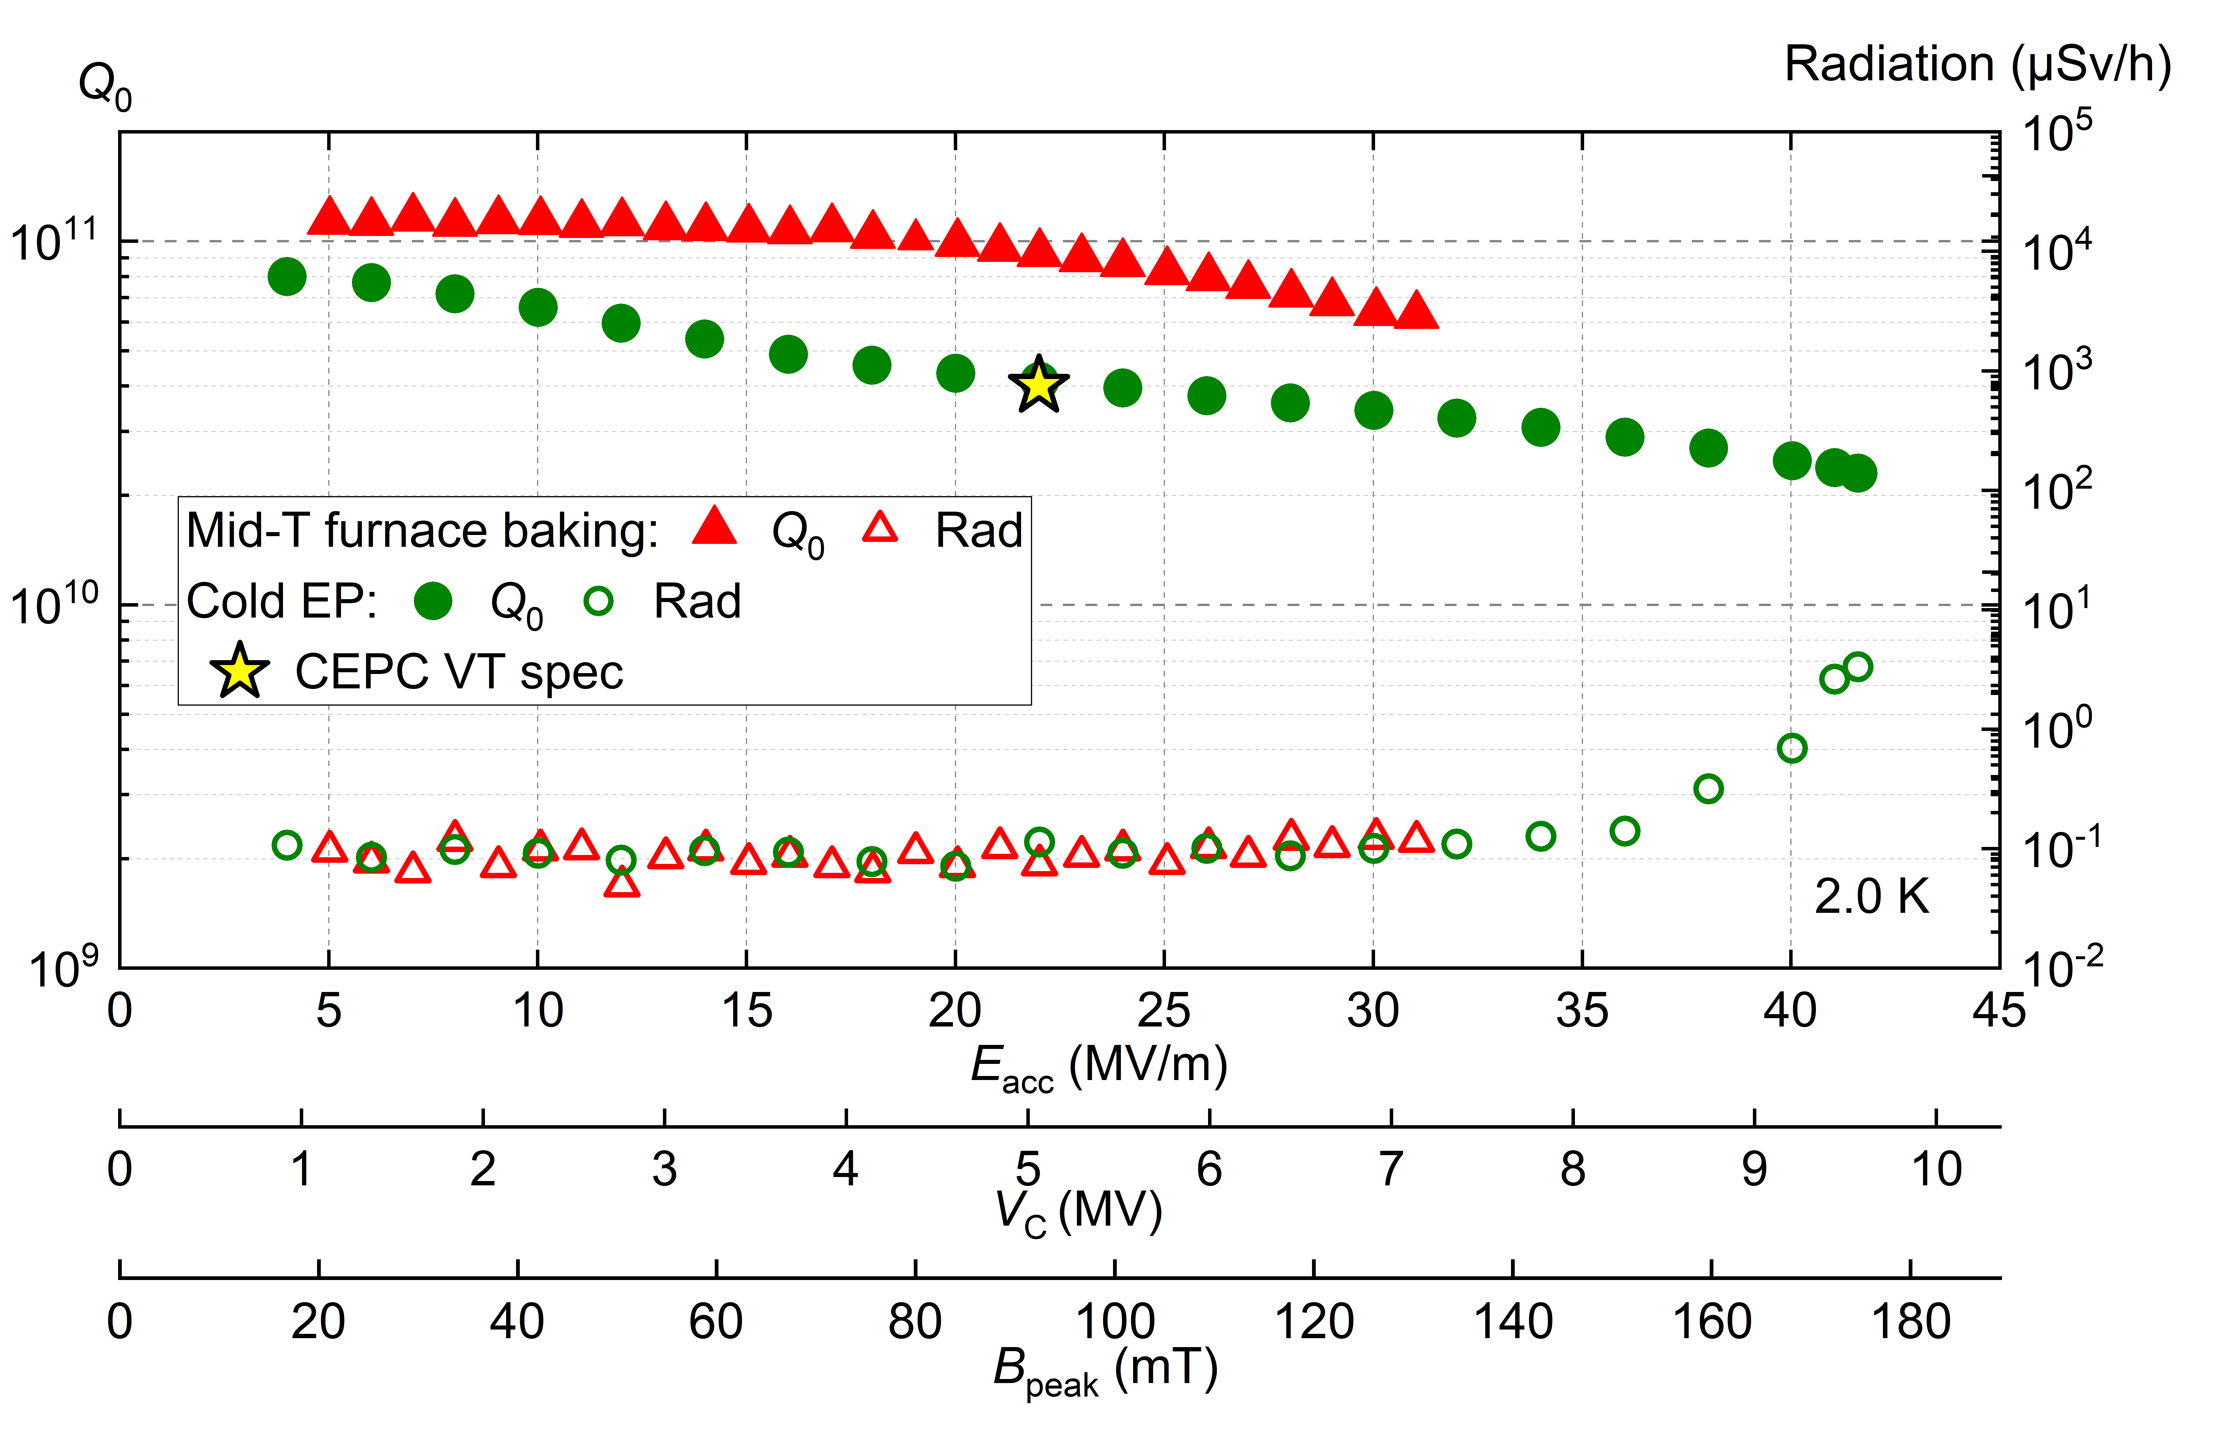
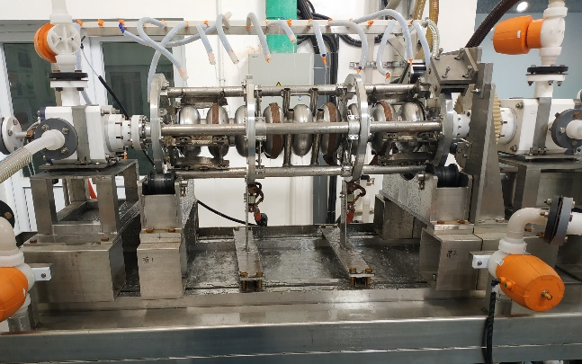
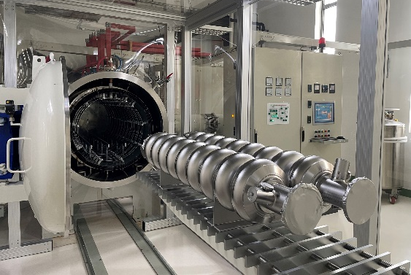
IHEP High Q 650 MHz and 1.3 GHz Cavity
High Q 1.3 GHz 9-cell
650 MHz 2-cell BCP
High Q 650 MHz 1-cell

Slide 7
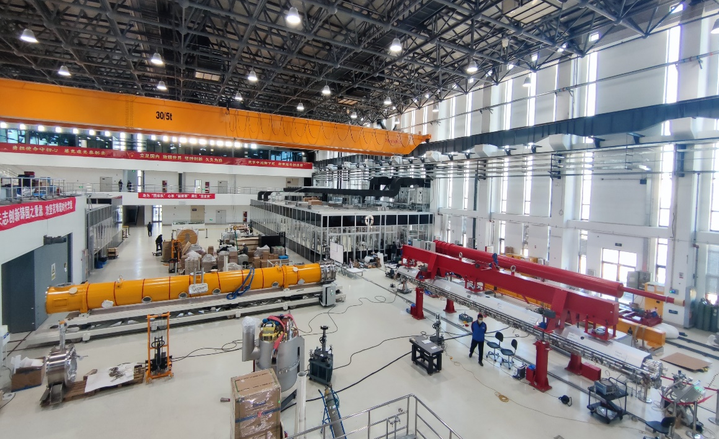
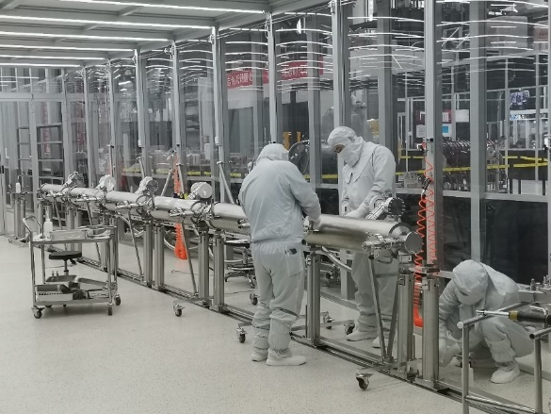
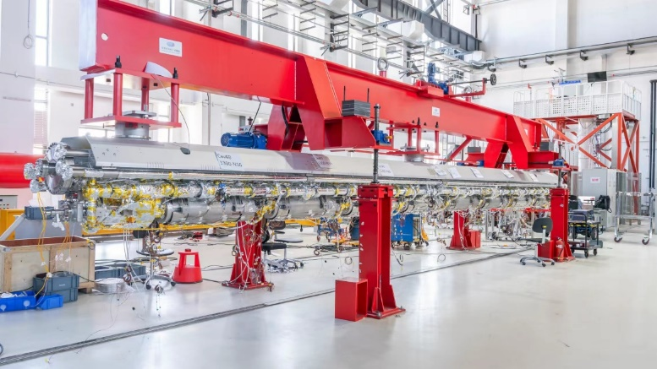
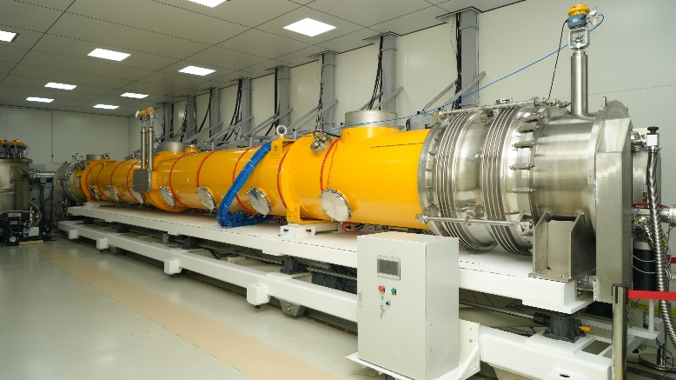
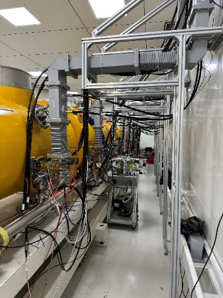
IHEP Mid-T High Q 1.3 GHz Cryomodule
From Jiyuan Zhai
World’s first 1.3 GHz cryomodule with 8 mid-T (medium-temperature furnace bake) 9-cell cavities.
World’s record Q cavity in the cryomodule. Exceeds CEPC specification.
Parameters | IHEP Mid-T CM Horizontal Test | LCLS-II & HE Spec | CEPC Booster Higgs mode Spec
Avg. usable CW E_{acc} | > 23 MV/m | 2.7×10¹⁰ @ 16 & 20.8 MV/m | 3.0×10¹⁰ @ 21.8 MV/m
Avg. Q₀ @ 21 MV/m | 3.6×10¹⁰ |  | 3.0×10¹⁰

Slide 8
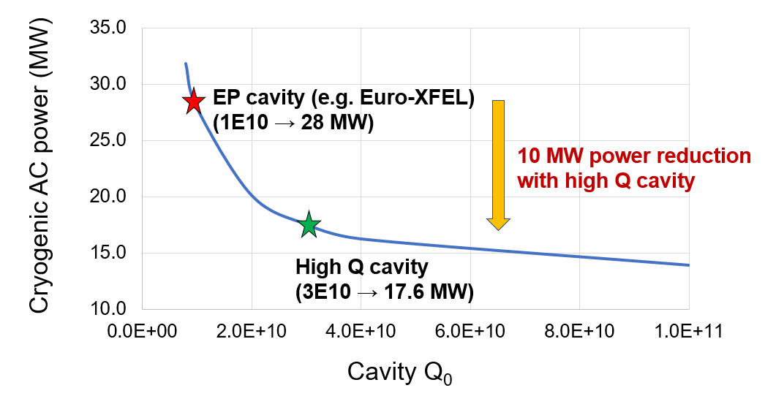
High Q SRF significance for a green machine
The SRF system, along with its cryogenic auxiliaries, is one of the major electricity consumers. High Q-factor SRF cryo-modules effectively reduce the heat load, resulting in lower energy.
The CEPC 1.3GHz SRF cavities adopt the mid-temp baking technology, which enhances the Q factor by 5 times compared to the EP technique.
Using the high-Q SRF in CEPC 30MW mode may reduce the operational power by 10MW, For CEPC ttbar collider ring:2 K dynamic heat load will decrease from 60 kW to 20 kW by increasing Q0 from 1E10 to 3E10, saving 30 MW electric power.
Power consumption with respect to the cavity Q-factor
CEPC 50MW Higgs operation

Slide 9
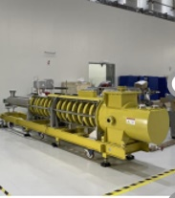
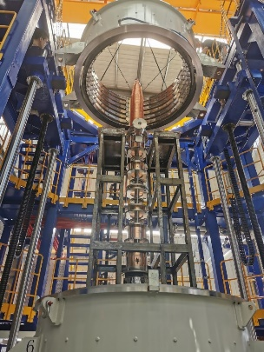
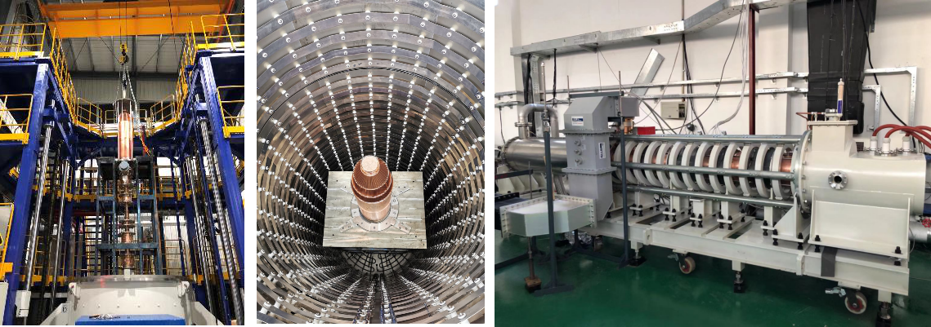
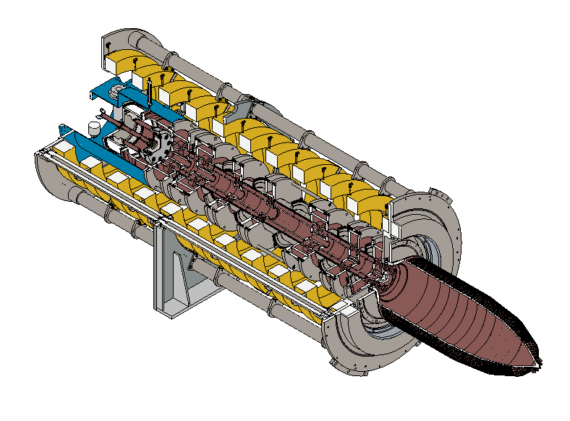
Develop high-efficiency klystron
Efficiency target of 80.5% for the third klystron (multiple injection high efficiency)
Efficiency target of 75% for the second klystron (single injection high efficiency)
First klystron, 62% efficiency, already met the standard
CEPC at 800 RMB/MWh and 6000 hours/year
Save Money
130M RMB
1 year
90 M RMB
Excessive electricity bill, M RMB
High-efficiency prototype klystron efficiency has reached 70.5% @ 630kW, now has been further modified
Efficiency, %
The CEPC can save 160M kWh of electricity per year by increasing the conventional efficiency (55%) of the klystron to a high efficiency of 80%.

Slide 10
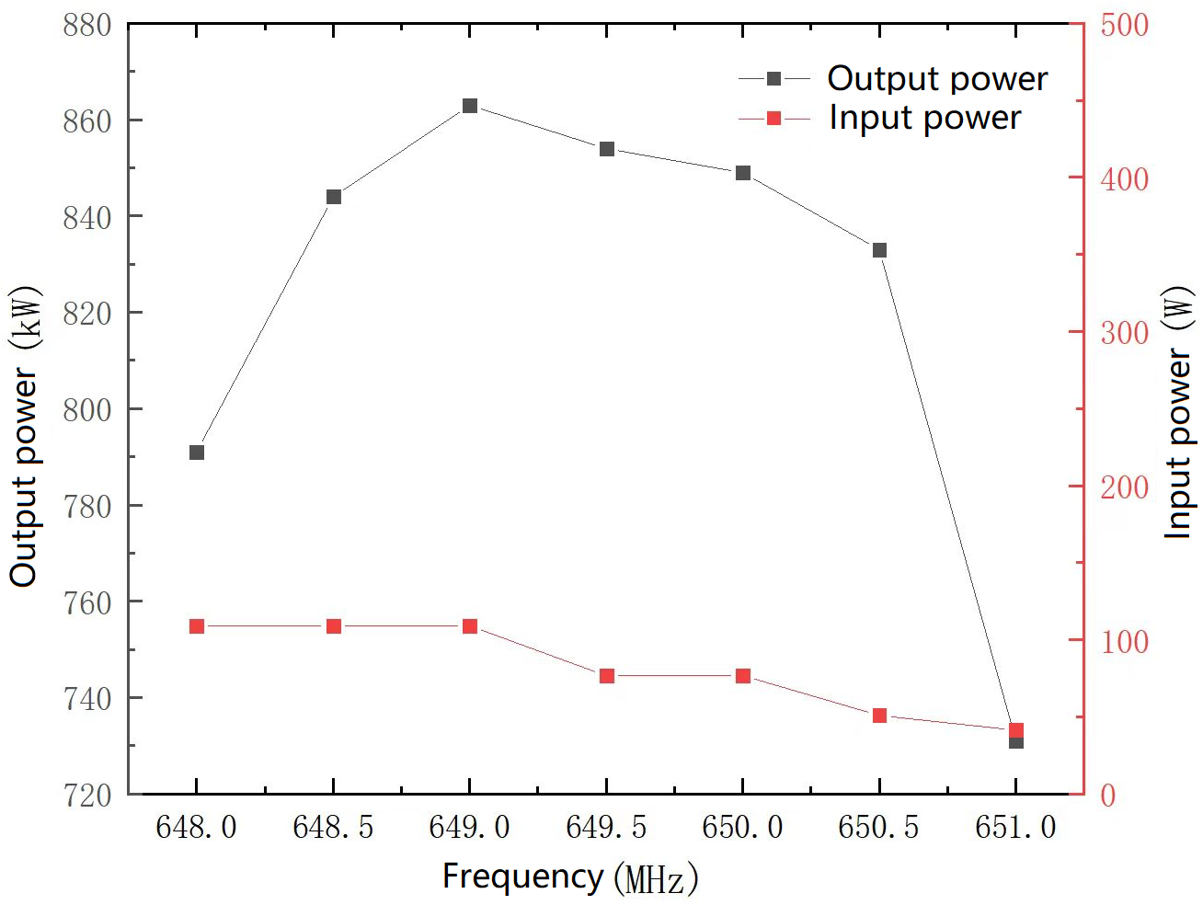
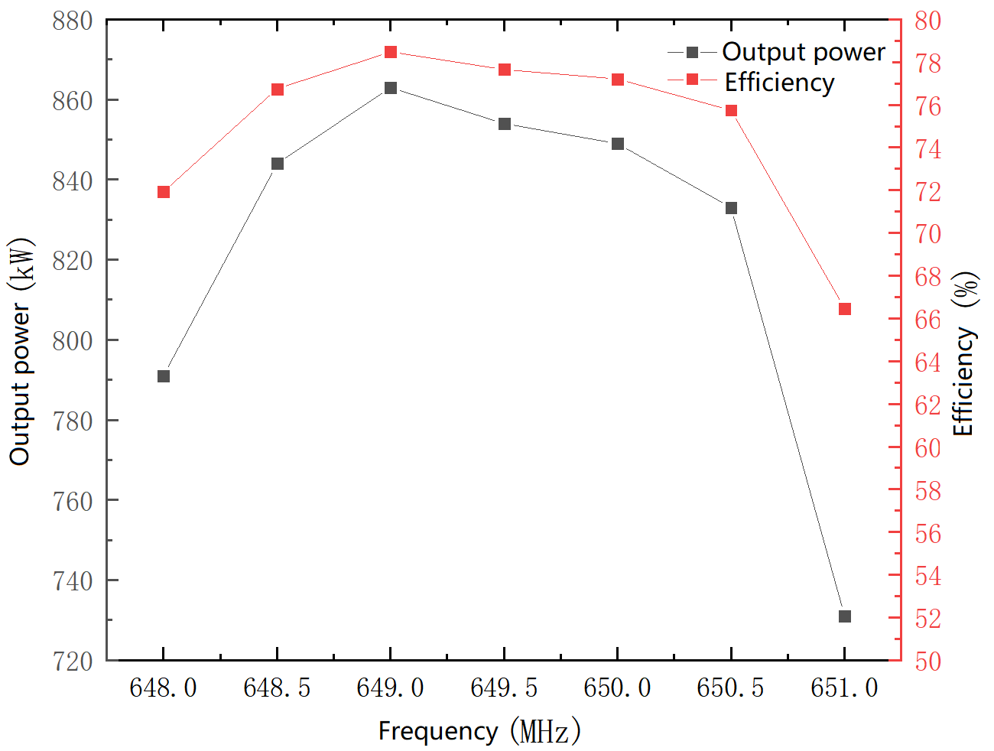
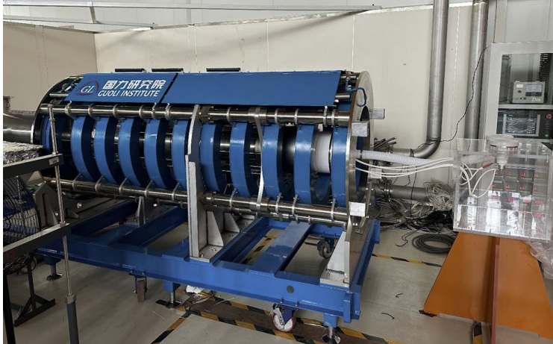
Develop high-efficiency klystron
2nd round test is on-going
2nd round test since January of 2023, 77.2% @849 kW was achieved in pulse mode
Further test is on going for wider pulse and CW mode
Output power vs. input power
Output power vs. Efficiency
A Multi-Beam Klystron will be completed soon, with the high power test scheduled in 2024

Slide 11
Environmental protection and optimization of Magnet design
Magnets provide one of the largest sources of power consumption in modern accelerators. By reducing the power requirements of magnets, more sustainable accelerators can be designed and built.
In CEPC magnet system, large amount magnets are needed. The following aspects are considered to optimize the magnet construction and operation cost.
    Low current density with less power consumption in the power cables.
    Compact magnets with narrow yokes and simple structure
    Dual aperture dipole and quadrupole magnets can save about 50% power consumptions.
    Low field strength dipole magnets, so combined magnets can be used.
    Recycling related to magnet heating is considered.
    Permanent and superconducting magnets are also an option under consideration.

Slide 12
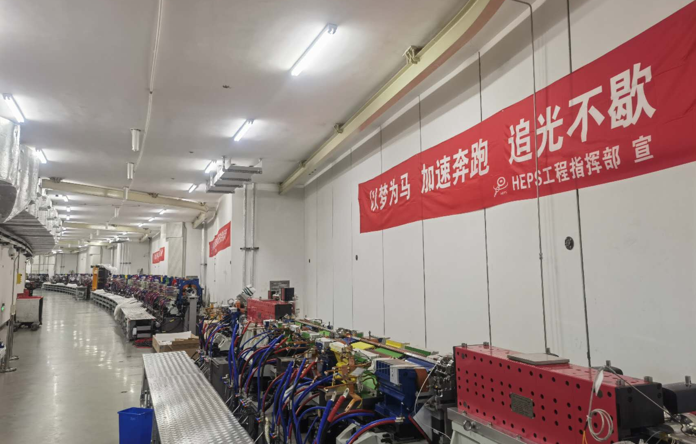
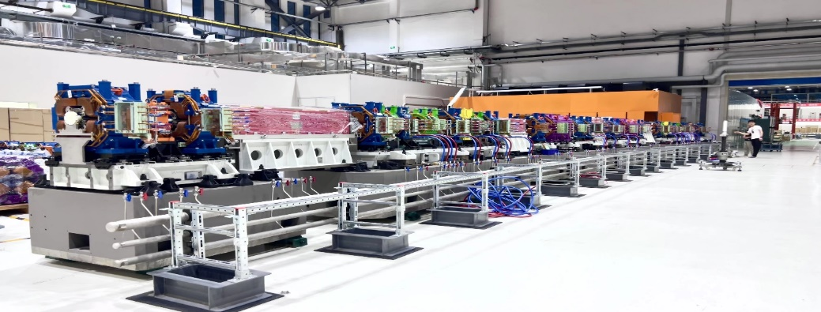
HEPS employs a permanent dipole magnet
Developing new technologies, the dipole magnets are made from pure permanent magnetic materials without consuming electricity during operation, all without affecting the device's performance.
Equivalent single excitation energy consumption of about 1.62kW.
Equivalent cooling, power efficiency additional energy consumption of about 1.3kW
240 magnets in the whole ring
Annual running time of 8000 hours
Annual saving electricity about 5.6 million kWh

Slide 13
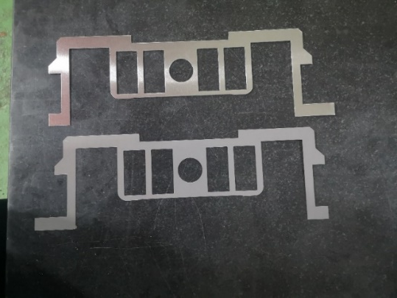
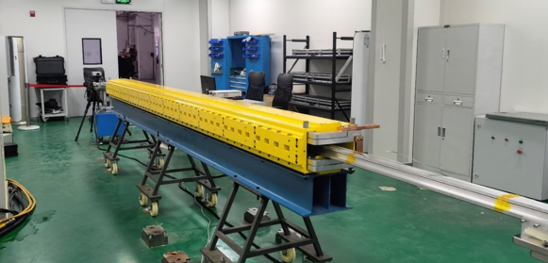
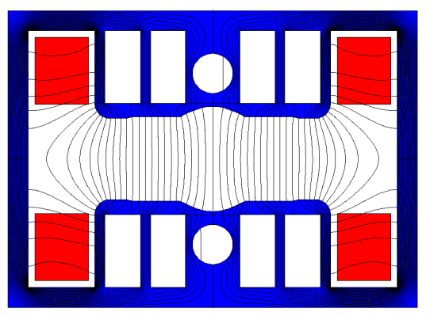
CEPC Booster magnets design
CEPC Booster magnets (19624 sets of magnets cover about 74 km )
  Field ramping with the beam energy ( from 30 GeV to180 GeV) in 10 seconds
  Low field and long dipole magnets: 95 Gs @30 GeV to 564 Gs @180 GeV with a length of 4.7 m.
  Resistant laminated magnets are the first choice.
  Low field dipole magnets with interleaved non-steel/steel laminations, narrow yoke and holes in the pole to reduce the magnet weight
  Aluminum busbar coils for cheap price and low weight ( Vs Copper)
  Combined dipole and sextupole magnets are used to reduce the power consumption of individual sextupole magnets.

Slide 14
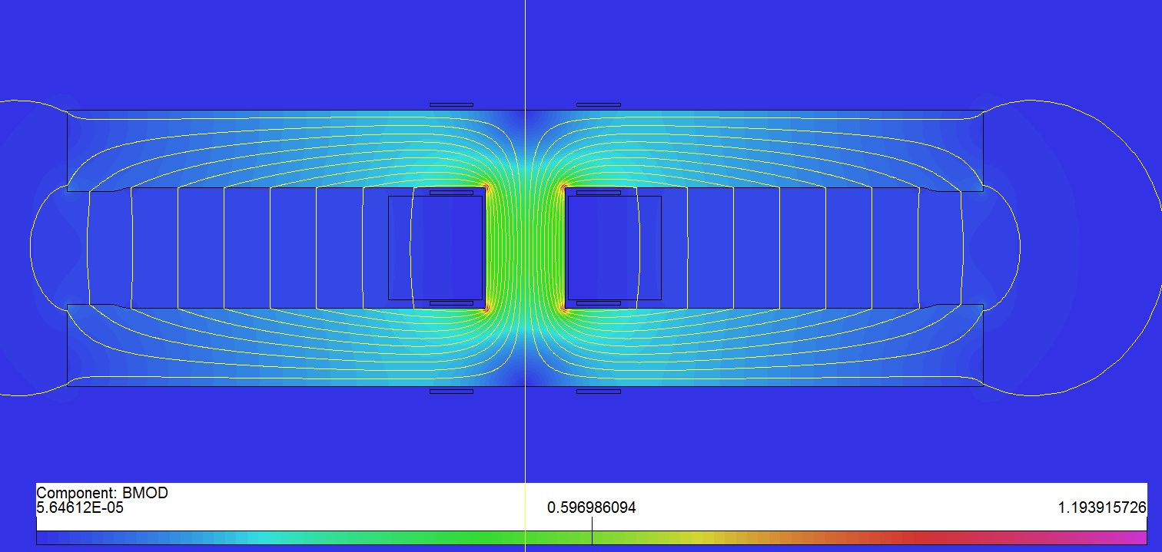
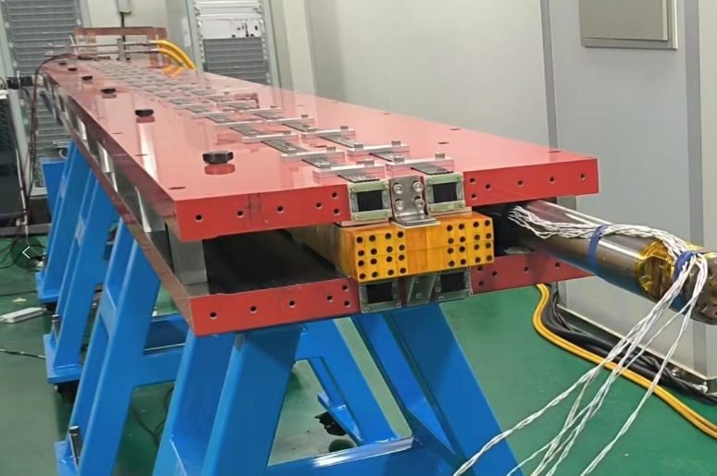
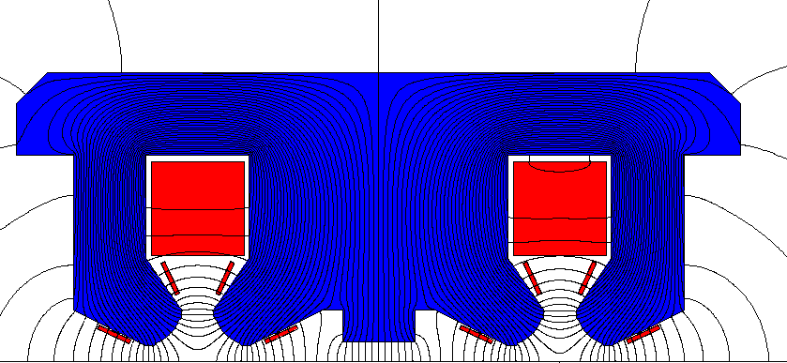
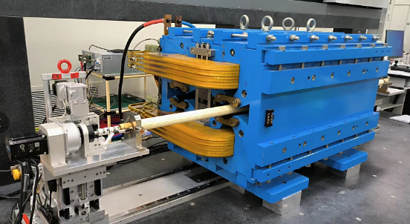
CEPC Collider magnets design
CEPC Collider magnets (17574 sets of magnets cover about 84.67 km)
  DC magnets work at four energies of 45.5, 80, 120 and 180 GeV
  Dual aperture magnets can decrease the number of units to manufacture, test, transport, install, maintain, and save about 50% power consumption.
  Compact magnets with narrow yokes and simple pole shape
  Pure solid iron is used for dual aperture dipole magnet with aluminum excitation bars
  Simple racetrack coil is used for dual aperture quadrupoles.

Slide 15
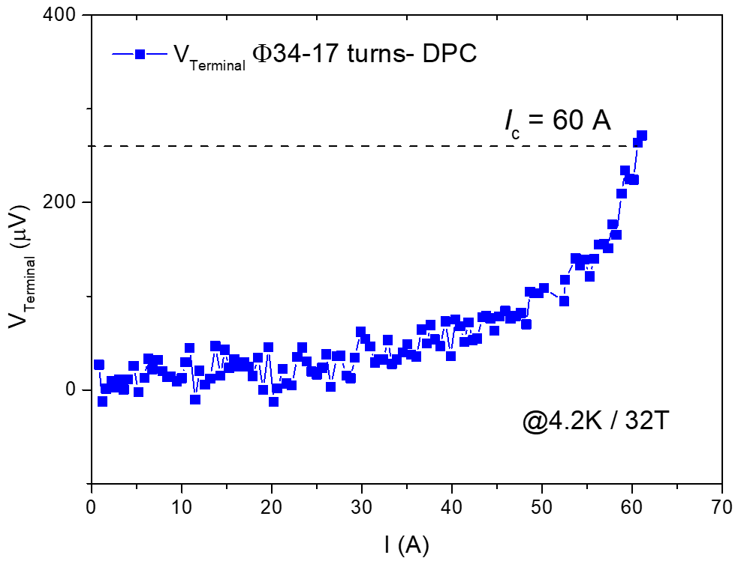
Develop the superconducting technology
CEPC's superconducting high-frequency system (with attached cryogenic system) is the main source of energy consumption. The high Q superconducting cavity can effectively reduce the heat load of the cryogenic system, effectively saving power
High-temperature superconducting (HTS) technology, can dramatically change the technical solutions of accelerator magnets and reduce energy consumption
High-performance superconducting cable is the key technology for superconducting magnets;
High-Q superconducting cavities at IHEP, with a quality factor of ~5e10. Average Q of superconducting cavities at EuXFEL is ~1e10
Chinese scientists pioneered iron-based high-temperature superconductivity technology IBS
  ◈ low cost ◈good stability ◈ flexible winding
High Q cavity for CEPC, comprehensive accounting can reduce the operating power of 10MW, annual power savings of about 60M kWh
50MW Higgs Mode Cryogenic System Power Consumption vs. Q
Performance of IBS solenoids under a 32 T
I_{c} reach 60 A at 4.2 K and 32 T
SC magnet
RF

Slide 16
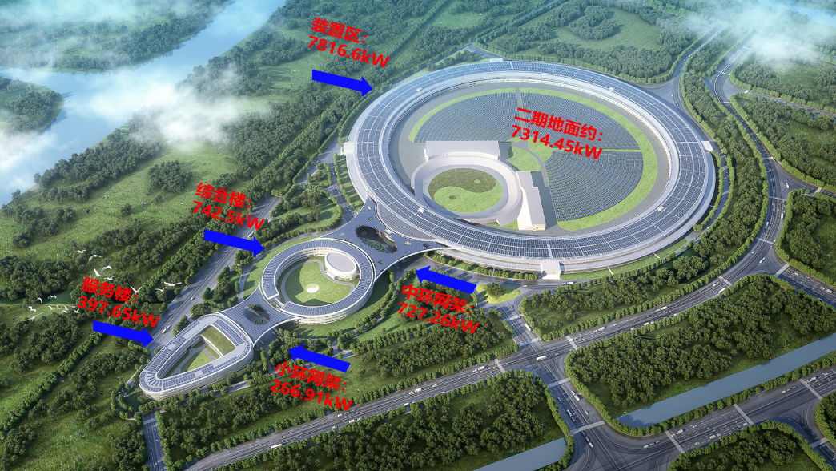
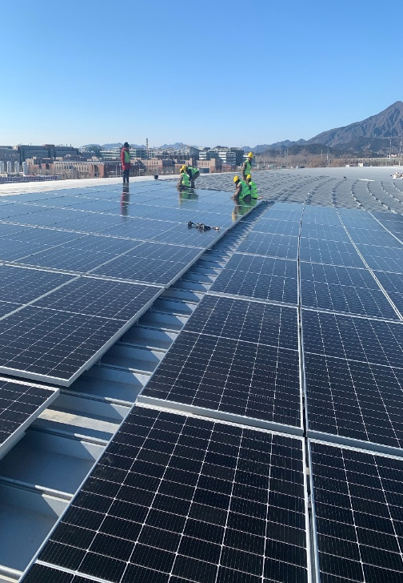
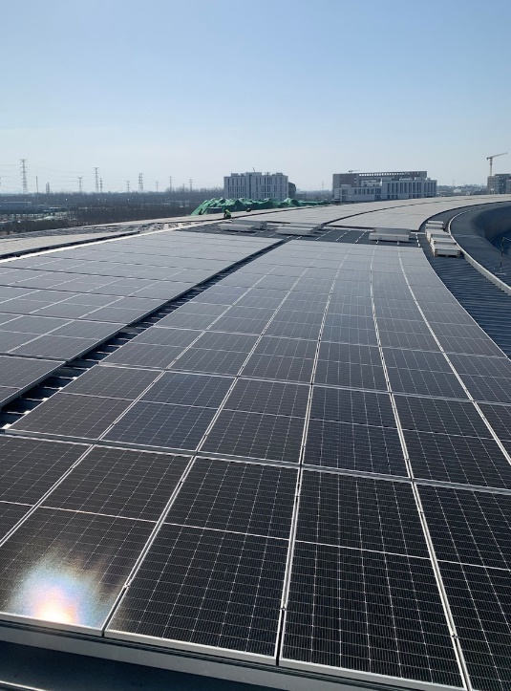
Clean energy implement and utility
High Energy Photon Source (HEPS) Photovoltaic facilities
HEPS buildings in Huairou are designed and installed with photovoltaic (PV) power generation systems on the roofs to realize the win-win effect of architectural functions and grid-connected power generation, and to create a clean, environmentally friendly, intelligent, convenient, and aesthetically pleasing high-tech park.
Adopting 465Wp/550Wp monocrystalline silicon photovoltaic modules, the first phase has a total installed capacity of 9,950.92 kWp. It is expected that the average annual power generation will be 10.30766 million kWh, and the equivalent average annual utilization hours will be 10,035.85h.
The electricity generated by the project is consumed locally.
The second phase is planned to lay PV modules on the ground inside the storage ring with an installed capacity of 7314.45kWp.
储存环屋顶施工现场
16

Slide 17
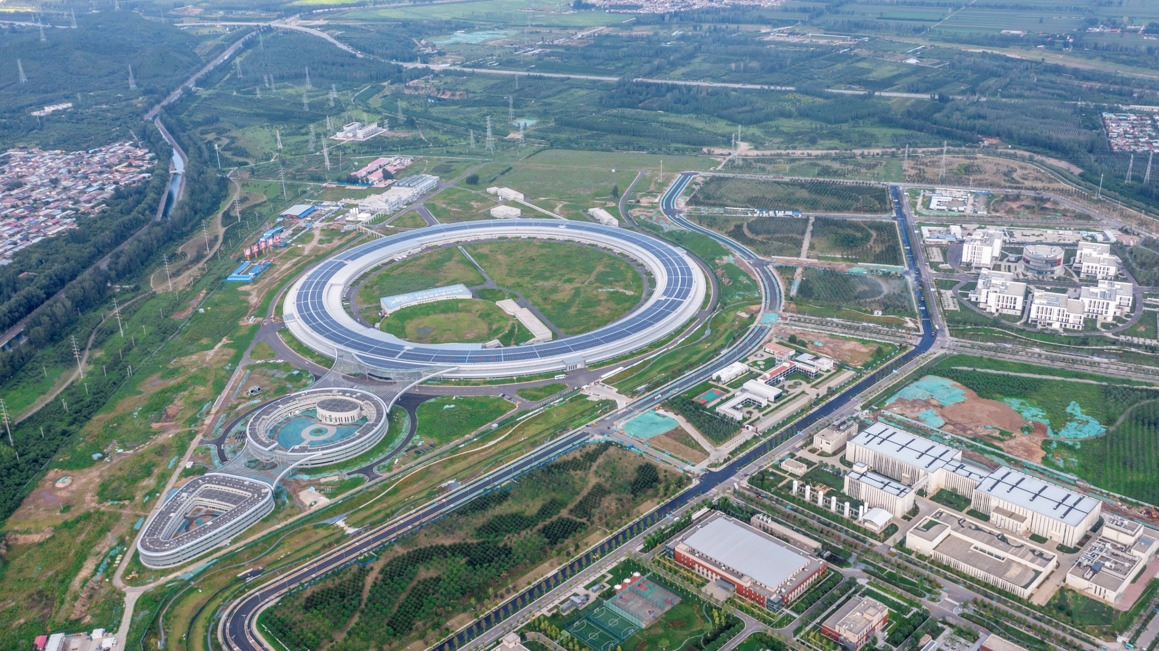
HEPS onsite picture

Slide 18
Clean energy implement and utility
The CEPC site selection is currently in progress，the utilization of clean energy should fully consider the geographical and climatic conditions of candidate locations.
Hydroelectric power, wind power, solar energy, bioenergy (biogas), these forms of energy represent renewable energy and are of great significance in reducing dependence on fossil fuels and mitigating climate change.
Even the energy storage, load shifting and peak shaving……

Slide 19
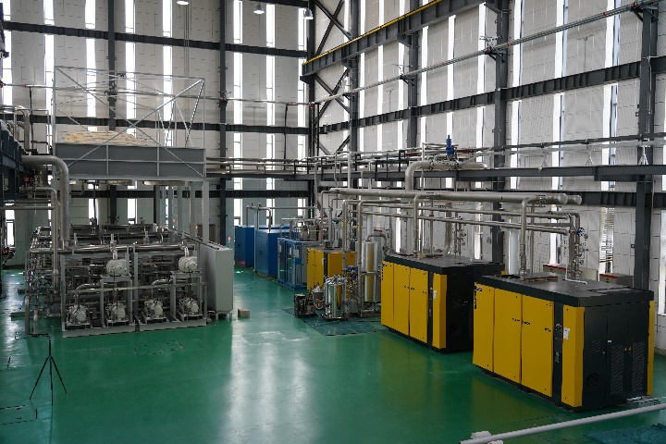
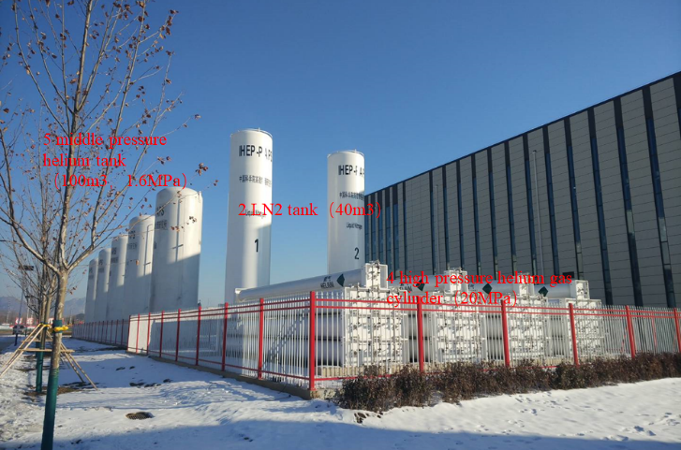
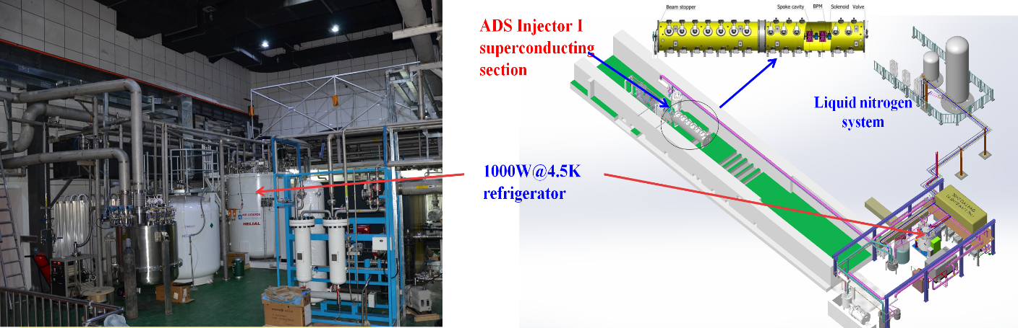
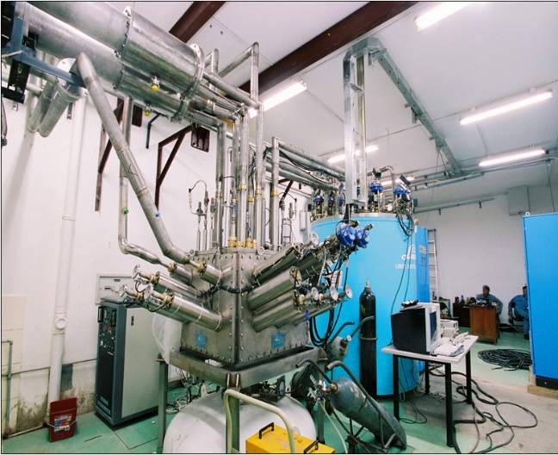
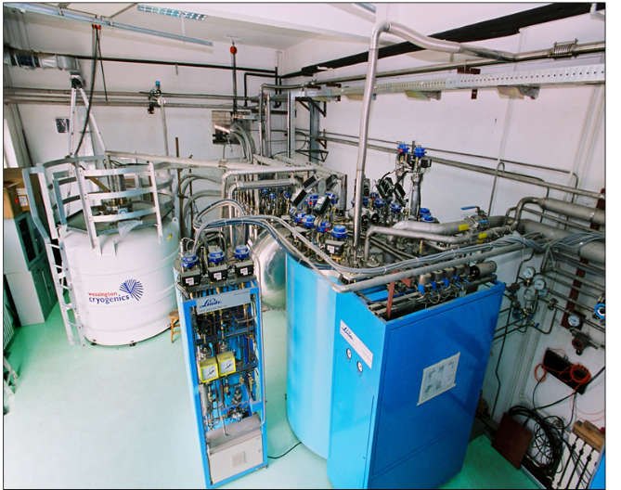


Full recovery/recycling of the liquid helium/helium gas
Helium gas is an associated resource of natural gas, which is non-renewable and mainly relies on imports in China. In recent years, due to the international situation, the price fluctuates greatly;
All the devices in IHEP realize all helium gas recovery: the liquid helium recovery and purification system of BEPCII(ADS)/PAPS、HEPS has been running stably for many years.
Promote the localization of large-scale liquid helium recycling system.
PAPS helium purification
and recycling system
ADS helium purification
and recycling system
BEPCII cryogenic system
HEPS cryogenic system

Slide 20


Optimization of the large cryogenic system
CDR
TDR
Eliminate many small valve boxes;
Process flow looks more easier;
Reduce the cryogenic cost;

Slide 21


CEPC waste heat recovery/reuse requirements
The CEPC collision ring has 16 cooling water circuit sites with a cooling water circuit heat load of 221MW.
The cooling water system comprises a low-conductivity water (LCW) closed-loop circuit, a cooling tower water (CTW) circuit, and a deionized water make-up system.
LCW system absorbs heat from the various accelerator equipment, which is transferred through a heat exchanger to CTW, and finally taken away by the cooling water system;

Slide 22



CEPC waste heat recovery/reuse requirements
CTW temperature： 5°C inlet and 11°C outlet; Total cooling load of 197 MW.(TDR report P854)
LCW temperature: 29°C inlet and 34°C outlet (TDR report P852); Total cooling load of 221MW (16 sites).
Low-grade energy can be converted into high-grade energy and utilized effectively through heat pump technology, photo-thermal technology and thermal energy storage technology.
TDR report **P851
TDR report *P973
TDR report P853

Slide 23
Possible solutions for CEPC waste heat reuse
Notes:
It can recover the waste heat for heating in winter by consuming electricity, which can improve the energy gradient utilization.
even better than the electric heat pump

Slide 24






Advantages of AHP
Solar energy has advantages of renewability and cleanliness. Comparing ① the required solar energy and ② heating supply capacity between the two different schemes, with the condition that utilize the solar energy and recover the same quantity of waste heat, can reveal the environmental and economic implications of each technology.
Two different schemes:
Photovoltaic (PV) to power → electric driven heat pumps (EDHP)
Photovoltaic (PV) to heat → absorption heat pumps (AHP)
Recovering 14MW waste heat from 1 site (221MW/16 sites);
Conclusion:
For the same recovery of 14MW of waste heat:
PV to heat → AHP solution requires 25% less solar energy than the PV to power →EDHP solution;
PV to heat → AHP solution provides 50% more heating energy than the PV to power →EDHP solution;
A smaller initial investment for a larger gain.
What is the efficiencies difference between PV to power and PV to heat?
(1) PV to power → EDHP:
Required PV energy to power:
$W_{E}=\frac{Q_{W}}{COP_{\text{ED}\text{HP}}−1}=\frac{\text{1}\text{4}\text{MW}}{3−1}=7\text{MW}；COP_{\text{CHP}}$ is the coefficient of performance of EDHP
EDHP
$$\text{PV}\text{→}\text{power}\text{→}\text{heat}$$
$$\text{15\%} \text{∗} \text{3} \text{=} \text{45\%}$$
Required solar energy：
$W_{S}=\frac{W_{E}}{η_{\text{PV}}}=\frac{\text{7}\text{MW}}{15\%}=46.67MW,η_{\text{PV} }$is the coefficient of solar photovoltaic efficiency
heating supply capacity:
1
2
AHP
$$Q_{S}=Q_{W}+W_{E}=14\text{MW}+7\text{MW}\text{=}\text{21}\text{MW}$$
$$\text{PV}\text{→}\text{PV} \text{heat}\text{→}\text{heat}$$
$$\text{50\%} \text{∗} \text{1.8} \text{=} \text{90\%}$$
(2) PV to heat → AHP:
Required PV energy to heat:
$Q_{H}=\frac{Q_{W}}{COP_{\text{AHP}}−1}=\frac{\text{14}\text{MW}}{1.8−1}=17.5\text{MW}$， COP_{AHP} is the coefficient of performance of AHP
3
4
GB/T 39857-201
GB/T 18430
GB/T 17581-2021
GBT 34620-2017
Required solar energy：
$W_{S}=\frac{Q_{H}}{η_{\text{PT}}}=\frac{\text{17.5}\text{MW}}{50\%}=35\text{MW}$； $η_{\text{PT}}$ is the PV to heat efficiency
heating supply capacity:
$$Q_{S}=Q_{W}+Q_{H}=14\text{MW}+17.5\text{MW}\text{=}\text{31.5}\text{MW}$$

Slide 25


HEPS Waste Heat Sources Utilization
A heat recovery chiller unit is used to recover waste heat typically discharged into the atmosphere through cooling towers. While meeting the cooling load, this system utilizes the byproduct of refrigeration operation, which is waste heat, to produce inexpensive hot water. Simultaneously, it reduces the heat emissions and noise from the cooling tower, thereby mitigating the "heat island effect" in the city.
HEPS (presumably a facility or system) has installed four heat recovery chiller units: 2 * 5500 kW and 2 * 2800 kW. During operation, it can provide a maximum of approximately 13 MW of recovered heat energy at 42°C.
The maximum heat load for HEPS is 10,413 kW in winter and 4,117 kW in summer. When the system is running, the recovered heat source can fully replace municipal heat sources.
The equipment was installed and commissioned by the end of 2022.

Slide 26
Summary
The development of environmentally friendly, green and sustainable accelerator is one of the current hot topics;
The comprehensive development of green accelerator requires a cross-section of management, municipal planning, energy recycling, specialized technology, theoretical innovation and other areas, and it is complex and difficult to coordinate all aspects of integrated consideration;
Further green accelerator development & research works are still going on
……

