Slide 1
Spin-polarized electron sources for future linear colliders
Jared Maxson
Cornell Physics, CLASSE
LCWS 2024

Slide 2
Outline
Nanostructured GaAs photocathodes: a wonder material with high QE and nearly 100% polarization
GaAs Limitations
New GaAs Activating Layers
Beyond GaAs:
  GaN
  Alkali Antimonides
Outlook and future work

Slide 3
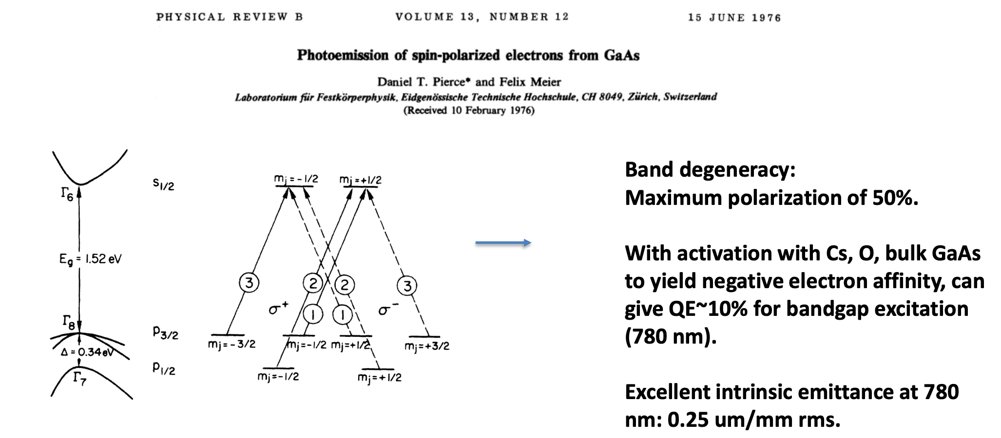
GaAs: Inception
GaAs is the go-to polarized electron source in present HEP/NP accelerators.
Discovery of spin-polarized photoemission:

Slide 4
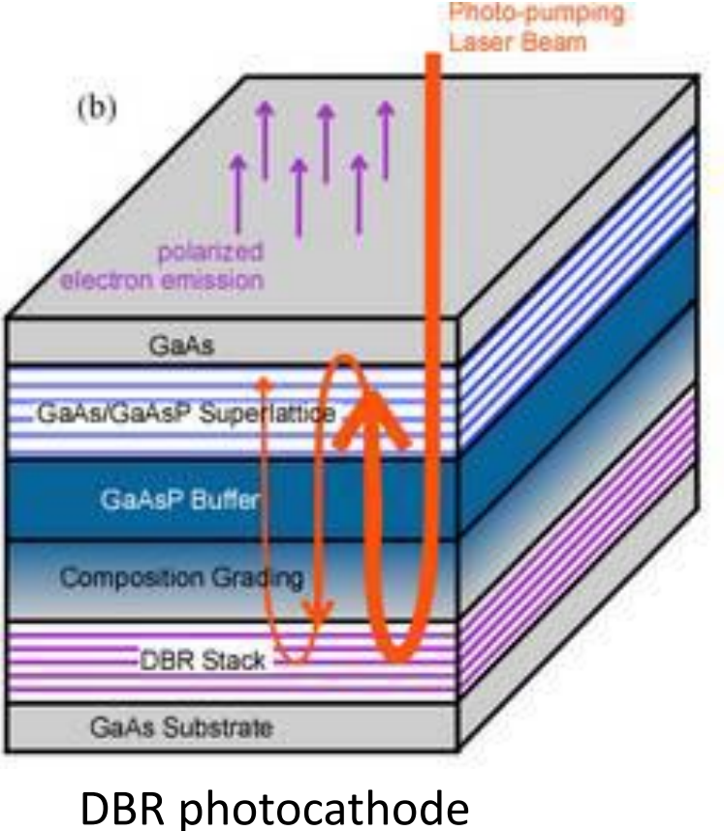
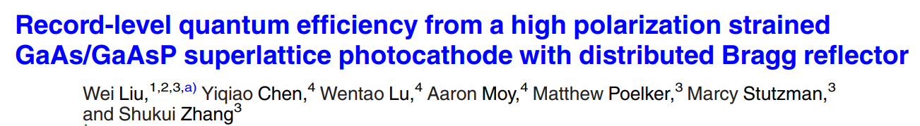
Enhancing Polarization and QE
Critical advancements:
  Break the band degeneracy via strain induced by an epitaxial superlattice.
  Increase QE by increasing absorption via optical interference via a layered structure
  Wonder-cathodes with high QE and polarization thanks to precision materials engineering:
QE enhanced to >6%, with polarization of 84%.
Downside? Not really! May increase temporal response time to the 10 picosecond scale, but this is not important for large bunch charges.
Figures from Wei Liu

Slide 5
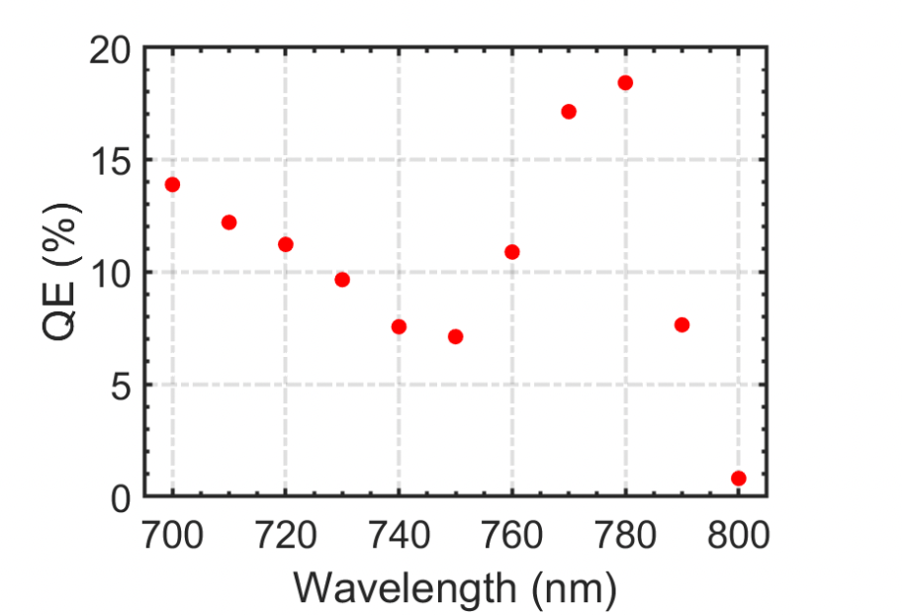
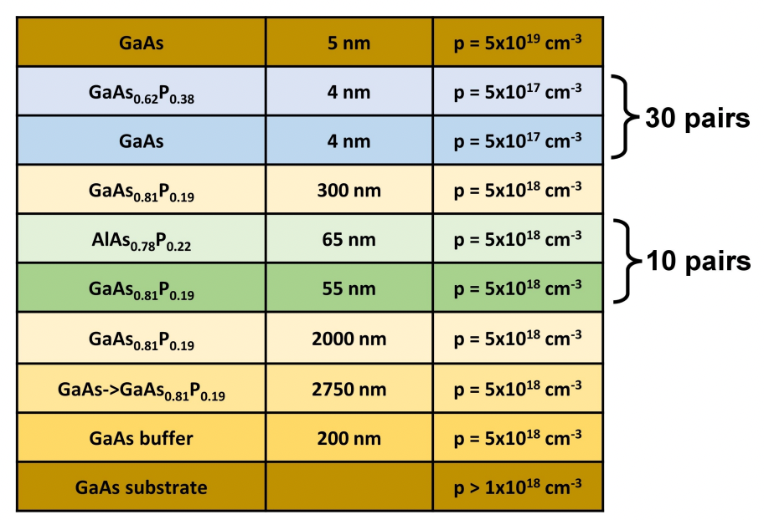
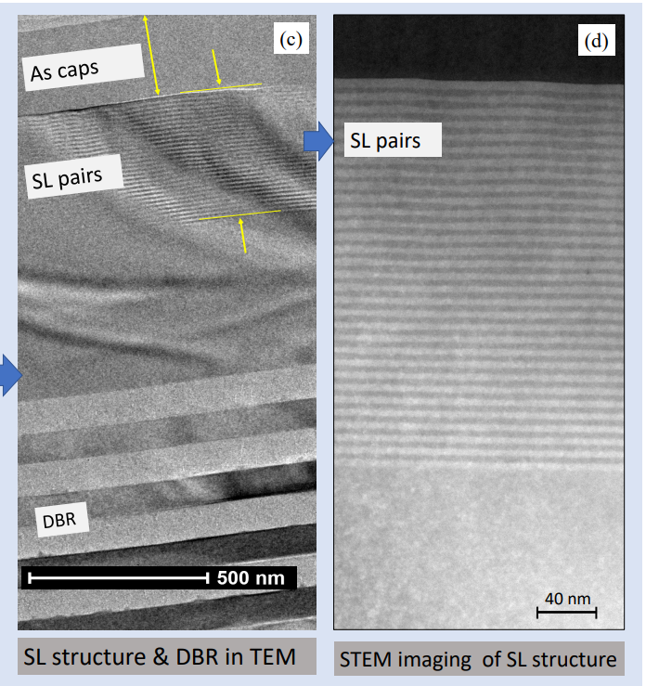
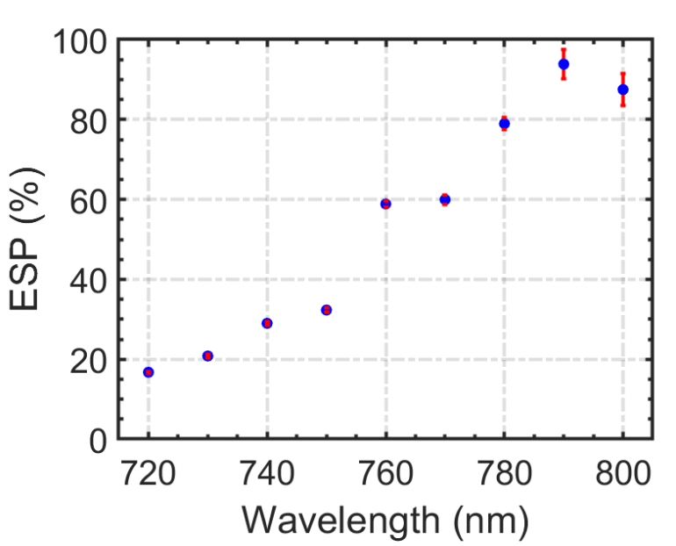
Current State of the Art
Collaboration of Brookhaven and Sandia National Labs pushing for next generation GaAs sources. (Data from L. Cultrera)
Multilayer layout:
TEM Micrographs:
~90% spin polarization with >10% QE!
L. Cultrera, P. Saha , M. Boukhicha, A. Muhowski, S. Hawkins, V. Patel, IPAC 2024, paper WEPC46
New Brookhaven/Sandia/KEK collaboration
has been formed

Slide 6
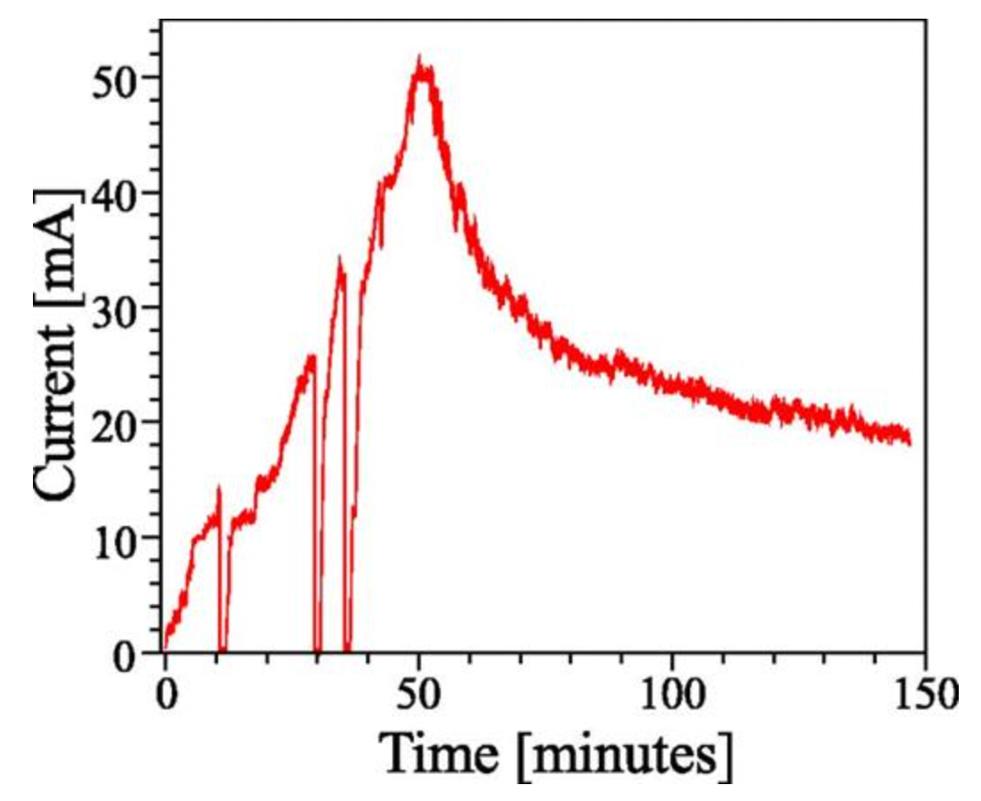
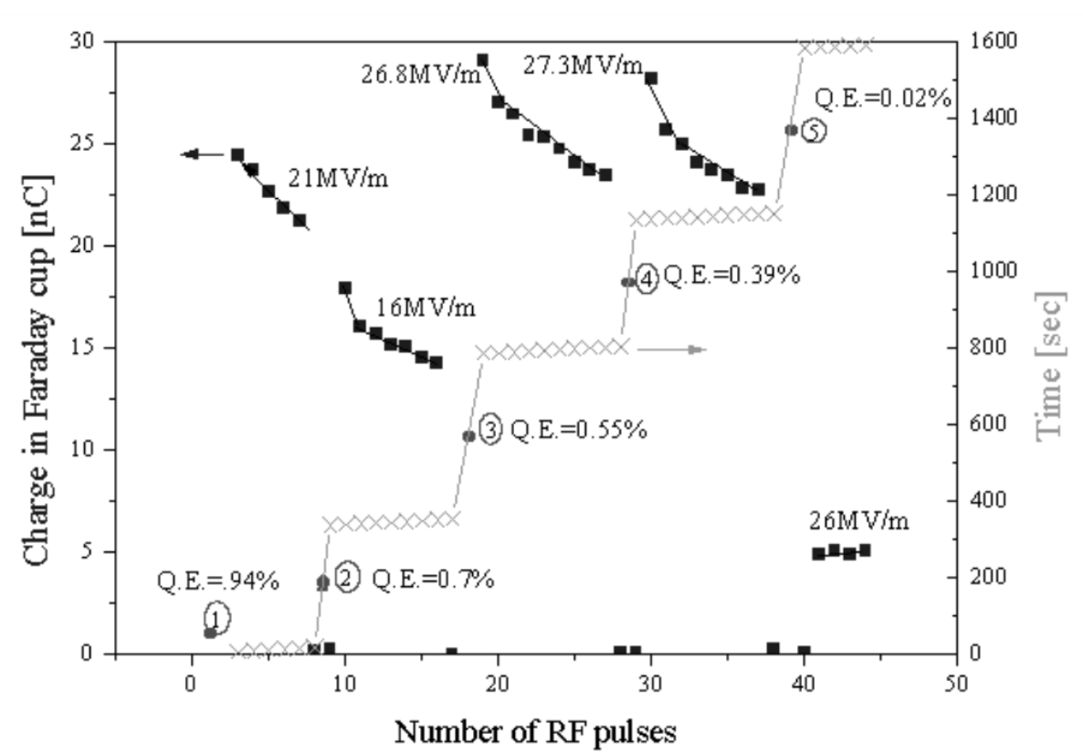
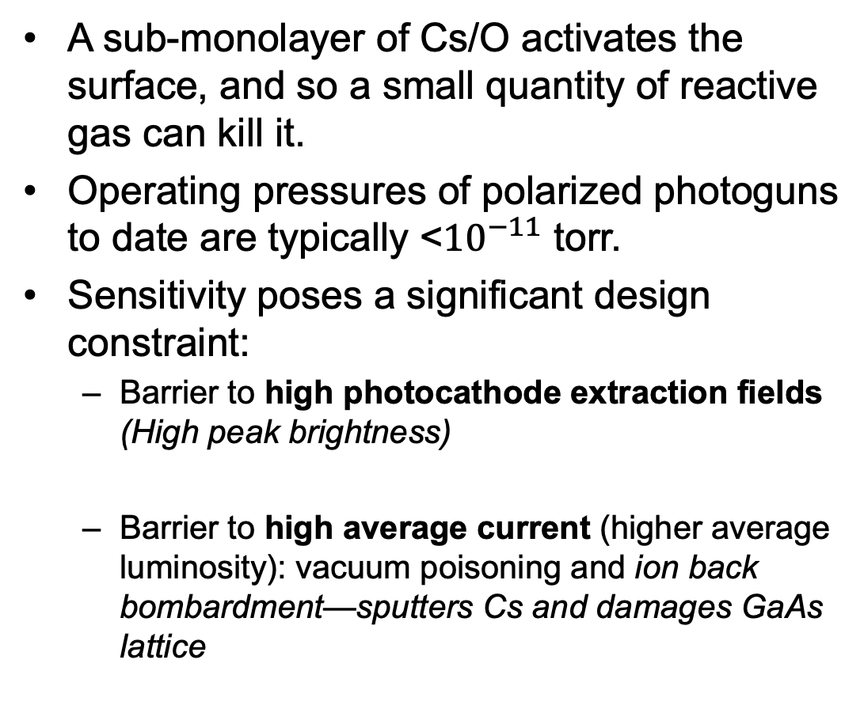
GaAs Limitations: Sensitivity
Cornell: Appl. Phys. Lett. 102, 034105 (2013)
A sub-monolayer of Cs/O activates the surface, and so a small quantity of reactive gas can kill it.
Operating pressures of polarized photoguns to date are typically <${10}^{−11}$ torr.
Sensitivity poses a significant design constraint:
  Barrier to high photocathode extraction fields (High peak brightness)
  Barrier to high average current (higher average luminosity): vacuum poisoning and ion back bombardment—sputters Cs and damages GaAs lattice
GaAs:Cs/O
DC Gun
GaAs: Cs/O
RF Gun
30 MV/m
BINP: PAC 1999, paper MOCR4

Slide 7
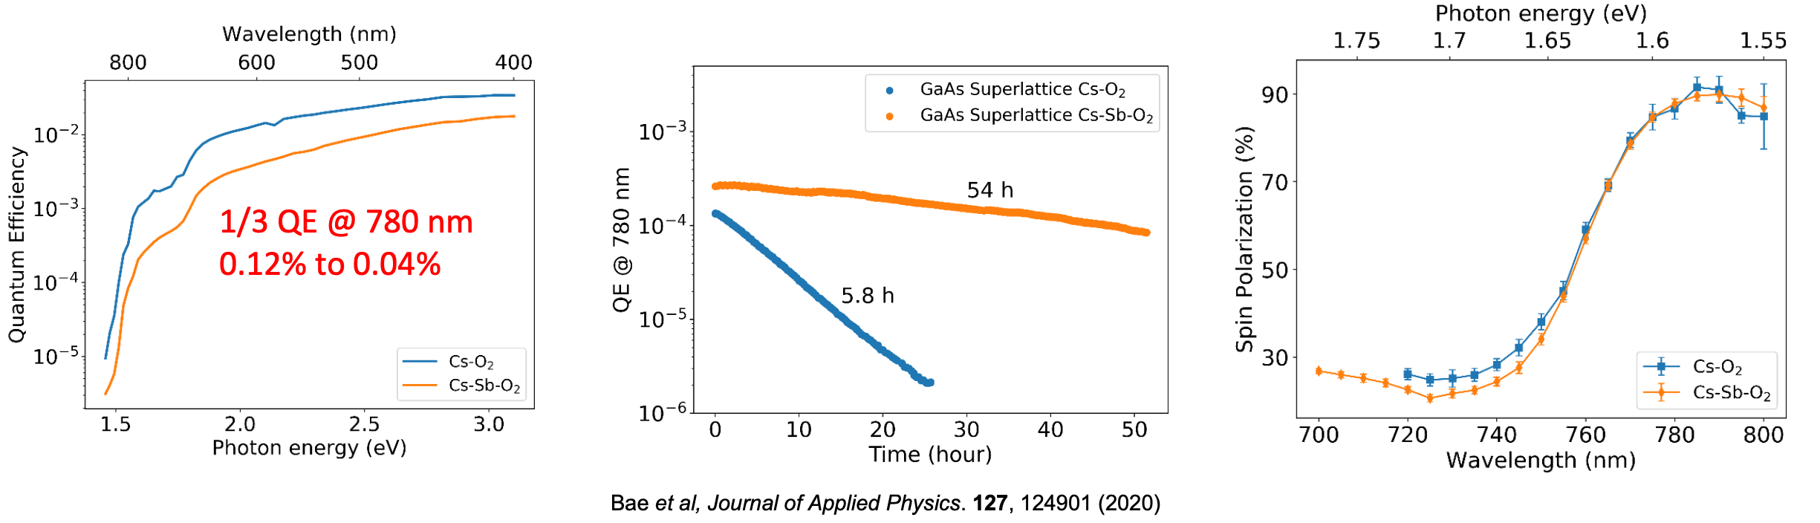
More Robust GaAs Activating Layers
Are there other activating layers for GaAs that are more robust?
Activation with Cs-Te first discovered in 2015 (Kuriki et al., IPAC 2015 TUPWA062)
Our work: Coating with Cs-Sb-O yields a more robust surface than Cs-O alone—at the cost of QE. Spin polarization can be preserved!
10x lifetime improvement against chemical poisoning.
High current tests suggest protection against ion-back bombardment is less dramatic—hypothesis similar sputtering to Cs:O overlayer.
(No DBR)

Slide 8
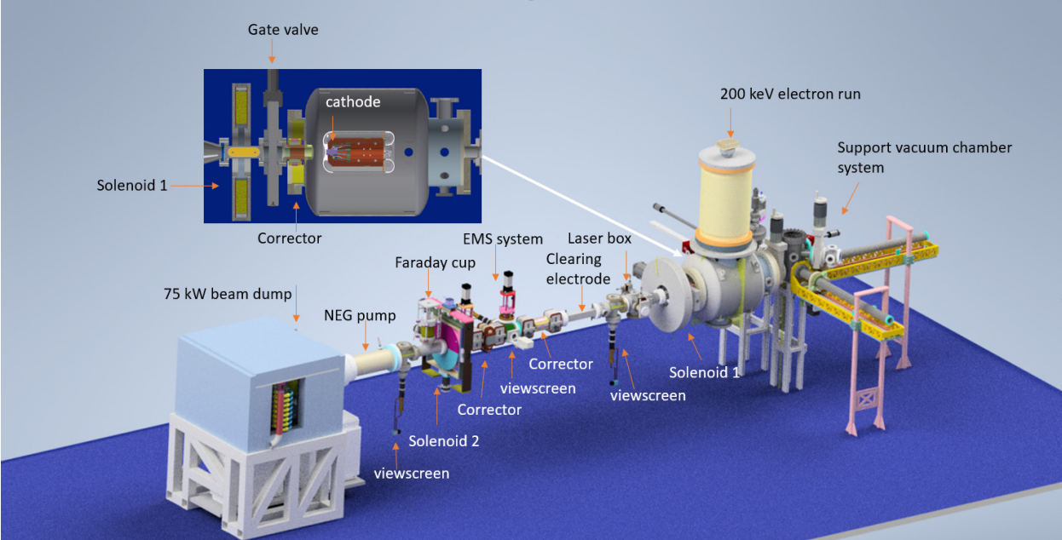
Our high average current test facility at Cornell: HERACLES

Slide 9
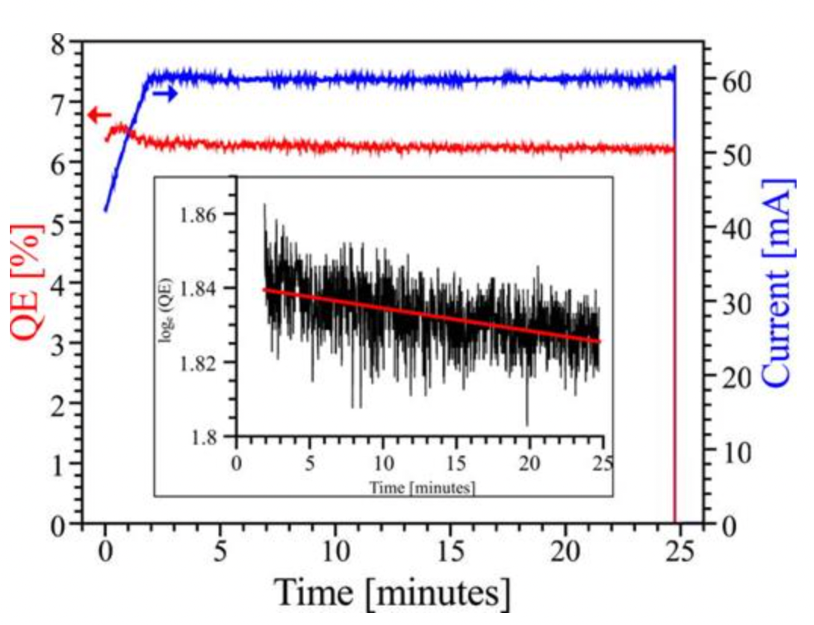
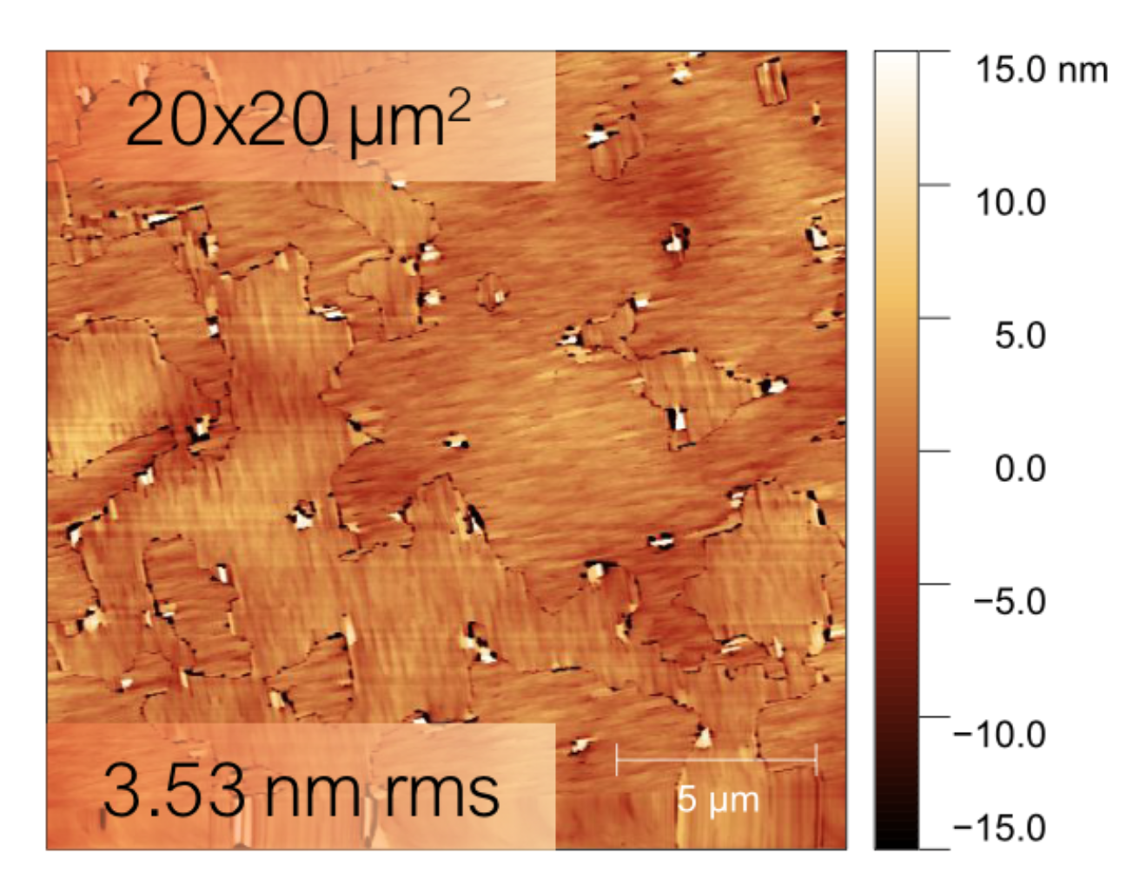
Beyond GaAs: New Materials
Is it possible we can find an alternative to GaAs that isn’t so sensitive?
For example, could we eliminate the need for a damping ring or increase source average current dramatically?
I’ll discuss two examples being studied actively:
  Alkali Antimonides: A family of bulk visible
  light photoemitters
Cubic GaN: Wide Bandgap analog of GaAs
Cs-K-Sb
AFM Image of Cornell-Grown Cubic GaN

Slide 10
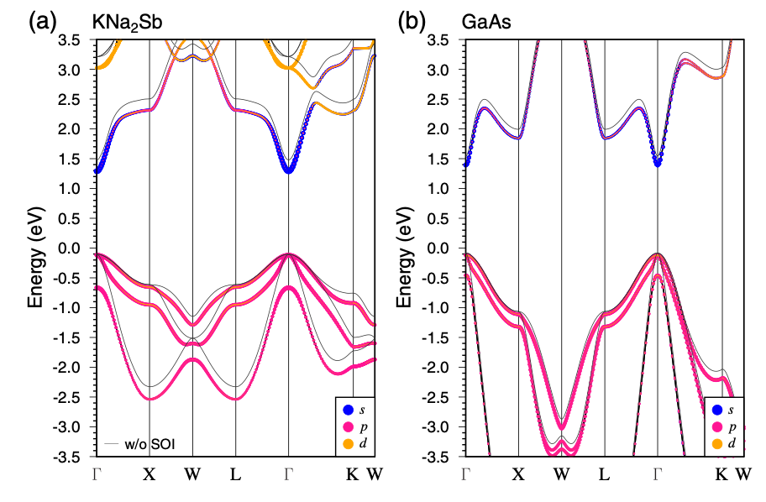
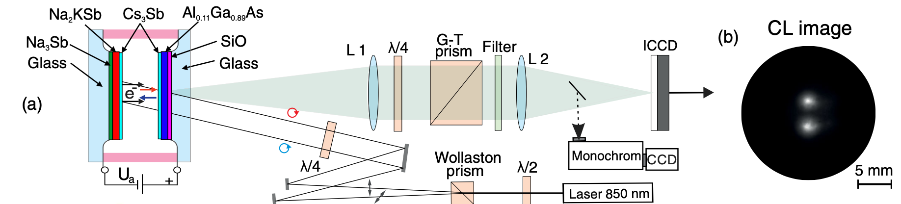
Alkali Antimonides for polarized photoemission
Alkali antimonides have cubic crystal structure, are bulk visible light photoemitters, and generally more rugged than GaAs.
Very challenging to grow high quality, crystalline films! Nonetheless, recent measurement suggests polarized photoemission is possible:
Polarization inferred from degree of circular polarization of cathodoluminescence (CL). Observed similar levels of CL polarization as unstrained GaAs---- polarized electrons!
Band Structure very similar to GaAs…
Very promising result! Future study should include direct polarization measurement (eg. Mott scattering).

Slide 11
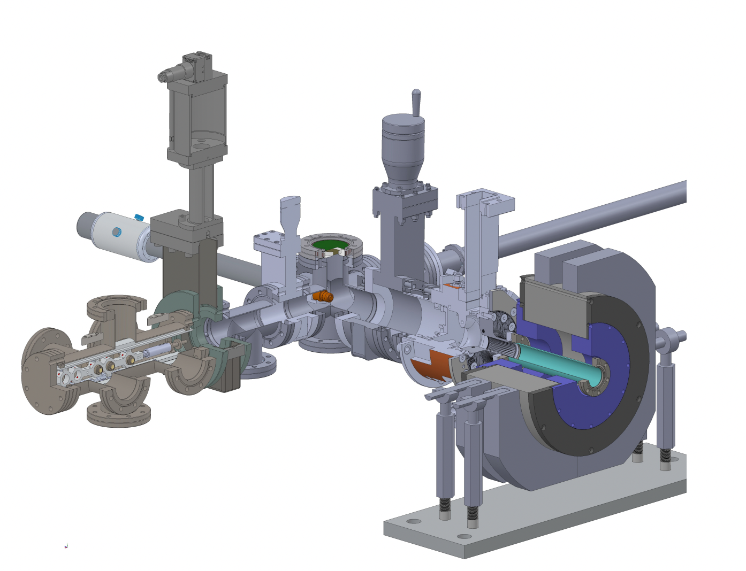
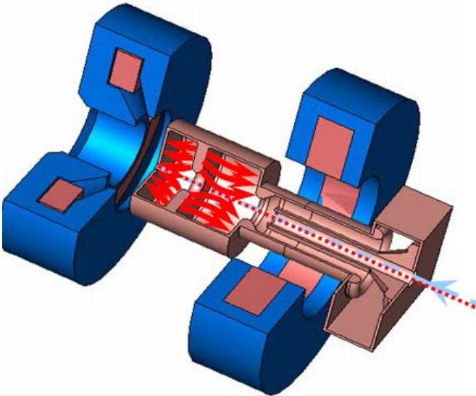
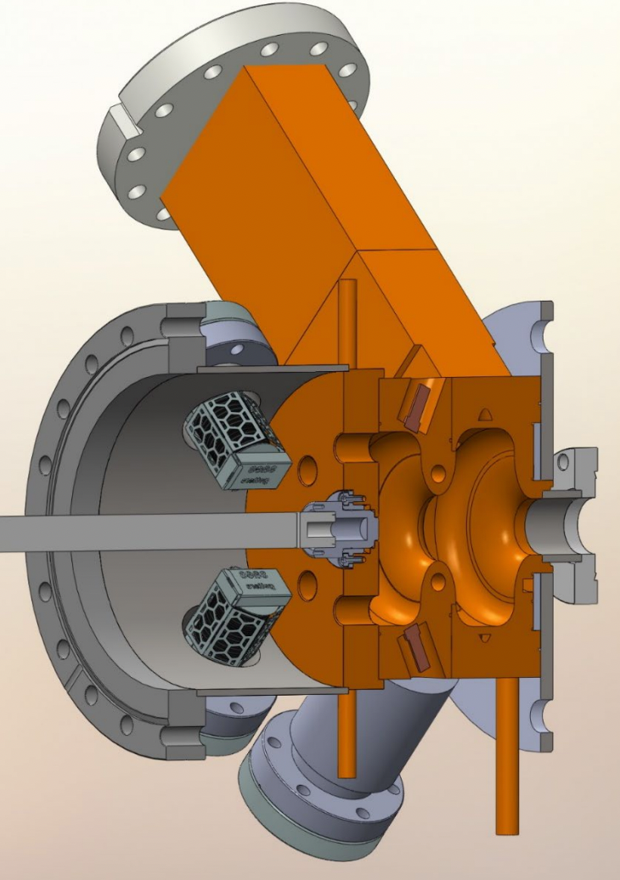
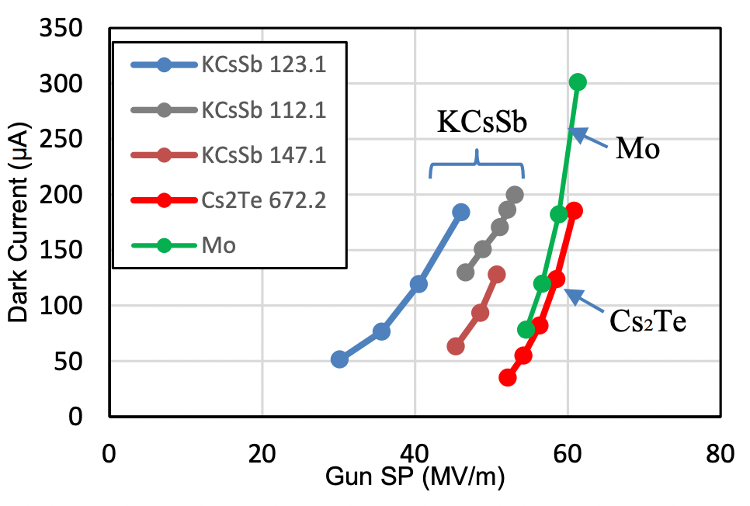
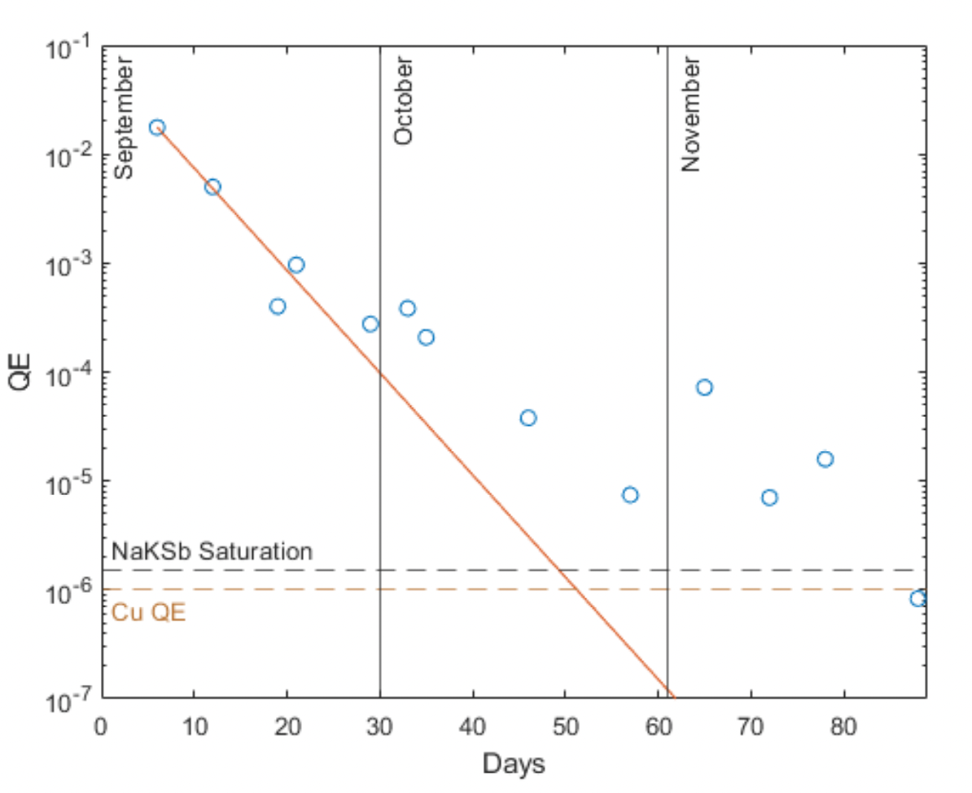
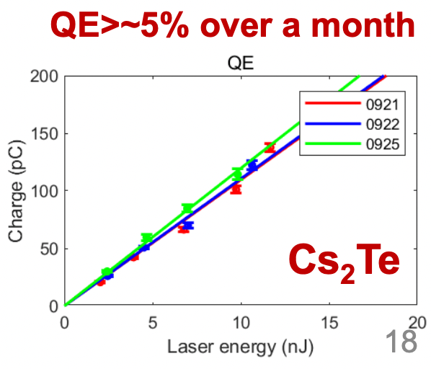
Alkali Antimonides in High gradient Guns
Tests planned C-Band (LANL and UCLA) soon!
Alkali antimonide photocathodes are now being tested in L and S-band high gradient normal conducting guns:
PITZ, L-band
UCLA PEGASUS, S-band
Tsinghua U, S-band
Mohanty et al. FEL 2022
Garcia et al, IPAC 2024
R. K. Li, P3 Workshop, 2023

Slide 12
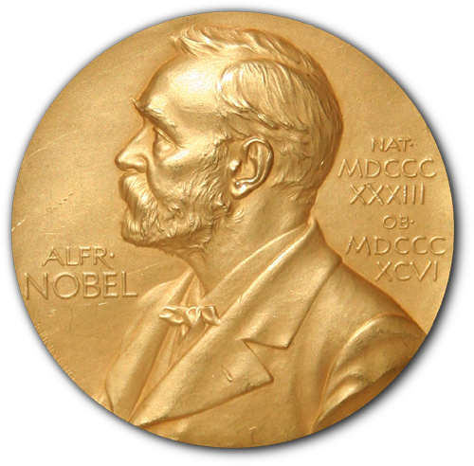
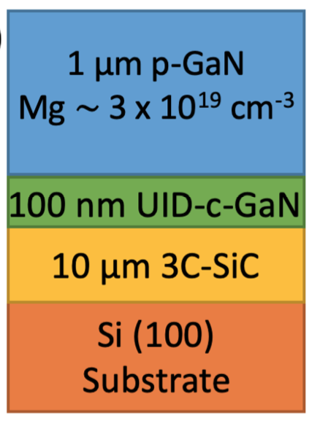
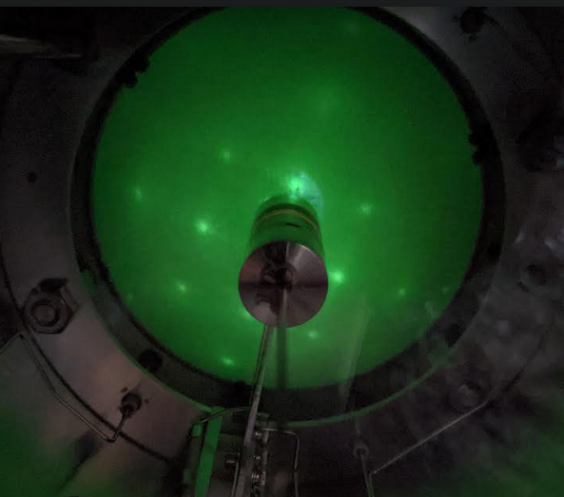
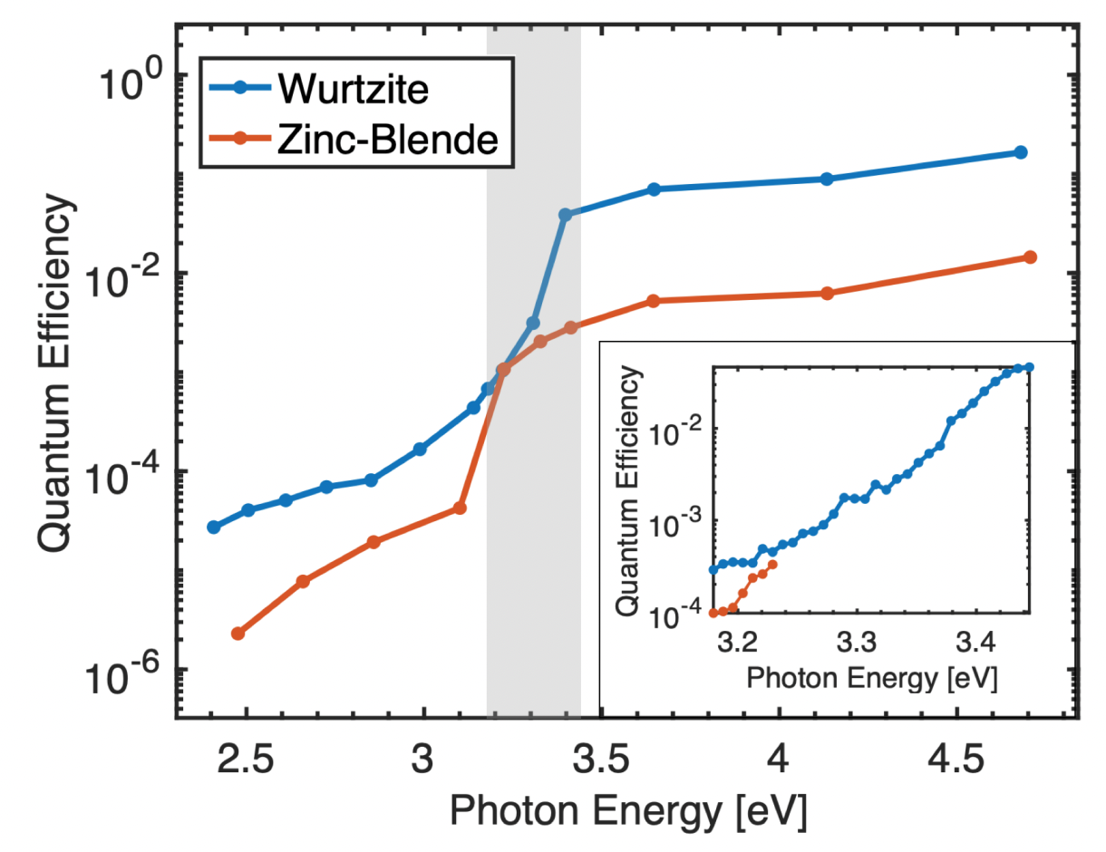
Gallium Nitride
GaN: A wide bandgap semiconductor, enabler of the blue LED.
  Cubic (Zinc-Blende) and hexagonal (Wurtzite) phases
Cubic phase is the closest analog to GaAs.
May also enable more robust activating layers such as CsI, and if appropriately band-engineered, can have high QE without Cs. (Here we are using Cs.)
Local expertise at Cornell: Jena/Xing Group.
DOE-HEP grant to study cubic GaN, Polarization, and new activating layers.
(Hexagonal)
(Cubic)

Slide 13
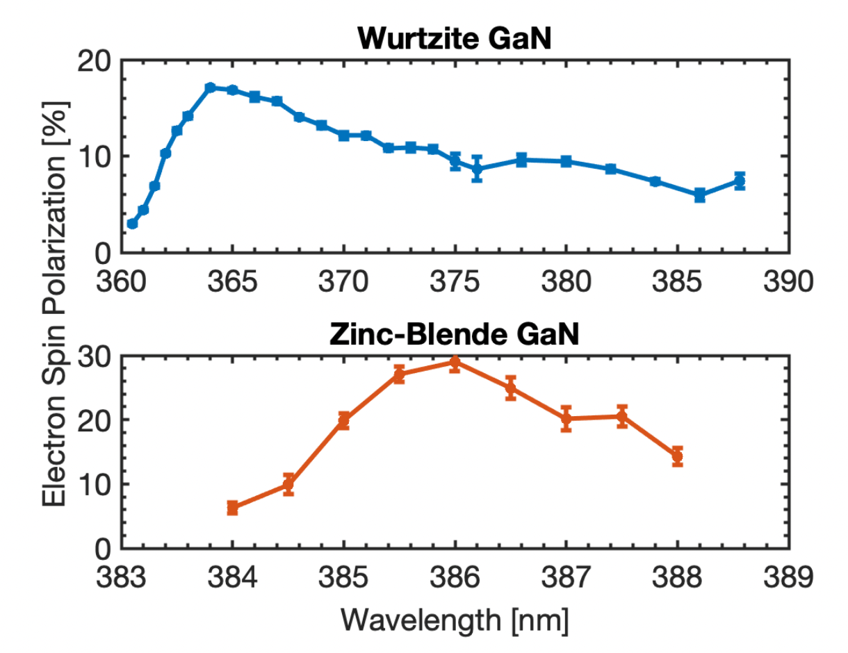

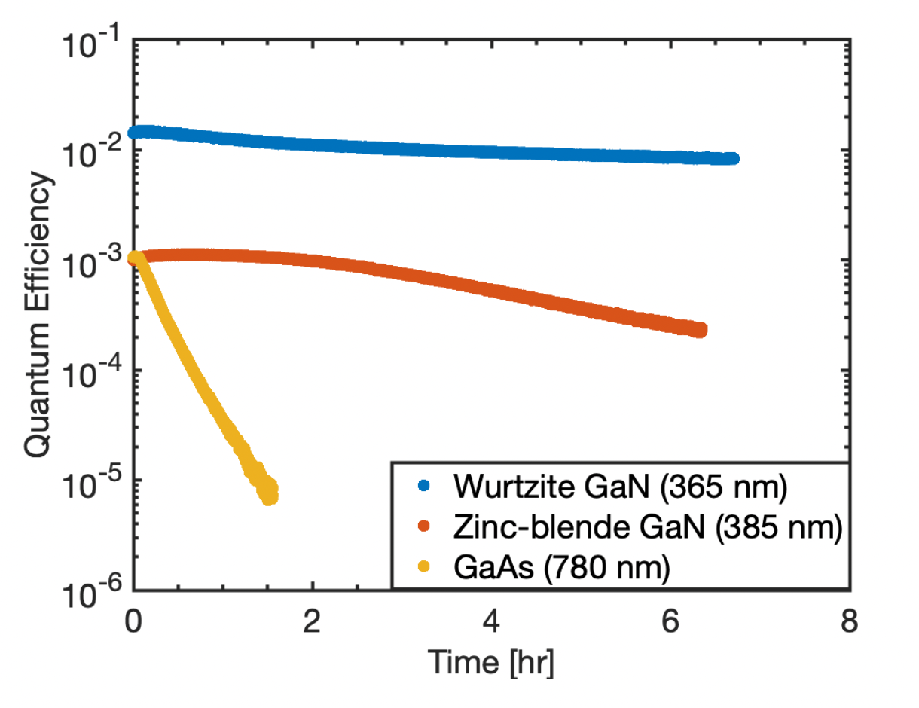
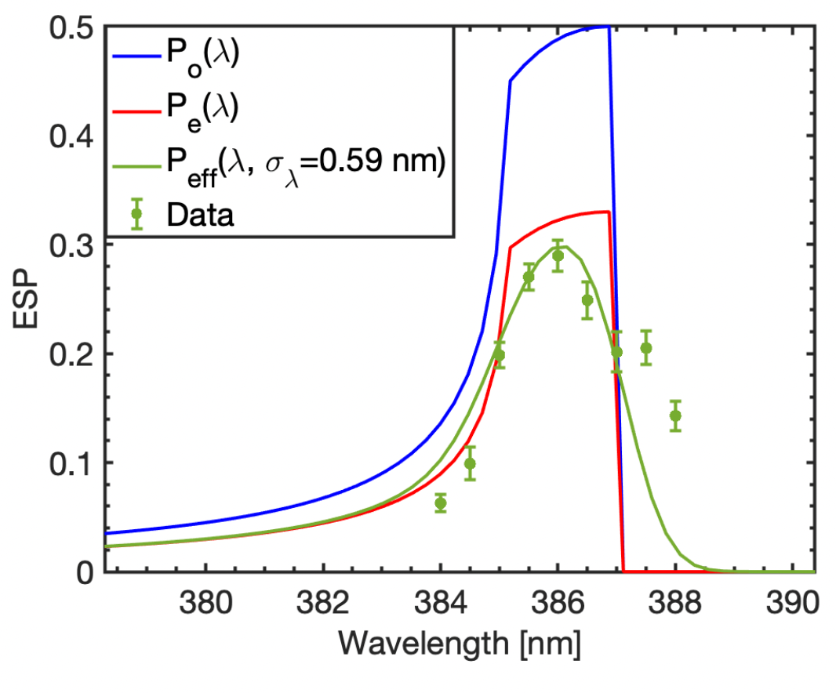
Polarized Electrons From GaN
Major difference between GaAs / GaN: N is light--less spin orbit splitting.
Need <1 nm bandwidth tunable light source around ~390 nm.
The first thing we notice is that GaN has much longer lifetime to chemical poisoning than GaAs.
We observe spin polarized emission in both cases.
Data fits a simple model
including depolarization and
Bandwidth effects.
Unstrained
https://arxiv.org/pdf/2405.04481

Slide 14
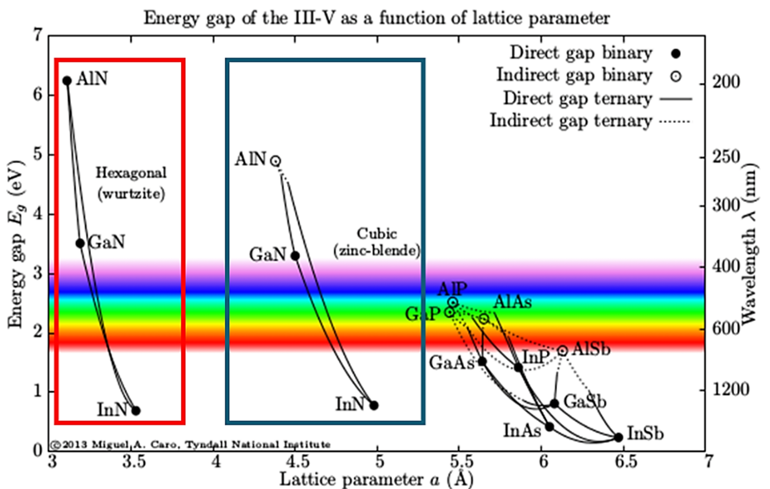
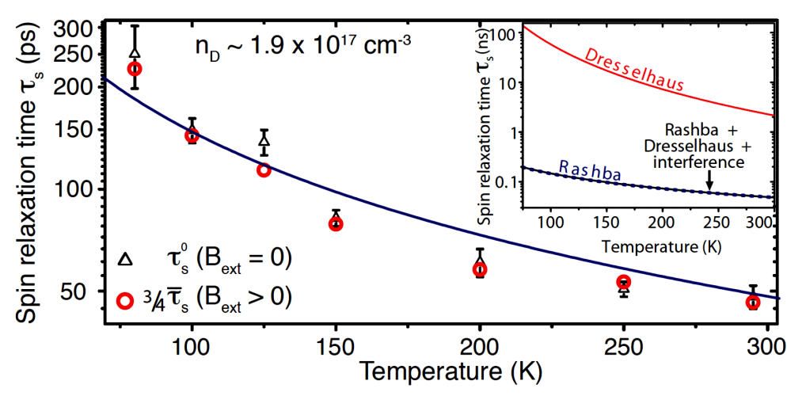
Routes to higher performance in GaN
Spin relaxation time in hexagonal GaN is at least 50x faster than in Cubic GaN, may explain lower peak ESP in hexagonal case.
One way to overcome this fast relaxation is to cool the emitter: gains up to a factor of 5 in relaxation time for hexagonal GaN.
Cubic GaN requires lattice strain to achieve above 50% spin polarization, but hexagonal GaN does not, in theory.
Another exciting route for study: Alloying with InN, to reduce bandgap for visible light operation.
Phys. Rev. B, vol. 81, p. 155216, 2010.

Slide 15
Summary and Outlook
GaAs is now extremely mature and we have the global expertise to generate nearly 100% polarization with >10% quantum efficiency.
GaAs remains extremely vacuum sensitive—new activation layers may help with robustness against chemical poisoning.
  Ion back bombardment? Still under investigation.
New, more robust materials might help expand access to polarized electrons (higher current, higher gradient sources)
  GaN: more robust, and a promising polarized emitter. Demands more materials engineering.
  Alkali antimonides: robust…what is their ultimate polarization performance?

Slide 16
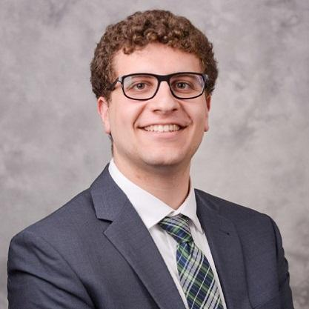
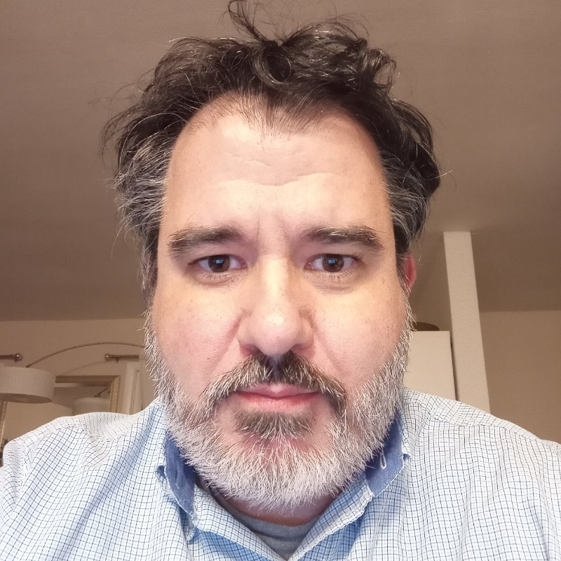
Thanks!
Accelerator Physicists
Thanks to our funding
agencies:
M.B. Andorf
I.V. Bazarov
S. J. Levenson
L. Cultrera (BNL)
Materials Scientists
D. Jena
J. Encomendero
V. V. Protasenko
H.G. Xing
Special thanks to A. Galdi, J.K. Bae, N. Otto, and B.A. Carmona.
1

