Slide 1
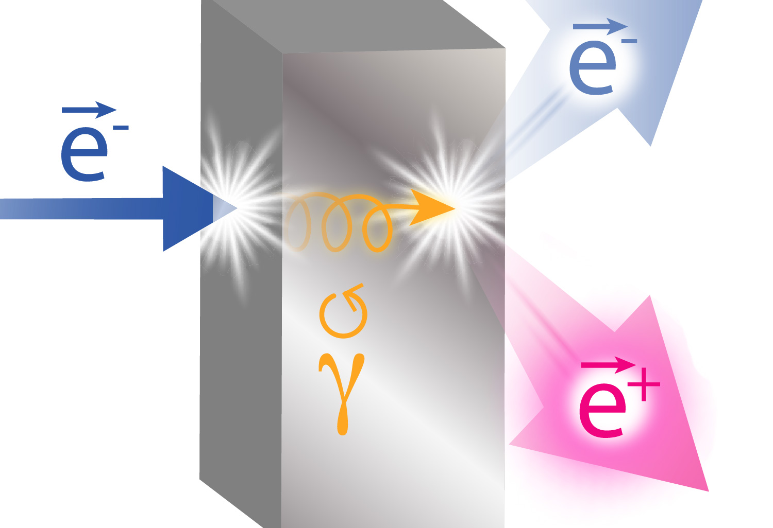
Update on Ce⁺BAF Positron Activities
Concept of Ce⁺BAF injector
Current Ce⁺BAF projects/proposals
Simulations of positron capture and acceleration
Andriy Ushakov (Jefferson Lab)
on behalf of the Ce⁺BAF Working Group
Work supported by the U.S. Department of Energy Office of Nuclear Physics under contract DE-AC05-06OR23177 and Office of High Energy Physics US-Japan Science & Technology Cooperative Program

Slide 2
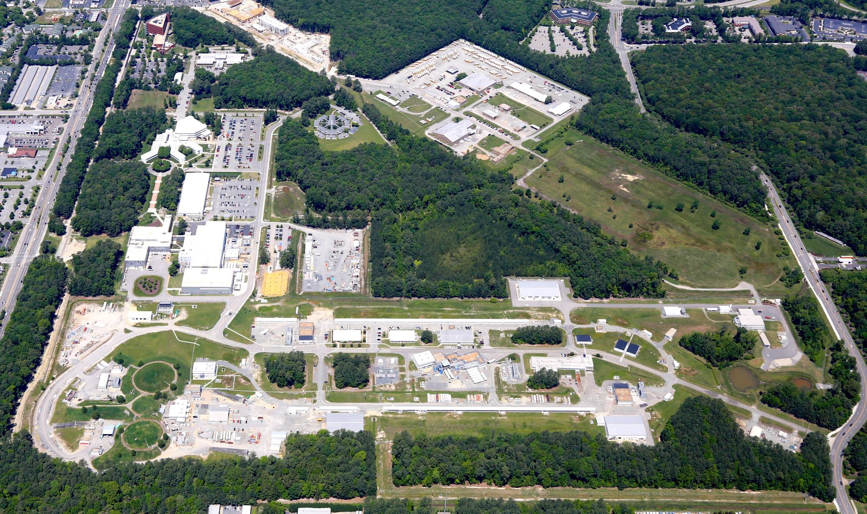
12 GeV Ce⁺BAF : Polarized Electron or Polarized Positron Beams
Machine Parameter | Electrons | Positrons
Hall Multiplicity | 4 | 1 or 2
Energy (ABC/D) | 11/12 GeV | 11/12 GeV
Beam Repetition | 249.5/499 MHz | 249.5/499 MHz
Duty Factor | 100% cw | 100% cw
Unpolarized Intensity | 170 µA | > 1 µA
Polarized Intensity | 170 µA | > 50 nA
Beam Polarization | > 85% | > 60%
Fast/Slow Helicity Reversal | 1920 Hz/Yes | 1920 Hz/Yes

Slide 3
Program Advisory Committee Positron Experiments (July 2023)
NUMBER | TITLE | CONTACT PERSON | HALL | DAYS REQUESTED | DAYS AWARDED | SCIENTIFIC RATING | PAC DECISION
PR12+23-002 | Beam Charge Asymmetries for Deeply Virtual Compton Scattering on the Proton at CLAS12 | Eric Voutier | B | 100 | 100 | A- | C1
PR12+23-003 | Measurement of Deep Inelastic Scattering from Nuclei with Electron and Positron Beams to Constrain the Impact of Coulomb Corrections in DIS | Dave Gaskell | C | 9.3 | 9.3 | A- | C1
PR12+23-005 | A Dark Photon Search with a JLab positron beam | Bogdan Wojtsekhowski | B | 60 |  |  | Deferred
PR12+23-006 | Deeply Virtual Compton Scattering using a positron beam in Hall C | Carlos Munoz Camacho | C | 137 | 137 | A- | C1
PR12+23-008 | A Direct Measurement of Hard Two-Photon Exchange with Electrons and Positrons at CLAS12 | Axel Schmidt | B | 55 | 55 | A | C1
PR12+23-012 | A measurement of two-photon exchange in unpolarized elastic positron–proton and electron–proton scattering | Michael Nycz | C | 56 | 56 | A- | C1
C1 = Conditionally Approved w/Technical Review by the Lab
Approved 155 days Hall B & 202 days in Hall C for 357 total PAC days
Three years of running at 34 weeks per year
(PAC day = two calendar day)

Slide 4
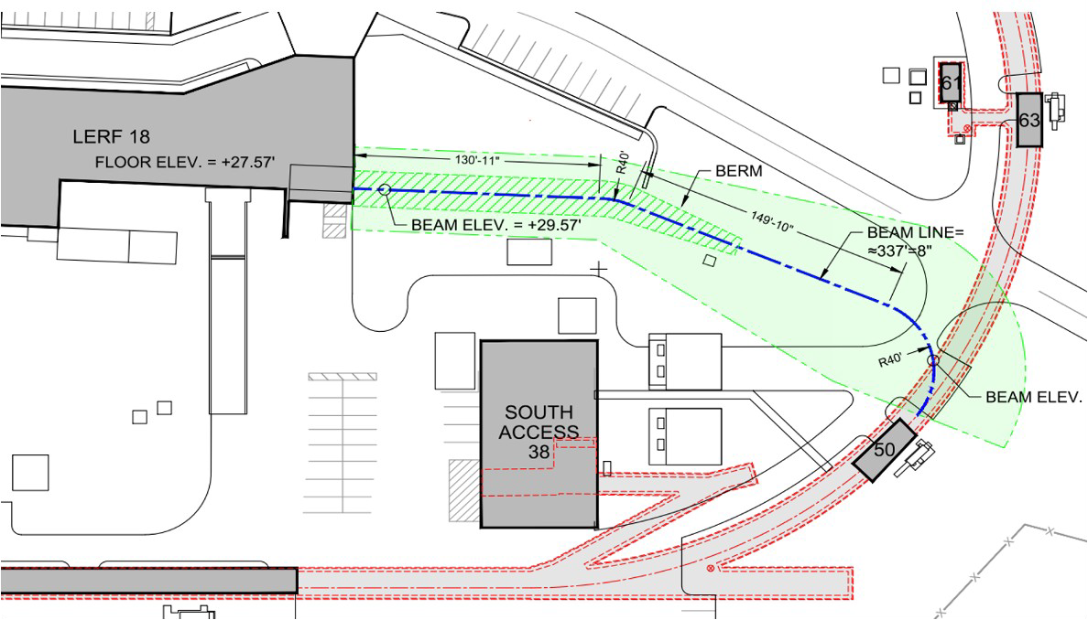
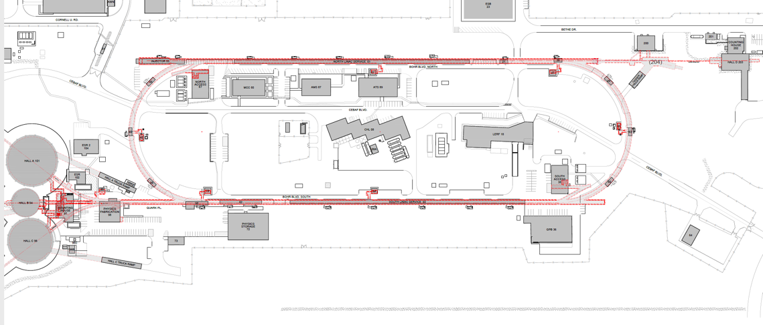
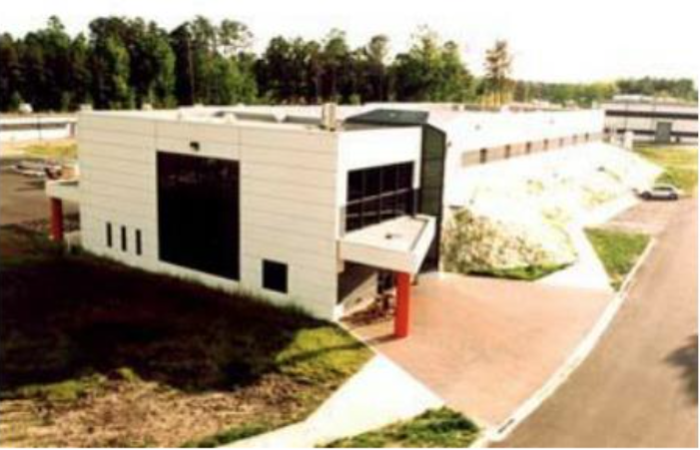
Turning the LERF into a Positron Injector Facility
New Beamline
to CEBAF Tunnel
CEBAF Polarized
Electron Injector
123 MeV e⁺ Beam
Injected to NL
New e⁺ Injector
at LERF
Strategic decision was taken to imagine using former FEL facility, starting with an R&D test bed
123 MeV e⁺
LERF
New Transport Line
along SL and West Arc
LERF – Low Energy Recirculation Facility

Slide 5
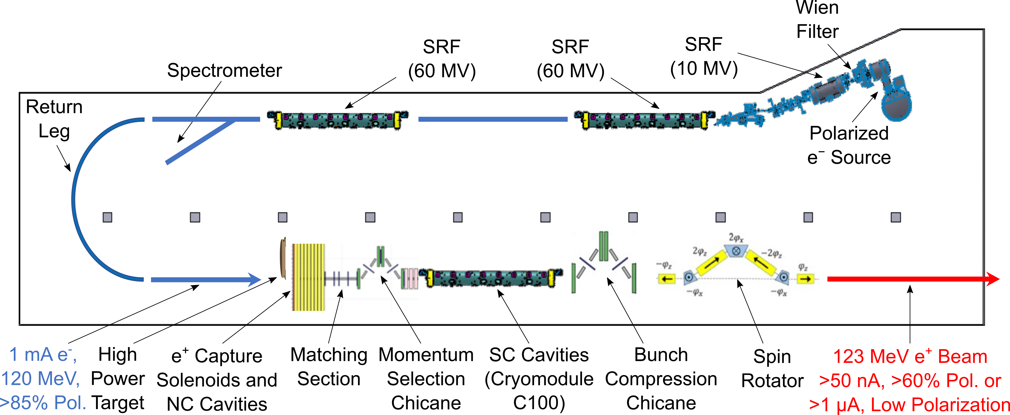
LERF Polarized Positron Injector Concept
Conceptual Development
  Improve design of positron injector
  Develop pCDR
Address Critical Risk Areas
  mA polarized e⁻ source
  High power target
  CW capture cavity

Slide 6
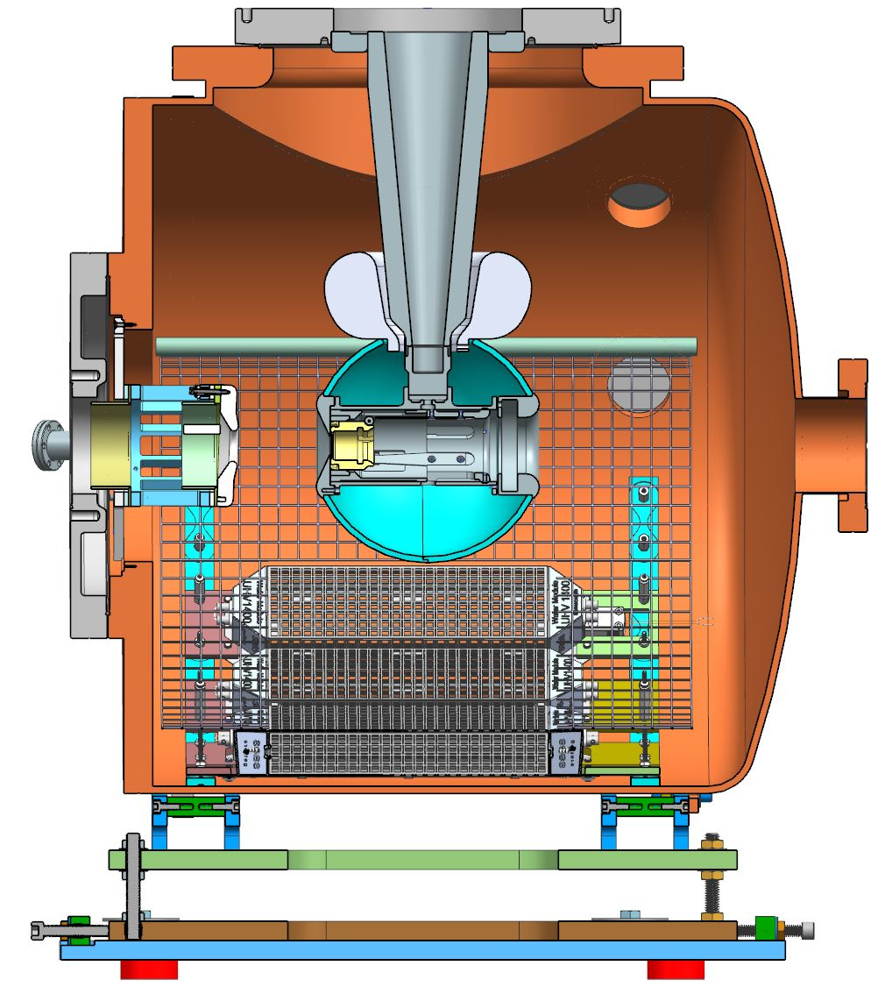
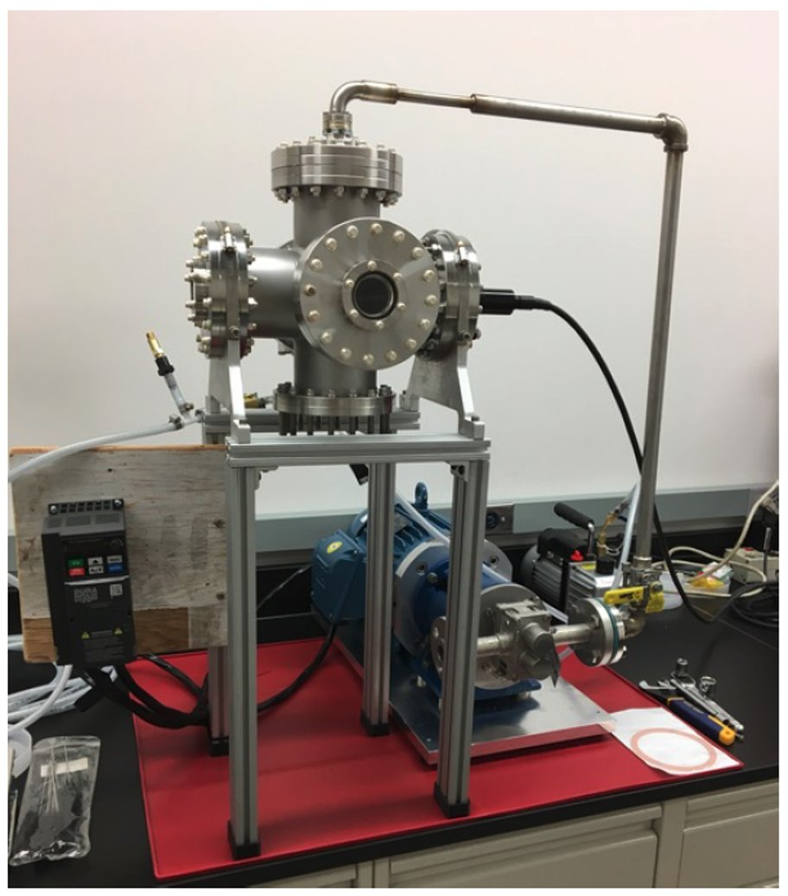
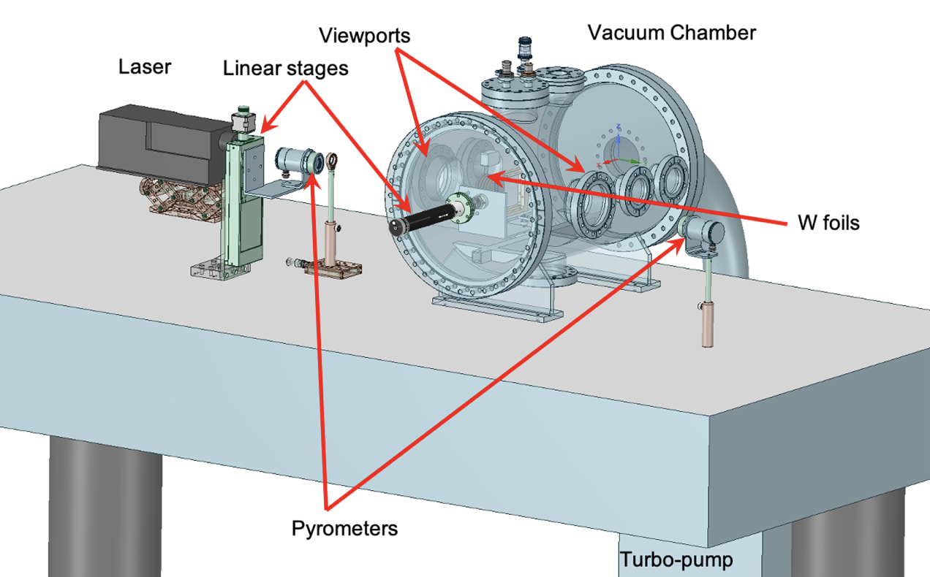

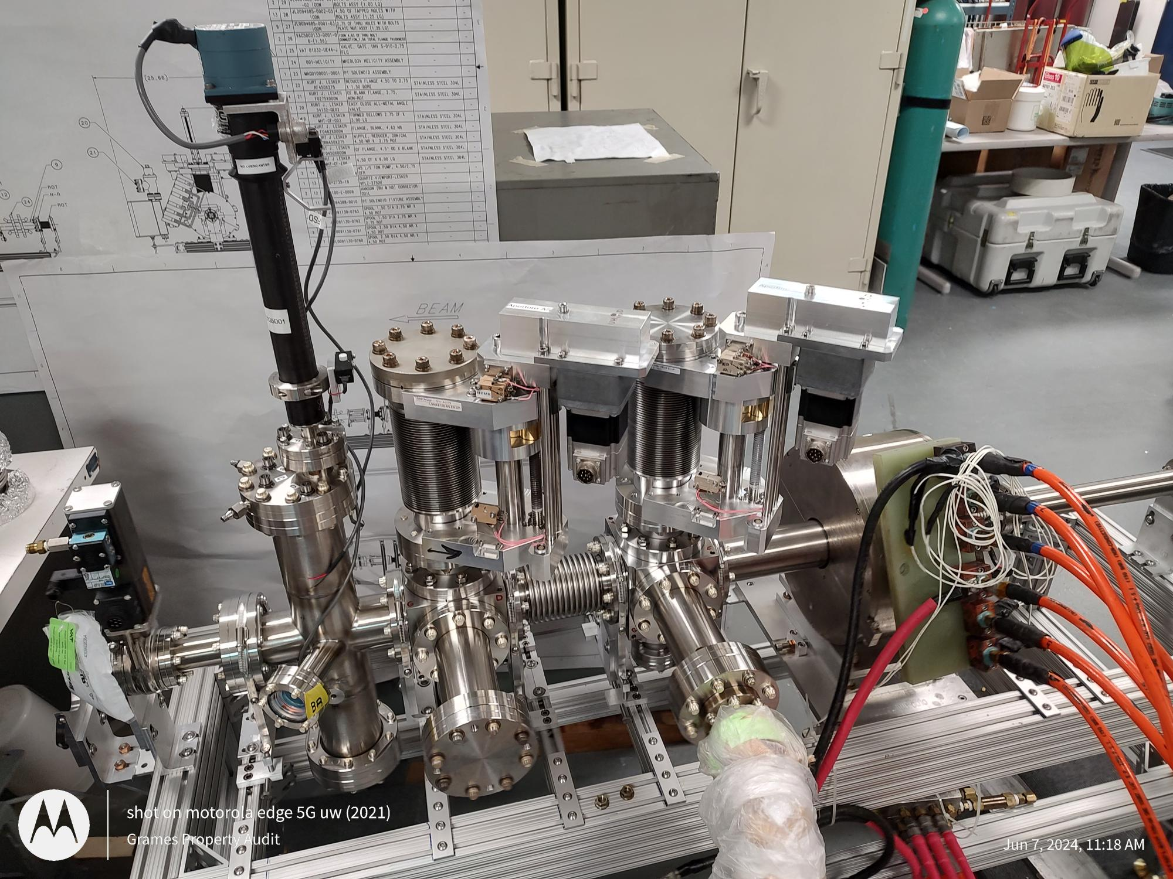
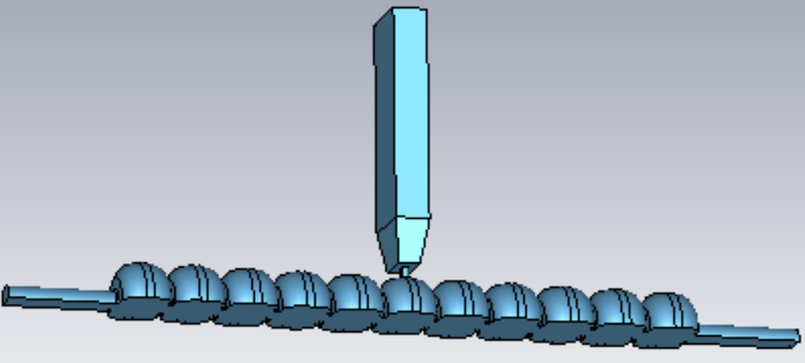
Ce⁺BAF Positron Activities
JLab LDRD Proposal
demonstrate mA e⁻ source
DOE SBIR Phase2
test GaInSn jet target
DOE NP Proposal
test prototype W target
JLab LDRD
measure CEBAF acceptance
Silviu Covrig Dusa
“CFD simulations of high power positron converter targets”,
Session: Sources,
Jul 10, 2024, 9:20 AM
Shaoheng Wang et al.
“Capture cavities for the CW polarized positron source Ce⁺BAF”,
Session: Normal conducting RF,
Jul 10, 2024, 9:00 AM
DOE HEP Proposal
prototype capture cavity

Slide 7
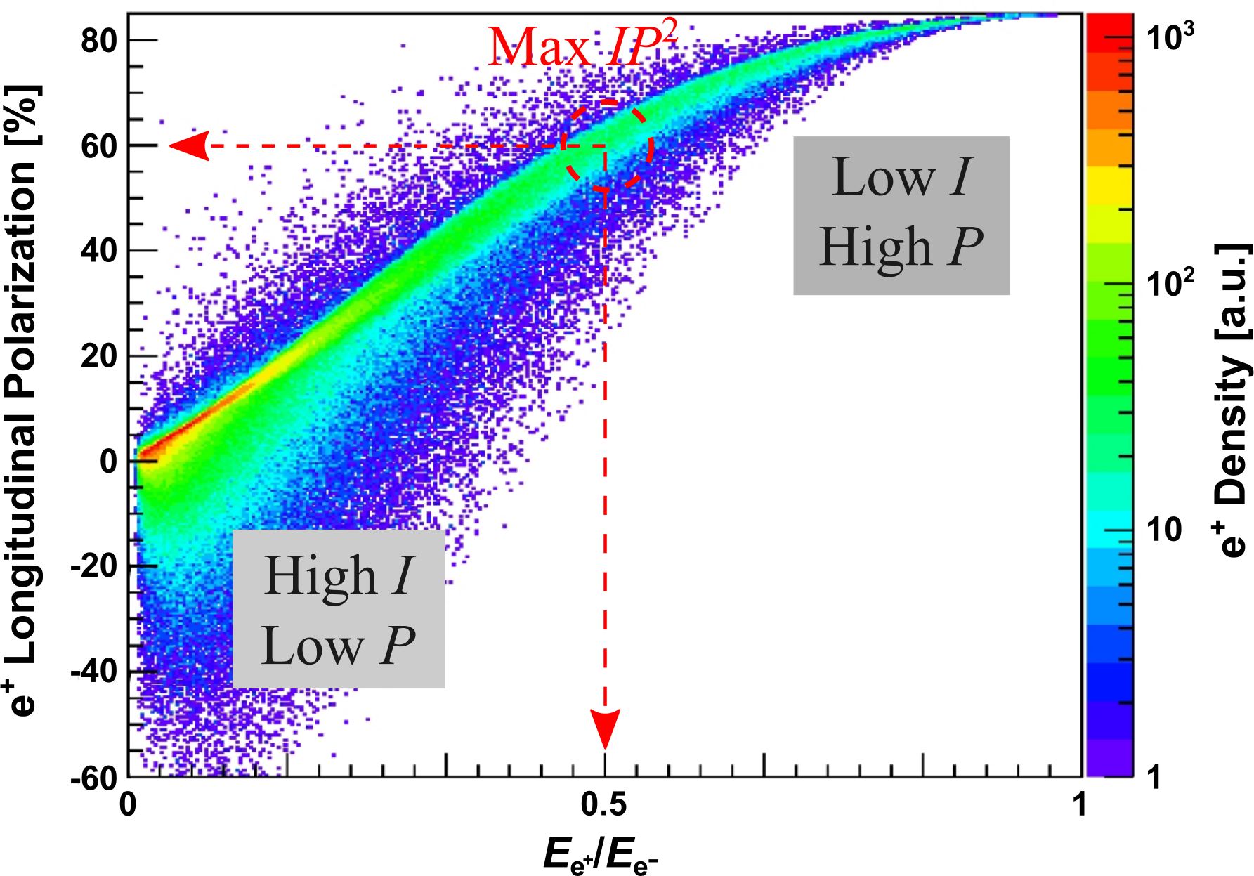
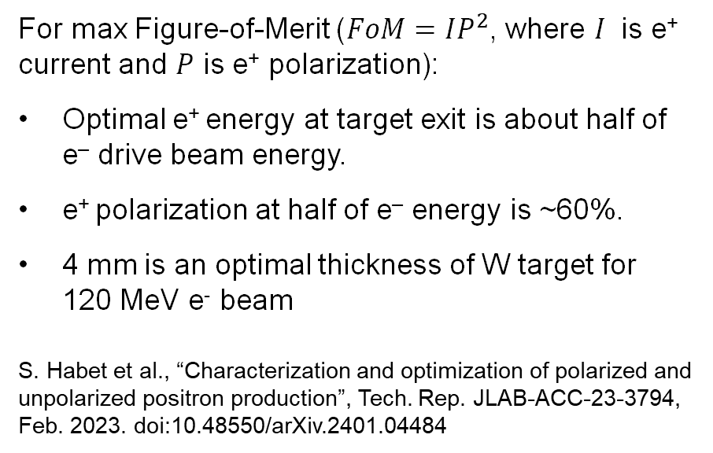
Selection of e⁺ Energy at Target Exit and Thickness of Tungsten Target
e⁺ Polarization vs Energy at Target Exit
For max Figure-of-Merit ($FoM=IP^{2}$, where $I$ is e⁺ current and $P$ is e⁺ polarization):
Optimal e⁺ energy at target exit is about half of e‒ drive beam energy.
e⁺ polarization at half of e‒ energy is ~60%.
4 mm is an optimal thickness of W target for
120 MeV e⁻ beam
S. Habet et al., “Characterization and optimization of polarized and unpolarized positron production”, Tech. Rep. JLAB-ACC-23-3794, Feb. 2023. doi:10.48550/arXiv.2401.04484

Slide 8
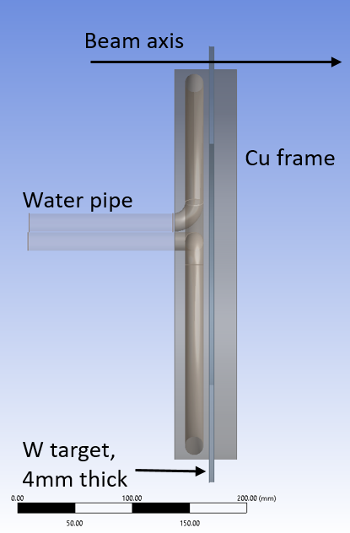
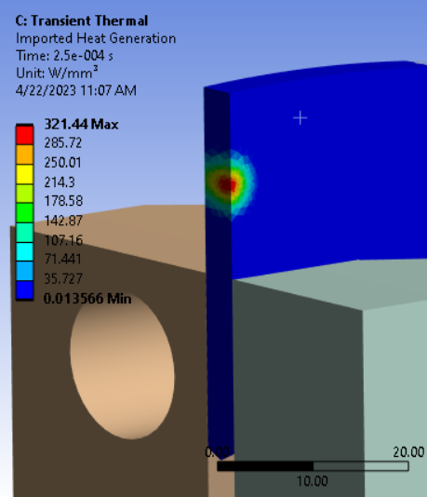
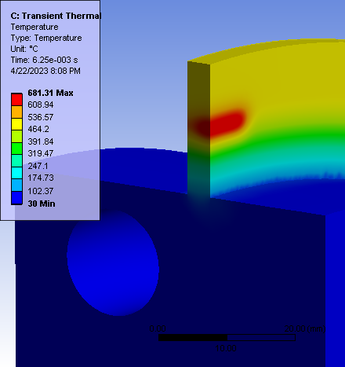
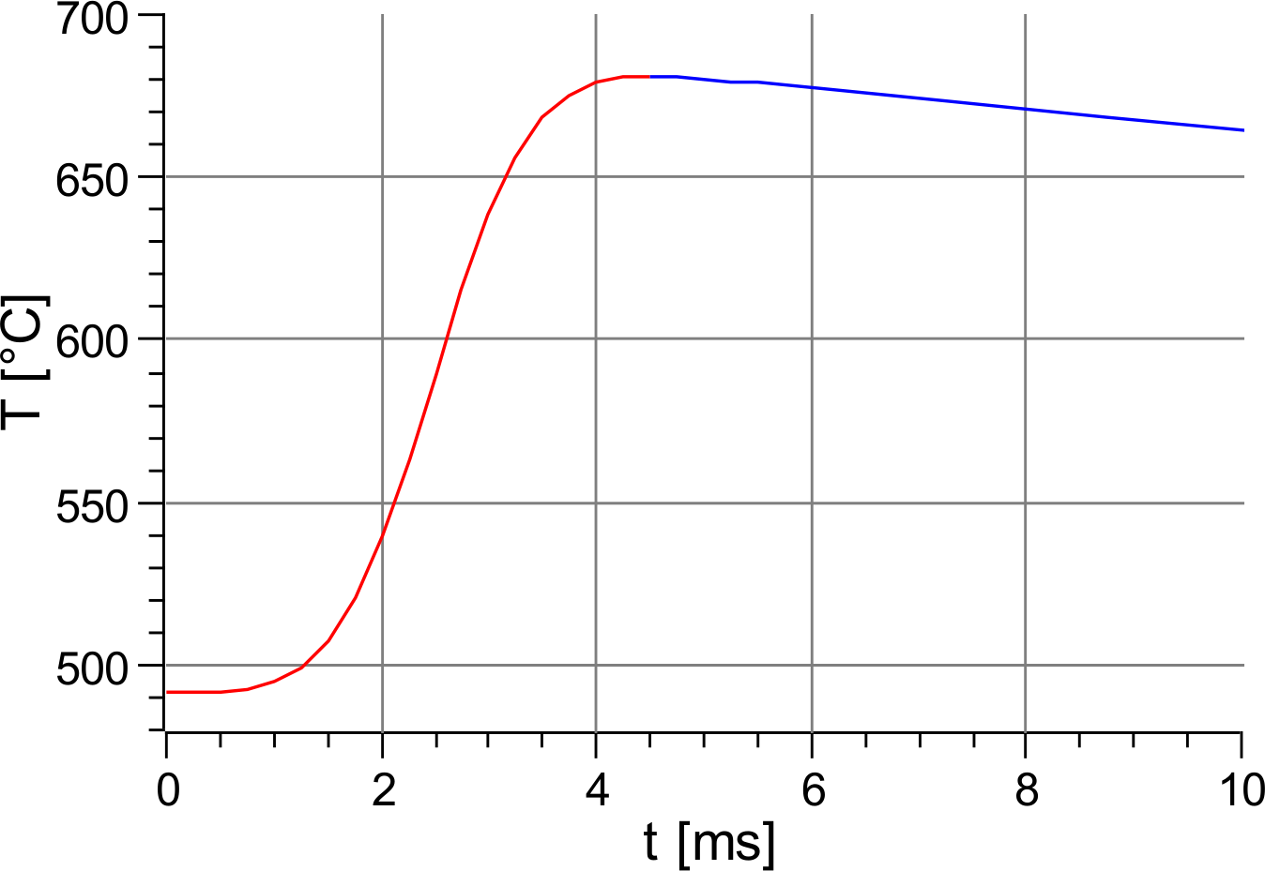
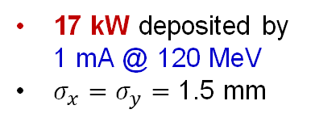
Concept and Challenges of High-Power Target
Target Concept (Side View)
Heat by Beam
Temperature in Rot. Target
A. Ushakov et al., IPAC’23, WEPM120
Cycling Temperature
Some parameters of currently considered high-power e⁺ target:
~40 cm target diameter
2 Hz rot. frequency
8 mm radius of water channel
0.3 kg/s water mass flow (1.5 m/s)
Target Challenges:
High power deposited by beam → cool and rotate
Radiation damage → rotate
Material fatigue cause by cycling temperature → study material properties under realistic conditions
17 kW deposited by 1 mA @ 120 MeV
$σ_{x}=σ_{y}=$ 1.5 mm

Slide 9
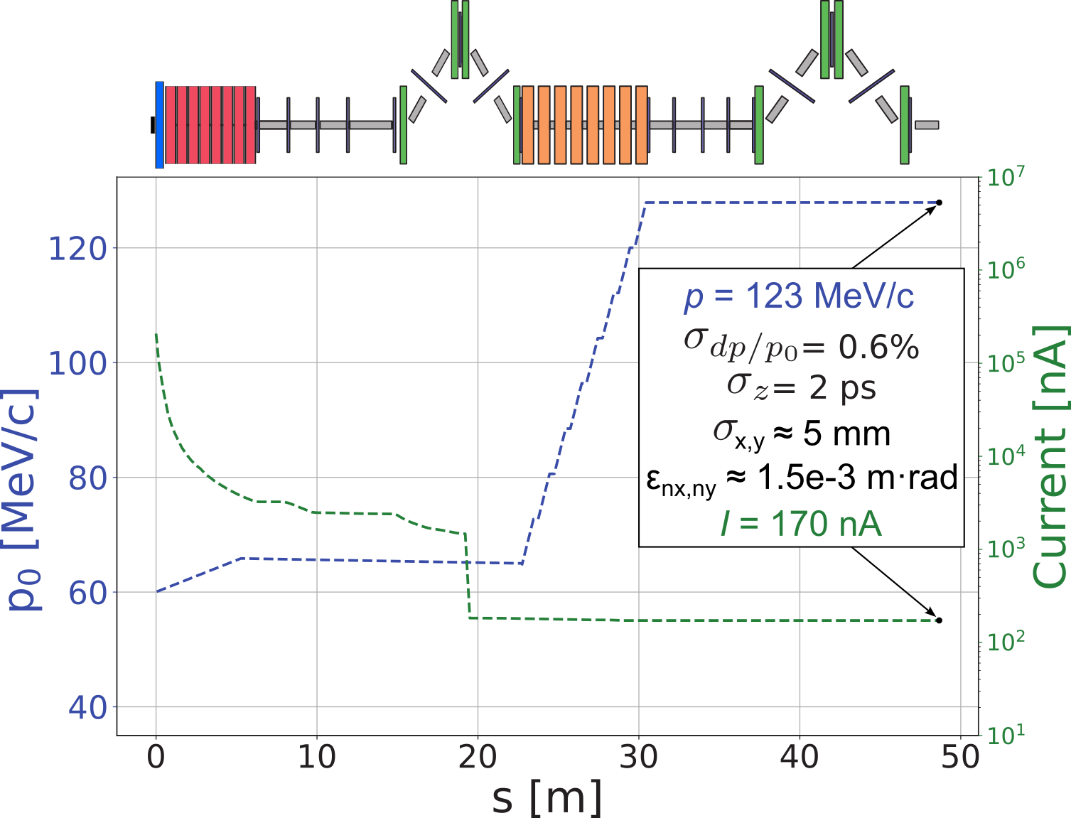
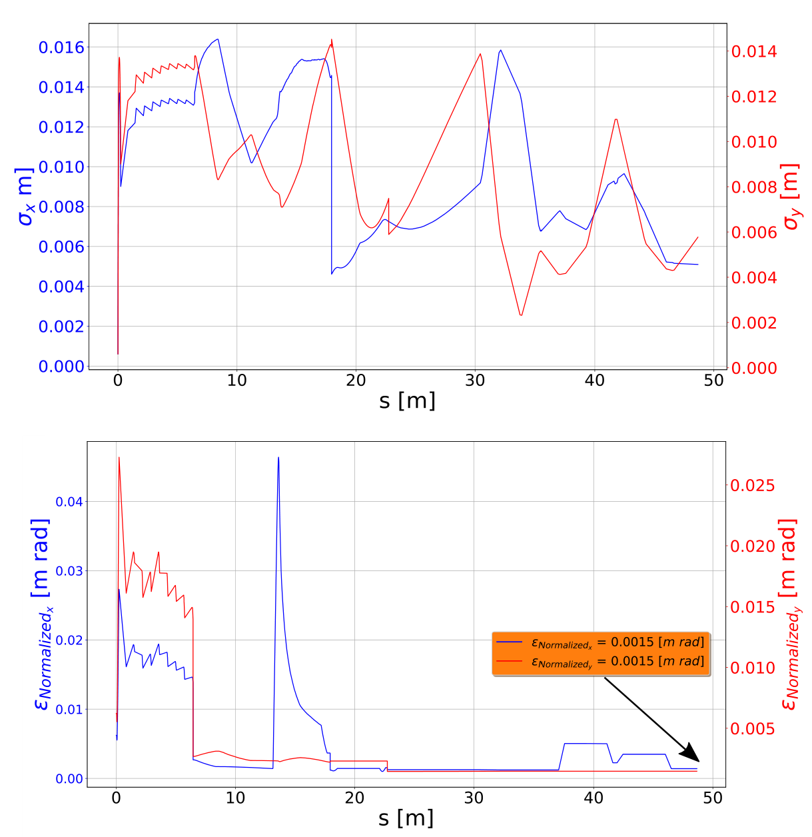
Simplified Model of Beam Line and e⁺ Beam Parameters in Polarized Mode
e⁺ Current and Energy along Beam Line
(S. Habet, PhD Thesis, Dec. 2023)
e⁺ Bunch Size and Emittance along Beam Line
(S. Habet, PhD Thesis, Dec. 2023)
Quarter-Wave Transformer (QWT) – 2 solenoids
Polarized mode, 60 MeV @ target:
B₁ = 2.5 T, L₁ = 25 cm, B₂ = 0.05 T, L₂ = 6 m
Unpolarized mode, 19 MeV @ target:
B₁ = 1.3 T, L₁ = 25 cm, B₂ = 0.05 T, L₂ = 6 m

Slide 10
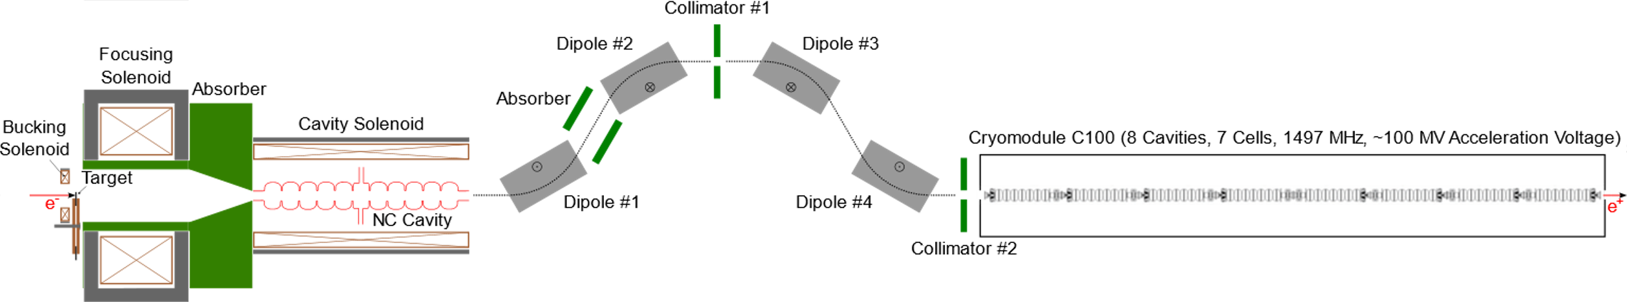
Modeling Positron Injector in FLUKA and General Particle Tracer (GPT)
EM Fields
3D magnetic fields of solenoids - OPERA, CST
NC SW Cavity - Advanced Computational Electromagnetics Code Suite (ACE3P)
SC Cavities - CST
FLUKA
Simulations of all particle in target, capture solenoid and NC cavity
GPT
Positron production in 4 mm thick tungsten target by 1 mA @ 120 MeV e⁻ was calculated in Geant4 and imported to GPT at target exit
Positrons are tracked up to end of C100 cryomodule

Slide 11
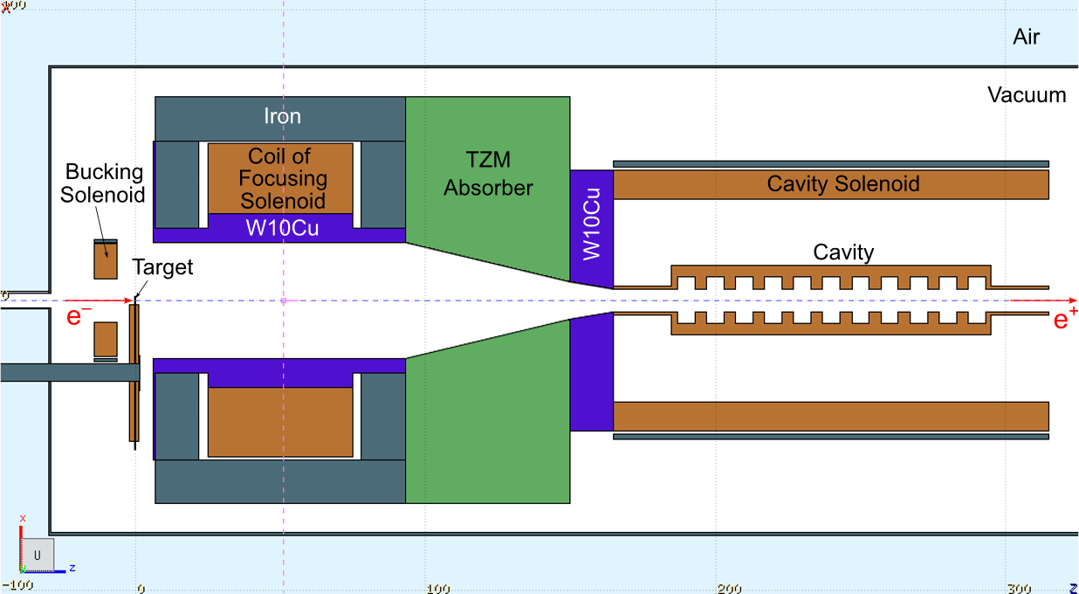
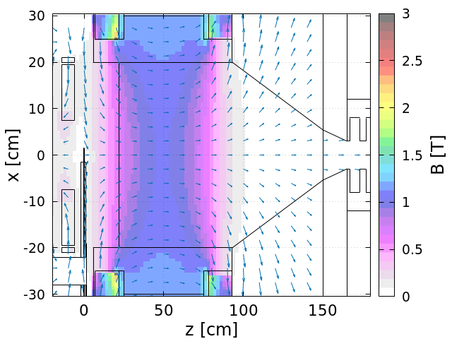
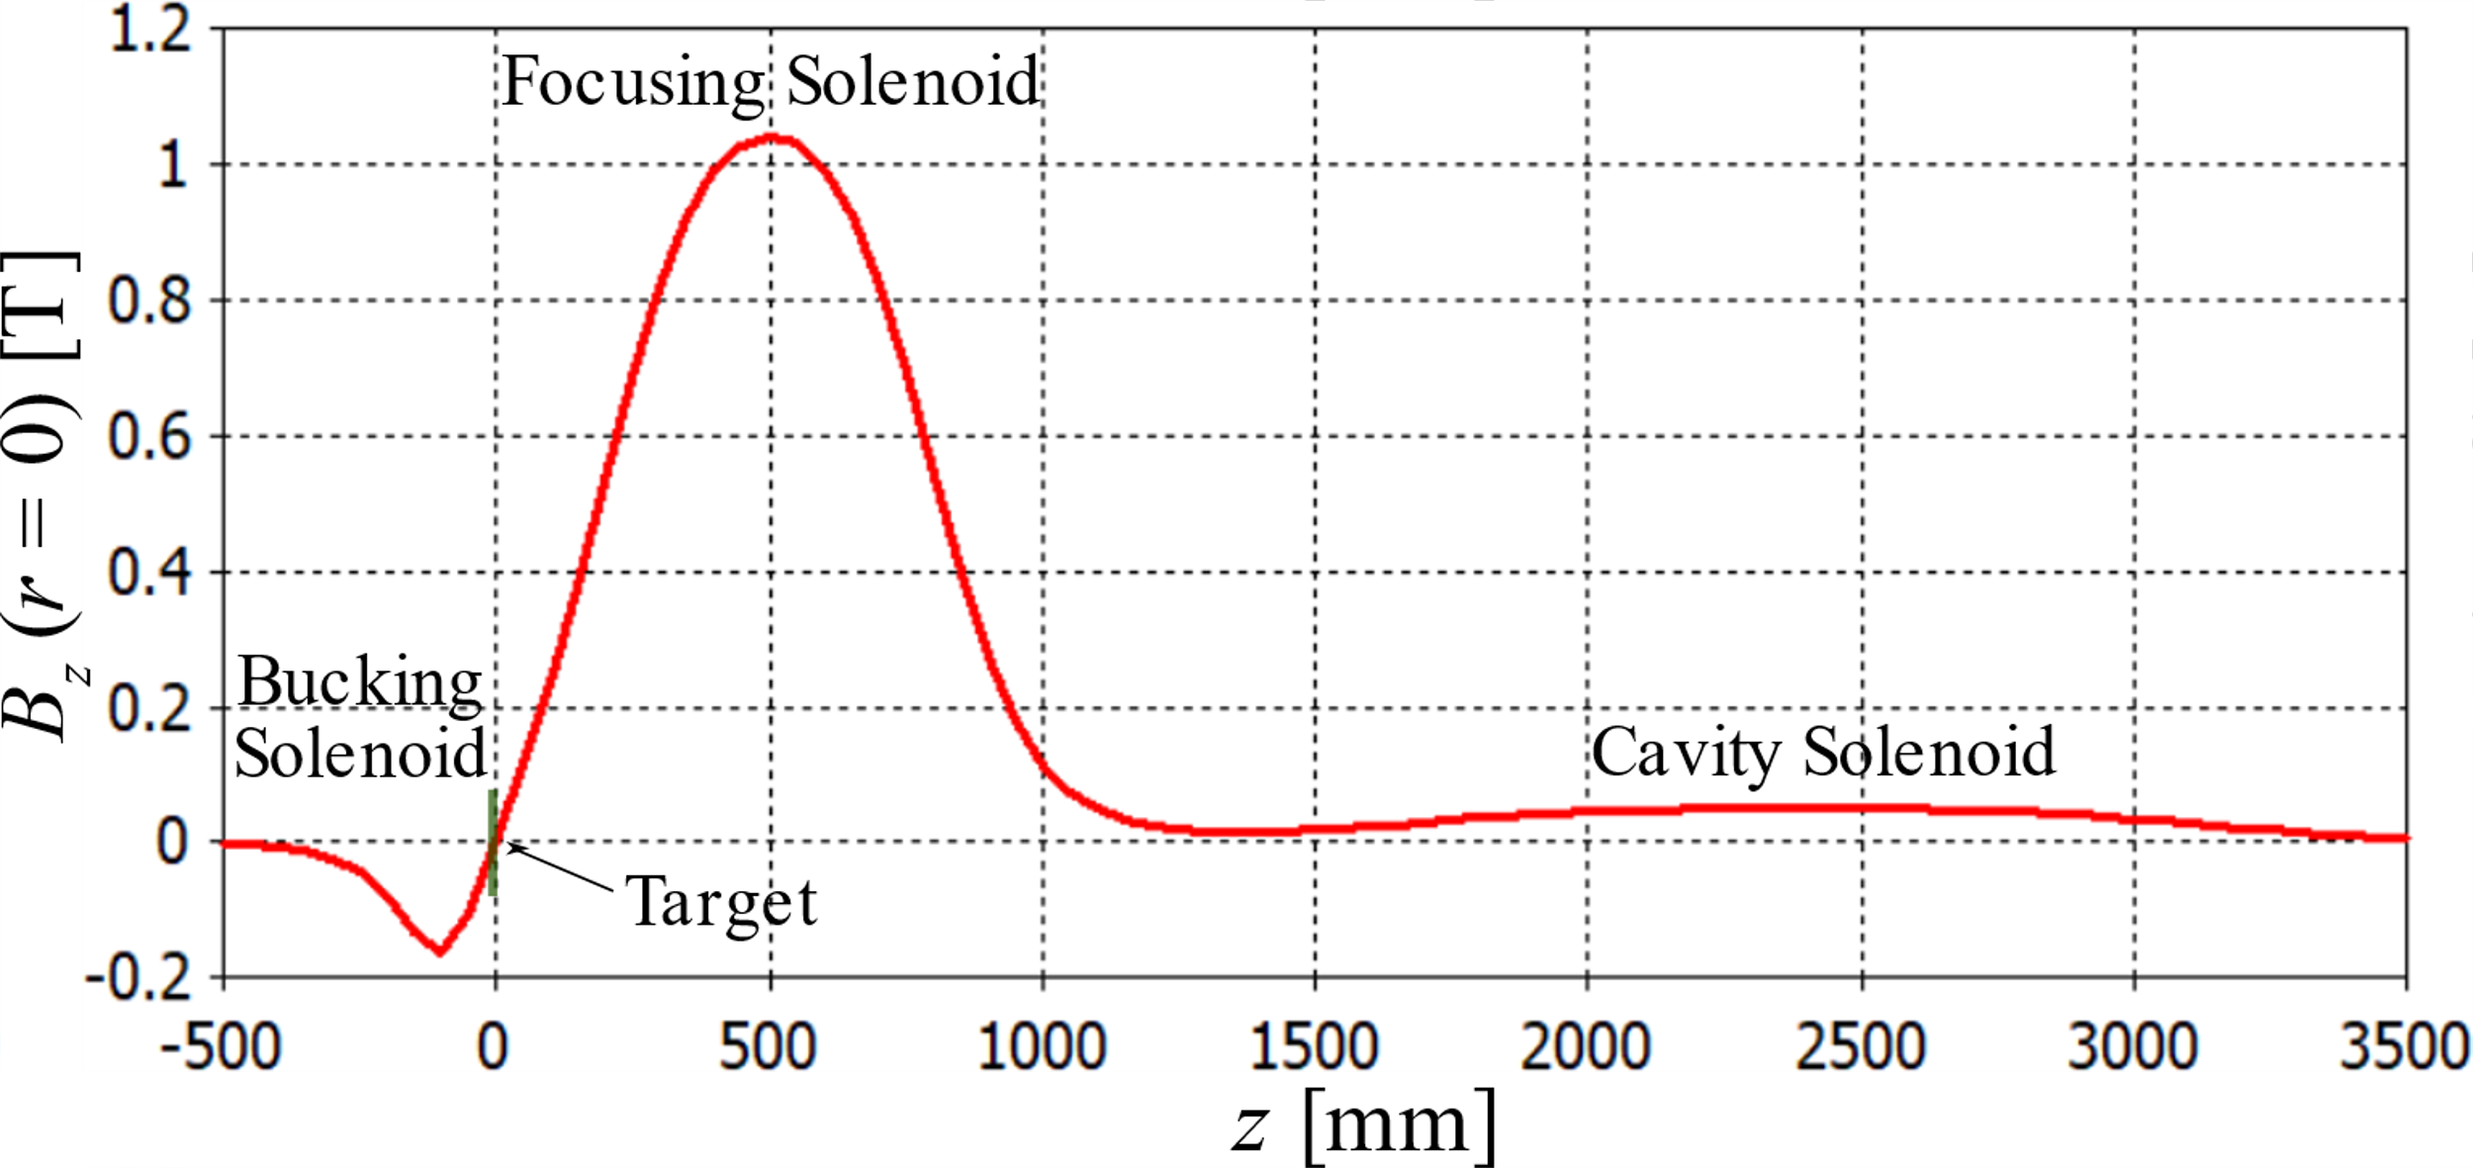
Model with Compensation Solenoid and Cavities
Geometry (FLUKA)
Bucking
Solenoid
Main Solenoid
Absorbers
Target
e⁺
Cavity
Same 14 mm square Cu conductor
(15 mm square including insulator)
with 11 mm hole
for both main and bucking
solenoids
j ≈ 446 A/cm²
B_{max}(r = 0) = 1.03 T
Water flow:
~500 cc/sec, 18 bar
Conductor of bucking sol.:
L = 8 cm
R_{in} = 7.5 cm
R_{out} = 19.5 cm
Conductor of main sol.:
L = 50 cm
R_{in} = 30 cm
R_{out} = 54 cm

Slide 12
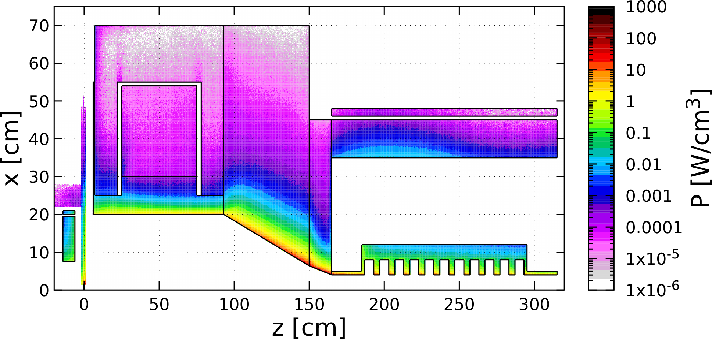
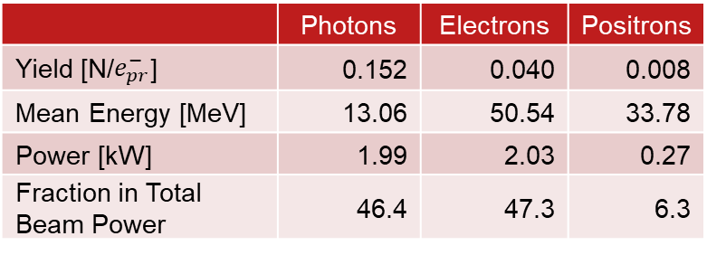
Distribution of Power Deposited by 1 mA @ 120 MeV e‒ Beam (FLUKA)
 | Power [kW]
Target | 18.32
Compensation Solenoid | 0.74
Coil of Main Solenoid | 0.02
Iron of Main Solenoid | 0.07
W10Cu Absorber inside Main Solenoid | 18.68
TZM Absorber (99.4% Mo, 0.5% Ti, 0.1% Zr) | 54.96
W10Cu Absorber upstream Cavities | 12.61
Solenoid around Cavity | 0.62
Cu Cavities | 6.50
Total Absorbed Power | 115.12 (96%)
Power of γ, e‒, e⁺ at z = 315 cm | 4.29
Steel
TZM
Cu Coil
Cu Coil
W10Cu
W10Cu
Cu Cavity*
Compensation
Solenoid
Target
A. Ushakov et al., IPAC’24, MOPC54
Mechanical design and simulations of temperature,
thermal stress, radiation damage and
optimization of whole e⁺ capture system
have to be done / will be continued
 | Photons | Electrons | Positrons
Yield [N/$e_{pr}^{−}$] | 0.152 | 0.040 | 0.008
Mean Energy [MeV] | 13.06 | 50.54 | 33.78
Power [kW] | 1.99 | 2.03 | 0.27
Fraction in Total Beam Power | 46.4 | 47.3 | 6.3
* FLUKA model does not have E-field in cavity

Slide 13
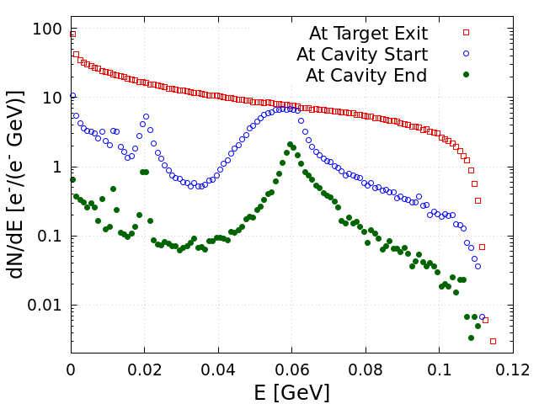
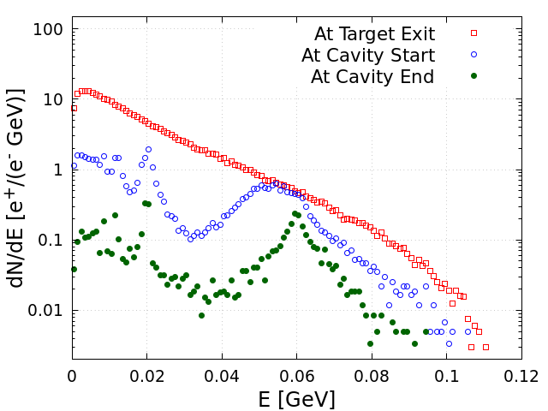
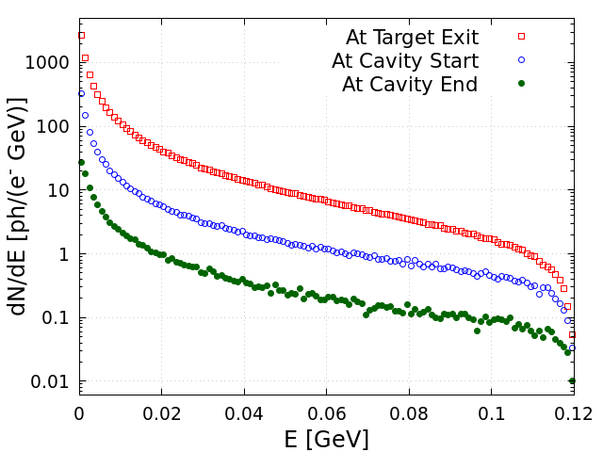
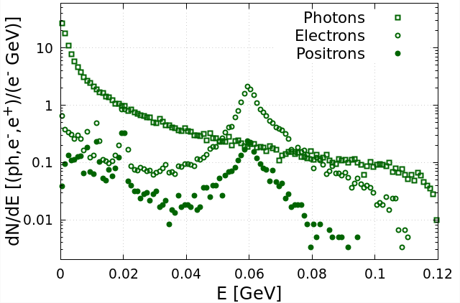
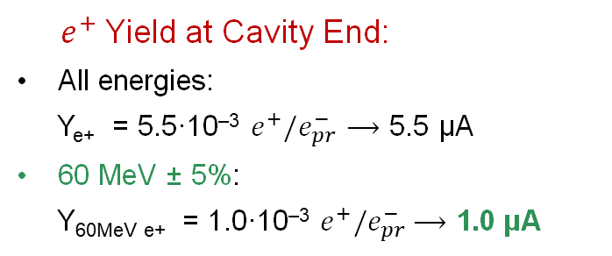
Energy Distributions of e‒, e⁺ and γ at Different Z-Positions (FLUKA)
Electrons
Positrons
Photons
At Cavity End
will be removed by forward dump
will be deflected by dipole
and dumped
${ e}^{+}$Yield at Cavity End:
All energies:
Y_{e+} = 5.5·10^{‒3} $e^{+}/e_{pr}^{−}⟶$ 5.5 µA
60 MeV ± 5%:
Y_{60MeV e+} = 1.0·10^{‒3} $e^{+}/e_{pr}^{−}$ $⟶$ 1.0 µA

Slide 14
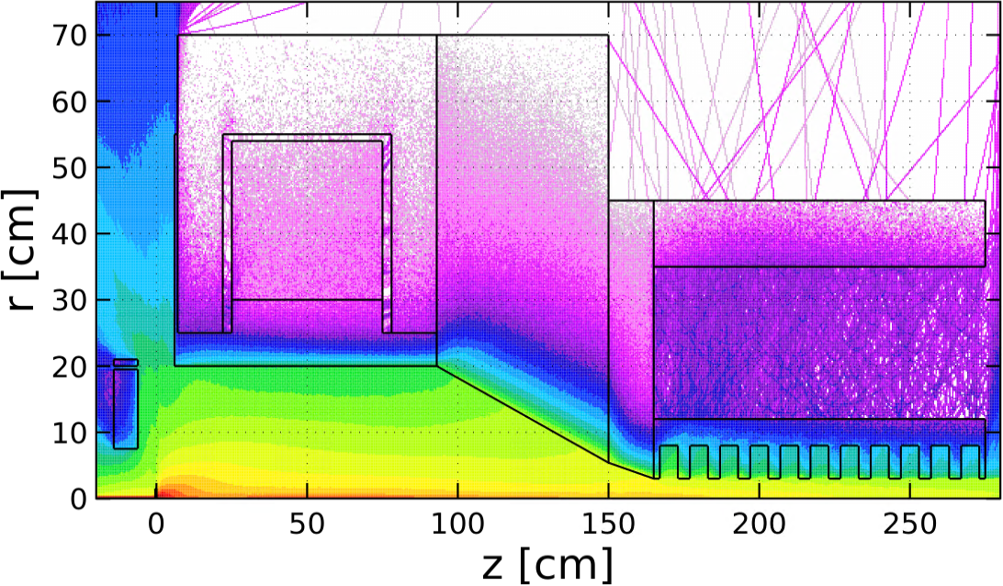
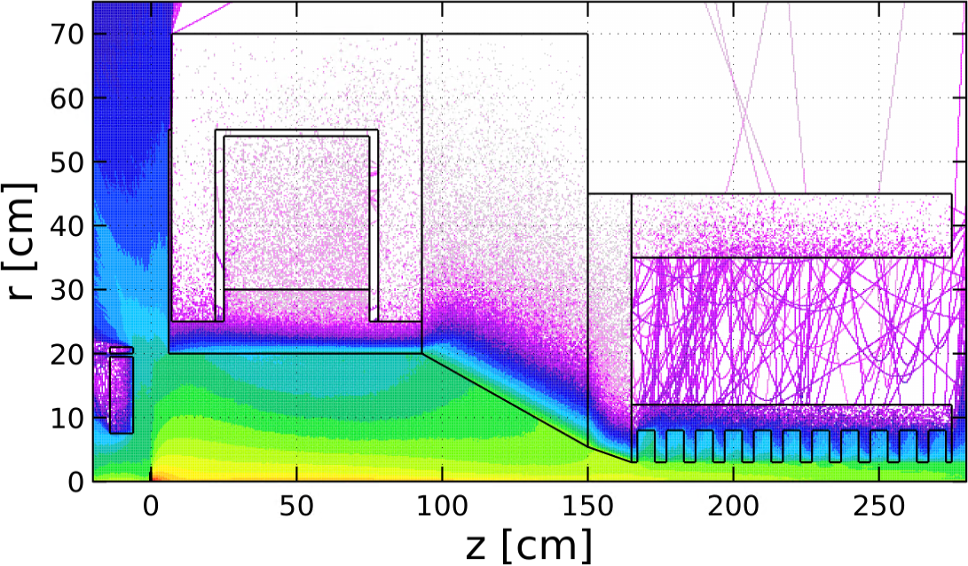
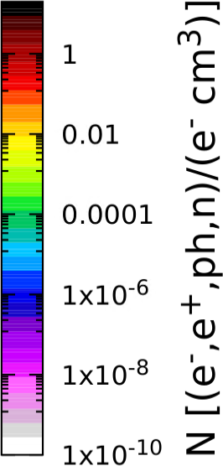
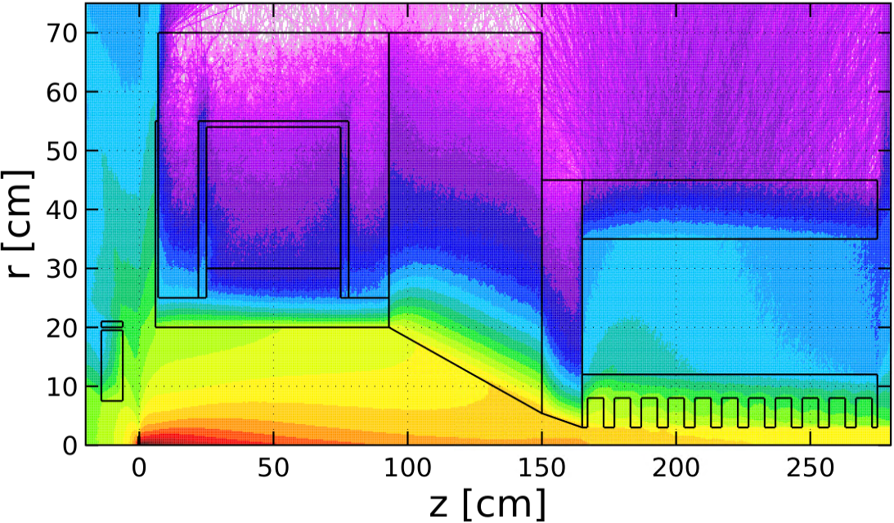
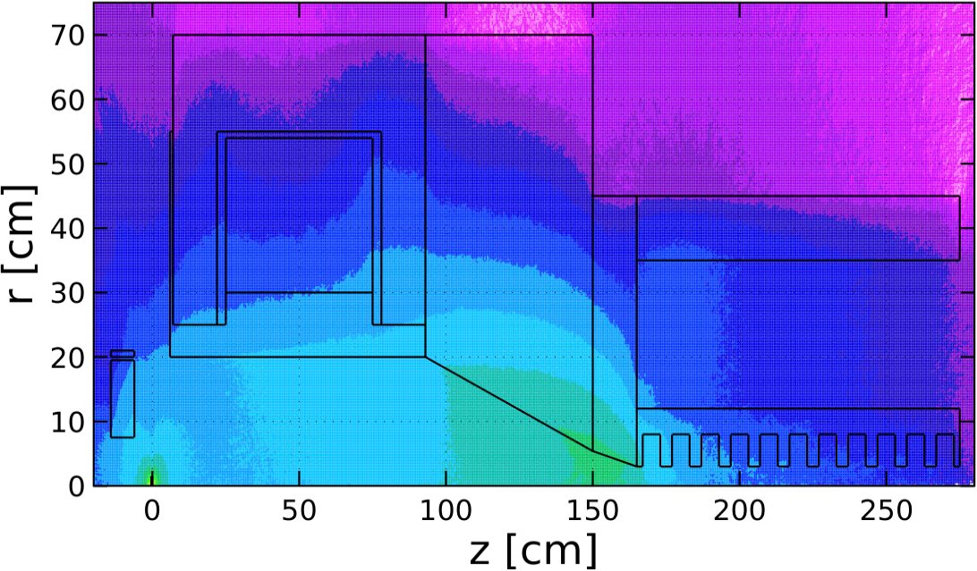
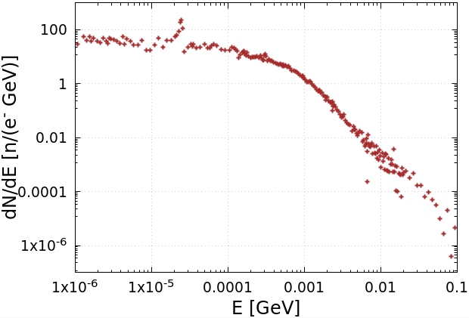


Spatial Distributions of e‒, e⁺, γ and n. Neutron Energy and Yield (FLUKA)
Electrons
Positrons
We have begun working with the Radiation Control Department on radiation shielding
Photons
Neutrons
Energy Spectrum of Neutrons
Neutron Yield:
$Y_{n}=9.2∙{10}^{−3}$ ${n/e}_{pr}^{−}$
$(5.7∙{10}^{13}$ $n/s)$

Slide 15
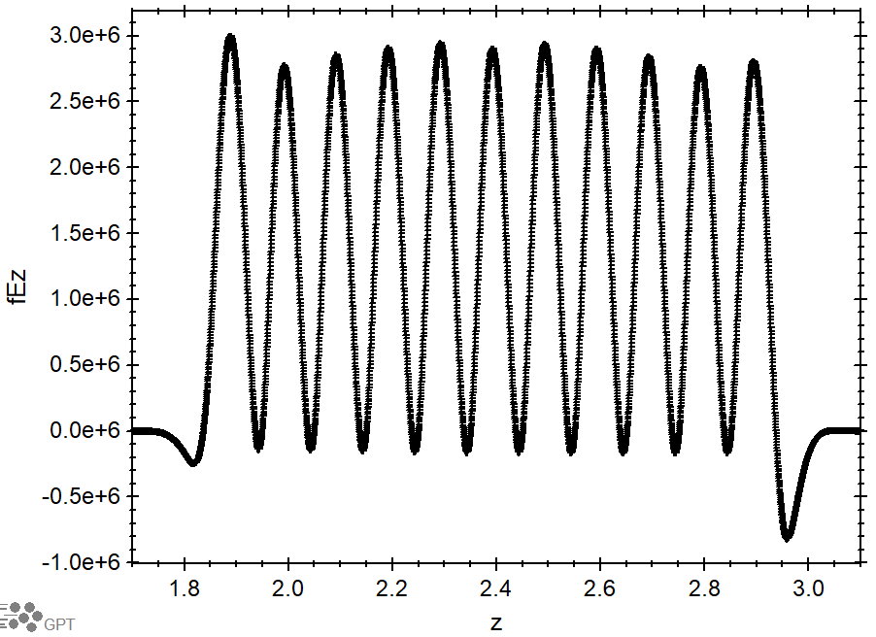
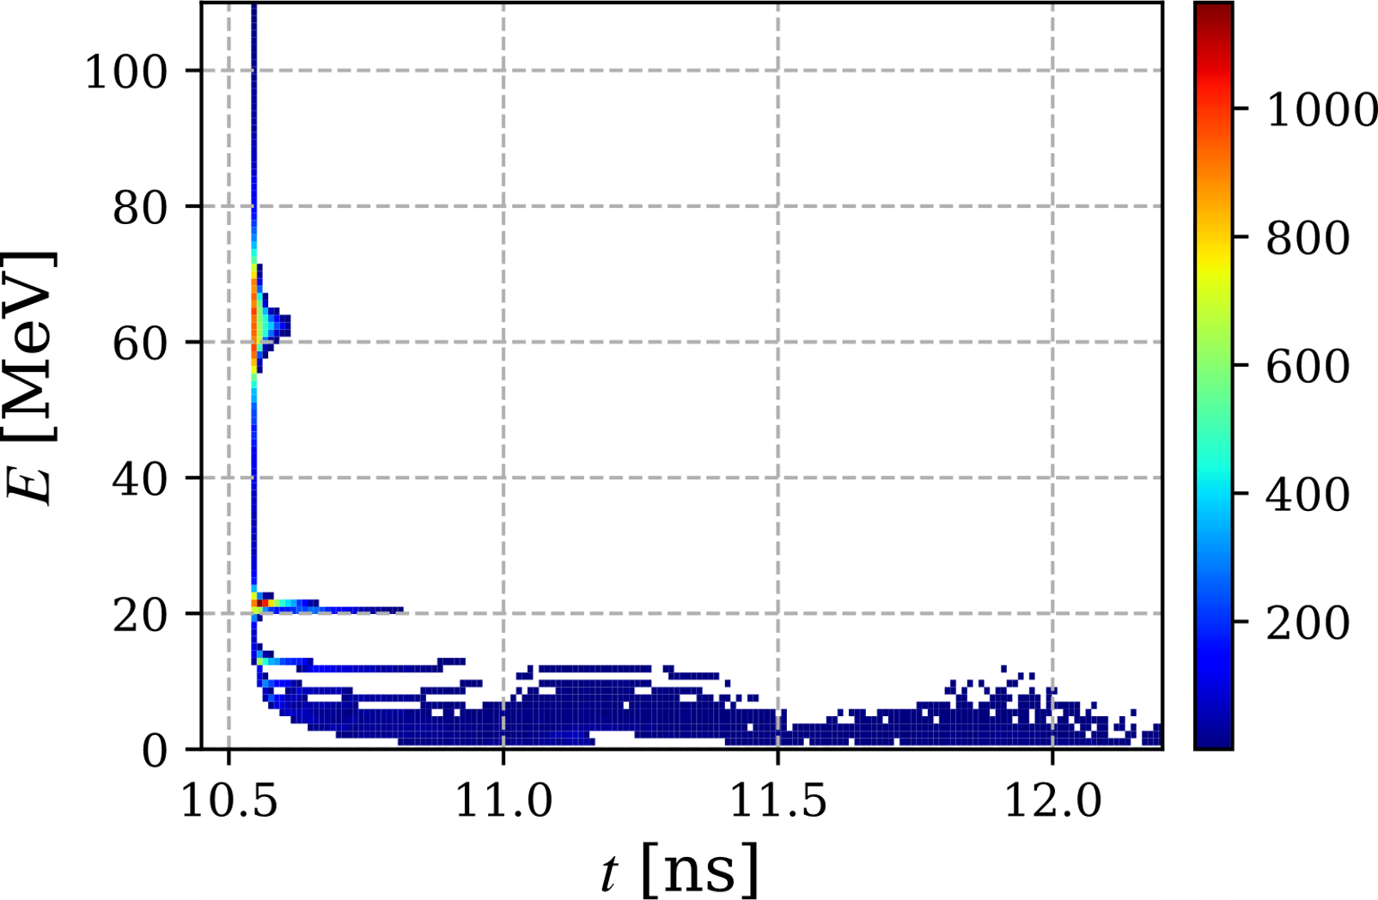
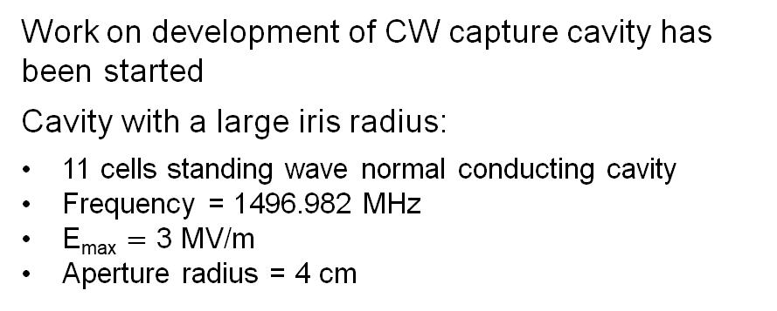
Standing Wave Capture Cavity (Shaoheng Wang)
Work on development of CW capture cavity has been started
Cavity with a large iris radius:
11 cells standing wave normal conducting cavity
Frequency = 1496.982 MHz
E_{max} $=$ 3 MV/m
Aperture radius = 4 cm
Time-Energy Phase Space at Cavity Exit (GPT)
E = 62.5 MeV
|ΔE|/E = 2%
I = 609 nA
σ_{z} = 4.5 mm
ε_{n} = 11.4 mm·rad

Slide 16
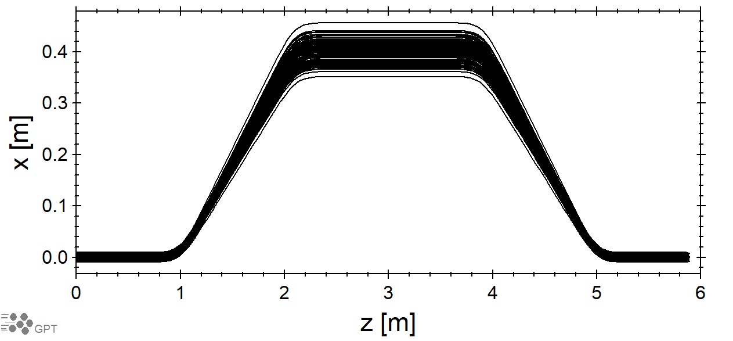
Energy Selection Chicane and SRF Cryomodule C100
Dipoles
Field = 0.34 T
Bending angle = 20°
Angle of entrance/exit pole face = 10°
Gap = 9 cm
First coefficient of fringe fields Enge function
(2/Gap) = 22 m⁻¹
e⁺ Energy = 62.34 MeV (γ = 122)
Bending radius = 61.16 cm
Absorber/Collimators
Δx_{absorber} = 25 cm, length = 1 m
Δx_{col1} = 2.2 cm, length = 10 cm
r_{col2} = 2.0 cm, length = 10 cm
SRF Cryomodule (C100) at the end of chicane
8 cavities, 7 cells, 1497 MHz
Total accelerator length of 8 m
Field adjusted to accelerate e⁺ from ~62 MeV to
123 MeV
Trajectories of e⁺ with γ = 122 and σ_{γ} = 6

Slide 17
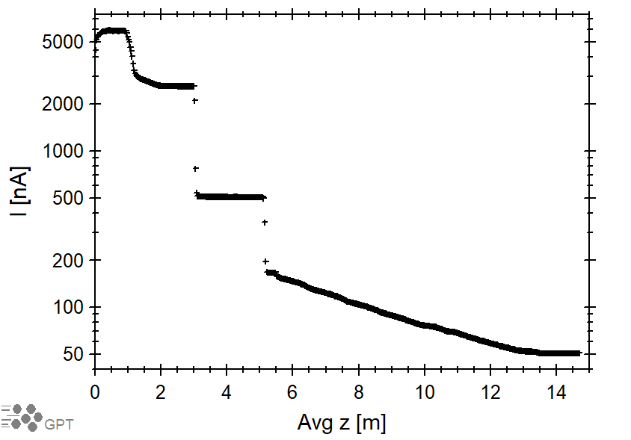
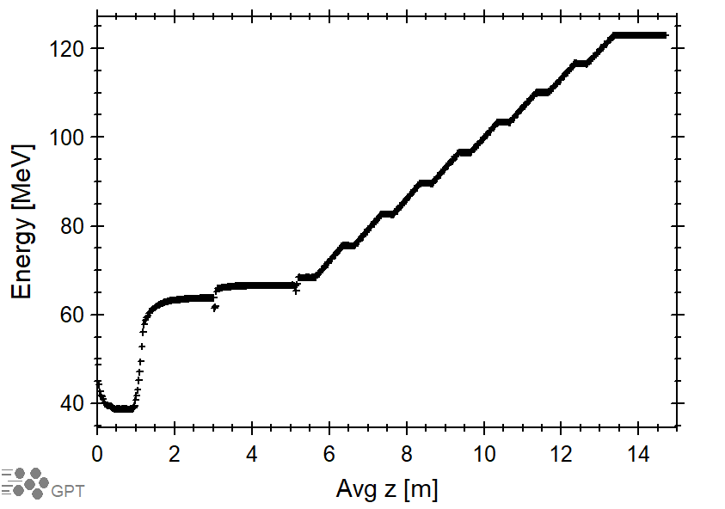
e⁺ Current and Energy vs Z in Chicane and Cryomodule (Preliminary Results)
Positron Current vs Z
Positron Average Energy vs Z
Avg z = 0 is at exit of NC capture cavity

Slide 18
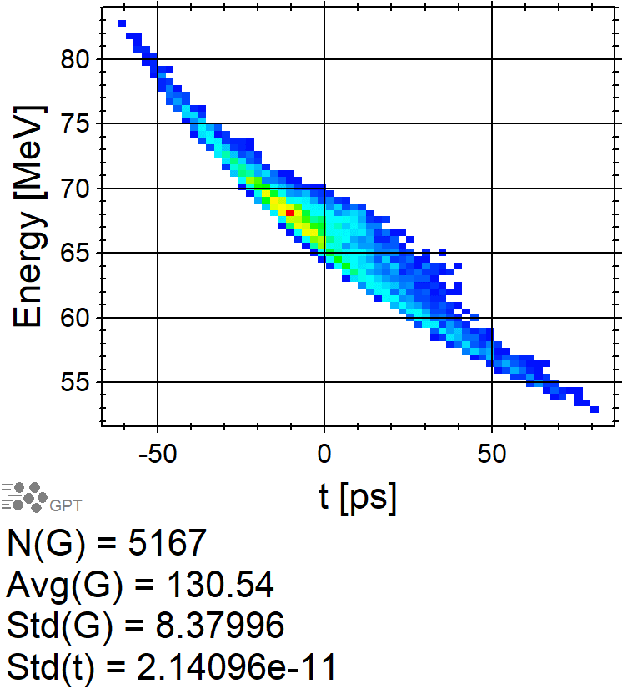
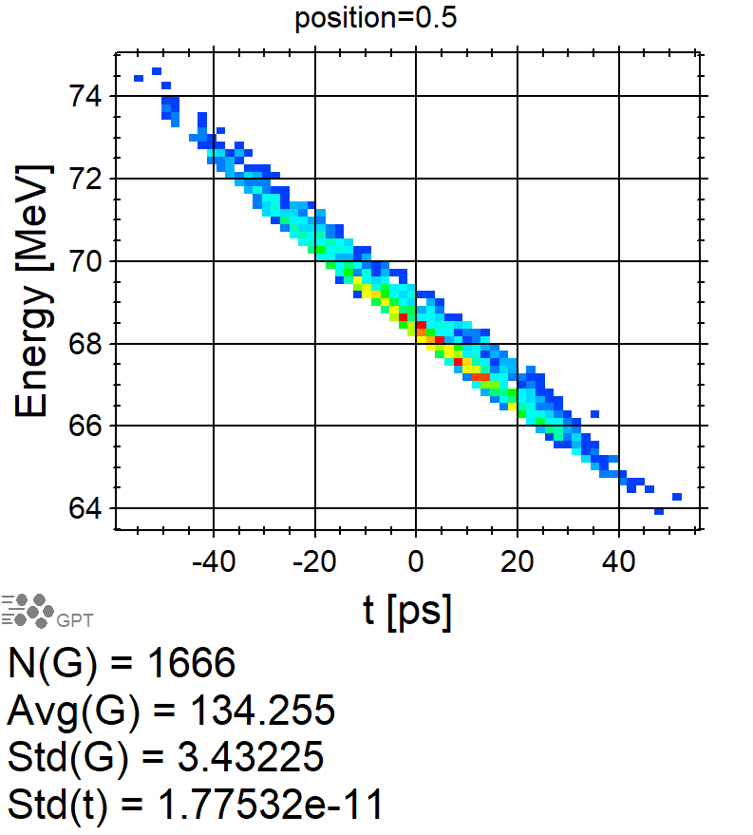
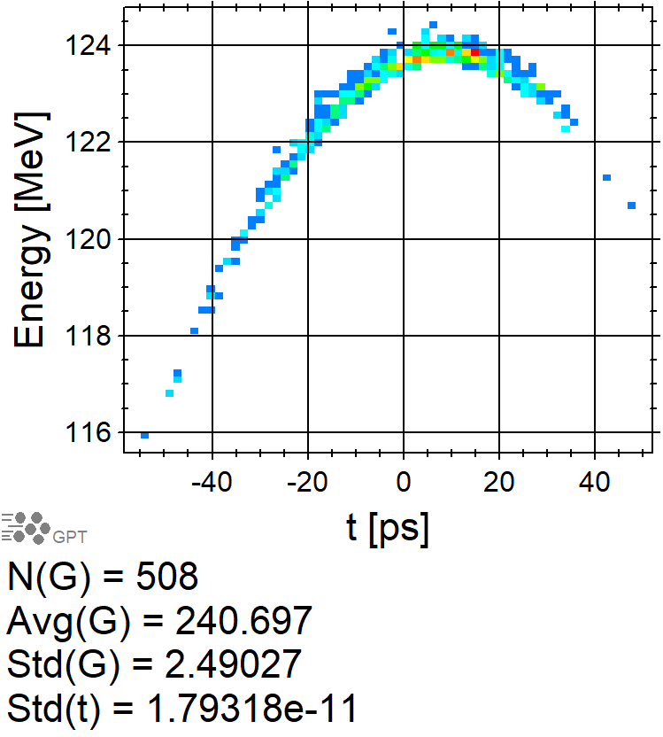
Time-Energy Phase Space after Collimator #1 and before/after Cryomodule
After Collimator #1
At Entrance of C100
At Exit of C100
I = 516.7 nA
I = 166.6 nA
I = 50.8 nA
ΔE/E = 6.4%
ΔE/E = 2.6%
ΔE/E = 1.0%
σ_{t} = 21.4 ps
σ_{t} = 17.75 ps
σ_{t} = 17.9 ps

Slide 19
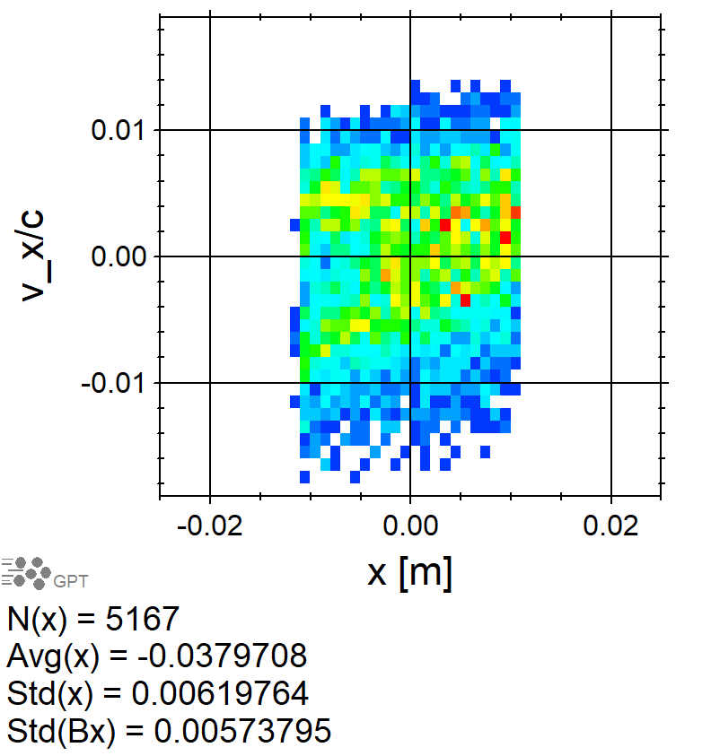
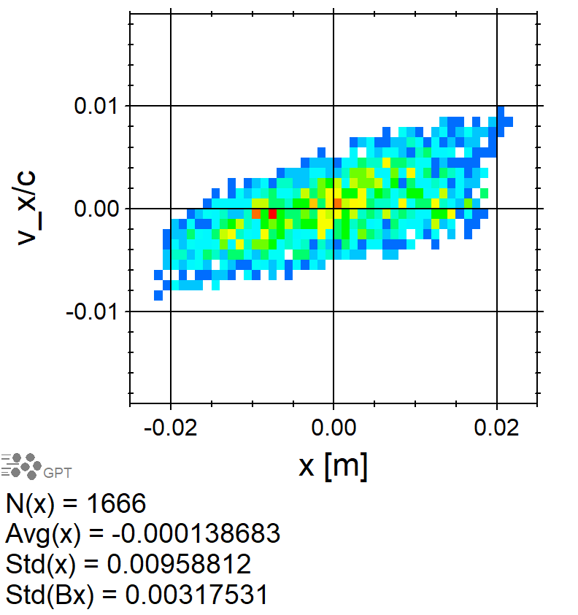
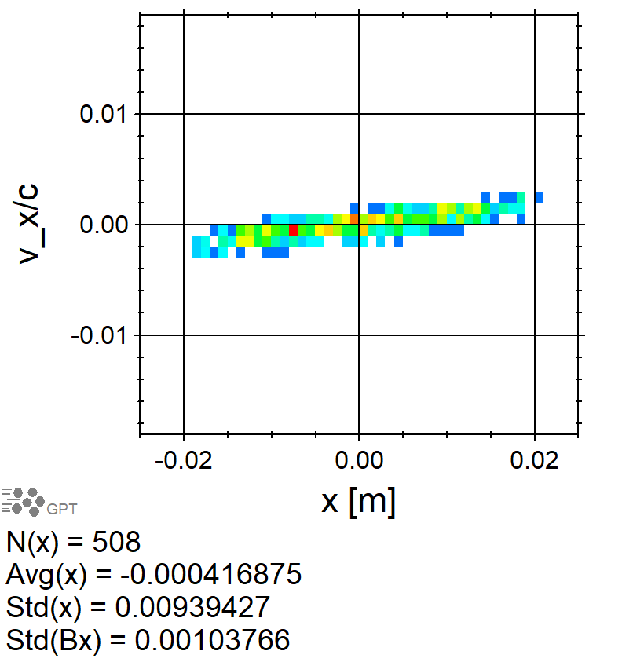
XX’ Phase Space after Collimator #1 and before/after Cryomodule
After Collimator #1
At Entrance of C100
At Exit of C100
ε_{nx} = 1.4 mm·rad
ε_{ny} = 1.8 mm·rad

Slide 20
Summary
We are working on improving the design of the Ce⁺BAF injector concept and critical risk areas:
  mA polarized e⁻ source
  High power target
  CW capture cavity
Current project/proposal:
  Proposal for mA e⁻ source with >85% polarization
  Test prototype tungsten target
  Test liquid metal target (Xelera)
  Development of normal conducting CW capture cavity
  Measure CEBAF acceptance
Improving simulation model by using more realistic geometries and fields of e⁺ injector components

Slide 21












Acknowledgments
We would like to acknowledge members of the Ce⁺BAF Working Group, the Jefferson Lab Positron Working Group, the DOE industry partner Xelera, members of the DOE US-Japan HEP Collaboration, and collaborators at Universities and National Labs which contribute to the positron R&D effort.
T. Abe, J. Benesch, A. Bogacz, L. Cardman, J. Conway, S. Covrig, P. Degtiarenko, Y. Enomoto,
S. Gessner, P. Ghoshal, S. Gopinath, J. Grames, J. Gubeli, S. Habet, C. Hernandez-Garcia, D. Higinbotham,
A. Hofler, R. Kazimi, M. Kostin, F. Lin, V. Kostroun, V. Lizarraga-Rubio, K. Mahler, Y. Morikawa, S. Nagaitsev,
E. Nanni, M. Poelker, N. Raut, B. Rimmer, Y. Roblin, A. Seryi, K. Smolenski, M. Spata, R. Suleiman,
A. Sy, D. Turner, C. Valerio-Lizarraga, E. Voutier, M. Yamamoto, S. Zhang

Slide 22
Invite you to join us at Jefferson Lab in September.
Thank you.

Slide 23
Backup Slides

Slide 24
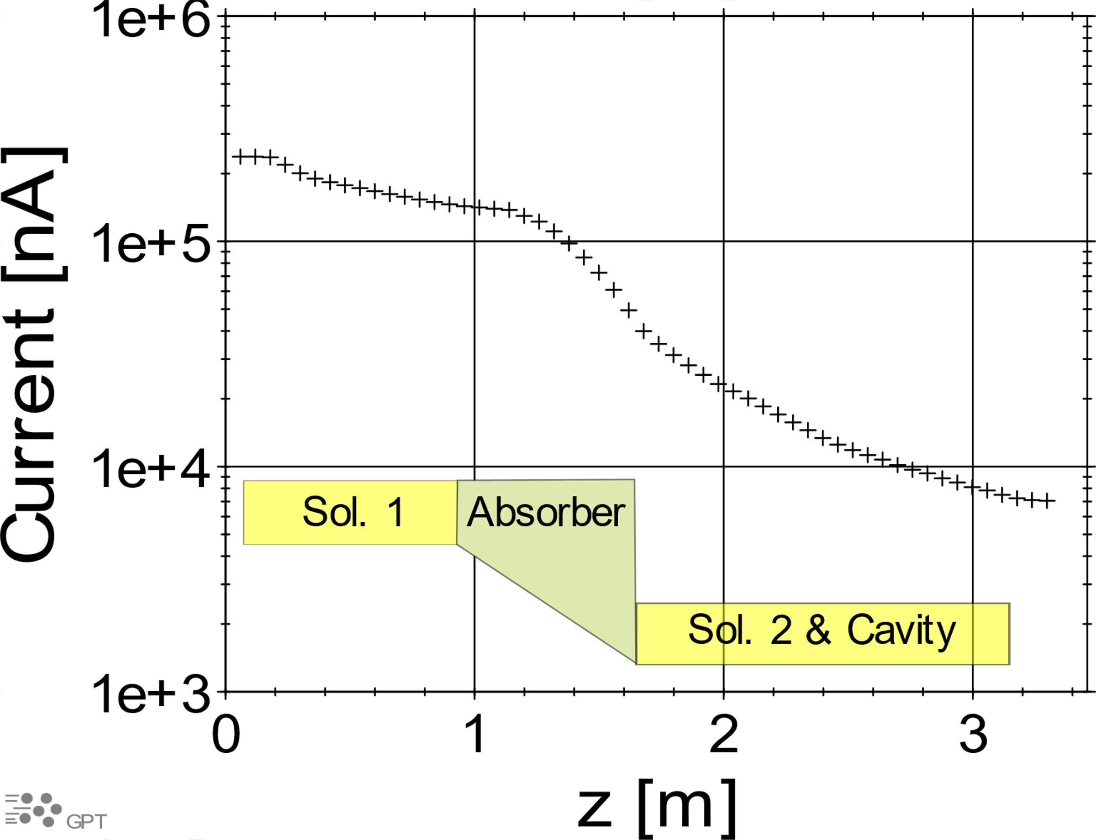

e⁺ Beam Current vs Z at Capture 1.03 T Solenoid and NC Capture Cavity
e⁺ Current And Energy along Beam Line
(S. Habet, PhD Thesis, Dec. 2023)
e⁺ Current vs Z at Capture Solenoid
and 1st Cavity
Current at the End of Capture Cavity:
  Elegant (Sami): $I_{e^{+}}$= 3 µA
  GPT (Andriy): $I_{e^{+}}$= 7 µA

Slide 25


e⁺ Current and Energy Spread at Exit of C100 vs Aperture Size of Collimator #1
e⁺ Current vs Aperture Size (Δx)
of Collimator #1
Energy Spread vs Aperture Size (Δx)
of Collimator #1
I (Δx_{col1} = 2.2 cm) = 50.8 nA
σ_{E}/E (Δx_{col1} = 2.2 cm) = 1%

