Slide 1
ILC Damping Ring Design:
Changes from TDR
2024.7.10 K. Kubo

Slide 2
Change of ILC DR Design from TDR
For Higher Luminosity (especially at 250 GeV ECM)
  Normalized horizontal emittance 6.3 um → 4 um
(Already reported and approved)
e.g. Presentation in ALCW2018 (https://agenda.linearcollider.org/event/7826/sessions/4644/#20180531)
Make Design Realistic
  Change positions and lengths of magnets

Slide 3
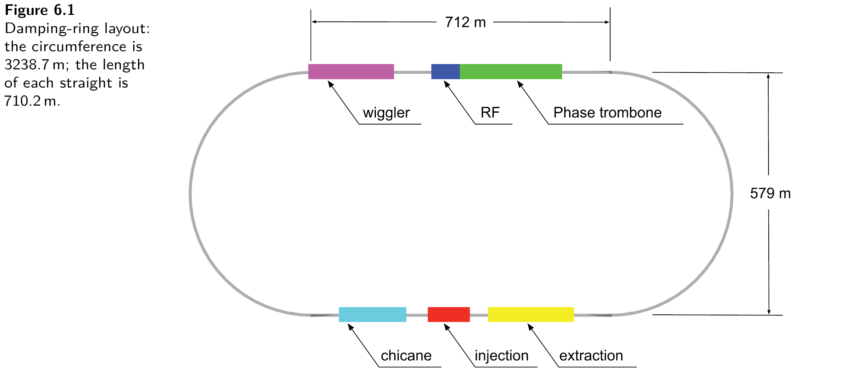
TDR
Changes keep
Same beamline geometry
Basically the same optics

Slide 4
Horizontal emittance design (normalized)
TDR
At IP: 10 um
In DR: 6.3 um
Growth in RTML: 0.9 um (designed synchrotron radiation)
New
At IP: 5 um
In DR: 4 um
Growth in RTML: 0.7 um (designed synchrotron radiation)
(by changing turnaround design)

Slide 5
Possible choices for emittance reduction
Stronger focusing (smaller beta-function) in arcs
  Dynamic aperture significantly reduce.
    Probably not acceptable.
Longer and weaker bending magnets
  Space exist for lengthening magnet from 3m (TDR) to 5 m
  Simple and easy
  No negative impact to dynamic aperture
  This is chosen
+ In Wiggler dominant ring (as ILC DR):
emittance ~ 1/(radius)^2 in arc
damping time not changed significantly

Slide 6
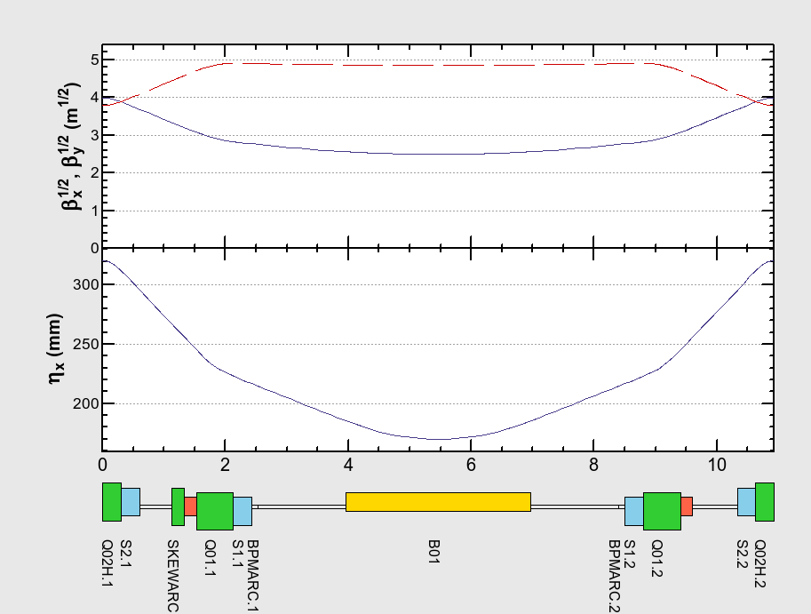
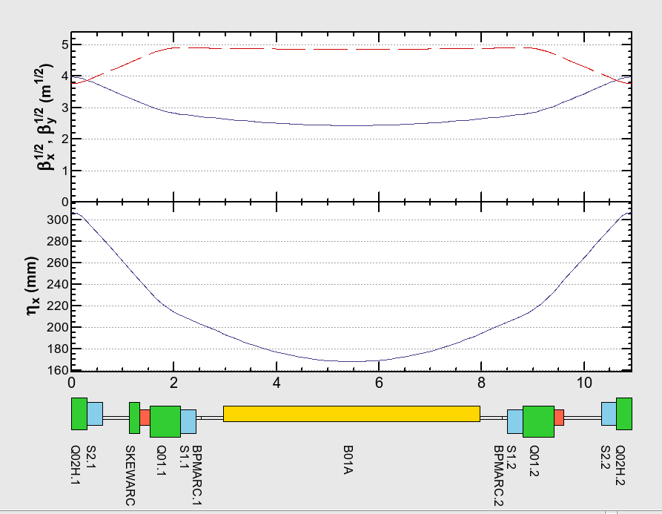
Optics of Arc Cell
TDR, 3 m bend
5 m bend
 | TDR | New (long bend)
Horizontal normalized Emittance (um) wo/w intra-beam scattering | 5.74, 6.27 (IBS) | 3.14, 3.97 (IBS)
Damping time x/y/z (ms) | 23.9/23.9/11.9 | 25.5/25.5/12.8

Slide 7
Dynamic Aperture calculation
Tool prepared in SAD
Set initial orbit and energy deviation and perform tracking
Survived in 1000 turns tracking → “accepted”
No errors included.
No special treatment of wiggler’s magnetic field.

Slide 8
Dynamic aperture
TDR design 3 m bend
New arc cell: long (5 m) bend
Aperture is larger than requirement

Slide 9
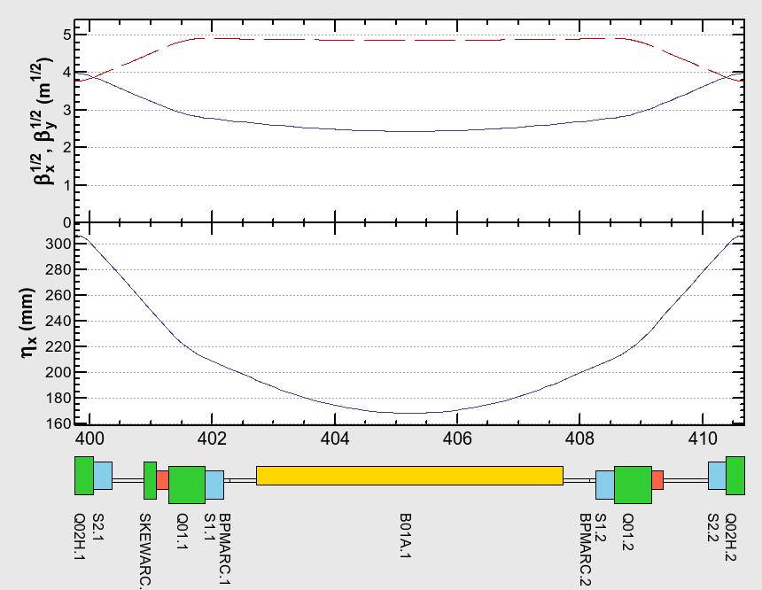
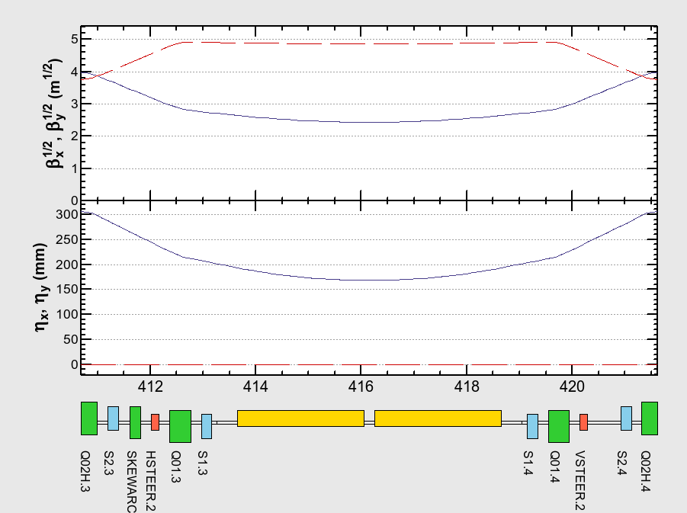
Additional Changes after ALCW2018
Realistic Design (consideration of construction, transportation, etc.)
Insert spaces between magnets
Divide one 5 m bend into two 2.4 m bends
Arc Optics Design in 2018
Present Arc Optics Design

Slide 10
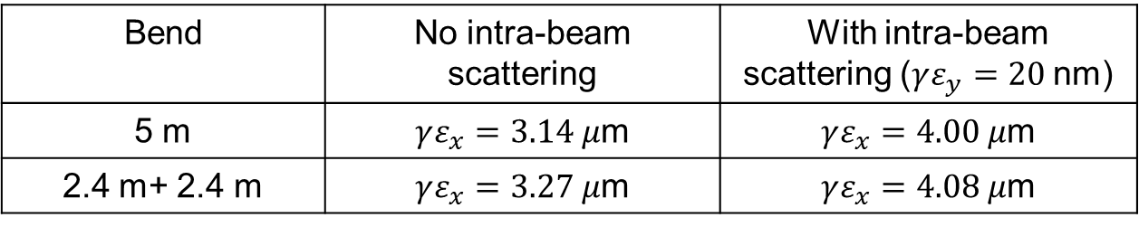
Additional Changes after ALCW2018 cnt’d
Basically the same optics
  Dynamic aperture checked. No significant change.
Reduction of total bend magnets length
  emittance increase slightly, not significant
Horizontal normalized emittance
Bend | No intra-beam scattering | With intra-beam scattering ($γε_{y}=20$nm)
5 m | $γε_{x}=3.14 μ$m | $γε_{x}=4.00 μ$m
2.4 m+ 2.4 m | $γε_{x}=3.27 μ$m | $γε_{x}=4.08 μ$m

Slide 11
SUMMARY
Longer and weaker bending magnet for lower horizontal emittance
Divide long bending magnet into two
(5 m → 2. 4 m + 2.4 m).
Spaces between magnets
Same beamline geometry
Basically the same optics
Changes give no negative effect to dynamic aperture
(However, more realistic estimation of dynamic aperture is desirable.)

