Slide 1

Emittance tuning knobs for CLIC ML
LCWS 2024, July 8-11, 2024
Andrii Pastushenko
10/07/2024

Slide 2
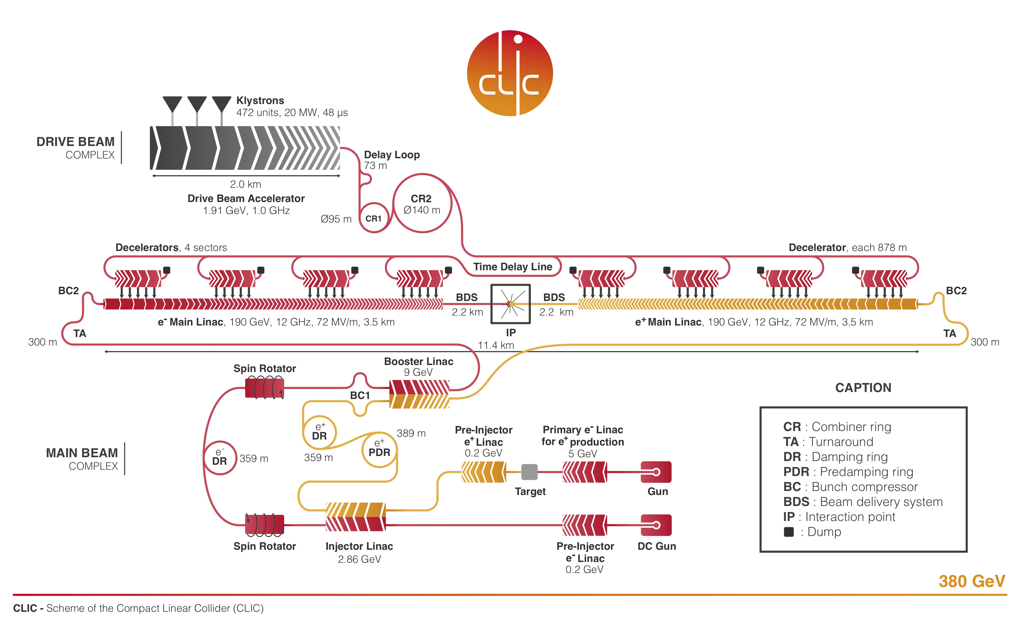
CLIC 380 GeV
Notes:
To start: You probably know very well this picture, the structure of the CLIC complex.
From the e+, e- sources, we have DR, RTML, Main Linac, and BDS.

Slide 3
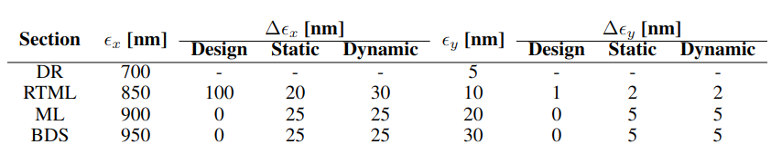
CLIC 380 GeV
Emittance budget
A nanometer vertical beam size at the IP calls for a very small vertical emittance. Limiting emittance growth throughout the beamline is crucial.
Each CLIC subsystem has allocated emittance growth budget for static and dynamic imperfections. Respecting these allows CLIC to meet the target luminosity.
For ML, the budget is 5 nm for static imperfections and 5 nm for dynamic imperfections.
The budget is met by utilizing various Beam Based Alignment techniques.
Notes:
Start with: It is well known that high luminosity requirement for linear colliders mean a nanometer beam size at the IP.
- Small beam size at the IP: strong focusing at the FFS + small vertical emittance -> limiting emittance growth is crucial
- CLIC designs foresees ..
It is assumed that correction and alignment techniques are sufficient to respect it.
You can see this budgets in the table below
- For ML it is 5 and 5

Slide 4
CLIC 380 GeV
Integrated simulations
The vertical budgets are the similar to the 3 TeV design. Typically, it is easier to meet the budget for 380 GeV.
Integrated simulations starting from the exit of the DR to the IP including static errors give the average luminosity of ¹:
With ground motion included:
90% of the machines reach:
Design luminosity is 1.5x10³⁴cm⁻²s⁻¹
¹ C. Gohil, et. al. “Luminosity performance of the Compact Linear Collider at 380 GeV with static and dynamic imperfections”, 2020
Notes:
It was noted that by performing BBA on the entire machine the statisticely performance is better than calculating the luminosity using the budgets for each subsystem.

Slide 5
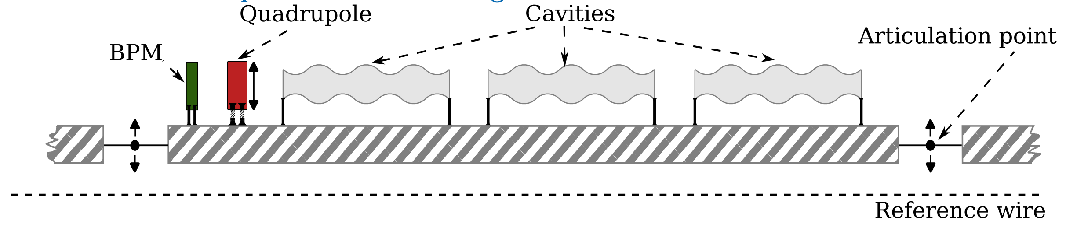
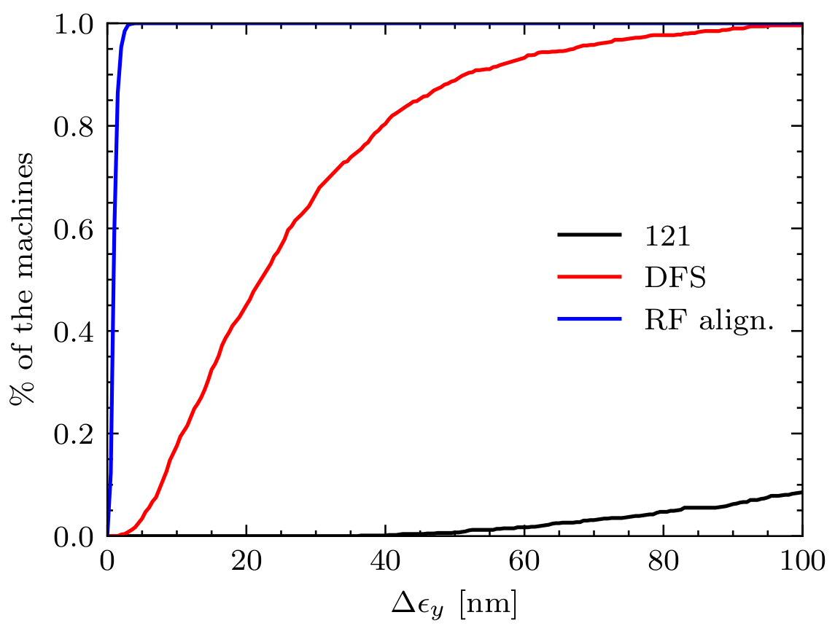
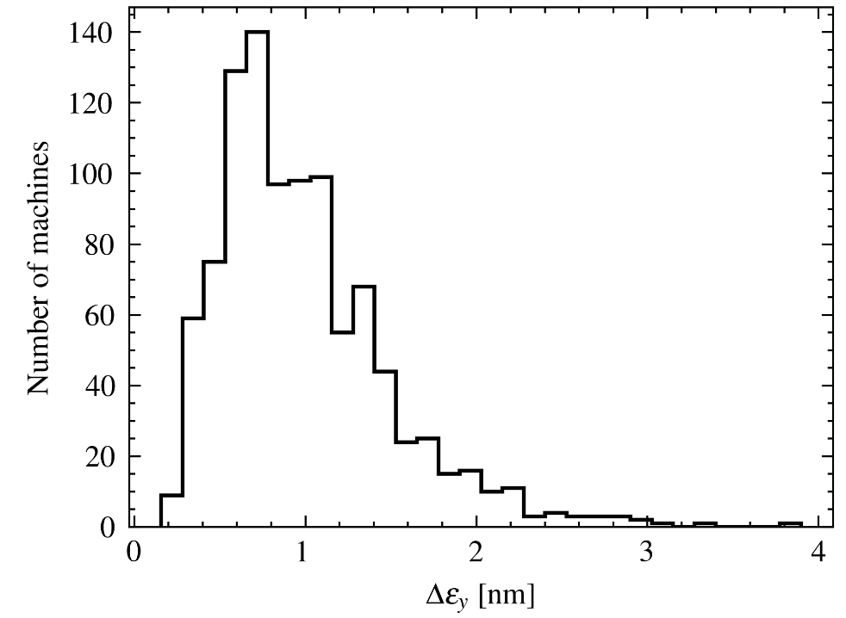
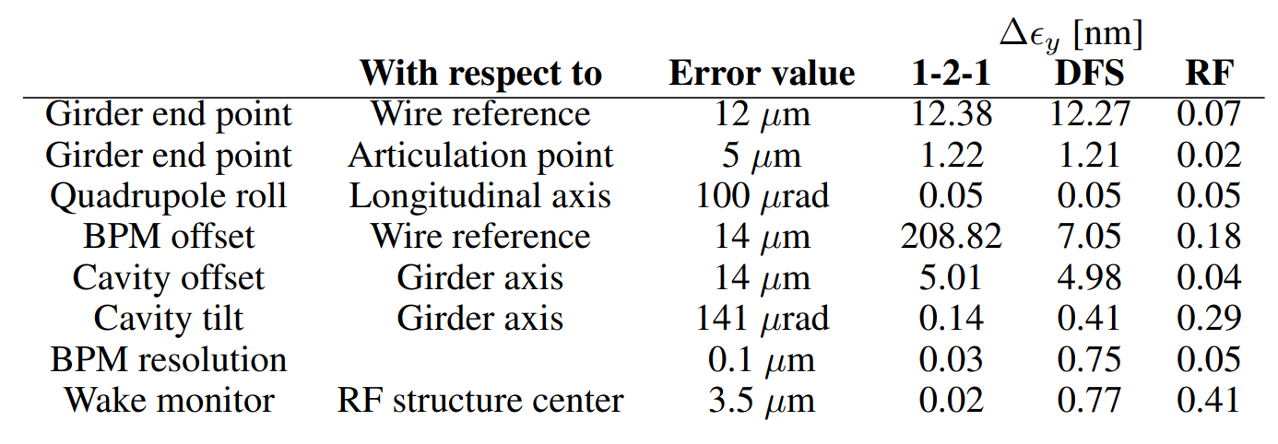
CLIC ML alignment
Each element is prealigned after installation
Beam based alignment
One to one steering (1-2-1)
Dispersion free steering (DFS)
Accelerator structure alignment (RF alignment)
Summary²:
100 % of the machines < 4 nm
²N. Blaskovic Kraljevic, D. Schulte, “Beam-based beamline element alignment for the main linac of the 380 GeV stage of CLIC”, IPAC 2019
Notes:
Start with: Here is schematic picture of the ML segment.
- It includes girders interconnected with each other and elements on it. Elements are cavities, quadrupoles and BPMs
- After the ML is assembled the elements are prealigned:
Girder end points wrt Reference wire
Each 2 girder end points wrt to the articulation point they share
Elements on girders are aligned wrt the girders
You can see in the table on the left, the errors after the prealignment and their impact on the emittance growth.
- To meet the budget for static errors the BBA is used
It consists of 121 (beam is steered through the centers of the BPMs)
DFS (Beam orbit and dispersion are corrected simultanously)
RF alignment (Girders are moved to minimize the signal in the WFM – The wakefield kicks are minimized)
=======NEXT=======
- With such a BBA, we meet the budget for static errors, such that 100% of the machines have emitttance growth below 4 nm.

Slide 6
CLIC ML alignment
Wakefield monitors (WFMs) are very important for the RF alignment. So far the accuracy we used is 3.5 μm. Changes to the accuracy influences the performance:
  With accuracy > 7.5 μm, static error budget is not met!
  Realistic value so far is 10 μm³.
We need some margin here and tools to reduce the emittance to be within the budget!
³K. N. Sjobak, et. al., “CLIC Wake Field Monitor as a detuned Cavity Beam Position Monitor: ..”, arXiv:2307.06681
Notes:
The WFMs are the important part of the RF alignment.
The previous results presented assumed the WFMs accuracy of 3.5 micron.
From what I know, it is pretty optimistic.
BBA performance is sensitive to this value, since with accuracy larger than 7.5 micron, BBA alone cannot fit within the budget.
Emittance tuning knobs can provide the needed margin here to get within the budget.

Slide 7
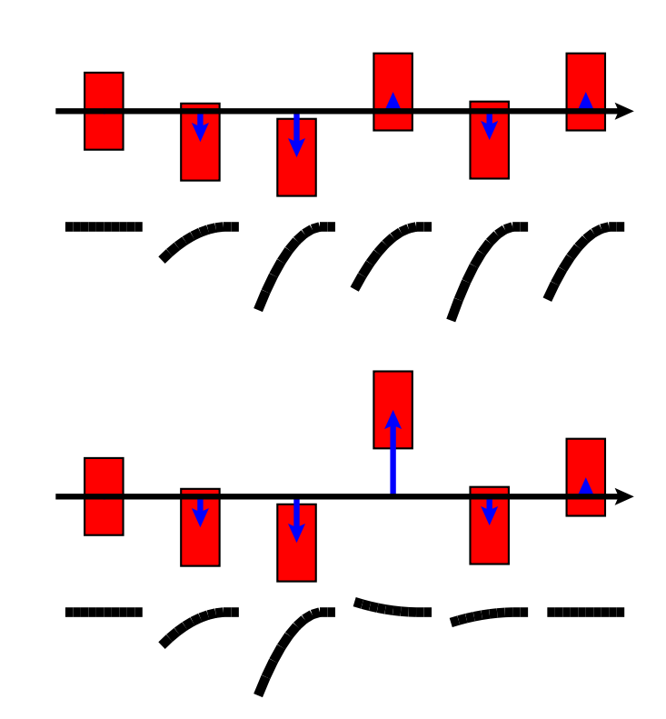

Emittance tuning knobs
Emittance tuning knobs
Residual emittance growth comes from the wakefields of the misaligned accelerating structures.
To compensate the unwanted wakefield kicks, we need to offset the beam vertically inside of the cavities. This can be done by misaligning cavities (girders) or creating orbit bumps with displaced quadrupoles.
Emittance tuning knob⁴ – is a set of elements offset that allows to reduce the emittance growth.
Evaluate potential of using the tuning knobs to: squeeze down the budget for static errors and provide a backup solution for RF alignment.
⁴ A. Pastushenko, D. Schulte, “Emittance tuning bumps for the Main Linac of CLIC 380 GeV”, IPAC 2023, THPL087
Notes:
Start with: Residual emittance growth mainly comes from the wakefield kicks.
Although the budget is met, it is possible to push the emittance growth further down. Such that, the emittance growth budget for the static errors could be reduced.
For this, we need to use so-called emittance tuning bumps or knobs.
- On the right top picture you see the impact the misaligned cavities have on the beam. The tail is kicked, such that the beam a kind of banana shape.
In a simplified form we need to apply a counter kick to flatten the beam, as on the bottom picture.
Such a counter-kick can be generated by either misaligning the cavities or by creating an orbit bump in the cavities area.
- So, the emittance tuning knob would be the set of cavities/girders or quadrupoles misalignment that flatten the beam longitudinal profile and reduce the emittance.

Slide 8
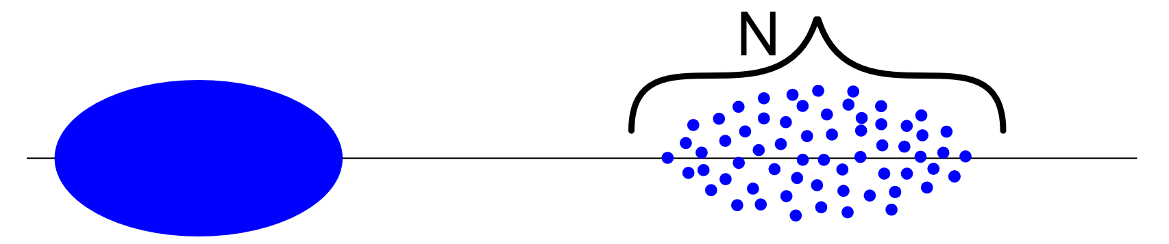
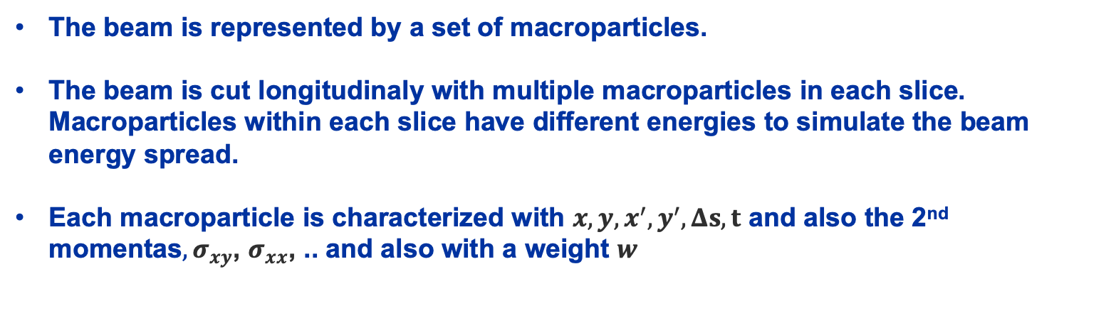
Emittance tuning knobs
Macroparticle model of the beam
The beam is represented by a set of macroparticles.
The beam is cut longitudinaly with multiple macroparticles in each slice. Macroparticles within each slice have different energies to simulate the beam energy spread.
Each macroparticle is characterized with $x, y, x^{′}, y^{′}, Δs, t$ and also the 2nd momentas$, σ_{xy}$, $σ_{xx}$, .. and also with a weight $w$
Macroparticle beam simplified:
M
Notes:
Start with: So, for this study we use a so called macroparticle model of the beam.
~those of you who use PLACET, might be familiar with that.
-Instead of the beam on the left, we have a set of macroparticles as on the right.
In PLACET, we slice the beam longitudinaly and put multiple macroparticles in each slice.
To simulate the energy spread – macroparticles within each slice have differene energies
- Each macroparticle is characterized with weight, its coordinates and also 2nd momentas

Slide 9
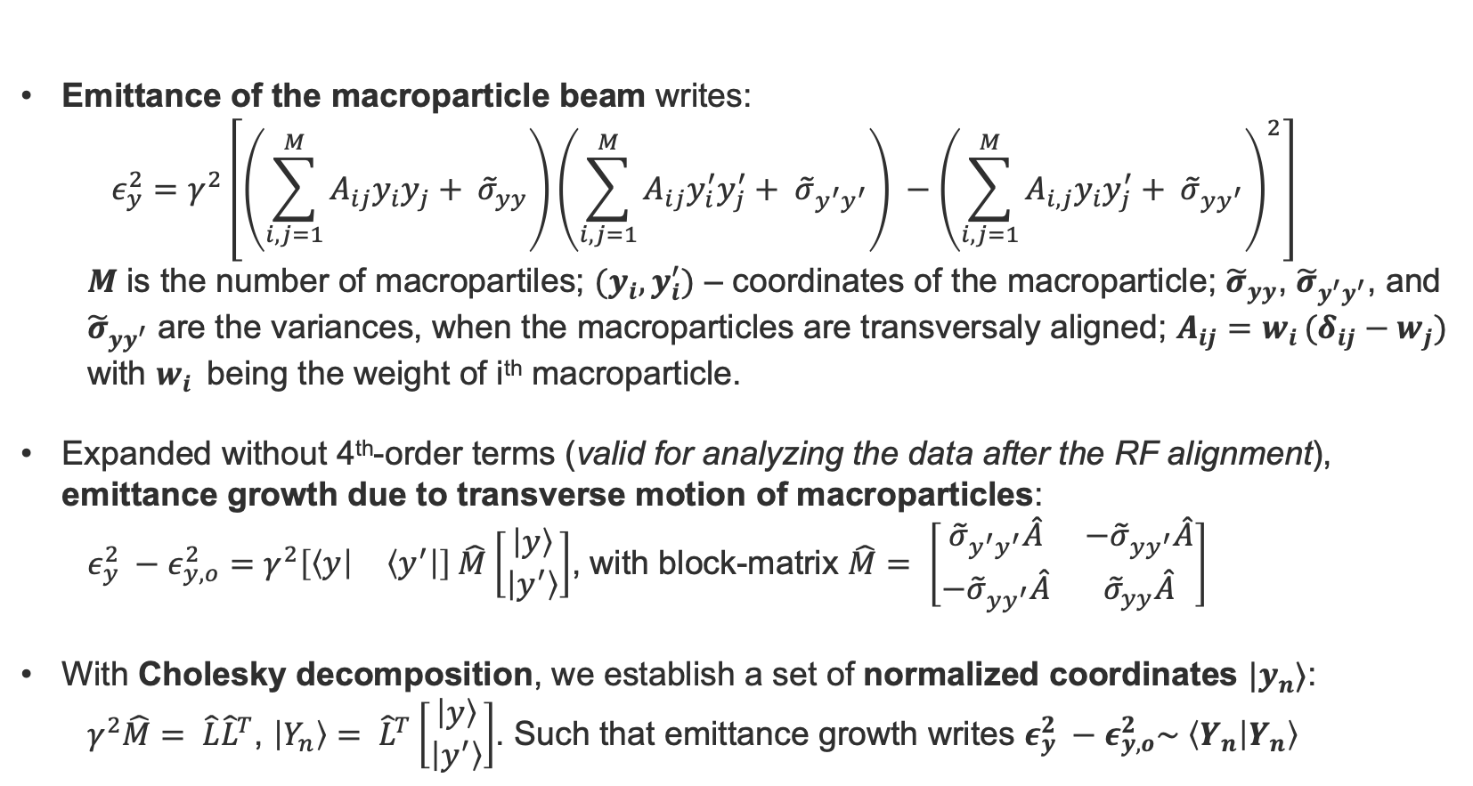
Emittance tuning knobs
Emittance of the macroparticle beam
Emittance of the macroparticle beam writes:
  $$ε_{y}^{2}=γ^{2}\left[\left(\sum_{i, j=1}^{M}{A_{ij}y_{i}y_{j}}+ {\tilde{σ}}_{yy}\right)\left(\sum_{i, j=1}^{M}{A_{ij}y_{i}^{′}y_{j}^{′}}+ {\tilde{σ}}_{y^{′}y^{′}}\right) −{\left(\sum_{i, j=1}^{M}{A_{i, j}y_{i}y_{j}^{′}}+ {\tilde{σ}}_{yy^{′}}\right)}^{2}\right]$$
  $M$ is the number of macropartiles; $(y_{i}, y_{i}^{′})$ – coordinates of the macroparticle; ${\tilde{σ}}_{yy}$, ${\tilde{σ}}_{y^{′}y^{′}}$, and ${\tilde{σ}}_{yy^{′}}$ are the variances, when the macroparticles are transversaly aligned; $A_{ij}=w_{i }(δ_{ij}−w_{j})$ with $w_{i }$ being the weight of i^{th} macroparticle.
Expanded without 4th-order terms (valid for analyzing the data after the RF alignment), emittance growth due to transverse motion of macroparticles:
  $ε_{y}^{2} −ε_{y, o}^{2}=γ^{2}\left[\begin{matrix}\left\langle y\right| & \left\langle y^{′}\right|\end{matrix}\right] \hat{M}\left[\begin{matrix}\left|y\right\rangle \\ \left|y^{′}\right\rangle \end{matrix}\right]$, with block-matrix $\hat{M}= \left[\begin{matrix}{\tilde{σ}}_{y^{′}y^{′}}\hat{A} & −{\tilde{σ}}_{yy^{′}}\hat{A} \\ −{\tilde{σ}}_{yy^{′}}\hat{A} & {\tilde{σ}}_{yy}\hat{A}\end{matrix}\right]$
With Cholesky decomposition, we establish a set of normalized coordinates $|y_{n}⟩$:
  $γ^{2}\hat{M}= \hat{L}{\hat{L}}^{T}$, $\left|Y_{n}\right\rangle = {\hat{L}}^{T}\left[\begin{matrix}\left|y\right\rangle \\ \left|y^{′}\right\rangle \end{matrix}\right]$. Such that emittance growth writes $ε_{y}^{2} −ε_{y, o}^{2}\sim \left\langle Y_{n} | Y_{n}\right\rangle$
Notes:
Star with: In such a format, assuming the emittance growth comes from the macroparticles transverse misalignments emittance writes like this.
- This large equation can be further expanded into a smaller format.
* Here emittance_y_0 is the beam emittance when all the macroparticles are aligned transversaly. Which means no dispersion and no wakefield kicks.
- And then, with Cholesky decomposition, we get a normalized phase space, such that emittance growth writes easily as this.

Slide 10
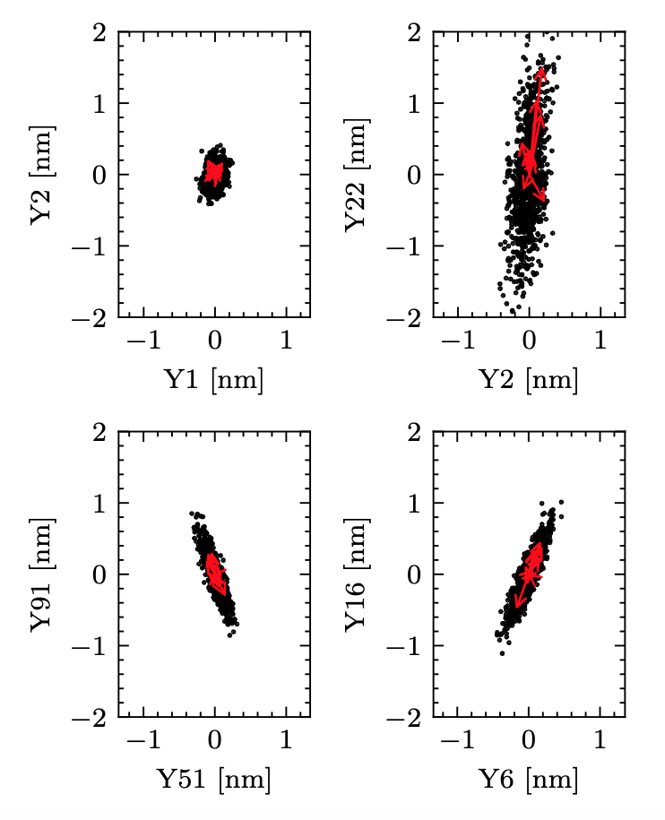
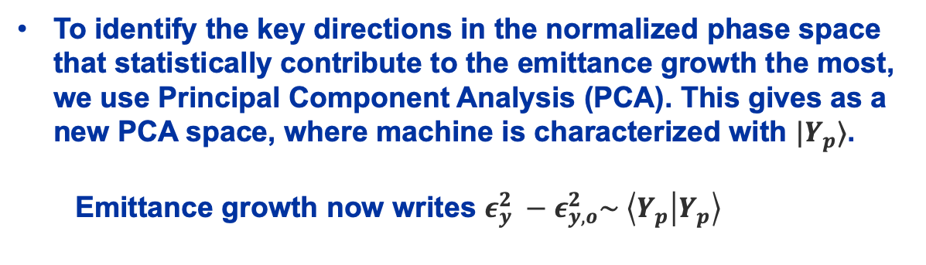
Emittance tuning knobs
Emittance of the macroparticle beam
To identify the key directions in the normalized phase space that statistically contribute to the emittance growth the most, we use Principal Component Analysis (PCA). This gives as a new PCA space, where machine is characterized with $|Y_{p}⟩$.
  Emittance growth now writes $ε_{y}^{2} −ε_{y, o}^{2}\sim \left\langle Y_{p} | Y_{p}\right\rangle$
To build the knobs, we need to identify the source of the residual emittance growth.
We perform the BBA simulation (1-2-1 + DFS + RF alignment) and evaluate macroparticles coordinates at the ML exit.
We convert the coordinates to normalized coodrinates. Each machine has its unique vector in the normalized phase space. The length of that vector is proportinal to the emittance growth.
For the study we used the setup with 11 longitudinal slices and 5 macroparticles in each slice.
That gives:
55 macroparticles in total.
110 normalized coordinates.
110 principal components.
Notes:
Start with: To build the knobs, we need to identify the source of residual emittance growth.
Or in our case – which or what combination of normalized coordinates are the main contributors to the emittance growth.
- To do this, we simulate the BBA. We randomly misalign the elements, apply the BBA, evaluate macroparticles coordinates and identify normalized coordinates.
- To identify the key configurations (or directions) in the normalized phase-space, we apply the PCA.
It builds a new set of orthogonal directions, by doing the following.
The first principal direction is arrenged to maximize the variance of the data projected on it.
The second one is found the same way, with a constraint to be orthogonal to the first one.
and so on.
=======NEXT=======
-This is an example of the PCA, performed on the data.
In the study, we use a beam of 11 slices with 5 macroparticles per slice.
In red are shown the principal components projected on the 2d plot.

Slide 11
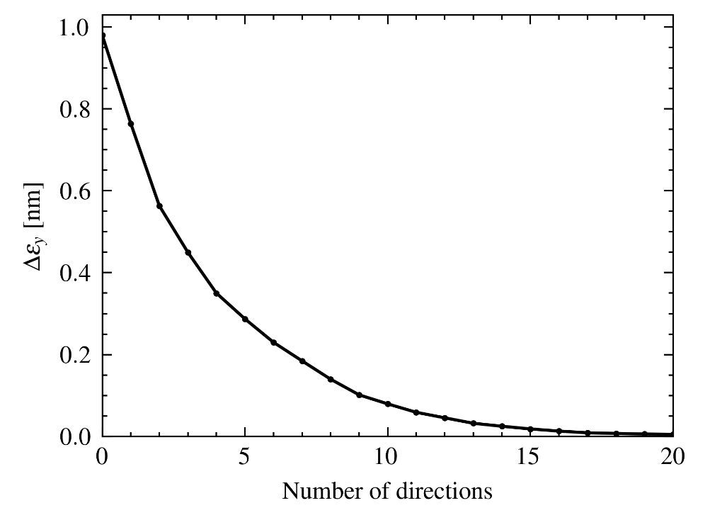
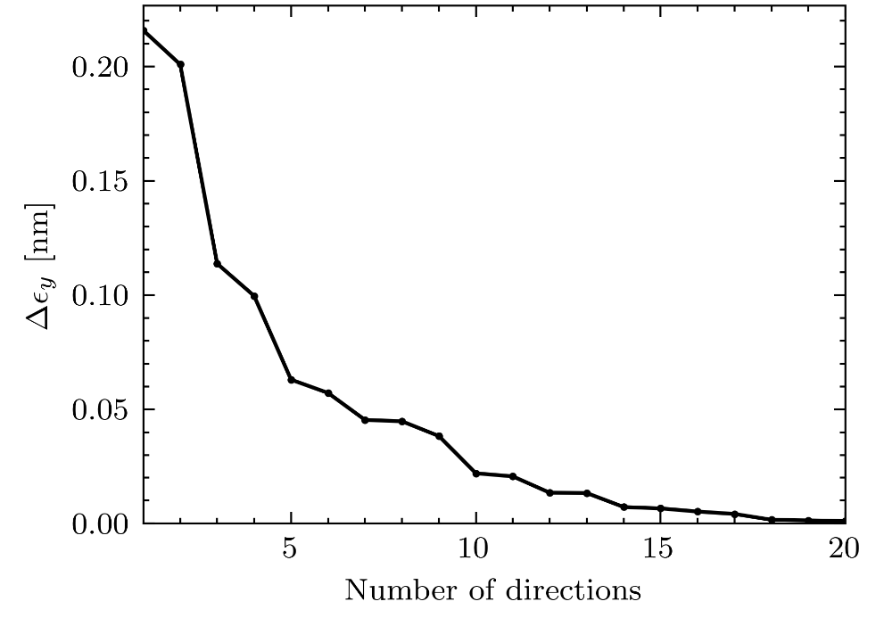
Emittance tuning knobs
PCA
Or, if we assume we can correct first N principal components, what RMS emittance growth we can expect after that:
From PCA we can evaluate how much of the emittance growth, each principal direction carries.
# of principal componets | Emittance growth [nm]
0 | 0.98
5 | 0.3
10 | 0.08
Notes:
Start with: Since the variance of the projected data (or principal components) have a meaning of the emittance growth,
we can associate the emittance growth with each principal component. (see the left plot)
- From that we build the plot shown on the right.
It shows, what RMS emittance growth we can expect if we cancel the certain number of principal components.
=======NEXT=======
- 0 corresponds to 1 nm RMS growth, which Is the same thing we have after the BBA
for 5 it is 0.3
and for 10, it is 0.08.
In the studies further on, we set the number of principal components to correct to 10
Tthat means we are expected 10 knobs. 1 knob per each principal component.

Slide 12
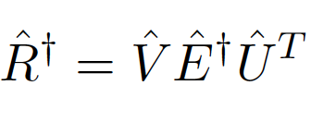
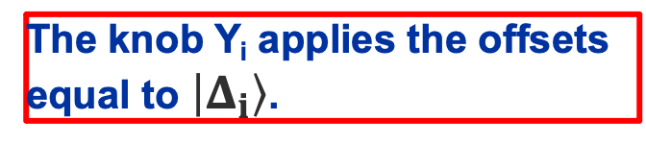

Emittance tuning knobs
Knobs construction using pseudo-inverse
There are several degrees of freedom when constructing the knobs using pseudo-inverse:
Elemens to use for the knob construction - Quads, Girders, Quads+Girders.
Cutoff in the pseudo-inverse.
  Pseudo-inverse matrix is evaluated with Singular Value Decomposition (SVD):
So, we can set the limit (cutoff) to zero the nonimportant singular values.
We build the response matrix $\hat{R}$ of the beam coordinates in the PCA space on the quads/girders vertical offsets:
  $$R_{ij}= \frac{{\tilde{Y}}_{p, i}}{Δy_{j}}$$
  The size is 110x2062 (1489 girders + 574 quadrupoles).
To find the orthogonal knob that modifies beam coordinate $Y_{p, i}$ in the PCA space we need to solve:
  $$\min\left\|\hat{R}\left|Δ_{i}\right\rangle −λ|I_{i}⟩\right\|$$
  With $\left|Δ\right\rangle$ being the elements offsets and the vector $|I_{i}⟩$ having the format:
  $\left|I_{i}\right\rangle = {\left[0 ⋯1⋯0\right]}^{T}$ and with $λ=10 nm$.
The obvious solution is:
  $$\left|Δ_{i}\right\rangle ={λ\hat{R}}^{†}|I_{i}⟩$$
  ${\hat{R}}^{†}$ is a pseudo-inverse matrix.
The knob Y_{i} applies the offsets equal to $\left|Δ_{i}\right\rangle$.
Notes:
Start with: So, the obvious way to solve this, assuming the system is linear is to build the response matrix
We offset girders and quadrupoles and observe the change of beam coordinates in the PCA space.
- Then finding a set of the correct offsets, that modify separatly only 1 principal component (we call it an orthogonal knob) narrows down to solving the linear regression.
- The obvious solution here writes with a pseudoinverse.
So, a knob, would a set of the offsets labeled with delta
=======NEXT=======
- But this solution is not good.
It is dense (which means all the elements are utilized)
Also, the elements’ offsets are not controlled.
As you can see on the plot on the left, some girders even have the offsets larger then mm, which is not acceptable

Slide 13
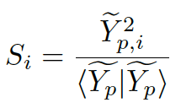
Emittance tuning knobs
Knobs construction using pseudo-inverse
By finding the balance between the knob performance and offsets we construct
Knobs on the qudrupoles’ offsets
Knobs on the girders’ offsets
<- The offsets tend to be larger
Optimal cutoff is around 10⁻⁴ – 10⁻³. The girders’ offsets are around 6 – 20 μm.
The knobs Y₇ and Y₈ cannot be constructed.
Optimal cutoff = 10⁻⁶. Quadrupoles RMS offset is in the range 1-10 μm.
Notes:
We scan the set of cutoffs and keep track of the RMS offsets and performance of the knobs.
Concerning the score. Ideally we want a score of 1. There is a range of cutoff values for which the knobs have a score of 1.
So, in principle it is possible to choose the solution here, but the drawback of them is they they all are dense (all quads/girders are used.)
Also, in the case of offsets it is a full distribution with many quadrupoles (for example) having offsets around 0 microon

Slide 14
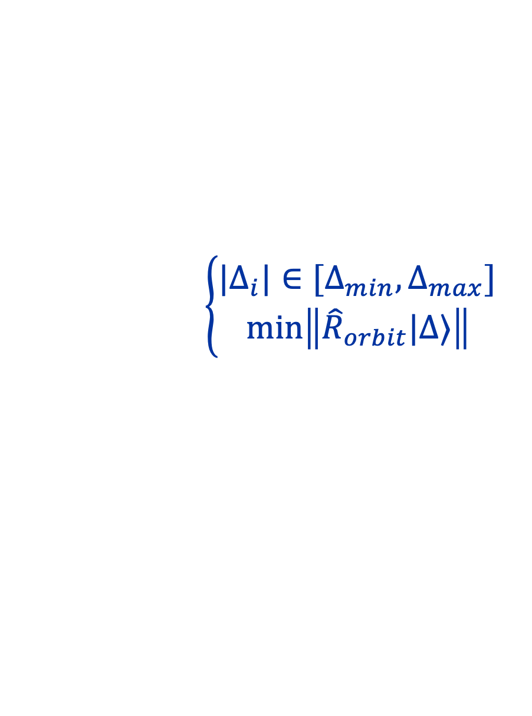

Emittance tuning knobs
Optimal knobs
The optimal knob should:
  Be based on the offsets of couple tens of girders/quadrupoles.
  Have a reasonable offsets associated with it. Offsets at the mm level mechanically are not possible. At the same time, they cannot be too small.
  Beam orbit to be controlled. It must stay at the reasonable level.
The task to be solved:
$$\left\{\begin{aligned}{|Δ}_{i}|∈[Δ_{min}, Δ_{max}] \\ \min\left\|{\hat{R}}_{orbit}|Δ⟩\right\| \end{aligned}\right.$$
And use the smallest number of quads/structures!
$$\min\left\|\hat{R}\left|Δ\right\rangle −|I_{j}⟩\right\|$$
+
Notes:
To start with: So, we want to build, lets call them optimal knobs.
- Such knobs are going to invoke the offsets of at most couple of tens of girders/quadrupoles
- The elements offsets cannot be too large. Certainly mm offsets are not acceptable.
The same applies to the offsets too small. Nanometer offsets are not feasible.
- Also, we want to keep track of the beam orbit, since, quads in particular can steer the beam significantly.
- So, the task to solve is the linear regression with additional regularizations.
- But also, we want to solve this with the smallest number of elements.

Slide 15
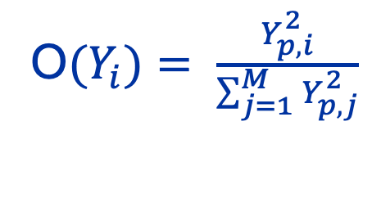
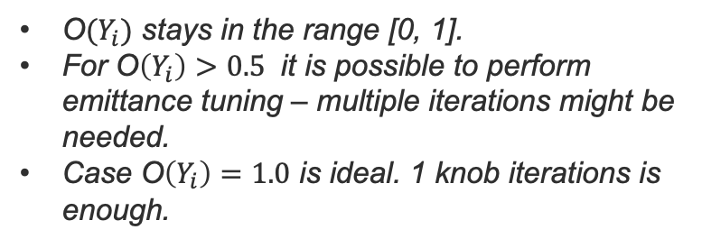

Optimal knobs
We build a model in Tensorflow: linear model with custom regularization:
The offsets < 1 µm (< 10 µm for girders) are penalyzed (‘Zero penalty’).
The large values are clipped to 100 µm.
The RMS beam orbit (among all the BPMs) is penalyzed. Also, to deal with the outliners, additional penalty is added for the BPMs with orbit > 20 µm.
  + no orbit change at the ML exit.
We search for the optimal setup of the quads/girders by applying Forward Feature Selection (FFS).
O$(Y_{i})$ stays in the range [0, 1].
For O$\left(Y_{i}\right)>0.5$ it is possible to perform emittance tuning – multiple iterations might be needed.
Case O$\left(Y_{i}\right)=1.0$ is ideal. 1 knob iterations is enough.
To quantify the solutions I use the custom score, that I called orthogonality:
O$(Y_{i})= \frac{Y_{p, i}^{2}}{\sum_{j=1}^{M}{Y_{p, j}^{2}}}$
$$Y_{p, i}$$
- Beam i^{th} coordinate in the PCA space
Notes:
To start: So, we build a linear model in Tensorflow and apply several custom regularizations:
- The offsets smaller than 1 or 10 micrometers are penalyzed, I called zero penalty
- The large offsets are clipped at 100 microns.
- Beam orbit is also penalyzed. Additionally to deal with outliners, the beam orbit above 20 micron is also penalyzed.
- To find the smallest number of elements that can solve this problem we use a so called Sequential feature selection approach with forward run.
- And also, we utilize a custom metrics, I called orthogonality.
Essentially it compares the contribution of principal component that we build a know for with a total emittance growth, coming from the other principal components
So, value of 0 is bad, value of 1 is perfect, but with any value > 0.5, we would be able to perform the emittance tuning, but the number of iterations may be large.

Slide 16
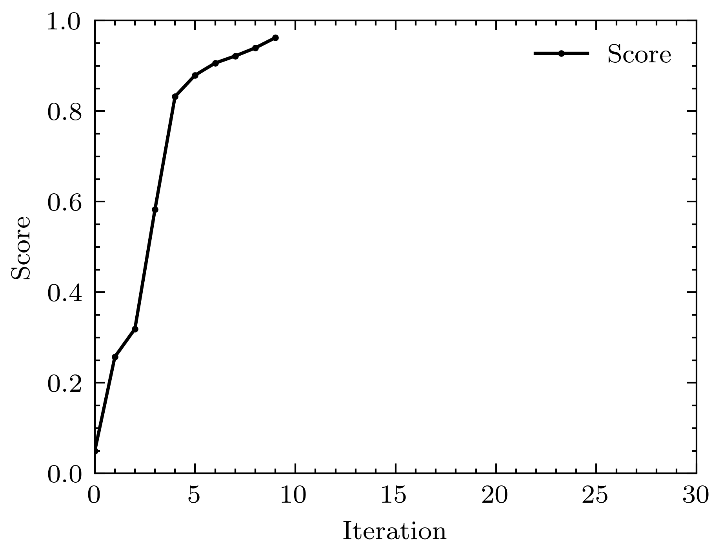
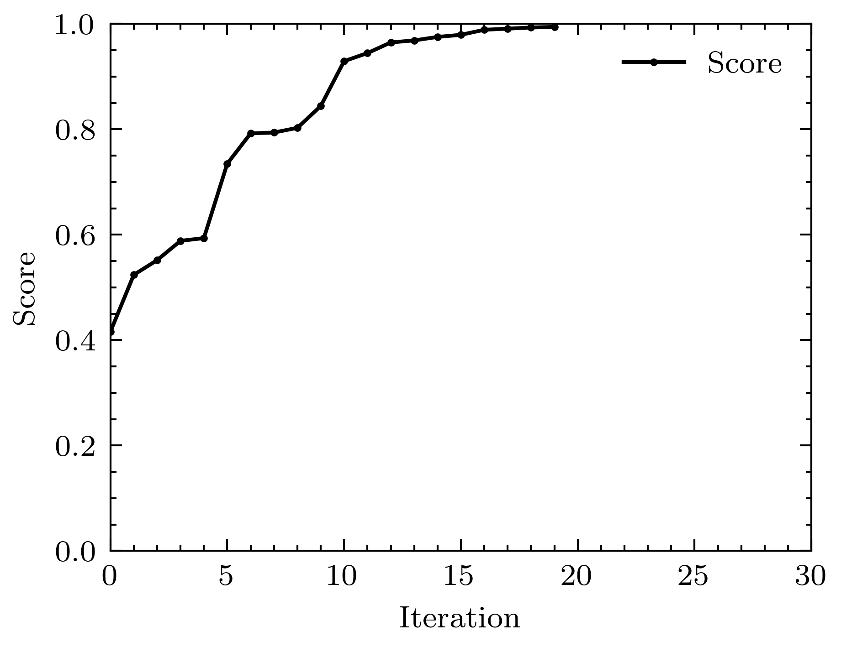
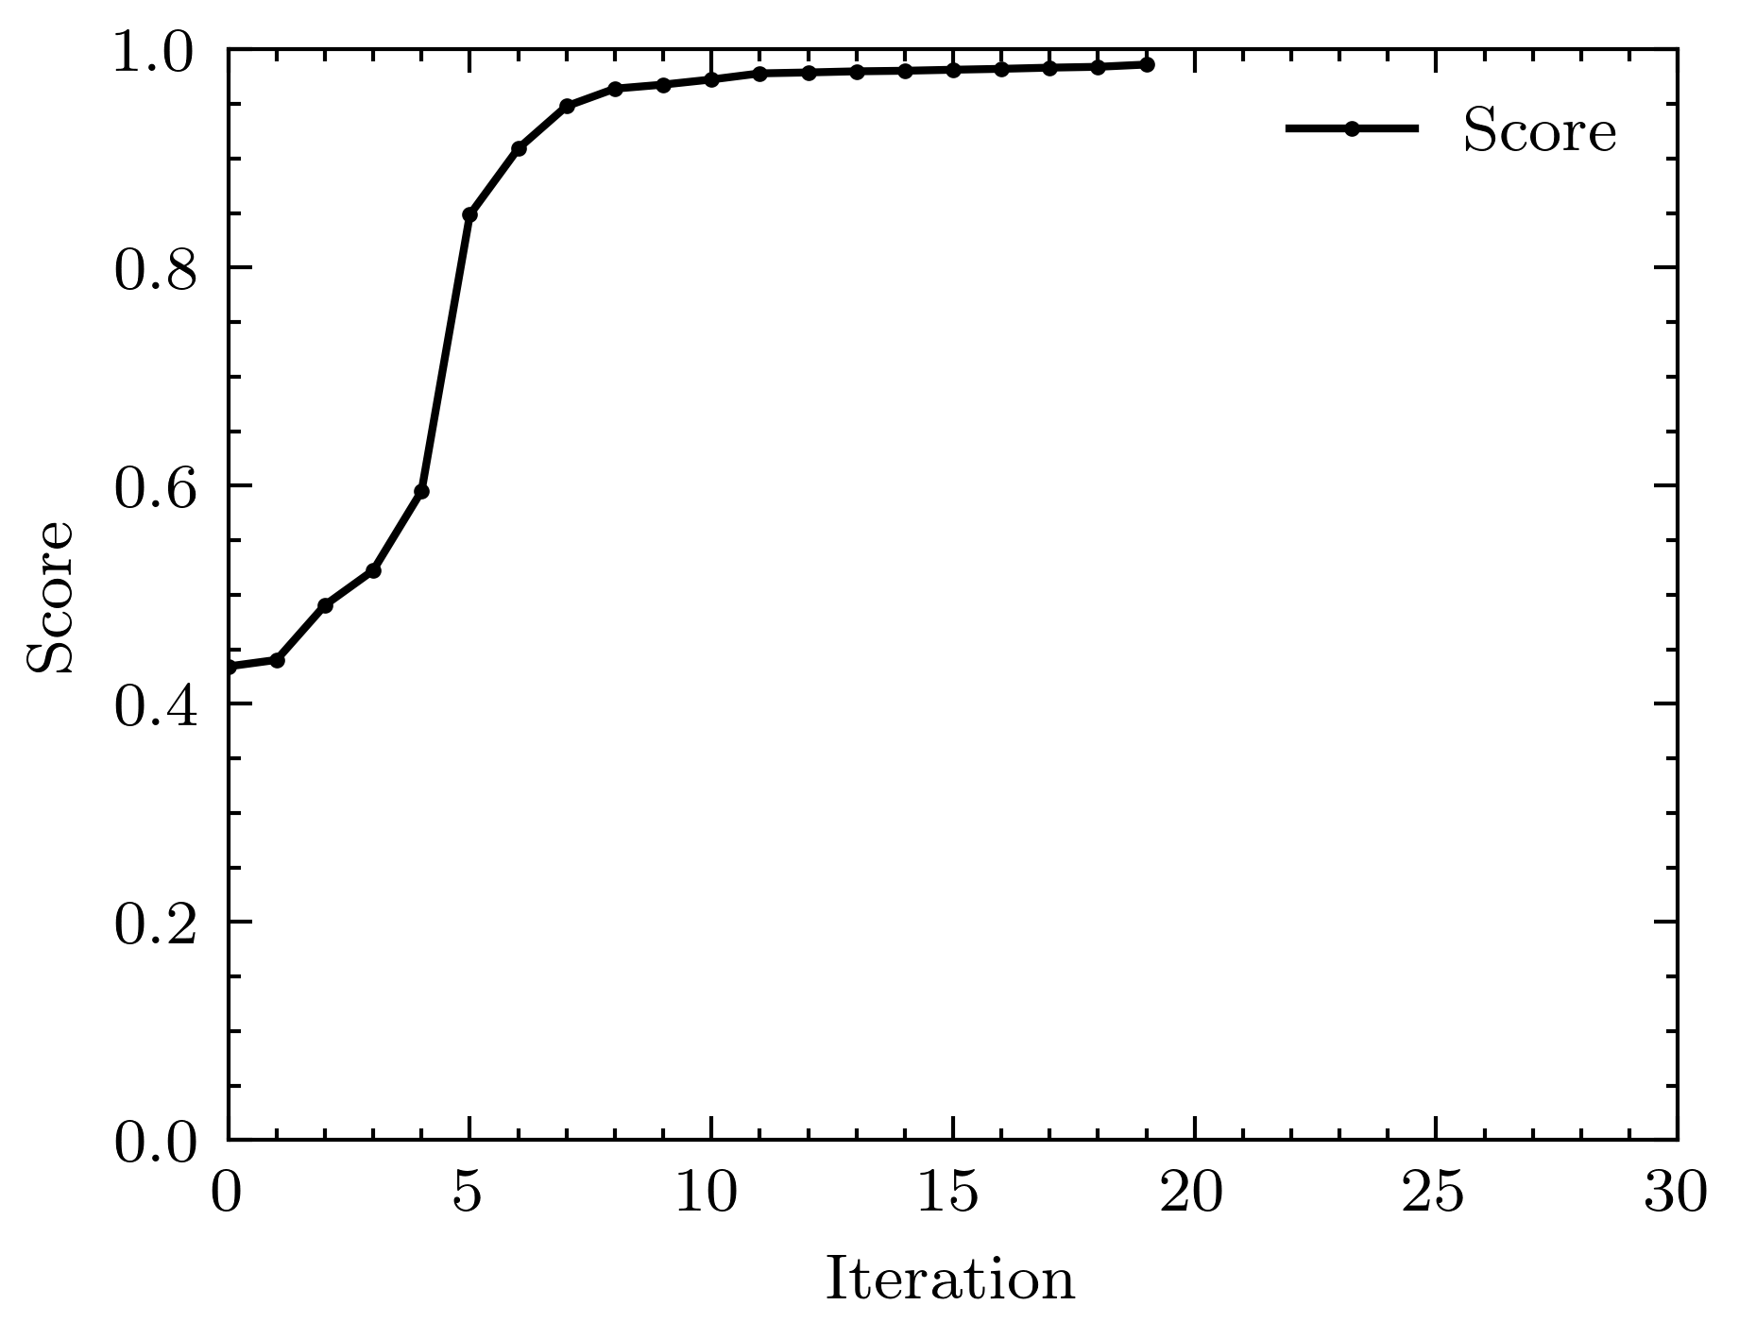
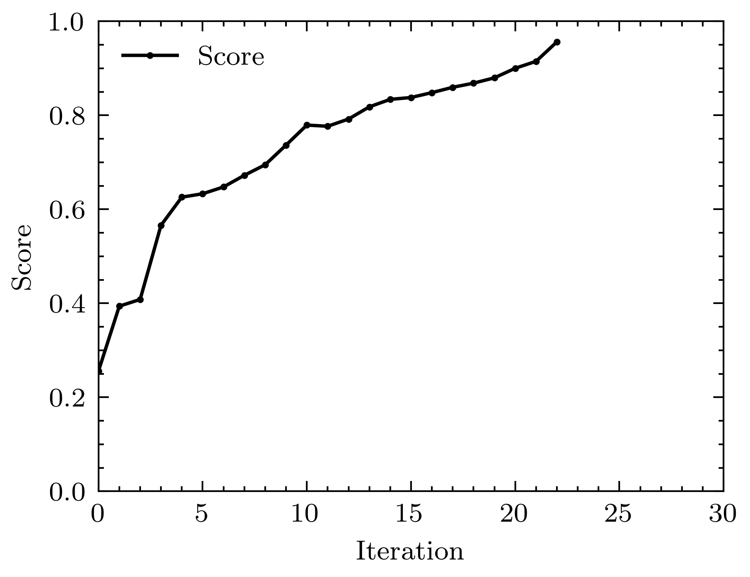
Optimal knobs
Knobs construction summary
Some examples of the Sequential Selection
Knob | Score | N_elements
Y1 | 0.96 | 12
Y2 | 0.96 | 15
Y3 | 0.97 | 10
Y4 | 0.95 | 9
Y5 | 0.97 | 13
Y6 | 0.96 | 23
Y7* | 0.92 | 10
Y8* | 0.96 | 19
Y9 | 0.96 | 19
Y10 | 0.96 | 25
Y₁
Y₂
Y₅
Y₁₀
The set is featured here:
https://github.com/drozzoff/CLIC380_linac_knobs/tree/2024_03_07
Notes:
To start: here you can see an example of the forward run.
The score as a function of the number of elements involved for some of the knobs.
- To balance the score and the number of elements, I picked the following configurations for the knobs. In total it requires 117 element

Slide 17
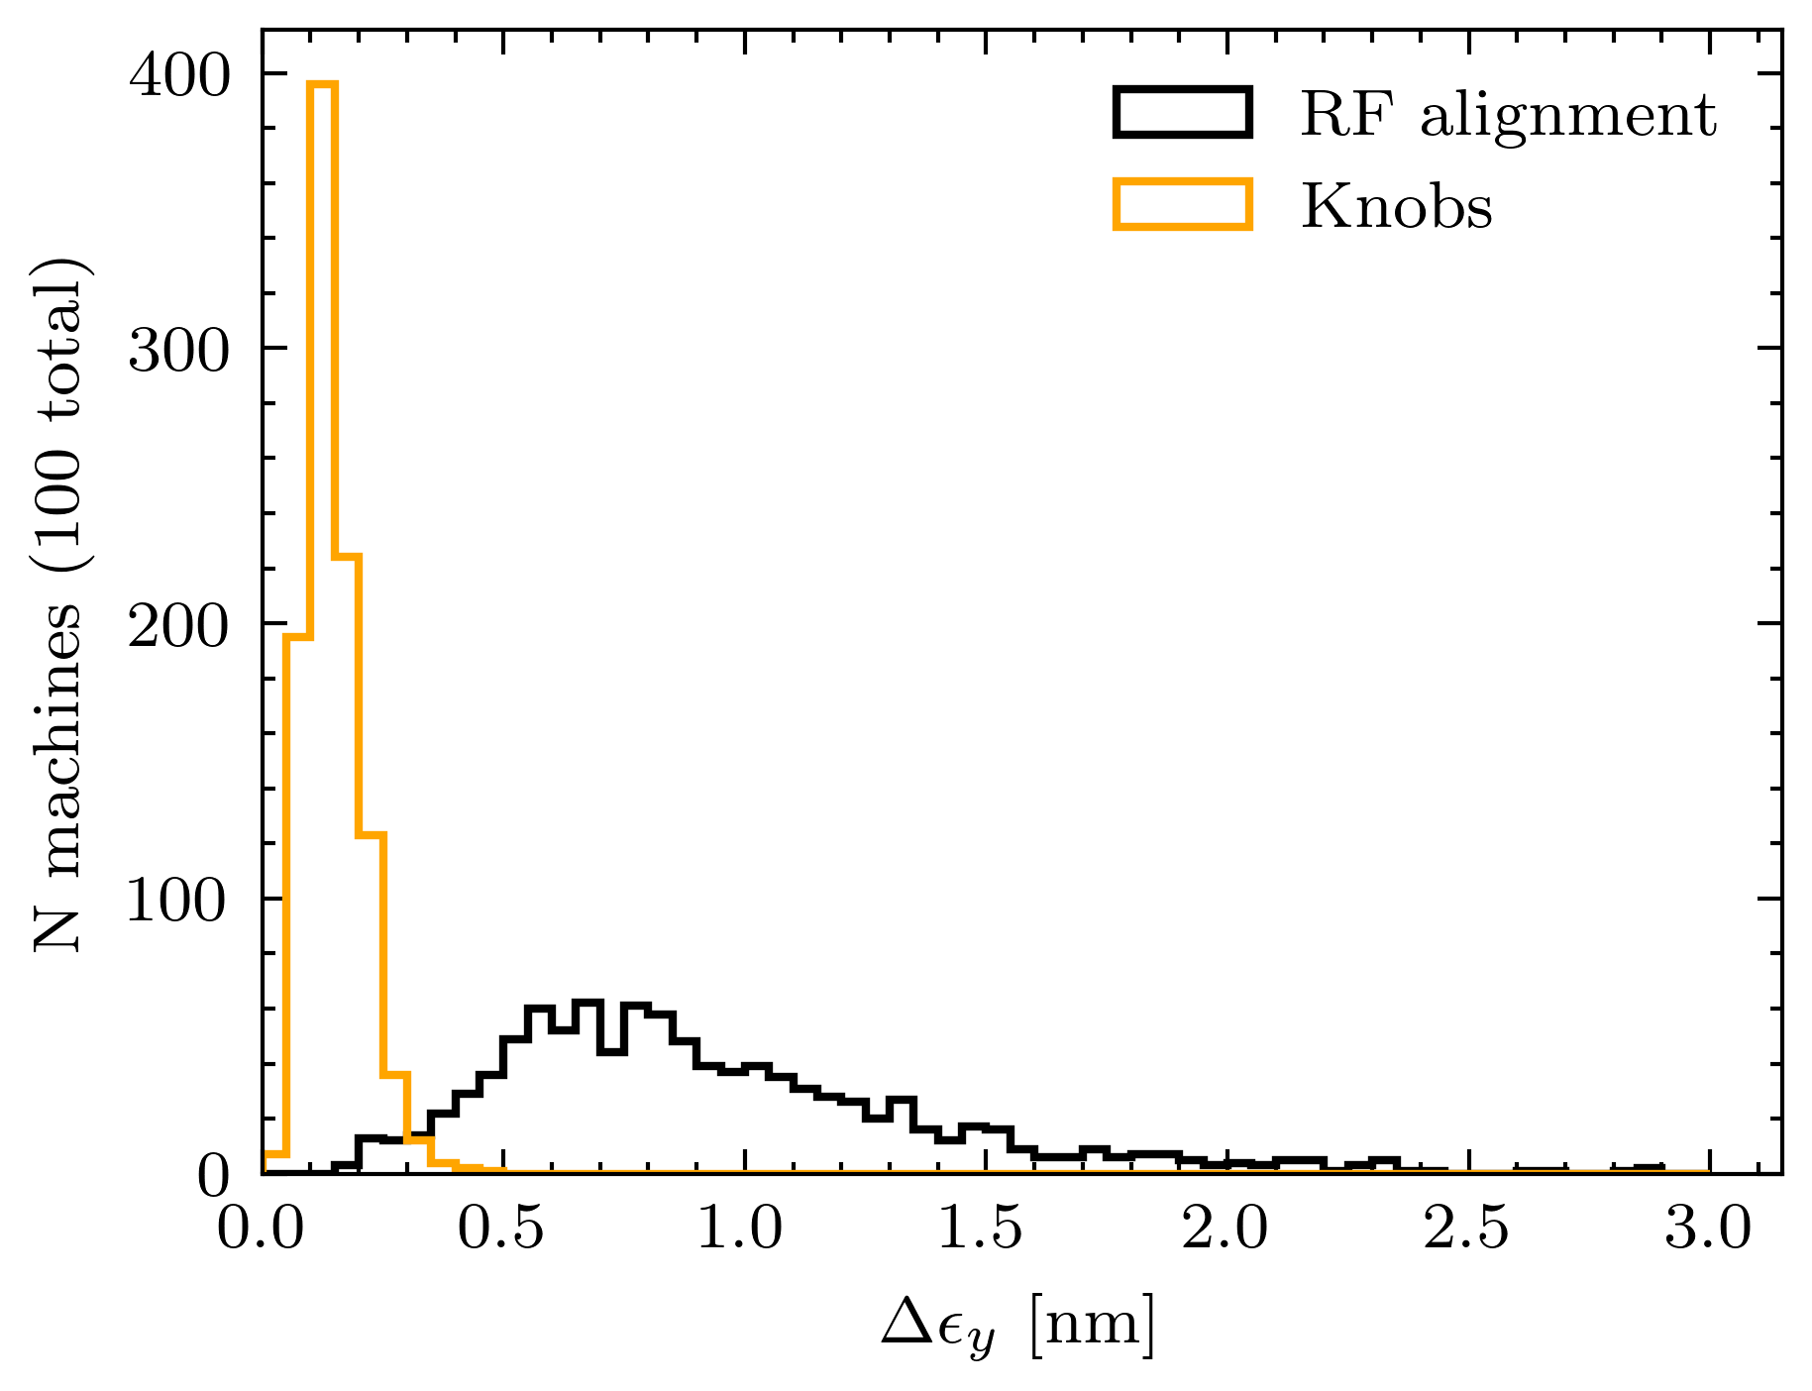
Optimal knobs
Tuning performance
To check the performance of the knobs we simulate the BBA and knobs tuning for in PLACET for 1000 machines
The setup:
  Distribute randomly the static imperfections after the prealignment.
  Apply the BBA: 1-2-1 correction, DFS, and RF alignment
  Scan each knob (Y1 – Y10).
Summary:
100% of the machines have emittance growth < 0.5 nm.
It is possible to squeeze in the budget for static errors down to < 1 nm or even 0.5 nm!
Notes:
To start: So, ultimately, to test the knobs we perform the tuning simulations.
So, we do the test in PLACET. We randomly misalign the elements, perform the BBA and after, we do 1 iteration of 10 knobs.
- On the left, you can see a comparison of the emittance growth before the knobs were applied and after.
In total, 100% of the machines have emittance growth below 0.5 nm.
- So, with 10 emittance tuning knobs, it is possible to reduce the emittance budget even down to 0.5 nm.

Slide 18
Emittance tuning knobs
Tuning performance
Performance of the knobs when the RF alignment is not perfect (accuracy > 3.5 μm)
All the machines respect the budget for up to 25 μm.
The budget is not respected for > ~7 μm
Notes:
To star: Another aspect why such tuning knobs are important.
- But also, if we use another set of the knobs, constucted on the data after the DFS instead of RF alignment.
It is possible to get similar performance to RF alignment. Performance of such knobs is shown on the right.
10 knobs are enough to meet the budget.
These knobs were not optimized the same way I showed previously, but I pretty sure, the results would be the same.
I in no way saying we should not use RF alignment, because these are 2 different ways of correcting.
One is BBA, another one requires emittance measurements (or in reality it would be luminosity).
But as back up solution, could be usefull.

Slide 19
Summary
With a set of emittance tuning knobs it is possible to reduce emittance growth down to < 0.5 nm and consequently increase the luminosity.
Emittance tuning knobs provide additional margin for the emittance budget.
Such a set of knobs can assist when the RF alignment is not perfect.

Slide 20
Thank you for your attention!

Slide 21
Back-up

Slide 22
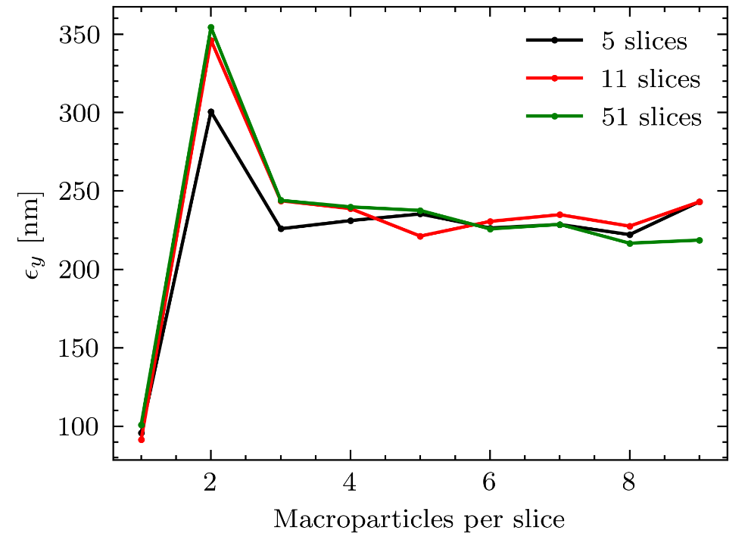
Macroparticle model of the beam
Beam emittance as a function of the number of slices and macroparticles.

Slide 23
Application range of the emittance simplification
Emittance evaluated after the RF alignment
Emittance evaluated after the DFS
works well
Underestimates the emittance

Slide 24
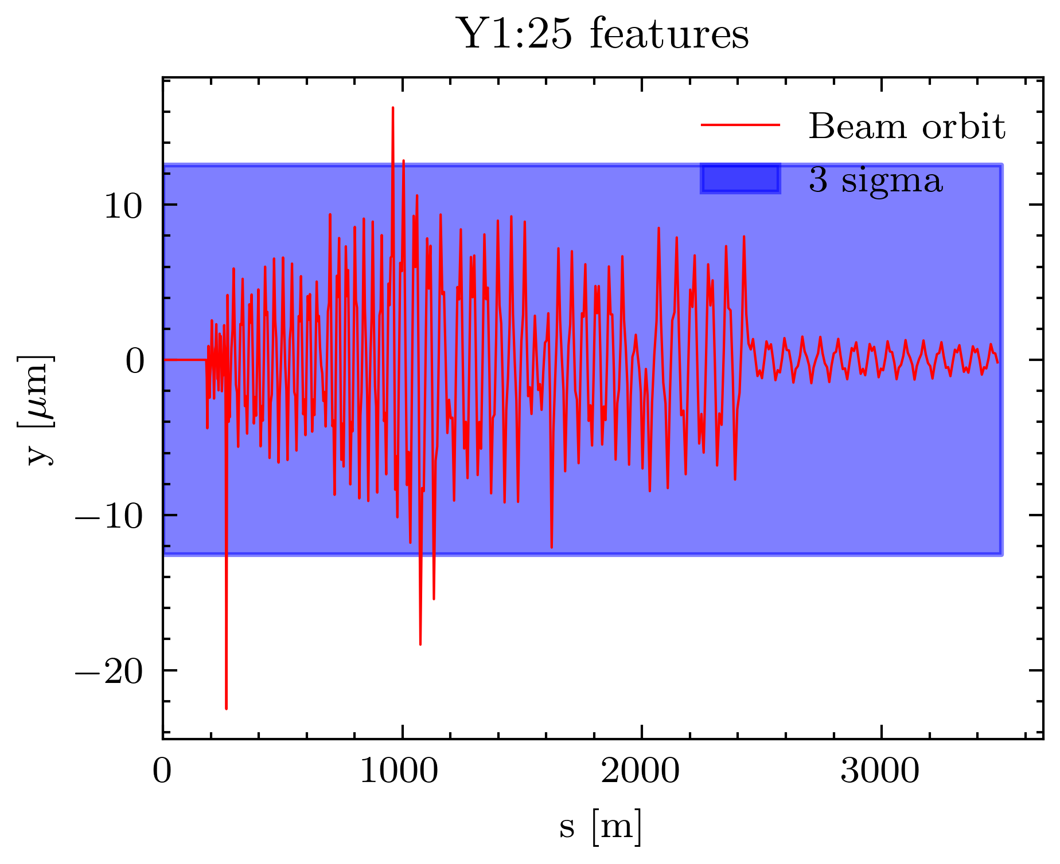
Optimal knob example
Knob Y6
Quads offsets [µm]
13.5
4.3
-1.0
1.1
15.5
3.7
3.1
-1.0
-1.0
10.5
-5.2
1.7

Slide 25
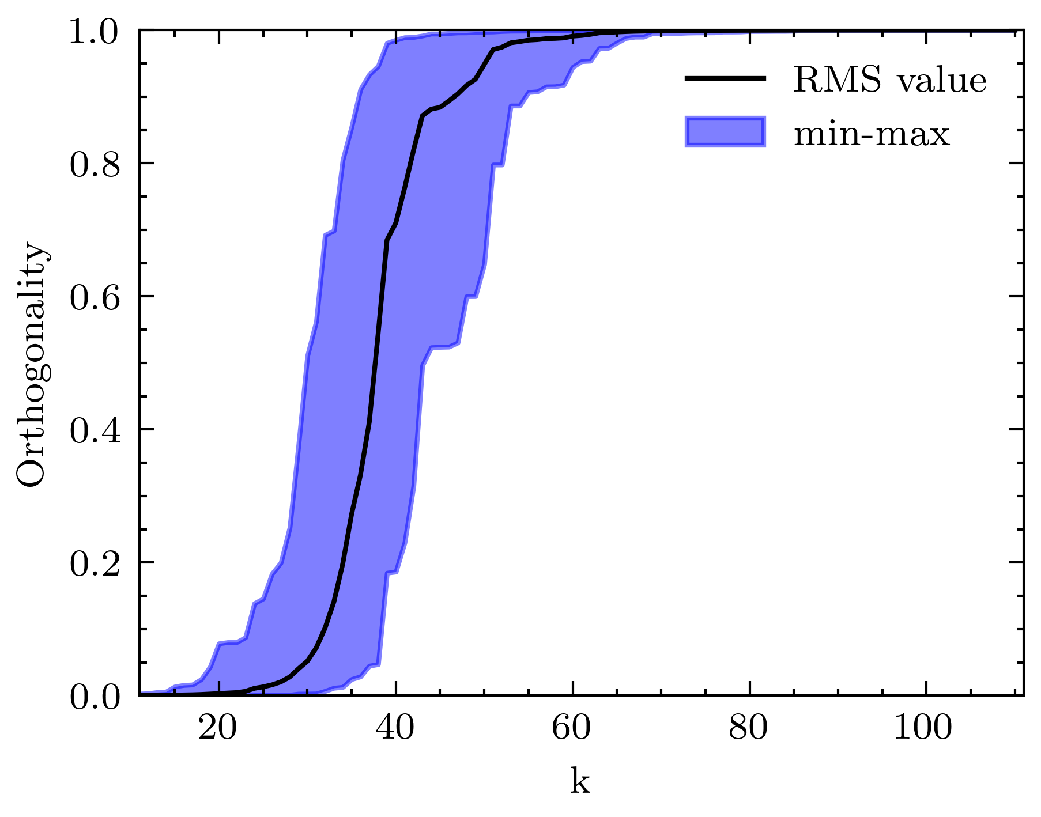
Principal directions
To simplify the analysis I limit the number of principal directions, skipping those that do not contribute to the score.
In the knobs constructions, 70 principal directions were used instead of 110.

