Slide 1


Positron source for CEPC
Xiaoping Li, Cai Meng, Jingru Zhang, Zhe Duan, Jindong Liu, Jie Gao
环形正负电子对撞机
Circular Electron Positron Collider

Slide 2
Content
Parameters and layout of the CEPC Linac
Positron source for CEPC
  Electron beam for positron production
  Positron generation and Pre-acceleration
  R&D of key components for positron source
Other sources related research activities
Summary

Slide 3
Content
Parameters and layout of the CEPC Linac
Positron source for CEPC
  Electron beam for positron production
  Positron generation and Pre-acceleration
  R&D of key components for positron source
Other sources related research activities
Summary

Slide 4
Parameters and layout of the CEPC Linac
Baseline design of the CEPC Linac
  A 30GeV room temperature Linac
  A combination of S-Band (2860MHz) and C-Band (5720MHz)
  The Linac tunnel length is 1.8km
Parameter | Symbol | Unit | Baseline
Energy | E_{e-}/E_{e+} | GeV | 30
Repetition rate | f_{rep} | Hz | 100
Bunch number per pulse |  |  | 1 or 2
Bunch charge |  | nC | 1.5 (3)
Energy spread | σ_{E} |  | 1.5×10⁻³
Emittance | ε_{r} | nm | 6.5

Slide 5
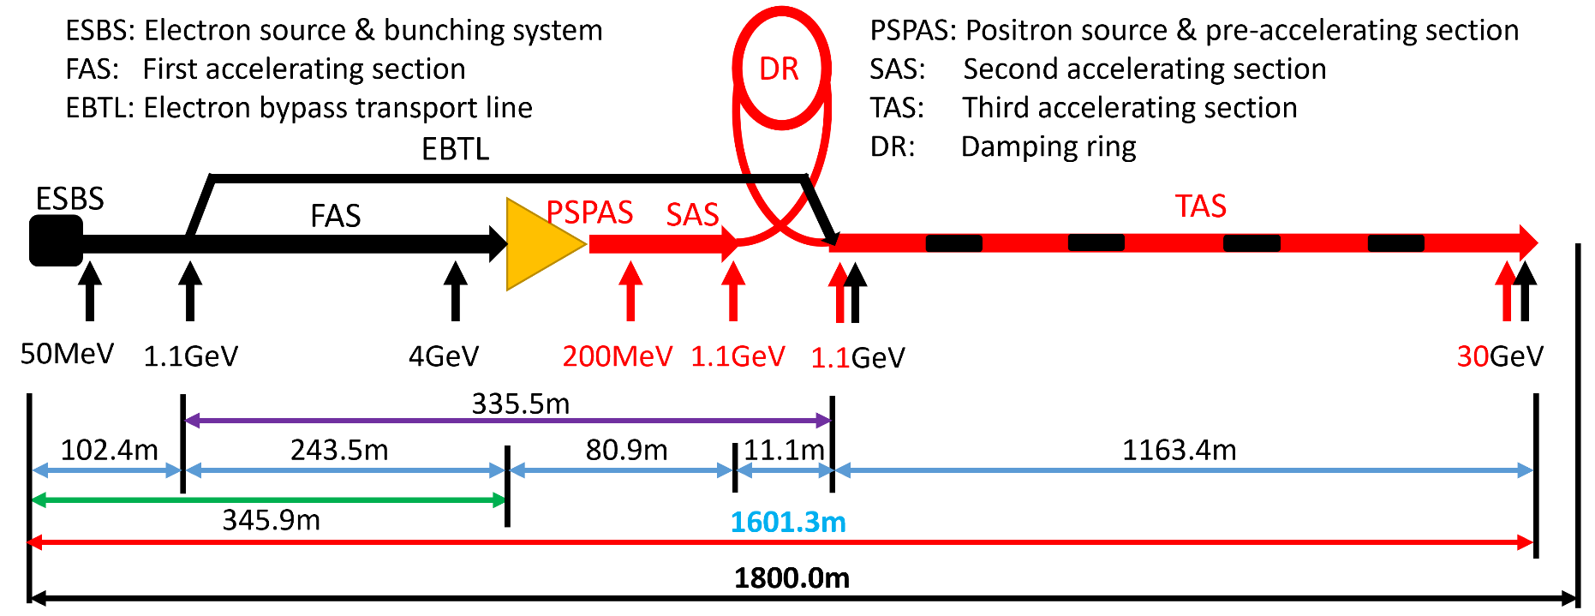
Parameters and layout of the CEPC Linac
Layout of the CEPC Linac
  FAS+PSPAS+SAS：S-Band
  TAS：C-Band（Higher gradient → Shorter linac tunnel length）

Slide 6
Content
Parameters and layout of the CEPC Linac
Positron source for CEPC
  Electron beam for positron production
  Positron generation and Pre-acceleration
  R&D of key components for positron source
Other sources related research activities
Summary

Slide 7
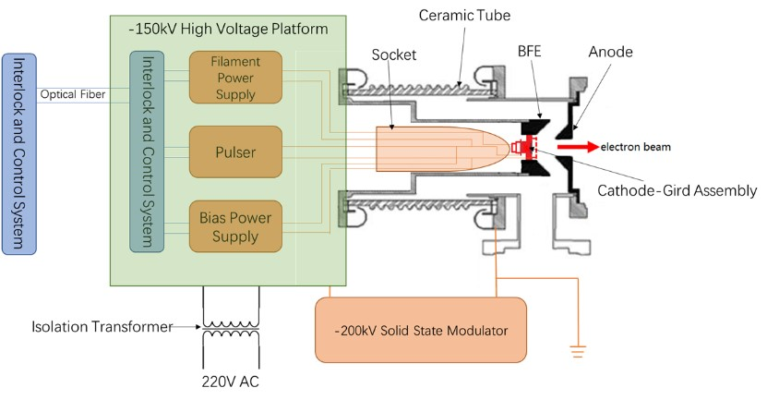
Positron source for CEPC
Electron beam for positron production
Electron source and bunching system (Baseline)
  Electron Gun
    A traditional thermionic triode gun
    3nC for electron injection
    11nC for positron generation
  Bunching
    Two SHBs (158.89MHz/476.67MHz)
    Buncher(2860MHz)
    Accelerating structure (2860MHz)
  Energy: 50MeV
  Normalized Rms Emittance: 80mm-mrad
  Transmission
    90%
  Verified at BEPCII and HEPS Linac

Slide 8
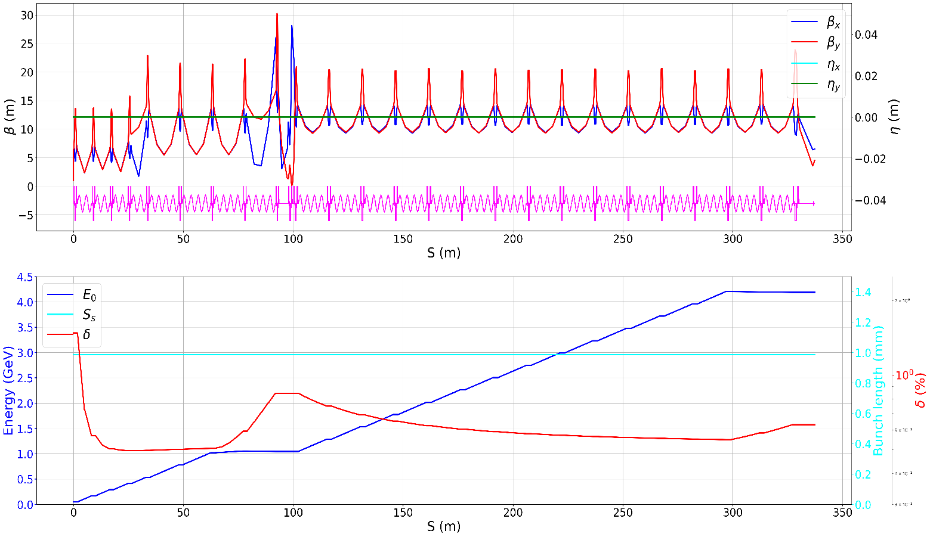
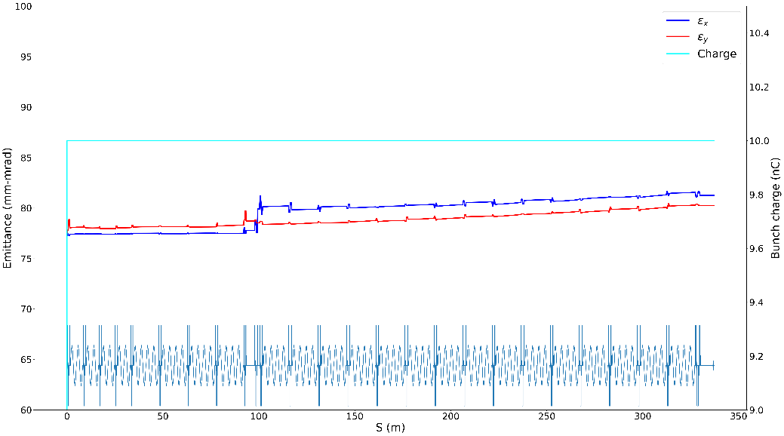
Positron source for CEPC
Electron beam for positron production
Acceleration: 50MeV→4GeV
  18+3(redundancy) S-band klystron
  1 klystron →4 accelerating structures
  Gradient: 22MV/m
Simulation results
  Energy: 4GeV
  Bunch charge: 10nC
  Energy spread: 0.63%
10nC@4GeV electron beam for positron production

Slide 9
Content
Parameters and layout of the CEPC Linac
Positron source for CEPC
  Electron beam for positron production
  Positron generation and Pre-acceleration
  R&D of key components for positron source
Other sources related research activities
Summary

Slide 10
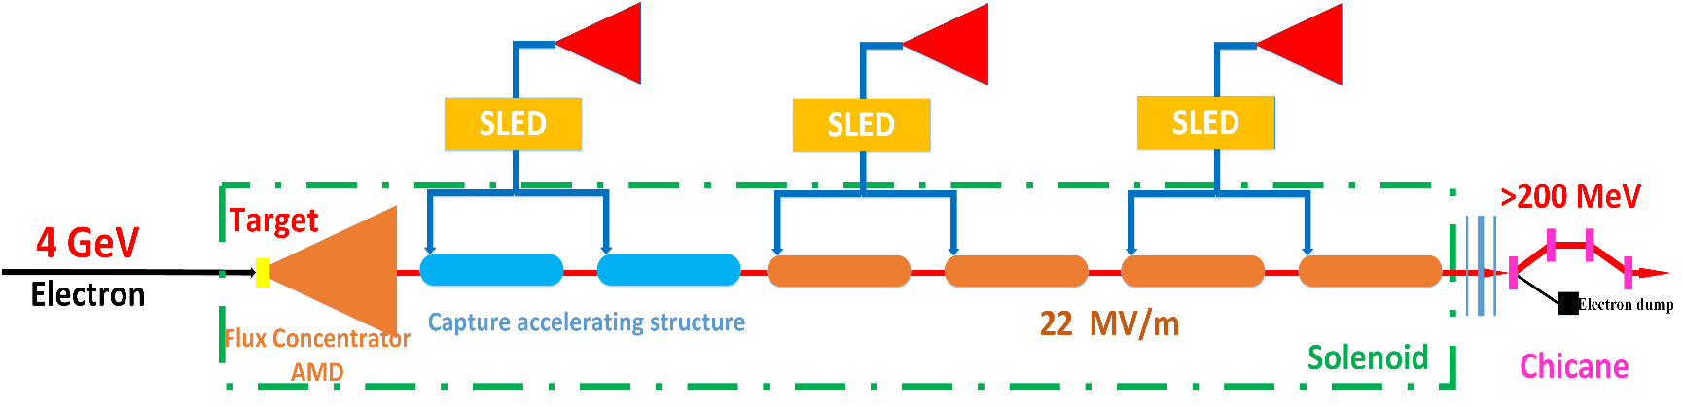
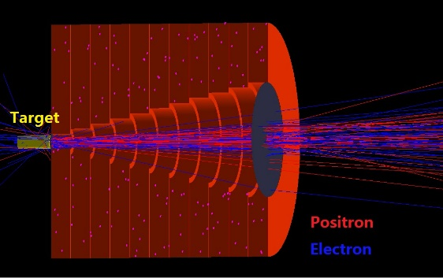
Positron source for CEPC
Positron source and Pre-acceleration
Positron source
  Target (Conventional)
    Electron beam: 10nC@4GeV
    Tungsten@15 mm
    Beam size: 0.5 mm
AMD (Adiabatic Matching Device)
  A flux concentrator
  Magnetic field: (5.5T→0T) + 0.5T Solenoid
Capture & Pre-accelerating section
  1 klystron → 2 accelerating structures
    Larger aperture S-band accelerating structure with aperture is 25 mm, gradient is 22 MV/m and length is 2 m
Chicane @ 200MeV
  Wasted electron separation
  Exit: ~5.5nC, Nor. Emittance: 2370mm-mrad
Notes:
.

Slide 11
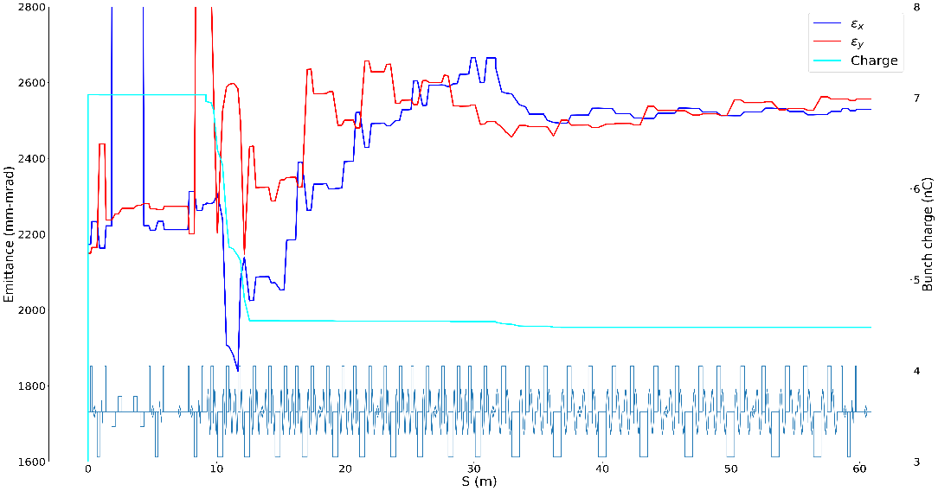
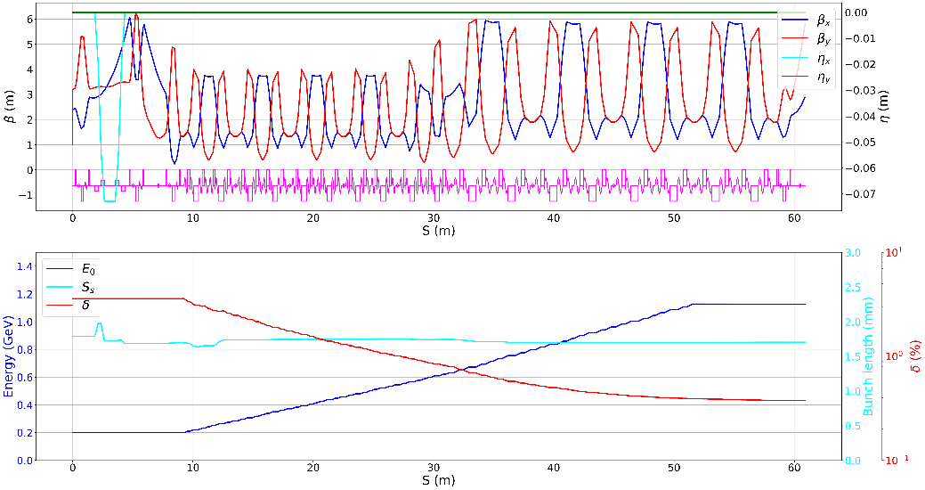
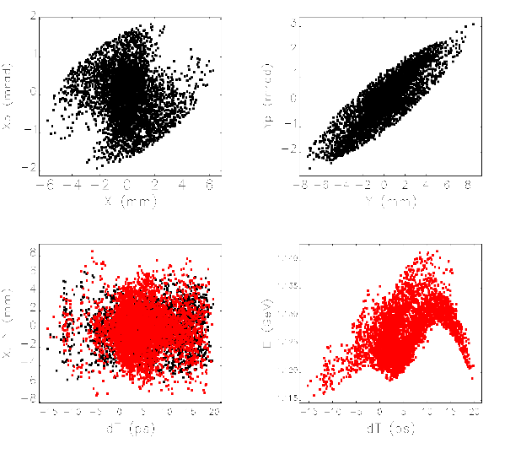
Positron source for CEPC
Positron source and Pre-acceleration
Acceleration：200MeV→1.1GeV
  8+1(redundancy) S-band klystron
  1 klystron →2 accelerating structures
    10 Larger aperture S-band accelerating structure@22MV/m
    8 normal S-band accelerating structure@27MV/m
Transverse focusing
  Triplet quadrupoles are outside of
  each accelerating structure
Simulation results
  Energy: 1.1GeV
  Energy spread: 0.4%
  Bunch charge: ~4.5nC
  Normalized rms Emittance: 2500mm-mrad

Slide 12
Content
Parameters and layout of the CEPC Linac
Positron source for CEPC
  Electron beam for positron production
  Positron generation and Pre-acceleration
  R&D of key components for positron source
Other sources related research activities
Summary

Slide 13
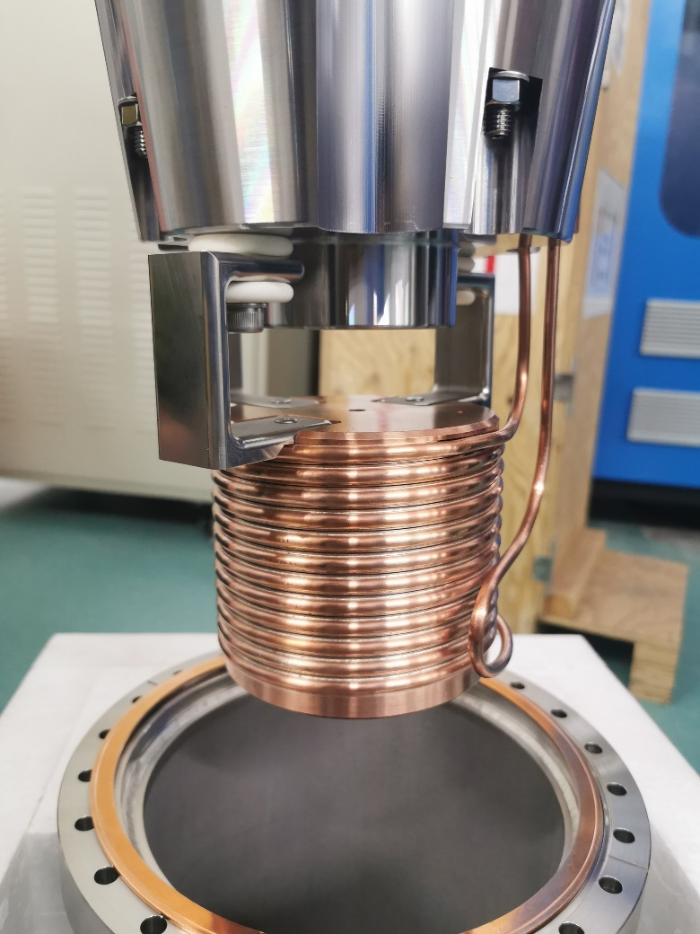
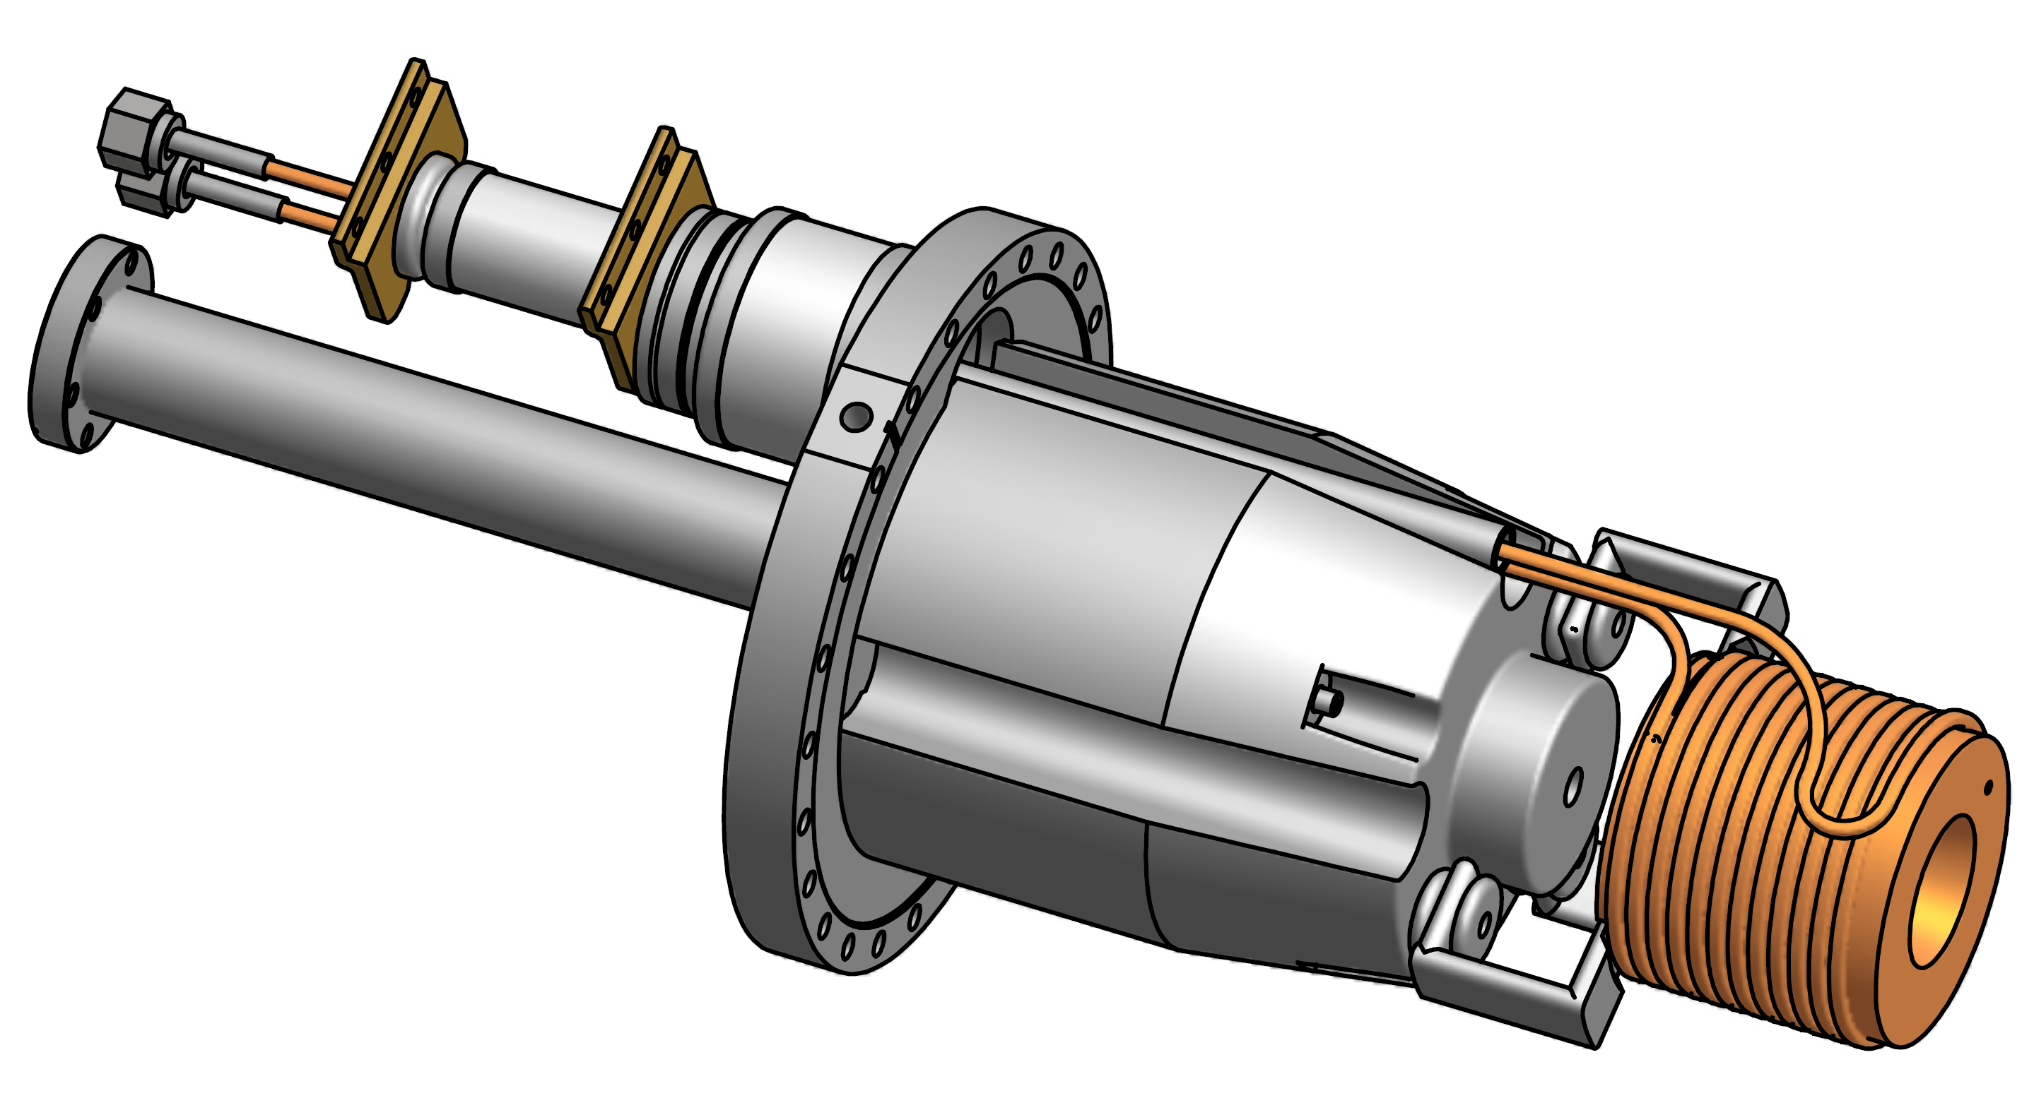
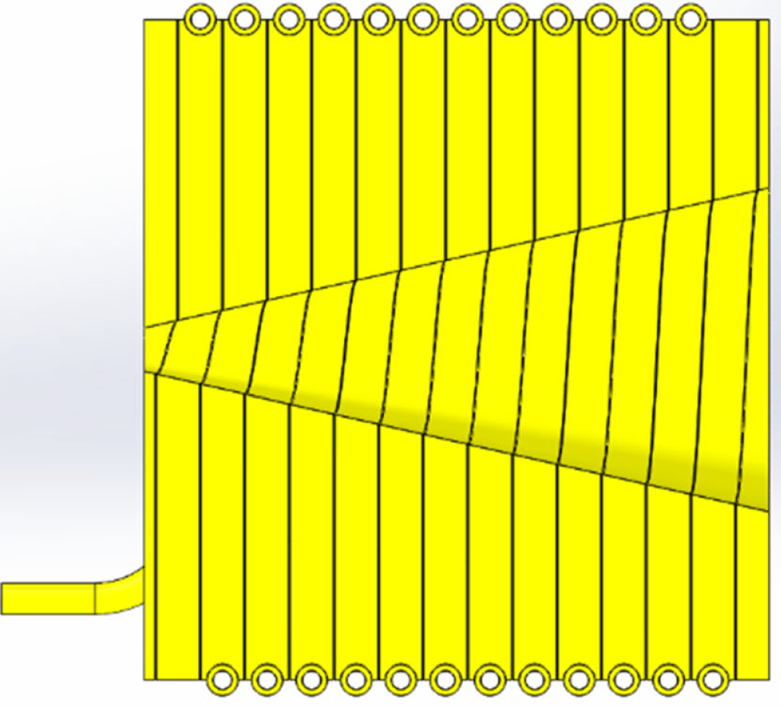
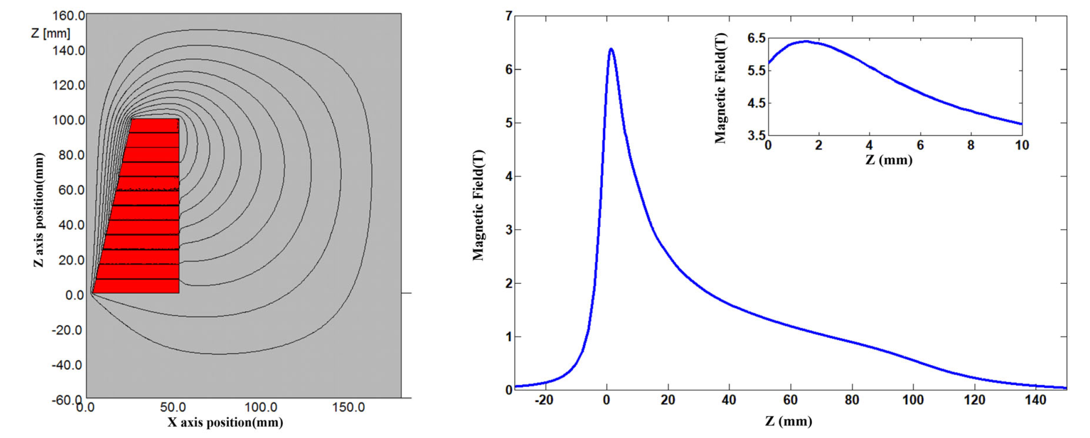
Positron source for CEPC
R&D of key components for positron source
A flux concentrator prototype has been successfully developed
  Manufactured under a cooperation MOU with KEK
  A trumpet-shaped copper coils：12 turns
  The inner diameters：7 to 52 mm
  Coils distance: 0.2 mm
  Total length: 100 mm
  Peak current: 15A
  Max pulse magnetic field: >6T@15kA
Notes:
.

Slide 14
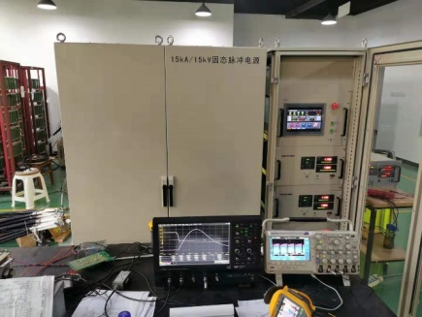
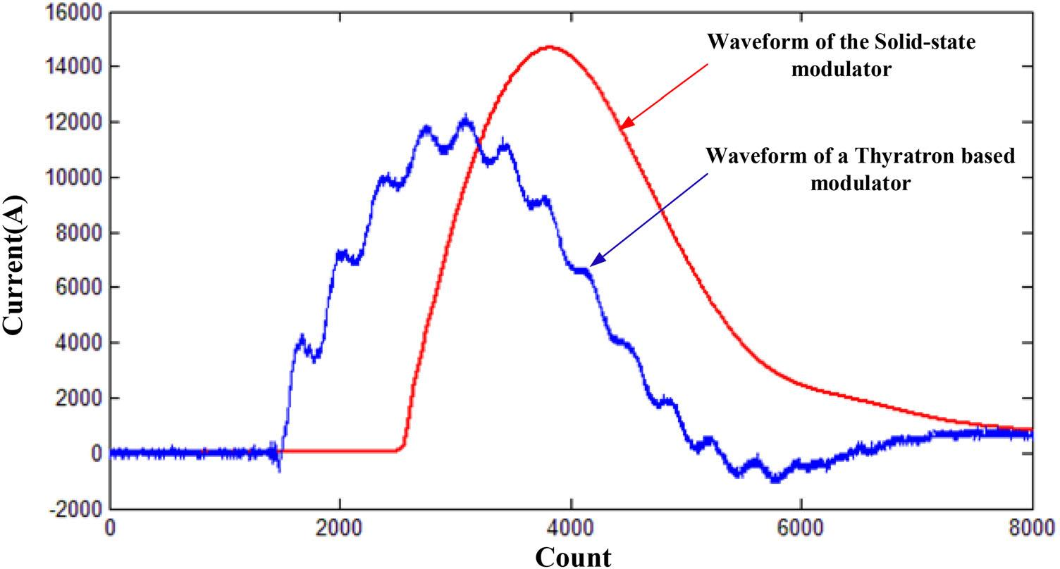
Positron source for CEPC
R&D of key components for positron source
A new pulse modulator has been developed for FC
  All-solid-state switching components IGCT instead of hydrogen thyratron (BEPC II)
  Obtained a higher peak current without high-frequency ripples
  Will be used for BEPCII operation this September
Parameters | Value
Input voltage | 380 V ±10%
Output pulse current | 15 kA
Pulse width | 5 μs
Output waveform | Half sine
Capacity peak voltage | 15 kV
Current stability | < 0.1%
Notes:
.

Slide 15
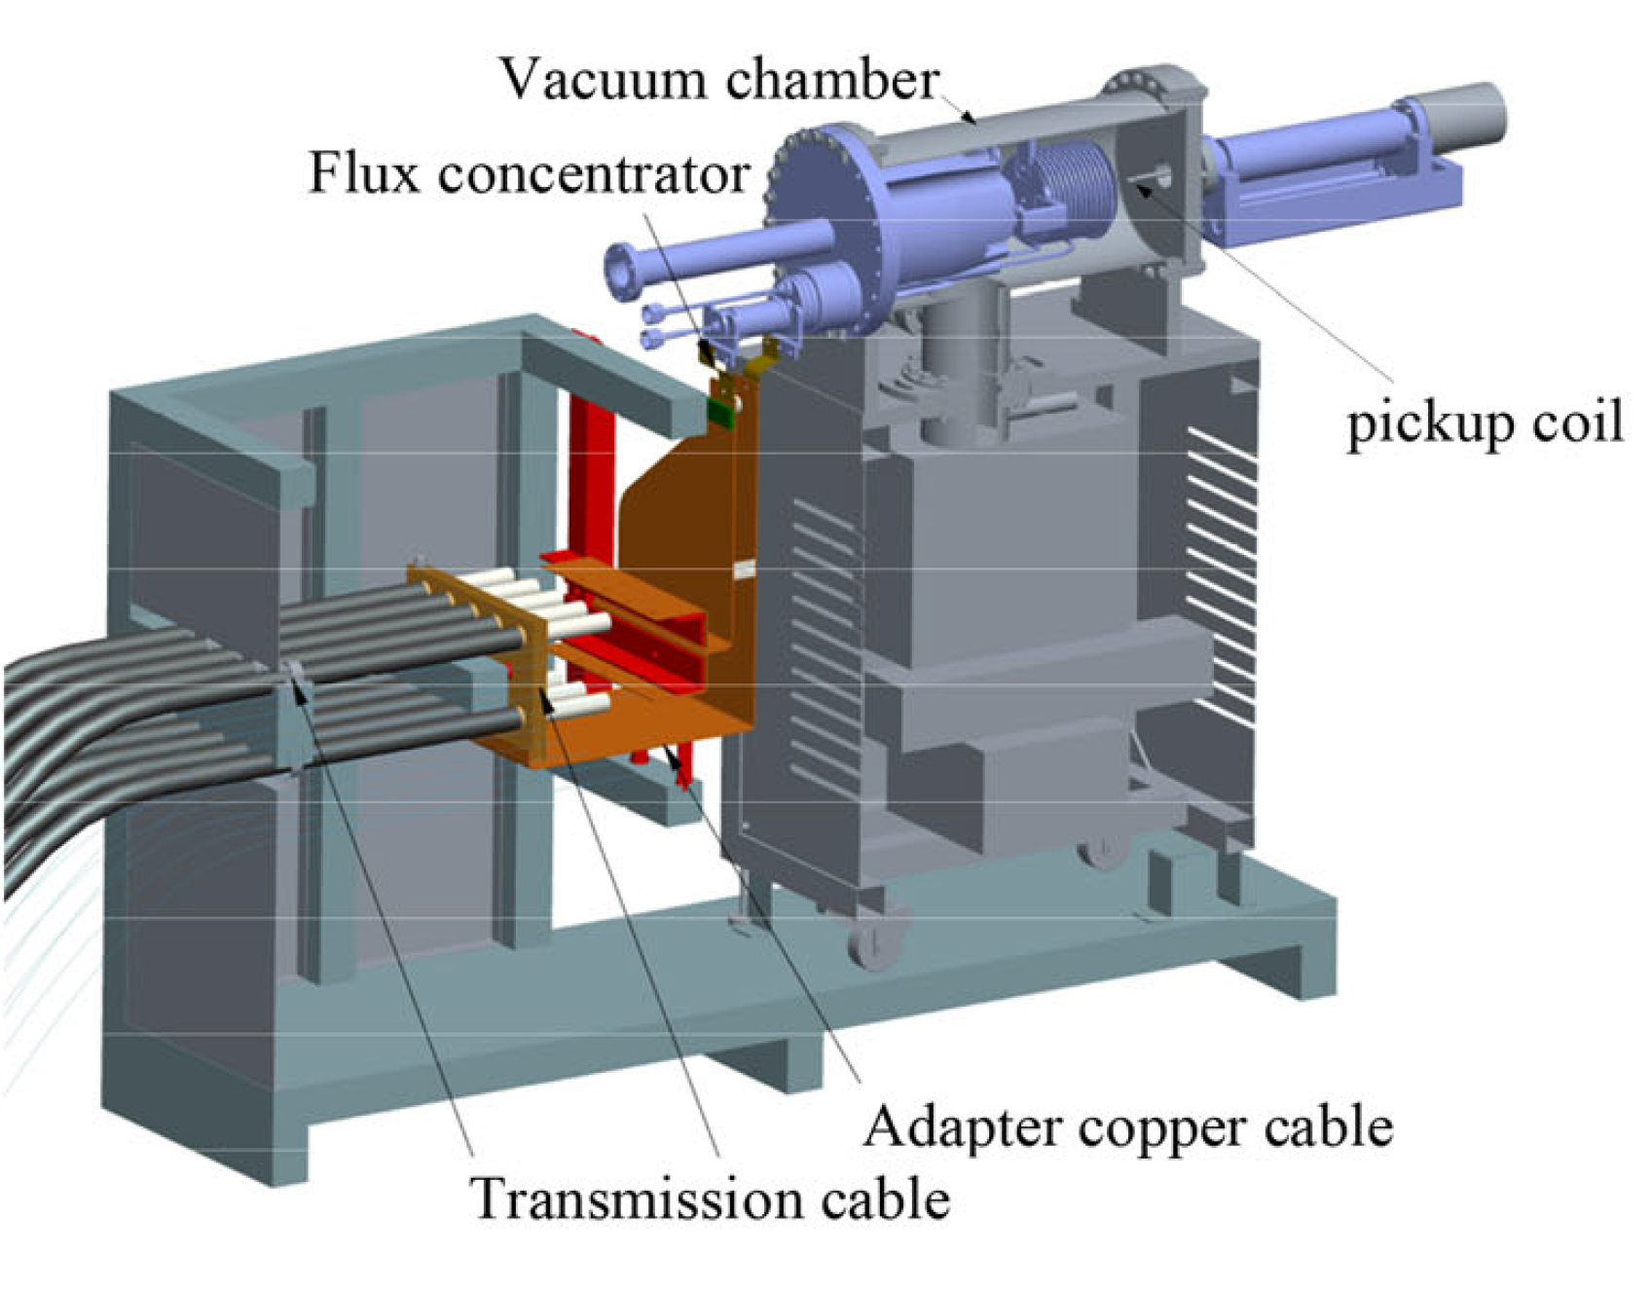
Positron source for CEPC
R&D of key components for positron source
Test results of the FC
  A test bench has been built up for performance verification of the FC
  The test results of FC agreed well with the designed parameters
  A peak magnetic field of 6.2 T had been obtained inside the FC at a 15kA driving current
  Can meet the requirements of CEPC positron source baseline design
Notes:
.

Slide 16
Content
Parameters and layout of the CEPC Linac
Positron source for CEPC
  Electron beam for positron production
  Positron generation and Pre-acceleration
  R&D of key components for positron source
Other sources related research activities
Summary

Slide 17
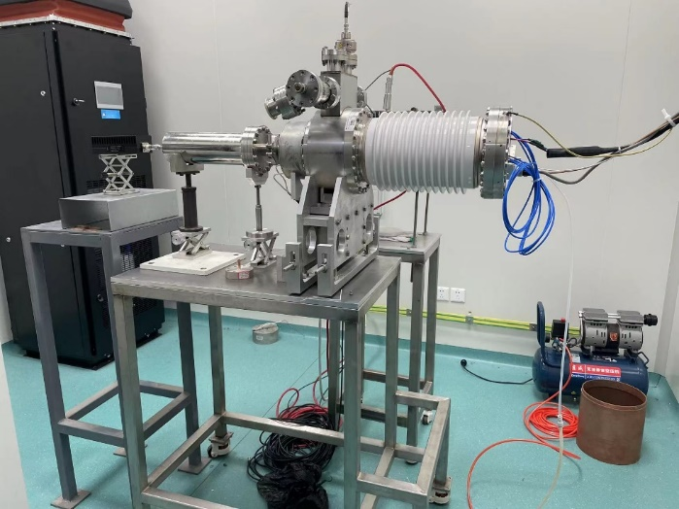
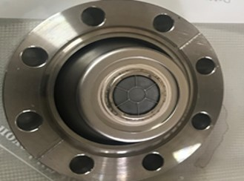
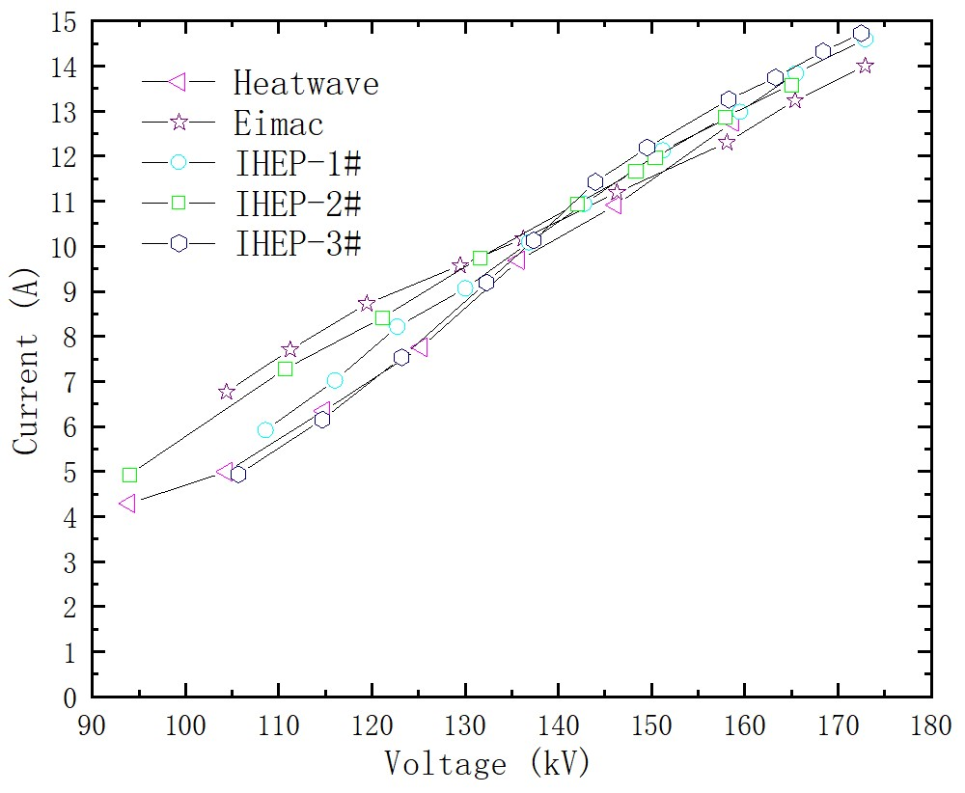
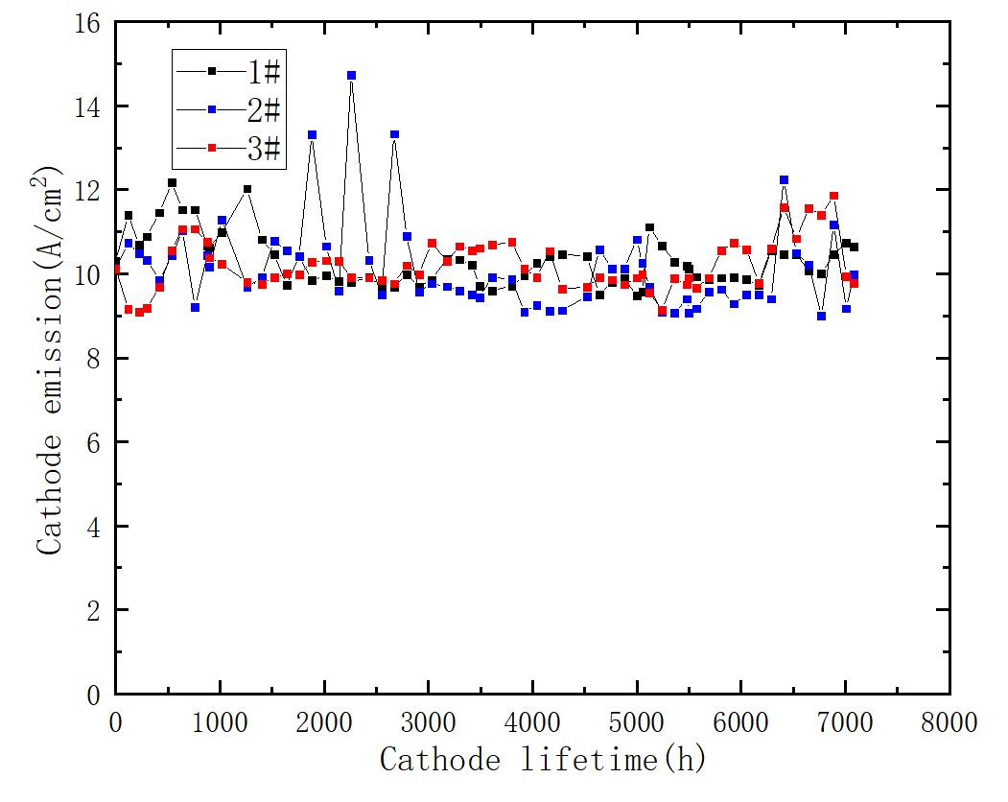
Other sources related research activities
A thermionic triode gun
  A prototype of electron gun and its test platform had been built up
    Used for domestic cathode-grid assembly R&D
    The cathode emission capacity had been tested up to 12A@150kV
    The emission capacity does not decrease within 7000 hours operation
Notes:
.

Slide 18
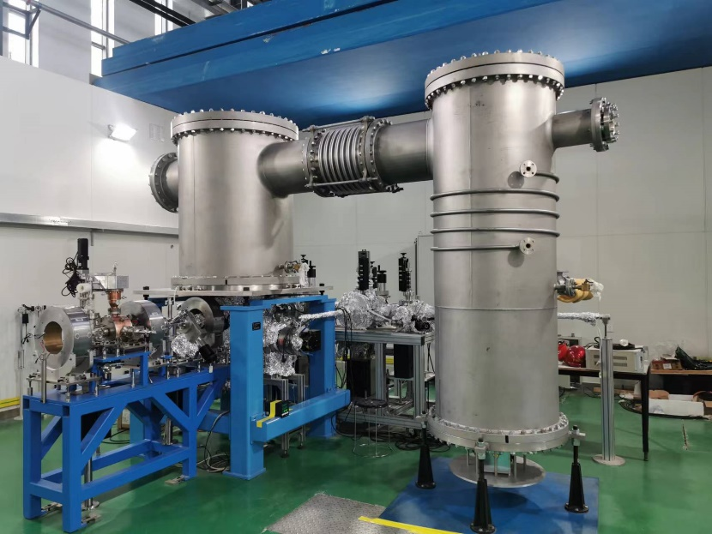
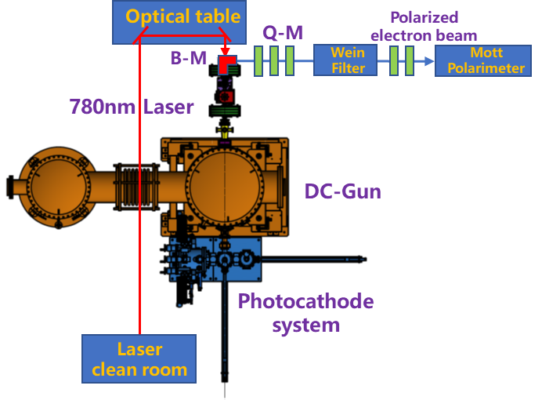
Other sources related research activities
A polarized electron source R&D plan
  Based on a 500kV photocathode dc-gun has been built up at PAPS, Huairou, Beijing
    Superlattice photocathodes R&D collaborating with a domestic company (Acken, Suzhou)
    Research on the polarization manipulation and measurement (Collaborate with JGU, Mainz)
    Two-stage experiments will be considered in near future (200kV/400kV)
Notes:
.

Slide 19
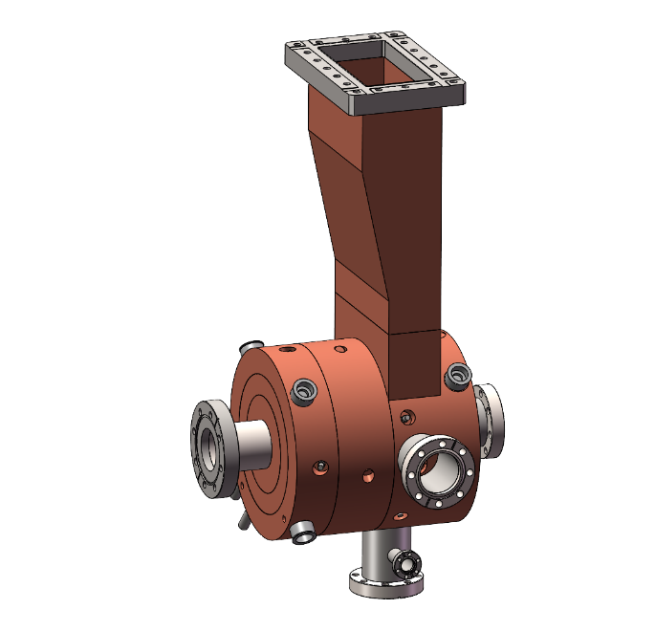
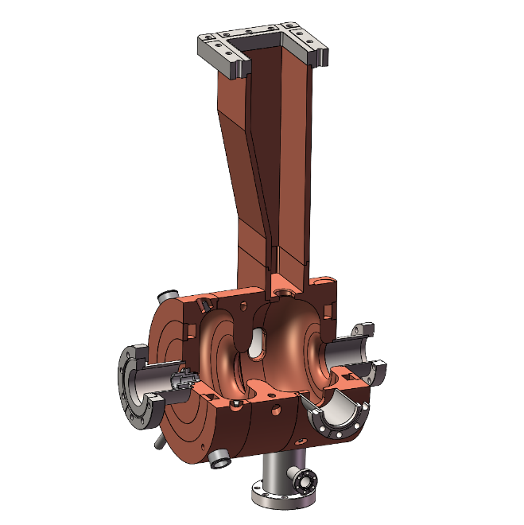
Other sources related research activities
A L-Band photocathode RF Gun
  A L-Band photocayhode RF Gun has been developed (Under processing now)
  Potential for generating high bunch charge electron beam (≥10nC）
    An alternative solution for the thermionic gun of CEPC Linac
    Avoiding additional frequency introduced by SHBs which lead to a complex timing system for CEPC
  Developed for PWFA experiment research on BEPCII (A project has been approved by CAS)
Parameters | Value | Unit
Frequency | 1299.48 | MHz
Cell | 1.55 | cell
Input power | 6.5 | MW
Q factor | 24291 | -
Gradient at cathode | 60 | MV/m
RF pulse length | 10 | μs
Notes:
.

Slide 20
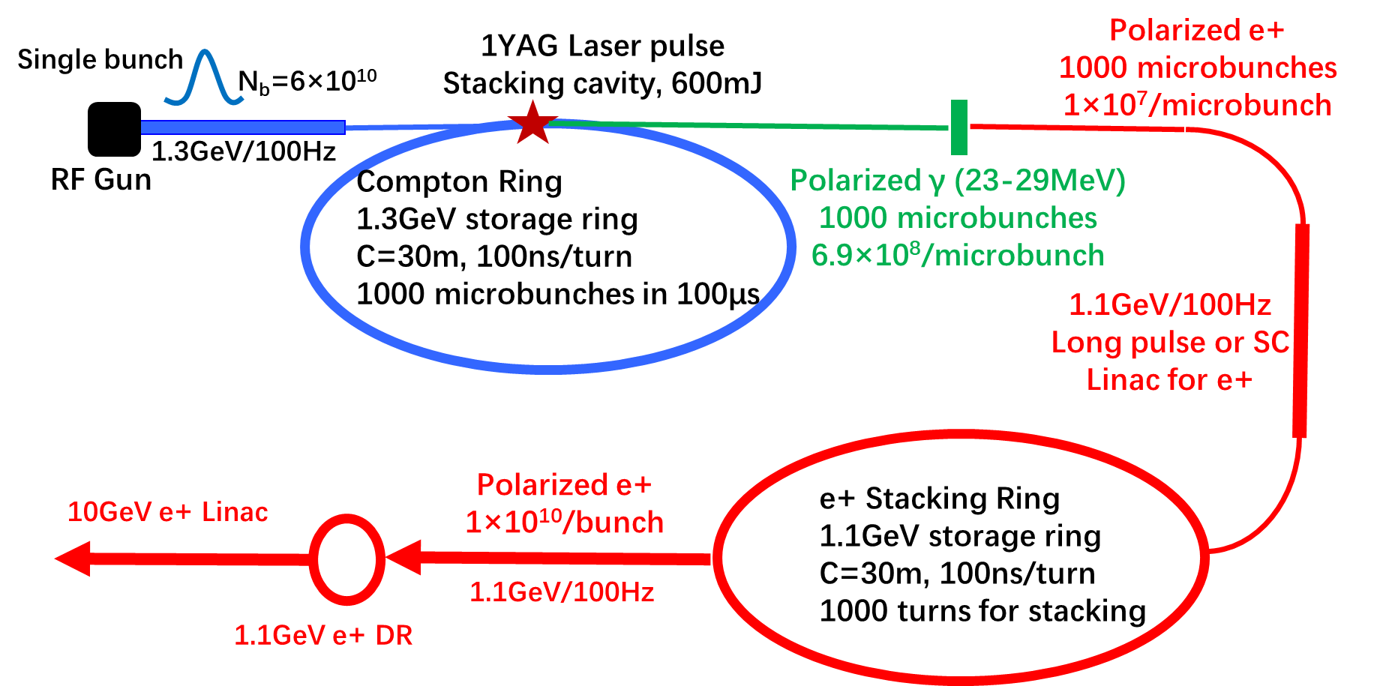
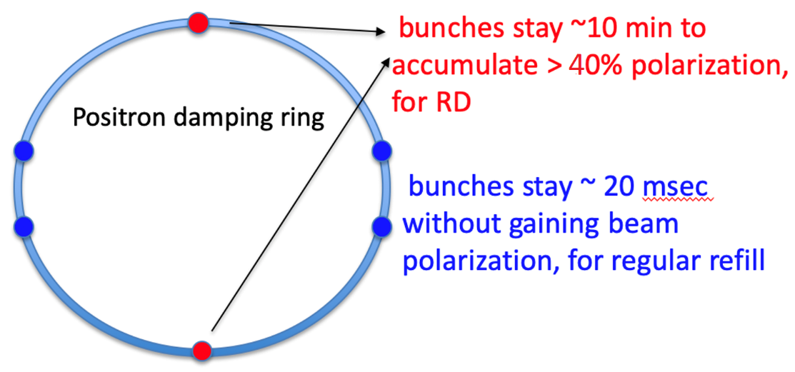
Other sources related research activities
Polarized positron beam generation
  Preliminary consideration on a Compton Ring and a Stacking Ring for the generation of polarized e+ beams~1×10¹²e+/second
    A potential solution to generate polarized positrons in CEPC
    Up to now, just a conceptual consideration (requires a lot of further simulation works in future)
  Using the self-polarization to generate polarized e+ beams in DR
    Need a higher energy in DR around 2GeV and a strong dipole strength
    Current research shows that extracted beam polarization @ 10min ~ 44%
Very promising for resonant depolarization
Notes:
.

Slide 21
Content
Parameters and layout of the CEPC Linac
Positron source for CEPC
  Electron beam for positron production
  Positron generation and Pre-acceleration
  R&D of key components for positron source
Other sources related research activities
Summary

Slide 22
Summary
The CEPC Linac is a 30 GeV room temperature S-band and C-Band combined linear accelerator working at 100Hz.
Positron source for CEPC adopting a conventional scheme.
A flux concentrator prototype and its pulse modulator has been developed and tested.
Other sources related research activities in IHEP are mentioned.

Slide 23

Thank you for your attention!

Slide 25
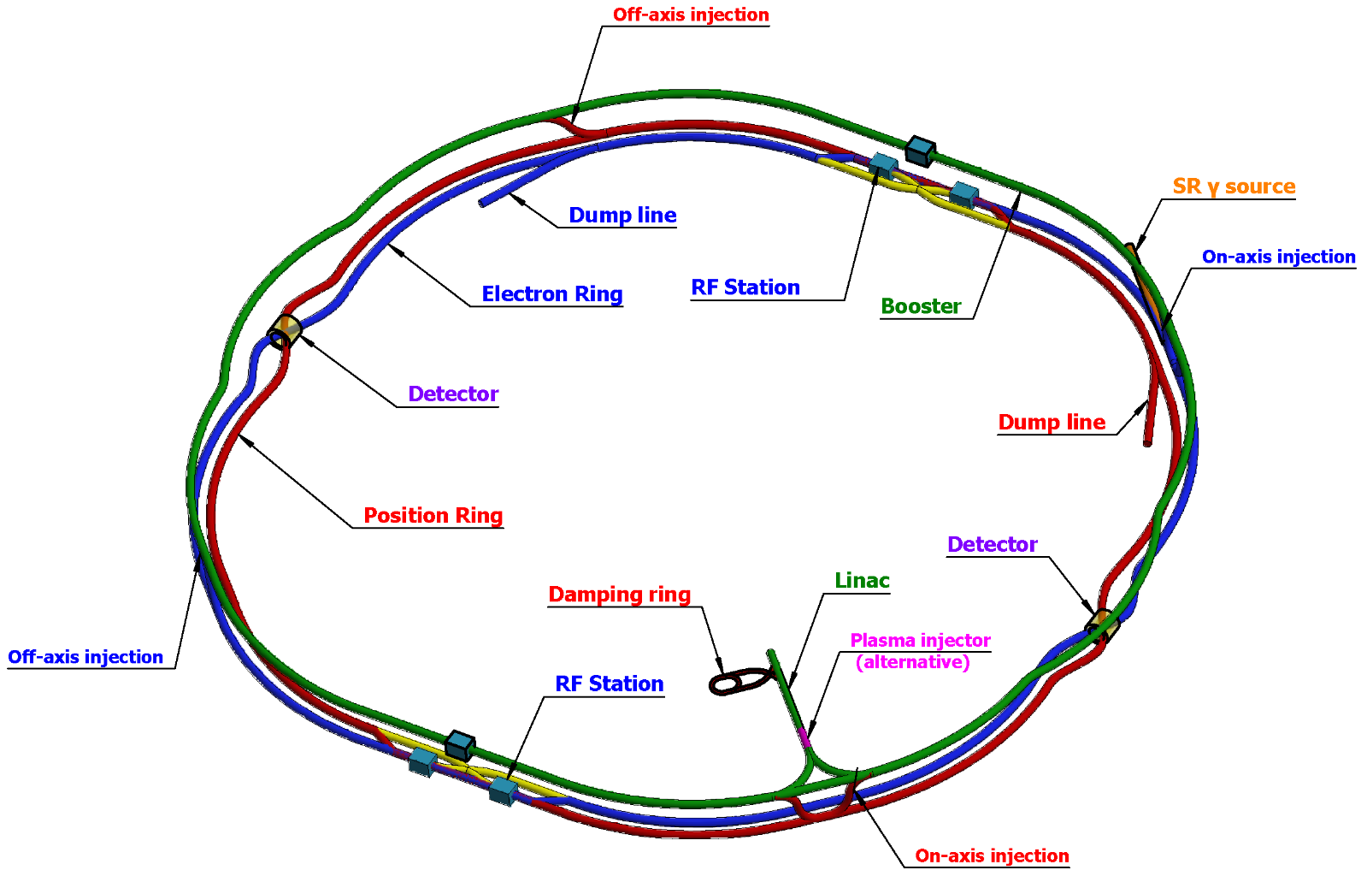
Introduction: CEPC Layout
CEPC as a Higgs (ttbar,H, W, Z) Factory
  Linac, 30GeV, 1.8km
  Full energy Booster, 100km
  Collider, 100 km
  Transport lines
Linac design
  Meet requirements
  High availability
  Reserve upgrade potential

Slide 26
Introduction: Linac energy
The maximum energy of booster is 180GeV and circumference is 100 km
  Large circumference & Low injection energy → Low magnetic field
    design difficulty in magnet (field) and power supply (stability)
  Large extraction energy → Large field range
    design difficulty in magnet (excitation efficiency) and power supply (power)
Increasing the energy of the Linac is the easiest way: 30 GeV
Magnet |  | Low injection energy |  |  | Max. Extraction energy | Cost
 |  | 10GeV | 20GeV | 30GeV | 180GeV
CT Air-core coil |  | Yes | Yes | Yes | No | Very high
iron-corn magnet | oriented silicon steel sheet | No | Yes | Yes | Yes | high
 | Non-oriented silicon steel sheet | No | No | Yes | Yes | low
Wen Kang
Session M2-2: #1
effect of residual magnetism

Slide 27
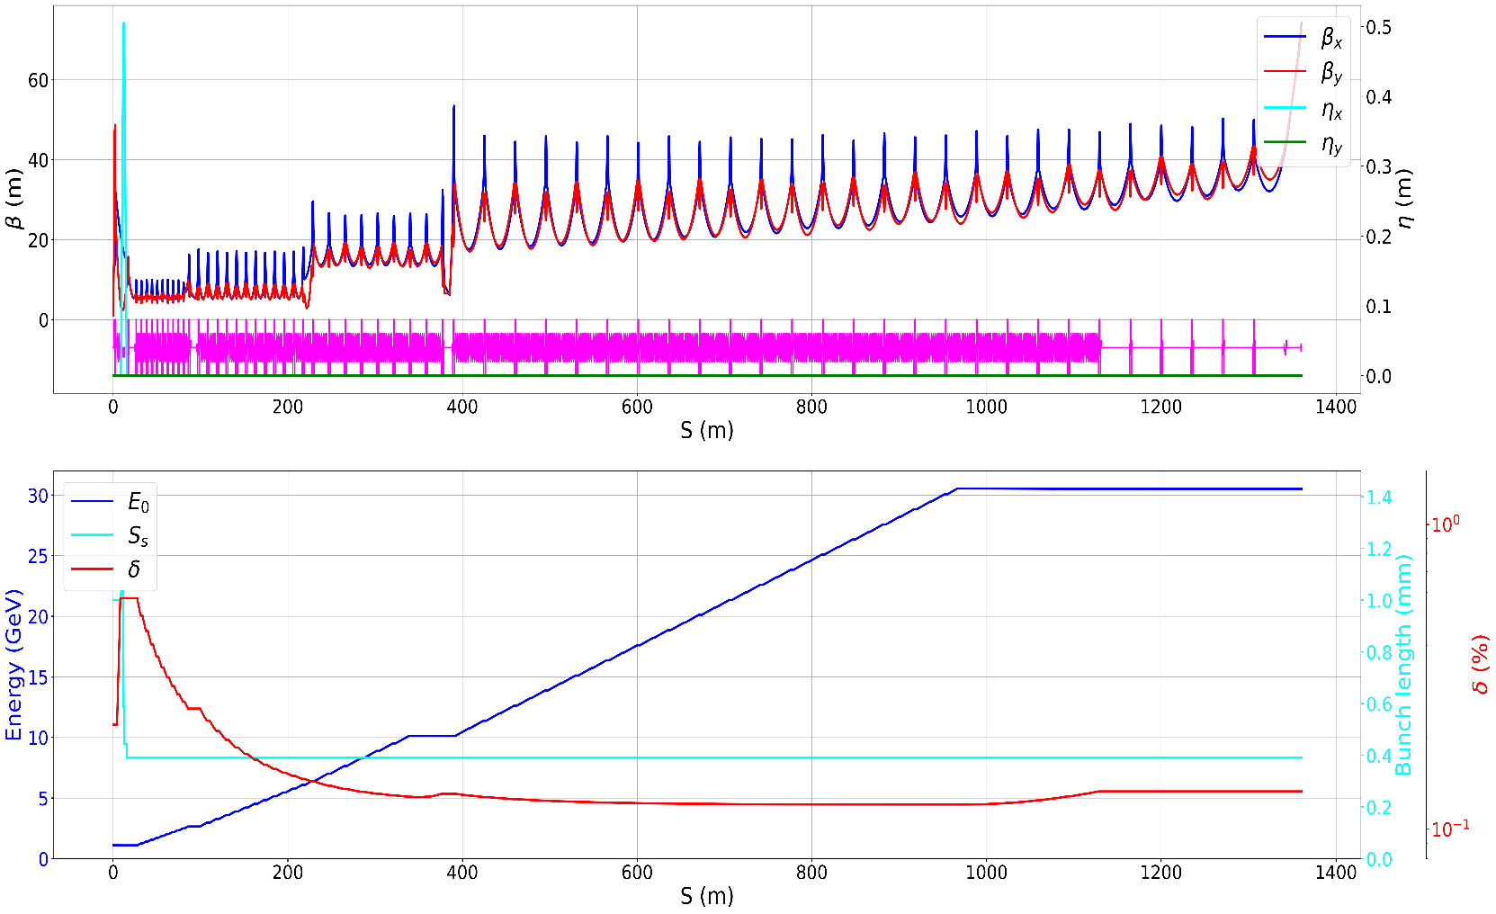
Positron Linac: TAS
Simulation results( including Wakefield & CSR)
Parameter | Unit | Value | Simulated
 |  |  | Positron
Beam energy | GeV | 30 | 30.50 | 30.01
Repetition rate | Hz | 100 | /
Bunch charge | nC | 1.5 | 1.5 | 3.0
Energy spread | 10⁻³ | 1.5 | 1.33 | 2.19
Emittance(x/y) | nm | 6.5 | 3.37/1.68 | 3.90/1.71
Bunch length (RMS) | mm | / | 0.4 | 0.4
@3nC

Slide 28
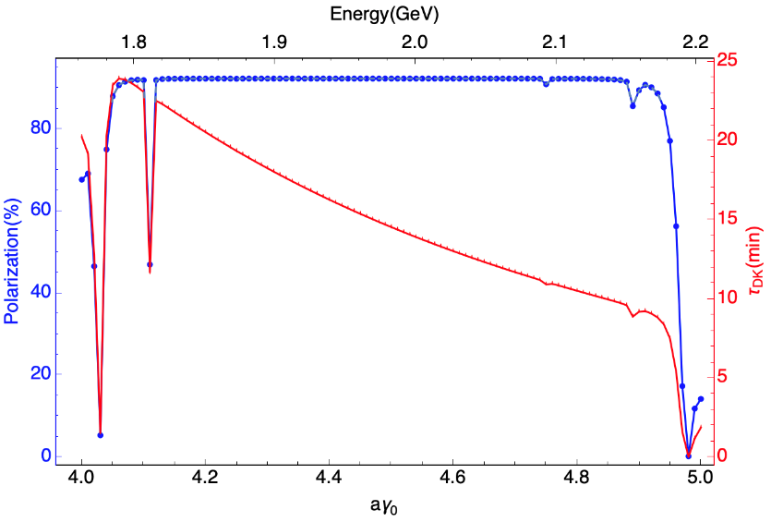
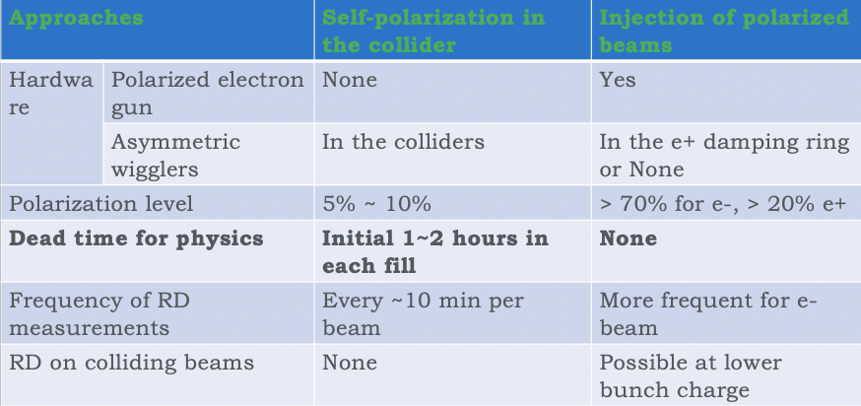
Positron damping/polarizing ring
Using the self-polarization to generate polarized e+ beams
  For Resonant depolarization (very promising)
    extracted beam polarization @ 10min ~ 44%
    No physics dead time, improved availability & int. luminosity
  for polarized colliding beams (under study)
    Higher energy and/or asymmetric wigglers
    More bunches
DR V4.0 | unpolarized e+ | polarized e+
Energy (Gev) | 1.983
Circumference (m) | 144.2
Number of trains | 2(4)
Number of bunches/trian | 1(2)
Total current (mA) | 12.4
Dipole strength B₀ (T) | 1.92
U₀ (kev/turn) | 397.9
Damping time x/y/z (ms) | 4.8/4.8/2.4
Momentum compaction | 0.0078
Storage time | 20 ms | 10 min
δ₀ (%) | 0.0917
ε₀ (mm.mrad) | 132
injection σ_{z} (mm) | 6
Extract σ_{z} (mm) | 6.7 | 6.6
ε_{inj} (mm.mrad) | 2500
ε_{ext x/y} (mm.mrad) | 133/13 | 132/13
δ_{inj} /δ_{ext} (%) | 0.18 /0.092
RF acceptance (%) | 1.85
Longitudinal tune | 0.025

Slide 29
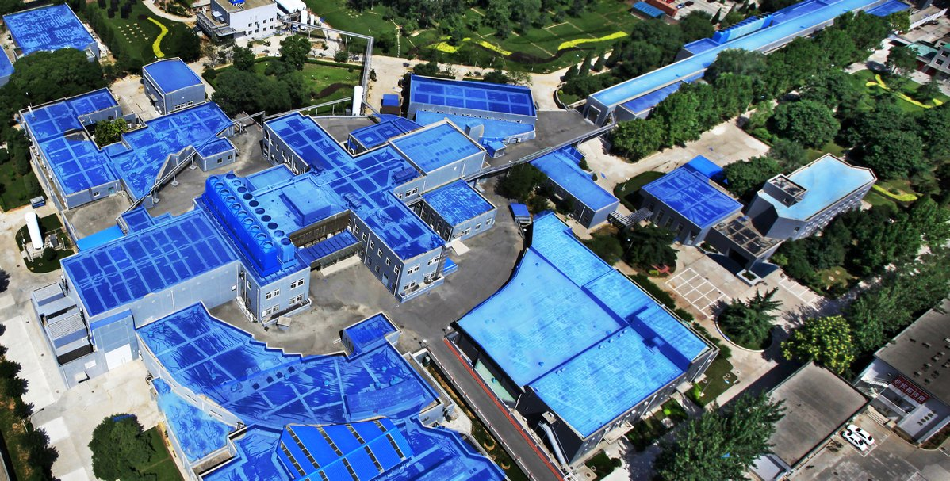
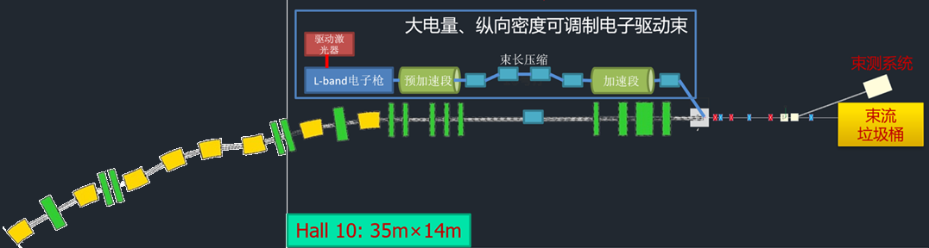
基于BEPCII，打造正电子加速、级联加速独特研究平台
针对正电子加速、尾场级联加速及外注入级联等关键科学挑战的研究需求，基于BEPCII高能正负电子束流，结合大电量电子驱动器，建设世界独有的束流驱动尾场加速研究平台
BEPCII 2 GeV正负电子束流

Slide 30
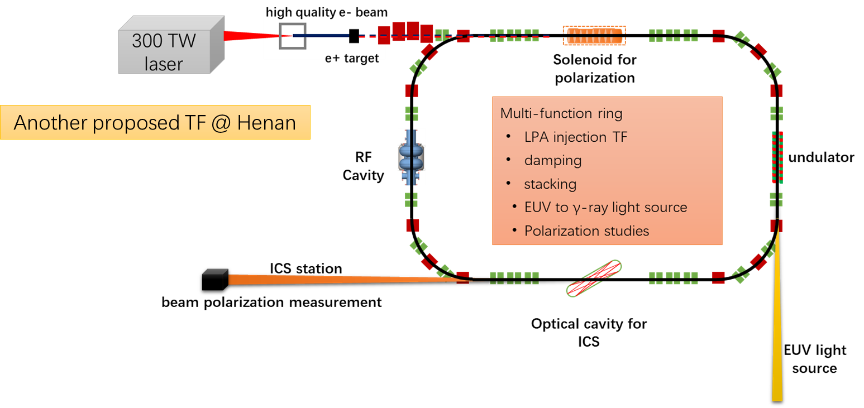

激光等离子加速器 + 储存环 test facility @ 河南

