Slide 1
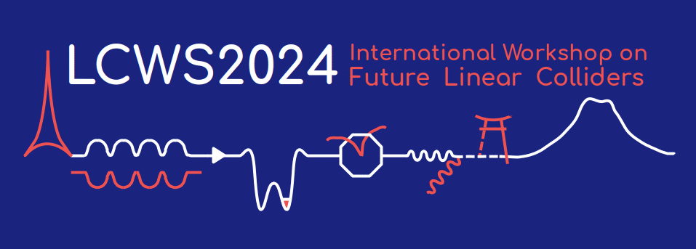


Development of the RF power distribution System for the ILC Prototype Cryomodule
LCWS2024
2024/07/09
Prakash JOSHI

Slide 2
Contents
International Linear Collider (ILC) and its main linac
Local power distribution system (LPDS) for ILC Technology Network (ITN) cryomodule
Proposed updates in the ILC power distribution system (PDS)
Concept of circulator-less LPDS
Summary

Slide 3
International Linear Collider (ILC) and its main linac
Local power distribution system (LPDS) for ILC Technology Network (ITN) cryomodule
Proposed updates in the ILC power distribution system (PDS)
Concept of circulator-less LPDS
Summary

Slide 4
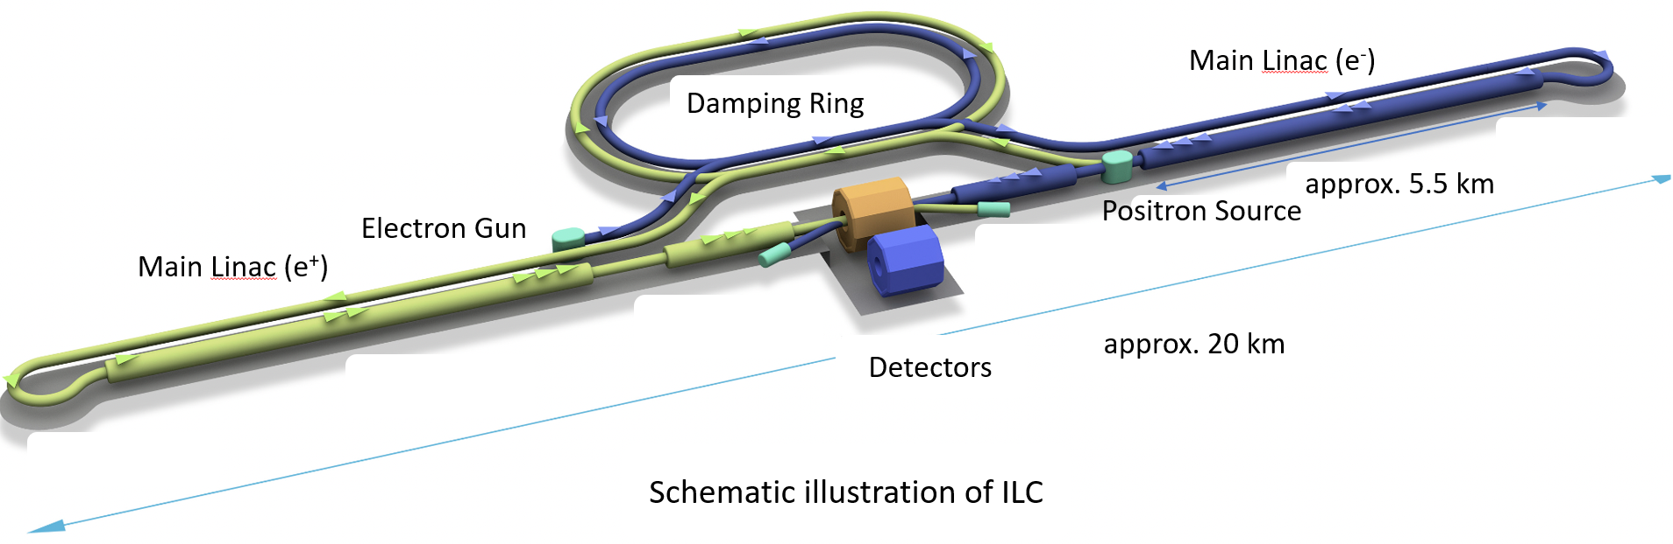
ILC and Main Linac
Future linear electron-positron collider
Center of mass energy 250 GeV
Total length of about 20 km, with a length of both main linacs of about 11 km
In main linacs, about 8000 SRF cavities driven nearly in about 200 RF stations
Ref.: https://linearcollider.org

Slide 5
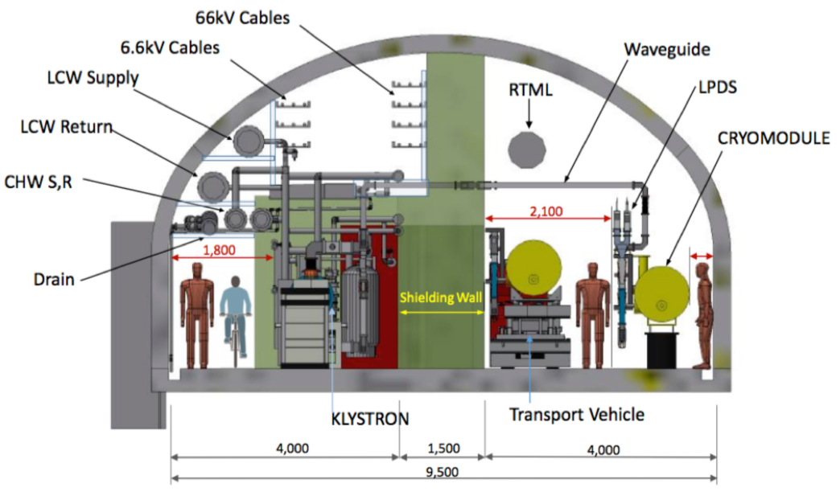
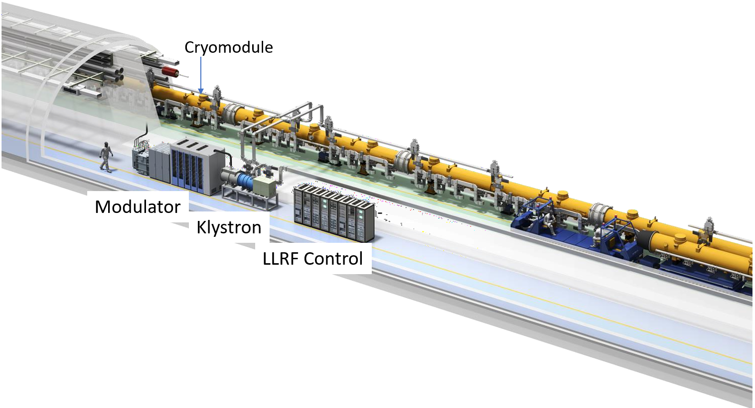
ILC Main Linac
Power distribution system
Accelerator tunnel and klystron gallery separated by shielding wall
Allows access to modulators, klystrons, and LLRF control racks during operation
Local power distribution system integrated with cryomodule (based on European XFEL experience)
Ref.: https://linearcollider.org

Slide 6
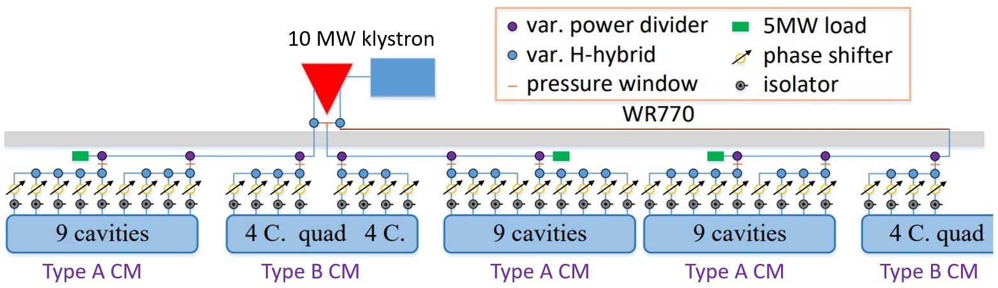
ILC-TDR Power Distribution System
A 10 MW Multibeam klystron drives 39 SRF cavities
A type A cryomodule contains 9 Cavities and a type B cryomodule contains 8 cavities
A type B cryomodule is placed between two type A cryomodules
Local power distribution system
Power Distribution System (PDS) according to ILC-TDR
Ref.: ILC-TDR volume-3 II

Slide 7
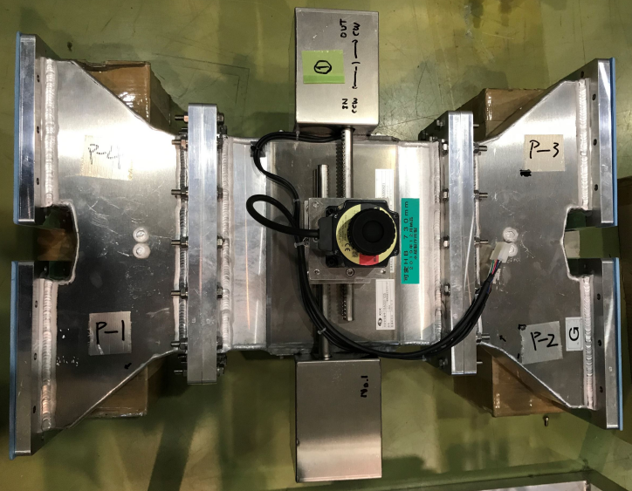
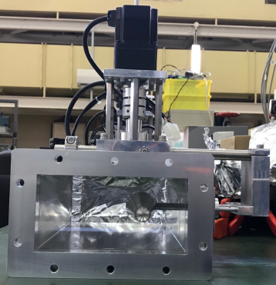
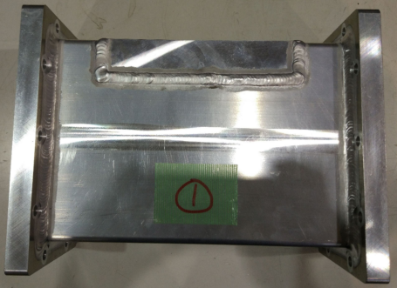
Local power distribution system
for the ILC
LPDS with adjustable RF power and phase, which is necessary to operate each cavity with its max. possible gradient to achieve max. possible beam energy
Variable hybrid
Compact LPDS developed at KEK
Variable hybrid (VH) to adjust the coupling ratio
Variable phase shifter (VPS) mitigates the phase introduced by VH
Fixed phase shifter (FPS) for the RF input phase difference of 90º between the adjacent cavities
Variable phase shifter
Fixed phase shifter
Ref.: Baiting Du Ph.D. Thesis (SOKENDAI 2020)

Slide 8
International Linear Collider (ILC) and its main linac
Local power distribution system (LPDS) for ILC Technology Network (ITN) cryomodule
Proposed updates in the ILC power distribution system (PDS)
Concept of circulator-less LPDS
Summary

Slide 9
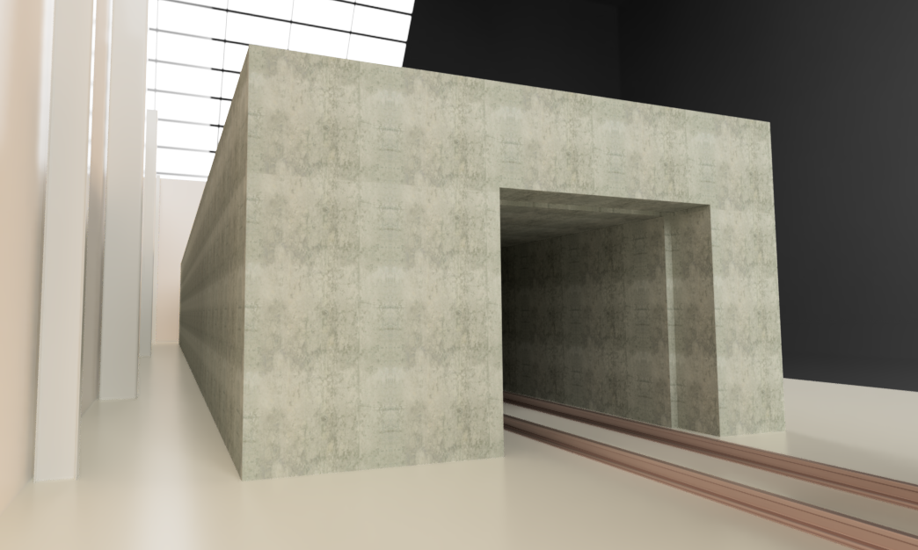
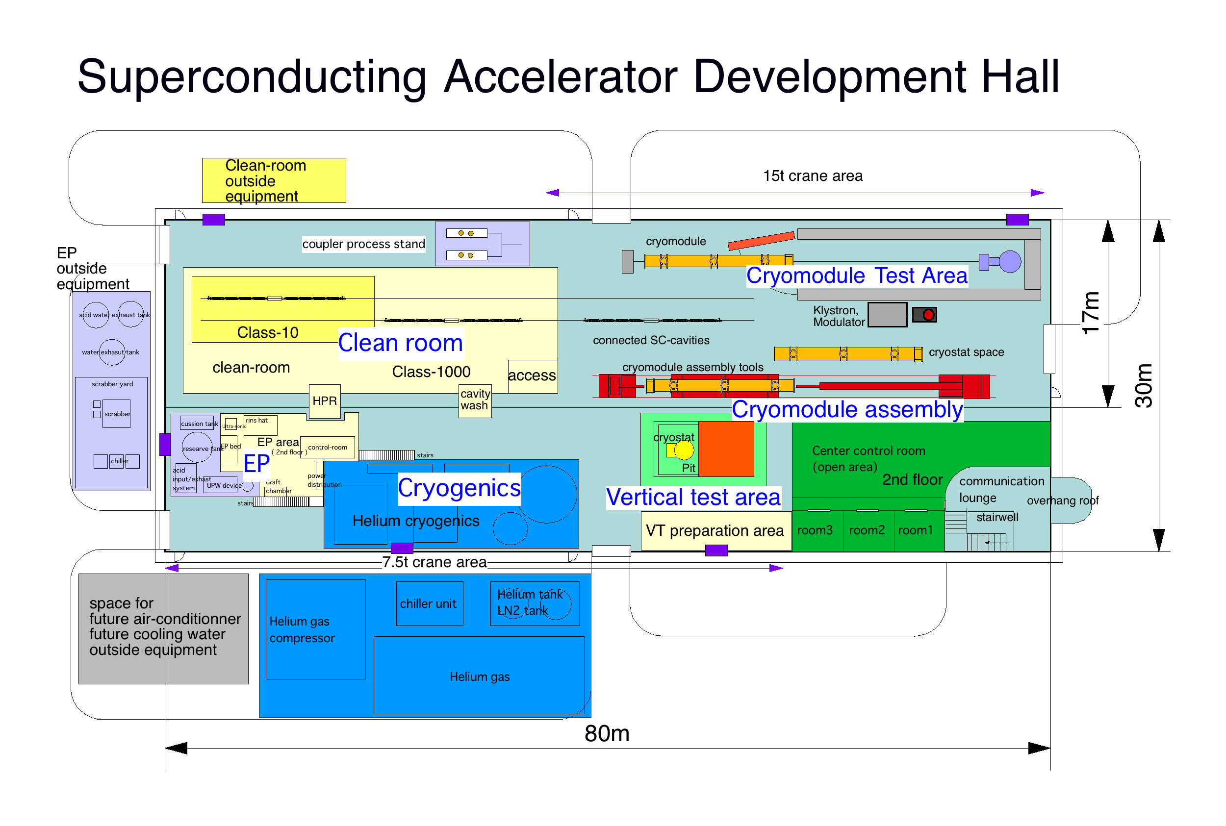
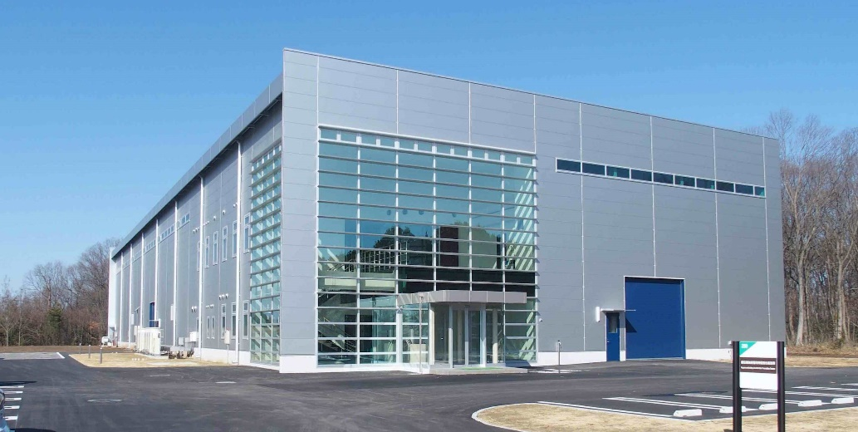
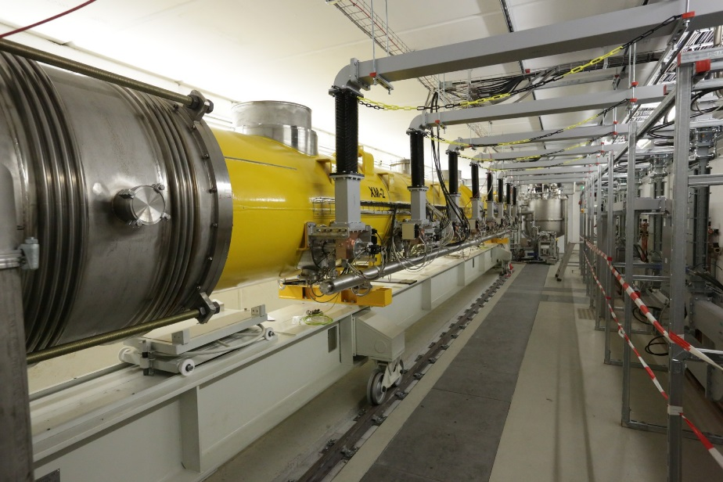
ITN CM construction and RF system
The ILC Technology Network (ITN) is jointly initiated by KEK and the International Development Team (IDT) of the ILC to execute High-priority work packages such as SRF
Details: Talk from T. Saeki
“Status of fabrication of 9 cell cavities”
Test bunker for ITN
Center of Innovation (COI) Building
The cryomodule test is planned in the Japan FY 2027
Refer: Y. Yamamoto SRF 5-year plan in Japan for ILC, LCWS2023
E-XFEL Accelerator Module Test Facility

Slide 10
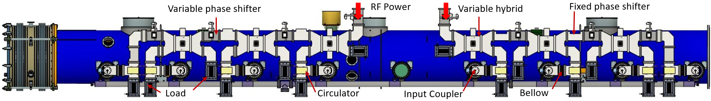
LPDS for the ITN CM
Main features of the LPDS
Ensure LPDS stays within the length of the CM which is necessary for multi-CM assembly
Low center of gravity for mechanical stability
The circulators connected to the input couplers using bellows to minimize mechanical stress on the input couplers
Minimum number of the waveguide components as possible to reduce the mass and cost of the system

Slide 11
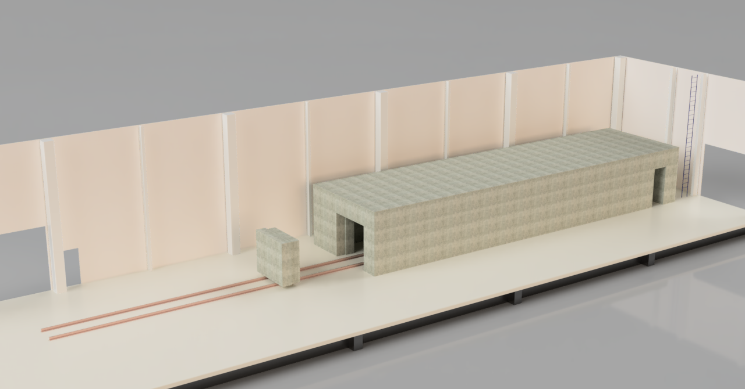
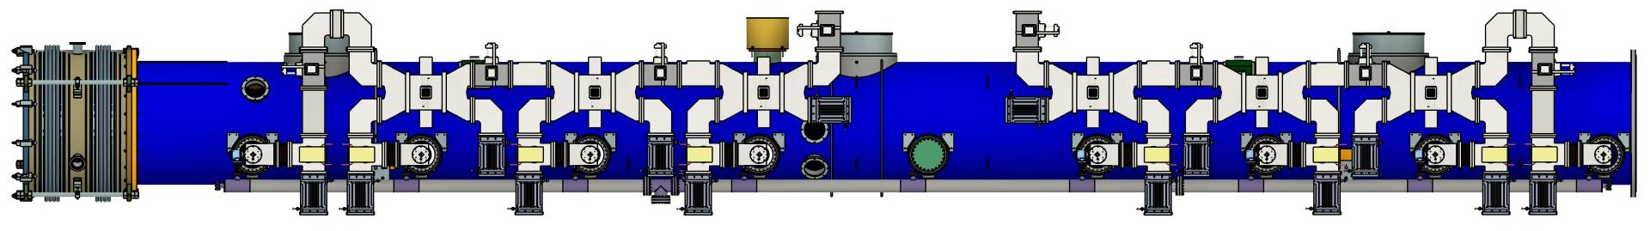
Low field emission model for the ITN CM
This is necessary due to the insufficient thickness of the concrete shielding wall due to limited space at the planned test stand
The RF input phase difference between the adjacent cavities is 180 degrees to avoid the acceleration of dark current
Planned test stand
Updated the fixed phase shifters
No other change
Updated the fixed phase shifters
Δφ=180º
Δφ=180º
Δφ=180º
Δφ=180º
Δφ=180º
Δφ=180º

Slide 12
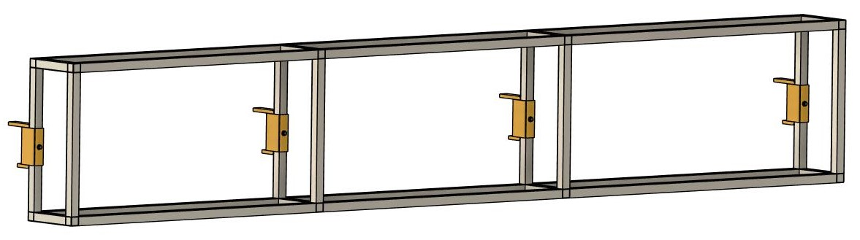
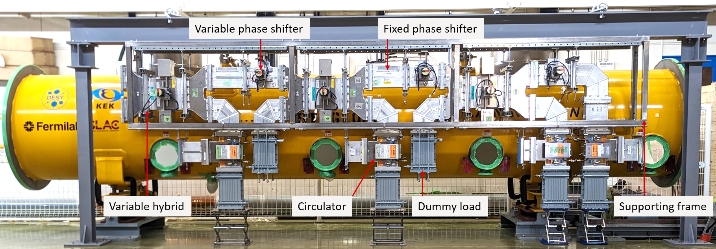
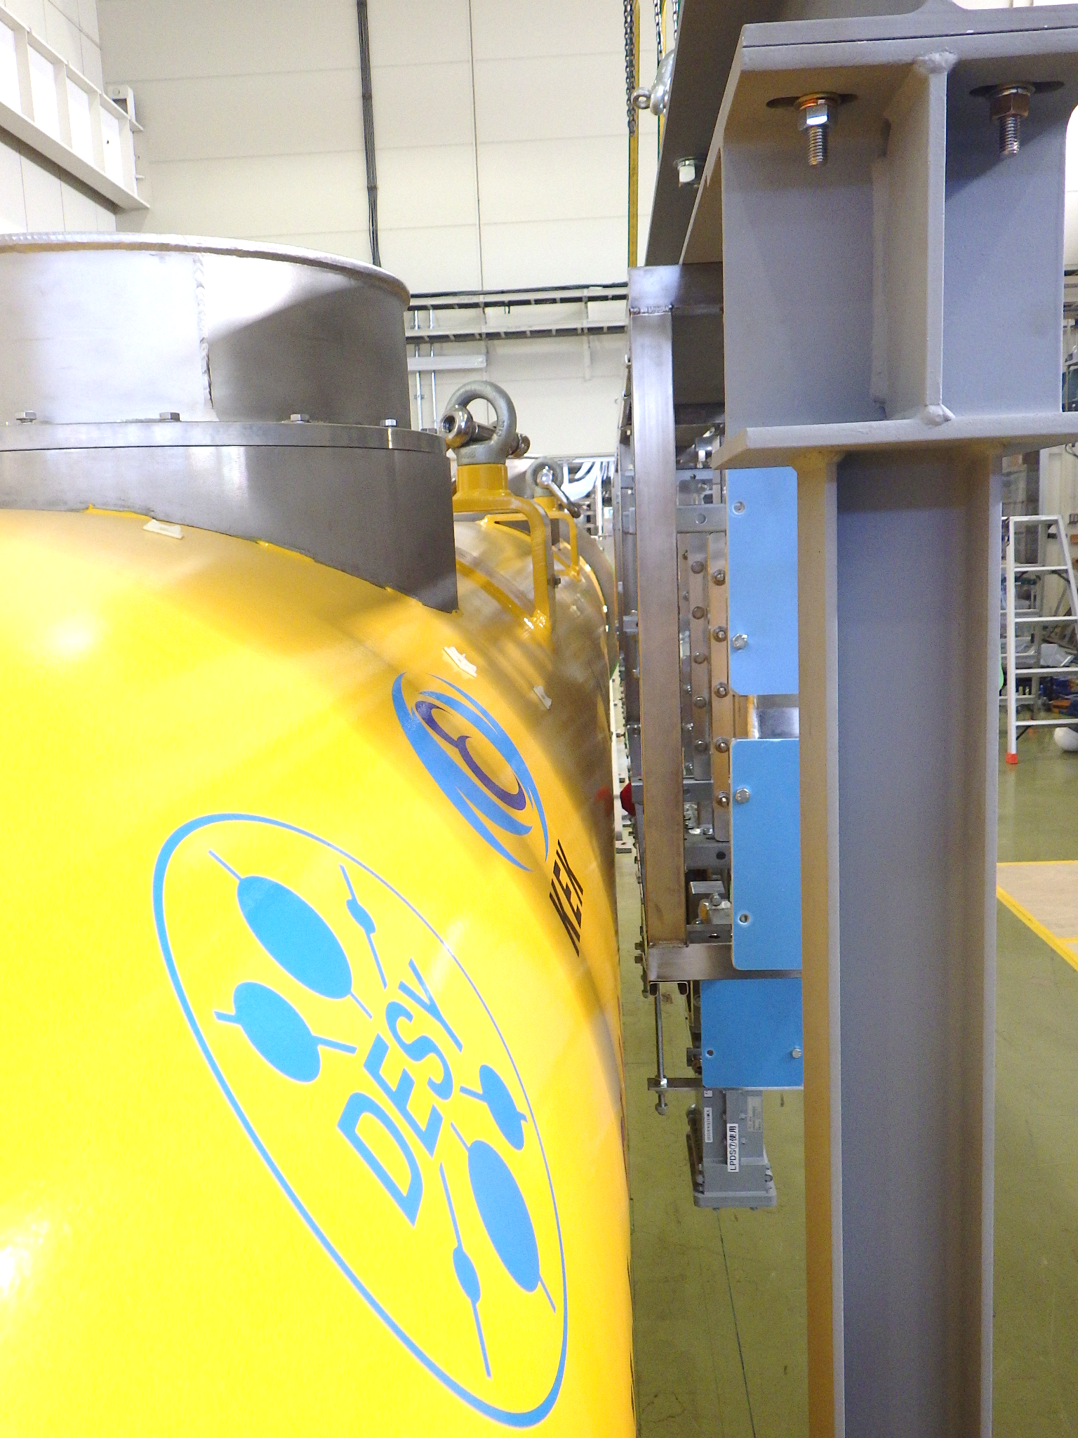
LPDS Support System
Motivation
Mounting LPDS onto CMs inside the tunnel is not efficient
CM pre-assembled with LPDS will be installed inside the tunnel
A prototype LPDS support system was designed and fabricated
A first integration of LPDS into the support system was tested
Transferred in front of the CM
Plan: The support frame will be updated so that it can be fastened to CM
CAD model of the support frame
Lateral view
Front view of the LPDS integrated in support frame

Slide 13
International Linear Collider (ILC) and its main linac
Local power distribution system (LPDS) for ILC Technology Network (ITN) cryomodule
Proposed updates in the ILC power distribution system (PDS)
Concept of circulator-less LPDS
Summary

Slide 14
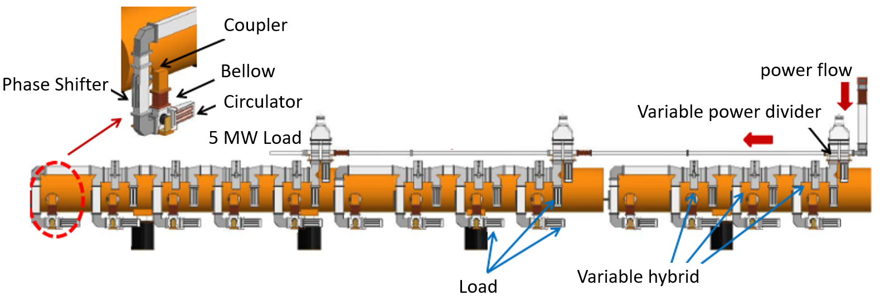
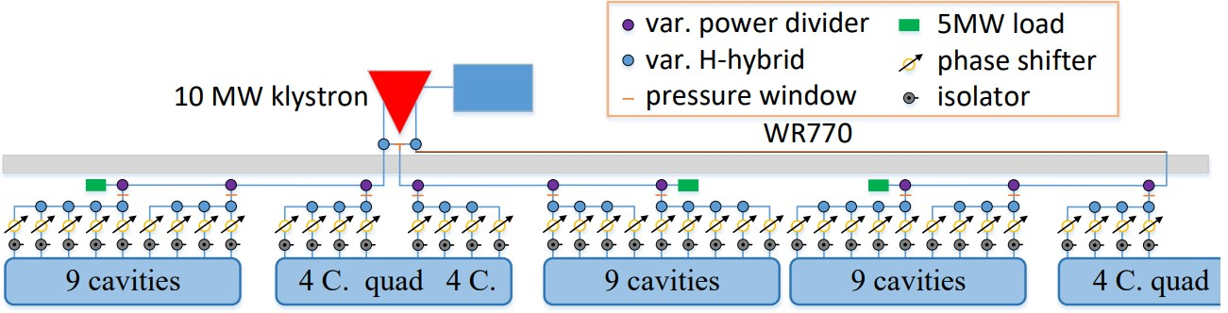
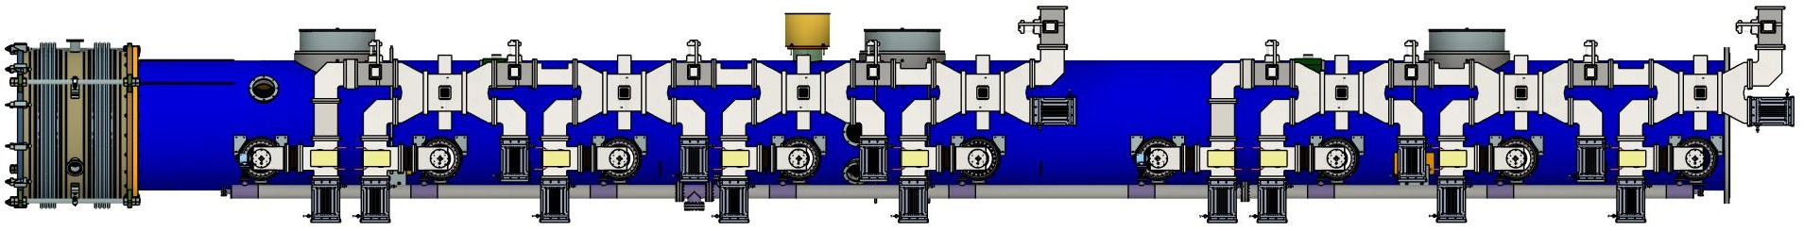
Proposed updates in the ILC PDS
Update
5 MW variable power divider (VPD)
Remove
VPD & 5 MW load
(Under development)
LPDS according to ILC-TDR
PDS according to ILC-TDR
LPDS conflicts with CM
during multi-CM assembly
LPDS configuration based on ITN

Slide 15
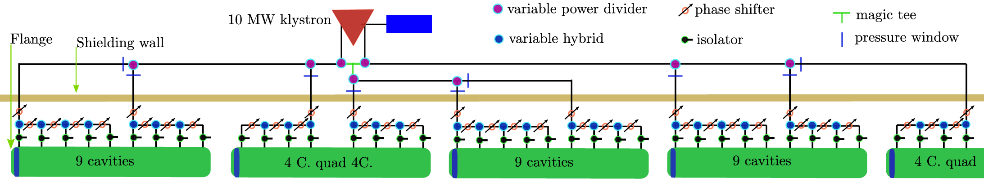
Proposed updates in the ILC PDS
Updates
Installation of 5 MW VPD at the output port of klystron
Remove the 5 MW load and VPD at the end of the LPDS
Revise the configuration of the LPDS
VPD and pressure window in klystron gallery
Old
PDS according to ILC TDR
Proposed
Proposed PDS for the ILC

Slide 16
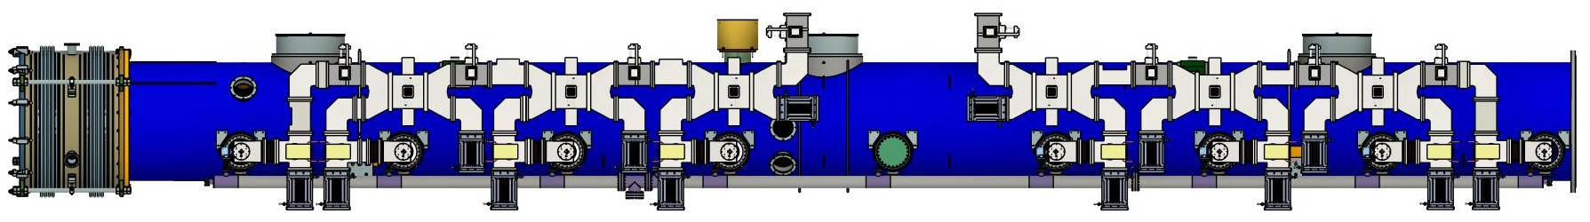
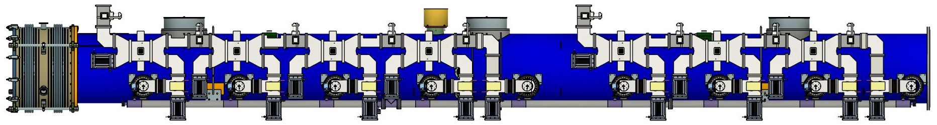
PDS for the ILC
Use of these LPDS
can drive the ILC main Linac
Beam
LPDS for type B (ITN) CM
LPDS for type A CM

Slide 17
International Linear Collider (ILC) and its main linac
Local power distribution system (LPDS) for ILC Technology Network (ITN) cryomodule
Proposed updates in the ILC power distribution system (PDS)
Concept of circulator-less LPDS
Summary

Slide 18
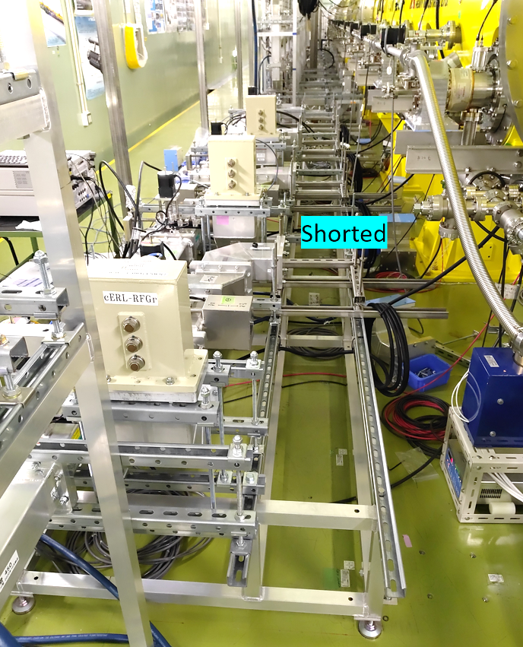
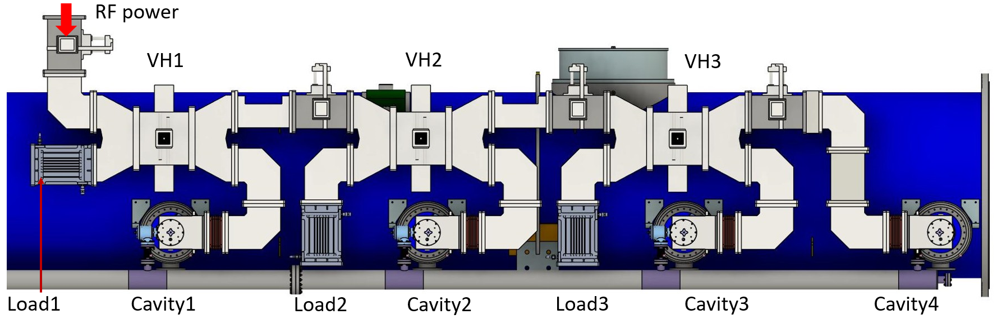
Concept of LPDS without Circulator
Motivation
Reduction of the cost and mass of the waveguide system
without compromising the safety of the klystron
Four Cavity LPDS
LPDS without Circulator
Conclusion:
Average power distribution: No power is reflected upstream
Worse case*: About 6% of the input power was reflected upstream
Low-power measurement of
LPDS without circulator
*Worse case: Reflection from odd-numbered cavities 25% below and even-numbered cavities 25% above the average or vice-versa.

Slide 19
International Linear Collider (ILC) and its main linac
Local power distribution system (LPDS) for ILC Technology Network (ITN) cryomodule
Proposed updates in the ILC power distribution system (PDS)
Concept of circulator-less LPDS
Summary

Slide 20
Summary
LPDS of the ITN cryomodule was updated
  LPDS within the length of CM
  Low center of gravity
  Minimum number of waveguide components
  Alternate configuration of low-field emission
A prototype support system was fabricated and the first integration tested
Proposed updates for the ILC power distribution system
  Installation of 5 MW VPD at the output port of the klystron
  Removable of VPD and load at the end of LPDS
  Revised configuration of LPDS
The concept of LPDS without a circulator was introduced
  Analytical calculations, simulations, and low-power tests look promising

Slide 21



Thank you for your attention
Supported by: MEXT Development of key element technologies to improve the performance of future accelerators program (JPMXP1423812204).
Email: prakashj@post.kek.jp

Slide 22
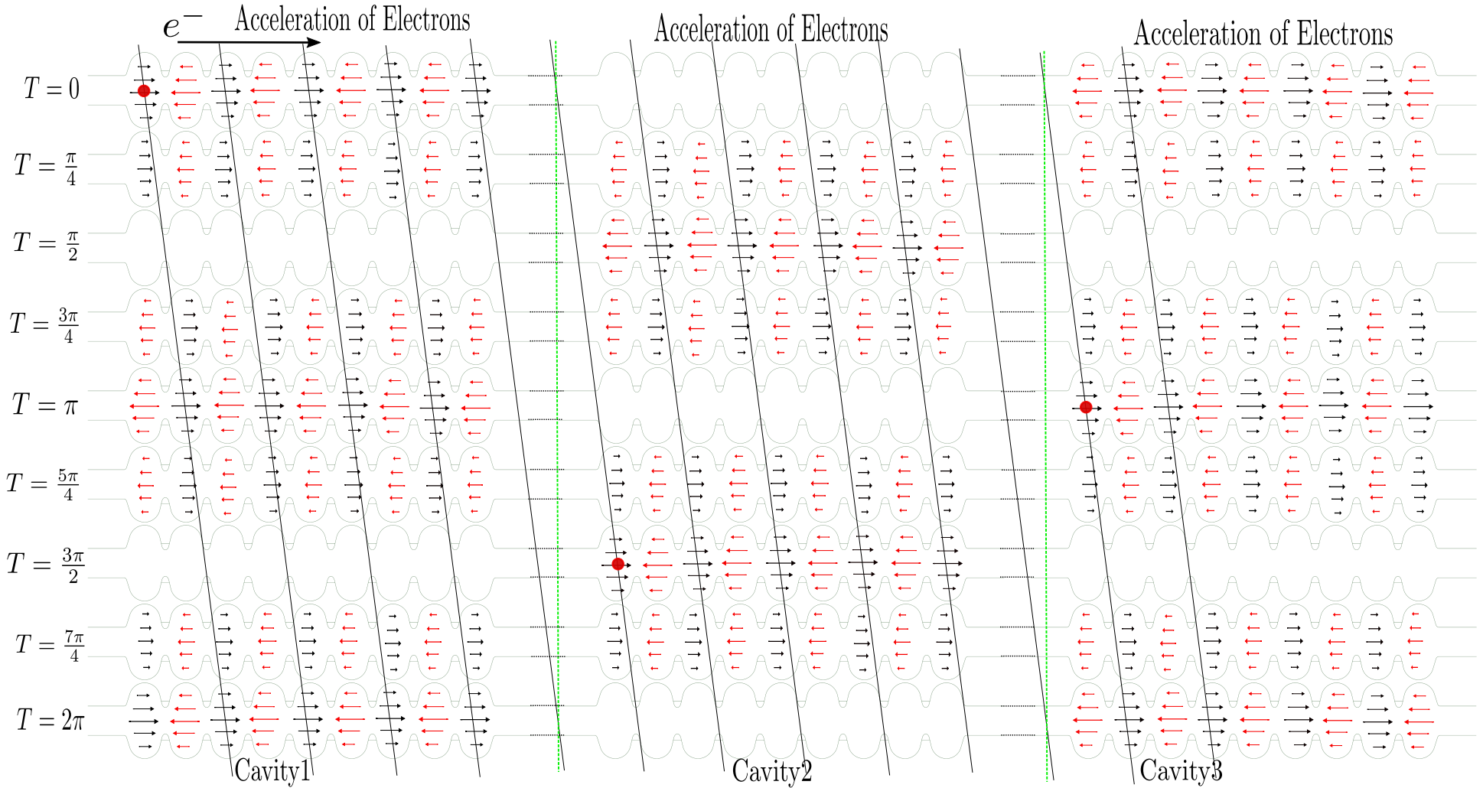
Backup Files
RF input phase difference 90º
RF input phase difference 90º

Slide 23
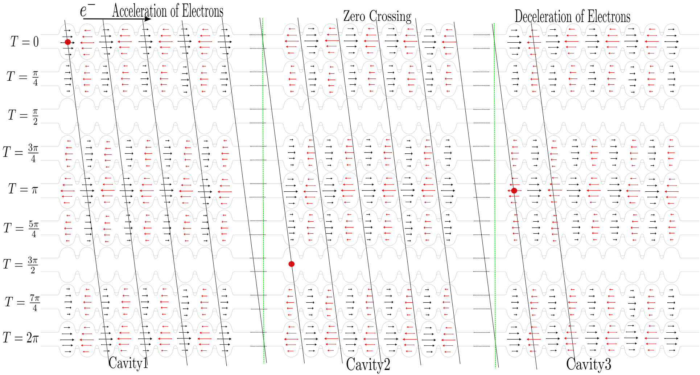
Low Field Emission
RF input phase difference 180º
RF input phase difference 180º

Slide 24
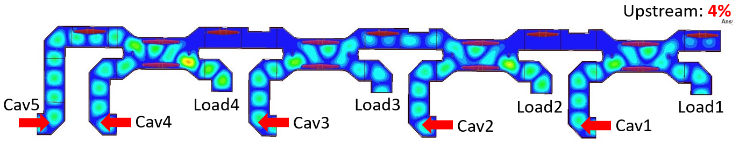
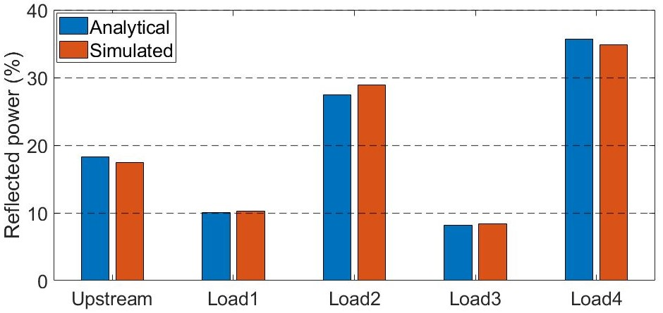
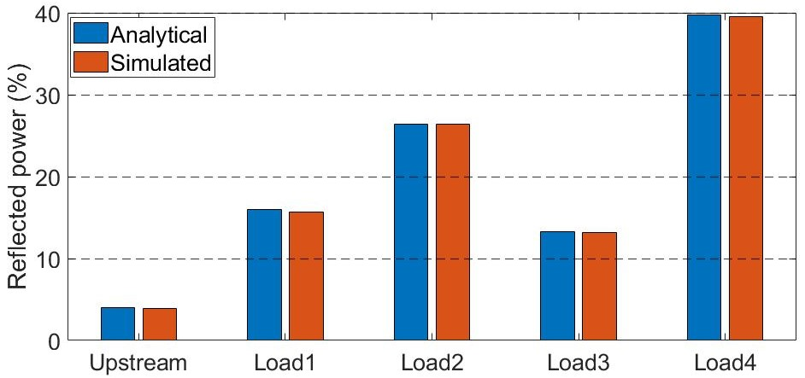
Concept of CM without Circulator
Five Cavity LPDS
This is similar to adding one variable hybrid at the input of the 4 cavity LPDS
Average power distribution: About 4% of the input power is reflected upstream
Worse case: About 18% of the input power is reflected upstream
No power
Cavity1, 3 and 5, 25% above the average and Cavity2 and 4, 25% below the average.
Average power distribution

Slide 25
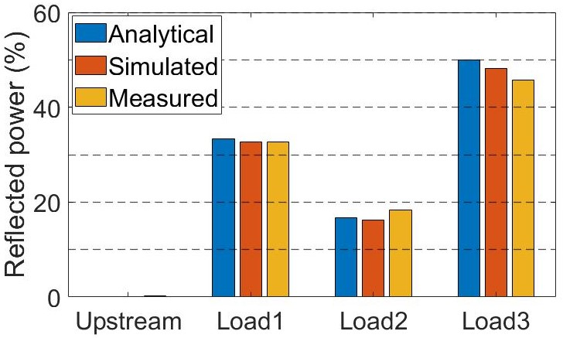
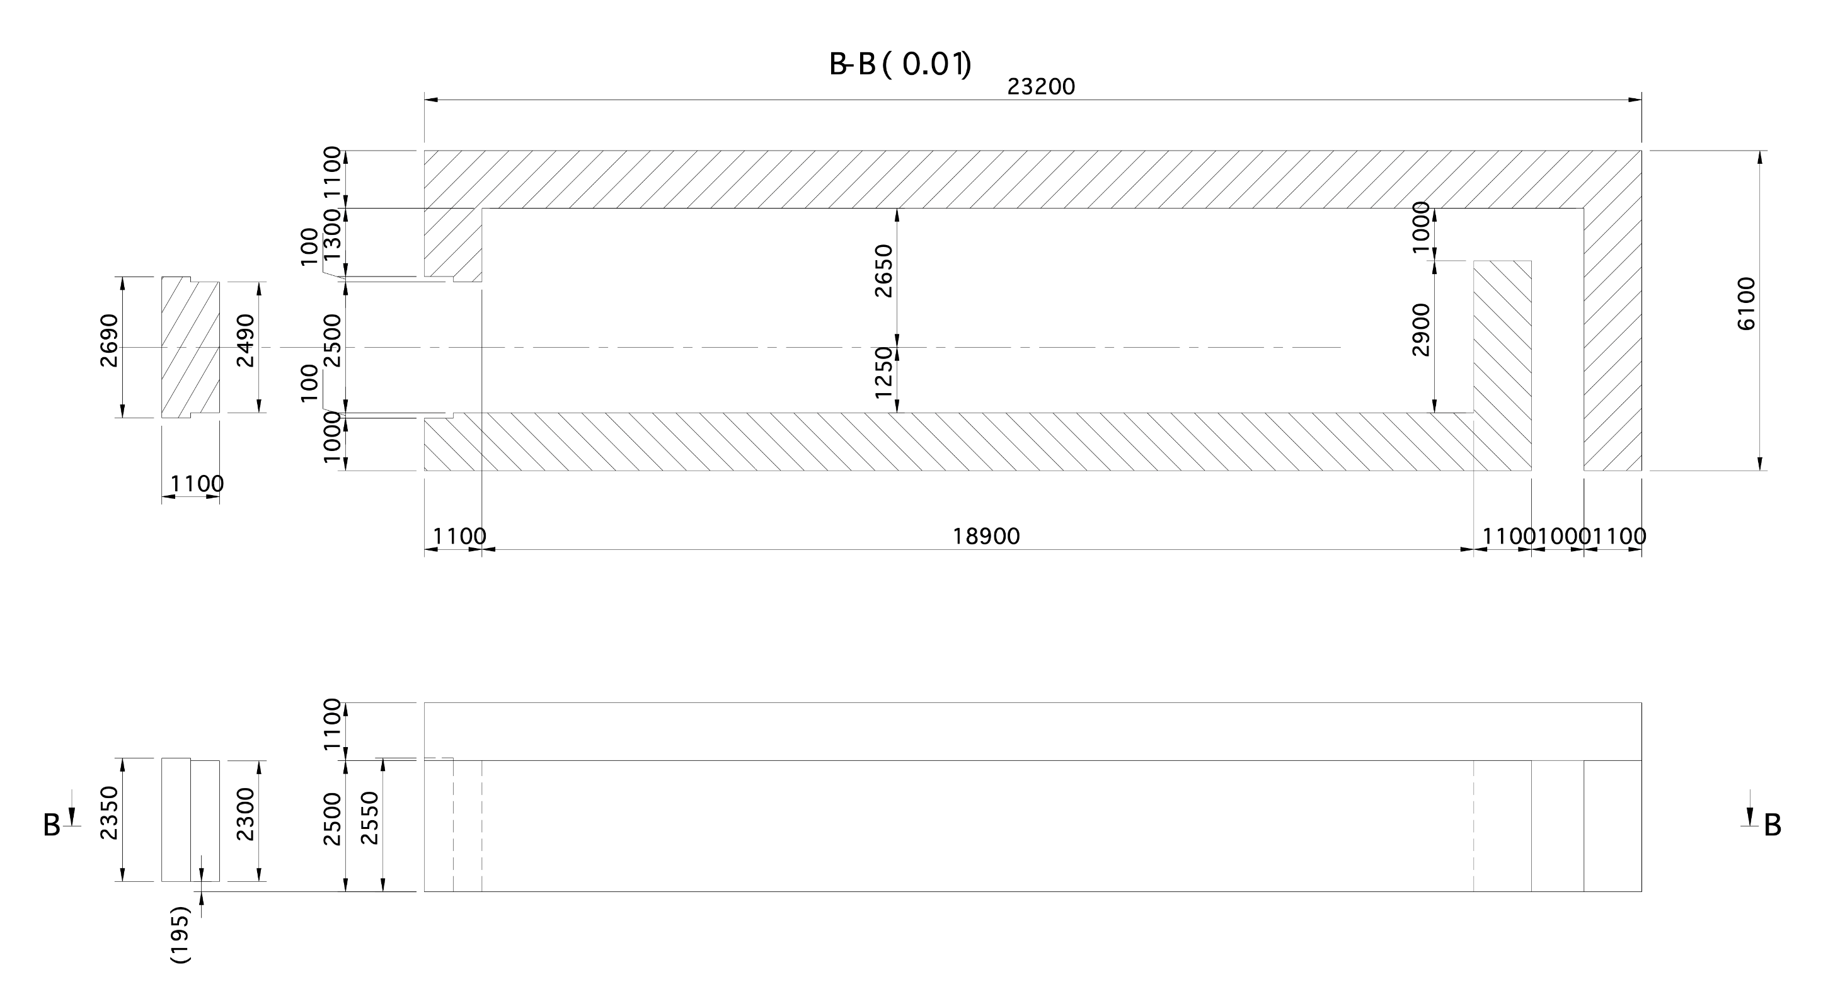
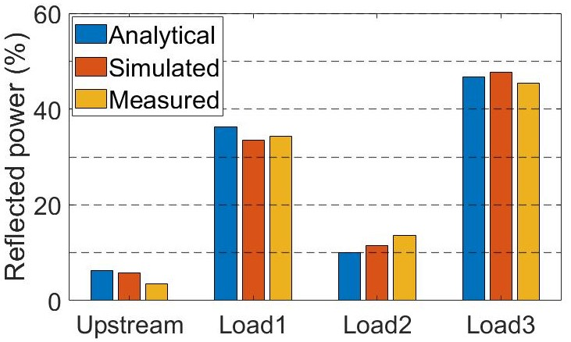
Comparison among analytical calculation, simulation and low-power measurements for four cavity LPDS
Drawing of the ITN test stand
Average power distribution
Odd-numbered cavities 25% below and even-numbered cavities 25% above the average or vice-versa.

