Slide 1
ILC Beam Line Changes from TDR
LCWS2024 2024.7.10 K. Kubo

Slide 2
This report is based on activities of the meetings
ILC Beamline Related to CFS (2019~)
Members:
Y. Enomoto, H. Hayano, K. Kubo, T. Okugi, T. Sanuki, N. Terunuma, K. Yokoya,

Slide 3
Changes of beamlines from considerations of
CFS & beam dynamics
Shift Damping Ring
Longer turnaround
Longer turnaround
E compress
E compress
ML reserve space
Undulator,
e+ source
e- source
ML reserve space
Virtical bend
IP
Virtical bend
BDS
BDS
Undulator
e+ ML
e- ML

Slide 4
Specify curved and flat regions
(Details are not described in TDR. )
Between end of e+ ML to end of e- ML, including undulator section for e+ production is in the same plane, which is horizontal at IP.
MLs are following earth’s curvature.
Insert vertical bends at ML ends and approximately same locations for return lines.
(0.58 mrad for e- ML and 0.40 mrad for e+ ML)
Returns lines are straight or curved, following the corresponding beamlines.
As a result, the elevation of e- ML is less than that of e+ ML by 43 cm.
IP
BDS
BDS
Undulator
e+ ML
e- ML

Slide 5
Specify curved and flat regions (cont’d)
One alternative was putting the undulator in curved region, before the bending downstream of e- ML. However,
  Different angles of e+ source beamline and e- BDS. Complicated tunnel configuration.
It is desirable to make IP region horizontal for the physics detectors.
  Otherwise, if mid point of the straight region is horizontal, the inclination of the detector would be 0.064 mrad.
IP
BDS
BDS
Undulator
e+ ML
e- ML

Slide 6
Main Linac reserved space
Downstream -> upstream
Length is adjusted to satisfy the timing constraint.
Same reserved length for e- and e+
(Already approved)
Old
ML
Reserved
Reserved
ML
New
Reserved
ML
ML
Reserved

Slide 7
Timing constraint
( L₁ + L₂ + L₃ ) – L₄ = n x C_{DR}
C_{DR}
L2
L1
e+ production
L3
e+
IP
L4
e-
Each positron bunch (A) is injected in the same bucket of the bunch (B) which is collided with the electron bunch producing the bunch (A).
Or,
An electron bunch produces positron bunch (A), collides with positron bunch (B).
Then, (A) should be injected in the same bucket of the ring as the bunch (B)
Construction error will be corrected by
“timing adjusting chicane” located at the end of e+ 5 GeV booster linac.

Slide 8
Turnaround

Slide 9
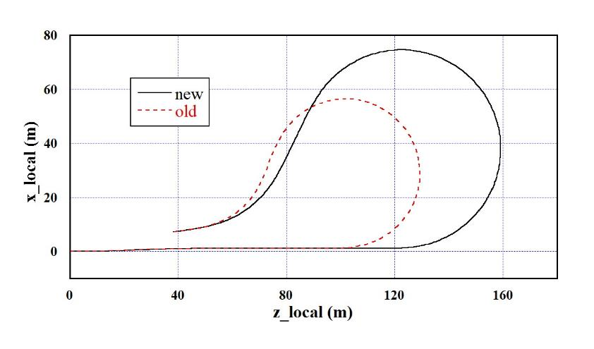
Longer Turnaround
Problems of the original design:
Horizontal normalized Emittance growth 390nm (even larger number is in TDR, 480nm) is not acceptable for the new (250 GeV) design with lower horizontal emittance at collision.
Space between bending magnets is too tight. (0.7m)
Old parameters:
Horizontal normalized Emittance growth 390nm
Total length 274.9 m
New parameters:
Horizontal normalized Emittance growth: 175nm
Total length 353.18 m

Slide 10
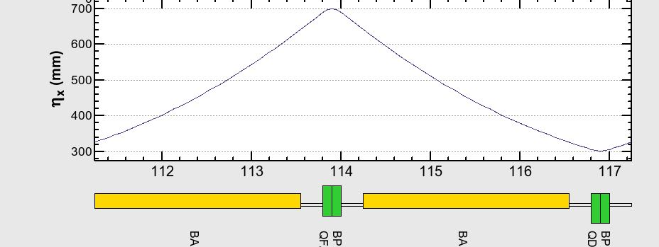
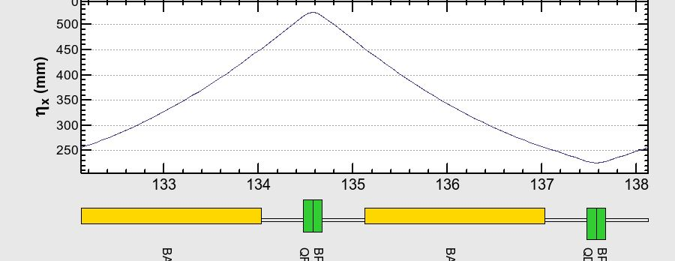
Longer Turnaround (cont’d)
Old parameters:
Bend length 2.3 m, bend angle 0.109 rad
Bend to bend space 0.7 m
New parameters:
Bend length 1.9 m, bend angle 0.082 rad.
Bend to bend space 1.1 m
Arc Cell
Old
New

Slide 11
Undulator, e+ source

Slide 12
e- beamline for e+ production
(undulator, dogleg, e+ production target and photon dump)
Change total length of undulator from 147 to 231 m.
  Increase number of undulator magnets from 84 to 132 magnets (each is 175 cm long).
Move the undulators downstream by 168.8 m. Make the dogleg shorter accordingly.
---- For keeping the positron yield with 125 GeV electron beam energy, lower than TDR,
  Longer undulator is needed.
  Distance to the positron production target cannot be too long because of the increased production angle of photons due to the lower energy of electrons.
Note: Dogleg should be replaced with longer one when the beam energy is increased to 250 GeV

Slide 13
e- beamline for e+ production (cont’d)
(undulator, dogleg, e+ production target and photon dump)
Move photon dump farther from the positron production target.
--- For avoiding destruction of photon dump, transverse size of photon beam should be large, requiring larger distance from the target and the dump.
Move e+ production target downstream by 6.0 m. The positron capture section and the booster linac are also moved accordingly. (Distance from the undulator center to the target is 407.1 m)
--- For avoiding interference of target room shield and quadrupoles in e- BDS.
.

Slide 14
Comparison of TDR and new length (unit: m)
 | TDR | New | Difference
BDS start to IP | 2241 | 2274 | 33
Undulator center to target | 559 | 401 | -158
Undulator end to BDS | 464.1 | 306.1 | -158
Dogleg bend to bend | 316.0 | 151.2 | -164.8
Undulator start to end | 317.9 | 317.9 | 0
Space befor undulator | 0 | 165 | 165
Undulator section start to BDS | 802.8 | 809.8 | 7.0

Slide 15
Positron Source Beamline
Replace 125 MeV capture section by 400 MeV capture section
--- For better capture efficiency.
Shift beamline by 3.6 m, replacing chicane by dogleg
--- 3.6 m for making space of transporting cryomodules.
--- Dogleg for making space for the photon beam to its beam dump

Slide 16
e- source

Slide 17
Electron Source Beamline
Move e- source upstream, close to the end of e+ ML.
Long beam transfer line is inserted between the booster linac and LTR line.
--- For
  Reducing LHe transfer line length
  Avoiding interference with collimators in BDS.
The exact position of e- gun is chosen for avoiding interference between the gun laser room and the LHe transfer line.
Damping Ring
New e- source
Old e- source
e+ ML
e+ BDS

Slide 18
Common changes in e- and e+ source Beamline
Move energy compressor from LTR to downstream of booster linac.
--- For consolidating the RF and LHe systems in one place
Make the chicane of the energy compressor vertical.
--- For reducing necessary width of the tunnel
Damping Ring
5 GeV booster linac
Old energy compressor
New energy compressor

Slide 19
e- and e+ source tuning dump (5 GeV) positions
Move from middle of LTR to before LTR.
--- For reducing lengths of beamline and number of magnets.
Damping Ring
Old dump
Source and 5 GeV linac
New dump

Slide 20
Common changes in e- and e+ source Beamline
Make the super conducting booster linac region close to horizontal. (The linac is laser straight, but vertical bend is inserted for making the center of the linac horizontal)
--- For making LHe supply easier
Bend the beam transport line slightly, before LTR, following the BDS.
--- For eliminating need to widen the tunnel
Horizontal at IP
SC
SC
To Damping Rings
e+ source
e- source
To Damping Ring
Old
Linacs
New
BDS
IP

Slide 21
LTR/RTL

Slide 22
LTR/RTL Geometry
Change e+ LTR, e- RTL line geometry
  Longer straight regions at both sides of the e+ spin rotator solenoids
  e- RTL is changed accordingly.
  e+ side and e- side become asymmetric.
--- For keeping long enough regions for switching two spin rotators
(Details are not described in TDR)
Two solenoides with opposite fields for switching polarization of e+ beam
solenoide
Kicker magnet
Kicker magnet
solenoide
Need space
Need space

Slide 23
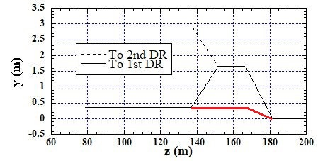
e+ Damping Ring injection line
Damping Ring is 0.35 m higher than the LTR.
2nd e+ Damping Ring will be 2.5 m higher than the 1st Ring (if constructed).
Make a simple vertical dogleg for 0.35 m elevation
If two e+ rings are needed, reconstruct beamline as:
Raise 1.6 m first, then, branch into two lines, up and down by 1.25 m
  (two beamlines the same length)
e+ beamline length 0.14 m increase. Timing adjusting chicane is designed to address this change.
--- This design is simple at the beginning.
The second damping ring may not be necessary.
(Details not in TDR)
DR2
DR1
LTR

Slide 24
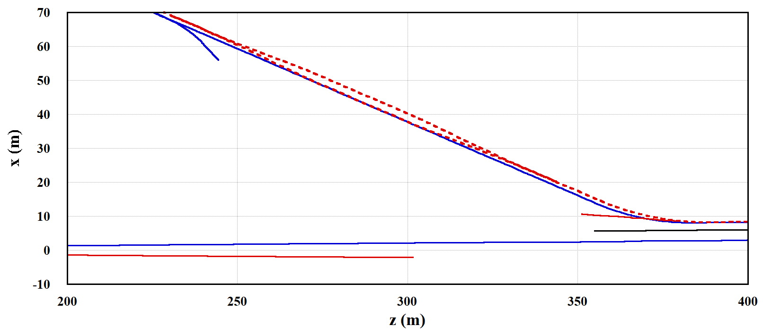
Position of Damping Rings, LTR/RTL
Change in 2022:
Shift Damping Ring 2.1 m farther from Linac and IP
--- Result of e+ source dogleg change (from 1.5 m to 3.6 m), for keeping straight-line lengths in e+ LTR line.
Change in 2023:
Additional shift of Damping Ring, 100 m farther from Linac and IP
--- For making enough space around IP and Linac-RTL/LTR branches for beam dumps.
e- RTL dump
e+ source dump
Damping Ring
photon dump
e- source
e+ source
e+ main dump
e+ BDS
e- BDS
IP

Slide 25
Position of Damping Rings, LTR/RTL (cnt’d)
New
Shift DR by ~100 m
Old
RTL
~250 m increase
Return
~230 m decrease
Total ~20 m longer

Slide 26
Damping Ring – lower horizontal emittance
2017
Longer bending magnet, 3 m -> 5 m
  For reducing horizontal emittance
  → Presentation in ALCW2018 (https://agenda.linearcollider.org/event/7826/sessions/4644/#20180531), etc.
2023
Divide bending magnet, 5 m -> 2.4 m x 2
  For easier construction and transfer, etc.
Add space between magnets.
  For realistic design
  → Will be reported in DR session of this workshop

Slide 27
Main linac reference points (PM-8, PM+8)
Move the reference point, PM-8 and PM+8, upstream (farther from IP) by 2 m.
(The reference points are the centers of the LHe domes)
--- For avoiding interference between the LHe transfer line and quadrupole magnets.

Slide 28
Changes of beamlines Summary
Shift Damping Ring
Longer turnaround
Longer turnaround
E compress
E compress
ML reserve space
Undulator,
e+ source
e- source
ML reserve space
Virtical bend
IP
Virtical bend
BDS
BDS
Undulator
e+ ML
e- ML

