Slide 1




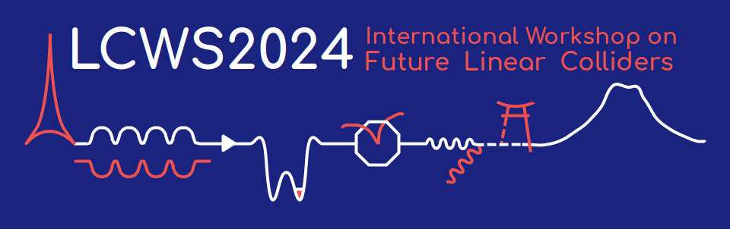
Source WG
Summary
Masao KURIKI
Spencer Gessner
Joe Grames
Yoshinori Enomoto
Gudrid Moortgat-pick

Slide 2


Statistics
18 contributions
Electron 1
Undulator Positron 4
E-Driven Positron 13
~25 participants regularly including online participants

Slide 3
Title | Speaker | Affiliation
CEPC positron source | Li Xioping | IHEP
Update on Ce+BAF Positron Activities | Andriy Ushakov | Jefferson Lab.
SuperKEKB positron beam tuning using AI/ML | Y. Enomoto | KEK
Postron source for STCF | Ailin Zhang | IHEP
The Compact Positron Source | Spencer Gessner | SLAC
CFD simulations of high power positron converter targets | Silviu Covrig Dusa | Jefferson Lab.
Spin-polarized electron sources for future linear colliders | Jared Maxson | Cornell U.
Positron Capture beam loading simulations with RF-track | Nafiseh Mesbah | CERN
Present status and plan on E-driven positron source for ILC | Yoshinori Enomoto | KEK
ILC electron-driven positron source Design by black-box optimization | Shunpei Kuroguchi | Hiroshima U.
Rotating target for E-Driven ILC positron source | Yu Morikawa | KEK
Capture cavity design | Masafumi Fukuda | KEK
FCC positron source | Iryna Chaikovska | IN2P3/ILCLab.
Update of the CLIC positron source | Yongke Zhao | CERN
HALHF positron source | Gudrid Moortgat-Pick | U. of Hamburg
Hydrodynamic Simulations of an Argon-filled Tapered Plasma Lens for Optical Matching at the ILC Source | Manuel Formela | U. of Hamburg
Prototyping Pulsed Solenoid and Rotating Wheel for the undzlator-based source | Grigory Yakopov | DESY
Update on plasma stability measurements of the prototype plasma lens for positron matching | Niclas Hamann | U. of Hamburg

Slide 4
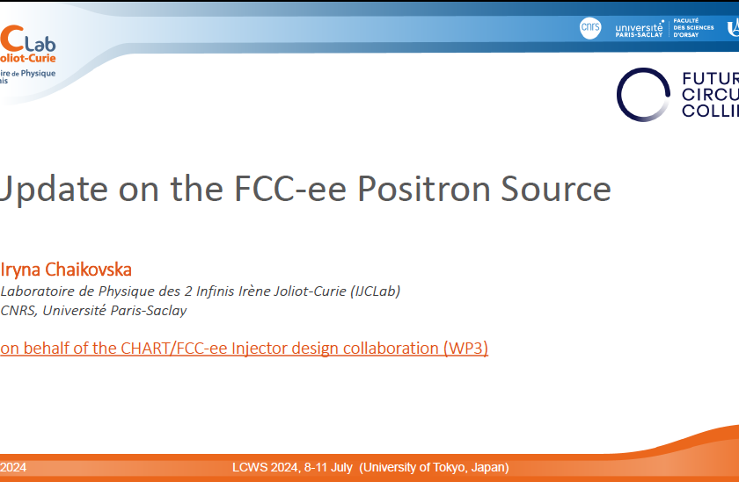
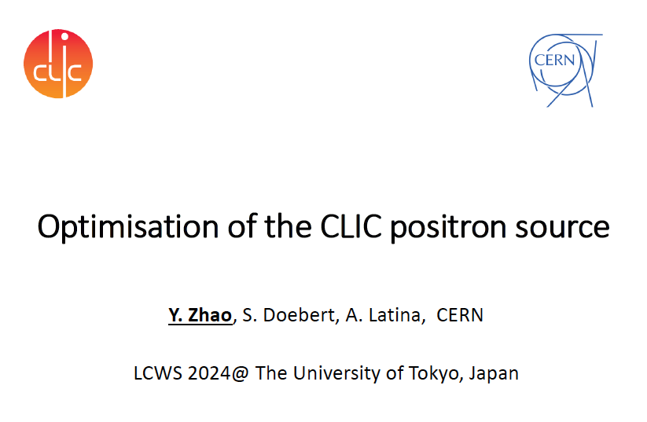
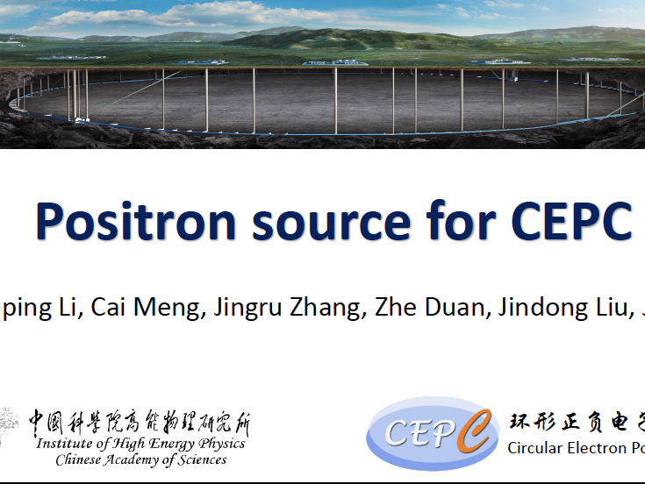
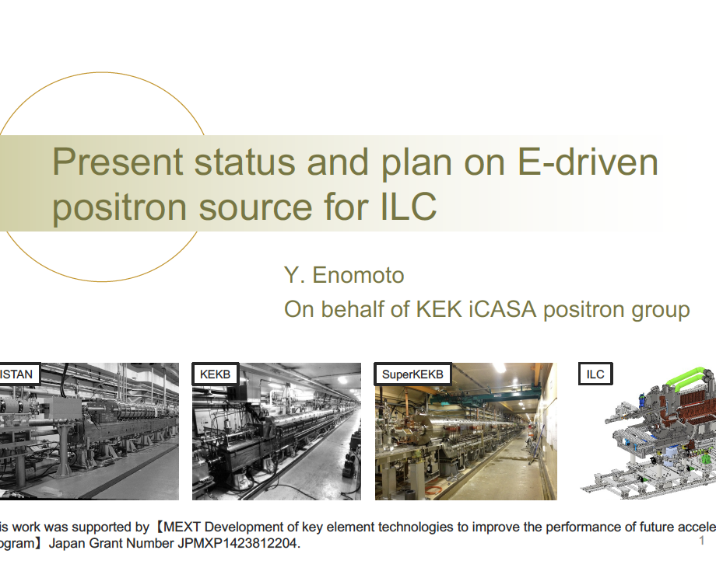
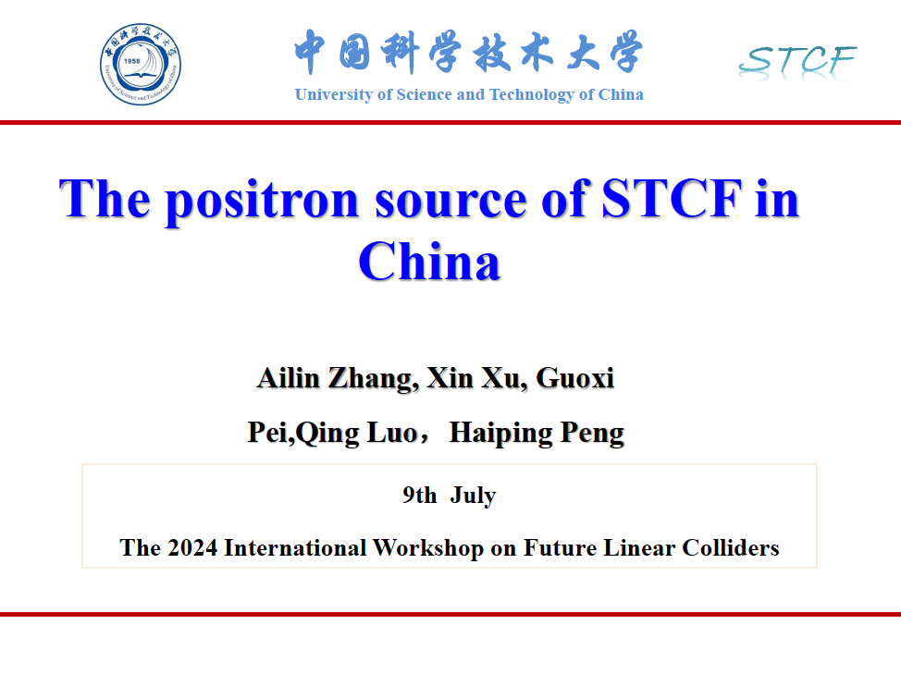

Slide 5
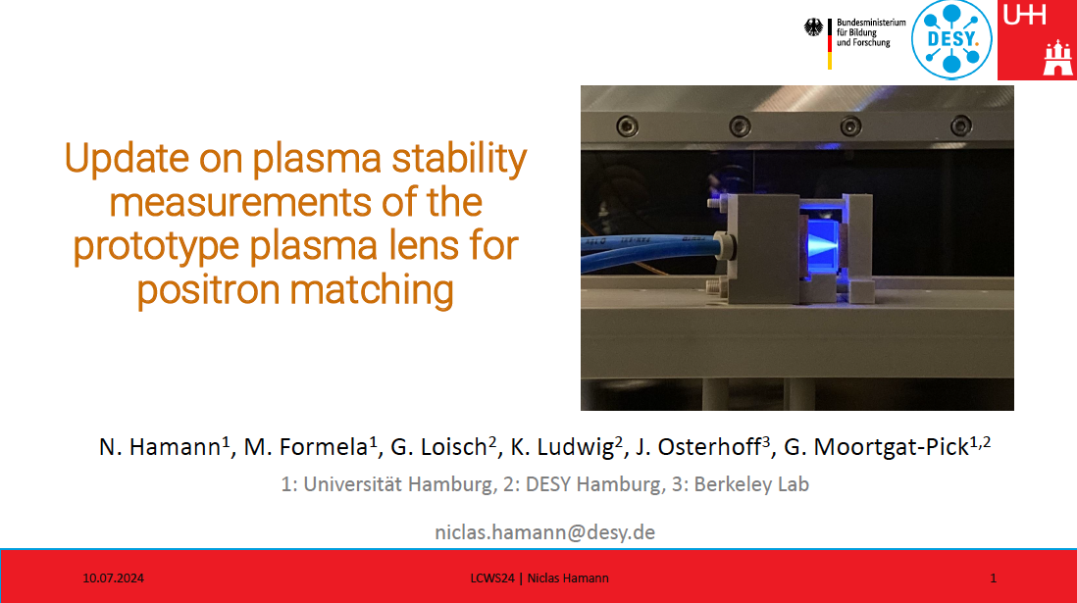

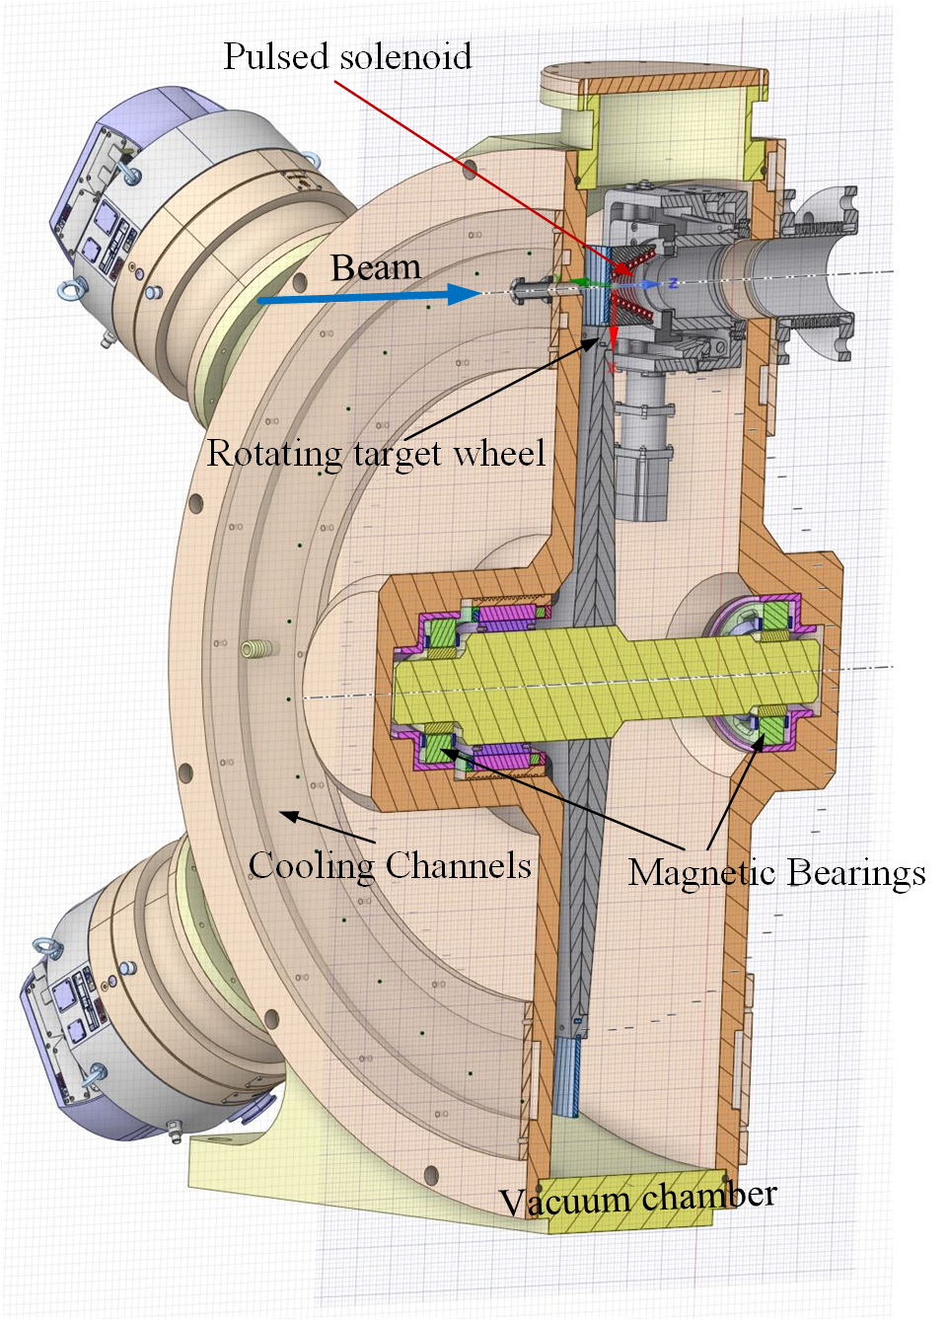
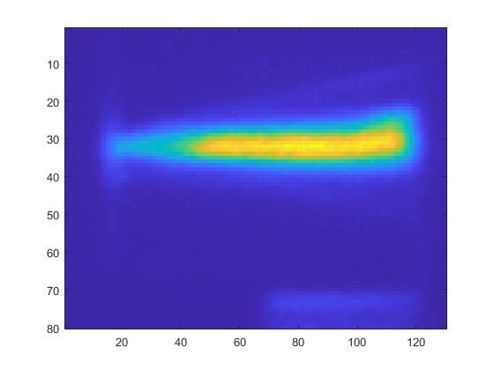
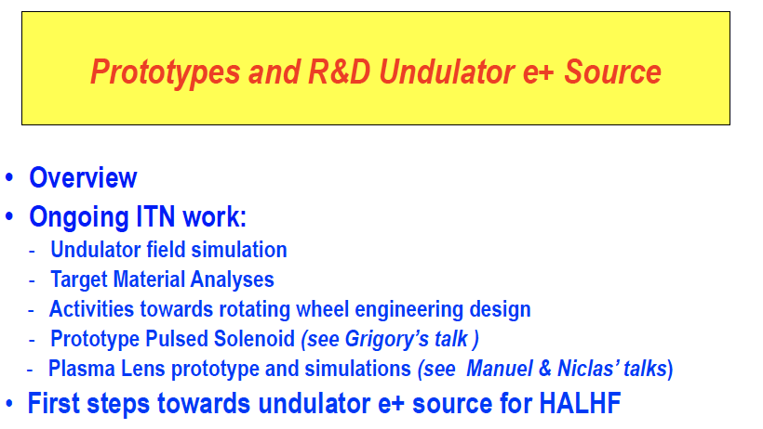
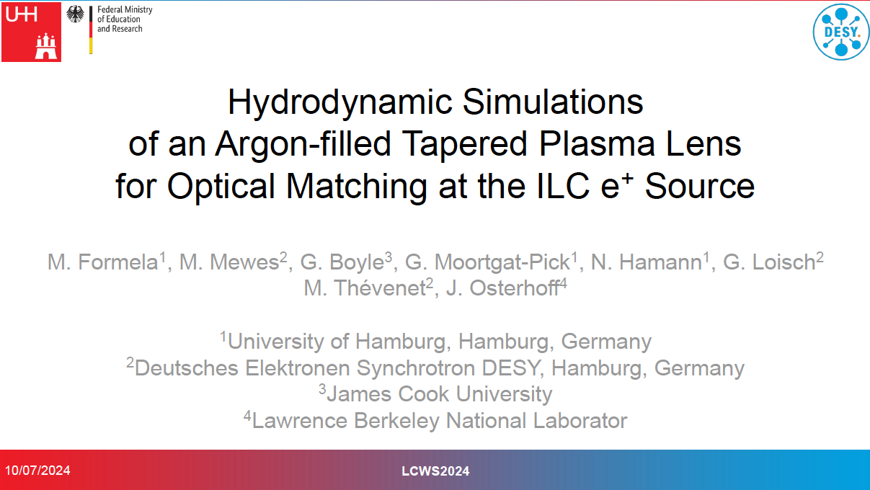
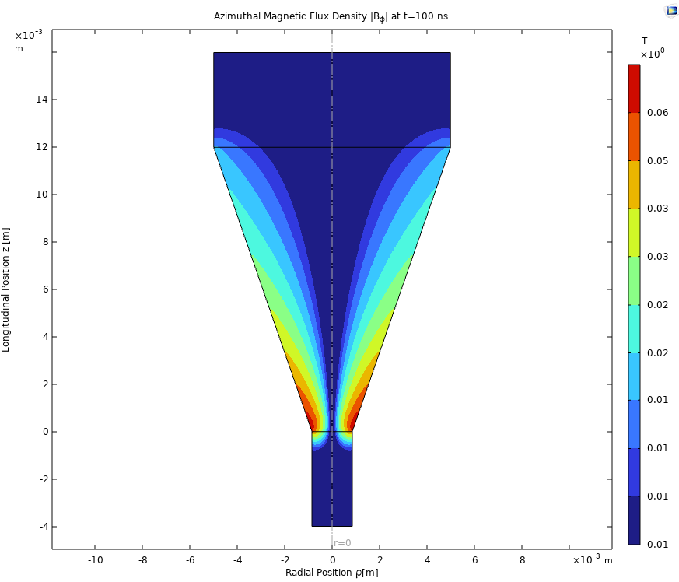

Slide 6
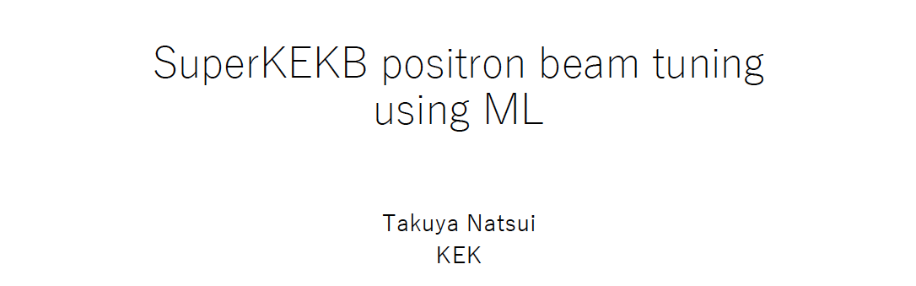
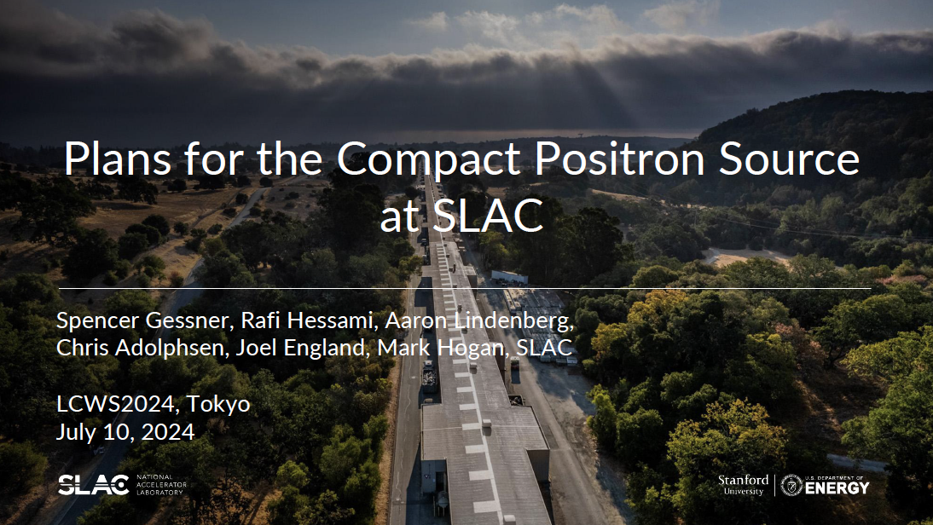
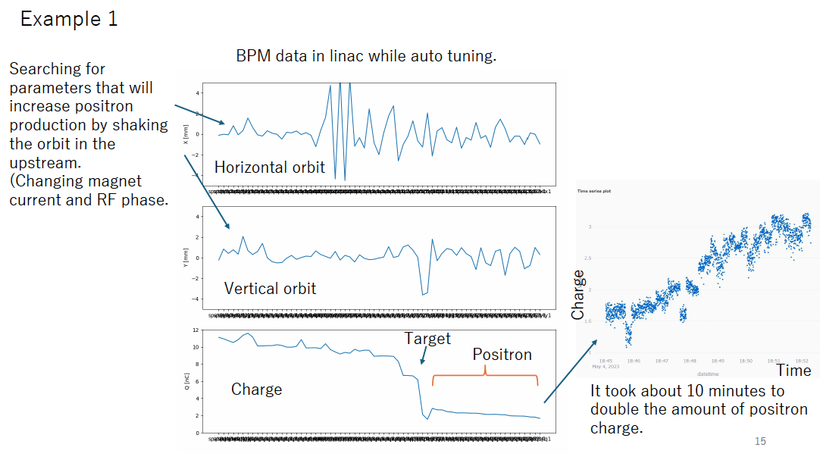
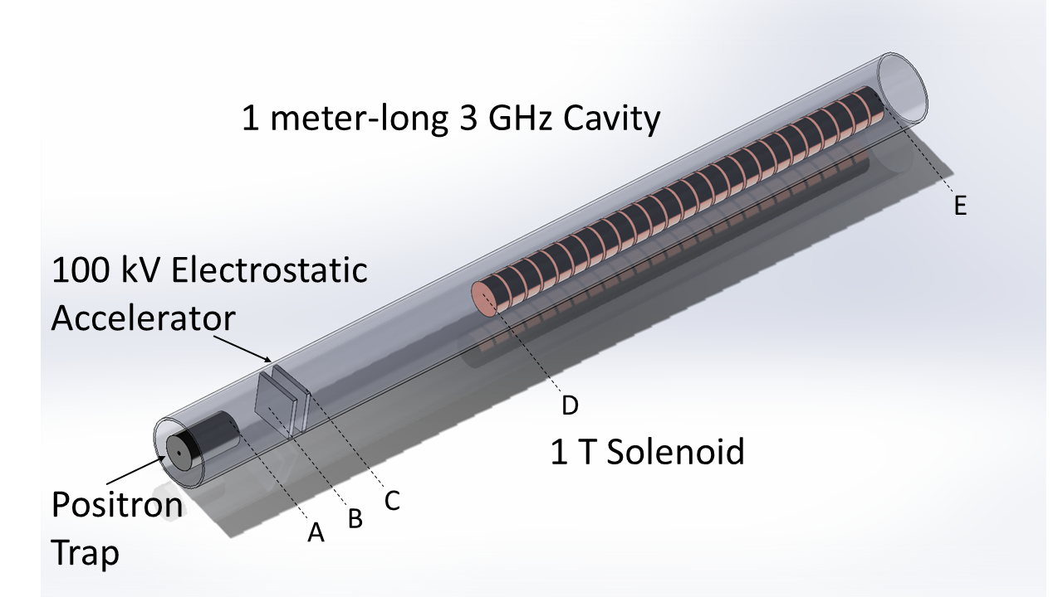
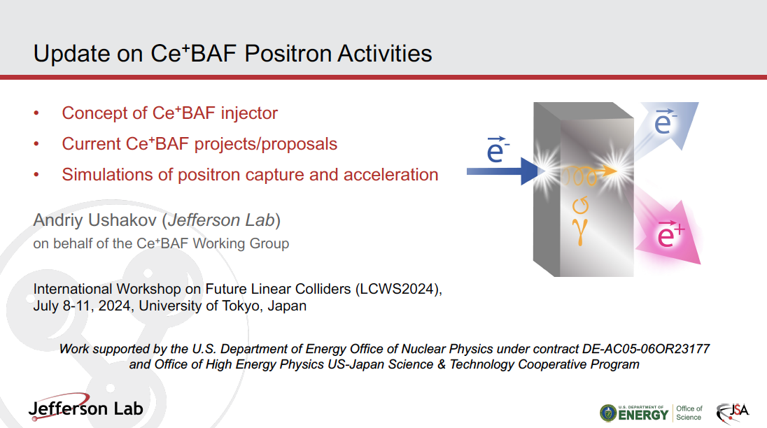
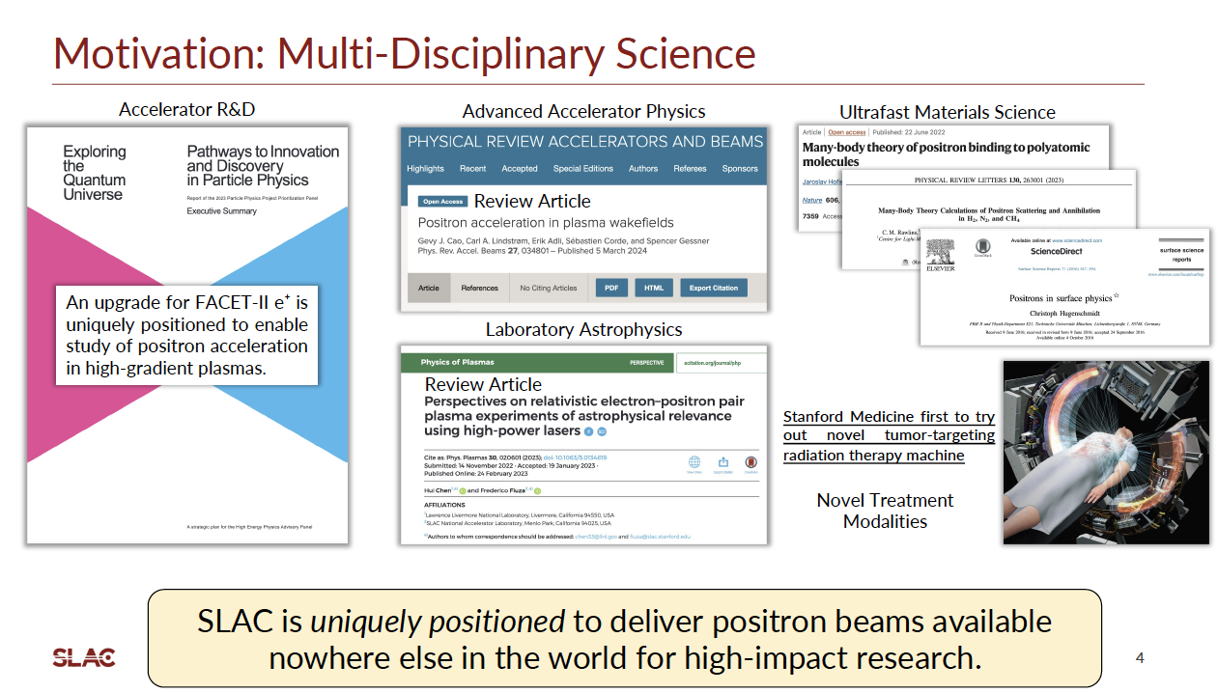

Slide 7
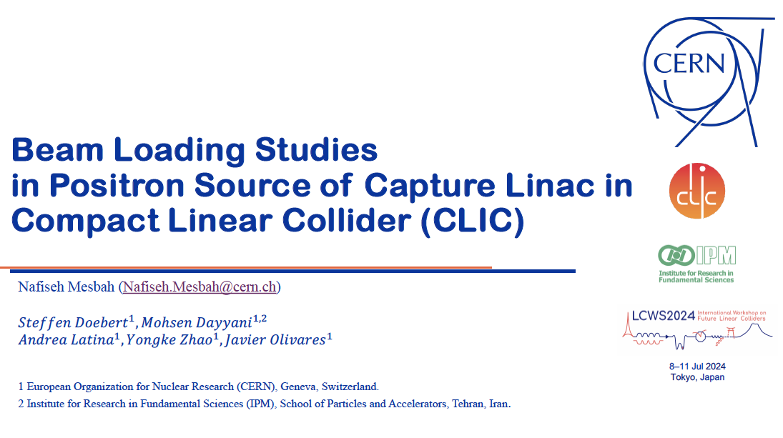
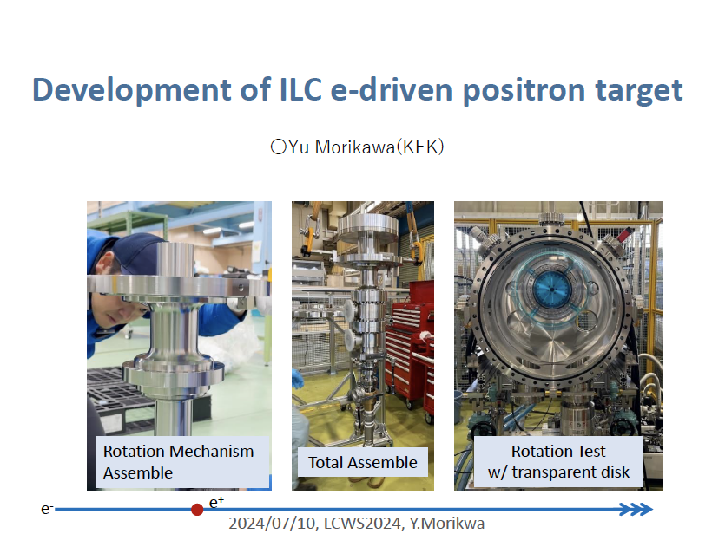
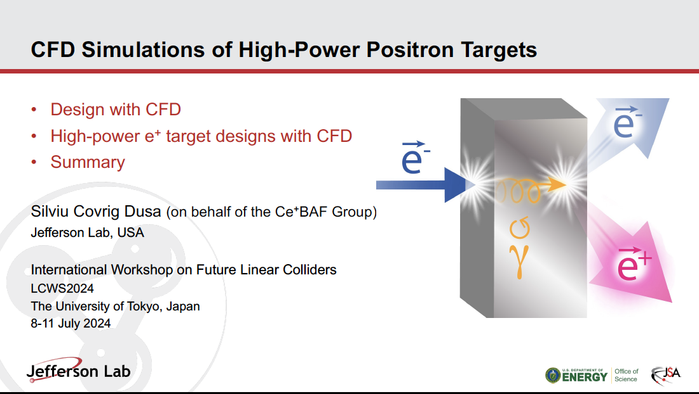
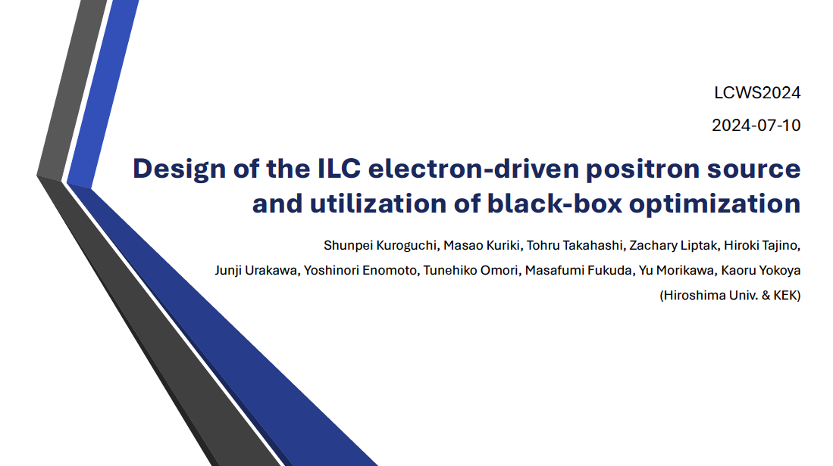
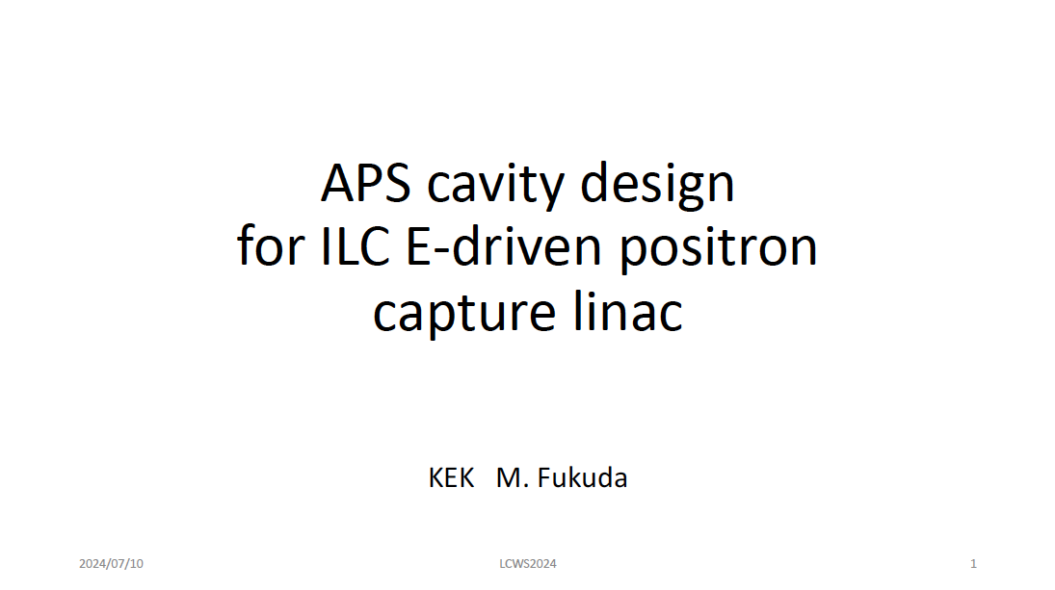

Slide 8
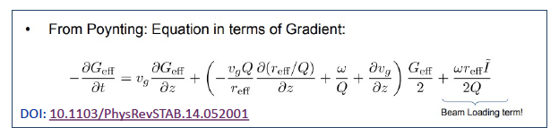
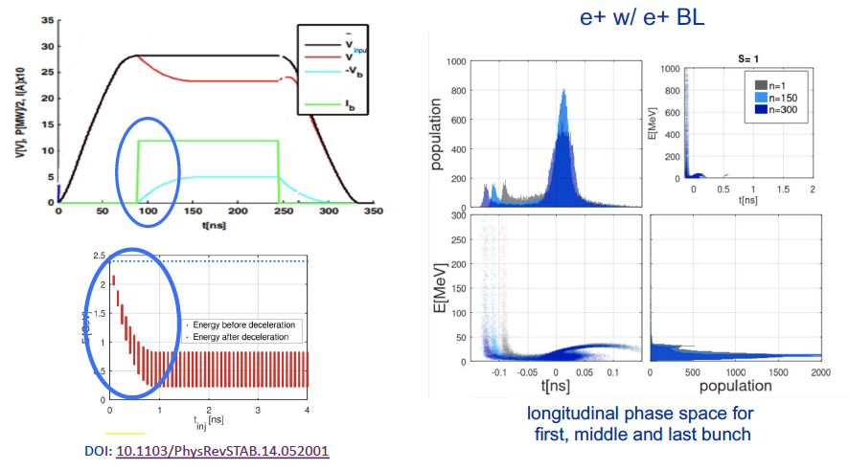

Slide 9
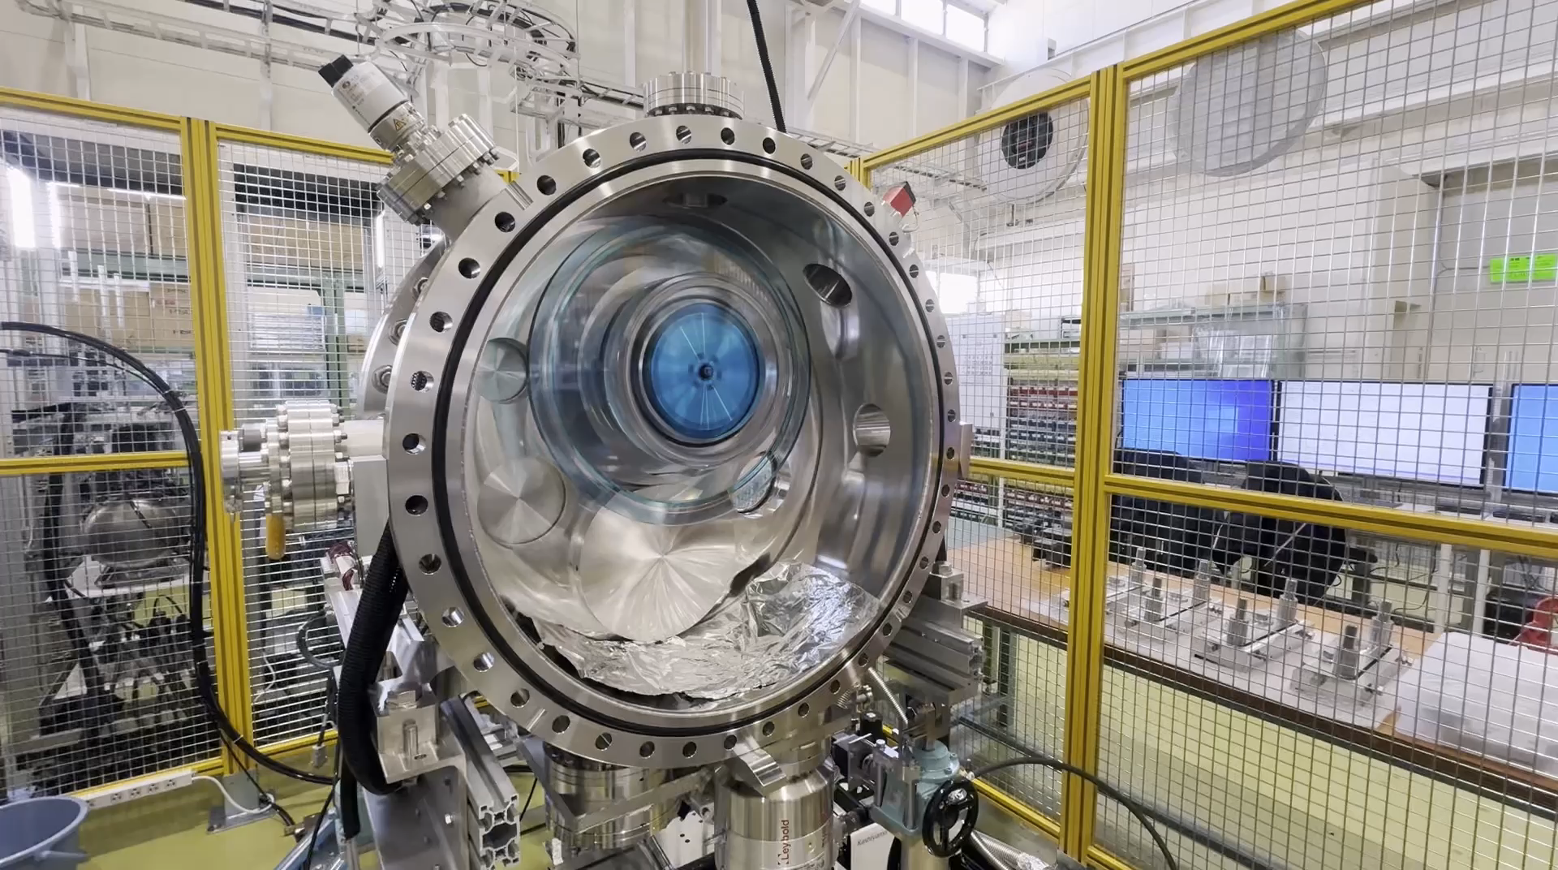
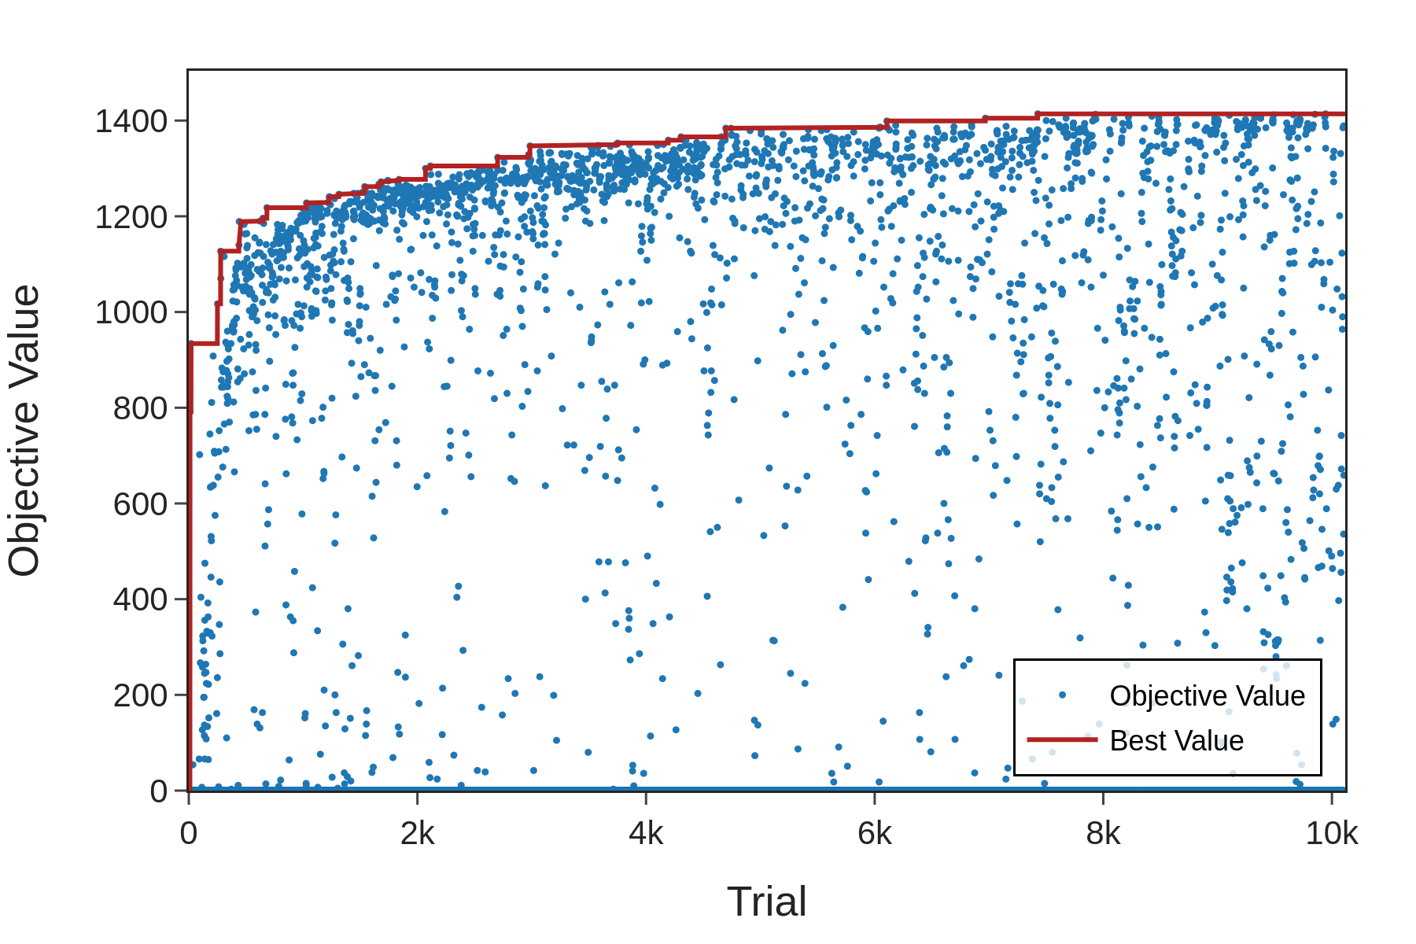
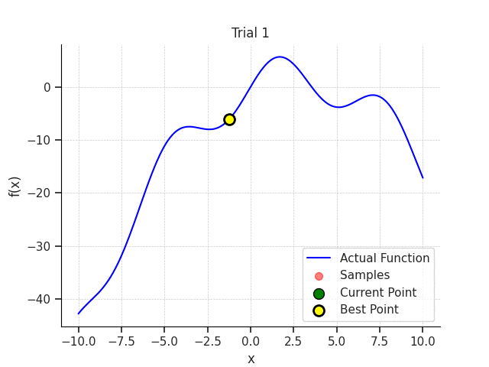
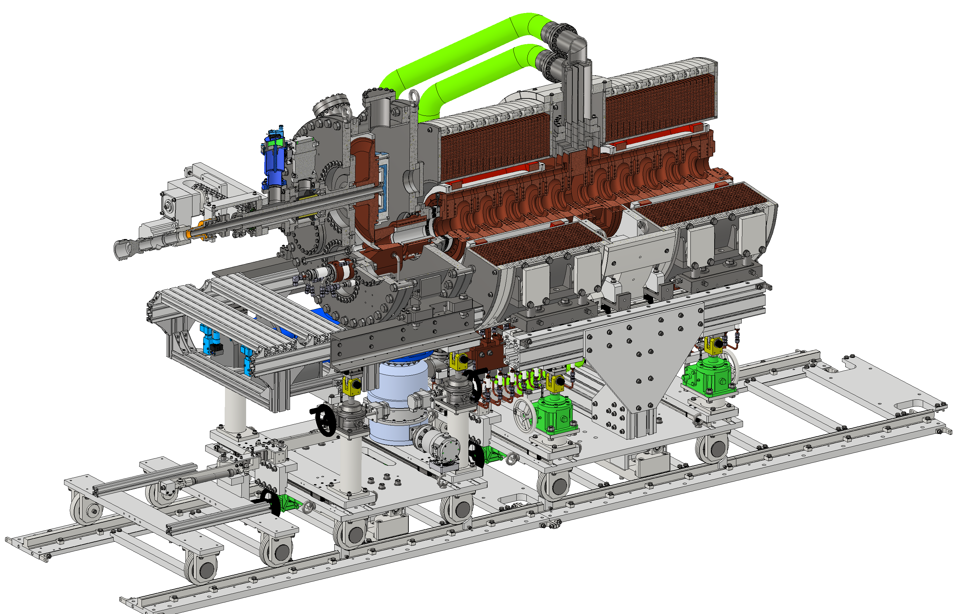
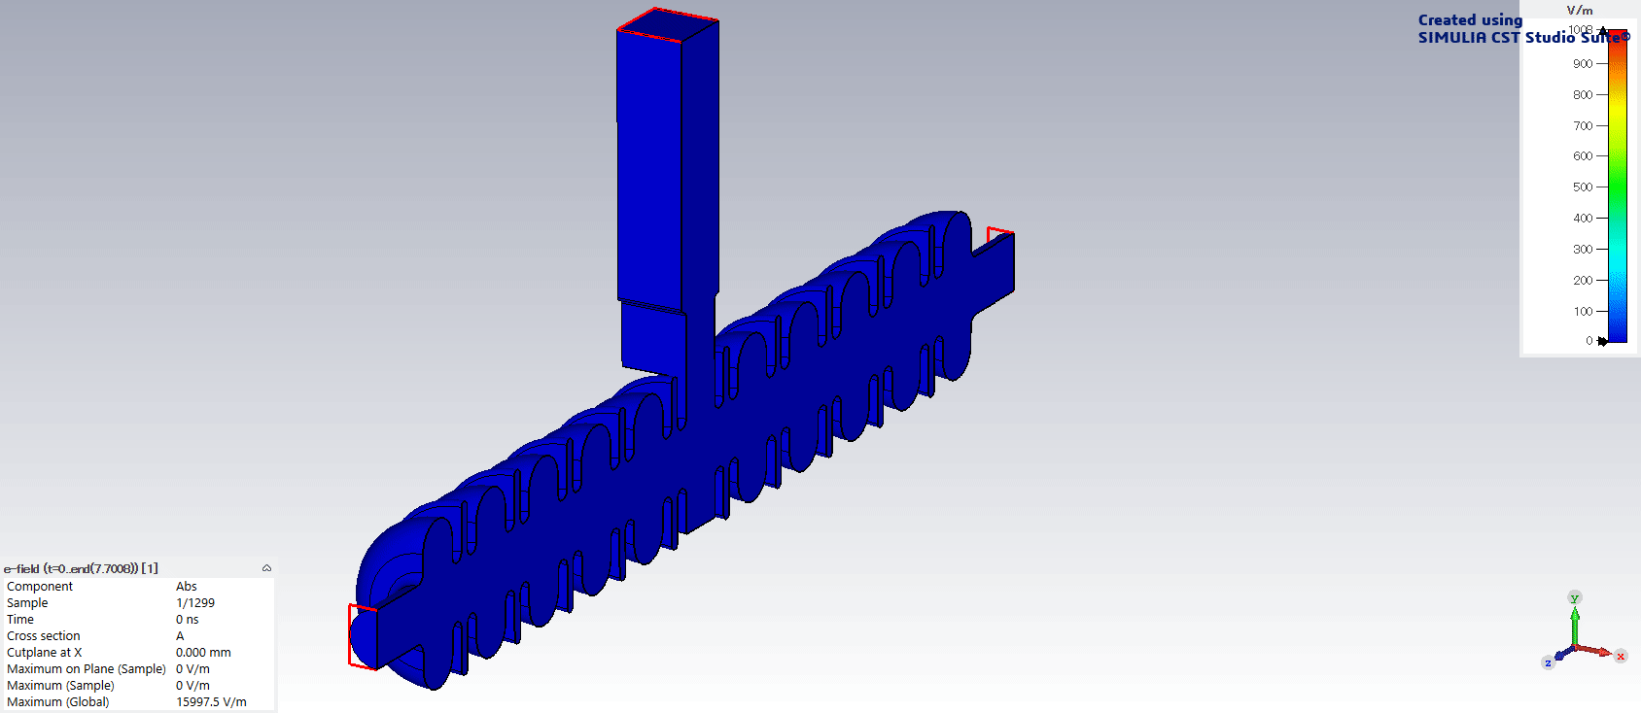

Slide 10
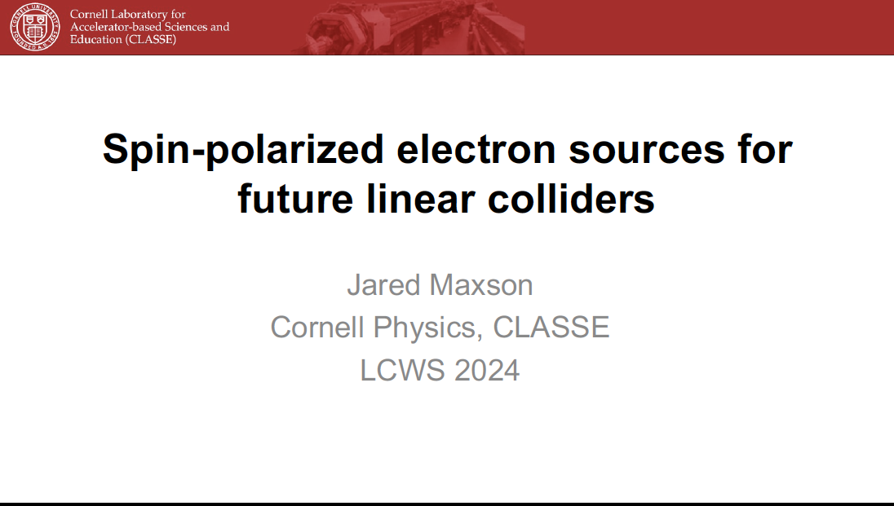
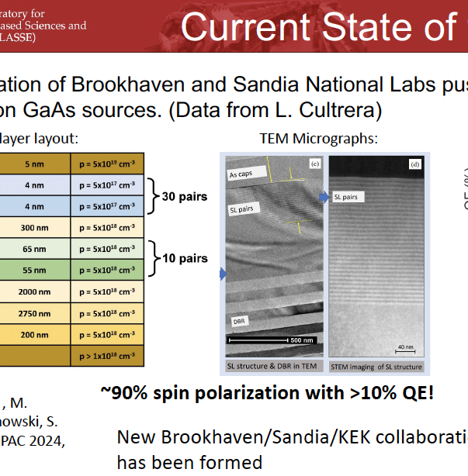
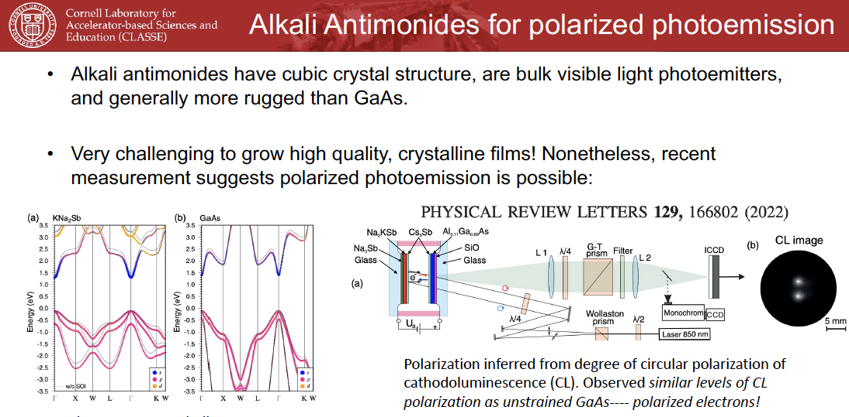

Slide 11
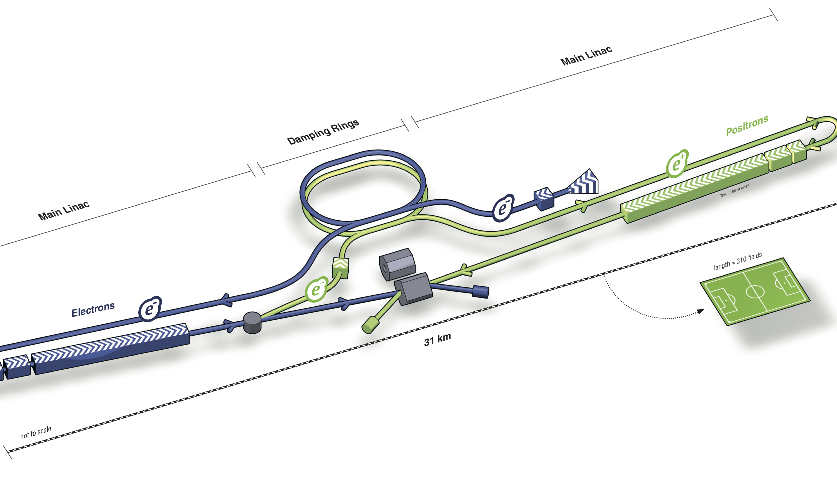
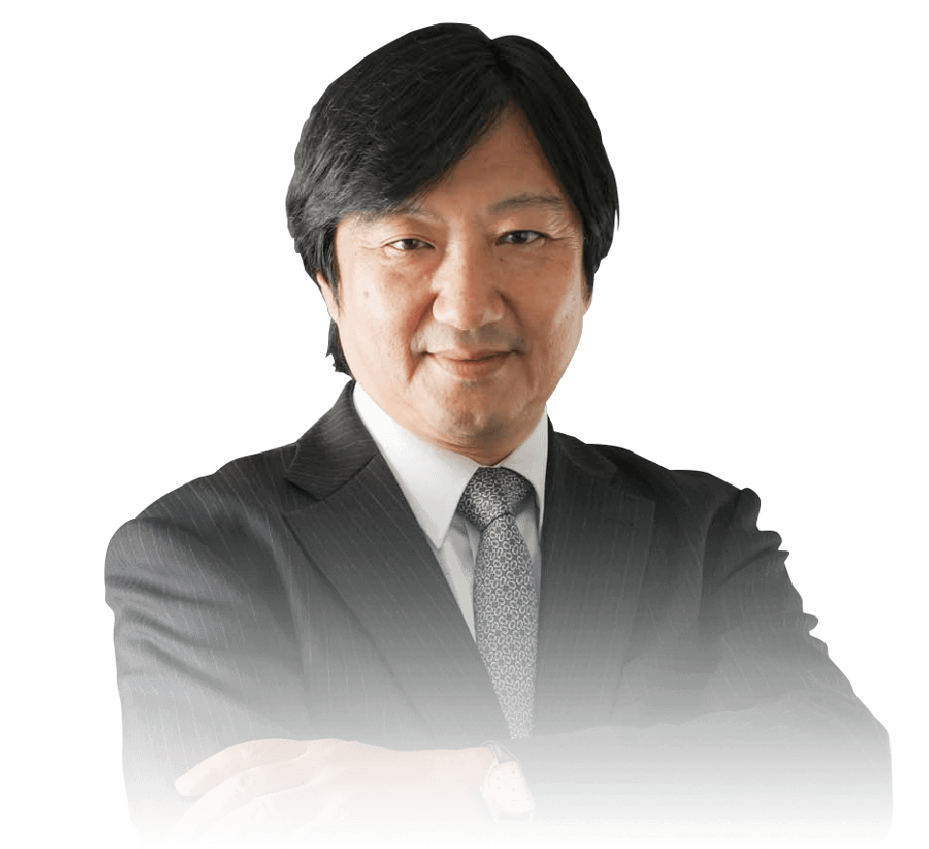
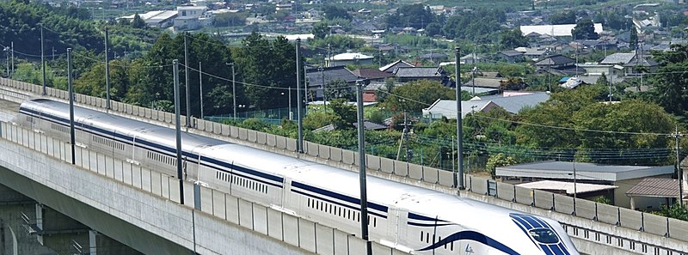
No Source, No Collision!

