Slide 1

Beam Dynamics Summary
Andrea Latina (CERN), Toshiyuki Okugi (KEK), Nicolay Solyak (FNAL)
July 11, 2024

Slide 2




Contents
CLIC
- 3 presentations
ILC
- 1 presentation
C³
- 2 presentations
Machine Learning at KEK
- 1 presentation

Slide 3
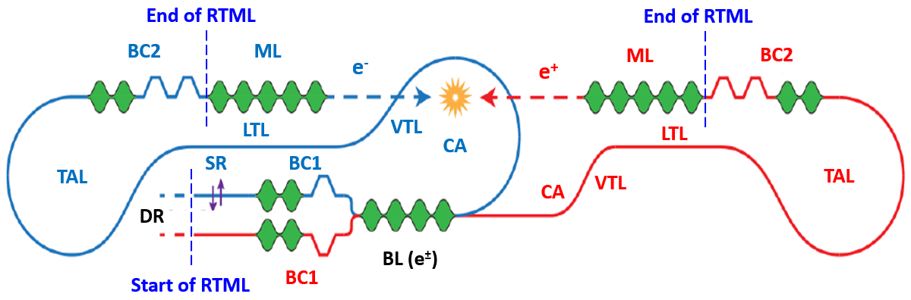
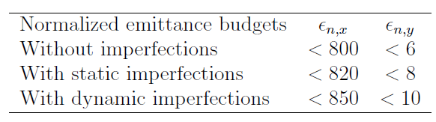
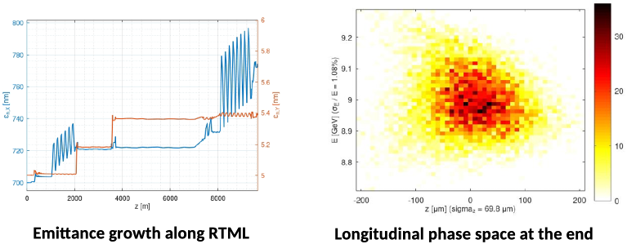
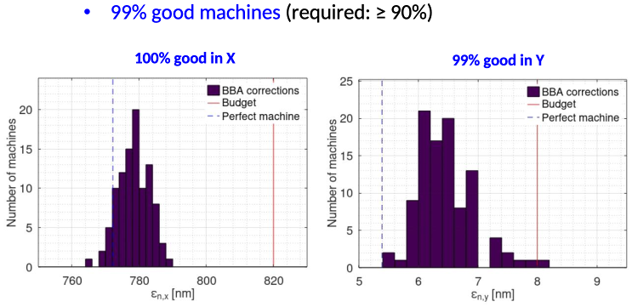
CLIC Updates /I
(Yongke Zhao, CERN)
Rings to Main Linac:
Optimization of BC2 for power consumption and cost
Consolidation of the tuning procedures
Such an increase in performance allows for the redefinition of emittance growth budgets and, ultimately, the production of more integrated luminosity.

Slide 4
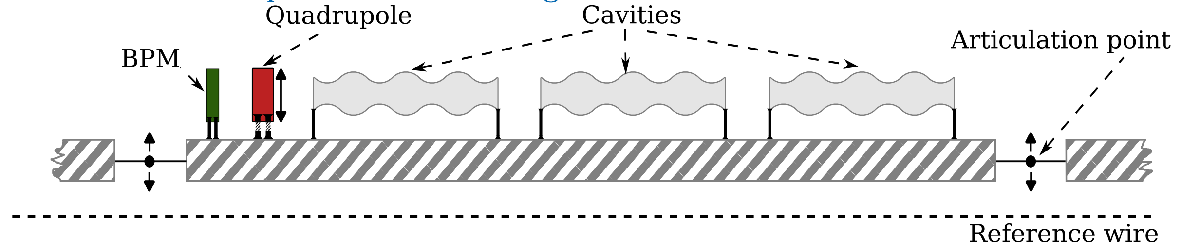
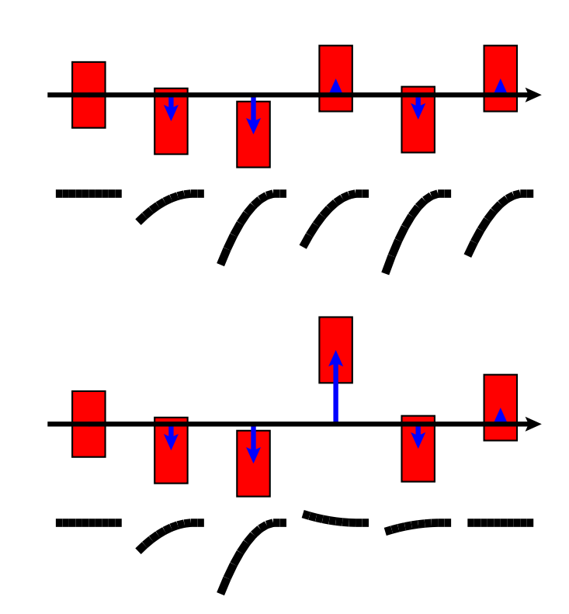
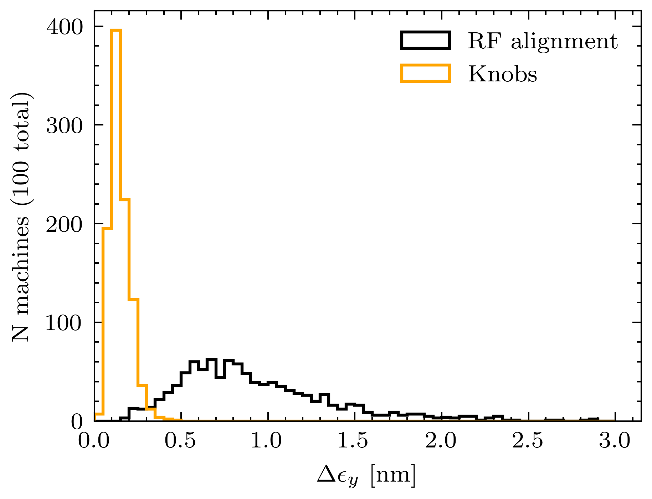
CLIC Updates /II
(Andrii Pastushenko, CERN)
Main Linac: tight emittance growth budget: 5 nm for static imperfections
and 5 nm for dynamic imperfections
New optimized emittance tuning bumps
Search for the optimal setup of the quads/girders using Forward
Feature Selection (FFS) in Tensorflow.
Wakefield monitors
100% of the machines have emittance growth < 0.5 nm.

Slide 5
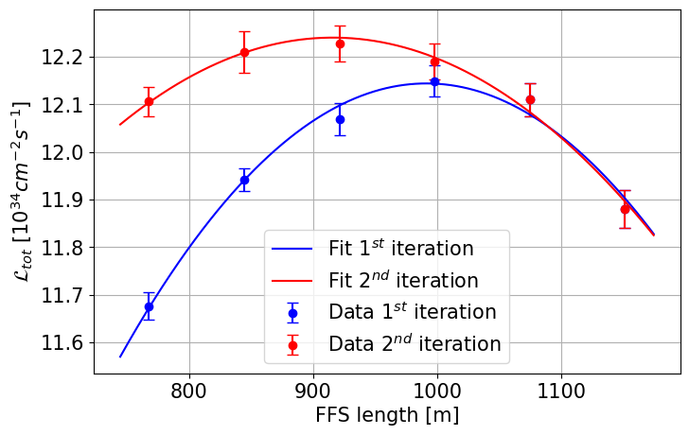

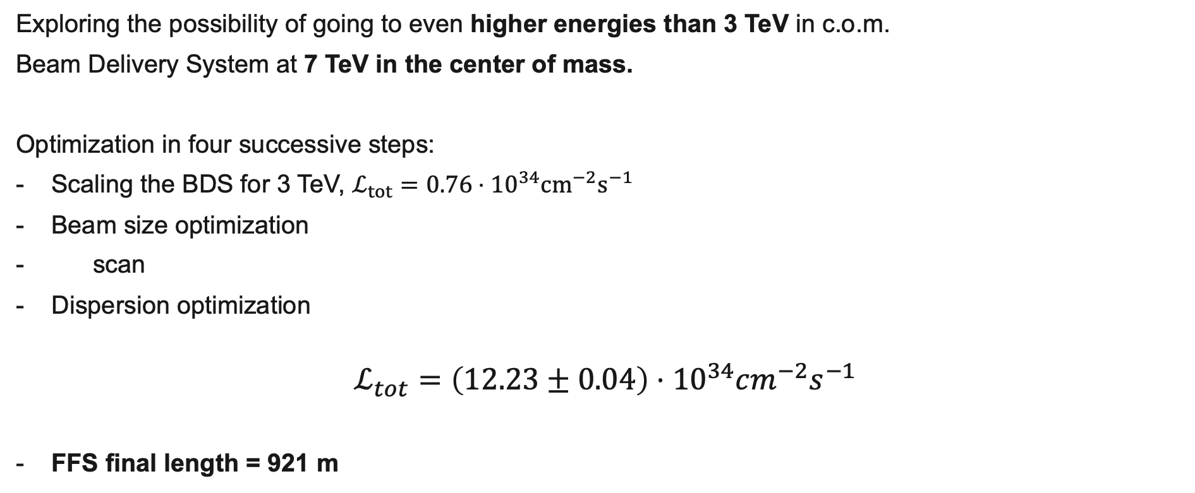
CLIC Updates /III
(Enrico Manosperti, CERN)
Exploring the possibility of going to even higher energies than 3 TeV in c.o.m.
Beam Delivery System at 7 TeV in the center of mass.
Optimization in four successive steps:
Scaling the BDS for 3 TeV, $ℒ_{tot}=0.76⋅{10}^{34}cm^{−2}s^{−1}$
Beam size optimization
scan
Dispersion optimization
$$ℒ_{tot}=\left(12.23±0.04\right)⋅{10}^{34}cm^{−2}s^{−1}$$
FFS final length = 921 m

Slide 6
ILC Updates
(Kiyoshi Kubo, KEK)
Consolidation of the TDR Lattices
Reporting the activities of the ILC Beamline Related to CFS (2019~)
  Y. Enomoto, H. Hayano, K. Kubo, T. Okugi, T. Sanuki, N. Terunuma, K. Yokoya
Considerations of CFS & beam dynamics
Main Linac reserved space moved
Longer turnarounds optimized for 250 GeV
Added “timing adjusting” chicanes
Undulator region
Positron source beamline
Electron source beamline

Slide 7
C³ Luminosity optimization
(Dimitris Ntounis, Stanford University & SLAC)
Surrogate model optimization

Slide 8
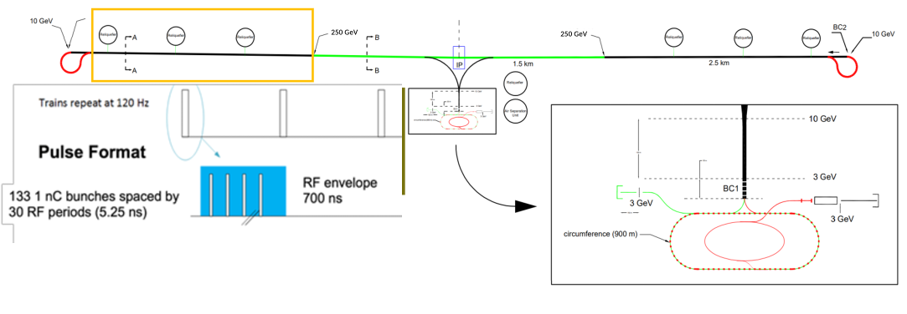
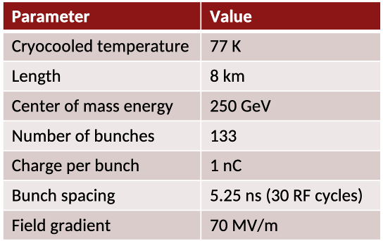
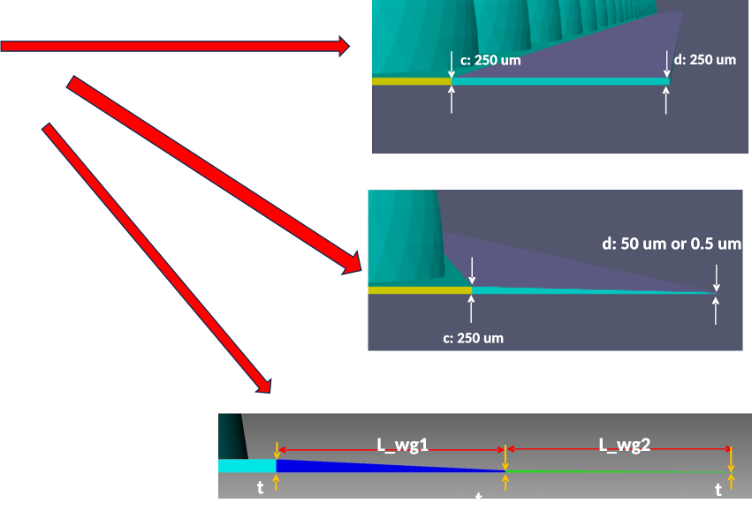
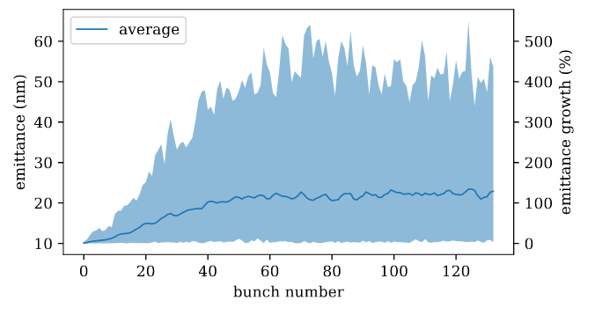
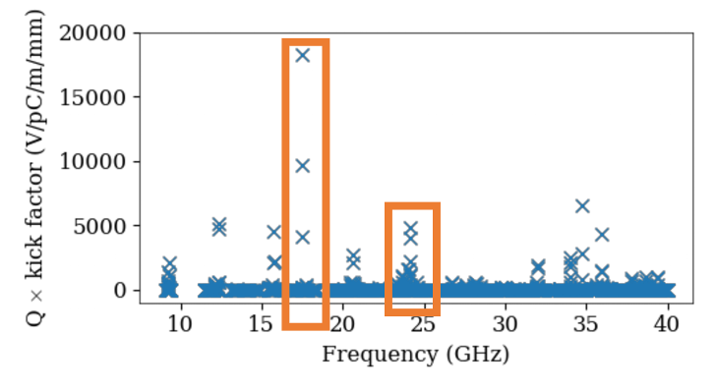
C³ Main Linac
(Wei-Hou Tan, SLAC)
250 GeV beam dynamics studies
Studying the impact of long-range wakefields on the beam
emittance due to bunch-to-bunch random jitter
Mitigation: damping
Mitigation: detuning
Identified frequency bands that need detuning

Slide 9
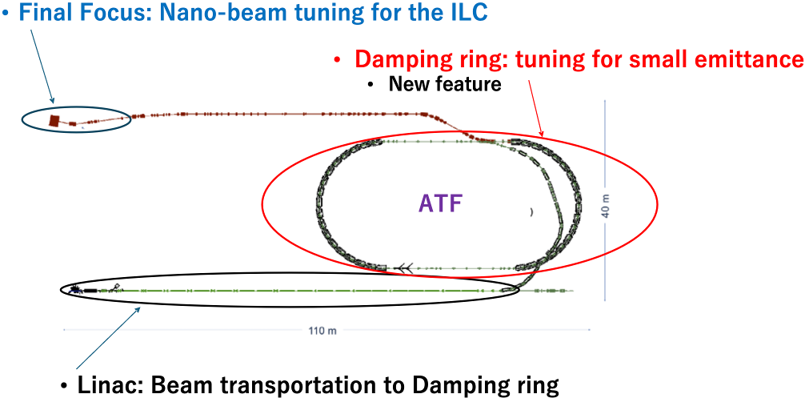
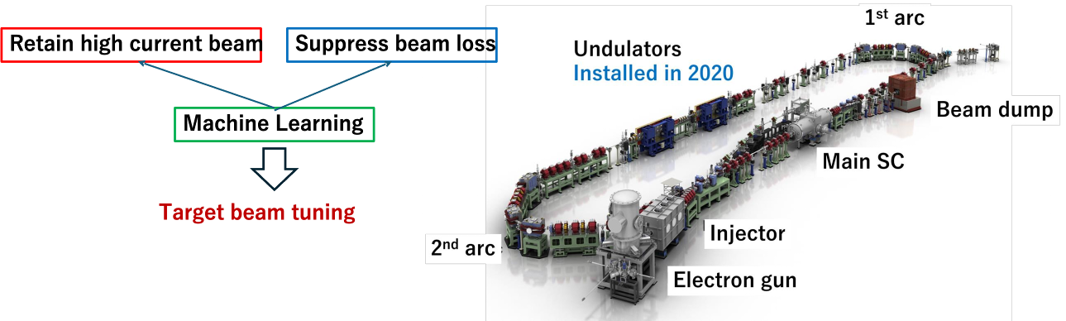
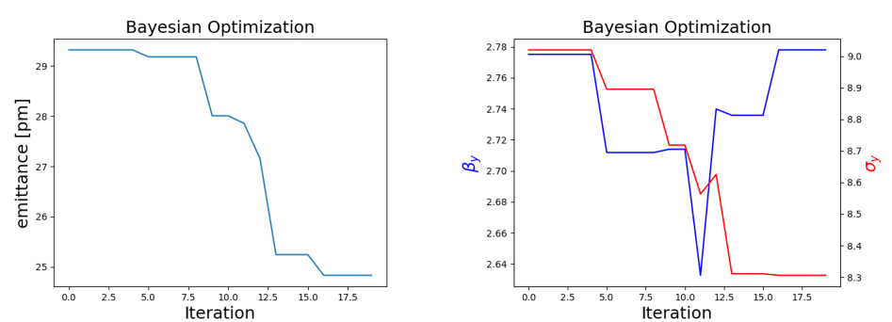
Machine Learning at KEK
(Masakazu Kurata, KEK)
ATF2: Small beam
FFS: Chromaticity correction using 5 sextupole magnets
DR: optimization for smaller emittance
ML: small emittance
Measures in place for robust optimization
Main Linac
Compact ERL

Slide 10
Thank you for your attention.
A. Latina – Beam Dynamics Summary – LCWS2024

