Slide 1
State of the art in low-emittance storage rings and CLIC DR design
Y. Papaphilippou (CERN)
Thanks to F. Antoniou, M. Barnes, C. Belver, M. Carla, A. Grudiev, P. Ferracin, S. Papadopoulou, D. Schörling, P. Zisopoulos (CERN), H. Ghasem (Diamond), L. Fajardo (LBNL), A. Bernard (KIT-ANKA), F. Torral, M. Dominguez (CIEMAT), J. Holma, M. Pont, F. Perez (ALBA), T. Mastorides (CalPoly)

Slide 2
Emittance targets
2008
Operation
Design

Slide 3
Emittance targets
2020
Operation
Design

Slide 4
Design targets and guidelines
Reach horizontal emittances <100pm, with vertical emittance of a few pm, ideas for round beams to reach ~10 pm in both planes
  Lattice design with Multi-Bend Achromats (series of TME cells), damping wigglers, innovative bedning magnets (longitudinal gradient, anti-bends, complex bends…)
Longitudinal emittance free for most rings, usually enlarged for increasing lifetime, unless interest for short bunches (low-alpha operation, crab cavities) for users or downstream systems (LC DRs)
Bunch charge of ~10⁹-10¹⁰ with structure depending on the application (100-500 MHz in light sources, 1-2 GHz for damping rings)
Energy: A few GeV depending on users’ or design requirements
  Exception e+/e- future circular colliders, i.e. 45-180 GeV
  Geometrical horizontal emittance scales as γ², whereas (almost) all collective effects mitigated at higher energies
Circumference: Typically a few 100-1000 m
  Exception e+/e- future ring colliders 10s of km
  Driven by the low horizontal emittance requirements ~ θ³ ∝ C⁻³

Slide 5
Low emittance ring challenges and mitigations
High-bunch brightness in all three dimensions
  Intrabeam Scattering effect reduced by choice of ring energy, lattice design, wiggler technology, alignment tolerances
  Electron cloud in e⁺ rings mitigated by chamber coatings and efficient photon absorption
  Fast Ion Instability in the e⁻ rings reduced by low vacuum pressure and train gaps
  Space charge vertical tune-shift limited by energy choice, reduced circumference, bunch length increase
  Other collective instabilities controlled by low –impedance requirements on machine components
Repetition rate and bunch structure
  Fast damping times achieved with SC wigglers
  RF frequency drives requirements of power source, high peak and average current, transient beam loading
Injection (Dynamic aperture) and extraction (emittance stability)
  Driving septum/kicker technology (thickness, rise time, jitter tolerance)

Slide 6
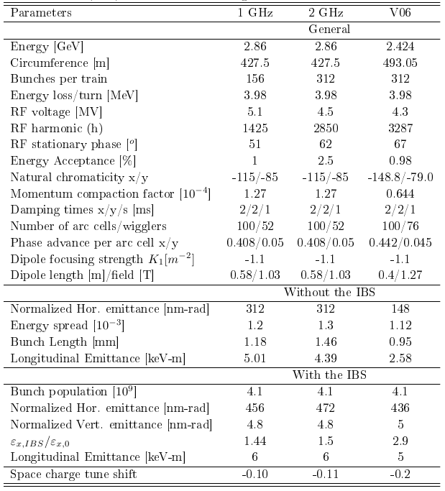
Example: The CLIC DR CDR design
Performance parameters of the CLIC DR for the 1 GHz and 2 GHz options in comparison to the V06
  Increased energy (2.424→2.86 GeV)
  Reduce the circumference by 15%
  Ultra-low emittances in all 3 planes
  Reduced IBS effect (from 3 to 1.5)
  Reduced space charge tune shift (-0.2 → -0.1)
  Lower RF stable phase (70º→51º (62º))
F. Antoniou

Slide 7
Improving CLIC DR design
Reviewed DR based on recent design developments and collaboration effort in the low emittance rings community (both beam dynamics and technology)
  New DR arc cell (longitudinally varying bends) and SC wigglers for circumference reduction (collective effects)
  RF frequency choice and LLRF technical development (power reduction)
  Stripline kicker + pulser tests
  SC wiggler tests and developments

Slide 8
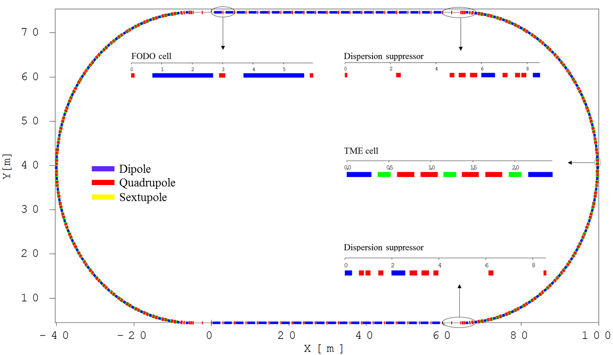
CLIC DR layout
Racetrack shape with TME arc cells and FODO straight sections filled with high field super conducting damping wigglers

Slide 9
Revising CLIC DR design
CDR design of the main CLIC DRs
Parameters, Symbol [Unit] | uniform
Circumference, C [m] | 427.5
Norm. horiz. emittance , γε_{x} [nm-rad] * | 657
Reduce the number of arc TME cells with longitudinally variable bends
Reduce the number of wiggler using higher wiggler field
500 nm (700 nm) required output emittance
*The emittance is calculated using the Bjorken-Mtingwa formalism through MADX.
Using the Piwinski form., the original design (with the uniform dipoles) reaches the target horizontal emittance.

Slide 10
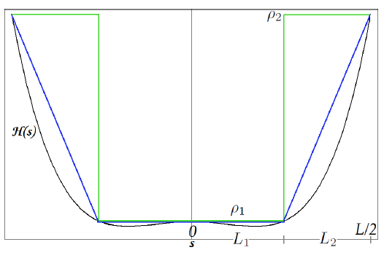
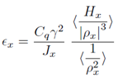



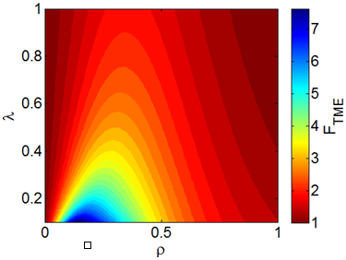
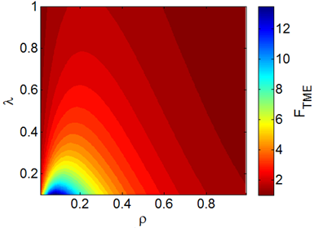



Longitudinally variable bends
S. Papadopoulou
Bending radii ratio
Step profile
Trapezium profile
Lengths ratio
Emittance reduction factor
The parameterization of the emittance reduction factor FTME with the bending radii ratio ρ and the lengths ratio λ, always for λ>0.1.

Slide 11
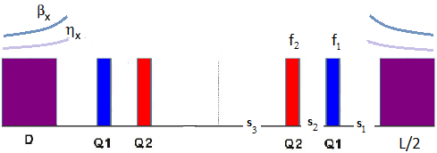
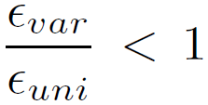


TME Cell optimisation
S. Papadopoulou
With the variable bends, lower emittances are reached, providing flexibility to reduce the number of TME cells, for reaching target emittance in a shorter ring.

Slide 12
CLIC DR Design parameters
Optimised lattice design achieves all target parameters for a mitigated IBS effect and a ring circumference that is reduced by ~13% with respect to the old lattice
Remarkable Dynamic Αperture, allowing very comfortable on-axis injection
Significant margin for the CLIC DR emittance target (500nm), for an eventual increase of the required bunch population, as lately proposed due to the CLIC re-baselining

Slide 13
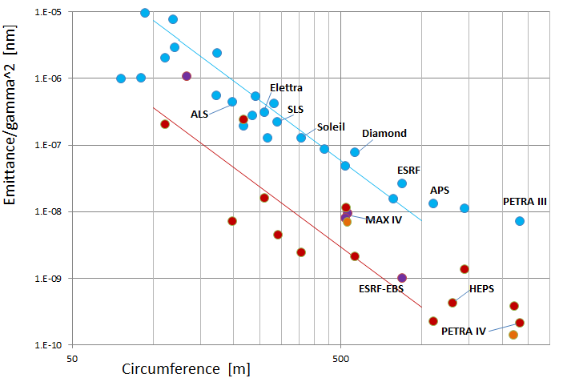
Emittance vs energy and circumference
Emittance normalized to energy vs. circumference
ε_{x} ∝ (Energy)² / (Circumference)³
“Bartolini plot”
Theoretical
Emittance scaling
ε ∝ γ ² C ⁻³
K ≈ 2 → ≈ −1
improvement ×20
Emittance / (Energy/mc²)² [nm]
upgrade
projects
operational
commissioning
or construction
planned
CLIC DR
with damping wigglers
A. Streun, Lattice review meeting, 2020

Slide 14
Horizontal vs Vertical emittance
Operation
Design

Slide 15
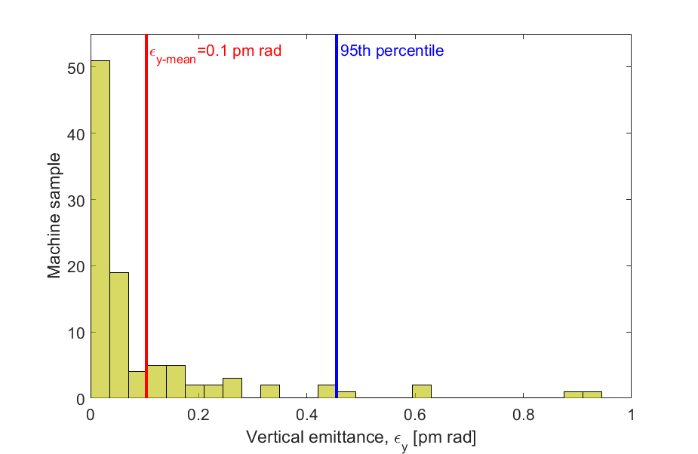
Vertical emittance tuning
Vertical emittance in the CLIC DR including all errors, specified misalignments and BPM offsets, rolls and noise jitter (100 random seeds)
Error | Unit | Value
Dipole/quadrupole/sextupole/BPM vertical misalignment | μm | 40/16/70/70
Dipole/quadrupole/sextupole roll | μrad | 70/50/100
BPM roll | μrad | 70
BPM noise | nm | 200
The mean value of the vertical emittance for 100 seeds is around 0.1 pm rad and for 95% of machine samples, the vertical emittance is below 0.5 pm rad.
H. Ghasem

Slide 16
Low Emittance Rings technologies

Slide 17
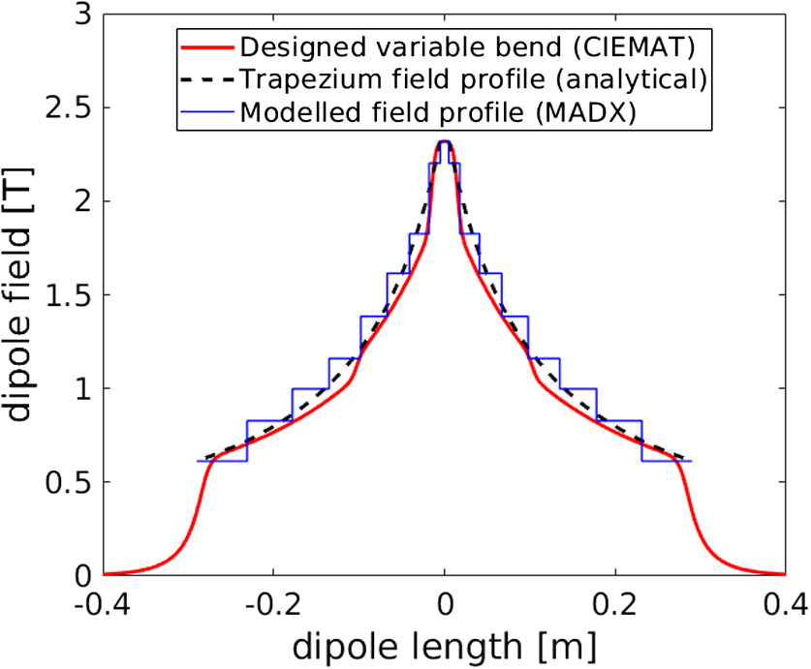
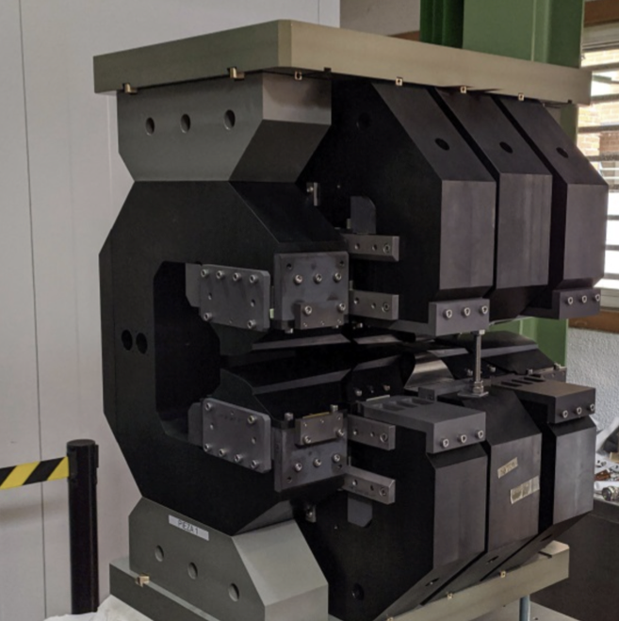


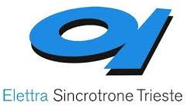

VAriable Dipole for the Elettra Ring – VADER @ IFAST
Fabricate an innovative dipole magnet prototype with longitudinal varying dipole field, including a transverse gradient for the ELETTRA upgrade
Permanent magnet concept with trapezoidal bending radius, 2.3 T peak field and ~10 T/m gradient, already established (CERN/CIEMAT)
Proved the horizontal emittance reduction to ultra-low levels of i.e. ~60 pm @ 2.86 GeV, for the CLIC DR
First demonstrator constructed/qualified by CIEMAT and new prototype under construction
Y. Papaphilippou
(A. Poyet)
M. Dominguez
F. Toral
E. Karantzoulis
D. Castronovo
R. Geometrante

Slide 18
NbTi Wiggler tests at ANKA
A. Bernard, P. Zisopoulos

Slide 19
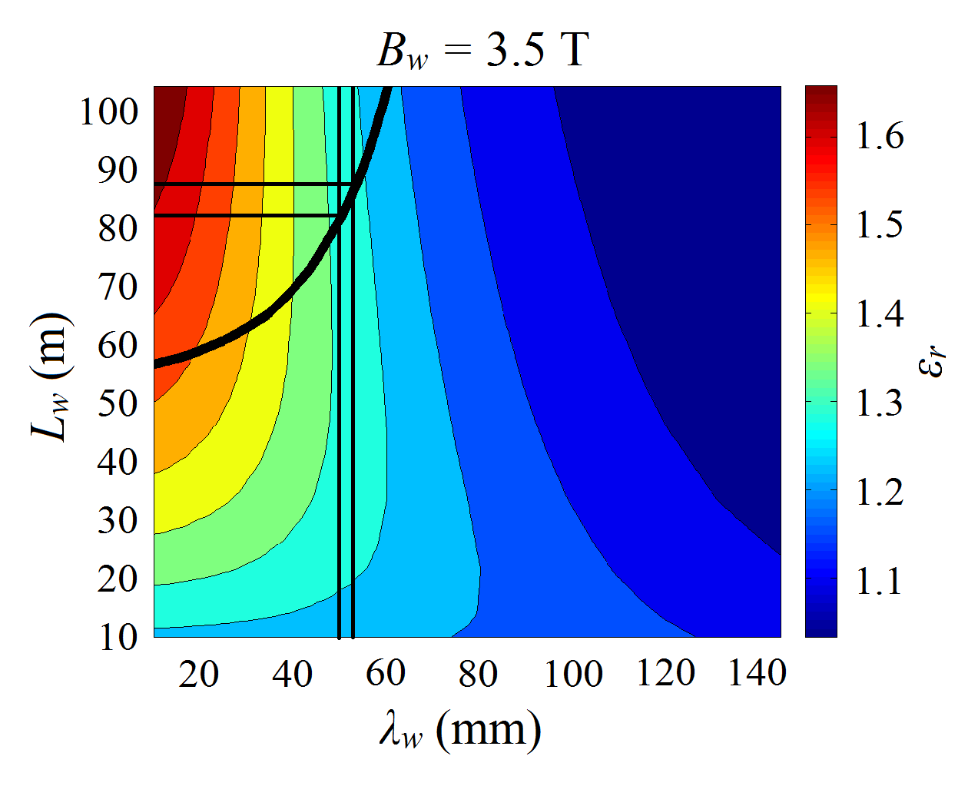
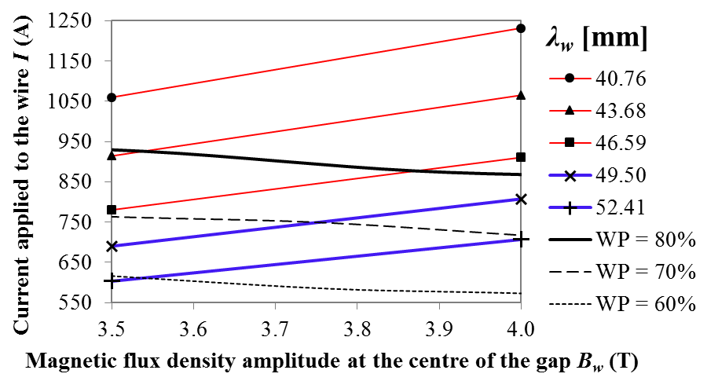
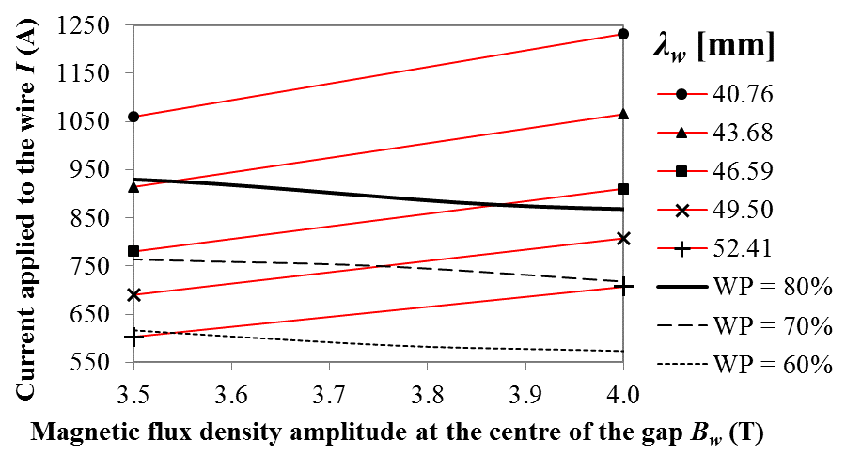
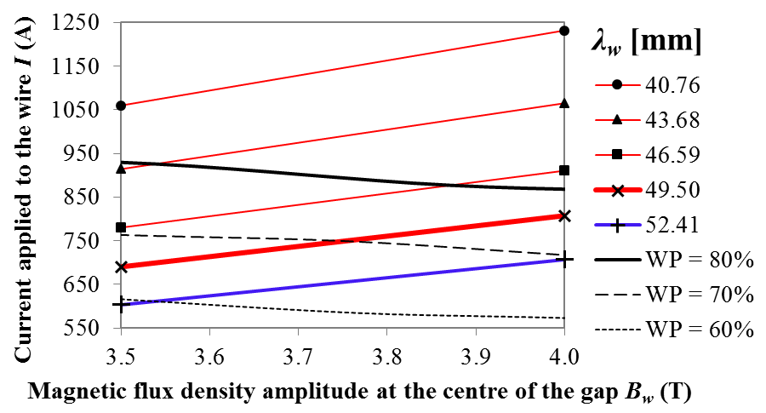
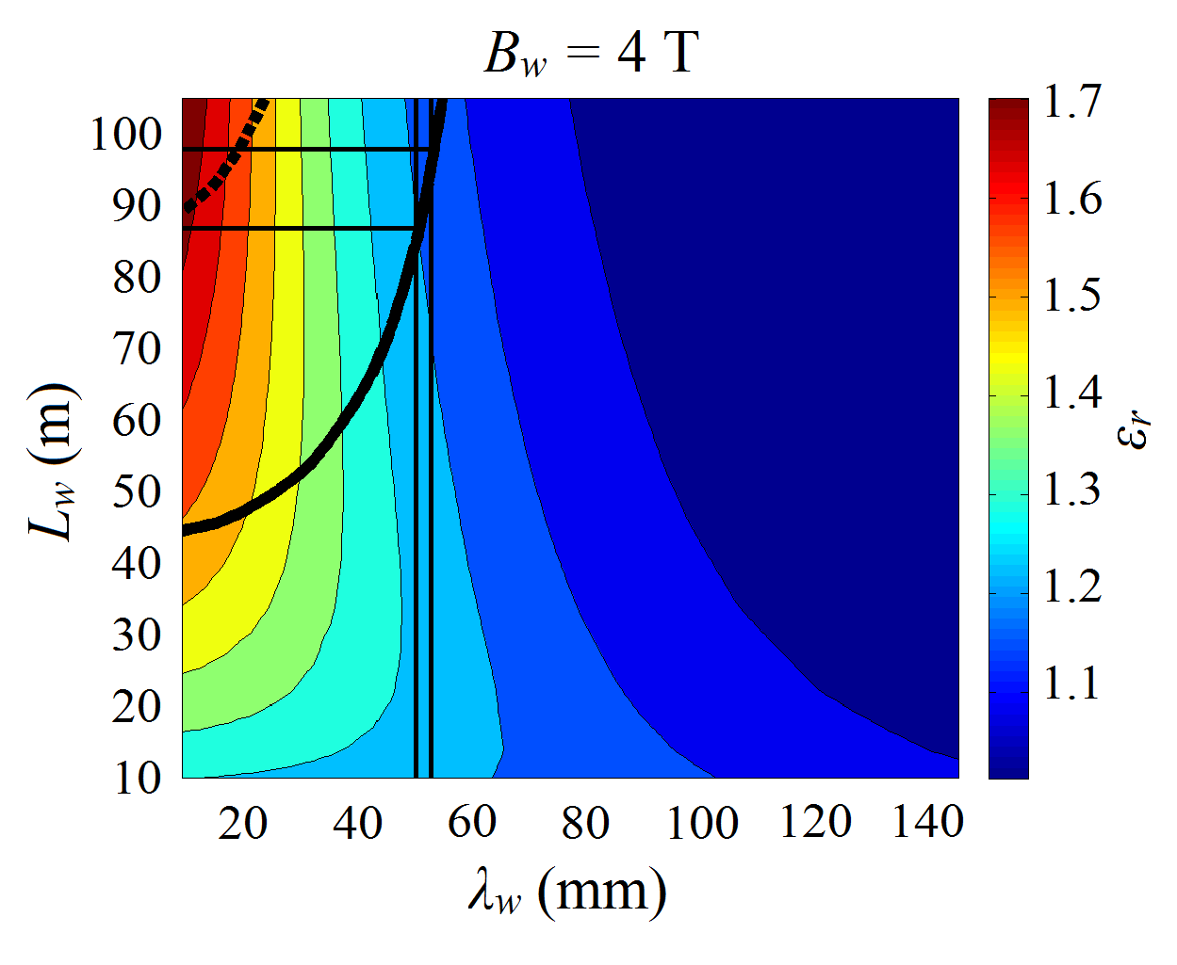
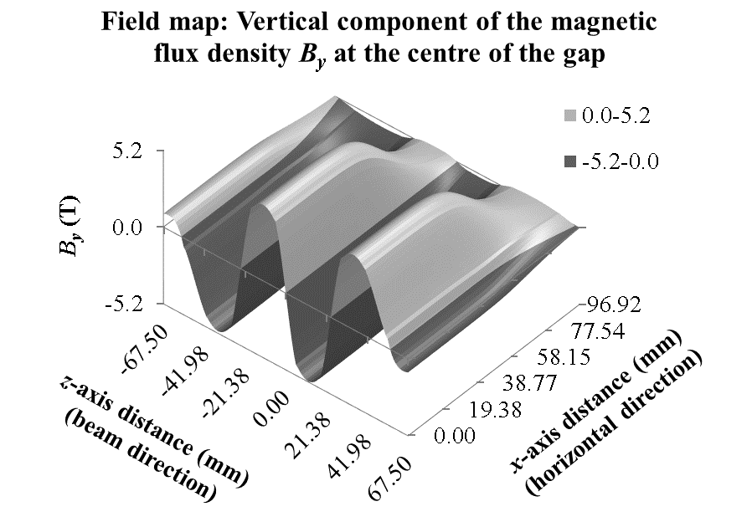
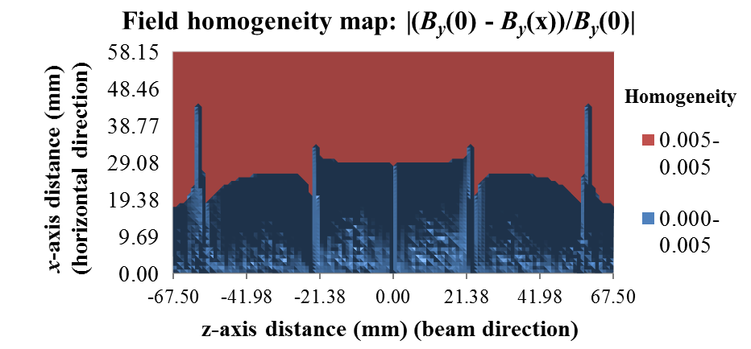
Nb₃Sn wiggler Design
L. Fajardo
Larger potential L_{w} reduction with λ_{w} = 49.5 mm
Additional restriction:
Keeping the working point (WP) below 80% of the magnet’s current limit for all 3.5 T ≤ B_{w} ≤ 4 T
Scenarios for achieving 3.5 T ≤ B_{w} ≤ 4 T with 40 mm ≤ λ_{w} ≤ 55 mm values:
Selected λ_{w} for
3.5 T ≤ B_{w} ≤ 4 T

Slide 20
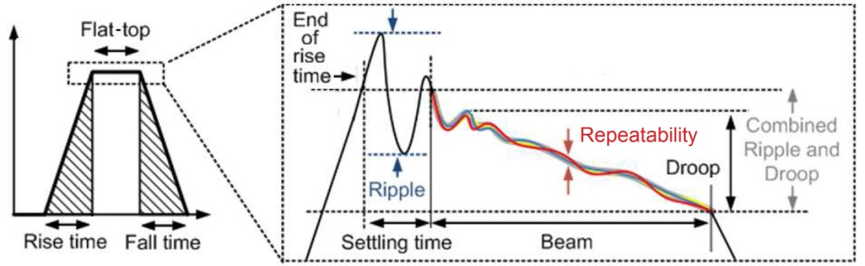
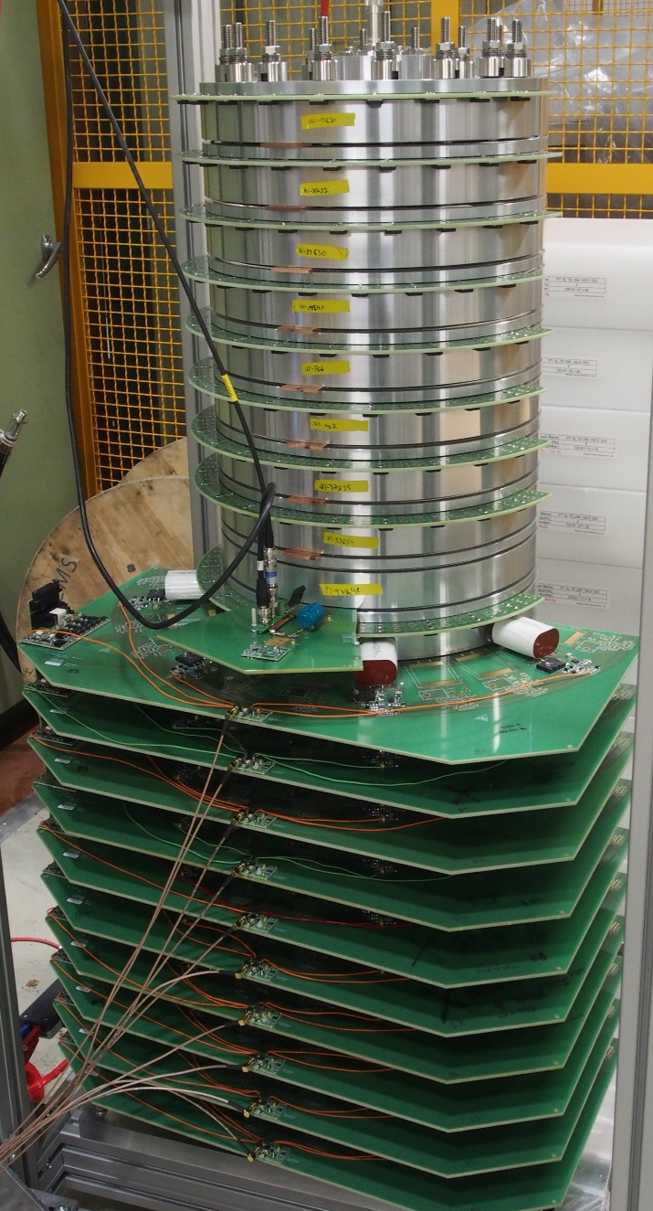
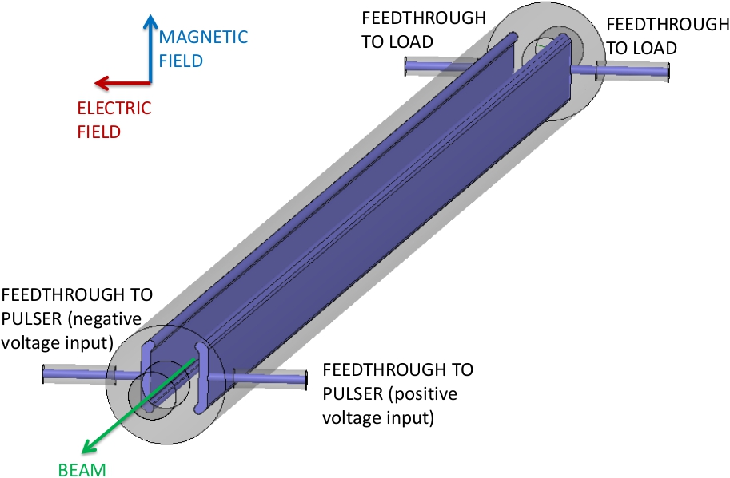
Kicker System challenges and tests at ALBA
Striplines
Field homogeneity: ± 0.01% over 1 mm radius.
Very low impedance: 0.05 Ω/n in longitudinal and 200 kΩ/m in transverse.
Inductive Adder
Flat-top repeatability: ± 0.01%
Flat-top stability: ± 0.02%
Rise/fall times ≤ 100 ns desired.
M. Barnes, C. Belver, J. Holma, M. Carla

Slide 21
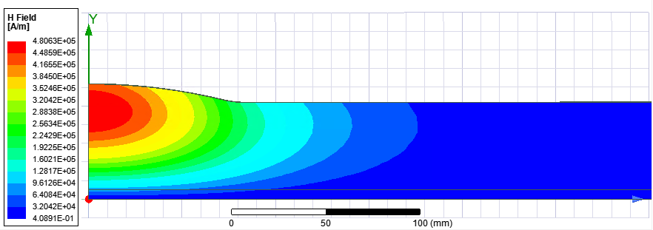
Design of DR cavity for ultra-low R/Q of 14.3Ω
Increase cavity aperture to reduce loss factor => reduce R/Q per cavity
Increase cavity length to reduce transit time factor => reduce R/Q per cavity
Optimize cavity wall shape to minimize H-field to reach largest stored energy per cavity under the H-field limit of 80 kA/m (100 mT, private communication, W. Venturini, 2021) => reduce number of cavities
R/Q per cavity x N of cavities must be below Total R/Q: 14.3 Ω
Novel cavity: Barrel Cell Cavity (BCC) geometry
New design of the DRs demonstrates significant reduction of the power consumption
A. Grudiev, T. Mastorides

Slide 22
Summary
Extreme low emittance @ high intensity beam generation and transfer drives several beam dynamics challenges
  Lattice design, coherent and incoherent collective effects, instabilities, low emittance tuning, ions, space-charge, e-cloud, impedance budget, feedback specs
All drive associated technologies
  Magnet design
  Beam transfer system (stripline, pulser)
  RF system, including LLRF
  Vacuum system
  Alignment
  Associated instrumentation
Continue collaboration with low emittance rings community for R&D and experimental tests

Slide 23
Thank You

Slide 24
Reserve

Slide 25

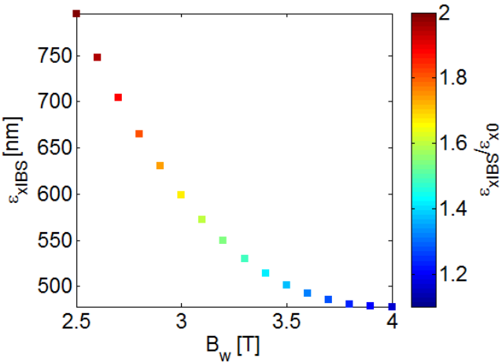
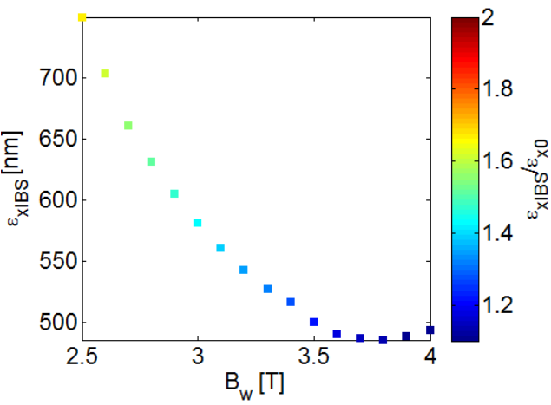
Optimisation of Wiggler FODO
Results obtained after optimization of the arc TME cell.
When increasing the wigglers’ peak field B_{w}, the emittance and the IBS effect are lowered ^{[3]}.
Based on technological restrictions, a new working point for the damp. wiggler is proposed to be at 3.5T (prev. 2.5T), with 49mm period length
Removing some wiggler FODO cells from the existing straight section (N_{FODO}=13 per section) is possible.
N_{FODO}=10 per straight section
Step profile
Trapezium profile
Parametrization of the steady state emittance and the IBS effect with the wiggler’s peak field B_{w}

Slide 26
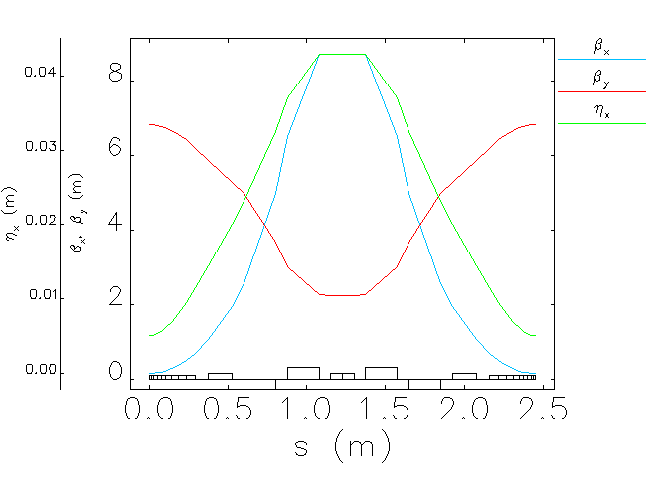
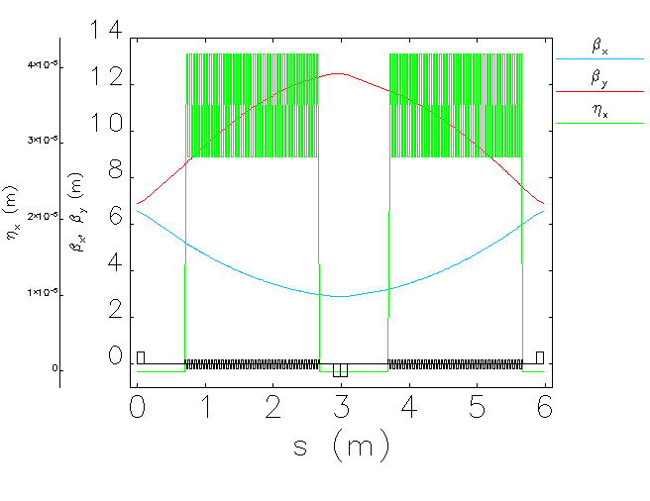
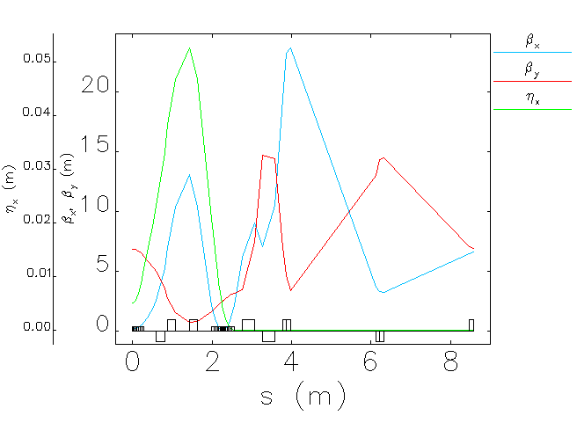
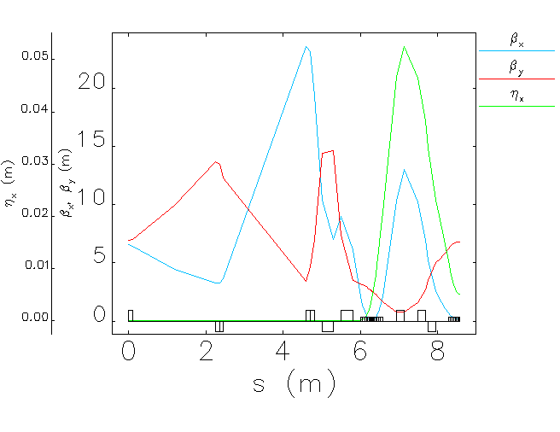
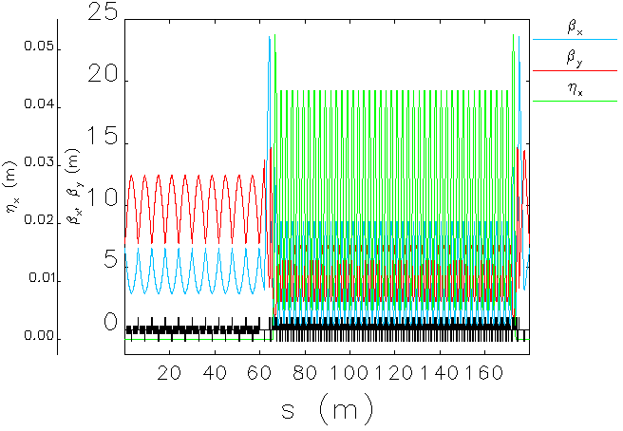
CLIC DR Optics
Parameters | Value
Energy [GeV] | 2.86
Circumference [m] | 359.44
No. of Dipole/wiggler | 90/40
Hor./Ver. Tune | 45.27/13.33
Nat./nor. emittance [pm/nm] | 79.00/442.18
Nat. chromaticity | -134.42/-41.63
1st order mom. compaction | 1.17E-4
Energy spread | 1.28E-3
Energy loss per turn [MeV] | 5.79
Damping time [ms/ms/ms] | 1.17/1.19/0.60
Radio frequency [GHz] | 2
RF voltage [MV] | 6.5
Bunch length/charge [mm/nC] | 1.26/0.91
Number of particles per bunch | 5.7E10
Natural emittance+ IBS [pm] | 110
Energy spread + IBS | 1.33E-3
Bunch length + IBS [mm] | 1.31
TME cell;
Length= 2.45 m
ψ_{x}/2π= 0.442
ψ_{y}/2π= 0.1
FODO cell;
Length= 5.969
ψ_{x}/2π= 0.238
ψ_{y}/2π= 0.096
Wiggler (l=2 m, B=3.5 T, L_{λ}=49 mm)
Dispersion suppressor;
Length=8.57
ψ_{x}/2π= 0.85
ψ_{y}/2π=0.757
Dispersion suppressor;
Length= 8.56
ψ_{x}/2π= 0.85
ψ_{y}/2π= 0.748
H. Ghasem

Slide 27
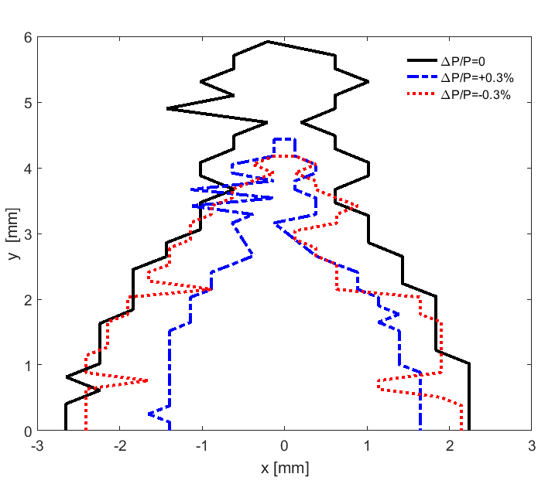
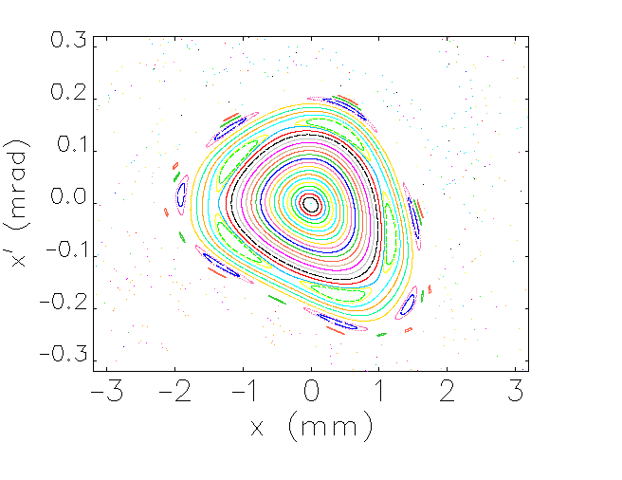
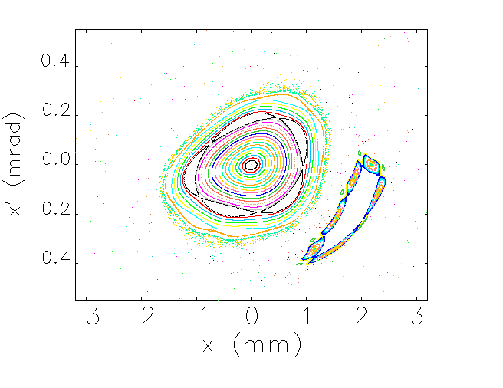
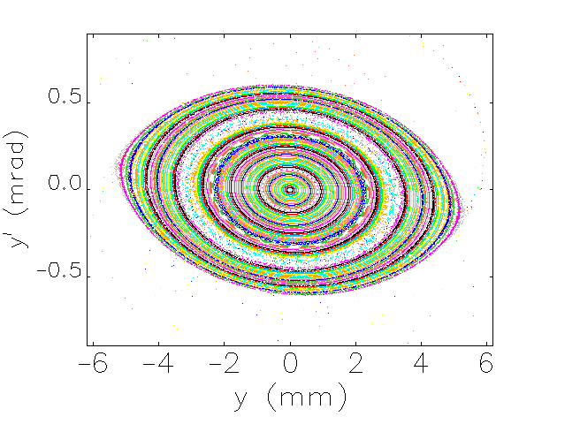
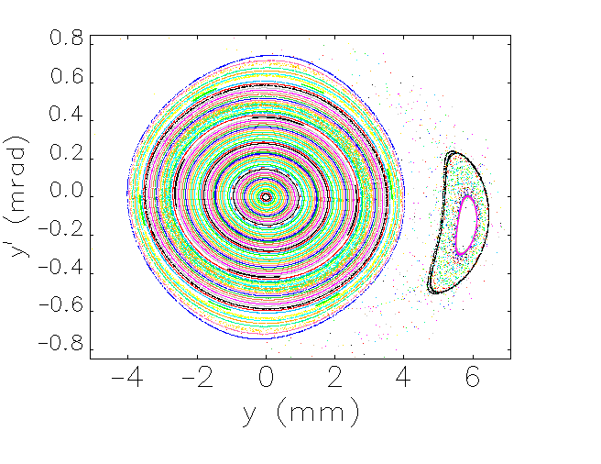
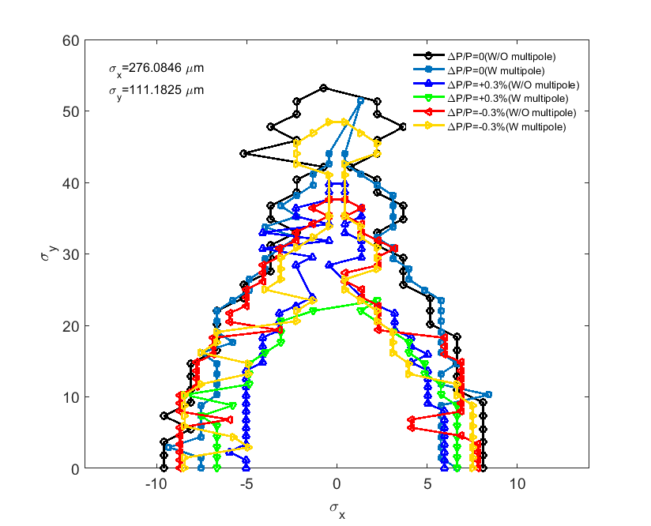
Dynamic aperture with errors
ΔP/P=0.3%
ΔP/P=-0.3%
H. Ghasem
The injected positron beam specification
(ε_{xn}=65 μm and ε_{yn}=10 μm, δ=0.3%)

Slide 28
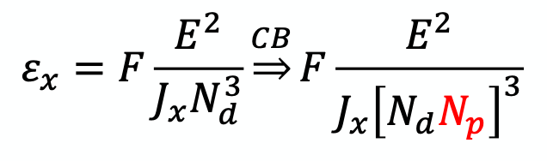
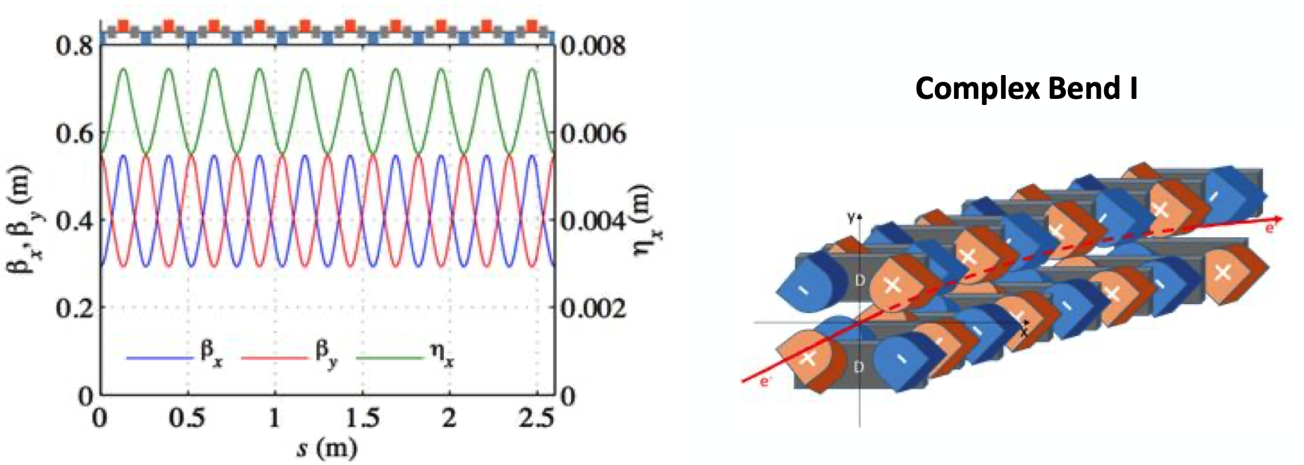
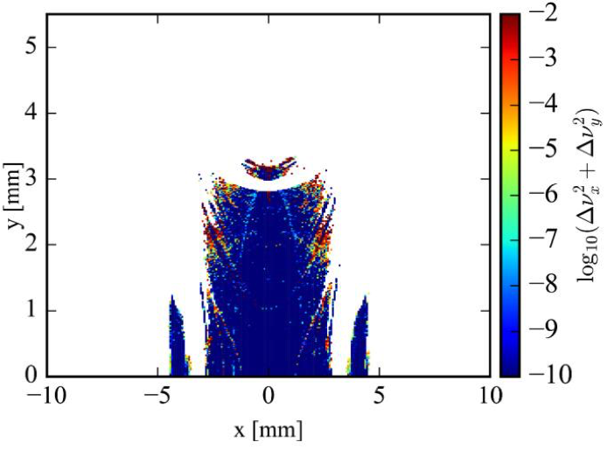
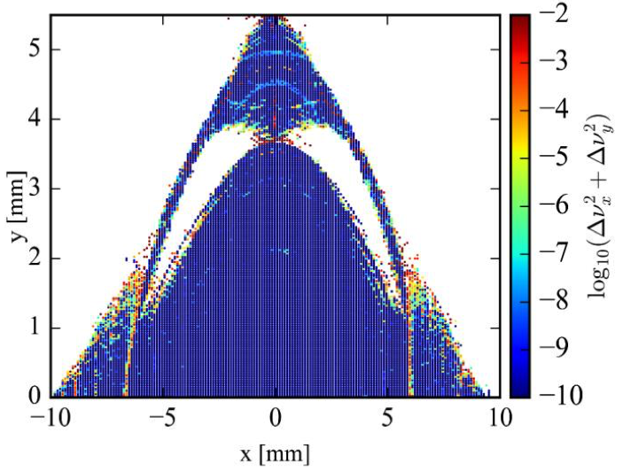
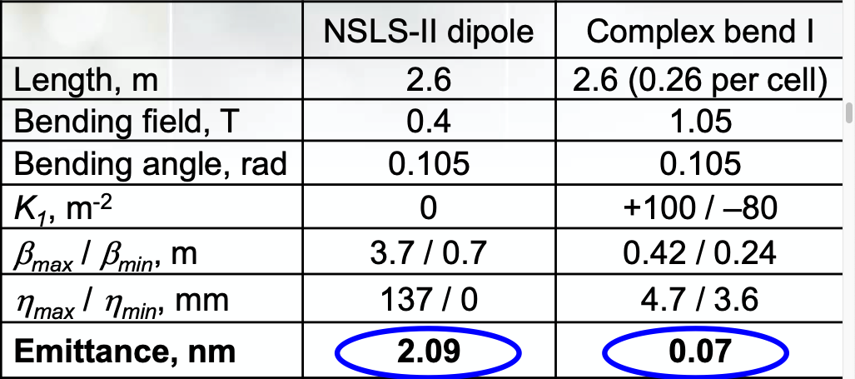
Low Emittance Lattice Design in Synchrotron Light Sources by Using Complex Bends – Guimei Wang
A bending element consisting of dipole poles, interleaved with strong focusing and defocusing quadrupole poles, QF-D-B-D-QD-D-B-D (CB)
Integration in the NSLSII lattice for 30-fold emittance reduction
DA increase with octupoles (3 families)

Slide 29
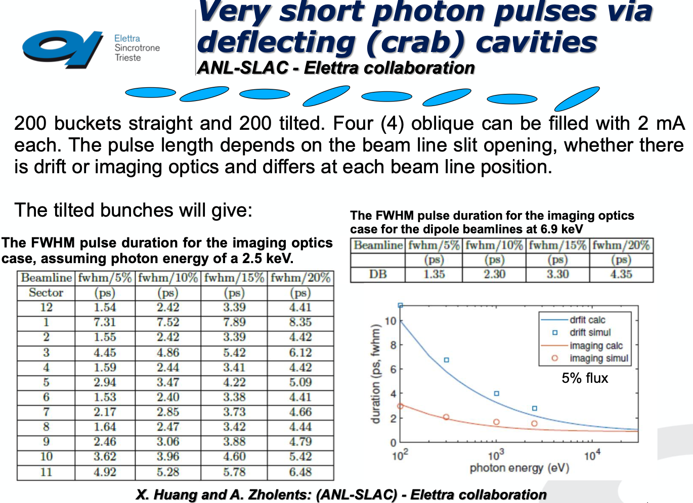
Elettra 2.0 - Emanuel Karantzoulis

Slide 30
NbTi Wiggler tests at ANKA
P. Zisopoulos

Slide 31
NbTi Wiggler tests at ANKA
P. Zisopoulos

Slide 32
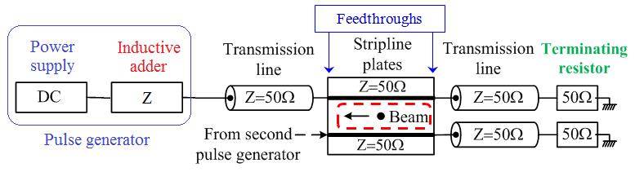
Extraction Kicker System
Previous studies demonstrated that the stripline kicker is the most suitable technology.
Striplines parameters | Values | Inductive adder parameters | Values
Beam energy | 2.86 GeV | Pulse rise and fall time | 100 ns
Deflection angle | 1.5 mrad | Pulse flat-top | 900 ns
Aperture | 20 mm | Extraction stability | ± 0.02%
Effective length | 1.7 m | Repetition rate | 50 Hz
Extraction inhomogeneity | ± 0.01%
M. Barnes, C. Belver, J. Holma

