Slide 1
Ultra low beta* experimental studies at ATF2 and future plans
LCWS 2024, July 8-11, 2024
Andrii Pastushenko
09/07/2024

Slide 2
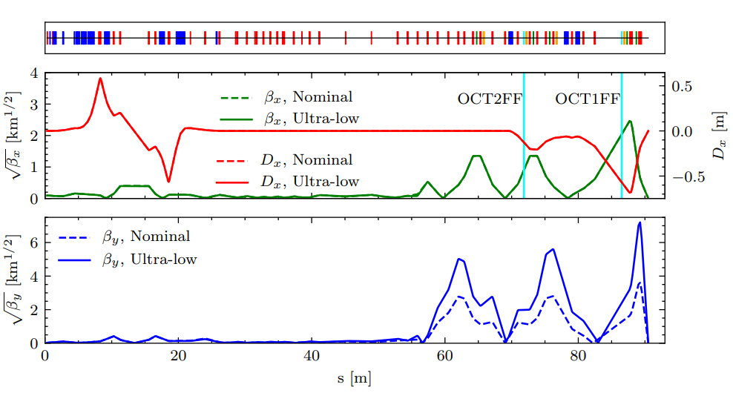
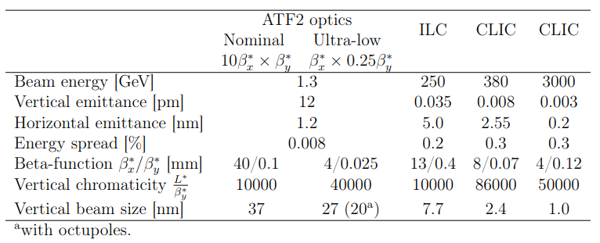
ATF2 Ultra-low β* optics
Ultra low β* (0.25 β*_{y}) optics aims to test the FFS tunability at higher chromaticity level, approaching CLIC ones.
To reduce the impact of the multipolar errors, the optics runs with larger (25βx*) horizontal beta-function.
To tackle the 3rd order aberrations a pair of octupoles was installed.
Notes:
- Ultra-low is what we call the optics that operates with 4 times smaller IP vertical beta function compared to the nominal optics.
- This is done to have a higher chromaticity in the beamline and approach the ones at CLIC.
Doing so brings us the similar tuning difficulties we are going to face with CLIC.
*Just to recall, the nominal optics was designed to face the similar tuning challenges as at ILC
The key values are shown in the Table here.
- From the previous experience and the related studies, we figured out that tuning 1 times 0.25 optics would be extremely challenging because of the impact of multipolar errors, so we made the horizontal beta function 25 larger.
So, when I mention Ultra-low tuning further on, I mean the tuning of the optics denoted as 25beta_x times 0.25beta_y
- Similarly, to tackle the third aberrations, a pair of octupoles was installed in the lattice.

Slide 3
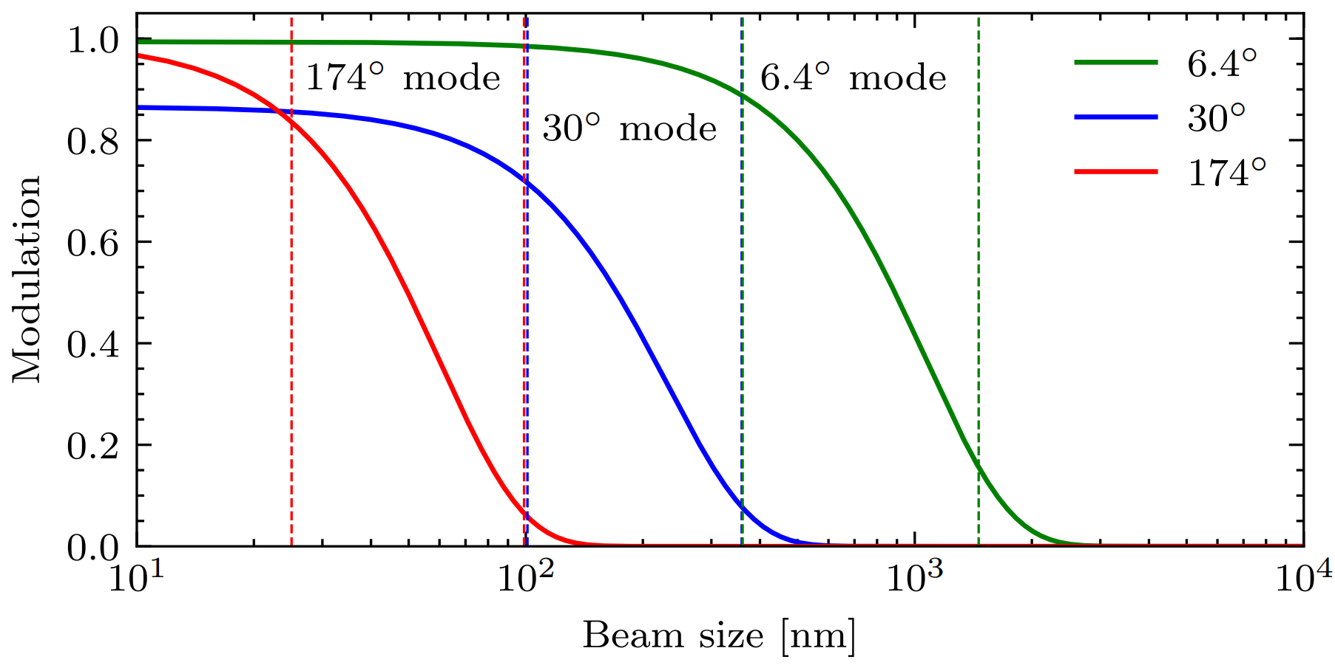
ATF2 tuning procedure
Typical tuning routine (~1 week):
Machine preparation:
  Start up, DR tuning, BPM calibrations, etc.
FFS and extraction tuning
  Orbit + dispersion corrections →Multi-OTR → optics matching → sextupoles BBA → IPBSM setup
Beam size tuning with IPBSM
  Linear knobs → non-linear knobs → octupoles (?)
! The bunch charge has to stay low to reduce the impact of the intensity dependence.
Notes:
- Since, we talk about the small beam size tuning, the Ultra-low tuning procedure is similar to the Nominal optics tuning.
- So, it typically would mean a dedicated tuning week, where we setup the optics on Monday and proceed with the tuning until Friday.
In particular that includes: Machine preparations: startup, DR tuning, BPMs calibrations etc. (1-2 shifts)
FFS tuning: orbit and dispersion correction; Carbon wire scans and optics matching, BBA,and IPBSM setup (1-2 shifts)
And then the beam size tuning with IPBSM using linear, nonlinear knobs and potentially octupoles. ()
-When we do the IPBSM tuning, we tune beam typically from micrometer size down to (ideally) tens of nanometers.
So we utilize several modes, name (2-8, 30, and 174 degree modes) to measure certain beam size ranges.
Also, we evaluate the beam size through measuring the so called modulation, as shown in the plot on the right.
So, we tune the beam in, for example, 6.4 degree mode, switch to 30 and tune the beam further, same for 174.
But, from the past experience, the last stage is the hardest one.
- Also, in order to minimize the intensity dependance effects, we typically operate at low bunch charge.

Slide 4
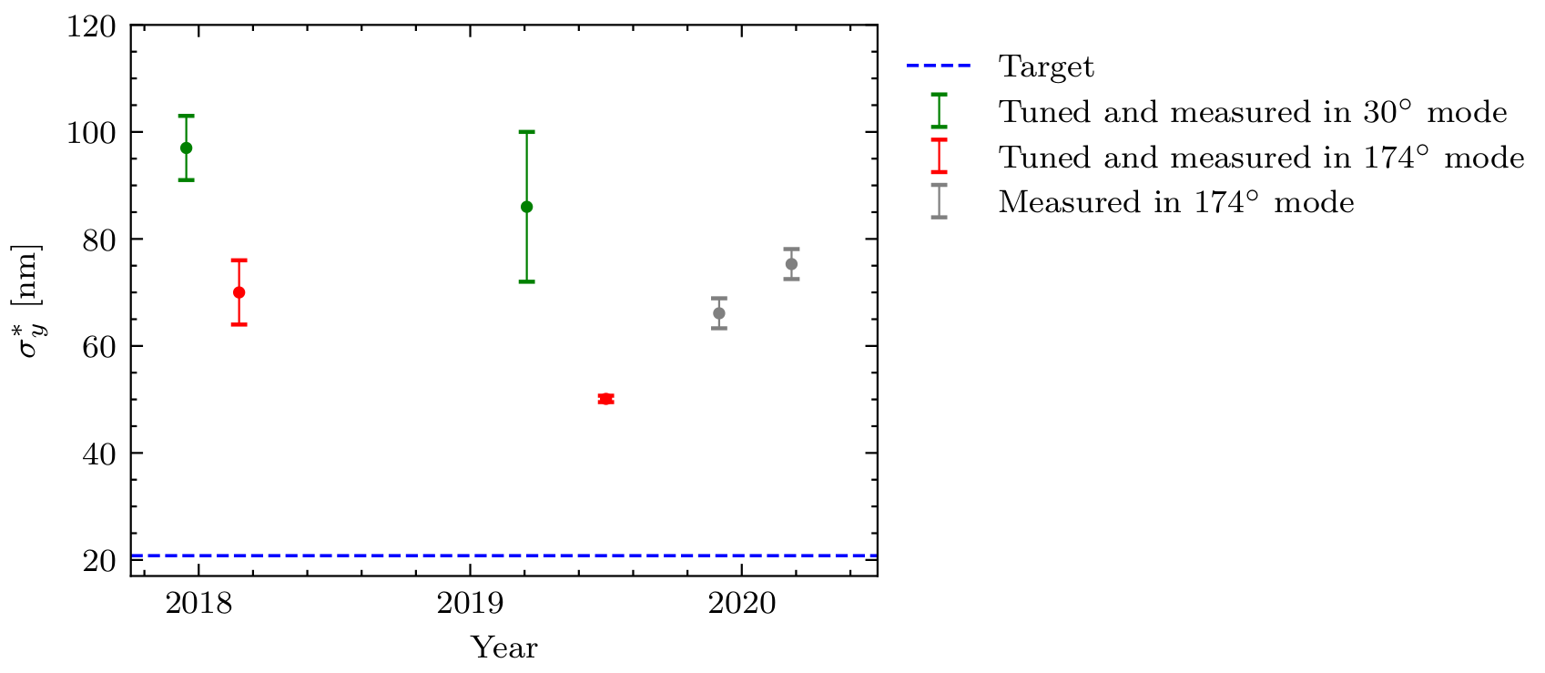
Tuning history (25 x 0.25 optics)
In all the cases, the bunch charge was about 10⁹.
Notes:
-This plot sums up the tuning results we had with the Ultra-low.
-We had in total 6 Ultra-low campaigns where we did the beam size tuning in period of 2018-2020.
After 2020, because of Covid pandemic there were no Ultra-low studies at ATF2.
This December in fact, is the first time since then when we are going to set the Ultra-low optics in the machine. *We are having shifts this Friday.
So, in this plot, I distingvish the results, by whether we managed to switch to 174 mode and whether the modulation was stable to perform the beam tuning or not.
So, twice out 6 we did not manage to get modulation in 174, twice we switched 174 but modulation was not stable for tuning, and twice we managed to to perform the beam size tuning in 174 degree mode.

Slide 5
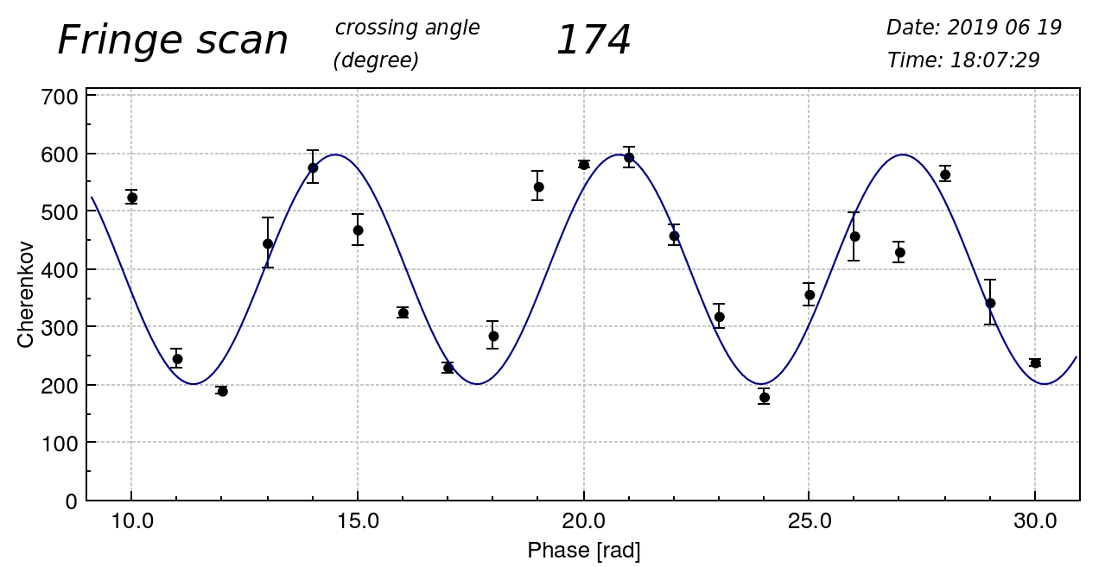
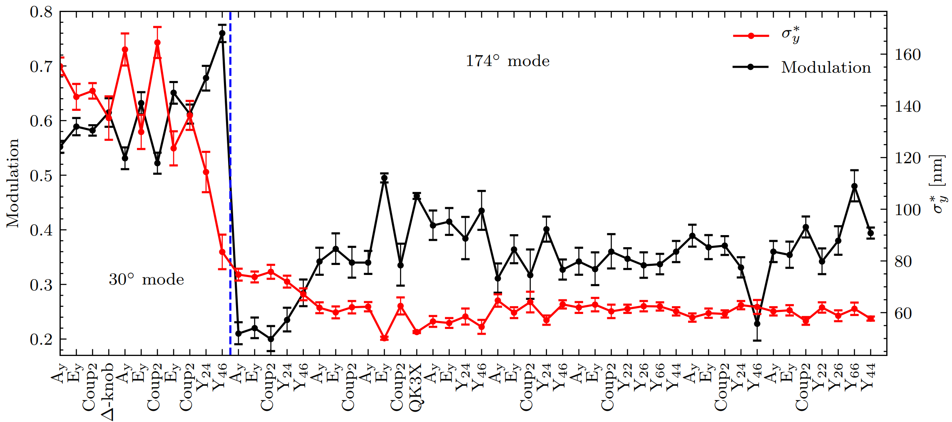
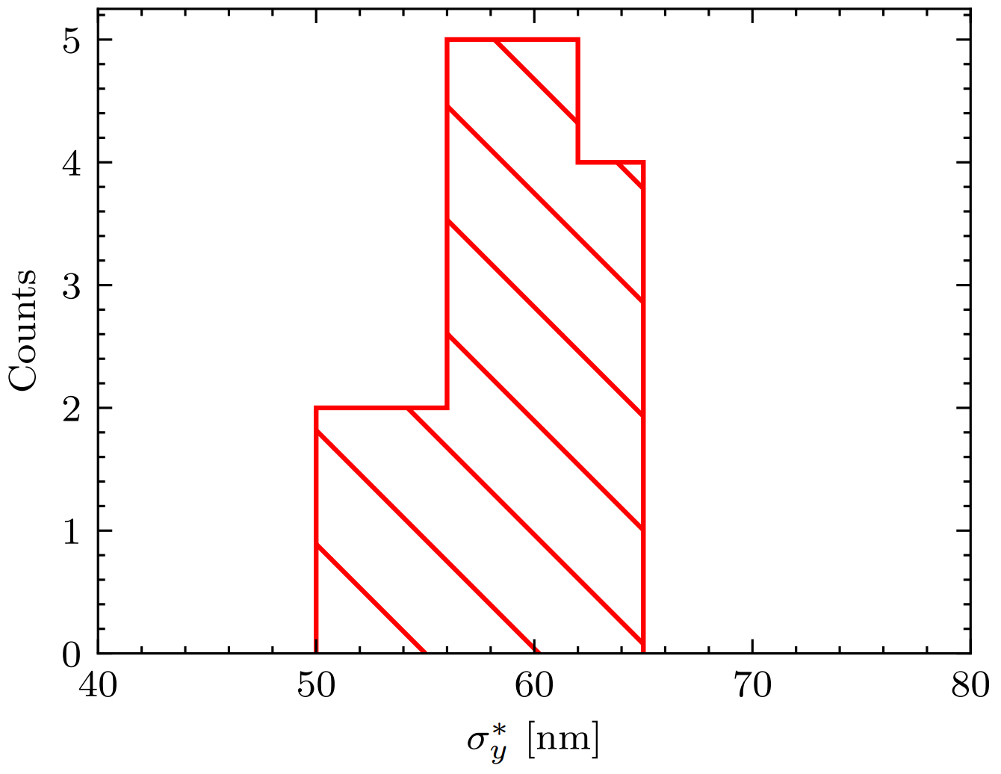
Small beam size achievements (June 2019)
The beam size achieved was 50 ± 0.6 nm.
The beam size was stable at the level of ~ 60 nm for a long period of time.
Notes:
In particular, we managed to tune the beam size down to 50 nm in June 2019.
It was stabilized at the level of 60 nm for an extended period of time, as shown on the plot on the right.

Slide 6
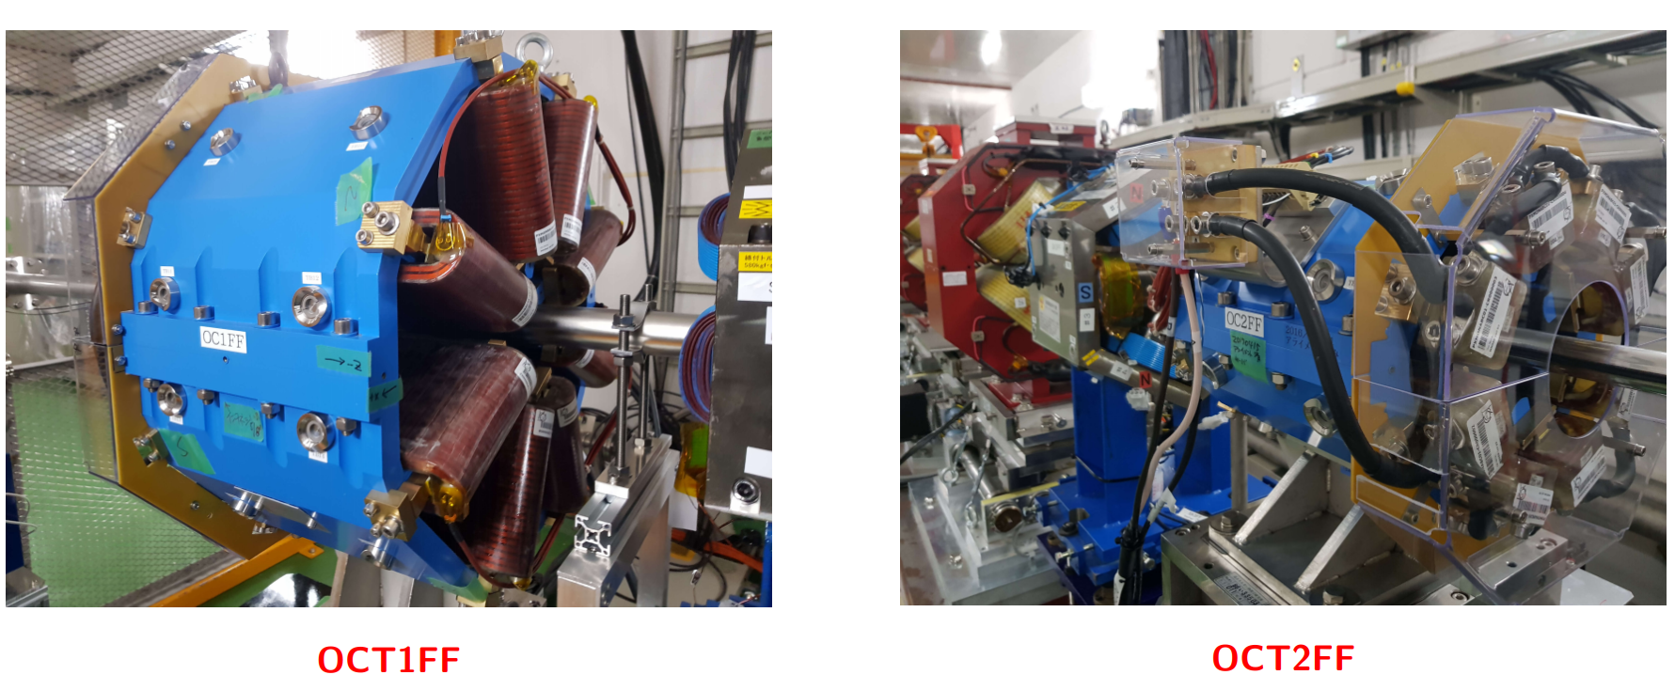
Octupoles
Installed in 2017
Repositioned in 2019
The octupoles impact starts to be visible once we reach the beam size ~ 40 nm.
Octupoles BBA was performed multiple times in the past.
  Using dipole component (with IPBPMs). ~ 2017/2018
  Using quadrupole component (with IPBSM). ~ 2019/2020
No beam size reduction observed with octupoles yet.
Notes:
Also, few words about the octupoles.
As I menstioned already, we had them installed in 2017 with aim to tackle the 3rd order aberrations, particularly with Ultra-low optics.
-We repositioned them in 2019 to have a better setup and also tried several alignment techniques:
We tried alignment using the dipole component in 2017/2018.
We also tried the alignment using the quadrupolar component in 2019/2020
-Simulations show that octupoles impact becomes visible when the beam size is tuned well to around 40 nm.
That means that before we use them, we need to tune the beam well in 174 degree mode.

Slide 7
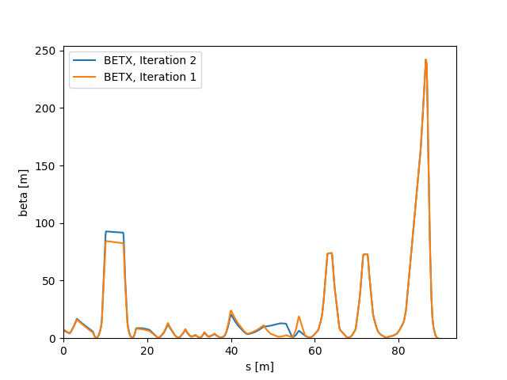
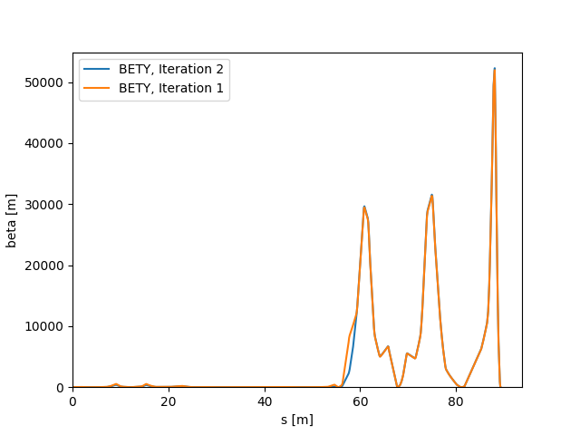
ATF2 Ultra-low β* optics test, December 2023
Goals:
Train on the small beam size tuning and ATF2 operation.
Set up the Ultra-low β* optics.
Test the optics matching routines.
β_{x}*[mm] / β_{y}*[μm] | 100/25 (target)
Initial | 79 / 76
1st iteration | 85 / 29
2nd iteration + correct FB phase | 178/ ?
Notes:
Just one slide about the December 2023 operation.
The goal was refresh in the memory how to operate the machine and to check the Ultra-low optics after a long break.
We set up the optics in the machine, performed orbit/dispersion corrections, and also tested out codes for the optics matching.
Prospect – to go and have more time for the Ultra-low tuning in October (?)

Slide 8
Summary
In the past the small beam size of ~ 50 nm was achieved with Ultra-low β* optics.
Several techniques to align the octupoles were tested.
Main concerns based on the past experience:
  Orbit stability
  Wakefields
  IPBSM performance

Slide 9
Prospects
Tune 25x0.25 optics
Verify the octupoles importance
Switch to 10x0.25, 1x0.25 optics and longer L* optics design
New tuning approaches (ML..)
Automatization of the routine tasks.

Slide 10
Thank you for your attention!

