Slide 1
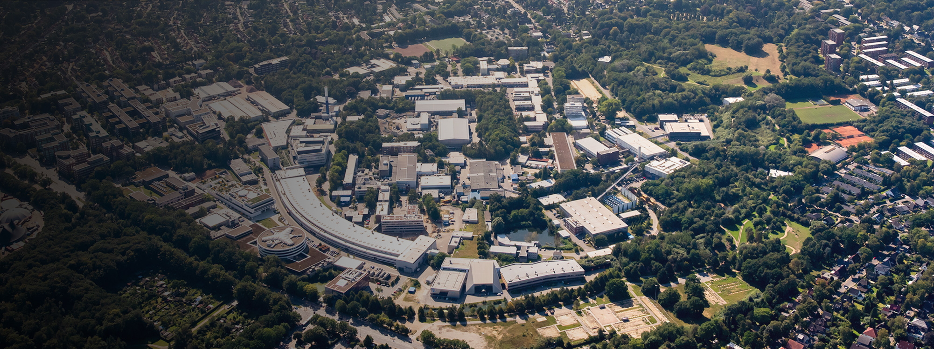
Mechanical design studies of the pulsed solenoid for positron sources
Possible methods for manufacture
G.Moortgat-Pick, P.Sievers, S.Riemann, S.Doebert, G.Yakopov
Tokyo
LCWS2024

Slide 2
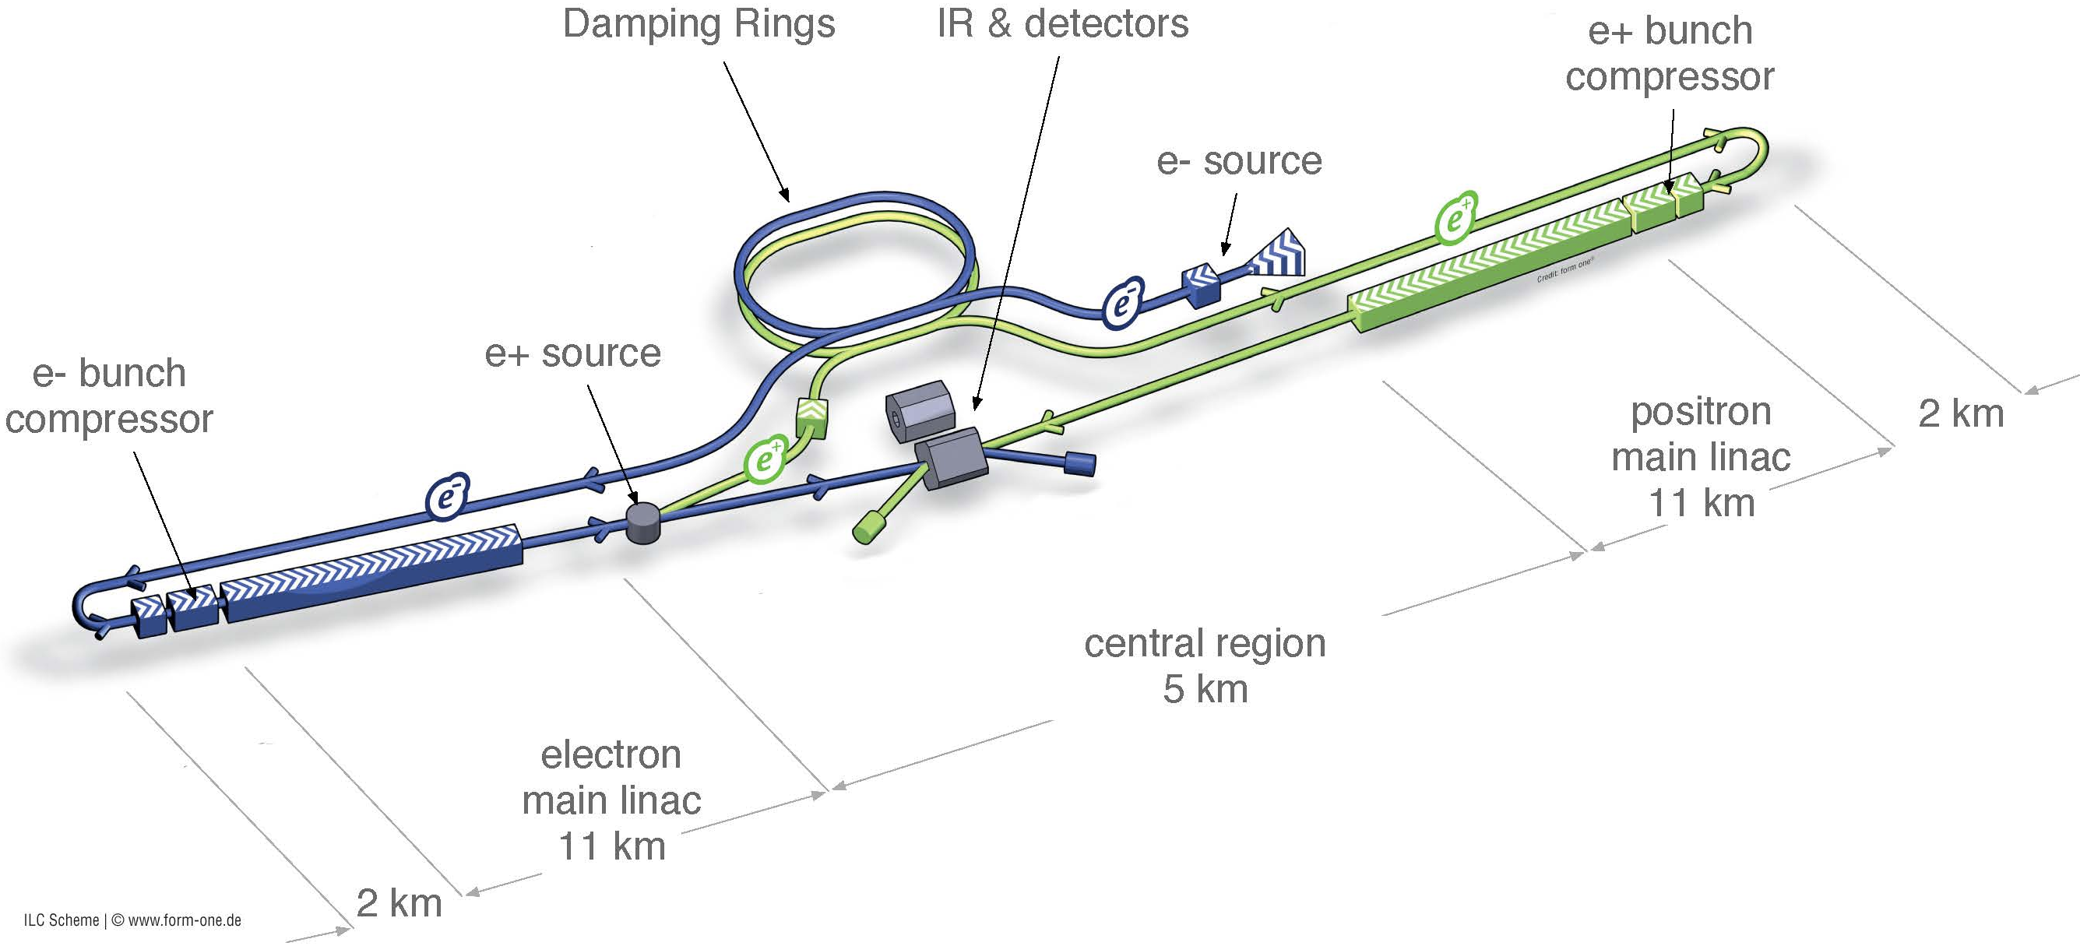
Polarized positrons for ILC are generated with a helical superconducting undulator by interaction of high-energy circularly polarized gamma photons with a titanium target.

Slide 3
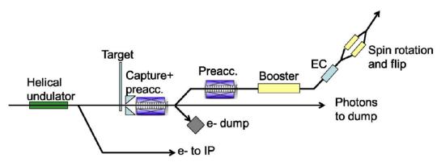
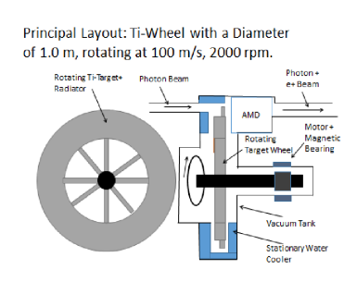
The target is produced in the form of a rotating wheel.
A pulsed solenoid is used to match the emittance of the positron bunch with the acceptance of the accelerating-focusing channel.

Slide 4
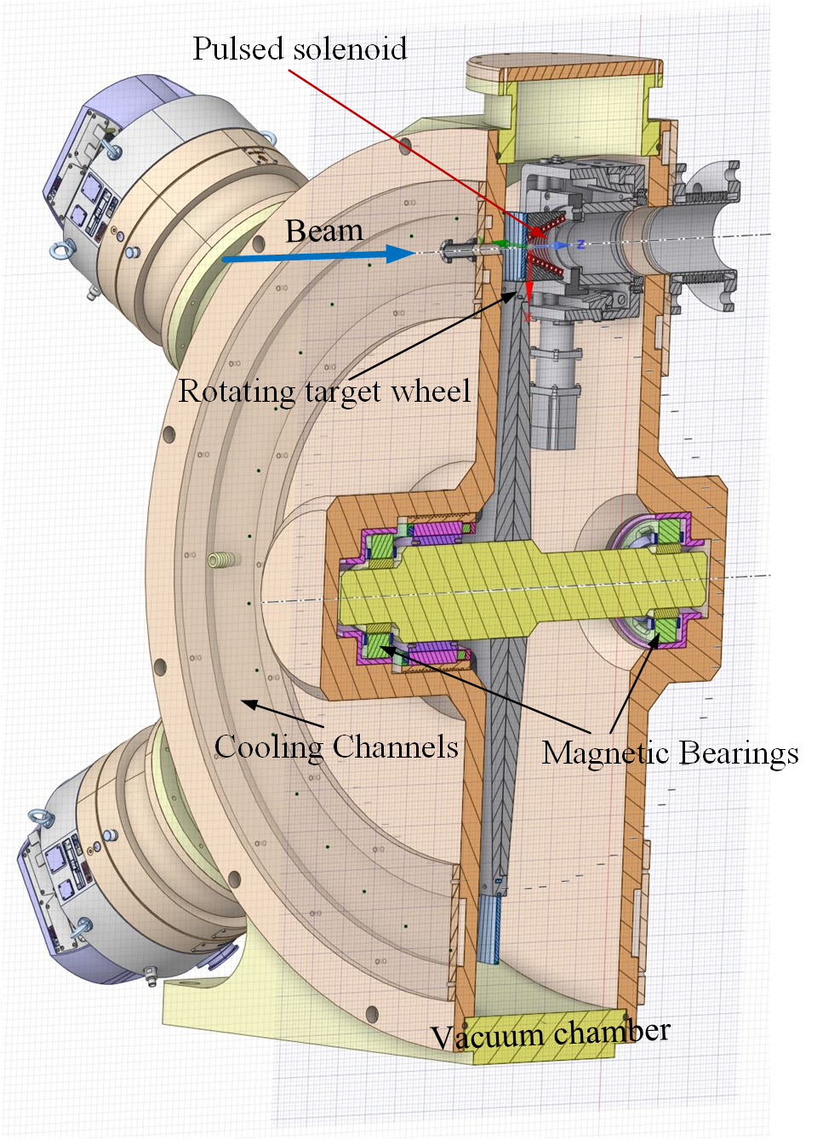
Cross-section of the vacuum chamber with rotation target wheel, magnetic bearing system, and pulsed solenoid
Diameter of wheel: 120 cm, 2000 rpm
Tangential velocity at r=50 cm: 100 m/s
The mass of the wheel 50 kg (without shaft)
Ti-alloy target 7mm thickness
The repetition rate of the beam pulses is 5 Hz
Heat input around the wheel is about 2 kW
Thermal radiation cooling from both sides of the target

Slide 5
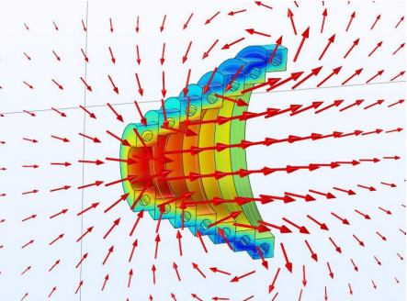
Basic concept of the pulsed solenoid
The concept of the solenoid has already been developed and presented in the relevant papers
[G. Moortgat-Pick, C. Tenholt, S. Riemann, G. Loisch].
From a mechanical point of view, the solenoid should have a conical shape with the corresponding geometrical dimensions.

Slide 6
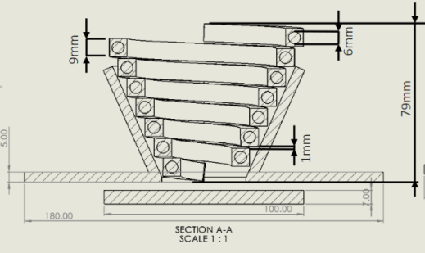
Requirements
The solenoid will be made of a copper conductor with a cross-section of 9x9 mm and have a channel with a diameter of 6 mm for cooling. It must be equipped with current and water leads.

Slide 7
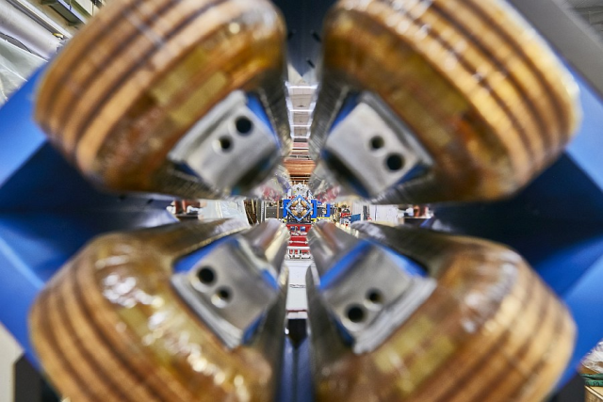
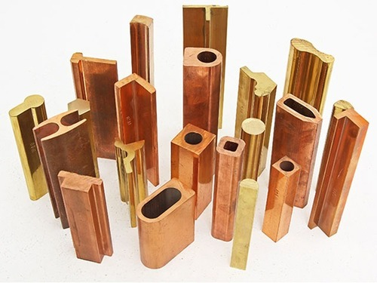
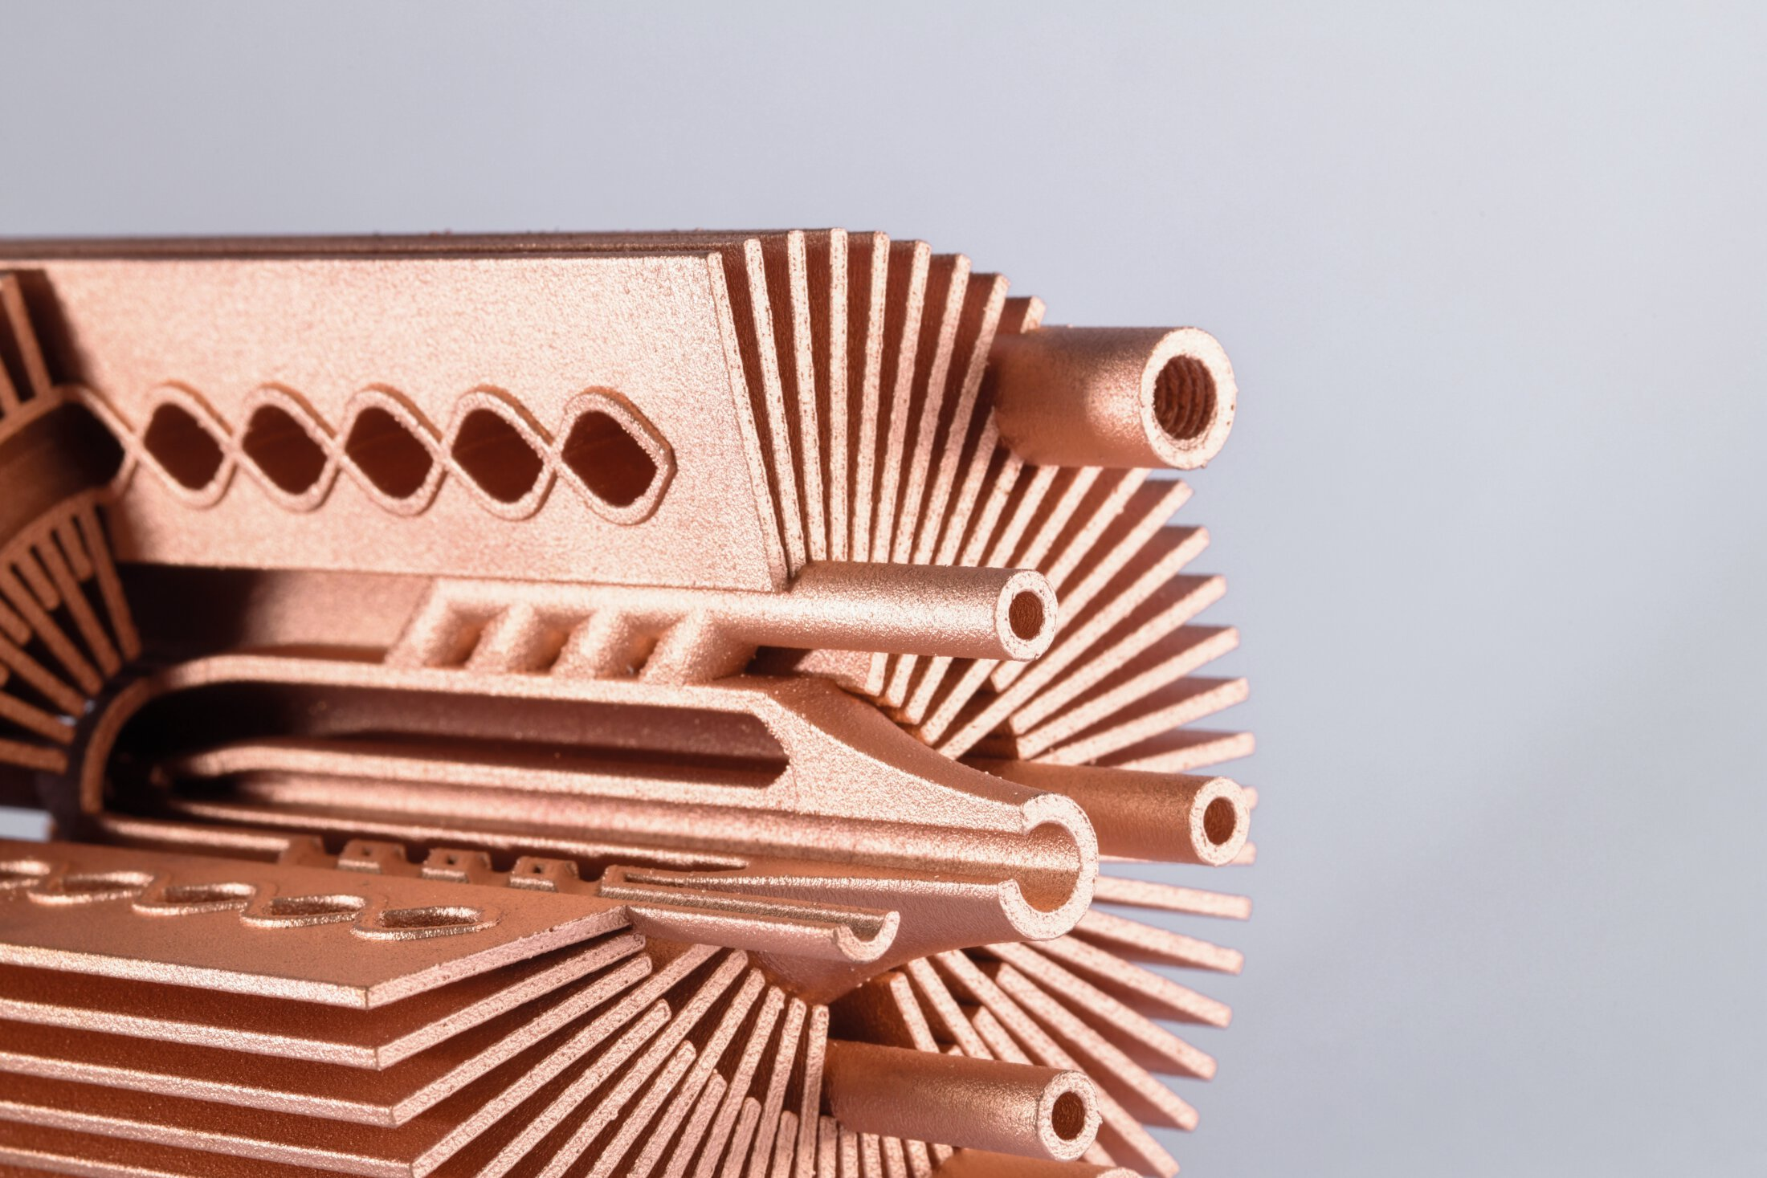
Three possible approaches for manufacturing the solenoid coil
Using a standard conductor from the optics used in the accelerator (cross-section 9x9mm with a hole diameter of 6mm).
Manufacturing a special conductor of the required cross-section using the extrusion method of copper.
3D printing with copper (proposed by Martin Lemke)

Slide 8
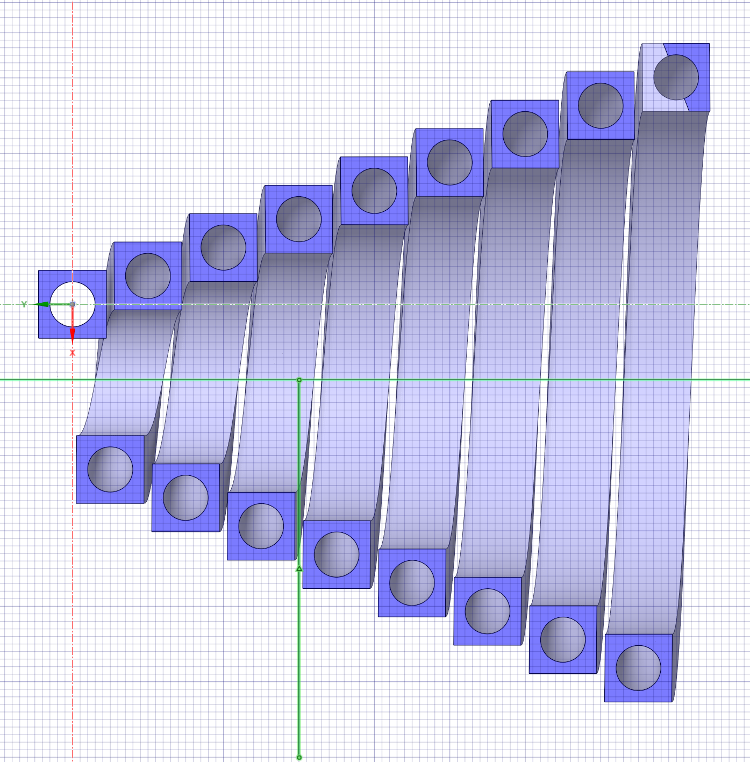
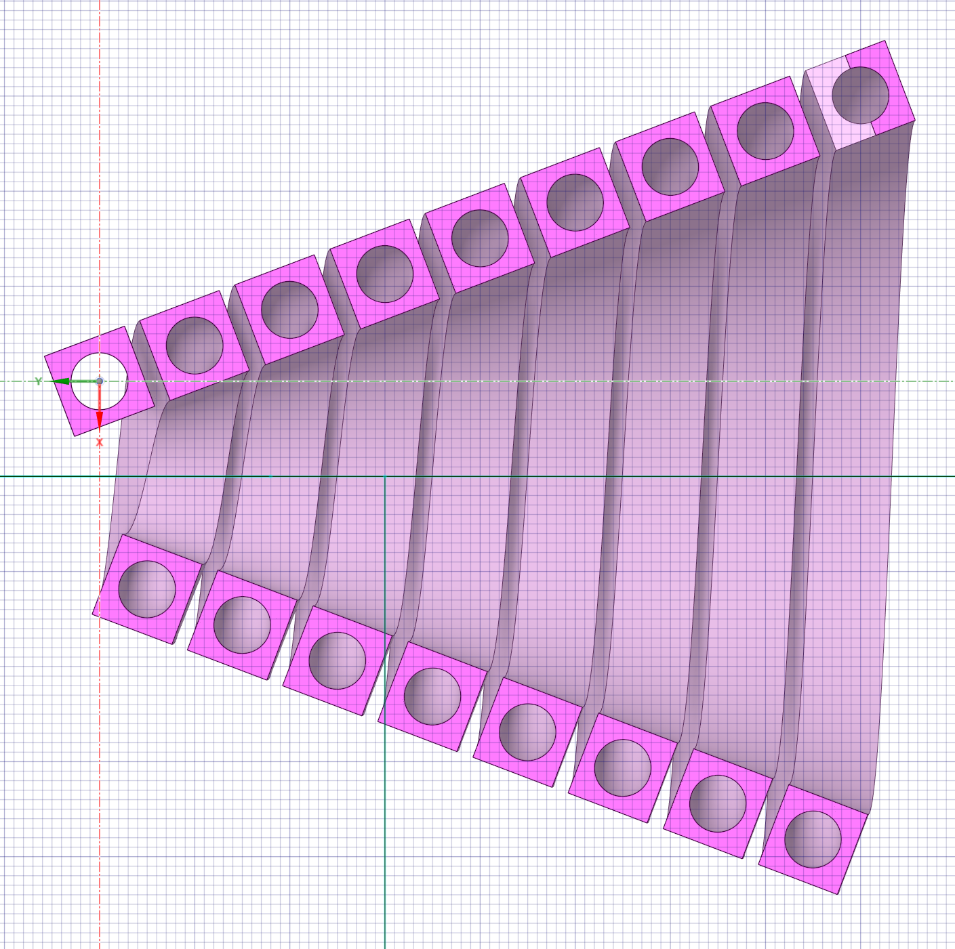
Coil turns turned at the angle of the solenoid cone

Slide 9
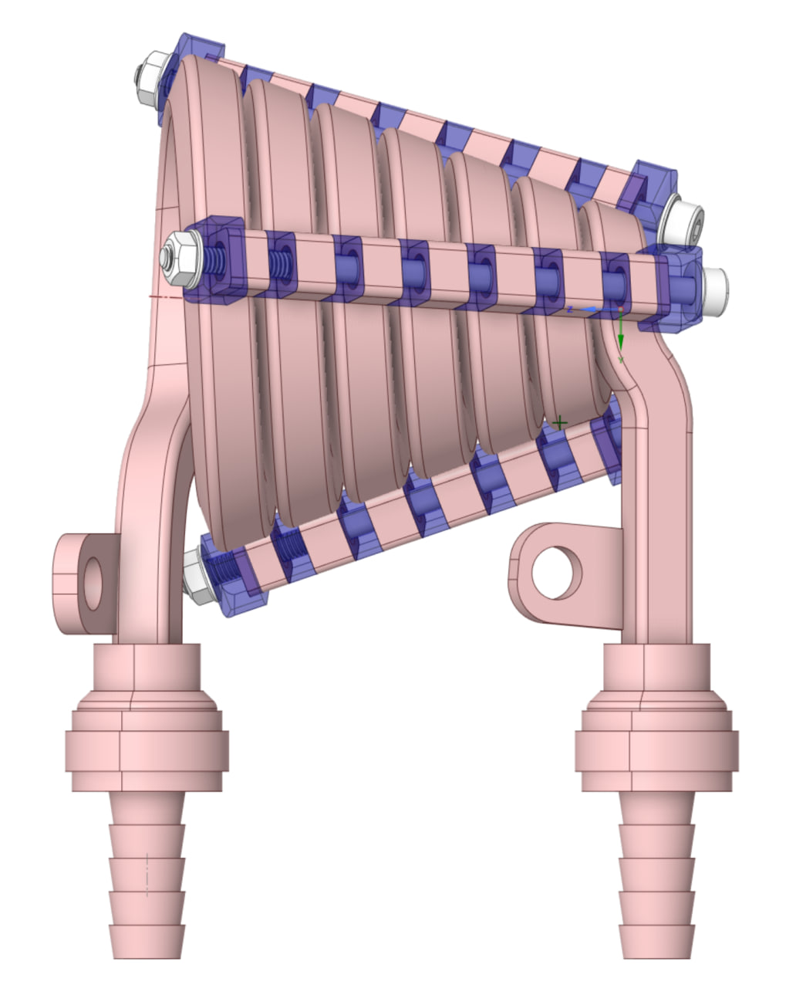
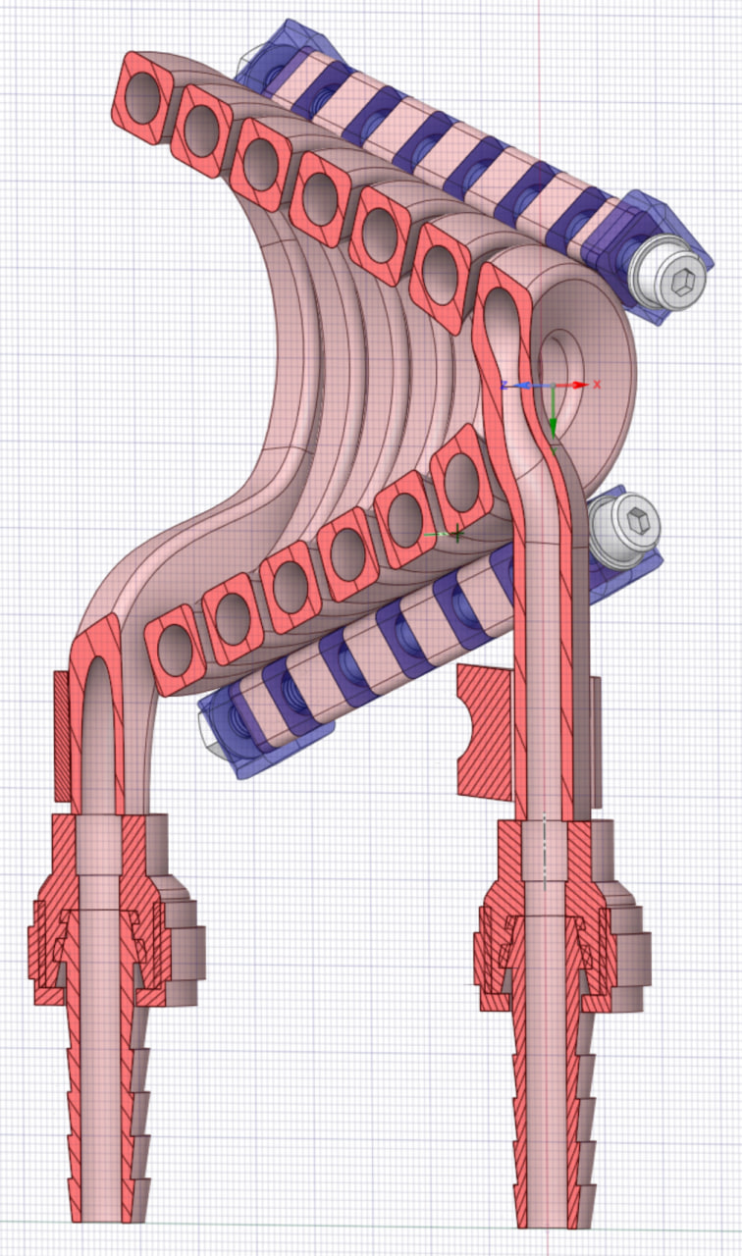
Design presented at FutureColider@DESY conference in January 2024

Slide 10
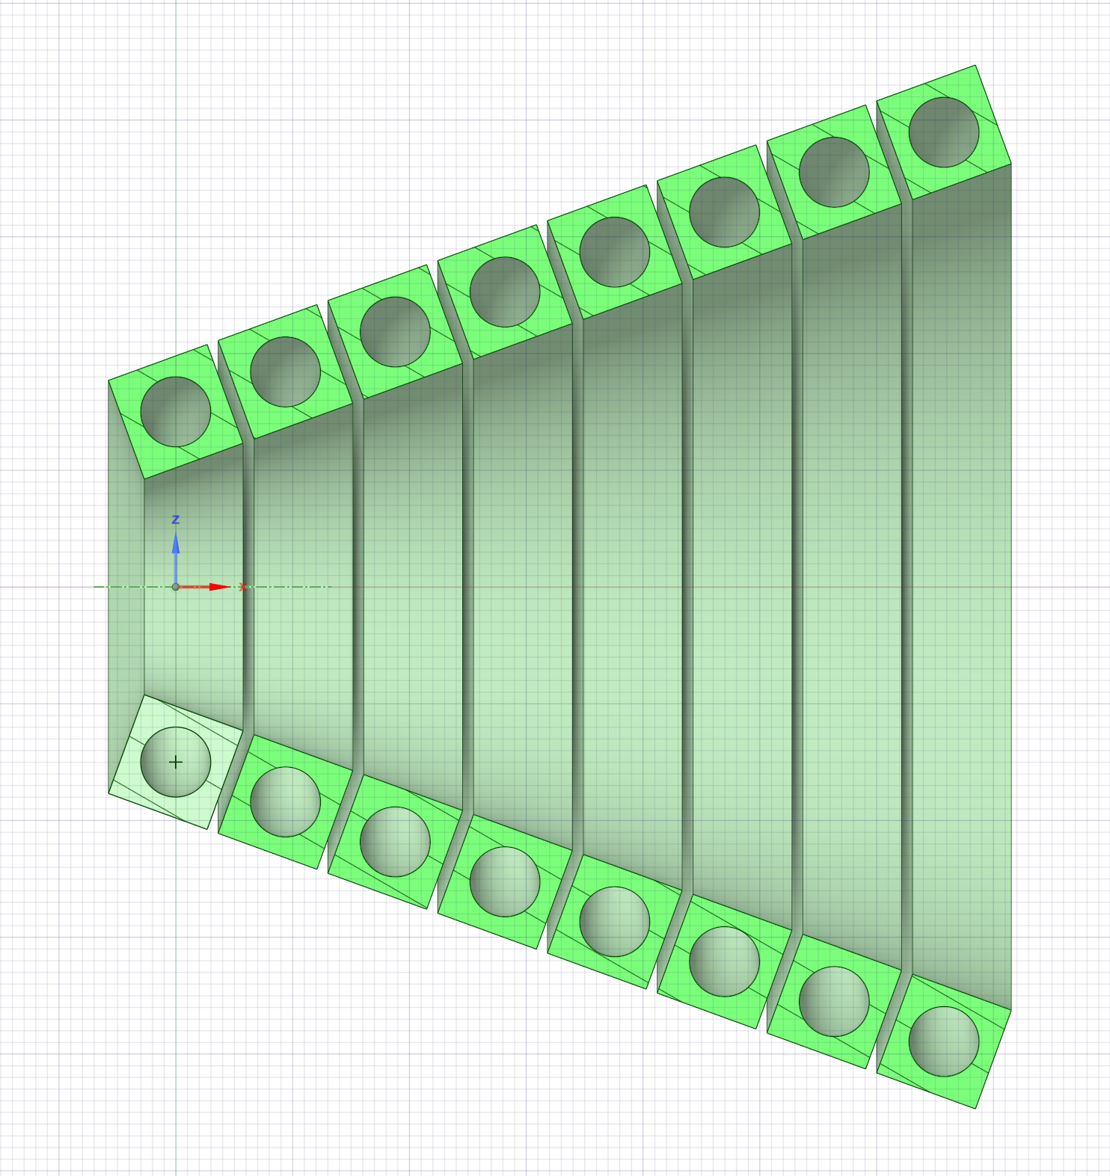
Focal plane parallel to the target plane

Slide 11
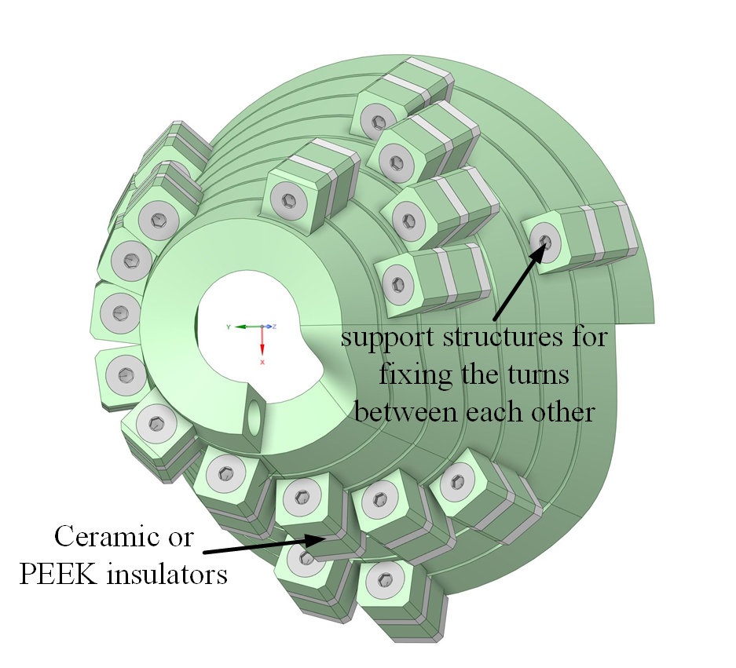
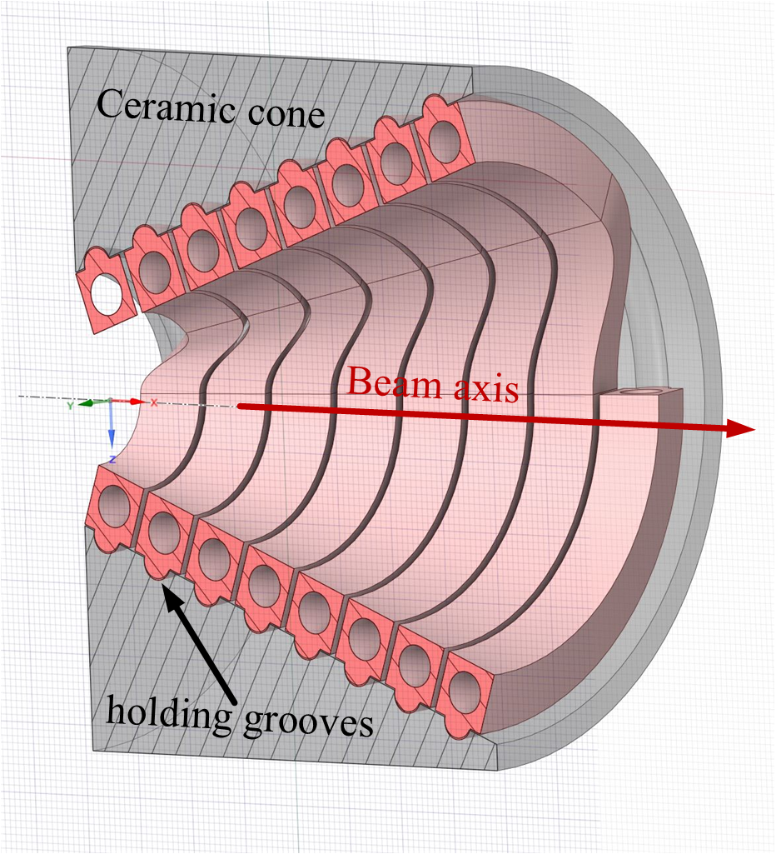
As a result, the prototypes proposed today looks like this:

Slide 12
Conclusions and plans:
The following ideas have been proposed, requiring further analysis:
Turning the turns of the coil by an angle equal to the cone angle of the solenoid, which will reduce the coil's "looseness" and smooth the magnetic field gradient along the axis.
3D printed inter-turn transitions, allowing the turns to be placed in a plane parallel to the target plane.
Two methods of fixing the solenoid turns are proposed, which are estimated to increase the operational lifespan by an order of magnitude
Everything mentioned above requires magnetic and stress simulations, which are part of our future plans.

Slide 13
Thanks for your attention!
Grigory Yakopov
FTX
office: 01e/O2.515
grigory.yakopov@desy.de
Phone: +49 40 8998 70110

Slide 14
BACKUP Slides
The problem of the mechanics of such a pulsed device is the result of the action of electrodynamic forces in the elements of the magnet, primarily in its conductive units. Pulsed mechanical action during operation of the magnet should not lead to unacceptable mechanical stress in its elements. Usually this problem can be solved by applying external mechanical connections.
In relation to PS, the problem of mechanical fastening of winding turns is exacerbated due to the impossibility of using organic insulation under conditions of intense flows of ionizing radiation. Here it is possible to use, in essence, only ceramic insulation, and in limited quantities.

Slide 15
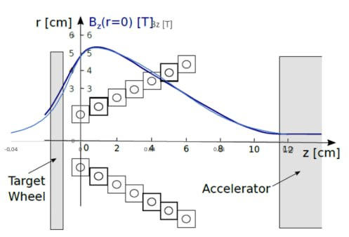

Slide 16
Powering of the Cu-Conductor.
length l=1 m,
pulsed with half sine pulses of 4 ms, 50 kA peak at 5 Hz.
Av. Ohmic resistance: 2.38 10^-4 Ω.
Av. d.c.Voltage: 12. V.
Av. Pulsed power: 5.95 kW.
PEDD(el): 1.86 J/g pulse, well below the accepted limit of 10 J/g.
ΔT=4.66 K/pulse.
Av. Power density: 83 W/cm^3.
*Use high quality, oxygen free Copper with high electrical conductivity: σ=5.85 10^5 (1/Ωm).

Slide 17
Cooling of the Conductor.
Water flow with a velocity of 6 m/s through the conductor gives a mass flow of 0.17 l/s.
• Pressure drop ΔP=6 Bar/meter.
• ΔT in water over the conductor length of 1 m: 8.35 K.
Water inlet at 20 oC.
Peak temperature rise in the coil above the water temperature just after a pulse, during steady state cycling: 18.3 K.
Peak temperature in the conductor: at the inlet 38.3 oC, at the outlet 46.7 oC.

