Slide 1
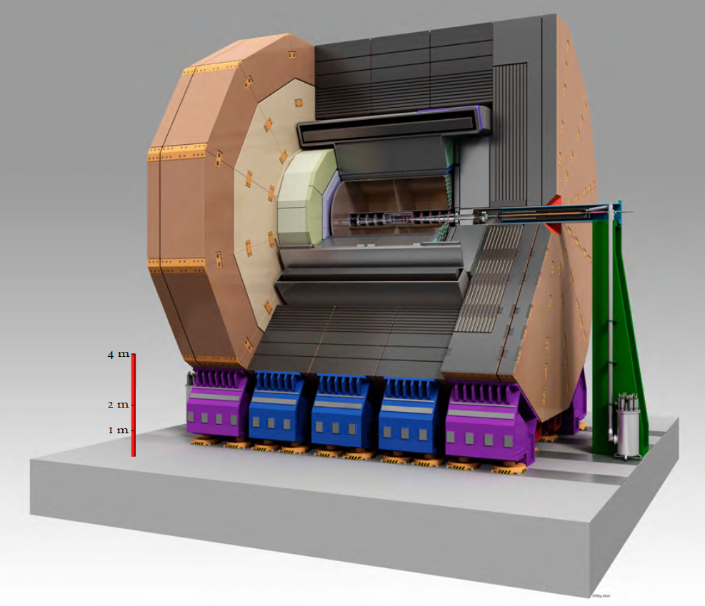
Report status and news
Kiyotomo Kawagoe Ties Behnke
5.9.2023
ILD group meeting

Slide 2
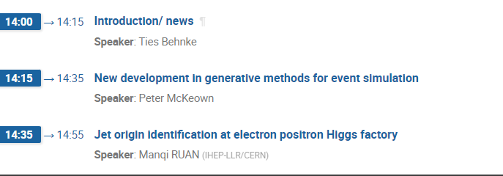
Agenda today

Slide 3
News from ILD
ILD management team as elected:
Ties Behnke, Spokesperson
Kiyotomo Kawagoe, deputy Spokesperson
Mary-Cruz Fouz: technical coordinator, Karsten Buesser, deputy
Filip Zarnecki, physics coordination, Taikan Suehara deputy
Frank Gaede, Software, Daniel Jeans deputy
Elected members of the ET
Jean Claude Brient
Jenny List
Marcel Vos
Graham Wilson

Slide 4
Plans for an ILD meeting
Proposal:
Dedicated 2-day ILD meeting in January (dates 16./17.1.2024, at CERN)
General discussion on state of ILD
Focus on future developments of the concept for
  ILC (linear colliders)
  Asymmetric colliders (HALHF)
  FCC-ee
We anticipate 1.5 days of meetings and discussions (heavy on discussions)
CERN as a location, so people can connect this with other meetings
Middle of the week (Tue/Wd) so that before and after specialized meetings can take place

