Slide 1
38th Meeting of SRF Group in IDT/WG2
Recent progress of SRF 5-year plan in FY2023-2027 (Kirk)
Others (if any)
Attendees: A. Yamamoto, K. Umemori, E. Cenni, L. Monaco, R. Geng, B. List, D. Delikaris, P. Burrows, Kirk
https://agenda.linearcollider.org/category/256/
Kirk

Slide 2
Recent progress of SRF 5-year plan
Japan (KEK)
  License agreement with DESY is under progress
    KEK discussed with H. Weise which institutes are included in ITN
  Leaders for each sub-group were assigned at KEK
  MG material procurement
    A vendor cannot produce any MG material for cavity production from this FY
    KEK should consider to change the strategy, KEK and FNAL will negotiate strongly with a vendor
  Procurement for dust-free gate valve and shortest connecting bellows beampipe
  Negotiation on HPGS with KHK and local government is continuing
  KEK started the discussion with oversea vendors for cavity production
  Discussion with some vendors related to power coupler started
  Discussion with some vendors related to SCQ started
Overseas
  Americas
    JLAB sent the proposal for ITN to KEK
  Europe
    Enrico went back to CEA
      We discussed cavity production, radiation simulation, magnetic shield, etc.
    DESY is preparing for new license agreement with KEK

Slide 3
Leaders for each sub-group at KEK
Sub-group | Leader
Cavity | T.B.D.
Frequency tuner | Mathieu Omet
Power coupler | Kirk
Magnetic shield | Ryuichi Ueki
SCQ magnet (+BPM) | Yasushi Arimoto (Hitoshi Hayano)
Clean work/Vacuum work | T.B.D.
Cryomodule | Kirk
Infrastructure at COI | Shinichiro Michizono
RF | Toshihiro Matsumoto
Cryogenics | Hirotaka Nakai/Kota Nakanishi
Cavity fabrication | Takayuki Saeki

Slide 4
Summary of MG disk material
(updated!)
Billet | length [mm] | # of disks | necessary disk | Purpose
1st batch (slicing done) |  | 21 | 4 | Korea 1-cell
 |  |  | 4 | CFF MG 1-cell
 |  |  | 6 | DESY (they are interested in inspecton on this MG disks)
 |  |  | 4 | EU 1-cell (one cavity)
 |  |  | 1 | KEK-9 for welding test related to HPGS (iris)
 |  |  | 1 | KEK-9 for welding test related to HPGS (CET)
 |  |  | 1 | KEK-9 for welding test related to HPGS (equator) 1.7mm as mill ends
270L (currently stored in KEK, slicing will be done in FY2023) Eddy current scan @DESY as free of charge | 270 | 86 | 25 | CFF 9-cell 2024 (HPGS)
 |  |  | 22 | EU 9-cell 2024 (HPGS)
 |  |  | 8 | EU-training disks(RI=4, ZANON=4)
 |  |  | 4 | US 1-cell (unknown number)
 |  |  | 9 | Supporting back data related HPGS documentation for safety check
 |  |  | 6 | for delivery inspection
 |  |  | 10 | US 9-cell 2024 (HPGS)
 |  |  | 2 | reserve
200L (currently stored in KEK) | 200 | 65 | 25 | CFF 9-cell 2025 (HPGS)
 |  |  | 25 | CFF 9-cell 2025 (HPGS)
 |  |  | 12 | US 9-cell 2024 (HPGS)
 |  |  | 3 | reserve
270L (currently stored in KEK) | 270 | 86 | 25 | Oversea vendor from Japan 9-cell 2025 (HPGS)
 |  |  | 22 | Oversea vendor from Japan 9-cell 2025 (HPGS)
 |  |  | 22 | EU 9-cell 2025 (HPGS)
 |  |  | 6 | for delivery inspection
 |  |  | 11 | reserve
1200L (delivery deadline will be the end of CY2024) | 200 | 1 (not sliced) | 1 | Crab
 | 200 | 65 | 25 | CFF 9-cell 2026 (HPGS)
 |  |  | 25 | CFF 9-cell 2026 (HPGS)
 |  |  | 15 | US 9-cell 2026 (HPGS)
 | 200 | 65 | 65 | reserve
 | 200 | 65 | 25 | EU 9-cell 2026 (HPGS)
 |  |  | 25 | EU 9-cell 2026 (HPGS)
 |  |  | 6 | for delivery inspection
 |  |  | 9 | reserve
 | 200 | 65 | 25 | EU 9-cell 2026 (HPGS)
 |  |  | 25 | US 9-cell 2026 (HPGS)
 |  |  | 15 | reserve
 | 200 | 65 | 25 | US 9-cell 2026 (HPGS)
 |  |  | 25 | US 9-cell 2026 (HPGS)
 |  |  | 15 | reserve
united to one 9-cell cavity
A vendor stops this production!
KEK and FNAL will negotiate with a vendor before TTC meeting in Dec.

Slide 5
Production Schedule of Cavity and Ancillaries for 5-year Plan (FY starts from April in Japan)
 |  | JFY2023 |  |  |  | JFY2024 |  |  |  | JFY2025 |  |  |  | JFY2026 |  |  |  | JFY2027
 |  | CY2023 |  |  | CY2024 |  |  |  | CY2025 |  |  |  | CY2026 |  |  |  | CY2027
 |  | 1 | 2 | 3 | 4 | 1 | 2 | 3 | 4 | 1 | 2 | 3 | 4 | 1 | 2 | 3 | 4 | 1 | 2 | 3 | 4
Asia | 1-cell FG | 4
 | 1-cell MG | 2
 | 9-cell FG | 1 |  |  |  | 5
 | 9-cell MG | 1 |  |  |  | 1 |  |  |  | 4 |  |  |  | 1
 | Power coupler |  |  |  |  | 2 |  |  |  | 8
 | Frequency tuner |  |  |  |  | 1 |  |  |  | 8
 | SCQ magnet+BPM |  |  |  |  | 1 |  |  |  | 1
 | Magnetic shield |  |  |  |  | 1 |  |  |  | 8
 | Cavity string
 | CM production
 | CM assembly
 | CM test
 | Cryogenics
 | HLRF
 | Rail of cavity string
 | CM assembly area
 | CM test area
Americas | 1-cell FG
 | 1-cell MG
 | 9-cell FG
 | 9-cell MG
Europe | 1-cell FG |  |  |  | 1
 | 1-cell MG |  |  |  | 1
 | 9-cell FG |  |  |  |  |  |  |  | 1 |  |  |  | 1 |  |  |  | 2
 | 9-cell MG |  |  |  |  |  |  |  | 1 (training) |  |  |  | 1 |  |  |  | 2
Total number of production never changes!
It’s necessary to reconsider the cavity production using MG material.

Slide 6
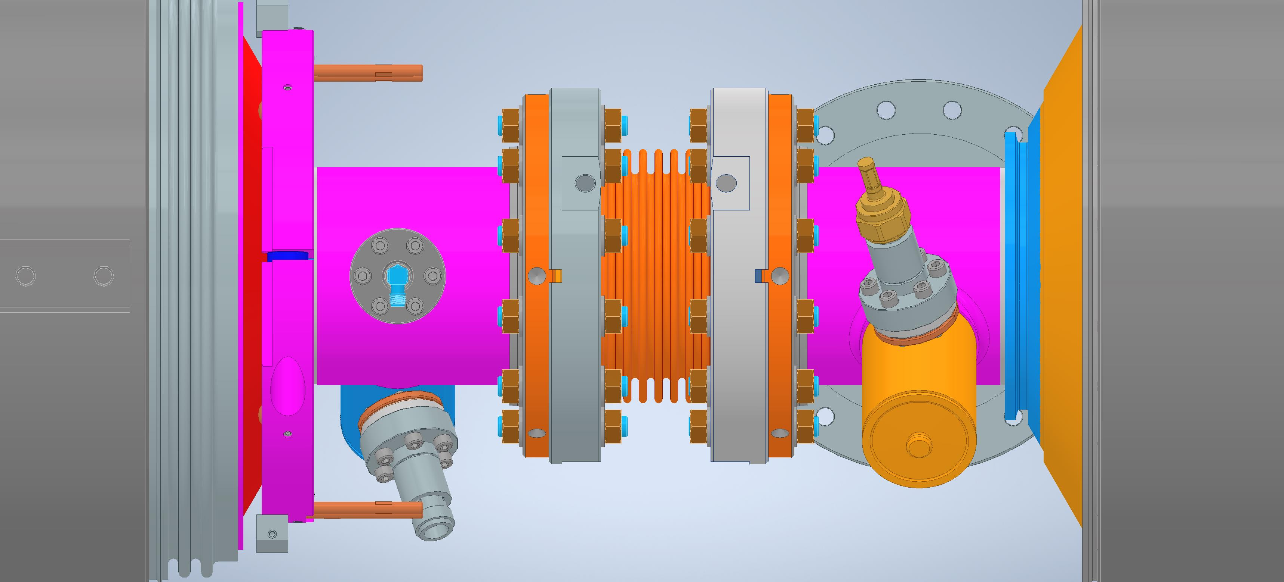
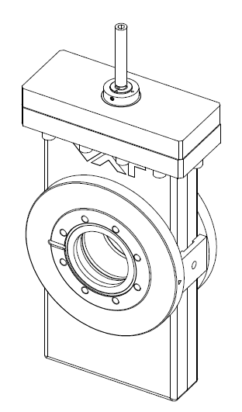
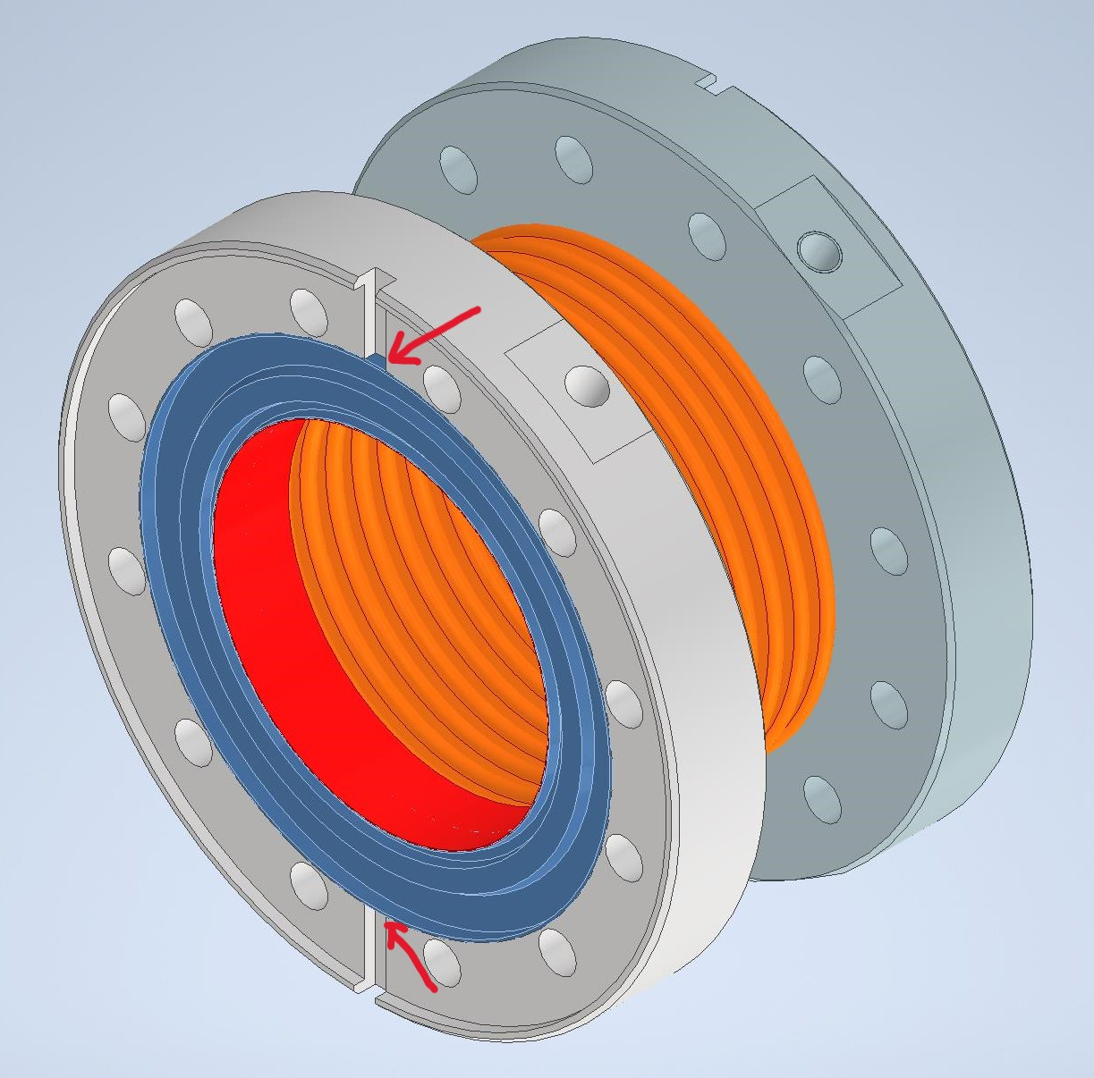
Procurement of vacuum parts
Shortest bellows beampipe
Dust-free gate valve
79.3 mm

Slide 7
Meeting/Conference schedule
Meeting # | Date | Contents
38 | 29/Aug | Recent progress of SRF 5-year plan
39 | 12/Sep or 26/Sep
 | 13/Oct | Advisory board review for MEXT
 | 16~17/Oct | Visit to CERN to discuss ITN
 | 5~8/Dec | TTC Meeting 2023 @FNAL, US

