Slide 1
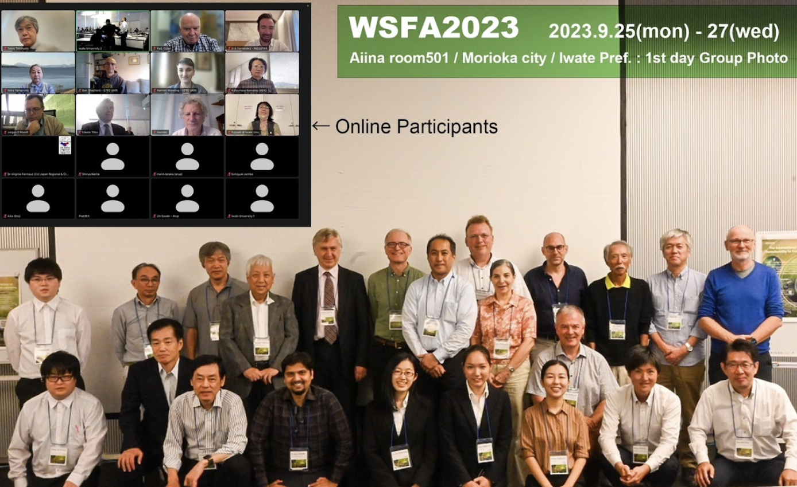
https://indico.desy.de/event/39980/

Slide 2
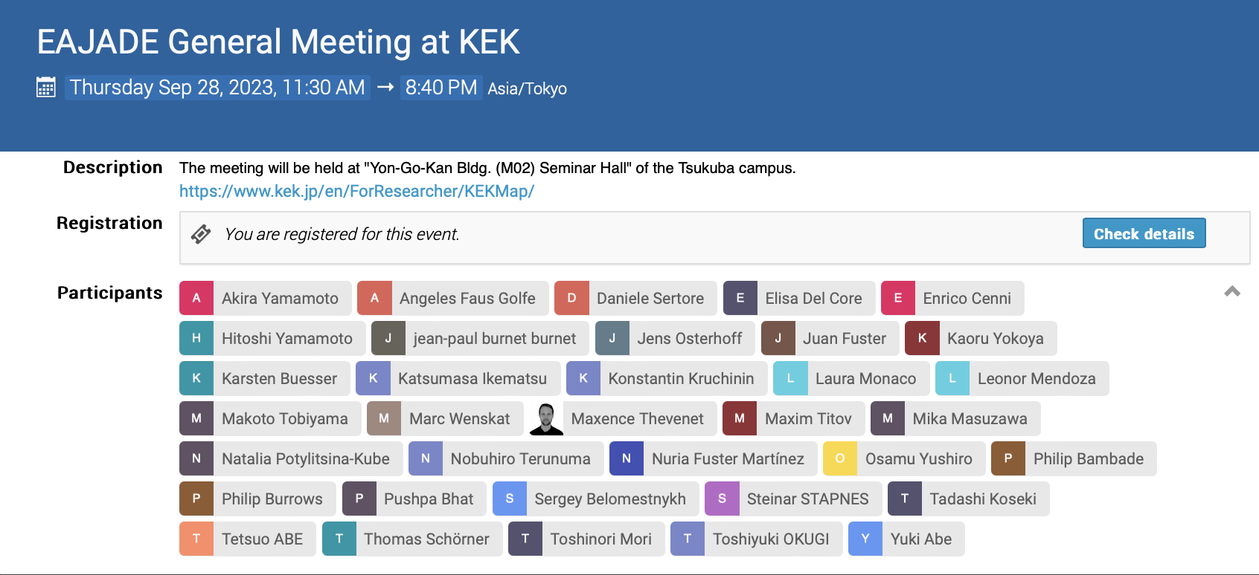

Slide 3
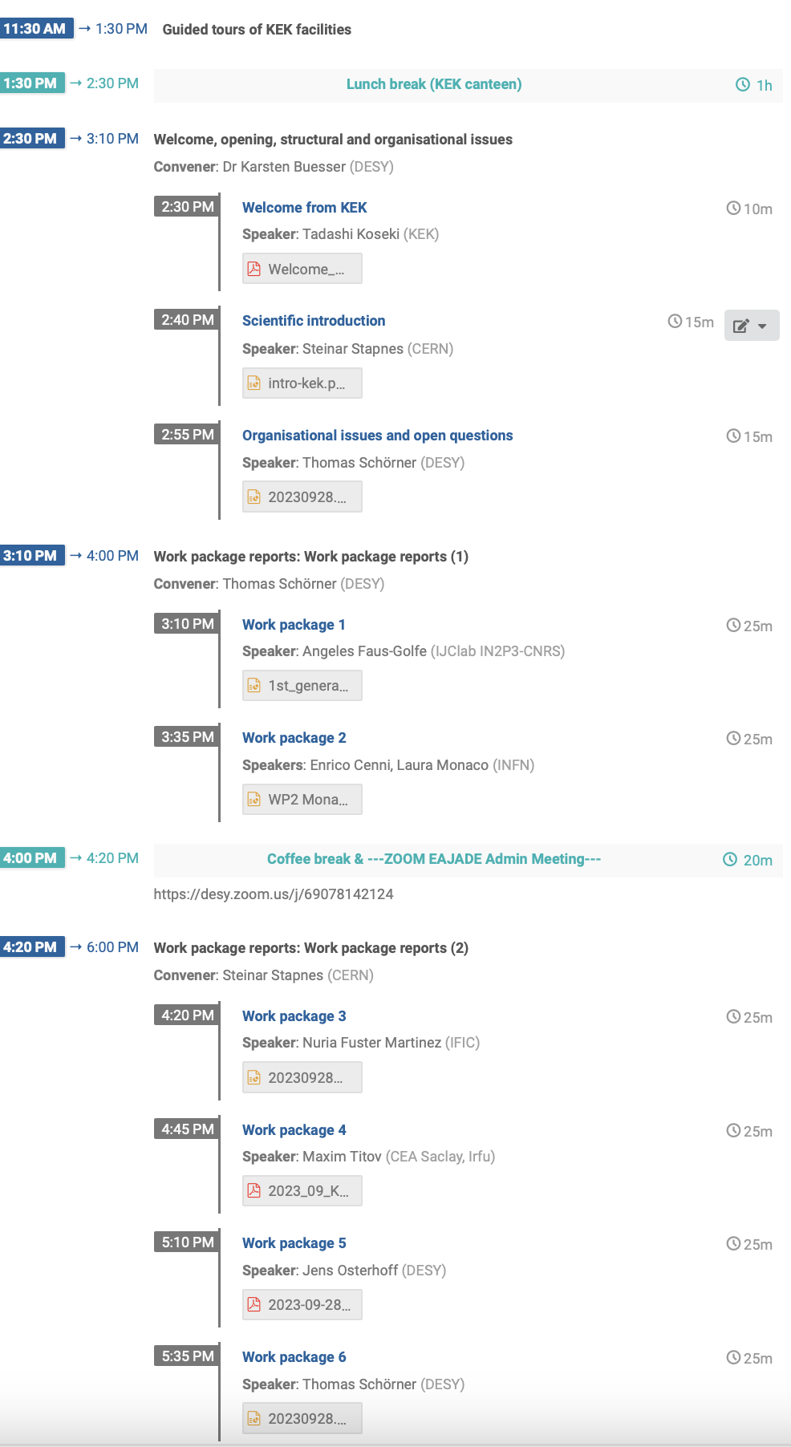
Agenda:
https://indico.desy.de/event/40403/

Slide 4
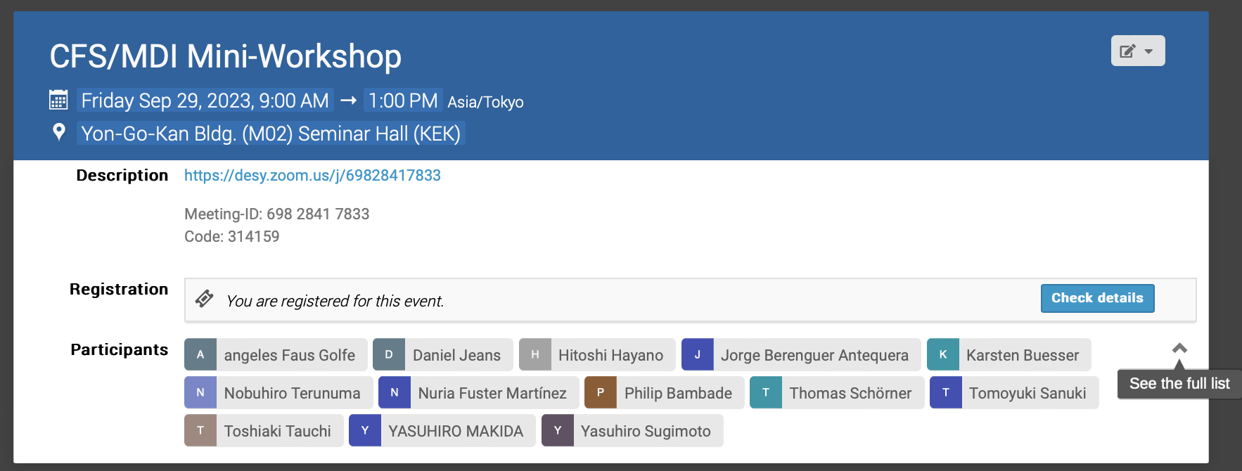
CFS/MDI Mini-Workshop 29 September 2023
https://indico.desy.de/event/40176/
Reviving former E-JADE mini-workshops

Slide 5
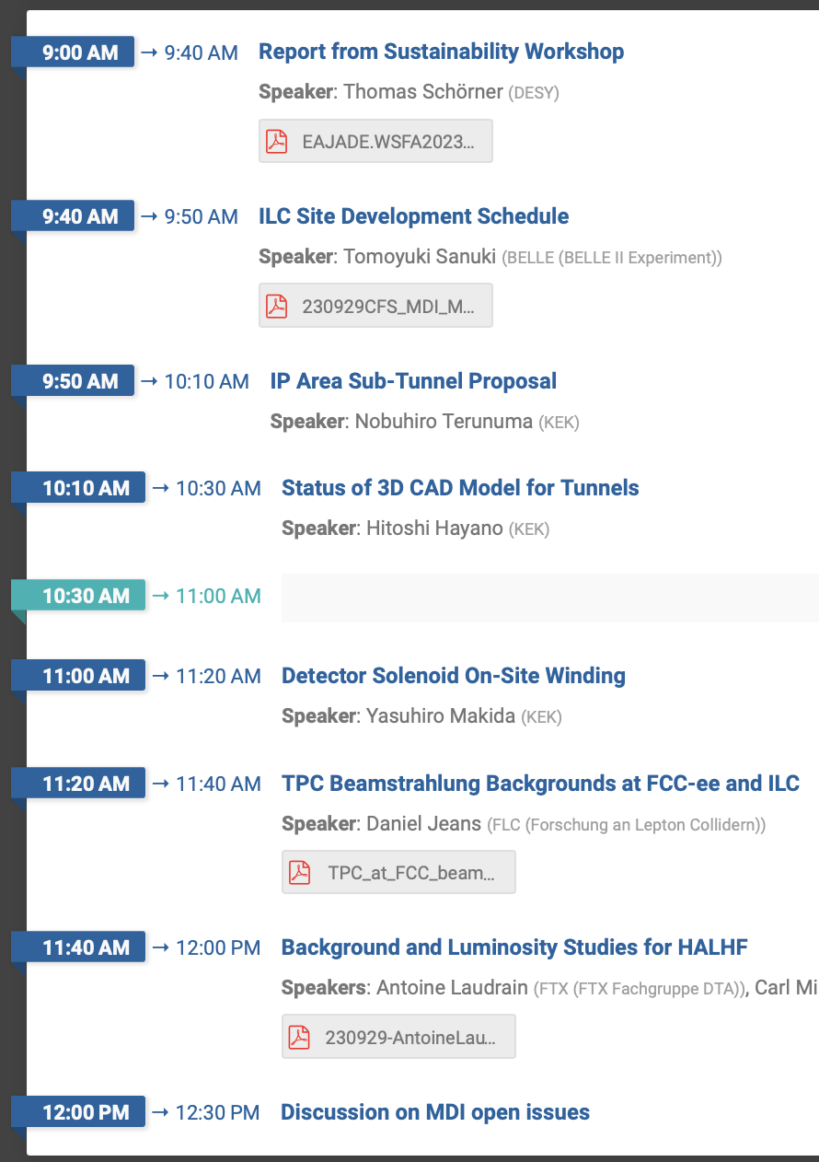
CFS/MDI Mini-Workshop 29 September 2023
Creating reference schedule based on past work (site development, magnet construction, accelerator assembly time line, detector installation)
Large uncertainty in all schedules, ball was dropped in 2019
Local planning, legal procedures, environmental assessment, land purchase will require 4-6 years between green light and construction start.
Detect. assembly start only after AH is ready (8-10 years after green light.
➔ Reference schedule by the end of this fiscal year!
Reviving former E-JADE mini-workshops
Suggesting new access tunnel for the BDS, (espec. beam dump region)
Optimisation of access tunnels in 3D CAD system – IP has been shifted by 5 km since fewer residents affected
Magnet winding as THE bottleneck. Discussing new sharing between on- and off-site work (smaller modules etc.)
TPC background from Beamstrahlung comparable per BX in ILC and FCC (and Beamstrahlung dominates over ee→qq)
But BX frequency 4.5k times higher at FCC
➔ Can a TPC work at FCC?
Boost leads to reduced muon momentum resolution (factor 2.2), mitigate via extended forward barrel region.
Understanding F/B asymmetry and Bhabha / lumi requires more studies
Beam strahlung effects + others require asymmetric bunch charge+length
➔ There is lots to be done!

