Slide 1
IDT WG2 Activities
Benno List
ILC Europe Meeting
4.10.2023

Slide 2
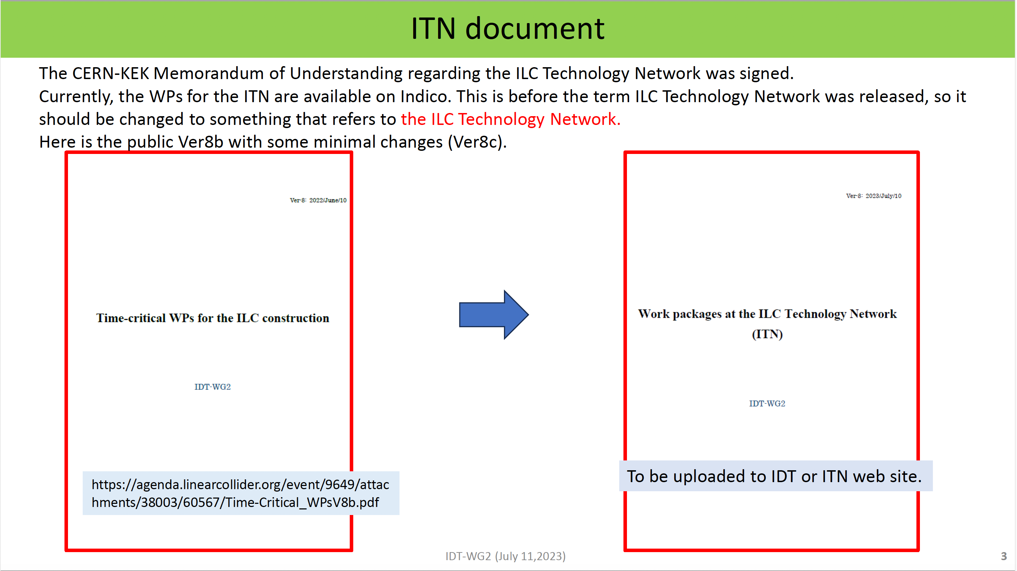
-> available from
https://agenda.linearcollider.org/event/10075/
S. Michizono 11.7.23
https://agenda.linearcollider.org/event/10075/

Slide 3
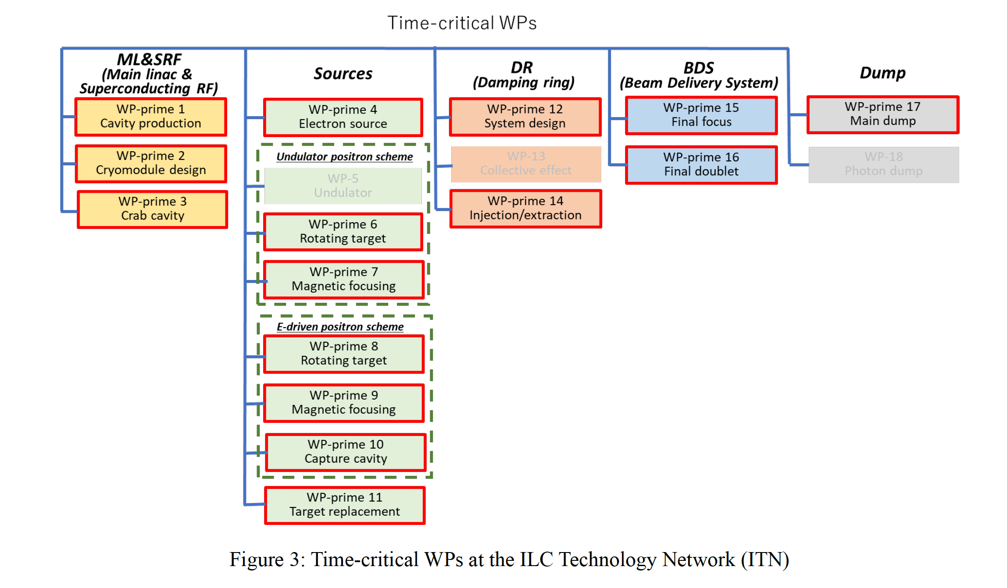
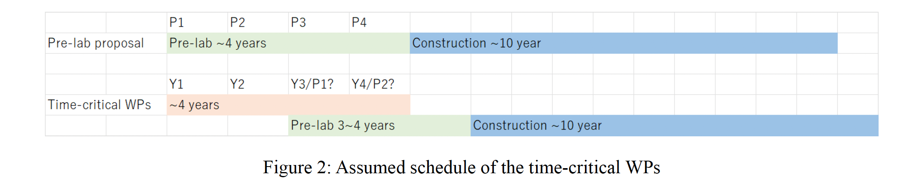
ITN: Work Packages
https://agenda.linearcollider.org/event/10075/contributions/52733/attachments/38998/61522/Time-Critical_WPsV8e.pdf

Slide 4
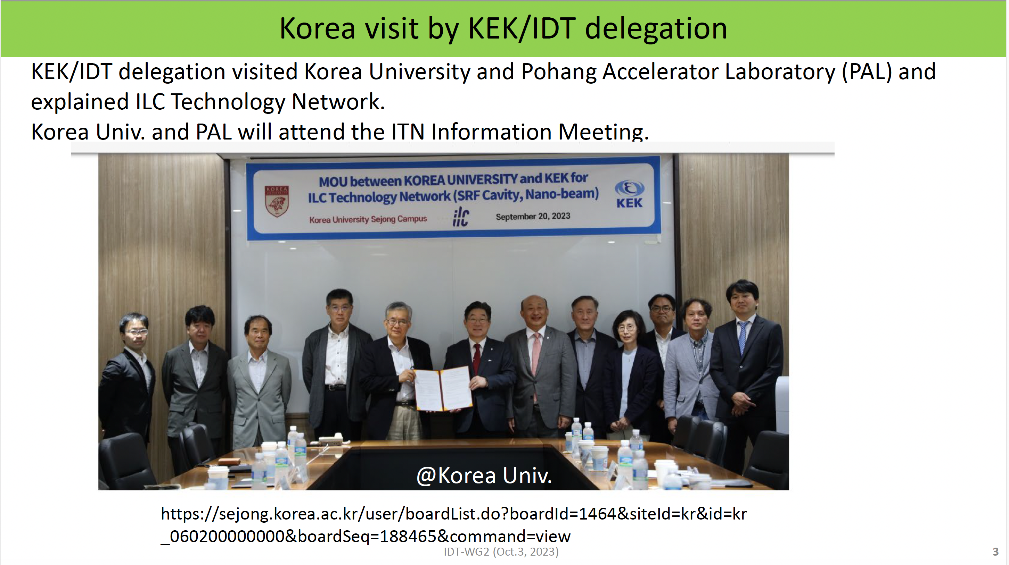
S. Michizono 3.10.23
https://agenda.linearcollider.org/event/10183/

Slide 5
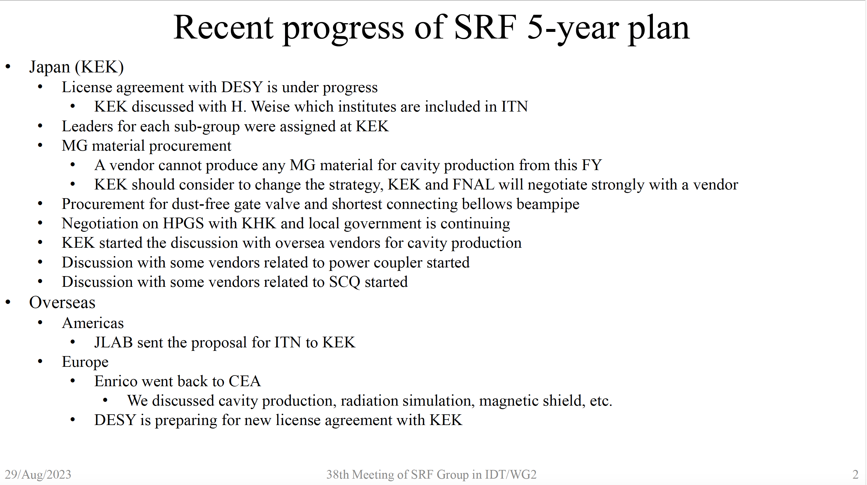
SRF Subgroup
Y. Yamamoto 5.9.23
https://agenda.linearcollider.org/event/10105/

Slide 6
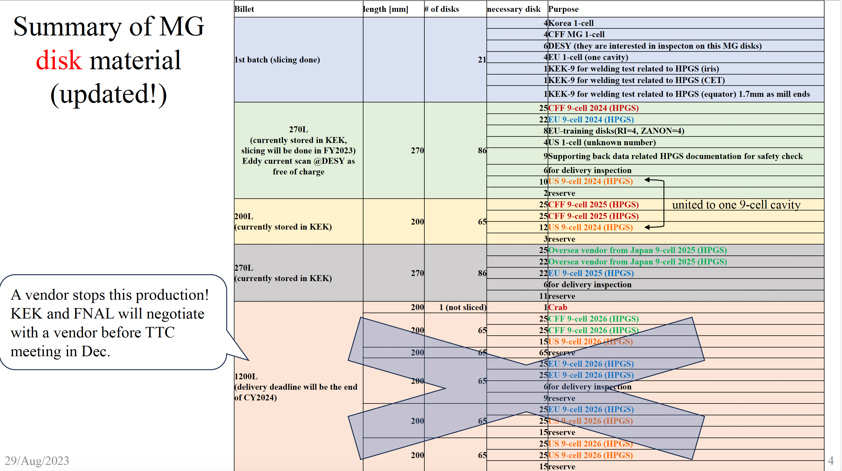
Medium Grain Material
Y. Yamamoto 5.9.23
https://agenda.linearcollider.org/event/10105/

Slide 7
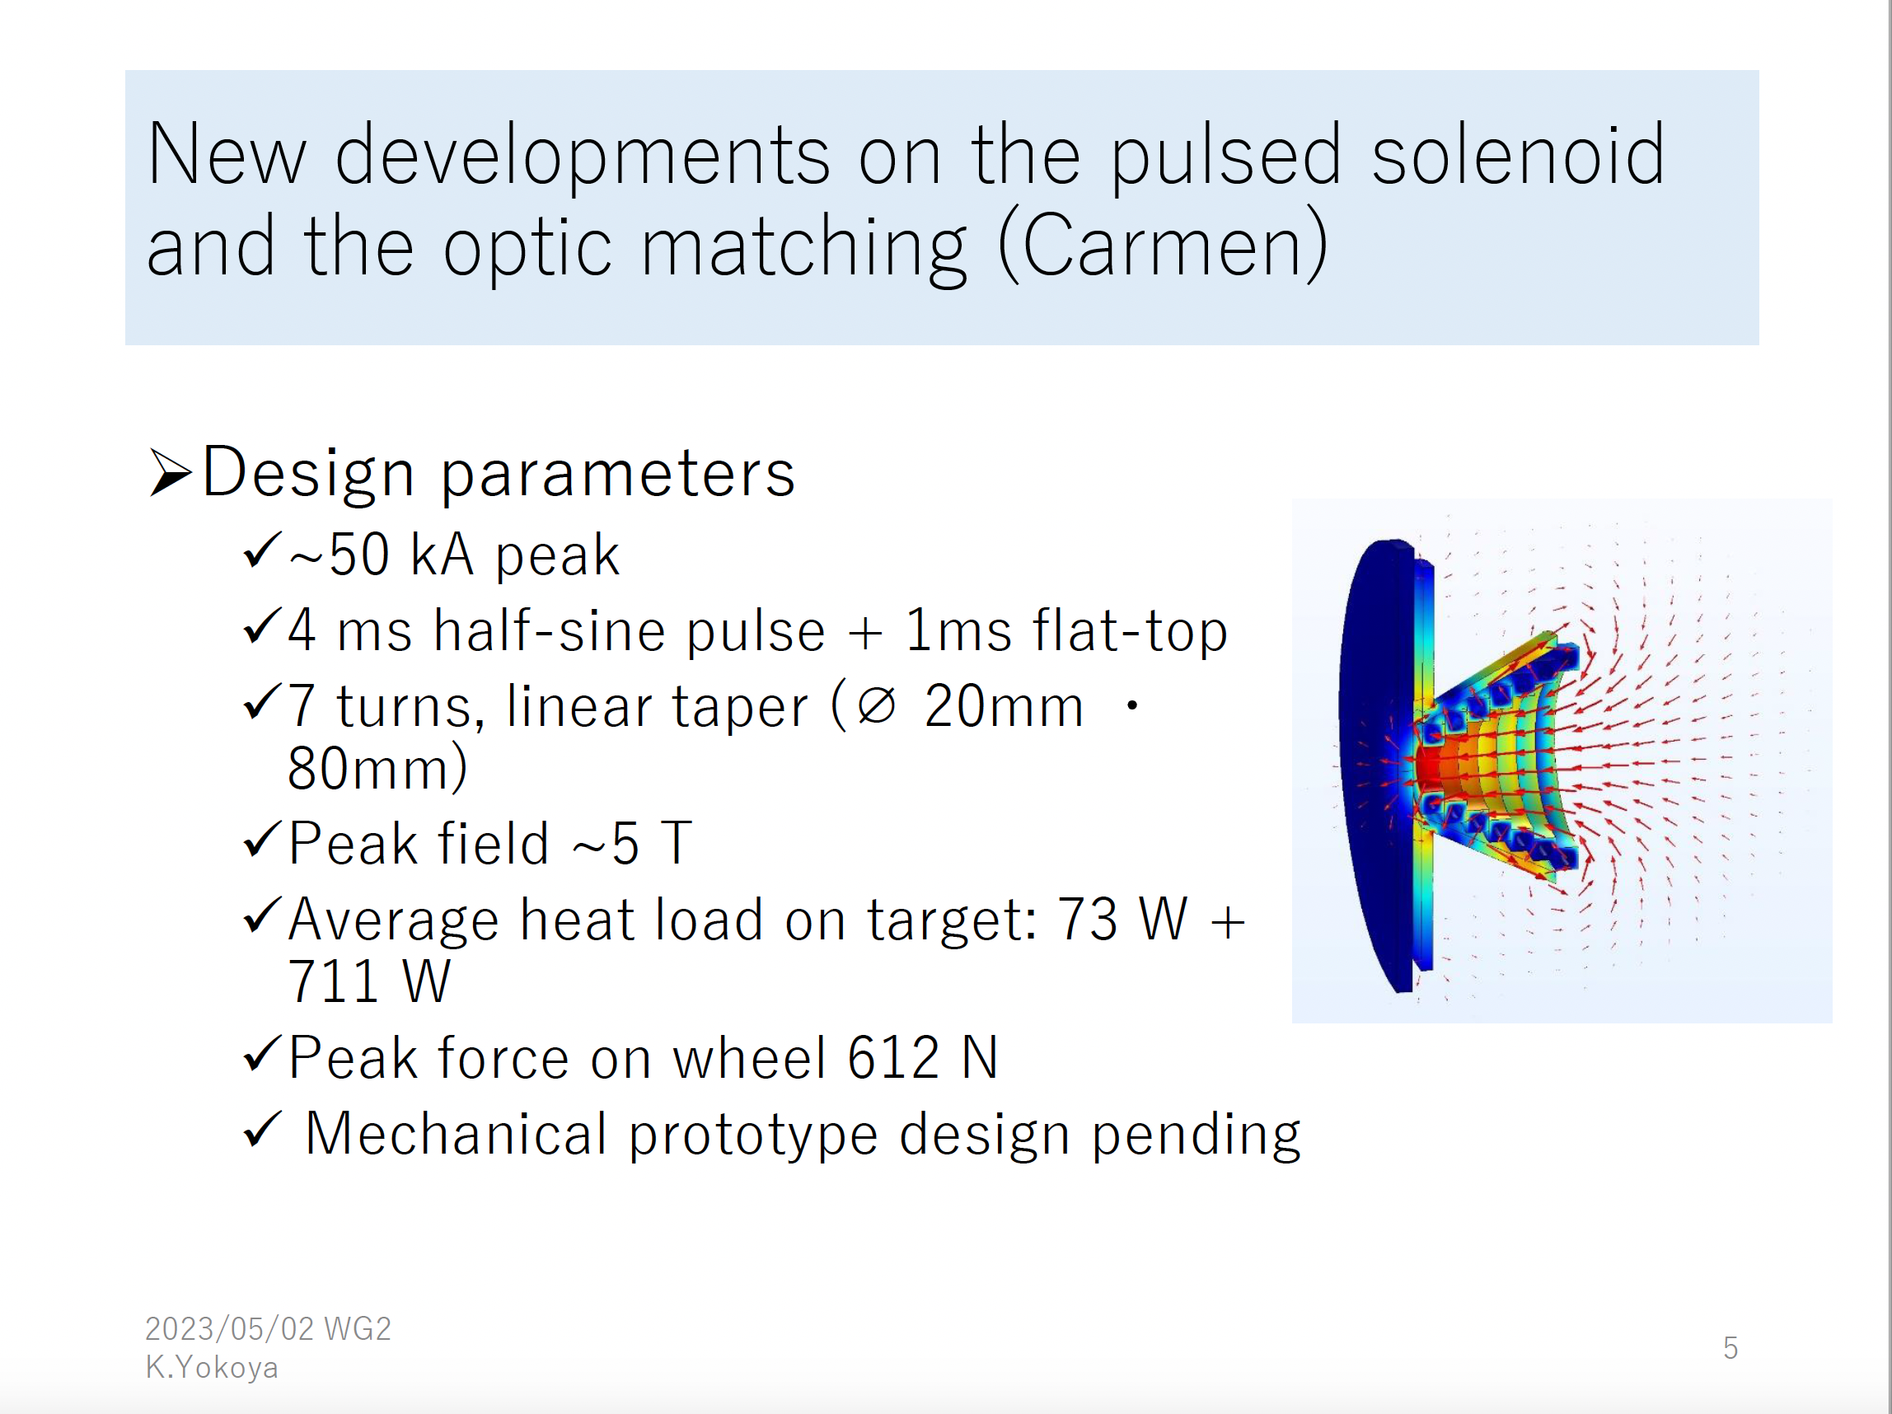
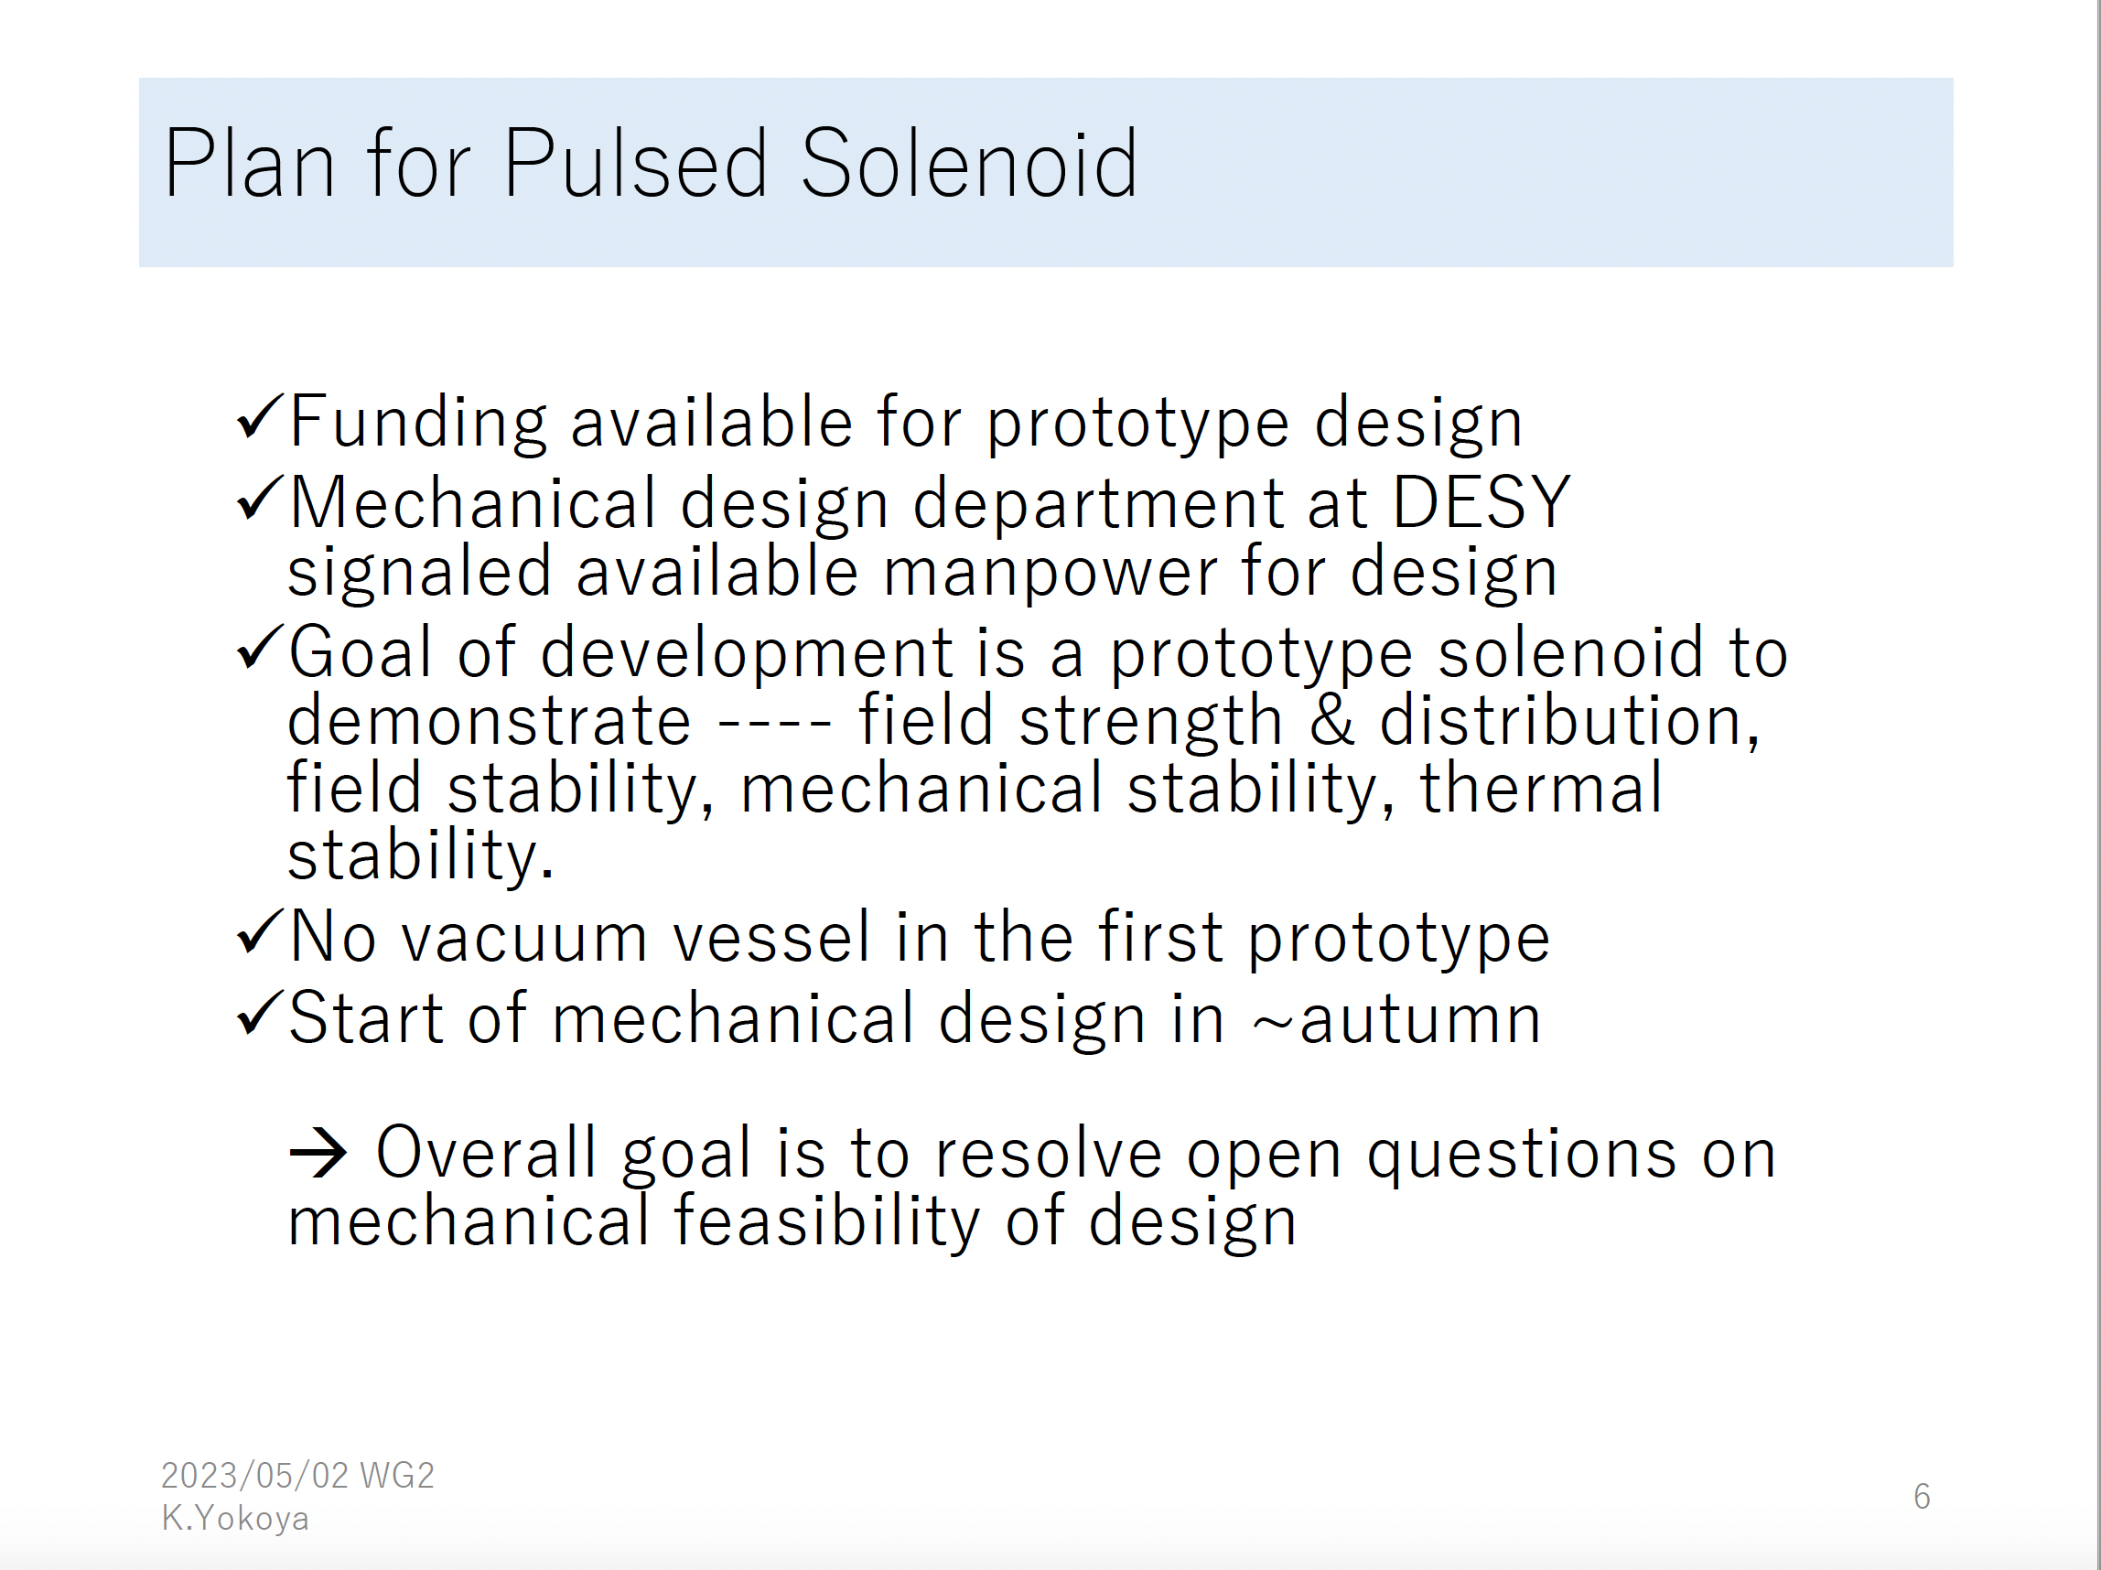
Positron Source R&D: Flux Concentrator
Engineering design to be done at DESY
Financed by ITN
K. Yokoya 11.7.23
https://agenda.linearcollider.org/event/10075/

Slide 8
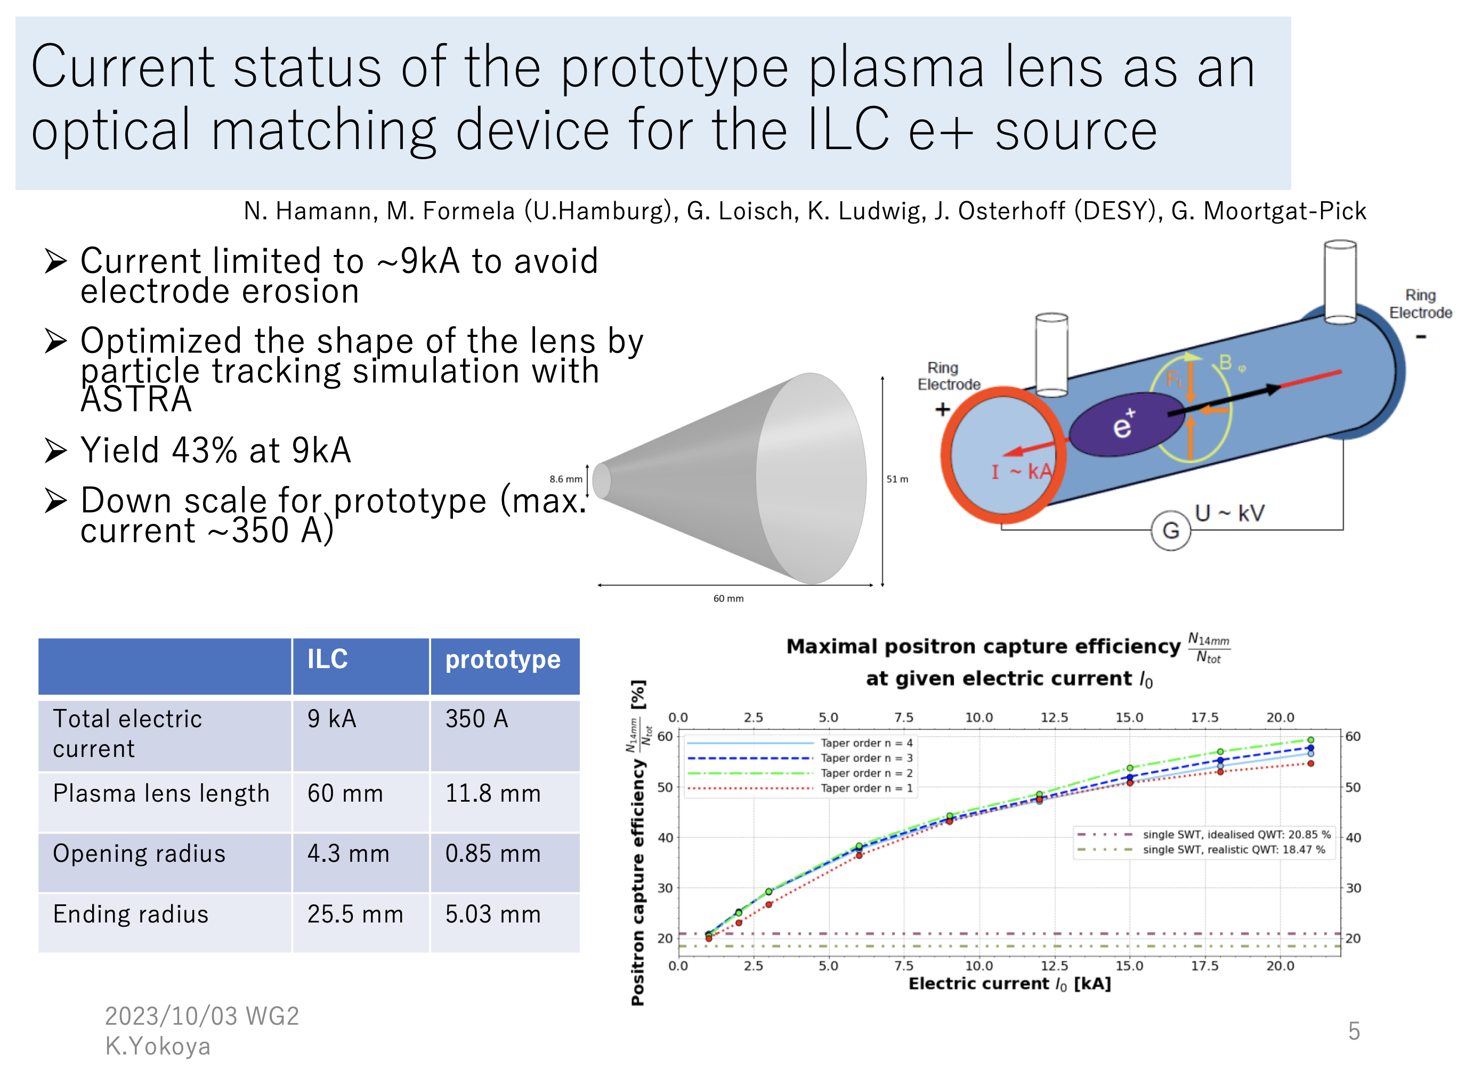
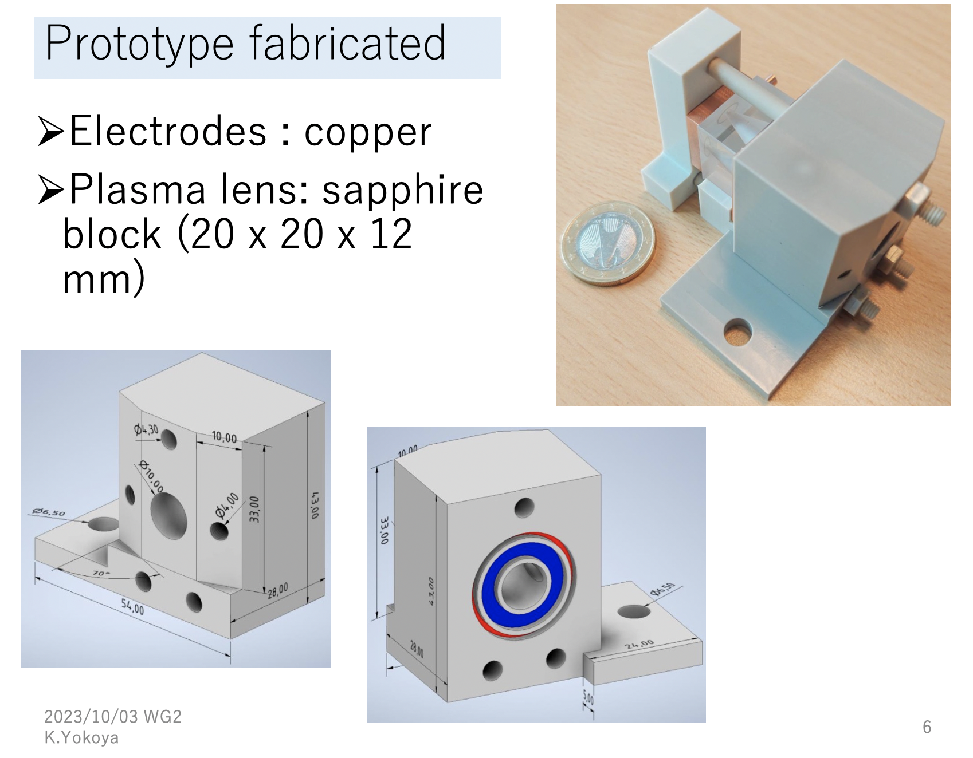
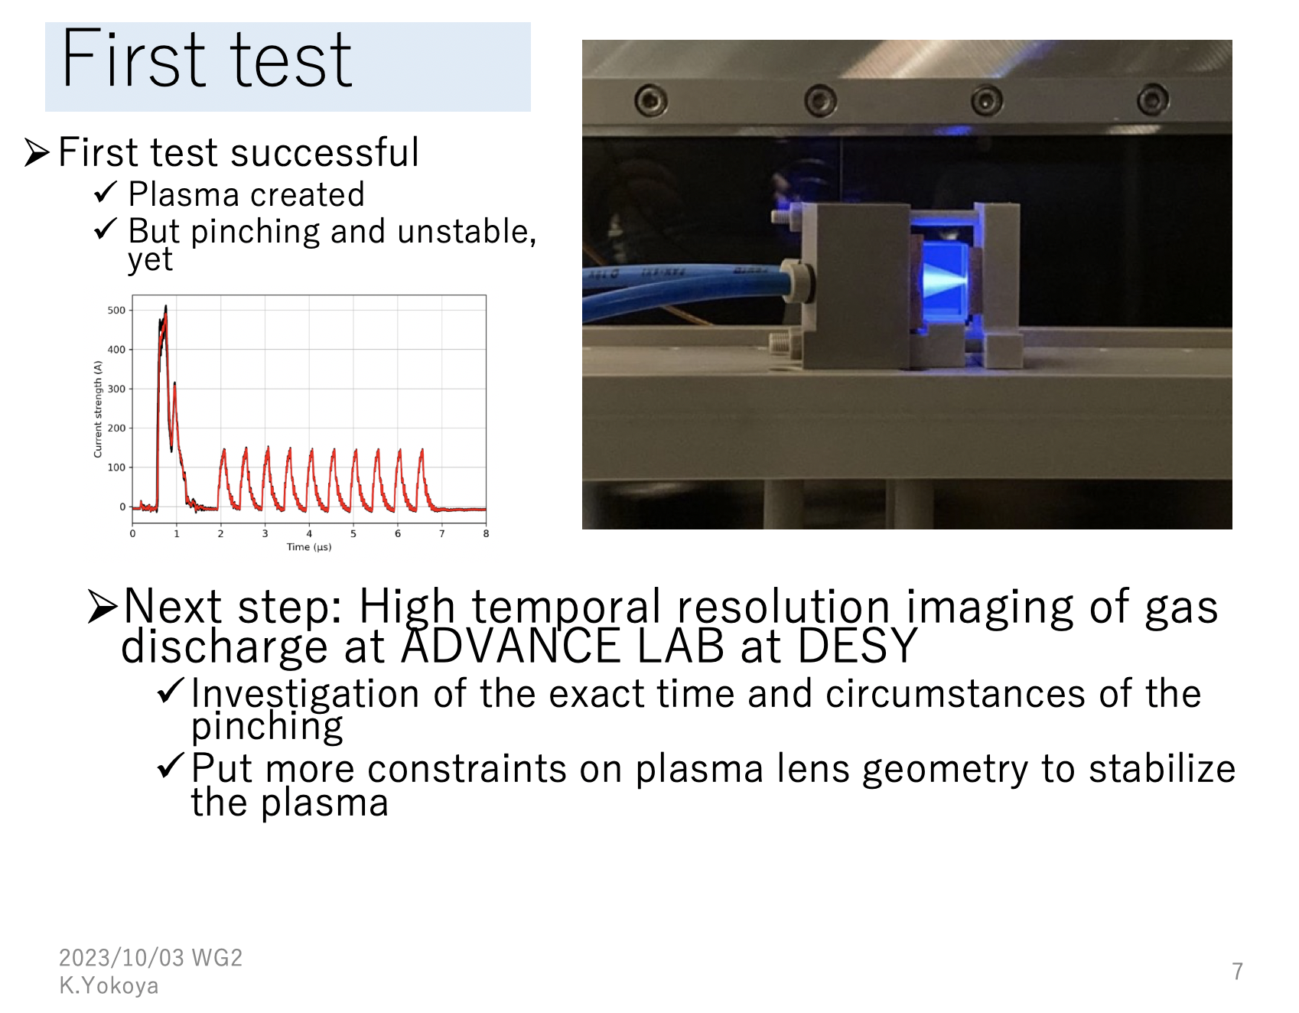
Positron Source R&D: Plasma Lens as OMD
K. Yokoya 3.10.23
https://agenda.linearcollider.org/event/10183/

Slide 9
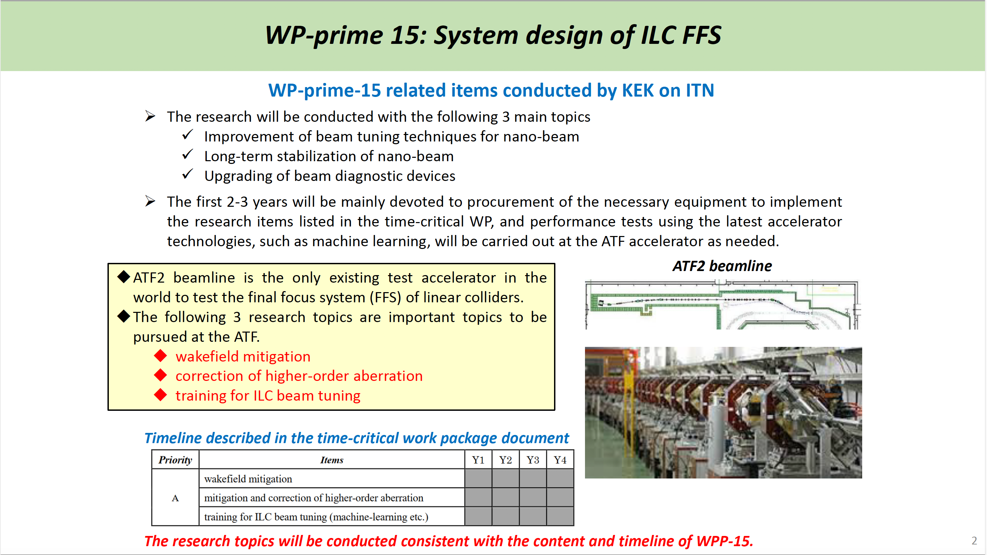
BDS, DR, Dumps Subgroup
T. Okugi 5.9.23
https://agenda.linearcollider.org/event/10105/

Slide 10
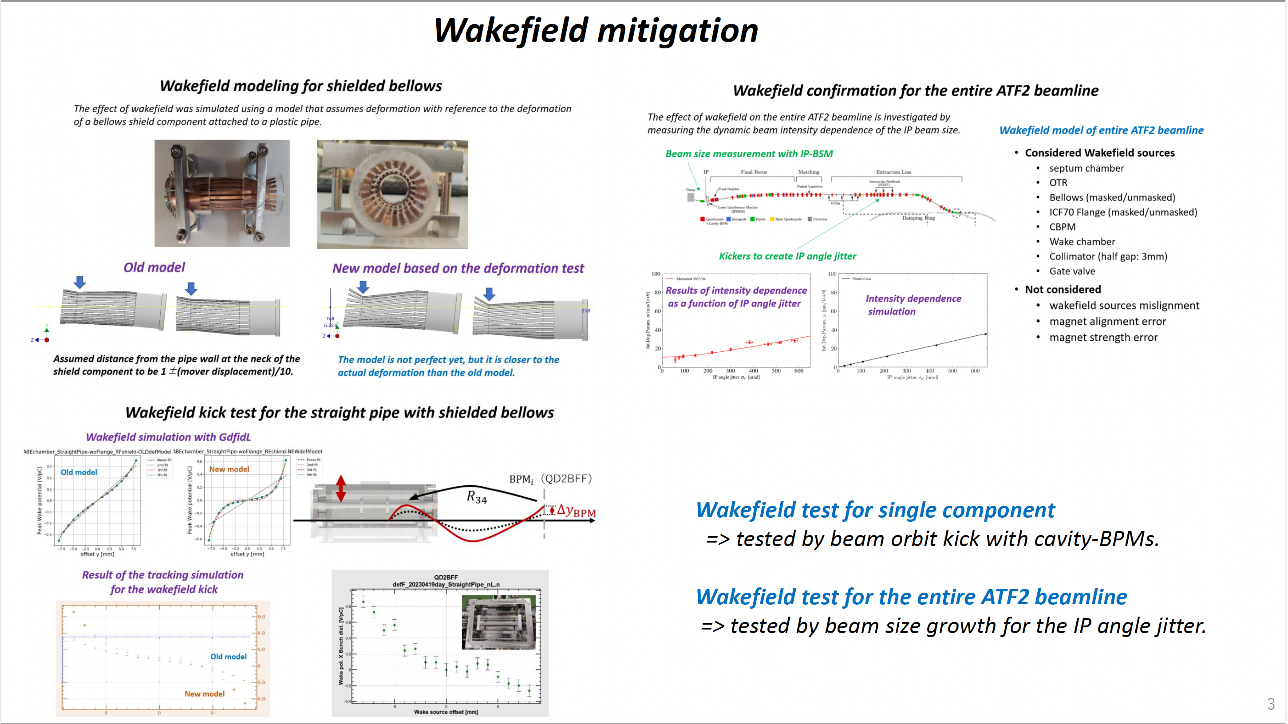
T. Okugi 5.9.23
https://agenda.linearcollider.org/event/10105/

Slide 11
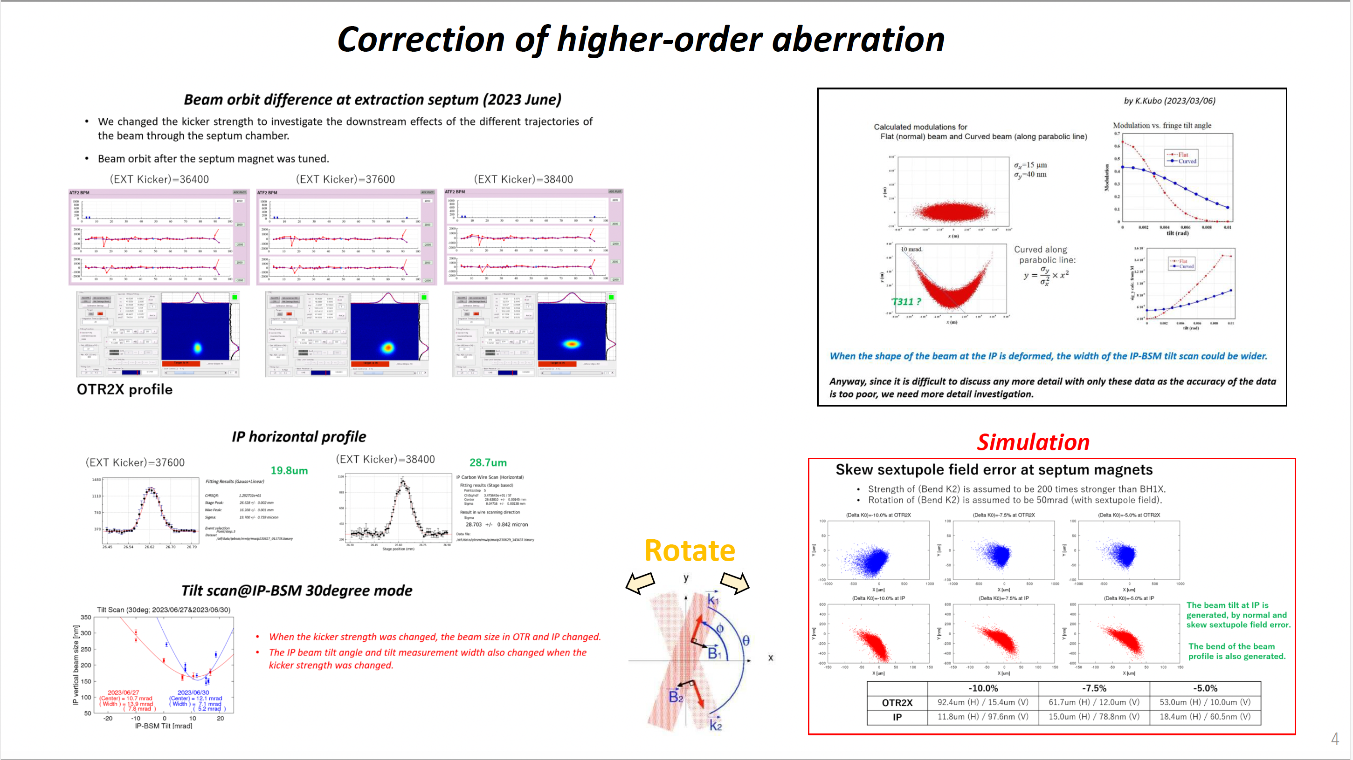
T. Okugi 5.9.23
https://agenda.linearcollider.org/event/10105/

