Slide 1
IDT WG2 Activities
Benno List
ILC Europe Meeting
9.11.2023

Slide 2
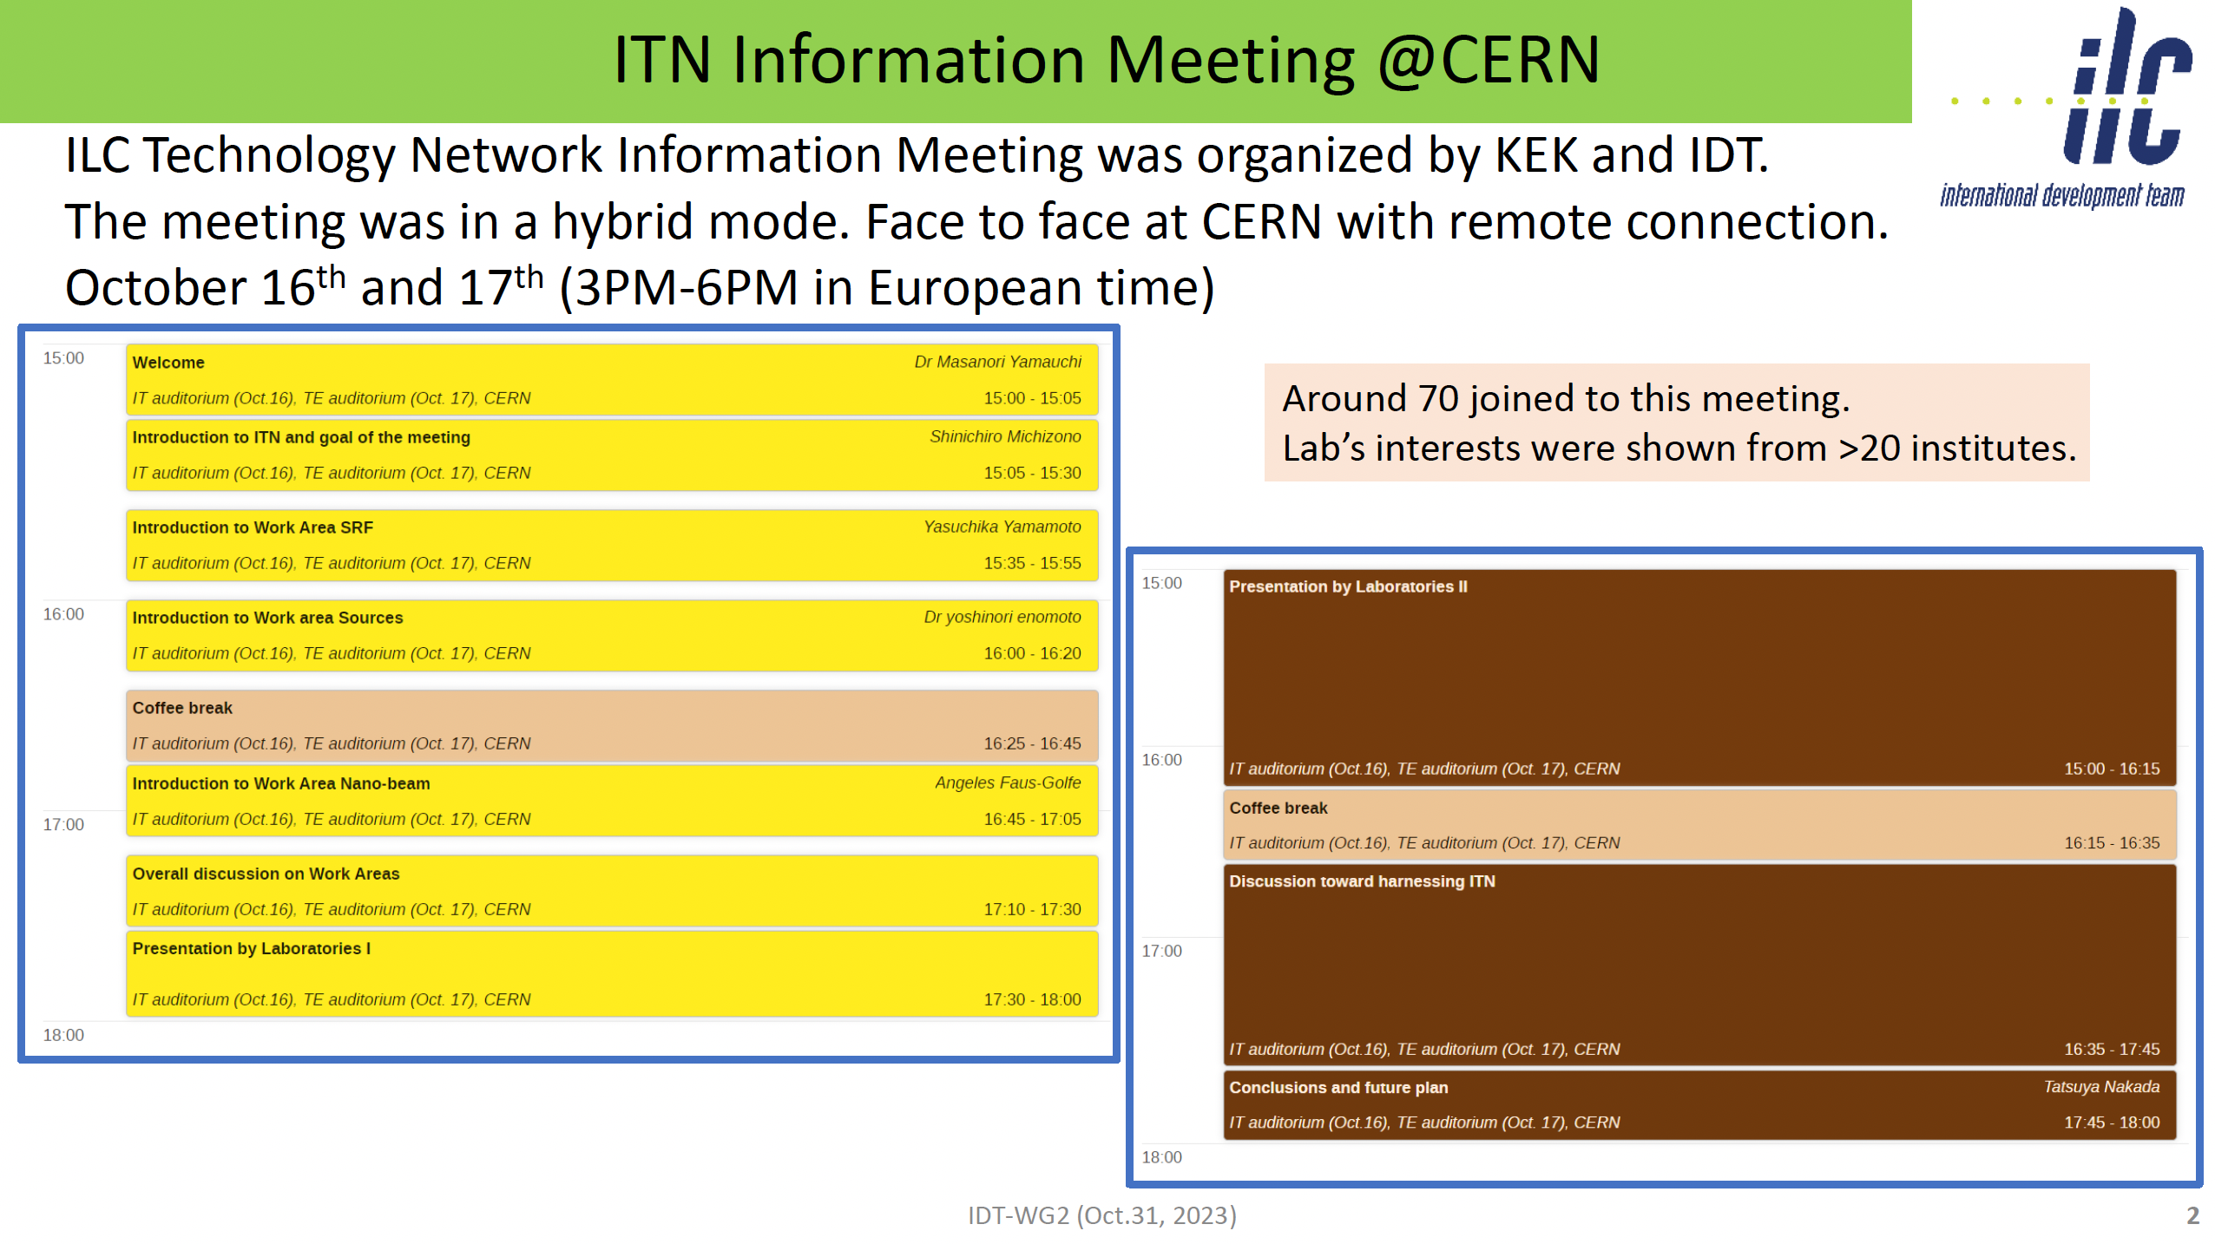
S. Michizono
IDT WG2 Meeting 31.10.23
https://agenda.linearcollider.org/event/10200/contributions/53479/

Slide 3
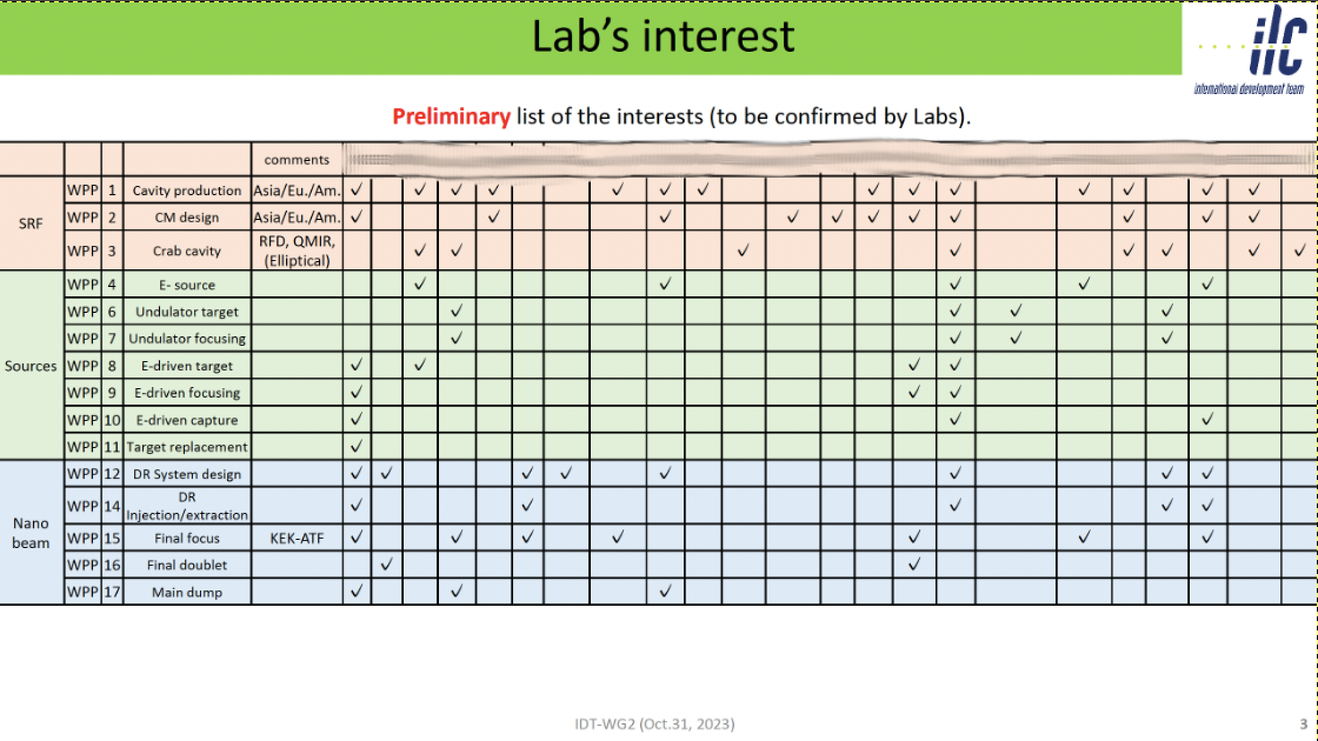
Linking IDT and ITN
IDT Subgroups (SRF, Sources, BDS/DR/Dumps) will contact & invite representatives from interested/participating labs
Will update table and work out in more detail scope of planned activities
Subgroup meetings in the coming weeks,
BDS subgroup has started

Slide 4
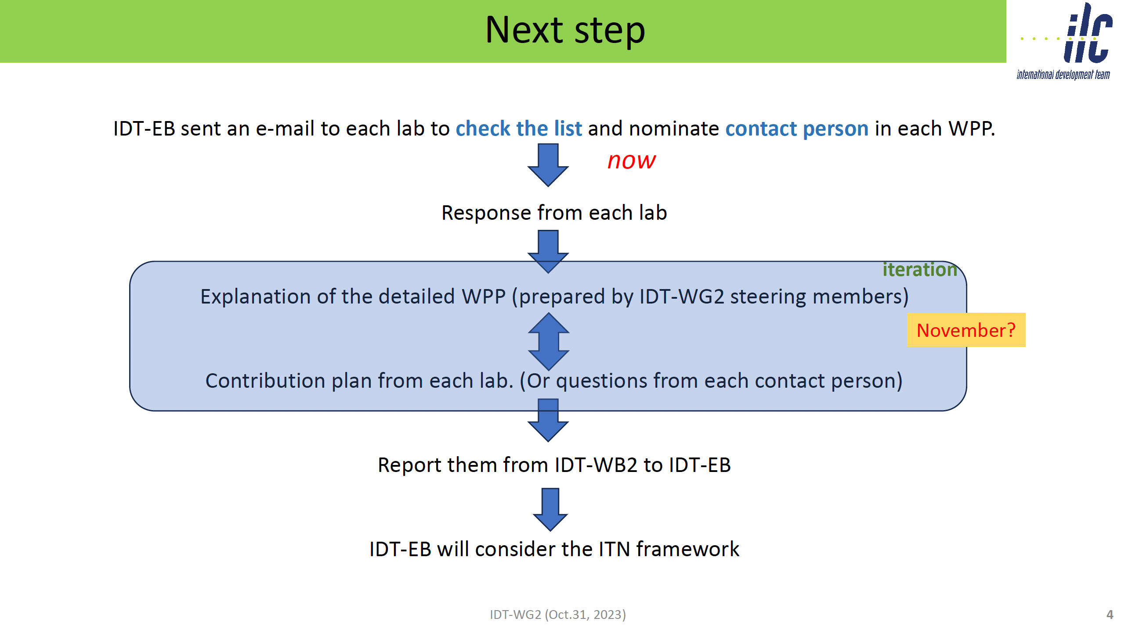

Slide 5
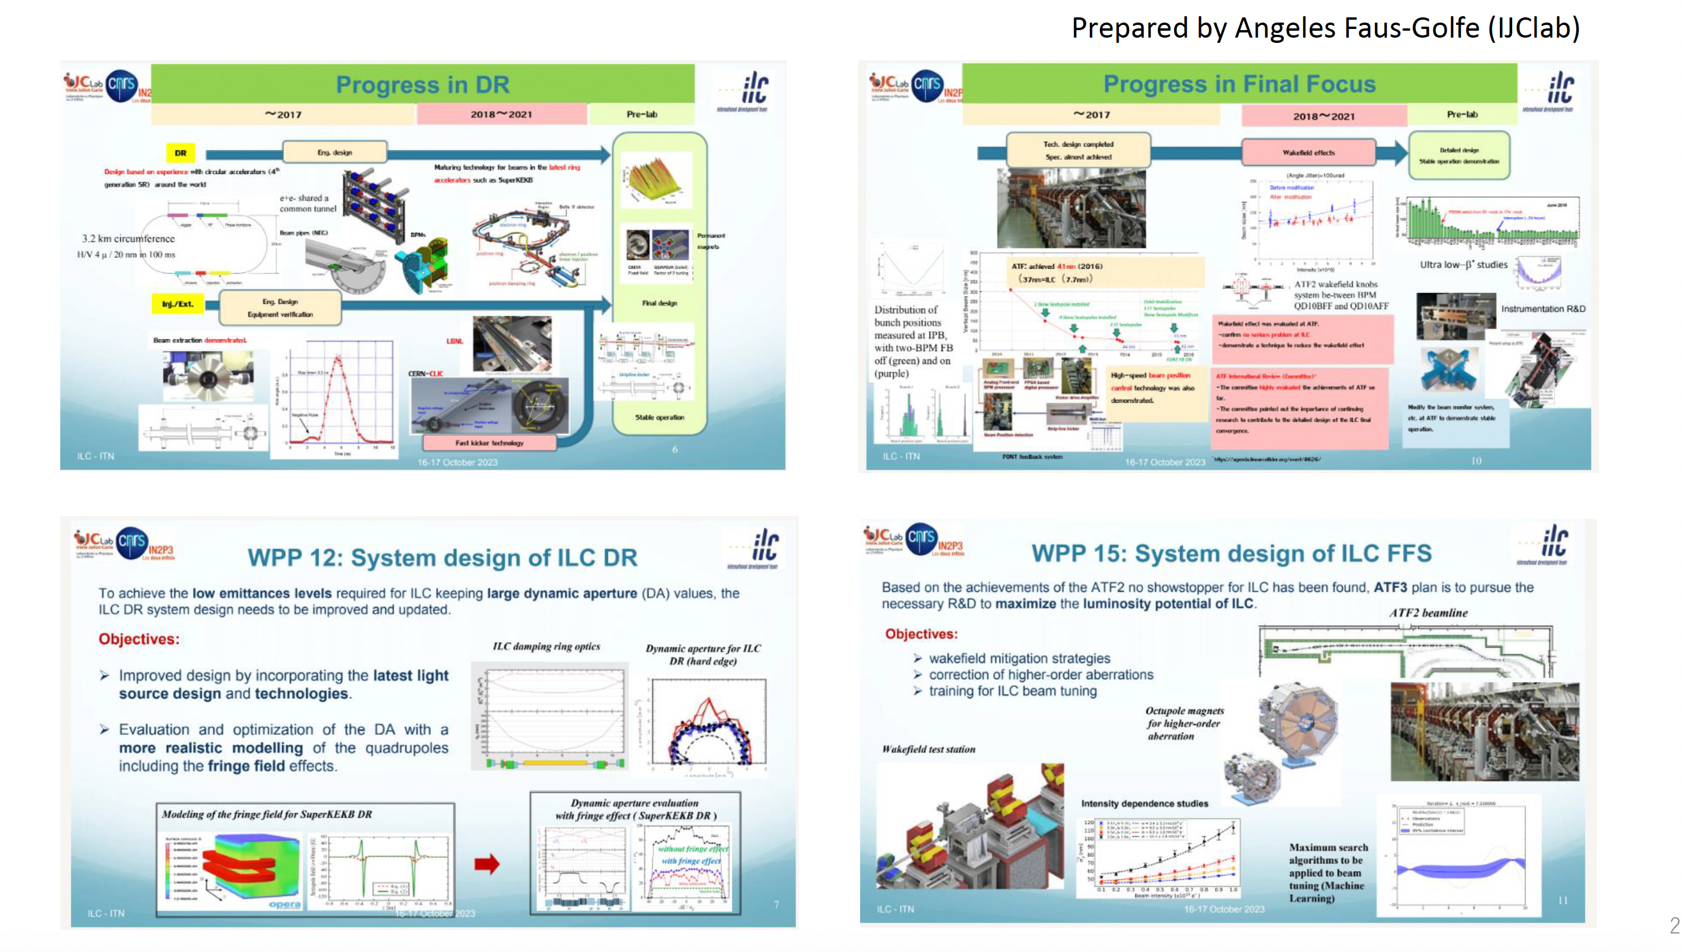
T. Okugi
IDT WG2 Meeting 31.10.23
https://agenda.linearcollider.org/event/10200/contributions/53483/

