Slide 1
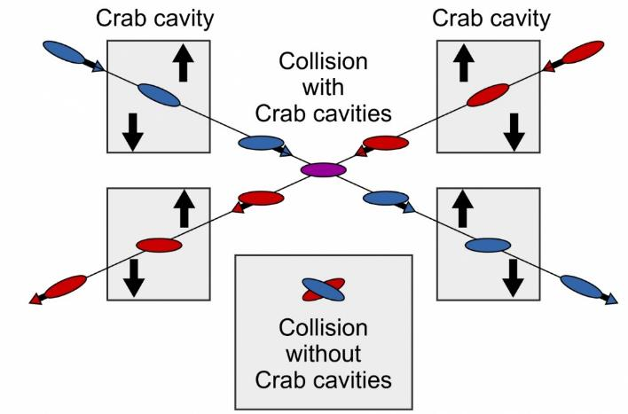

WG2 SRF: WP3 Crab Cavities
Design Review #6
Peter McIntosh
UKRI-STFC Daresbury Laboratory
13th Oct 2023

Slide 2
Agenda for WP3 Design Review #6 (BST)
Friday 13th October 2023 | Friday 21st October 2022
14:00 | Welcome and Introduction | P McIntosh (STFC) | 5 min
14:05 | KEK Nb Procurement status | A Yamamoto (KEK)/K Yasuchka (KEK) | 20 min
Cavity Design Updates
14:25 | RF Dipole (RFD) | Suba De Silva/Jean Delayen (ODU/JLab) | 15 + 5 min
14:45 | Quasi-waveguide Multicell Resonator (QMiR) | Andrei Lunin (FNAL) | 15 + 5 min
15:05 | Collaborative discussion | All | 20 min
15:25 | Next steps | P McIntosh (STFC) | 5 min
15:30 | Meeting close
https://agenda.linearcollider.org/event/10190/

Slide 3
Scope Design Review #6
Hear about progress for Nb material procurement:
  Clarify timescales expected and alignment needed for CC design readiness.
  Any issues still to resolve?
Review the RF and QMiR CC developments following April down-selection:
  Determine how much work still to do before prototype manufacture can start.
Review possible areas for contribution from the Elliptical, DQW and WoW teams.
Identify next stage development and determine future meetings.

Slide 4
Collaborative Areas Identified from DR#5 (July)
RFD:
  EM design verification
  RF properties
  HOM impedances
  Wakefield analysis (longitudinal, transverse) for short bunch length
  Full cavity multipacting analysis
  Engineering design and analysis
  Fabrication
  Tuner concept development
QMiR:
  Statistical HOM analysis
  Multipacting simulation
  Cavity Electro-Mechanical cross-simulations
  Frequency tuner design

Slide 5


MANY THANKS
Questions?

