Slide 1
RF DIPOLE DESIGN UPDATE
Crab Cavity Design Review Workshop #6
October 13, 2023

Slide 2
Outline
RF Design
Updated HOM Damping
Stress Analysis
Cavity Components for Fabrication
Cavity Fabrication Sequence
Material Dimensions
Next Steps

Slide 3
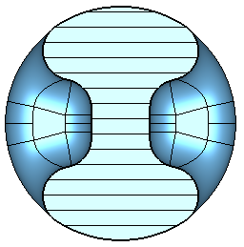
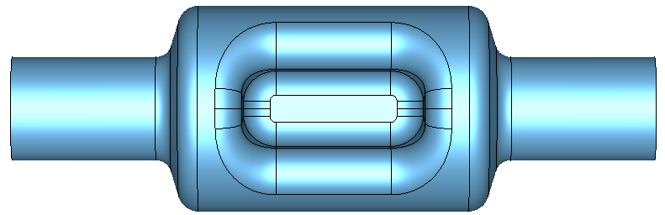
1.3 GHz RFD Cavity Design
Pole separation = 25 mm and beam aperture = 50 mm
Optimized the pole shape (pole height and length):
  To achieve peak surface field requirements of E_{p} < 45 MV/m and B_{p} < 80 mT
Property | Value
Operating frequency [GHz] | 1.3
1st HOM [GHz] | 2.089
E_{p}/E_{t}* | 3.81
B_{p}/E_{t}* [mT/(MV/m)] | 6.78
B_{p}/E_{p} [mT/(MV/m)] | 1.78
G [Ω] | 129.88
R/Q [Ω] (V²/P) | 439.51
R_{t}R_{s} [Ω²] (V²/P) | 5.71×10⁴
*Reference length V/E_{t} = λ/2 [mm] | 115.3
V_{t} max per cavity [MV] | 1.36
E_{p} [MV/m] | 44.94
B_{p} [mT] | 79.96
V_{t} per cavity [MV] (@ 125 GeV) | 0.9225
Stored energy (U) [J] | 0.237
P_{diss} [W] (for R_{s} = 30 nΩ) | 0.45
Q₀ (for R_{s} = 30 nΩ) | 4.33×10⁹
25 mm
310 mm
50 mm
31.5 mm
99.4 mm
130 mm
Cavity Dimensions (rf volume) | Value
Pole separation [mm] | 25
Beam aperture [mm] | 50
Cavity Length [mm] (flange-to-flange) | 310
Cavity Diameter [mm] | 99.4
Pole Length [mm] | 85
Pole Height [mm] | 31.5
Angle [deg] | 22.5
 | 250 GeV | 1 TeV
Max V_{t} per cavity [MV] | 1.36 | 1.36
Total V_{t} [MV] | 1.845 | 7.4
Number of cavities | 2 | 6
V_{t} per cavity [MV] | 0.9225 | 1.234
V_{t,max} / V_{t,operational} | 1.47 | 1.10

Slide 4
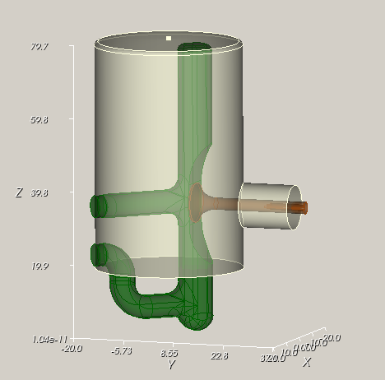
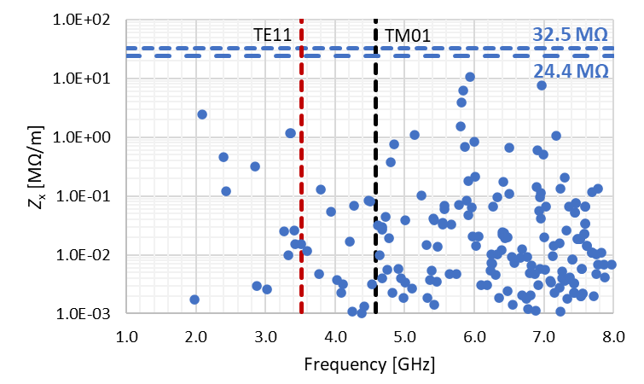
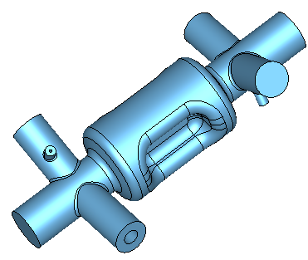
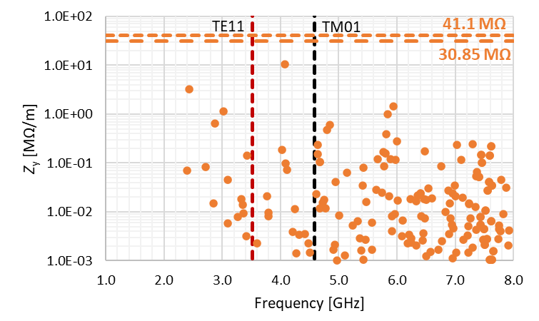
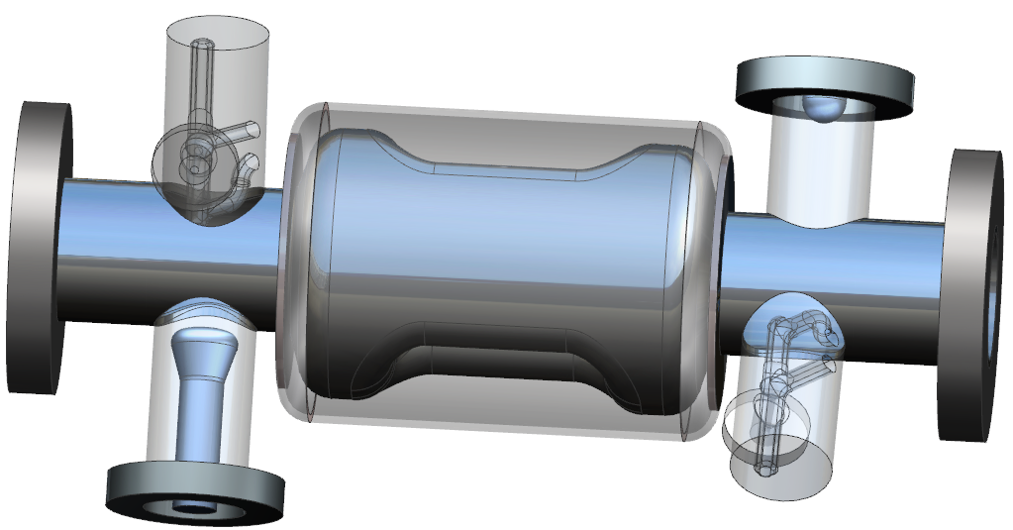
Updated Higher Order Mode Damping
Total impedance threshold:
  For 125 GeV → Z_{x} = 48.8 MΩ/m and Z_{y} = 61.7 MΩ/m
  For 500 GeV → Z_{x} = 195.2 MΩ/m and Z_{y} = 246.8 MΩ/m
Damping achieved with two TESLA style HOM couplers placed on each of the beam pipes
  No interference with He jacket
TESLA type HOM coupler
Field Probe
HOM2
HOM1
FPC

Slide 5
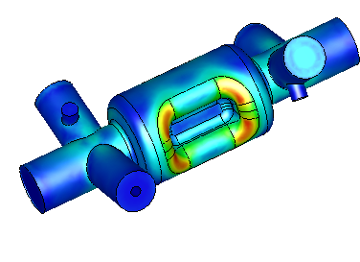

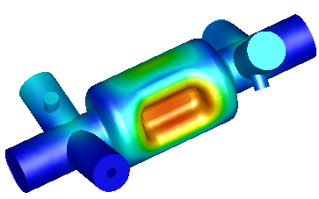

Stress Analysis
Fine Grain Nb material properties at room temperature
  (JLAB-TN-09-002 – C100 Cryomodule Niobium Cavity Structural Analysis)
  Young’s modulus – 82.7 GPa (1.2×10⁷ psi)
  Poisson’s ratio – 0.38
Allowable stress < 43.5 MPa (For FG)
Cavity thickness – 3 mm
Boundary conditions – Cavity constrained at beam pipes and FPC
Maximum stress is 25.5 MPa
  Doesn’t require stiffening

Slide 6
Cavity Components of 1.3 GHz RFD Cavity
Goal – To fabricate and test a cavity prototype including couplers (FPC, FP with test antennas and HOMs)
Cavity body thickness - 3mm
Thickness of beam pipes, HOM cans – 3 mm
HOM hooks and probes – Nb
FPC and FP probes – Cu
Cavity flanges – SS 316LN with Cu gaskets
Machined center body and end caps
Ports fabricated by rolling Nb sheets (or from tubes)
  Flanges brazed to Nb ports

Slide 7
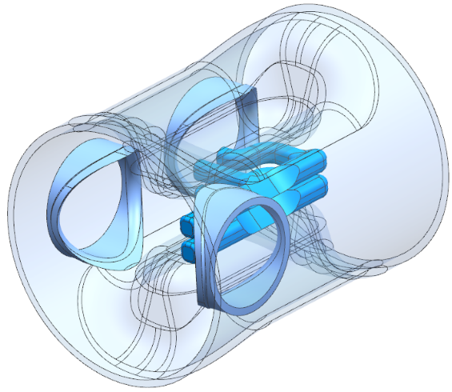

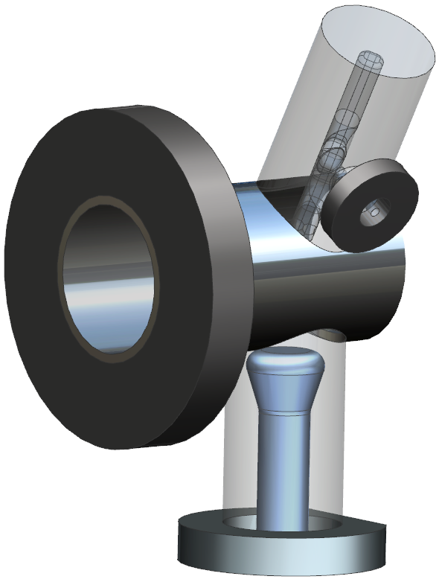
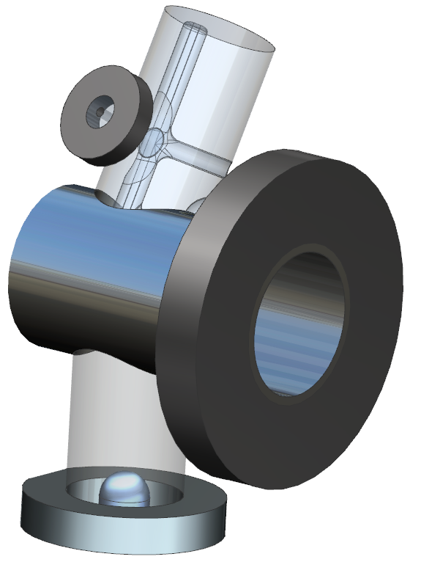
Fabrication Sequence – Beam Pipe Assemblies
Form tubes for FPC, FP and 2 HOM couplers
Machine HOM hooks and probes from remaining material from center body
Machine transition piece from remaining material from center body
Weld HOM hooks to tubes
Weld transition pieces to beam tube
Weld HOM couplers, FPC and FP ports to beam tube
Braze HOM coupler flange, FPC and FP flanges
Braze beam tube flanges
×2

Slide 8
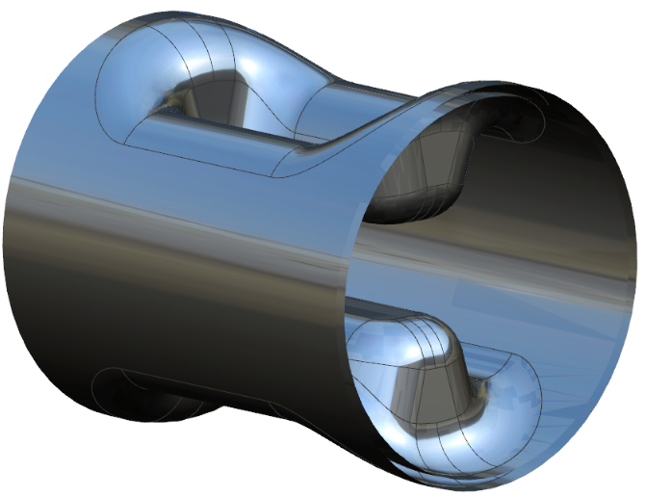
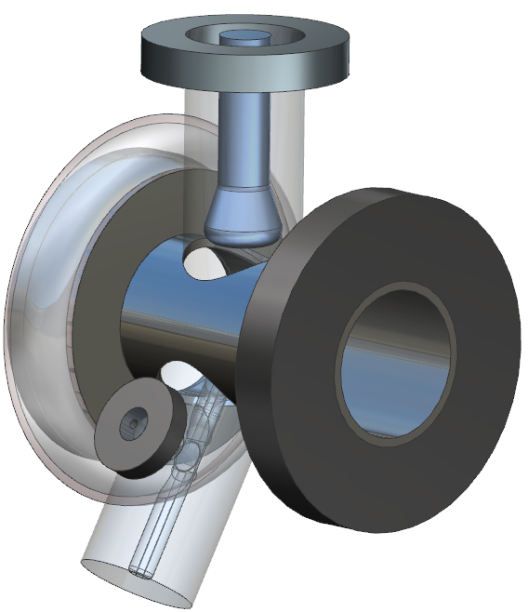
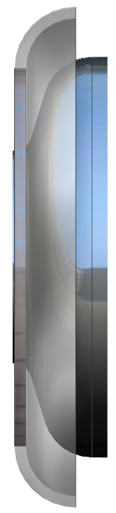
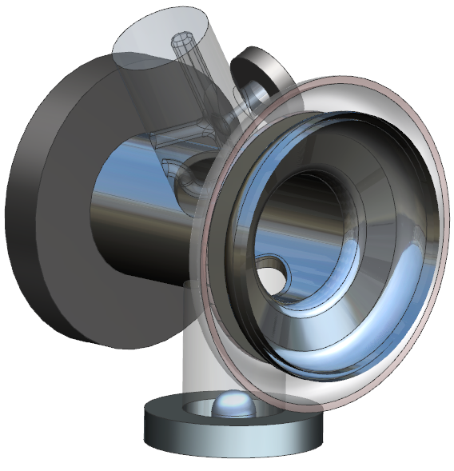
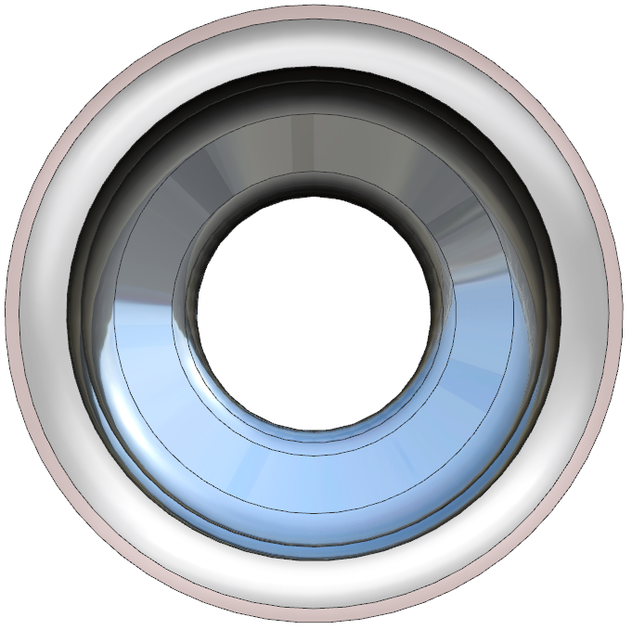
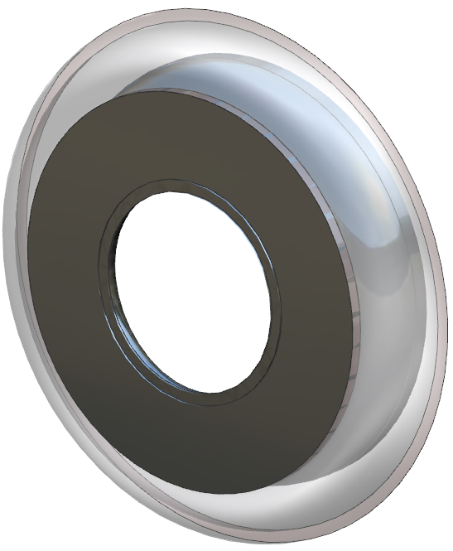
Fabrication Sequence – Center Body and End Cap
Machine center body
  No tuner adapter in the prototype cavity
Machine end caps including He jacket transition rings
Form NbTi rings for He jacket
Weld NbTi ring to end caps
Weld beam tube assemblies to end caps – full penetration weld from inside the end cap
NbTi ring
Nb ring for He jacket

Slide 9
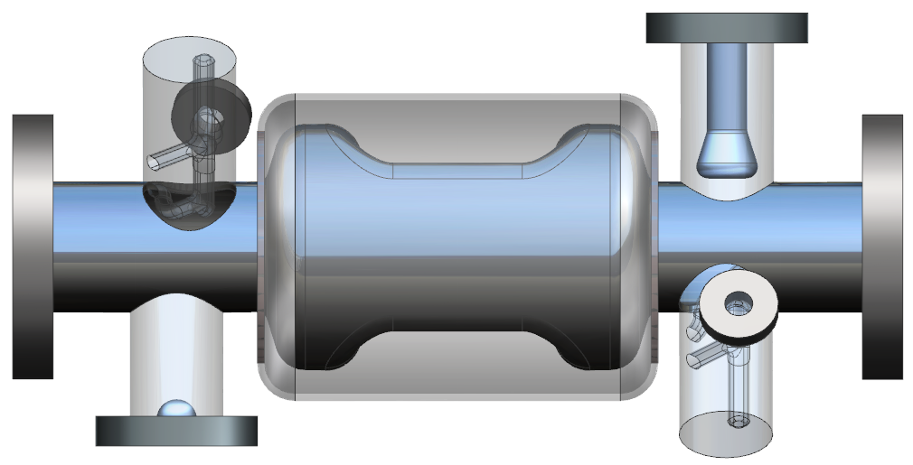
Fabrication Sequence – Cavity
Weld cavity center body to end cap assemblies
  Clearance on NbTi rings to EBW the center body to end caps
TIG weld Ti He jacket
  Ti He jacket will be welded in two halves

Slide 10
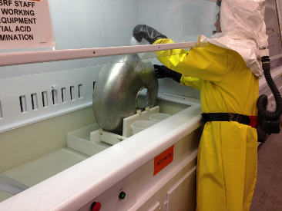
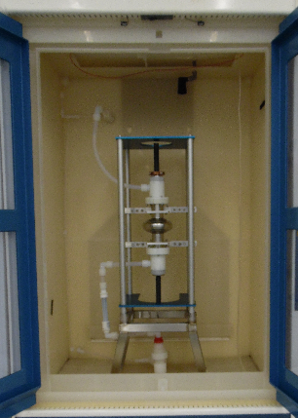
Cavity Processing
Electropolishing of parts for bulk removal (120 microns)
  Immerse parts EP acid bath in the fume hood
  Need to develop procedure
Light BCP on fully welded cavity in the BCP cabinet
  Removal of 30 microns

Slide 11
Material Dimensions
FG ingots for center body and two end caps
End caps (×2)
Center body
110 mm
110 mm
40 mm
150 mm
Single ingot
110 mm
230 mm

Slide 12
Material Dimensions
16”
FG Nb sheet for
  Beam pipes
  FPC and FP ports
  HOM coupler cans
Beam Tube
Beam Tube
12”
Cavity Part | Material Type | Dimensions [mm] | Qty
Beam tubes | Sheets | 115 mm × 180 mm × 3 mm | 2
HOM cans | Sheets | 65 mm × 148 mm × 3 mm | 2
FPC tube | Sheets | 84 mm × 148 mm × 3 mm | 1
FP tube | Sheets | 84 mm × 148 mm × 3 mm | 1
HOM Can
HOM Can
FPC Tube
FP Tube
Extra width included in all parts
No spare pieces

Slide 13
Next Steps
Full engineering analysis and design
Develop detailed fabrication plan including
  Forming dies
  Machining and welding fixtures
  Cavity drawings package
Cavity processing procedures and tools

Slide 14
Back Up Slides

Slide 15
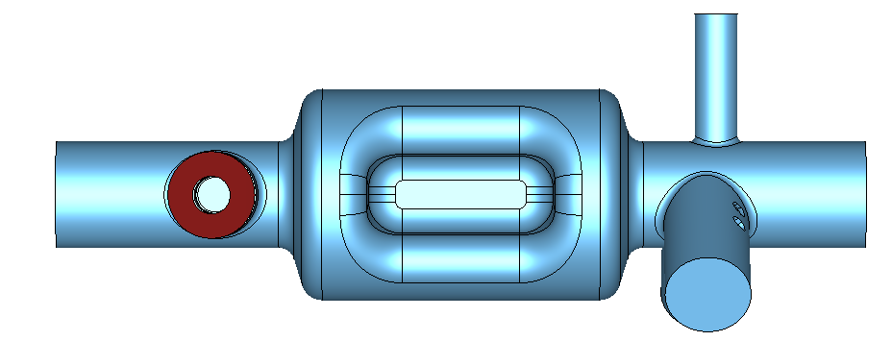
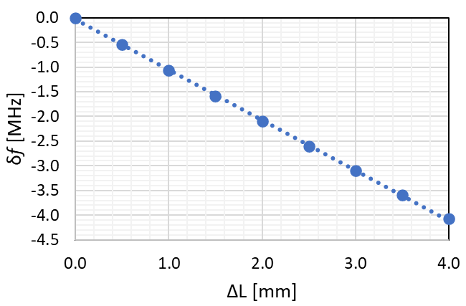
Final Frequency Tuning
Frequency tuning before the final weld of end cap assemblies to center body
Trim tuning done by trimming center body symmetrically in a vertical stacked assembly
Trimming sensitivity = –1.017 MHz/mm
ΔL/2
ΔL/2

Slide 16
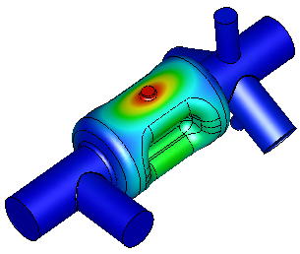

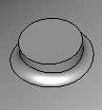
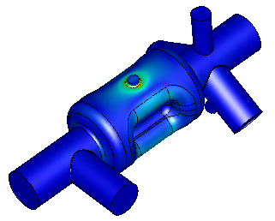
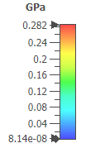
Tuning Sensitivity
Nb material properties at cryo temperature for annealed MG
  Young’s modulus – 114 GPa (1.65×10⁷ psi)
  Allowable stress < 283 MPa (For MG)
Cavity thickness – 3 mm
Cavity constrained at beam pipe ports and FPC
Required tuning range – 100-180 kHz
Tuning force (Both push and pull) – 175 N
Tuner Adapter
Ø 1.5 cm
Total Displacement | Tuning Sensitivity | Tuning Range
0.34 mm | 9.5 MHz/mm | ±3.24 MHz

Slide 17
Main Cavity Components
Center body and 2 end caps to be machined from ingot
Include additional length and diameter to include tolerances
Part | RF Dimensions | RT Dimensions | Ingot Size | Notes
 | Diameter = 99.4 mm | Diameter = 99.6 mm | Diameter = 125 mm | Including 3 mm sheet thickness + 10 mm for tuner adapter
 | Length = 130.2 mm | Length = 130.4 mm | Length = 150 mm | Including extra length for trim tuning
 | Diameter = 99.4 mm | Diameter = 105.6 mm | Diameter = 115 mm | Including 3 mm sheet thickness
 | Length = 30.5 mm | Length = 30.6 mm | Length = 40 mm

