Slide 1
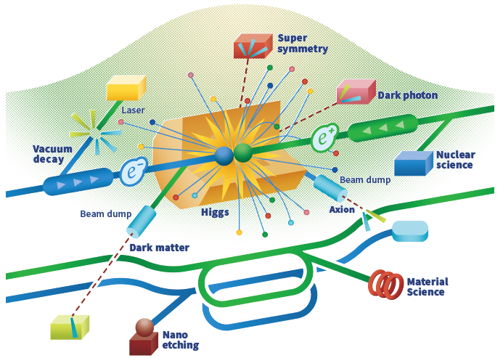

QMiR Crab Cavity for ILC
Andrei Lunin, Vyacheslav Yakovlev
October 13, 2023
WP3 Crab Cavity Design Meeting #6

Slide 2
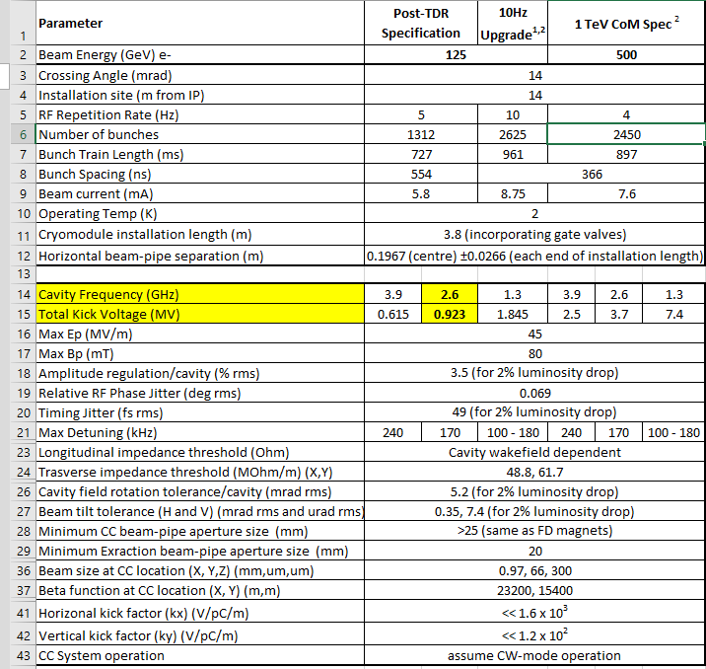
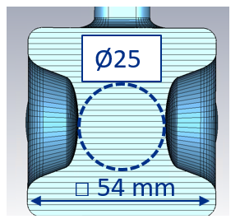
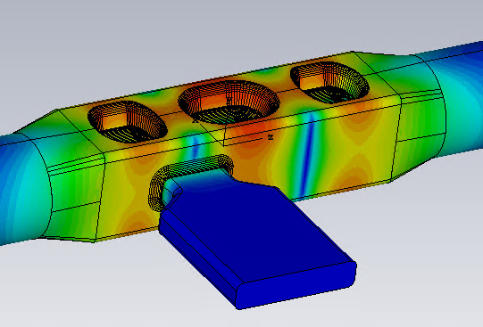
Requirements for QMiR 2.6 GHz Crab Cavity
Freq | 2600 MHz
V_{kick} | 0.92 MV
(R/Q)_{t} | 225 Ω
G-factor | 160
Bp, max | 70 mT
Ep, max | 35 MV/m
W_{STORED} | 0.24 J
Length | 500 mm
√
√
√
√
√
√
√
√
√

Slide 3
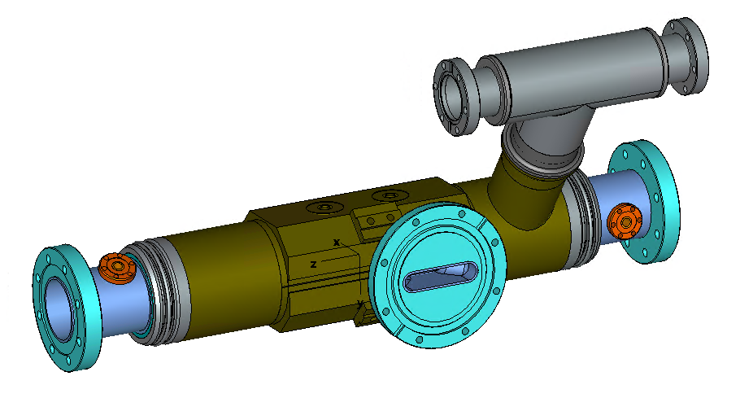
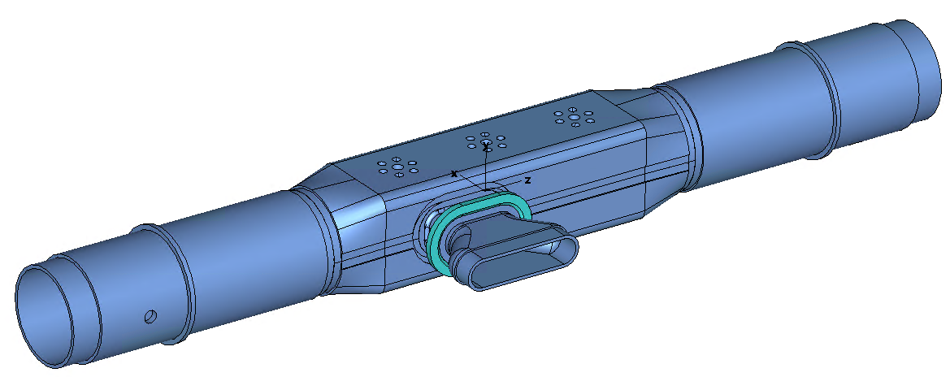
Finalized Mechanical Design of QMiR (Y. Orlov)
The cavity body divided into several shorter parts
Nb thickness is 4 mm (reduced to 3 mm for welds)
NbTi Transition Rings for welding the LHe-vessel
NbTi End Flanges with Al diamond seal

Slide 4
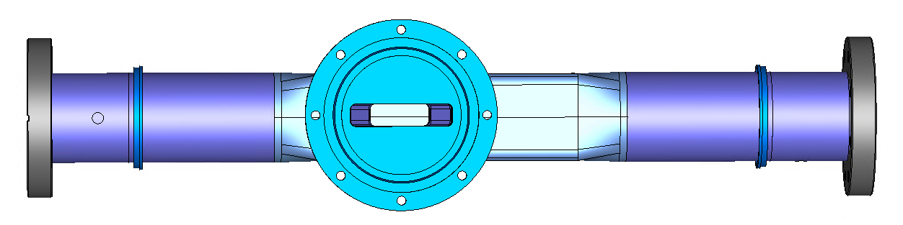
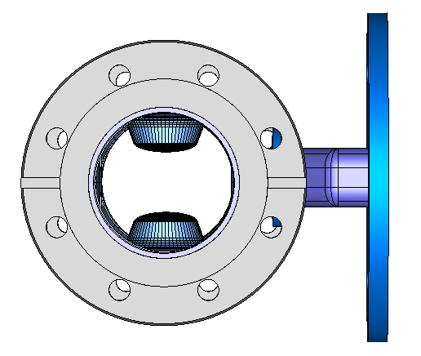
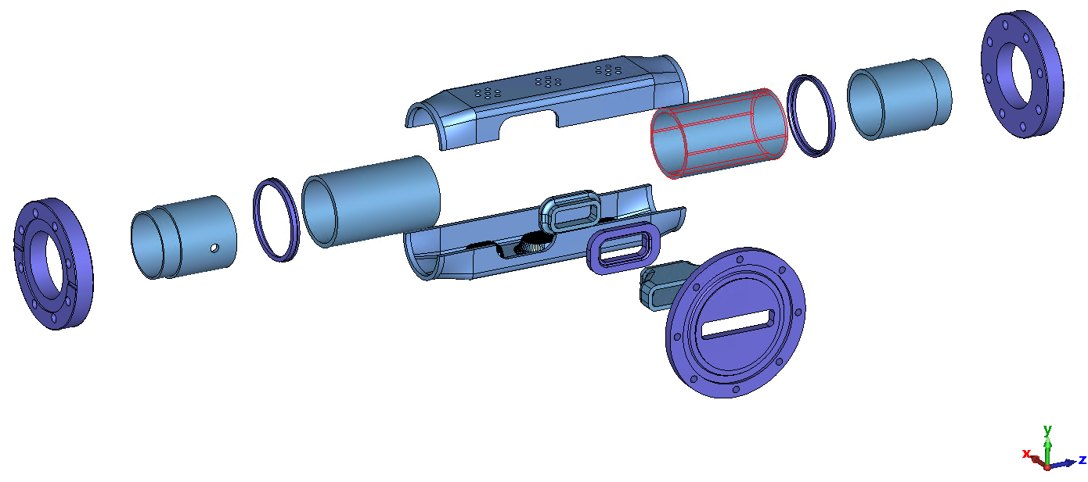
QMiR Parts
Ø113.5 mm
600 mm
2 x 250 mm
Ø65 mm
2 x 103 mm
2 x 71 mm
Nb (4mm)
NbTi
All parts are milled from solid Nb ingots

Slide 5
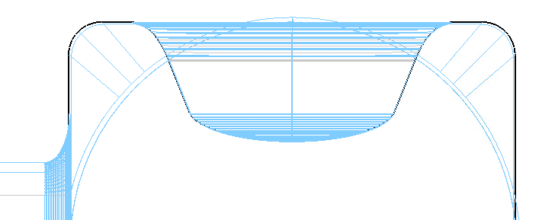
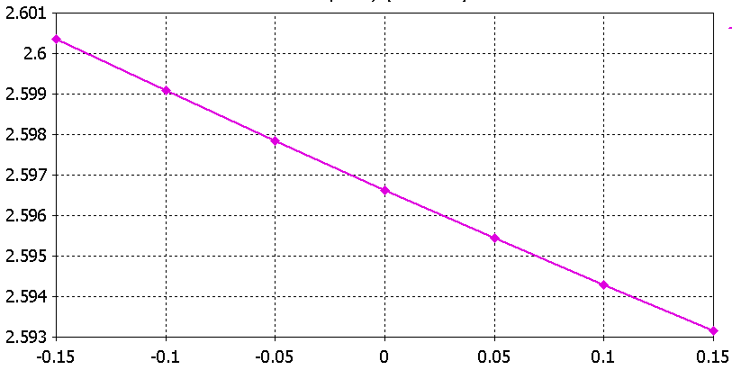
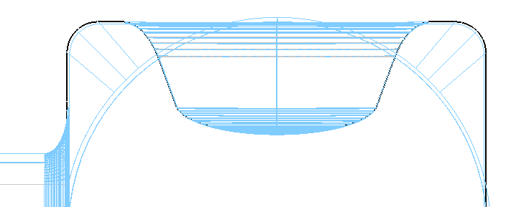
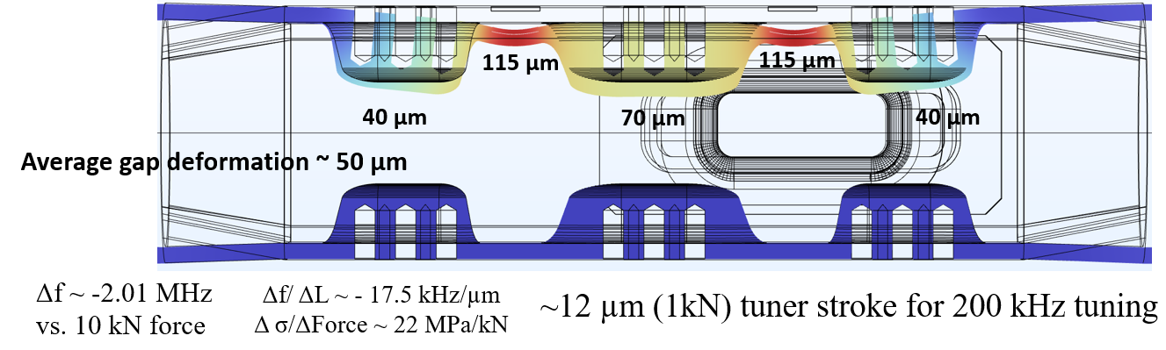
Cavity EP-cleaning and Final Frequency Tuning
Frequency Change [MHz]
+epd
□ 54.1-2*epd
□ 54.1 mm
Manual Frequency Tuning
epd [mm]
Nominal frequency @RT before cooldown, F0_RT ≈ 2.6/1.00143 = 2596.3 MHz
Expected frequency sensitivity of EP, df/d(epd) ≈ -24 MHz/mm
For maximum Nb removal of +150 μm, df ≈ - 3.6 MHz
Desirable cavity frequency before EP: ≈ 2599 (+1) MHz

Slide 6
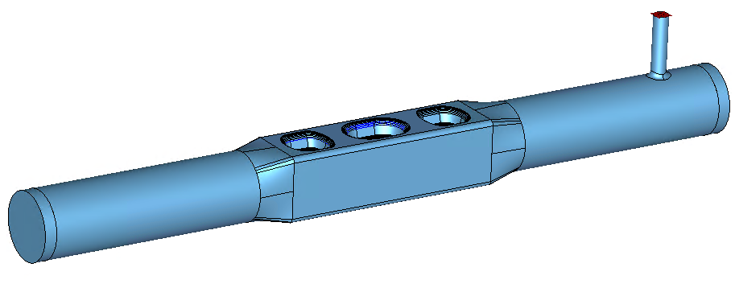
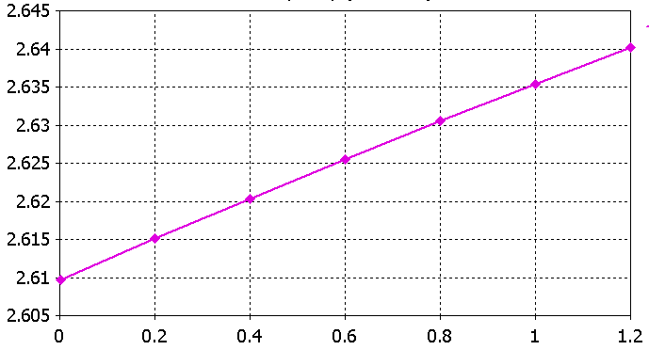
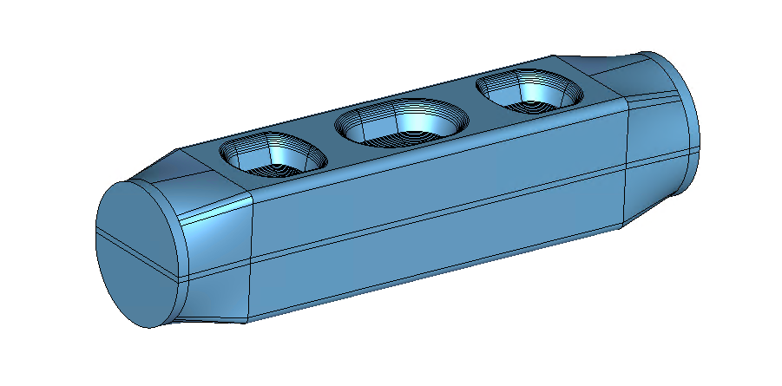
Central Part Frequency Tuning
Frequency w/o WG
F0_RT_WG = 2596.3 MHz
F0_RT_NOWG = 2600.1 MHz
Frequency Change [MHz]
EBW-shrinkage sensitivity
dH
dH [mm]
Expected frequency sensitivity due to EBW shrinkage: ≈ -26.6 MHz/mm
Expected frequency shift due to WG-coupling: ≈ -3.8 MHz
Misalignment of cylindrical parts (Ø56) (< ±0.2 mm) leveled by the EBW seam.

Slide 7
Summary of Cavity Tuning
Production step | Target Frequency, MHz | Remarks
1. Machined Central Part (CP) | 2625.4 | dH = +1 mm
2. Before CP EBW | 2618.8 | dH = +0.5 mm
3. Welded CP | 2612.0 | dH = 0 ±0.1 mm
4. Welded CP + BP | 2602.9 | 1st freq. tune
5. Full cavity (CP+BP+WG) | 2599.1 | Final bead pull and freq. tune control
6. Full cavity after EP (@RT) | 2596.4 | EP ≈ < -100 μm
7. Cavity @2K | 2600.1 | dF_err = < (+1) MHz
Final cavity frequency @2K after cooldown is preferable to have a positive frequency error, less than the tuner range of ~ 1 MHz
Frequency check is required after each step

Slide 8
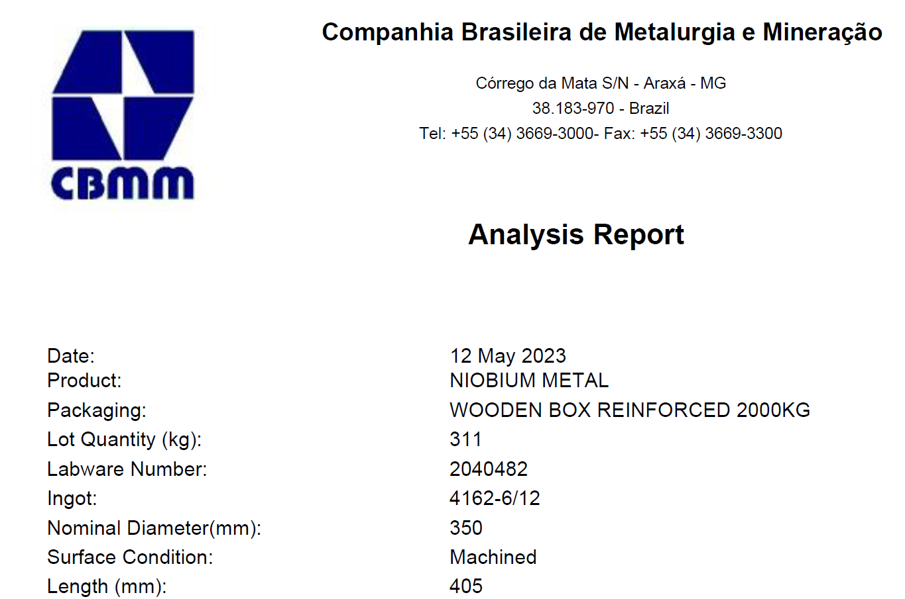
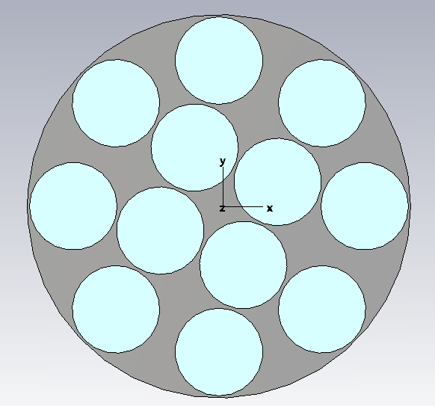
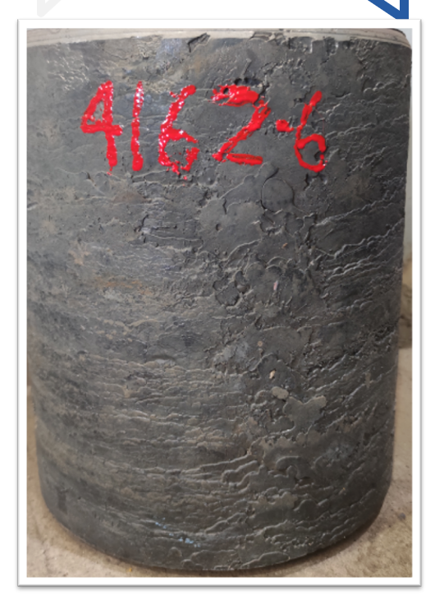
Nb Material Procurement
Ø350 mm
Purchase Order placed on 09/21/23
CBMM is working on the logistics now
Estimated delivery time is 4-6 weeks
Next: Preparation for cutting samples (wired EDM)
Next: RRR test and EB-welding test

Slide 9
QMiR Raw Materials Needed
High-RRR Nb Ingots
1 x Center part
1 x Cylinder
1 x WG Part
□ 65 mm
Ø65 mm
35 mm
260 mm
360 mm
□ 80 mm
Nb-Ti Ingots
3 x Flange
3 x (WG Ring, 2 x LHe Ring)
Ø150
Ø100
20 mm
20 mm

Slide 10
Progress in Production of QMiR/CC Prototype
Cavity Mechanical Design
Validation of mechanical concepts completed
Final mechanical drawings are ready
Some parts may still require minor changes for better welding
Series of meetings with ANL (paused until P5 report)
- cavity fabrication plan, QA inspections, chemistry, etc.
Production and prototyping
Procurement of Nb material is completed
Cavity frequency tuning plan is ready
Close cooperation with ANL on the next steps:
  Niobium QA (RRR, inclusions, … )
  Develop EDM wire cut drawings for niobium
  Develop a machining and EB welding fabrication plan
Fermilab is open for collaboration
- loss/kick factor simulations with GdfidL
- multipactor analysis
- HOM analysis

