Slide 1
Linking ILD to the DRD organization
ILD group meeting at CERN, 15-17 January 2023
P. Allport (Birmingham), D. Contardo (IP2I)

Slide 2
Outline
General considerations on links of strategic projects to DRD programs
Highlights of DRD Work Packages related to ILD concept
Linking ILD to the DRD collaboration organization
Outlook

Slide 3
Reminder of current assumptions on collider project timelines*
DRD collaboration targeted projects
stepping stones*
ALICE-3, LHCB-II
ATLAS, CMS*
BELLE-3*
ALICE ITS3
BELLE-2
FCC-ee, CLIC. MC
DRD start
EIC - ePIC
CEPC
SppC – CepC +18 + 10 y
FCC-ee - FCC-hh + 16 +10 y
ILC
2024
2026-28
LS3
2031-32
2033-34
LS4
2036
2038-2040
2048
experiment entering engineering phase
SoA 1st implementation in experiments
not yet approved, technical planning constraints:
  ALICE-3, LHCB-II, FCC-ee - CLIC : HL-LHC planning
  CEPC, ILC : approval decision
  MC : accelerator muon cooling R&D
  SppC, FCC-hh : accelerator magnet R&D
* projects identified in ECFA detector roadmap with timelines for physics start (from ICFA/Desy seminar December 2023)
some other short term programs also enter stepping stones ex. FAIR, fixed target at SPS…
ATLAS/CMS could be replacement for radiation tolerance of the inner pixel and LGAD ToF layers in the forward region, Belle-3 could be a further
pixel upgrade for higher luminosity, these projects were not part of the ECFA detector roadmap

Slide 4
Typical project technical and approval steps
and DRD collaboration objective
TDR
experiment funding approval
EDR
experiment LoI
TRL8
physics
“blue sky” R&D
TRL3
DRD
TRL6
engineering
TRL8
production/installation
game changers
new technologies
new paradigms
mature concepts
explore performance phase space of technology options*
final devices and systems
specific to experiment concepts
DRD collaborations aim to ensure that R&D readiness is not a primary project schedule driver
they allow proper coverage of common technical options with sustained resources
they can also provide a forum for some common “blue sky” activities
* generic systems and engineering aspects are also considered in DRDs

Slide 5
Broad brush timelines for (generic) DRD collider projects*
needs carefully project planning to anticipate transition to the experiment specific stage
2024
ITS3/BELLE-2
2y
3y
2029
entering dedicated engieering with R&D tails in DRDs
EIC - ePIC
2y
6y
2032
ALICE-3/LHCb-II
3y
2y
6y
2035
CMS/ATLAS
6y
2y
3y
only consideration at this stage not documented
CEPC
3y
9y
2036
ILC
6y
3y
9y
assuming 2040 physics start
FCC-ee /CLIC/MC
12y
3y
9y
2048
DRD collaborations should consider parallelism of activities with project teams in transition periods
different project timelines can allow to envisage technology changes
for lepton colliders DRD cover several experiment concepts and beam conditions (physics requirements)
full simulations are needed for specific project rates and beam backgrounds (with technical impact)
* assuming similar typical time scales for specific experiment planning of same small/medium/large scale projects

Slide 6
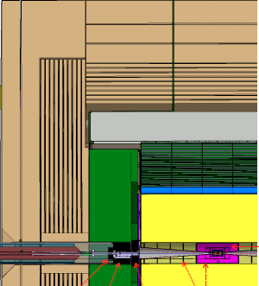
DRD1 “Gaseous Detectors” - WPs related to ILD concept
https://drd1.web.cern.ch/
WP4 : Tracking TPC
  distortion/ion backflow challenge at FCC-ee & CepC
  MPGD readout for PID possibly with dN/dx
WP5 : Calorimetry
  MPGD and RPCs for HCAL
    possibly with ToF precision
WP7 : MPGD for TL/SET
ILD : https://arxiv.org/abs/2003.01116
HCAL
TL/SET
TPC

Slide 7
DRD3 “Solid State Detectors” - WPs* related to ILD concept
WP1: Monolithic CMOS sensors
  SET/TL**- FTD/SIT - VTX
    strip layers p_{T} precision - possibly as TL
    pixel layers IP precision, hit position & low X/X₀
  ECAL – FCAL (BeamCal, LHCAL, LumiCal)
    compactness - pads or pixels for digital calorimetry
WP2 : Hybrid sensors
  SET/TL
    LGAD (pads) position and/or time precision
  ECAL – FCAL (LumiCAL, LHCAL, BeamCal)
    possibly layers with ToF capability
WP4 : non-Silicon based materials
  BeamCal (GaAs…)
WP5 : Interconnexion and device fabrication
  enabling high channel density in light & compact devices at low power consumption
ILD : https://arxiv.org/abs/2003.01116
ECAL
TL/SET
VTX
FTD - SIT
BeamCal, LHCAL, LumiCal
* DRD3 WP and WG organization is still being finalized
** TL = ToF Layer for PID to cover low momentum blind region of TPC - a light device as developed in DRD4 could be considered

Slide 8
DRD6 “Calorimetry” - WPs related to ILD concept
http://cds.cern.ch/record/2886494
WP1: sandwich calorimeter with fully embedded electronics several configurations and sensitive materials in relation with DRD1, DRD3 and DRD6 WP3 for scintillating & photodetectors*
  ECAL
    Si/W CALICE like design system and readout aspects
    FCAL highly compact calorimeter
    DECAL digital with MCMOs
    Sc-ECAL analog with scintillating strips
  HCAL
    AHCAL analog with organic or glass scintillating tiles
    TSDHCAL RPCs with precision timing
    MPGD HCAL
WP4: electronics and DAQ (transverse)
  low power electronics with continuous readout for CC
ILD : https://arxiv.org/abs/2003.01116
HCAL
ECAL
BeamCal, LHCAL, LumiCal
* Photodectors can have also relations to DRD2 and DRD4 in areas of common specifications

Slide 9
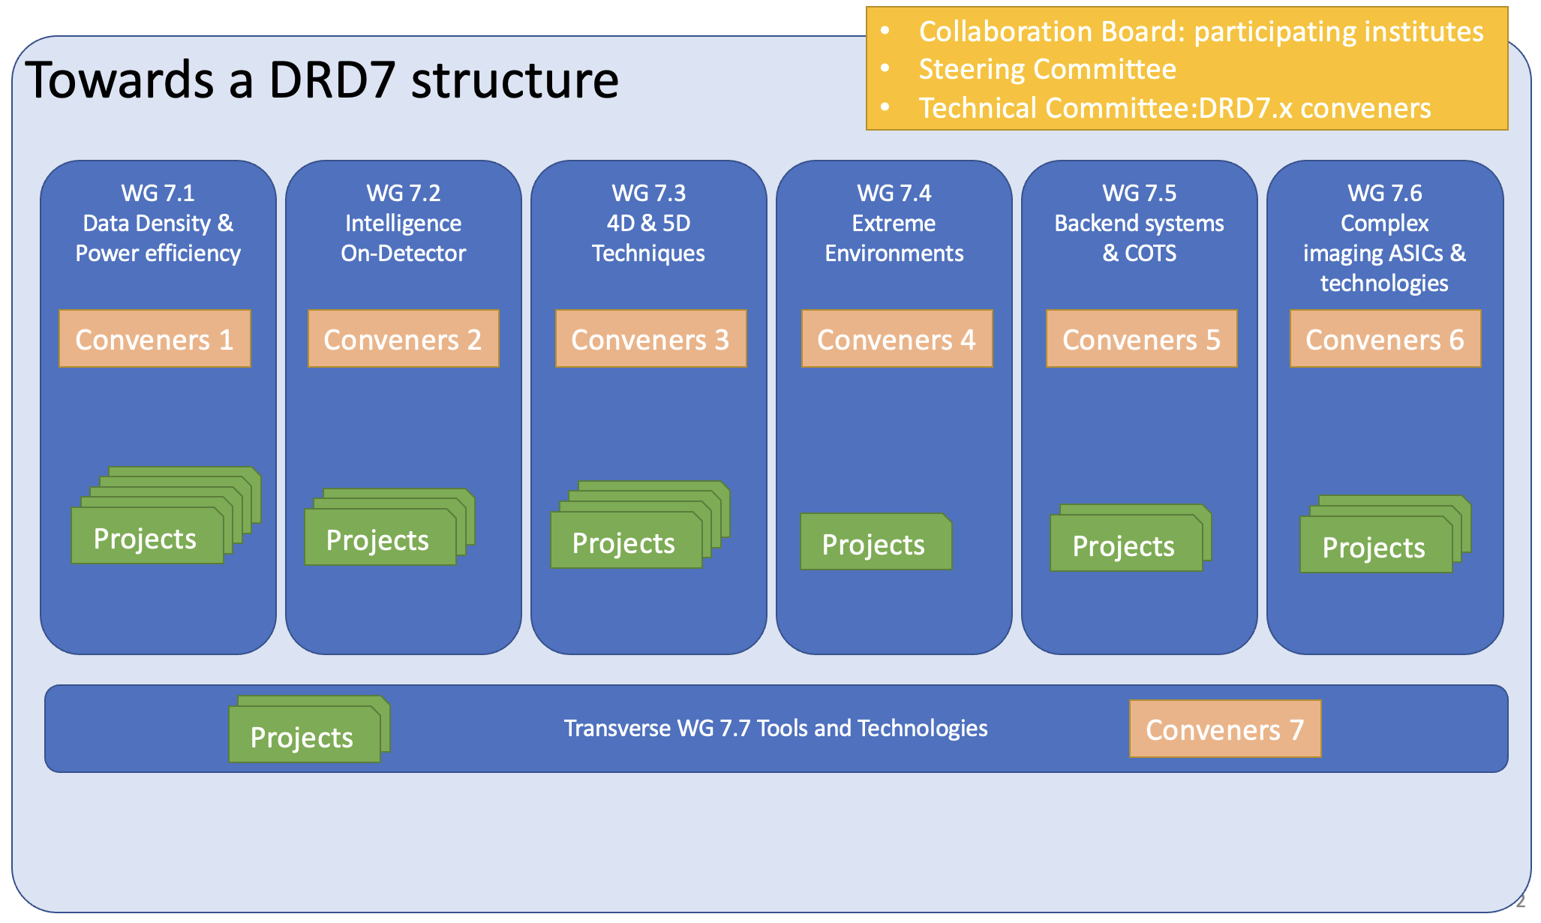
ILD concept relation to other DRDs
DRD4 Photon and PID
  Photodetectors - SiPM readout for scintillators in calorimetry and ToF light device options
DRD5 quantum and emerging technologies - proposal in preparation targeting approval at June RB
  relation to collider experiment systems possibly in new (low-D, heterogenous) materials
DRD7 electronics systems - proposal in preparation targeting approval at June RB
  relation to ILD in WG1/2/3/5/6/7 projects are being developped (16 proposals received so far)
ultra-low
power ADC & TDC
Calibration
clock disri.
Photonics
powering
wireless
eFPGA
RISC-V
virt. elec.
rad. tol. of
adv. nodes
cyro. PDK
cooling
cots, tools
& IP
no BE from
FE to DAQ
access to
techno. & IPs
access to 3D
integration
DRD8 mechanics and integration
  being investigated under impulse of tracker integration forum

Slide 10
Linking ILD project to the present DRD framework
  DRD contributions are through institutes
    it is assumed that several institutes of the ILD proto-collaboration are members of the DRDs
      with their scientific interests well included in the present DRD programs
    each institute has a representative in the Collaboration Boards
      The CBs are currently establishing collaboration rules and management structures & teams
  DRDs next step is the preparation of MoU to plan deliverable contributions & funding
    ILD as a proto-collaboration can foster internally contributions around WPs of interest
      DRD organizations are building on existing communities & topical R&D programs, ex. CALICE, FCAL, LCTPC… (that can serve several projects in this framework)
MoUs will be updated every 3 years
    based on R&D success reviewed by the DRDC and with the ECFA Detector Panel (EDP) providing input on the evolution of specifications and timelines given by the project concept groups
      with this purpose concept group liaisons can be formally identified*
      a first light iteration of inputs could happen on the timescale of initial MoUs
      with a second deeper update by the following DRD programme cycle and the next ESPP update
        simulation in project concept groups are essential to identify most critical R&D parameters
      the ECFA WG3 on detector R&D could provide the forum to discuss these inputs in the community
* at this stage concept groups can be collider project proto-collaborations (FCC-ee/CepC) or experiment proto-collaborations (ILD/SiD)

Slide 11
Outlook
The scheme to link projects (or other R&D programs) to the DRD organization
is still an open topic where feedback is welcome
EDP is setting a forum with DRD leaders (for cross-activities) where this can be discussed

