Slide 1
IDT WG2 Activities
Benno List
ILC Europe Meeting
20.12.2023

Slide 2
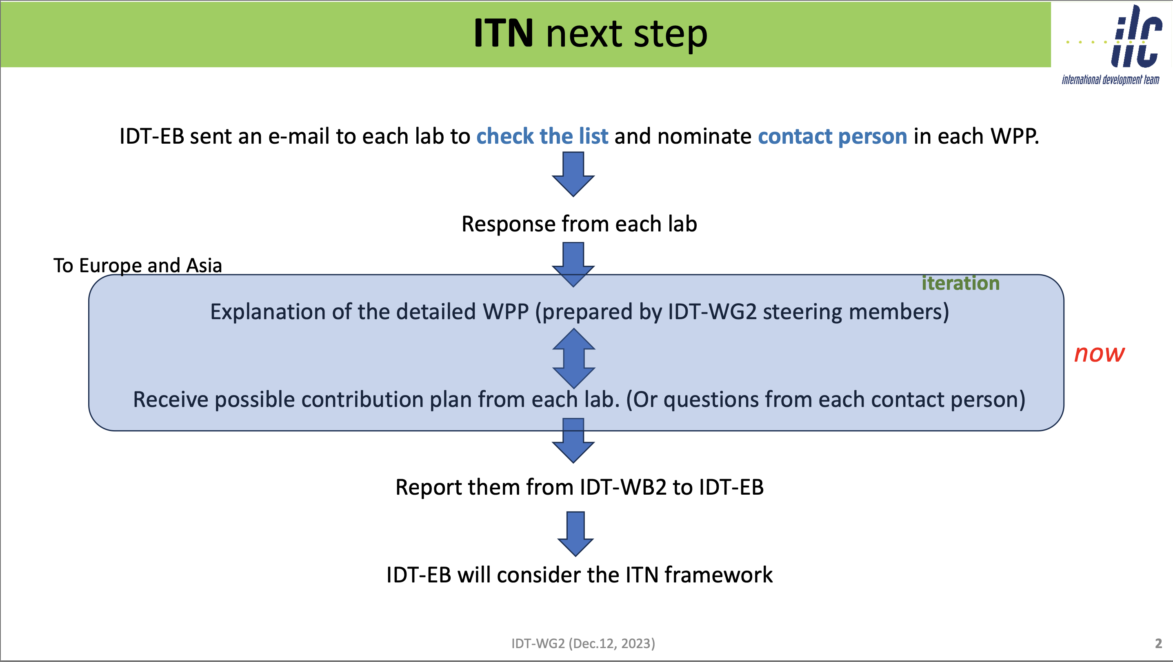
S. Michizono
IDT WG2 Meeting 12.12.23
https://agenda.linearcollider.org/event/10231/

Slide 3
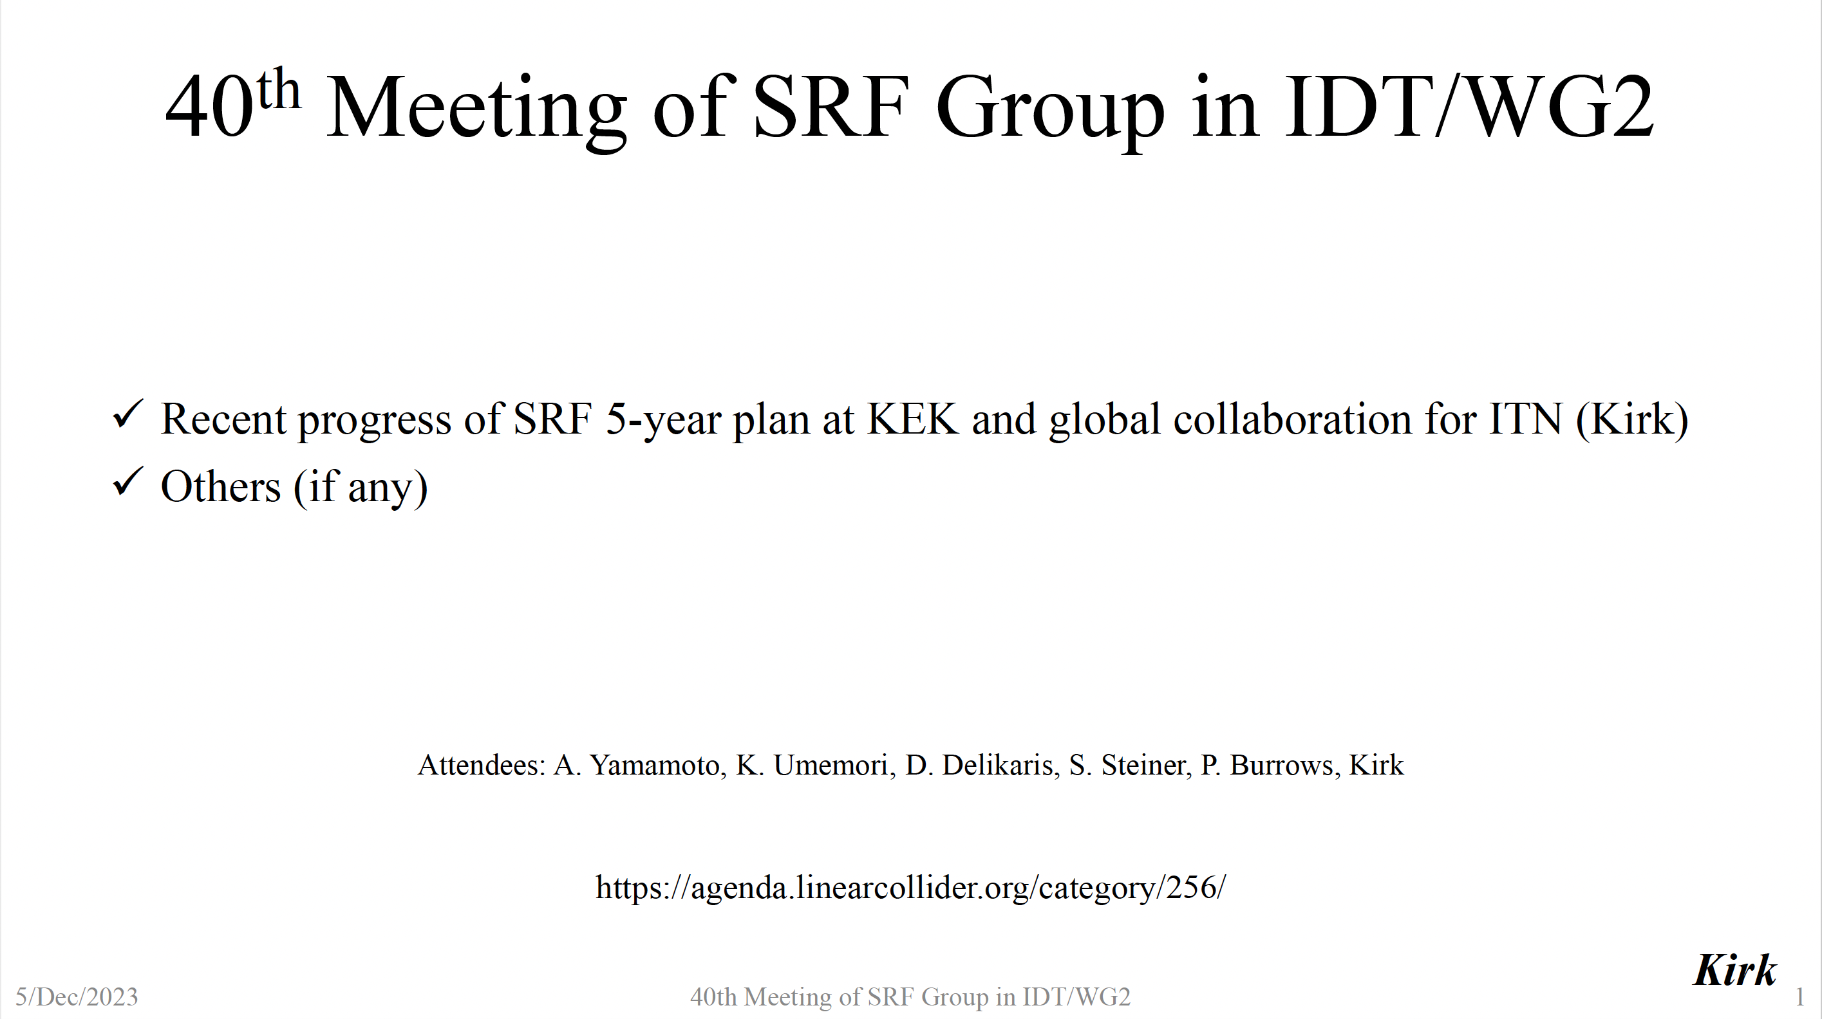
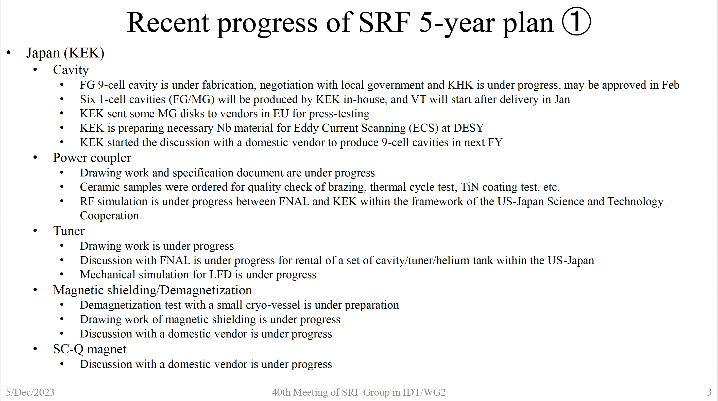
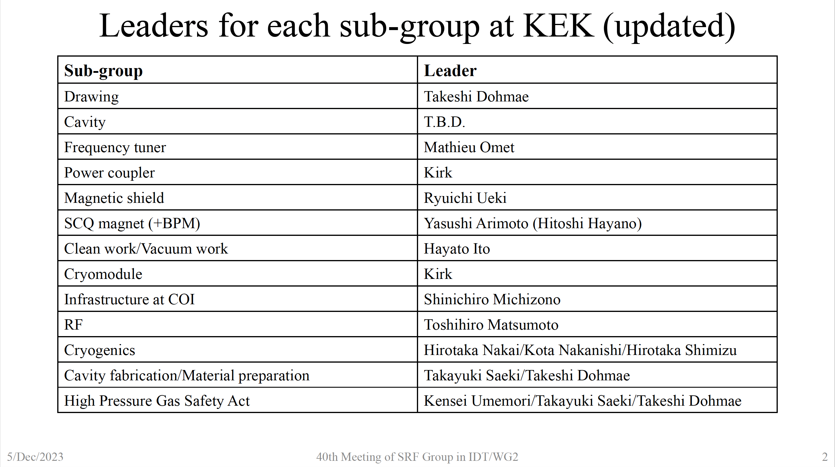
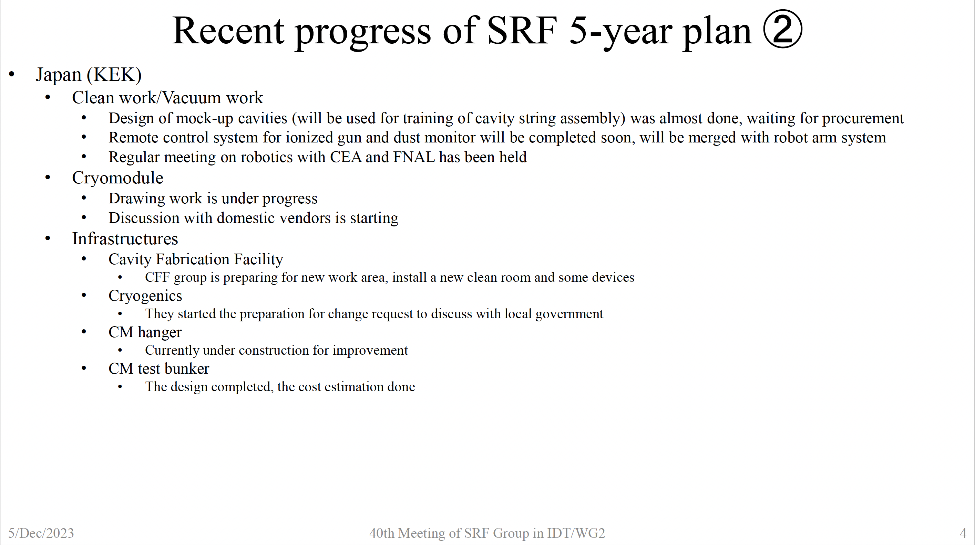
SRF Subgroup Progress
Kirk Yamamoto
IDT WG2 Meeting 12.12.23
https://agenda.linearcollider.org/event/10231/

Slide 4
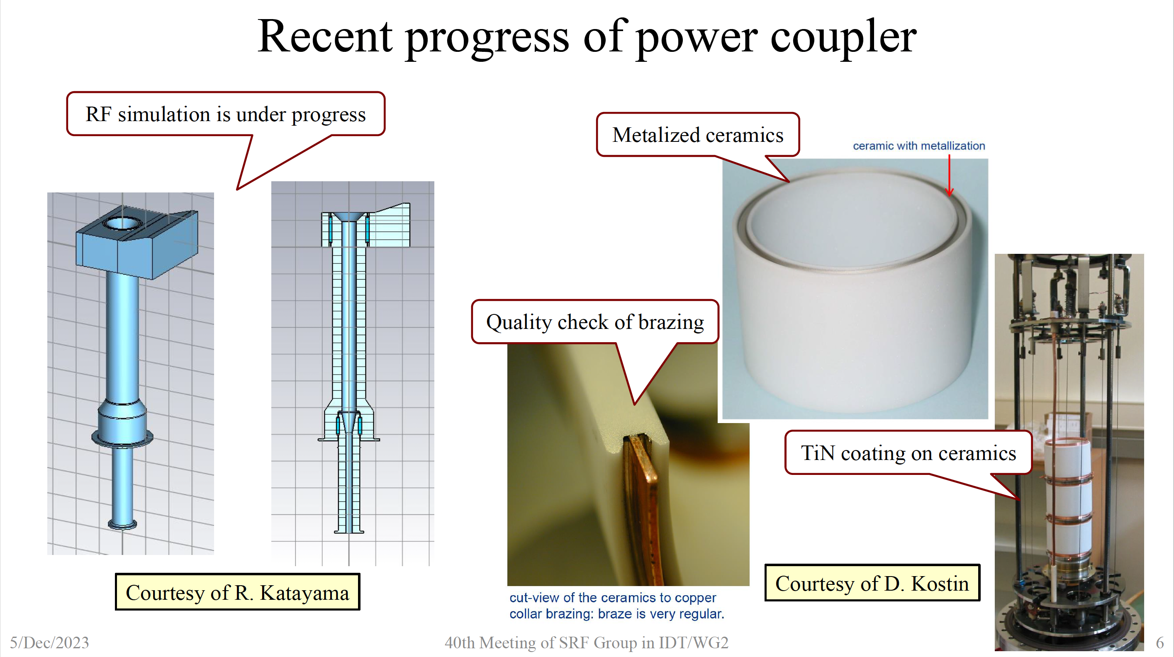
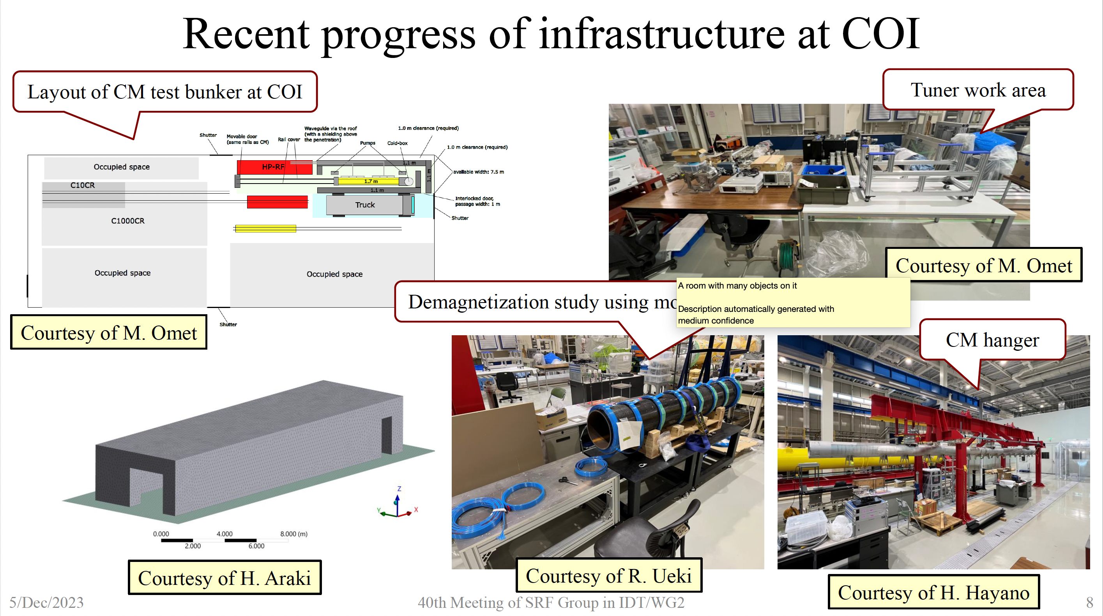
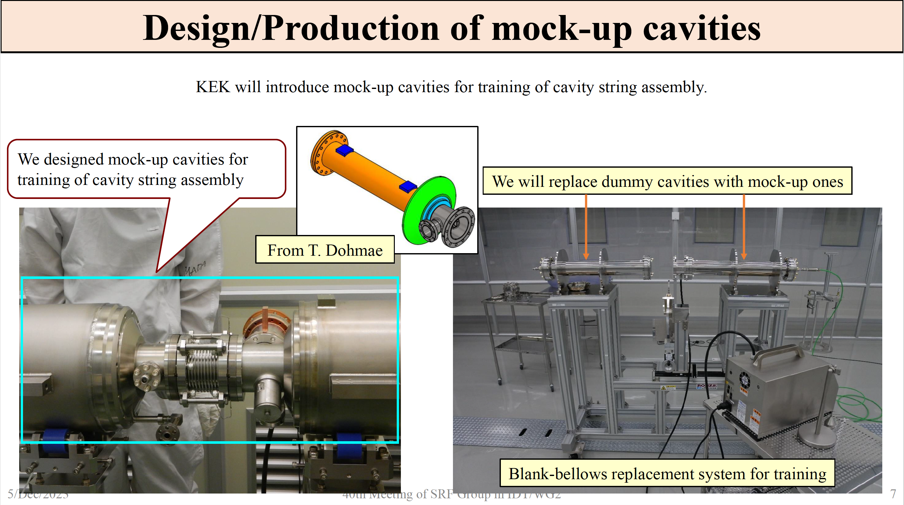
R&D Progress
Kirk Yamamoto
IDT WG2 Meeting 12.12.23
https://agenda.linearcollider.org/event/10231/

Slide 5
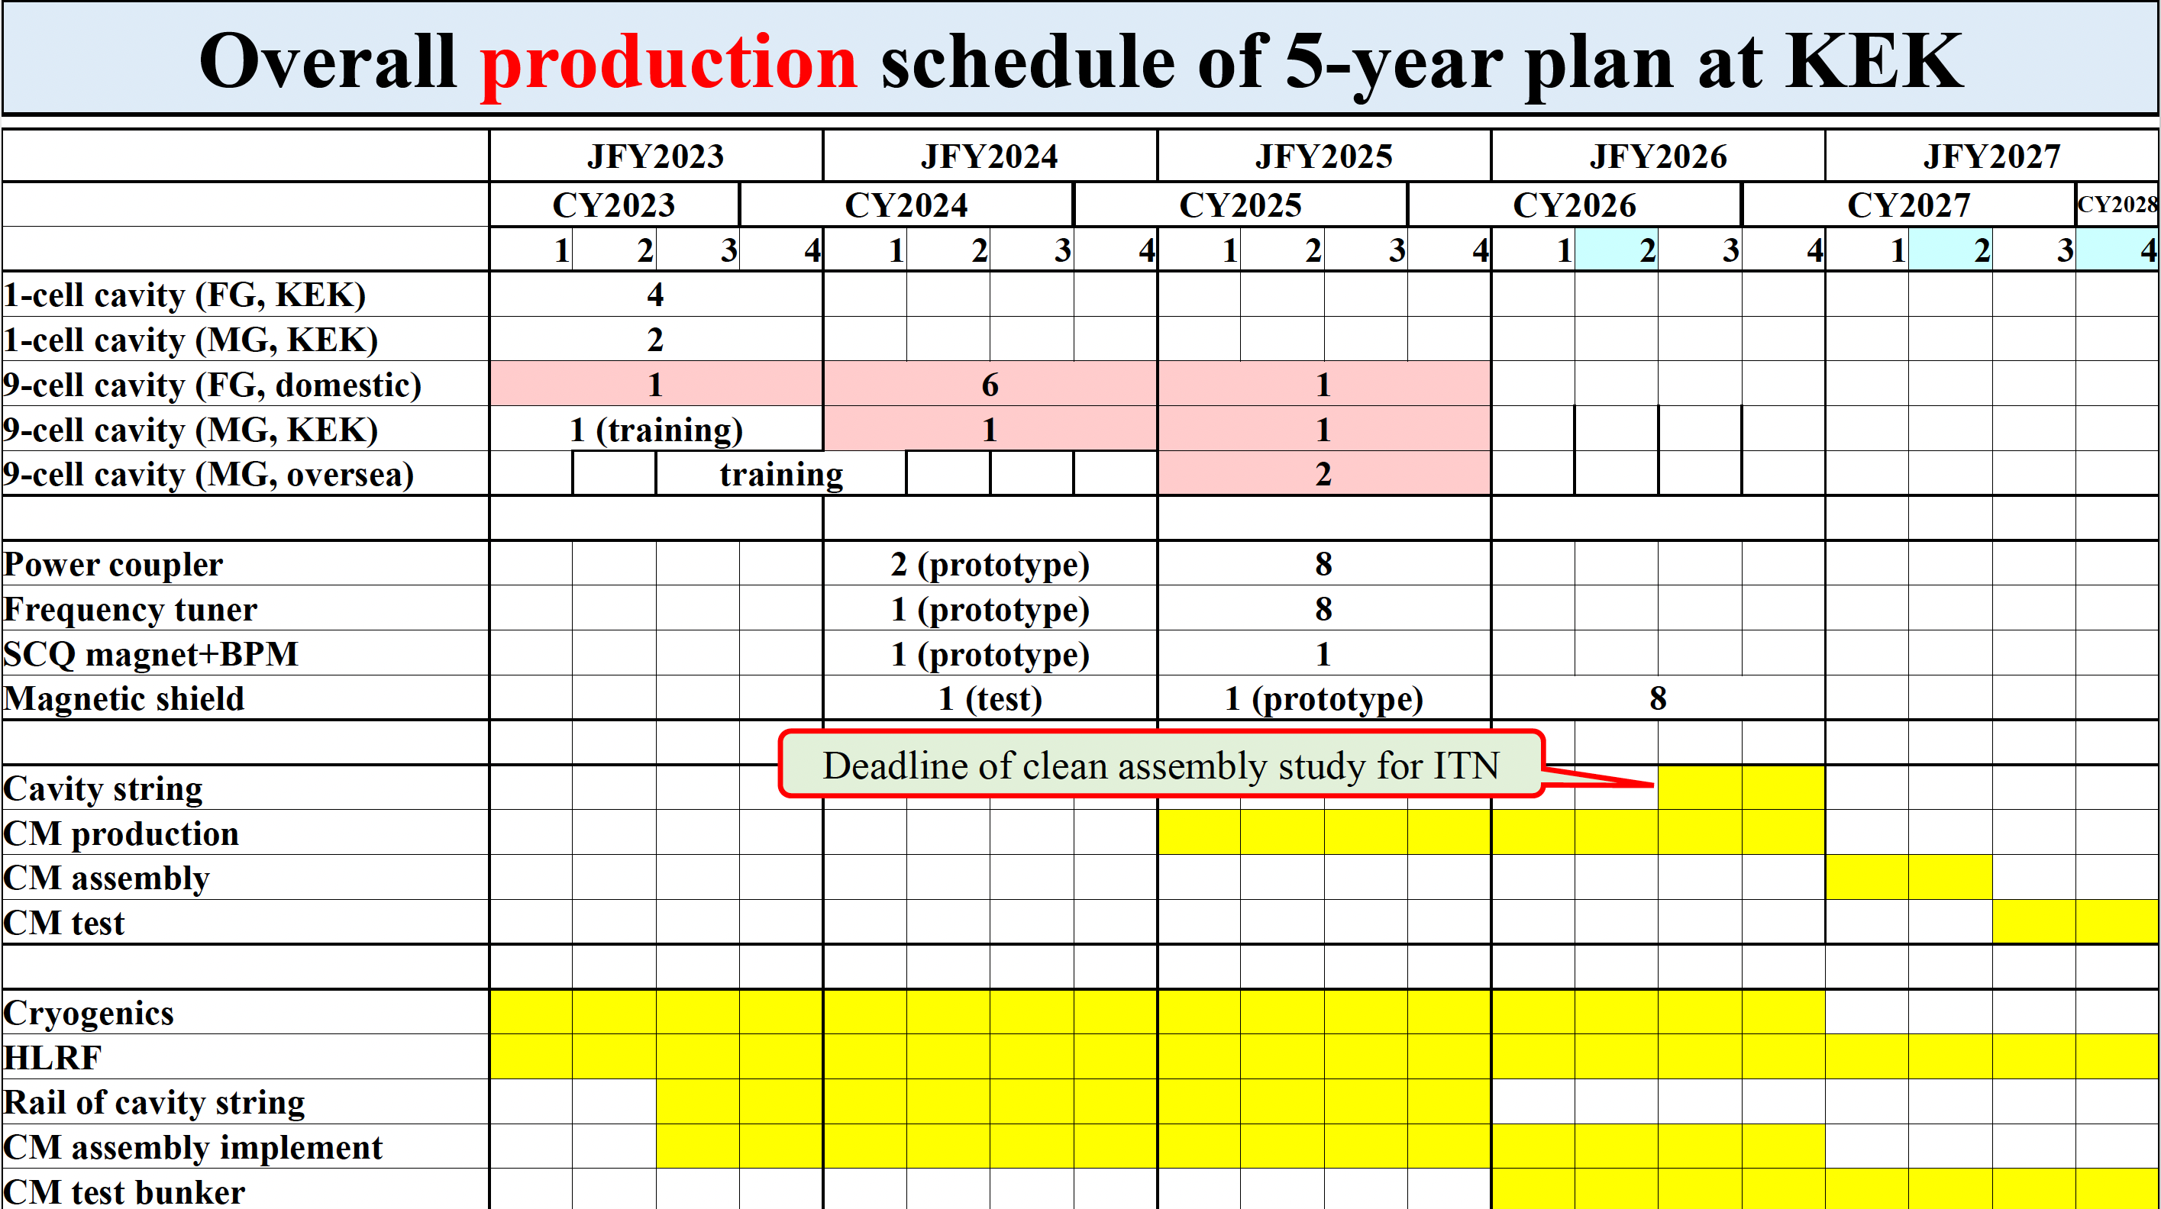
5-Year plan
Kirk Yamamoto
IDT WG2 Meeting 12.12.23
https://agenda.linearcollider.org/event/10231/
NOW

Slide 6
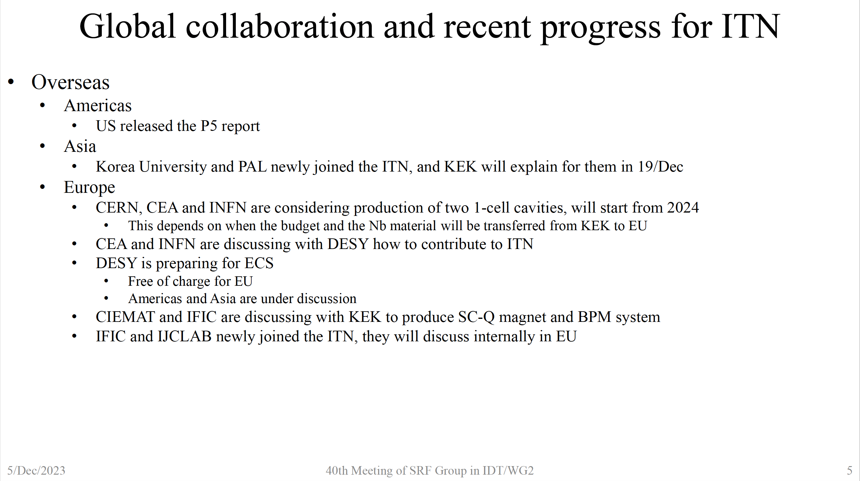
Global Collaboration
Kirk Yamamoto
IDT WG2 Meeting 12.12.23
https://agenda.linearcollider.org/event/10231/

Slide 7
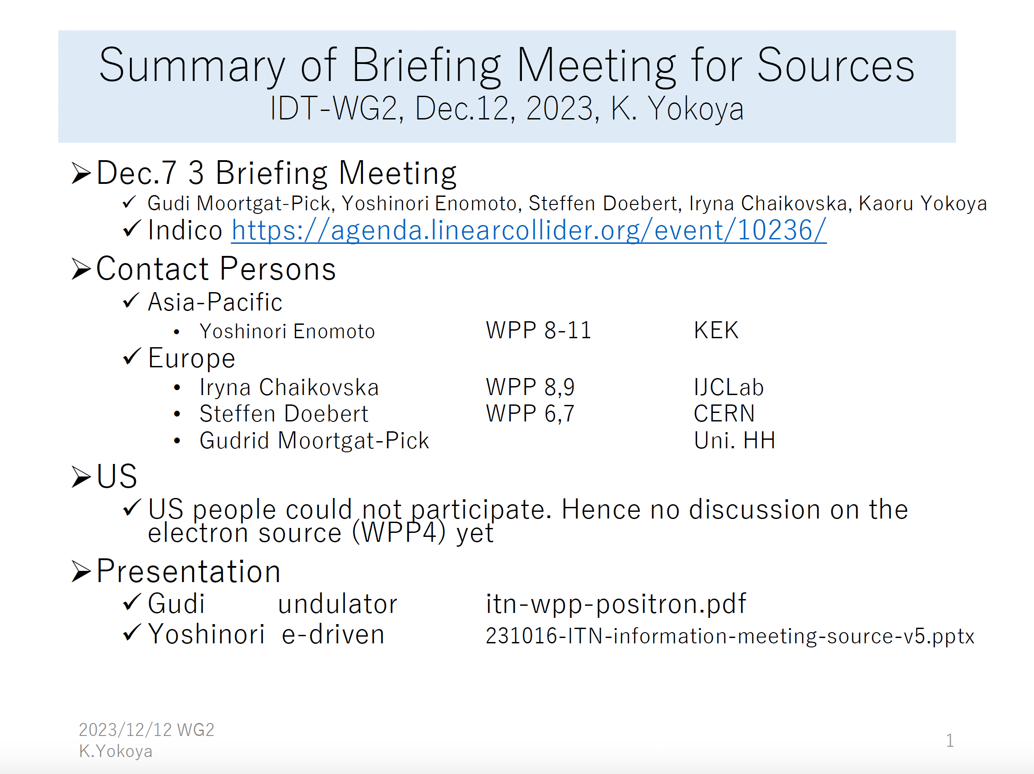
Sources Status Report
Kaoru Yokoya
IDT WG2 Meeting 12.12.23
https://agenda.linearcollider.org/event/10231/

Slide 8
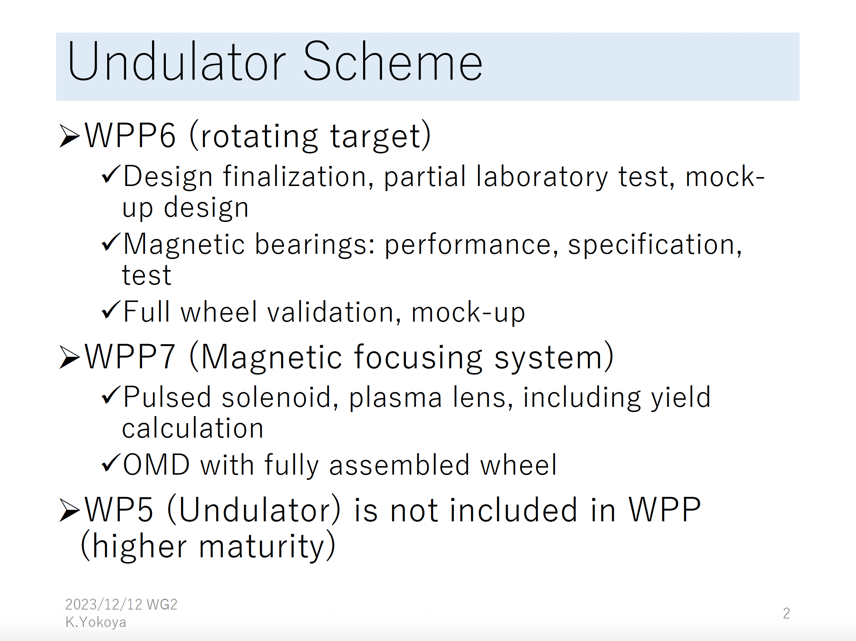
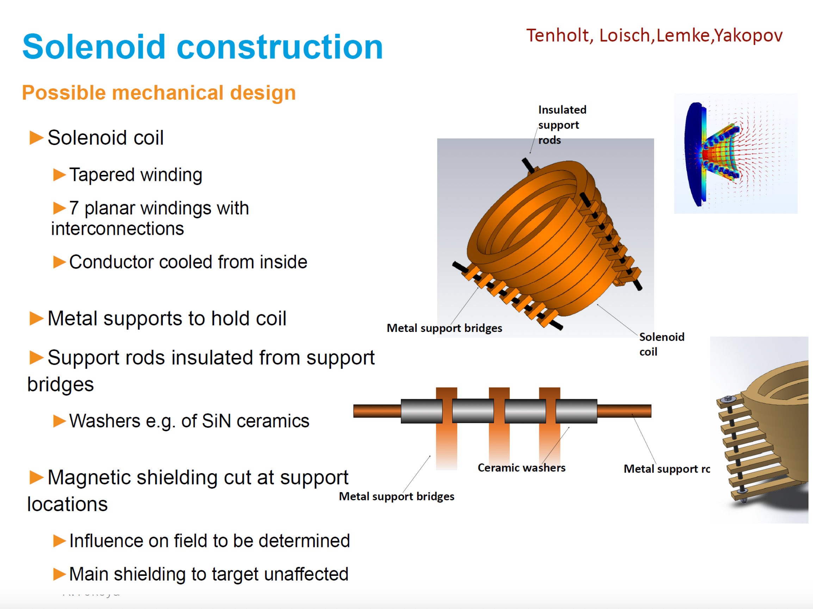
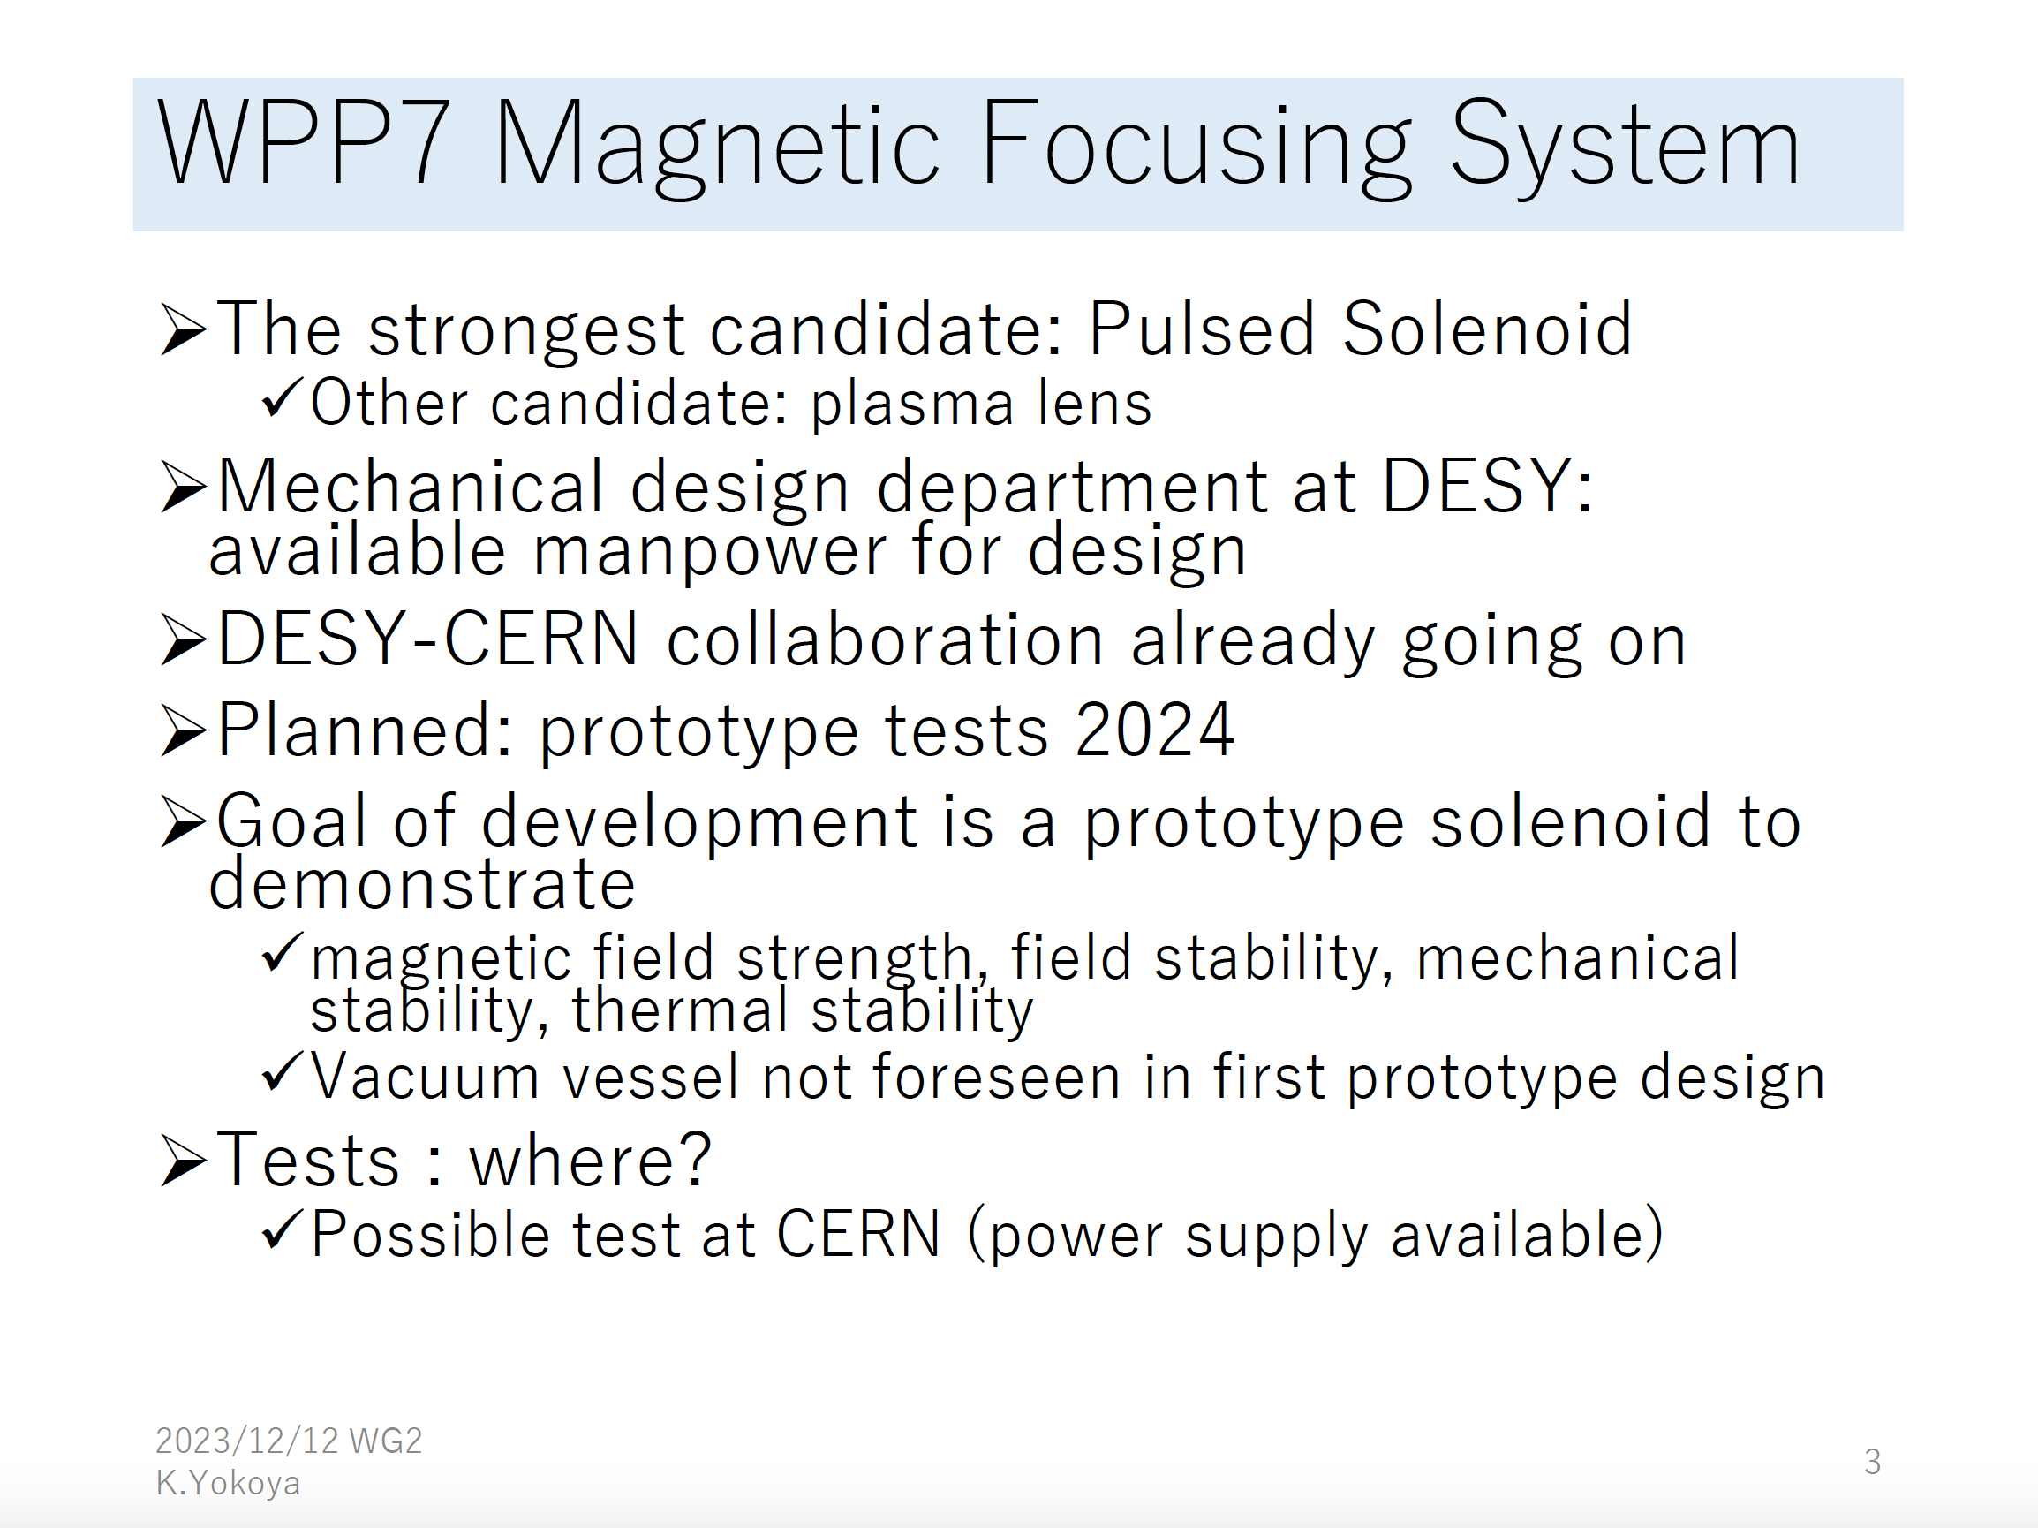
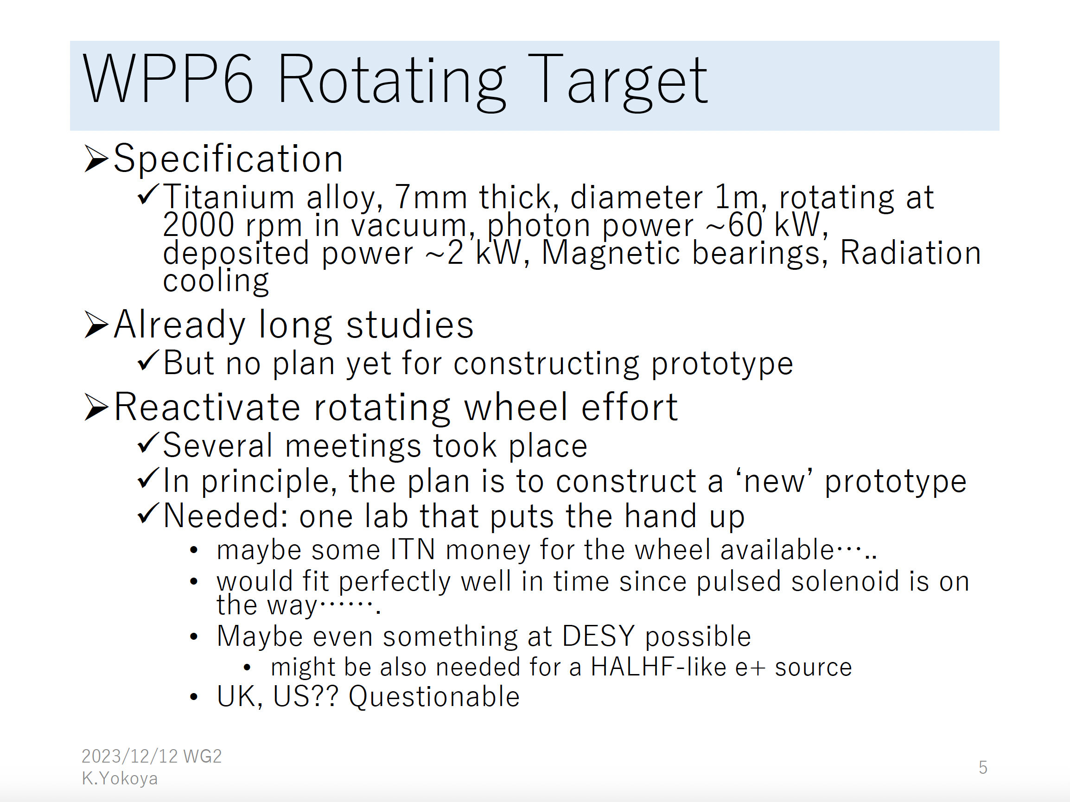
Undulator Source
Kaoru Yokoya
IDT WG2 Meeting 12.12.23
https://agenda.linearcollider.org/event/10231/

Slide 9
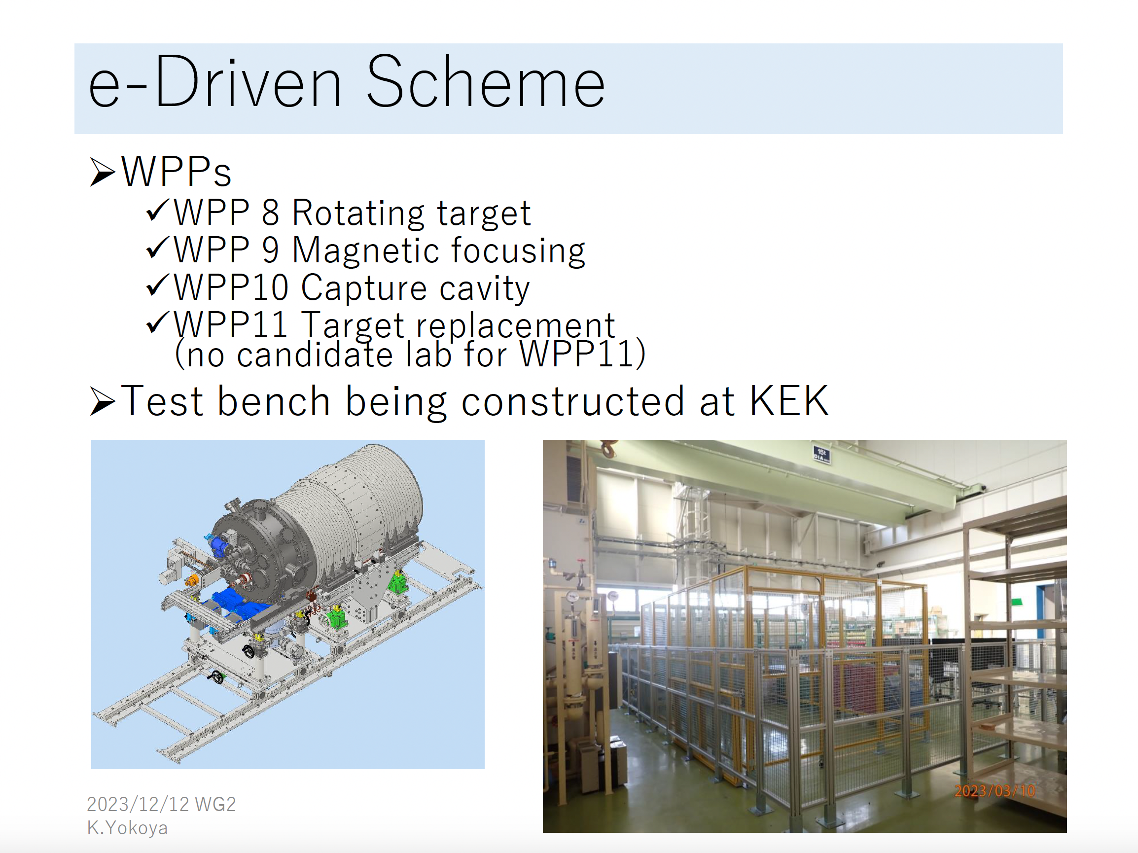
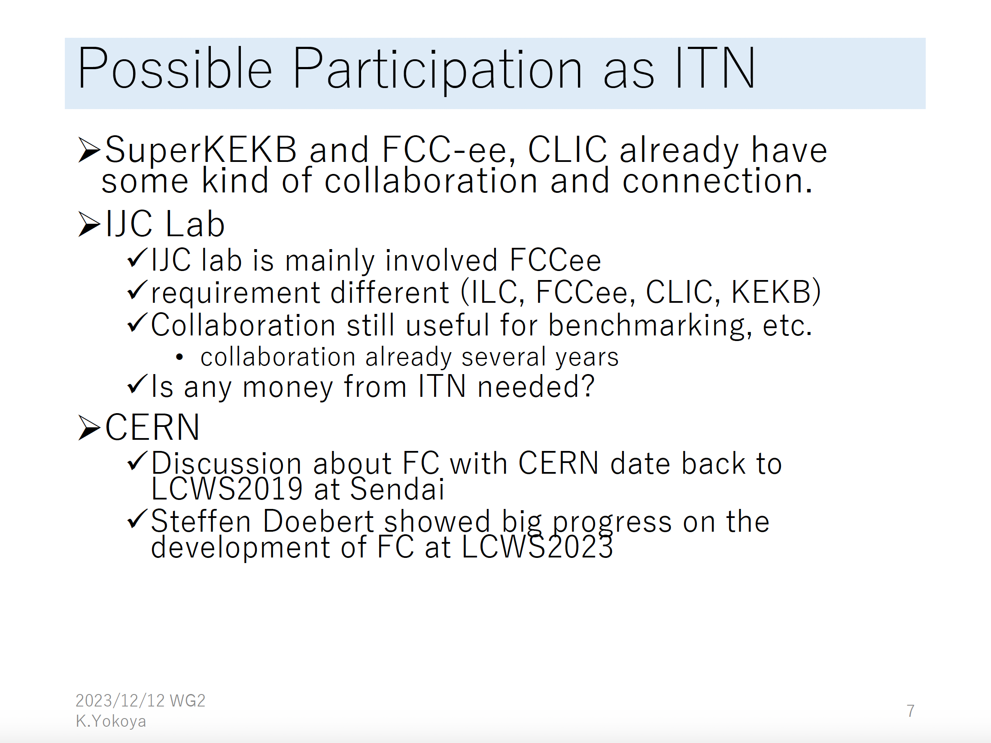
E-Driven Source
Kaoru Yokoya
IDT WG2 Meeting 12.12.23
https://agenda.linearcollider.org/event/10231/

