Slide 1
Summary of Briefing Meeting for Sources
IDT-WG2, Dec.12, 2023, K. Yokoya
Dec.7 3 Briefing Meeting
  Gudi Moortgat-Pick, Yoshinori Enomoto, Steffen Doebert, Iryna Chaikovska, Kaoru Yokoya
  Indico https://agenda.linearcollider.org/event/10236/
Contact Persons
  Asia-Pacific
    Yoshinori Enomoto WPP 8-11 KEK
  Europe
    Iryna Chaikovska WPP 8,9 IJCLab
    Steffen Doebert WPP 6,7 CERN
    Gudrid Moortgat-Pick Uni. HH
US
  US people could not participate. Hence no discussion on the electron source (WPP4) yet
Presentation
  Gudi undulator itn-wpp-positron.pdf
  Yoshinori e-driven 231016-ITN-information-meeting-source-v5.pptx

Slide 2
Undulator Scheme
WPP6 (rotating target)
  Design finalization, partial laboratory test, mock-up design
  Magnetic bearings: performance, specification, test
  Full wheel validation, mock-up
WPP7 (Magnetic focusing system)
  Pulsed solenoid, plasma lens, including yield calculation
  OMD with fully assembled wheel
WP5 (Undulator) is not included in WPP (higher maturity)

Slide 3
WPP7 Magnetic Focusing System
The strongest candidate: Pulsed Solenoid
  Other candidate: plasma lens
Mechanical design department at DESY: available manpower for design
DESY-CERN collaboration already going on
Planned: prototype tests 2024
Goal of development is a prototype solenoid to demonstrate
  magnetic field strength, field stability, mechanical stability, thermal stability
  Vacuum vessel not foreseen in first prototype design
Tests : where?
  Possible test at CERN (power supply available)

Slide 5
WPP6 Rotating Target
Specification
  Titanium alloy, 7mm thick, diameter 1m, rotating at 2000 rpm in vacuum, photon power ~60 kW, deposited power ~2 kW, Magnetic bearings, Radiation cooling
Already long studies
  But no plan yet for constructing prototype
Reactivate rotating wheel effort
  Several meetings took place
  In principle, the plan is to construct a ‘new’ prototype
  Needed: one lab that puts the hand up
    maybe some ITN money for the wheel available…..
    would fit perfectly well in time since pulsed solenoid is on the way…….
    Maybe even something at DESY possible
      might be also needed for a HALHF-like e+ source
    UK, US?? Questionable

Slide 6
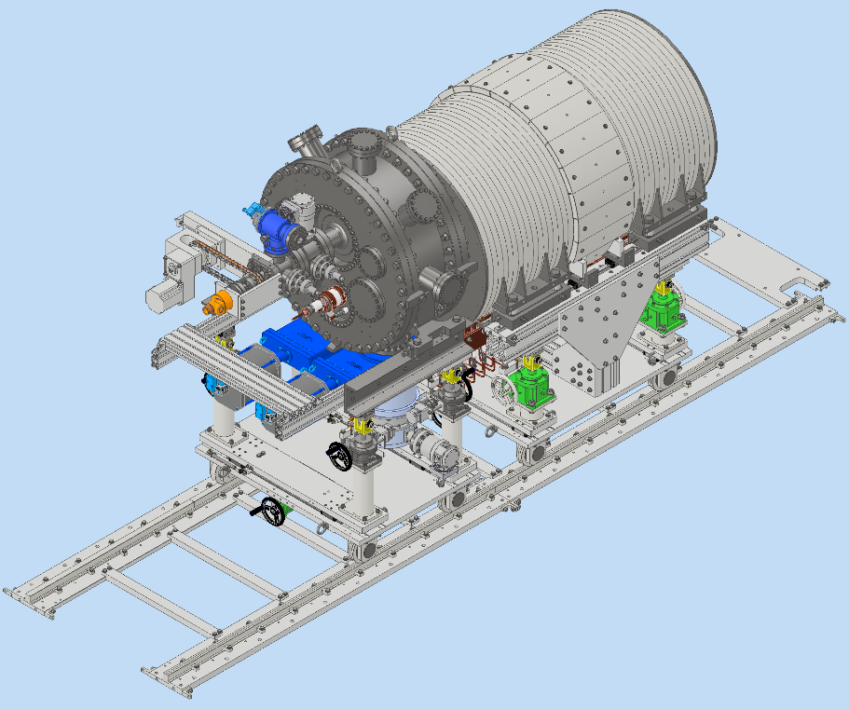
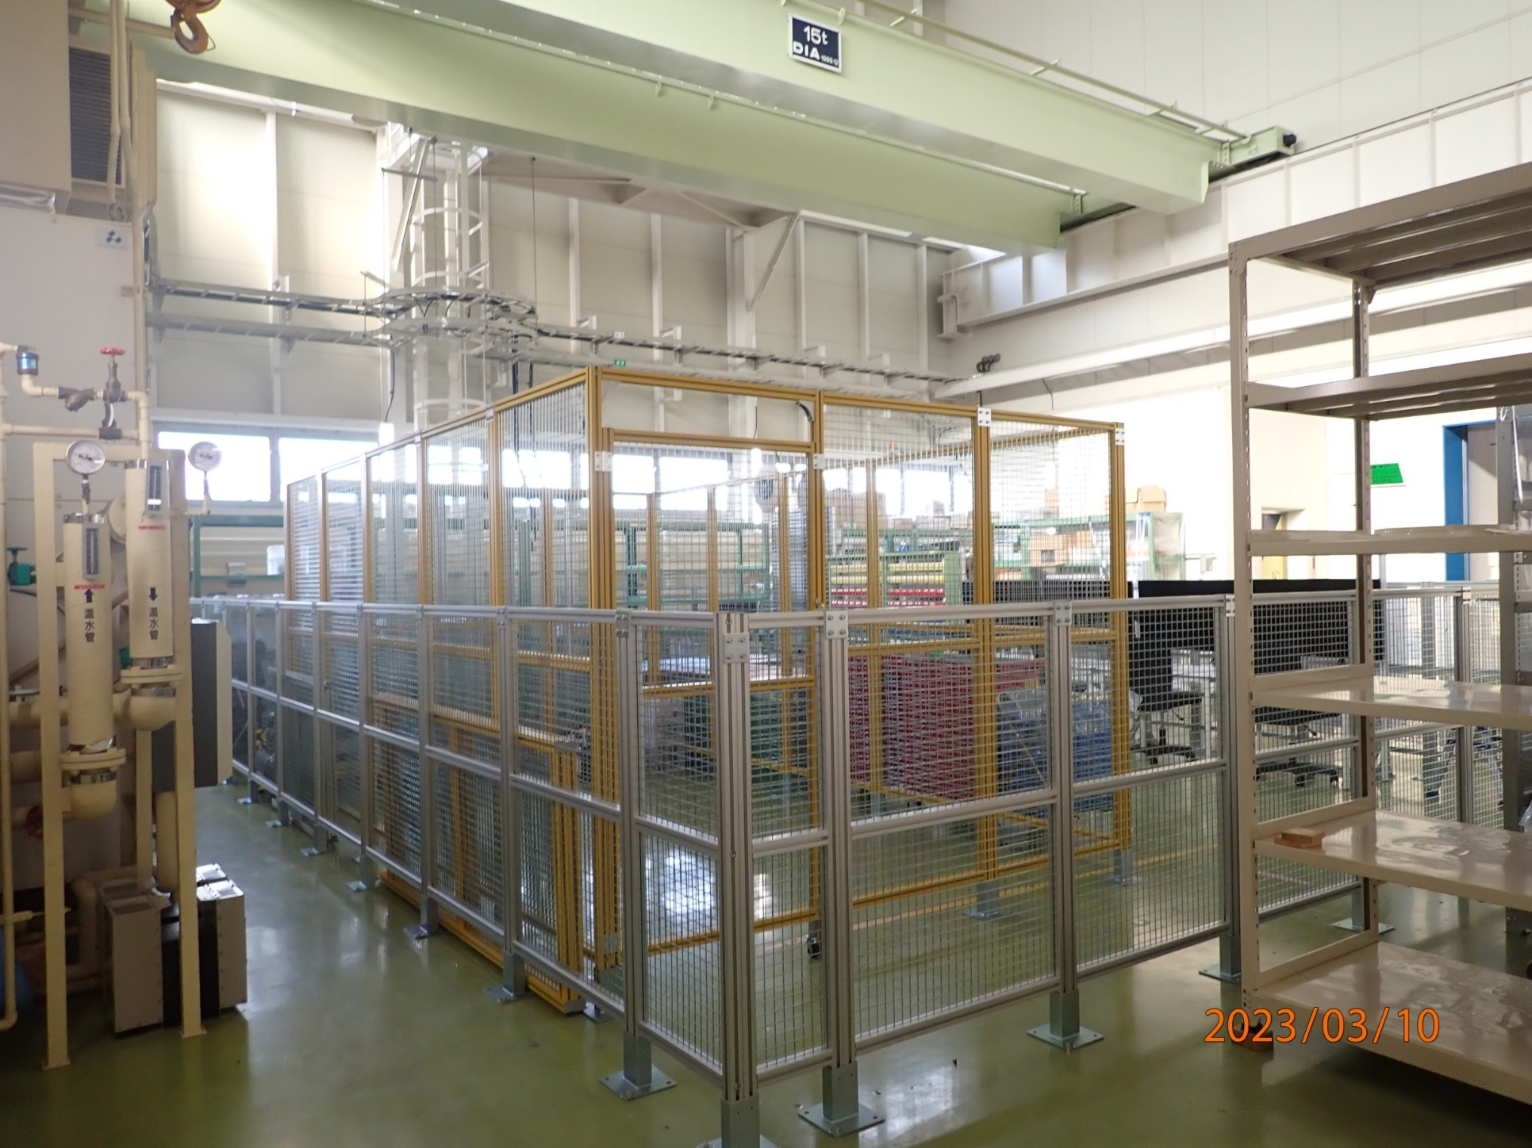
e-Driven Scheme
WPPs
  WPP 8 Rotating target
  WPP 9 Magnetic focusing
  WPP10 Capture cavity
  WPP11 Target replacement
  (no candidate lab for WPP11)
Test bench being constructed at KEK

Slide 7
Possible Participation as ITN
SuperKEKB and FCC-ee, CLIC already have some kind of collaboration and connection.
IJC Lab
  IJC lab is mainly involved FCCee
  requirement different (ILC, FCCee, CLIC, KEKB)
  Collaboration still useful for benchmarking, etc.
    collaboration already several years
  Is any money from ITN needed?
CERN
  Discussion about FC with CERN date back to LCWS2019 at Sendai
  Steffen Doebert showed big progress on the development of FC at LCWS2023

