Slide 1
ITN Briefing Meeting for Source Grope
Work packages for e-driven positron scheme
Yoshinori Enomoto (KEK)

Slide 2
ILC Technology Network
ML&SRF
(Main linac &
Superconducting RF)
Sources
DR
(Damping ring)
BDS
(Beam Delivery System)
Dump
WP-prime 1
Superconducting cavity
WP-prime 4
Electron source
WP-prime 12
System design
WP-prime 15
Final focus
WP-prime 17
Main dump
WP-prime 2
Cryomodule design
Undulator positron scheme
WP-13
Collective effect
WP-prime 16
Final doublet
WP-18
Photon dump
WP-5
Undulator
WP-prime 3
Crab cavity
WP-prime 14
Injection/extraction
WP-prime 6
Rotating target
WP-prime 7
Magnetic focusing
E-driven positron scheme
WP-prime 8
Rotating target
WP-prime 9
Magnetic focusing
WP-prime 10
Capture cavity
WP-prime 11
Target replacement

Slide 3
Comparison of positron sources
Big jump from SuperKEKB and SLC
  3 x SLC in beam power (74 kW)
  4 x SuperKEKB in capture efficiency
Technologies developed in the project will be used for more than decades in this field, as SLC did 30 years ago
●past
▲present
◆future
ILC e-driven
CLIC
High efficiency
SuperKEKB
FCCee
BEPC
DAFNE
VEPP-5
CEPC
KEKB
SLC
ILC undulator
High power

Slide 4
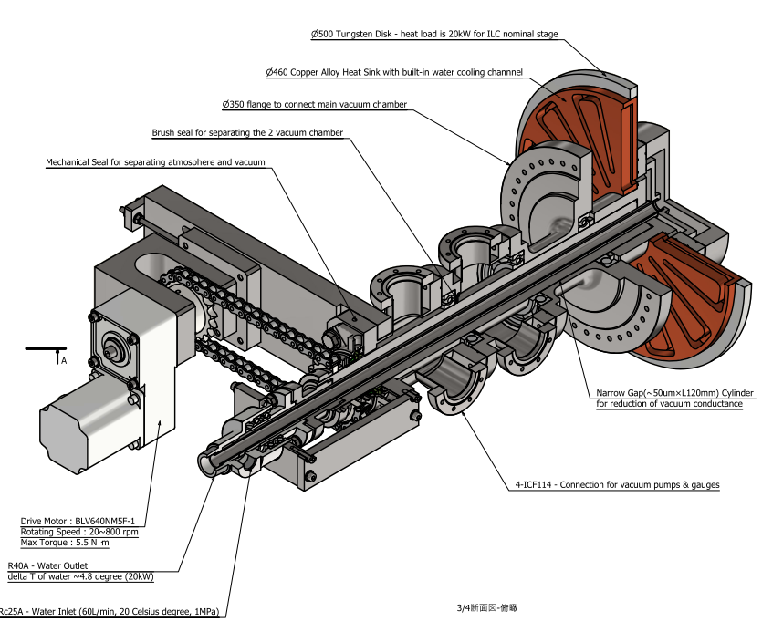
WP-8 Rotating Target (for e-driven Scheme)
74 kW (3 x SLC) beam power
Rotating mechanism
  Water-cooled
  UHV compatible
  225 rpm
Target disk
  W-Cu connection
    Mechanical and thermal evaluation
    CFD simulation using experimental data
    HIP, SPS, Brazing
  Target material selection and evaluation
    Mechanical property at operating temperature
    Cost, lead time, available size, uniformity

Slide 5
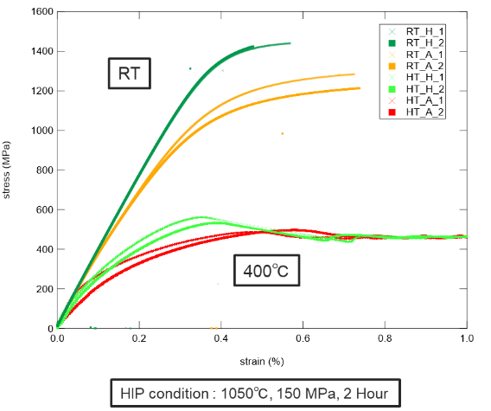
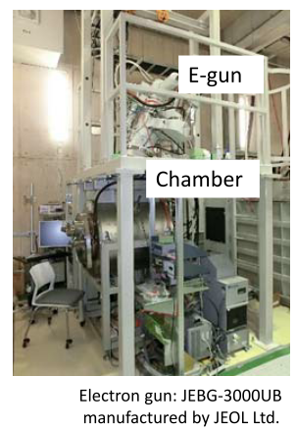
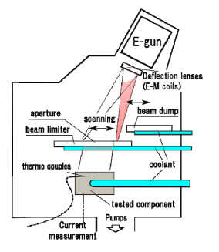
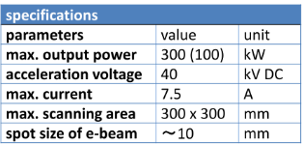
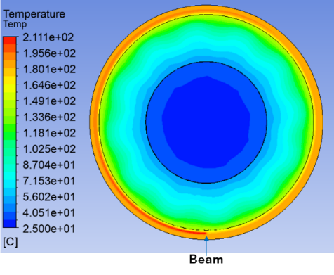
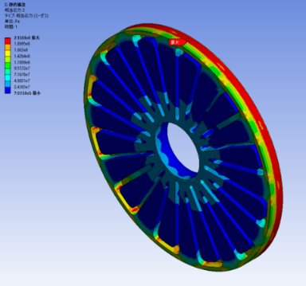
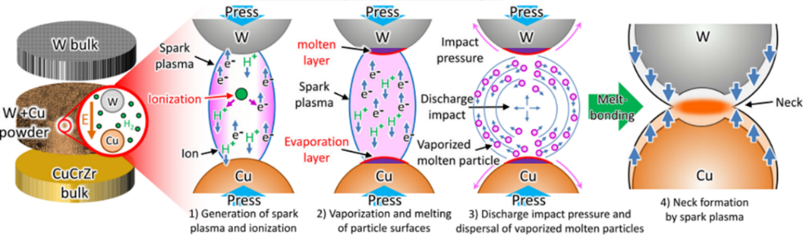
WP-8 Rotating Target (for e-driven Scheme)
74 kW (3 x SLC) beam power
Rotating mechanism
  Water-cooled
  UHV compatible
  225 rpm
Target disk
  W-Cu connection
    Mechanical and thermal evaluation
    CFD simulation using experimental data
    HIP, SPS, Brazing
  Target material selection and evaluation
    Mechanical property at operating temperature
    Cost, lead time, available size, uniformity

Slide 6
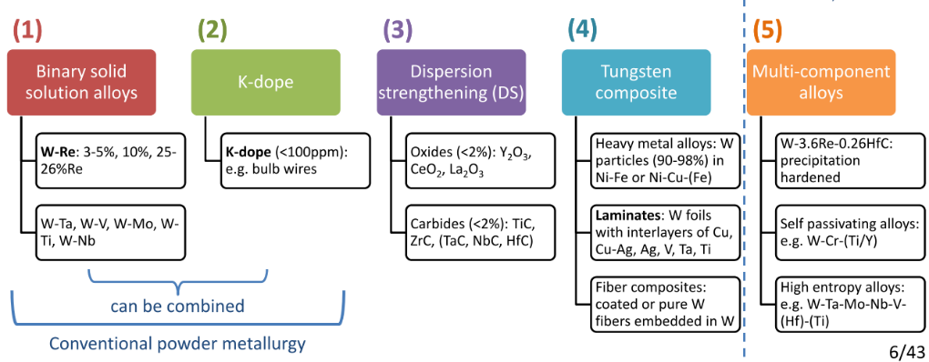
WP-8 Rotating Target (for e-driven Scheme)
74 kW (3 x SLC) beam power
Rotating mechanism
  Water-cooled
  UHV compatible
  225 rpm
Target disk
  W-Cu connection
    Mechanical and thermal evaluation
    CFD simulation using experimental data
    HIP, SPS, Brazing
  Target material selection and evaluation
    Mechanical property at operating temperature
    Cost, lead time, available size, uniformity
To improve strength, ductility, recrystallization resistance, radiation tolerance, many alloying and composite technologies have been developed.
We should keep in mind their availability, cost, lead time and availability.
Especially, W is made by sintering, making large plate keeping uniformity is difficult.
In the case of alloy, uniformity is much more important than that for pure W.
There are no high-power positron target which use large size (50 cm diamater) W-alloy as far as I know.

Slide 7
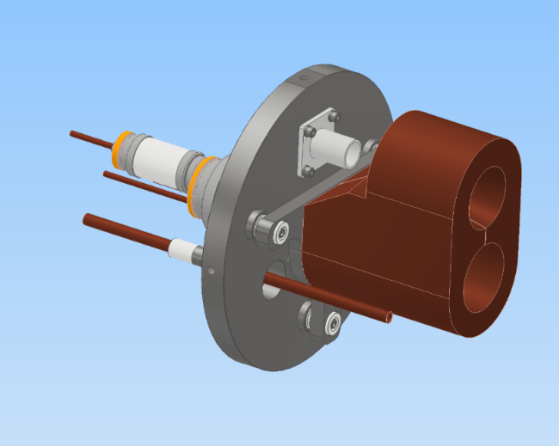
WP-9 Magnetic focusing (for e-driven Scheme)
Flux concentrator
  More than 10 times higher ohmic loss compared with that of SKEKB
  Additional beam loss from target
  In addition to EM design, thermal and mechanical engineering are important
Pulsed power supply
  300 Hz compatible
    Due to un-even pules to pulse period
  More than 10 times higher power compared with that of SKEKB
  Energy recovery mechanism is necessary
  Flat top control during 1 pulse (66 bunches, 500 ns)
  Compactness to be installed in the accelerator tunnel
  Similar parameters for kicker magnet power supply
 | ILC* | SKEKB
current | 35 kA | 12 kA
Pulse width | 10 us | 5 us
Repetition | 100 Hz | 50 Hz
Ohmic loss | 10 kW | 0.7～0.8 kW (measured)
Beam loss | 4 kW | Small
Total loss＠Load | 14 kW | 0.7～0.8 kW (measured)
P.S. power | 150 kW | 12 kW
*parameters for ILC are not fixed

Slide 8
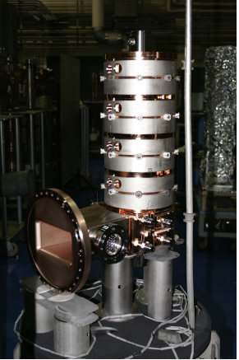
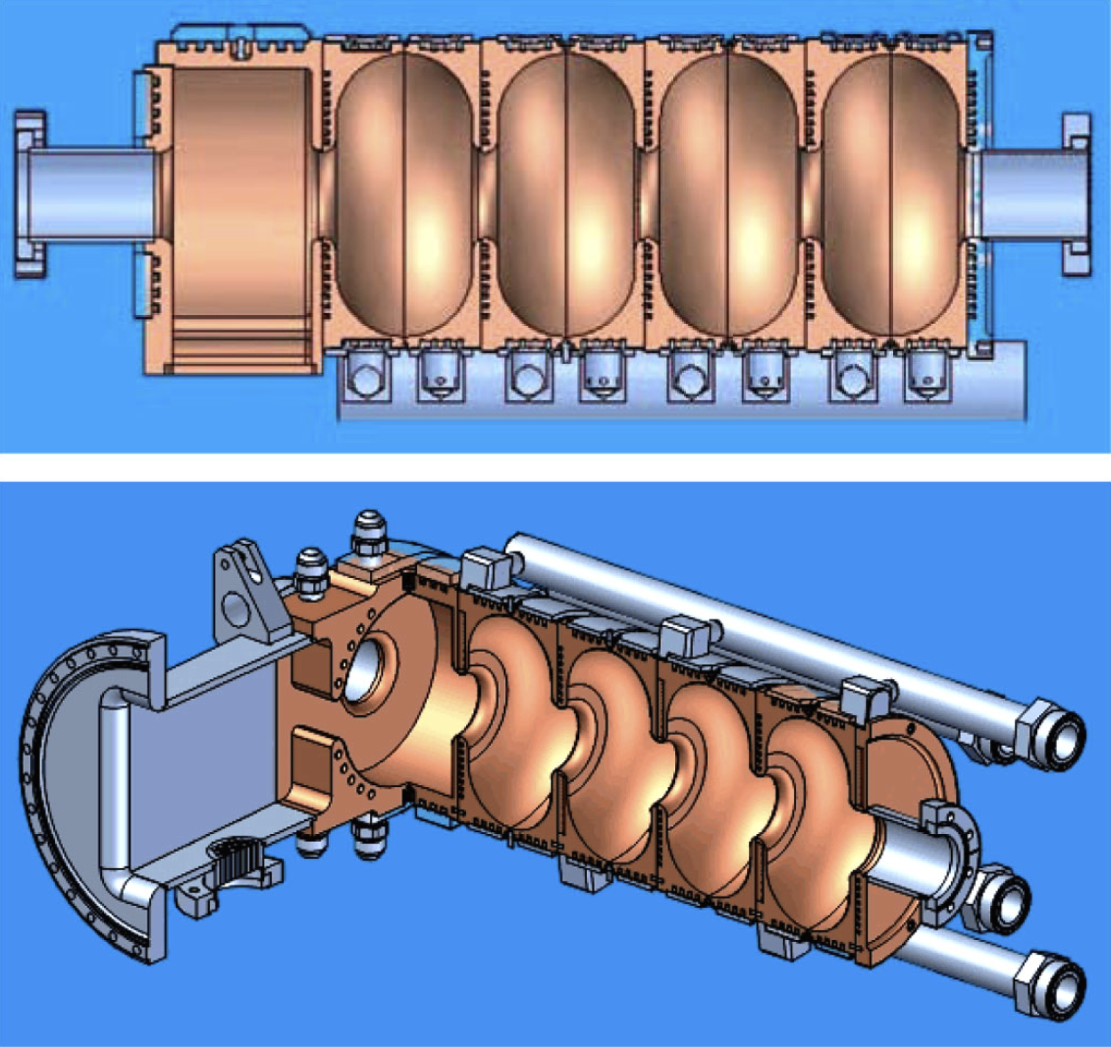
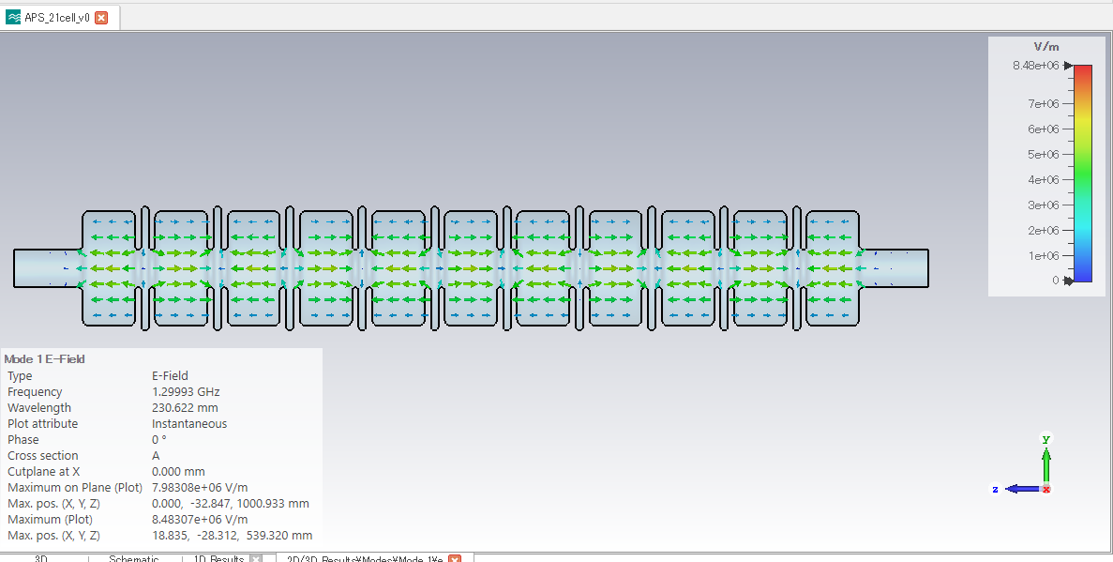
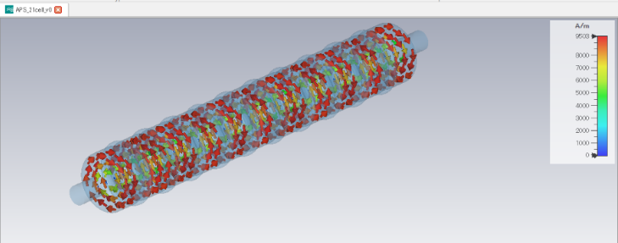
WP-10 Capture cavity
Design challenges of Large aperture L-band cavity
  Beam loading compensation for multi bunch operation
    Full model RF and beam simulation
  Very high heat load of shower from the target
    novel cooling design
  Remote beam flange connection
    Connection point is surrounded by solenoid
Previous design and prototype at SLAC
Phys. Rev. AB 12, 042001 (2009)
3D RF simulation of APS cavity at KEK

Slide 9
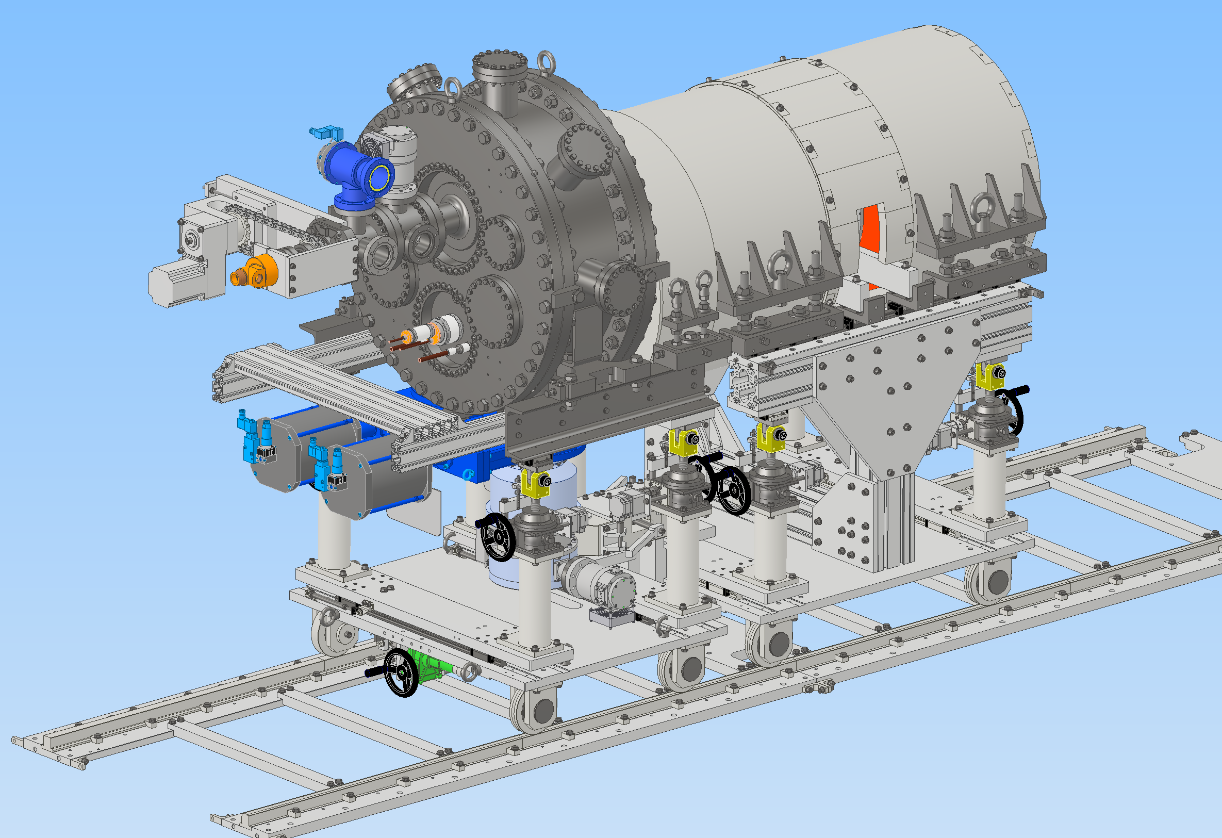
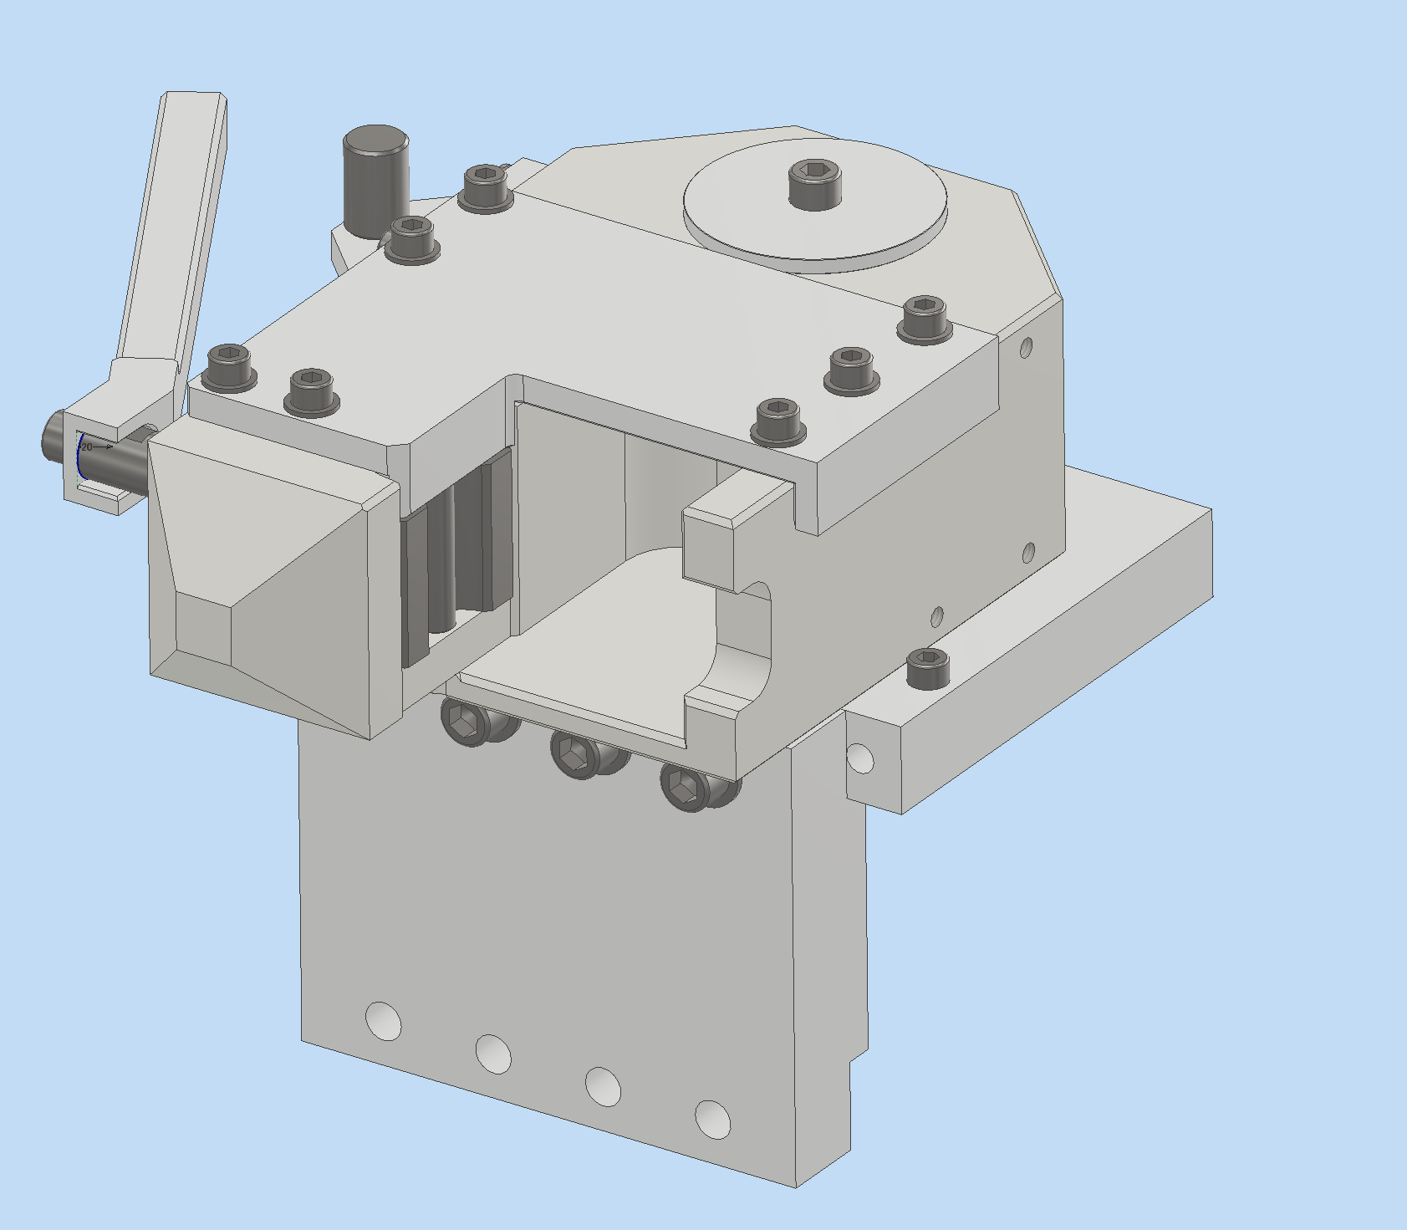
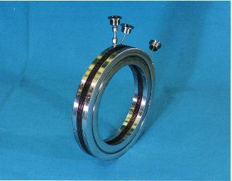
WP-11 Target replacement
Target area will be activated heavily
Many Common technology to all the other high-power accelerator
Not only simulation and evaluation, experience and knowledge transfer are important
  3 times exchange experiences through SKEKB operation
  Collaboration with other high power target facilities, J-PARC, RIKEN, FRIB…
Mechanical, vacuum engineering
  Automatic flange connection
  Movable base
Girder structure on rail
Automatic connection coupler
Pillow seal

Slide 10
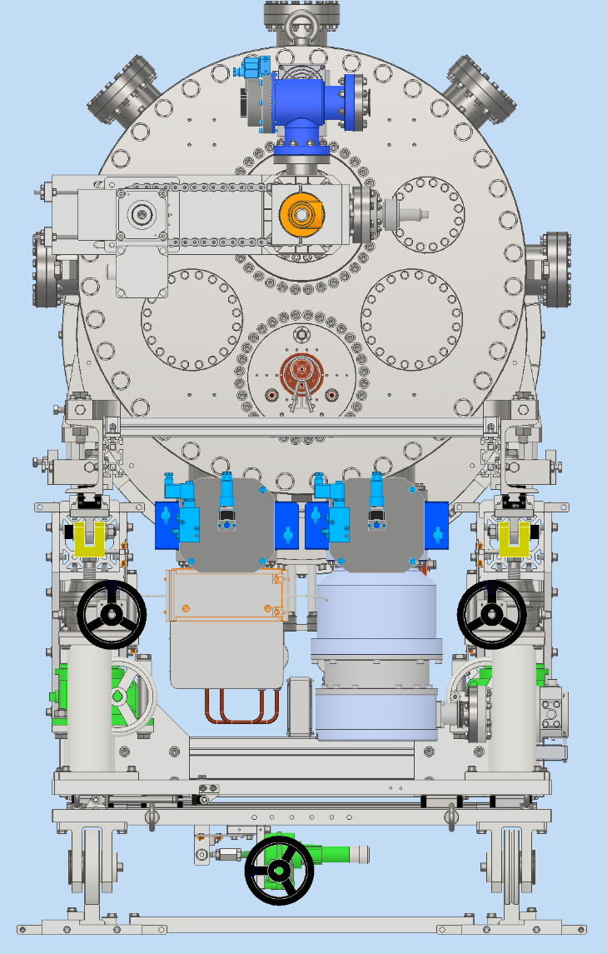
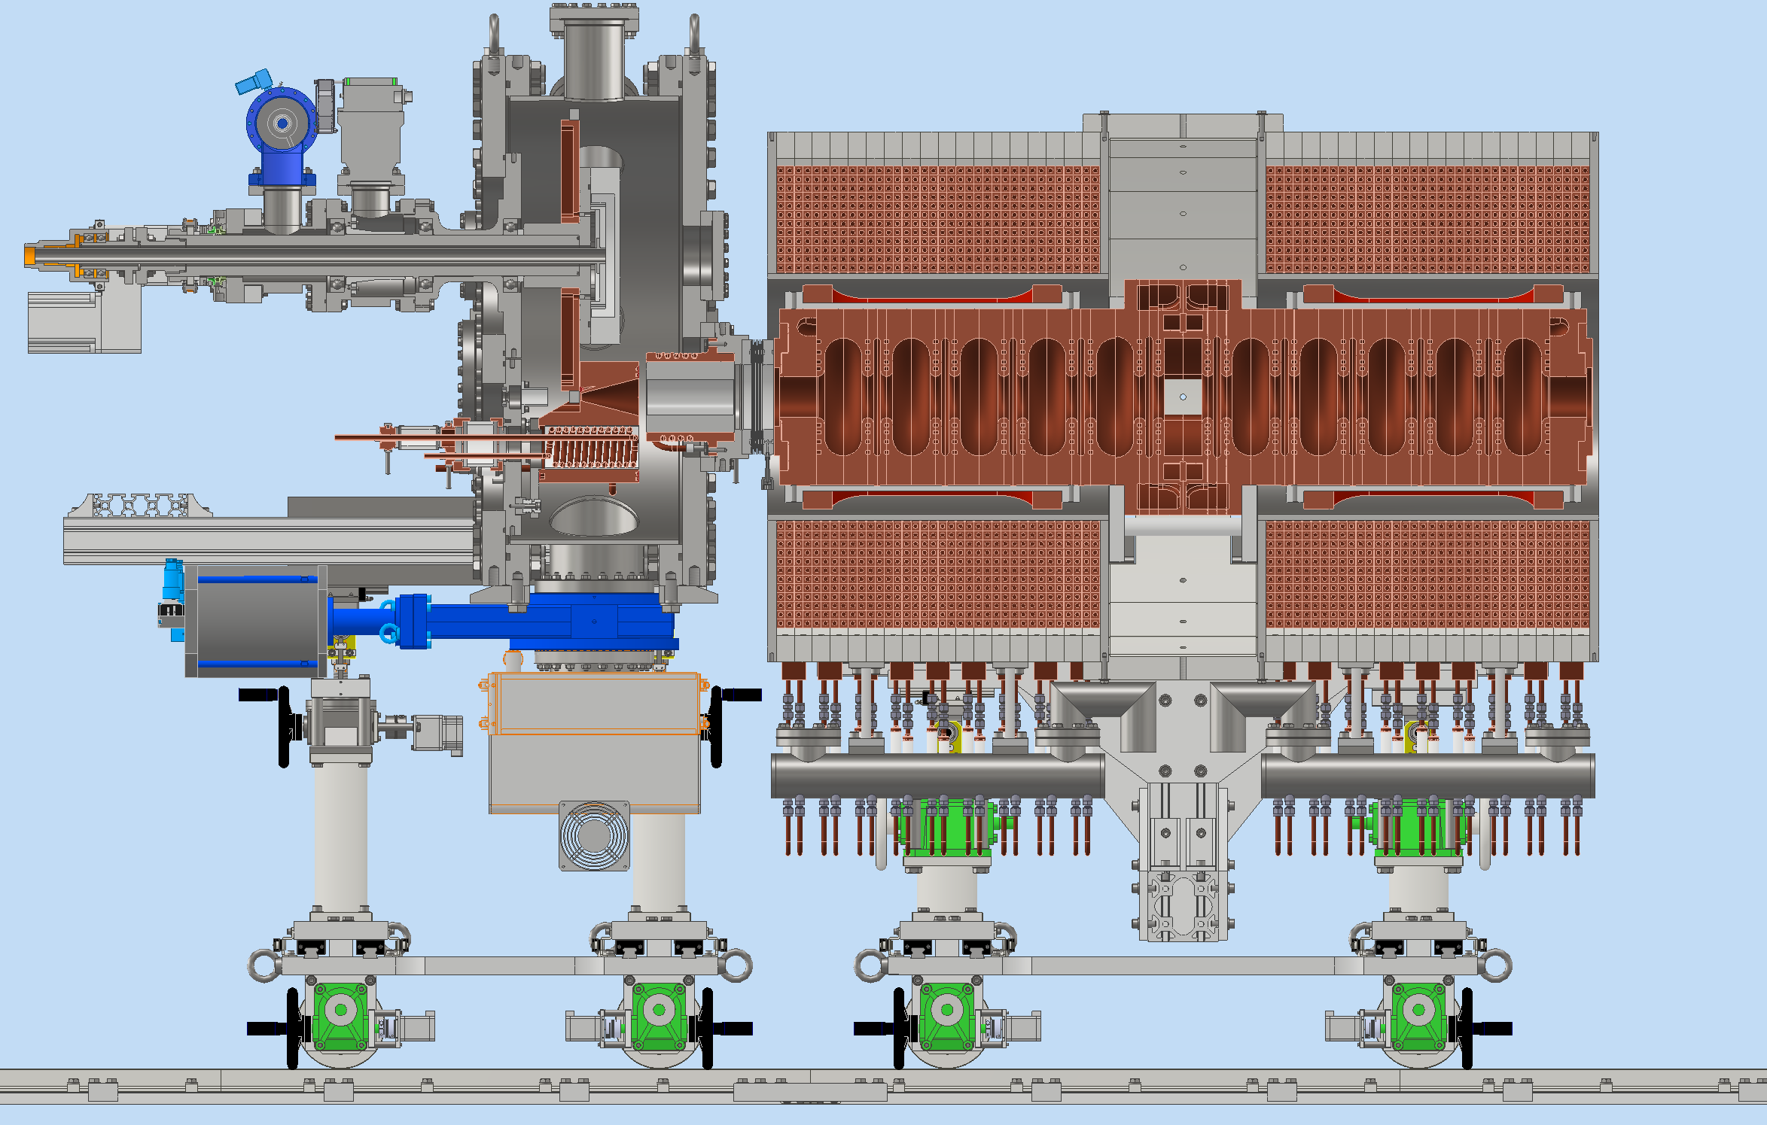
Latest 3D model

Slide 11
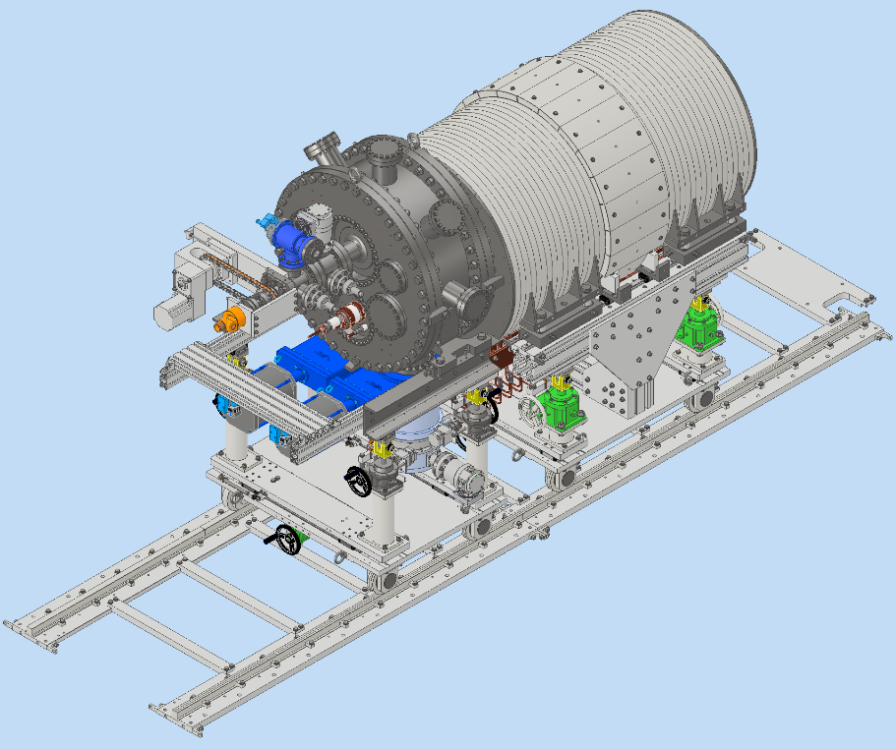
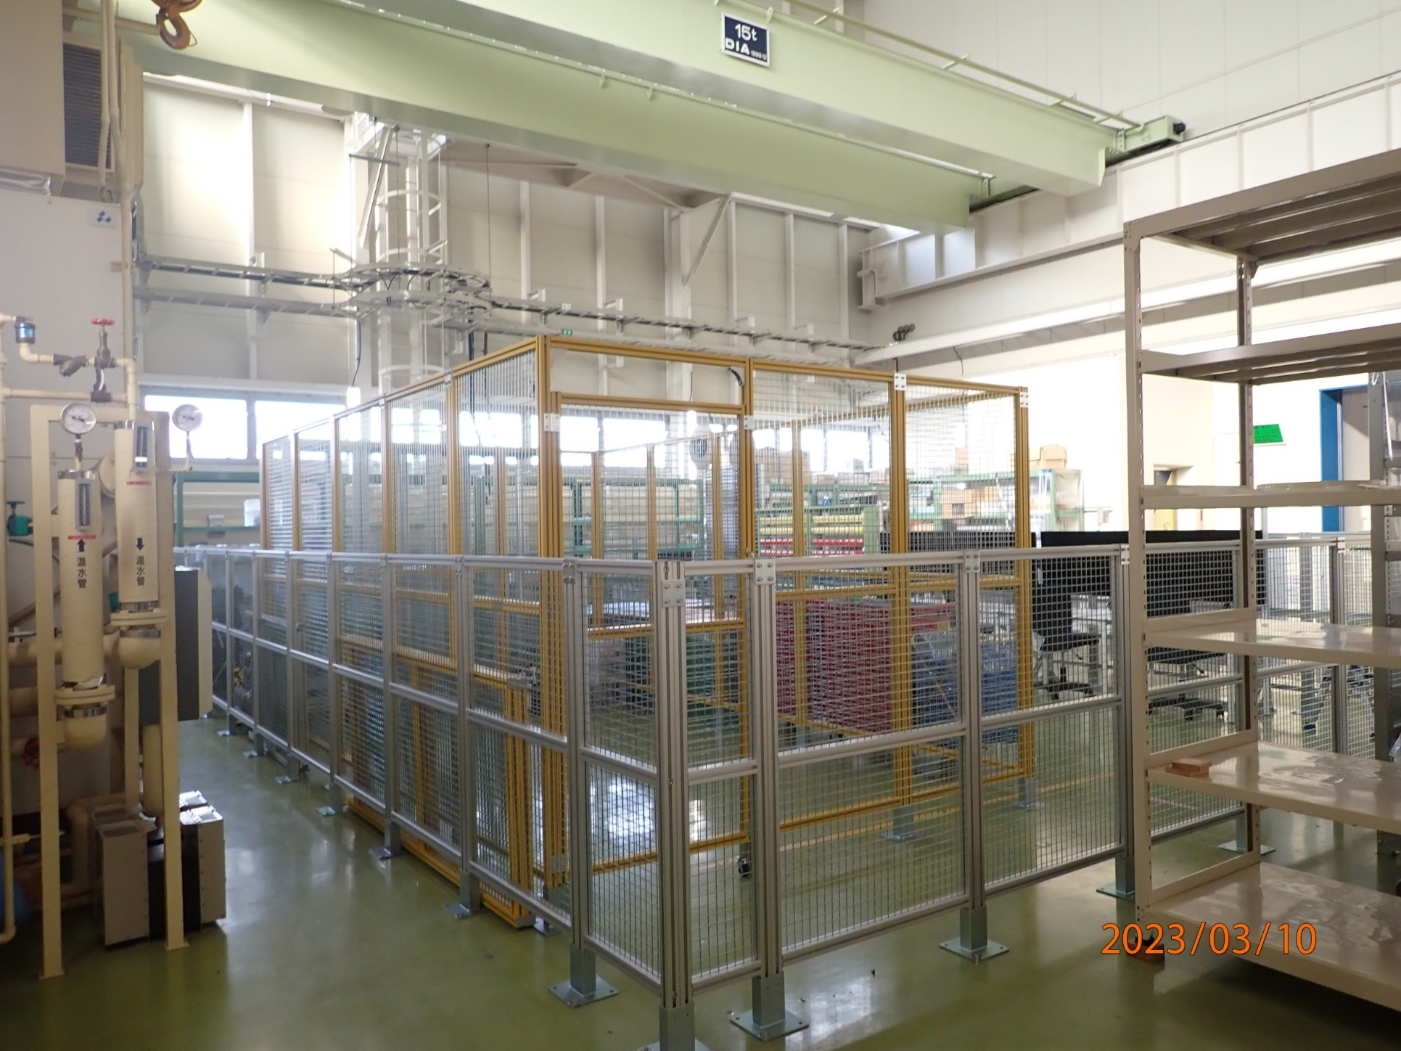
Test bench in KEK

Slide 12
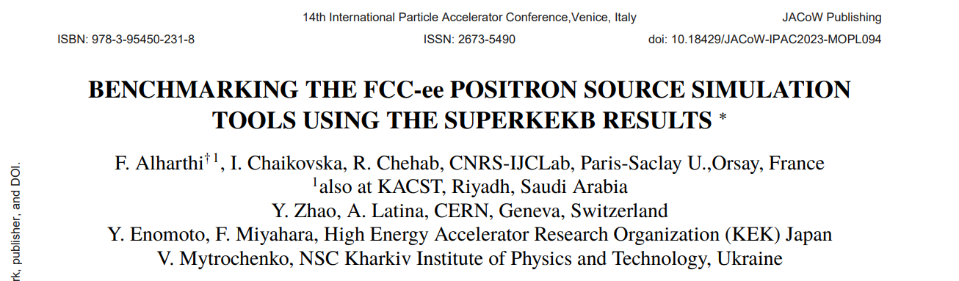
IJCLab / FCCee
SuperKEKB and FCC-ee has been collaborating for many years using the framework of FJPPL
  Iryna-Enomoto collaboration started in 2018
  First collaborative work between KEK and LAL started in 1980’s by our Predecessors.

Slide 13
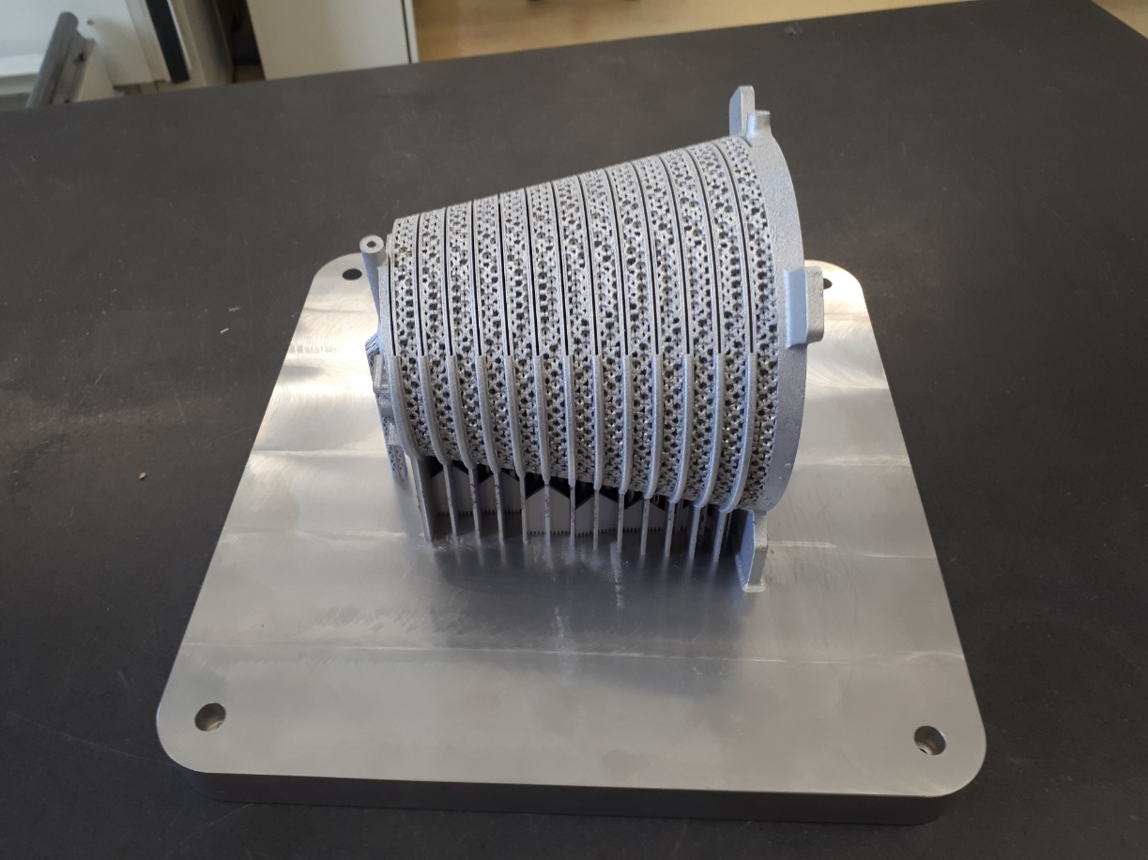
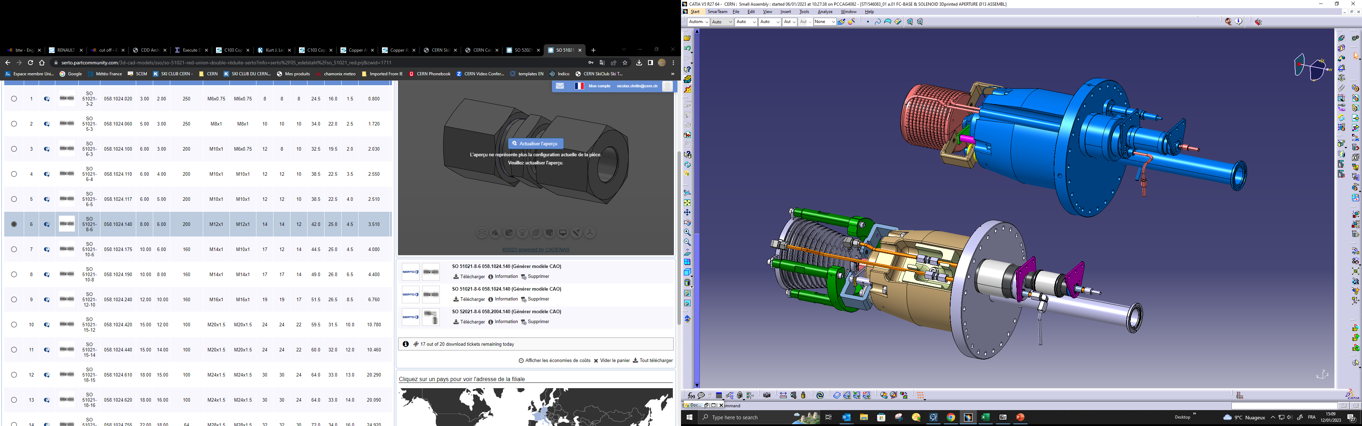
CERN / CLIC
Discussion about FC with CERN date back to LCWS2019 at Sendai
Steffen showed big progress on the development of FC at LCWS2023
Steffen Doebert@LCWS2023
FC made by 3D printer@CERN
SuperKEKB model
CLIC flexible folder for several prototype

Slide 14
Discussion
SuperKEKB and FCC-ee, CLIC already have some kind of collaboration and connection.
How do we expand and integrate collaboration using ITN framework?
Considering present status and progress of ILC, FCC-ee and CLIC, it’s a good timing to advance our collaboration!!

