Slide 1
40th Meeting of SRF Group in IDT/WG2
Recent progress of SRF 5-year plan at KEK and global collaboration for ITN (Kirk)
Others (if any)
Attendees: A. Yamamoto, K. Umemori, D. Delikaris, S. Steiner, P. Burrows, Kirk
https://agenda.linearcollider.org/category/256/
Kirk

Slide 2
Leaders for each sub-group at KEK (updated)
Sub-group | Leader
Drawing | Takeshi Dohmae
Cavity | T.B.D.
Frequency tuner | Mathieu Omet
Power coupler | Kirk
Magnetic shield | Ryuichi Ueki
SCQ magnet (+BPM) | Yasushi Arimoto (Hitoshi Hayano)
Clean work/Vacuum work | (temporarily) Kirk
Cryomodule | Kirk
Infrastructure at COI | Shinichiro Michizono
RF | Toshihiro Matsumoto
Cryogenics | Hirotaka Nakai/Kota Nakanishi/Hirotaka Shimizu
Cavity fabrication/Material preparation | Takayuki Saeki/Takeshi Dohmae
High Pressure Gas Safety Act | Kensei Umemori/Takayuki Saeki/Takeshi Dohmae

Slide 3
Recent progress of SRF 5-year plan ①
Japan (KEK)
  Cavity
    FG 9-cell cavity is under fabrication, negotiation with local government and KHK is under progress, may be approved in Feb
    Six 1-cell cavities (FG/MG) will be produced by KEK in-house, and VT will start after delivery in Jan
    KEK sent some MG disks to vendors in EU for press-testing
    KEK is preparing necessary Nb material for Eddy Current Scanning (ECS) at DESY
    KEK started the discussion with a domestic vendor to produce 9-cell cavities in next FY
  Power coupler
    Drawing work and specification document are under progress
    Ceramic samples were ordered for quality check of brazing, thermal cycle test, TiN coating test, etc.
    RF simulation is under progress between FNAL and KEK within the framework of the US-Japan Science and Technology Cooperation
  Tuner
    Drawing work is under progress
    Discussion with FNAL is under progress for rental of a set of cavity/tuner/helium tank within the US-Japan
    Mechanical simulation for LFD is under progress
  Magnetic shielding/Demagnetization
    Demagnetization test with a small cryo-vessel is under preparation
    Drawing work of magnetic shielding is under progress
    Discussion with a domestic vendor is under progress
  SC-Q magnet
    Discussion with a domestic vendor is under progress

Slide 4
Recent progress of SRF 5-year plan ②
Japan (KEK)
  Clean work/Vacuum work
    Design of mock-up cavities (will be used for training of cavity string assembly) was almost done, waiting for procurement
    Remote control system for ionized gun and dust monitor will be completed soon, will be merged with robot arm system
    Regular meeting on robotics with CEA and FNAL has been held
  Cryomodule
    Drawing work is under progress
    Discussion with domestic vendors is starting
  Infrastructures
    Cavity Fabrication Facility
      CFF group is preparing for new work area, install a new clean room and some devices
    Cryogenics
      They started the preparation for change request to discuss with local government
    CM hanger
      Currently under construction for improvement
    CM test bunker
      The design completed, the cost estimation done

Slide 5
Global collaboration and recent progress for ITN
Overseas
  Americas
    Waiting for their decision after the conclusion by P5 will open this week
  Asia
    Korea University and PAL newly joined the ITN, and KEK will explain for them in 14/Dec
  Europe
    CERN, CEA and INFN are considering production of two 1-cell cavities, will start from 2024
      This depends on when the budget and the Nb material will be transferred from KEK to EU
    CEA and INFN are discussing with DESY how to contribute to ITN
    DESY is preparing for ECS
      Free of charge for EU
      Americas and Asia are under discussion
    CIEMAT and IFIC are discussing with KEK to produce SC-Q magnet and BPM system
    IFIC and IJCLAB newly joined the ITN, they will discuss internally in EU

Slide 6
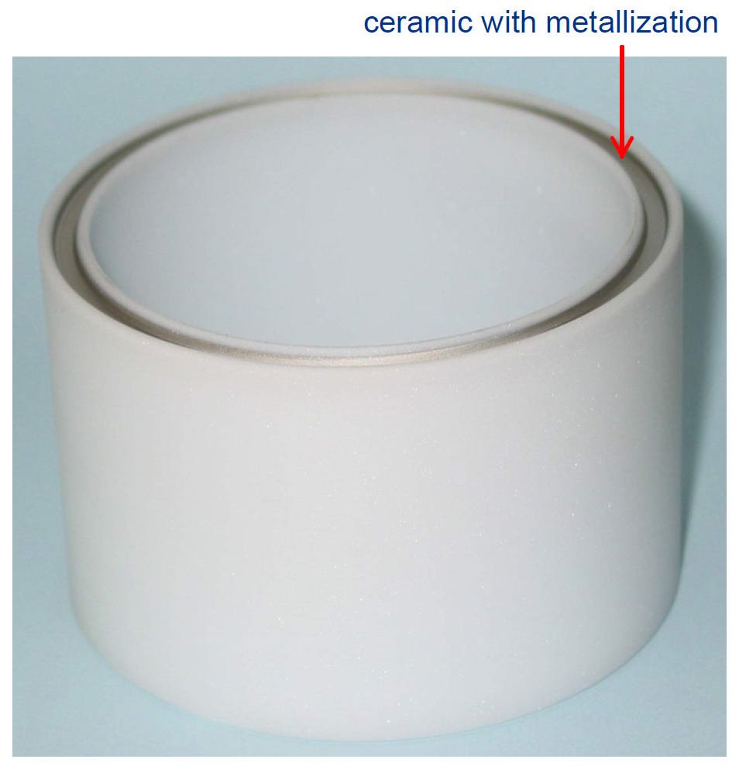
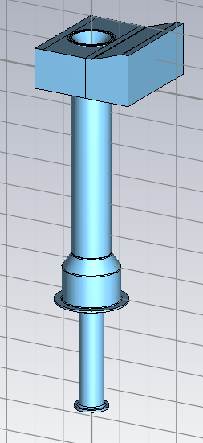
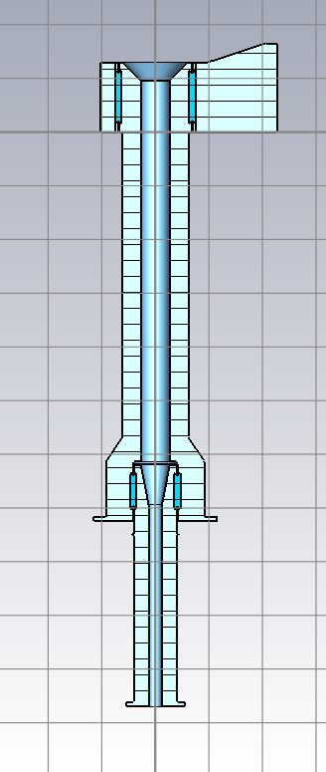
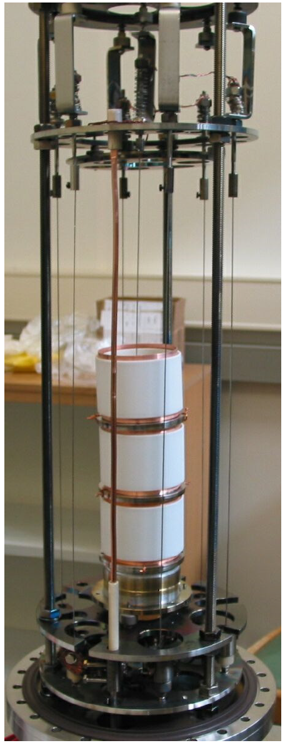
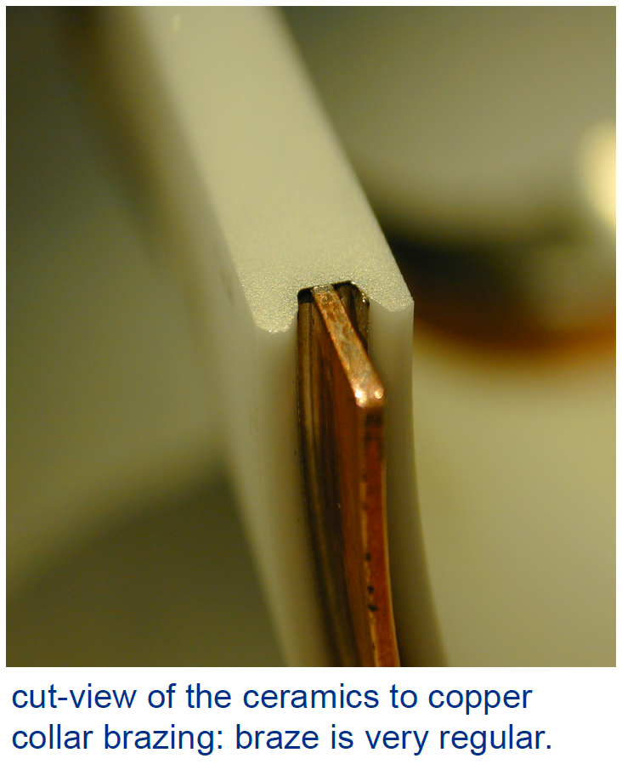
Recent progress of power coupler
RF simulation is under progress
Metalized ceramics
Quality check of brazing
TiN coating on ceramics
Courtesy of R. Katayama
Courtesy of D. Kostin

Slide 7
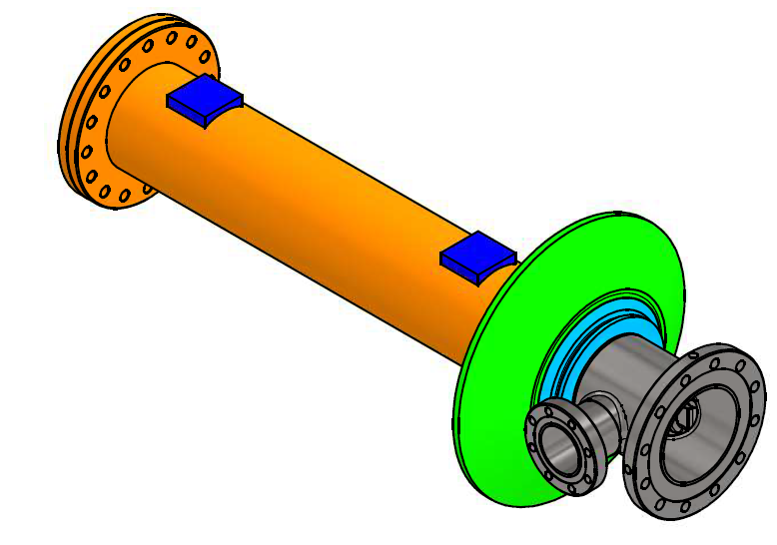
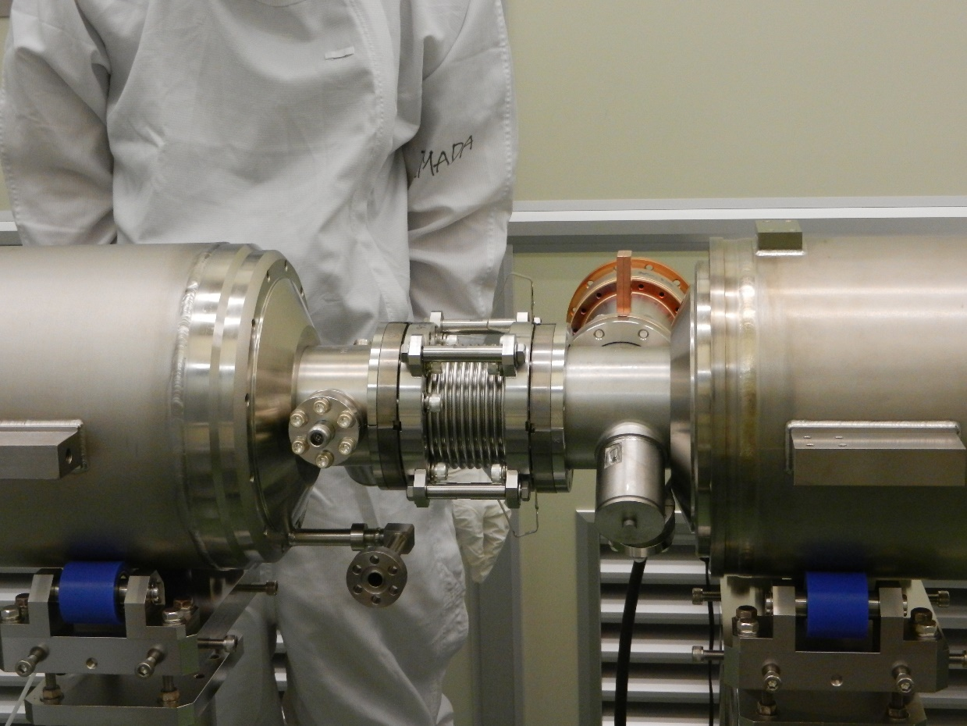
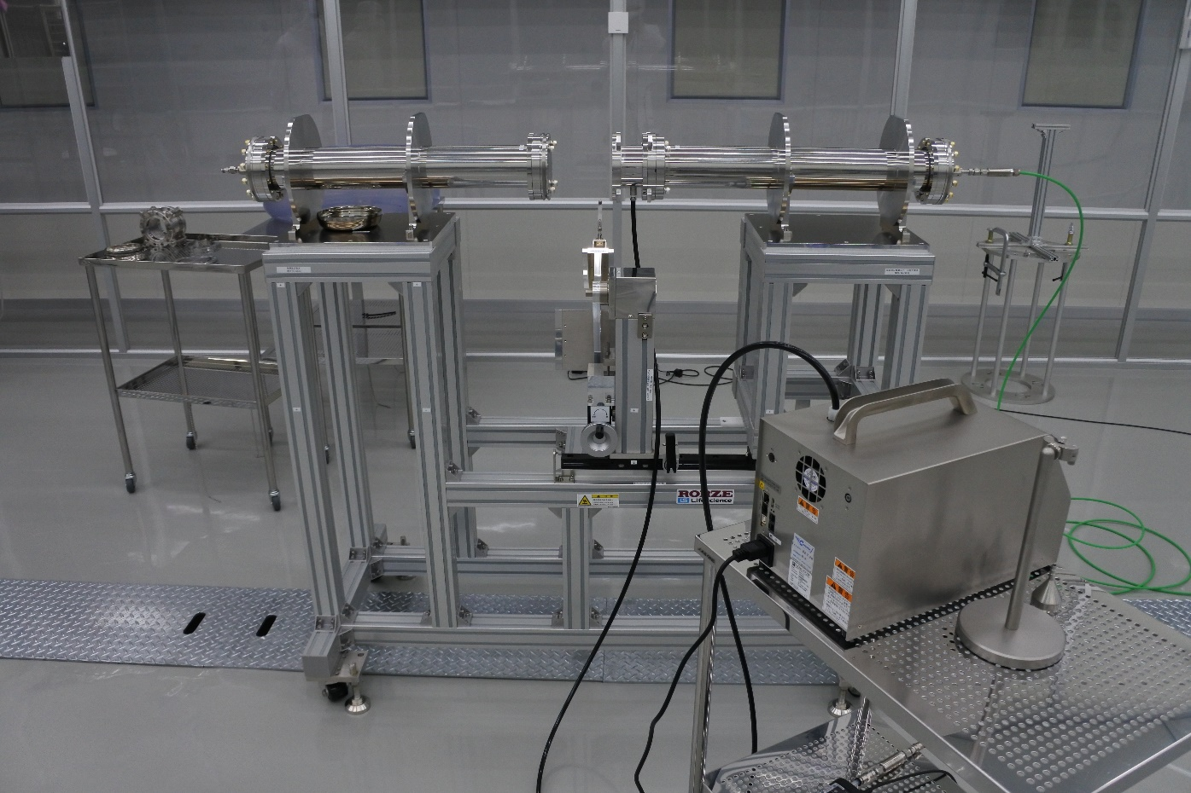
Design/Production of mock-up cavities
KEK will introduce mock-up cavities for training of cavity string assembly.
We designed mock-up cavities for training of cavity string assembly
We will replace dummy cavities with mock-up ones
From T. Dohmae
Blank-bellows replacement system for training

Slide 8
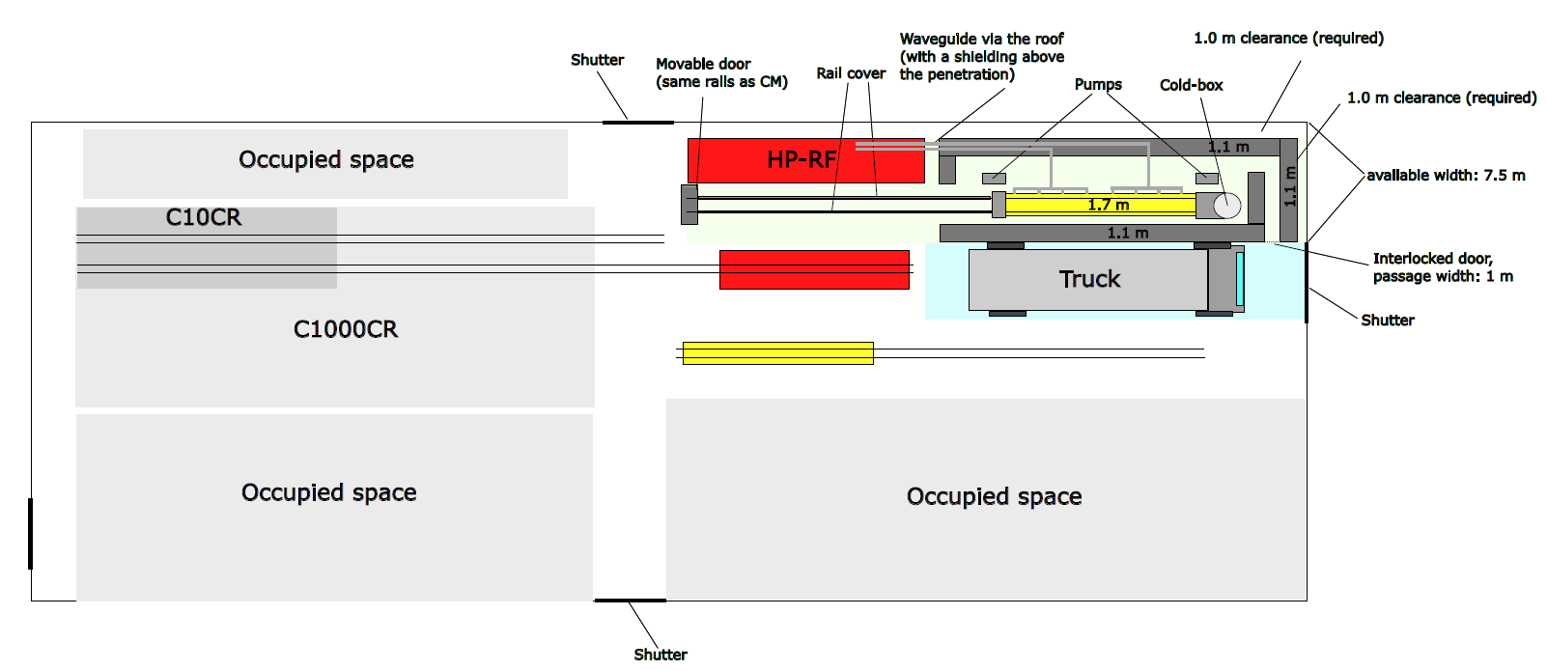
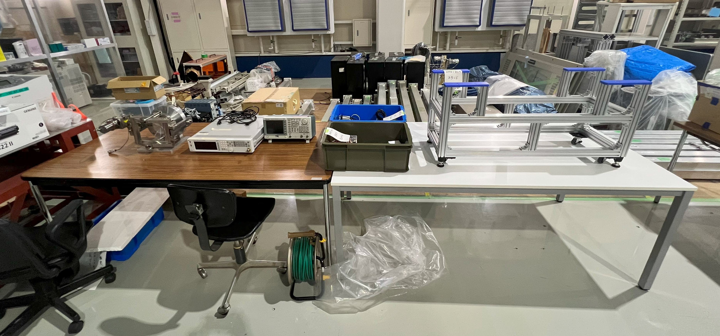
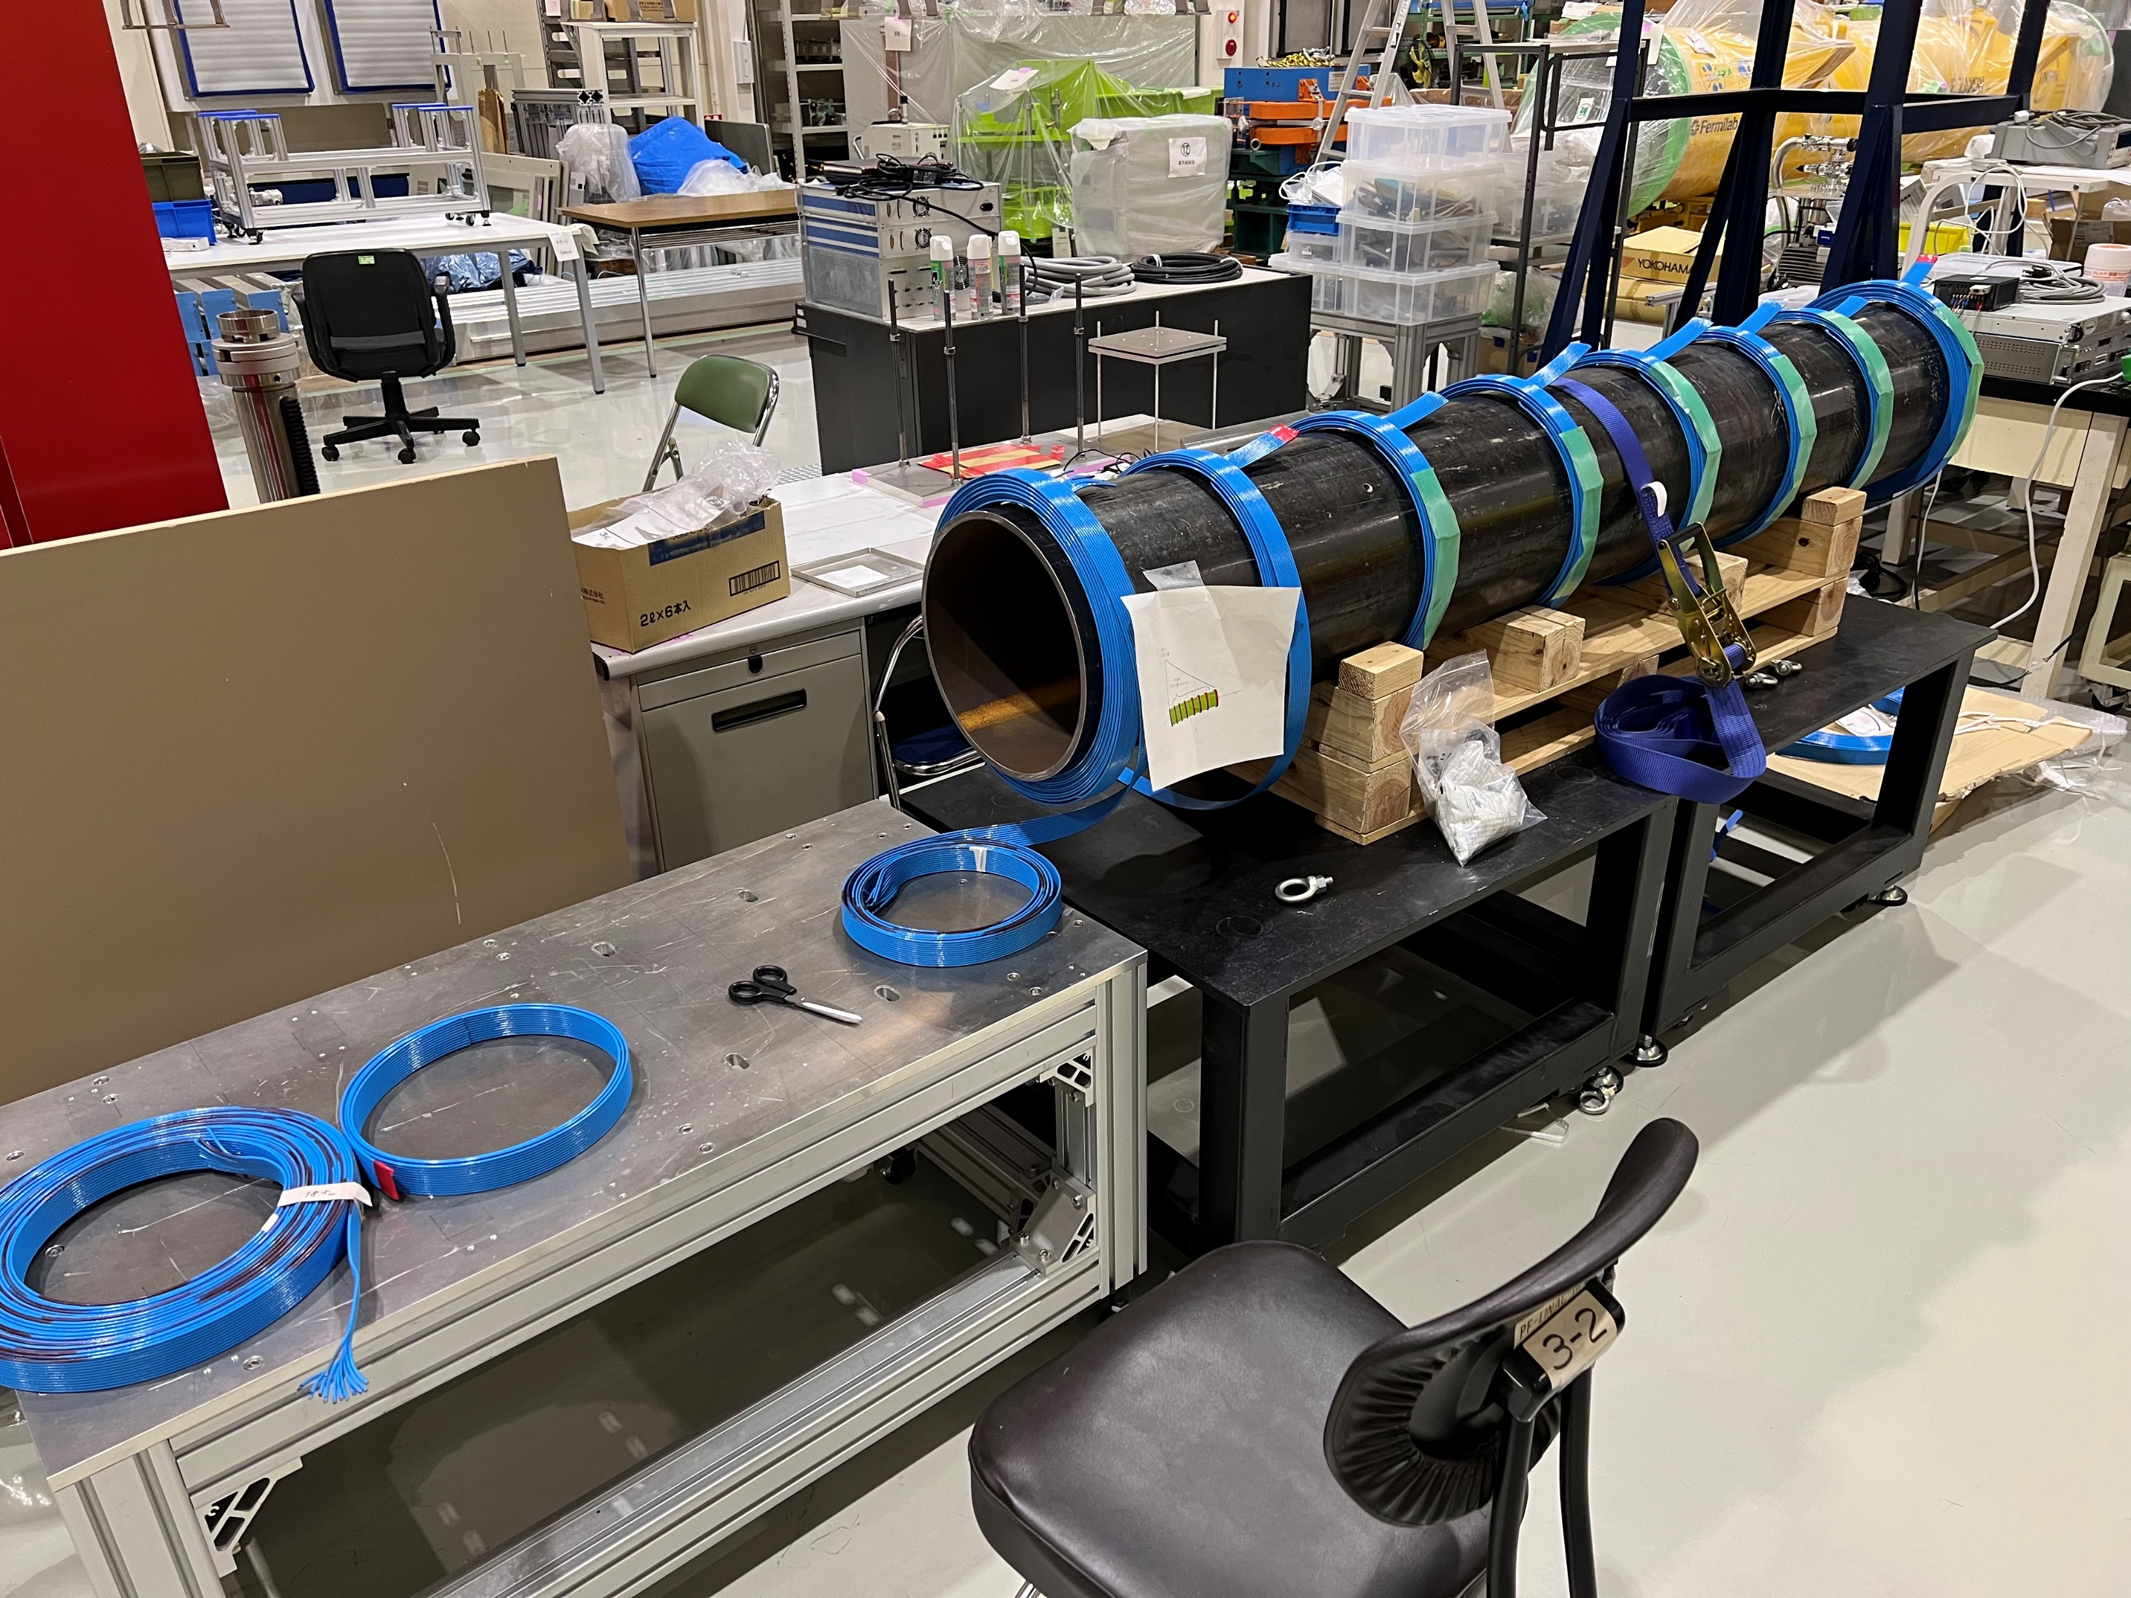
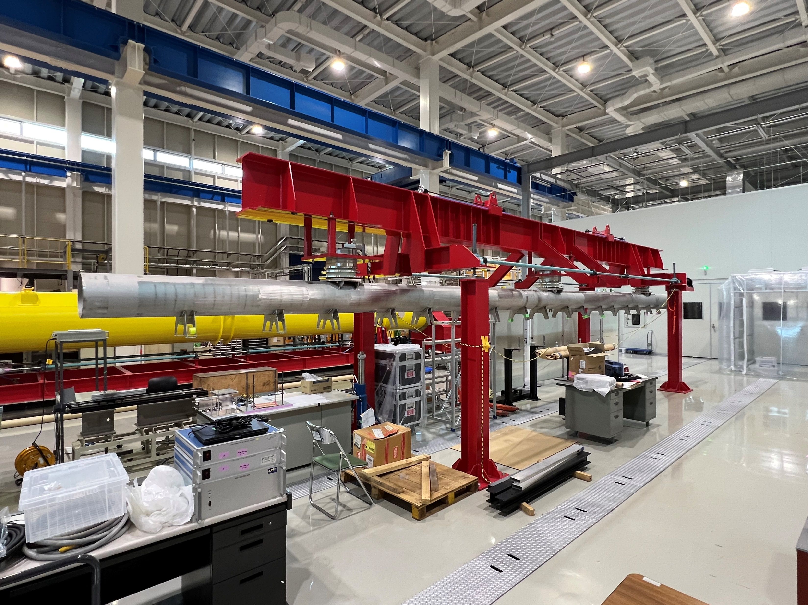
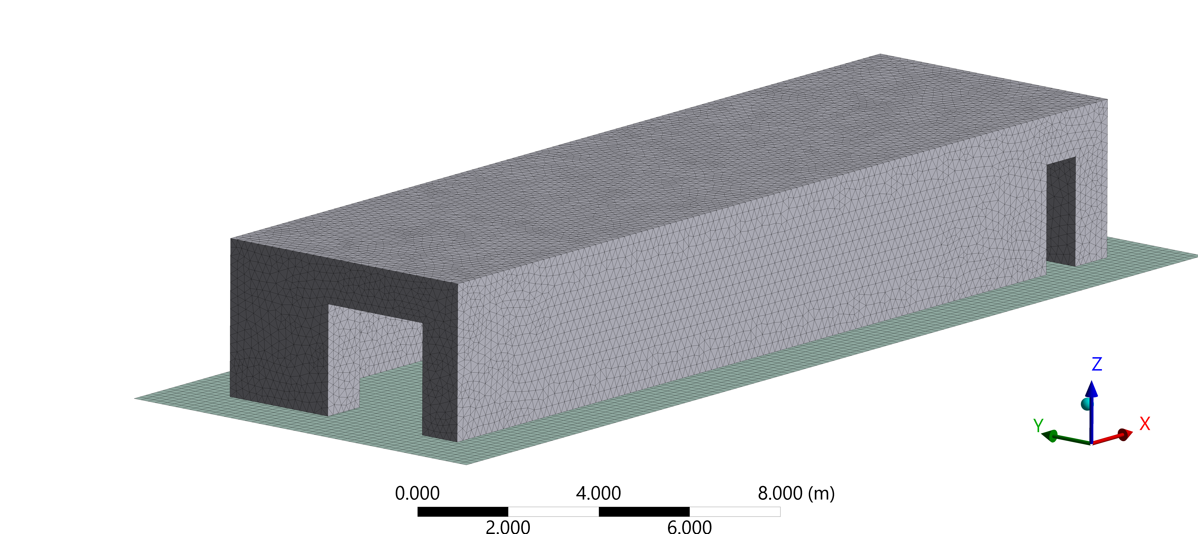
Recent progress of infrastructure at COI
Layout of CM test bunker at COI
Tuner work area
Courtesy of M. Omet
Demagnetization study using mock-up CM
Courtesy of M. Omet
CM hanger
Courtesy of H. Araki
Courtesy of R. Ueki
Courtesy of H. Hayano

Slide 9
Overall production schedule of 5-year plan at KEK
 | JFY2023 |  |  |  | JFY2024 |  |  |  | JFY2025 |  |  |  | JFY2026 |  |  |  | JFY2027
 | CY2023 |  |  | CY2024 |  |  |  | CY2025 |  |  |  | CY2026 |  |  |  | CY2027 |  |  |  | CY2028
 | 1 | 2 | 3 | 4 | 1 | 2 | 3 | 4 | 1 | 2 | 3 | 4 | 1 | 2 | 3 | 4 | 1 | 2 | 3 | 4
1-cell cavity (FG, KEK) | 4
1-cell cavity (MG, KEK) | 2
9-cell cavity (FG, domestic) | 1 |  |  |  | 6 |  |  |  | 1
9-cell cavity (MG, KEK) | 1 (training) |  |  |  | 1 |  |  |  | 1
9-cell cavity (MG, oversea) |  |  | training |  |  |  |  |  | 2
Power coupler |  |  |  |  | 2 (prototype) |  |  |  | 8
Frequency tuner |  |  |  |  | 1 (prototype) |  |  |  | 8
SCQ magnet+BPM |  |  |  |  | 1 (prototype) |  |  |  | 1
Magnetic shield |  |  |  |  | 1 (test) |  |  |  | 1 (prototype) |  |  |  | 8
Cavity string
CM production
CM assembly
CM test
Cryogenics
HLRF
Rail of cavity string
CM assembly implement
CM test bunker
Deadline of clean assembly study for ITN

Slide 10
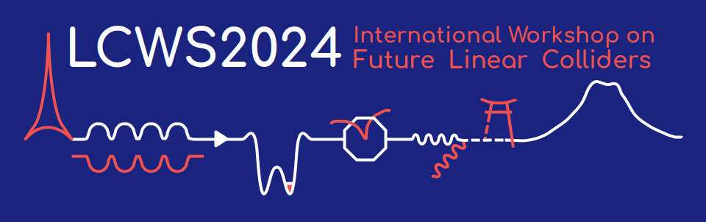
Meeting/Conference schedule
Meeting # | Date | Contents
40 | 5/Dec | Recent progress of SRF 5-year plan and global collaboration for ITN
 | 5~8/Dec | TTC Meeting 2023 @FNAL, US
 | 8~11/Jul/2024 | LCWS2024 @Tokyo, Japan
https://agenda.linearcollider.org/event/10134/

