Slide 1
LC Sustainability: Shadow Costs, Publication Strategy
Benno List, DESY
LCWS 2023, SLAC
Dec 14, 2023

Slide 2
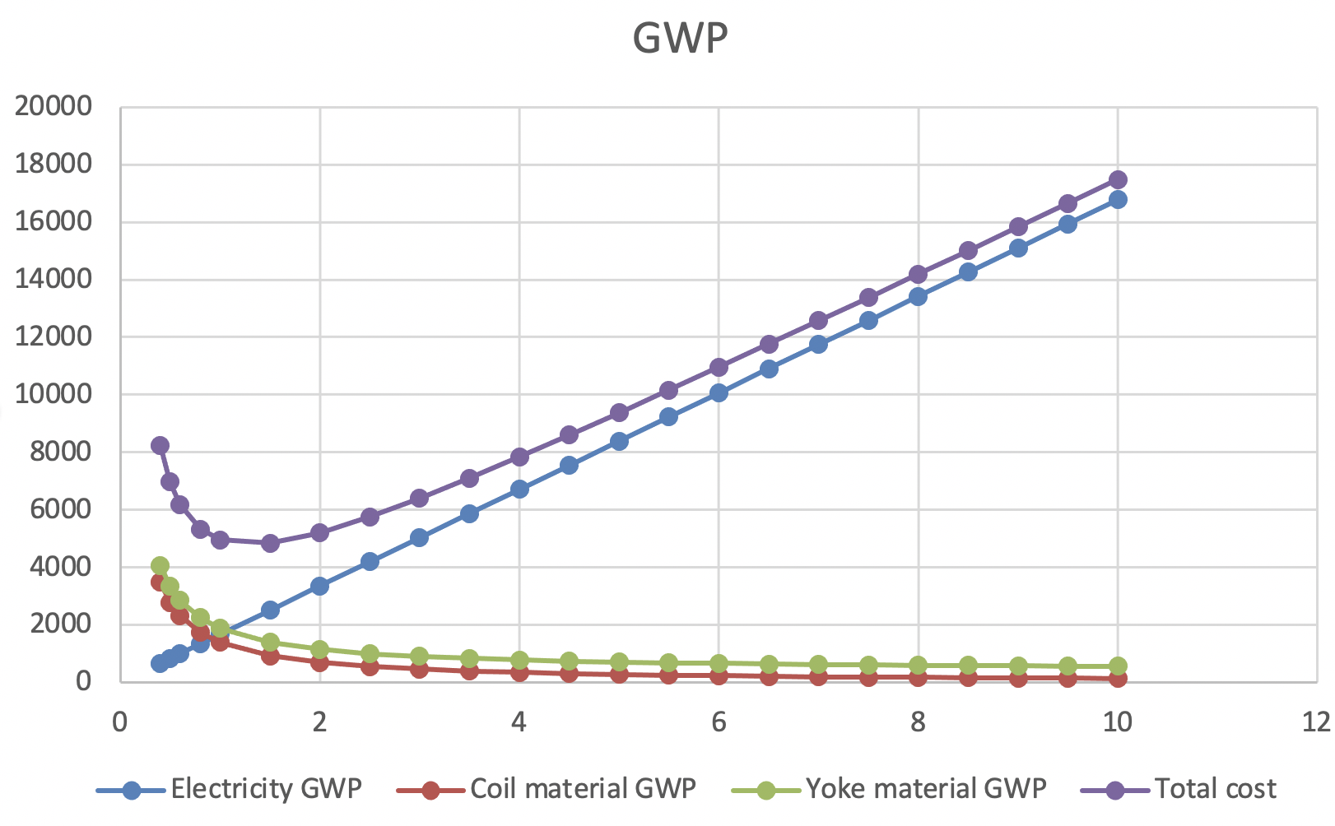
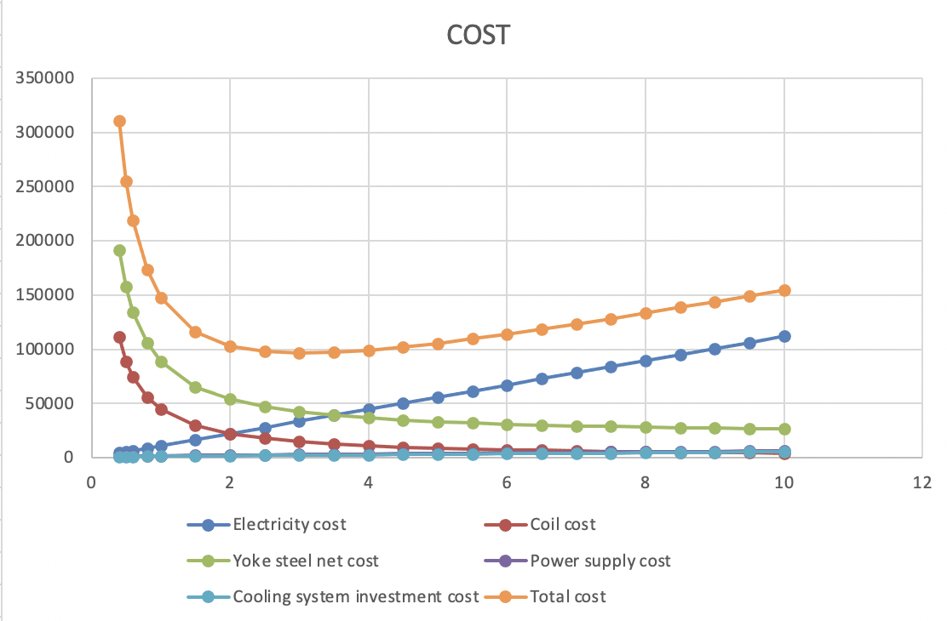
Example: Cost vs CO2 Optimisation
Resistive electro magnet:
Evaluate CO2 (GWP) and cost as a function of coil current density
High density: less copper, but more electric losses
Plausible claim: ”We moved from 5A/mm2 to 3, saving 3000kg of CO2 over the lifetime of the magnet”!
Increases investment cost by 15000$, but reduces electricity cost by 20000$
-> saves 5000$ over the magnet lifetime
-> just economic sense (although already a tough sell to funding agencies)
The sustainable optimum would be at 1.5A/mm2, saving another 1500 kg CO2, but costing another 20000$ in invest, which is more than the 15000$ saving in electricity
Are you prepared to move away from the economic optimum towards the environmental optimum?
Easy
CO2
Hard
€$¥

Slide 3
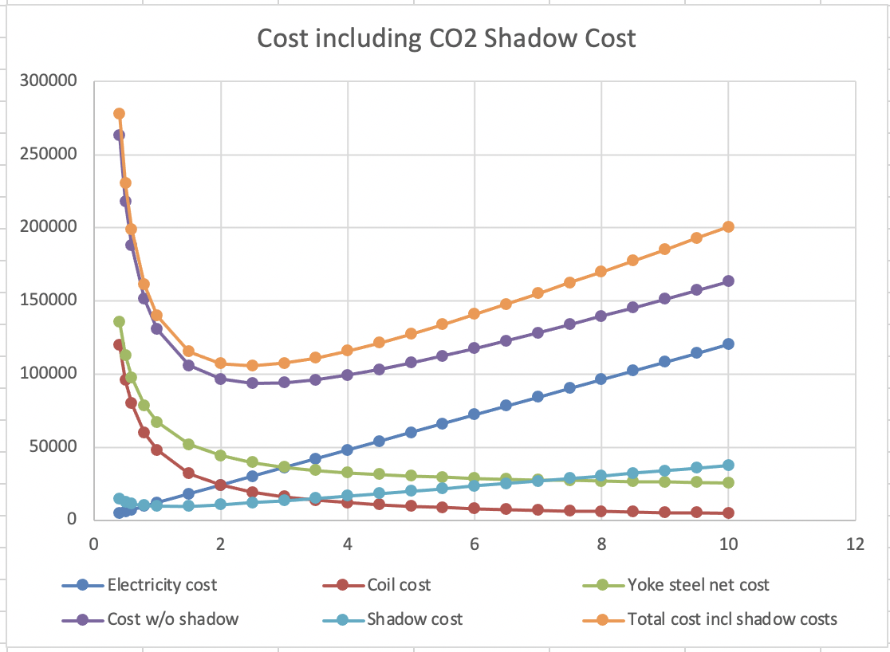
Shadow Costs
Are you prepared to move away from the economic optimum towards the environmental optimum?
Concept of shadow costs:
Gives an economic “value” to CO2 savings:
a ton of CO2 (savings) is worth e.g. 200€
Including the shadow costs in the overall costs shifts the cost optimum towards lower CO2
Shadow costs allow to include environmental effects in a cost-benefit analysis
Caveats
  Shadow costs are significantly lower than the claimed overall damage from CO2 emissions
  Nobody pays you the “savings” in shadow costs, instead you pay a very real cost increase for lowering the shadow costs
  Shadow costs are so small (currently, 80€/ton) that in many cases they do not motivate significant CO2 savings
  (the figure was made with a whopping 2000€/ton figure!)
Easy
Hard

Slide 4

Cost and Sustainability
Improvements in resource efficiency (shorter tunnel, less power) generally reduce CO2
-> are often presented as “improving sustainability” (including by myself!)
This is correct, but nothing new:
the incentive to reduce resource use is mostly cost reduction.
This has always been there
But: in most cases,
cost optimum ≠ sustainability optimum!
The litmus test of a serious sustainability concept: are you prepared to move away from the cost optimum towards an environmental (sustainability) optimum?
This requires evaluating cost and environmental (e.g., CO2) impact
Cost
CO2
CC-BY 2.0 Marco Verch via Flickr
https://www.flickr.com/photos/30478819@N08/49500013537

Slide 5
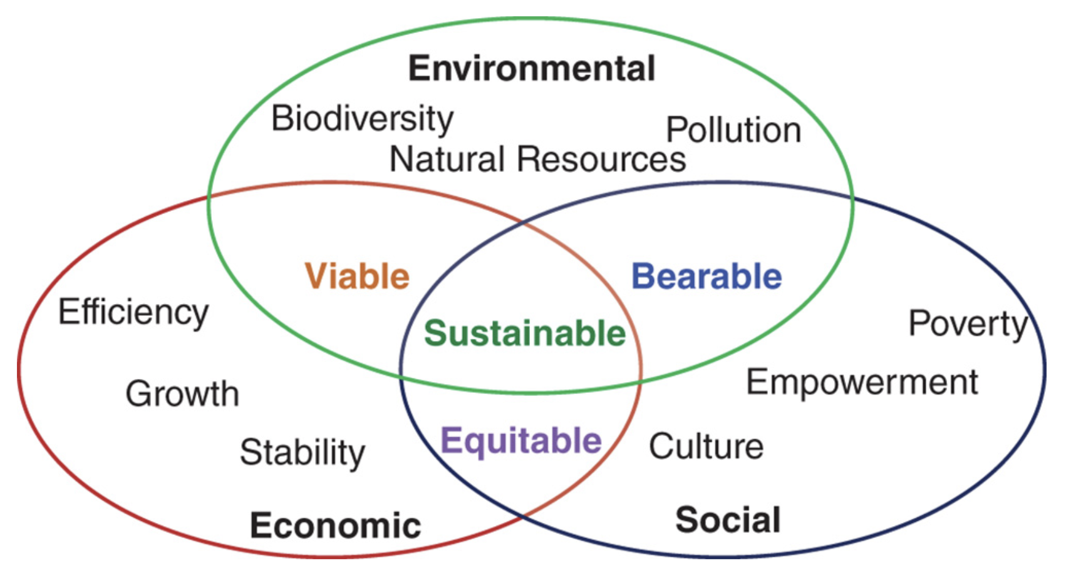

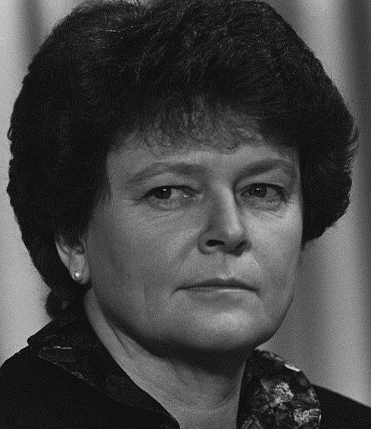
Sustainability: What It Is…
Development that meets the needs of current generations without compromising the ability of future generations to meet their needs and aspirations. (WCED, 1987)
WCED (World Commission for Environment and Development) (1987) Our Common Future, Oxford University Press, Oxford.
Cover of the “Brundtland Report” 1987
R.Y. Surampalli et al. (eds), Sustainability. Wiley 2020.
Observation:
“Economy”, i.e. cost, is also part of “Sustainability”
Nevertheless: Let us talk about tension between
cost and sustainability,
although more strictly it is
environmental vs economic sustainability
Three aspects:
environmental
economical
social
Gro Harlem Brundlandt at WEF 1989
© WEF, CC-BY-SA-2.0

Slide 6
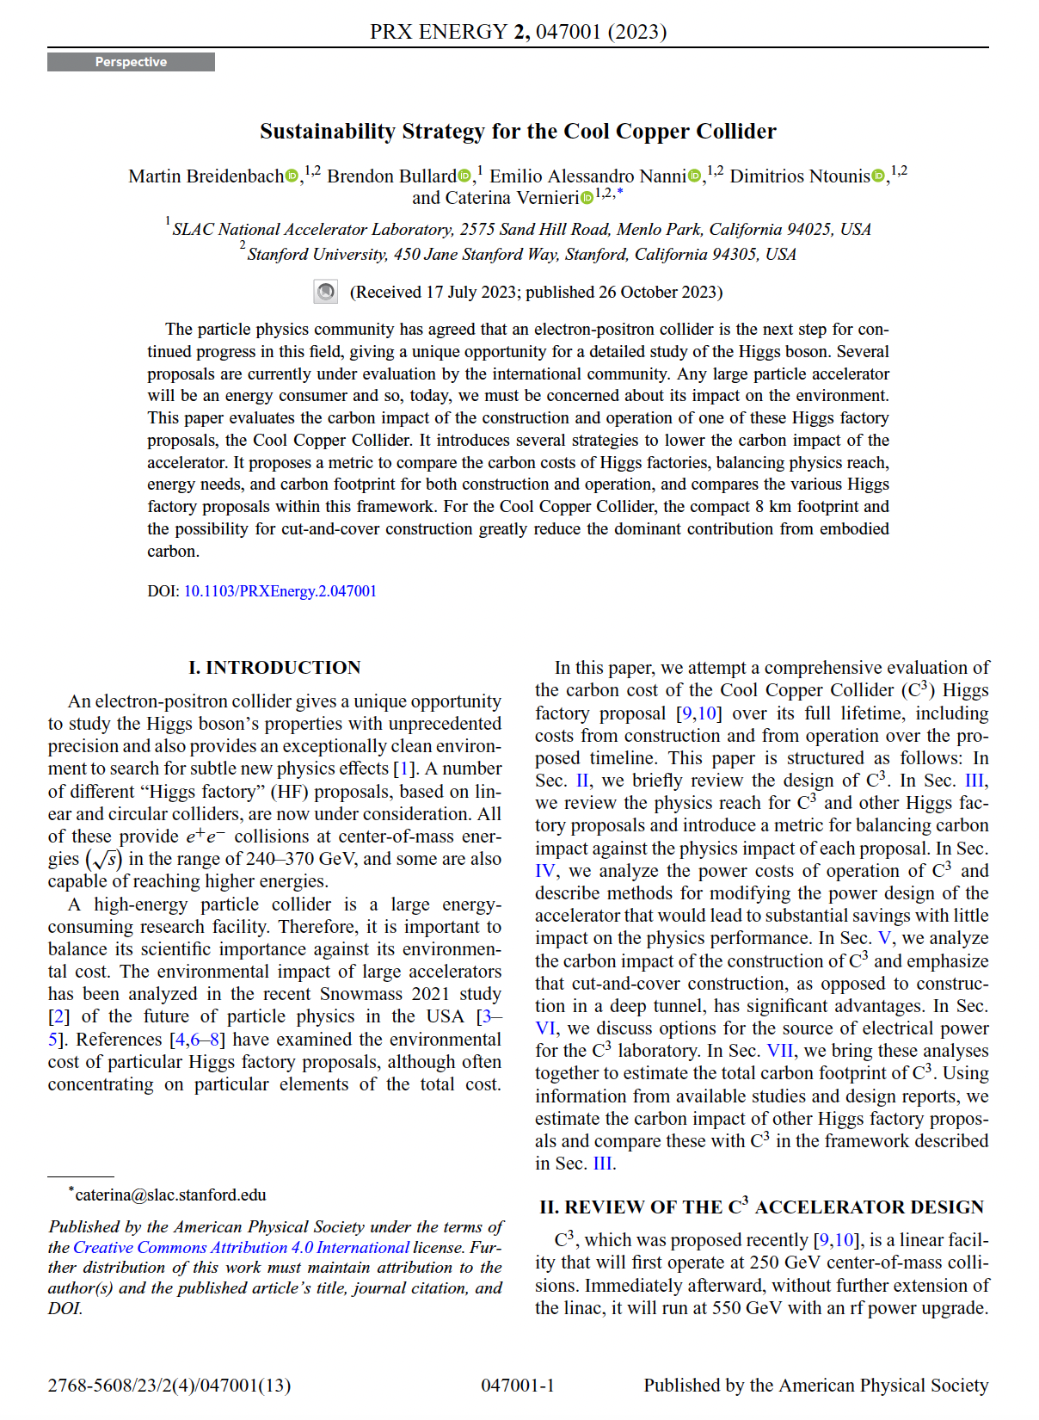
Publication Strategy
Consider 2 papers
  ARUP study
  More general “sustainability studies” paper
ARUP study
  Finished => publication ready
  Very thorough, conforms to international standards -> needs a strong methodology part, somewhat technical
  Authorship needs to include ARUP personnel
Sustainability Studies
  We have a lot of material
  Worth publishing
  Varying degree of thoroughness and rigor
  Certainly not worse than C3 sustainability paper
  Consider same journal:
  PRX Energy

Slide 7
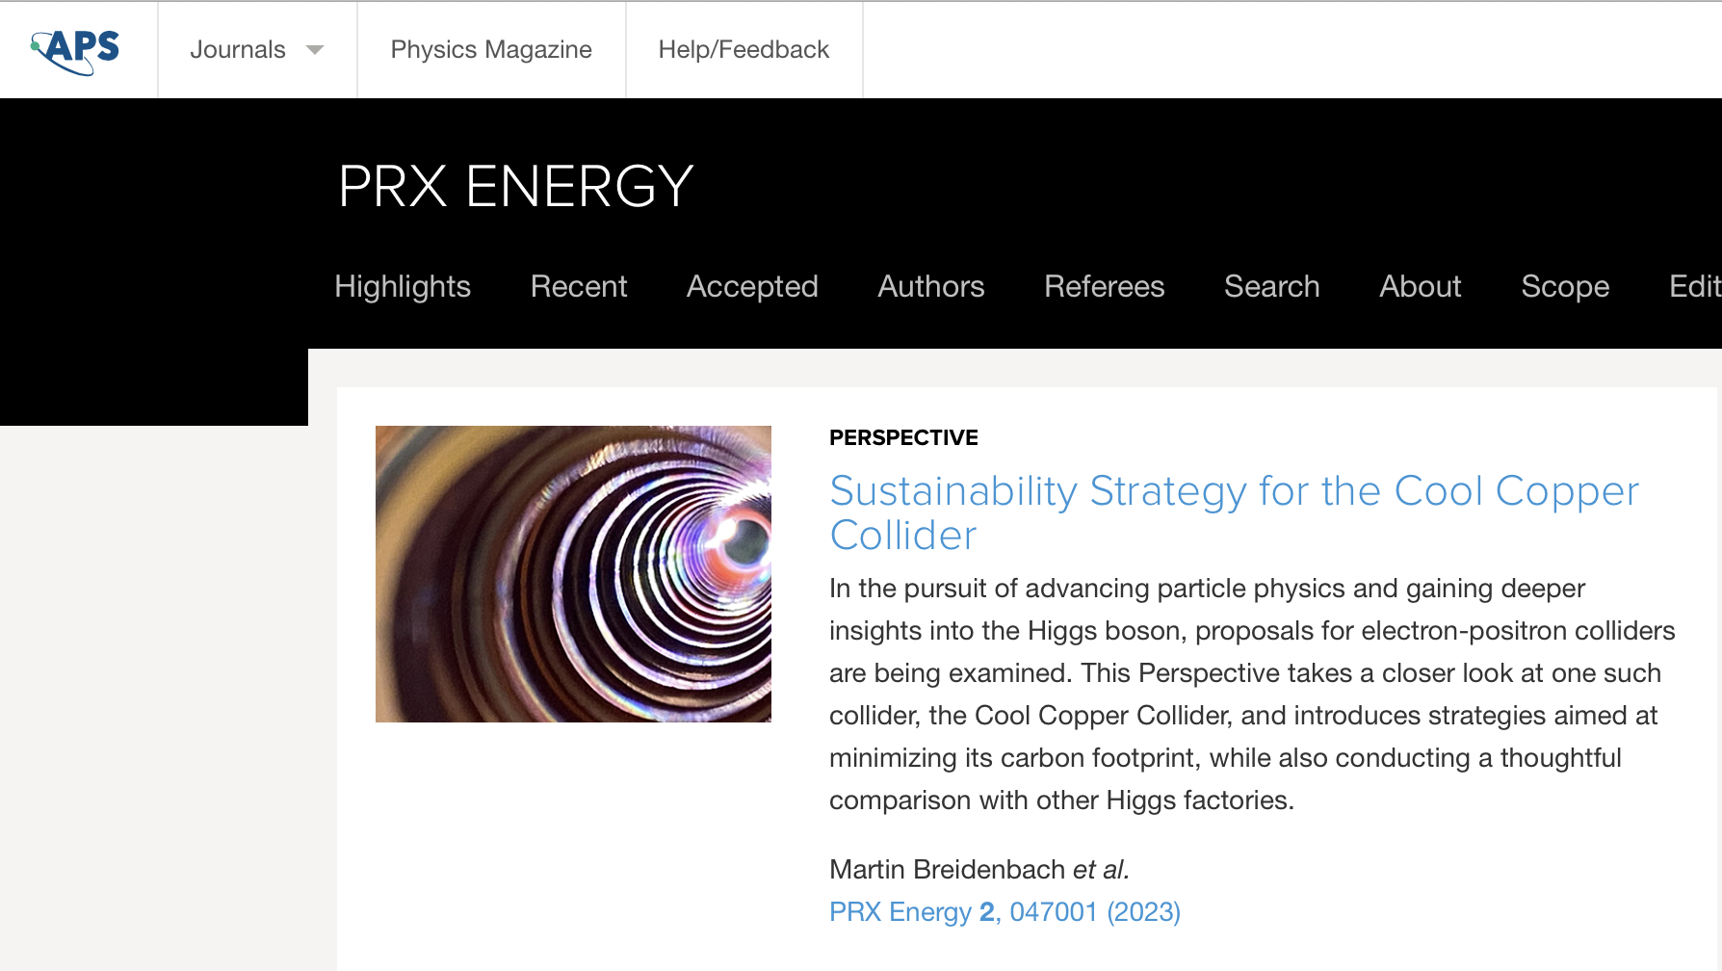
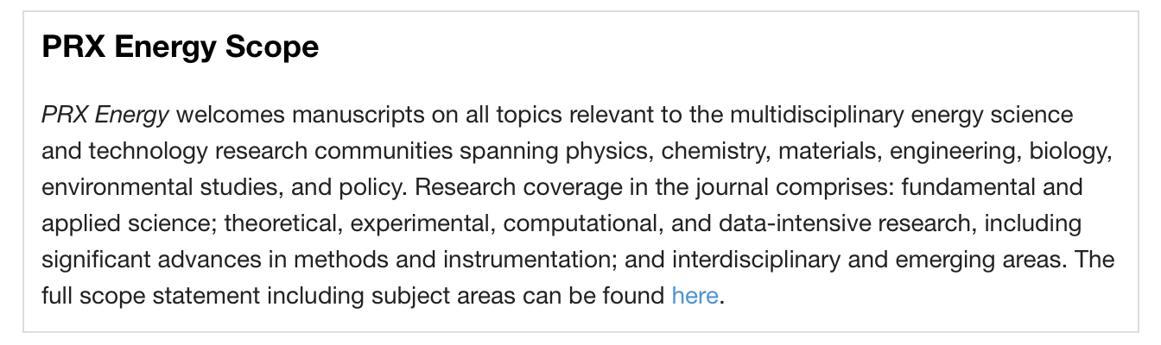

Journal: Physical Review X - Energy
https://journals.aps.org/prxenergy/
New: Launched April 22,
2 volumes

Slide 8
Digest of C3 Paper
C3 Paper (PRX Energy 2, 047001) adresses several aspects which should be covered in our paper. Chapter headings:
Power consumption and optimization
  Present our evaluation of power consumption (never shown in peer reviewed article)
Carbon impact of construction
  Refer to (separate) ARUP study
Mitigation Strategies for Operation
  Discusses projections for regional carbon intensity (check/refine -> Benno)
  Describe Fraunhofer study for CLIC -> Q: could this be updated???
  Discuss Japan concept for carbon offsets
Analysis of Total Carbon Footprint
  Sums it up
  Provide our own plots, including Carbon Profile (work out for ILC as well)
  Biggest issue: Estimate for accelerator construction!
To be discussed:
C3 paper has a chapter on “Comparison of Higgs Factory Physics Reach”
Tries to quantify physics benefit by weighted average of precision improvements over HL-LHC
Pro: Defines a measurable Key Performance Indicator KPI
Con: Approach is highly debatable
What do we do?
Adopt?
Argue?
Ignore?

Slide 9
Outline
Introduction
  Introduce Life Cycle concept, importance of overall design, three pillars (system design subsystem optimization, operation)
Accelerator Design
  Explain general approach (energy and lumi, construction vs operation, high gradient requires pulsed op + SC or 2-beam, effectiveness: nanobeam)
  Parameter tables
Construction
  LCA of civil construction
  LCA of accelerator (sketch!)
Operation
  Power consumption (tables, explanations / discussion)
  Operation modes (Fraunhofer study), mention demand side flexibility, prospects for RES
  Mitigation (CO2 offset, Green ILC, Heat recovery)
  Carbon intensity of el. power
Decommissioning
  One paragraph mentioning waste, including radioactive stuff, no quantitative analysis yet
LCA result
  Total carbon for specified run scenarios
  Carbon emission profile
  Mention need for more impact categories

Slide 10
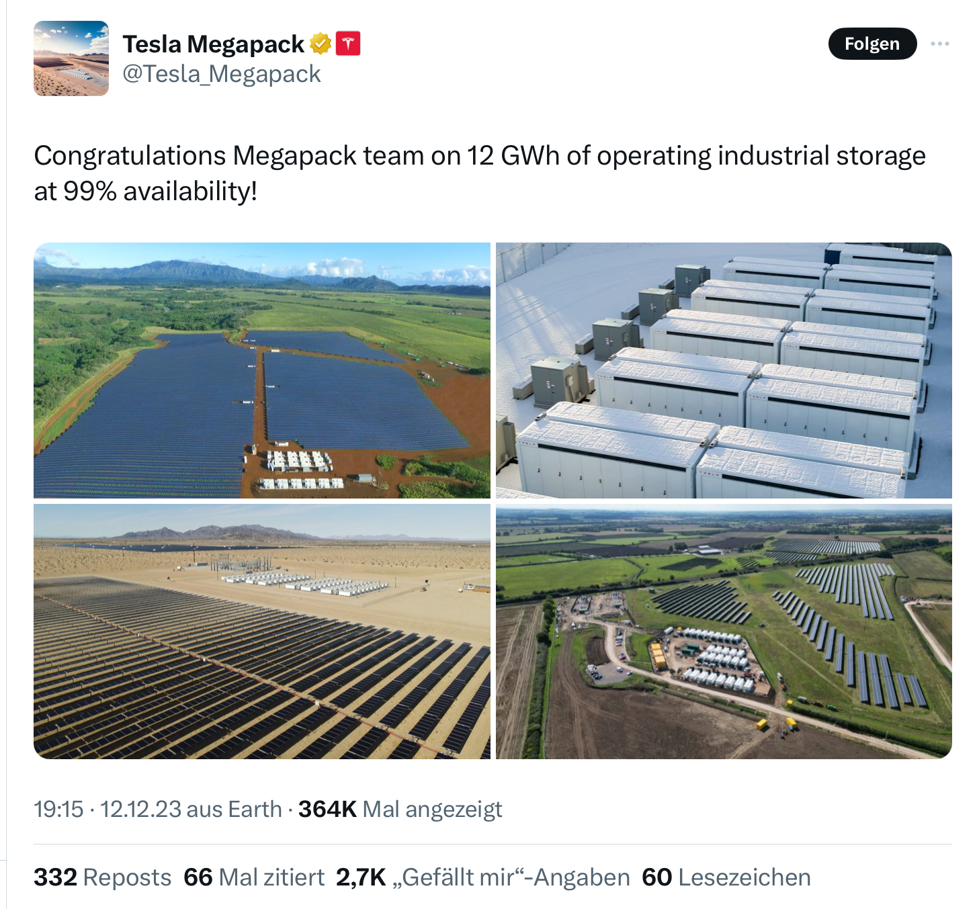
To Do
Unify approach to running time per year, machine development, downtimes etc; refine/define ILC power estimate in down times
Make carbon emission profile for ILC
Revisit potential for energy storage?
100MW x 10h = 1GWh possible
Accelerator LCA
Cost: ~2M$ for 3MWh according to
https://www.teslarati.com/tesla-hiring-megapack-factory/

