Slide 1
LC Sustainability: ICHEP, Publication Strategy, Accelerator LCA
Benno List, DESY
LC Sustainability meeting
Feb 15, 2024

Slide 2
Abstract for ICHEP
Sustainability Studies for Future Linear Colliders
Benno List, Shinichiro Michizono, Takayuki Saeki, Thomas Schörner-Sadenius, Steinar Stapnes, Maxim Titov
Sustainability has become a prioritized goal in the design, planning and implementation of future accelerators; approaches to improved sustainability include overall system design, optimization of subsystems, and operational concepts. A direct quantification of the ecological footprint, is currently performed only sporadically, with Lifecycle Assessments (LCA) emerging as a more comprehensive approach.
Two large electron-positron linear colliders are currently being studied as potential future Higgs-factories, CLIC at CERN and ILC in Japan. These projects are closely collaborating on methods to reduce the power consumption of accelerator components and systems, and smart integration of future accelerator infrastructure with the surrounding site and society. In a recent, common study an LCA of the construction of tunnels, caverns and shaft of both accelerators was conducted. This contribution will present this and other current results and future activities.
Presenter???

Slide 3
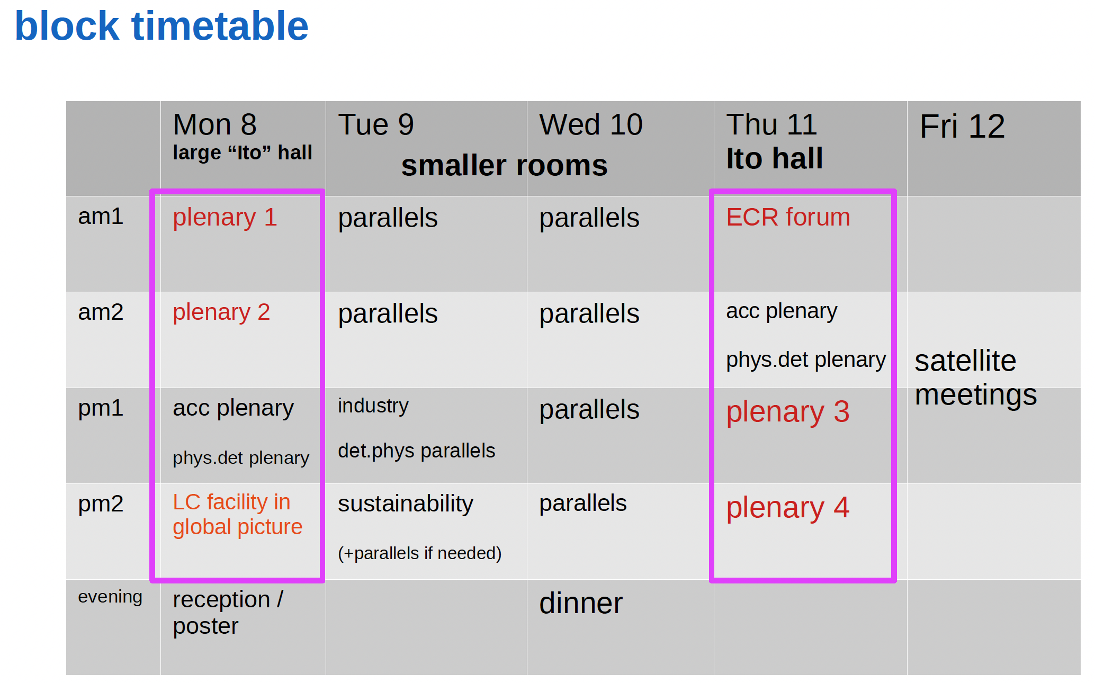
LCWS Sustainability Session and Further Workshops
Onveners list: https://agenda.linearcollider.org/event/10134/page/344-study-groups-and-conveners
Benno List (DESY)
Takayuki Saeki (KEK)
Brendon Bullard (SLAC)
Maxim Titov (CEA)
Need to get going
Is one plenary enough?
Further plans?

Slide 4
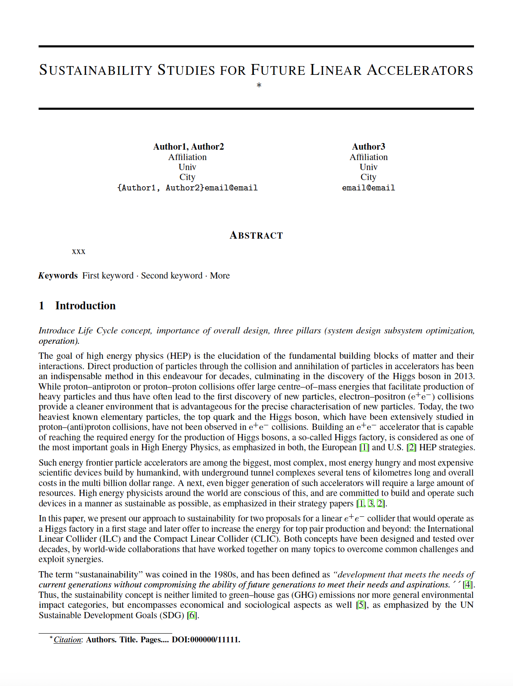
Paper on Overleaf – Have a Look, please
Introduction
Accelerator Design
Construction
Operation
Decommissioning
LCA Results
  Open Questions
Managing Sustainability
  Construction Phase
    Civil Engineering –Accelerator – Detectors - Organisation
  Operation
    Civil Engineering- Accelerator – Detectors- Campus and Site - Computing
  Decommissioning Phase
    Accelerator
  Cross Cutting Activities
Acknowledgments

Slide 5
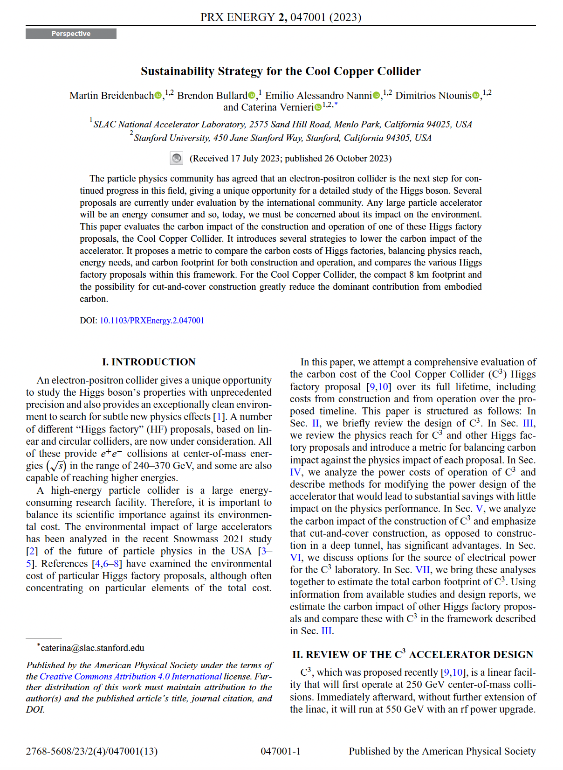
Publication Strategy
Consider 2 papers
  ARUP study
  More general “sustainability studies” paper
ARUP study
  Finished => publication ready
  Very thorough, conforms to international standards -> needs a strong methodology part, somewhat technical
  Authorship needs to include ARUP personnel
Sustainability Studies
  We have a lot of material
  Worth publishing
  Varying degree of thoroughness and rigor
  Certainly not worse than C3 sustainability paper
  Consider same journal:
  PRX Energy

Slide 6
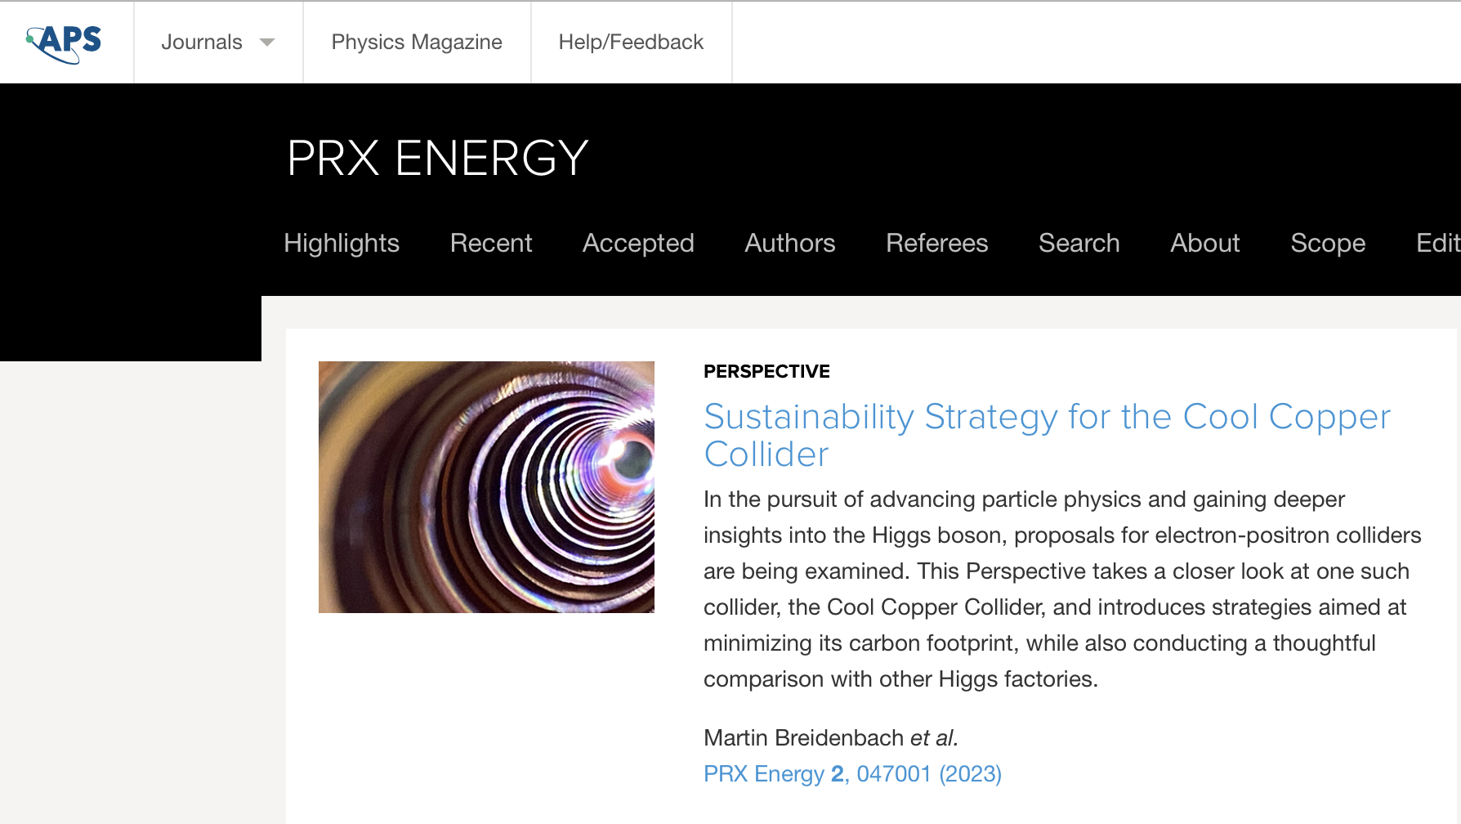
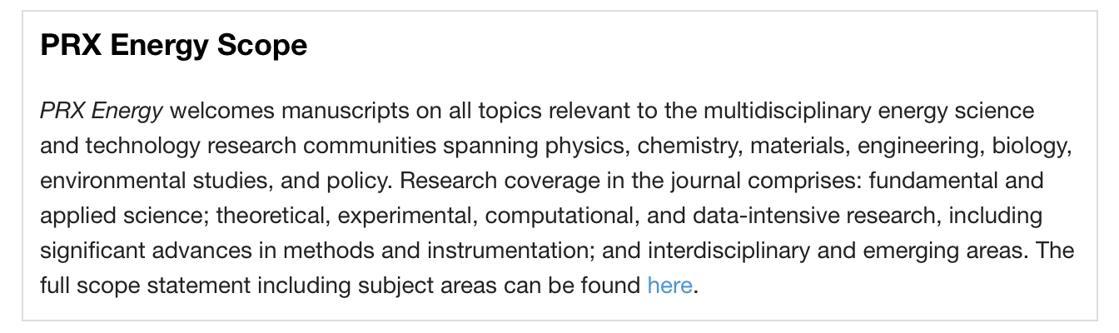
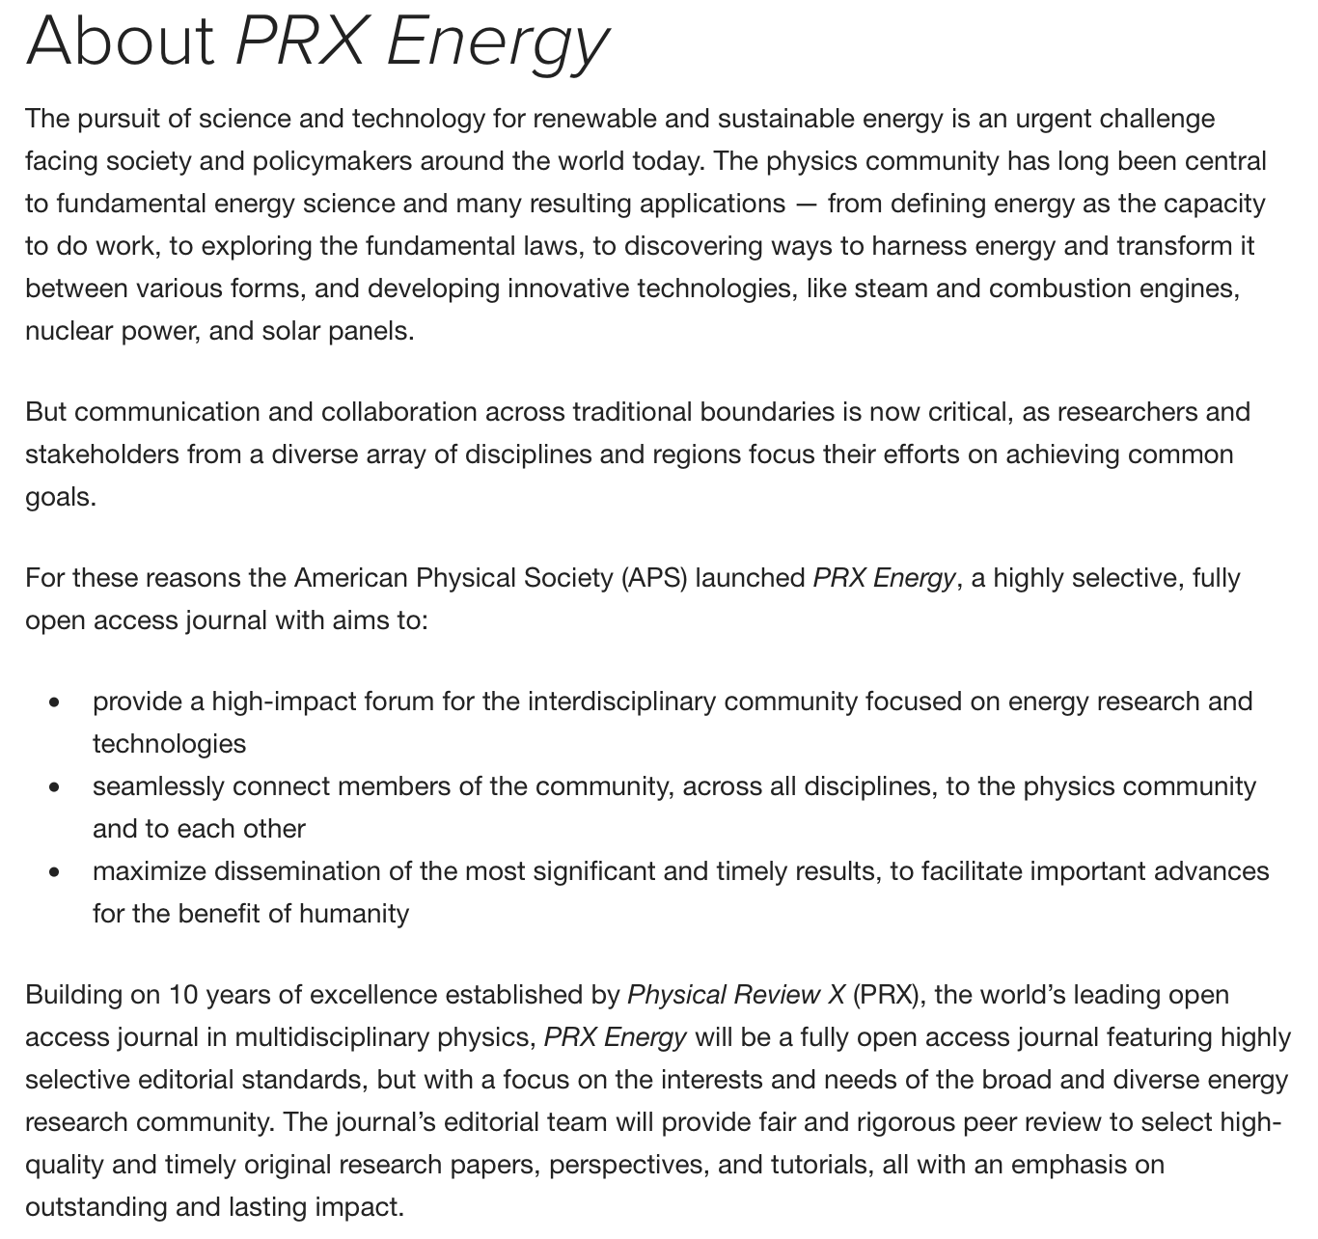
Journal: Physical Review X - Energy
https://journals.aps.org/prxenergy/
New: Launched April 22,
2 volumes

Slide 7
Digest of C3 Paper
C3 Paper (PRX Energy 2, 047001) adresses several aspects which should be covered in our paper. Chapter headings:
Power consumption and optimization
  Present our evaluation of power consumption (never shown in peer reviewed article)
Carbon impact of construction
  Refer to (separate) ARUP study
Mitigation Strategies for Operation
  Discusses projections for regional carbon intensity (check/refine -> Benno)
  Describe Fraunhofer study for CLIC -> Q: could this be updated???
  Discuss Japan concept for carbon offsets
Analysis of Total Carbon Footprint
  Sums it up
  Provide our own plots, including Carbon Profile (work out for ILC as well)
  Biggest issue: Estimate for accelerator construction!
To be discussed:
C3 paper has a chapter on “Comparison of Higgs Factory Physics Reach”
Tries to quantify physics benefit by weighted average of precision improvements over HL-LHC
Pro: Defines a measurable Key Performance Indicator KPI
Con: Approach is highly debatable
What do we do?
Adopt?
Argue?
Ignore?

Slide 8
Outline
Introduction
  Introduce Life Cycle concept, importance of overall design, three pillars (system design subsystem optimization, operation)
Accelerator Design
  Explain general approach (energy and lumi, construction vs operation, high gradient requires pulsed op + SC or 2-beam, effectiveness: nanobeam)
  Parameter tables
Construction
  LCA of civil construction
  LCA of accelerator (sketch!)
Operation
  Power consumption (tables, explanations / discussion)
  Operation modes (Fraunhofer study), mention demand side flexibility, prospects for RES
  Mitigation (CO2 offset, Green ILC, Heat recovery)
  Carbon intensity of el. power
Decommissioning
  One paragraph mentioning waste, including radioactive stuff, no quantitative analysis yet
LCA result
  Total carbon for specified run scenarios
  Carbon emission profile
  Mention need for more impact categories

Slide 9
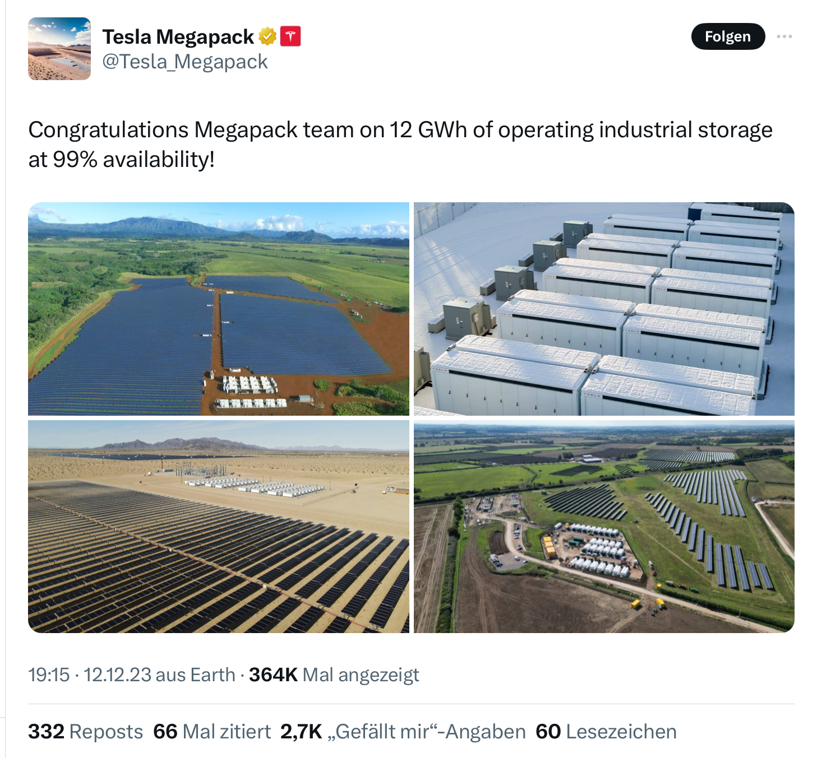
To Do
Unify approach to running time per year, machine development, downtimes etc; refine/define ILC power estimate in down times
Make carbon emission profile for ILC
Revisit potential for energy storage?
100MW x 10h = 1GWh possible
Accelerator LCA
Cost: ~2M$ for 3MWh according to
https://www.teslarati.com/tesla-hiring-megapack-factory/

Slide 10
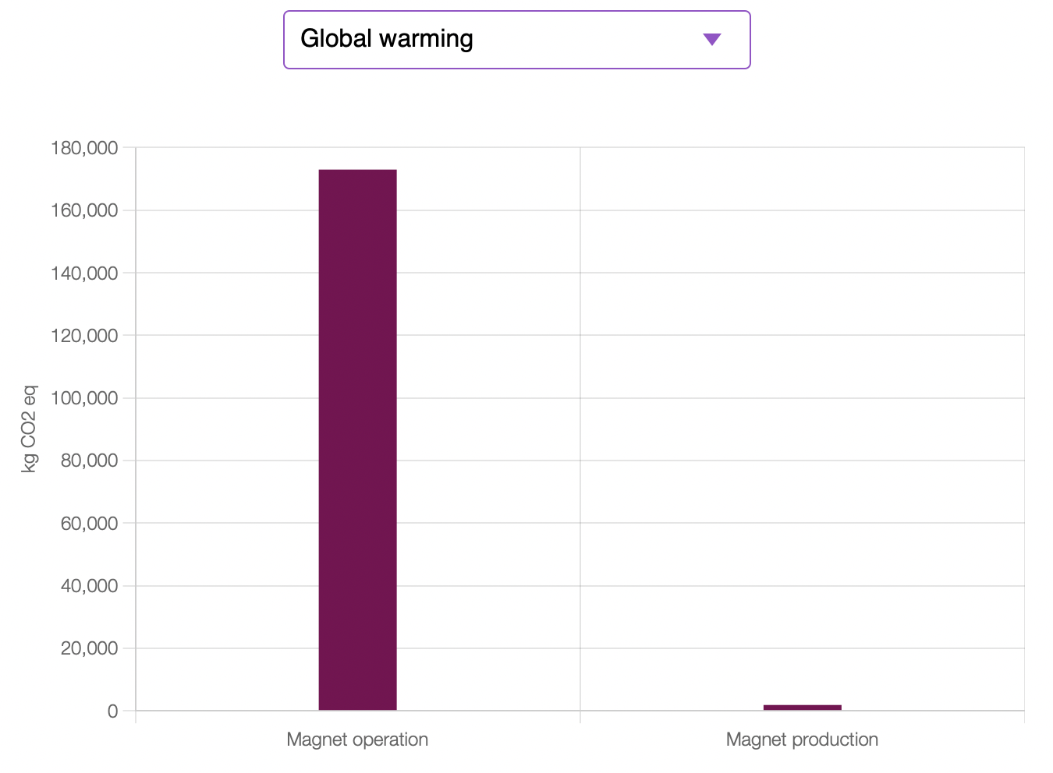
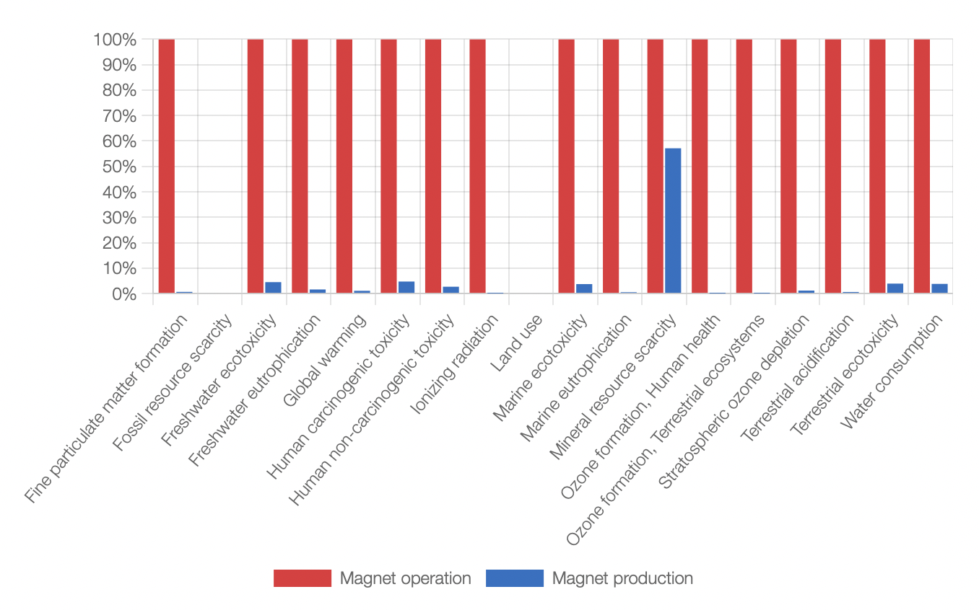
Accelerator LCA
I have re-started work on magnets:
Following discussions with Hannah Wakeling, I work with OpenLCA (https://www.openlca.org )
Allows to make a professional LCA of a magnet -> good, but a LOT of work
Could be used to get impact factors (kg steel / kg copper -> GWP or other estimators) and apply that to all magnets in a list
Restarted looking at CLIC list of magnets

Slide 11
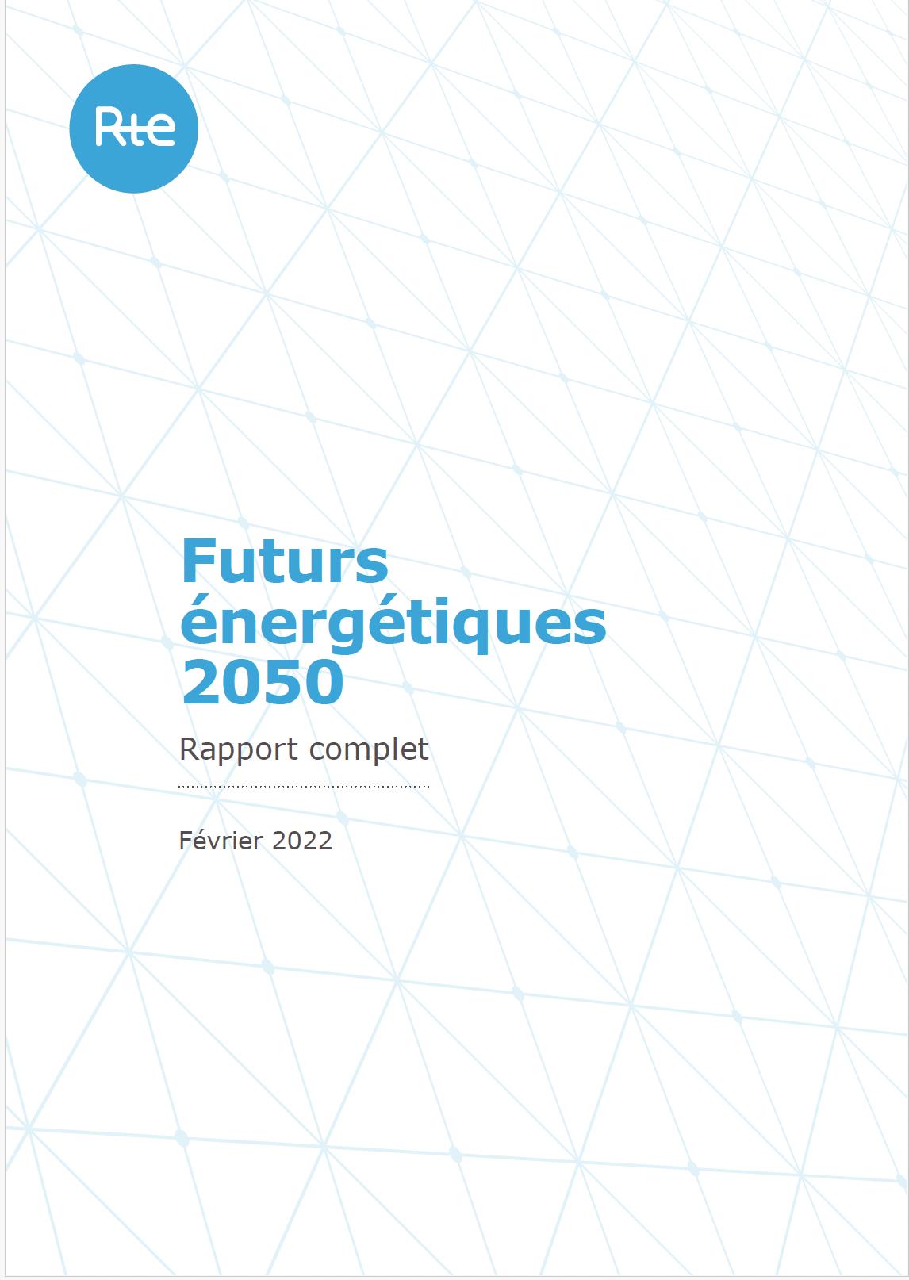
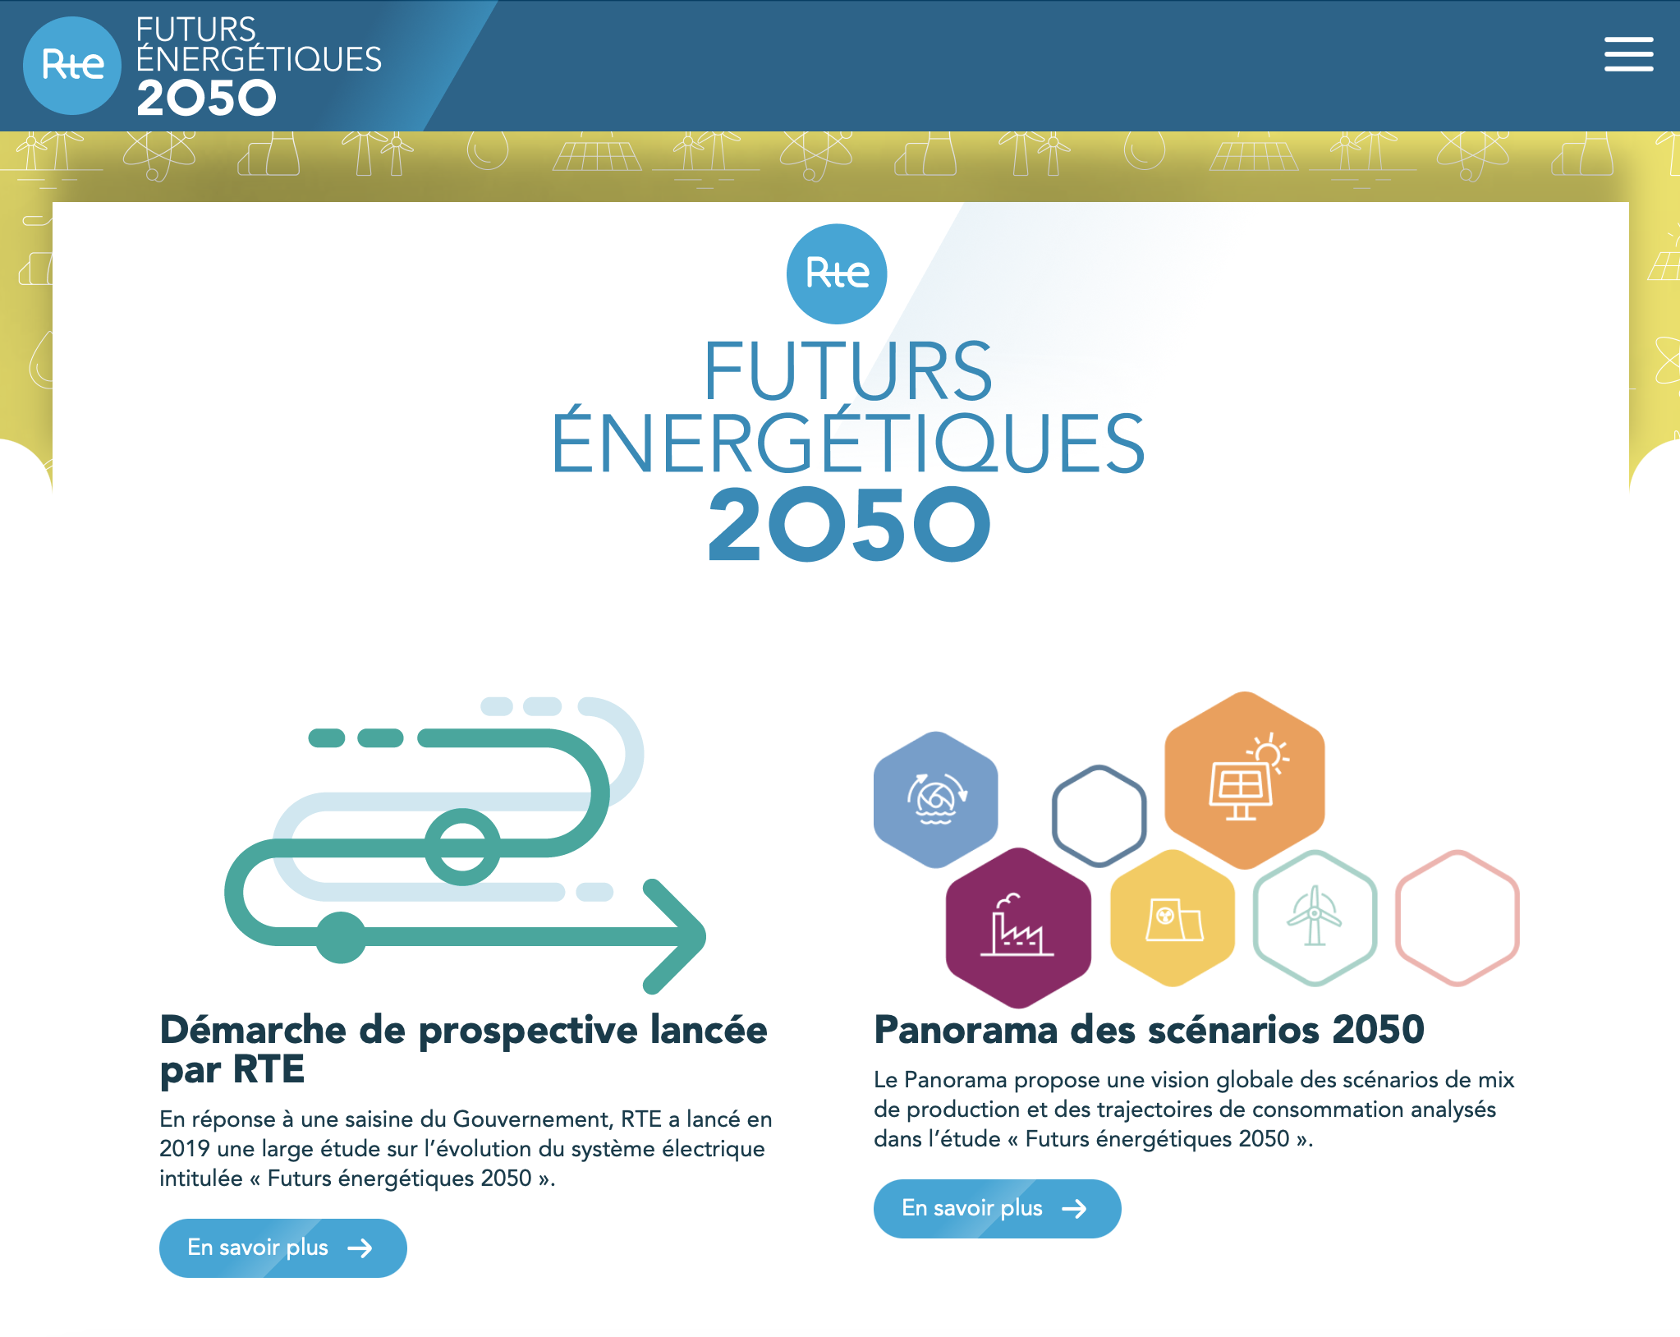
Electricity Carbon Intensities in France
https://assets.rte-france.com/prod/2022-06/Futurs%20énergétiques%202050%20_%20rapport%20complet.zip
https://rte-futursenergetiques2050.com

Slide 12
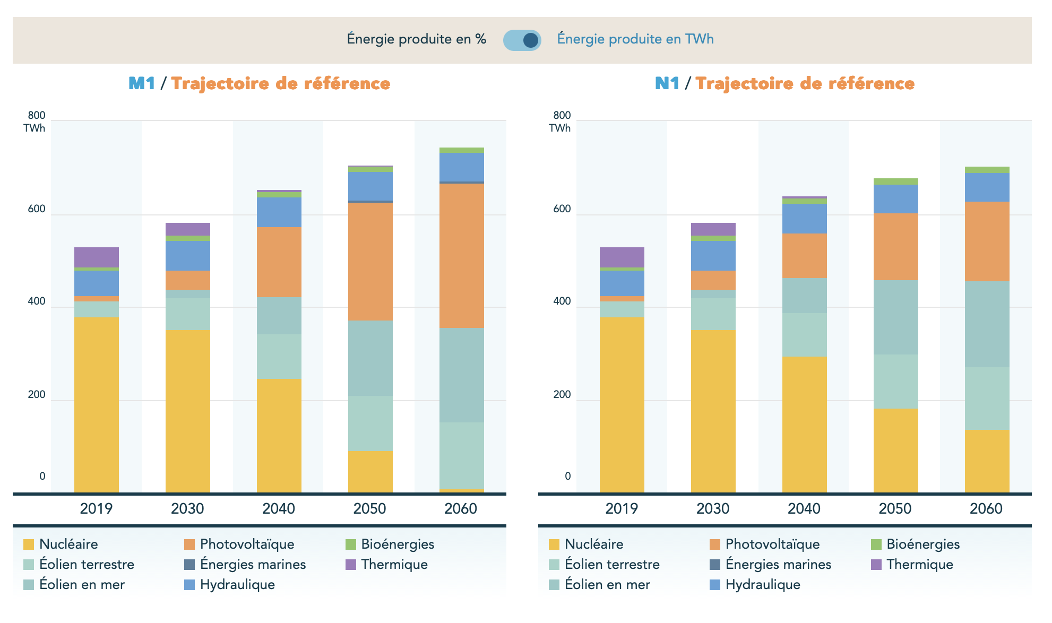
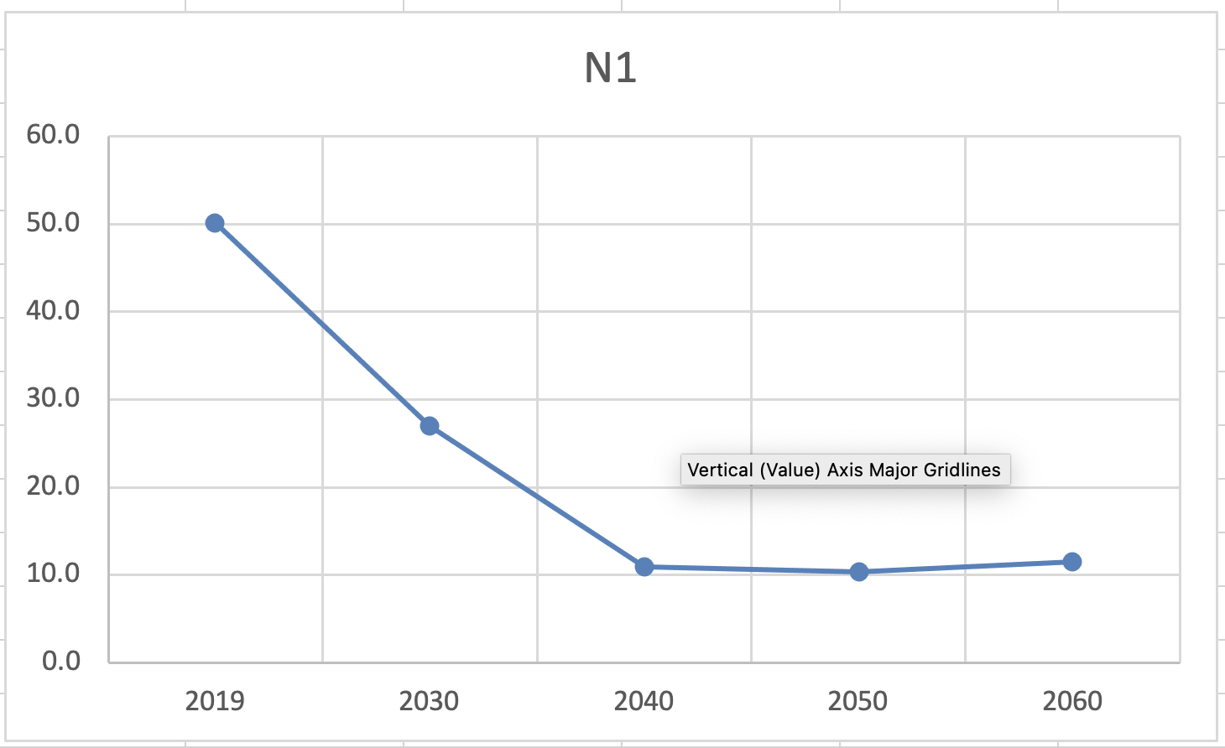
RTE Study
RTE (https://www.rte-france.com ):
réseau de transport d'électricité français -
the French grid operator
Study provides detailed scenarios with many variations for development of French electricity mix up to 2050
Enough data to calculate CO2 emission factors
-> plan: consolidate this to have meaningful reference numbers
Broadly in agreement with our “12.5 g/kWh”
https://rte-futursenergetiques2050.com
My calc

