Slide 1

The T2K TPC upgrade
Collaboration Meeting
March 12-14, 2024
Paul Colas, Irfu/DPhP
And also Tristan Daret, Shivam Joshi, Samira Hassani, Jean-François Laporte…
Thanks to Thorsten Lux and David Henaff to whom I stole slides

Slide 2
Introduction
T2K (Tokai to Kamioka) is a long baseline νe-νμ oscillation experiment in Japan. ND280 is the near detector at 280m from the target, used to monitor the beam composition and intensity.
The tracking is carried out by large TPCs (Proposal by Dean Karlen and Marco Zito).
Upgrade in progress by adding 2 more ‘High Angle TPCs’ to the 3 vertical ones on each side of an instrumented target

Slide 3
These TPCs were very much inspired by LCTPC R&D, both for the field cage and for the Micromegas TPCs. Standard readout for the first 3, and resistive readout for charge sharing for the last 2.
The requirement differs from ILC’s : more relaxed space resolution (several 100 microns), and dE/dx e-µ separation rather than K-π

Slide 4
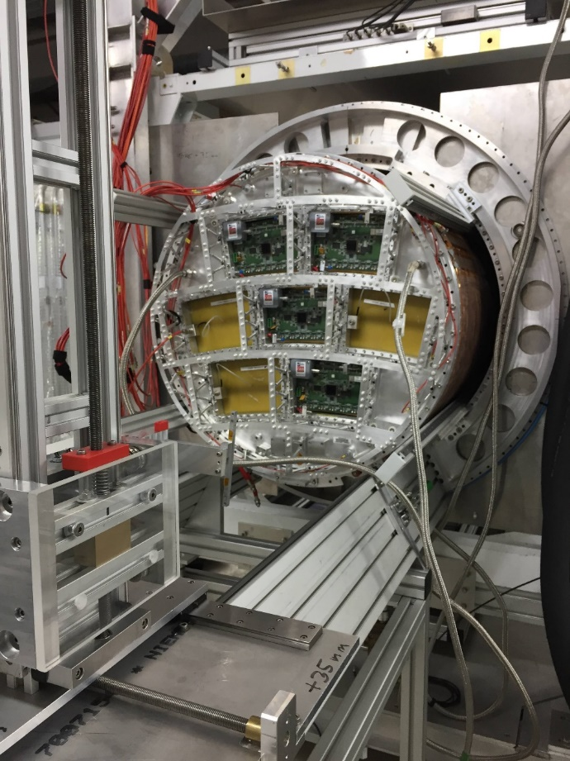
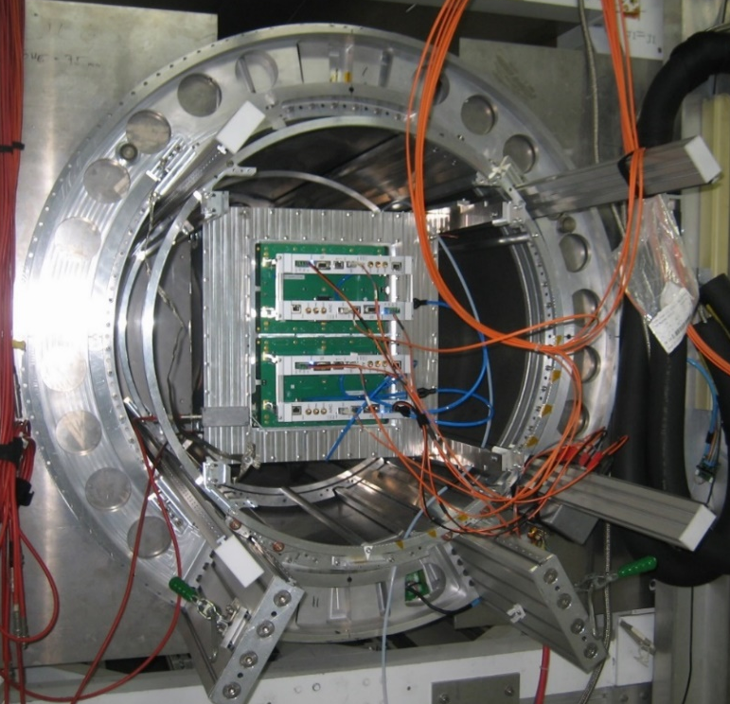
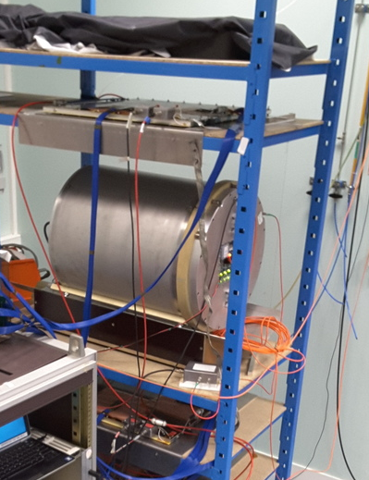
A lot was learnt in the last decade
Beam test at DESY in 2015 (LCTPC, 2 DLC modules)
Cosmic-ray test at Saclay in 2017 (T2K)
Beam test at CERN in August 2018 (T2K)
Beam test at DESY in November 2018 (LCTPC)
Cosmic-ray test in Saclay since January 2019 (LCTPC/FCC)
Beam test at DESY in June 2019 (T2K)
Cosmic test at CERN since December 2019 (T2K)
Cosmic tests in Saclay in 2020 (T2K)
Beam test a DESY in June 2021
Cosmic test at CERN in 2022
Systematic characterization of ~40 T2K modules, X-ray test bench, CERN 2022-2024
5 TPC of 15, 58, 60, 100 and 150 cm length with 1000 to 2000 channels
All with DLC charge spreading
Overal conclusion : extremely reliable and stable operation

Slide 5
Largely based on the LC-TPC design
Note that the first half cage realized exhibited current leakage, preventing a normal operation. This problem arised from an antistatic spray. Extra insulation was added.

Slide 7
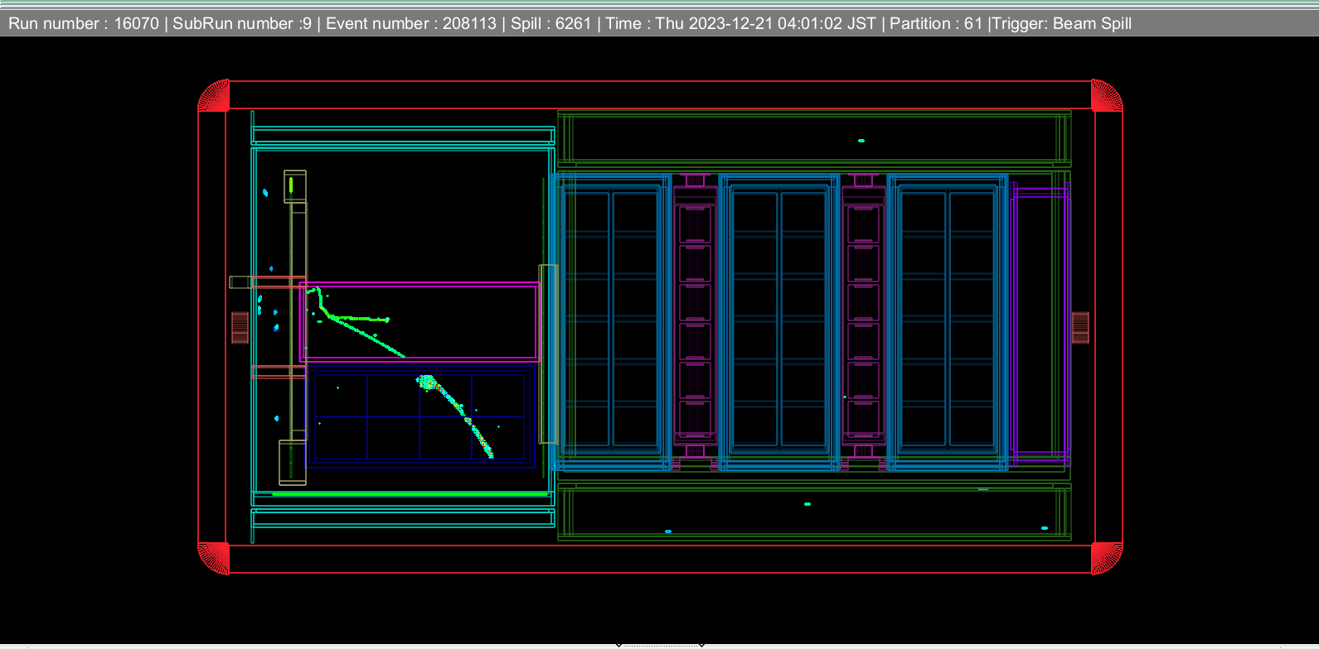
Bottom TPC delivered at JPARC on August 25. It was shipped by plane. Re-tested in surface building.
Installed in the UA1 magnet on September 7th.
Commissioned September-October 2023. Cosmics and debugging.
Data taking February 5 to March 6. Stable operation.
One of the first event displays :

Slide 8
Charge Sharing
See talk by Shivam Joshi at Collaboration meeting 2023

Slide 9
Particle Identification by dE/dx
Slides by Tristan Daret

Slide 10
Must adapt to the case with charge sharing of resistive Micromegas (ERAM)

