Slide 1
ILC Weekly Meeting
05.30.2024

Slide 2
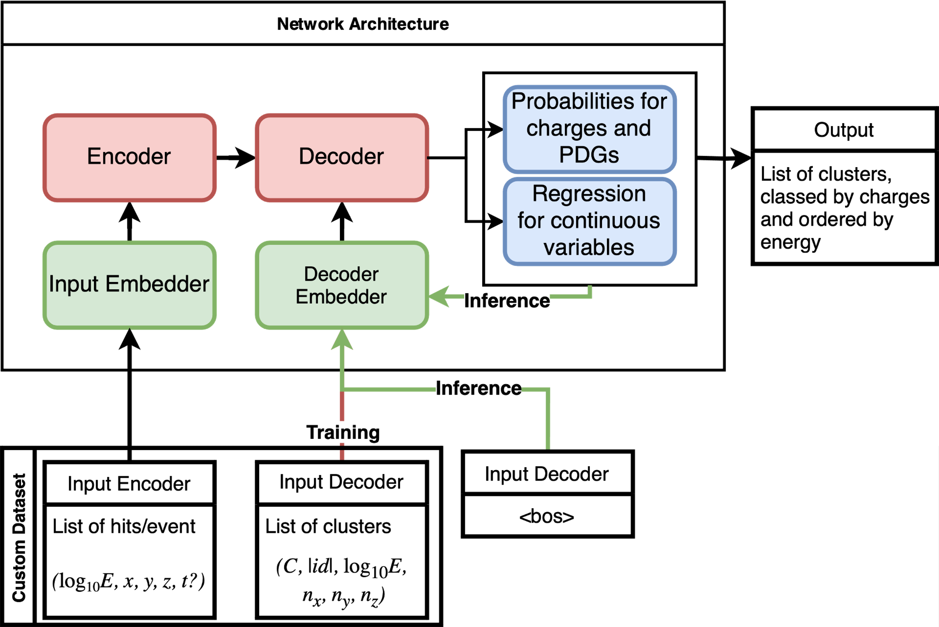
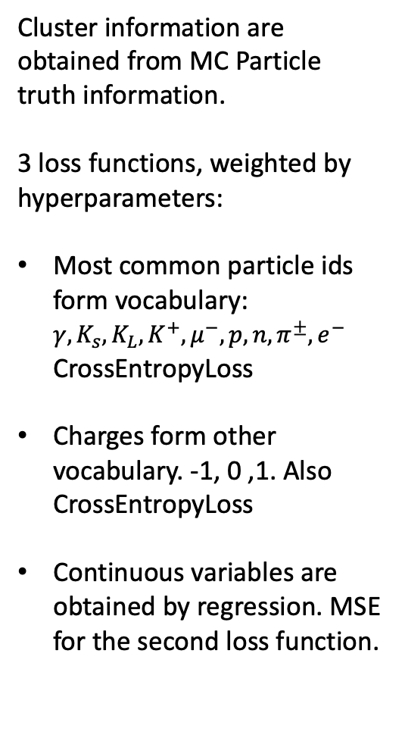
Recap
Cluster information are obtained from MC Particle truth information.
3 loss functions, weighted by hyperparameters:
Most common particle ids form vocabulary: $γ, K_{s}, K_{L},K^{+}, μ^{−}, p, n, π^{±}, e^{−}$ CrossEntropyLoss
Charges form other vocabulary. -1, 0 ,1. Also CrossEntropyLoss
Continuous variables are obtained by regression. MSE for the second loss function.

Slide 3
Since 2 weeks ago
Implemented method to shrink labels from awkward arrays to 1 representative/ cluster
Implemented the vocabularies for PDGs and charges necessary for loss functions
Implemented the validate, train and inference function. Still needs testing
Git repository at: https://github.com/Paul-3004/ILANCE_Transfo.git
Custom Dataset is now fully operational

Slide 4
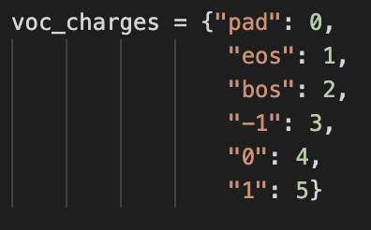
Loss functions
Pytorch’s CrossEntropyLoss for charges and particles pdg
  Possibility to ignore a specified index, as long as the index is the same as target value
Pytorch’s MSELoss for continous DOF.
  No possibility of directly ignoring special tokens
Necessary to create vocabularies for charges and particles, then implemented in the Dataset’s special tokens
Can ignore the values by applying mask and setting their values to 0 manually.

Slide 5
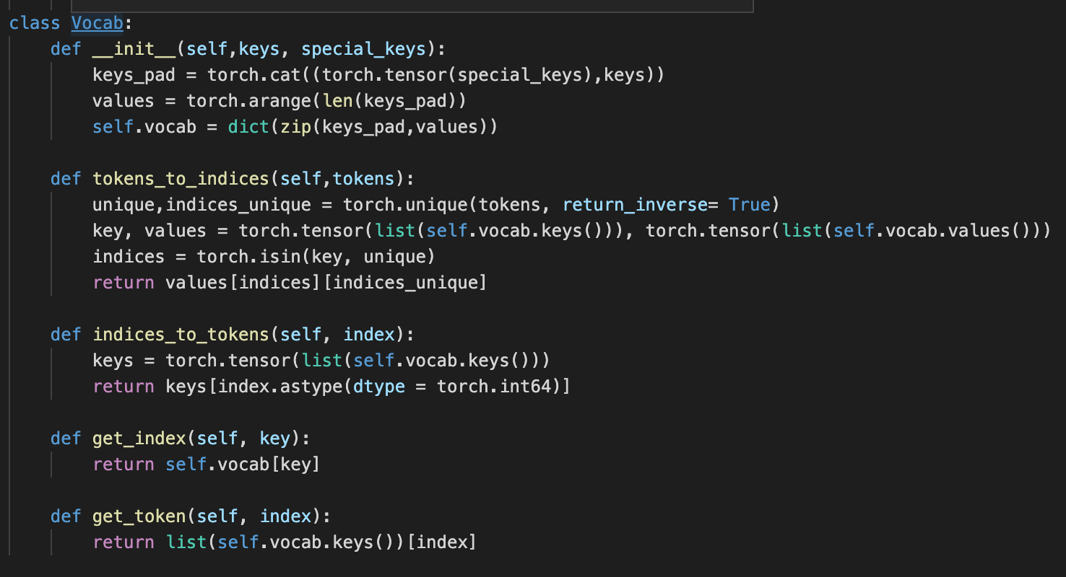
Vocabs I
One class for both instances
Basically a dict that can do translation
Keys: actual values of the charges/PDGs
Values: unique indices associated to each particle
3 first entries are for the special keys (tokens)

Slide 6
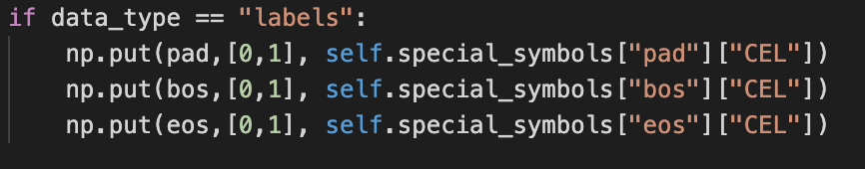
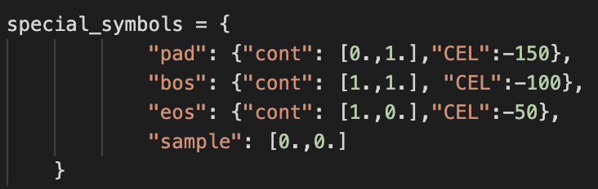
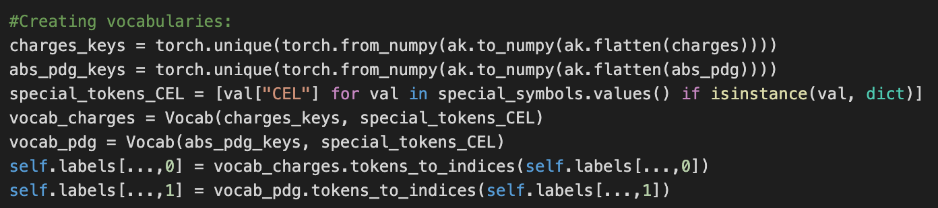
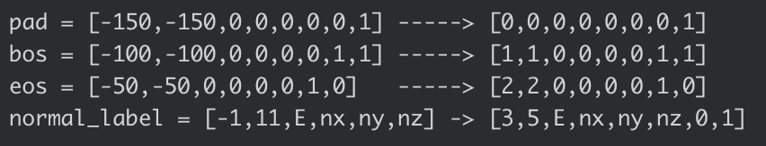
Vocabs II
In AddSpecialSymbols::__call__
Need to update special tokens during formatting
Adding values of keys in special tokens
Creating and using vocabs to translate
In CollectionHits::formatting

Slide 7
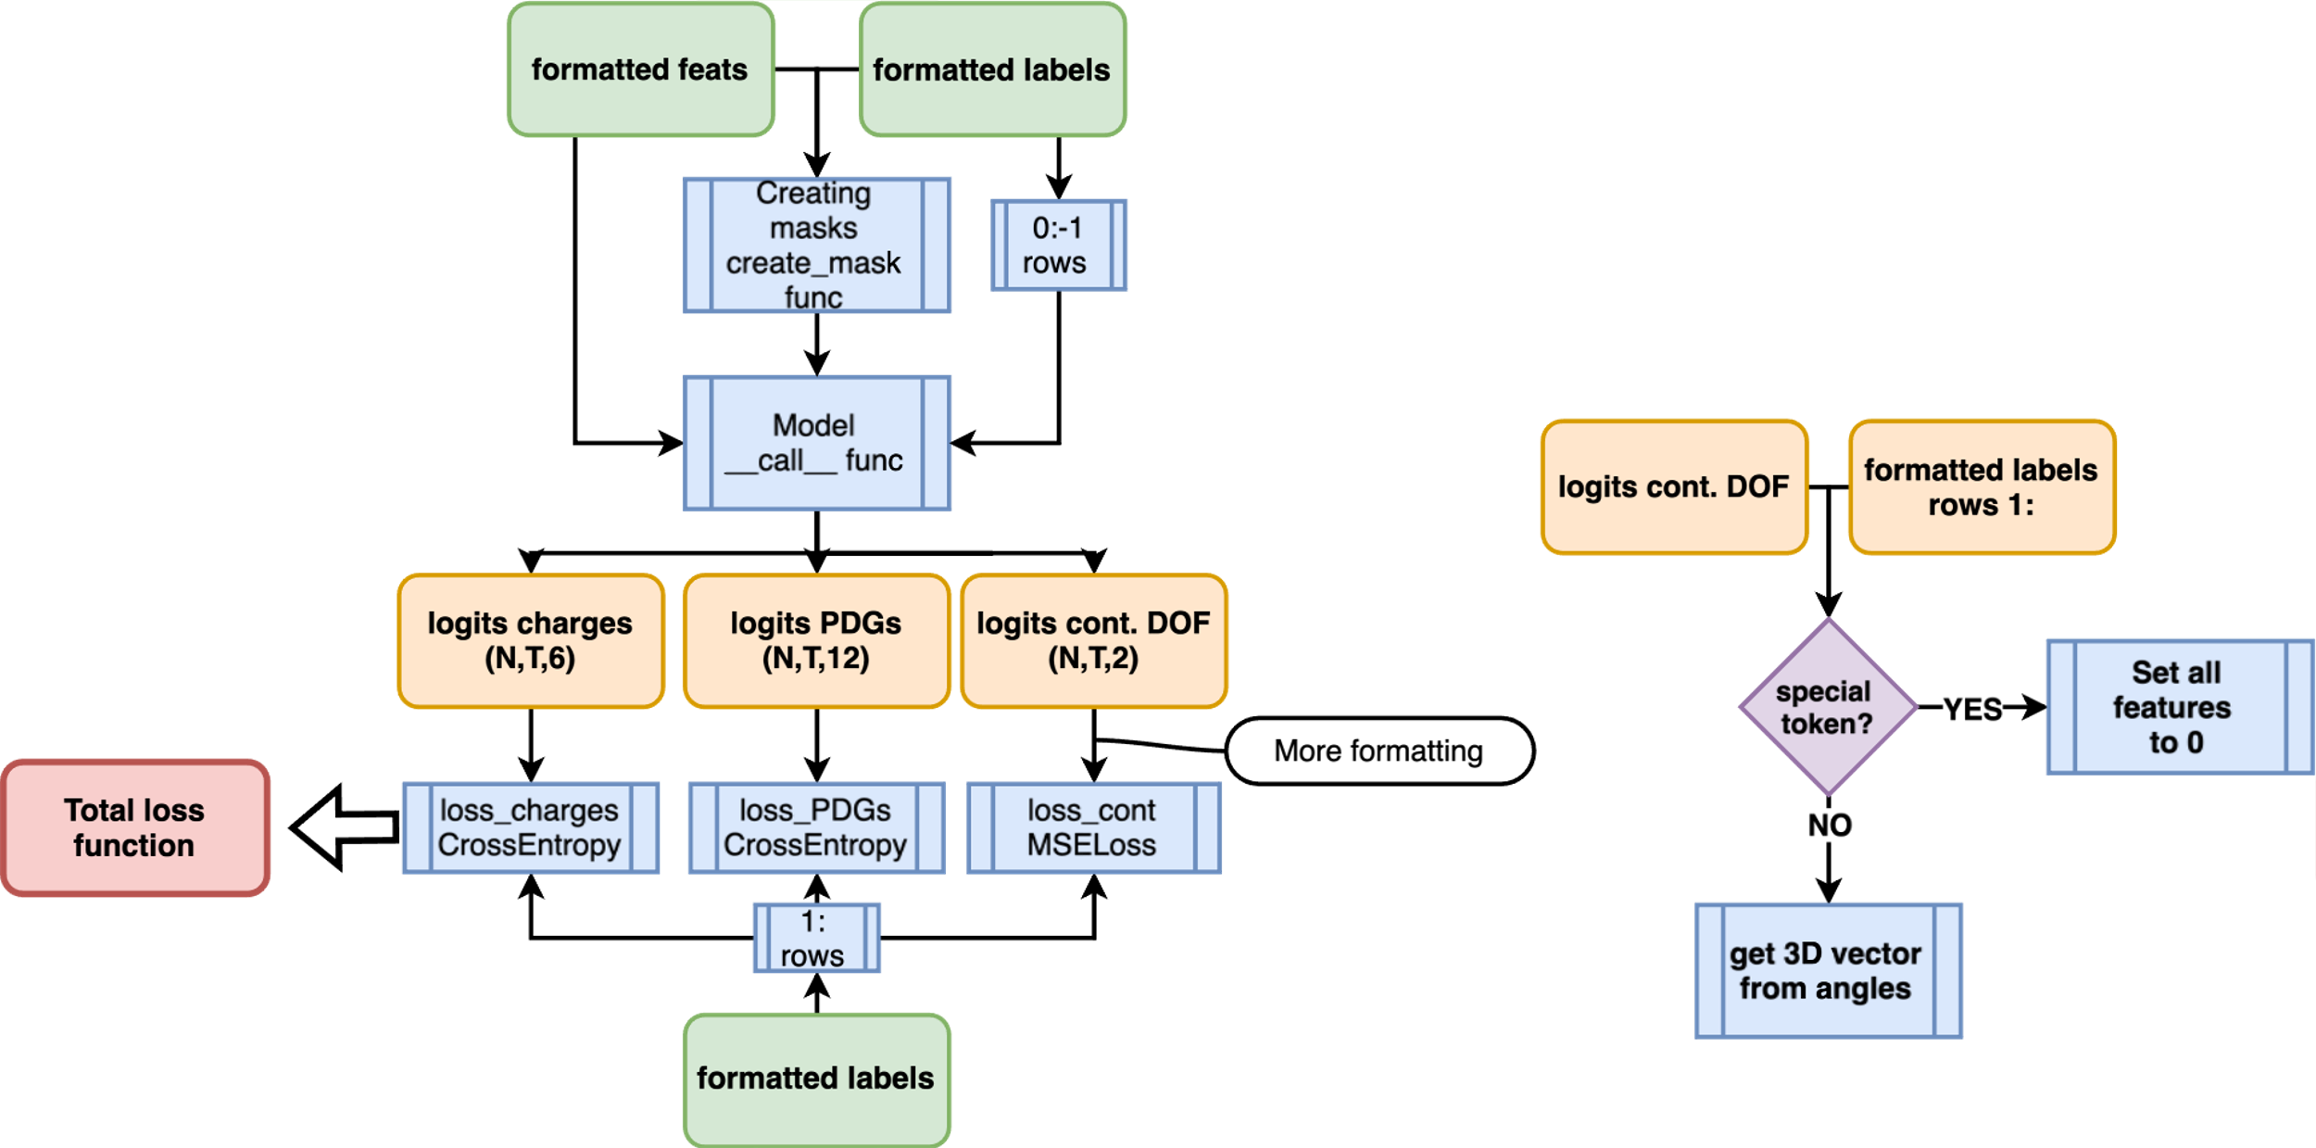
Training

Slide 8
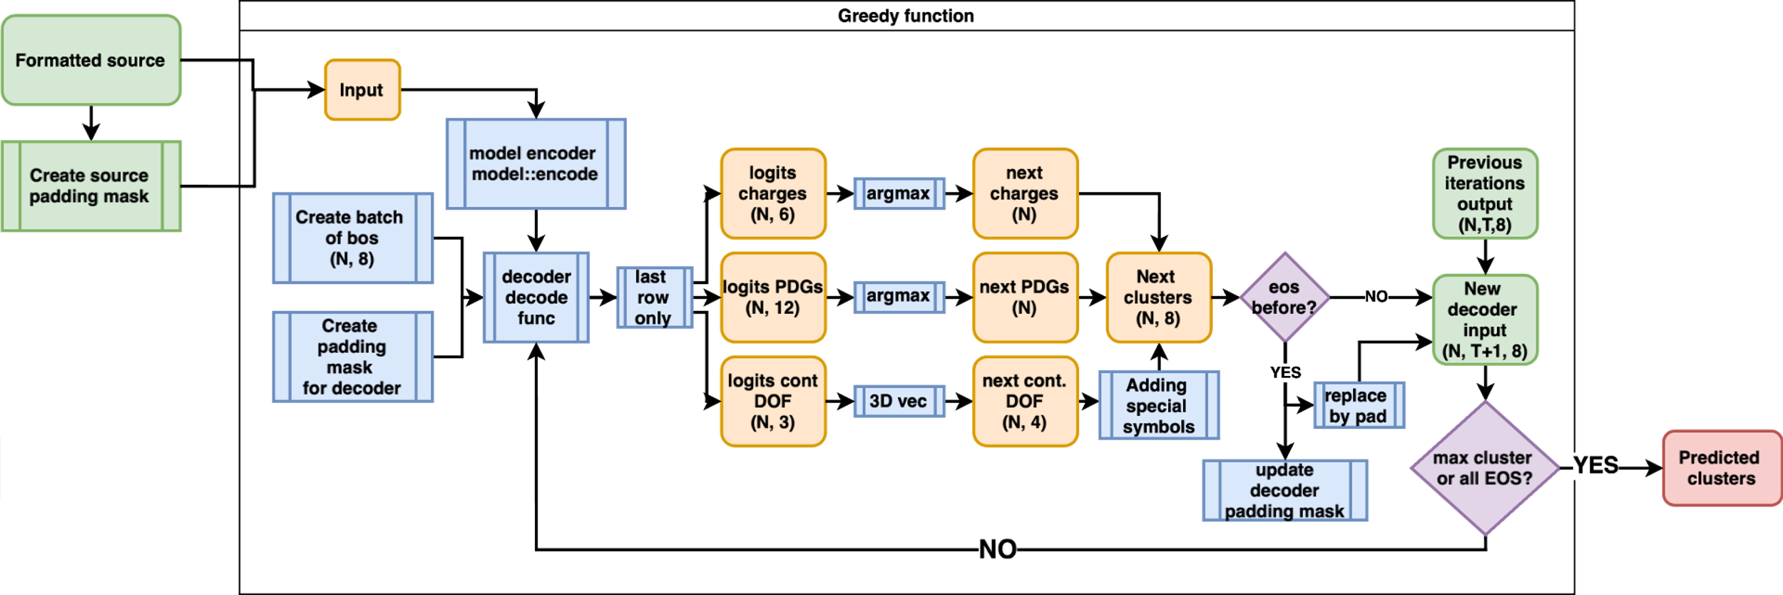
Inference

