Slide 1
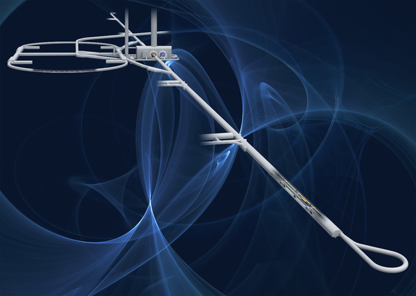
Implenting a Transformer as a Particle Flow Algorithm
03.07.2024
Paul Wahlen,
Supervised by Taikan Suehara & Junping Tian

Slide 2
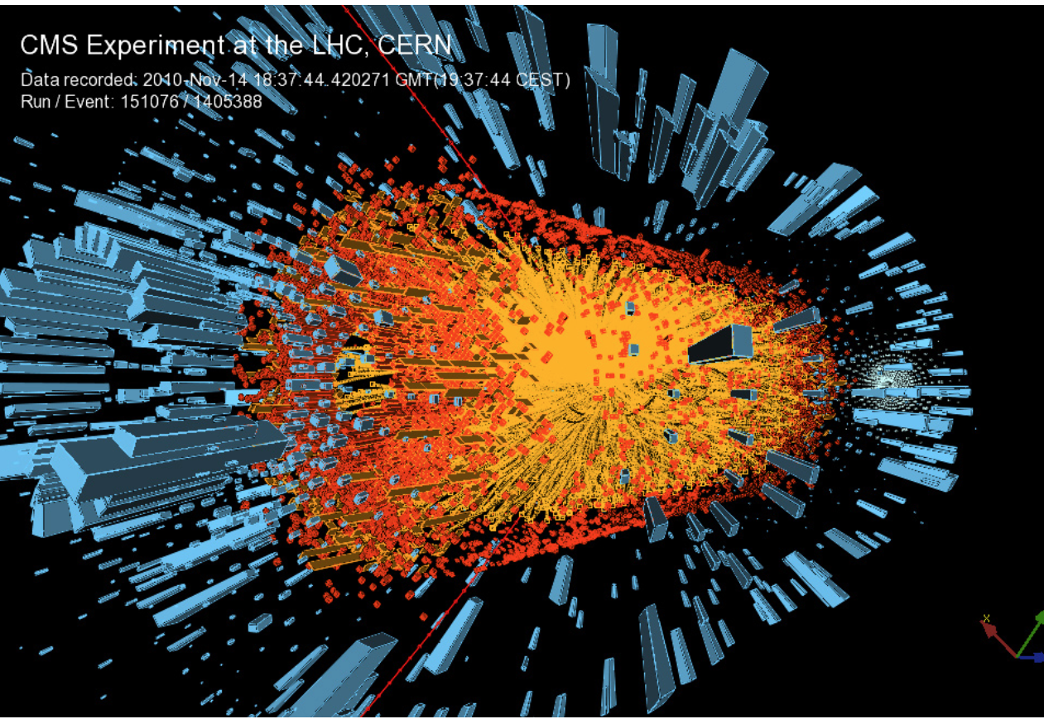
The problem with particle accelerators…
Particles produced during collision
Going through the detectors…

Slide 3
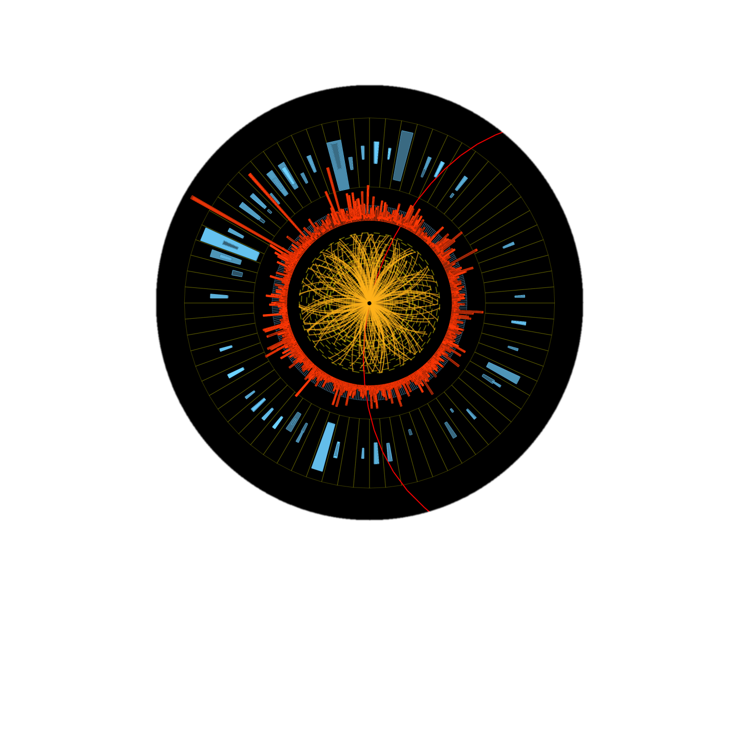

The problem with particle accelerators…
?
?
PDG?
Energy?
Momentum?
From the detectors, how do we retrieve the particles initially produced?
Only energy deposits and tracks are left behind

Slide 4





A possible solution (hopefully)
Charge
PDG
Energy
Momentum
Energy deposit
Position
Looks somewhat similar to a well known problem: machine translation
My name is Paul
私はポールです
Nowadays, achieved using a Neural Network called Transformer

Slide 5
Project concept
Using a Transformer to predict the particles generating the clusters
 | Sequence to Sequence | Physics
Input | Sentence | List of hits from 1 event
Output | Machine translation of Seq | List of clusters to which belongs each hit
token | Depends, words/ few char. | 1 hit
Special tokens | bos, eos, unkwn, pad | bos, eos, sample, pad
Special symbols and general formatting of the raw dataset is done by a custom Pytorch’s Dataset

Slide 6
Machine Translation
List of probabiliities for each token
私
My Name is Paul
1
24
47
1
24
0.95
47
1
24
1
24
47
47
1
Tokenization
My
Name
is
Paul
Look up from vocab.
0
3
5
47
24
1
Input to Transformer
Higher dim. embedding
0
3
5
47
24
1
0
3
5
47
24
1
0
3
5
47
24
1
0.34
0.84
0.71
0.55
0.12
0.98

Slide 7
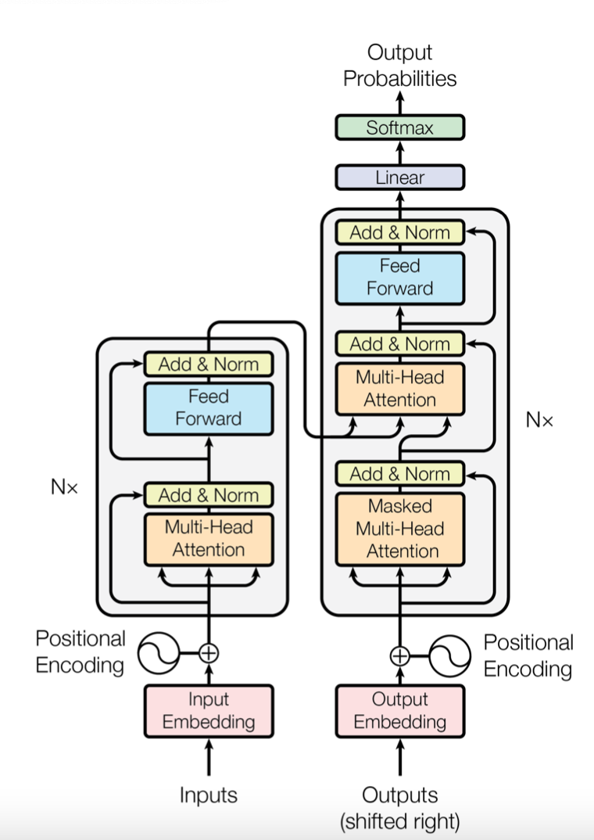
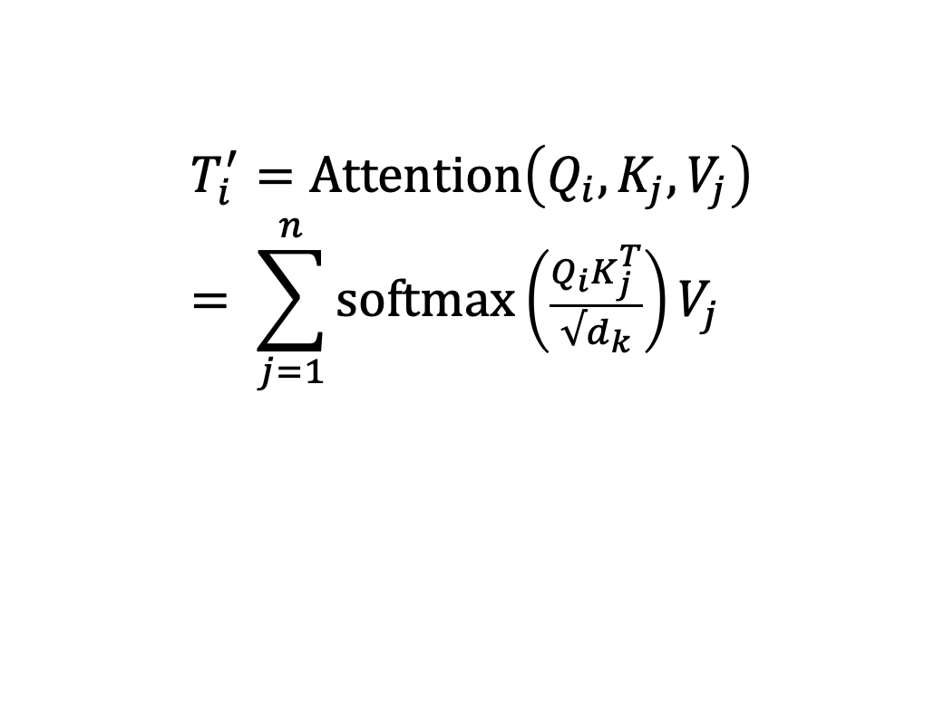
Inside a transformer
Multi-head Attention: Allows tokens to communicate with each other to better understand the context in which they are used.
Q1
Qn
Query
T1
V1
…
Tn
Vn
Value
K2
Kn
Key
$$T_{i}^{′}=\text{Attention}\left(Q_{i}, K_{j}, V_{j}\right)= \sum_{j=1}^{n}{\text{softmax}\left(\frac{Q_{i}K_{j}^{T}}{√d_{k}}\right)V_{j}}$$

Slide 8
Shaping the output we want
Determined during training, when the model adjusts its parameters to minimize the loss function
Good prediction means that the ”distance” between model output and truth is small.
Categorization
Regression
In both cases, the further away from the truth, the larger the value of the loss function
Cross-Entropy
Mean Squared Error

Slide 9
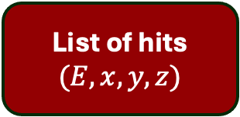
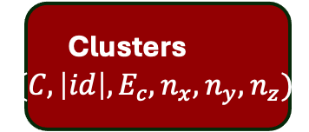
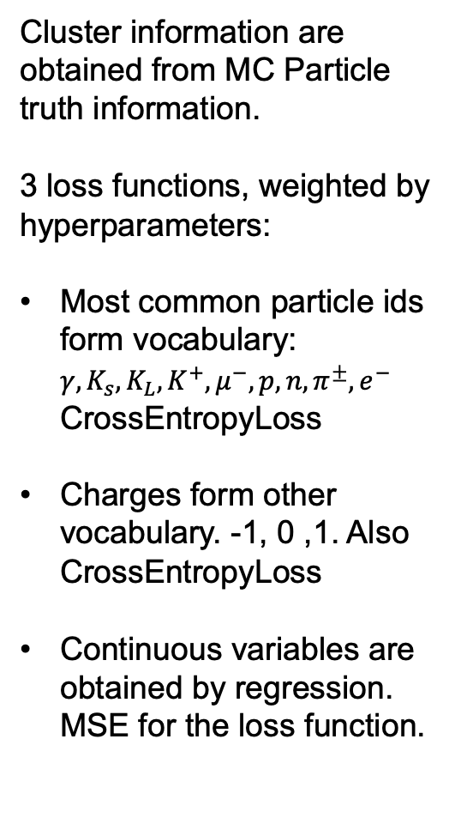
General Architecture
Select max.
probability
Next cluster
Cluster information are obtained from MC Particle truth information.
3 loss functions, weighted by hyperparameters:
Most common particle ids form vocabulary: $γ, K_{s}, K_{L},K^{+}, μ^{−}, p, n, π^{±}, e^{−}$ CrossEntropyLoss
Charges form other vocabulary. -1, 0 ,1. Also CrossEntropyLoss
Continuous variables are obtained by regression. MSE for the loss function.
Probabilities for next charges, PDGs, tokens
Linear regression for next cluster energy and dir.
ENCODER
Layers
DECODER
Layers
ENCODER
EMBEDDER
DECODER
EMBEDDER
List of hits
$$(E, x, y, z)$$
Clusters
$$({C, \left|id\right|, E}_{c}, n_{x}, n_{y}, n_{z})$$

Slide 10
Photons
Model was tested against clusters generated by either single photons or 2 photons
Maximum accuracy is not achieved since photons can split into particles/antiparticles, etc...
Dataset | Charges | PDGs | direction | Energy | Excess
1 photons | 88% | 88% | 5 degrees | 6.1% | -0.27
2 photons | 93% | 96% | 7 degrees | 1.1% | -0.079

Slide 11
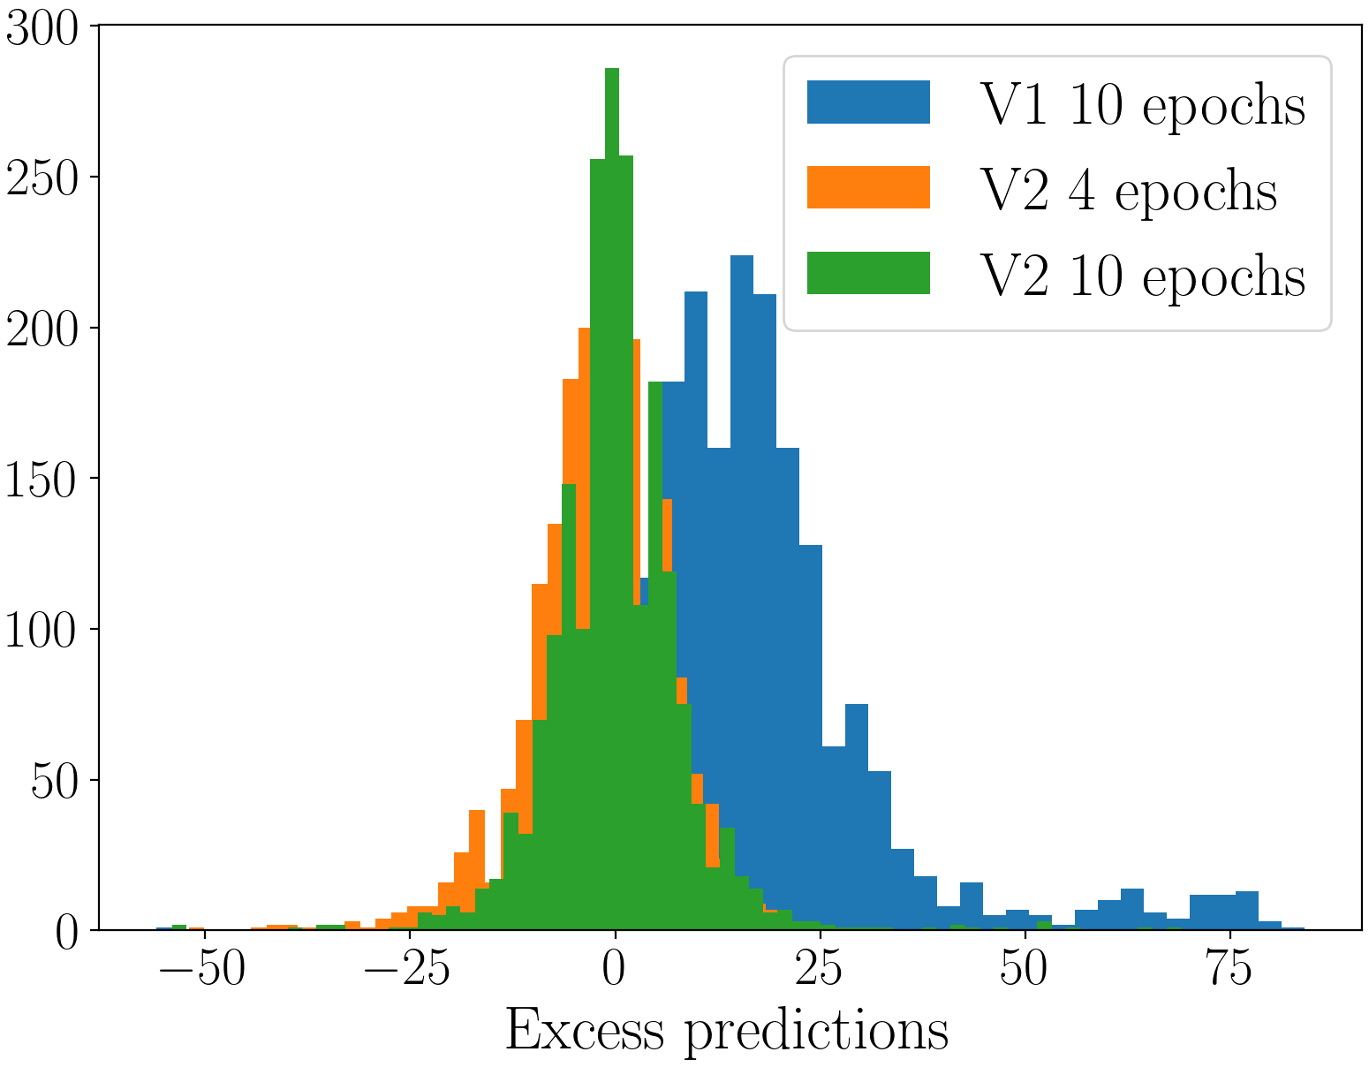
Further work
Increasing the complexity of the dataset using 10 taus to form the clusters
Focusing on predicting the correct numbers of clusters first

Slide 12
Conclusion
Implementing a transformer to cluster hits in calorimeters for particle flow with an architecture analog to what is used in Language Model
High accuracy achieved for most simple datasets
Currently trying to generalize to more complex dataset

