Slide 1
ILD PRESENTATION 03/07
A New Method For Measuring Higgs Mass At ILC
Berger Thomas supervised by Junping TiaN

Slide 2
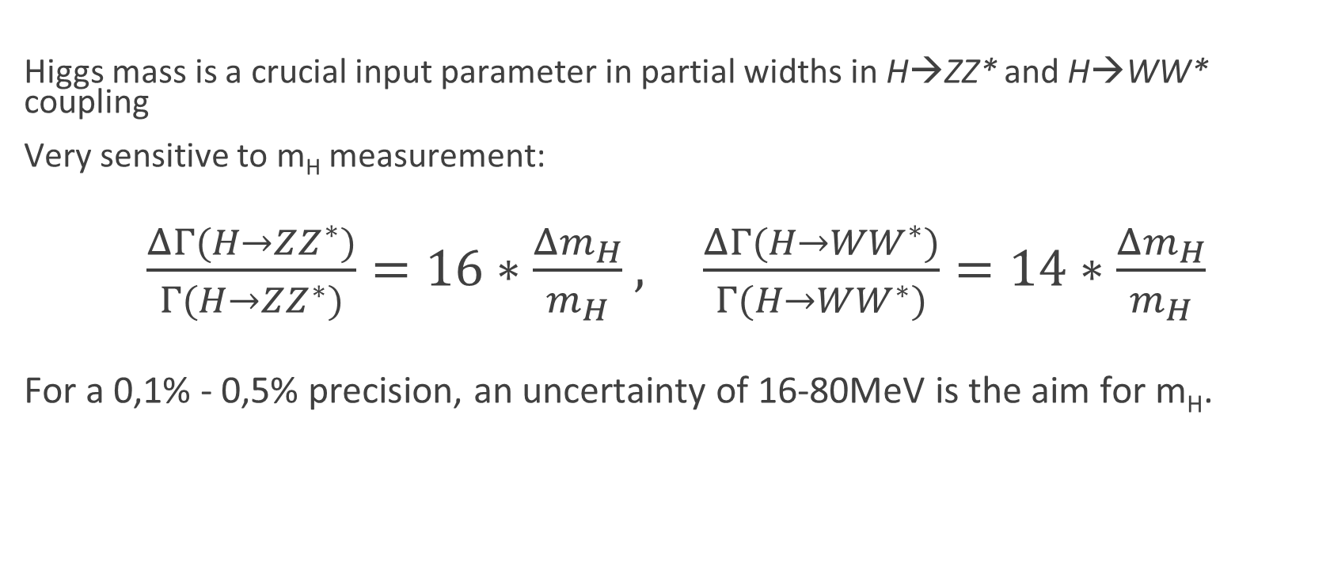
Motivations & Physics
Higgs mass is a crucial input parameter in partial widths in H→ZZ* and H→WW* coupling
Very sensitive to m_{H} measurement:
$\frac{ΔΓ(H→ZZ^{∗})}{Γ(H→ZZ^{∗})}=16∗\frac{{Δm}_{H}}{m_{H}}$, $\frac{ΔΓ(H→{WW}^{∗})}{Γ(H→WW^{∗})}=14∗\frac{{Δm}_{H}}{m_{H}}$
For a 0,1% - 0,5% precision, an uncertainty of 16-80MeV is the aim for m_{H}.

Slide 3
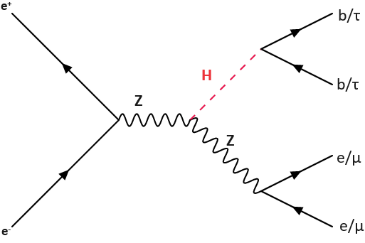
The New Method
Studied Processes are e⁺e⁻→ ZH, Z→ µ⁺ µ ⁻ and H→τ⁺τ⁻ compared with H→bb̅.
Branching Ratios:
H→bb̅ 58,2%
H→τ⁺τ⁻ 6,3%
Z→ µ⁺µ/e⁺e⁻ 3,36%
Electron Channel could also be added.
Provide a complimentary method to Recoil Mass to be used at ILC

Slide 4
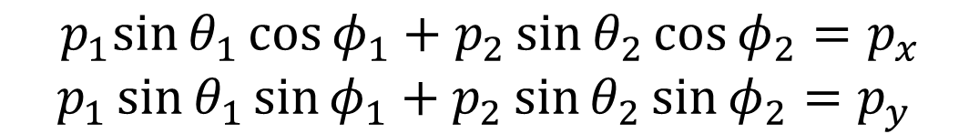
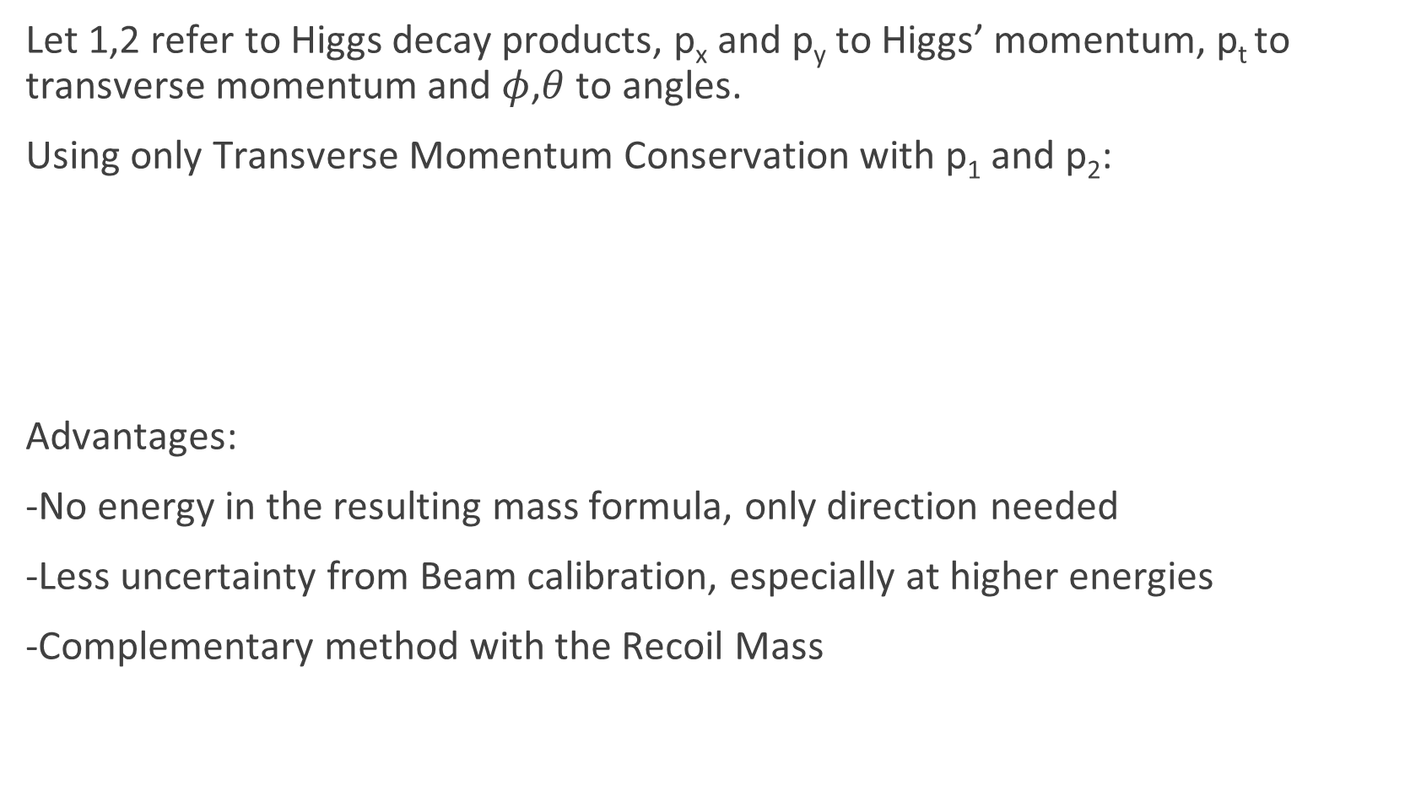
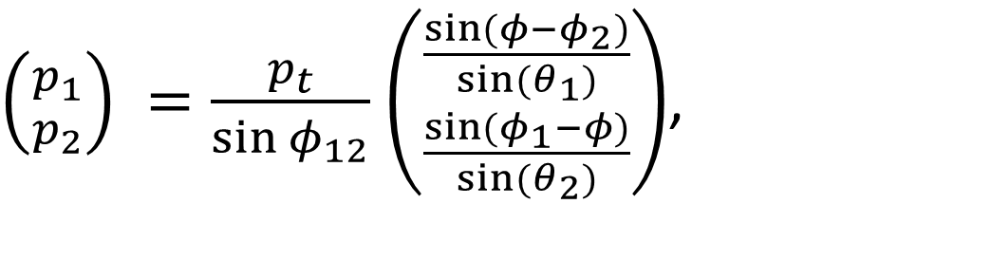
Let 1,2 refer to Higgs decay products, p_{x} and p_{y} to Higgs’ momentum, p_{t} to transverse momentum and $φ$,$θ$ to angles.
Using only Transverse Momentum Conservation with p₁ and p₂:
Advantages:
-No energy in the resulting mass formula, only direction needed
-Less uncertainty from Beam calibration, especially at higher energies
-Complementary method with the Recoil Mass
$\left({p_{1} \atop p_{2}}\right) =\frac{p_{t}}{\sin{φ_{12}}}$ $\left({\frac{\sin{(φ−φ_{2})}}{\sin{(θ_{1})}} \atop \frac{\sin{(φ_{1}−φ)}}{\sin{(θ_{2})}}}\right)$,
$${ p}_{1}\sin{θ_{1}}\cos{φ_{1}}+p_{2}\sin{θ_{2}}\cos{φ_{2}}=p_{x}$$
$$p_{1}\sin{θ_{1}}\sin{φ_{1}}+p_{2}\sin{θ_{2}}\sin{φ_{2}}=p_{y}$$

Slide 5
Simulations
Whizard: Event Generator with ISR, Beamstrahlung and Parton showers and hadronization by with Pythia ➔ Monte Carlo events or Truth events
GEANT4: Simulates the detectors and the detection of Truth events
PandoraPFA and LCFIPlus: Full event reconstruction with digitization, particle flow analysis, jet clustering…
Physics Analysis with ROOT

Slide 6
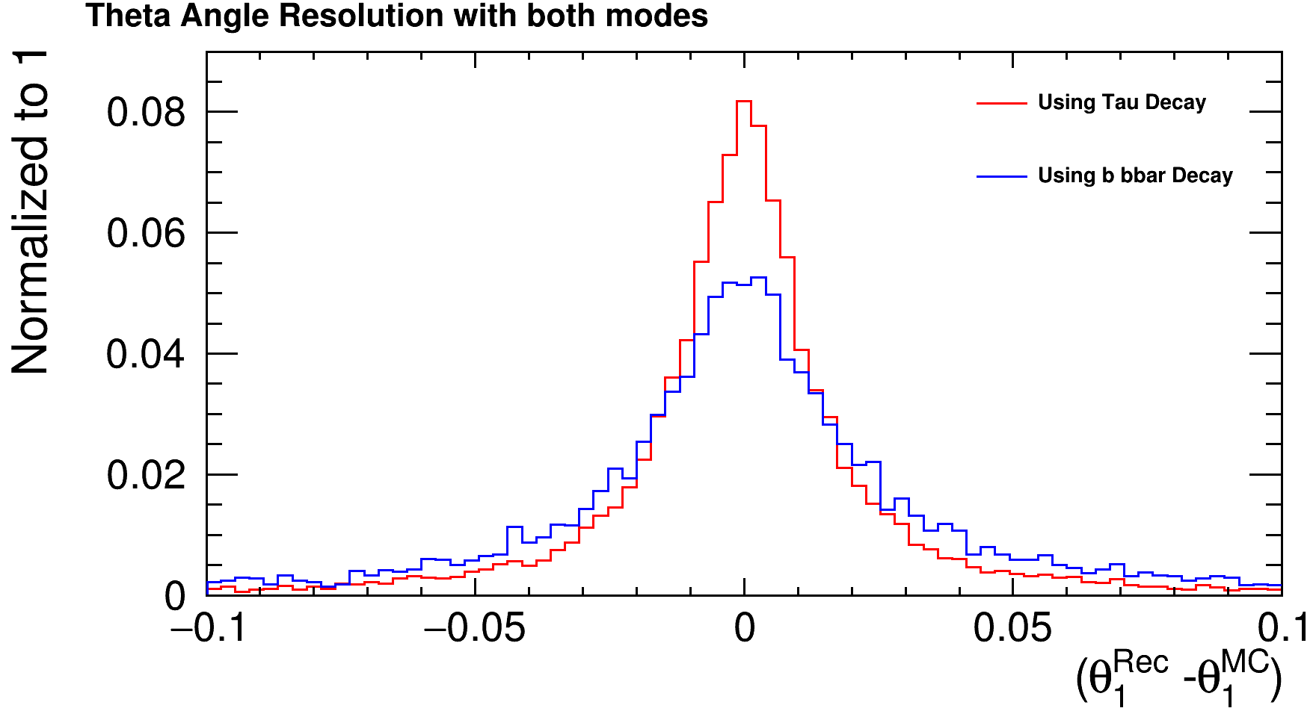
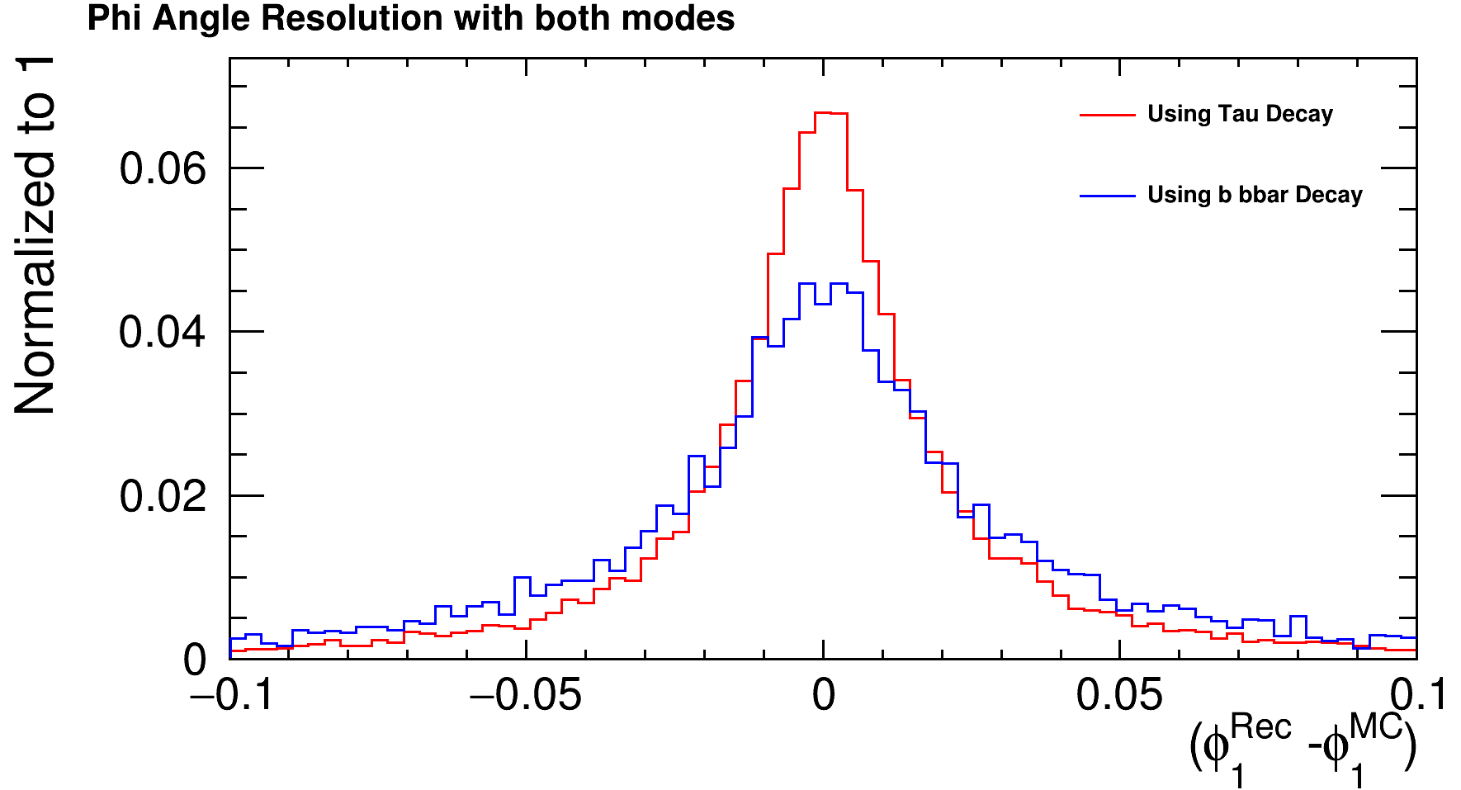
All data is computed for both of the H decay products and shown for either ττ or bb.
Relative Resolution for m_{H} and Absolute Resolution for angles are fitted with Gaussians with ROOT to get the errors of each channel
The distributions are similar in each cases for bb̅ and ττ with the bb̅ more peaked.

Slide 7
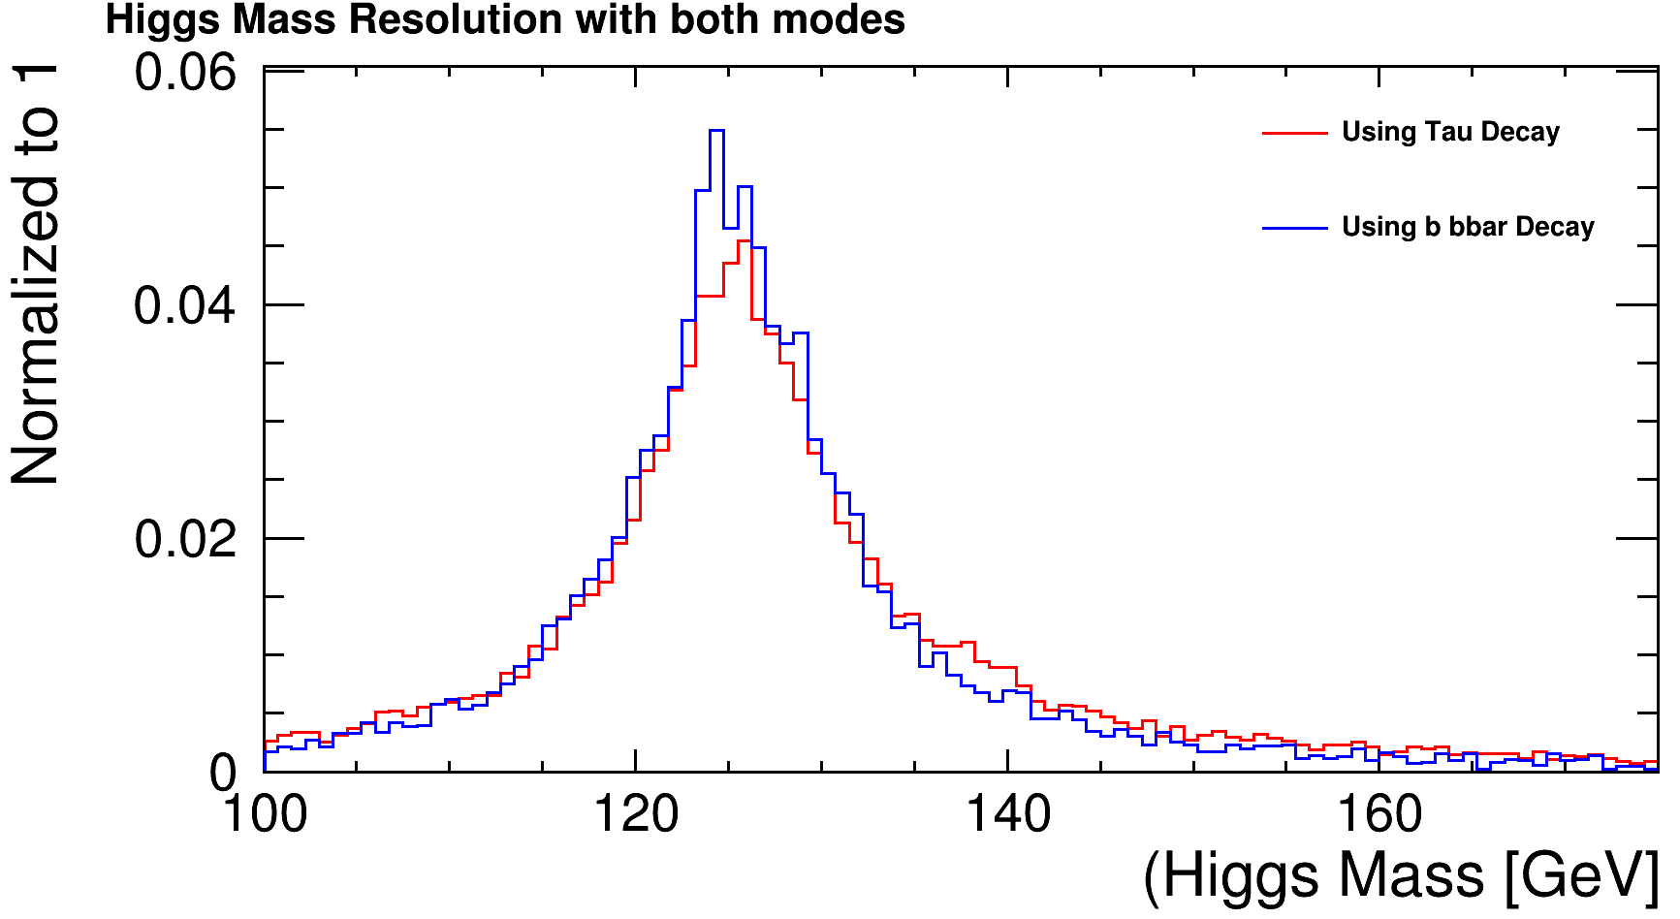
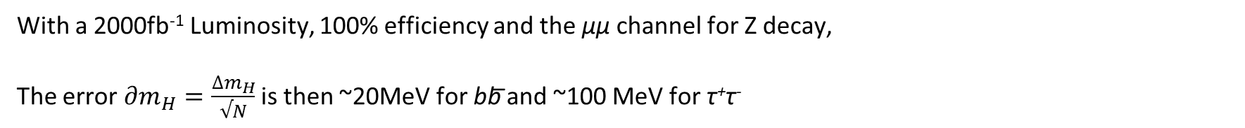
Resolution | $θ_{1}$[degree] | $φ_{1}$[degree] | Δm_{H} [GeV]
Using bb̅ | 0,80±0,03 | 0,92±0,02 | 4,17±0,16
Using τ⁺τ⁻ | 0,67±0,01 | 0,73±0,01 | 4,51±0,14
With a 2000fb⁻¹ Luminosity, 100% efficiency and the µµ channel for Z decay,
The error $∂m_{H}=\frac{∆m_{H}}{√N}$ is then ~20MeV for bb̅ and ~100 MeV for τ⁺τ⁻

Slide 8
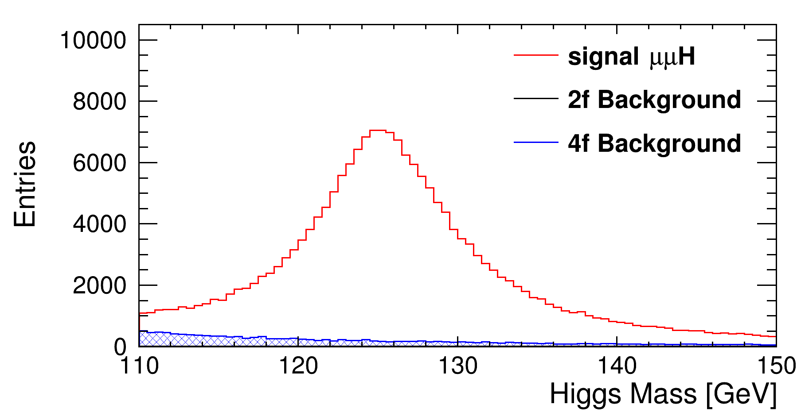
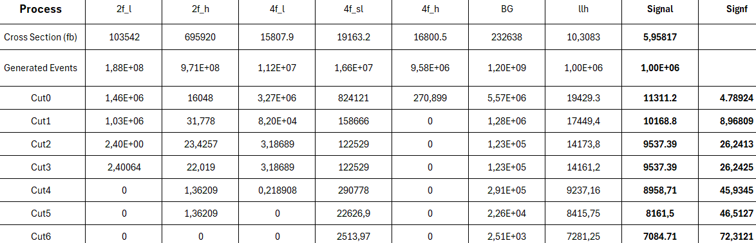
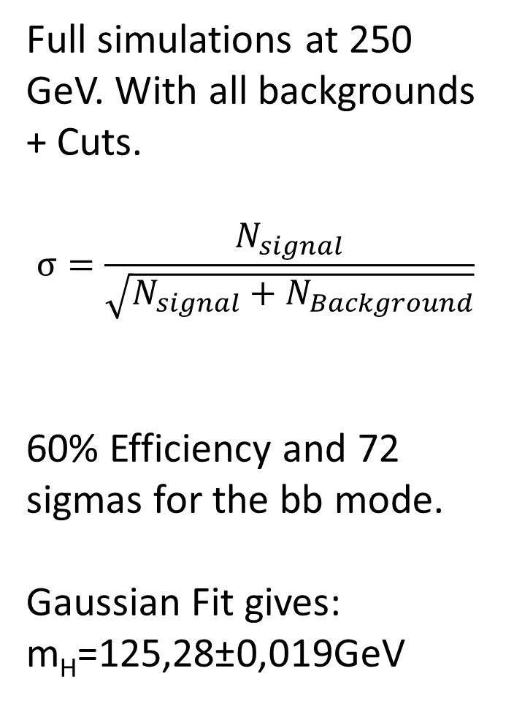
Full simulations at 250 GeV. With all backgrounds + Cuts.
$$σ=\frac{N_{signal}}{\sqrt{N_{signal}+N_{Background}}}$$
60% Efficiency and 72 sigmas for the bb mode.
Gaussian Fit gives:
m_{H}=125,28±0,019GeV

Slide 9
Cuts Applied to bb mode:
Cut 1: lepton pair must be muons with mass close to m_{Z} at 10GeV
Cut 2:n_{ChargedPFOs} >3 in each jet
Cut 3:E_{vis}+E_{lep} >150 GeV
Cut 4: b-likeness > 0,66
Cut 5: Lepton pair: abs(cos) < 0,9
Cut 6:Tight cut on Higgs mass: 110<m_{H}^{new}<150 GeV

Slide 10
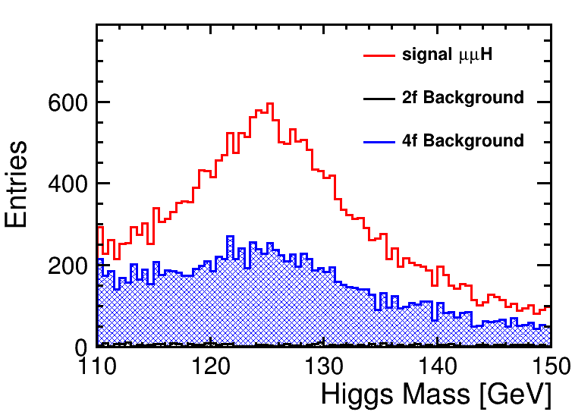
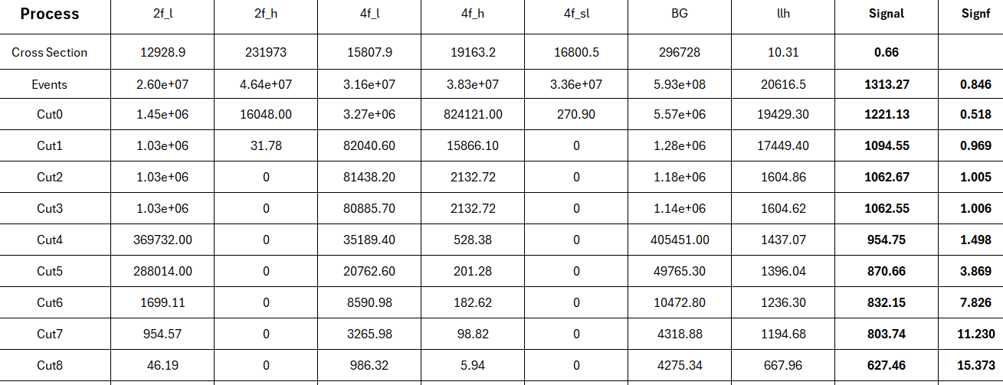
Worse significance and efficiency at 48% for tau channel and σ=15
Less events because BR(ττ)= 6% but BR(bb)=58%
Fit gives:
m_{H}=125,31± 0,072 GeV

Slide 11
For ττ:
Different Cuts and more added for leptonic background:
Cut 1: lepton pair must be muons with mass close to m_{Z}
Cut 2:n_{ChargedPFOs} <4 in each jet because τ decays to 1-prong or 3-prong
Cut 3:E_{vis}+E_{lep} >100 GeV
Cut 4:E_{vis}+E_{lep}<220 GeV
Cut 5: Lepton pair: abs(cos) < 0,9
Cut 6: At least 1 charged PFO in a jet: n_{ChargedPFOs} >0
Cut 7: Cut on System’s Recoil Mass: 110<m_{recoil}<150 GeV
Cut 8:Tight cut on Higgs mass: 110<m_{H}^{new}<150 GeV

Slide 12
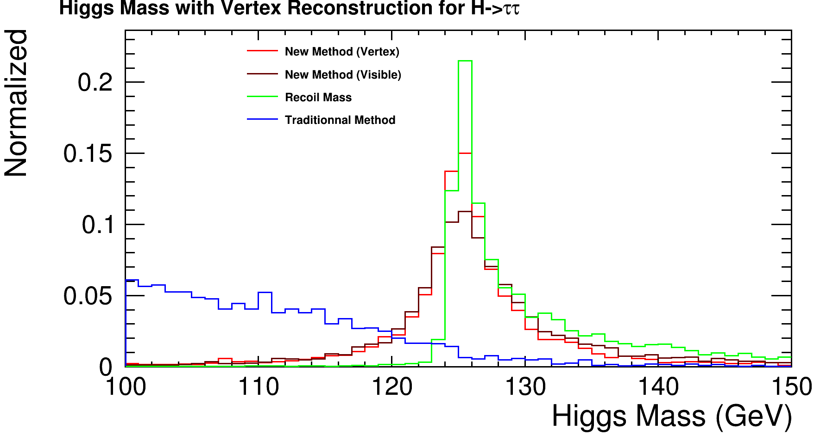
Possible Improvements:
Use the 2 Decay Vertices for measuring directions of b or τ
More peaked:
σ=2GeV
Δm_{H}=48 MeV
Small Number of events for ττ so need higher luminosity

Slide 13
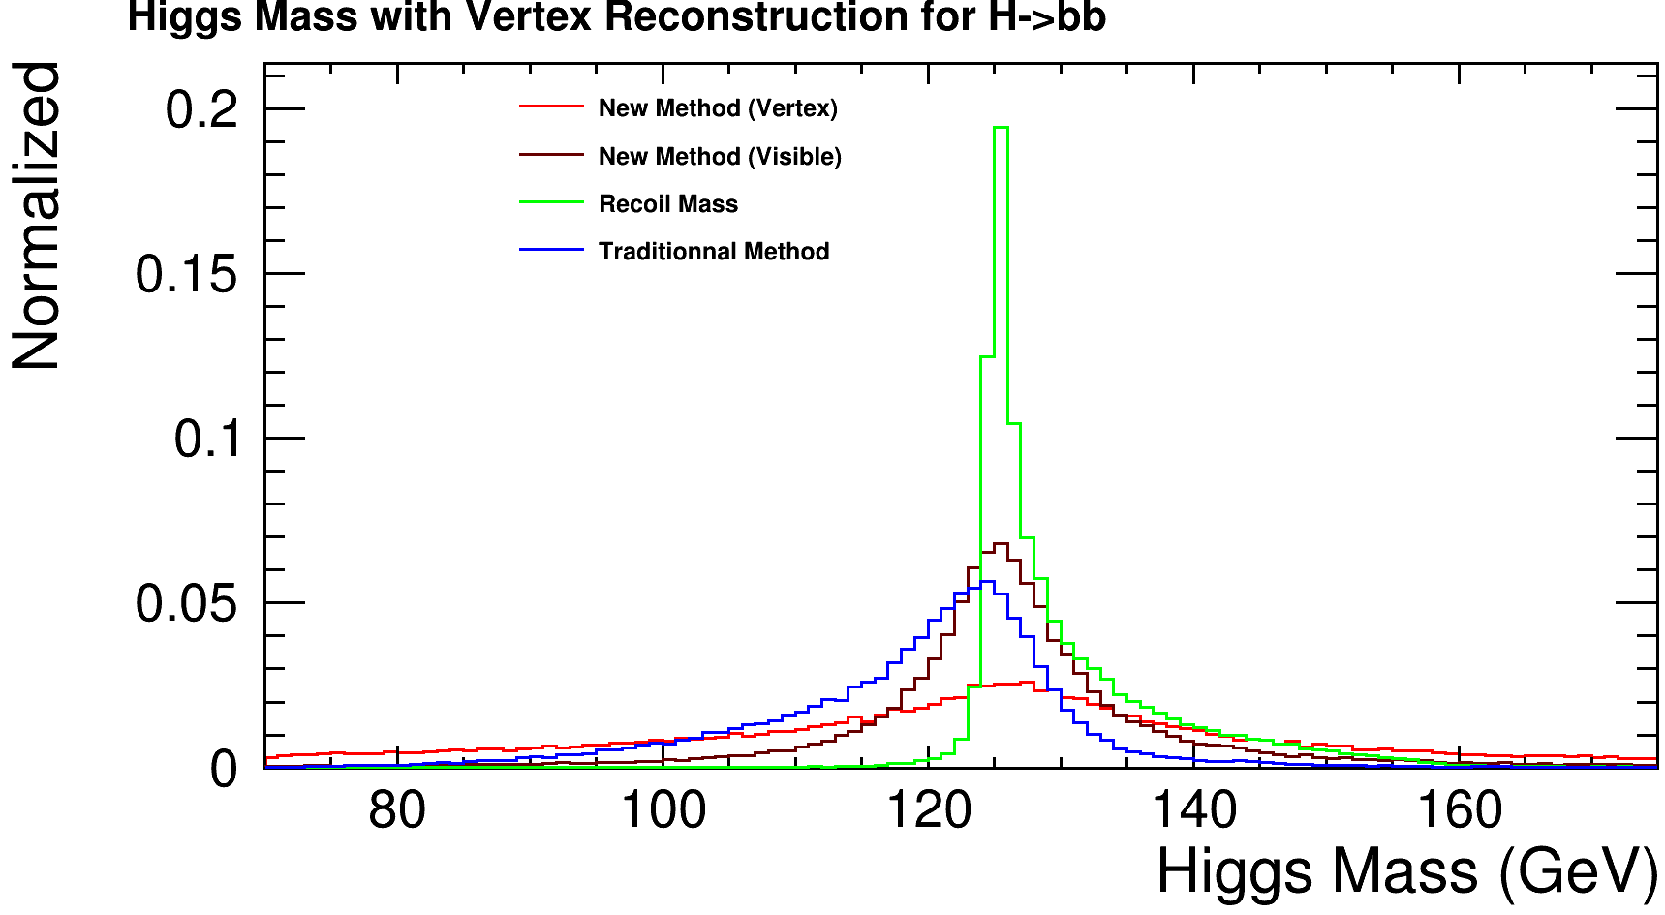
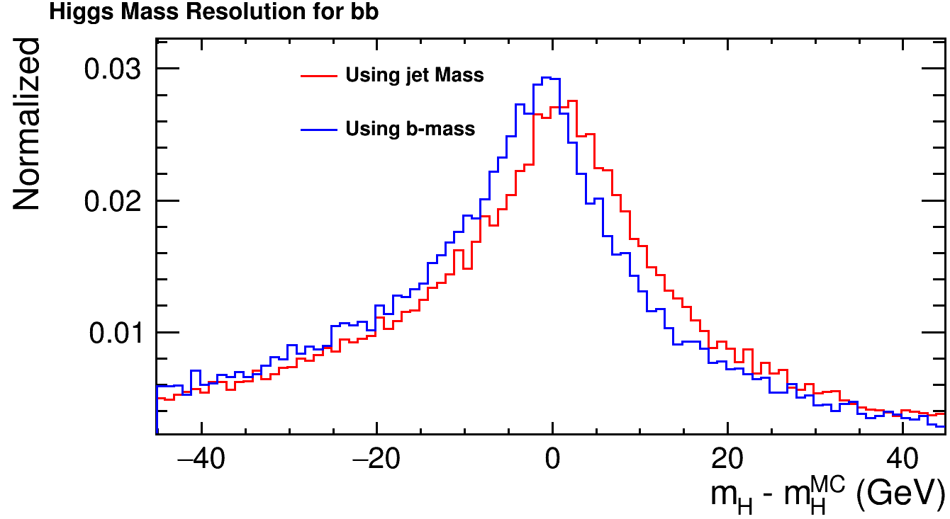
For bb, more events where 2 vertices are found but worse performance:
σ=7,4 GeV
Δm_{H}=242 MeV
Shift between b-jet mass and b mass. Not centered on 0 aswell.

Slide 14
Thank You For Your Attention

