Slide 1

ILD Status and News
Ties Behnke/ Kiyotomo Kawagoe 12.07.2024
ILD group meeting connected to LCWS2024

Slide 2
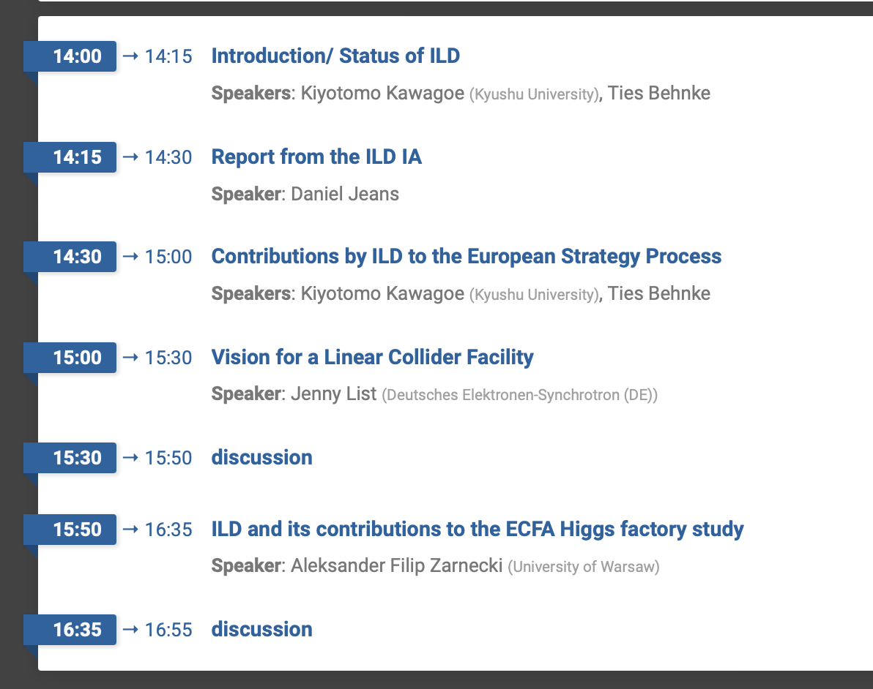
Agenda
Start at 7:00 in Paris time
We thank Colleagues in Europe, for joining early in the morning.

Slide 3
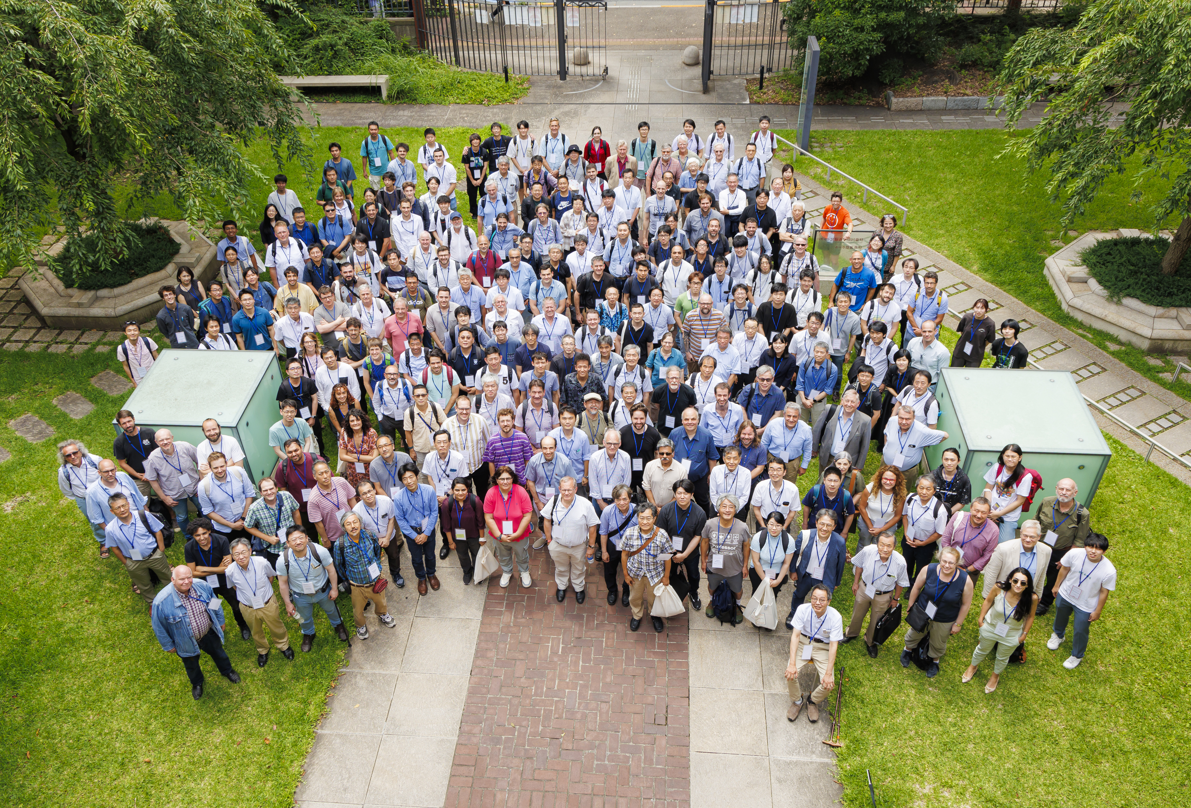
LCWS 2024
Tokyo: 8-11 July 2024 https://agenda.linearcollider.org/event/10134/program
340 participants (251 on site)
Many contributions from ILD. Thank you very much.
Thank you Daniel (PC chair) and Taikan (LOC chair)

Slide 4
Sachio Komamiya Memorial
https://agenda.linearcollider.org/event/10134/page/349-sachio-komamiya-memorial
Electric Memorial Book available

Slide 6
“Joint LC Vision” documents: to arXiv and input to EPPSU
Physics at a LC from 90 GeV to multi-TeV
A joint strategic vision for a LC Facility including upgrades, beyondcollider, etc. at any location in the world
Jenny will talk about this later.

Slide 7
ICHEP 2024 in Prague
ICHEP 2024, 18-24 July 2024: https://ichep2024.org
Many ILD contributions (7 talks, 3 posters)
ILD rehearsal sessions: 15, 16 July (afternoon in Europe) https://agenda.linearcollider.org/event/10391/
IDT-WG3 rehearsal session: 15 July (morning in Europe) https://agenda.linearcollider.org/event/10397/

Slide 8
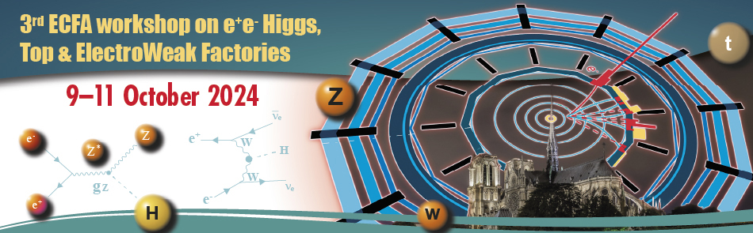
3rd ECFA workshop on e⁺e– Higgs/Top/EW factories (Paris)
Conference site: https://indico.in2p3.fr/event/32629/
Plan: have an ILD meeting on Tuesday afternoon of this week, in Paris
Preparation of the ESU input
Update of ILD and progress
Details to be announced

