Slide 1
A linear collider @ CERN
Outline
LC @CERN – parameters and implementation studies
Technical developments and challenges
Additions and Upgrades – Linear Collider Facility
Beyond 2025
Concluding slide
Steinar Stapnes – CERN
LCWS Valencia October 2025
1/27

Slide 2
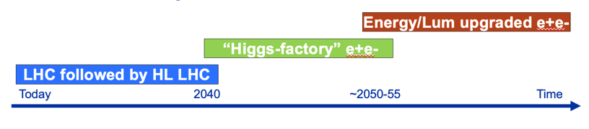
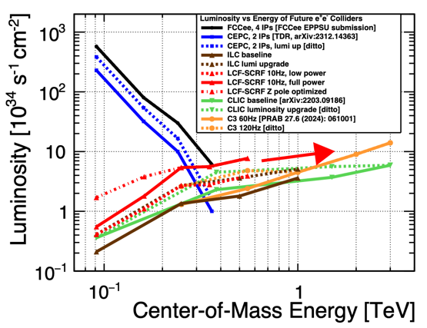
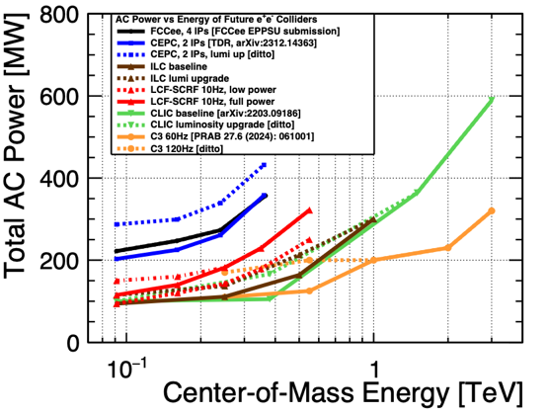
General goals for LCs
Start with mature technology, can expand in length and/or technology
Energy reach and flexibility:
Physics opportunities from Z-pole to TeV(s)
Flexible (E,L,cost, power) to adapt to development in physics and technology
Footprint, cost, power – next slides:
Lower cost to get to Higgs and top than a circular machine (initial machine)
Power similar to LHC, or lower, for initial configuration
Footprint (length/location) similar to LHC
Provide many opportunities and increased flexibility for the future:
Does not determine footprint of future energy frontier machines (hadrons or muons), and it has its own upgrade opportunities
Encourage accelerator and detector R&D for all these options
2
2/27

Slide 3
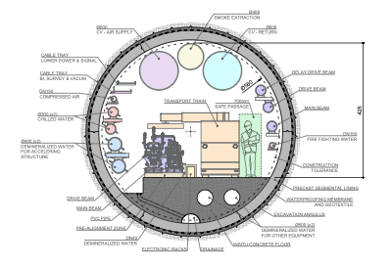
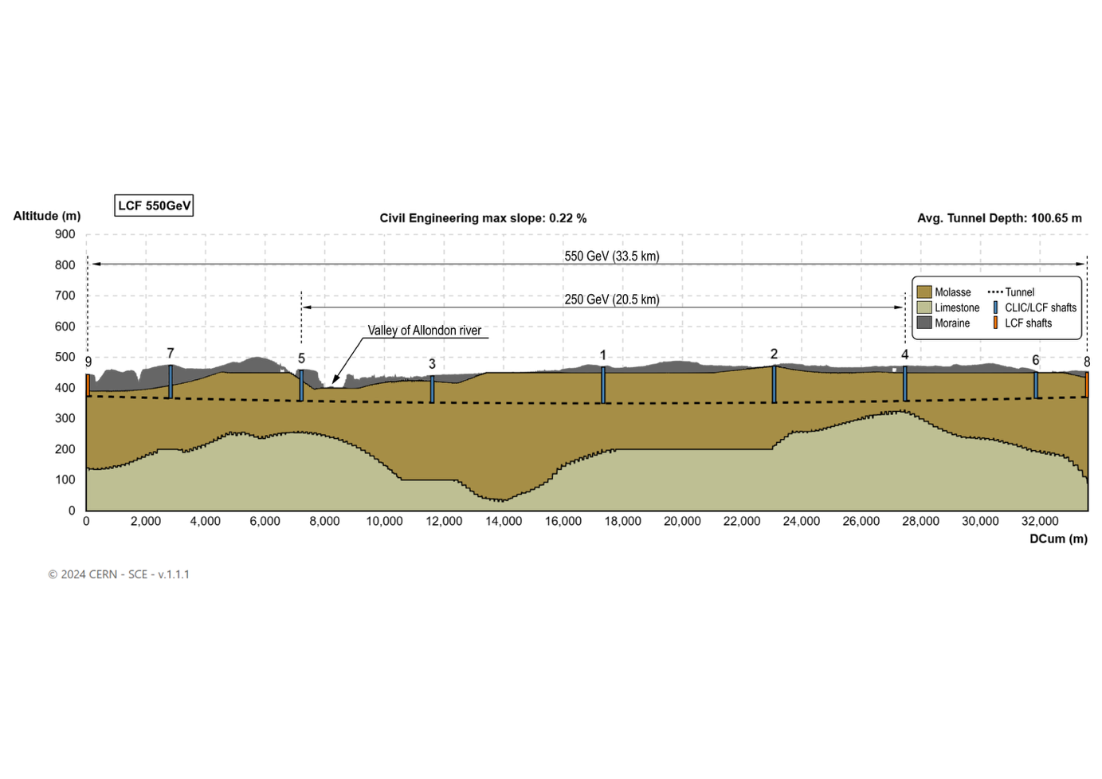
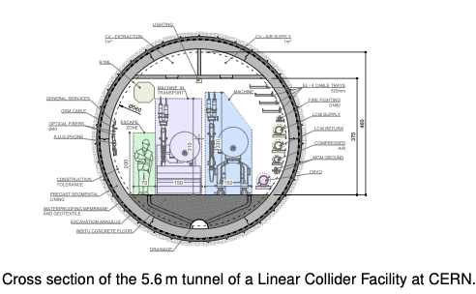
Linear Collider @ CERN – Civil Engineering I
Layout used for costing and drawings. Not final, can be translated, rotated and shafts can be moved.
Shallower profile, 29 km at 1.5 TeV, injectors and IPs on CERN land, one drive-beam
3
3/27

Slide 4
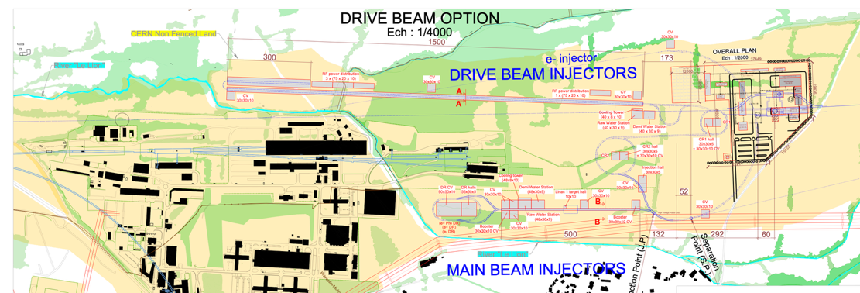
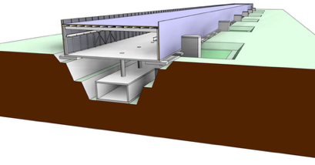
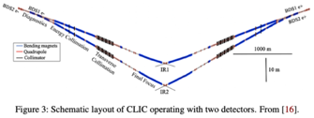
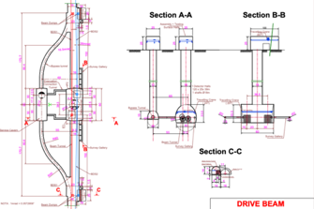
Linear Collider @ CERN – Civil Engineering II
CE studies for LC at CERN over the last ~15 years:
CLIC, up to 3 TeV. Contract with Amberg Engineering for CDR in 2012-2013.
ILC up 1 TeV. Contract with Amberg Enginering for the TDR in 2012-13.
CLIC up to 3 TeV, TOT (layout tool) with ARUP (engineering/consulting company), for the Project Implementation Report 2018
For the ESPP 2025, LCF/ILC up to 550 GeV, CLIC NCRF to 1.5 TeV, in both cases ~30km (29.5 and 33.5), using Geoprofiler layout tool
Injectors and experimental areas on Prevessin site (“CERN attributed land”)

Slide 5
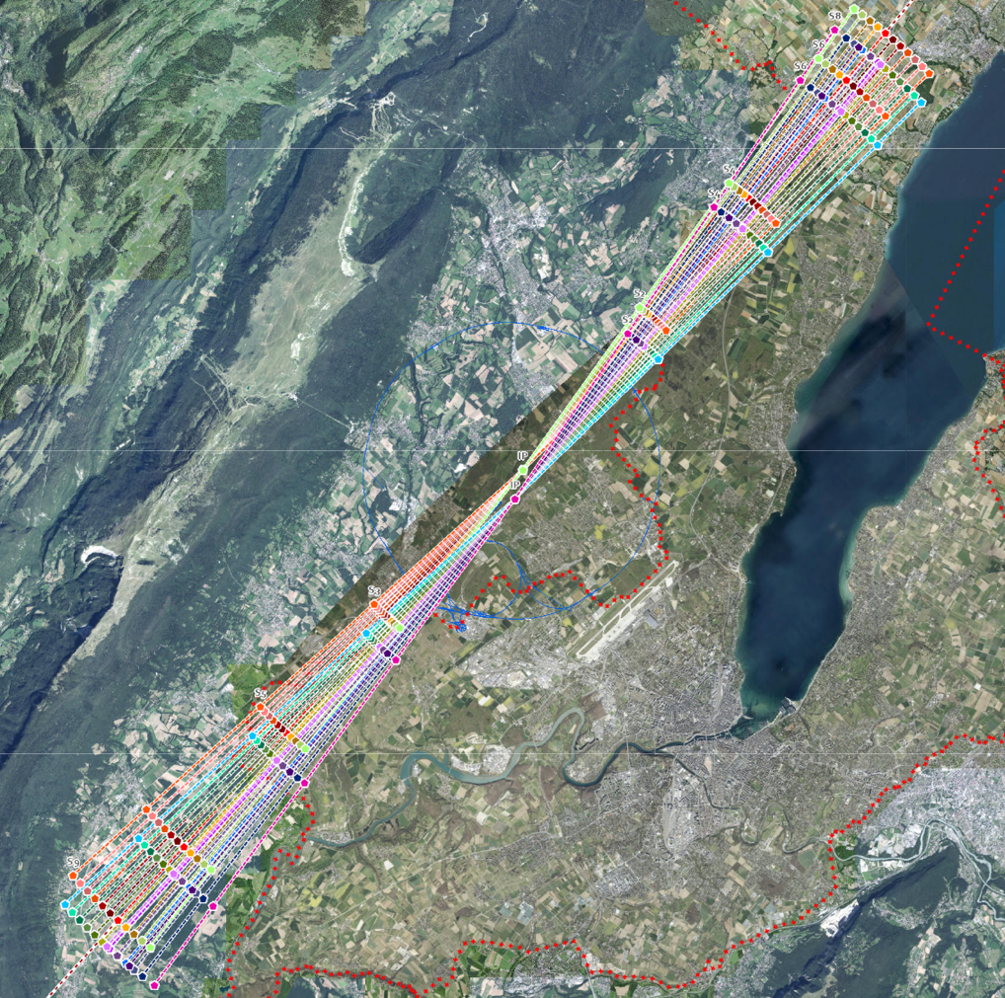
Layout and Placement Study
CERN is developing a placement optimisation tool with several scenarios under evaluation.
The collider may be rotated to determine the most practical alignment.
Assessment Criteria:
Feasibility of land acquisition based on land classification
Accessibility for construction
Accessibility for long term operation
Suitability of local geology for Shaft & Cavern construction
Two IP locations possible for LCF
Note, to do an improved CE study we need to study and baseline:
StoE for lattice/layout, BDS with two IP, dumps, klystron/modulators, cryo, services and infrastructure (CV, EL, access, safety, alignment, installation, etc), injectors including e+, DRs, running and upgrade scenarios, etc
5/27

Slide 6
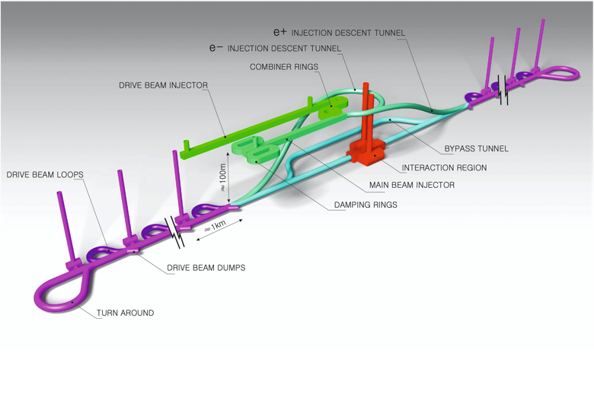
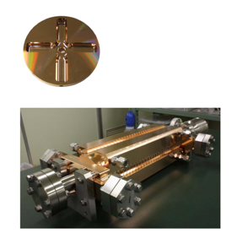
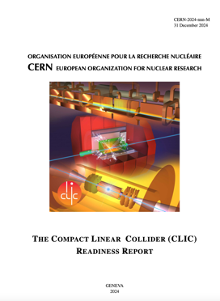
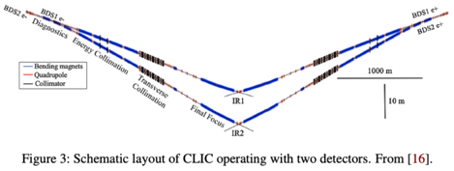
The Compact Linear Collider (CLIC)
Timeline: Electron-positron linear collider at CERN for the era beyond HL-LHC
Compact: Novel and unique two-beam accelerating technique with high-gradient room temperature RF cavities (~20’500 structures at 380 GeV), ~11.5 km in its initial phase
Expandable: Staged programme with collision energies from 380 GeV (Higgs/top) up to 1.5 TeV
CDR in 2012 had focus on 3 TeV. Project Implementation Plan in 2018 with focus in 380 GeV
Readiness Report submitted for the ESPP with focus 380 GeV for Higgs and top, upgradable to 1.5 TeV
Running at 100 Hz with two beam-delivery systems and two IP
Accelerating structure prototype for CLIC: 12 GHz (L~25 cm), 100 MV/m

Slide 7
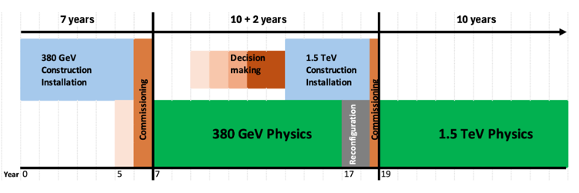
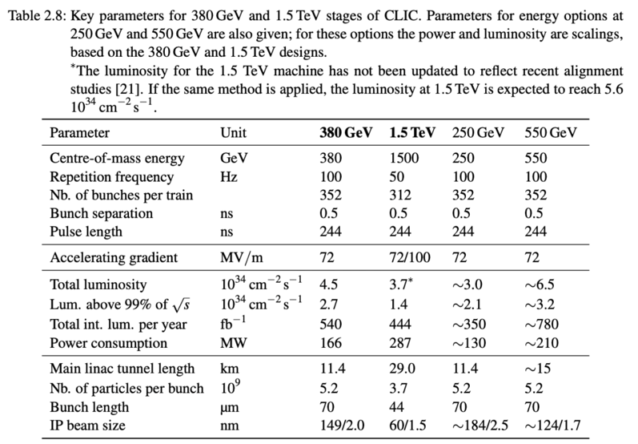
The CLIC ESPP parameters
Key parameters for 380 GeV and 1.5 TeV stages of CLIC. Parameters for energy options at 250 GeV and 550 GeV are also given; for these options the power and luminosity are scaled, based on the 380 GeV and 1.5 TeV designs.
∗The luminosity for the 1.5 TeV machine has not been updated to reflect recent alignment studies [15]. If the same method is applied, the luminosity at 1.5 TeV is expected to reach 5.6 x 10³⁴ cm⁻² s⁻¹
4.3 ab⁻¹
4 ab⁻¹
Z pole performance, 6.3x10³² – 1.2x10³⁴ cm⁻² s⁻¹
The latter number when accelerator configured for Z running (e.g. early or at the end of the first stage)
An alternative upgrade to 550 GeV, maintaining the repetition rate at 100 Hz and two IPs, is also considered. A possible implementation would be to start with a longer tunnel by 5 km from the beginning adding about 25 % to the initial cost of the CE of the baseline 380 GeV machine.

Slide 8
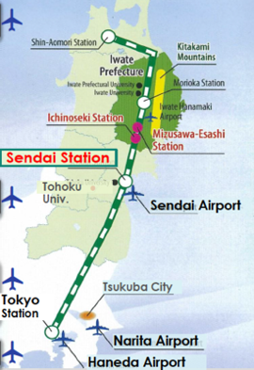
From the ILC250 accelerator facility to the CERN SCRF LCF
See more details in the presentation of Peter McIntosh in Venice (LINK)
Undulator based polarized positron source
The ILC implementation is extensively studies in Japan, civil engineering, integration locally, environmental impacts, etc
How would we implement a SCRF based LC at CERN:
Consider implementation of energies above 250 GeV (even initially), similar to the ILC TDR, specifically 550 GeV
Increase luminosity wrt to parameters used recently (ILC@Japan) and share on two IPs
Key changes: Bunch trains 5 Hz to 10 Hz, double numbers of bunches per train
Set more ambitious goals for energy efficiencies (cavities, klystrons)
Consider if such a facility can use improved or other RF technologies in the future (a true LC facility) – stimulate wide R&D and open options for the future
Combine with CLIC footprint/studies as much as possible.
Cost estimate as for CERN projects in CHF, with CE costs from CERN
8/27

Slide 9
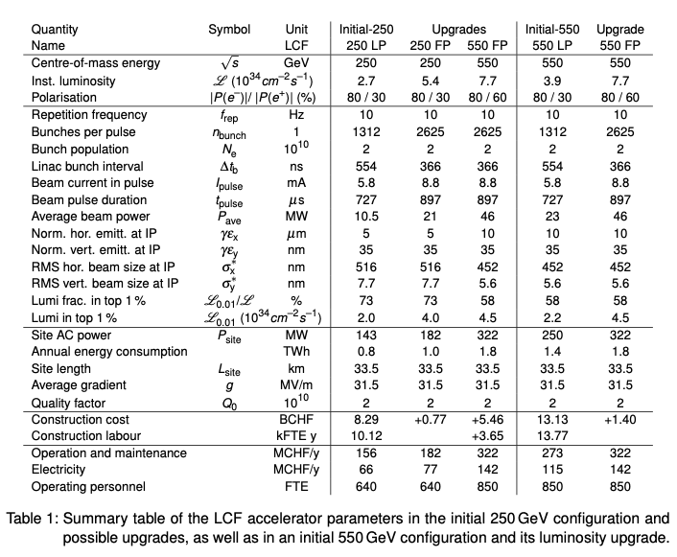
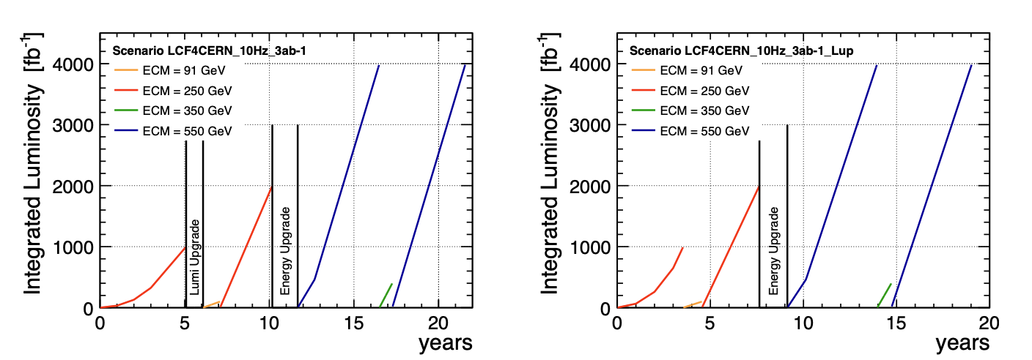
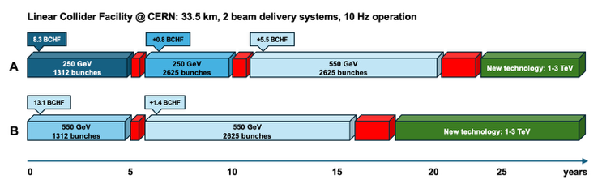
LCF – SCRF – ESPP parameters
Baseline (10Hz rate)
Start immediately with full power (1316->2625 bunches in train)
Summary table of the LCF accelerator parameters in the initial 250 GeV configuration and possible upgrades, as well as in an initial 550 GeV configuration and its luminosity upgrade
Note: tunnel extension to allow a 550 GeV upgrade is included in the initial programme
9/27

Slide 10
Costs – for construction
Unit: MCHF | LCF 250 (LP) | Δ LCF 550 (FP) | CLIC 380 | Δ CLIC 1500 | Cost Class
Collider | 3864 | 4204 | 2471 | 4684 | 3/3-4
Main Beam inj./transfer | 1181 | 86 | 1046 | 23 | 3/3-4
Drivebeam inj./transfer | - | - | 1060 | 302 | 3/3-4
Civil Engineering | 2338 | 0 | 1403 | 703 | 4
Technical Infrastructure | 1109 | 1174 | 1361 | 1404 | 4
Sum | 8492 | 5464 | 7341 | 7116
From “comparative report” (LINK):
Low Power (1312 bunches per train),
Full Power (2625 bunches per train)
CLIC 550 GeV is 30% higher than CLIC 380
In the report two experiments (not in table on the right) are estimated to 795 MCHF
ILC/LCF Cost exercises – and international reviews:
ILC TDR 2012-13, 500 GeV primarily (LINK)
ILC in Japan 2017-18, 250 GeV, reviewed by LCC (LINK)
Updates and review recently done for ILC Japan 19-20.12.2024 (LINK)
For “ILC like” implementation at CERN:
Redid Civil Engineering (CE) costing (previous slide); CE costs based on CLIC and other CERN projects, based on ILC layout with same linac footprint as for CLIC
Redid CF costing (EL, CV, etc)
Use 2024 costing for all components in their respective currencies, and change to
CHF with exchange rate
CLIC cost exercises – and international reviews:
CLIC CDR 2012-13, 3 TeV primarily and 500 GeV (LINK)
CLIC PiP 2018, 380 GeV primarily (LINK)
Updated 2024-25
10/27

Slide 11
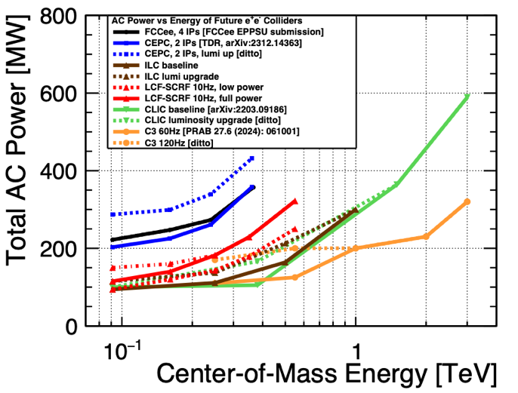
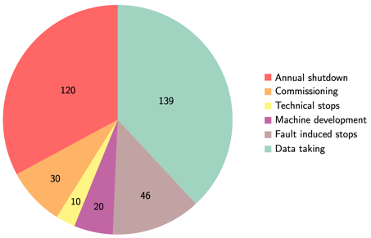
Power and energy
Power at 250-550 GeV in the 140-320 MW range for the LC projects above
Depends on energy AND luminosity (as shown earlier)
With a running scenario on the right this corresponds to 0.8 - 1.8 TWh annually
CERN is currently consuming 1.2 – 1.3 TWh annually
CERN “standard” running scenario used to convert to annual energy use, specify power for each state → energy
A decade of studies to reduce power:
Designs optimisations, SRF cavities (grad,Q), cryo efficiency, RF power system (klystrons, modulators, components), RF to beam efficiencies, improved magnets, operation when power is abundant, heat recovery, nanobeams and more.
 | LCF 250 (LP) | LCF 550 (FP) | CLIC 380 | CLIC 1500
Power (MW) | 144 | 320 | 166 | 287
Energy annually (TWh) | 0.8 | 1.8 | 0.8 | 1.4
11/27

Slide 12
Operation Costs and Sustainability Studies
12/27

Slide 13
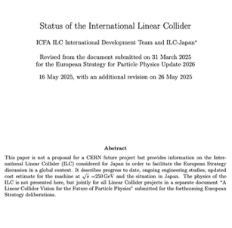
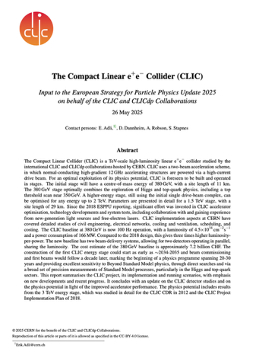
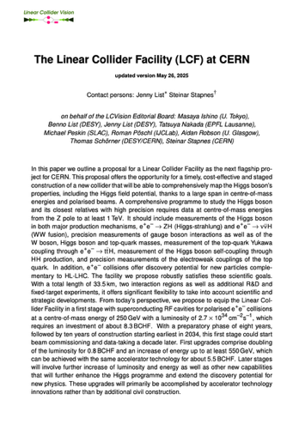
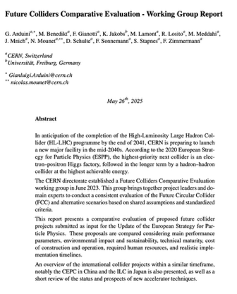
ESPP LC documentation – by end May
Linear Collider Facility (LCF) @ CERN – common implementation studies for two starting technologies:
CLIC@CERN, Linear Collider Facility starting with NCRF technology: https://indico.cern.ch/event/1439855/contributions/6461475/
Normal conducting RF, parameters for 90, 250, 380, 550, 1500 GeV
Comparative report:
https://indico.cern.ch/event/1439855/contributions/6542430/
LCF@CERN focussed on starting with ILC SCRF technology; benefits from all the ILC developments, CLIC CE and infrastructure studies at CERN, and link to new technologies as potential upgrades: https://indico.cern.ch/event/1439855/contributions/6461433/
Superconducting RF, parameters for 90, 250, 350, 550 GeV
13/27
Notes:
Add briefing book

Slide 14
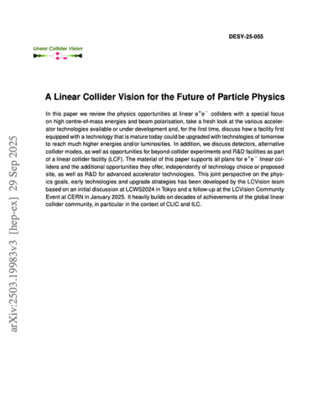
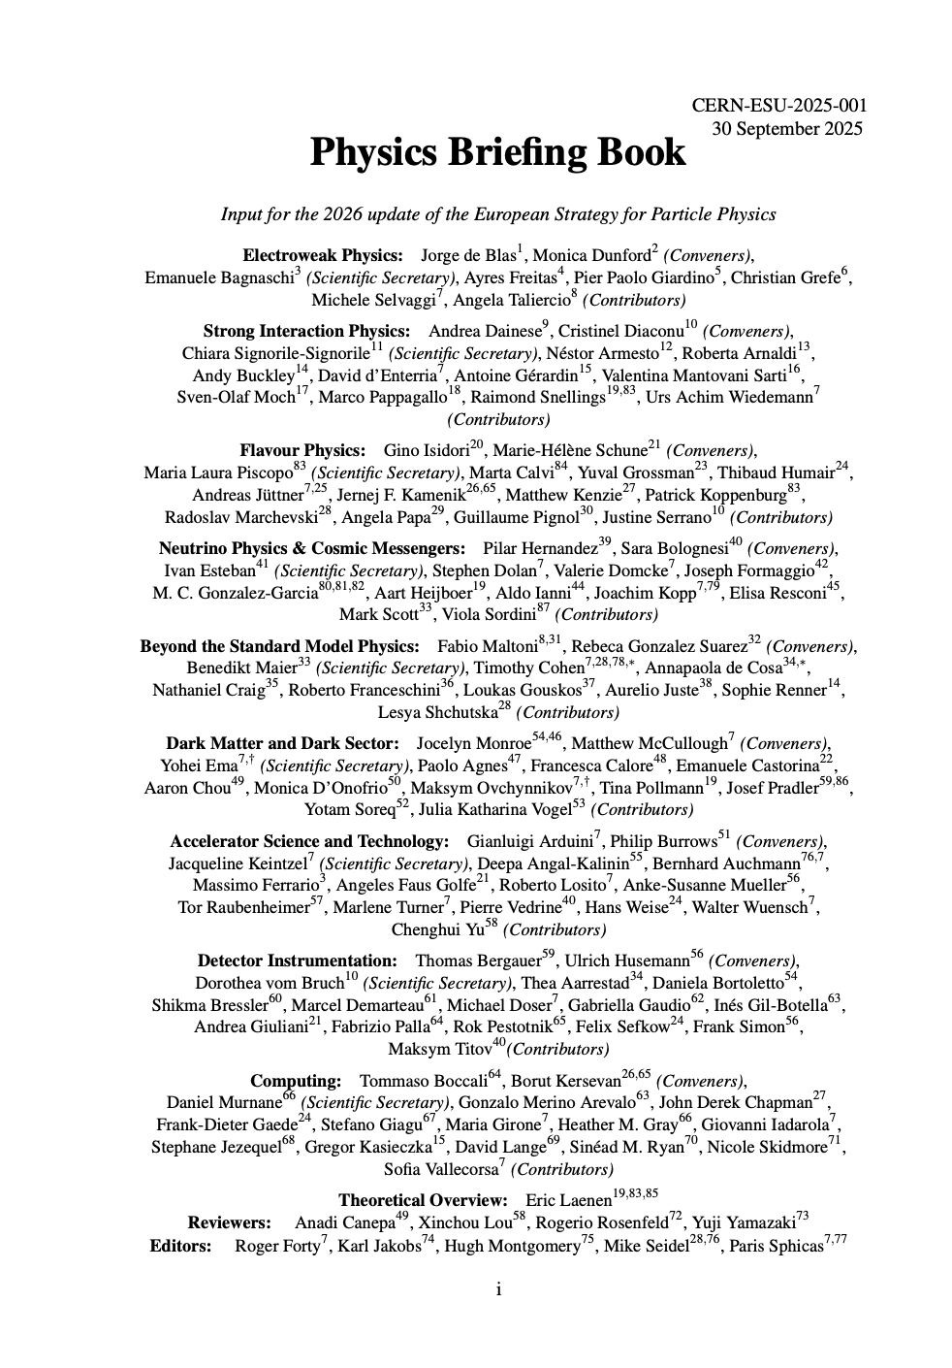
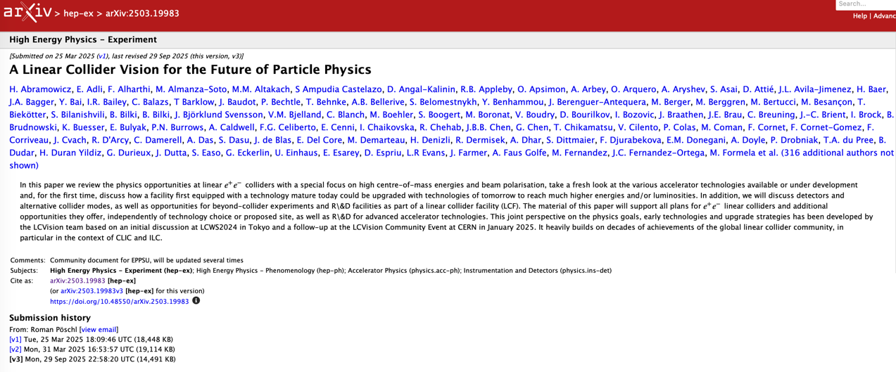
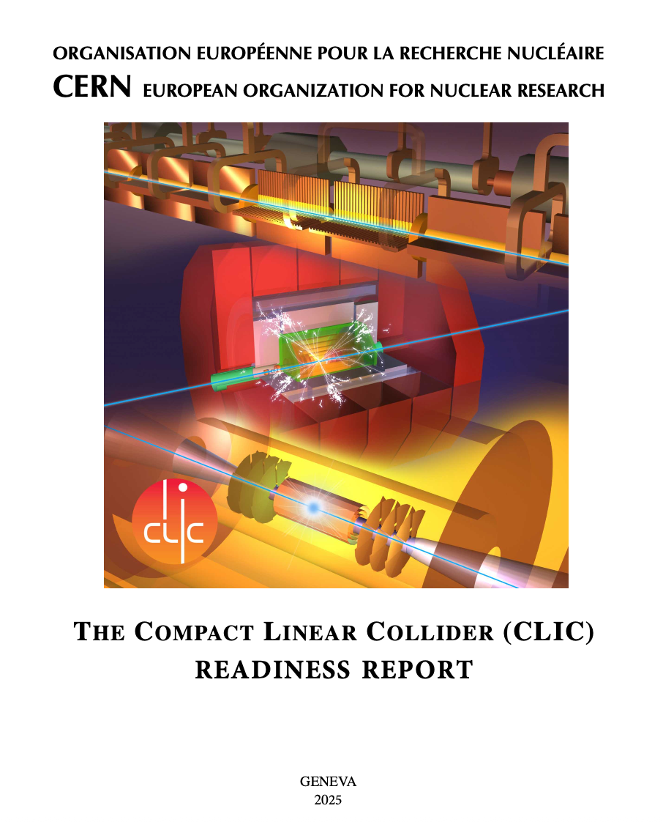
ESPP documentation – since Venice
Physics Preparatory Group: https://cds.cern.ch/record/2944678
Extended LCF document, new version: https://arxiv.org/abs/2503.19983
CLIC long Readiness Report towards EPJ: https://edms.cern.ch/project/CERN-0000267313
Report from the ESG WG2a (Comparative Analysis) underway (imminent).
Specific written input provided, included follow up meetings with the committee, for both LCF/SCRF and CLIC in September/early October.
Topics: Scope, Schedule, Costs, Risks and risk management, TRLs and R&D, Civil Engineering, some specific questions (no surprises)
14/27
Notes:
Add briefing book

Slide 15
From parameters/layout and to technology challenges
Looking ahead to next phase (summarizing from above) - baseline the parameters and site layout in 2-3 years:
StoE for lattice/layout, BDS with two IP, dumps, klystron/modulators, cryo, services and infrastructure (CV, EL, access, safety, alignment, installation, etc), injectors including e+, DRs, running and upgrade scenarios, etc
Next slides:
Some key technical challenges, status and identified risks (more guidance expected from the strategy process).
15/27

Slide 16
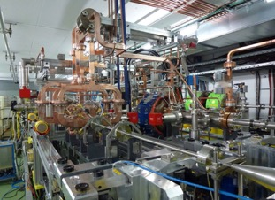
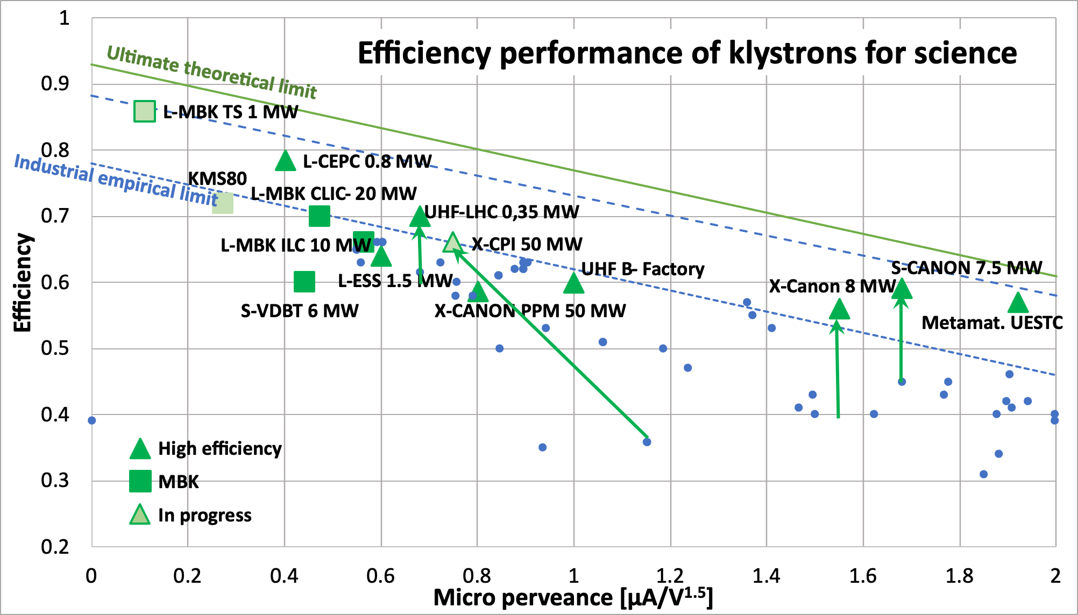
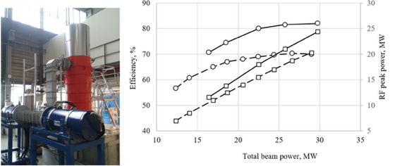
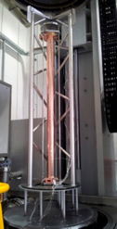
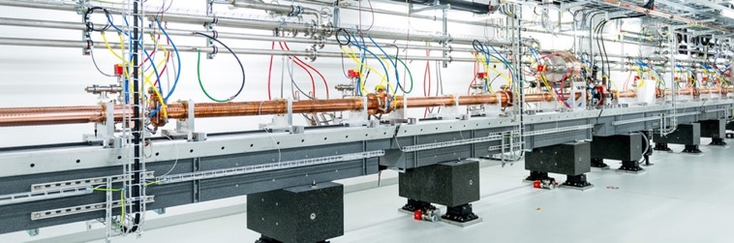
CLIC RF
CLIC baseline – a drive-beam based machine with an initial stage at 380 GeV
RF challenges
High-current drive beam bunched at 12 GHz
Power transfer and main-beam acceleration, efficient RF power
Towards 100 MV/m gradient in main-beam X-band cavities
The CTF3 (CLIC Test Facility at CERN) programme addressed all two-beam issues
X-band technology developed and verified with prototyping, test-stands, and use in smaller systems and linacs
Two C-band XFELS (SACLA and SwissFEL – the latter particularly relevant) now operational: large-scale demonstrations of normal-conducting, high-frequency, low-emittance linacs. Also ongoing, 1 GeV X-band linac at LNF (EUPRAXIA)
High efficiency power sources
See much more in Venice talk by Walter Wuensch: (LINK)
16/27

Slide 17
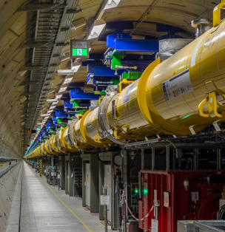
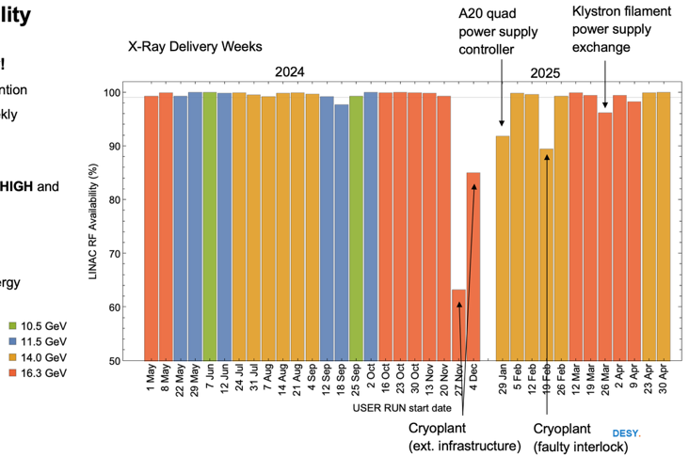
LCF with SCRF
SCRF features:
Very detailed and mature technical design and industrialisation, several FEL linacs build and being operated
Can be upgraded in Energy and Luminosity
Worldwide interest in technology
Large technology interest in Europe (EUXFEL and several other projects), and leading industries in Europe
Could it be exploited to reduce work and financial load on CERN during the HL period (lab support outside for in-kind cryomodules for example as foreseen for ILC – and also in Europe) ?
Can this be turned into a financing advantage and/or schedule advancement ?
EU-XFEL performance 2024-25
17/27

Slide 18
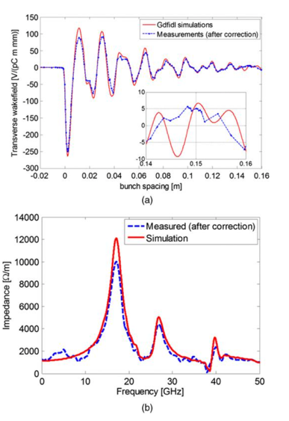
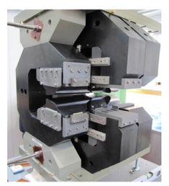
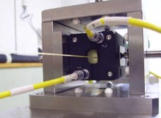
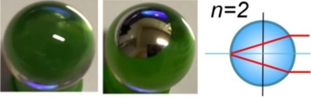
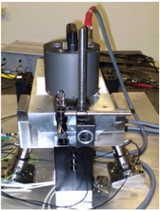
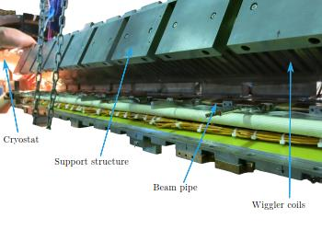
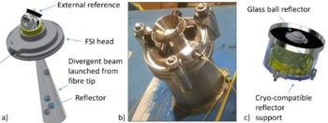
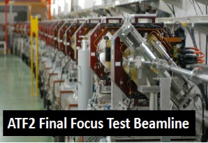
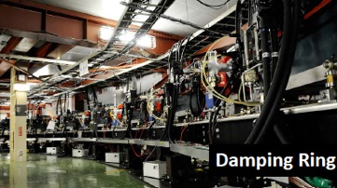
Luminosity related studies – examples
Target and achieved emittance in existing and planned machines
2018
Low emittance damping rings, preservation to the IP, final focus
Align components (10 μm over 200 m)
Control/damp vibrations (from ground to accelerator)
Beam based measurements – allow to steer beam and optimize positions
Algorithms for measurements, beam and component optimization, feedbacks
Experimental tests in existing accelerators of equipment and algorithms (FACET at Stanford, ATF2 at KEK, CTF3, Light-sources)
Final focus optimization, components, instrumentation and test (ATF the central facility)
2008
Longitudinal variable magnet for CLIC damping rings, wiggler prototype in KARA, extraction kicker in ALBA
Wake-field measurements in FACET
(a) Wakefield plots compared with numerical simulations. (b) Spectrum of measured data versus numerical simulation.
Alignment and stability components, also used in HL LHC
ATF2-3 at KEK:
Damping Ring and Final Focus beamline
18/27

Slide 19
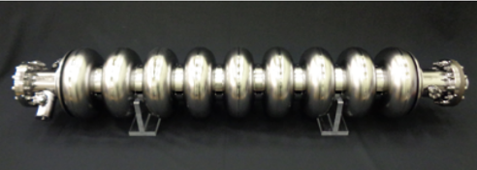
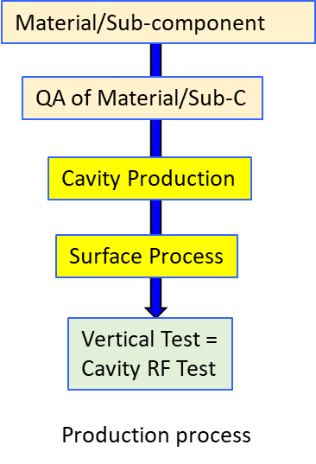
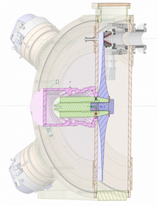


On-going technical studies in Europe – the ILC technology network topics
European ITN related studies (dedicated funding from Japan combined with European resources) are distributed over five main activity areas:
ML related tasks
SRF and ML elements: Cavities and Cryo Module,
Crab-cavities, ML quads and cold BPMs
Sources
Pulsed magnet and wheel/target for undulator scheme
Damping Ring including kickers
Low Emittance Rings
ATF activities, final focus and nanobeams
ATS and MDI
Implementation
CE, Cryogenics
Sustainability, Life Cycle Assessments
EAJADE (EU funding) for training of young scientists (linear and circular machines)
Studies in labs distributed across CERN, UK, Germany, France, Italy, Spain
See more details in the Venice presentation of Peter McIntosh (LINK)
and
Angeles Faus-Golfe on ATF2-3 (LINK)

Slide 20
From Technical Challenges to Upgrade Opportunities
Required in next phase:
Address key technical challenges and identified risks (more guidance expected from the strategy process). Among others
RF (incl. klystrons/modulators), positron production, final focus.
For CLIC also further drive-beam demonstration.
For the SCRF machine very closely connected with the ITN programme, including site specific studies as dumps and cryo.
Overview of LCF options longer term:
Additions, upgrades, R&D needed, long term developments
20/27

Slide 21
Additions/Upgrades– Beyond a collider/Improved SCRF, C3
21/27

Slide 22
Upgrades – PWA
22/27

Slide 23
Upgrades – higher luminosity, photons
23/27

Slide 24
LCF R&D – summary of next steps
Developments needed for Physics Beyond Collider and continued strong R&D for the upgrade options.
Analyse consequences for initial installation.
24/27

Slide 25
Schedule towards a LC@CERN
2026-28
Prep phase I:
T0, T0+5
Prep phase II:
Site investigation and preparation
T1, T1+10
Construction*:
Civil engineering
T1+11
Beam-commissioning
followed by physics
Design optimisation and finalization
Main technologies R&D conclusions
(Pre)Technical Design Report - two IPs at CERN
Definition of the placement scenario
Implementation studies with the Host states
Environmental evaluation & project authorisation processes
Industrialisation of key components
Engineering design completion
Construction of components
Installation and hardware commissioning
T0 is determined by a process in 2028-29 to validate the progress and promise of the project for a further development towards implementation.
*The construction phase is extended with respect to the technically-limited schedules to allow a transfer time into construction, and to avoid the resource conflict between HL-LHC operation and initiating beam commissioning for a next collider
T1 will be determined by the processes needed, by the CERN Council and with host-states, for project approval and to start construction

Slide 26
Next Steps towards a Linear Collider @ CERN
Project implementation: foresee 3+5-year preparatory periods, then construction ~10 years
Ideally starting preparation phases in 2026
Split in two phases, the first to establish final parameters and layout for a LC (see main points below)
2026-28 (resource estimate ~25-35 MCHF and ~150-180 FTEy)
Next 2-3 year – firm plan needed by end of year/January for options encouraged in ESPP update
Parameters and Layout:
StoE for lattice/layout, BDS with two IP
CE including dumps, klystron/modulators, services and infrastructure (CV, EL, access, safety, alignment, installation, etc)
Also CE for IPs, injectors including e+, DRs
Additions and Running & Upgrade scenarios
Technologies:
Address key technical challenges and identified risks (more guidance expected from the strategy process). Among others RF (incl. klystrons & modulators), positron production, final focus/ATF.
For CLIC also further drive-beam demonstration.
For the SCRF machine very closely connected with the ITN programme, including site specific studies as dumps and cryo.
PbC and Upgrades
Developments for Physics Beyond Collider (PbC)
Continued strong R&D for the upgrade options.
Analyse consequences for initial installation
Physics and Detector R&D:
Initial machine, upgrades, PbC …
…. and of course project management, costing, power, C02, scheduling, etc

Slide 27
Main points
A Linear Collider at CERN has a very attractive and broad physics programme and a very flexible facility
A Linear Collider as a staged project can be implemented at 8-9 BCHF for the first stage
Upgrading to - at least - 550 GeV is possible, to be implemented taking into account physics and resources as the programme and field evolve
A ~3 year programme is suggested to establish a LC baseline, building on and extending existing international collaborative R&D
Need more detailed implementation study to validate and optimize an LC@CERN (as outlined for 2026-28)
Guidance about energy, performance, concerns and cost goals from the ESPP update important
Much more detailed plans likely required by end of the year, for the period 2026-2028
An LC can be completed in parallel with the HL LHC programme (to the extend resources allow)
There are many opportunities for international support (technology and capabilities) in the preparation phases and during a potential construction

Slide 28
Many thanks to many.
Slides/plots/information from the documents mentioned on slide 13-14.
Several slides lifted directly from Jenny List’s talk in Venice.
Almost all topics will be discussed in more detail during this week.

Slide 29




A physics-driven, polarised operating scenario for a Linear Collider
Stage 1: 250-380 GeV
precision Higgs mass and total σ(ΖΗ)
precision Higgs couplings and total width to % level
resonance/compositeness search in ffbar, WW to 10’s TeV
1-yr excursion to the Z pole - sin²θ_{W} to 3e-6
Stage 2: 550 GeV
precision Higgs couplings and total width to sub-% level
top quark Yukawa to 3%, Higgs self-coupling to 11%
top quark electroweak couplings to 0.1%
resonance/compositeness search in ffbar, WW to 50 TeV
1-yr excursion to the ttbar threshold - mt to 40 MeV
Higher energies: 1000 GeV or above
top quark Yukawa to 1%, Higgs self-coupling in WW fusion
Higgsino search to 500 GeV
follow up HL-LHC discoveries of new Higgs and electroweak states
Fixed target program: dark sector, nonlinear QED
All discoveries of deviations from the SM can be verified in complementary reactions at higher energy, e.g. H self-coupling visible in two complementary HH production rxns.
4
ZHH
The projections are supported
by full-simulation studies with detailed
detector designs and machine bkgds.
WW fusion
combined
Much more in arXiv:250319983
29/24
From J.List/M.Peskin

Slide 30





Costs – more details
Cost matrix, updating SCRF and CFS (~75%), escalation and currency updates for the rest (~25%)
The cost composition and values of the 1.5 TeV complex have also been estimated. The energy upgrade to 1.5 TeV has a cost estimate of∼7.1billion CHF, including the upgrade of the drive-beam RF power needed for the 1.5 TeV stage.
The 250 GeV configuration will cost around 10% less than the 380 GeV complex.
A 550 GeV configuration around 30% more

Slide 31



Personnel and Operation Costs
Estimated according to guidelines in comparative study (LINK)
Plot on the right from Snowmass Implementation Report (LINK)
Personnel for construction is estimated in the 10000-11000 FTEy range, according to the formula (value excludes civil engineering):
Explicit Labour = 15.7 x (value)^{0.75}
Operation cost (material replacements, energy costs, and personnel for operation) also updated, important for overall affordability
 | CLIC 380 | LCF 250 (ave. LP,FP)
Maintenance and replacement costs (MCHF) | 137 | 170
Electricity costs (MCHF – using 80 EURO/MWh) | 63 | 69
Personnel for operation (FTE) | 650 | 800
Cost items are distributed on three maintenance groups, with 1,3,5 % annual replacement estimates
31/24

Slide 32




Sustainability: Life Cycle Assessment (LCA)
Civil engineering
Operational Power/Energy
The carbon intensity of energy in ~2050 (operation):
Use 14-18g/kWh
Hardware (both for NCRF and SCRF)
See also:
LDG sustainability panel group yesterday (LINK)
LCA reports (by ARUP): LINK

Slide 33
Towards Carbon Accounting with LCA
Unit (kton CO2) | LCF LP 250 (33.5 km) | LCF FP 550 (33.5 km) | CLIC 380 (11.5km) | CLIC 1500 (29.5 KM) | Reductions and comments
CE underground A1-A5 | 380 | 0 | 286 | 199 | ~50%
CE surface (for injectors & sites) A1-A5 | Only site buildings (small) | Only site buildings (small) | 118 | 0 | ~50%
Machine elements incl. injectors A1-A3 | 236 | 394 | 140 | ~135 | ~25%
Tunnel Services A1-A3 | 46 |  | 19 | ~20 | ~25%
Two detectors A1 | 94 | Upgrades | 94 | Upgrades | ~25%, very incomplete estimate
Operation annually | 13 | 28 | 13 | 22 | Assume 2050 numbers (prev. slide)
General comments:
LCAs are becoming very useful tools for design optimisation, material and supplier choices
Several parts will evolve (usually increase) with more studies, in particular hardware and services
Hardware the dominant contribution

Slide 34



Beyond a collider
Beam-dump / fixed-target / R&D / irradiation
Ample opportunities to foresee beam extraction / dump instrumentation / far detectors at a LCF
extraction of bunches before IP -> mono-energetic, extremely stable, few 10¹⁰ @ 1-10 Hz => super-LUXE (SF-QED 𝝌 = O(few hundred) & BSM search), super-LDMX, …
disrupted beam after IP -> broad energy and highly divergent, but up to 10¹⁵ eot / s super-SHIP, generic dark photon and ALP searches => together with e+e- cover all Dark Sector portals
Low-emittance, mono-energetic beams ideal for
high-rate detector and beam instrumentation tests
creating low-emittance beams of photons / muons / neutrons for various applications (hadron spectroscopy, material science, irradiation, tomography, radioactive isotope production, …)
accelerator development:
high-gradient accelerating structures, new final focus schemes, deceleration (for ERLs), beam and laser driven plasma, …
from extracted beam to test small setups - to large-scale demonstrators for upgrades of the main facility
dumps / extraction lines at ILC
main dump particle spectra

Slide 35




Super-conducting RF Upgrades
Need ~60 MV/m to reach 1 TeV in LCF tunnel
SCRF is one of the key directions of Accelerator R&D Roadmap
significant synergies with ERL needs
needs to be accompanied by R&D on high-efficiency klystrons, couplers, He refrigerators, …
progress is funding limited
5-year horizon: standing-wave, bulk niobium cavities: 50-60 MV/m
new baking: 2-step (75º/120º) or mid-T followed by low-T
new shapes
10-year horizon: traveling-wave cavities 60-70 MV/m “HELEN”
substantially lower kM => higher gradients for same magnetic quench limit
2x higher R/Q => lower losses
higher stability of field distribution -> longer structures
>10-year or break-through: Nb3Sn or multilayer cavities 100 MV/m
~2x higher transition T than Nb: 2K -> 4K
~2x higher DC superheating field than Nb
to-date only reached gradients up to 24MV/m with Nb3Sn

Slide 36







Cool Copper Technology
1-m prototype structure
Idea and R&D
C3 technology:
normal-conducting C-band copper cavities
operated at cryogenic temperatures (LN2 ~80K)
gradients demonstrated up to 155 MV/m
R&D:
plan towards demonstrator established during Snowmass
since then significant progress on system design, accelerator structure design, high gradient testing, vibration measurements, damping materials, alignment system, low-level rf & klystrons, … and cryo-module design
stand-alone facility 8km: 250 /550 GeV (70 /120 MV/m)
single-cell gradient
demo
Quarter-cryo-module

Slide 37

C3 as upgrade for LCF
the route to 3 TeV
studied in context of LCVision
LCF injector complex and damping rings compatible with C3:
larger LCF DRs = lower risk
replace fast->slow kickers (kick whole trains)
bunch compressor length / emittance sufficient
=> substantial part of infrastructure could be reused
cryo-plants need modification
SRF cryomodules could be sold / donated for XFELs / medical linacs /.. round the world
to be considered in design of beam delivery systems and dumps

Slide 38



HALHF
Hybrid-Asymmetric Linear Higgs Factory
e+e- LC using e-beam-driven plasma wakefield acceleration for the e- beam…
…and RF cavities for the e+ beam
=> asymmetric collisions with 𝛾=1.67 (HERA: 𝛾=3), luminosity ~ILC baseline
site-length and cost - small & cheap:
250 GeV: 4.9 km, 3.8 BCHF
550 GeV: 8.4 km, 6.3 BCHF
if R&D successful - estimated need:
213 MCHF & 341 FTEyrs over ~15 years

Slide 39

PWA Booster à la HALHF
as upgrade to LCF
can one apply the HALHF-scheme to (asymmetrically) double the ECM of a symmetric e+e- LC?
example: 250 GeV (125 GeV on 125 GeV) -> 550 GeV (550 GeV on 137.5 GeV, 𝛾=1.2)
e+ : only small increase in E(e+) needed - either operate at 35 MV/m or add few cryomodules
e-: re-purpose main linac to produce drive-beams for plasma stages => low gradient - high current operation
plasma stages would sit next to undulator source => need to foresee lateral space from beginning
PWA needs ~10x shorter bunches than LCF standard => the HALHF concept assumes that suitable sources will be available - same assumption here
conclusion:
conceptually possible
in detail many open questions
=> room for exciting R&D and creative system design!

Slide 40




10 TeV pCM wakefield collider
R&D and LCF pave the way
10 TeV Wakefield Collider Study
by 2028 produce a unified, self-consistent concept, including cost scales for a 10-TeV parton-center-of-mass (pCM) collider based on wakefield accelerator (WFA) technology
HEP-wide community effort, involving theorists, experimentalists and Linear Collider experts (~100 participants at last collaboration meeting)
investigates the Physics case for 10 TeV pCM e+e-, e-e-, and 𝛾𝛾 collisions
identifies R&D at current and proposes the required new R&D test facilities
would greatly benefit from R&D enabled by LCF
R&D challenges
optimization of power efficiency
demonstration of collider plasma modules with 10 GeV energy gain, > 100 pC of charge and normalized emittance < 100 nm
staging of collider modules
positron acceleration in plasma (not a problem in wake-driven structures or for 𝛾𝛾)
BDS and beam-beam effects at 10 TeV pCM

Slide 41




Energy- & Particle Recovery as path to High Luminosities
higher luminosity
Energy and particle recovery:
boost luminosity up to 10³⁶ / cm² / s and high e+ polarisation
by re-using particles and energy => requires to limit beam-strahlung, far from disruption limit
several concepts - e.g. ReLiC, ERLC
physics motivations for high luminosity in e+e- LC:
most measurements statistics limited => gain everywhere
e.g. few 0.1% on trilinear, few 10% quartic self-coupling…
also: electron Yukawa - effective absence of beam-strahlung allows mono-chromatisation
ReLiC
ERLC

Slide 42





Photon-Photon / e-photon collisions
energy- dependent minimum
in HH cross
section
Photon Collider
𝝲𝝲 / e𝝲 offers unique complementary physics opportunities e.g. self-coupling in 𝝲𝝲→HH with different BSM behaviour than e+e- / pp
high-intensity lasers convert e beam(s) into 𝛾 beam(s) directly at the IP => spin-0 luminosity spectrum sharply peaked
two methods:
optical lasers “classic” scheme
recent: X-ray lasers from X-FELs integrated into the facility (XCC)
sharp
spin-0 lumi peak
XCC
𝛾𝛾 → HH → 4b

Slide 43
Next Steps towards a Linear Collider @ CERN
Project implementation: foresee 3+5-year preparatory periods, then construction ~10 years
Ideally starting preparation after conclusion of EPPSU in mid-2026
Split in two phases, the first to establish final parameters and layout for a LC (see main points below)
2026-28 (resource estimate ~25-35 MCHF and ~150-180 FTEy), main topics below
Site Layout Refinement:
The next step is to refine the LC site layout, including shaft placement and detailed designs for surface and underground areas.
Accelerator Complex Design Optimisation:
The detailed design of the LC accelerator complex, especially its interfaces with civil engineering and detector systems (BDS and interaction area), will be further developed, with a particular focus on optimising the LC@CERN parameters.
Technology R&D with international partners:
Research on SCRF and X-band technologies, including RF sources, e- and e+ sources, nanobeam systems, beam delivery and damping rings.
Detector R&D:
Aligned with Higgs factory and broader technology initiatives

