Slide 1



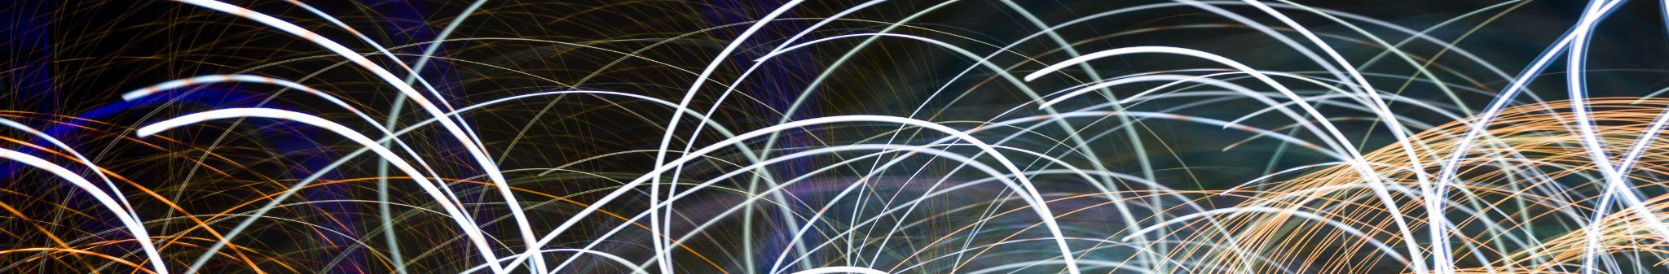
CLIC Status
Walter Wuensch, Erik Adli and Steinar Stapnes
CERN, University of Oslo, both

Slide 2


Introduction
Over the past year significant effort has been put into preparing documents for the ESPP update process. The following documents were produced:
CLIC ReaDiness Report, RDR – https://edms.cern.ch/project/CERN-0000267313
10 pager (with addendum) – https://indico.cern.ch/event/1439855/contributions/6461475/
In addition to promoting CLIC in the update process, the RDR has been useful for:
consolidating developments and achievements post updated baseline reports issued in 2016 and Project Implementation Plan 2018,
establishing consistency with the more complete 2012 CDR,
providing the foundation for planning for the future.
I would like to use this presentation to:
share highlights from the RDR to engage your interest and (re)discover the innovation of CLIC,
Introduce you to a few activities a bit at the edge of the project but are important collaborations.

Slide 3
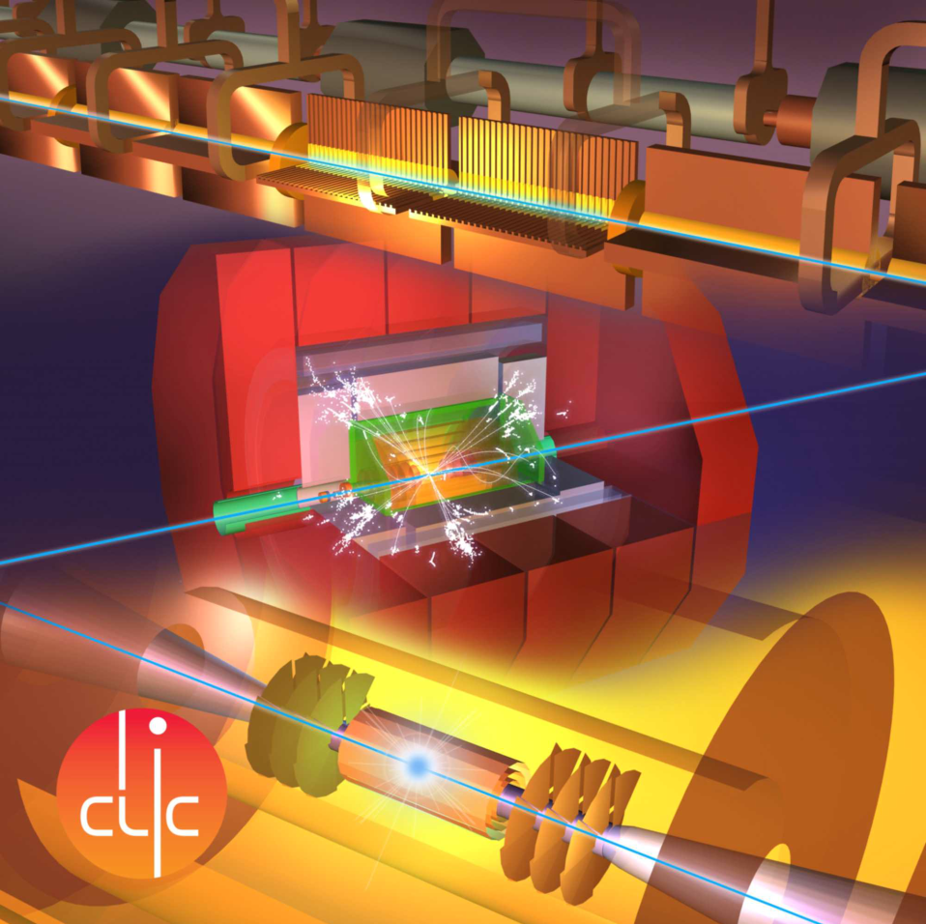
Table of Highlights
01
02
03
04
05
06
07
08
09
10
11
12
13
14
Two interaction regions
Collision energy options, staging
100/50 Hz operation
Emittance budgeting
Energy consumption
Injector update
L-band klystron
Drive beam pulse compression
Linac modules
Accelerating gradient
Applications of X-band technology
High-gradient fundamentals
High-temperature superconductors
Siting

Slide 4
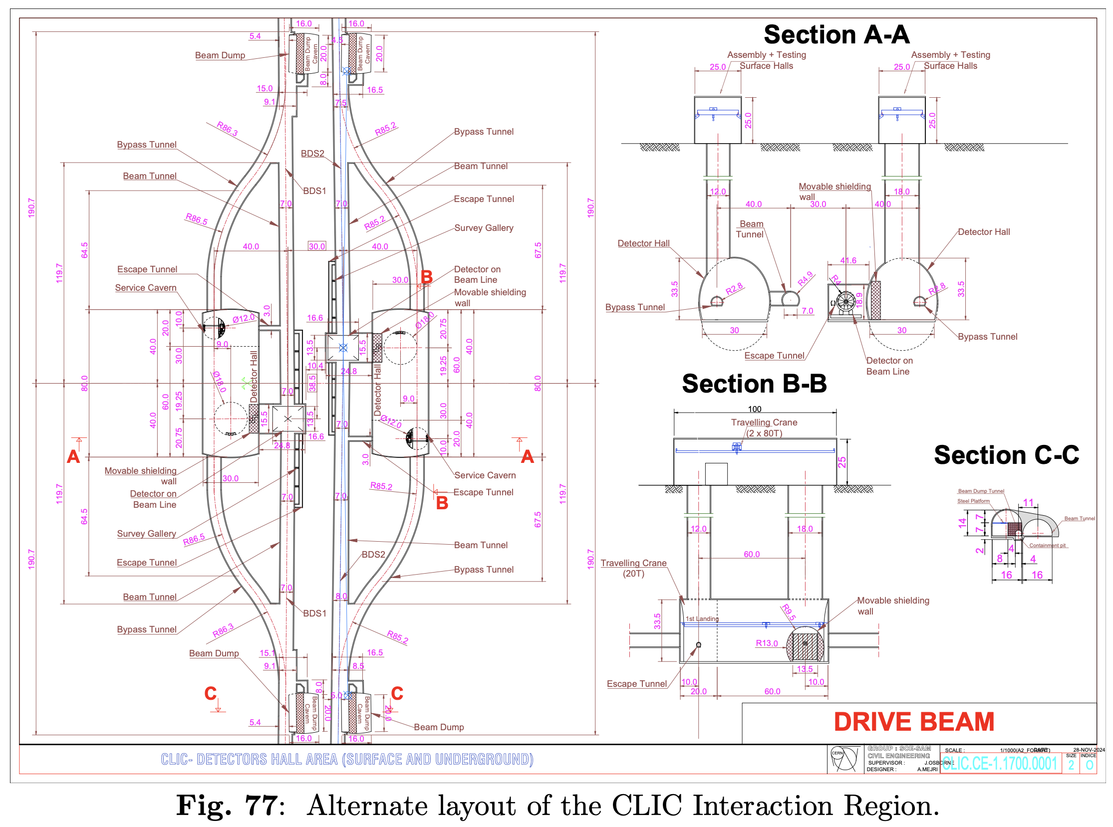
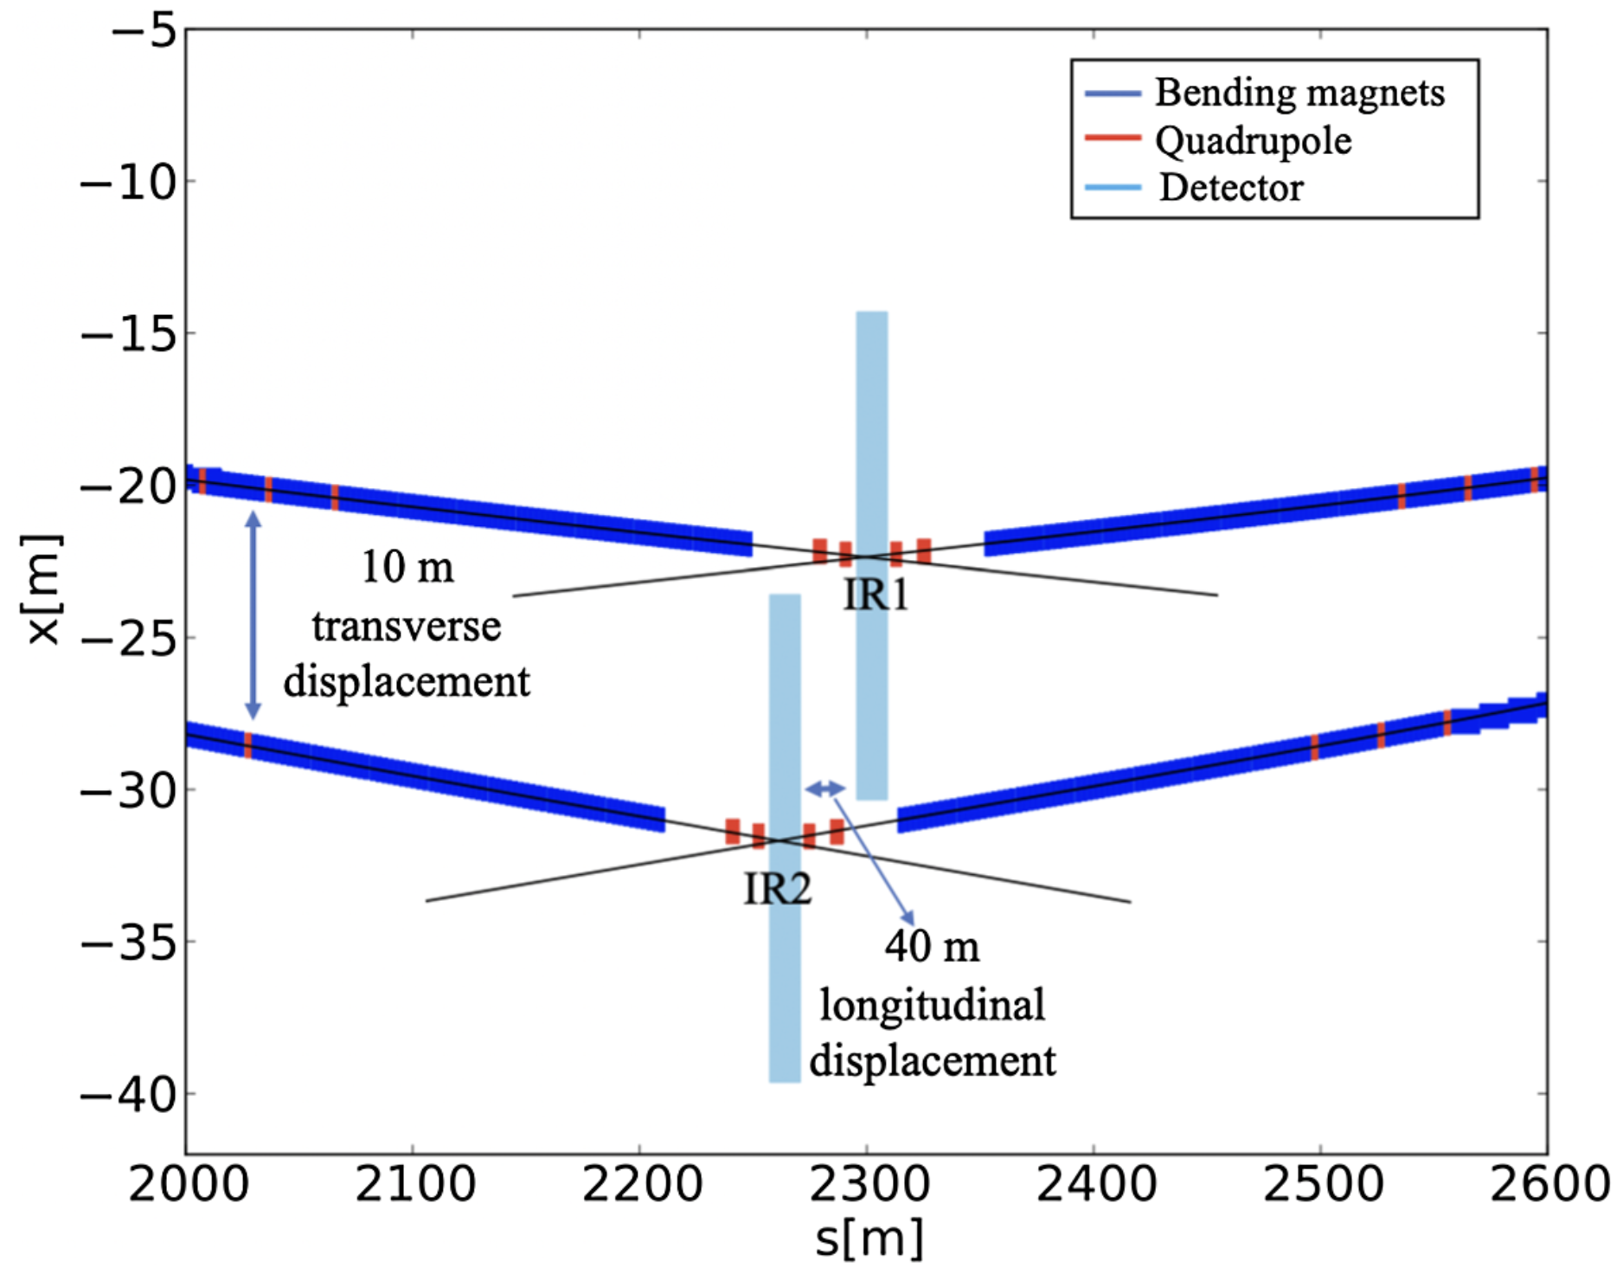
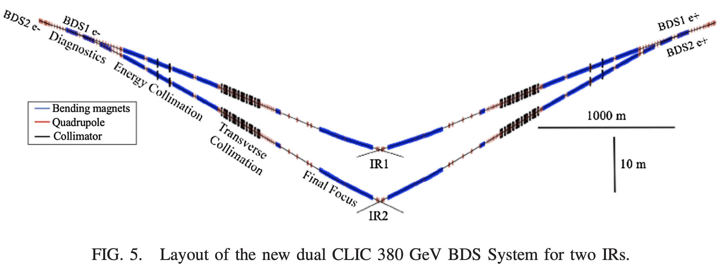
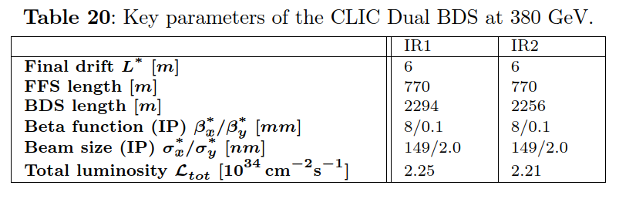
Two interaction regions
Addresses a long-standing concern: a single IR does not sufficiently serve the particle physics community
Two detectors can be operated each at an average rate of 50 Hz
All the luminosity can also be delivered to a single detector at 100 Hz
V. Cilento et al. Phys. Rev. Accel. Beams, 24 071001 (2021)

Slide 5
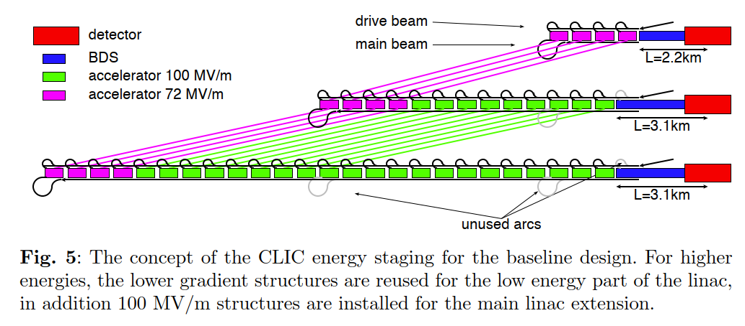
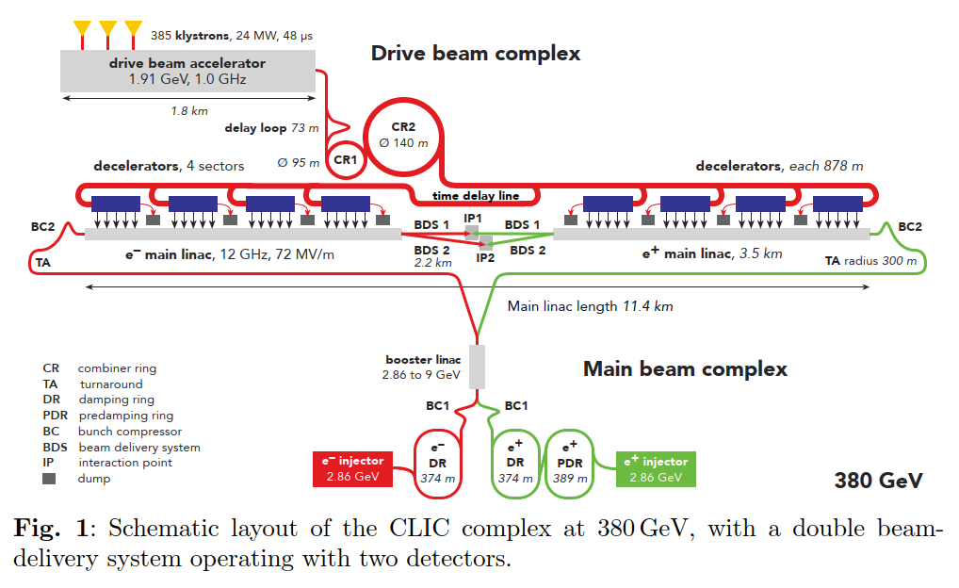
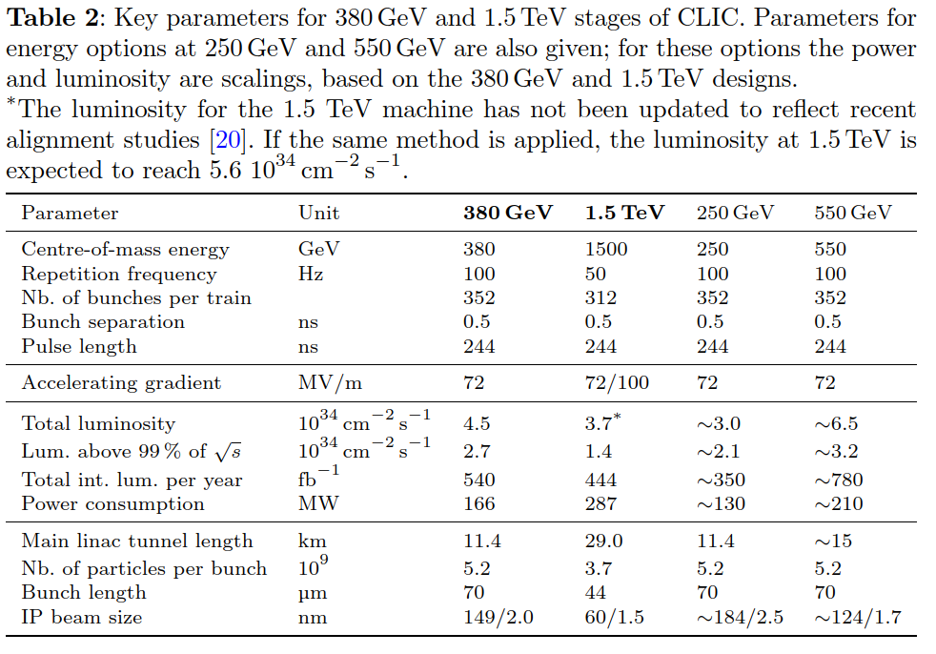
Energy staging
Energy up to 1.5 TeV with single drive beam injector, plus 30 km shallower tunnel.
550 GeV, 2 additional sectors each side.

Slide 6
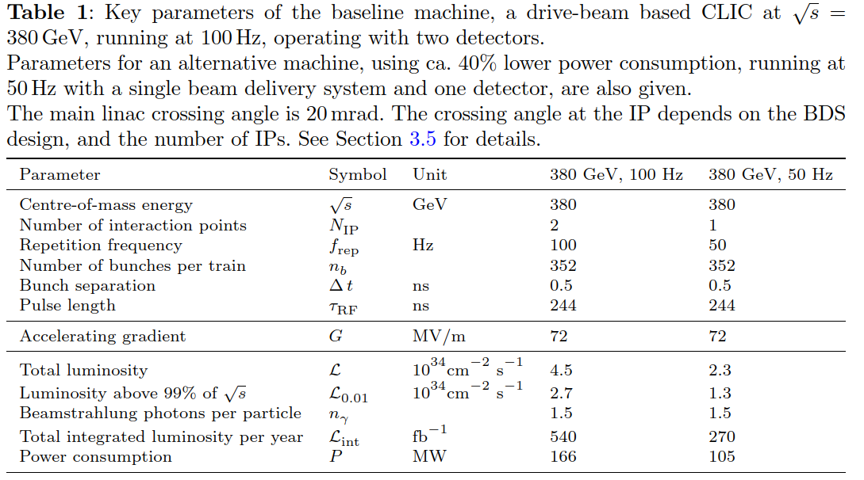
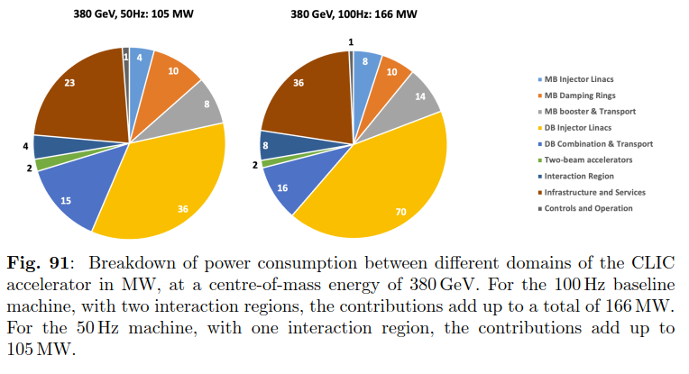
50 and 100 Hz operation
The re-evaluation of the level and distribution of power consumption at 380 GeV made clear that repetition rate – luminosity! - could be doubled with only 60% increase in power consumption.
Due to large fraction of non-pulsed consumption, magnets, infrastructure etc.
Contributes also to implementing two interaction regions.

Slide 7
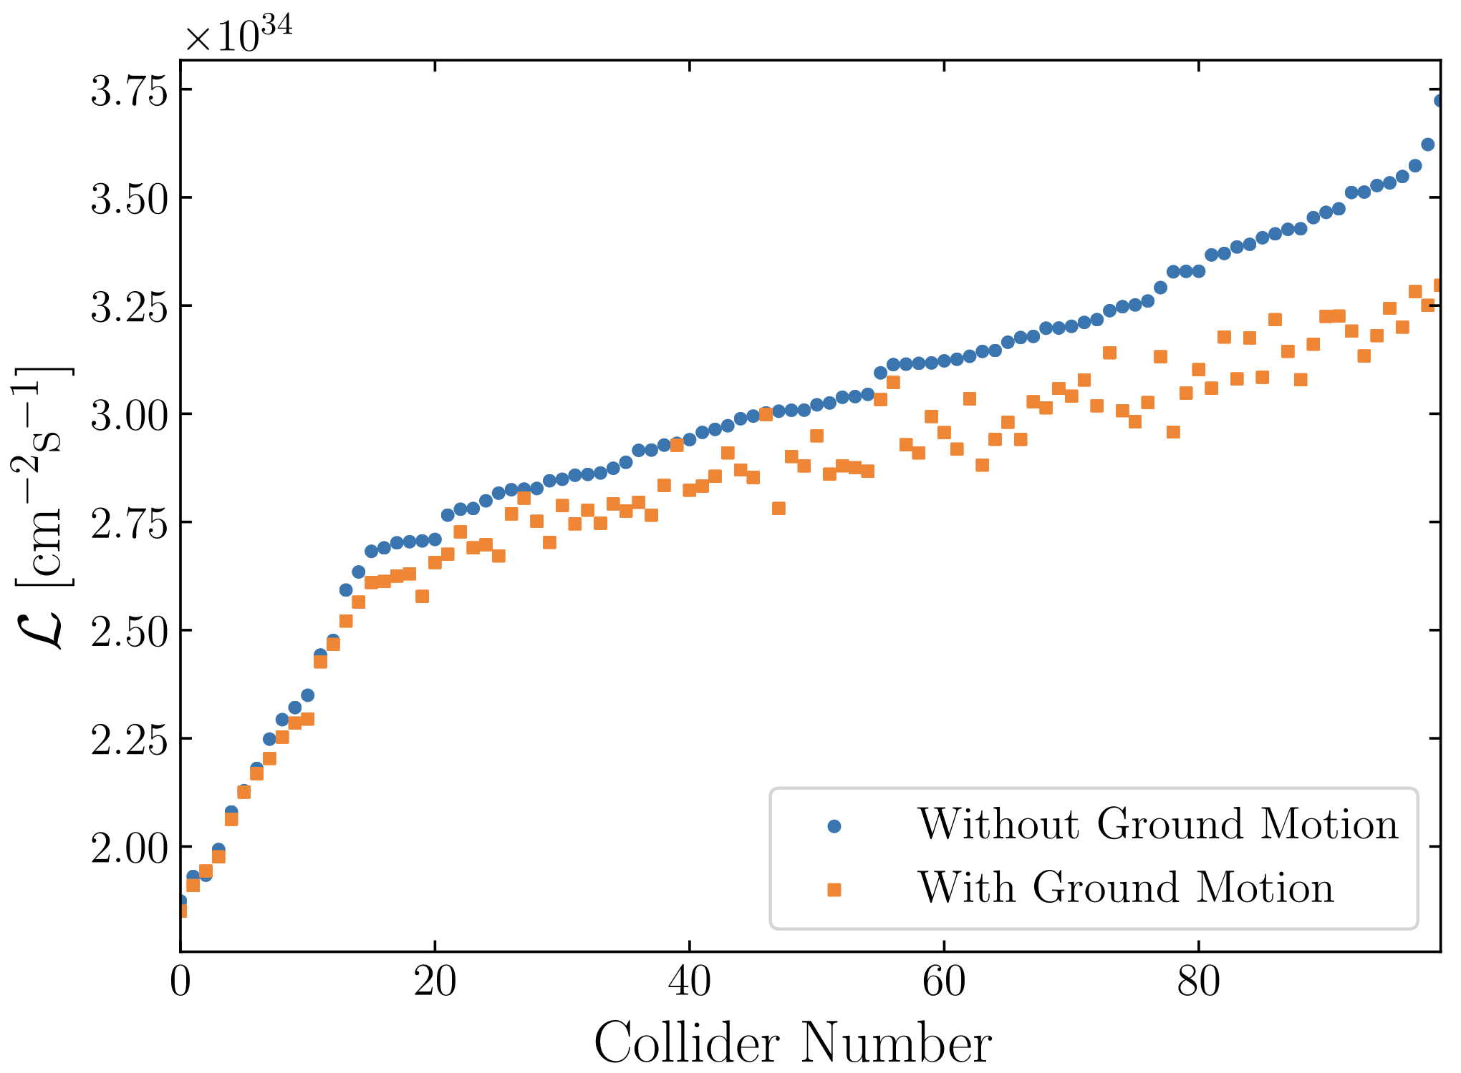
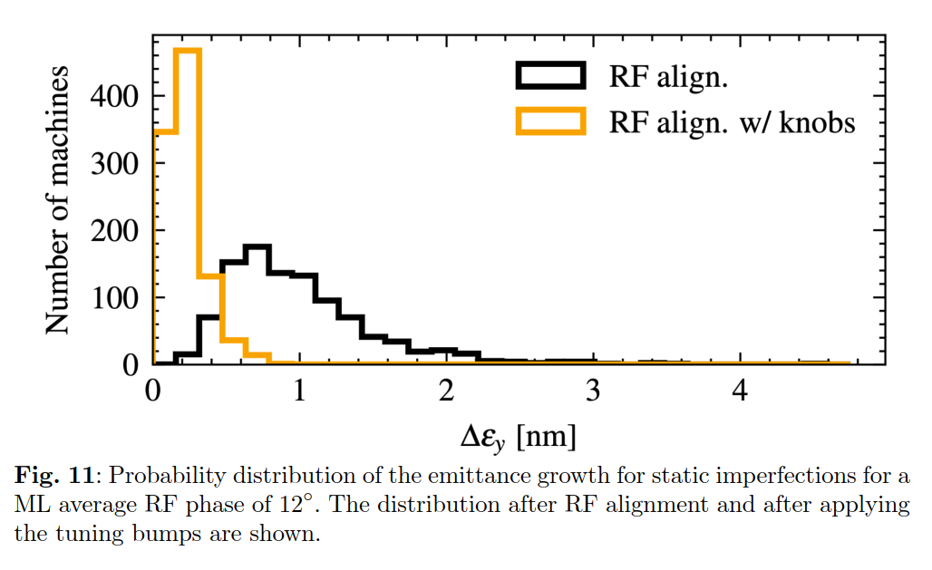
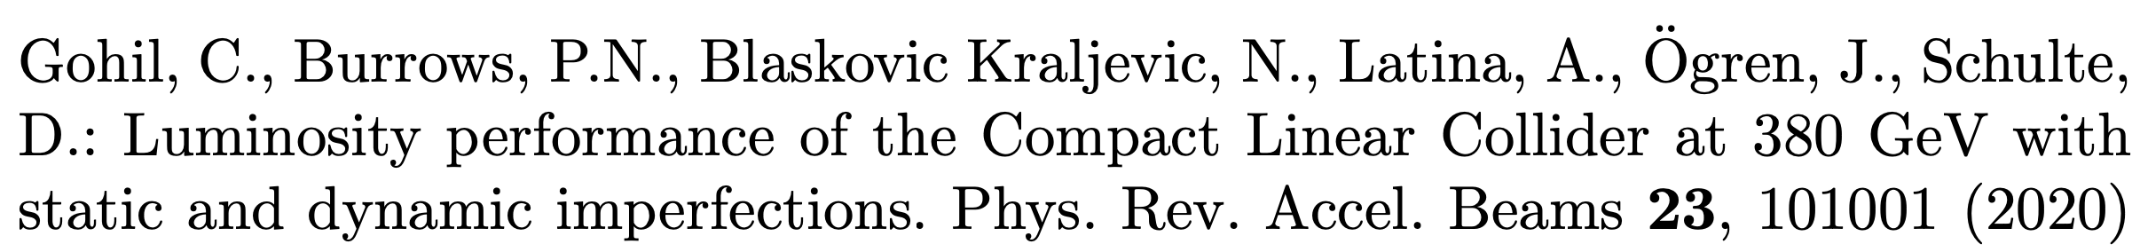
Emittance
margins
Emittance budgets to full start-to-end simulation
For the expected alignment imperfections and with a conservative ground motion model, 90% of machines achieve a luminosity of 4.5 × 10³⁴ /cm²/s or greater, at 380 GeV, 100 Hz. This is the value assumed for the 2025-2026 EPPSU.
The average luminosity achieved in simulations is 5.6×10³⁴ /cm²/s (380 GeV, 100 Hz).
Future improvements to the technologies used to mitigate imperfections, such as better pre-alignment, active stabilization systems and additional beam-based tuning, will also help increasing this luminosity surplus further. A start-to-end simulation of a perfect machine shows that a luminosity of 8.6 × 10³⁴ /cm²/s would be achieved (380 GeV, 100 Hz).
(L for 50 Hz)

Slide 8
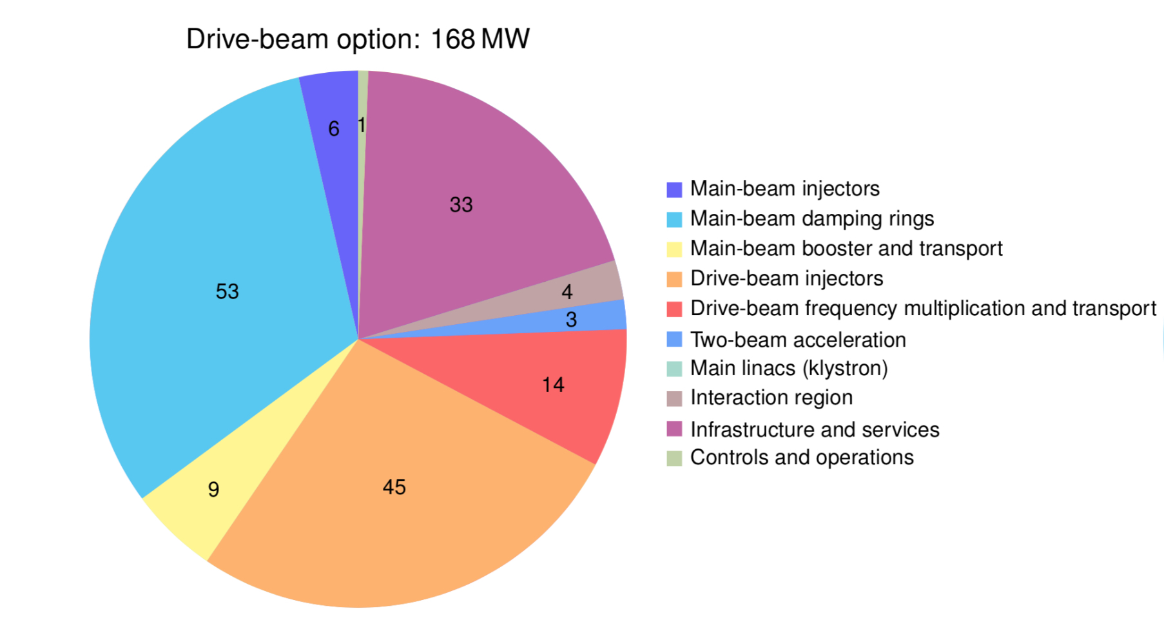
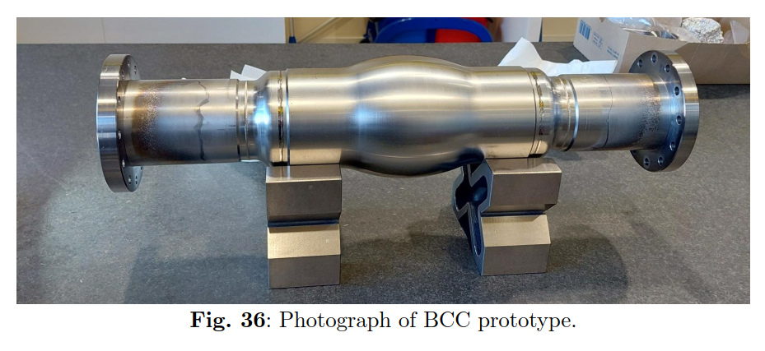
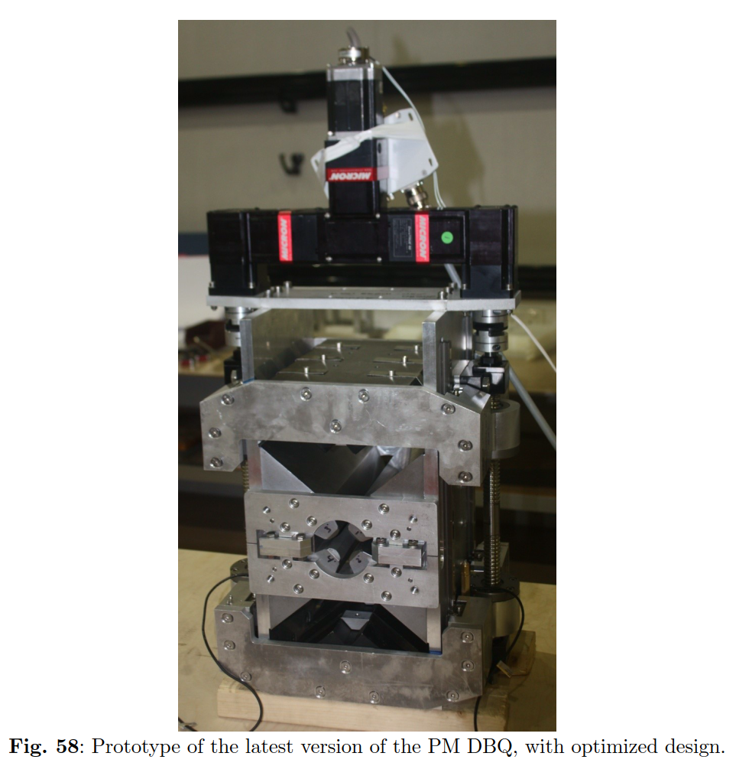
Energy consumption
Old values
Also Alexej Grudiev, SCRF Tuesday
n.b. Not yet part of power calculation.

Slide 9
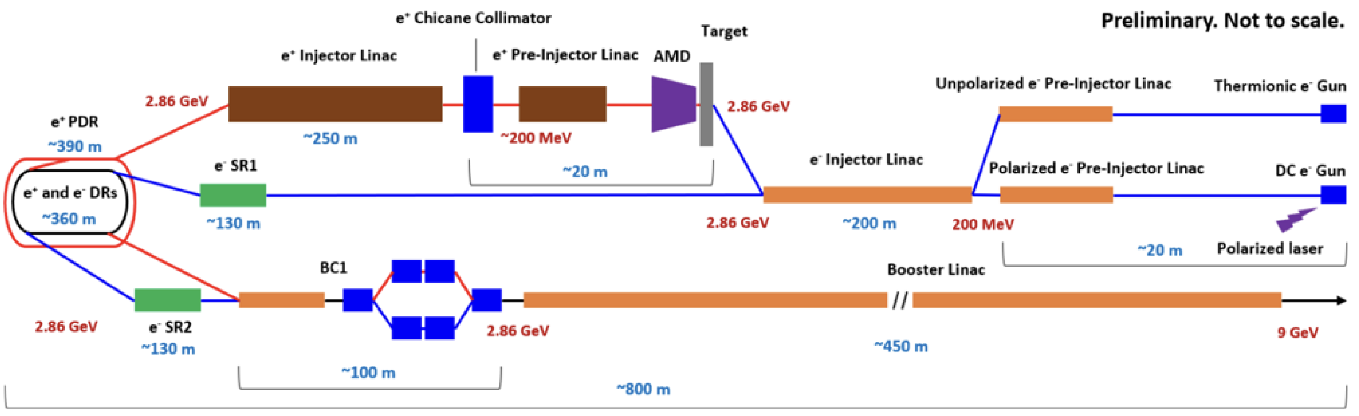
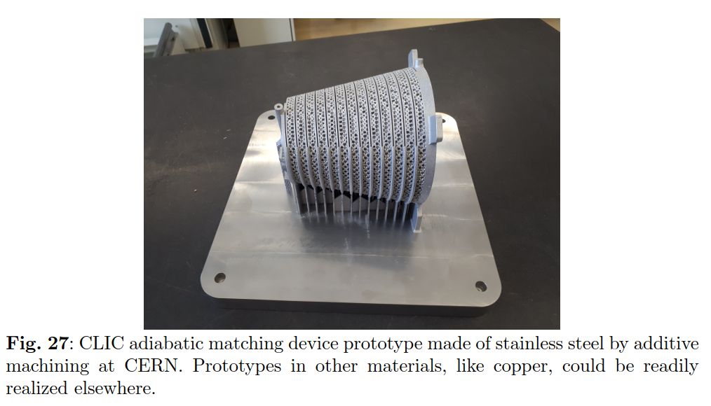
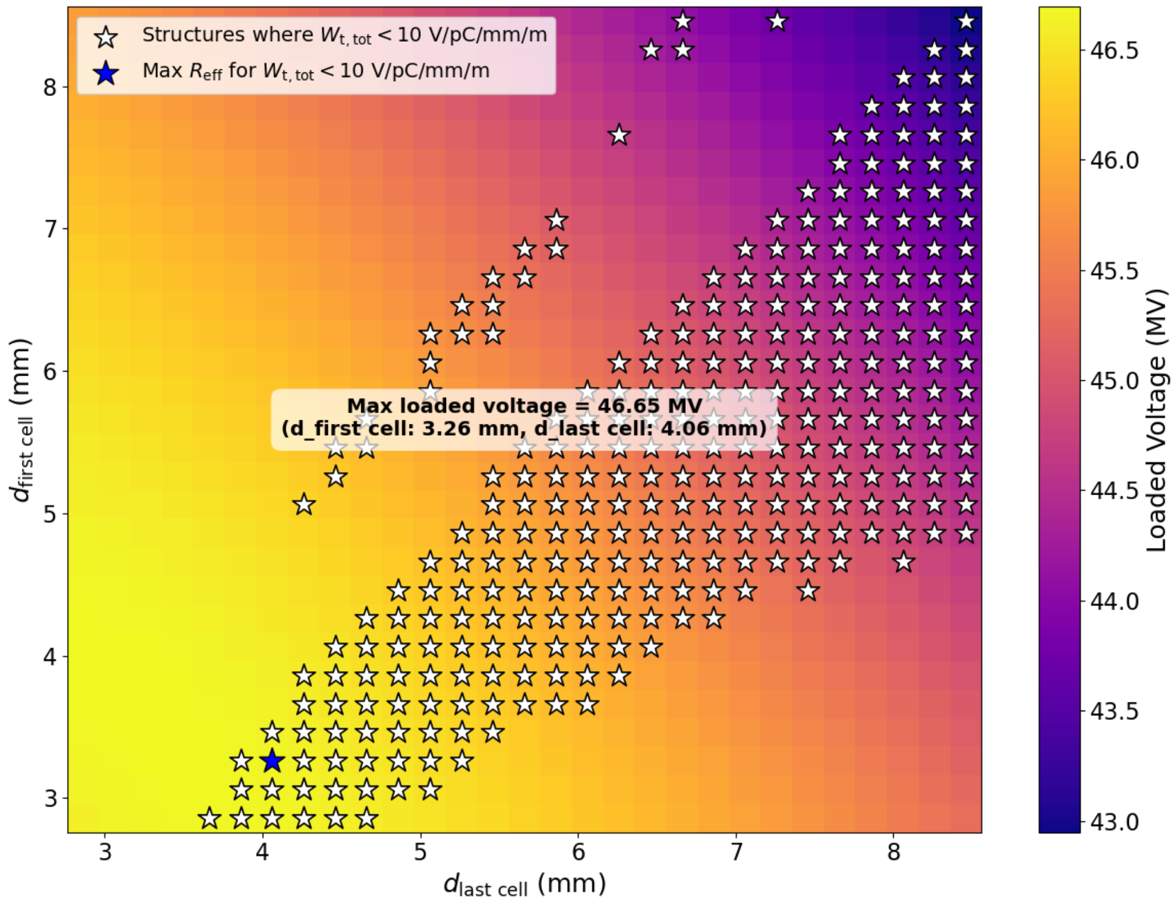
Injector update
Recent re-design and optimization of the linacs for the CLIC main beam injector complex.
Optimized high-efficiency2 GHz accelerating structures.
Focused on maximizing RF-to-beam efficiency under strong beam-loading conditions while ensuring compatibility with wakefield suppression and beam dynamics constraints.
Through parametric simulations, analytical modeling, and systematic scans of structure geometries, high-performance solutions were developed for the booster, electron, and positron injector linacs, achieving significant improvements in operational stability.
RF Design and Optimization of Linacs for the CLIC Main Beam Injector Complex
Kurtulus, Adnan ; Doebert, Steffen (CERN) ; Grudiev, Alexej (CERN) ; Latina, Andrea (CERN) ; Zhao, Yongke,
CERN-ACC-2025-0004 ; CLIC-Note-1201
A. Kurtulus, NCRF this morning

Slide 10
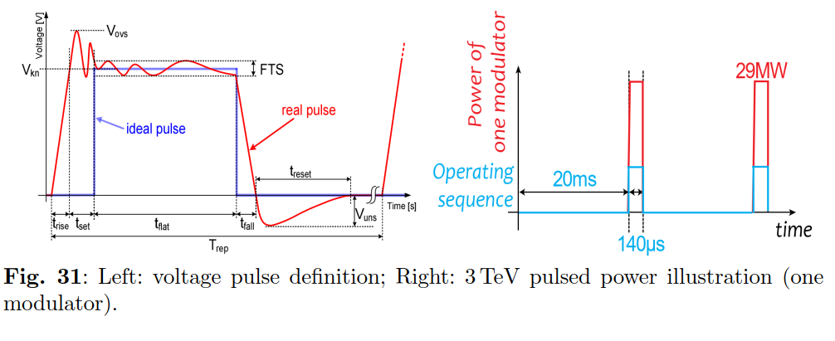
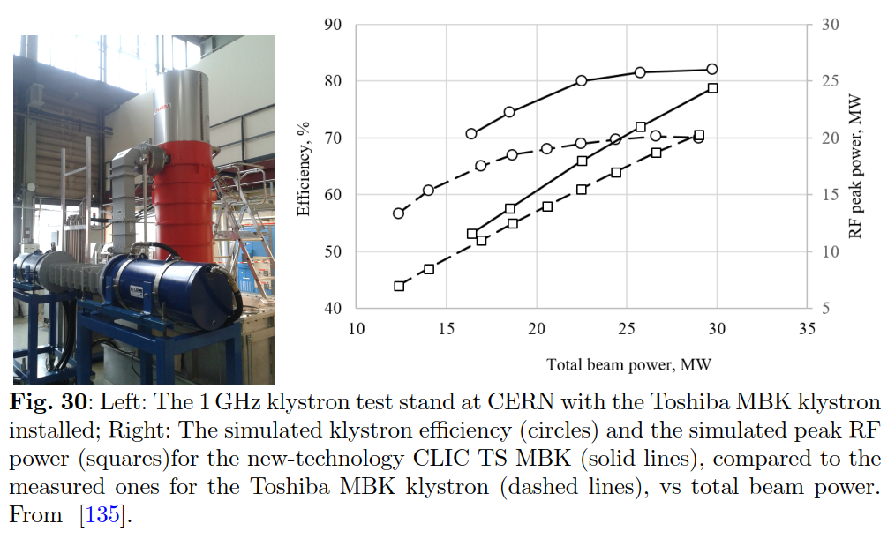
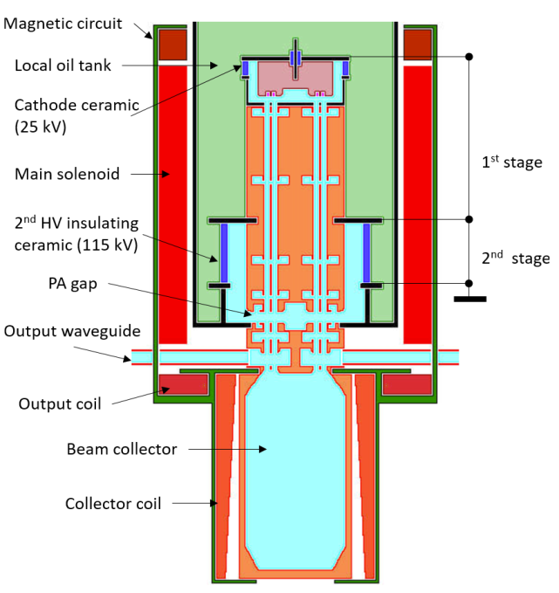
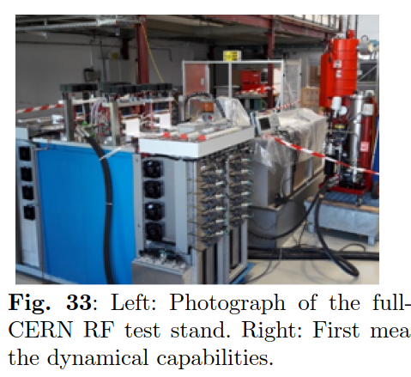
L-band power source
Efficiency is crucial – L-band source feeds drive beam accelerator.
CLIC-driven rf source developments are having a significant impact on other collider proposals.
Two-stage MBK

Slide 11
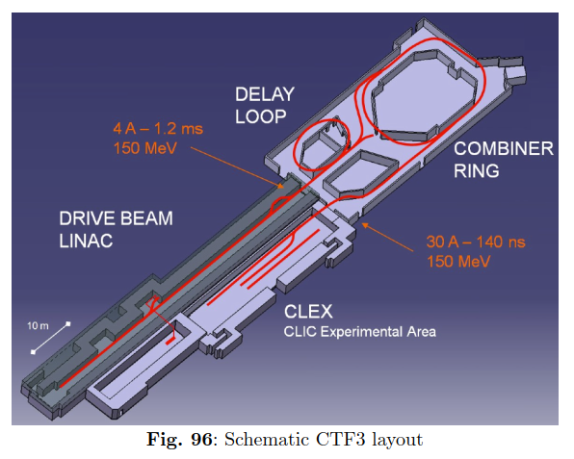
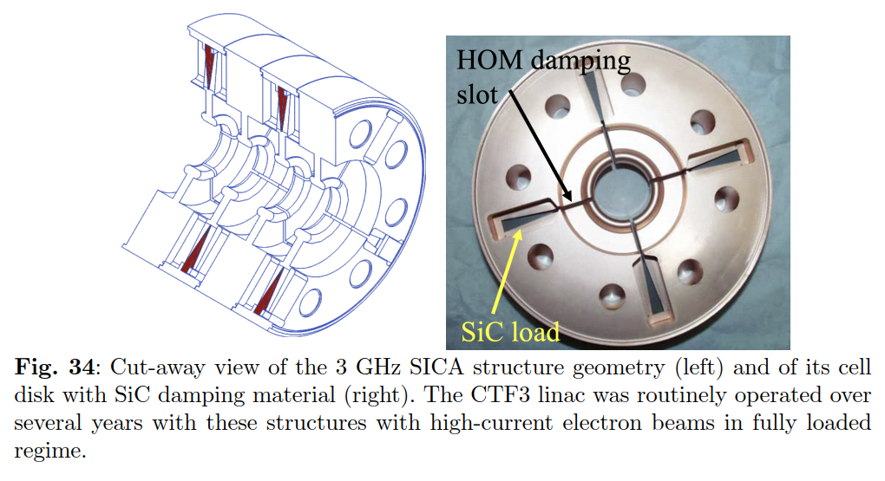
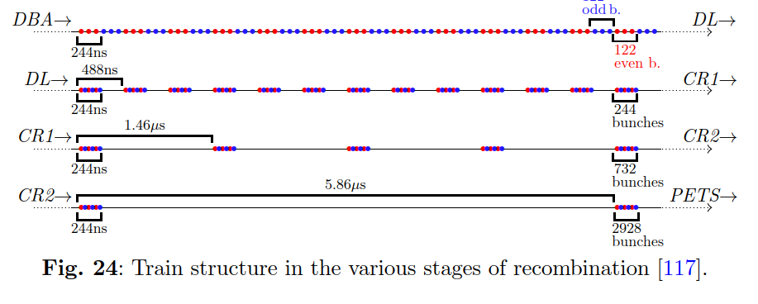
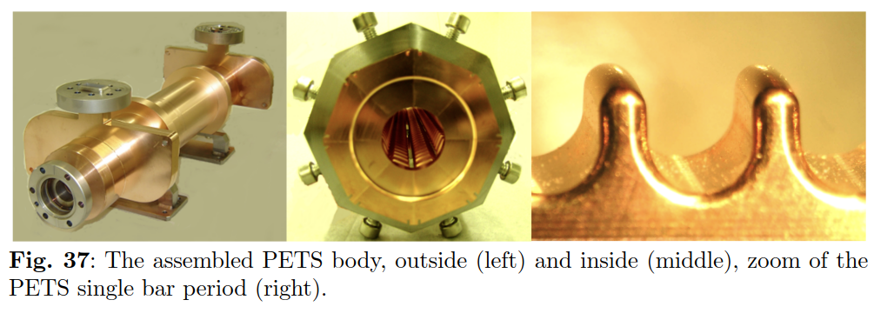
Drive beam
Power in
Power out
CLIC

Slide 12
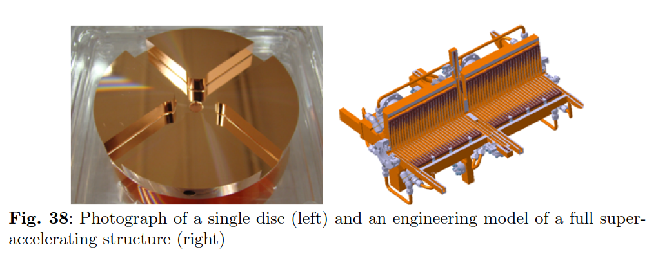
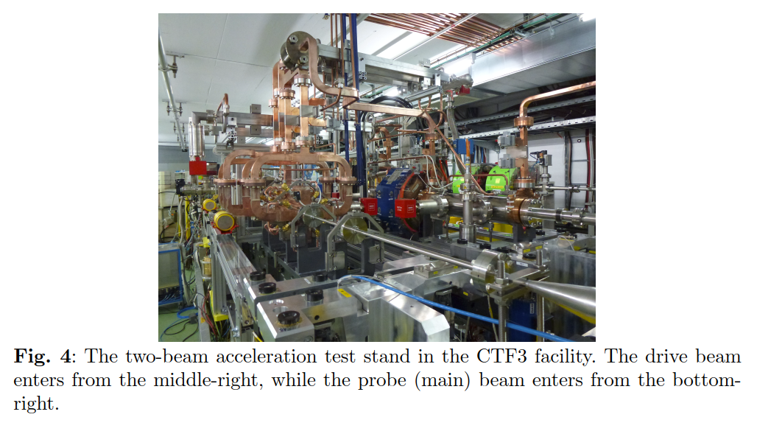
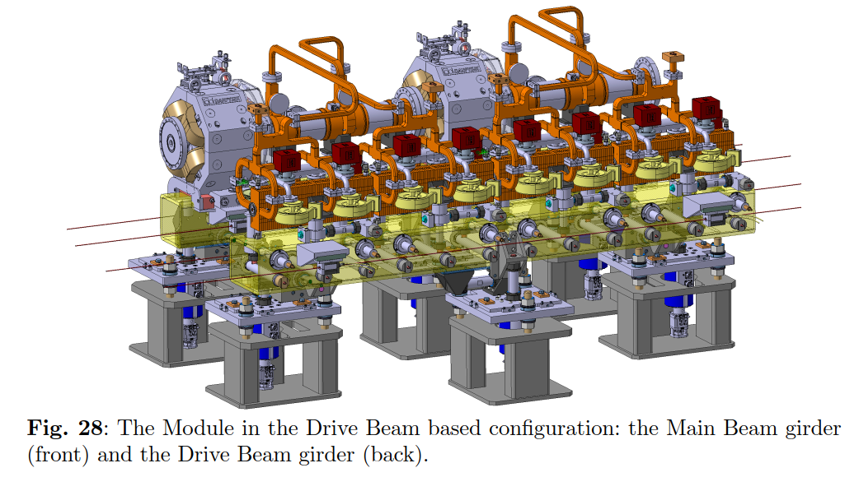
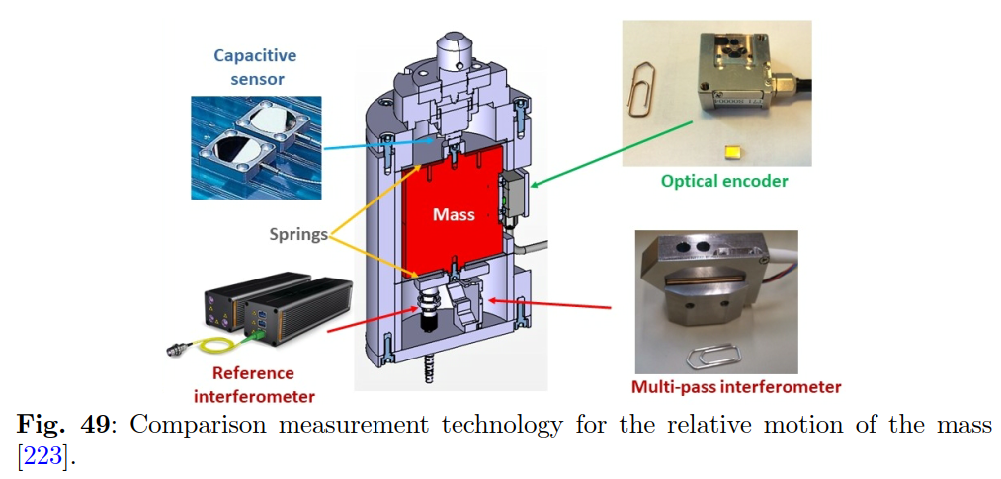
Linac modules

Slide 13
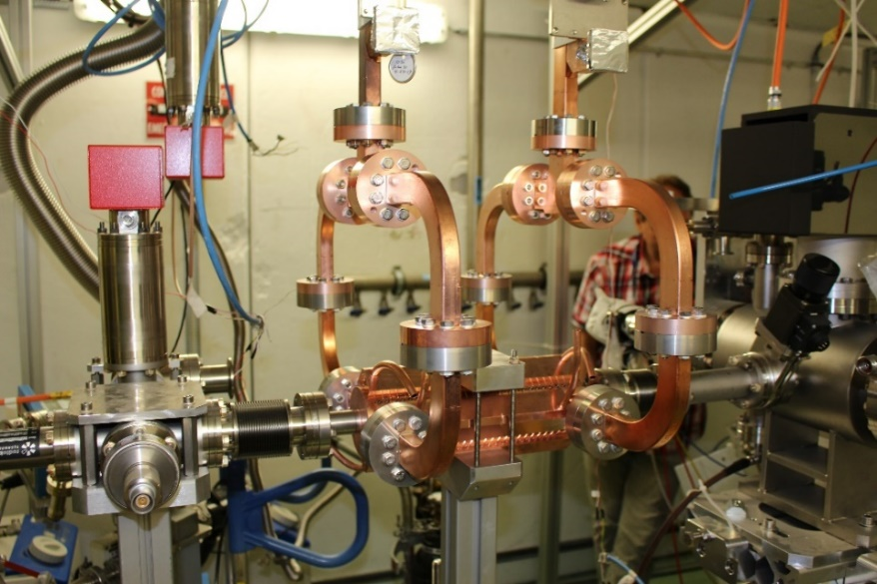
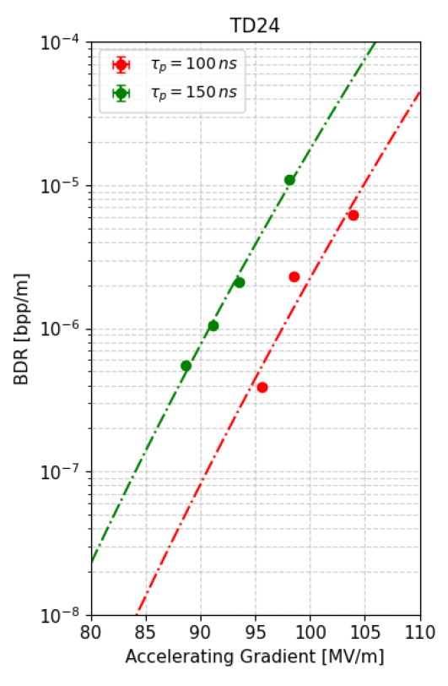
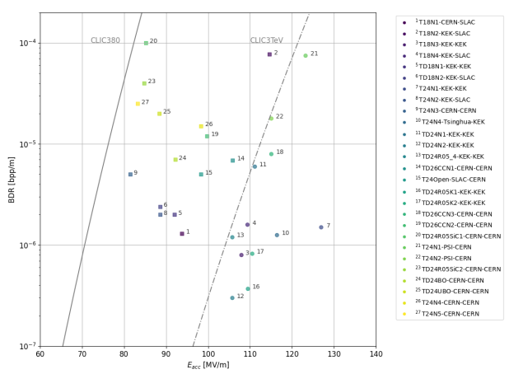
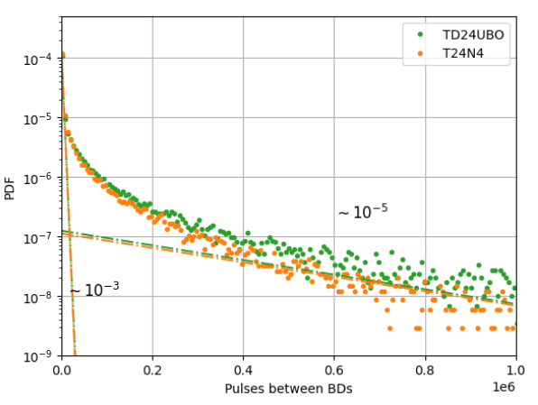
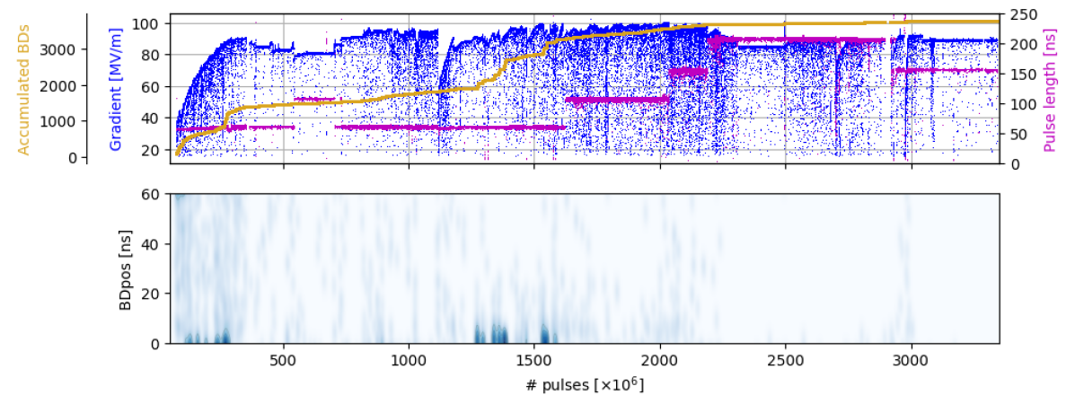
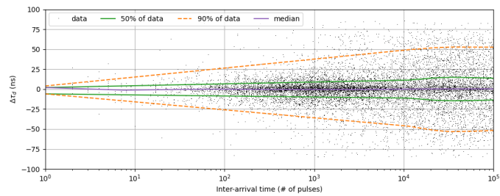
X-band high-gradient results
Paz Alonso, NCRF this morning

Slide 14
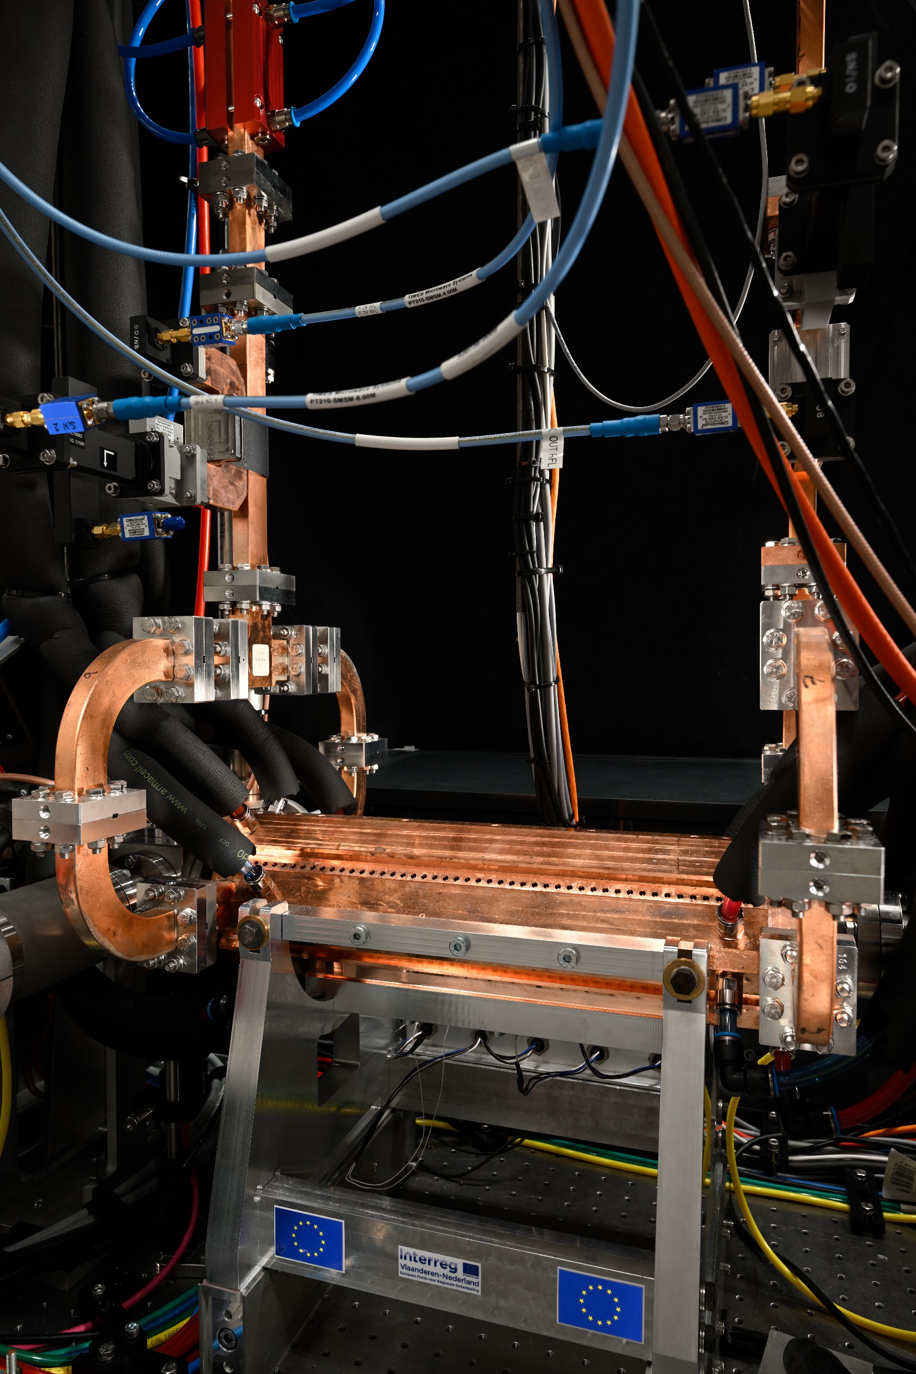

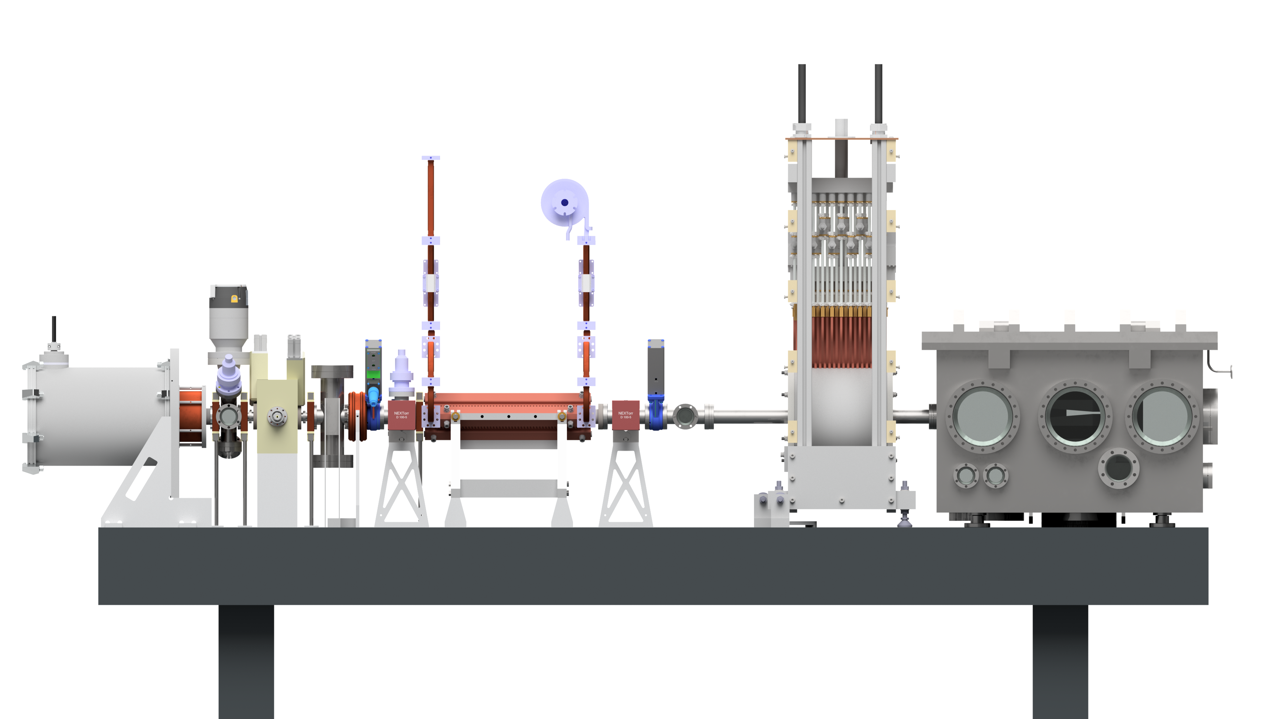
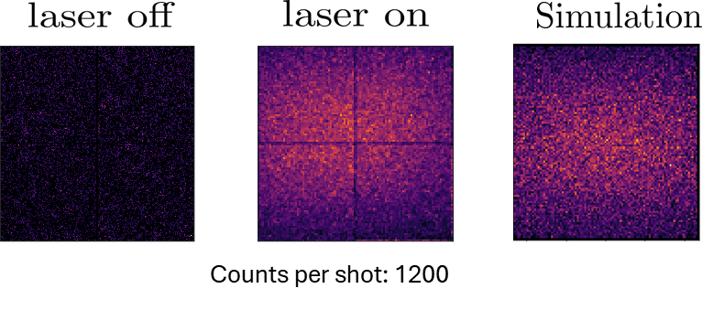
Applications of X-band and high-gradient technology
X-band and high-gradient technology is being used in numerous small and medium and small-scale applications, as well as beam manipulation devices in larger accelerators.
These uses are crucial for maintaing and advancing the technology in the face of reduced CLIC-specific resources.
https://indico.fnal.gov/event/65159/
More examples, L. Wroe industry and applications tomorrow afternoon.
Smart*Light – University of Eindhoven inverse Compton scattering source
Coen Sweers https://indico.fnal.gov/event/65159/contributions/311815/

Slide 15
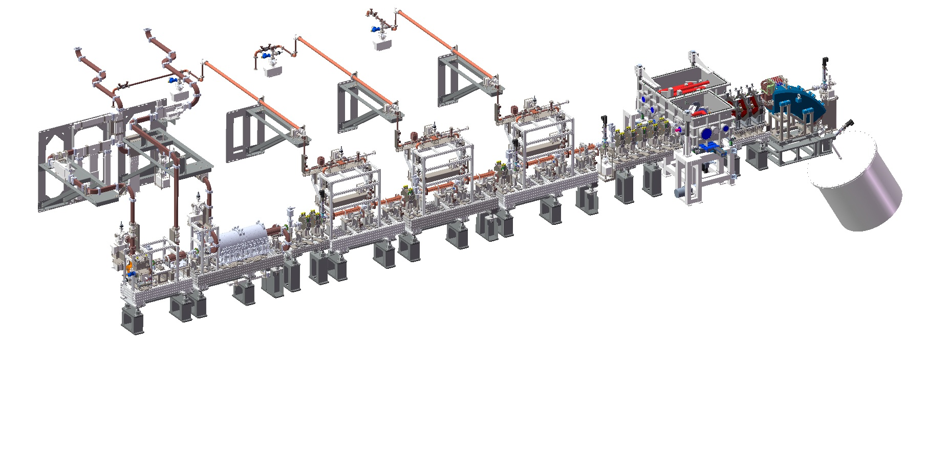
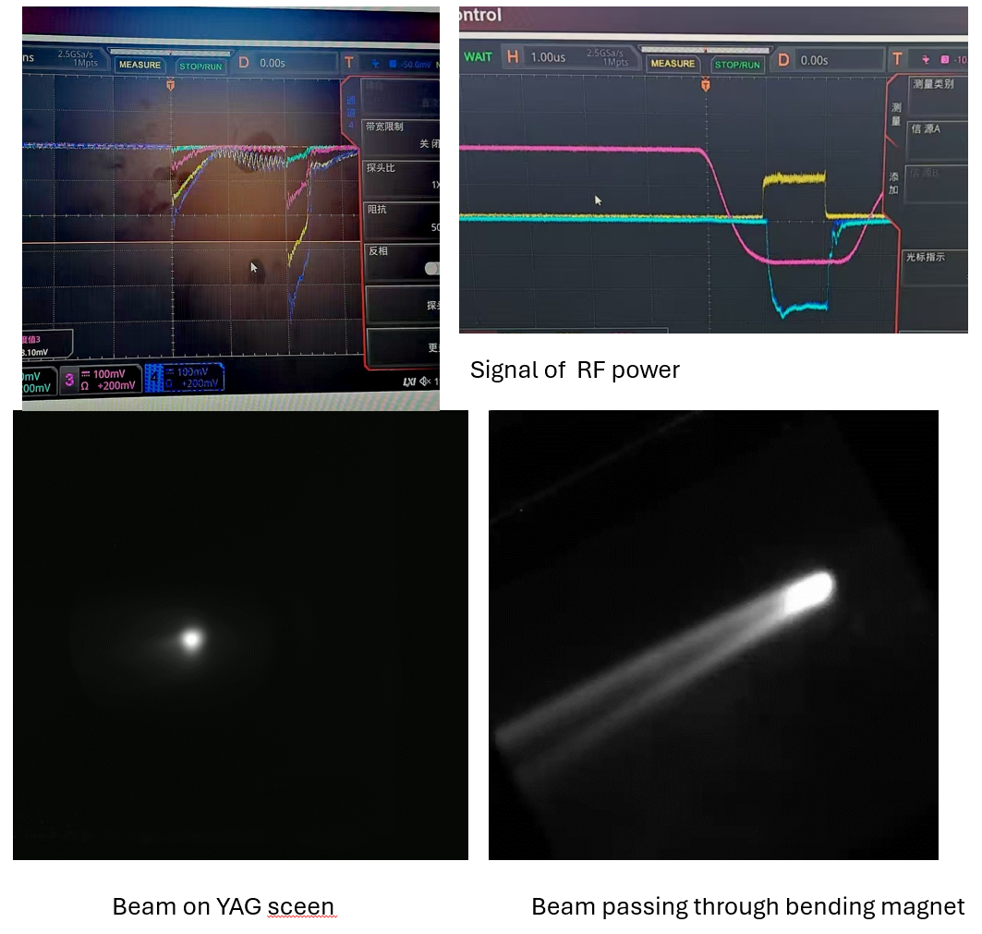
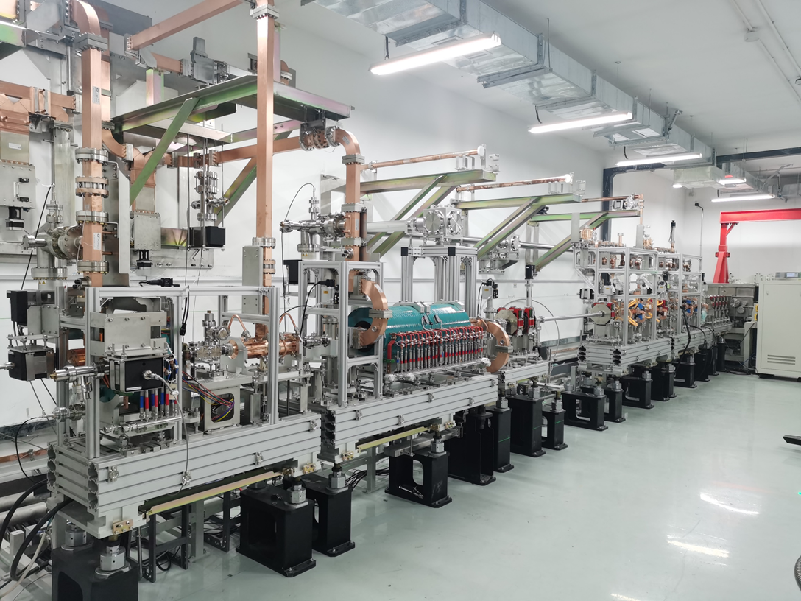
Applications of X-band and high-gradient technology
Tsinghua University inverse Compton scattering source - VIGAS

Slide 16

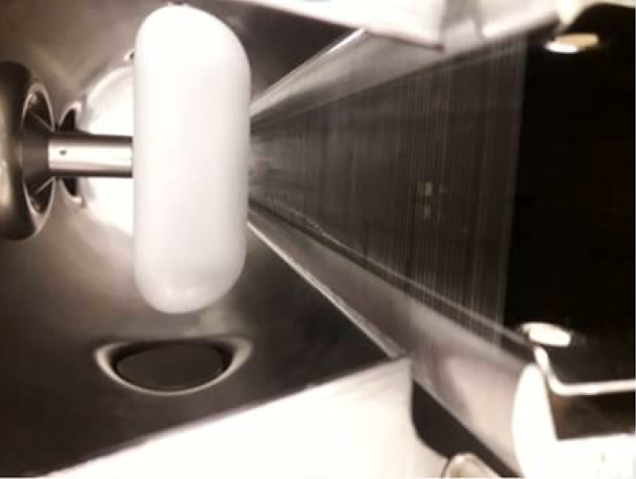
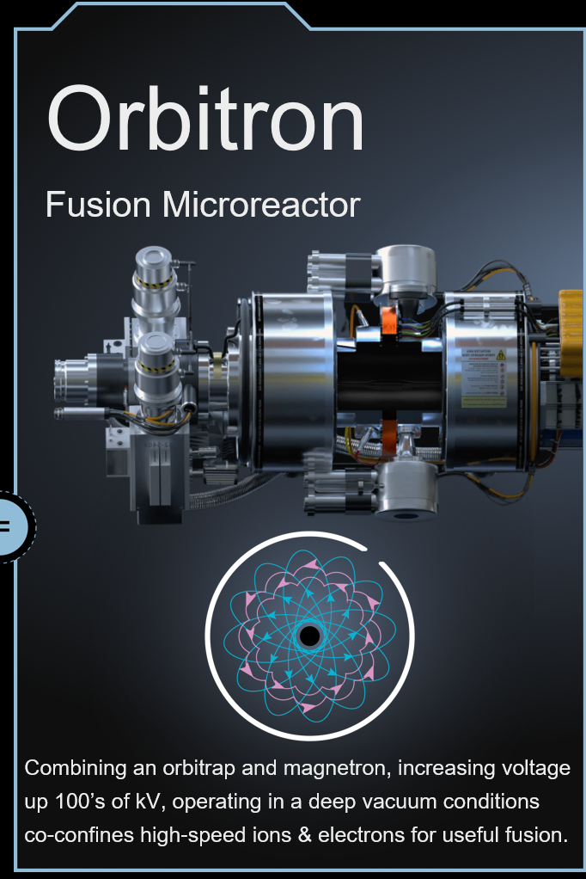
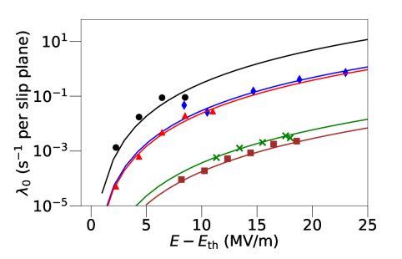
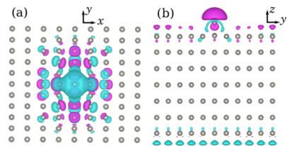
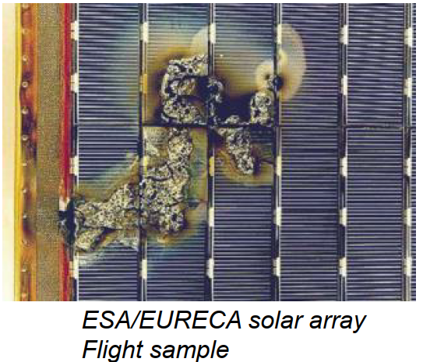
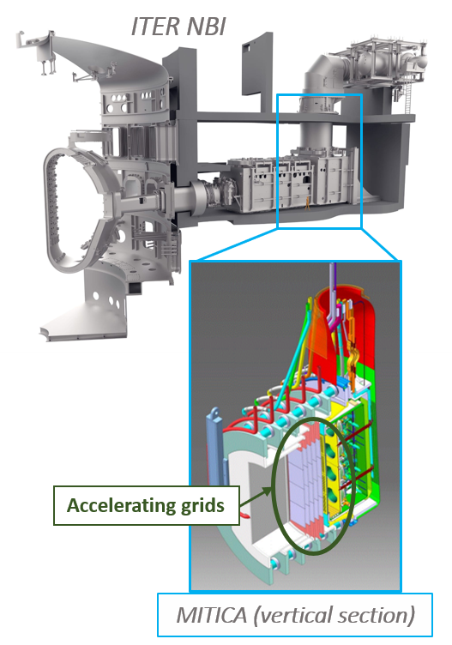


Fundamentals of high-fields
Fundamentals of Vacuum Breakdown in High-Field Systems
https://arxiv.org/abs/2502.03967
https://indico.cern.ch/event/1424597/
M. Bourghei
LHC electrostatic septum
J. Jarrige
F. Caruggi

Slide 17






High temperature superconductors for rf
Collaboration with C3
11.424 GHz
Power source limited test – already surface current equivalent to 2.6 MV/m in an ILC-type cavity.
A. Dhar, superconducting session yesterday

Slide 18



Site implementation
Implementation central complexes entirely on CERN property.

Slide 19


Monument to the CLIC two-beam scheme
Coming up on the 40th anniversary!

Slide 20
Acknowledgements
To the whole CLIC collaboration and, in particular for this presentation, to those who have contributed to preparing the RDR.
The RDR has been accepted for publication as a European Journal of Physics special topics.

