Slide 1

C³ Update
Emilio Nanni
2025 International Workshop on Future Linear Colliders (LCWS2025)
10/22/2025
Notes:
A lepton-collider Higgs factory, to precisely measure the couplings of the Higgs boson to other particles, followed by a higher energy run to measure the Higgs self-coupling, is widely recognized as a primary focus of modern particle physics. In this talk, we will present the study of a new concept for a high gradient, high power accelerator with beam characteristics suitable to study the Higgs boson, the Cool Copper Collider (C3), with the goal of minimizing the capital and operating costs. C3 is based on the latest advances in rf accelerator technology and utilizes optimized cavity geometries, novel rf distribution, and operation at cryogenic temperatures to allow the linear accelerator to achieve high accelerating gradients while maintaining the overall system efficiency. We will present the latest demonstrated performance of prototype accelerators and highlight the future development path for C3.

Slide 2
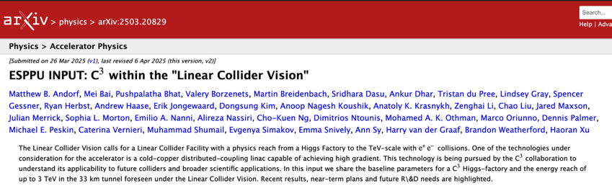
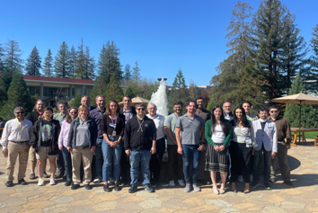
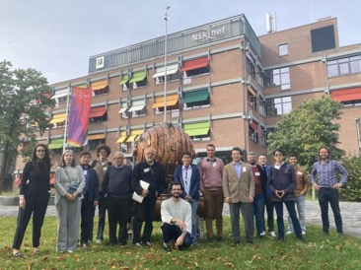
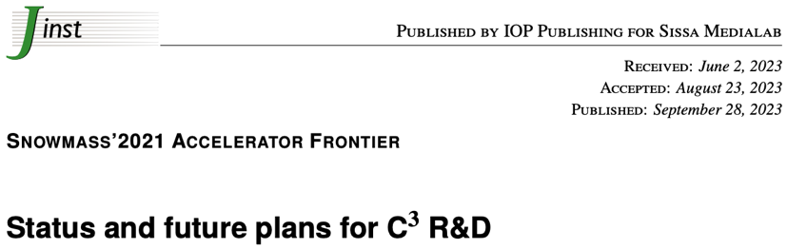
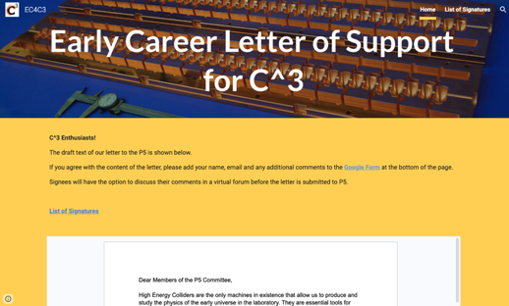
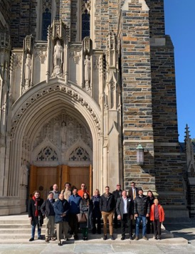
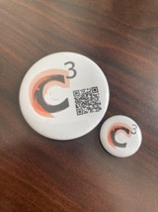
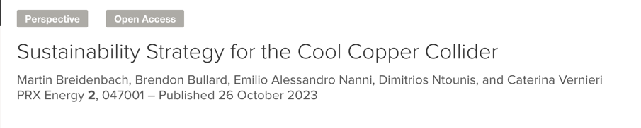
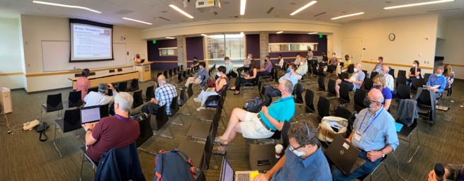
Acknowledgements
Community Events
https://web.slac.stanford.edu/c3/events
https://sites.google.com/view/ec4c3
More Details Here (Follow, Collaborate):
https://web.slac.stanford.edu/c3/
LCWS 2025

Slide 3
A novel route to a linear e⁺e⁻ collider…

Slide 4
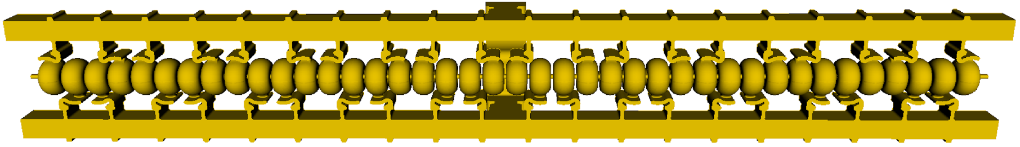
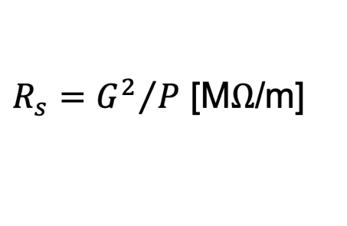

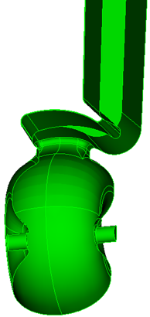
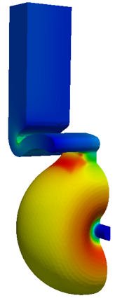
Breakthrough in the Performance of RF Accelerators
RF power coupled to each cell – no on-axis coupling
Full system design requires modern virtual prototyping
Vacuum space for rf cavities and manifold
Optimization of cell for efficiency (shunt impedance)
Control peak surface electric and magnetic fields
Key to high gradient operation
arXiv:1807.10195 (2018)
PRAB 23.9 (2020): 092001

Slide 5
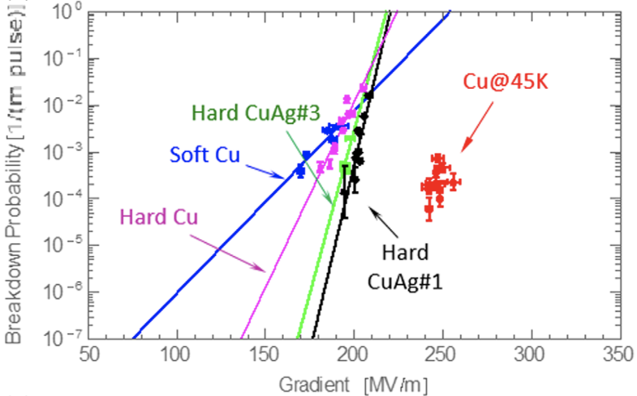
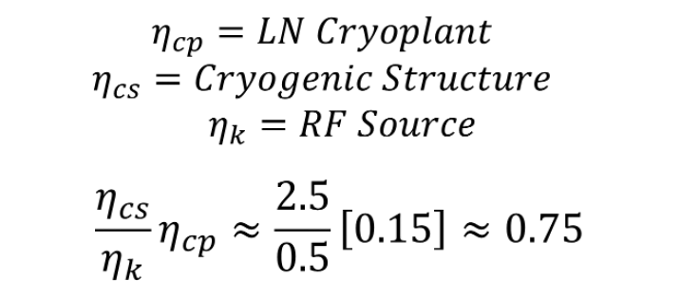
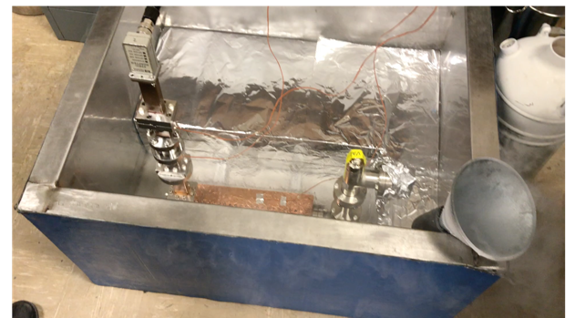
Cryo-Copper: Enabling Efficient High-Gradient Operation
Cryogenic temperature elevates performance in gradient
Material strength is key factor
Impact of high fields for a high brightness injector may eliminate need for one damping ring
Operation at 77 K with liquid nitrogen is simple and practical
Large-scale production, large heat capacity, simple handling
Small impact on electrical efficiency
Cryogenic temperature elevates performance in gradient
Material strength is key factor
Impact of high fields for a high brightness injector may eliminate need for one damping ring
Cahill, A. D., et al. PRAB 21.10 (2018): 102002.
LCWS 2025

Slide 6

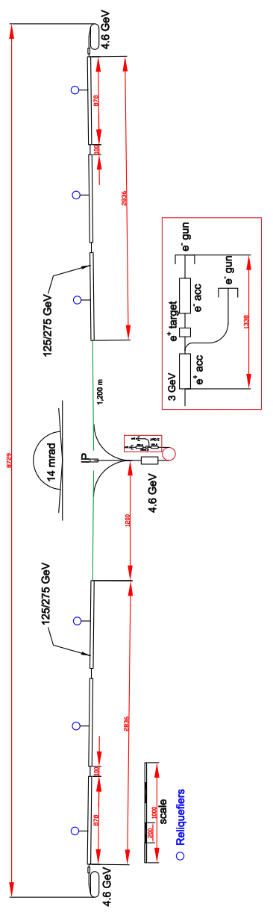
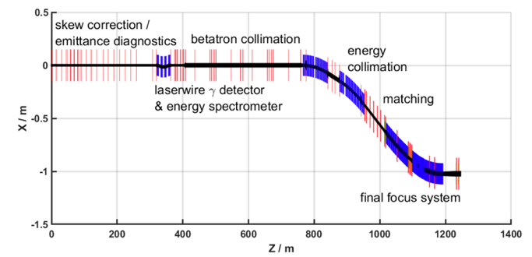
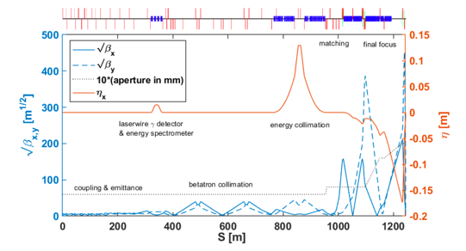
Accelerator Complex
8 km footprint for 250/550 GeV CoM ⟹ 70/120 MeV/m
Large portions of accelerator complex are compatible between LC technologies
Beam delivery and IP modified from ILC (1.5 km for 550 GeV CoM)
Damping rings and injectors to be optimized with CLIC as baseline
Costing studies use LC estimates as inputs
C³ - Investigation of Beam Delivery (Adapted from ILC/NLC)
C³ - 8 km Footprint for 250/550 GeV
LCWS 2025

Slide 7
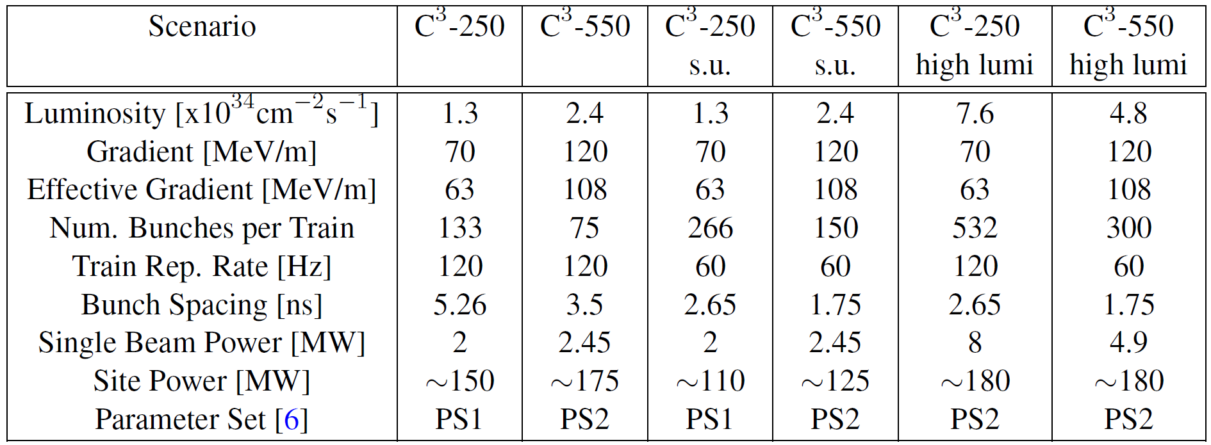
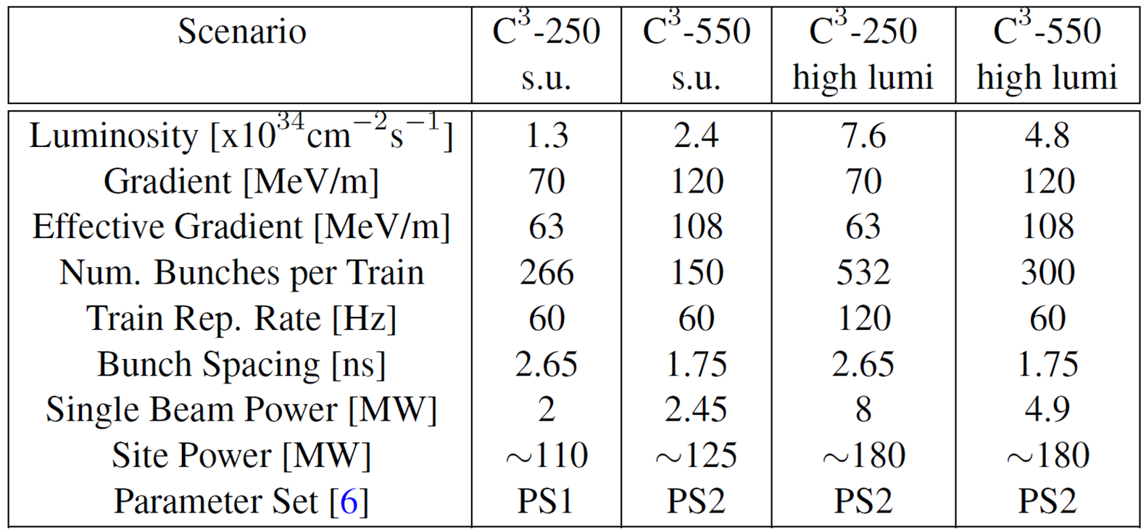
Table of Parameters
Updated parameters for ESPPU 2025, based on luminosity* + BIB studies (Tu 10:20 MDI)
LCWS 2025
*Ntounis, et al., Phys. Rev. Accel. Beams 27, 061001, 2024

Slide 8
C³ R&D Highlights at LCWS

Slide 9
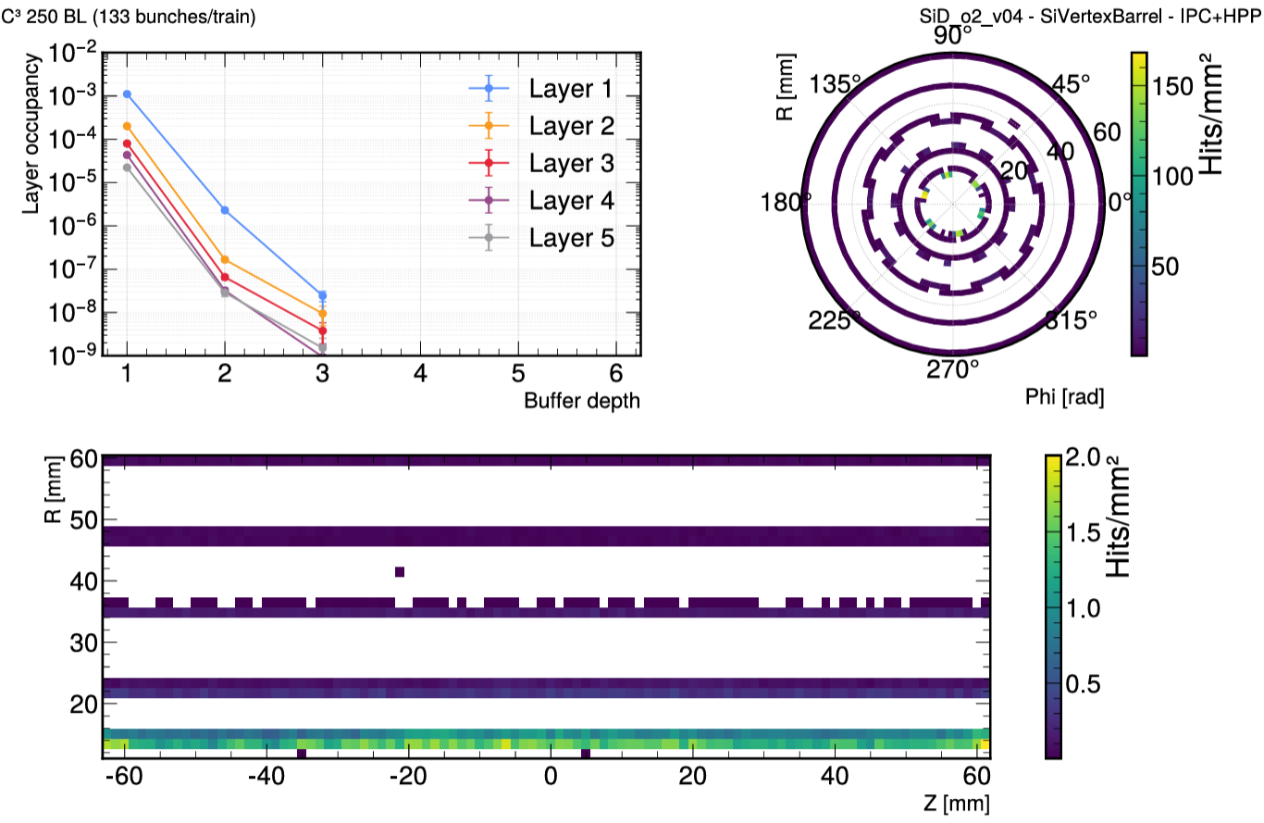
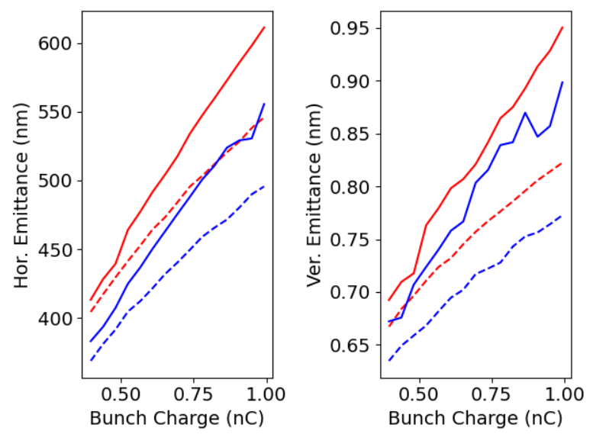
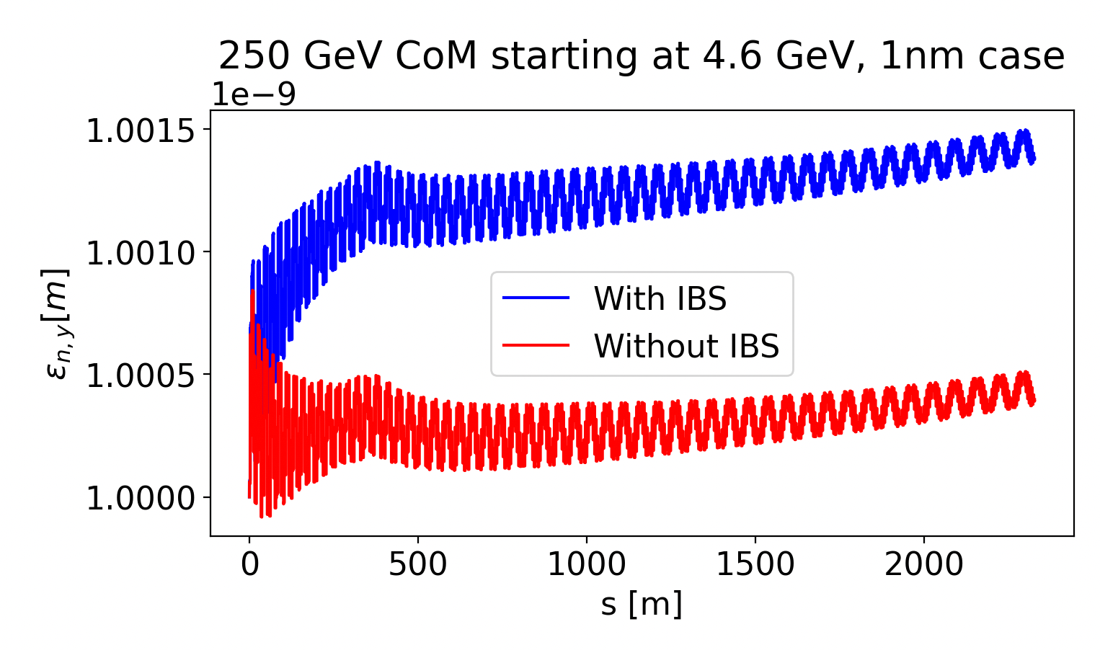
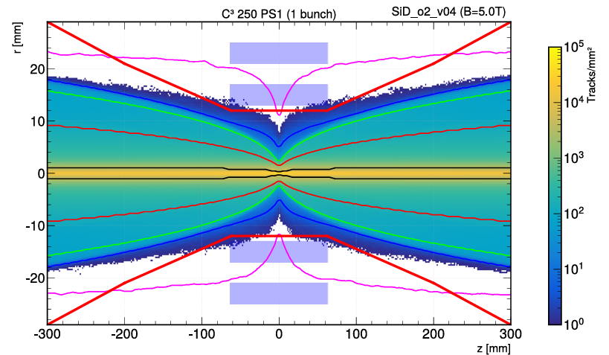
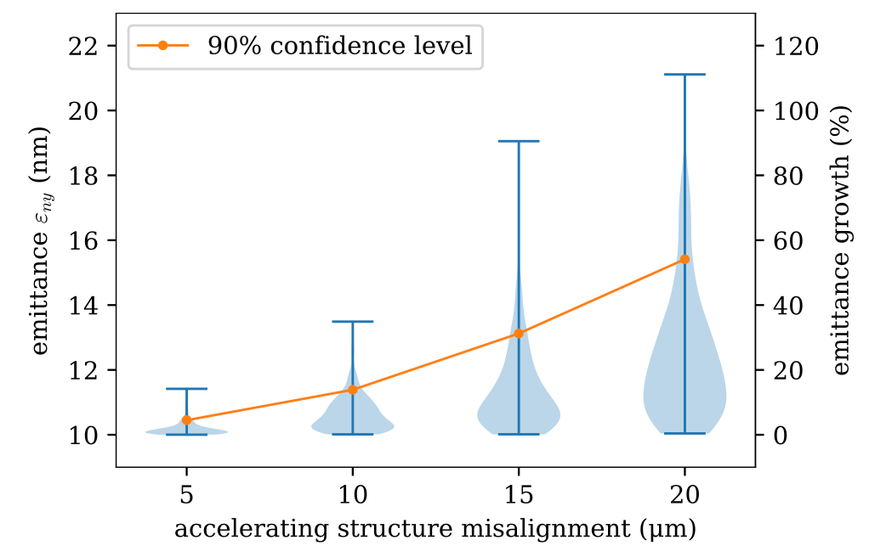
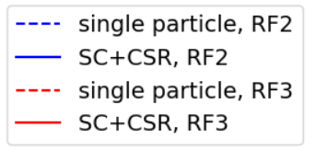
Beam Dynamics and Beam Induced Background
Optimization of DR and Bunch Compressor
Exploring theoretical minimum emittance and IBS
W 11:45 DRBD
W 11:20 DRBD
BIB & Luminosity Optimization
Tolerance studies published
Nuclear Instruments and Methods in Physics Research Section A (2025) 170660
Tu 10:20 MDI
LCWS 2025
Notes:
Sustainability lcws talk and paper

Slide 10
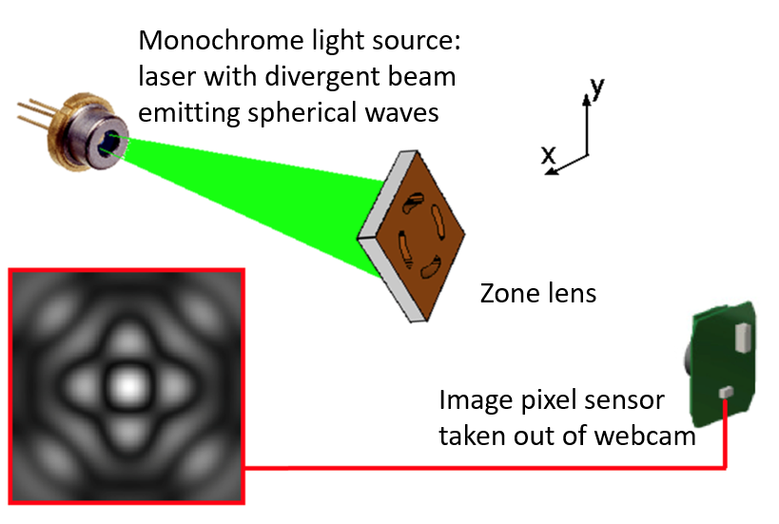
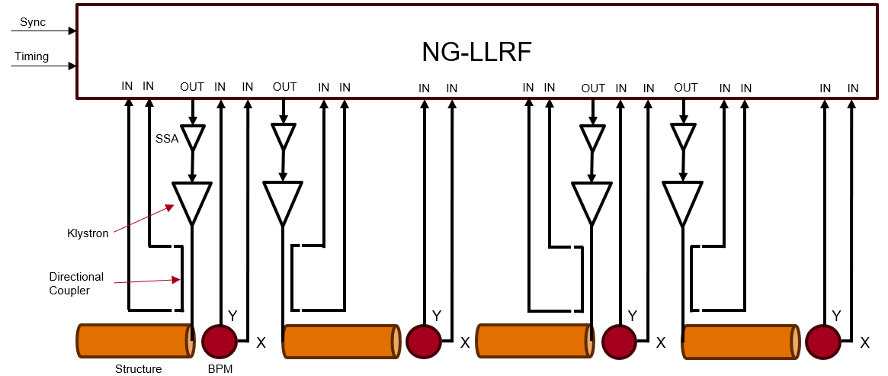
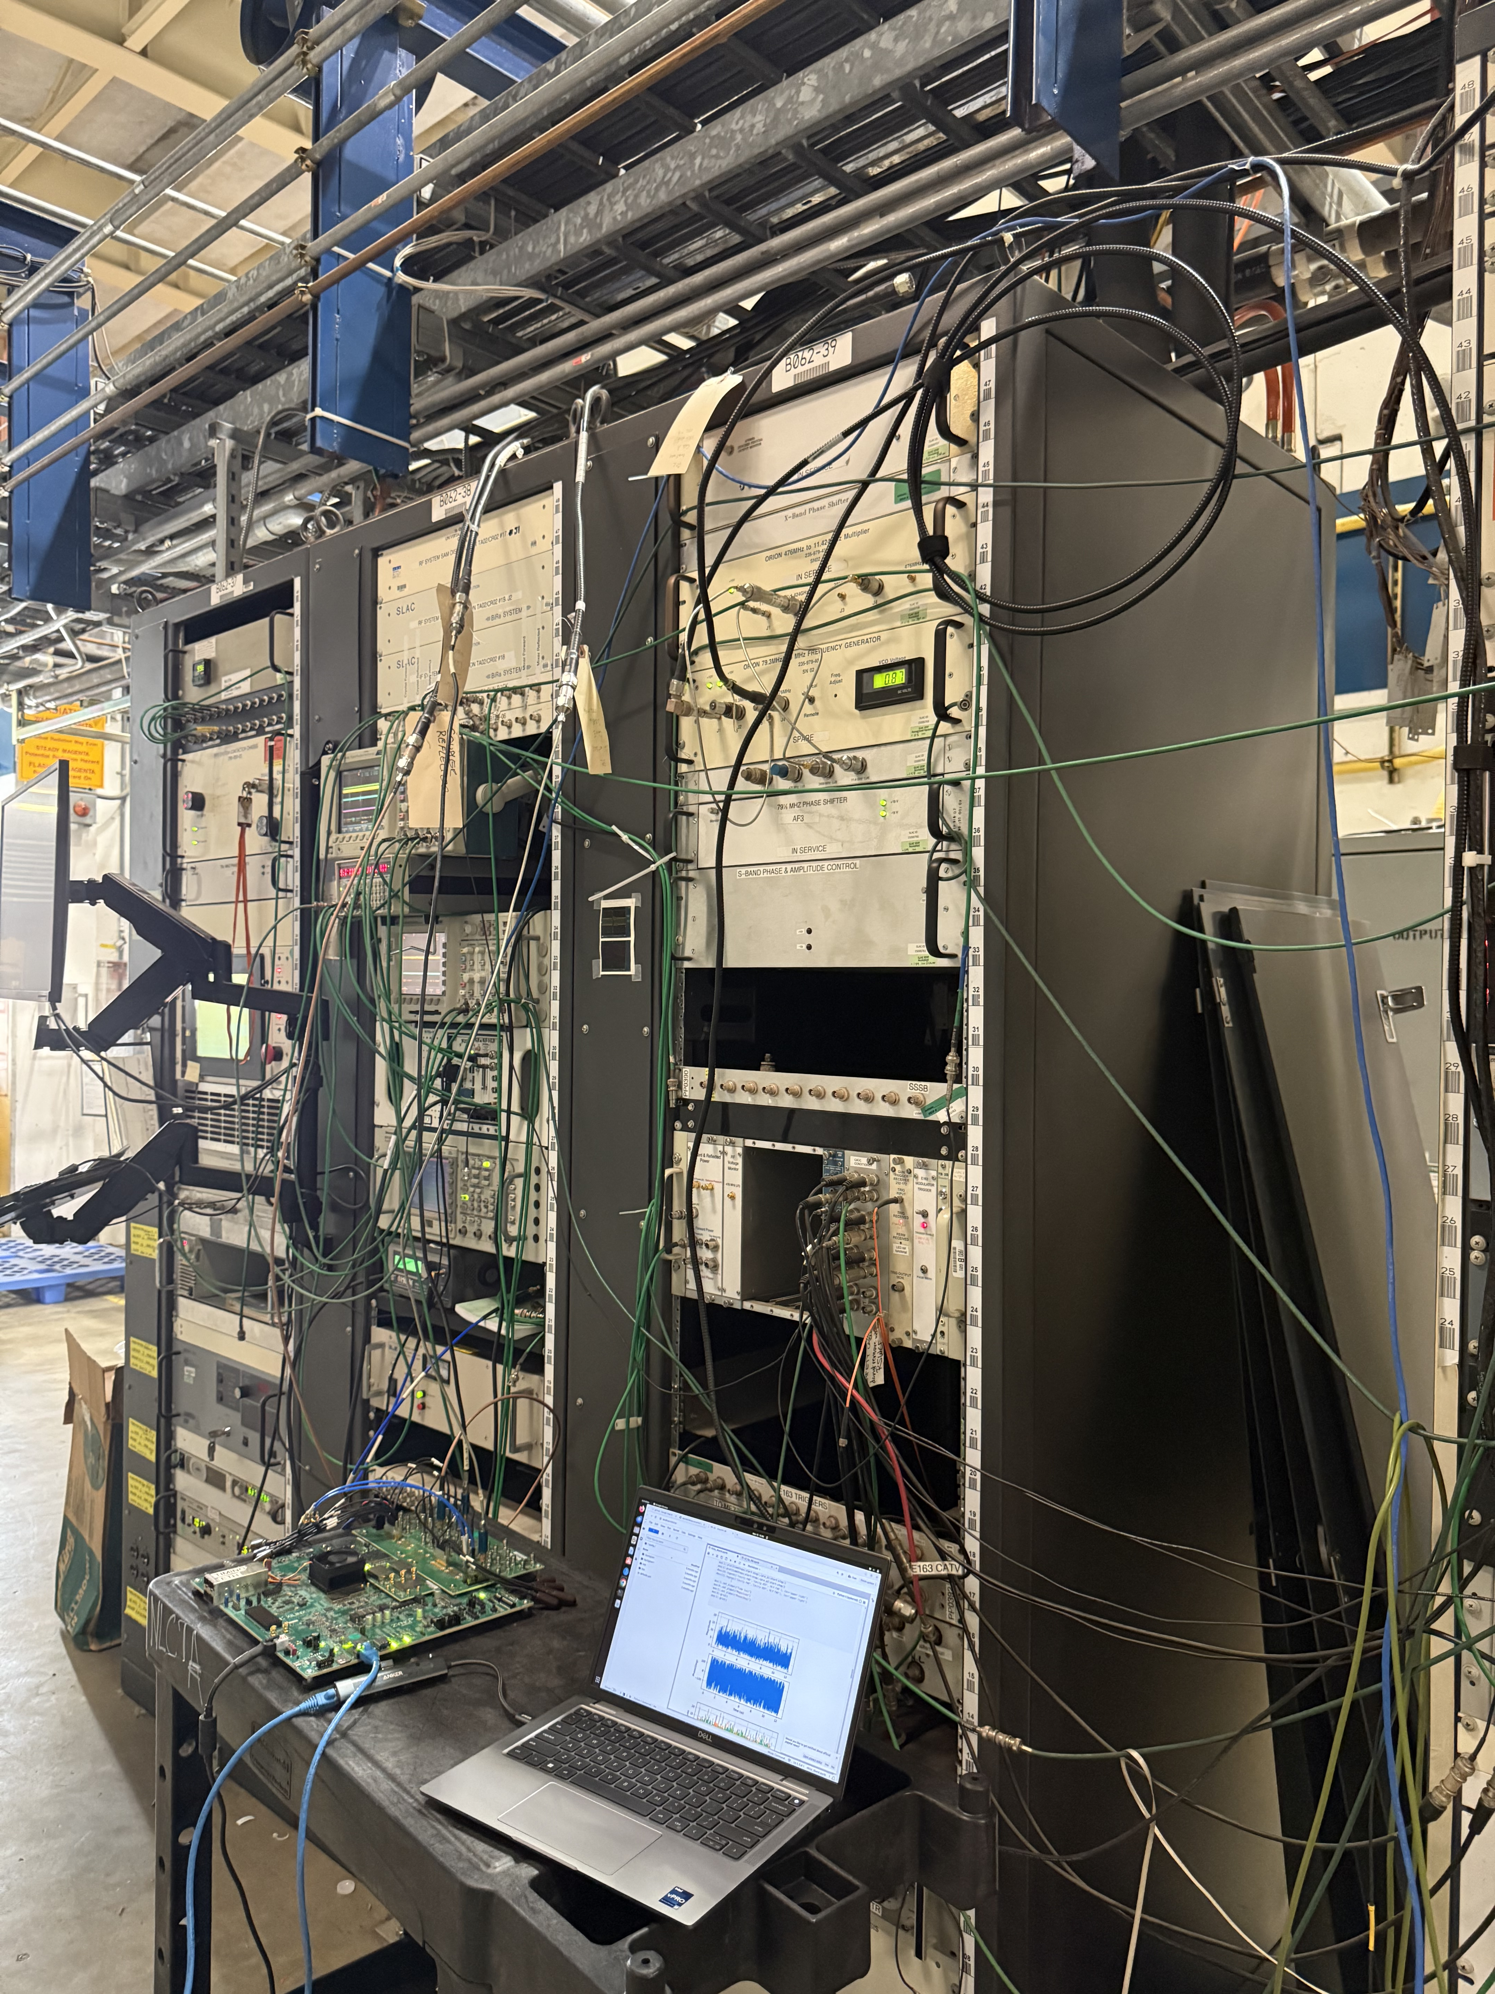
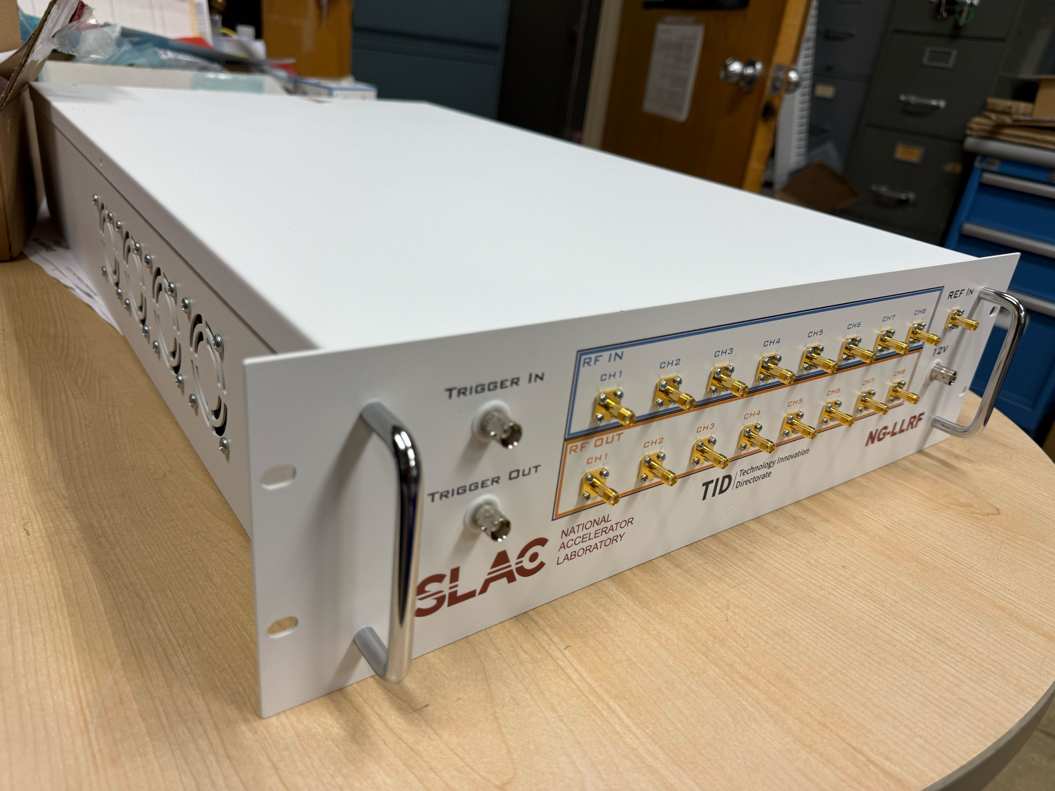
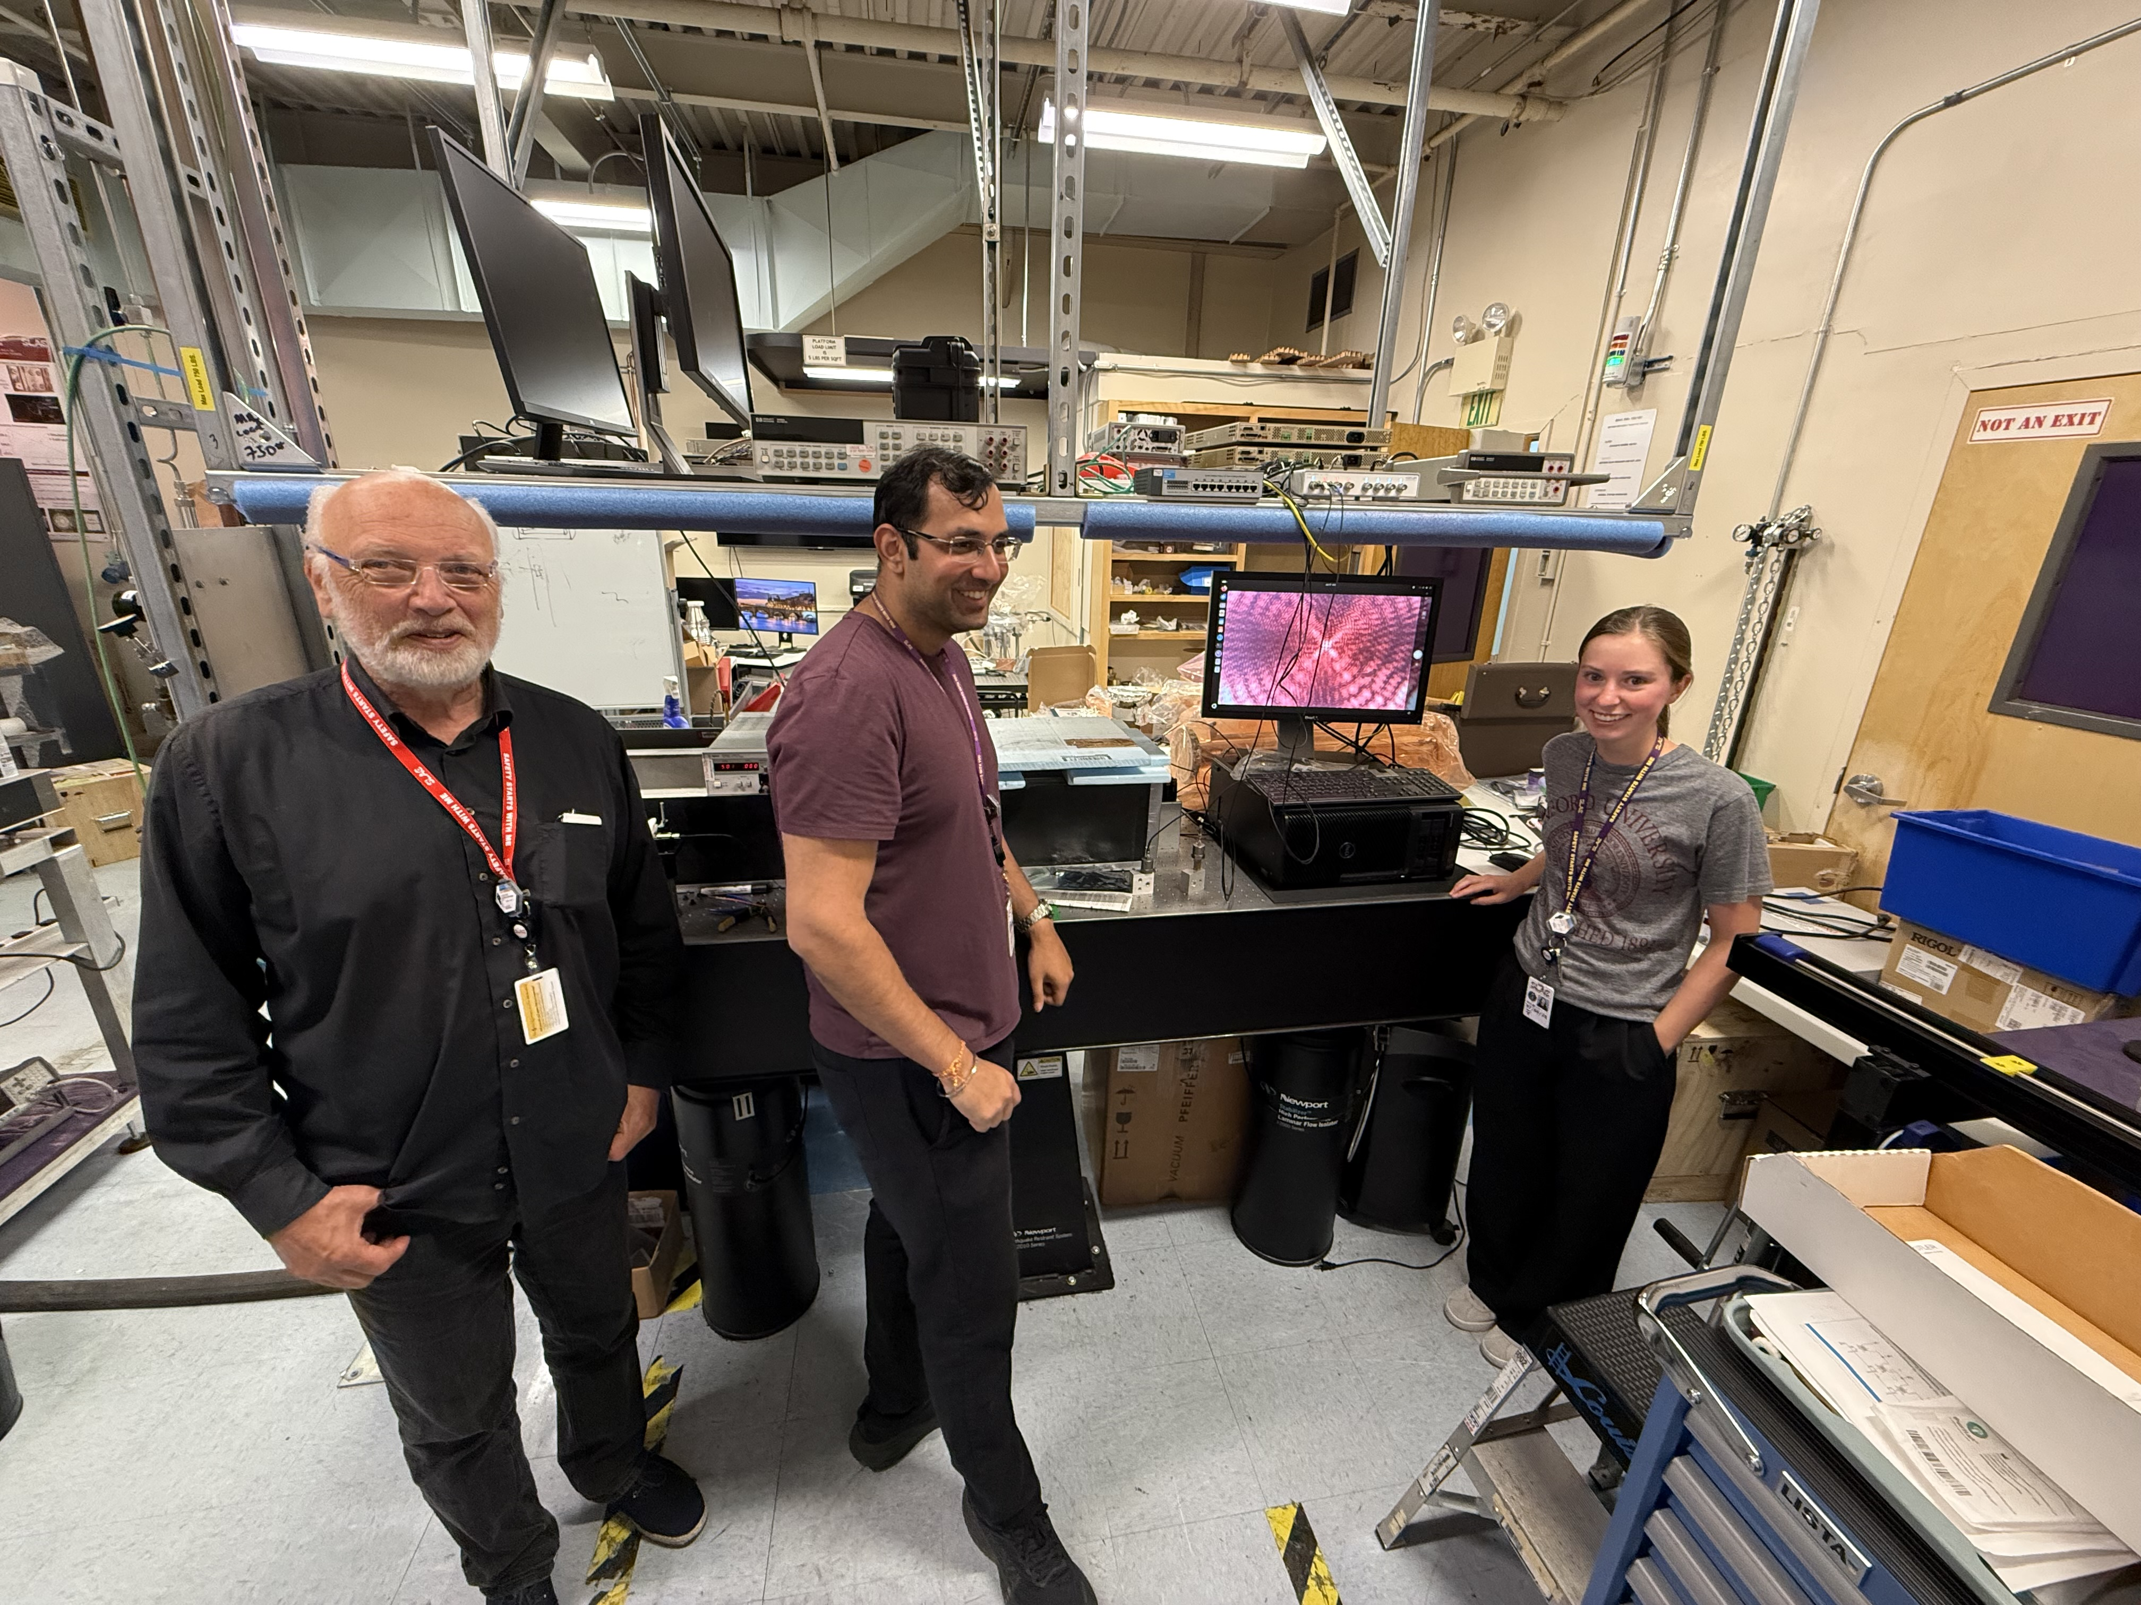
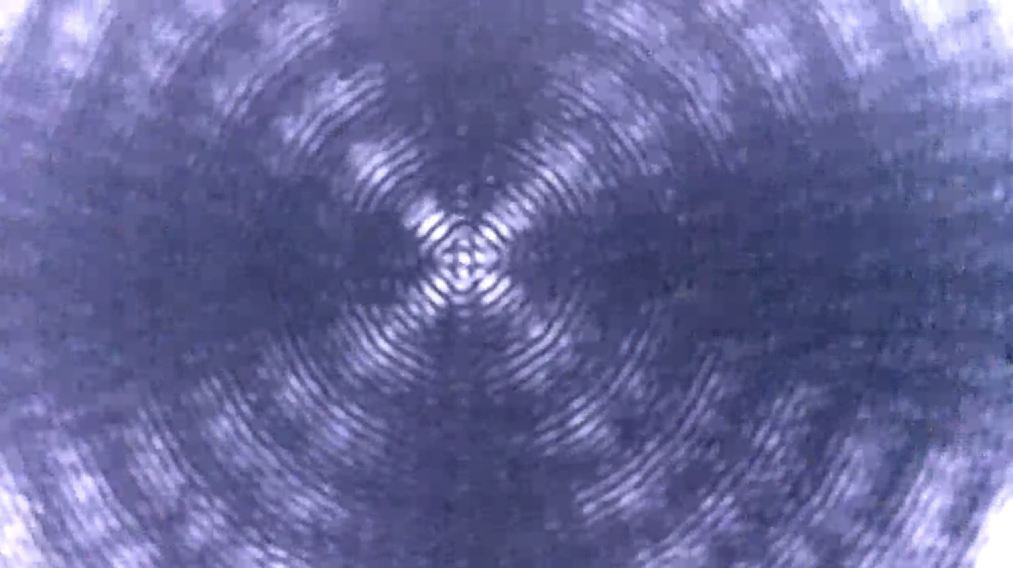
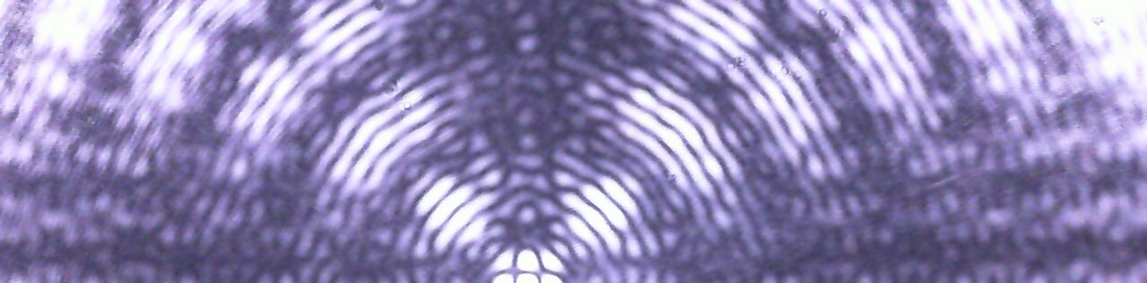
Auxiliary Systems: LLRF and Alignment
NG-LLRF in development based on RFSoC
Demonstrated C3 requirements in high power test
Initial thoughts to system implementation
Rasnik alignment system
AIR
LN
W 9:00 NCRF
W 9:40 NCRF
LCWS 2025
Notes:
Sustainability lcws talk and paper

Slide 11
C³ Demo

Slide 12
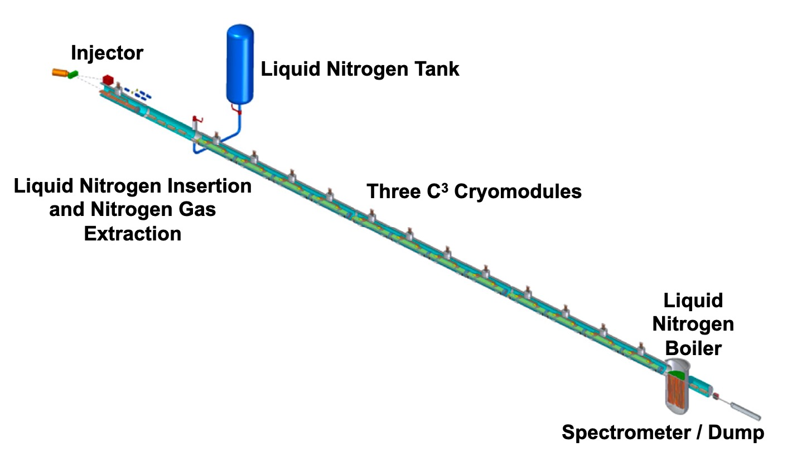
The Complete C³ Demonstrator
QCM
Stage 2:
Injector + Cryomodule
Demonstrate fully engineered cryomodule
~50 m scale facility
3 GeV energy reach
Answer technical questions needed for CDR

Slide 13
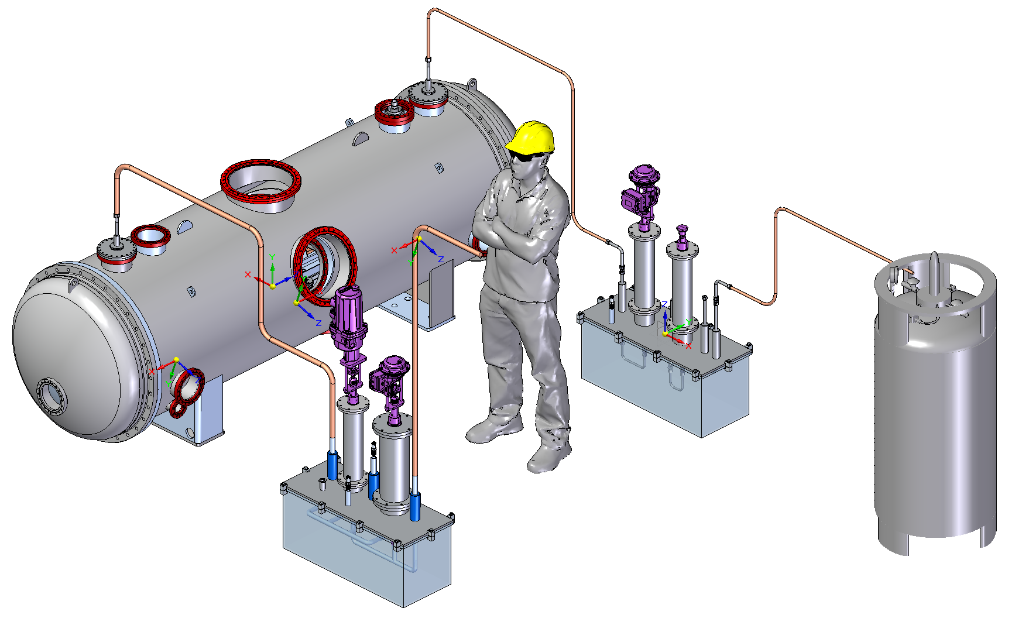
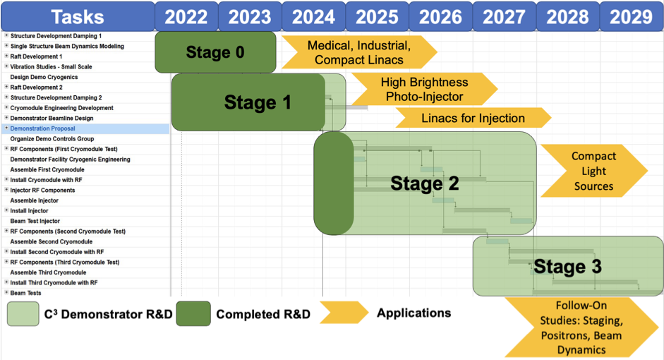
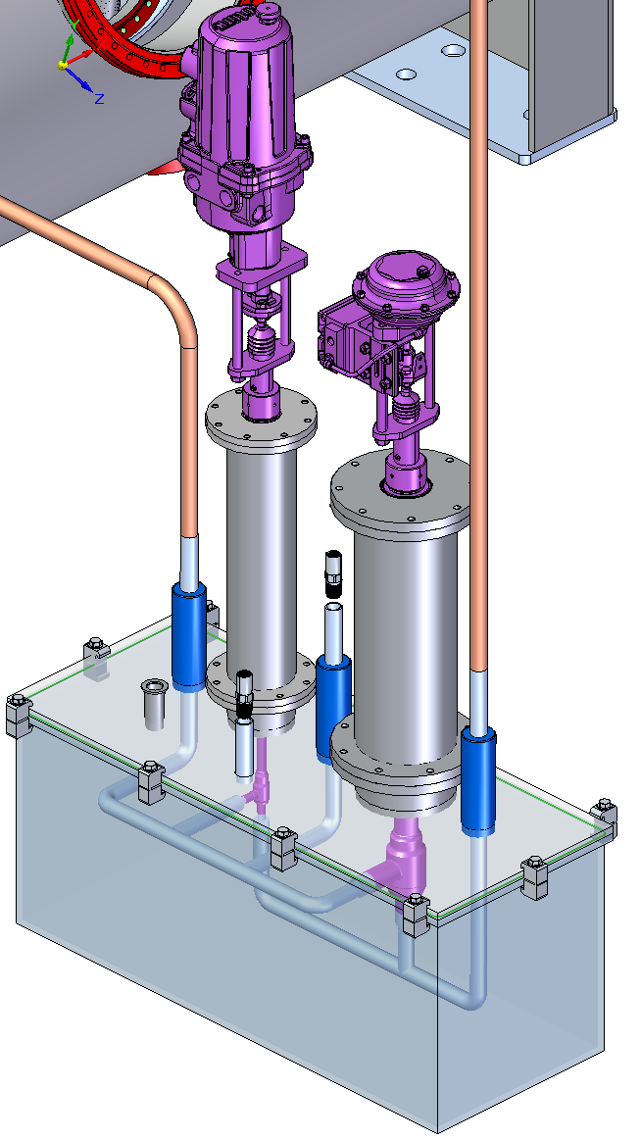
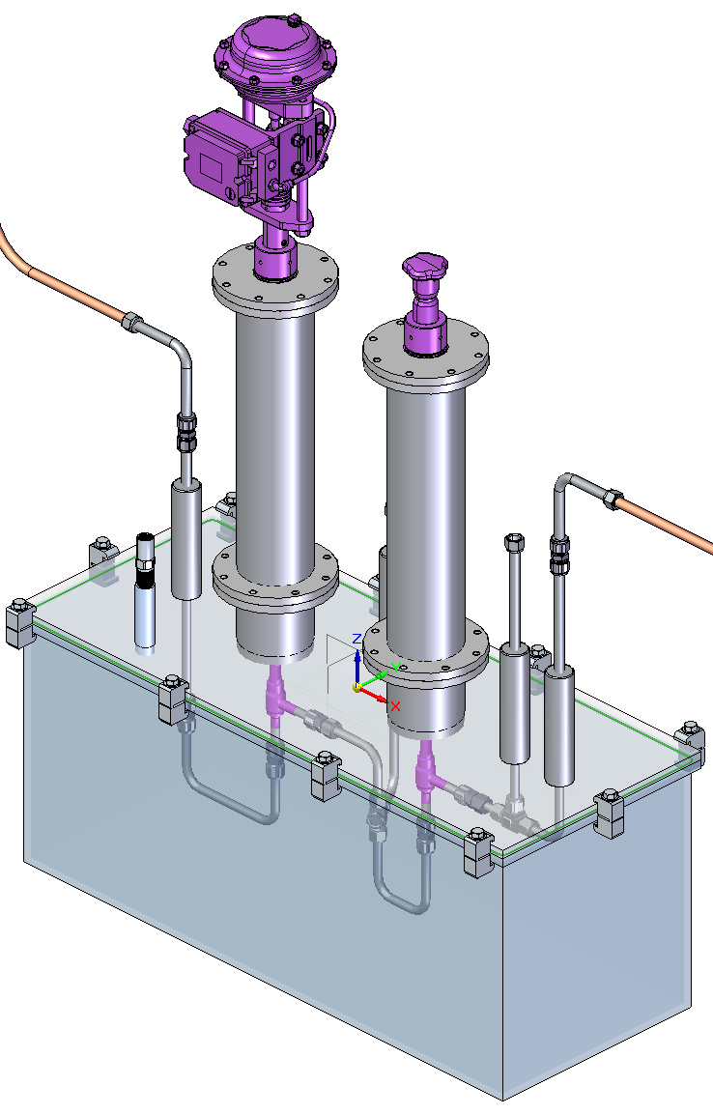
Quarter Cryomodule (QCM)
Vacuum insulation, raft length up to 2.5 m
First step into realizing Stage 2 goals
Outfit for alignment and vibration testing
Follow-on experiments with structures at high gradient and beam acceleration
Notes:
Sustainability lcws talk and paper

Slide 14
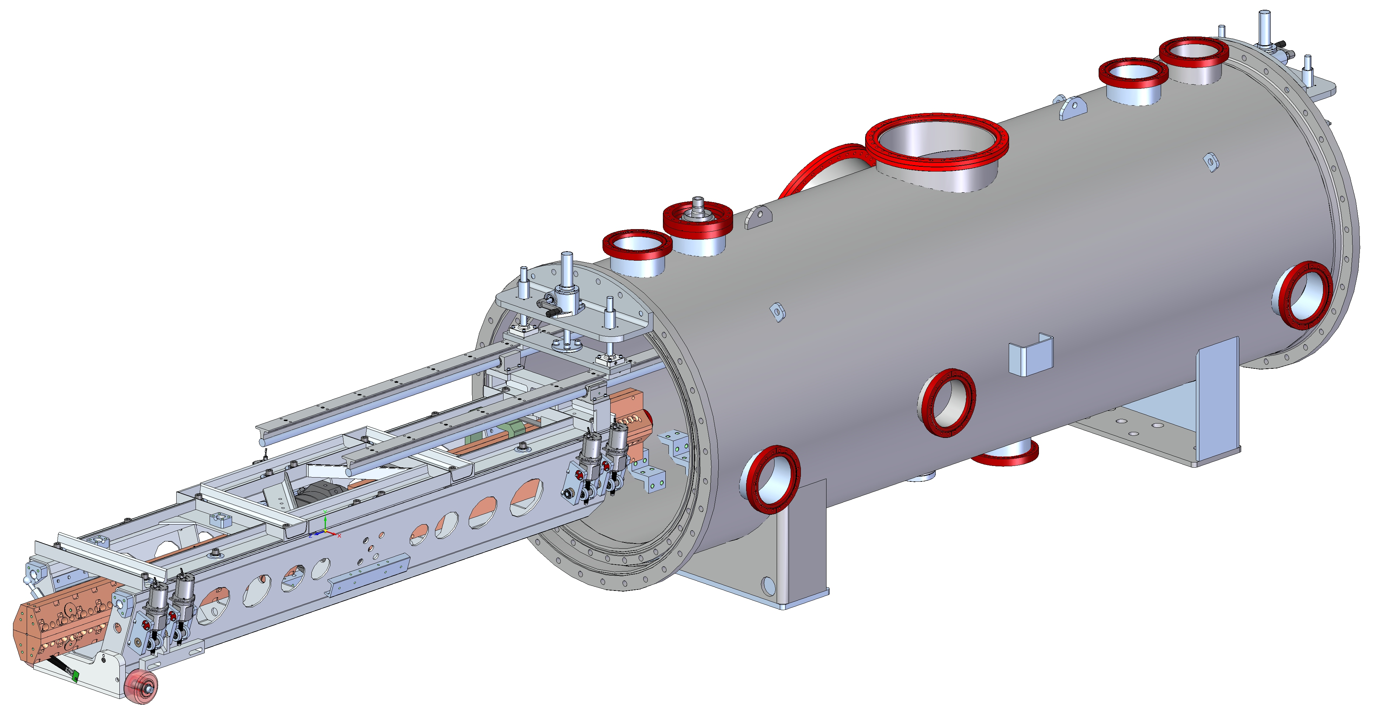
QCM Overview
W 9:20 NCRF
VESSEL
QUADRUPOLE
ACCELERATOR STRUCTURE
INSTALLATION HARDWARE
RAFT
MOUNTS

Slide 15
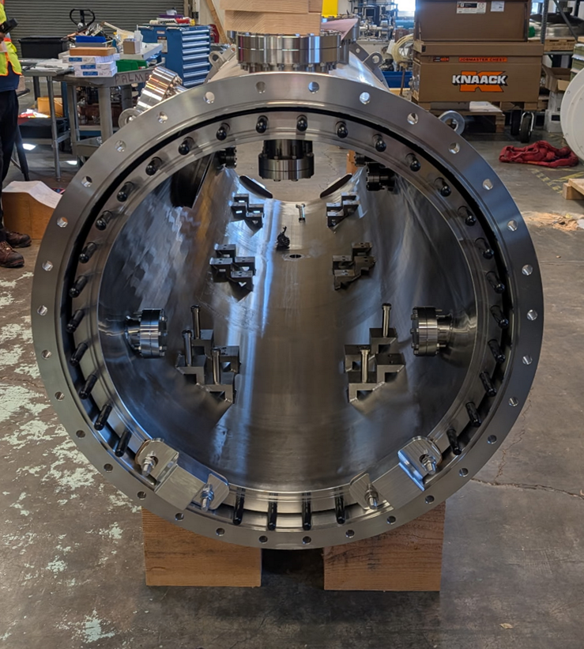
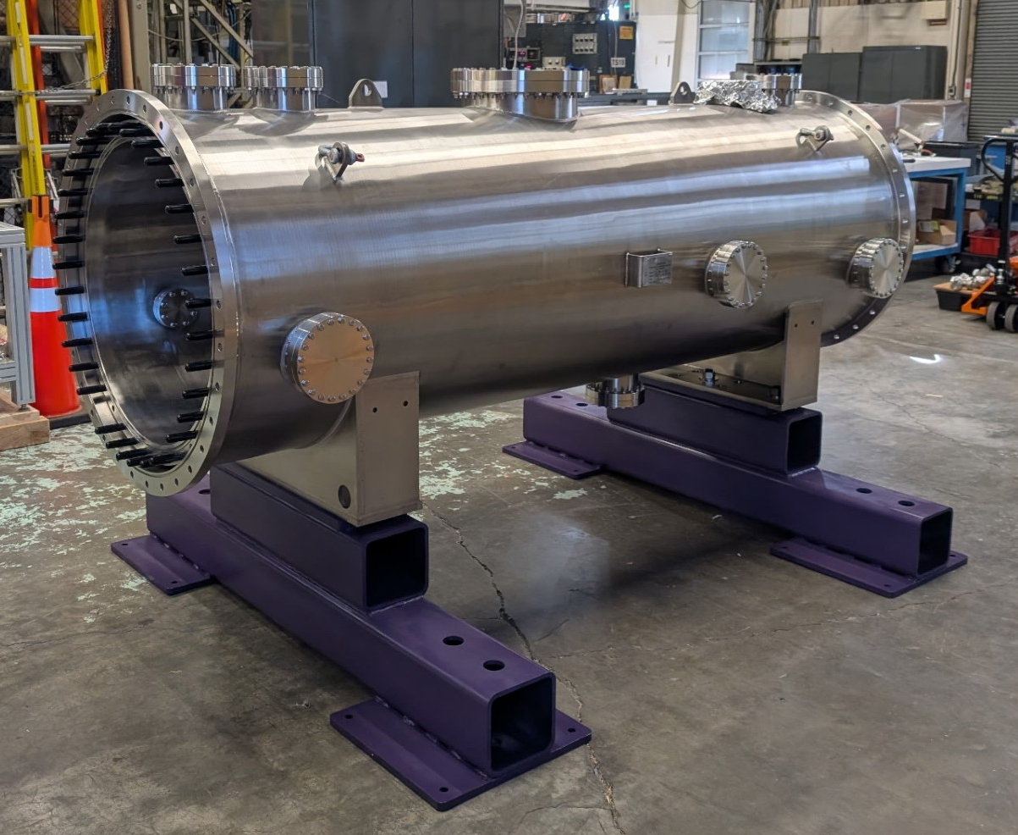
QCM Vessel
Stainless steel vessel with additional ports for ease of quick prototyping and measurement.
Cryo module was received, inspected, and reassembled.

Slide 16
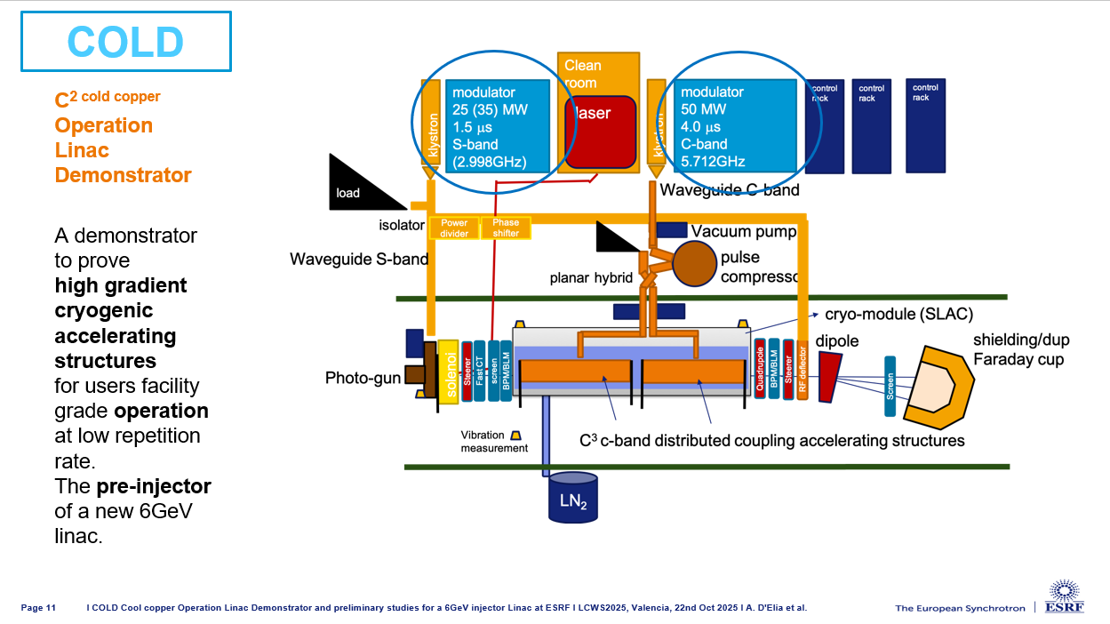
W 11:30 NCRF

Slide 17
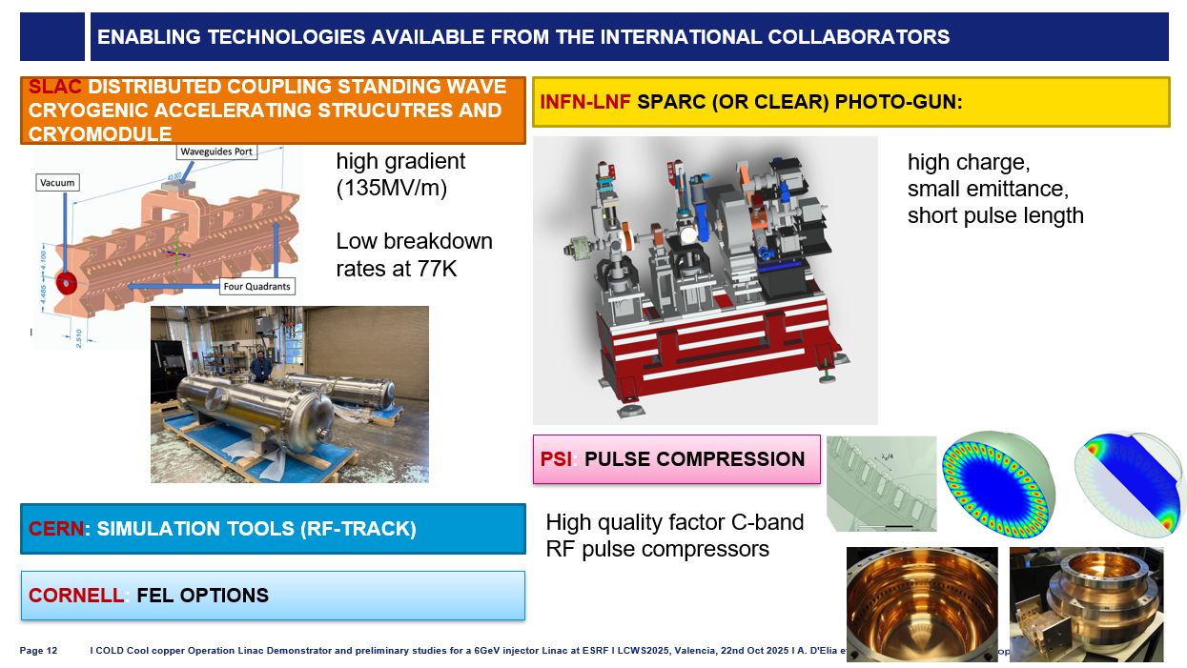

Slide 18
C³ in the Context of ESPPU and LC Vision

Slide 19
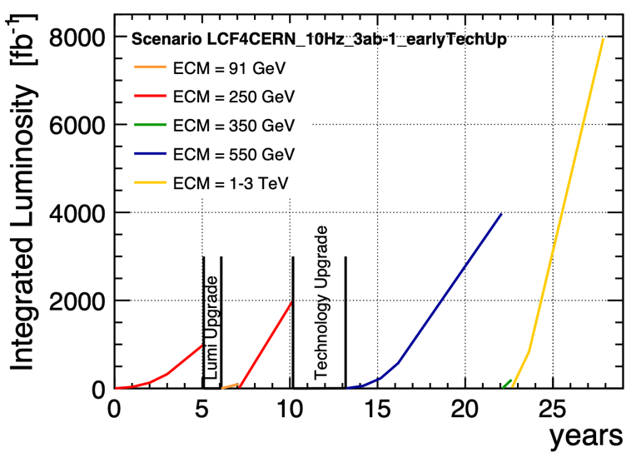
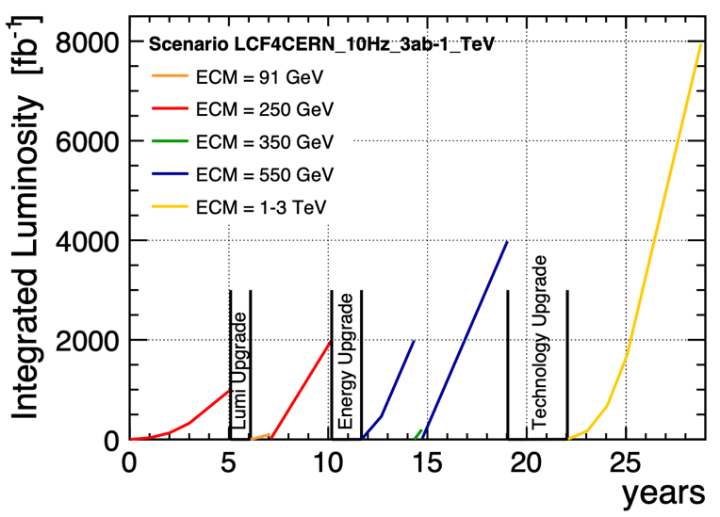
Routes to Higher Energy
A flexible strategy for a LCF
A Linear Collider
can be built with today’s technologies
combines adequate precision with large energy range providing new insights and consistency checks
What can be done after an initial 10…20 year program by making use of advanced accelerator concepts and technologies?

Slide 20
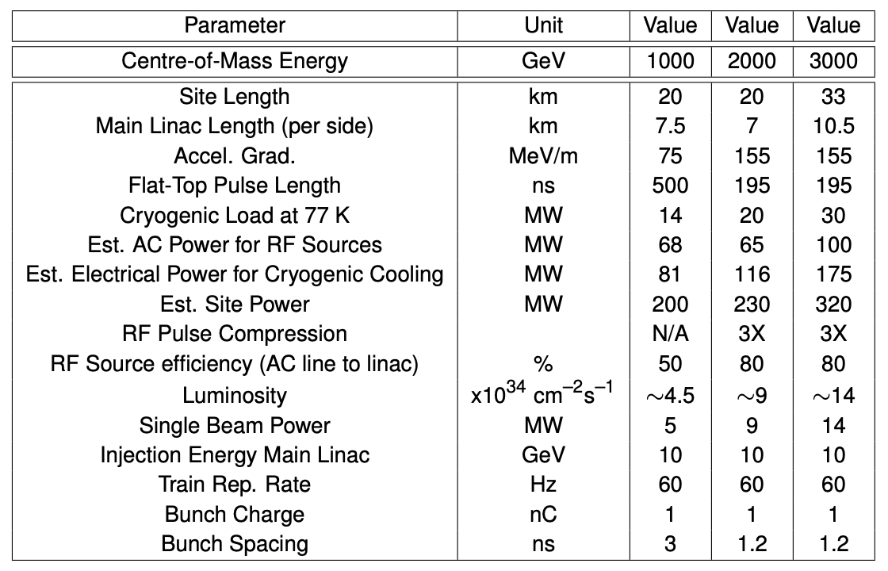
C3 as upgrade for LCF
the route to 3 TeV
studied in context of LCVision
LCF injector complex and damping rings compatible with C3:
larger LCF DRs = lower risk
replace fast->slow kickers (kick whole trains)
bunch compressor length / emittance sufficient
=> substantial part of infrastructure could be reused
cryo-plants need modification
SRF cryomodules could be sold / donated for XFELs / medical linacs /.. round the world
to be considered in design of beam delivery systems and dumps
Sustainability: C3 can be 2-4x more power efficient in TeV regime than CLIC / ILC Very exciting R&D target for the next decade!

Slide 21
Conclusion
C³ can provide a rapid route to precision Higgs physics with a compact 8 km footprint
C³ time structure is compatible with SiD-like detector overall design and ongoing optimizations.
C³ can be quickly be upgraded to 550 GeV
C³ can be extended to a 3 TeV e+e- collider
Looking forward to discussions on LC Vision and C3 inputs to ESPPU
More Details Here (Follow, Collaborate):
https://web.slac.stanford.edu/c3/
LCWS 2025

Slide 22
Questions?

Slide 23
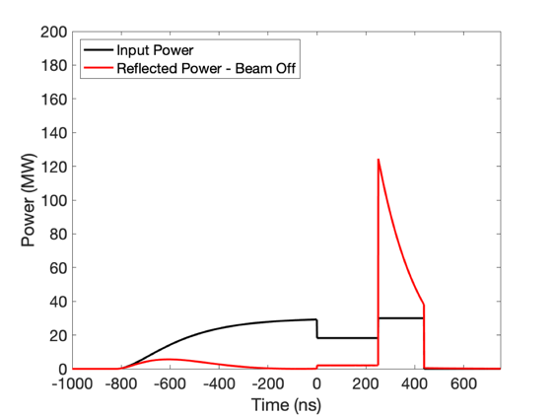
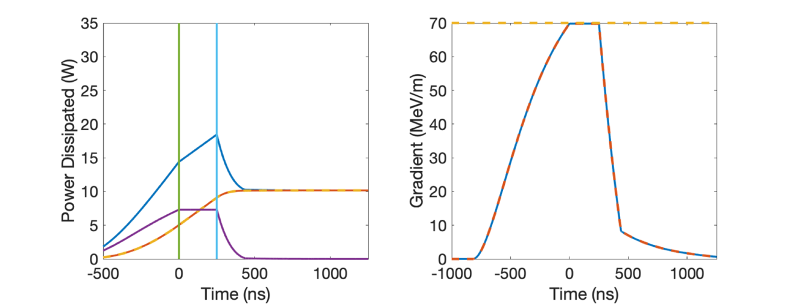
RF Power Requirements
70 MeV/m 250 ns Flattop (extendible to 1400 ns)
~2 microsecond rf pulse, ~30 MW/m
Conservative 2.3X enhancement from cryo
No pulse compression
Ramp power to reduce reflected power
Flip phase at output to reduce thermals
RF Power
One 65 MW klystron every two meters -> Matches CLIC-k rf module power
Gradient
Thermals
LCWS 2025

Slide 24
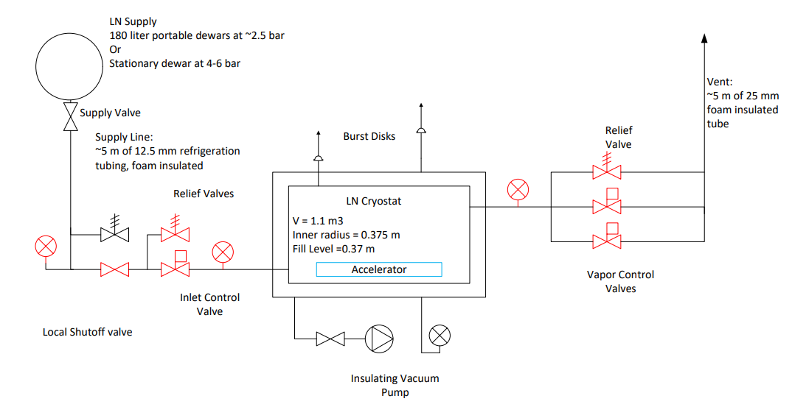
QCM with Cold Boxes
The LN2 plumbing includes cold boxes for supply and venting, implementing cryogenic valves (both manual and actuated) to meter the amount of LN2 in the QCM.
It includes pressure relief valves and burst disks as appropriate in the LN2 lines, vacuum cold boxes, and the QCM.
Valves are already in-house. Cold boxes are being manufactured in-house. Transfer lines are on order.

Slide 25


Power Consumption and Sustainability
Compact footprint <8 km for both underground and surface sites
Underground – less constraints on energy upgrade
Surface – lower cost and faster to first physics
Sustainability - construction + operations CO₂ emissions per % sensitivity on couplings
Polarization and high energy to improve sensitivity
Construction CO₂ emissions → minimize excavation and concrete
Operations → limit power, decarbonization of the grid and dedicated renewable sources
250 GeV CoM - Luminosity - 1.3x10³⁴
Parameter | Units | Value
Reliquification Plant Cost | M$/MW | 18
Single Beam Power (125 GeV linac) | MW | 2
Total Beam Power | MW | 4
Total RF Power | MW | 18
Heat Load at Cryogenic Temperature | MW | 9
Electrical Power for RF | MW | 40
Cryoplant Electrical Power | MW | 60
Accelerator Complex Power | MW | ~50
Site Power | MW | ~150
Surface-Site Mockup
Precision-Weighted Carbon Footprint
PRX Energy 2.4 (2023): 047001
Notes:
Sustainability lcws talk and paper

