Slide 1


Hybrid Collider Concepts
Brian Foster (Oxford/DESY)
Introduction
ALiVE
HALHF
Concluding Remarks
With thanks to J. Famer &
R. D’Arcy for slides & discussion

Slide 2
Introduction
For decades, as Marlene just explained, it has been realized that plasmas can be harnessed to give orders-of-magnitude higher accelerating gradients than conventional metallic cavities.
Many utterly unrealistic timelines were given for pp applications of PWFA (I will not discuss laser-driven, which does not (yet) have the requisite efficiency) – thwarted by asymmetry of plasmas => e⁺ acceleration difficult.
Hybrid Colliders avoid this problem by using conventional cavities to accelerate e⁺. Fine, but then asymmetry of plasma => highly asymmetric colliders!

Slide 3
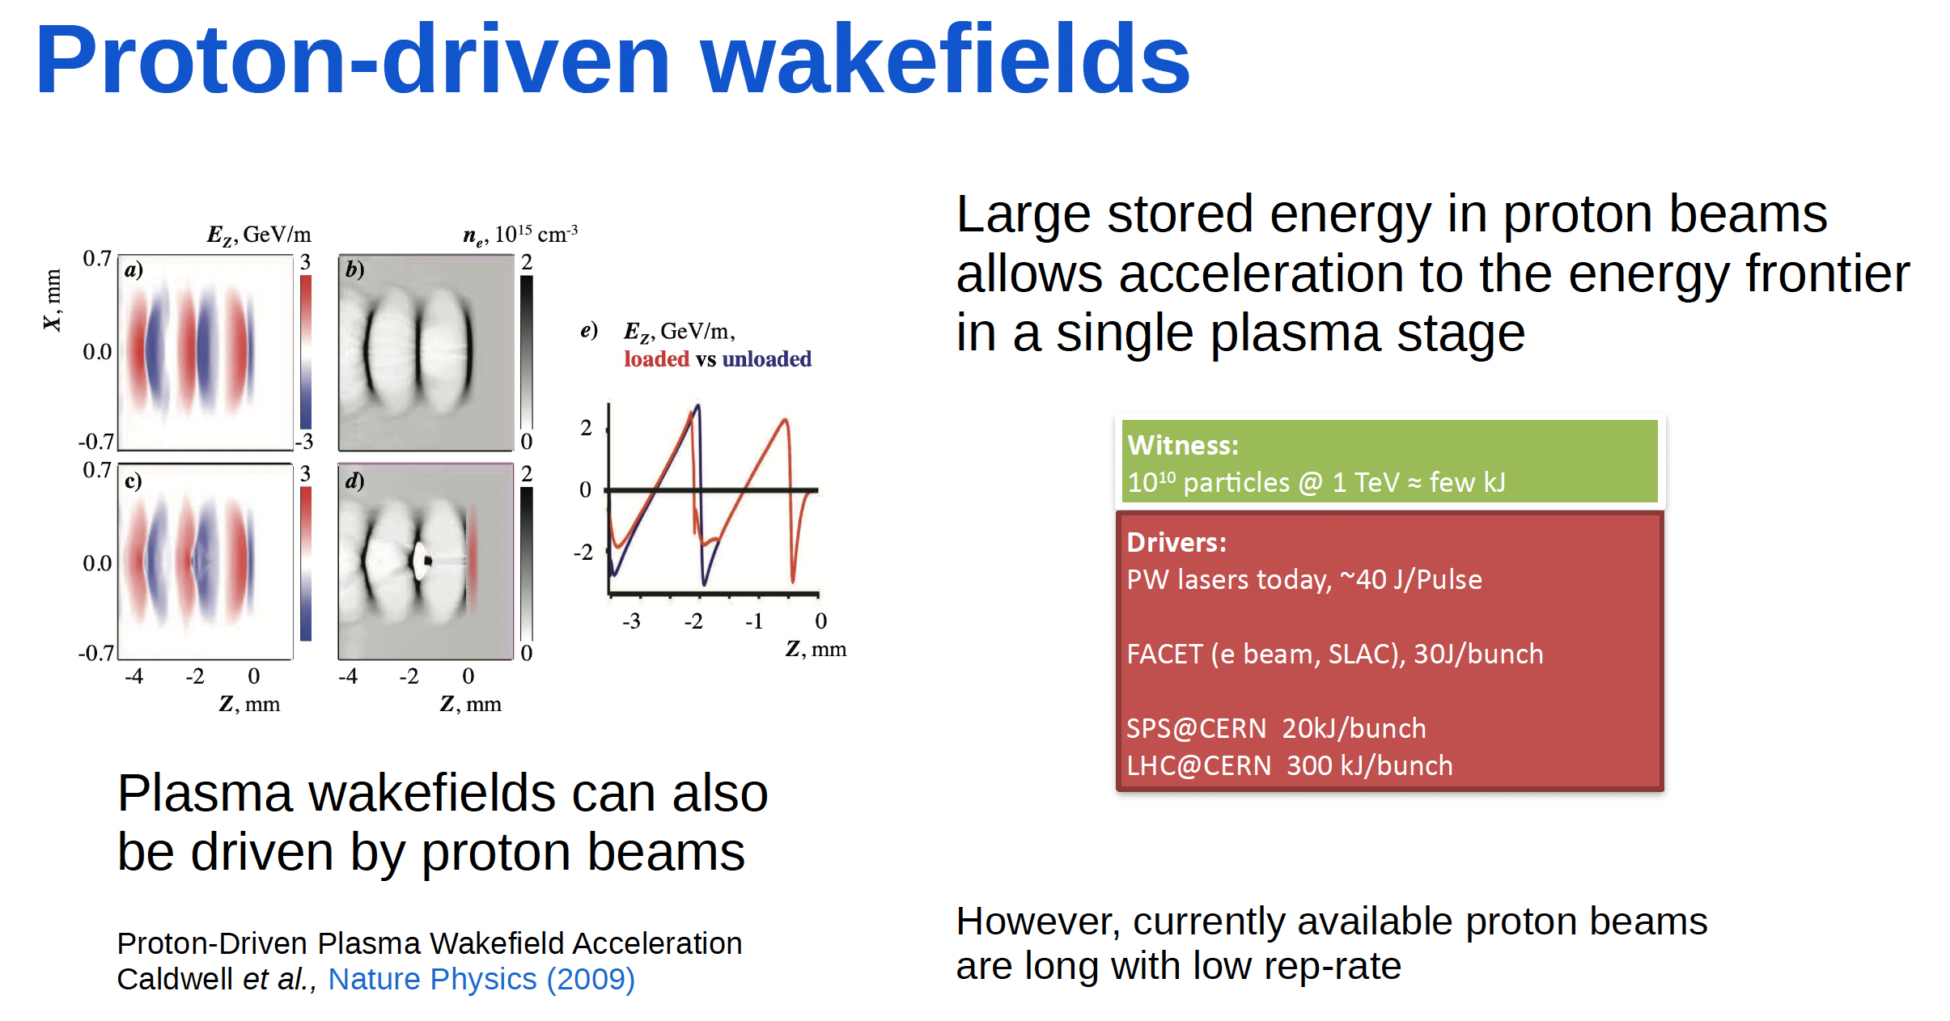
ALiVE
See J. Farmer talk
Thursday 9.00 am
(April 2025)

Slide 4
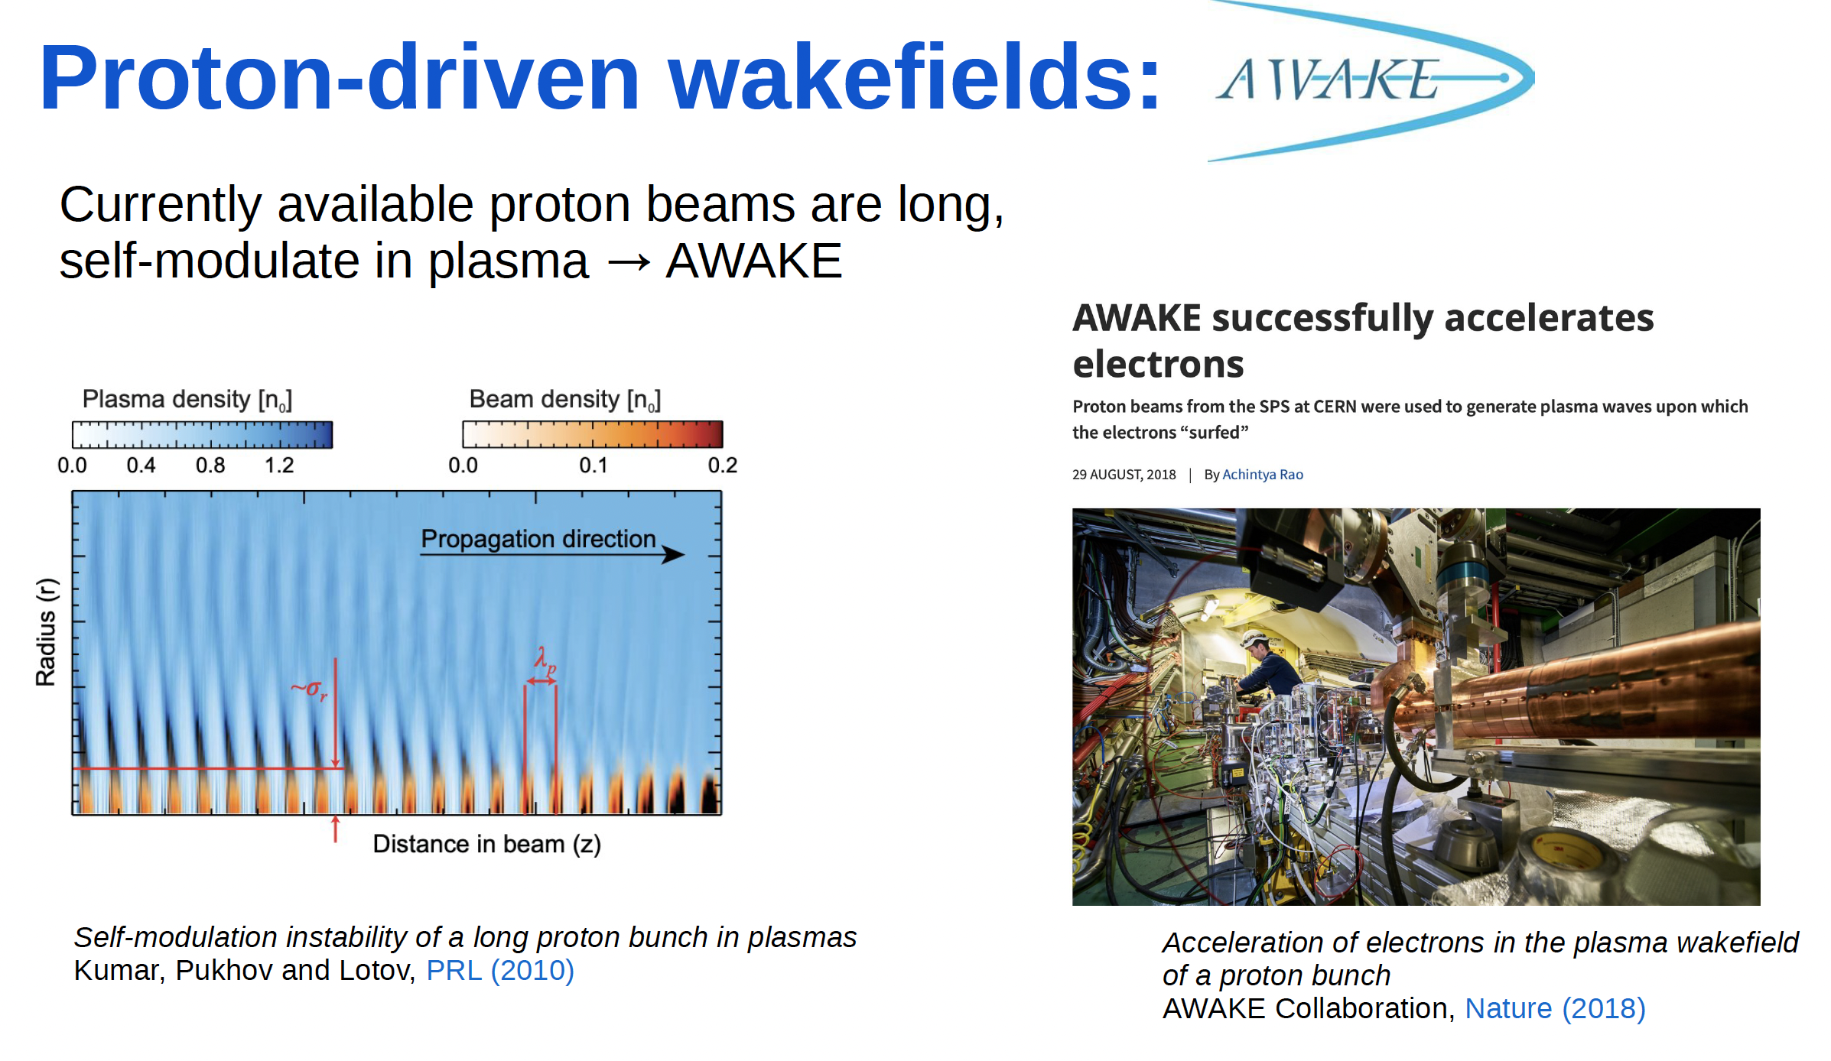
ALiVE
(April 2025)

Slide 5
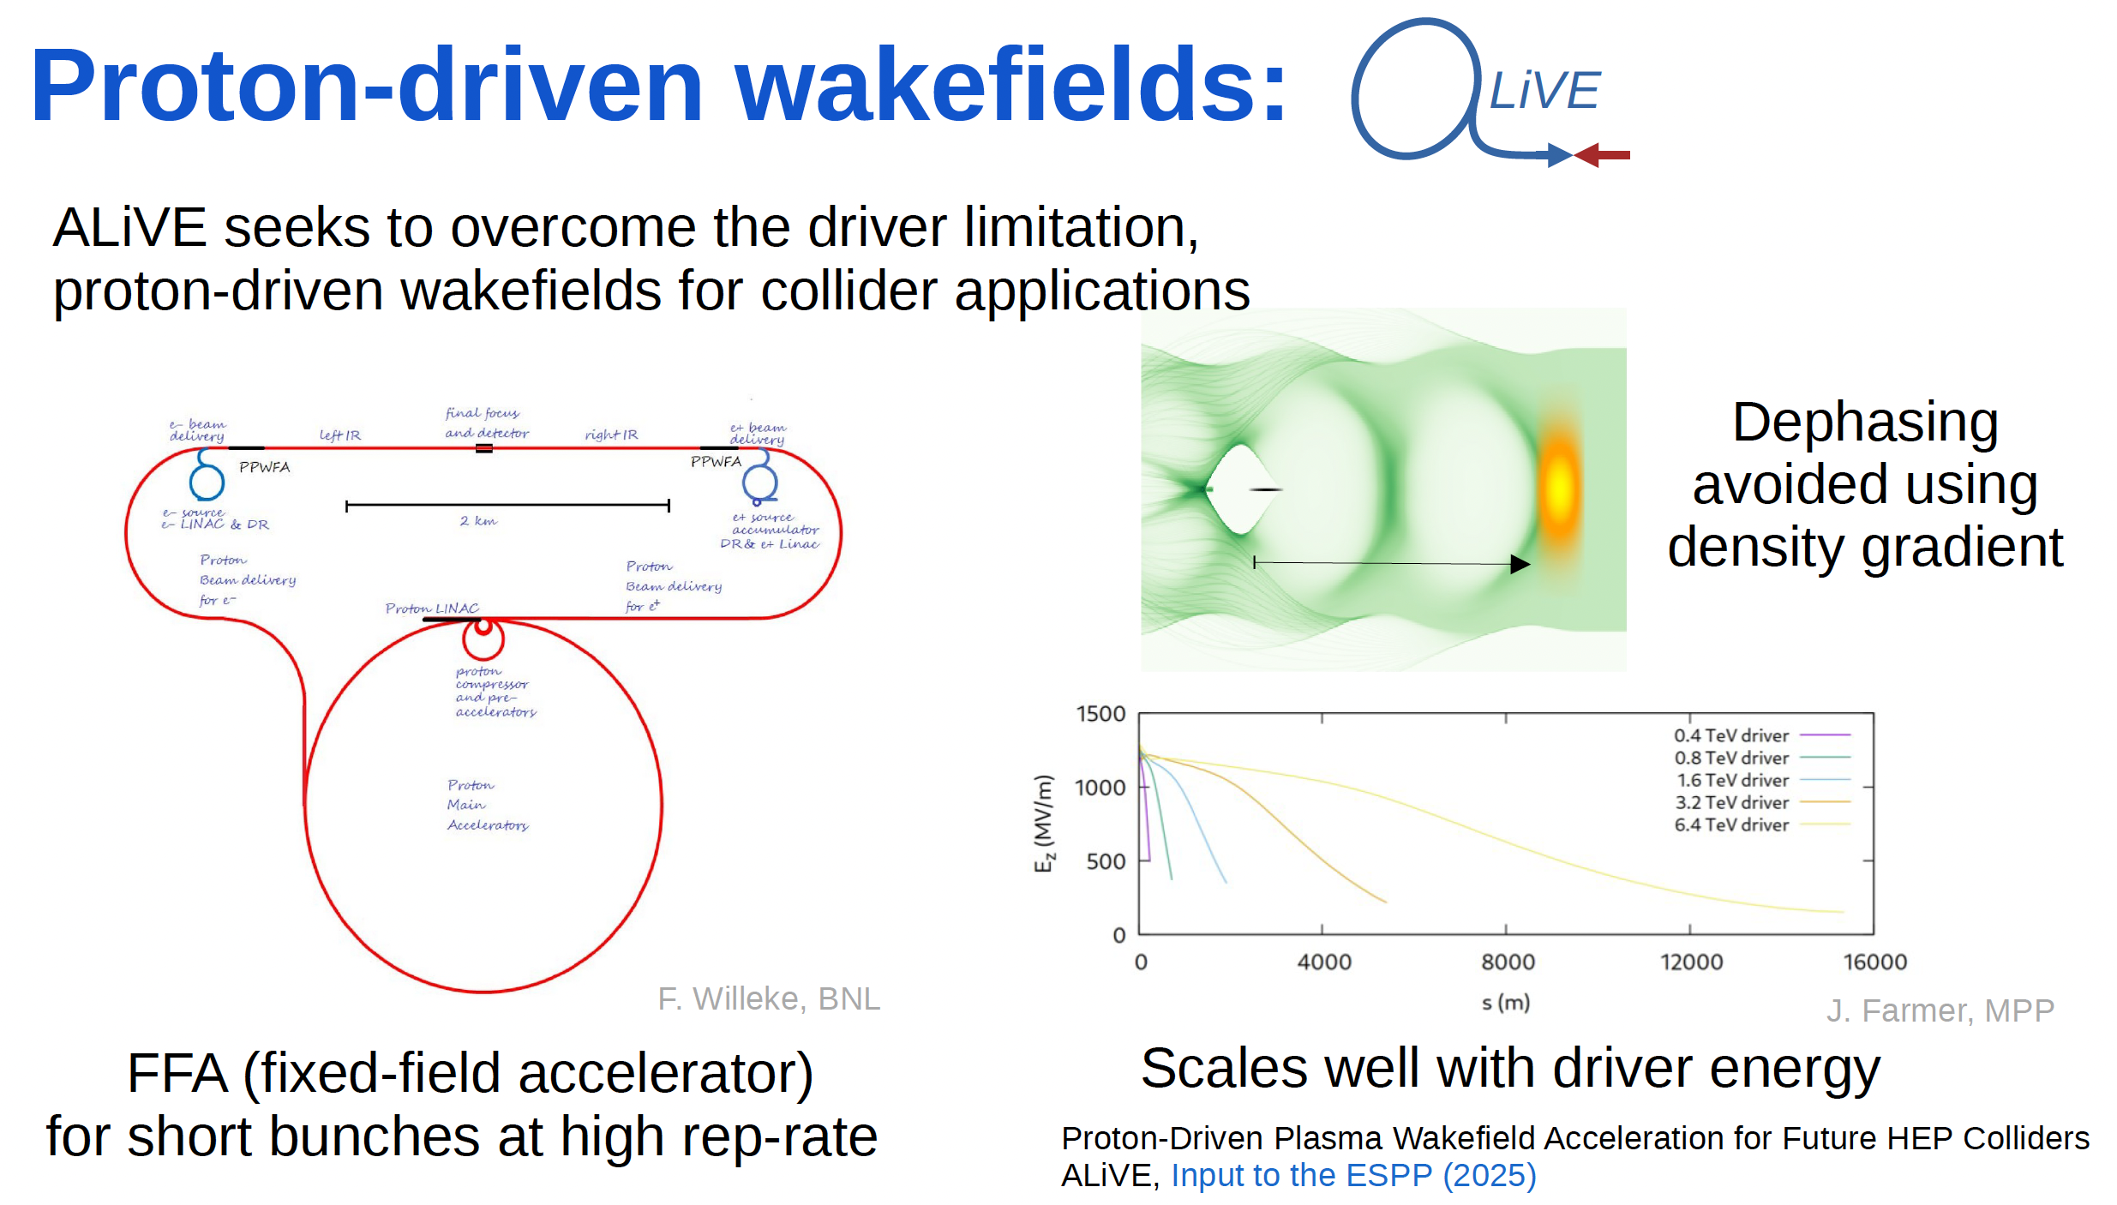
ALiVE
(April 2025)

Slide 6
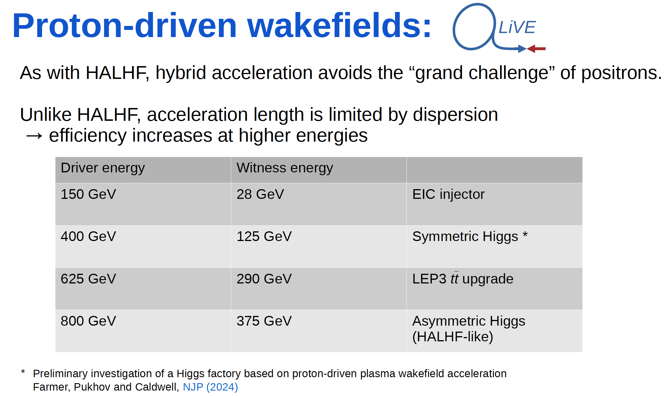
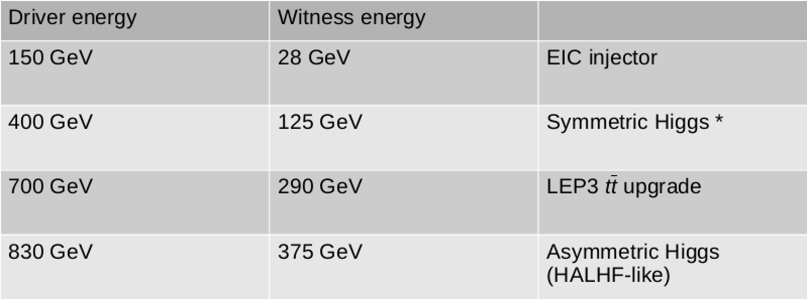
ALiVE

Slide 7
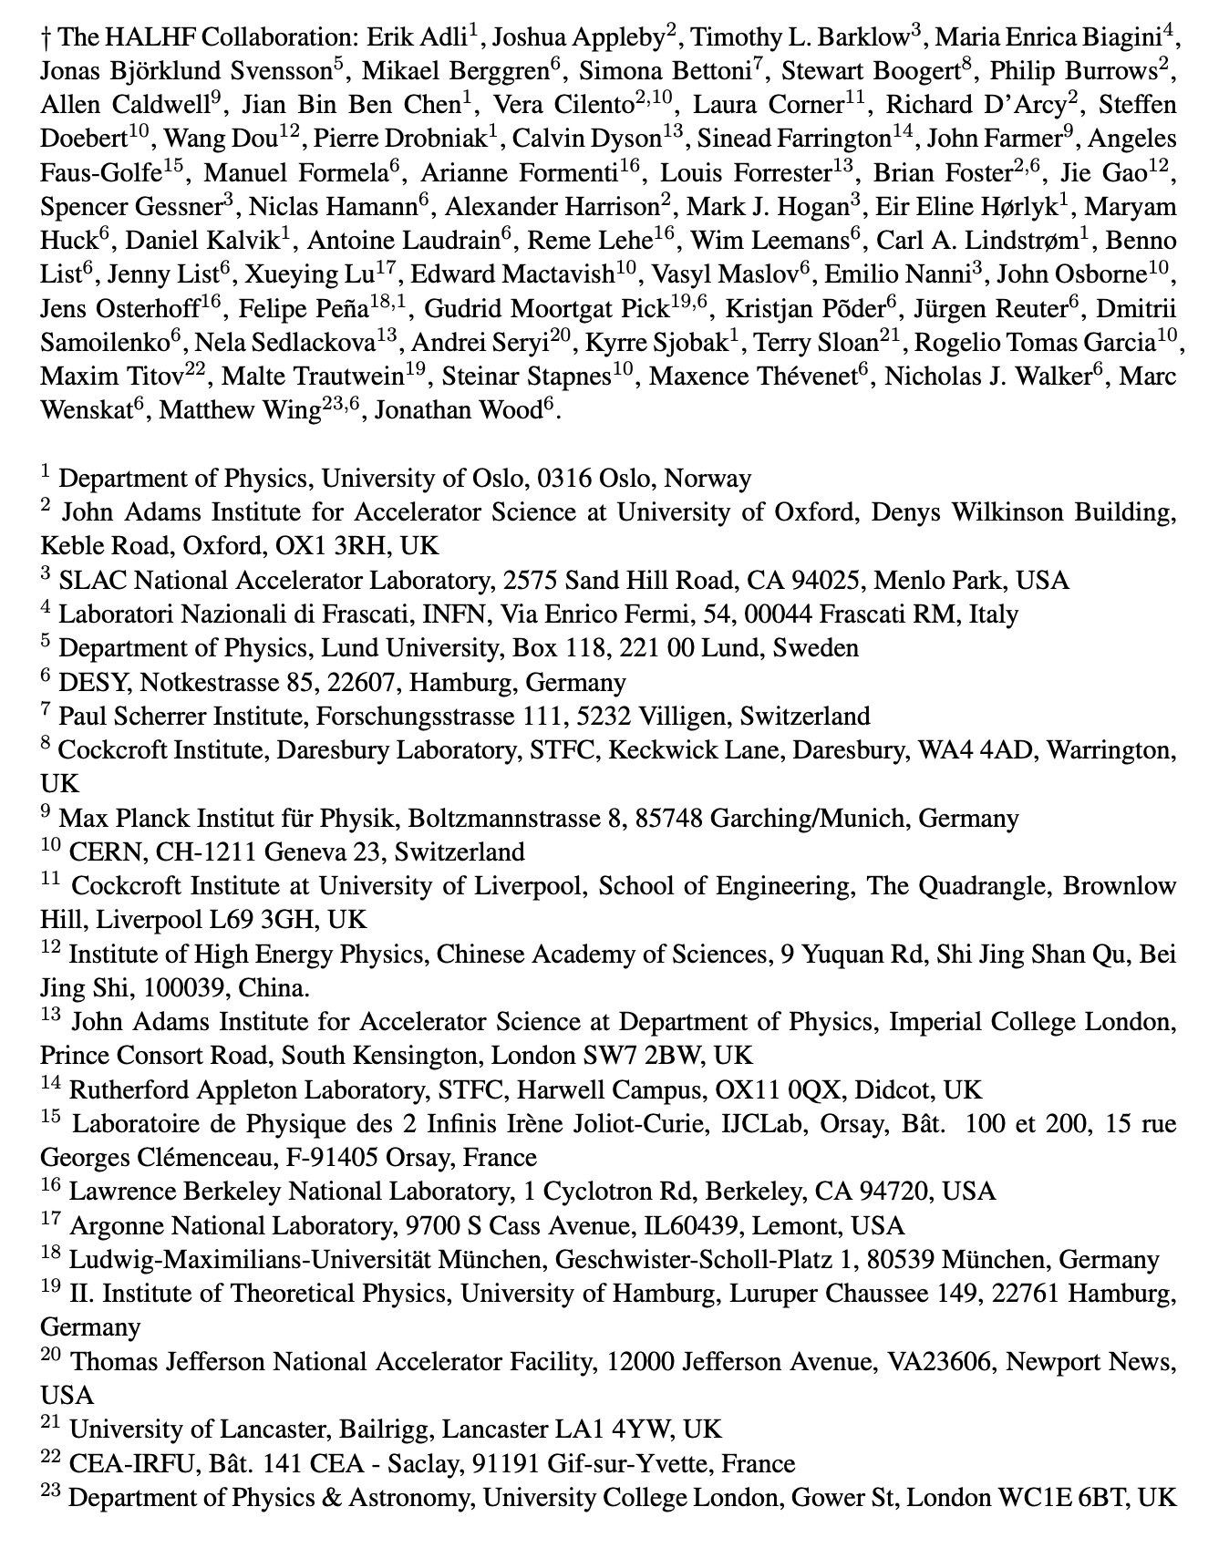
Hybrid Asymmetric Linear Higgs
Factory (HALHF)
(April 2025)

Slide 8

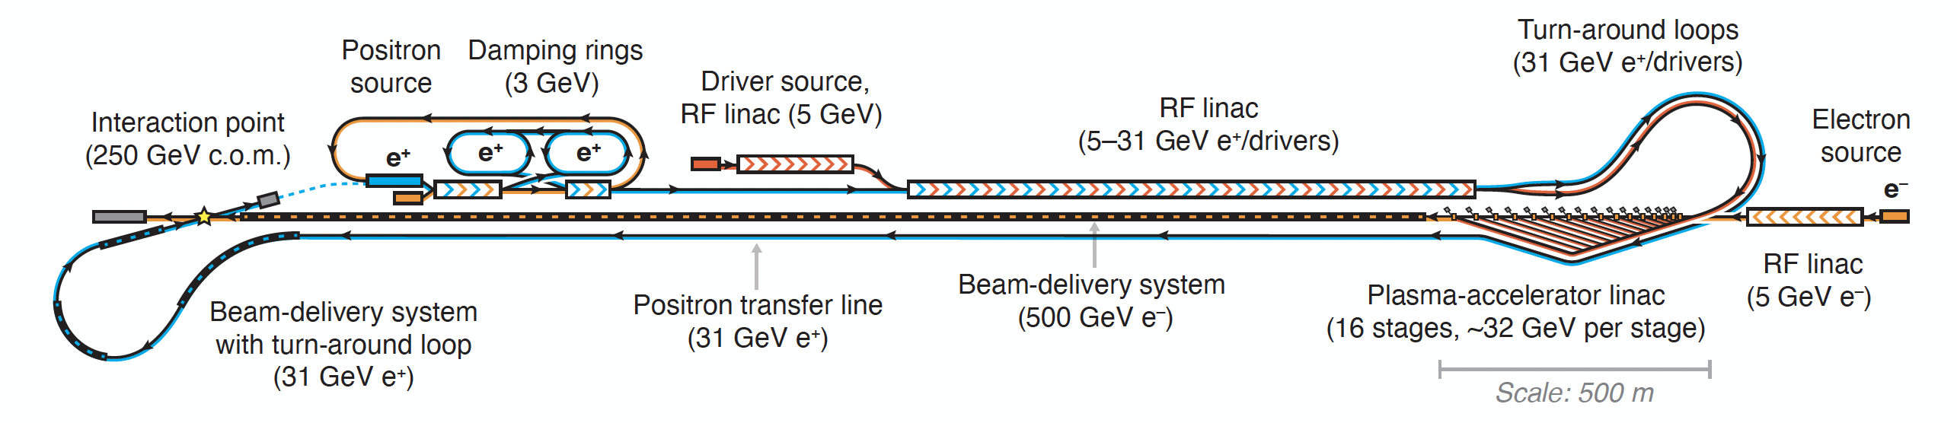
HALHF Status
HALHF workshop 3 – 8.10, Erice dedicated to reassessing baseline in
light of comments from colleagues and progress in design.
Original Baseline:
Foster, D’Arcy and Lindstrøm, New J. Phys. 25, 093037 (2023)
Principal problems:
“Turn-around” too small to retain required beam quality &
scales badly with energy;
“Dual-Purpose” linac difficult to design and inflexible.

Slide 9
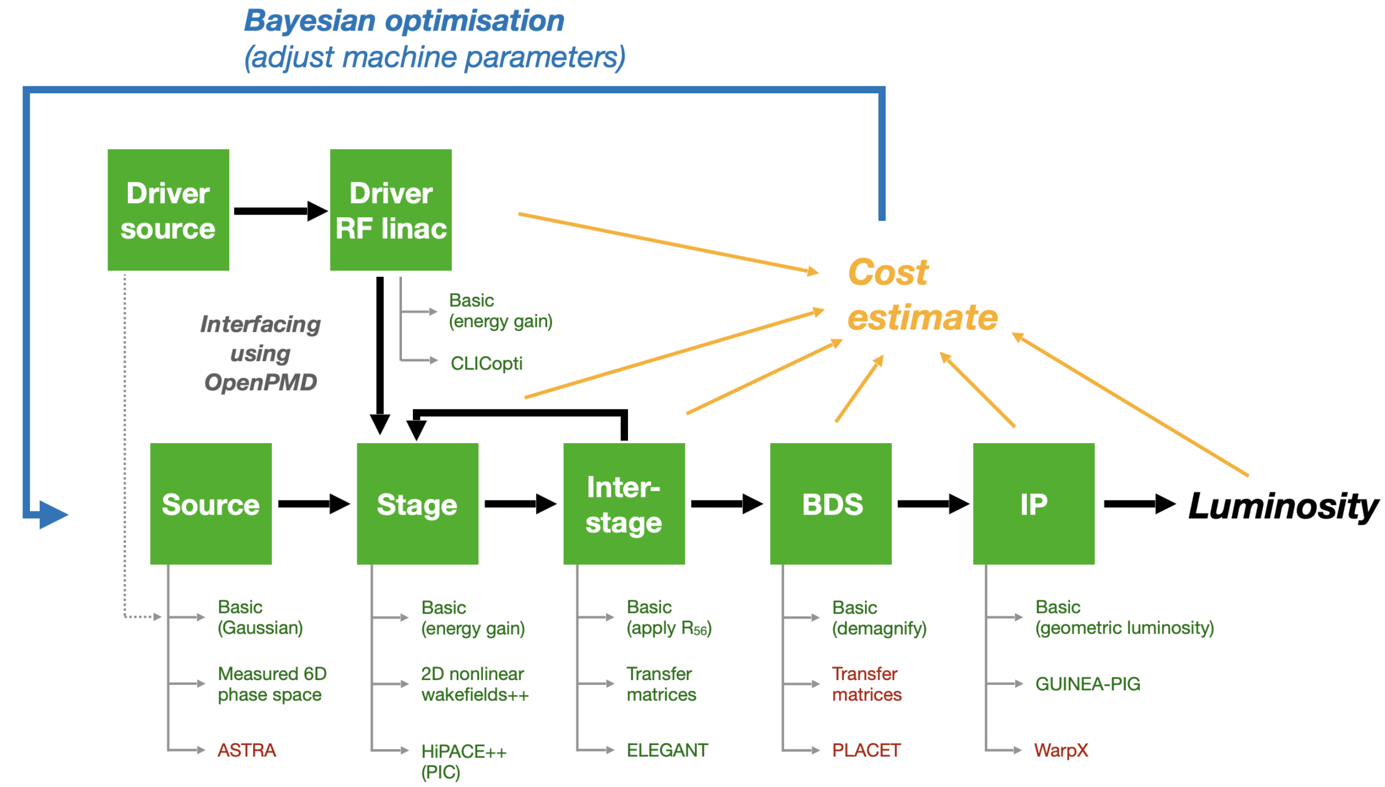
ABEL: The Adaptable Beginning-to-End Linac simulation framework
Facility Optimisation
A start-to-end simulation framework, using OpenPMD
Adaptable implementations
— choose fidelity versus speed for each subsystem
Running other codes via wrappers (also submits HPC jobs etc.)
— HiPACE++, WakeT, ImpactX, GUINEAPIG, ELEGANT, CLICopti
Run simulations as experiments
— run simulations with multiple shots, incl. random jitter
— perform automated scans (one-liner)
— perform parameter optimisations
“System code” (term borrowed from e.g. fusion)
— integrated cost modelling
— machine layouts
Chen et al., TUPS012, IPAC’25
See B. Chen
Thursday 9.20am
Now released as open source - Repository: https://github.com/abel-framework/ABEL

Slide 10
ABEL: The Adaptable Beginning-to-End Linac simulation framework
Facility Optimisation

Slide 11
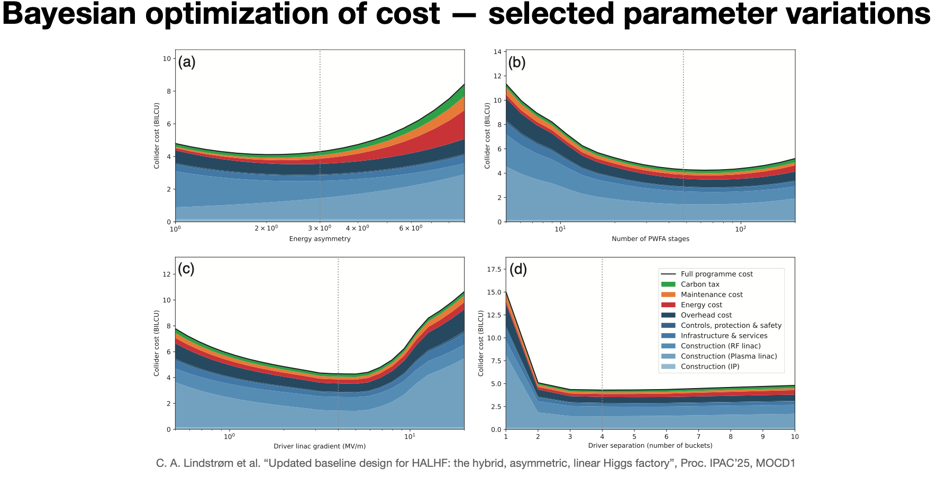
ABEL: The Adaptable Beginning-to-End Linac simulation framework
Facility Optimisation

Slide 12
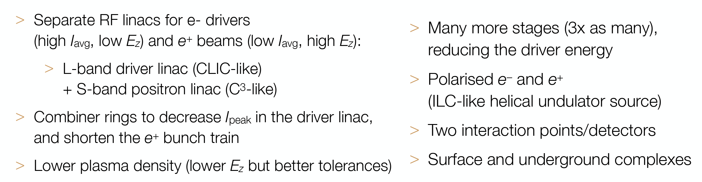
HALHF New Baseline
Foster et al., Phys. Open 23, 100261 (2025)

Slide 13
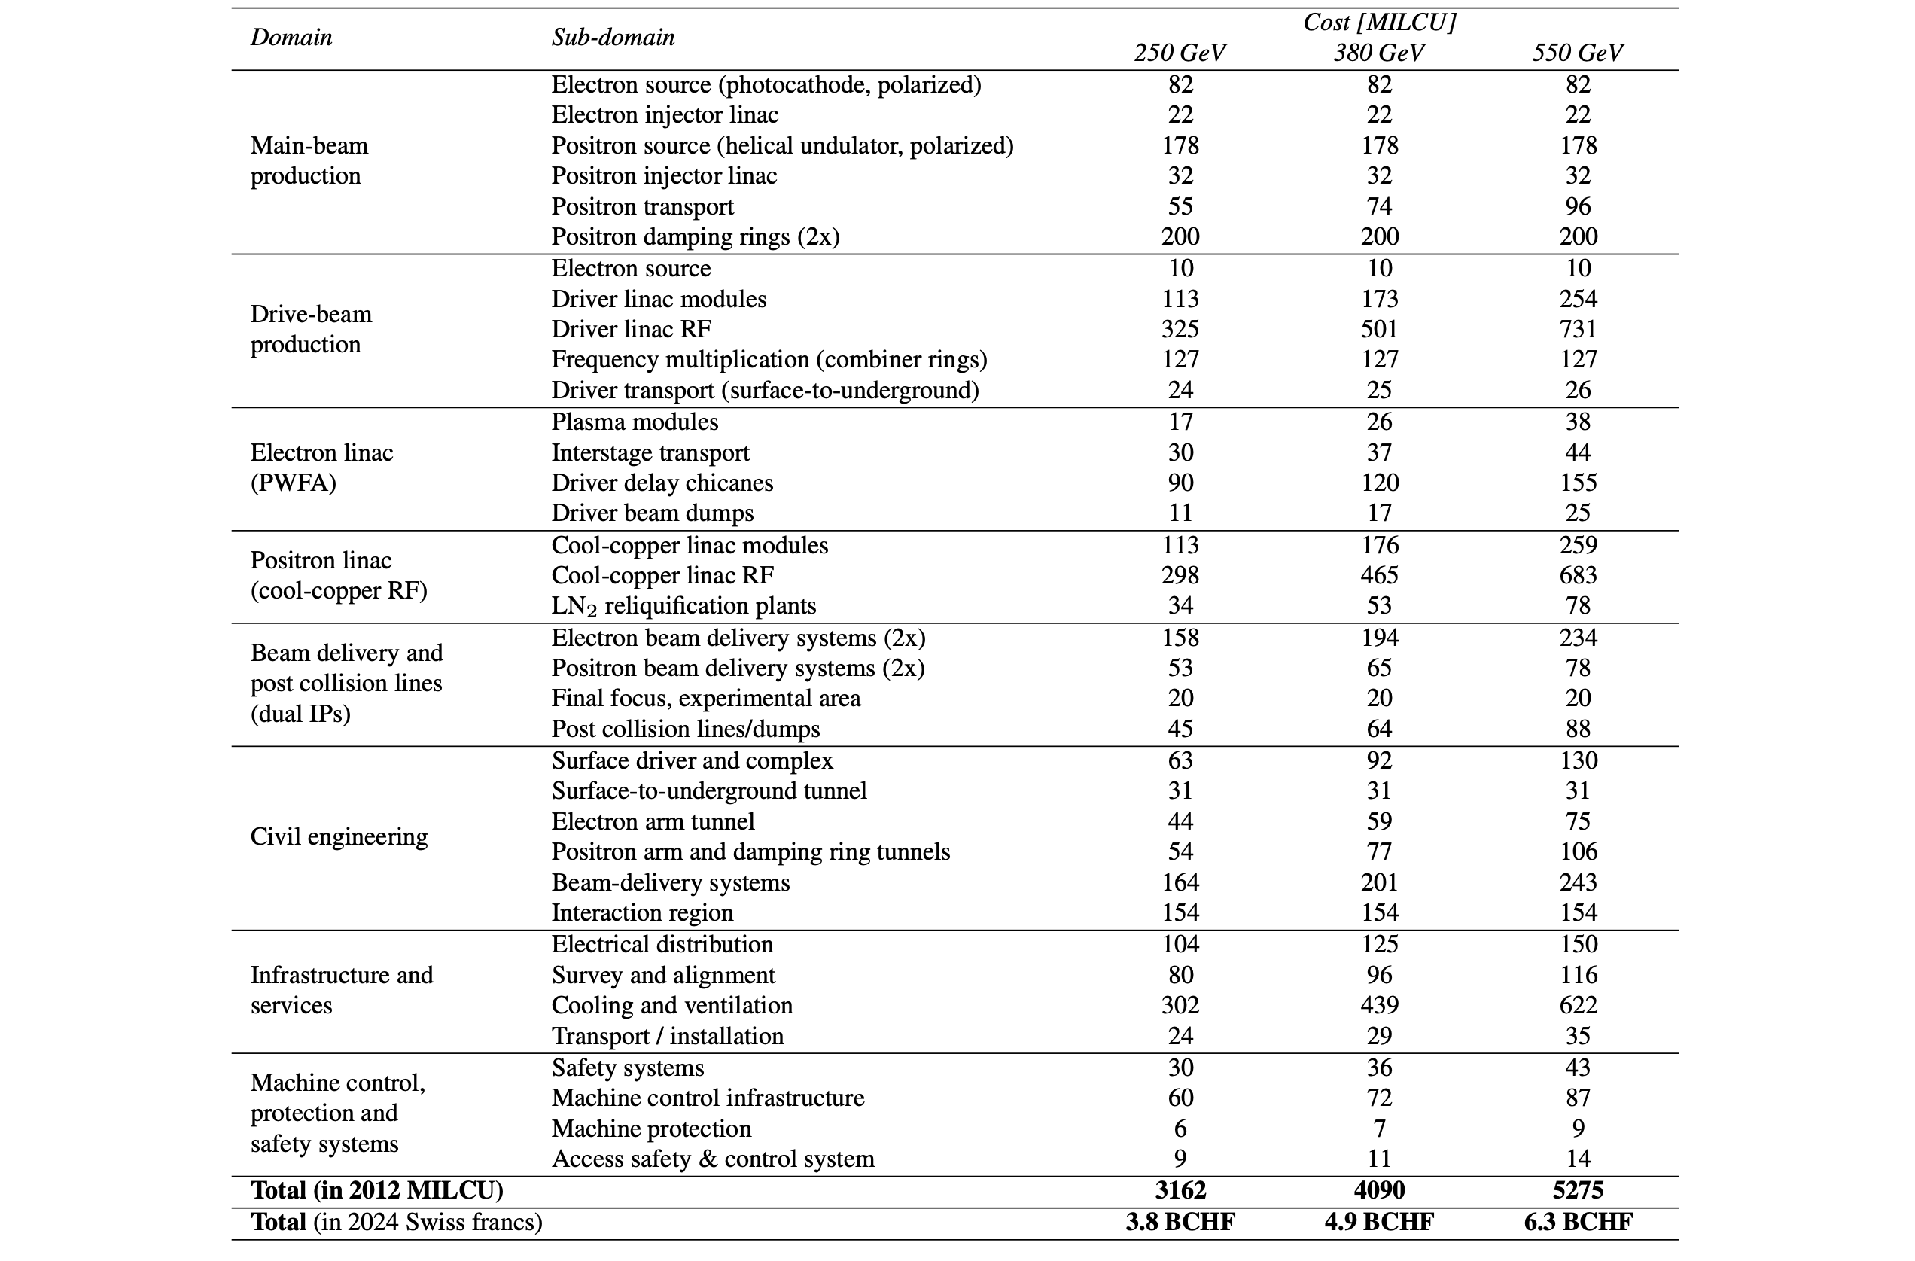
HALHF New Baseline
Cost estimates for HALHF 2.0
E. Adli et al. “HALHF: a hybrid, asymmetric, linear Higgs factory using plasma- and RF-based acceleration”, arXiv:2503.19880
Based on ILC and CLIC
Driver RF linac is a major cost driver
for the machine (~30%; 50% incl. e⁺ linac)
    Drivers: ~22 CHF/watt beam power
    Positrons: ~167 CHF/watt beam power
PWFA linac is not a cost driver (~7%)
    Driver distribution is cost driver here
BDS and IP (~13%) adds
Civil engineering adds ~25% to the machine cost, other overheads ~30%
    Cooling and ventilation is expensive (~3.6 CHF/watt wall-plug power)
  For E -> 10 TeV, see S. Gessner Friday talk

Slide 14
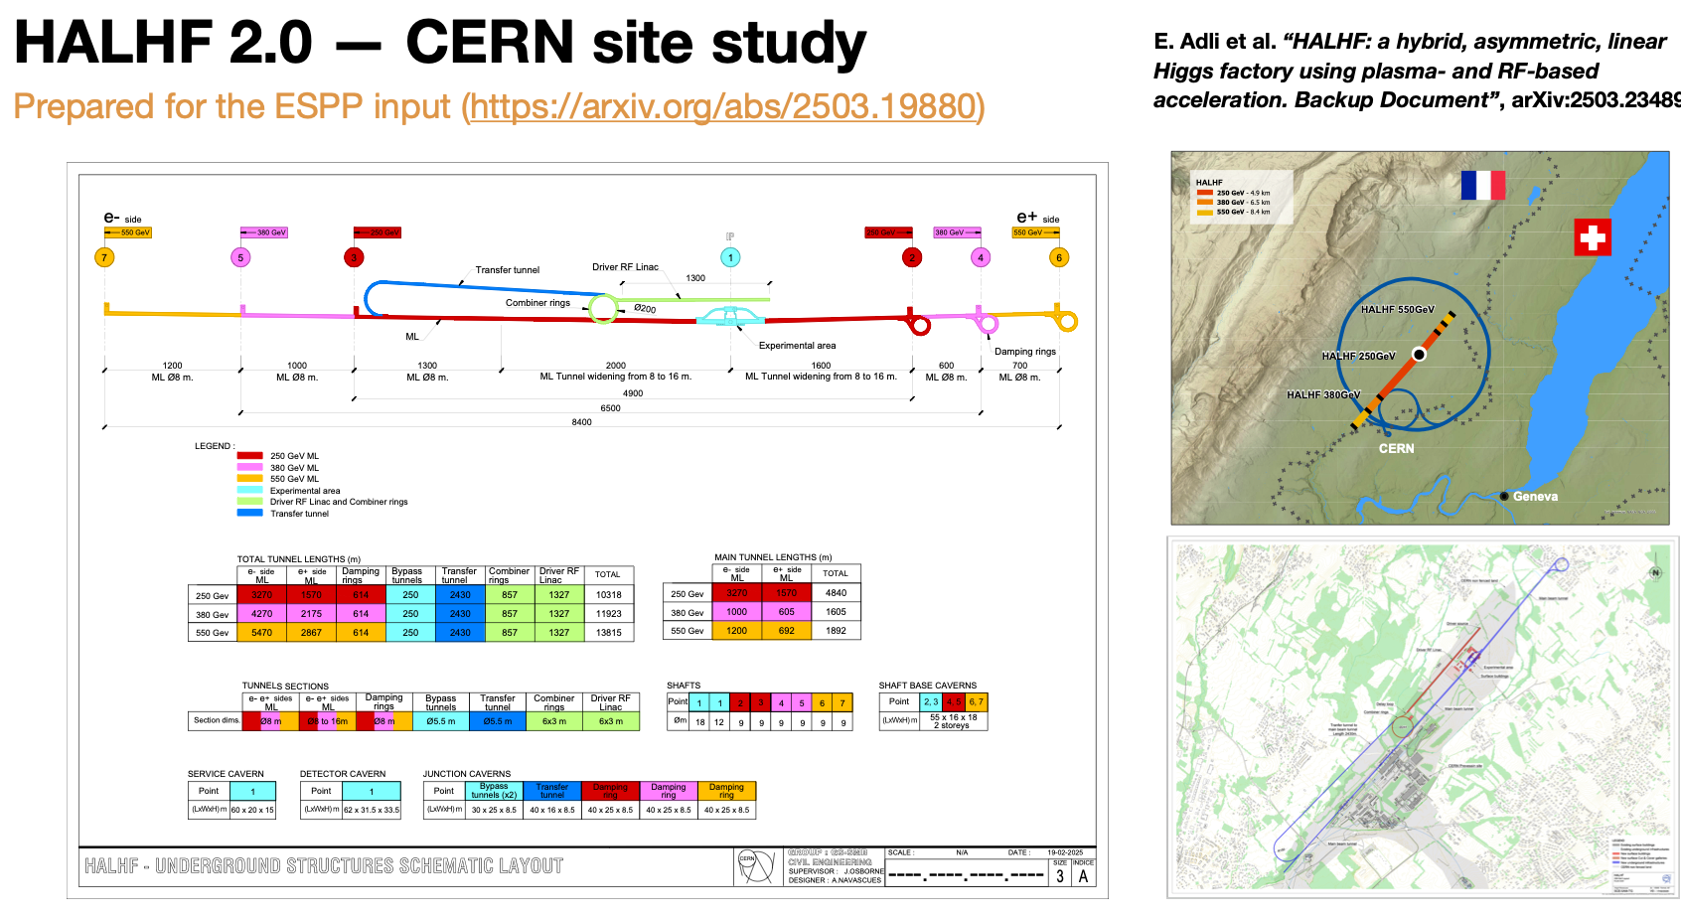
HALHF @ CERN

Slide 15
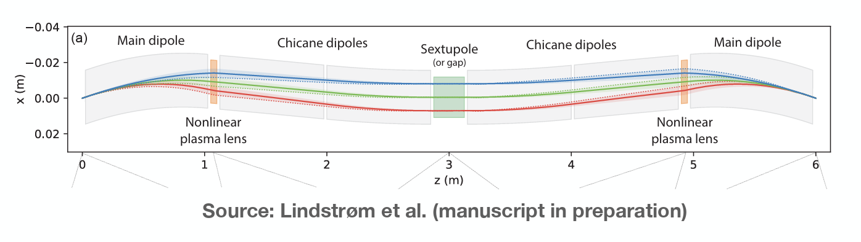
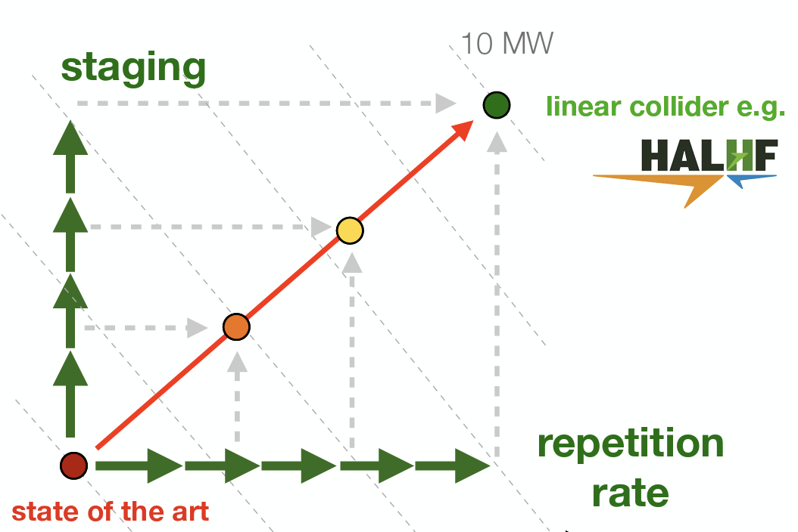
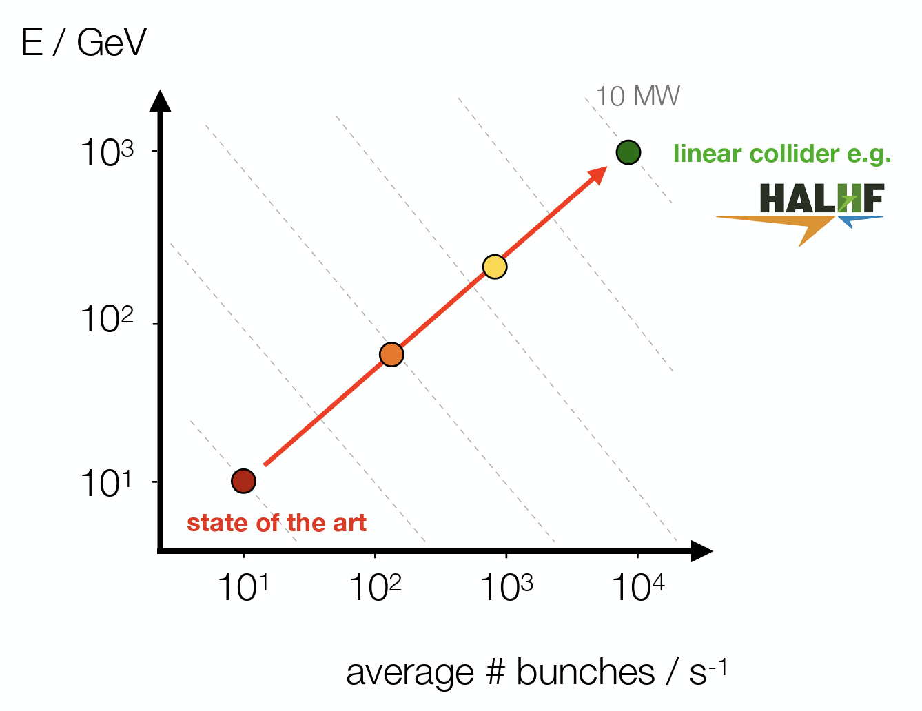
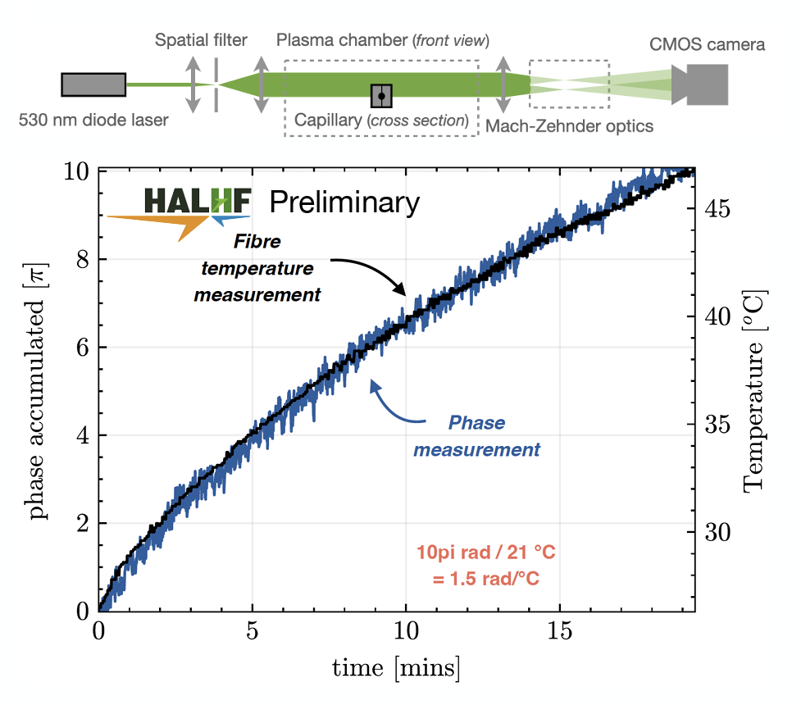
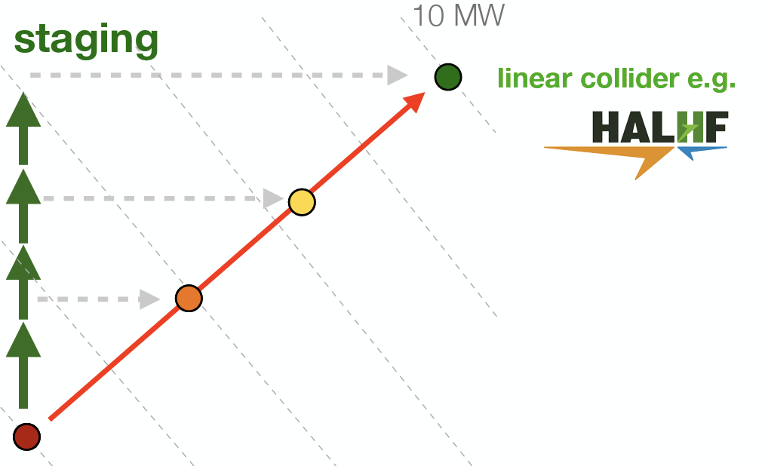
R&D Topics
OR – use p-driven
à la ALiVE
For BDS, see R. Tomas Garcia
Thursday 12.30 pm;
For other R&D see R. D’Arcy
Thursday 9:40am.

Slide 16
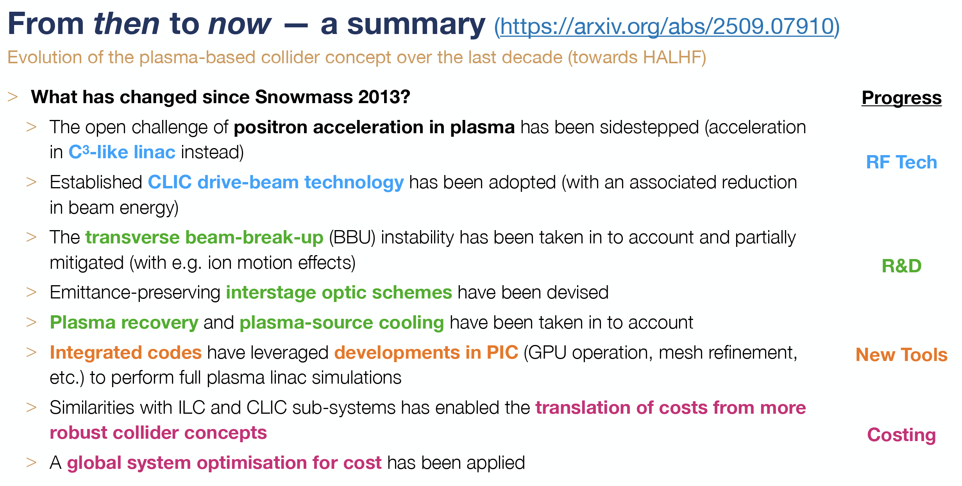
The march of progress
NB – many of these issues, particularly
transverse tolerances and instability
mitigation are still work in progress!

Slide 17
The march of progress
Despite ~ 0 project funding (only a few FTEs from JAI general programme, DESY (Gudi - first explicit HALHF postdoc) & CERN), HALHF is making rapid progress;
New baseline & costing carried out;
HALHF input to European Strategy:
10pager:https://arxiv.org/abs/2503.19880
Backup: https://arxiv.org/abs/2503.23489
~ 15 year R&D programme before approval
Regular monthly HALHF meetings;
Longer-term goal: pre-CDR next year; & funding to start R&D programme;
Contribute to 10 TeV design
S. Gessner talk, Tuesday

Slide 18
Summary & Outlook
There are “cheap” (!) ideas to get to both a Higgs Factory and
beyond – and a possible path to 10 TeV;
HALHF as “after-burner” for existing LC – MUCH easier for
CLIC than ILC – possible for both; γγ also being worked on;
All require significant R&D and funding – but footprint &
construction time small, could still be ready in 2040s;
R&D has many spin-offs and off-ramps to other sciences;
Synergies & collaboration between HALHF and ALiVE;
Great area for young people to experience designing a new
project – come and join us! https://adams-institute.ac.uk/halhf

Slide 19
BACKUP SLIDES

Slide 20
Hybrid Asymmetric Linear Higgs
Factory (HALHF)

Slide 21
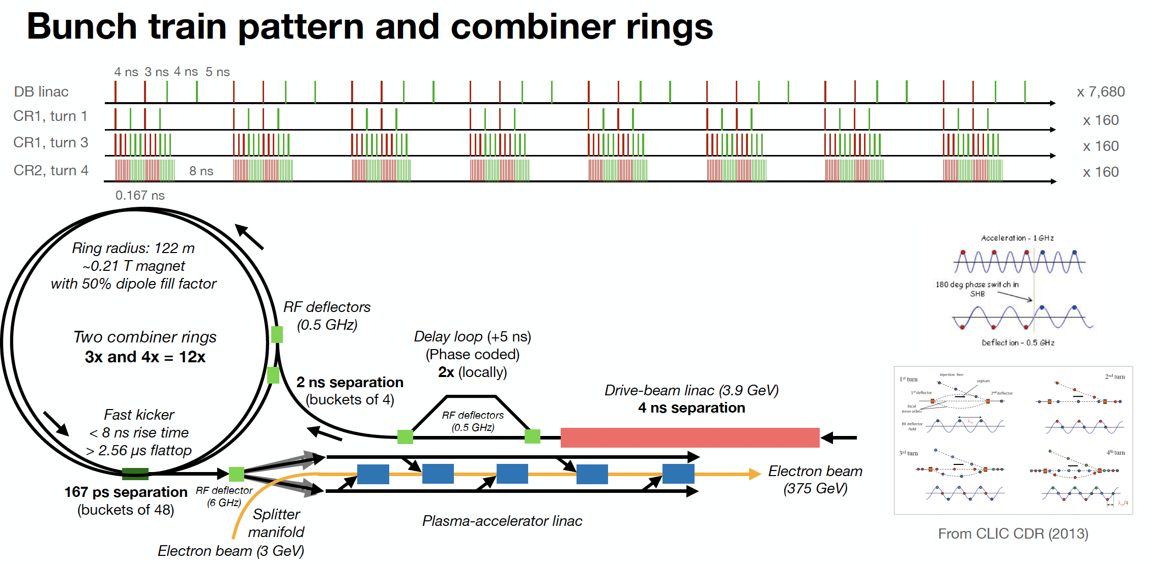
Bunch pattern

Slide 22
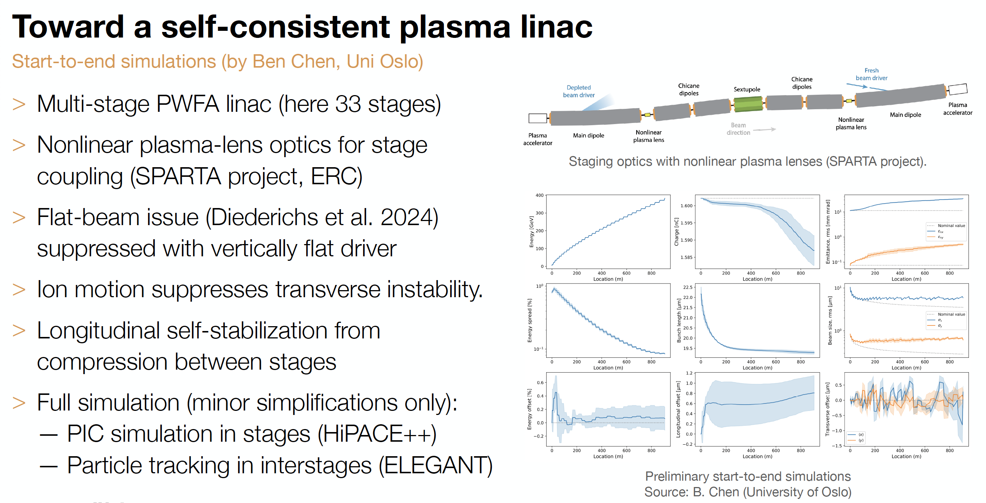
Recent Progress

Slide 23
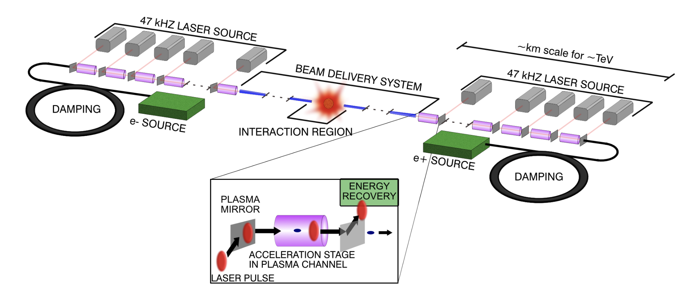
10 TeV Wakefield Collider Summary
Working Groups
System integration and optimization
Beam sources (incl. damping rings)
Drivers
  Laser
  Beams - SWFA
  Beams - PWFA
Linacs
  LWFA
  SWFA
  PWFA
Beam delivery system
Beam-beam interactions
Beam diagnostics
Machine-detector interface
HEP detector
HEP physics case
Environmental impact
Simulations/computing/AI
Green = Broader accelerator community
Orange/blue/purple = AAC specific
Red = HEP and broader community

