Slide 1
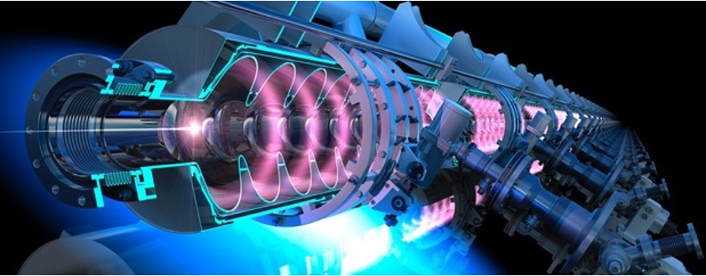
International Workshop on Future Linear Collider- LCWS 2025
ERL-based initiatives for luminosity upgrade
Energy-efficient paths to higher luminosity
Walid Kaabi
Valencia, October 22nd 2025

Slide 2
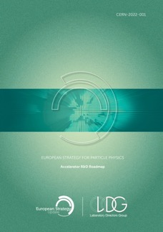
Motivation:
ESPP- Accelerator R&D Roadmap Report (2022):
“A particularly interesting prospect is to design and possibly build, in the further future, an energy-efficient, ultra-high-luminosity ERL-based electron positron collider at 500 GeV, termed HH500, which would enable the exploration of the Higgs vacuum potential with a measurement of the tri-linear Higgs coupling in e+e−”
Excerpt of the executive summary
Measurement precision at the % level requires a luminosity of 10³⁶ cm⁻² s⁻¹.
Increasing the luminosity by orders of magnitude beyond the existent proposals requires significant change in the overall approach on technological choices.
https://arxiv.org/ftp/arxiv/papers/2201/2201.07895.pdf
In this talk, we will highlight several ERL-based concepts, proposed to address this challenge.
2 of them were presented in the LC vision report: https://arxiv.org/pdf/2503.19983

Slide 3
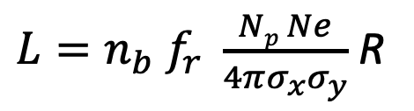
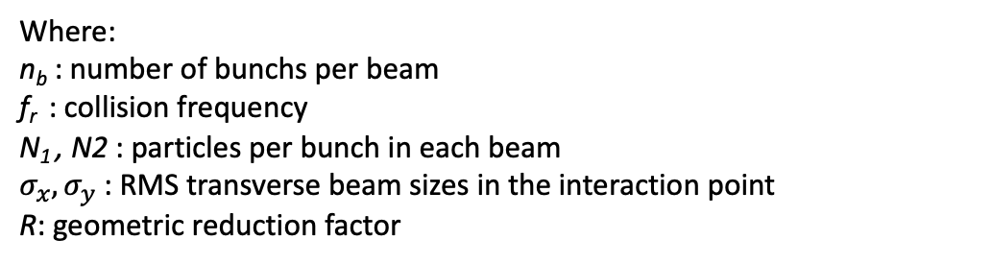
Introduction: Luminosity enhancement in a collider
In a linear collider, for two beams with Gaussian transverse profiles, colliding with a crossing angle $θ_{c}$ or having longitudinal bunch length $σ_{z}$, luminosity is given by the following formula:
$L=n_{b} f_{r} \frac{Np Ne}{4πσ_{x}σ_{y}}$ R
Where:
n_{b} : number of bunchs per beam
f_{r} : collision frequency
N₁ , N2 : particles per bunch in each beam
$σ_{x}{,σ}_{y}$: RMS transverse beam sizes in the interaction point
R: geometric reduction factor
Significant increase of luminosity implies an increase of particle production and therefore additional wall-plug power to handle the high beam current generated.

Slide 4
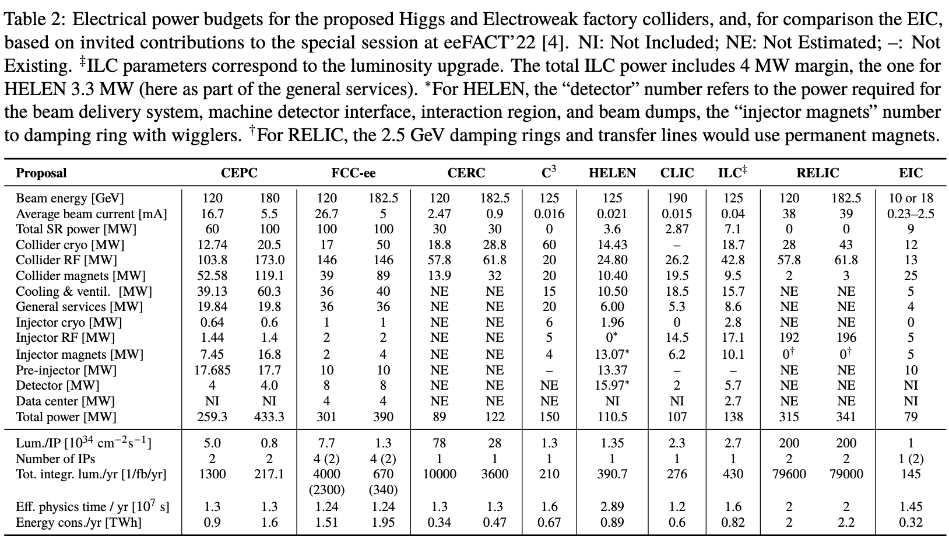
Introduction: Average power needs for future HEP projects
This table is the result of dedicated discussion session on Power budget and performance considerations for future Higgs factories held during eeFACT2022 workshop in Frascati.
https://accelconf.web.cern.ch/eefact2022/papers/frxas0101.pdf

Slide 5
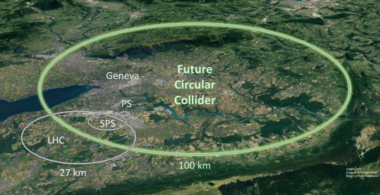
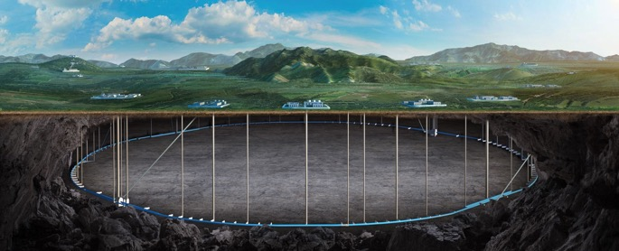
Introduction: Average power needs for future HEP projects
Example 1: FCC-ee (ZH mode)
Example 2: CEPC in Higgs factory mode
The total power consumption for a e+ e- Higgs factory is 300 MW. The power breakdown is as the following:
  RF for beam acceleration 51 % (145 MW)
  Cryogenic cooling 5 % (14 MW)
  Magnets 9 % (26 MW)
  Others 35 % (98 MW)
The total power consumption is 340 MW for the operation on Higgs mode, assuming a SR power of 50 MW/beam. The power breakdown is as the following:
  RF for beam acceleration 52 % ( 177 MW)
  Cryogenic cooling 3,2 % ( 11 MW)
  Magnets 17 % ( 58 MW)
  Others 27,3 % ( 93 MW)
FCC Conceptual Design Report, Eur. Phys. J. Special Topics 228, 261–623 (2019)
CEPC Technical Design Report, December 2024 (page 967)
* “Others” includes vacuum system, instrumentation, radio protection, control system, experimental devices, utilities, general services…

Slide 6
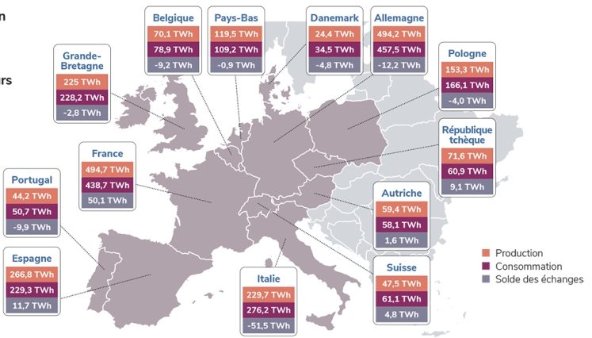
Introduction: Average power needs for future HEP projects
From 2 examples of Higgs factory, the total power consumption (300-340 MW) represent an estimated annual energy consumption of nearly 2 TWh for a typical yearly operating cycle.
It represent 1 to 6 % of the yearly consumption of some middle size European countries
Half of this consumption is for RF power, to accelerate the beam and compensate SR.
Efficiency enhancement of future large-scale facilities is an obligation toward:
Societal acceptability
Political commitments of hosted countries toward reaching carbon neutrality.
→ R&D on high Q₀ cavities, high efficiency klystrons development, permanent magnets, efficient cryoplant design
Production, Consumption and Exchange of the electrical power in some European countries (2023 data, updated in February 2024)
https://analysesetdonnees.rte-france.com/bilan-electrique-2023/europe#Introduction

Slide 7
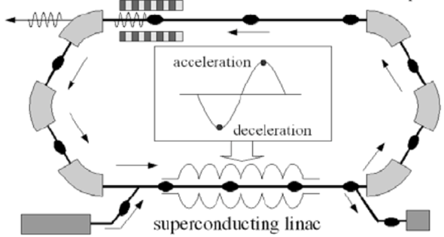
Introduction- ERL Concept
Acceleration:
RF power provided to cavities
The idea:
ERL Loop
(1’)
(1)
New beam injected in ERL loop
Acceleration to the top energy
(2’)…
(2)
acceleration
deceleration
ERL Loop
Kinetic energy of used beam recycled to re-excite cavities
Superconducting Linac
(4)
Beam used in IP
(3)
Injector
Beam dump
The benefits:
Important reduction of RF power consumption
Dumping the beam at injection power
Fresh beam in IP with the same characteristics
Deceleration:
180° RF Phase shift
More advantages:
Linac-like beam quality with extremely flexible time structure
High operating efficiency
Multi-pass configuration: High current carrying capability (no RF power limit) + High beam power in a compact machine
Notes:
By recovering the Energy of accelerated beams, Energy Recovery Linacs (ERLs) make large beam powers possible that would otherwise be prohibitively expensive.
Linacs produce high beam qualities for scientific experiments and for industrial applications, but their beam power is limited by the available electrical power.
ERLs surpass this power limit: much larger beam currents and beam powers become available because the beam energy is recaptured.
How do ERLs compare to other accelerators?
high currents, like storage rings, because the energy is recovered,
high beam quality (low emittance, bunch length, and energy spread) like linacs, because each bunch traverses it only once,
tolerates beam disruption as each bunch is used only once before it’s discarded.

Slide 8
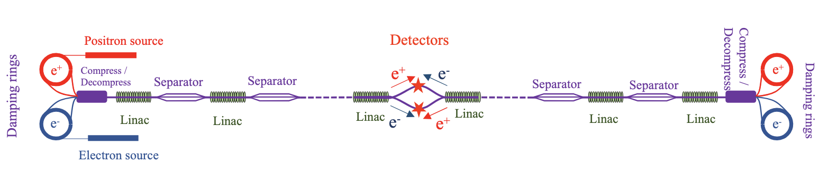
ReLiC: Recycling Linear e+ e- Collider
A proposed luminosity upgrade of linear Collider: targeted Luminosity > 10³⁶ cm⁻² s⁻¹ polarized beam collision
C-o-M energy: large range from 45 GeV to 700 GeV.
It extend ideas of recycling not only the beam energies after collision, but also the collided particles:
More in V. Litvinenko’s talk tomorrow
Conventional standing wave (SW), single-axis linacs, used to accelerate & decelerate e- & e+ beams.
Linacs are segmented into sections, divided by separators → separation between accelerated and decelerated beams (accelerated beams propagate on axis & deflection of decelerated beams).
2 interaction regions with 2 detectors → cumulated luminosity
Recirculation of particles allow increasing average current → Luminosity enhancement.
Damping rings used to restore emittance and energy spread of used beam before reuse.
Electron and positron sources to compensate losses by synchrotron radiation in the damping ring & IR,

Slide 9
ReLiC: Recycling Linear e+ e- Collider
Critical issue:
Synchrotron radiation and energy spread growth in IR (trajectory bend & beam aligning to prepare energy recovery.
Efficient particle recovery: large energy acceptance damping ring → losses by SR in separator & IR optics, Beamstrahlung during collision…
Synergy with other concepts and existing facilities:
R&D on high-Q and high Tc SCRF cavities, microphonics suppression systems (FR-FRT), HOM dampers (BLA and HOM couplers).
Development of efficient cryogenic systems
Common technologies with low emittance light sources, high current e+ e- colliders and damping ring lattices with large energy acceptance.
Specific need:
High rep-rate and accurate kickers

Slide 10
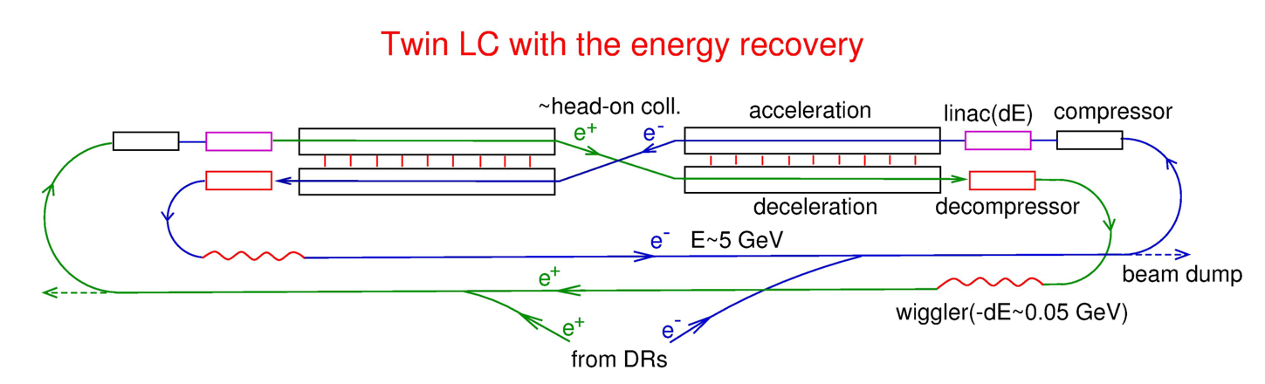
ERLC: A re-imagining of the ILC as an ERL
More in V. Telnov’s talk tomorrow
In each side of the IR, 2 parallel SC linacs, one for acceleration and the other for deceleration, connected one to the other with twin-axis cavities to exchange recovered beam power.
To reduce the energy spread arising from beam collisions, damping is ensured by wigglers at a return energy of about 5 GeV.
Duration of cycle is of several second (partial CW RF), imposed by the cryogenic consumption.
The concept was extended recently to an ERLC e- e- (Cf. V. Telnov talk tomorrow)

Slide 11
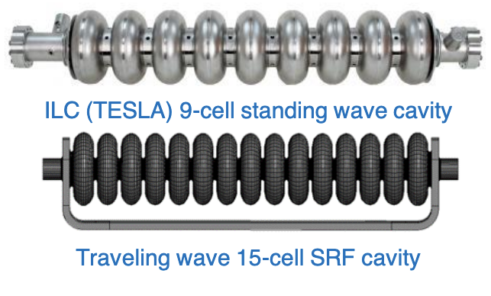
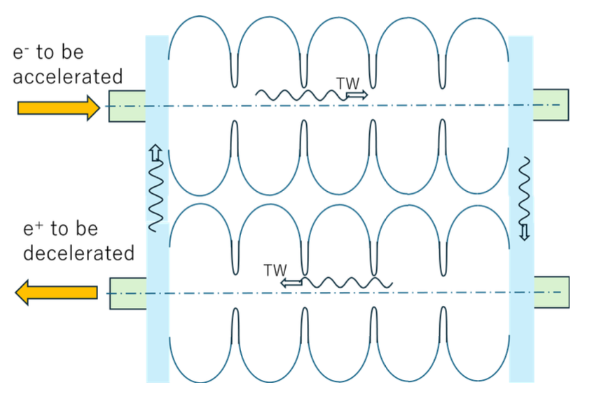
ERLC: A re-imagining of the ILC as an ERL
Critical issues and Synergy with other concepts and existing facilities :
Mitigation of the RF Losses in the cavities and HOM to limit the cryogenic consumption.
→ R&D on high-Q and high Tc SCRF cavities (Nb3SN)
→ R&D on HOM dampers (BLA and HOM couplers).
→ Development of efficient cryogenic systems
Specific need:
Development of Traveling Wave (TW) cavities (HELEN type), combined with the development of twin axis cavities

Slide 12
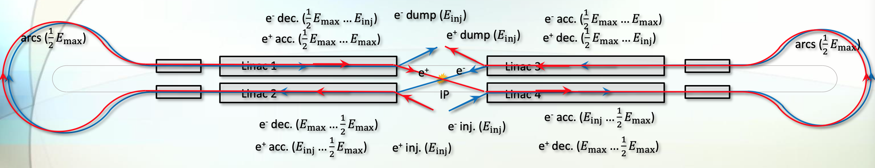
The Ghost Collider:
A new ERL-based concept of an e+ e- linear collider, 550 GeV center-of-mass, initially inspired by ERLC design, then evolved thanks to the properties of “ghost bunches”.
Linacs are the same length as the ILC ones, with partial CW RF (2s on- 4s off), or later full CW RF @ 4.5K.
Shape of arcs was optimised, reducing synchrotron radiation by 35.8%.
More in A. Hutton’s talk tomorrow

Slide 13


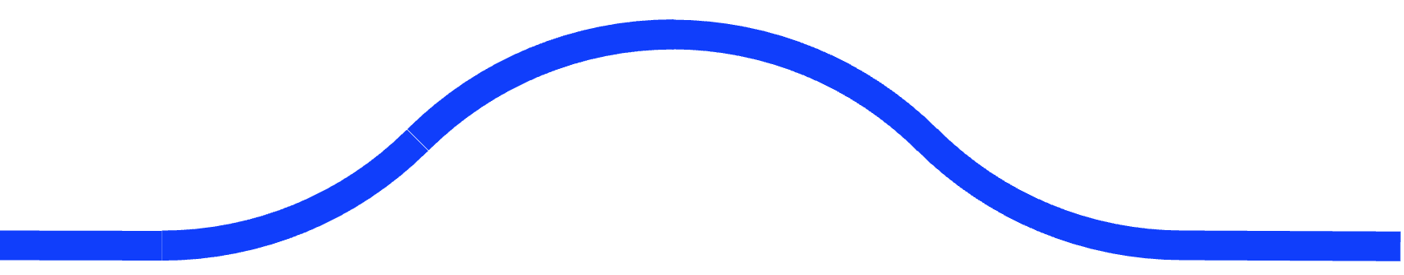


The Ghost Collider:
Ghost bunches are electrically neutral: equal numbers of e- and e+ traveling together in the same Linac buckets → No electromagnetic interactions with the linac environment:
  No excitation of High Order Modes (HOM)
  No multi-bunch Beam Breackup (MBBU)
Energy transferred between e- and e+ in the same bunch, decelerating one and accelerating the other → No need to couple linacs in the same side to transfer the power (no twin-cavity needed)
No electromagnetic interactions between ghost bunches travelling in opposite direction → Single bidirectional linac on either side of the IR
No electromagnetic interaction in IP as bunches are neutral → Possible to have several IPs in the IR, each of them with the design luminosity (1.6 10³⁴ cm⁻² s⁻¹).
SRF Linac
Chicanes
SRF Linac
Arc
Arc
IP

Slide 14
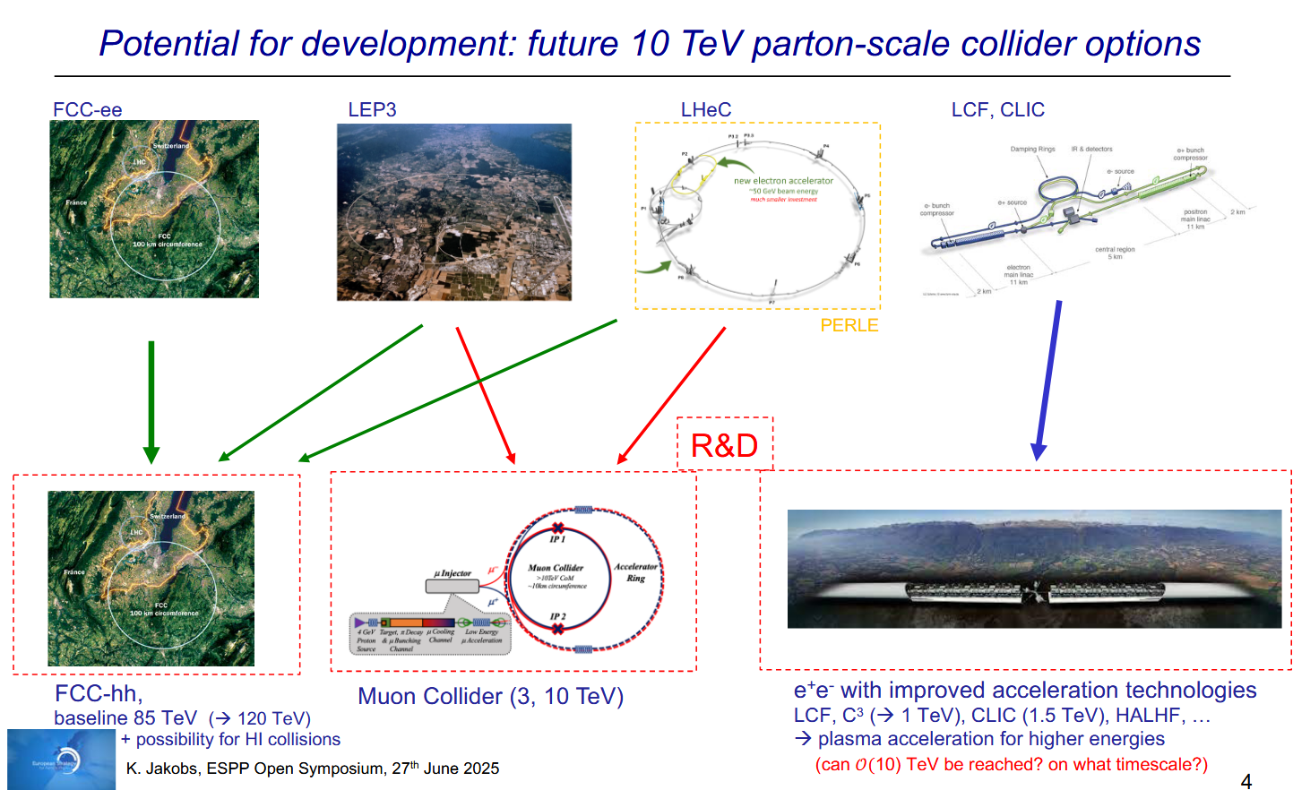
LHeC:

Slide 15
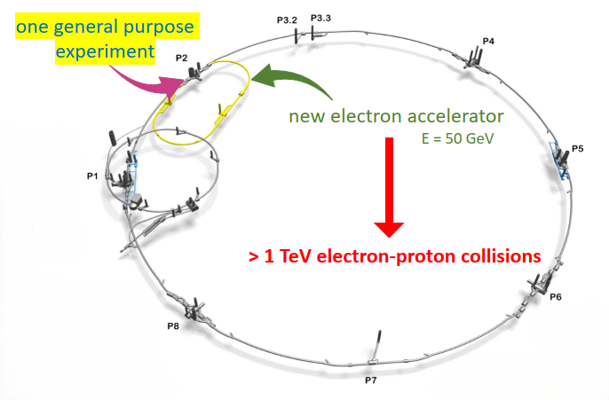

LHeC:
Beam Energy [GeV]
Luminosity [10³⁴cm⁻²s⁻¹]
Normalized emittance ge_{x,y} [mm]
Beta Function b*_{x,y} [m]
rms Beam size s*_{x,y} [mm]
Beam Current @ IP [mA]
Bunch Spacing @ IP [ns]
Bunch Population [10¹¹]
Bunch charge [nC]
LHeC
p | e⁻
7000 | 50
2.3
2.5 | 20
0.07 | 0.1
4 | 4
1100 | 50
25 | 25
2.2 | 0.078
35 | 1.24
1/3 LHC circumference
$\sqrt{s}$=1.18 TeV
2.5 GW beam power
2.5 GW beam power
HL-LHC – 7 TeV
HL-LHC proton beam parameters
Very low beta functions at the IP!
50 mA e⁻ current

Slide 16
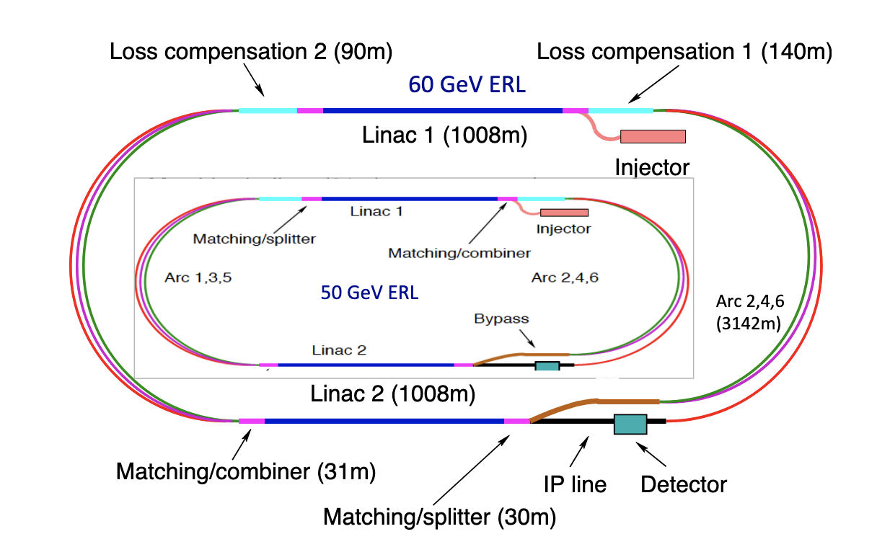
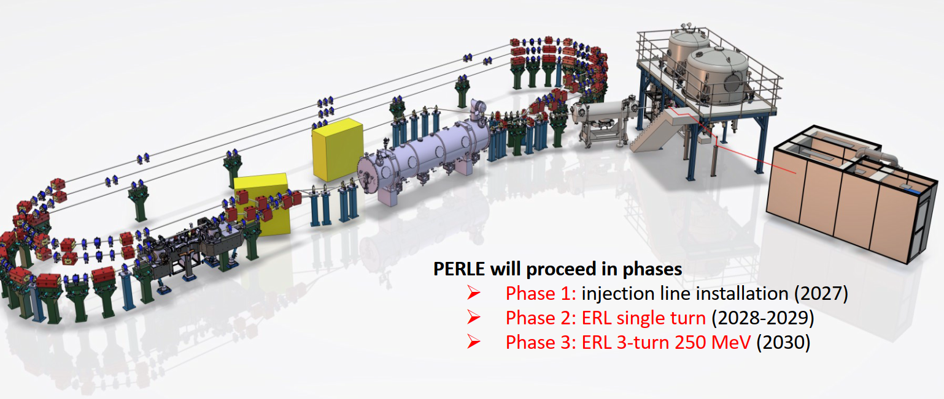
LHeC:
LHeC configuration and parameters:
Multi-turn ERL (3 pass up, 3 pass down)
Top energy: 50 GeV, ~ 9 GeV /Linac
1.25 nc bunch charge @ 40 MHz → 50 mA average current
802 MHz SRF system, targeted Q₀= 3. 10¹⁰
Beam damped at injection energy (7 MeV)
RF systems (at twice the LINAC frequency) to compensate for the synchrotron radiation loss in the arcs
$\sqrt{s}$=1.18 TeV
PERLE configuration and main parameters:
Multi-turn ERL (3 pass up, 3 pass down)
Top energy: 250 MeV, ~ 82 MeV /Linac
500 pc bunch charge @ 40 MHz → 20 mA
802 MHz SRF system, targeted Q₀= 3. 10¹⁰
Beam damped at injection energy (7 MeV)
→ 89 MeV- 20 mA
→ 250 MeV- 20 mA

Slide 17
Thank you for your attention!

Slide 18
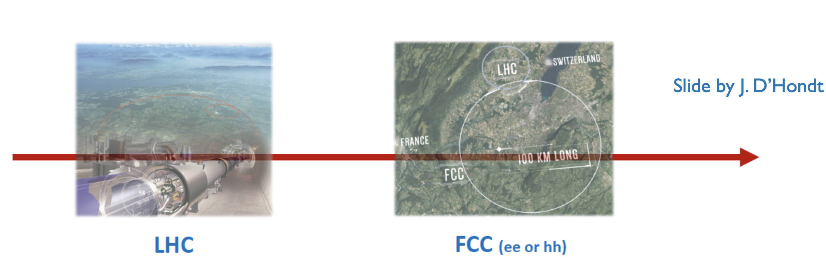
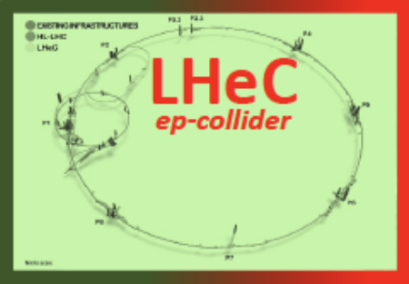
LHeC as a bridge:
In standalone mode (ep/eA only), LHeC may be a bridge between major colliders at CERN: between the end of HL-LHC (2041) and the next flagship CERN collider.

Slide 19
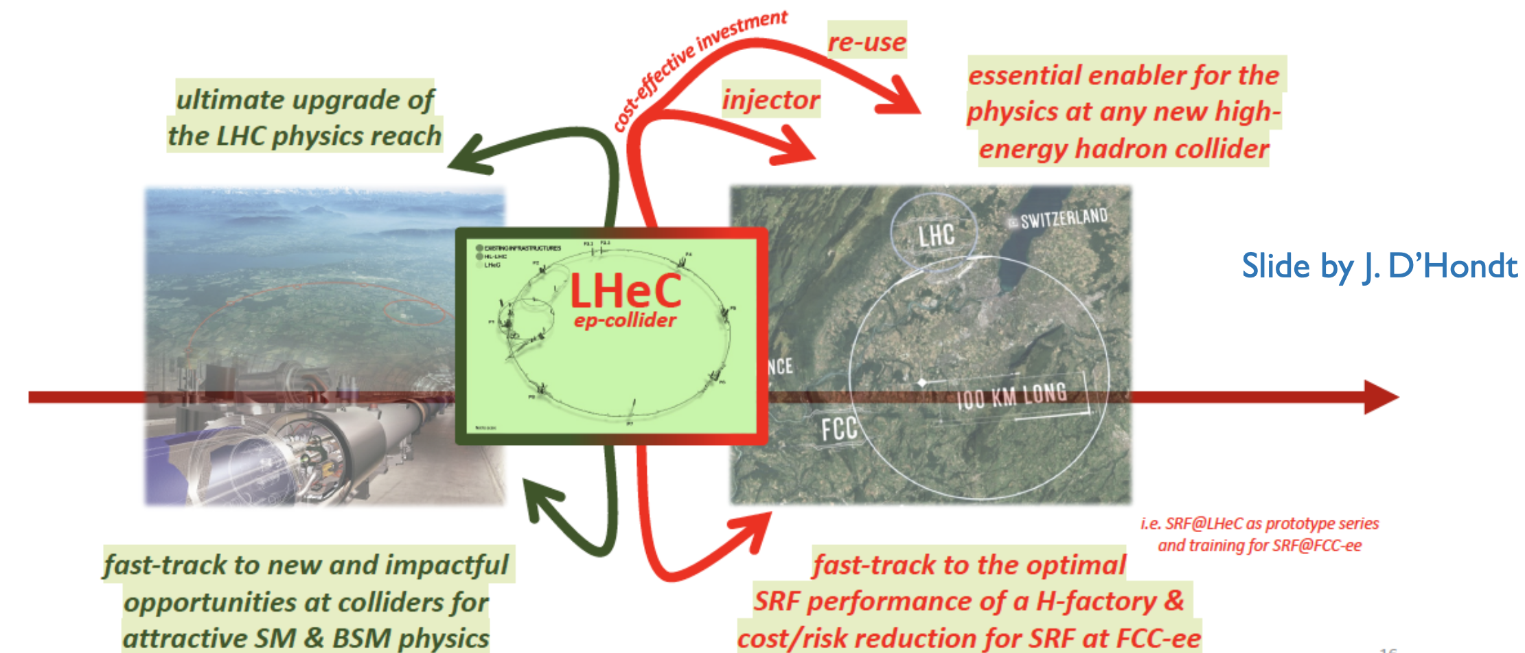
LHeC as a bridge:
In standalone mode (ep/eA only), LHeC may be a bridge between major colliders at CERN: between the end of HL-LHC (2041) and the next flagship CERN collider.

Slide 20
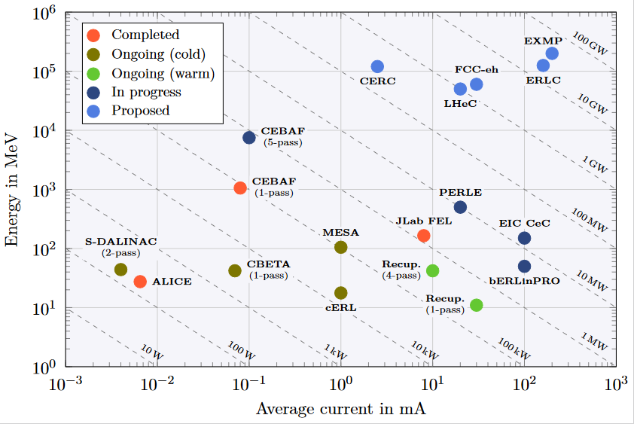
ERL - The global landscape
ERLs were recognized as one of the five main axis of accelerators R&D in support of the ESPP:
  High-field magnets
  High-gradient RF structures & systems
  High-gradient plasma laser accelerators
  Bright muon beams and muon colliders
  Energy Recovery Linacs
Two projects: PERLE & bERLinPro were recognized as "essential pillars of the ERL development," with milestones to be achieved by the next ESPP in 2026.
Funding Limited
Technology Limited
ESPP R&D Accelerator Roadmap: https://arxiv.org/ftp/arxiv/papers/2201/2201.07895.pdf

Slide 21
Further development toward improving ERL efficiency
Traveling wave (TW) bulk Nb structure:
The SRF traveling wave (TW) Nb structure in a resonant ring configuration are very promising in term of high achievable gradient and lower cryogenic losses compared to Standing Wave structure (factor of 2 higher 𝑅/𝑄 ).
In addition, the TW structure provides high stability of the field distribution along the structure with respect to geometrical perturbations. This allows for much longer accelerating structures, limited by the manufacturing technology only.
In the future, This could be a serious alternative for large-scale facility in general, and ERL-based one in particular, as it offer the compactness (high gradient) and the efficiency (low cryogenic loss).
For the time being we are at the stage of proof-of-principle experimental demonstrator with few cells.

