Slide 1


High-Gradient X-Band Structure Prototypes for CLIC: Lessons from a Decade of High-Power Tests
P. Alonso Arias, on behalf of the Xboxes team (RF-MKS)
International Workshop on Future Linear Colliders
Valencia, 2025

Slide 2

OUTLOOK
INTRODUCTION ON CLIC
- A study for a next generation Higgs factory
- Accelerating structures requirements
- Structures up to date
HIGH POWER TESTS OF CLIC STRUCTURES
-Xband test benches
-XBoxes at CERN
15 YEARS OF TESTING: TESTS RESULTS
- Gradient & BDR: an empirical law
- Gradient & BDR: scaled gradient
- Gradient & BDR: final performance of CLIC prototypes
- Conditioning : dark current and field emission
15 YEARS OF TESTING: LESSONS LEARNED
- Operational aspects: conditioning programmes
-Operational aspects: BD clustering
_Feedback to manufacturing: vacuum bake-out
-Feedback to manufacturing: Joining
CONCLUSIONS
1
LCWS 2025

Slide 3
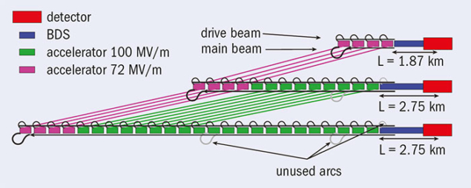
CLIC
A STUDY FOR A NEXT GENERATION HIGGS FACTORY
The Compact Linear Collider is a study for an e+ e- collider at energies from 380 GeV to 1.5 TeV
Main linac designed for compactness: high-gradient solution to reduce number of structures (spoiler: still large but imagine with 5 MV/m LHC cavities!)
Normal conducting X-band (12 GHz) accelerating structures operating at gradients up to 100 MV/m
LCWS 2025
1

Slide 4

CLIC
A STUDY FOR A NEXT GENERATION HIGGS FACTORY
The Compact Linear Collider is a study for an e+ e- collider at energies from 380 GeV to 1.5 TeV
Main linac designed for compactness: high-gradient solution to reduce number of structures (spoiler: still large but imagine with 5 MV/m LHC cavities!)
Normal conducting X-band (12 GHz) accelerating structures operating at gradients up to 100 MV/m
Risky and expensive part of CLIC project
LCWS 2025
1

Slide 5
CLIC
ACCELERATING STRUCTURES REQUIREMENTS
CLIC380
CLIC 1.5TeV
High gradient operation up to 72 MV/m
Active length of acceleration is 5.3 km
Breakdown rate must be limited to
0.01 events/pulse x 5.3×10³ m= 1.8×10⁻⁶ events/pulse
High gradient operation up to 100 MV/m
Active length of acceleration is 30 km
Breakdown rate must be limited to
0.01 events/pulse x 3×10⁴ m= 3×10⁻⁷ events/pulse”
12 GHz operation frequency
Manufacturing at micron-level tolerances to avoid degradation by beam-to-structure misalignment effects
“the conservative estimate is used in the current CLIC design which assumes that kicks due to breakdown will result in a full loss of luminosity of the pulse in which the breakdown occurs. CLIC parameters budget a 1% luminosity loss due to this effect. “
LCWS 2025
2

Slide 6
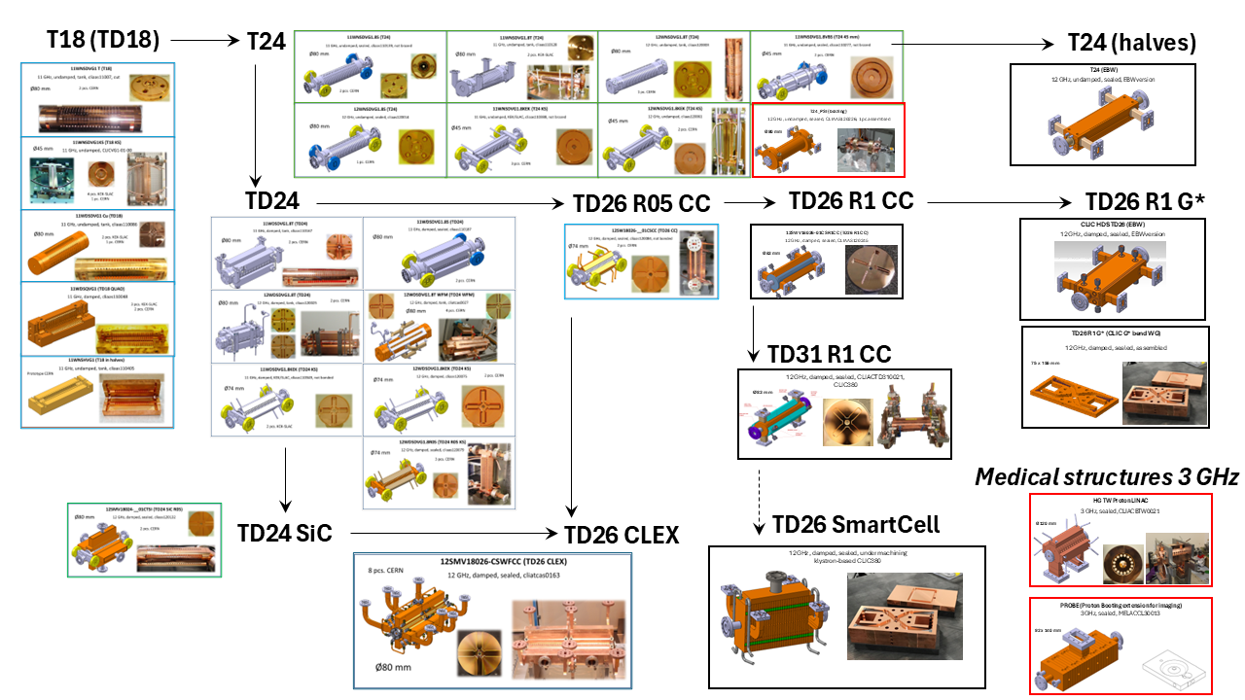
CLIC
17 YEARS OF STRUCTURE PROTOTYPES
LCWS 2025
3

Slide 7
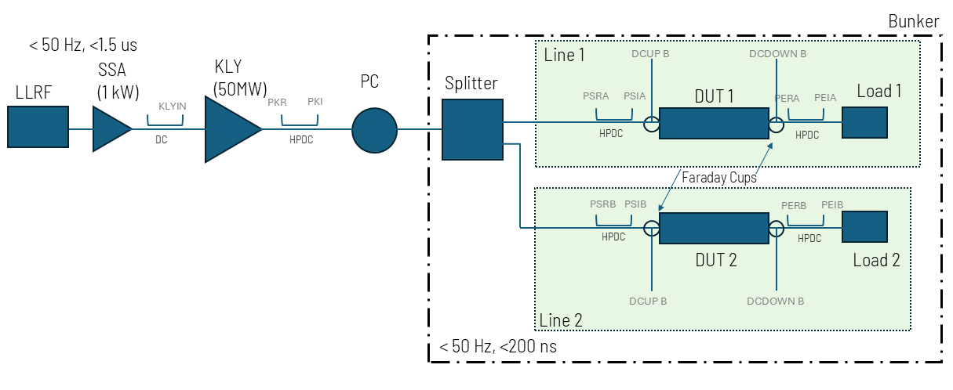
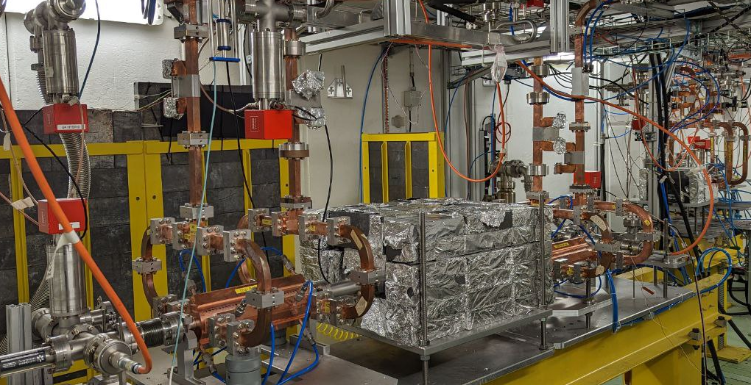
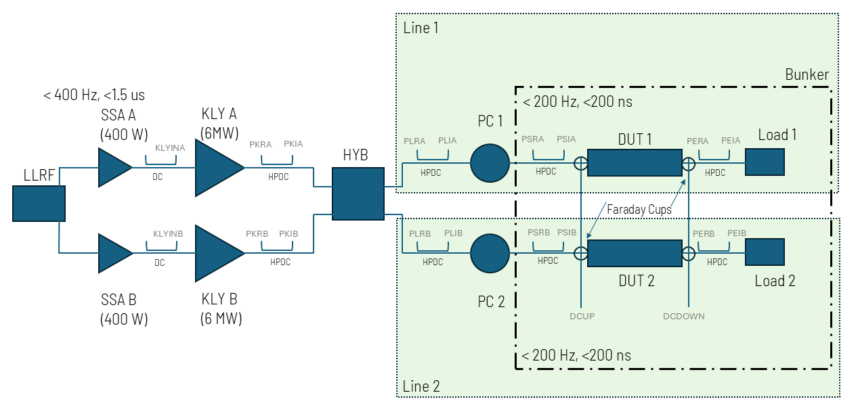
HIGH-POWER TESTS
X-BAND TEST BENCHES
1st test benches to test 12 GHz structures in KEK and SLAC. From 2012, Xboxes at CERN (Xbox1, Xbox2 and Xbox3)
Capabilities for simultaneous testing of up to 7 prototypes
XBOX2
  50 MW, 1.5 us
  150 MW, 250 ns
  50 Hz
XBOX3
  2x 6-10 MW, 5 us
  40-60 MW, 200 ns
  Up to 400 Hz (200 Hz/line)
LCWS 2025
4

Slide 8
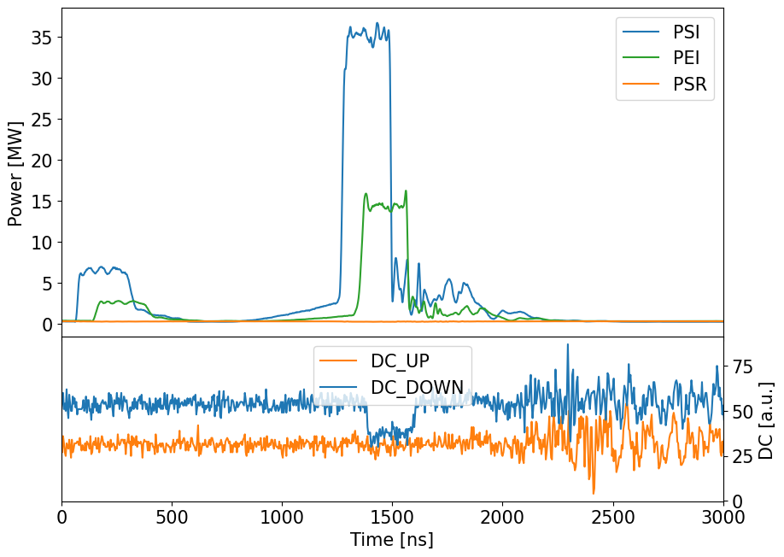
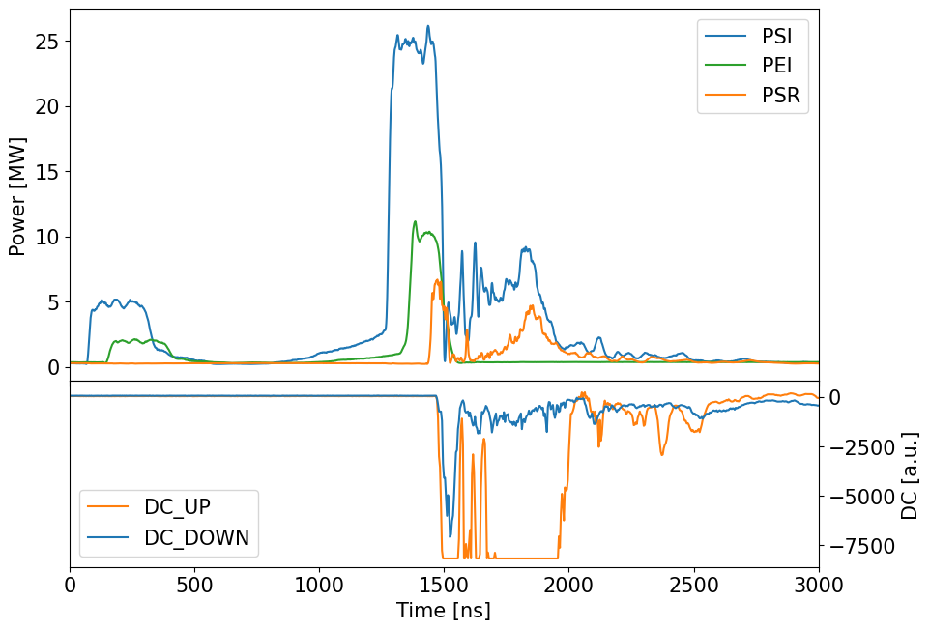
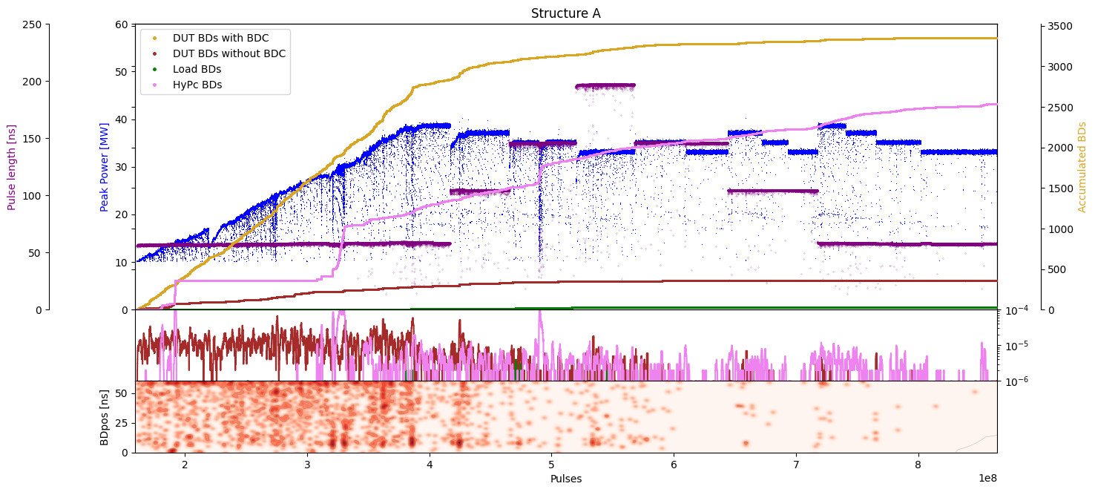
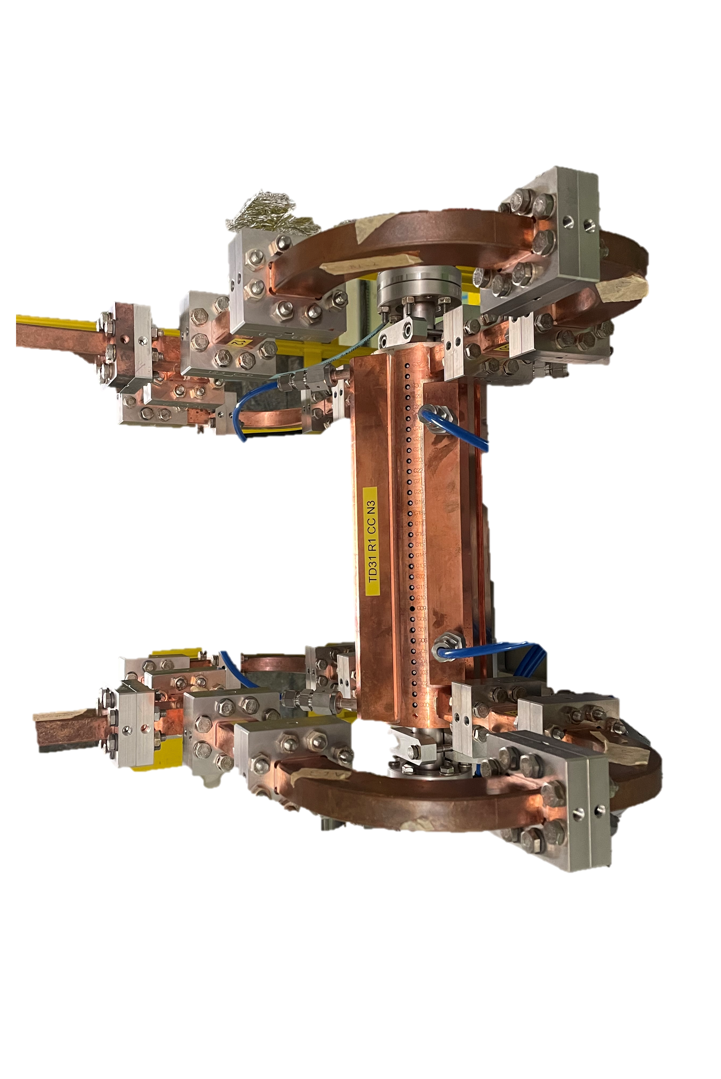
HIGH-POWER TESTS
XBOXES AT CERN
High-power pulsed RF generation + monitoring of relevant signals along the RF distribution line
Dark current signals
Upstream
Downstream
RF signals
Incident
Reflected
Vacuum signals
Flow
Temperature
Conditioning algorithm based on vacuum/ BDR +
Breakdown and field emission studies
LCWS 2025
5

Slide 9
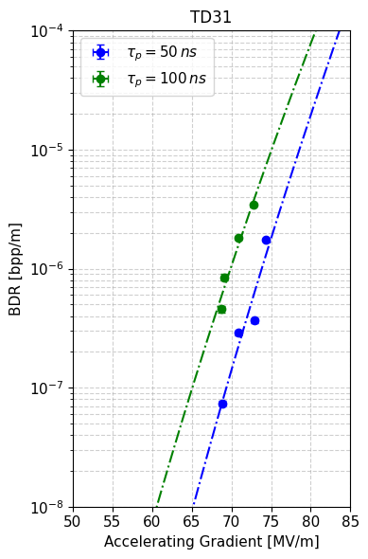
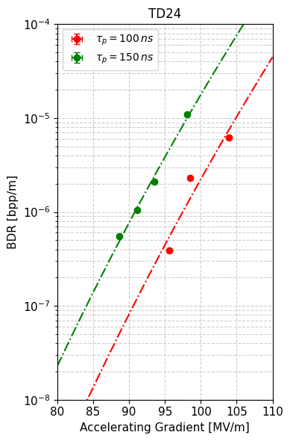
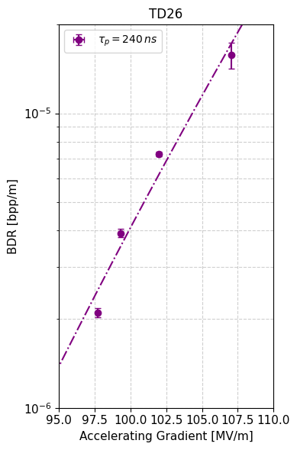

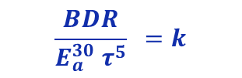
TEST RESULTS
AN EMPIRICAL LAW TO COMPARE PERFORMANCE
Different test conditions limit our capability to compare prototype performance (pulse width, available power…)
Measuring BDRs of 10⁻⁷ bpp would take months!
An empirical law (2006) has been observed among the different structures:
BDR$\sim E_{a}^{30}$
$$\frac{BDR}{E_{a}^{30} τ^{5}} =k$$
LCWS 2025
6

Slide 10
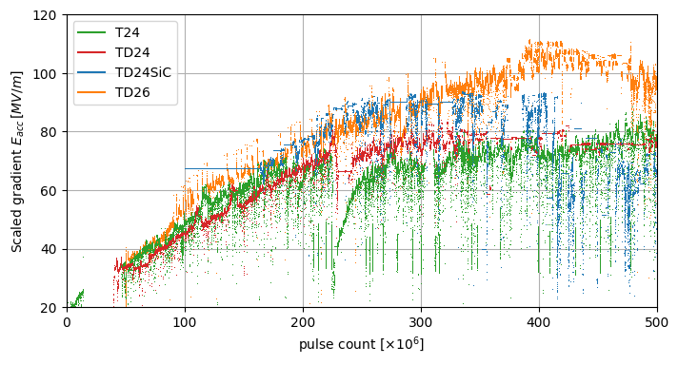
TEST RESULTS
SCALED GRADIENT
Prototypes tested at different test stands are compared on the same basis by using the scaling law
Scaled accelerating gradient is calculated in relation to the CLIC380 reference values of BDR and pulse length (1.8×10⁻⁶ bpp, 180 ns)
LCWS 2025
7

Slide 11
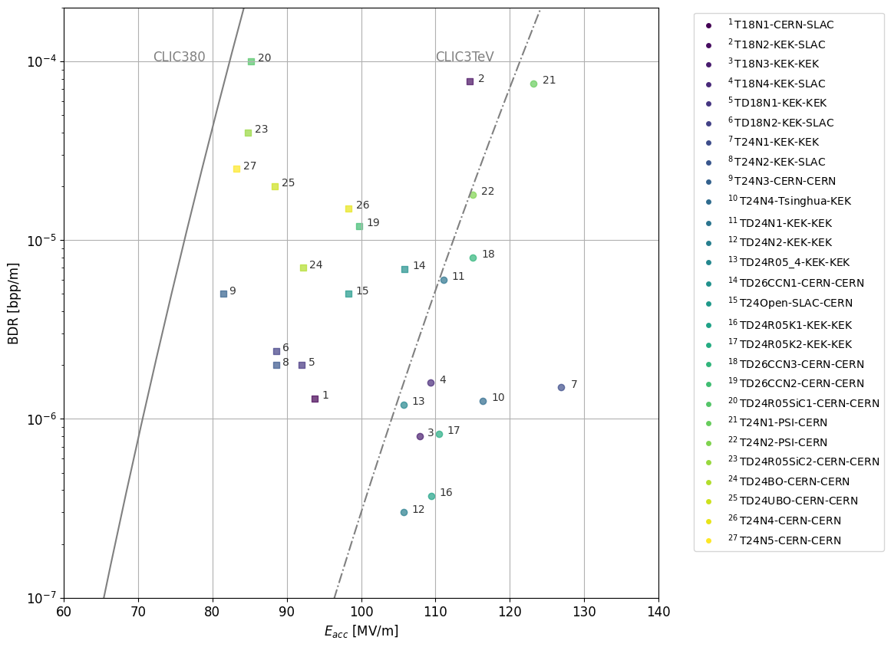
TEST RESULTS
FINAL PERFORMANCE
Around 30 prototypes tested. Most reached >80 MV/m at CLIC380 BDR specification
Some prototypes surpass 110 MV/m and 120 MV/m, confirming potential of X-band
Variability among prototypes with same design highlights the impact of manufacturing
CLIC380
CLIC 3TeV
P. Alonso-Arias et al. High Gradient RF Testing of X-band structures. A comprehensive review (in prep.)
LCWS 2025
8

Slide 12
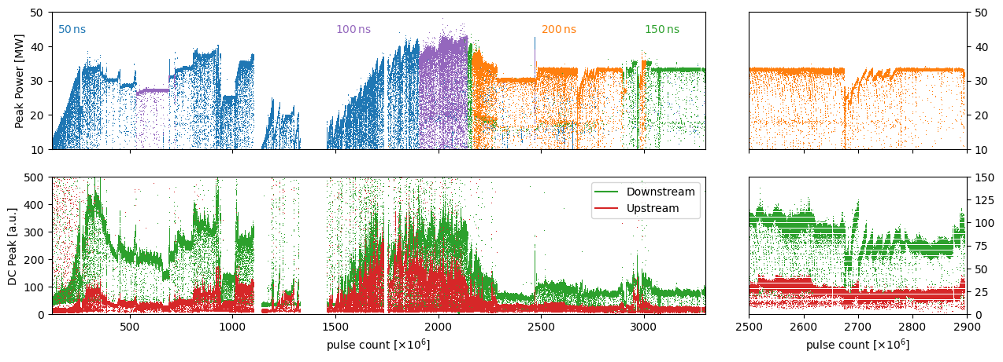
TEST RESULTS
CONDITIONING, DARK CURRENT & FIELD EMISSION
Observations during conditioning
DC is high during the initial pulses, with occasional stochastic jumps after BDs
Decrease of DC after conditioning
LCWS 2025
9

Slide 13
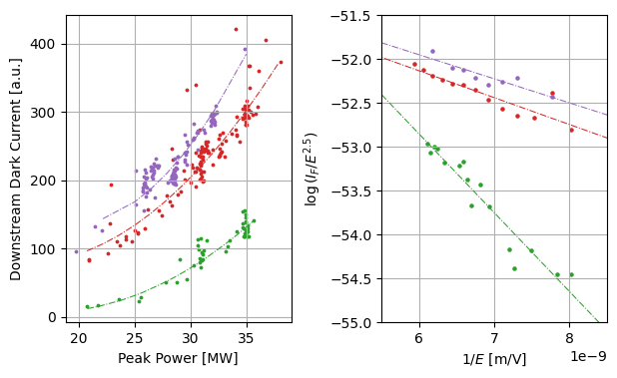

TEST RESULTS
CONDITIONING, DARK CURRENT & FIELD EMISSION
Field emitted electrons produce dark current (DC) following the Fowler-Nordheim law:
Conditioning progress
$$J=aβ^{2}E^{2}e^{\begin{aligned}−b \\ βE\end{aligned}}$$
Short power scans used to see progress and emission reduction during conditioning
Observations across tested prototypes: a progressive reduction in the field enhancement factor β
LCWS 2025
10

Slide 14
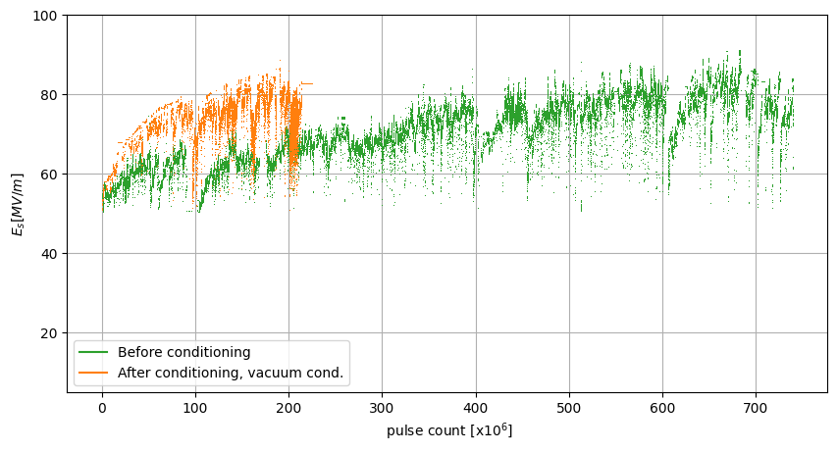
LESSONS LEARNED
OPERATIONAL ASPECTS: CONDITIONING PROGRAMMES
Thousands of structures to condition -> time consuming
Observations. Air vented structures have been found to condition faster if they had previously been conditioned at the required gradient
LCWS 2025
11

Slide 15
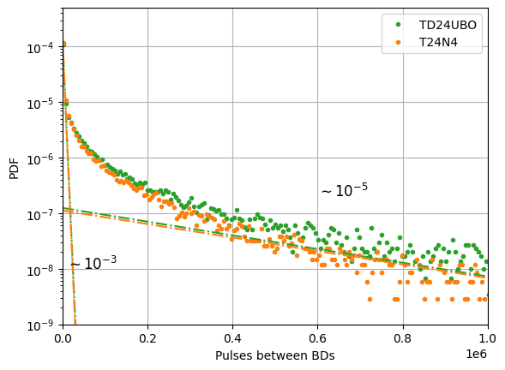
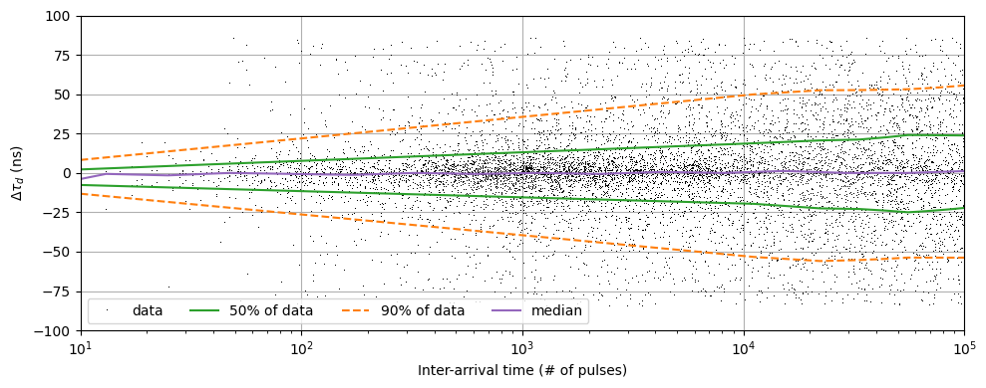
LESSONS LEARNED
OPERATIONAL ASPECTS: BD CLUSTERING
Temporal clustering
Two superimposed exponentials -> two BD processes
Primary BDs set the limit for the structure for achievable gradient
Secondary BDs set a limit for recovery time during operation
Spatial clustering
Clusters of BDs appear in small regions during short periods of time
Residual surface damage, material degradation…
Alter conditioning dynamics
LCWS 2025
12

Slide 16
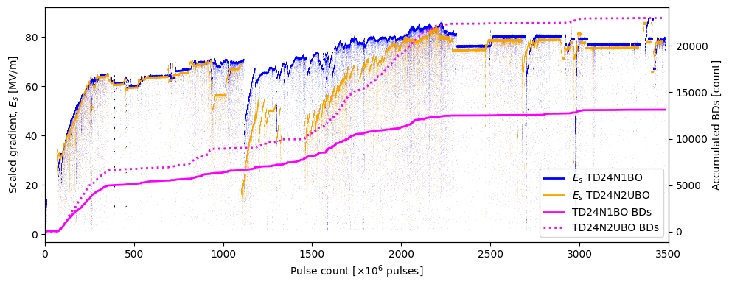
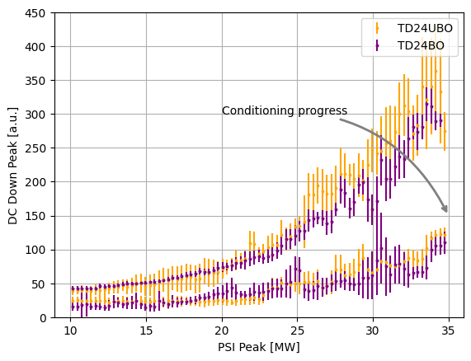
LESSONS LEARNED
FEEDBACK TO MANUFACTURING: BAKE-OUT
For CLIC prototypes, the nominal vacuum baking procedure (introduced by NLC/GLC) involves heating the assembled structure at 650 °C for 1–3 days.
TD24N5 (TD24UBO) assembled and installed without the bake-out, and TD24N4 (TD24BO) for control
Progress and performance is comparable!
Similar levels of dark current measured
LCWS 2025
13

Slide 17
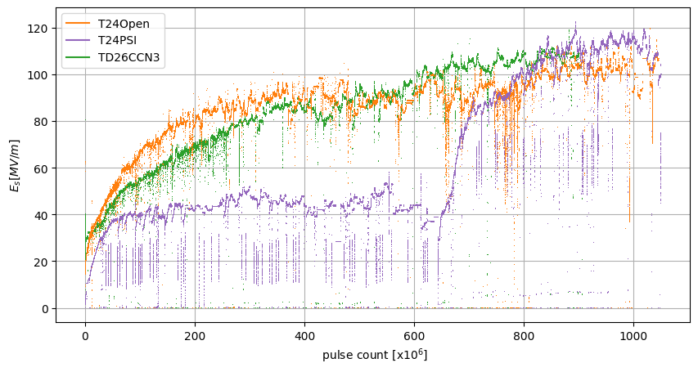
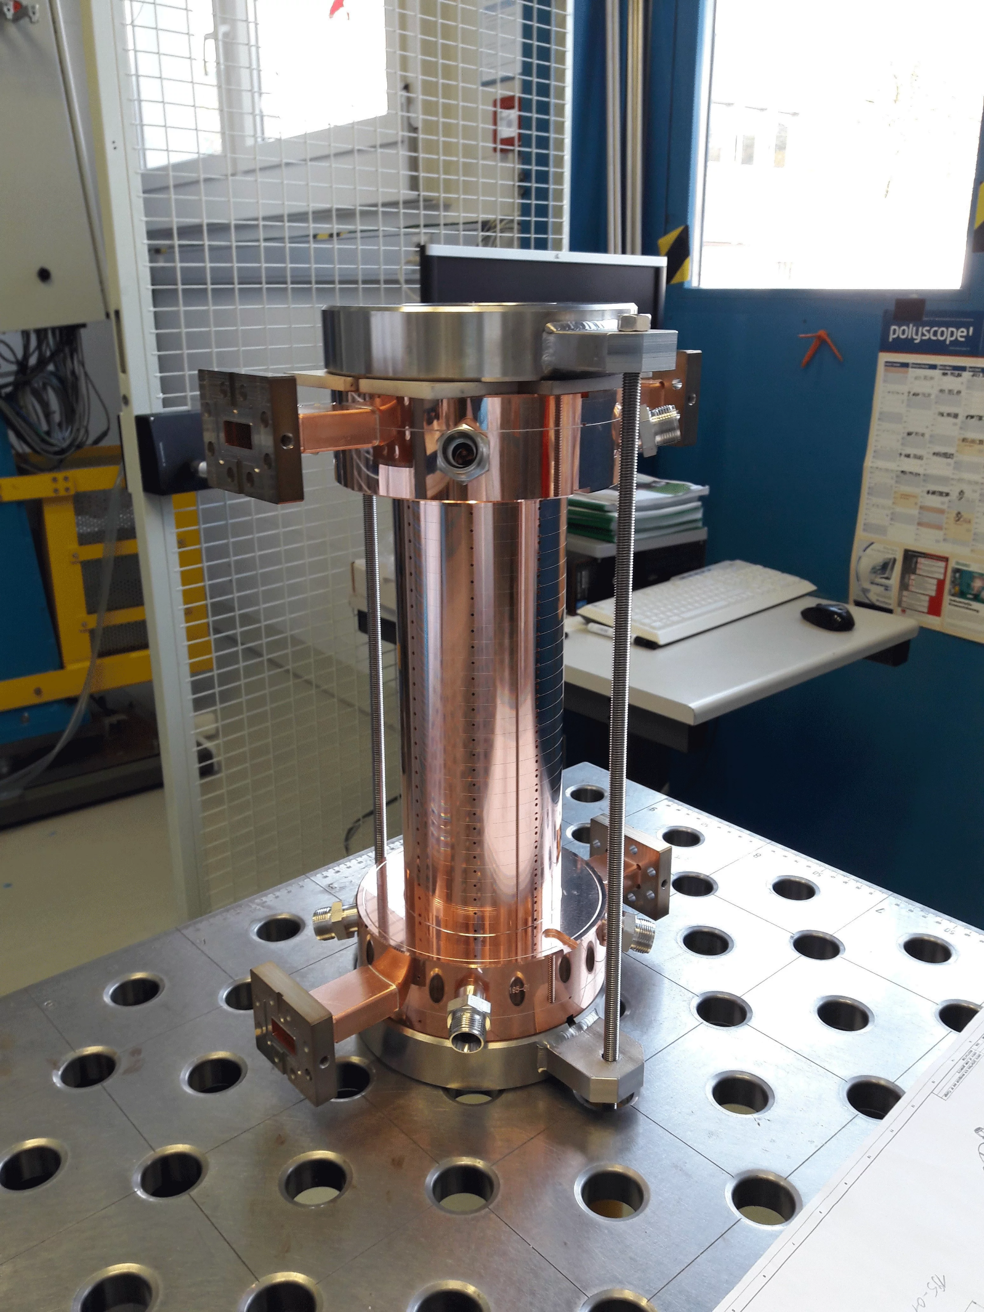
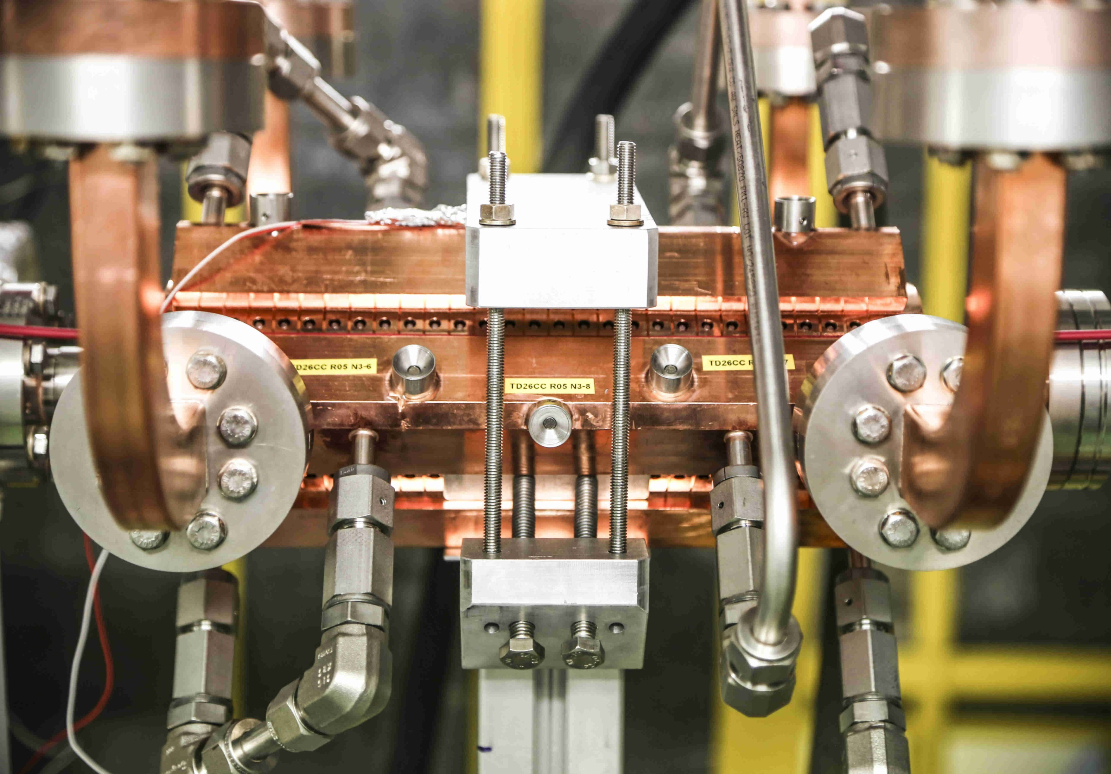
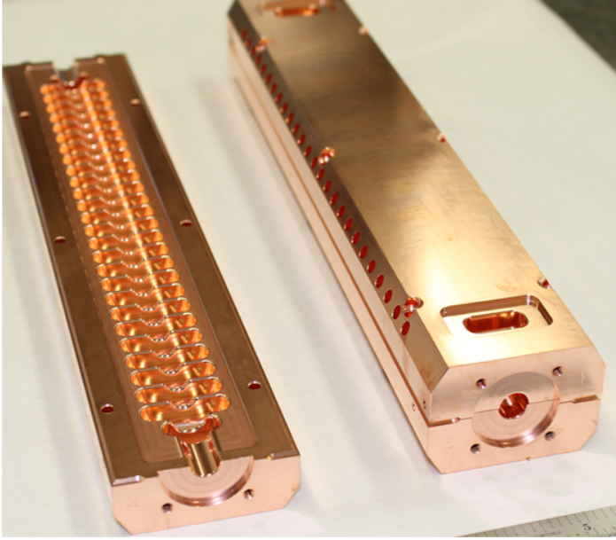
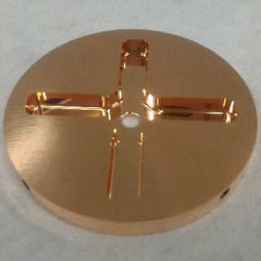
LESSONS LEARNED
FEEDBACK TO MANUFACTURING: JOINING
LCWS 2025
14

Slide 18
CONCLUSIONS
35 X-band structure prototypes + 15 years of high-power testing and studies of breakdown mechanisms and conditioning processes let us:
Optimise RF design parameters
Verify an empirical law expressing the
correlation between Eacc, pulse length, and BDR allowing:
Comparison of prototypes with common reference frame
Analysis of high-gradient performance limits
Get insight into conditioning and the
implications for linac operation
Refine fabrication strategies
LCWS 2025
15

Slide 19
High-Gradient X-Band Structure Prototypes for CLIC: Lessons from a Decade of High-Power Tests
Special thanks to all the people who have contributed with their work and advice during this year, including N. Catalán-Lasheras, A. Baig, M. Boronat, A. Chauchet, S. Curt, A. Grudiev, S. González-Antón, C. Marrelli, P. Martínez-Reviriego, L. Millar, P. Morales Sánchez, D. Soriano, I. Syratchev, M. Volpi, P. Wang, B. Woolley, W. Wuensch…
International Workshop on Future Linear Colliders 2025

Slide 20

XBOXES
BREAKDOWN LOCALISATION
BD time = $\frac{REF_{t}−TRA_{t}−t_{fill}}{2}$
There are other methods to localise BD (e.g. using phase) not being used at the moment
LCWS 2025

Slide 21
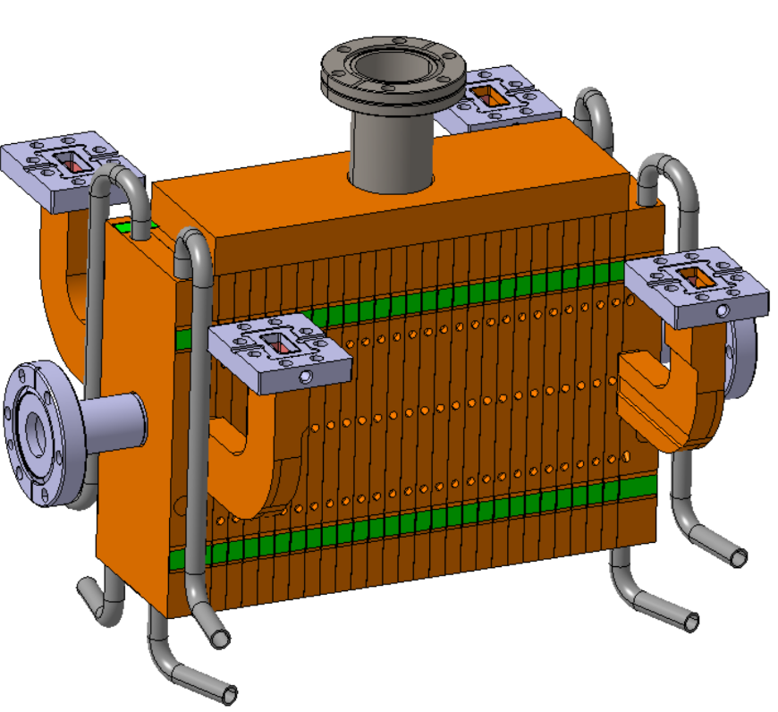
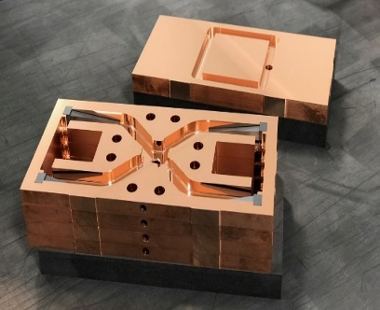
CLIC
CLICK: SMARTCELL PROTOTYPE
Redesigned to evolve from pure bonding to bonding+brazing and reducing steps
The new design integrates the RF area, HOM loads, the cooling circuits, and part of the vacuum system in one part
Disk in production, will be assembled this year 2025
More info here: P. Morales, Normal Conducting High Gradient prototype manufacturing
LCWS 2025

Slide 22
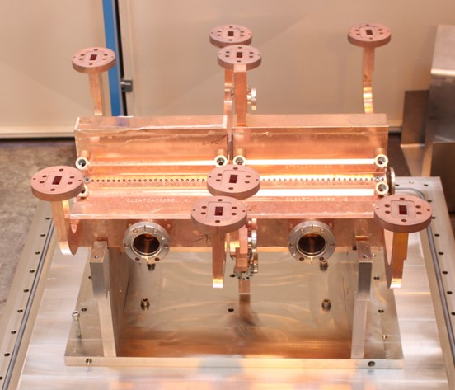
CLIC
CLICK: SMARTCELL PROTOTYPE
Redesigned to evolve from pure bonding to bonding+brazing and reducing steps
More info here: P. Morales, Normal Conducting High Gradient prototype manufacturing
LCWS 2025

Slide 23
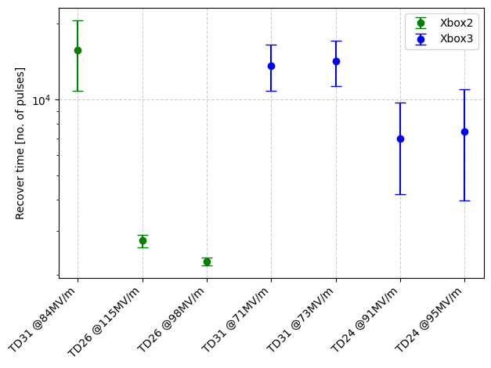
LESSONS LEARNED
OPERATIONAL ASPECTS: RECOVER AFTER BD
LCWS 2025

