Slide 1

Precision Multipole Control in RF Cavities for Advanced Beam Manipulation
Laurence Wroe
laurence.wroe@cern.ch

Slide 2
Contents
High-level motivation
Pillbox with beampipe equations
Overview of the Azimuthal Modulation Method
Applications (proof of concept)

Slide 3
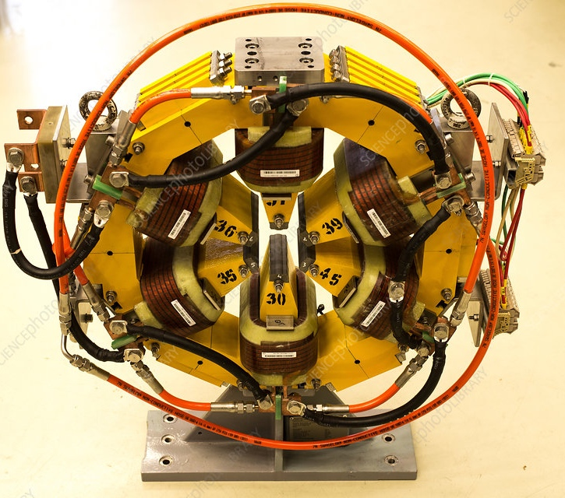
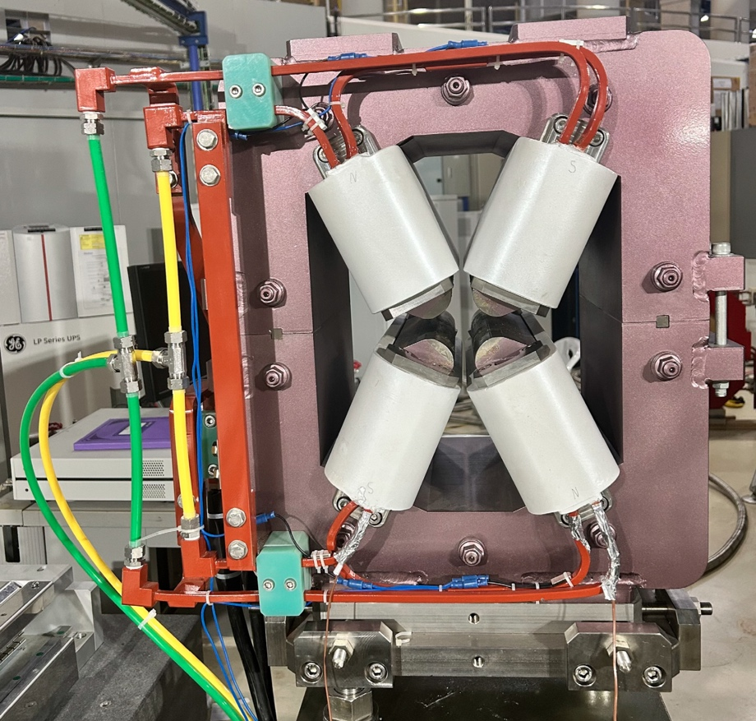
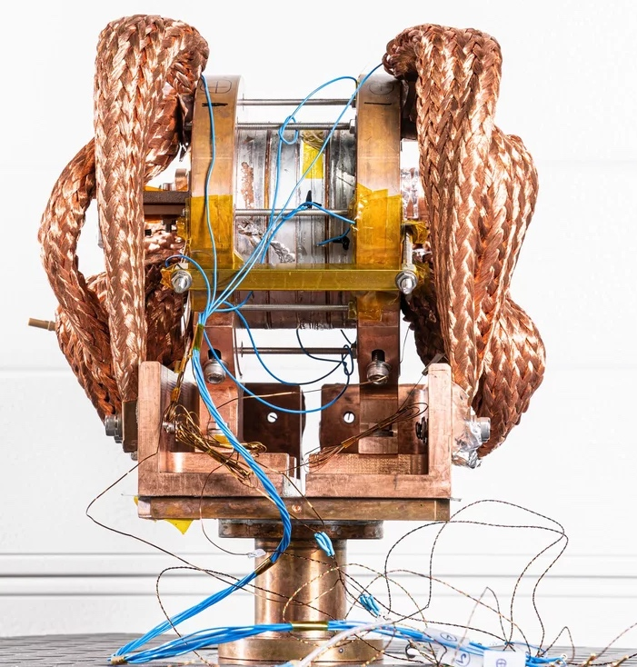

Magnet applications
Magnets are abundant in accelerators for many applications and functions
N-pole magnets
Sesame sextupole
Combined function
magnets
SPS-II Quad-Sext
Solenoid magnets
PSI superconducting solenoid
It is important we understand them!
Textbook

Slide 4
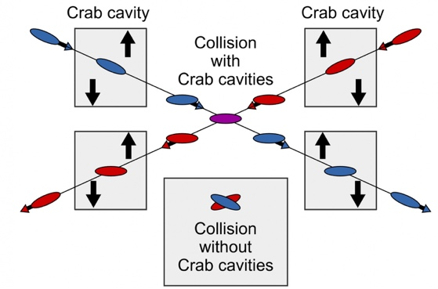
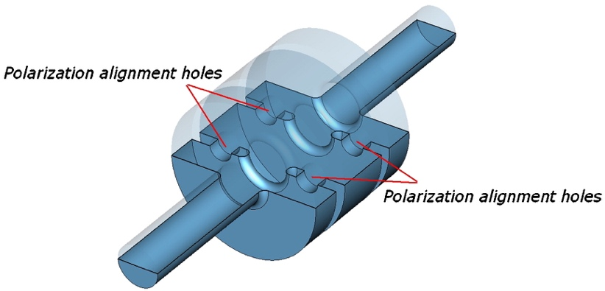
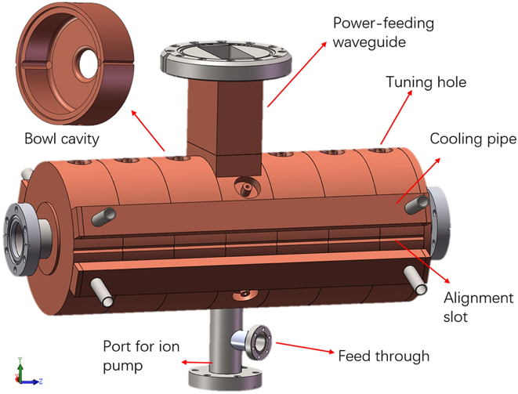
RF cavities can function as magnets
Comparatively weaker force but:
  fast (position-dependent kick within a bunch)
  compact (impart transverse kicks in limited space)
  synchronisable (high-precision with accelerating rf fields)
As such be used for imparting useful transverse kicks:
Crab cavities
Emittance exchange
Deflection cavities

Slide 5
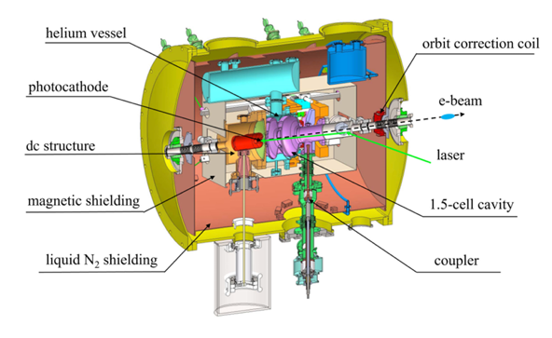
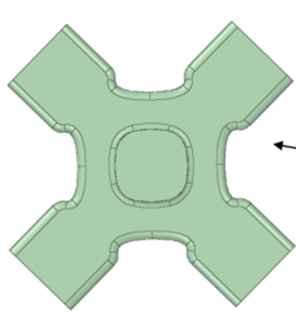
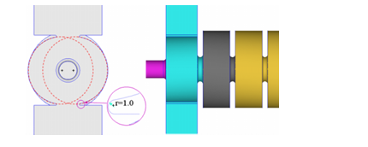

RF cavities can function as magnets
But likewise RF cavities can introduce unwanted kicks
Emittance blow up from dipole (and higher) components
-> Incorporate dual-feed coupler
LCLS injector
Emittance blow up from quadrupole and sextupole aberrations
-> Install corrector coils
DC-SRF-II photogun
Loss of uniformity from octupole and hexadecupole components
-> Shape the iris
DEFT linac

Slide 6
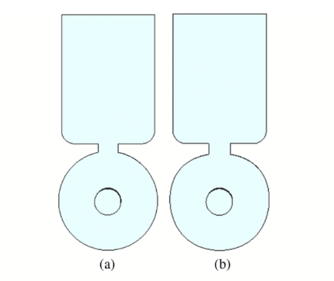
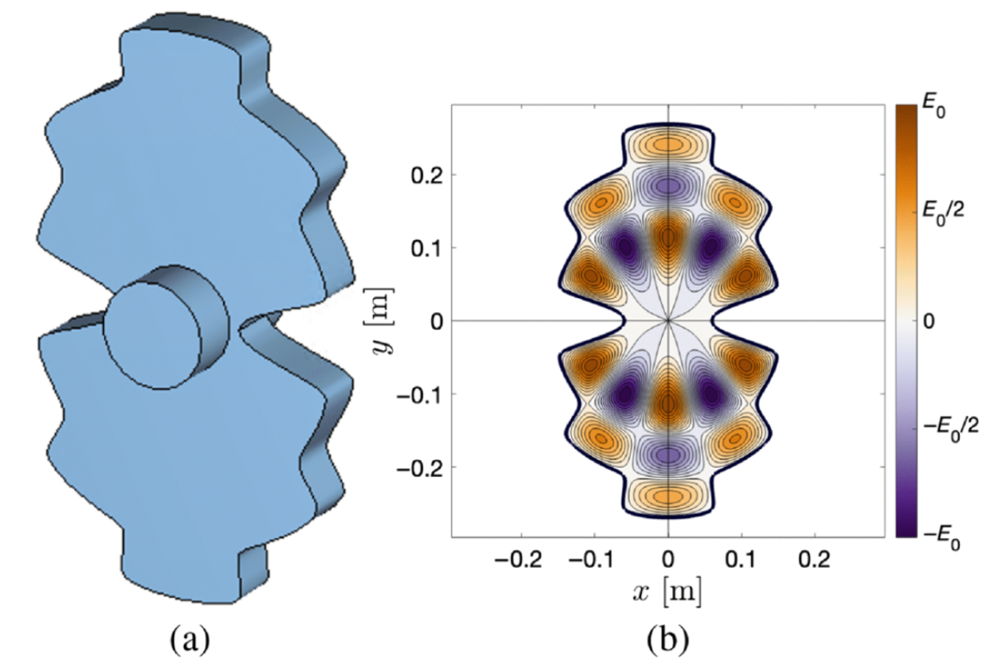
Questions to answer:
Is there a framework for precision control of multipoles in rf cavities?
Remove unwanted multipoles to mitigate the unwanted effects?
Create ‘combined function’ rf cavities?

Slide 7
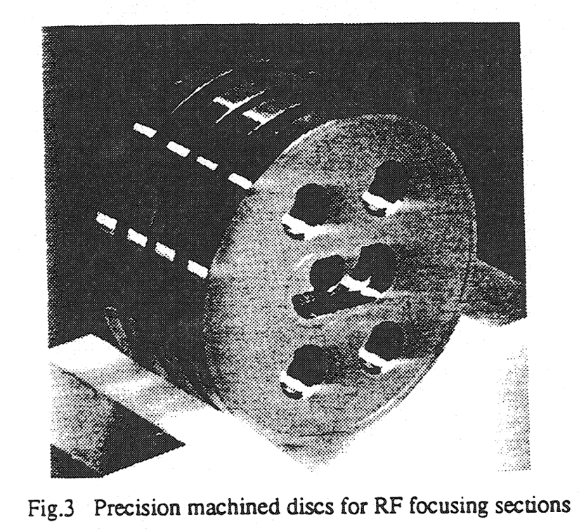
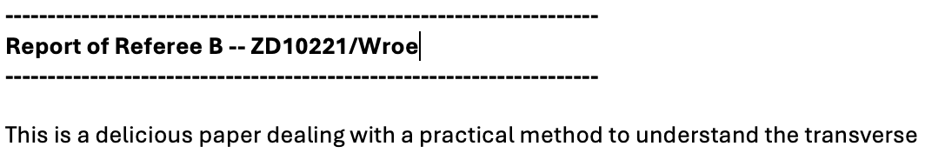
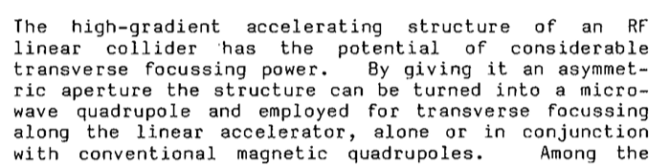
Resources that this presentation is based on
Papers
  Exploration of application and limitations (2022) link
  Including beam pipes and applications (2025) link
Talks
  Similar to this talk but more time & detail (2025) link
PhD thesis
  For the brave… (2023) link
Upcoming work
  Oliver Betteridge (Lancaster) extending the work to TE modes
Other significant works
  CLIC-Note-34 link, CLIC-Note-62 link, CLIC publication link
  Numerical computation of high-order transfer maps for rf cavities link

Slide 8
Contents
High-level motivation
Pillbox with beampipe equations
Overview of the Azimuthal Modulation Method
Applications (proof of concept)

Slide 9
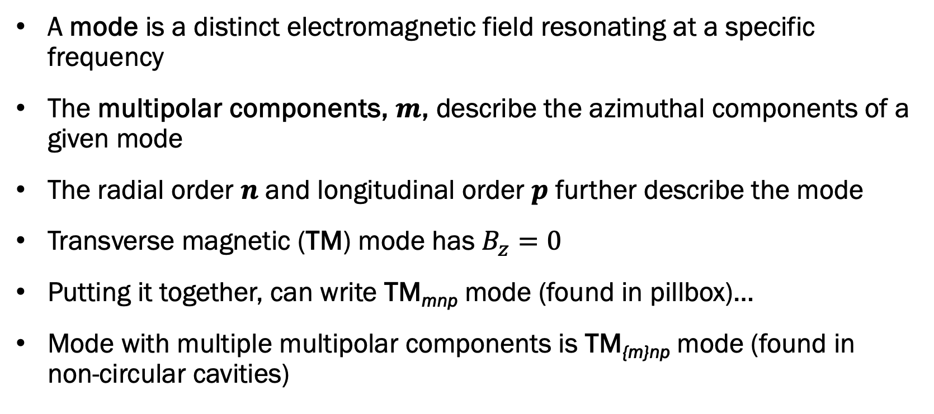
Definitions
A mode is a distinct electromagnetic field resonating at a specific frequency
The multipolar components, $m$, describe the azimuthal components of a given mode
The radial order $n$ and longitudinal order $p$ further describe the mode
Transverse magnetic (TM) mode has $B_{z}=0$
Putting it together, can write TM_{mnp} mode (found in pillbox)…
Mode with multiple multipolar components is TM_{{m}np} mode (found in non-circular cavities)

Slide 10
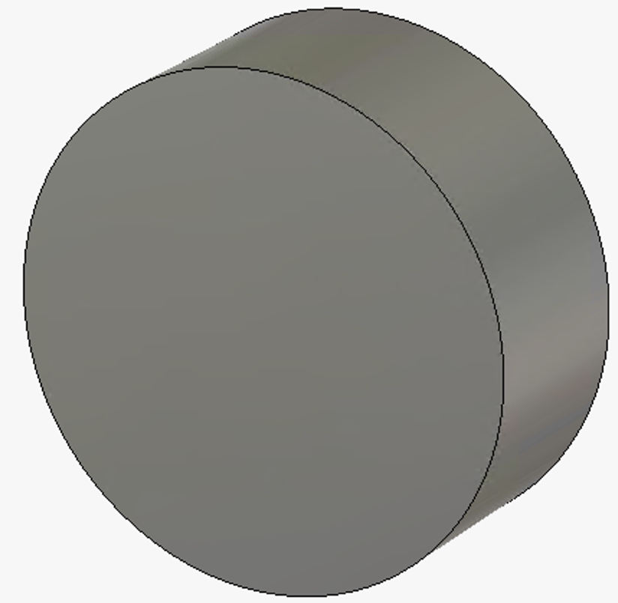
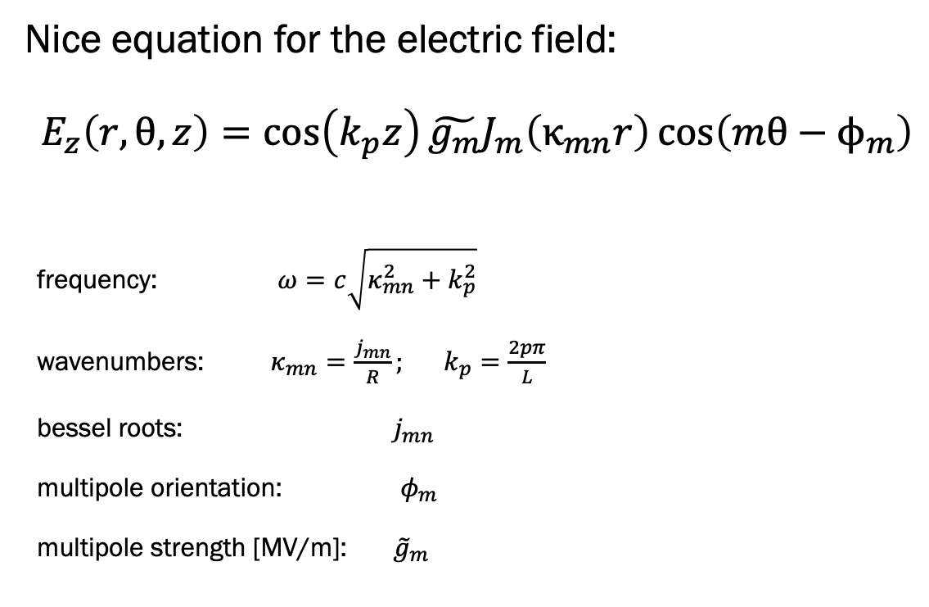
Pillbox – Longitudinal Electric Field
Nice equation for the electric field:
$$E_{z}\left(r,θ,z\right)=\cos\left(k_{p}z\right)\tilde{g_{m}}J_{m}\left(κ_{mn}r\right)\cos\left(mθ−ϕ_{m}\right)$$
frequency: $ω=c\sqrt{κ_{mn}^{2}+k_{p}^{2}}$
wavenumbers: $κ_{mn}=\frac{j_{mn}}{R}; k_{p}=\frac{2pπ}{L}$
bessel roots: $j_{mn}$
multipole orientation: $φ_{m}$
multipole strength [MV/m]: ${\tilde{g}}_{m}$
L
R

Slide 11
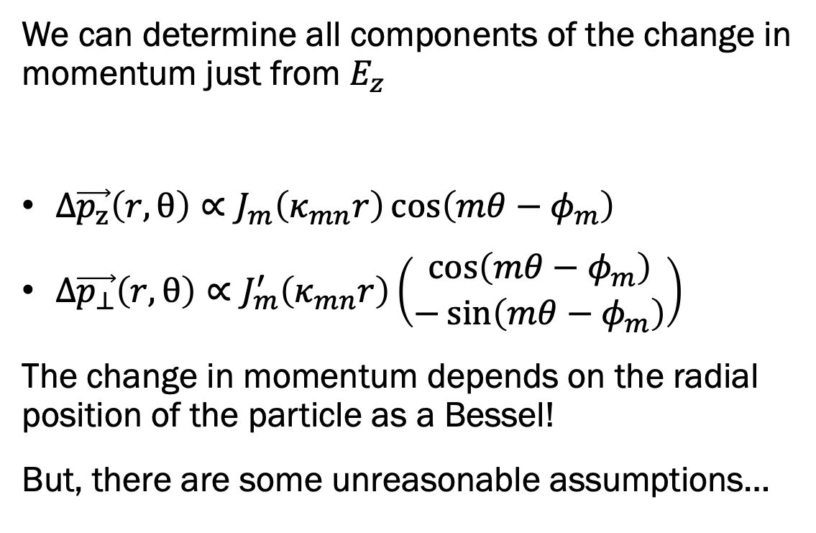
Pillbox – Change in Momentum
We can determine all components of the change in momentum just from $E_{z}$
  $Δ\vec{p_{z}}\left(r,θ\right)∝J_{m}\left(κ_{mn}r\right)\cos\left(mθ−φ_{m}\right)$
  $Δ\vec{p_{⊥}}\left(r,θ\right)∝J_{m}^{′}\left(κ_{mn}r\right)\left(\begin{matrix}\cos\left(mθ−φ_{m}\right) \\ −\sin\left(mθ−φ_{m}\right)\end{matrix}\right)$
The change in momentum depends on the radial position of the particle as a Bessel!
But, there are some unreasonable assumptions…
r
θ
L
R

Slide 12
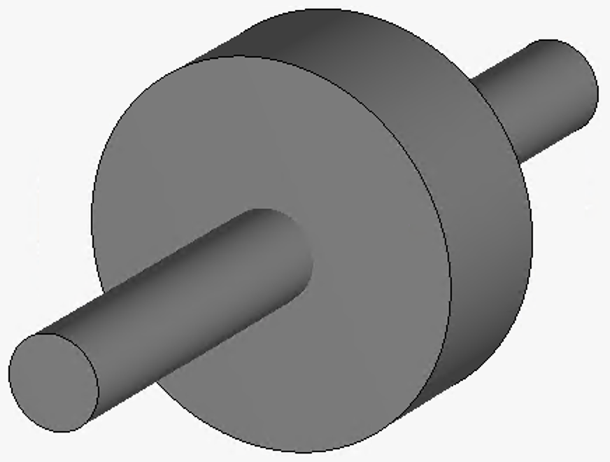
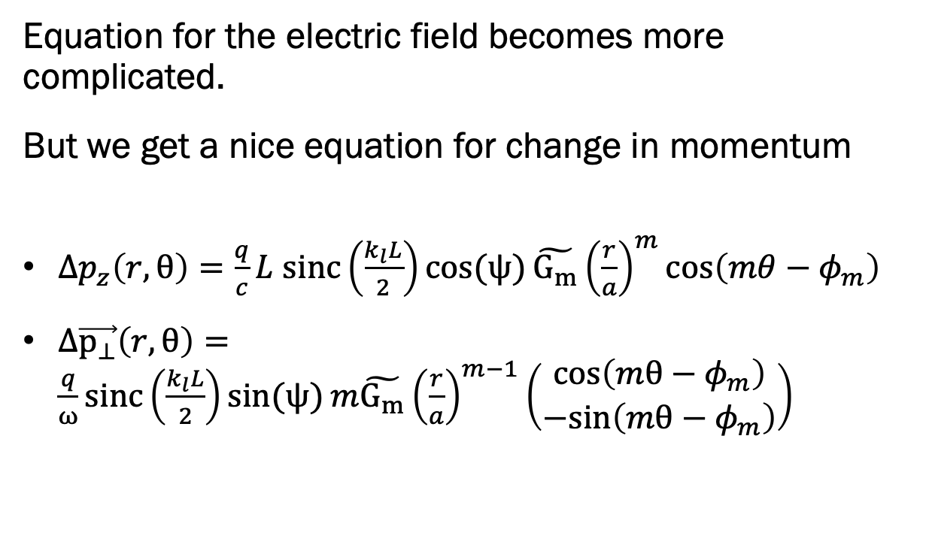

Adding in beam pipes
Equation for the electric field becomes more complicated.
But we get a nice equation for change in momentum
  $Δp_{z}\left(r,θ\right)=\frac{q}{c}L sinc\left(\frac{k_{l}L}{2}\right)\cos{(ψ)}\tilde{G_{m}}{\left(\frac{r}{a}\right)}^{m}\cos\left(mθ−φ_{m}\right)$
  $Δ\vec{p_{⊥}}\left(r,θ\right)=\frac{q}{ω}sinc\left(\frac{k_{l}L}{2}\right)\sin{(ψ)}m\tilde{G_{m}}{\left(\frac{r}{a}\right)}^{m−1}\left(\begin{matrix}\text{cos}\left(mθ−φ_{m}\right) \\ −\text{sin}\left(mθ−φ_{m}\right)\end{matrix}\right)$
L
R
a
*where: $\tilde{G_{m}}=\tilde{g_{m}}\left(k=0\right)J_{m}\left(ka\right)$

Slide 13
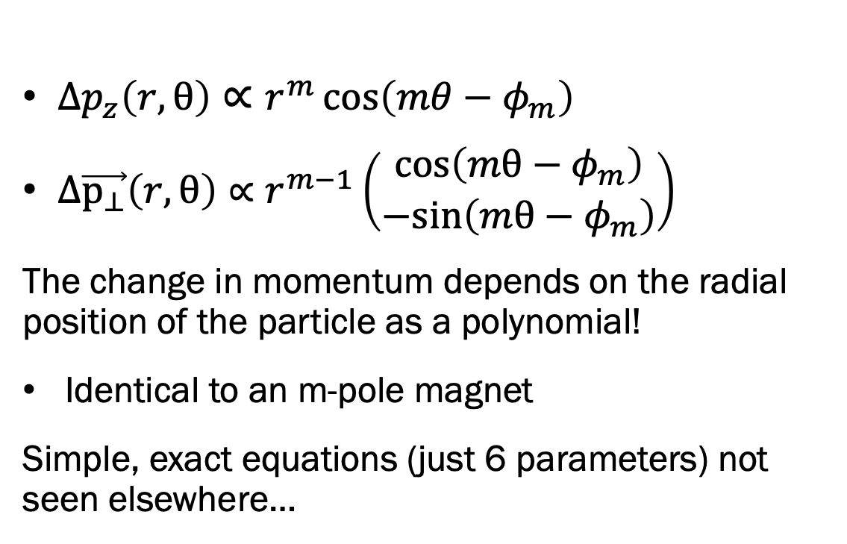
Beam pipe – Change in Momentum
  $Δp_{z}\left(r,θ\right)∝r^{m}\cos\left(mθ−φ_{m}\right)$
  $Δ\vec{p_{⊥}}\left(r,θ\right)∝r^{m−1}\left(\begin{matrix}\text{cos}\left(mθ−φ_{m}\right) \\ −\text{sin}\left(mθ−φ_{m}\right)\end{matrix}\right)$
The change in momentum depends on the radial position of the particle as a polynomial!
Identical to an m-pole magnet
Simple, exact equations (just 6 parameters) not seen elsewhere…
L
R
r
θ
a

Slide 14
Contents
High-level motivation
Pillbox with beampipe equations
Overview of the Azimuthal Modulation Method
Applications (proof of concept)

Slide 15
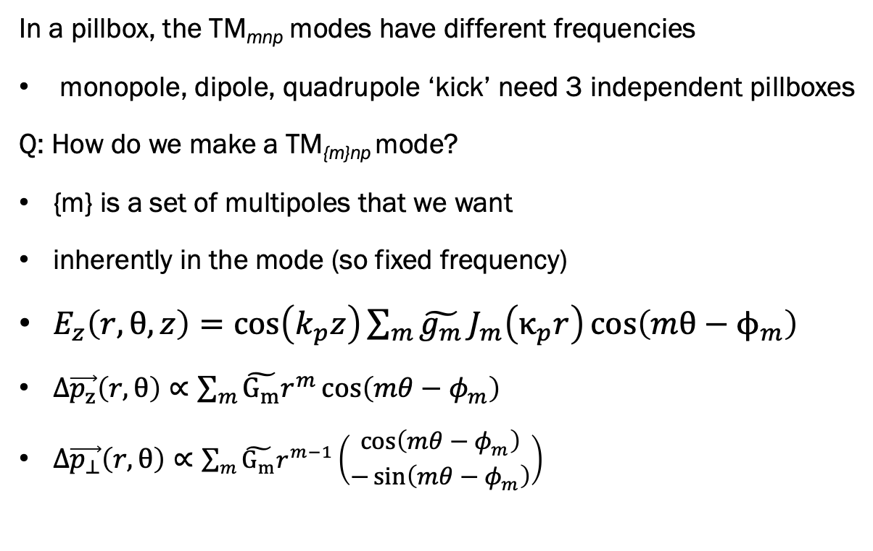
Setting the scene - TM_{{m}np}
TM₀₁₀
TM₁₁₀
TM₂₁₀
In a pillbox, the TM_{mnp} modes have different frequencies
monopole, dipole, quadrupole ‘kick’ need 3 independent pillboxes
Q: How do we make a TM_{{m}np} mode?
  {m} is a set of multipoles that we want
  inherently in the mode (so fixed frequency)
  $E_{z}\left(r,θ,z\right)=\cos\left(k_{p}z\right)\sum_{m}{\tilde{g_{m}}}J_{m}\left(κ_{p}r\right)\cos\left(mθ−ϕ_{m}\right)$
  $Δ\vec{p_{z}}\left(r,θ\right)∝\sum_{m}{\tilde{G_{m}}r^{m}}\cos\left(mθ−φ_{m}\right)$
  $Δ\vec{p_{⊥}}\left(r,θ\right)∝\sum_{m}{\tilde{G_{m}}r^{m−1}}\left(\begin{matrix}\cos\left(mθ−φ_{m}\right) \\ −\sin\left(mθ−φ_{m}\right)\end{matrix}\right)$
TM_{{0,1,2}10}

Slide 16
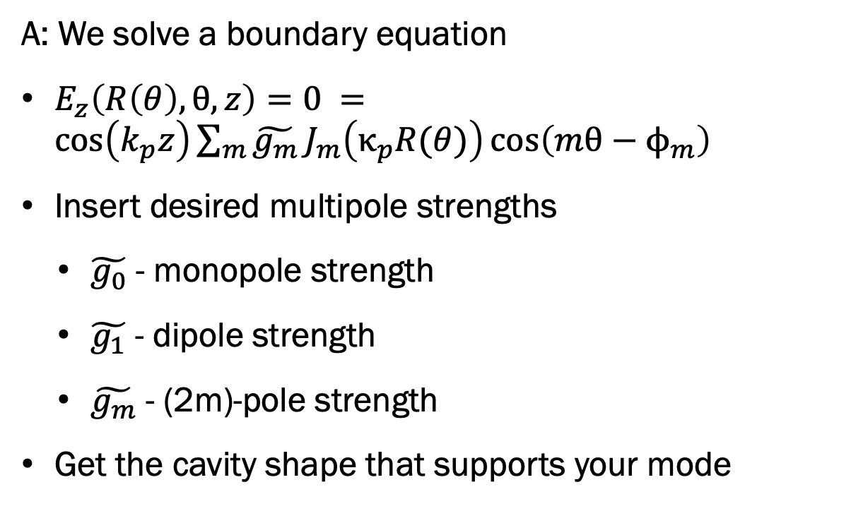
The Azimuthal Modulation Method
A: We solve a boundary equation
  $E_{z}\left(R\left(θ\right),θ,z\right)=0 =\cos\left(k_{p}z\right)\sum_{m}{\tilde{g_{m}}}J_{m}\left(κ_{p}R(θ)\right)\cos\left(mθ−ϕ_{m}\right)$
  Insert desired multipole strengths
    $\tilde{g_{0}}$ - monopole strength
    $\tilde{g_{1}}$ - dipole strength
    $\tilde{g_{m}}$ - (2m)-pole strength
  Get the cavity shape that supports your mode
L
R(θ)

Slide 17
Contents
High-level motivation
Pillbox with beampipe equations
Overview of the Azimuthal Modulation Method
Applications (proof of concept)

Slide 18
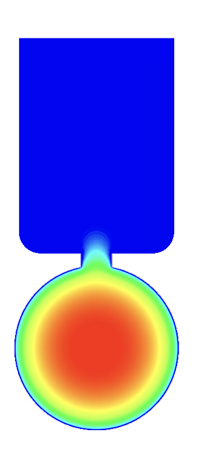
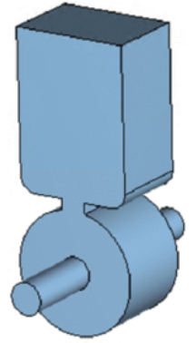
Example 1 -
Remove unwanted multipoles
RF power
Incorporating ancillaries breaks azimuthal symmetry:
  Power couplers, higher order mode extraction channels etc
This breaks the ‘purity’ of the mode – introducing unwanted multipoles
Let’s use the AMM to remove them

Slide 19

Example 1 -
Remove unwanted multipoles
Recipe for compensating slot power coupler:
  Optimise slot width for power transfer
  Solve for mode (e.g. in CST)
  Measure transverse multipole components
  Solve AMM boundary condition eqn (using negative of the measured multipole components)
  Rebuild with solved for shape
  Iterate the above until multipole components are negligible

Slide 20
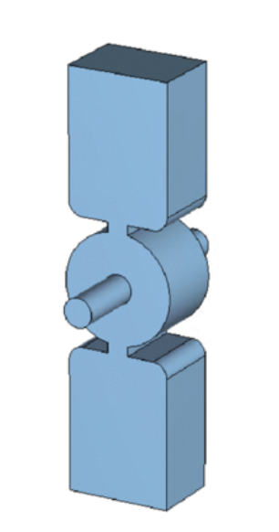
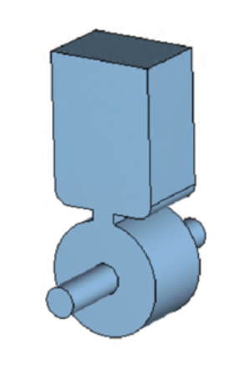
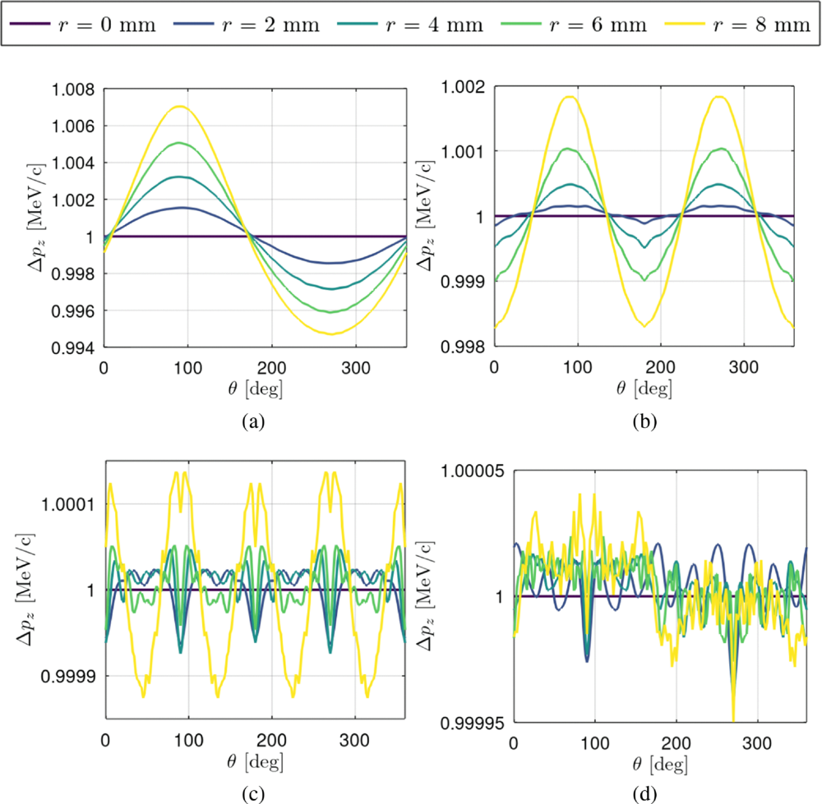

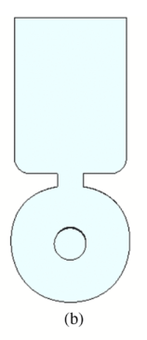
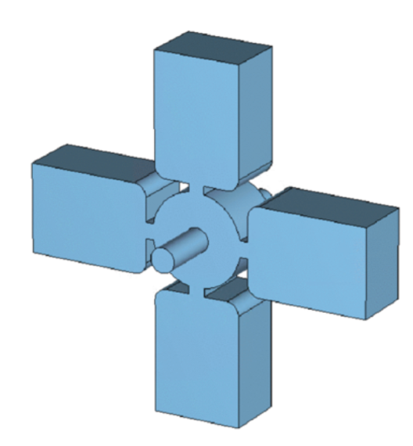
Example 1 -
Remove unwanted multipoles

Slide 21
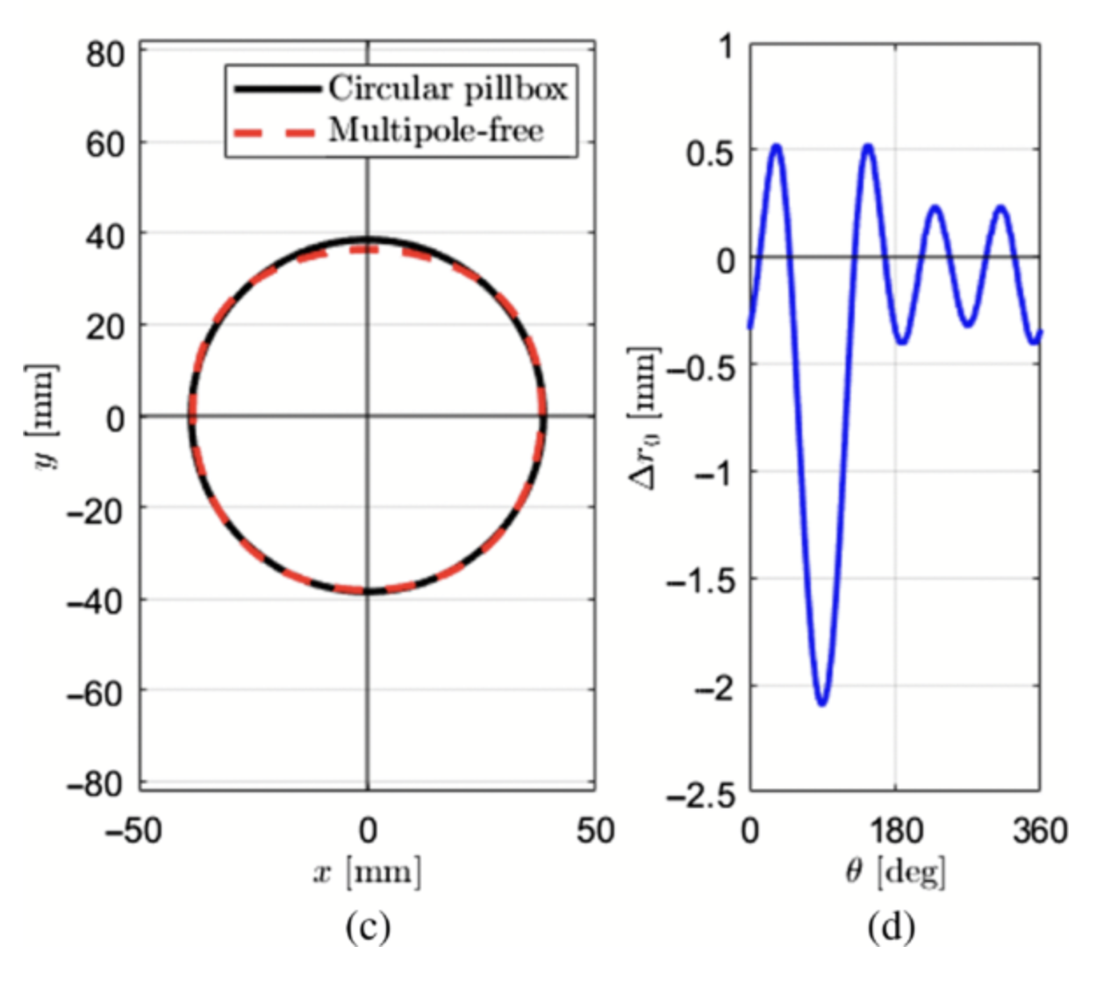
Example 1 -
Remove unwanted multipoles

Slide 22
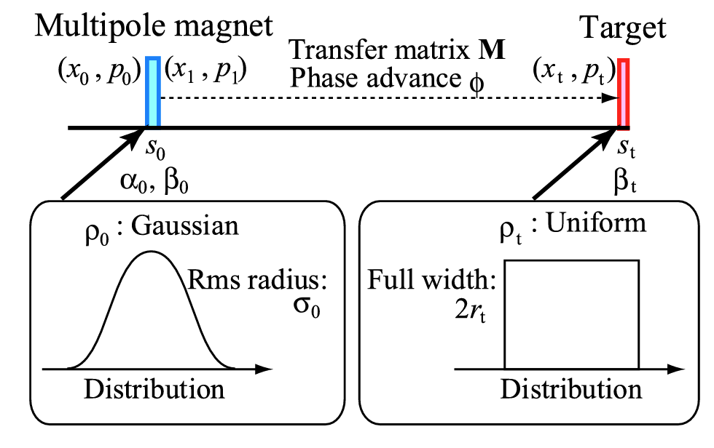
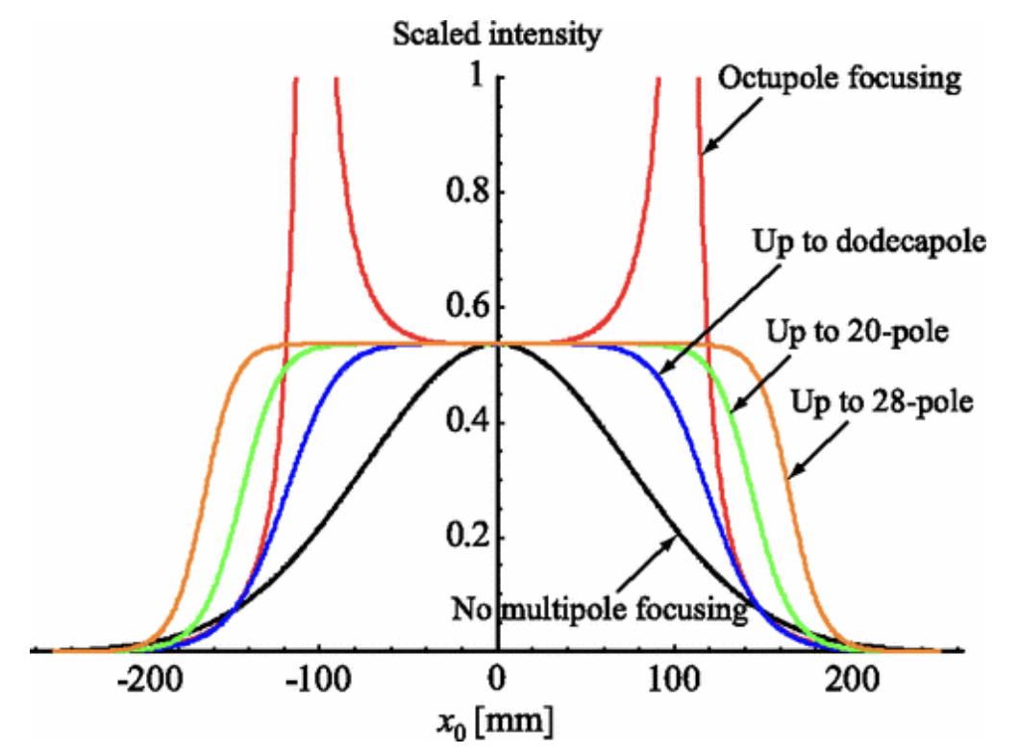
Example 2 -
Create a combined function cavity
Can use a combined function magnet to ‘uniformise’ a beam
Magnet needs:
octupole
dodecupole
hexadecupole (& so on)
components for better uniformisation
This is hard to manufacture, so just use an octupole
doi:10.1103/PhysRevSTAB.10.104001

Slide 23
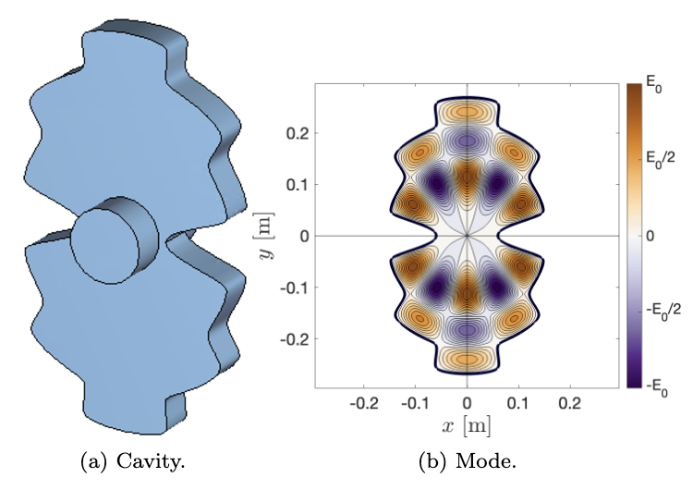
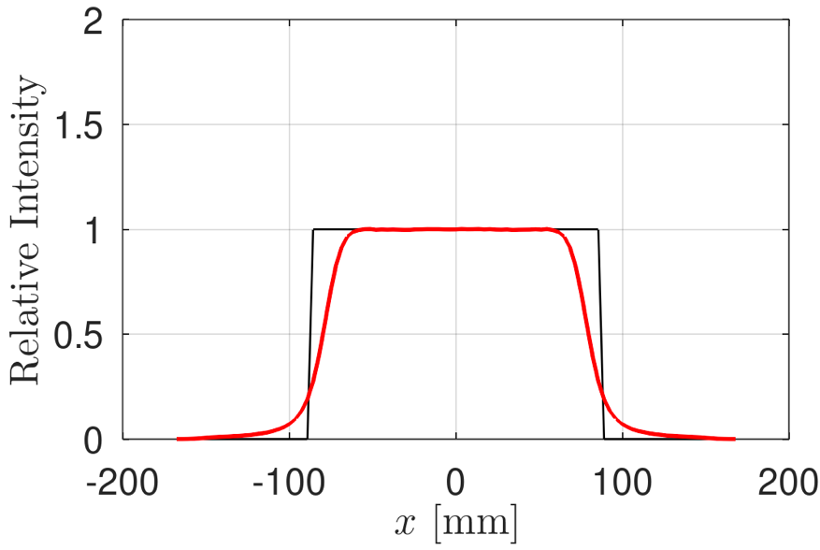
Example 2 -
Create a combined function cavity
AMM gives a method to make an rf cavity with desired magnet kicks!
Creating RF cavity with optimised octupole + dodecupole kick looks like this:
Creates a pretty (> 75%) uniform beam

Slide 24
Conclusion and next steps
Demonstrated:
  Framework for systematic, precision manipulation of multipoles
  Method for removing unwanted multipoles
  Method for creating ‘combined function’ rf cavities
There are many directions for extending this work…
  ‘TDR' for single-slot injector using the method
  ‘CDR’ for combined function application
  Implementation into a beam dynamics / integrated cavity designer
  Investigation of where Panofsky-Wenzel breaksdown (TW coupler)
  Many, many more potential applications (bespoke off-axis field, non-degenerate mode, precise non-linear fields…)

