Slide 1

The new Sherpa 3.0 event generator
Alan Price on behalf of the Sherpa collaboration
International Workshop on Future Linear Colliders, Valencia, October 2025
[JHEP 12 (2024) 156]

Slide 2
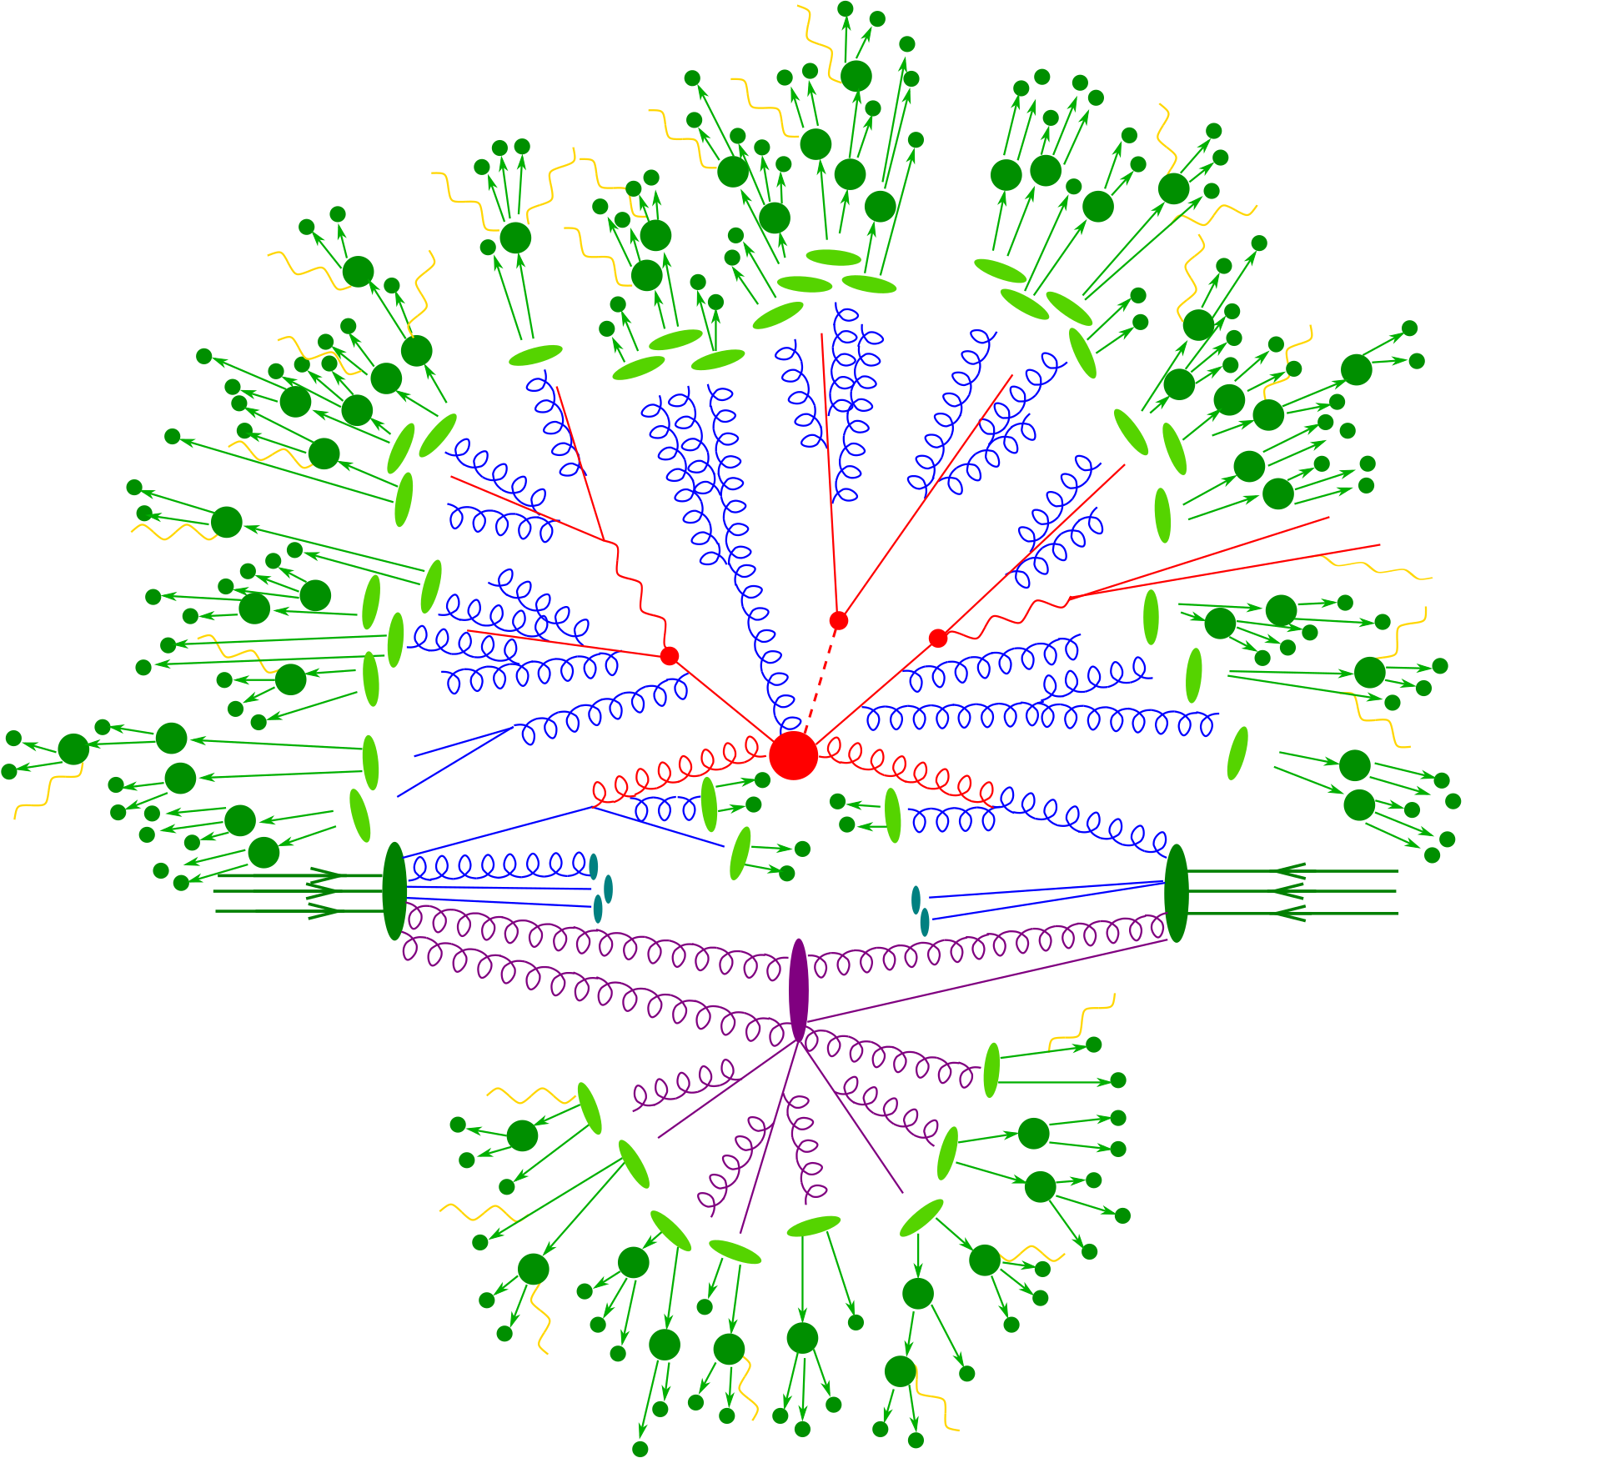
Monte Carlo event generators
Notes:
LHC practitioner’s expertise relevant for LC community!
Interfacing to experiments
Realistic final states
Hadronisation
CPU

Slide 3
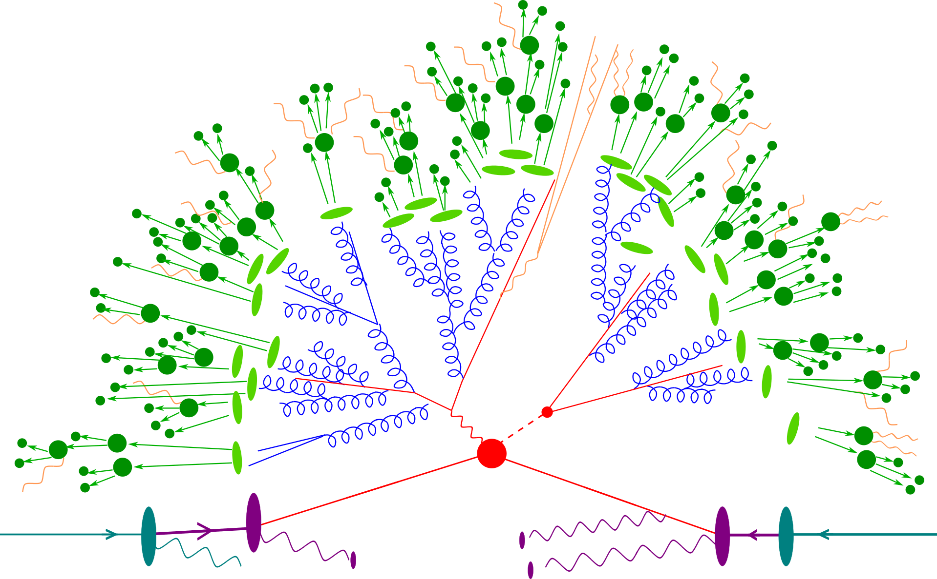
Monte Carlo event generators for LC

Slide 4
Monte Carlo event generators for LC
Beam spectra
Hadronisation & Hadron Decays
QED FSR
QCD FSR
Hard Scattering
ePDFs & ISR

Slide 5
Good things come to those who wait
Condensing the work of the last >5 years
new physics features
more intuitive user interface
more efficient CPU footprint
modern build system
comprehensive validation suite
3.0.0^{(*)}
Notes:
TODO: more sales advertisement style

Slide 6
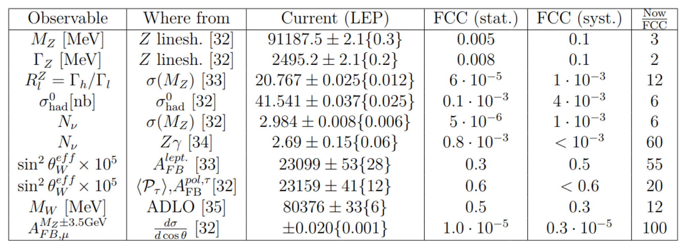
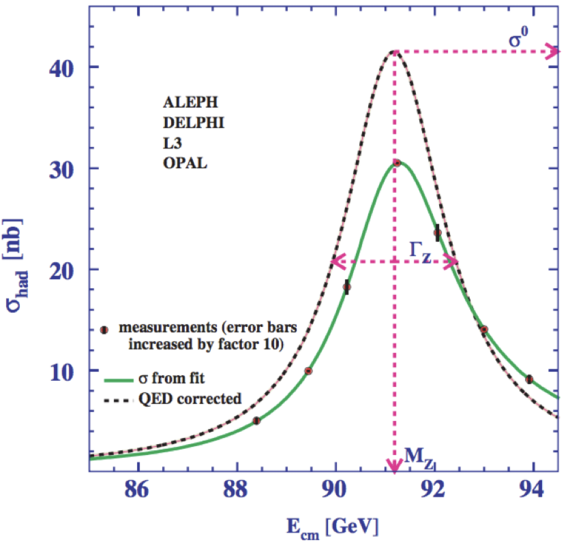
The Need For QED
Factor 2-100 improvement in the measurement of EWPOs
0.1% errors which could be ignored at LEP will dominate at future e⁺e⁻ machines
On the theoretical side this translates into a much more sophisticated modelling
Fixed Order improvements
Resummation techniques for both QCD/QED
Theoretical uncertainties need to be comparable (or lower!) than the experimental
[Jadach,Skrzypek, Eur. Phys. J. C79(2019)]

Slide 7
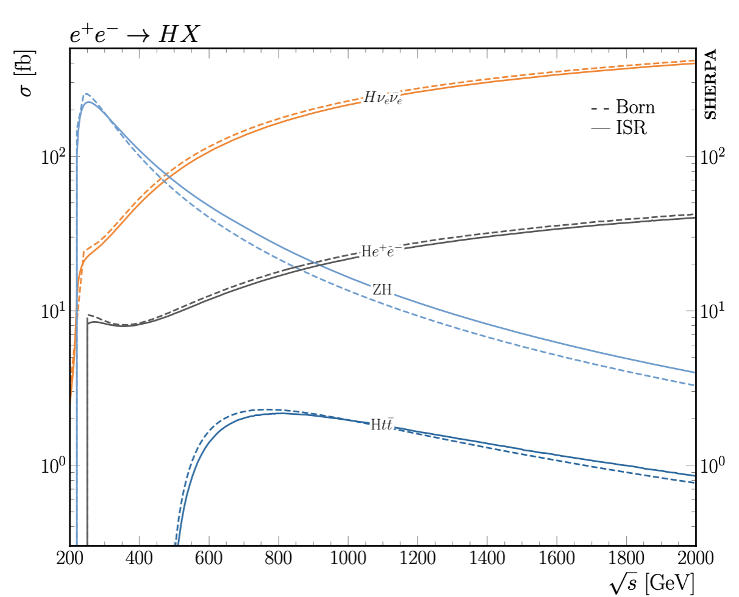
QED in the initial state
New in Sherpa 3.0: Real photon emissions in the initial state! [Krauss, Schönherr, Price 2022]
Extension of Sherpa YFS module for soft photon resummation in final state [Krauss, Schönherr 2008]
Supplemented with collinear logs up to O(𝛼³L³)
Complete treatment of muti-photon kinematics: Explicit photons, no simplified electron PDF
Matching to full NLO EW complete [Krauss,Price tbp]
NNLO Matching underway

Slide 8
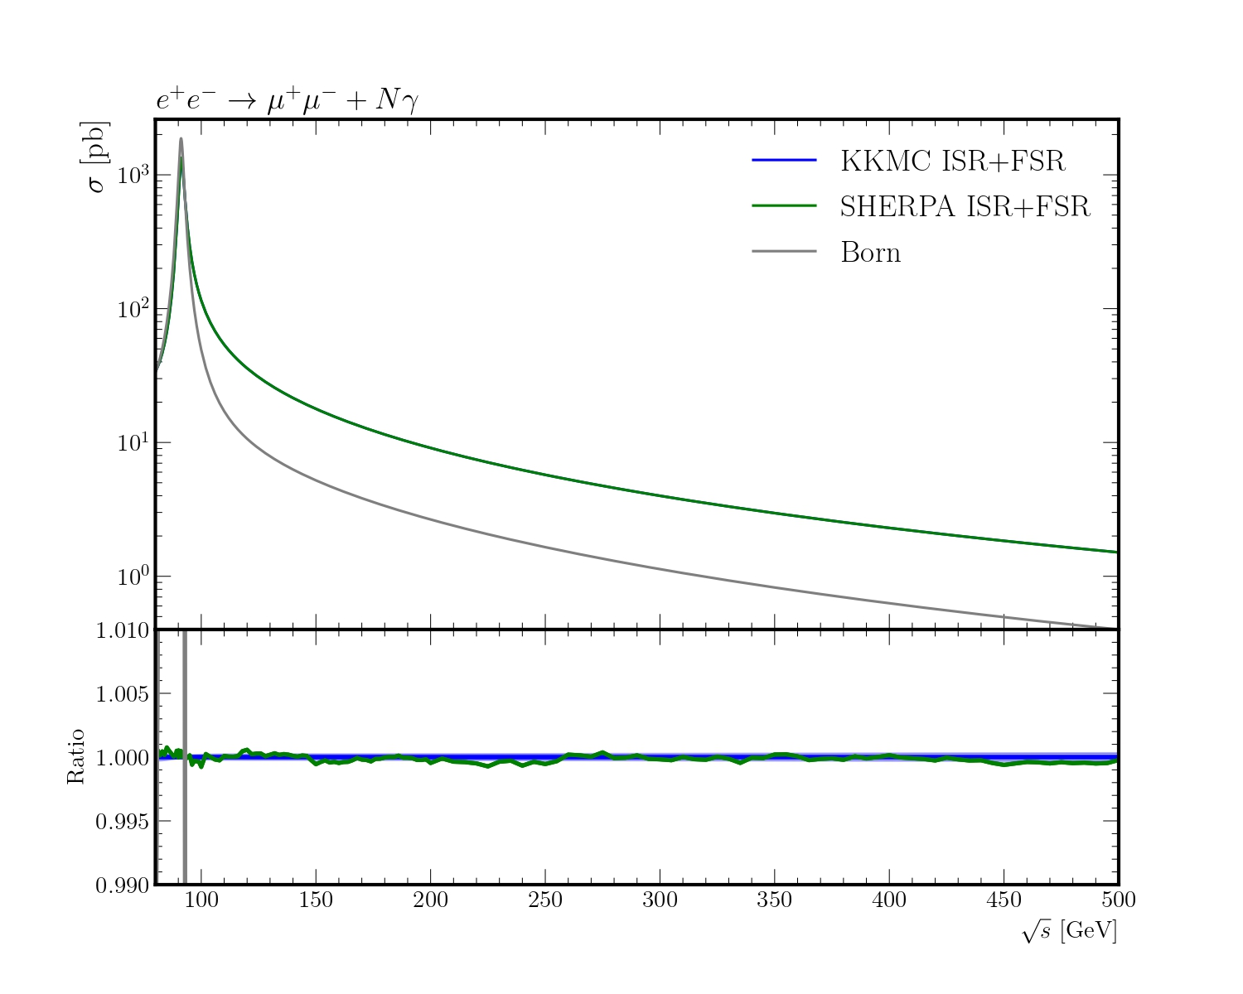
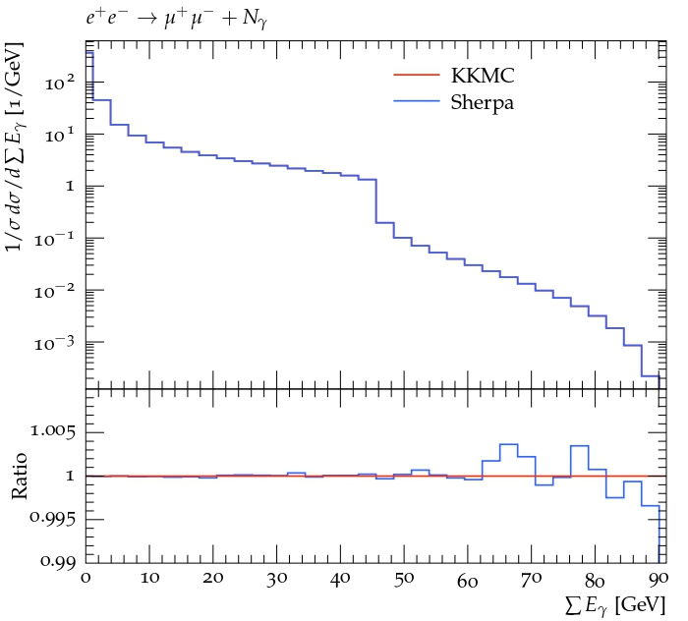
YFS Validation
KKMC: LEP Era YFS MC for e+e- -> ffbar Comput.Phys.Commun. 130 (2000) 260-325
Superb agreement in 𝜎 over a range of √s
Excellent agreement in the photon kinematics

Slide 9
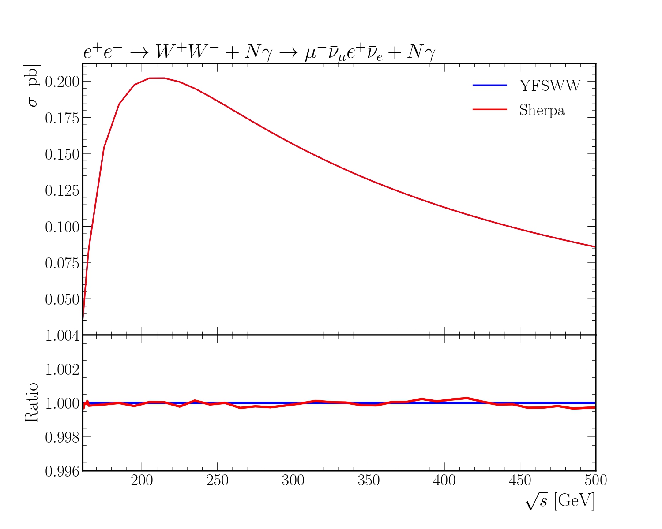
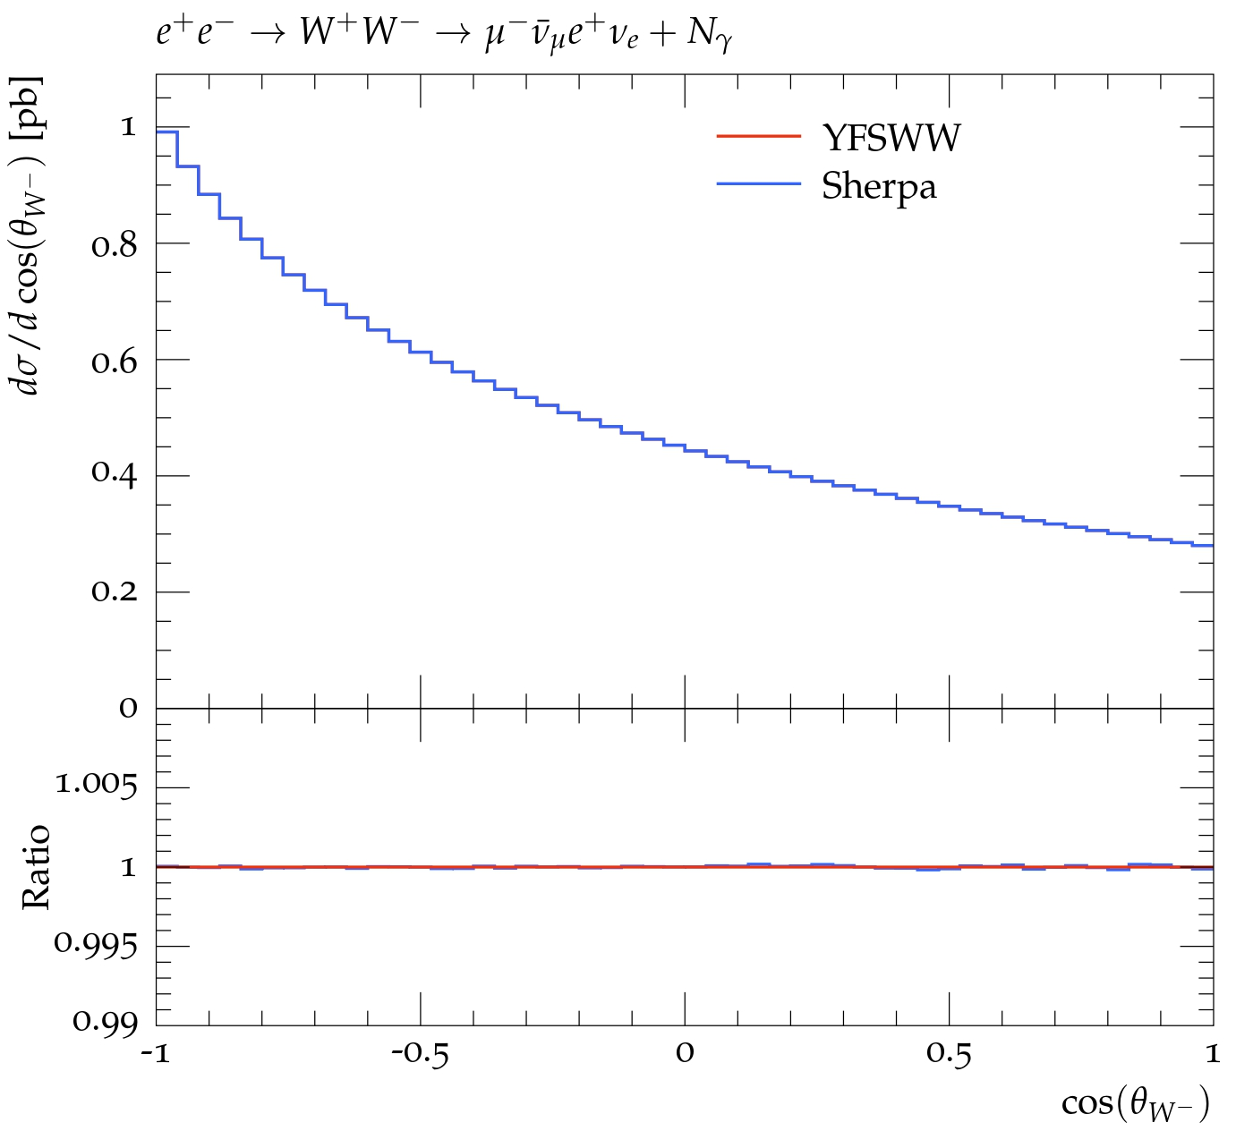
YFS Validation
YFSWW: LEP Era YFS MC for e+e- -> WW Comput.Phys.Commun. 140 (2001) 475-512
Superb agreement in 𝜎 over a range of √s
Excellent agreement in the W kinematics

Slide 10
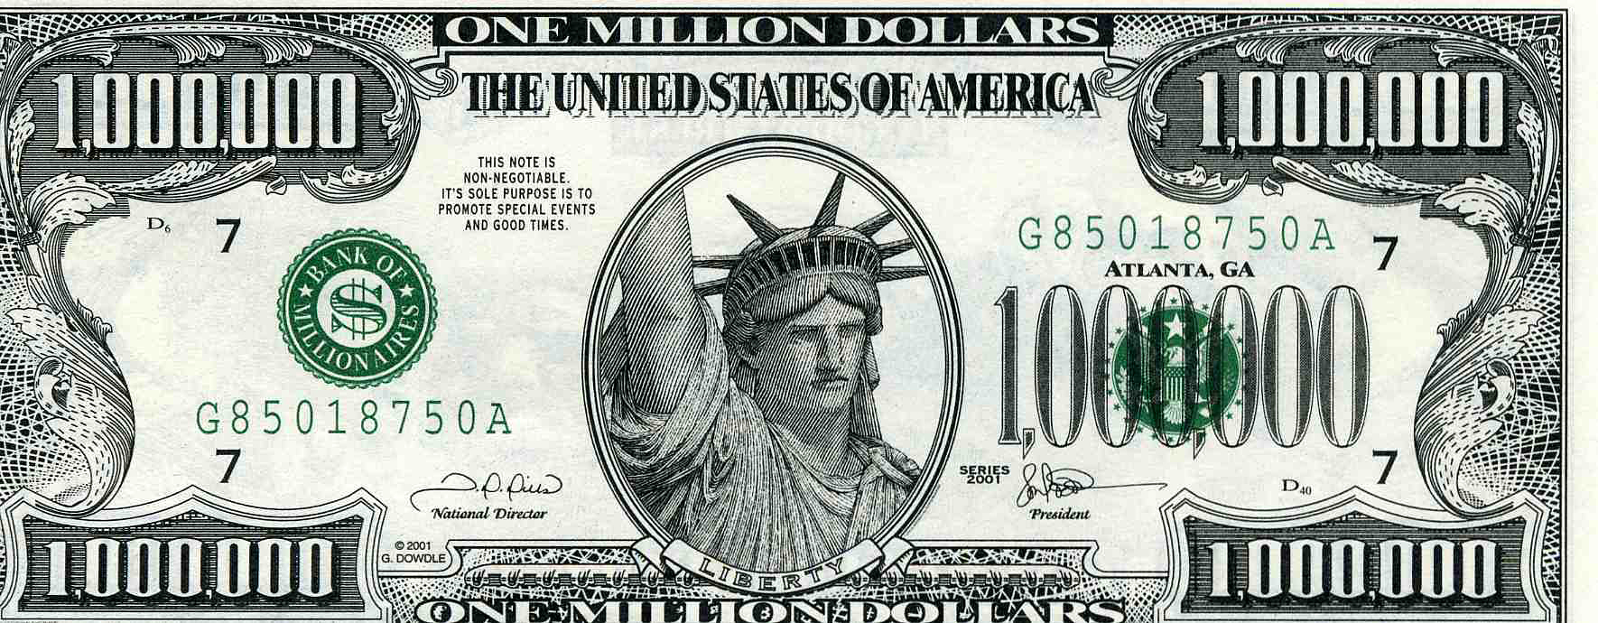
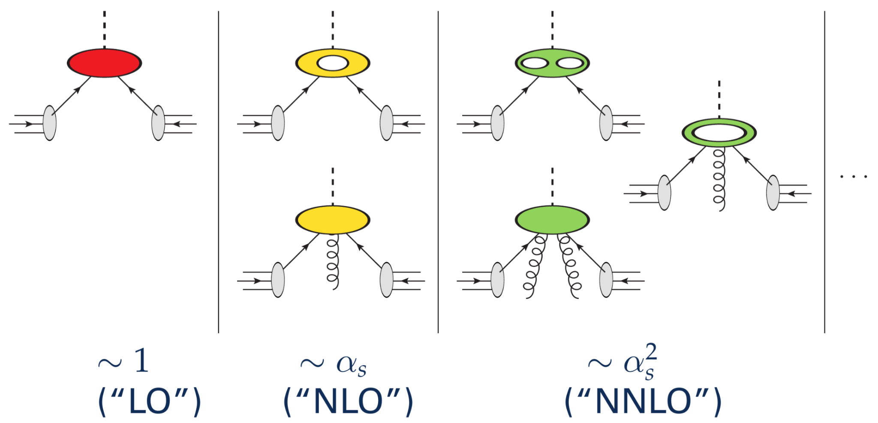

The need for (resummed) QCD
Don’t know how to solve QCD analytically
Only perturbation series in α_{S} for hard scattering
For predictions at fully-realistic particle level (low energies, hadrons, …): series diverges!
Resummation necessary, but only feasible in approximation:
Parton Showers (PS) resum the large contributions that repeat universally at each order!
😲

Slide 11
QCD parton showers around for a long time!
Parton shower concepts:
First Markov chains
Colour coherence
Angular ordering
Initial state evolution
NLO + parton shower matching
NNLO + parton shower matching
Early hadronisation models
Multi-jet merging
Multi-jet merging at NLO
1980
1990
1995
2005
2015
2025
1975
1985
2000
2010
2020
Pythia 1.0
Herwig 2.2
Sherpa 1.0.1
NNLOPS, UN2LOPS, Geneva
MiNNLOPS
QCD confinement

Slide 12
QCD parton shower corrections
Beyond the collinear approximation using higher-order calculations!
NLO matrix elements
Two families of methods, ~automated:
MC@NLO
implementations in MadGraph5_aMC@NLO, Sherpa, Herwig7
Powheg
implementation in POWHEG-Box for various processes, Whizard
Parton shower concepts:
First Markov chains
Colour coherence
Angular ordering
Initial state evolution
NLO + parton shower matching
NNLO + parton shower matching
Early hadronisation models
Multi-jet merging
Multi-jet merging at NLO
1980
1990
1995
2005
2015
2025
1975
1985
2000
2010
2020
Pythia 1.0
Herwig 2.2
Sherpa 1.0.1
NNLOPS, UN2LOPS, Geneva
MiNNLOPS
QCD confinement
Precision era!

Slide 13
QCD parton shower corrections
Beyond the collinear approximation using higher-order calculations!
NNLO matrix elements
Not automated, individual implementations for several processes (typically colour-singlet, ttbar)
NNLOPS/MiNNLOPS
UN2LOPS (Sherpa)
Geneva
Parton shower concepts:
First Markov chains
Colour coherence
Angular ordering
Initial state evolution
NLO + parton shower matching
NNLO + parton shower matching
Early hadronisation models
Multi-jet merging
Multi-jet merging at NLO
1980
1990
1995
2005
2015
2025
1975
1985
2000
2010
2020
Pythia 1.0
Herwig 2.2
Sherpa 1.0.1
NNLOPS, UN2LOPS, Geneva
MiNNLOPS
QCD confinement
Precision era!

Slide 14
QCD parton shower corrections
Beyond the collinear approximation using higher-order calculations!
Multi-jet matrix elements
Automated for arbitrary processes/models
Sherpa (with state-of-the-art ME generator built-in)
Herwig7 and Pythia8 (with external ME generators, e.g. MG5_aMC, Sherpa)
Parton shower concepts:
First Markov chains
Colour coherence
Angular ordering
Initial state evolution
NLO + parton shower matching
NNLO + parton shower matching
Early hadronisation models
Multi-jet merging
Multi-jet merging at NLO
1980
1990
1995
2005
2015
2025
1975
1985
2000
2010
2020
Pythia 1.0
Herwig 2.2
Sherpa 1.0.1
NNLOPS, UN2LOPS, Geneva
MiNNLOPS
QCD confinement
Precision era!

Slide 15
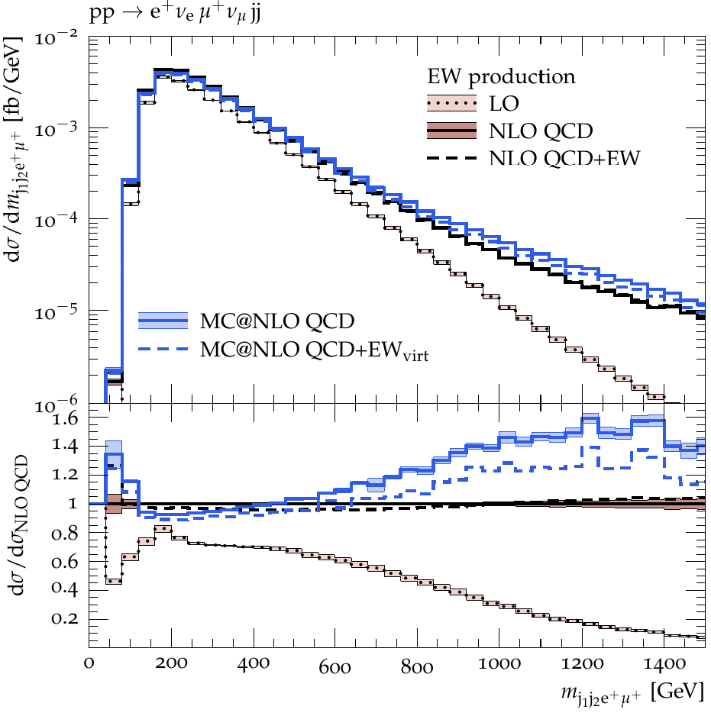
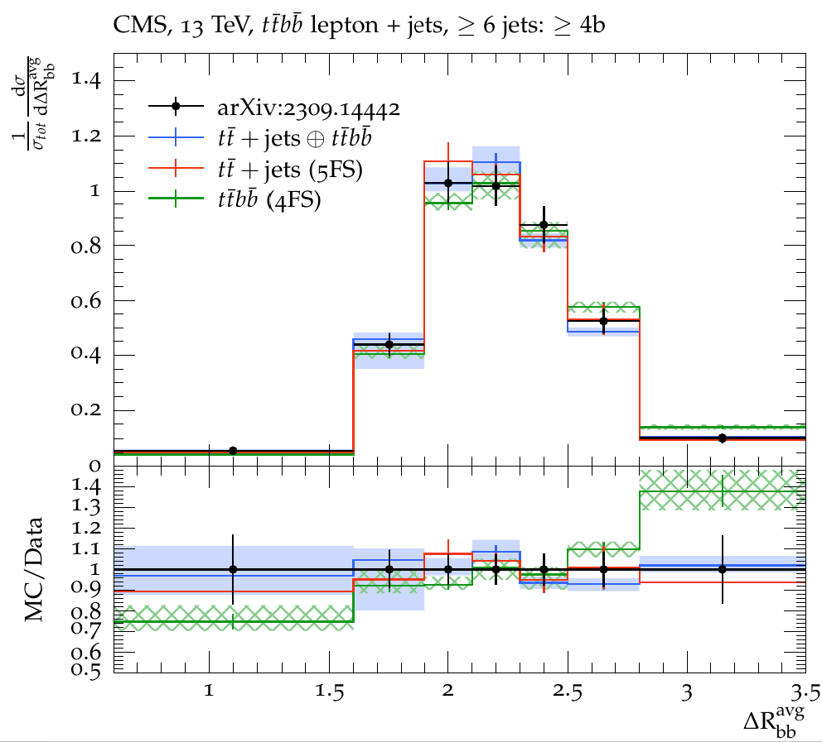
Recent state-of-the-art QCD predictions
At pp colliders …
[Denner, Pellen, Schönherr, Schumann 2024]
[Ferencz, Katzy, Höche, FS 2024]

Slide 16
Recent state-of-the-art QCD predictions
At pp colliders …
[Denner, Pellen, Schönherr, Schumann 2024]
[Ferencz, Katzy, Höche, FS 2024]

Slide 17
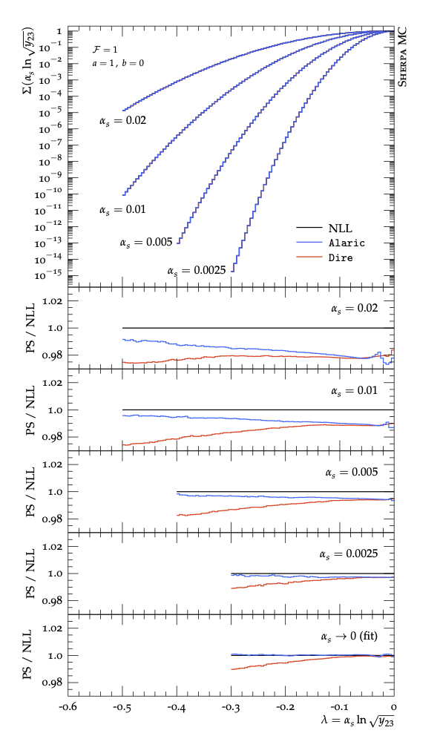
A Logarithmically Accurate Resummation In C++
NLL accuracy needed for Parton Showers [Dasgupta,Dreyer,Hamilton,Monni,Salam]
CSSHOWER and Dire not formally NLL accurate
ALARIC Shower applies partial fractioning of the eikonal
Allows for positive definite splitting function
across the whole phasespace
Extended to massive splittings [Assi, Hoeche, Phys.Rev.D 109 (2024) 11, 1]
Multijet merging [Hoeche, Krauss, Reichelt, Phys.Rev.D 111 (2025) 9]
NLO Matched [Hoeche, Krauss, Meinzinger, Reichelt]

Slide 18
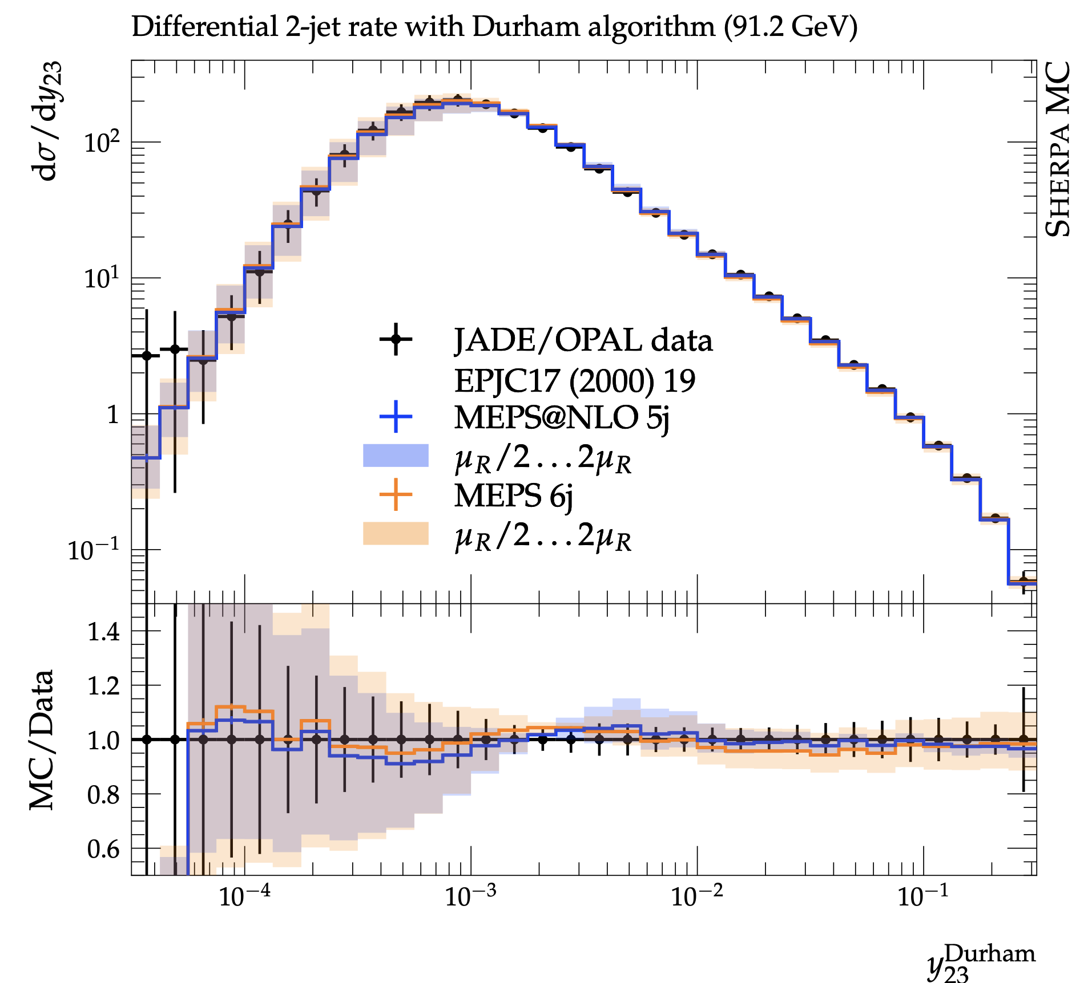
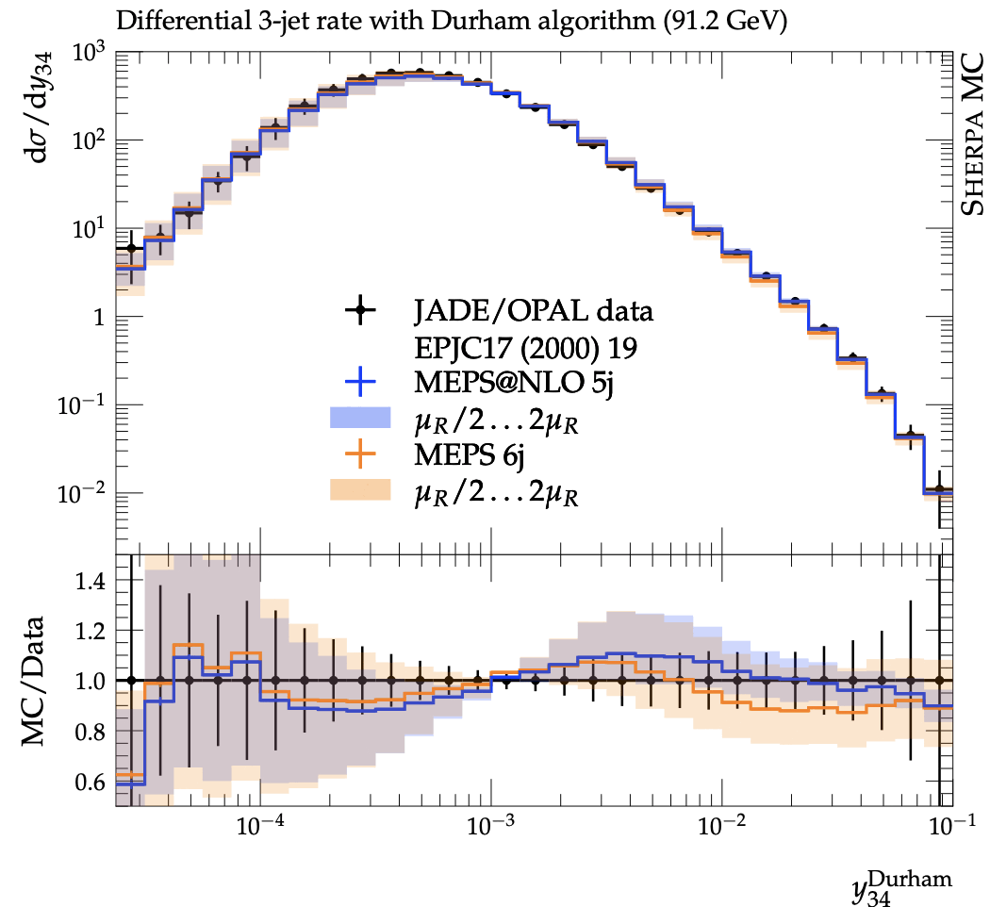
A Logarithmically Accurate Resummation In C++

Slide 19
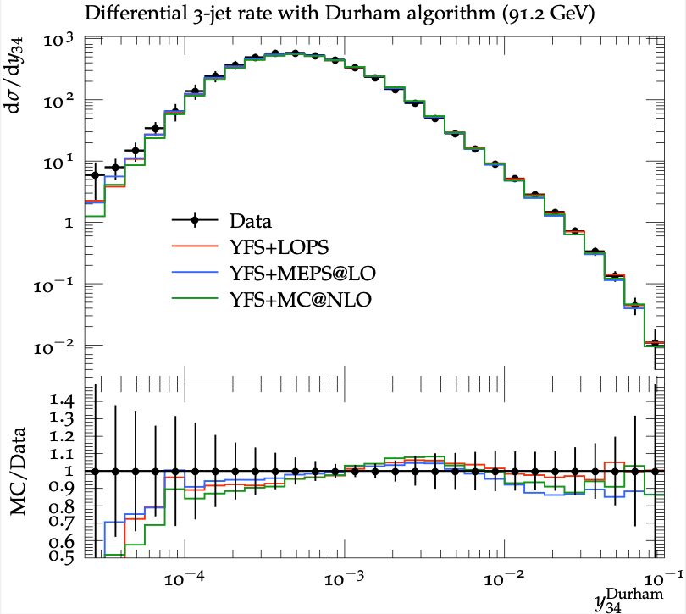
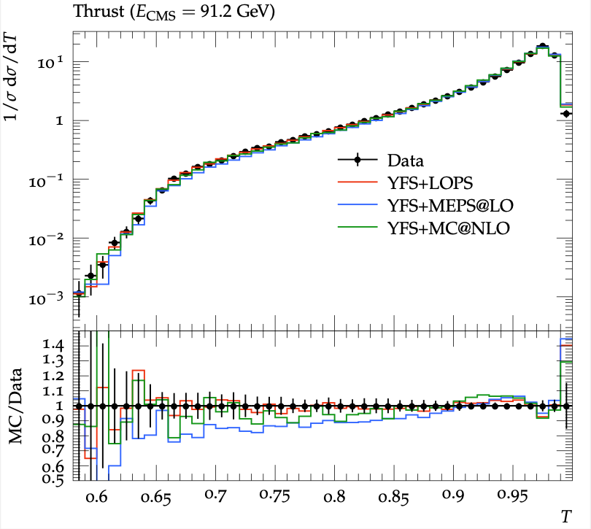
Recent state-of-the-art QCD predictions
… and at e⁺e⁻ colliders for hadronic final states:
e⁺e⁻ → jets
We can combine Sherpa’s state of the art QED ISR and QCD FSR.
New YFS seamlessly
combines with all of Sherpa’s native features!

Slide 20
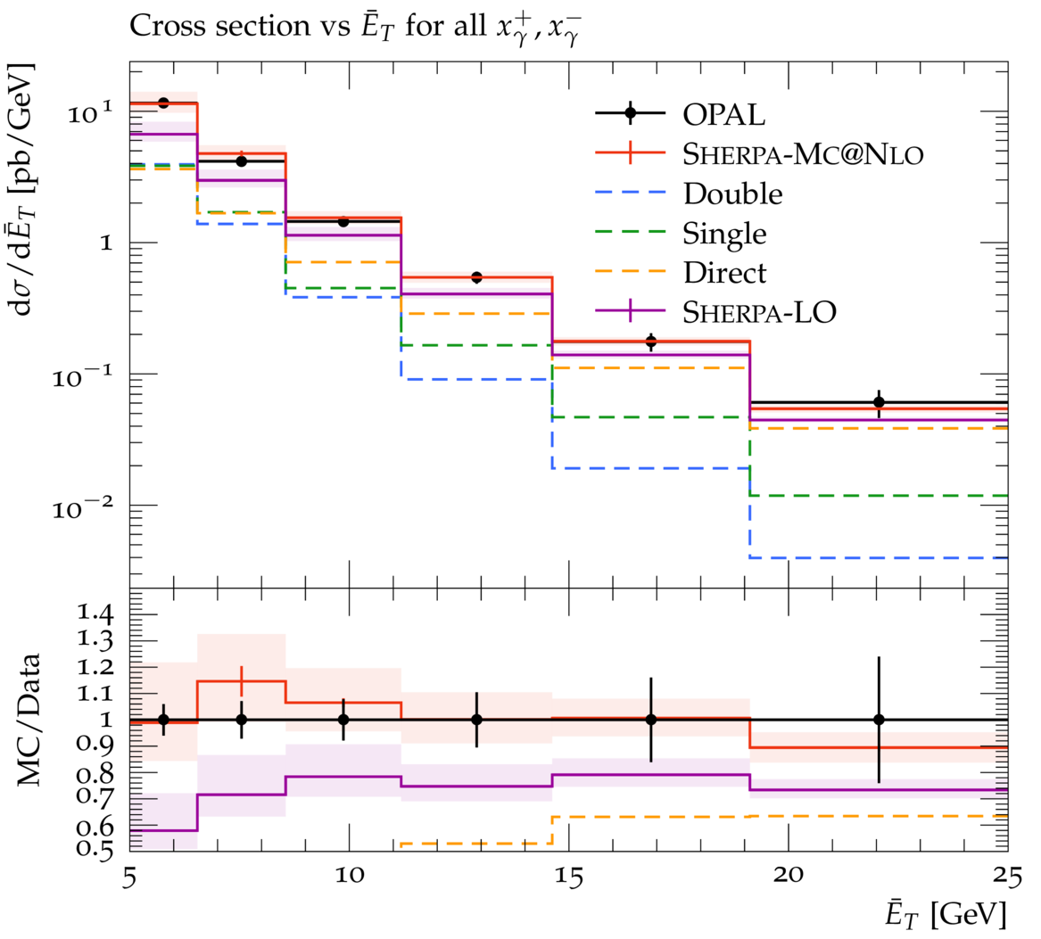
More QCD at Lepton Colliders: Photoproduction
Photon radiation from electron beams (e.g. via EPA) → photon induced scattering processes
Photoproduction dominant channel for ee → jets at LEP (inclusive)!
Photons can be direct or resolved
First MC@NLO calculation of photoproduction in Sherpa, incl. multiple interactions, hadronisation, etc.
Very good agreement with data from LEP and HERA
Allows for study of hadronic structure of the photon
BSM searches via photon fusion?
[Höche, Krauss, Meinzinger 2023]
Notes:
understand relationship to EPA (y beam from electron bunch in collinear approximation)

Slide 21
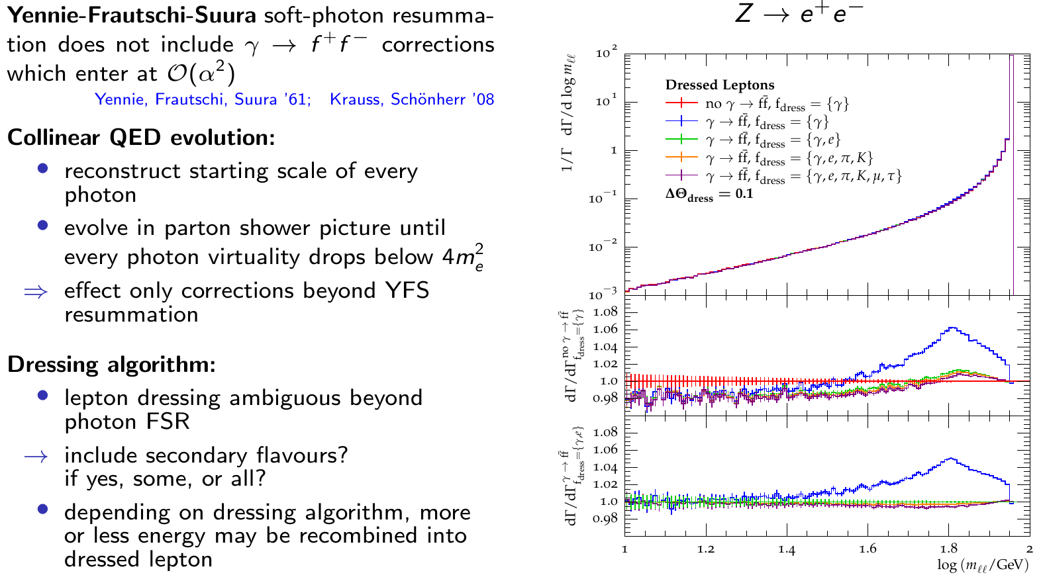
QED FSR: Photons splitting into fermions
[Flower, Schönherr 2023]
Connection with QED ISR underway! [Flower, Price]

Slide 22
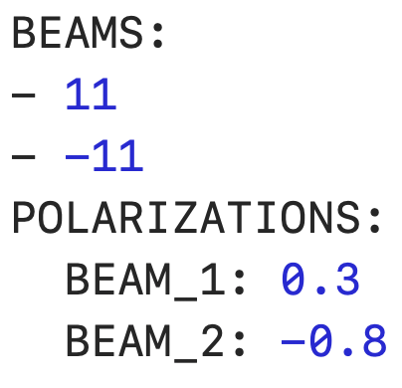
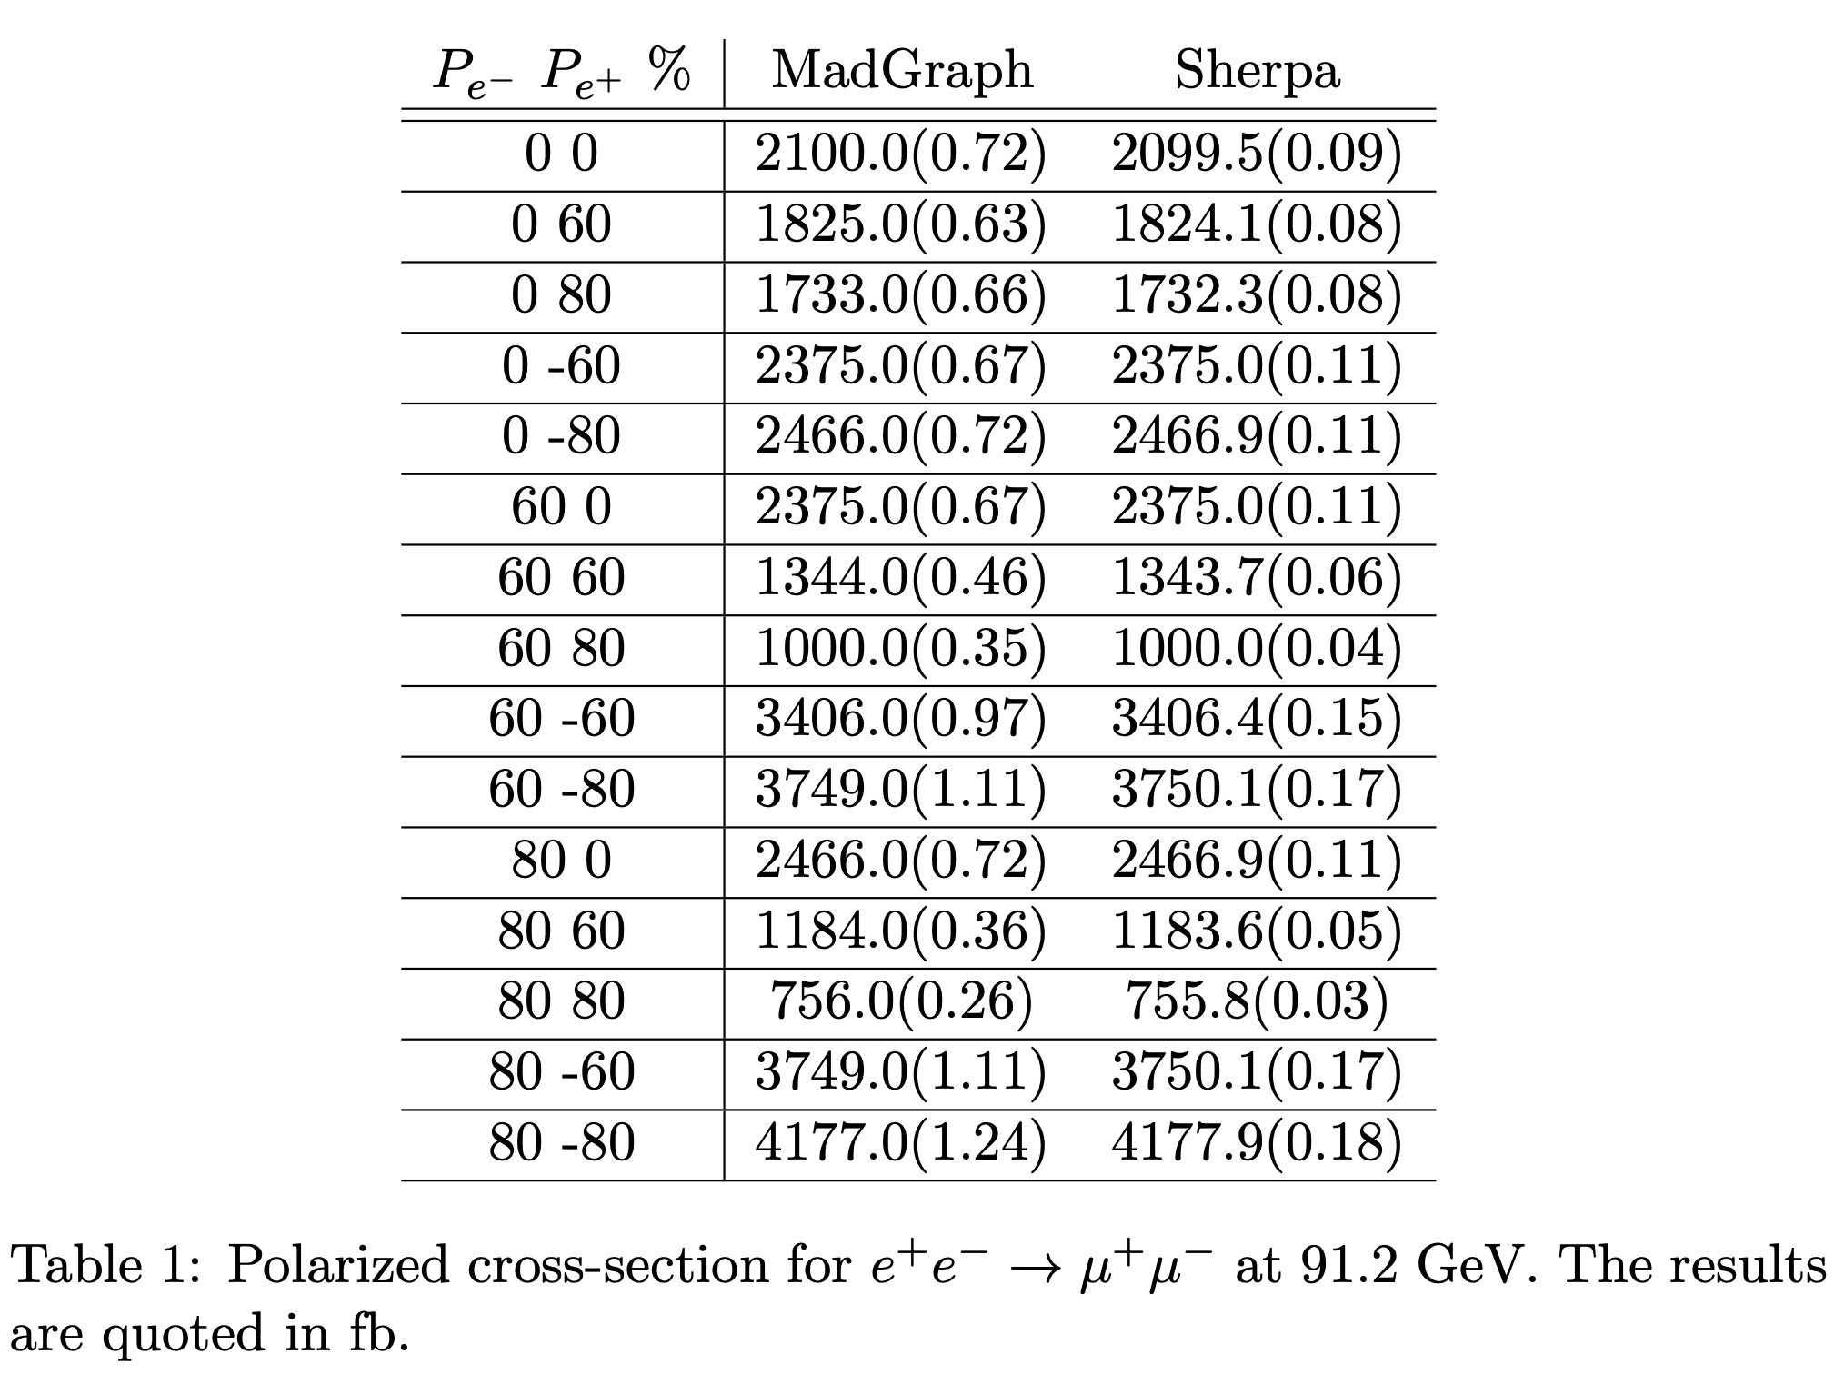
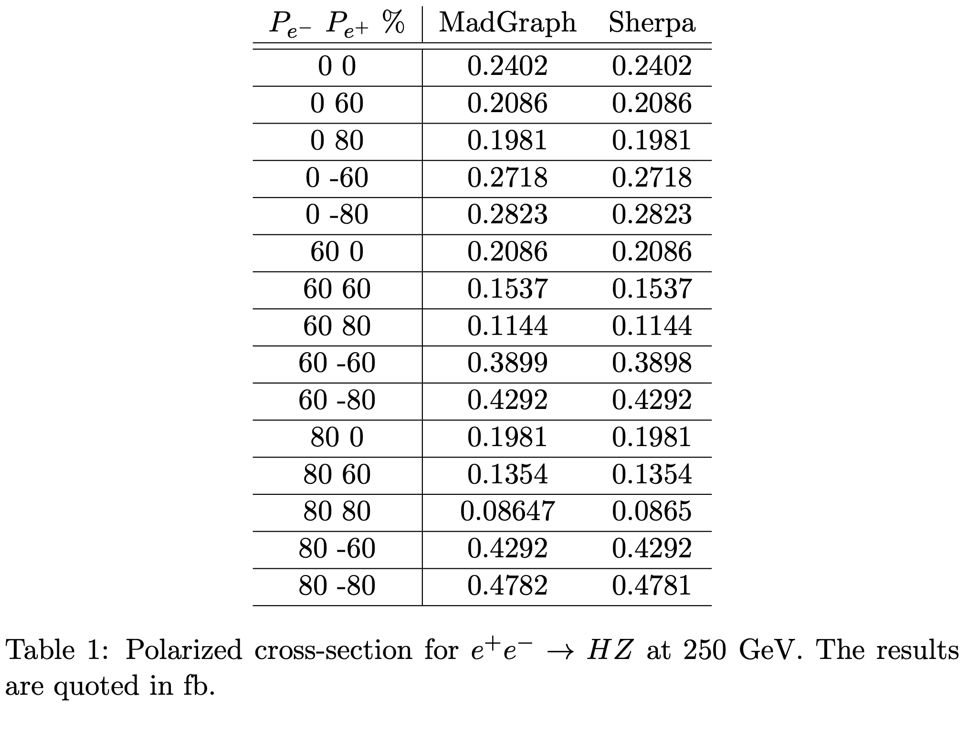
IS polarisation
Available in one of Sherpa’s ME generators (AMEGIC)
Recently resurrected for Sherpa 3
Reweight the ME with pol factor (1+P),(1-P)
Validated against Madgraph/Whizard
Automatically included in YFS: Soft photons blind to spin!

Slide 23
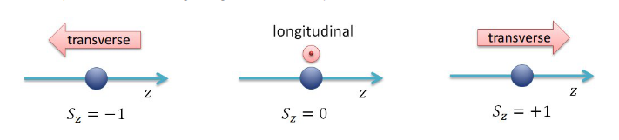
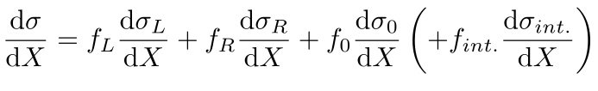
Polarised intermediate particles
Not only beams can be polarised!
Is LC physics sensitive to the polarisation of intermediate vector bosons?
Idea: Use polarised MC predictions as templates for analyses based on realistic final states
→ Exploit longitudinal polarisation for EWSB studies
→ Exploit SM-suppressed polarisation configurations for BSM studies
Lessons from LHC:
Analytical projections not applicable in the presence of lepton cuts
Exclusive predictions in MC event generators possible, ideally with higher order corrections

Slide 24
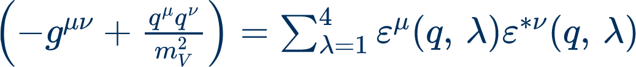
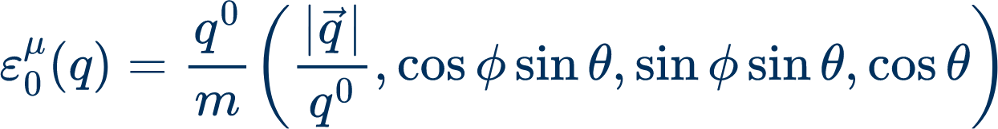
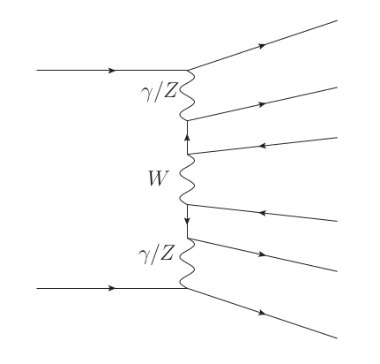
Polarised intermediate particles
Caveats for polarised predictions:
Polarization for intermediate particles
completeness relation
leads to interferences between different polarizations
Polarization basis
helicity basis
frame dependent!
Dr. Z. Zinonos: Tests of the Standard Model of Particles. https://www.mpp.mpg.de/~zinonos/material/lecture10.pdf
Polarization only defined in production ⊗ propagator ⊗ decay
factorizable amplitudes
problem: non-resonant diagrams
→ no polarisation definition, but necessary for gauge invariance
solution: appropriate approximations - gauge invariant options:
Pole Approximation ((D)PA)
Narrow-Width Approximation (NWA)
Notes:
TODO Frank

Slide 25
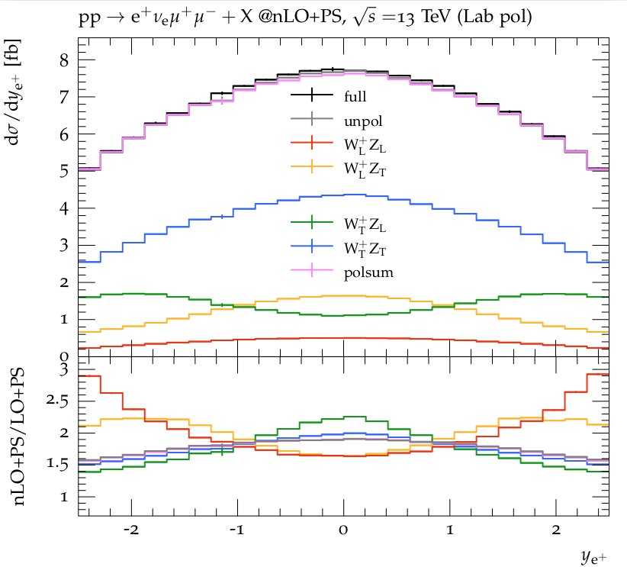
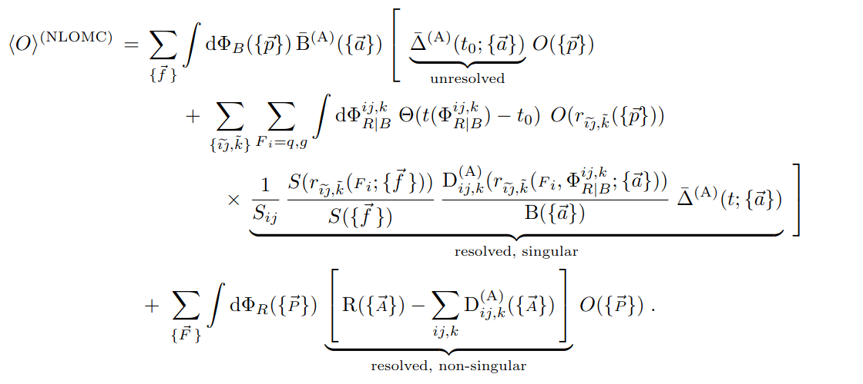
Sherpa’s new polarisation framework beyond LO
Methodology:
Unpolarised simulation run, polarised XS as event weights
All polarisation combinations, interferences, reference frames in one simulation run
Accuracy options:
nLO QCD+PS matching
[Hoppe, Schönherr, FS, 2023]
Born polarisation
(ultra-collinear/-soft virtual corrections unpolarised)
S-event
Polarisation of real correction
H-event

Slide 26
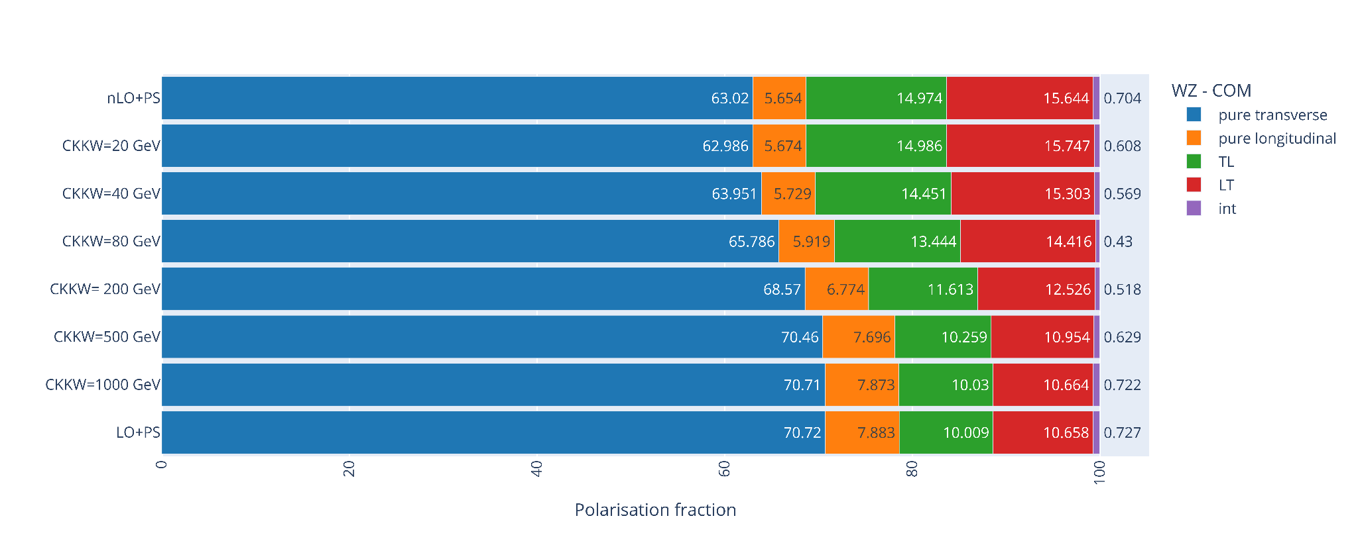
Sherpa’s new polarisation framework beyond LO
Methodology:
Unpolarised simulation run, polarised XS as event weights
All polarisation combinations, interferences, reference frames in one simulation run
Accuracy options:
nLO QCD+PS matching
Multi-jet merging, e.g. W(ev)Z(mm)+jets
[Hoppe, Schönherr, FS, 2023]
Born polarisation
(ultra-collinear/-soft virtual corrections unpolarised)
S-event
Polarisation of real correction
H-event

Slide 27
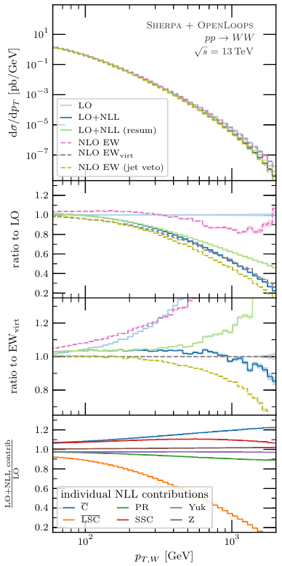
Electroweak corrections in Sudakov approximation
NLO EW corrections more & more important to reach precision targets for √s > 1 TeV
Complete NLO EW calculation possible, but not always feasible
Possible approximation: EW Sudakov logarithms [A. Denner & S. Pozzorini 2000, 2001]
NLO EW logarithmically enhanced for energies above EW scale
Large contributions in tails of kinematic distributions
Can be universally applied to any Sherpa calculation (in particular, in matched multi-jet matrix element calculations)
Automated in SHERPA [Bothmann, Napoletano 2020, Bothmann et al. 2021]

Slide 28
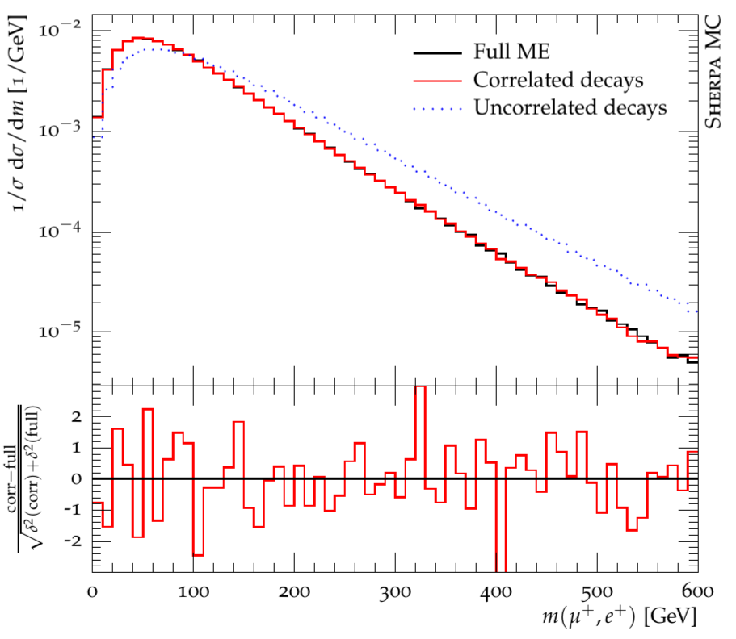
BSM models: UFO interface
Dream of phenomenologists or experimentalists: From a model’s Lagrangian L → simulated event samples
Important ingredient: UFO standard to automatically transfer Feynman rules (from FeynRules, SARAH, …) into event generators
Sherpa interface available for a while [Höche, Kuttimalai, Schumann, FS 2014]
New in Sherpa 3.0.0: UFO 2.0 interface with more flexibility, e.g. with form factors
Automatic decay tables/chains
Spin correlations
Effective field theories (SMEFT, HEFT) via UFO model
Squark pair production in MSSM

Slide 29
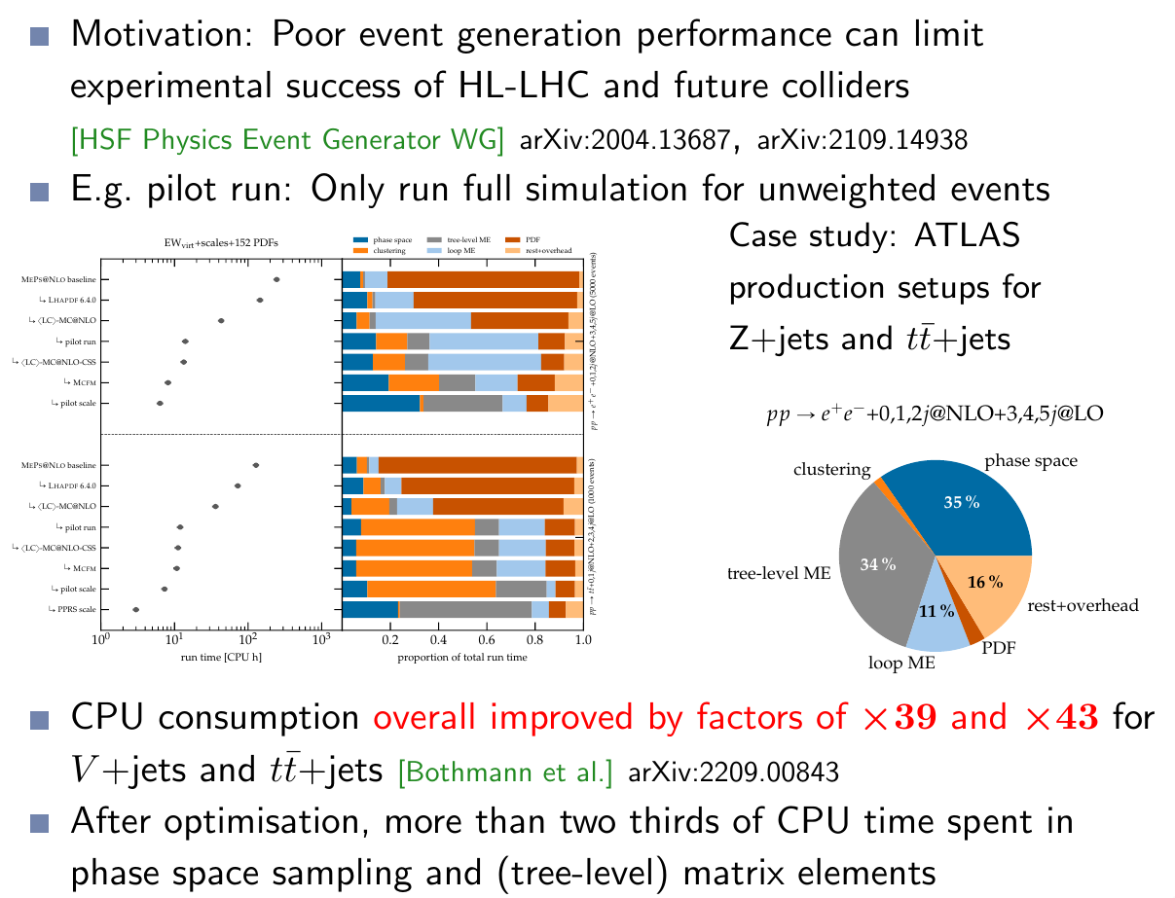
Significant CPU performance improvements
FCC-ee! ILC250?

Slide 30
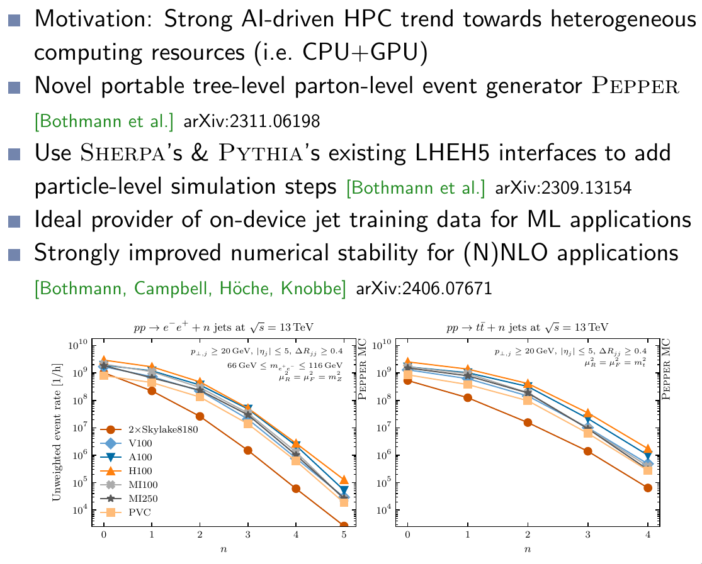
Portable GPU-accelerated event generation

Slide 31
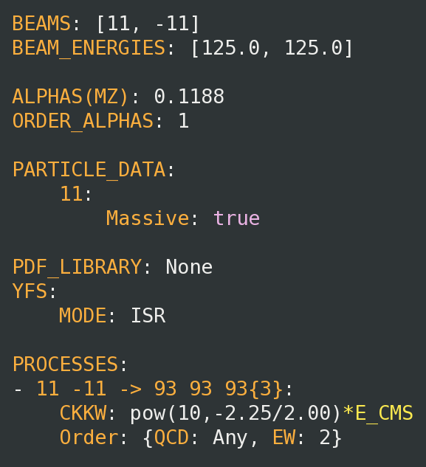
Conclusions
Hot off the press: Sherpa 3.0.0 released!
Download and information on Sherpa homepage: https://sherpa-team.gitlab.io/
New user interface (YAML language) Give it a try!
Availability in Key4Hep software stack:
Both Sherpa2 and Sherpa3 will be available in the nightlies
source /cvmfs/sw-nightlies.hsf.org/key4hep/setup.sh
Sherpa3-0-0 MyFavouriteProcess.yaml
Sherpa’s LHC expertise carries over to LC
Additionally dedicated developments for Linear Collider physics!
NEW: automated YFS for state-of-the-art QED corrections in the initial state [Alan Price]
NEW: photon → lepton splittings in YFS [Lois Flower]
NEW: state-of-the-art photo-production of ee → jets [Peter Meinziger]
[Key4Hep => Thomas Madlener’s talk]

Slide 32
Backup

Slide 33
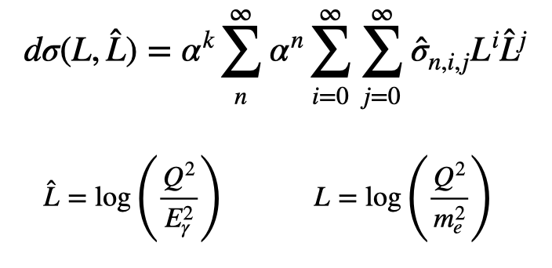
The Need For QED
Factor 2-100 improvement in the measurement of EWPOs
0.1% errors which could be ignored at LEP will be dominant at future e+e- machines
On the theoretical side this translates into a much more sophisticated modelling
Fixed Order Improvements
[Jadach,Skrzypek, Eur. Phys. J. C79(2019)]
Soft Log
Collinear Log

