Slide 1
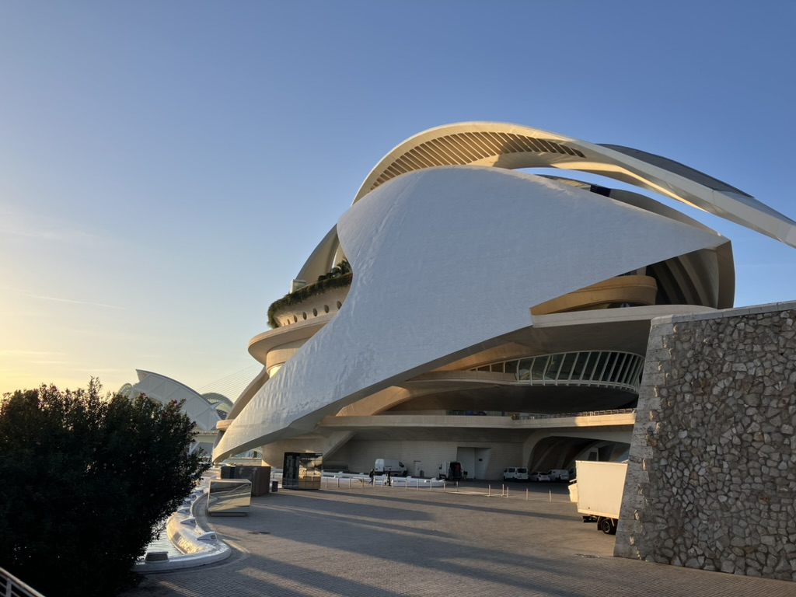

Black box optimization with TPE algorithm of ILC E-Driven Positron Source
Yodai Sasaki, Masao Kuriki (Hiroshima University)

Slide 2
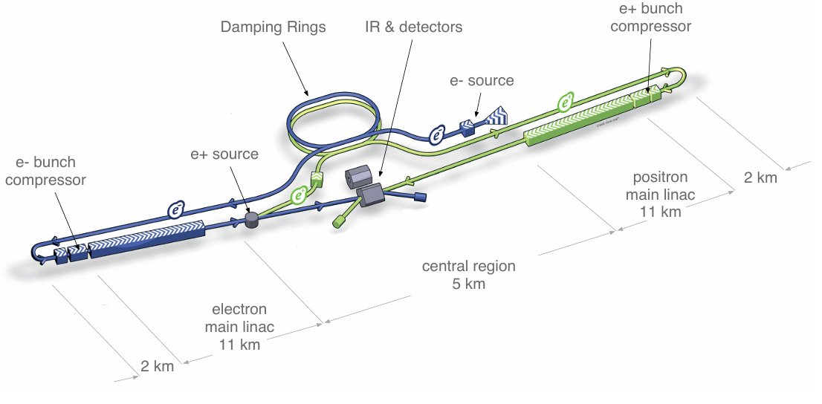
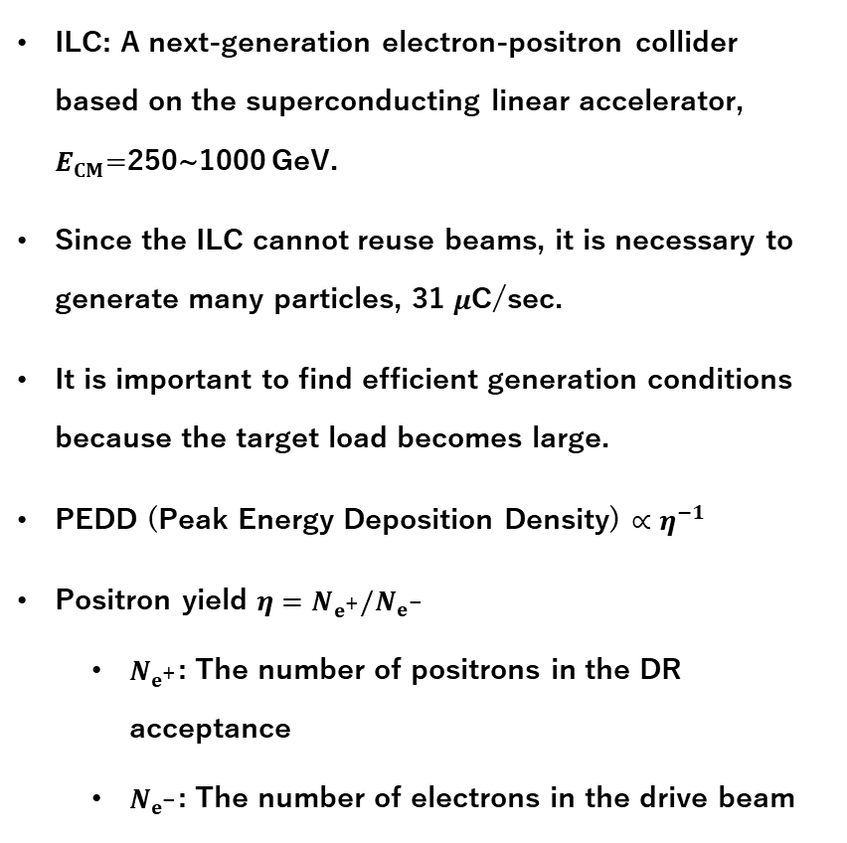
International Linear Collider
ILC: A next-generation electron-positron collider based on the superconducting linear accelerator, $E_{CM}$=250~1000 GeV.
Since the ILC cannot reuse beams, it is necessary to generate many particles, 31 $μ$C/sec.
It is important to find efficient generation conditions because the target load becomes large.
PEDD (Peak Energy Deposition Density) $∝η^{−1}$
Positron yield $η=N_{e^{+}}/N_{e^{−}}$
$N_{e^{+}}$: The number of positrons in the DR acceptance
$N_{e^{−}}$: The number of electrons in the drive beam
Schematic layout of the ILC
Behnke et al., “The International Linear Collider Technical Design Report- Volume 1: Executive Summary.”
W-Re target
positrons
3 GeV electrons

Slide 3
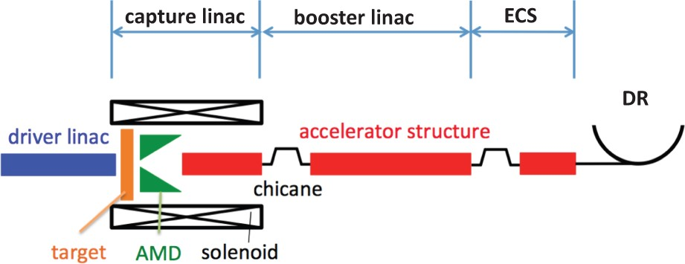
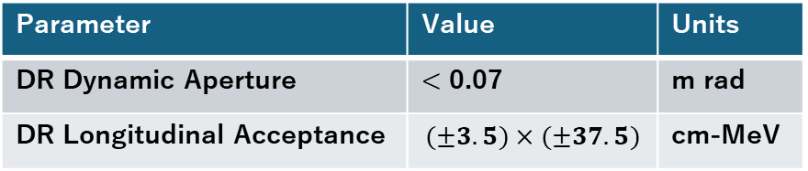
ILC Electron-driven positron source
Electrons and positrons are captured by the capture linac.
The electrons are separated from the positrons by bending magnets.
Positrons are accelerated to an energy of 5 GeV.
The ECS compresses the energy of the positrons.
We conducted research on more efficient positron generation and capture conditions.
Schematic layout of the ILC electron-driven positron source
Seimiya et al., “Positron Capture Simulation for the ILC Electron-Driven Positron Source.”
Parameter | Value | Units
DR Dynamic Aperture | < 0.07 | m rad
DR Longitudinal Acceptance | $$(±3.5)×(±37.5)$$ | cm-MeV

Slide 4
Start-to-end optimization
3 simulation codes are employed,
GEANT4: e+ production
GPT: Injector linac
SAD: Booster + ECS
The start-to-end simulation going to be performed and optimizes the whole system.
Black box optimization with TPE algorithm is a current candidate for the optimizer. Now, it is done only on Booster.
Schematic layout of the ILC electron-driven positron source
Geant4
GPT
SAD

Slide 5
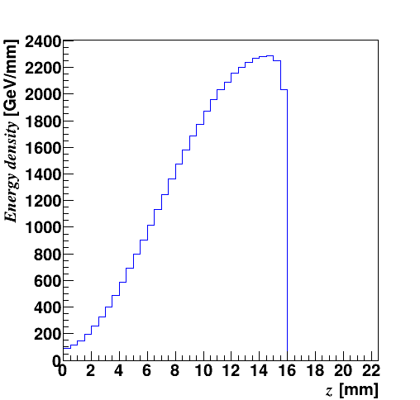
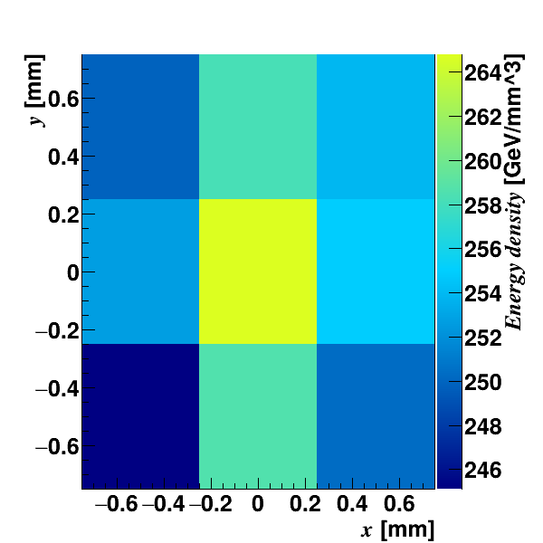
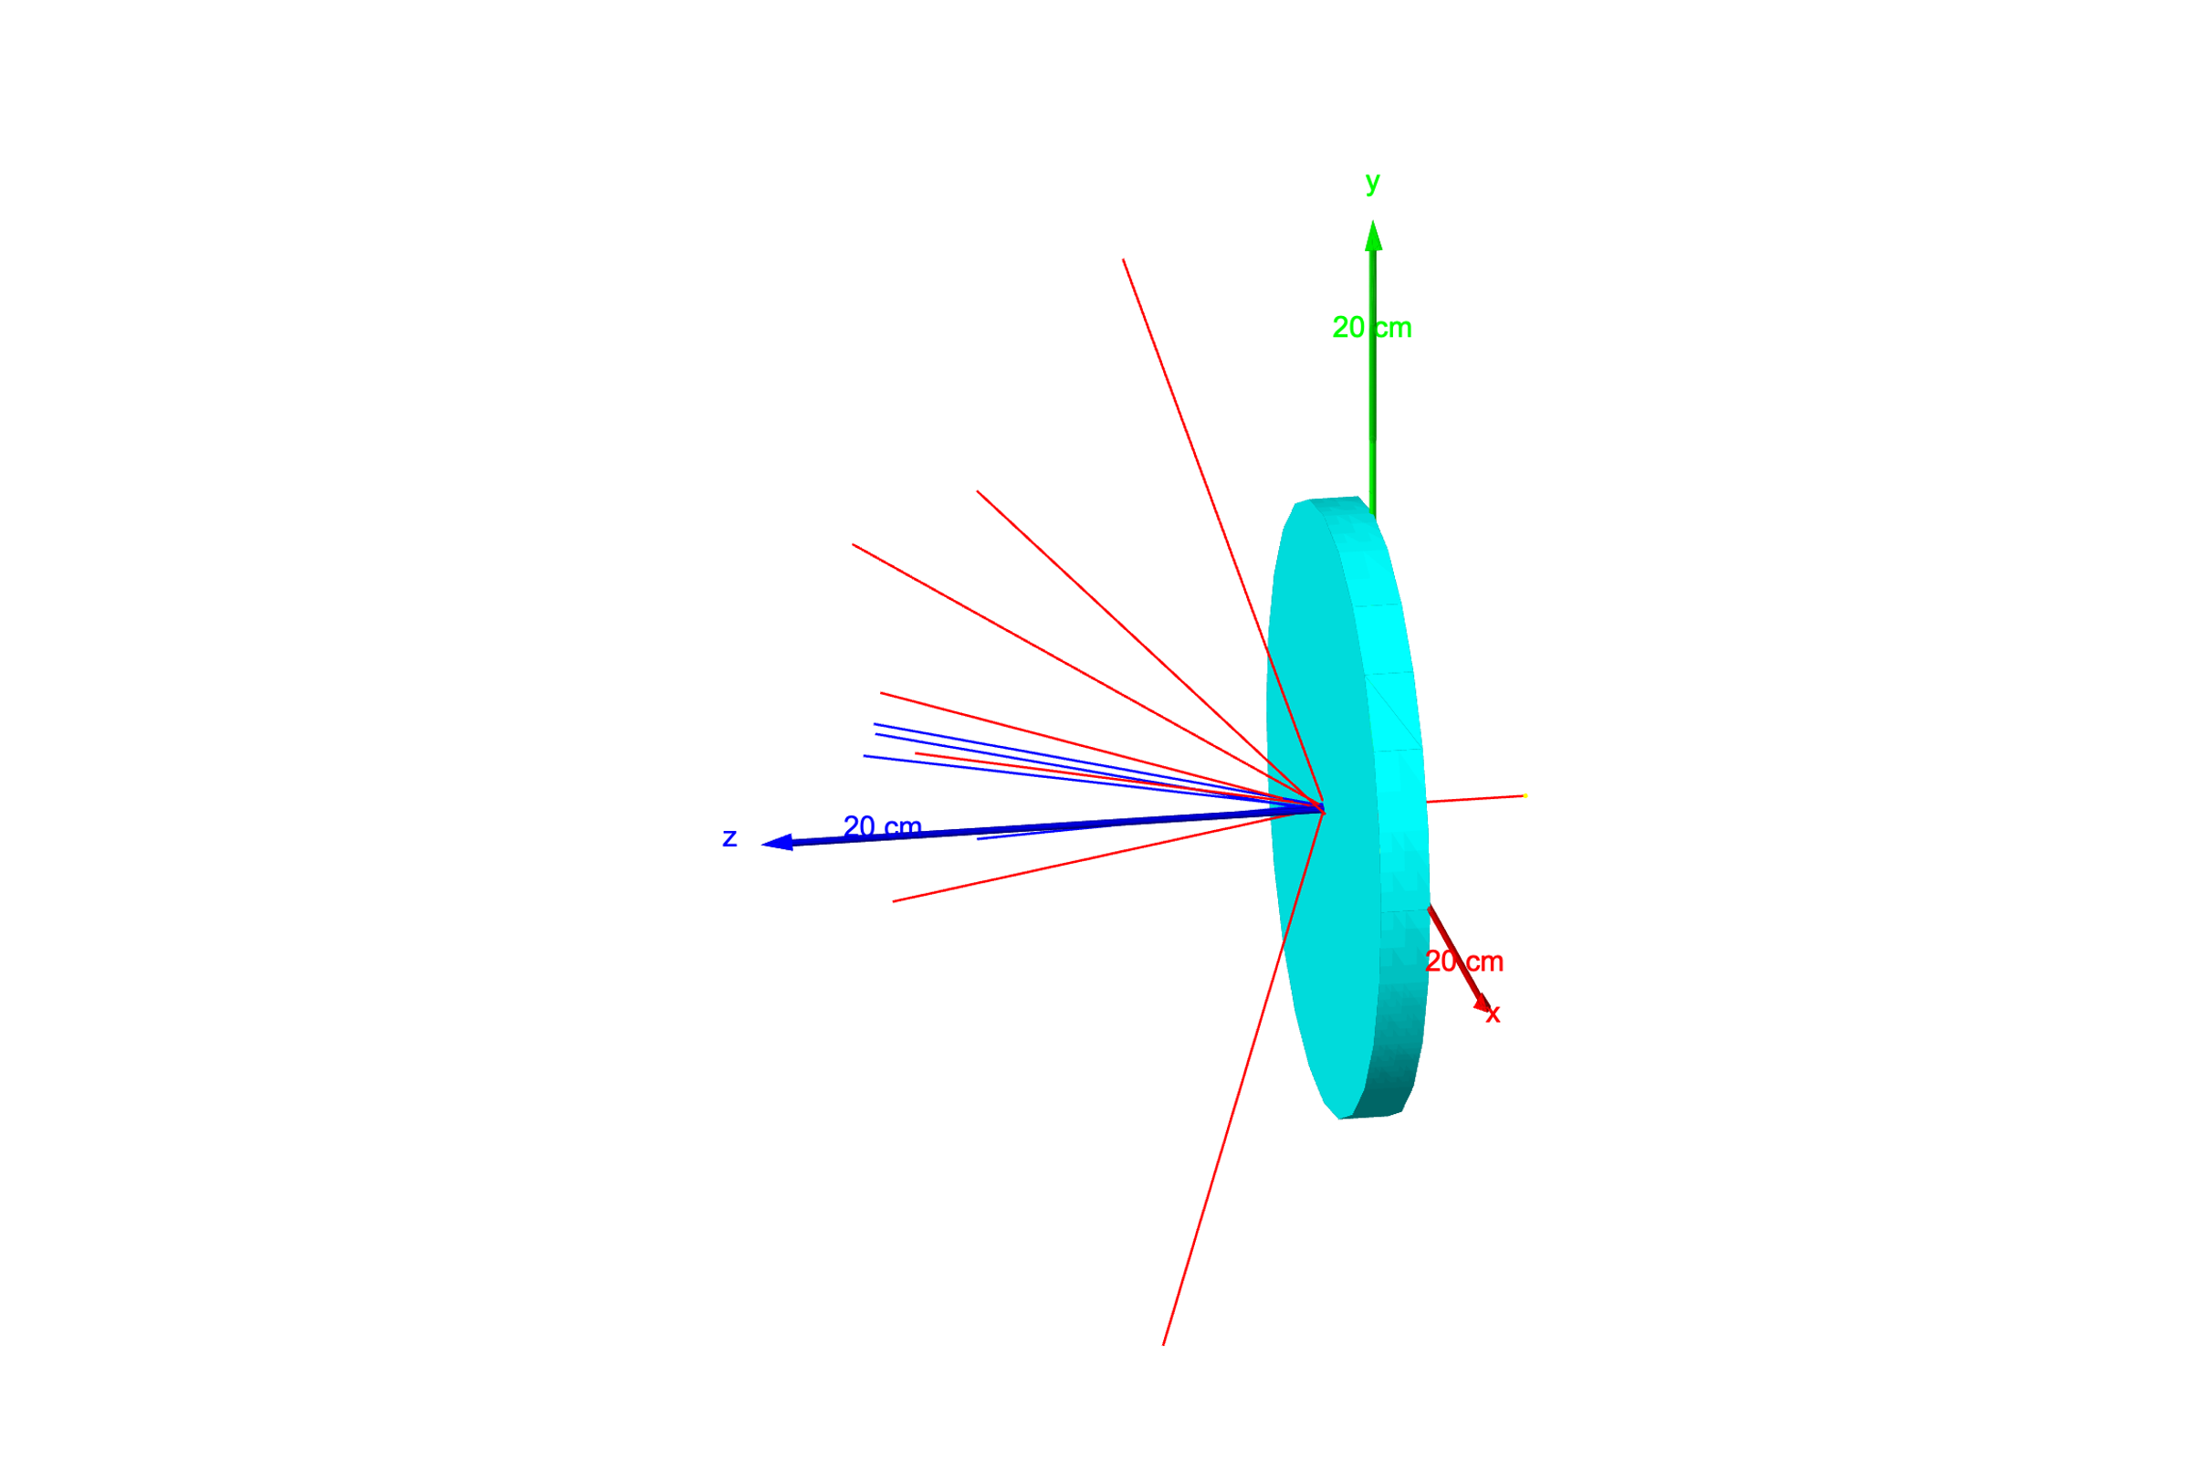
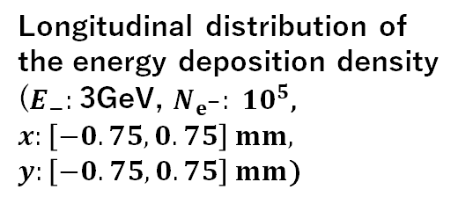
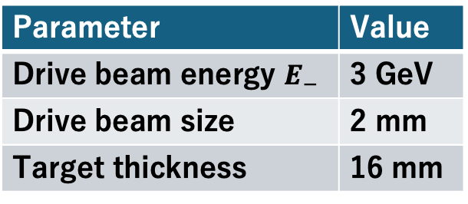
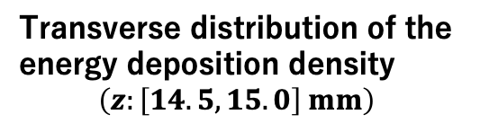
Positron Generation
Positron generation is simulated by GEANT4.
Present parameters
Parameter | Value
Drive beam energy $E_{−}$ | 3 GeV
Drive beam size | 2 mm
Target thickness | 16 mm
Longitudinal distribution of the energy deposition density
($E_{−}:$3GeV, $N_{e^{−}}: 10^{5}$, $x:\left[−0.75,0.75\right] mm,$
$y:\left[−0.75, 0.75\right] mm$)
Transverse distribution of the energy deposition density
$$\left(z:\left[14.5,15.0\right] mm\right)$$
Electromagnetic showers

Slide 6
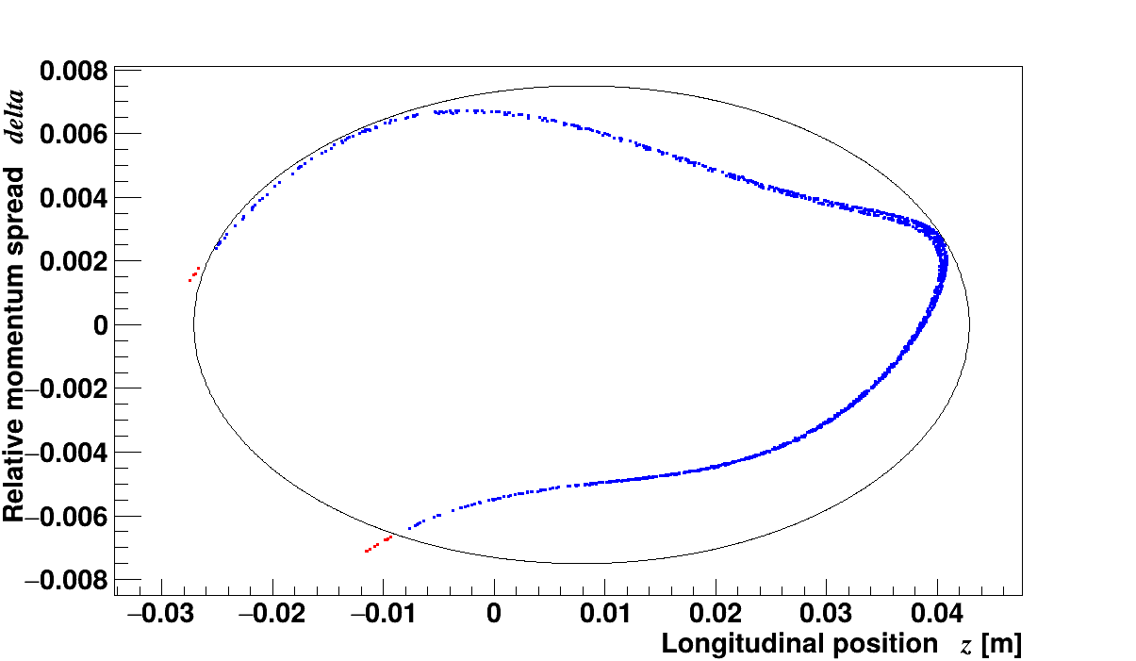
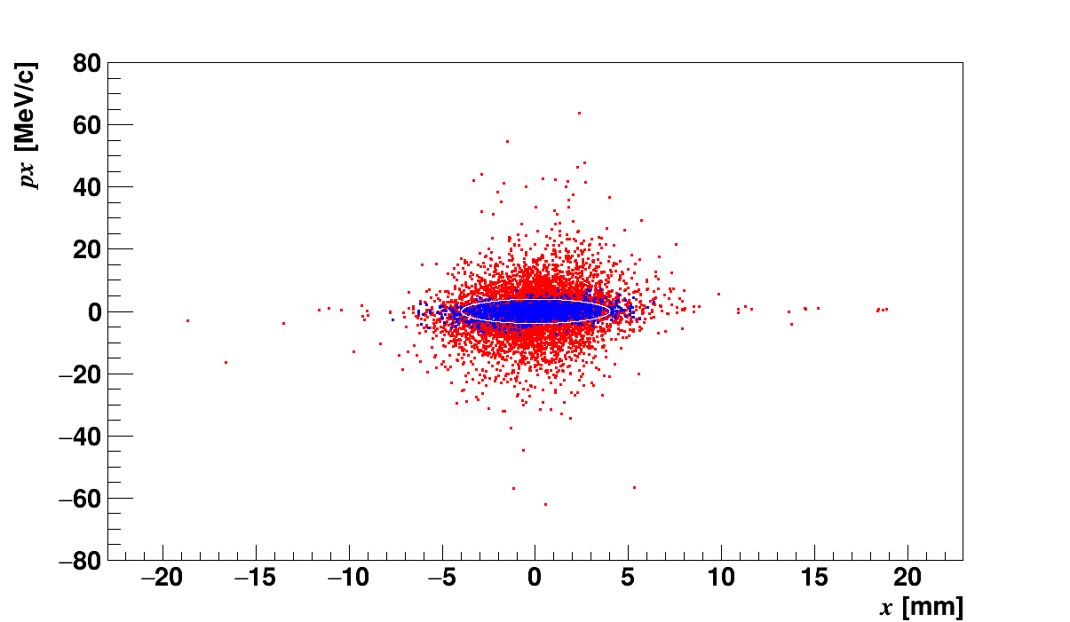
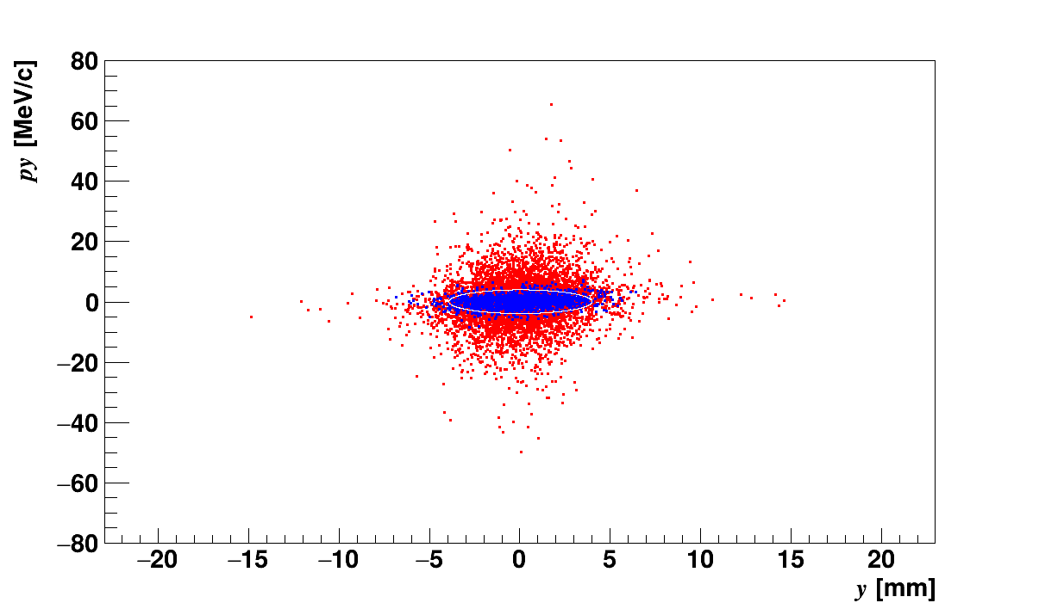
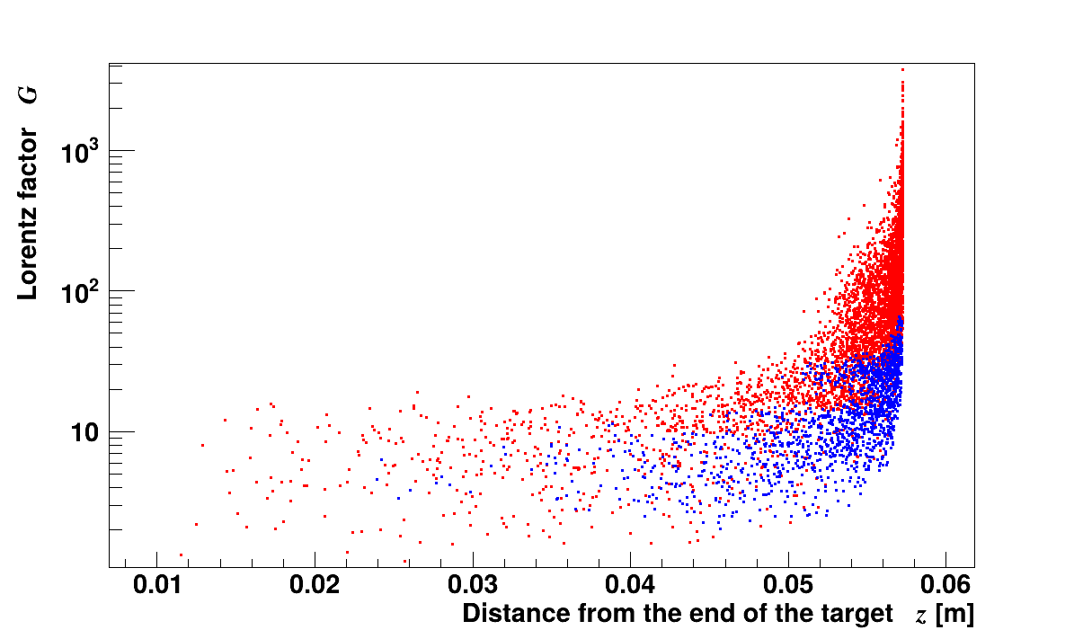


Provisional acceptance at the target exit
To examine the number of ”good positron” at the target, we set the provisional acceptance at the exit of the target.
The acceptance evaluated by backward trace of positron from the DR to target.
z-γ after ECS
●：All positrons
●：Accepted positrons
$x$-x’ on target
$$y−y^{′}on target$$
z-γ on target

Slide 7

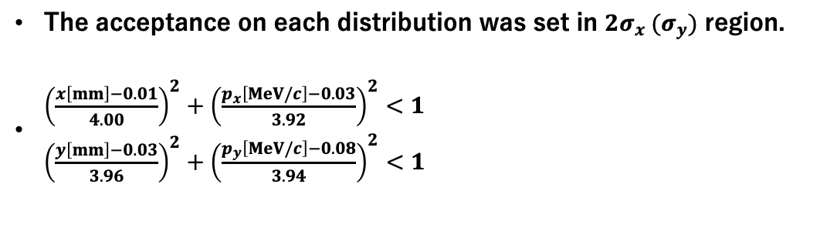

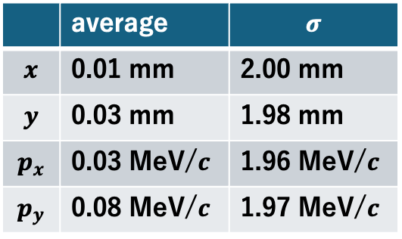
Transverse acceptance
The transverse phase space distribution after the target
 | average | $$σ$$
$$x$$ | 0.01 mm | 2.00 mm
$$y$$ | 0.03 mm | 1.98 mm
$$p_{x}$$ | 0.03 MeV/$c$ | 1.96 MeV/$c$
$$p_{y}$$ | 0.08 MeV/$c$ | 1.97 MeV/$c$
$$x$$
The acceptance on each distribution was set in $2σ_{x} (σ_{y})$ region.
$\begin{aligned}{\left(\frac{x\left[mm\right]−0.01}{4.00}\right)}^{2}+{\left(\frac{p_{x}\left[MeV/c\right]−0.03}{3.92}\right)}^{2}<1 \\ {\left(\frac{y\left[mm\right]−0.03}{3.96}\right)}^{2}+{\left(\frac{p_{y}\left[MeV/c\right]−0.08}{3.94}\right)}^{2}<1\end{aligned}$
$$y$$
●：All positrons
●：Accepted positrons

Slide 8
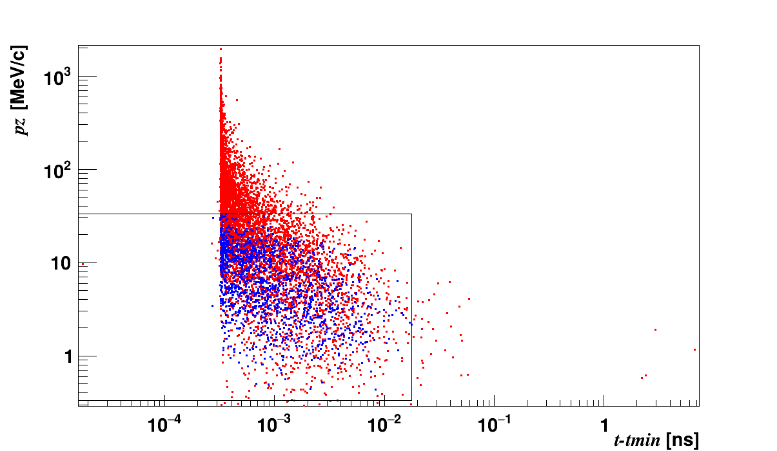
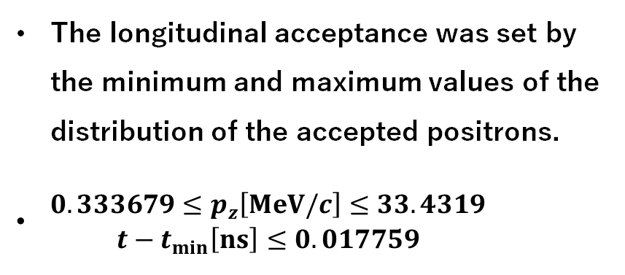
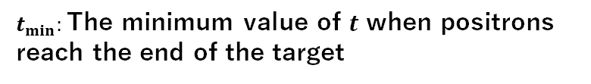
Longitudinal acceptance
The longitudinal acceptance was set by the minimum and maximum values of the distribution of the accepted positrons.
$\begin{aligned}0.333679≤p_{z}\left[MeV/c\right]≤33.4319 \\ t−t_{min}\left[ns\right]≤0.017759\end{aligned}$
The longitudinal phase space distribution after the target
●：All positrons
●：Accepted positrons
Number of positrons
 | Number
All positrons | 7292
Positrons in the provisional acceptance | 1600
$t_{min}:$The minimum value of $t$ when positrons reach the end of the target

Slide 9
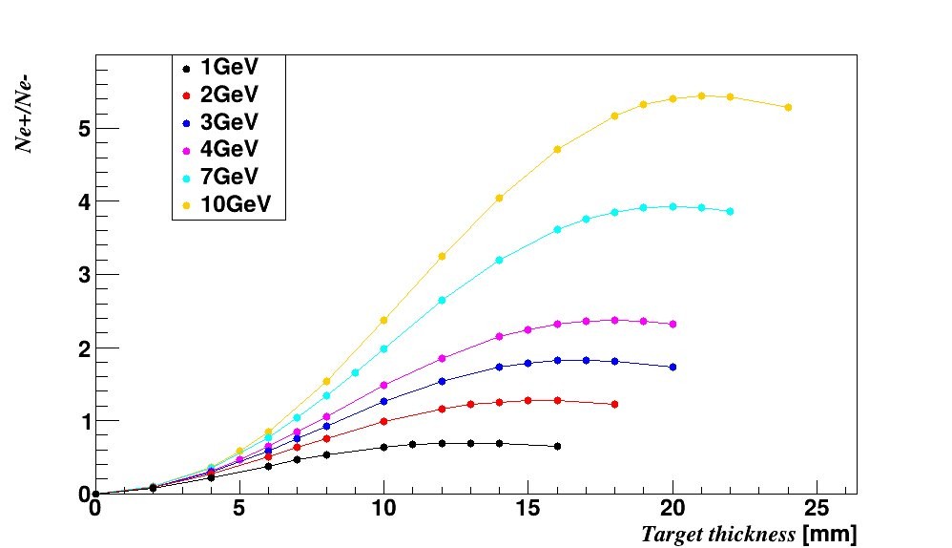
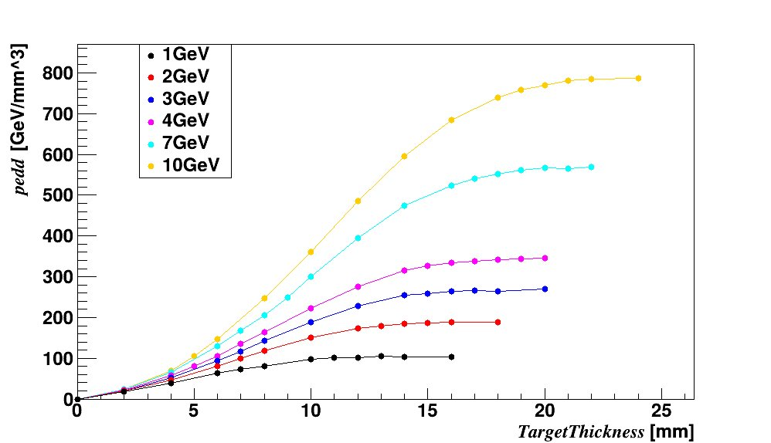
Positron Yield on target
Positron yield at the target
Peak energy deposition density of the target
The positron yield and peak energy deposition density are higher for higher drive beam energy.
The optimum target thickness is thicker for higher drive beam energy.

Slide 10
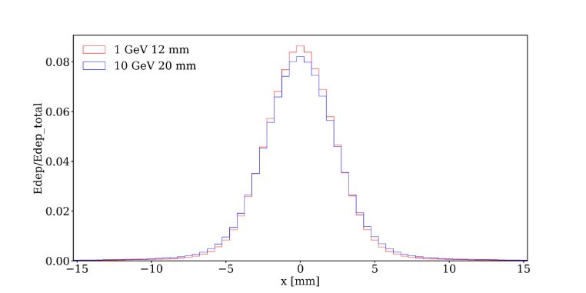
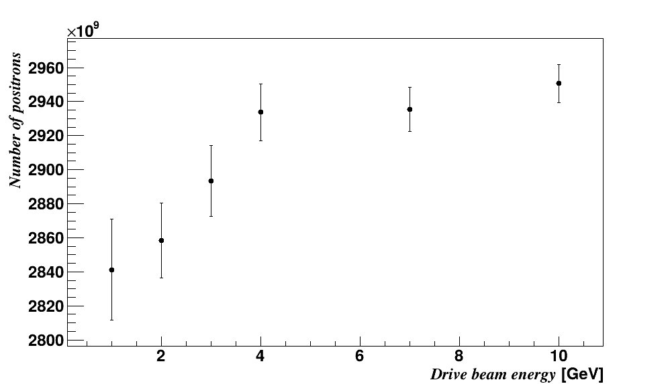
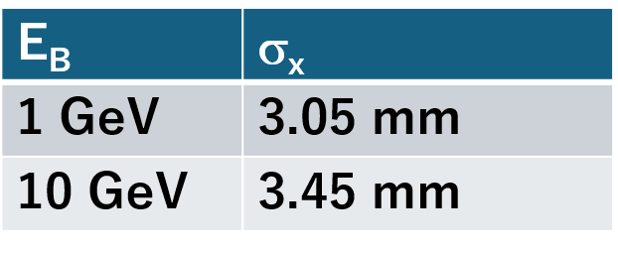
N of Positron/PEDD
The number of positrons normalized by PEDD
$x$distribution of the energy deposition
@ the target depth that maximizes the energy deposition density
4%
When the electron energy is high, the target length increases and the beam size becomes slightly larger due to scattering. This results in a reduction in PEDD.
The positron yield normalized by PEDD is higher for higher drive beam energy.

Slide 11
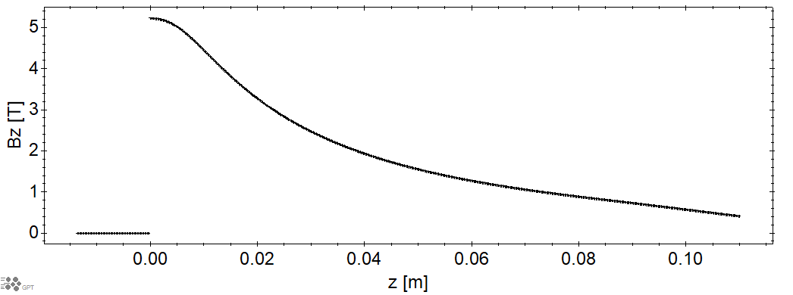
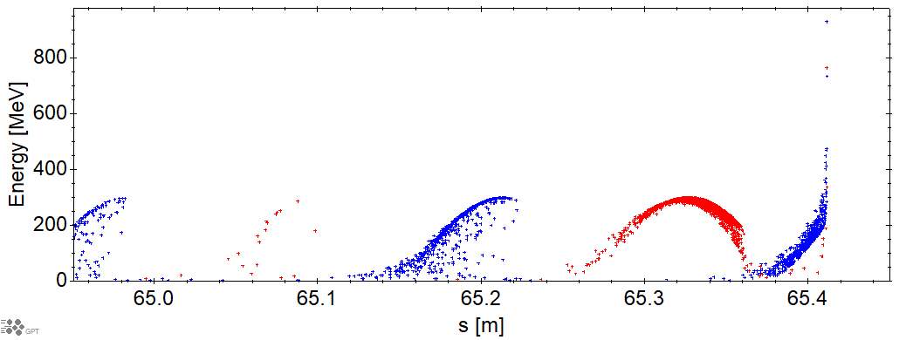
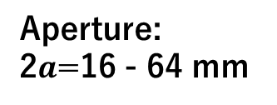
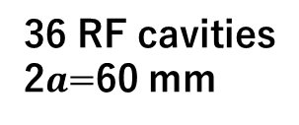
Capture linac
The adiabatic matching device suppresses the transverse momentum on the solenoidal field.
By deceleration capture, positrons are captured into a single bucket, while electrons overflow into multiple buckets.
The magnetic field of the AMD.
The longitudinal phase space distribution after the capture linac in the previous simulation.
Flux concentrator
●：Positrons
●：Electrons
36 RF cavities
2$a$=60 mm
Aperture:
2$a$=16 - 64 mm
Solenoid

Slide 12
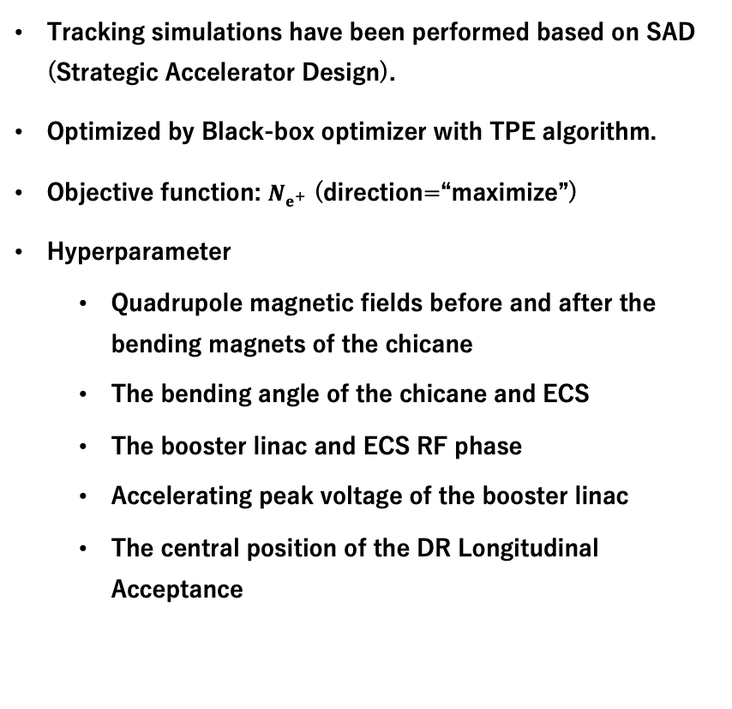
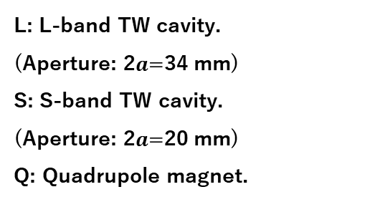
Simulations of the booster linac and ECS
Tracking simulations have been performed based on SAD (Strategic Accelerator Design).
Optimized by Black-box optimizer with TPE algorithm.
Objective function: $N_{e^{+}}$ (direction=“maximize”)
Hyperparameter
Quadrupole magnetic fields before and after the bending magnets of the chicane
The bending angle of the chicane and ECS
The booster linac and ECS RF phase
Accelerating peak voltage of the booster linac
The central position of the DR Longitudinal Acceptance
Schematic layout of the chicane
Schematic layout of the booster linac
Lattice config. | Number of lattice cells
4Q+1L | 14
4Q+2L | 29
4Q+4L | 18
4Q+4S | 26
L: L-band TW cavity.
(Aperture: 2$a$=34 mm)
S: S-band TW cavity.
(Aperture: 2$a$=20 mm)
Q: Quadrupole magnet.
Schematic layout of the ECS

Slide 13
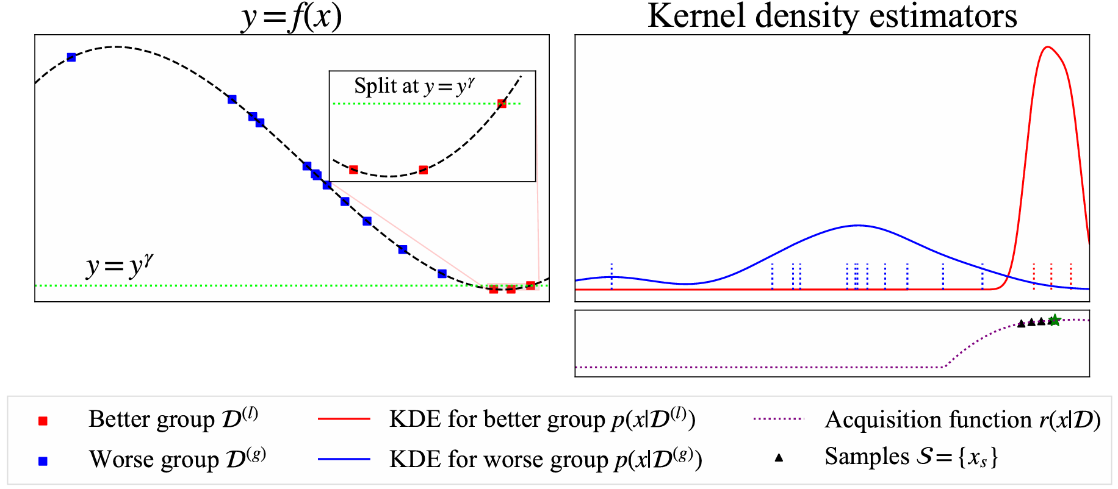
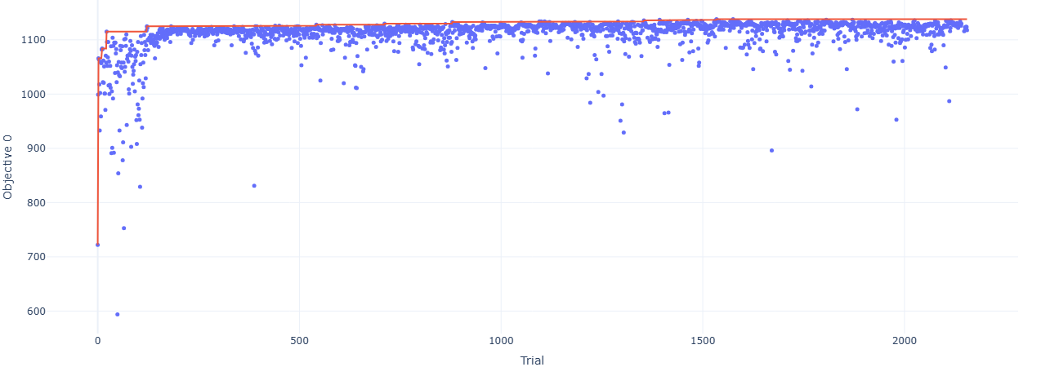
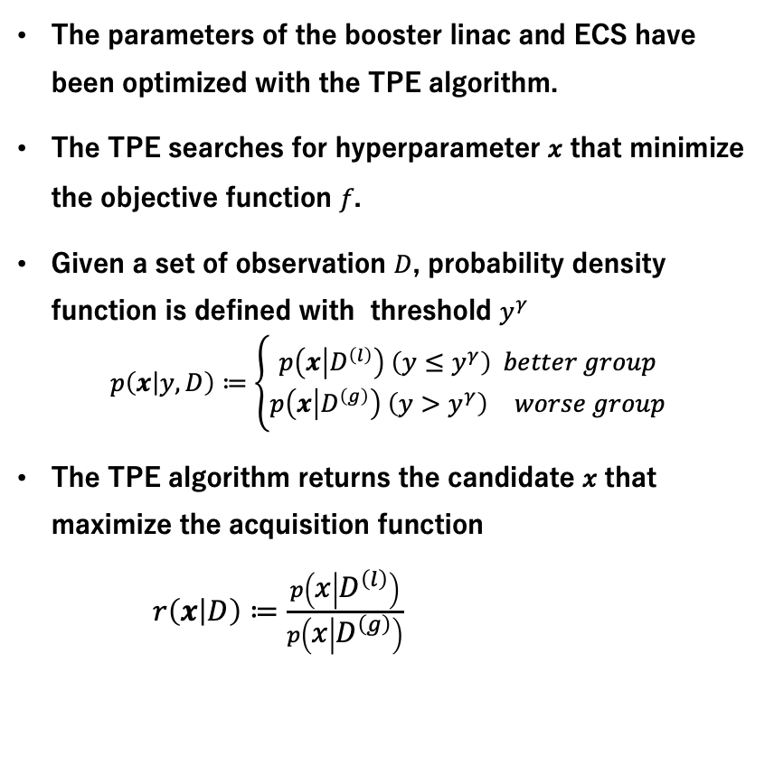
Tree-structured Parzen Estimator
The parameters of the booster linac and ECS have been optimized with the TPE algorithm.
The TPE searches for hyperparameter 𝑥 that minimize the objective function 𝑓.
Given a set of observation $D$, probability density function is defined with threshold $y^{γ}$
$$p\left(x | y, D\right)≔\left\{\begin{aligned}p\left(x | D^{\left(l\right)}\right) \left(y≤y^{γ}\right) better group \\ p\left(x | D^{\left(g\right)}\right) \left(y>y^{γ}\right) worse group\end{aligned}\right.$$
The TPE algorithm returns the candidate 𝑥 that maximize the acquisition function
$r\left(x | D\right)≔\frac{p\left(x | D^{\left(l\right)}\right)}{p\left(x | D^{\left(g\right)}\right)}$
Watanabe, “Tree-Structured Parzen Estimator.”

Slide 14
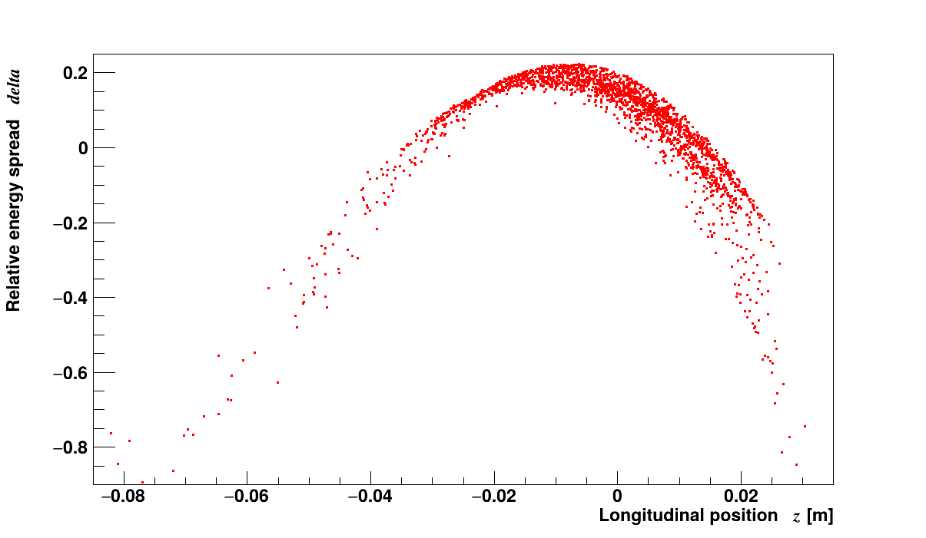
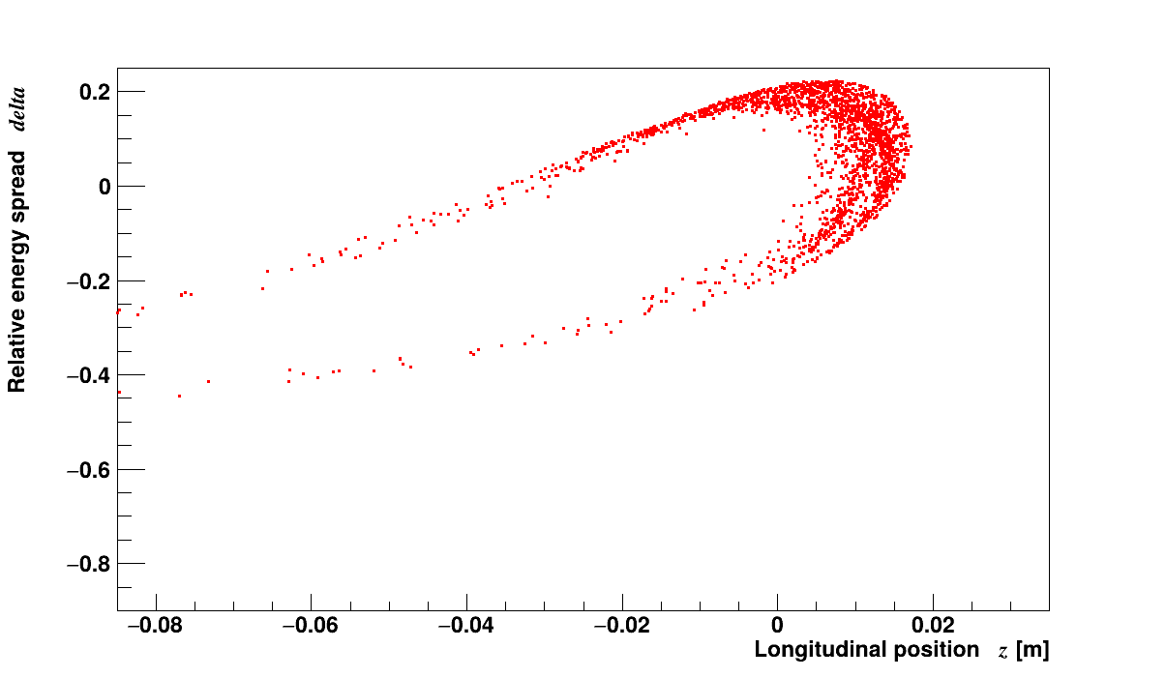
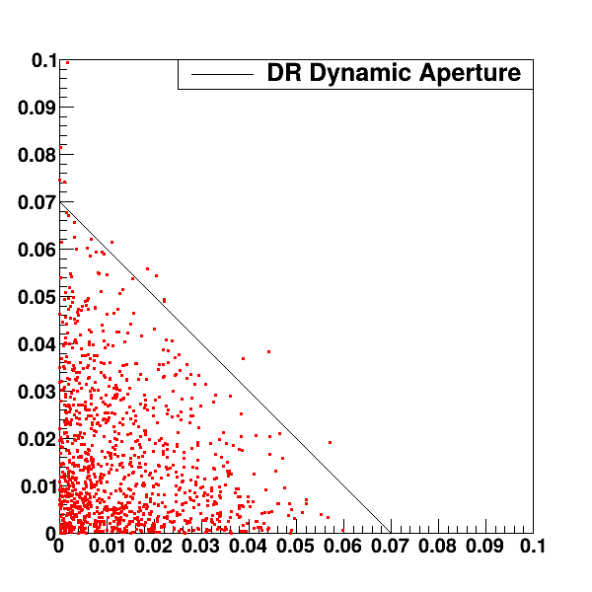
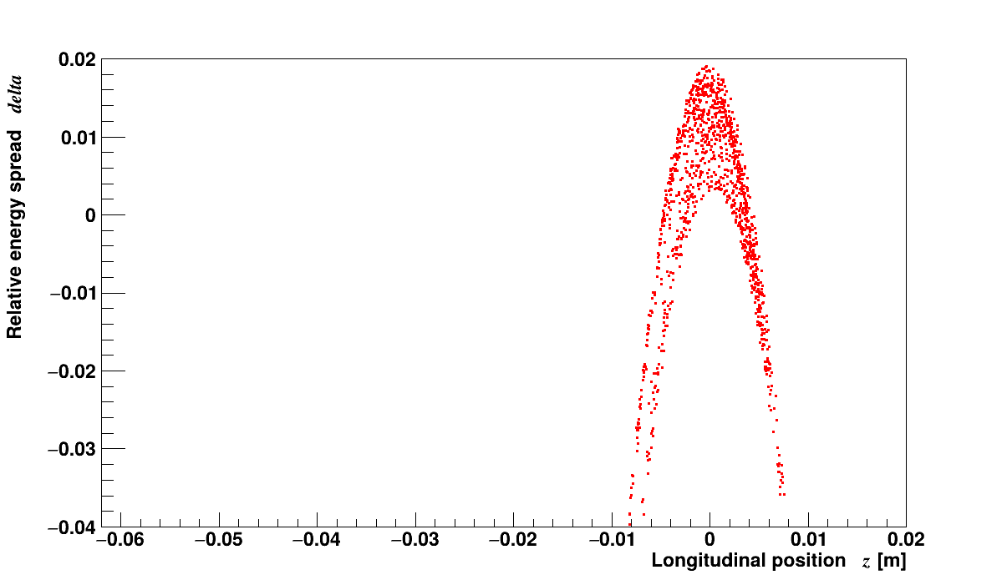
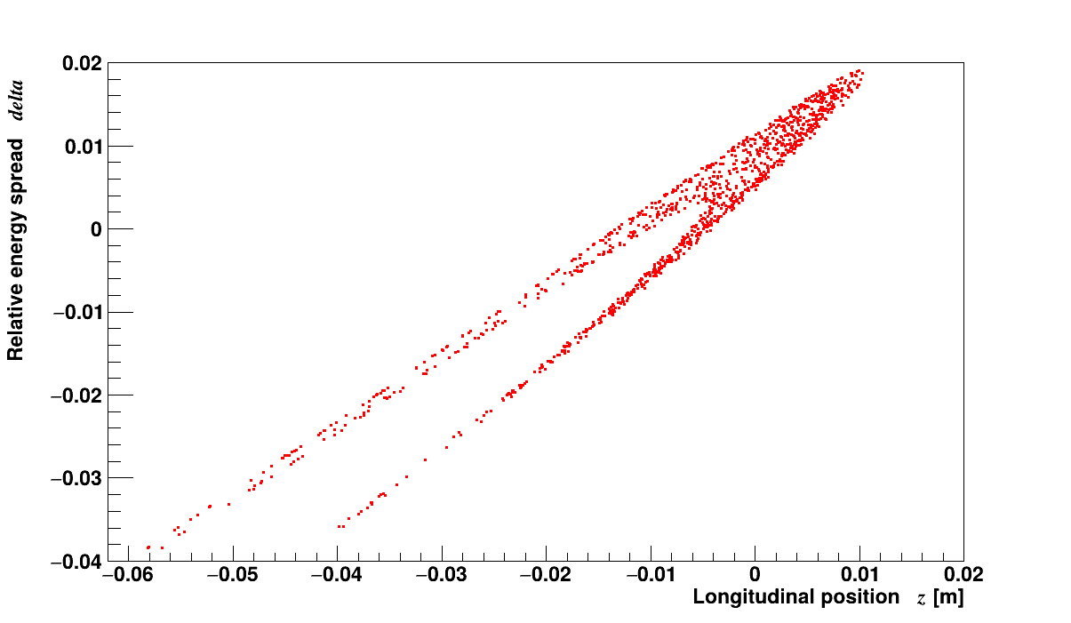
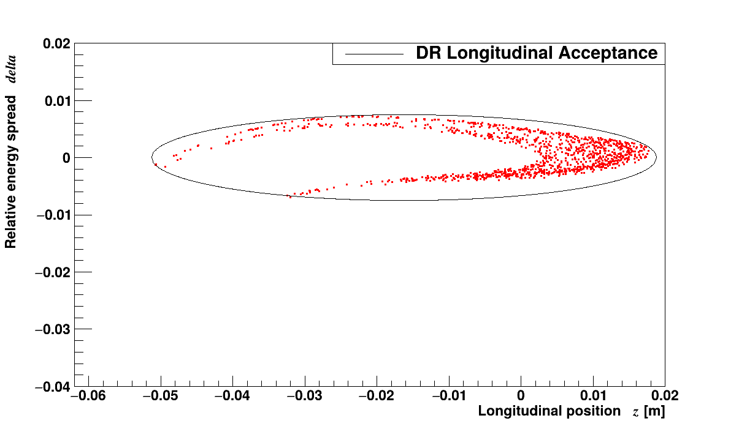
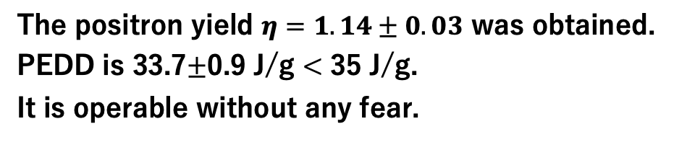


Results
The longitudinal phase space distribution of positrons.
After the capture linac.
After the chicane.
The positron yield $η=1.14±0.03$ was obtained.
PEDD is 33.7$±$0.9 J/g < 35 J/g.
It is operable without any fear.
DR dynamic aperture.
$$γ2J_{y}$$
After the booster linac.
After the chicane of the ECS.
After the ECS.
$$γ2J_{x}$$

Slide 15
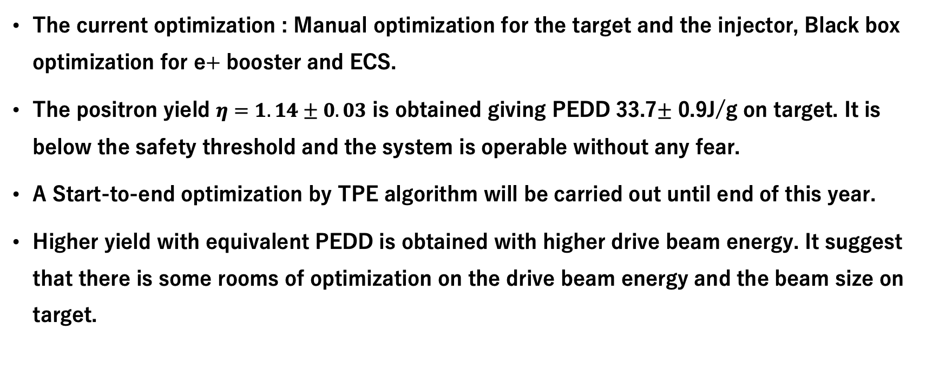
Conclusions & Future work
The current optimization : Manual optimization for the target and the injector, Black box optimization for e+ booster and ECS.
The positron yield $η=1.14±0.03$ is obtained giving PEDD 33.7$±$ 0.9J/g on target. It is below the safety threshold and the system is operable without any fear.
A Start-to-end optimization by TPE algorithm will be carried out until end of this year.
Higher yield with equivalent PEDD is obtained with higher drive beam energy. It suggest that there is some rooms of optimization on the drive beam energy and the beam size on target.

