Slide 1
Status of the CLIC injector complex and Positron Source
New injectors layout from the CLIC Readiness Report
Beam dynamics simulations (Yongke Zhao)
Positron Source Beam Loading studies (Nafiseh Mesbah)
AMD prototyping
Conclusion
Steffen Doebert on behalf of the CLIC collaboration
LCWS , Valencia, October 2025

Slide 2
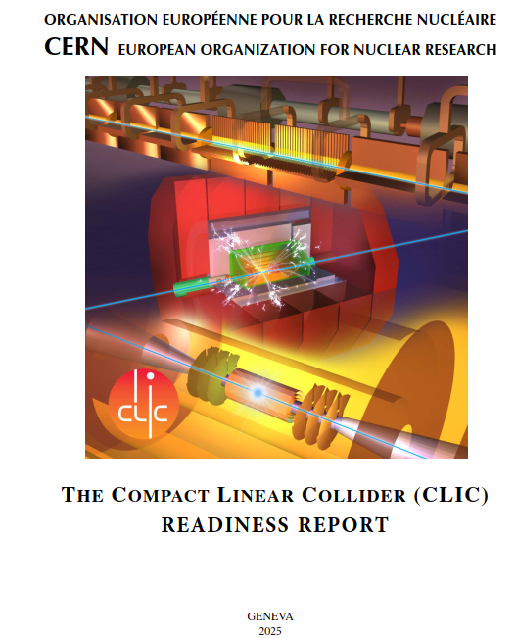
CLIC Readiness Report
Latest CLIC documentation as Input for the European Strategy Update 2025
Very Interesting Read with lots of updates for the CLIC machine, in particular a new injector layout
Being published in: “The European Physics Journal Special Topics”
https://edms.cern.ch/ui/file/3285253/1/2025_CLIC_Readiness_Report_V2025may26.pdf

Slide 3
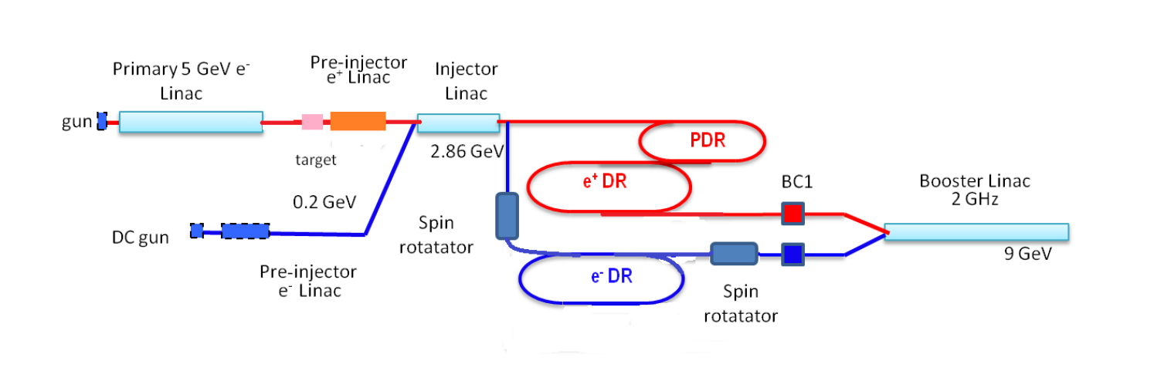
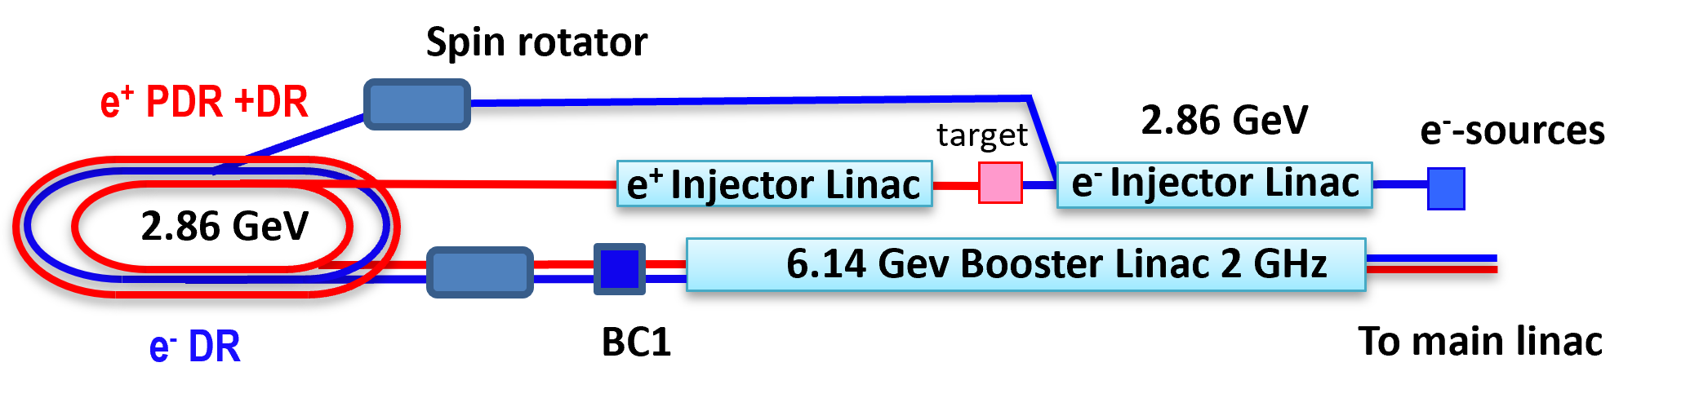
CLIC Readiness Report New injector layout and configuration
New positron production energy: 2.86 GeV
Separate positron capture linac up to 2.86 GeV
Folded layout to save space
New optimized accelerating structure
Used lessons learned from the FCCee injector optimization
Results in power and cost savings

Slide 4
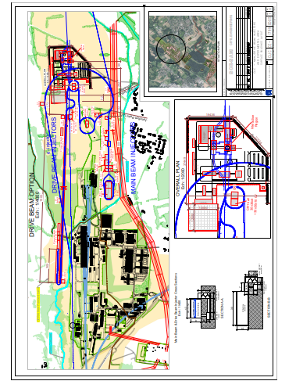

All situated on the CERN Prevesin site

Slide 5
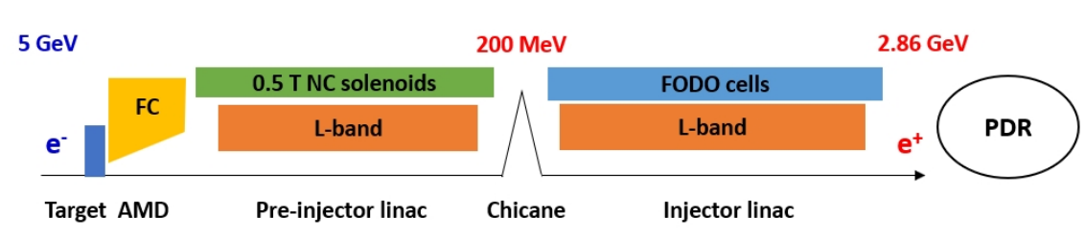
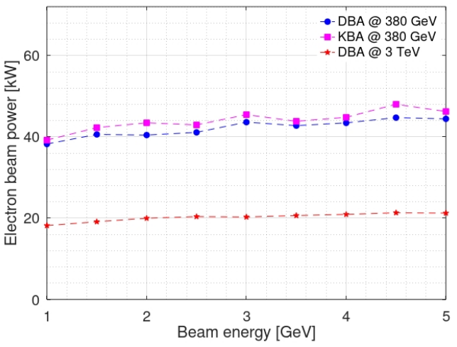
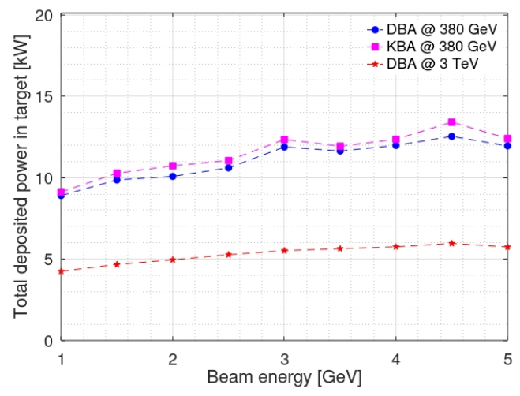
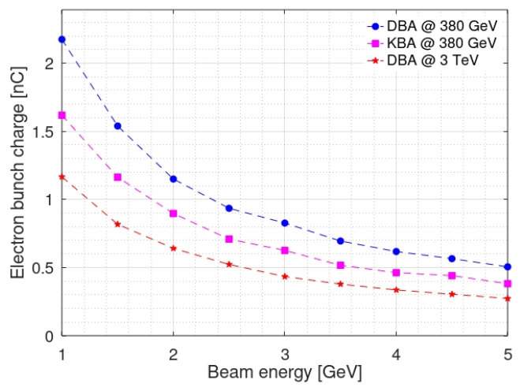
CLIC positron production
Based on our latest e+ source simulation (CLIC-Note-1200), it is possible to reduce the e- beam energy from 5 GeV to ~2.3 GeV (assuming 1 nC max.)

Slide 6
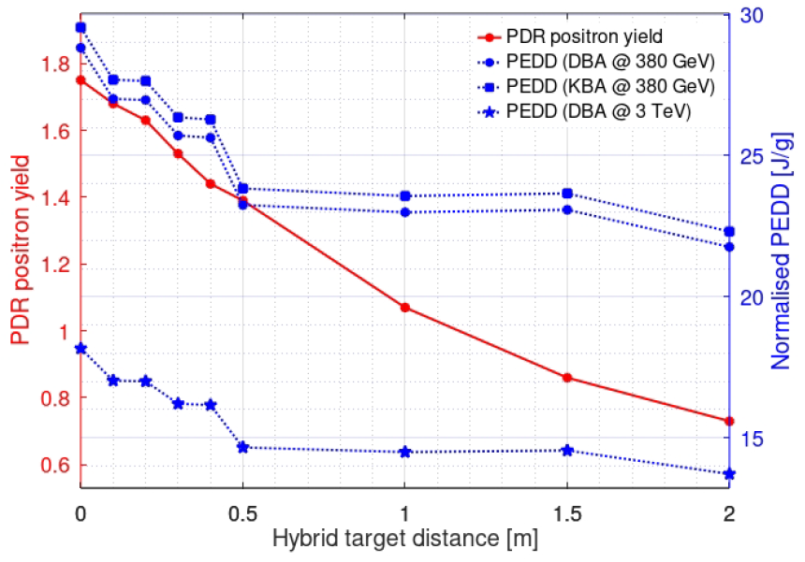
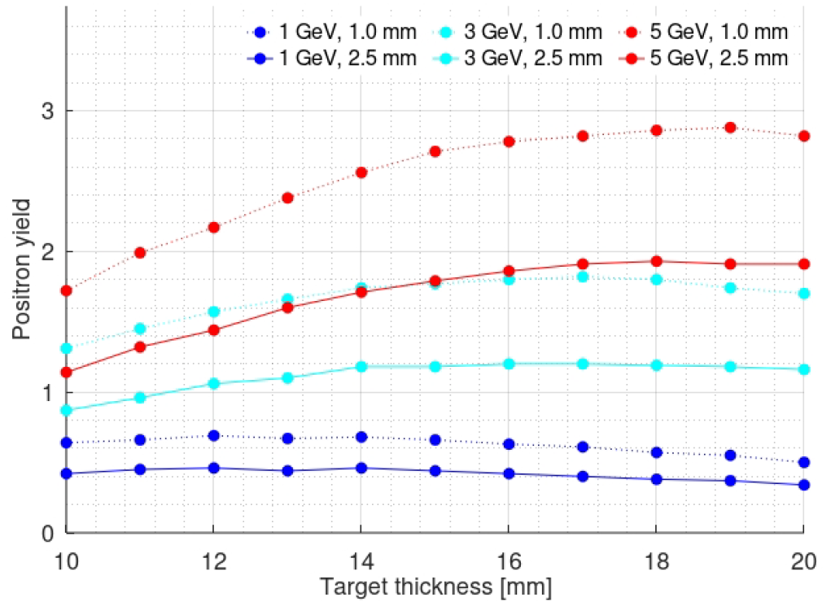
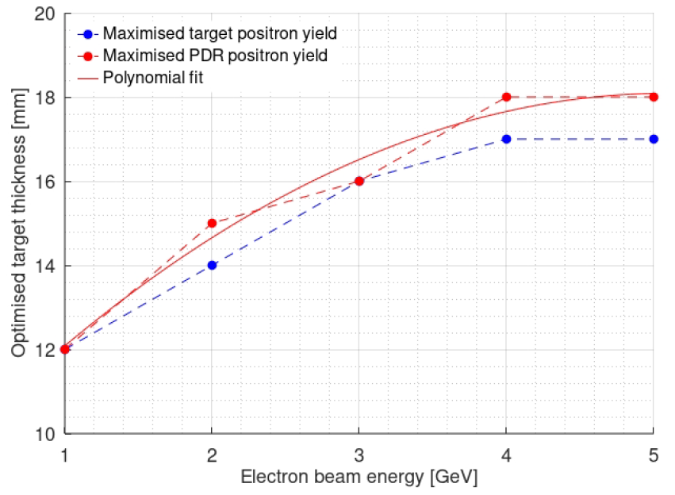
Positron Target Scheme, single amorphous target
Old baseline
Hybrid target option (CDR version)
Reoptimized in an old report published in 2019
Hybrid target distance scan
New baseline
Single target option
Optimized thickness: 18 mm
Single target thickness scans
Optimised target thickness vs beam energy
Positron yield improved by a factor of 1.65, deposited power in target reduced by a factor of 2.1, compared with the old optimization report published in 2019

Slide 7
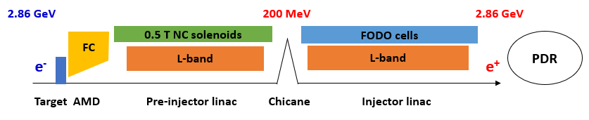
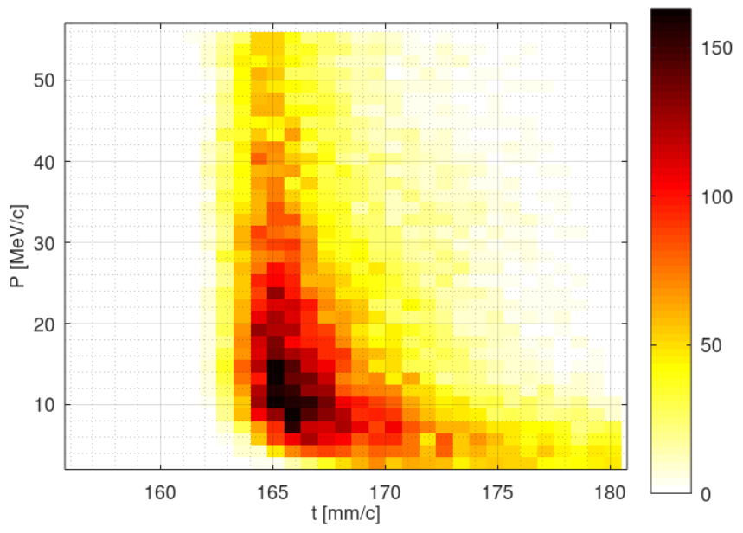
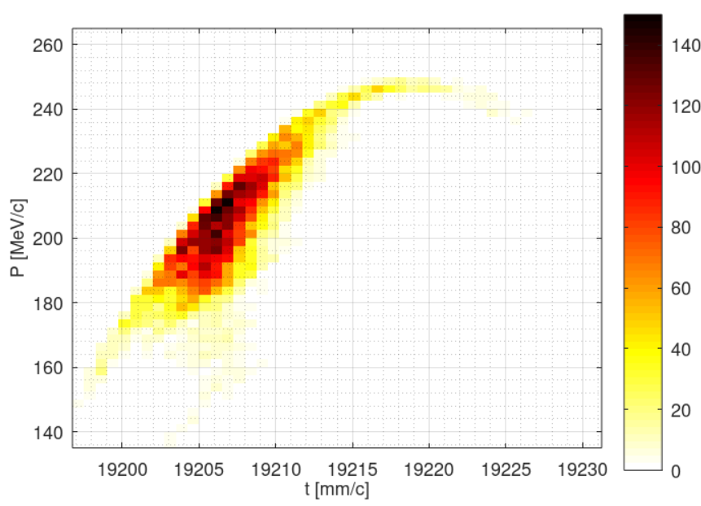
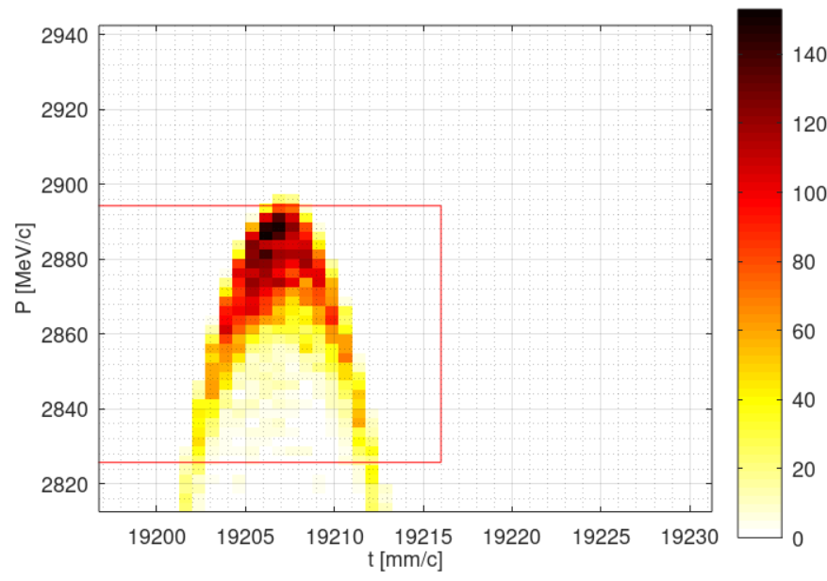
Revised beam dynamics design
PDR accepted e+ yield ~ 1.1, Electron bunch charge ~ 1.0 nC, PEDD ~ 31J/g
Spot size on target 2.5 mm, target thickness 16.5 mm
Revised solenoid field along capture linac
Revised beam dynamics in the linac up to 2.86 GeV
AMD exit Pre-Injector Linac exit Injector Linac exit

Slide 8
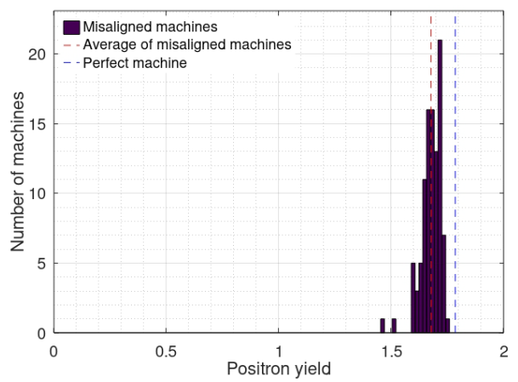
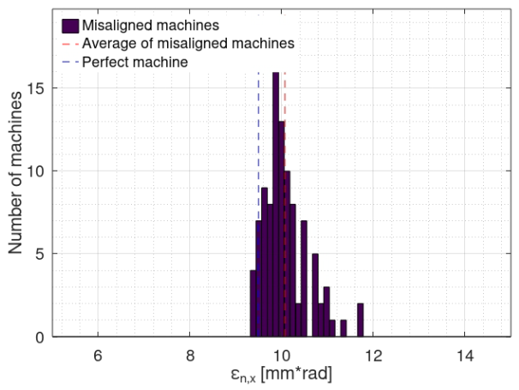
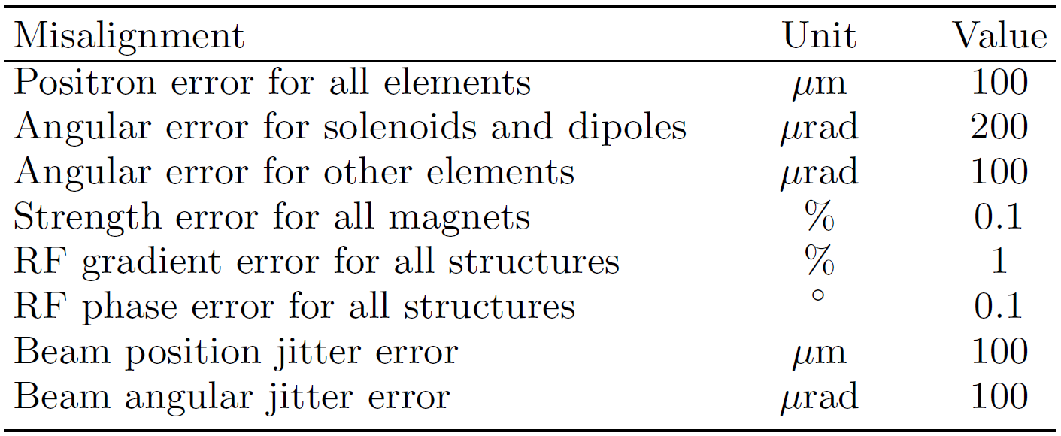
Study of Imperfections
100 randomly misaligned machines simulated
Misalignments & beam jitters (RMS)
Positron yield of all machines
Normalized emittance of all machines
Average positron yield reduced by 6%. Emittance also increased by 6%. Results are acceptable
Beam-based alignment corrections are not very necessary

Slide 9
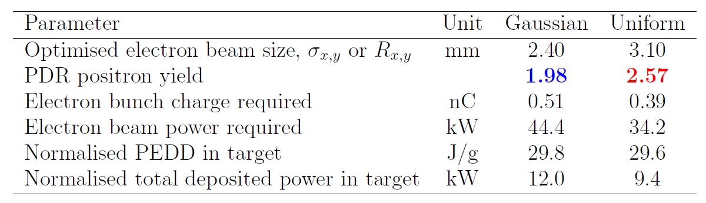
Alternative options: uniform beam
Primary e⁻ beam with uniform profile (transverse distribution)
Transverse positions
Transverse momentums
Horizontal position
Optimization results (e.g. DBA @ 380 GeV)
Significant improvement in yield (30%)
Uniform beam production is very challenging (to be designed)

Slide 10
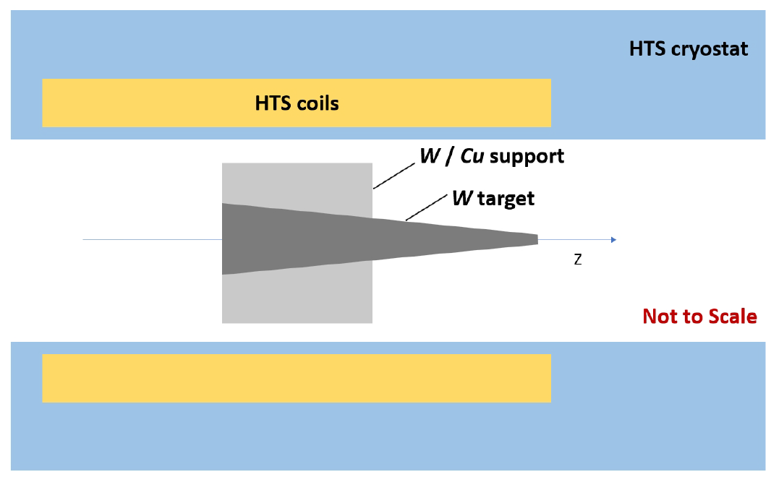
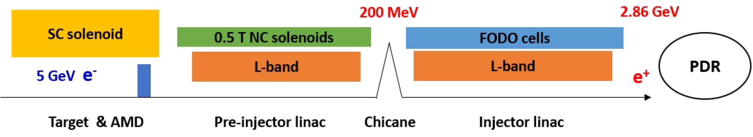
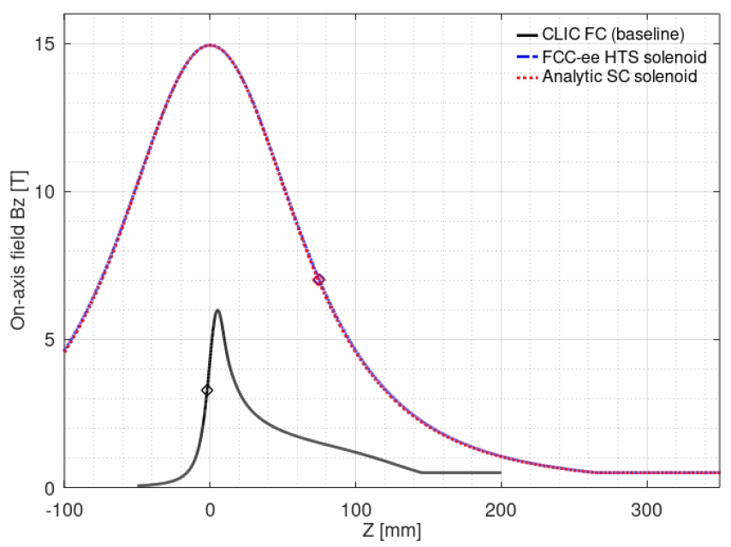
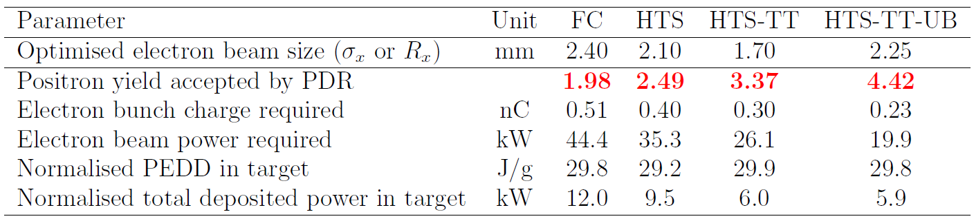
Alternative options: SC AMD, tapered target
Using a SC solenoid as AMD (similar to FCC-ee study)
Target can then be tapered to increase yield (originally conceived by Nicolas Vallis for FCC-ee study)
Schematic layout based on a SC AMD
Optimization results of using analytic SC solenoid field
The optimized field is the same as the FCC-ee HTS solenoid field (designed by PSI)
Schematic layout for tapered target
Results (DBA @ 380 GeV)
FC: FC based AMD. New baseline
HTS: FCC-ee HTS based AMD
HTS-TT: HTS + Tapered target
HTS-TT-UB: HTS + Tapered target + Uniform beam
Significant improvement in yield (25%) using SC AMD, though much lower than FCC-ee (~50%)
Also significant improvements in other challenging options
On-axis Bz field comparison

Slide 11
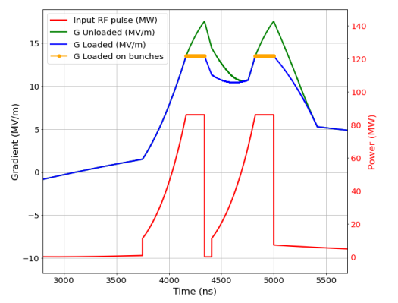
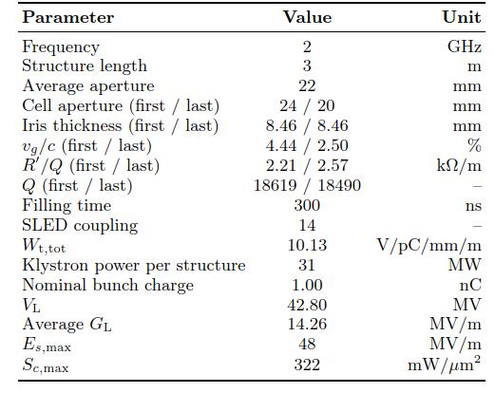
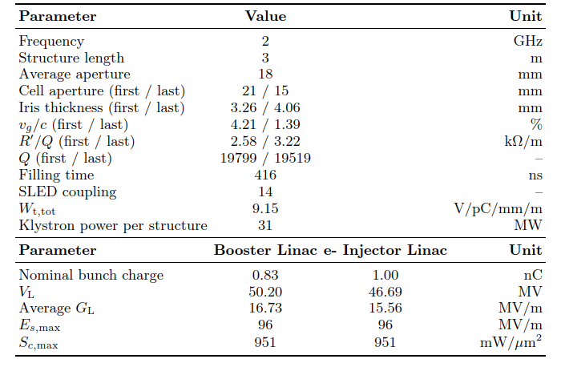
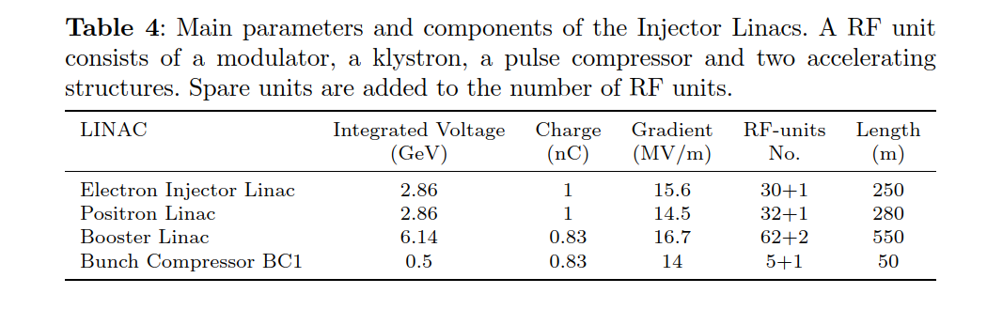
New injector linacs design
Positron Capture Linac
Electron and Booster Linac
See as well dedicated presentation by Adnan Kurtulus in this workshop

Slide 12
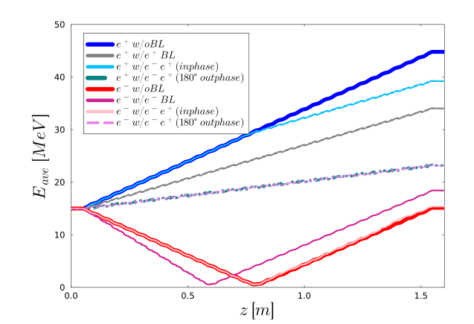
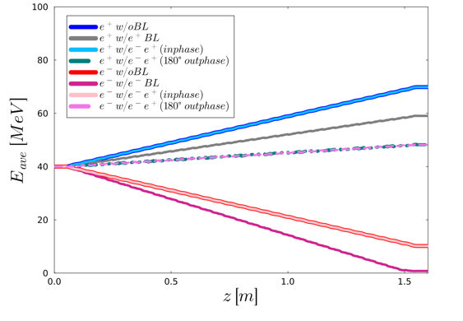
Beam loading in the positron capture Linac
Simulated with RF-Track
Example of beam loading effects in the first structure using gaussian beams
Nafiseh Mesbah

Slide 13
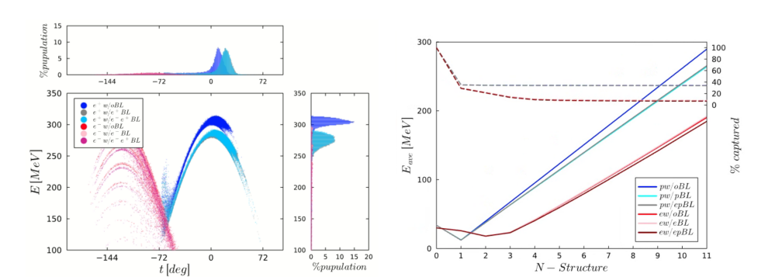
Beam loading in the positron capture Linac
Beam loading in the full capture linac with distribution tails cut.
Shown is the last bunch of the train
Nafiseh Mesbah

Slide 14
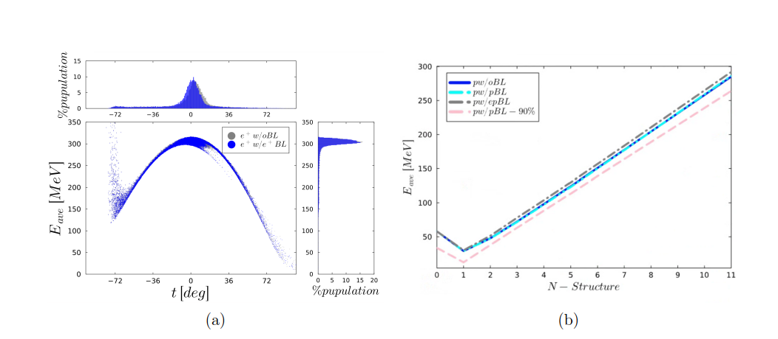
Beam loading in the positron capture Linac
Beam loading in the full capture linac without distribution tails cut.
Shown is the last bunch of the train
Nafiseh Mesbah

Slide 15
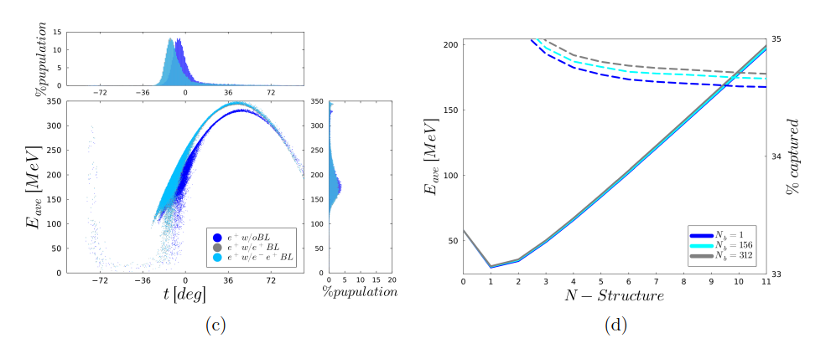
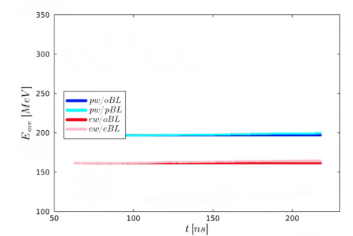
Beam loading in the positron capture Linac
Results after phase optimization to minimize beam loading effects.
Still many aspects to be understood but it looks with a phase optimization one can reach an acceptable result.
Nafiseh Mesbah

Slide 16

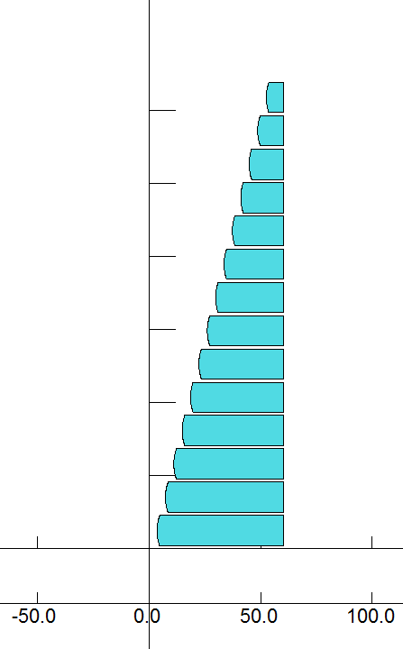
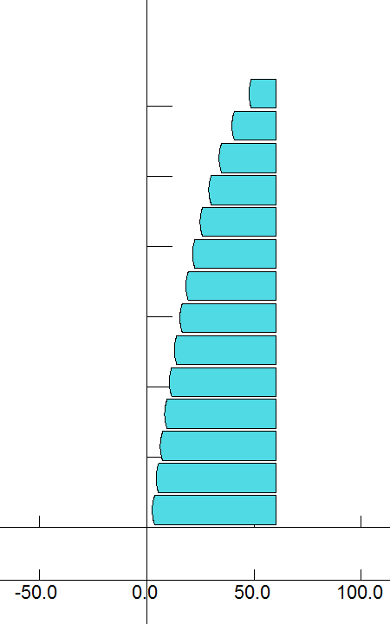
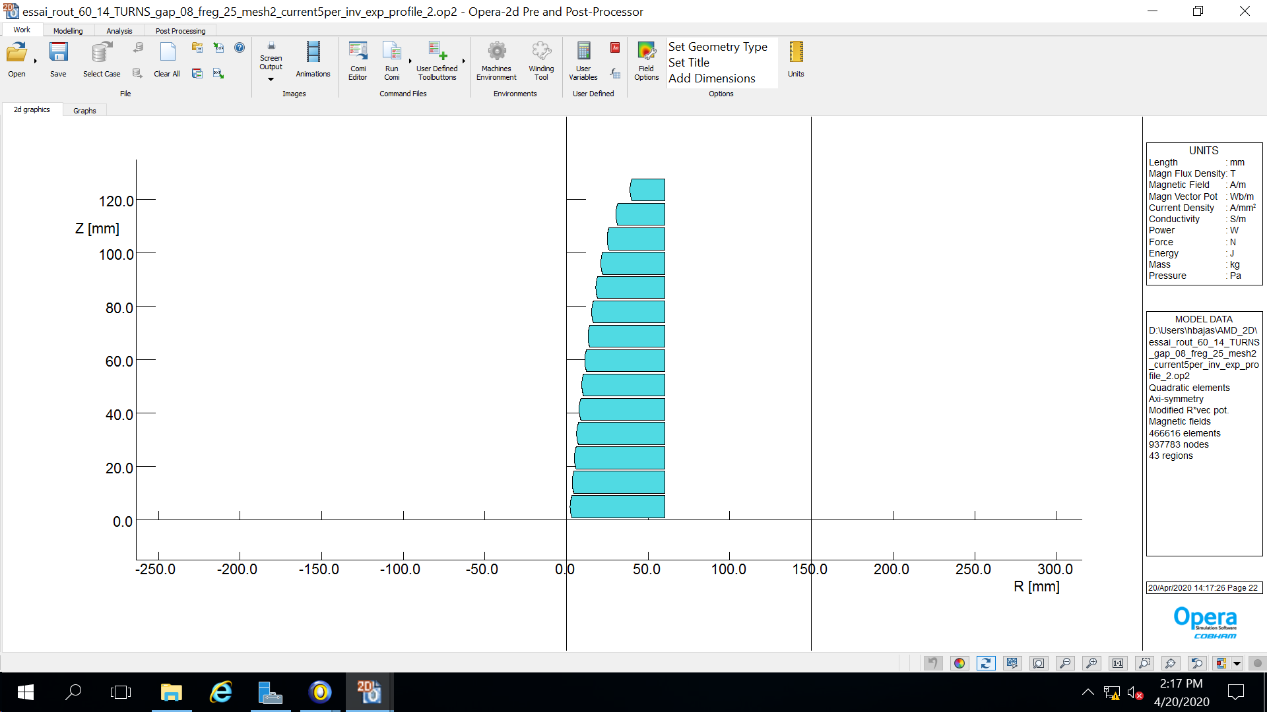

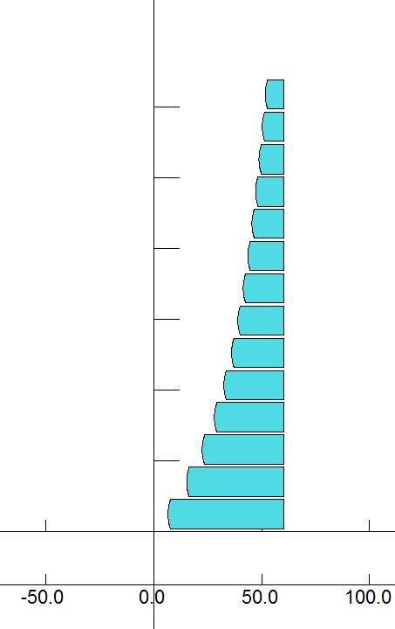
Zoo of new designs for the CLIC e+ source
From linear to non-linear profile for the FC aperture:
Linear
Concave downward (1)
Concave downward (2)
Concave downward + linear (3)
Concave upward
Hugues Bajas

Slide 17
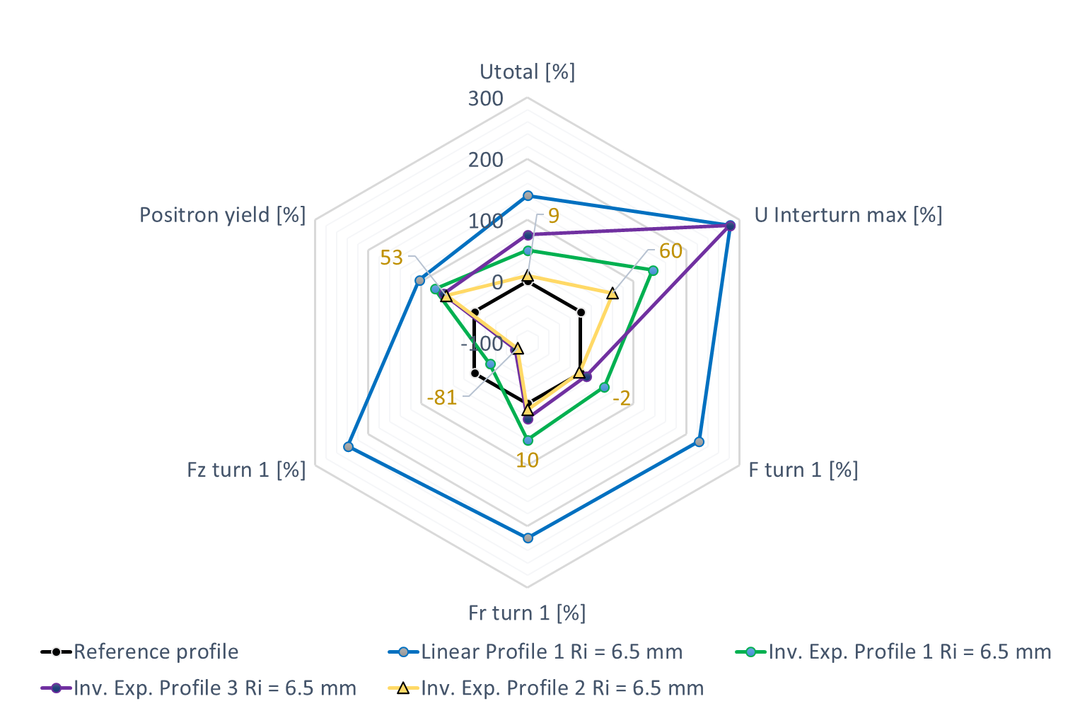
Design optimization for the CLIC e+ source
SLAC design @ 25 kHz & 13 kA
Vs.
linear modified design
with large aperture
Vs.
Non-linear design (1) Concave downward
Vs.
Non-linear design (3) Concave downward + linear
Vs.
Non-linear design (2) Concave downward
Adapting the non-linear shape (green vs. yellow) preserves the yield (53% higher).
The voltages get significantly lower.
The detrimental forces directed along the coil axis Z lowers too.
Hugues Bajas

Slide 18
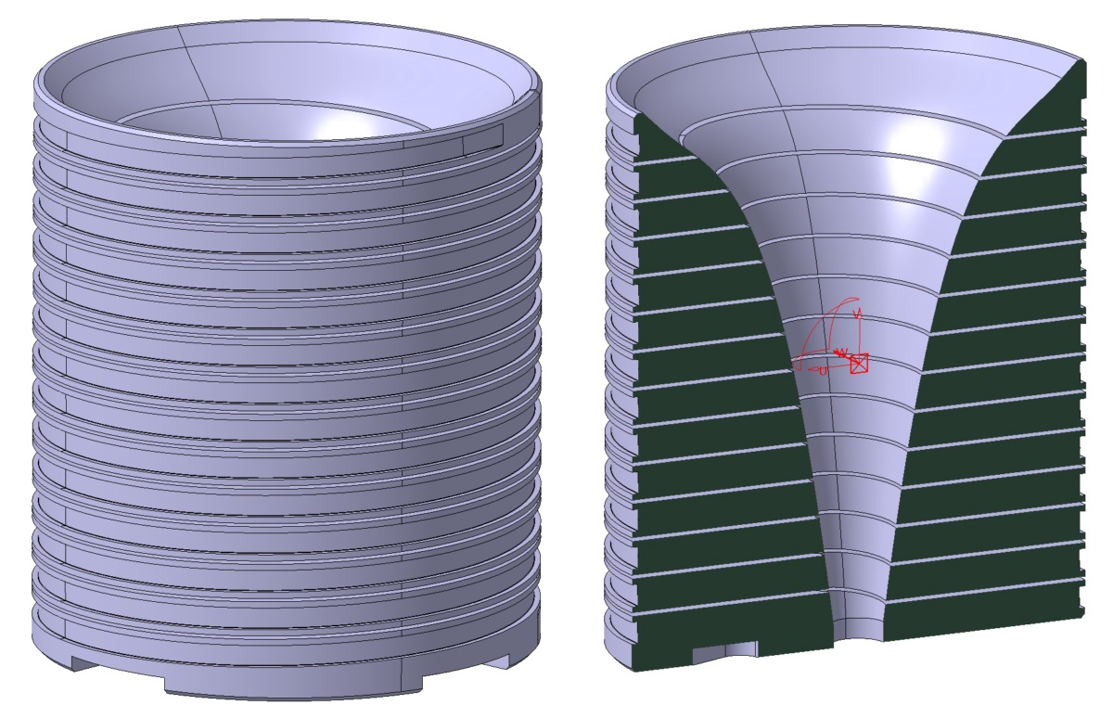
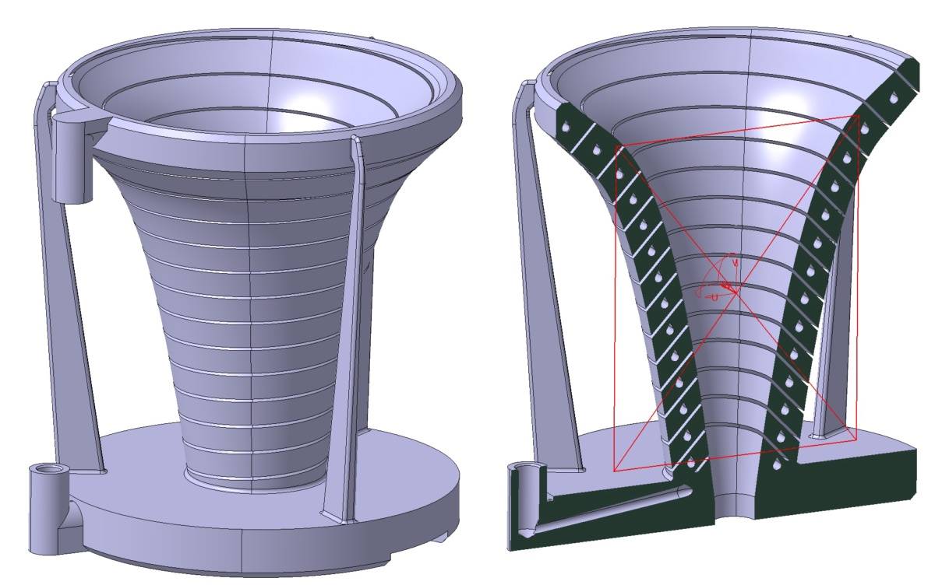
Manufacturing choices
“Classic” Machining with
Electric Discharge Machining (EDM)
Better precision and surface quality
“Innovative” Machining with 3D printing (at CERN with Titanium and Steel)
Huge freedom in design (include cooling pipes)

Slide 19
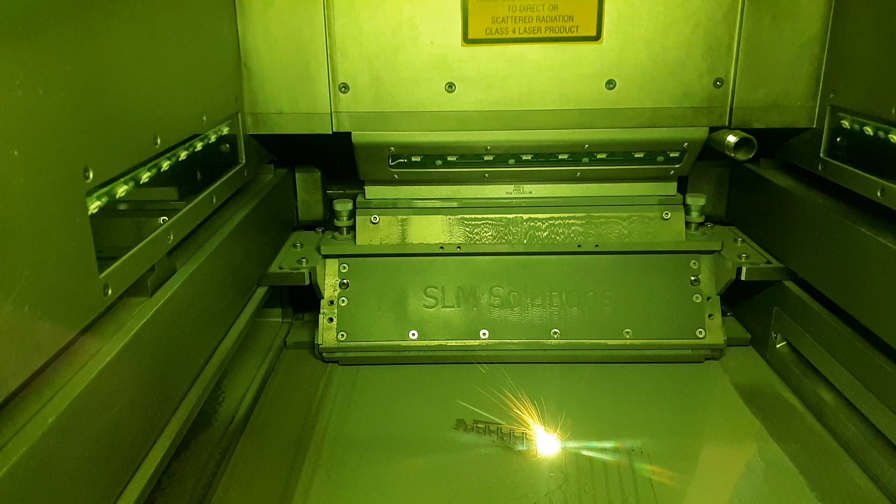
3D-printing

Slide 20
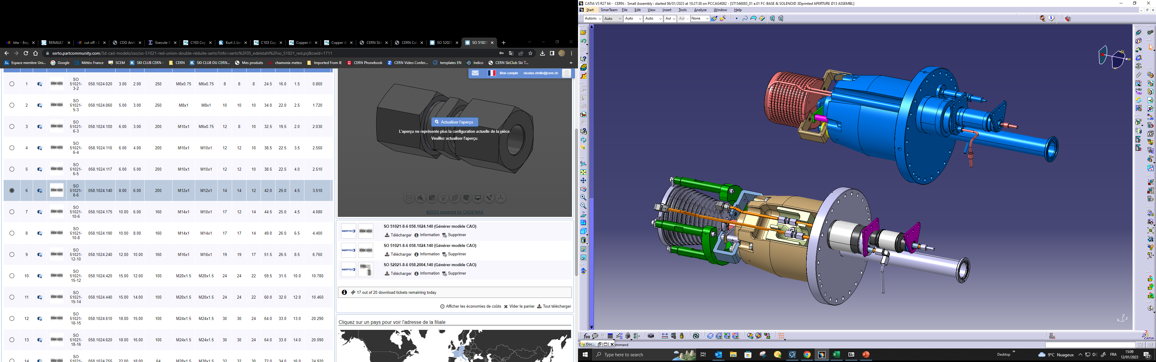
Possible Prototype testing within KEK test stand
Flexible holder for several prototypes

Slide 21
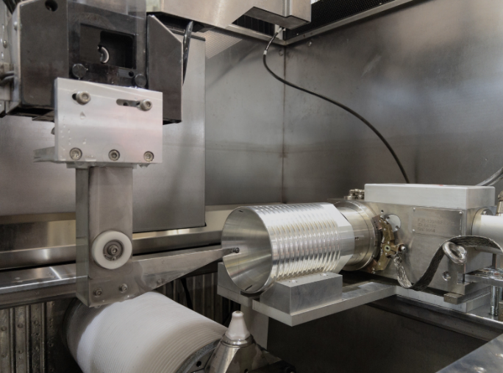
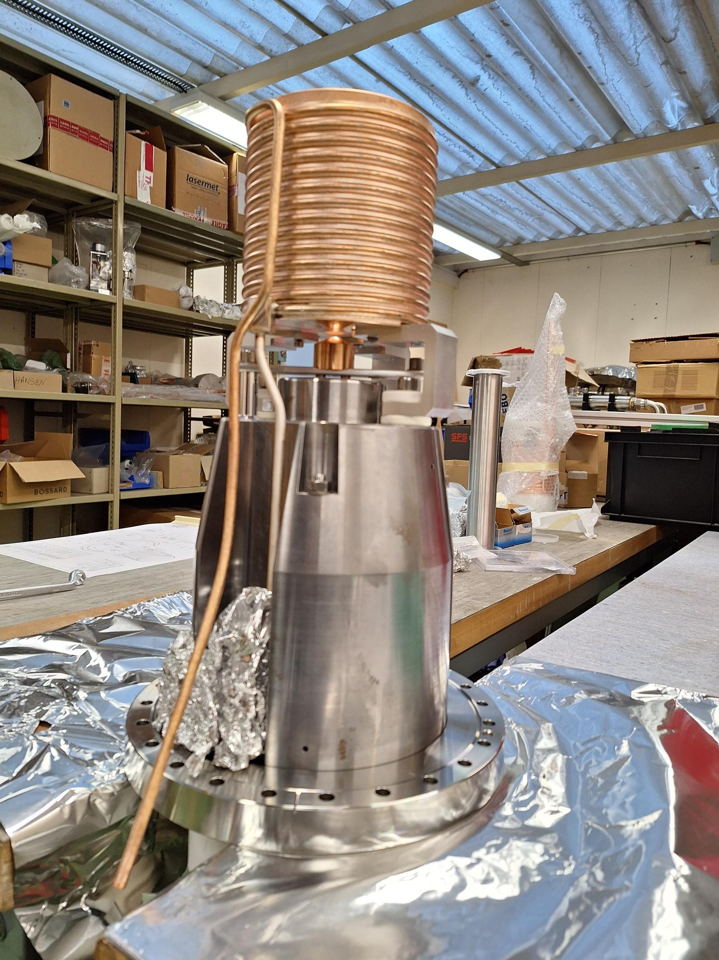
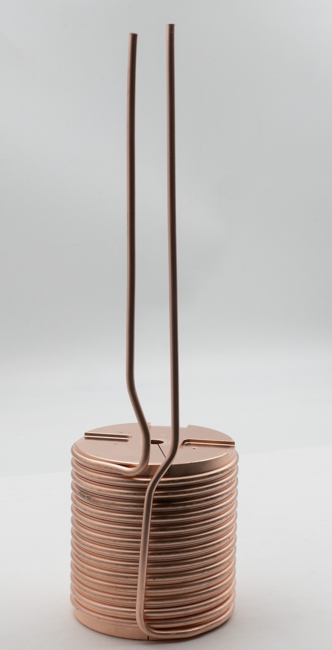
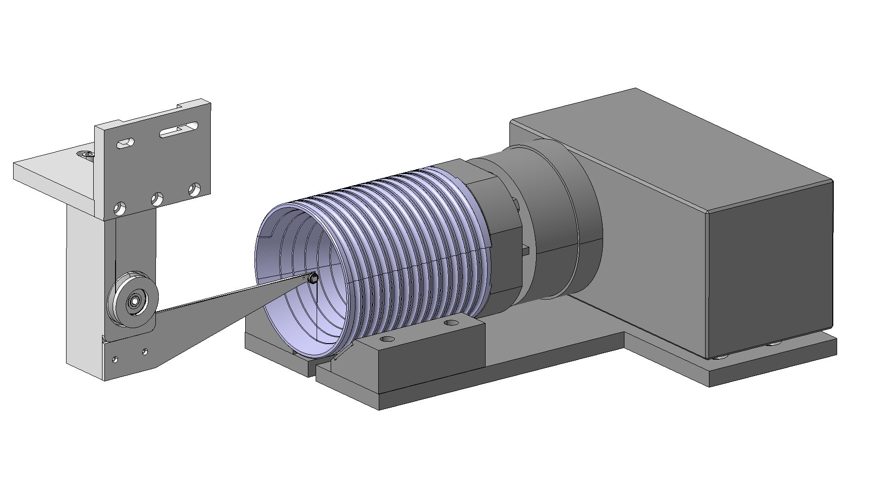
Manufacturing with EDM
These are challenging pieces to machine, needs huge effort.
Finally, we manged to manufacture two prototypes at CERN

Slide 22
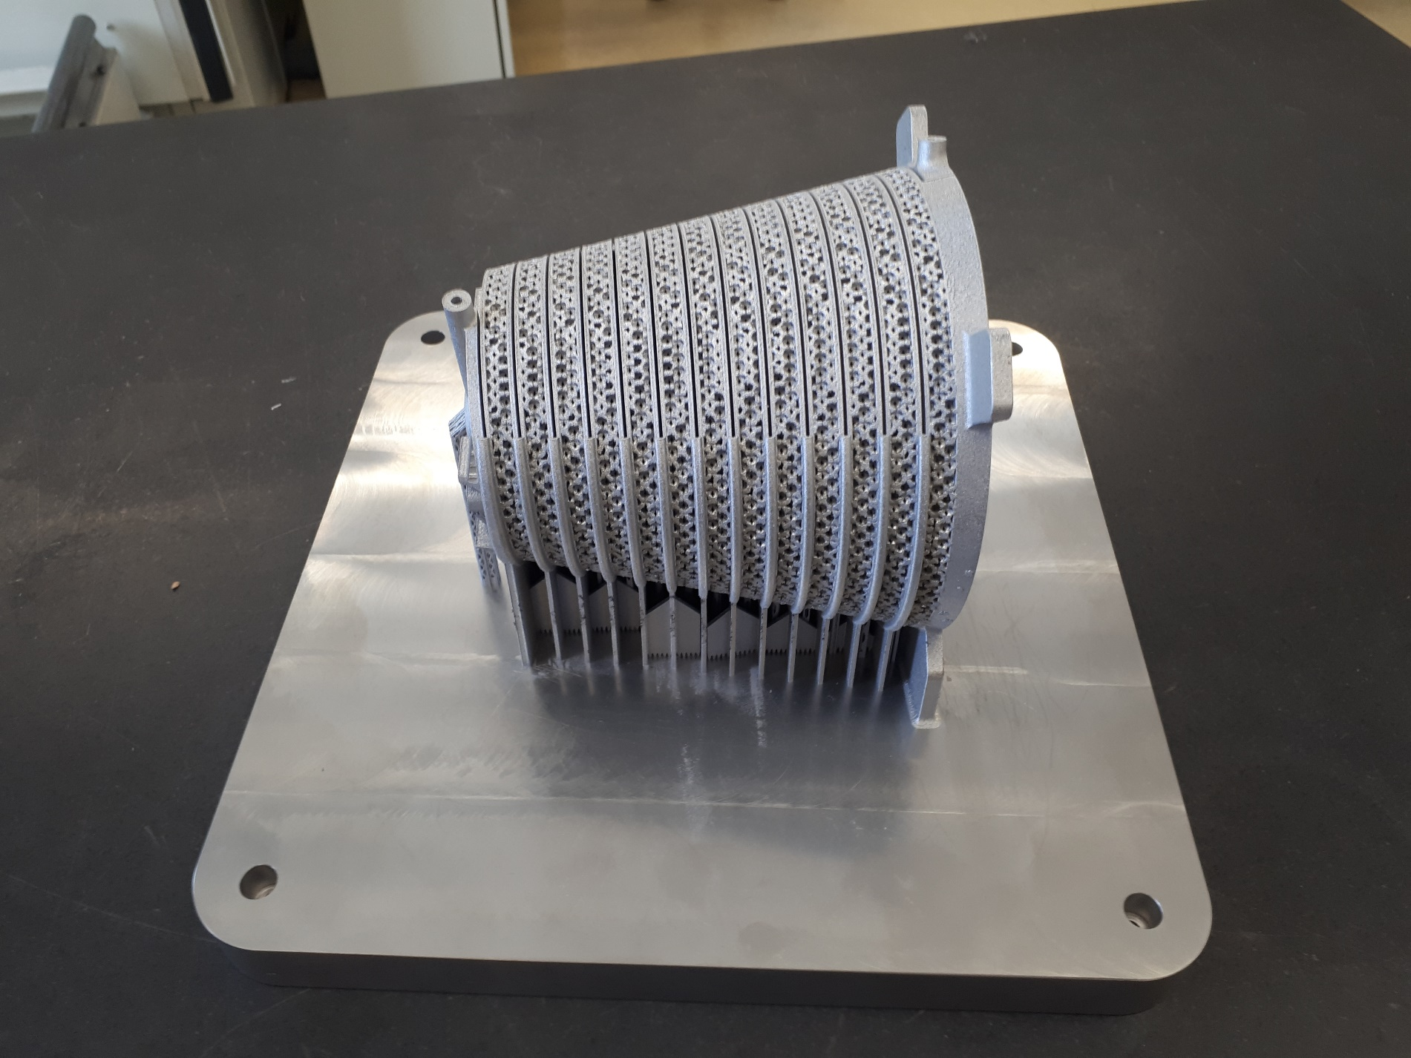
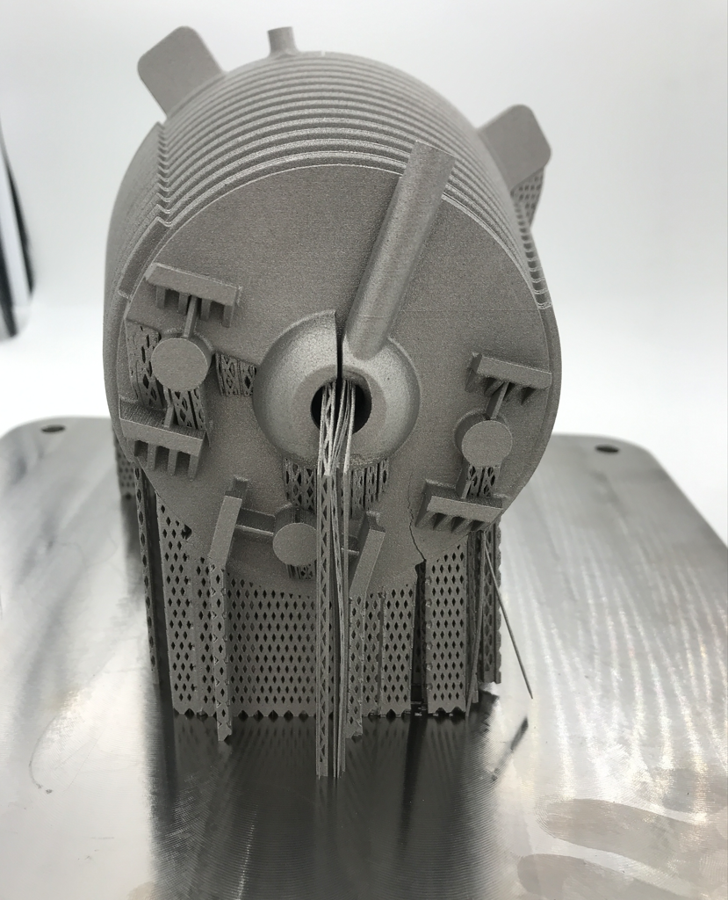
3D-printing results in Steel and Titanium
SS
TI
Not clear yet if this will be successful but would open very interesting options. Quite massive object for 3D printing

Slide 23
Conclusions
Revisited and updated the design of the whole CLIC injector chain for EPPSU exercise Probably most consistent design for CLIC until now Performance improvements, cost and power savings New positron production design, 2.86 GeV drive beam, amorphous target, new linac structures
Still studying beam loading effects on the CLIC bunch train. Great evolution of the simulation tools but still a lot of open questions.
Successful manufacturing of adiabatic damping devices with different manufacturing techniques. High power testing needed to advance further.
Waiting for EPPSU outcome to define future directions

