Slide 1






Update on the FCC-ee Positron Source
Iryna Chaikovska
Laboratoire de Physique des 2 Infinis Irène Joliot-Curie (IJCLab)
CNRS, Université Paris-Saclay
on behalf of the FCC-ee Injector Study collaboration

Slide 2
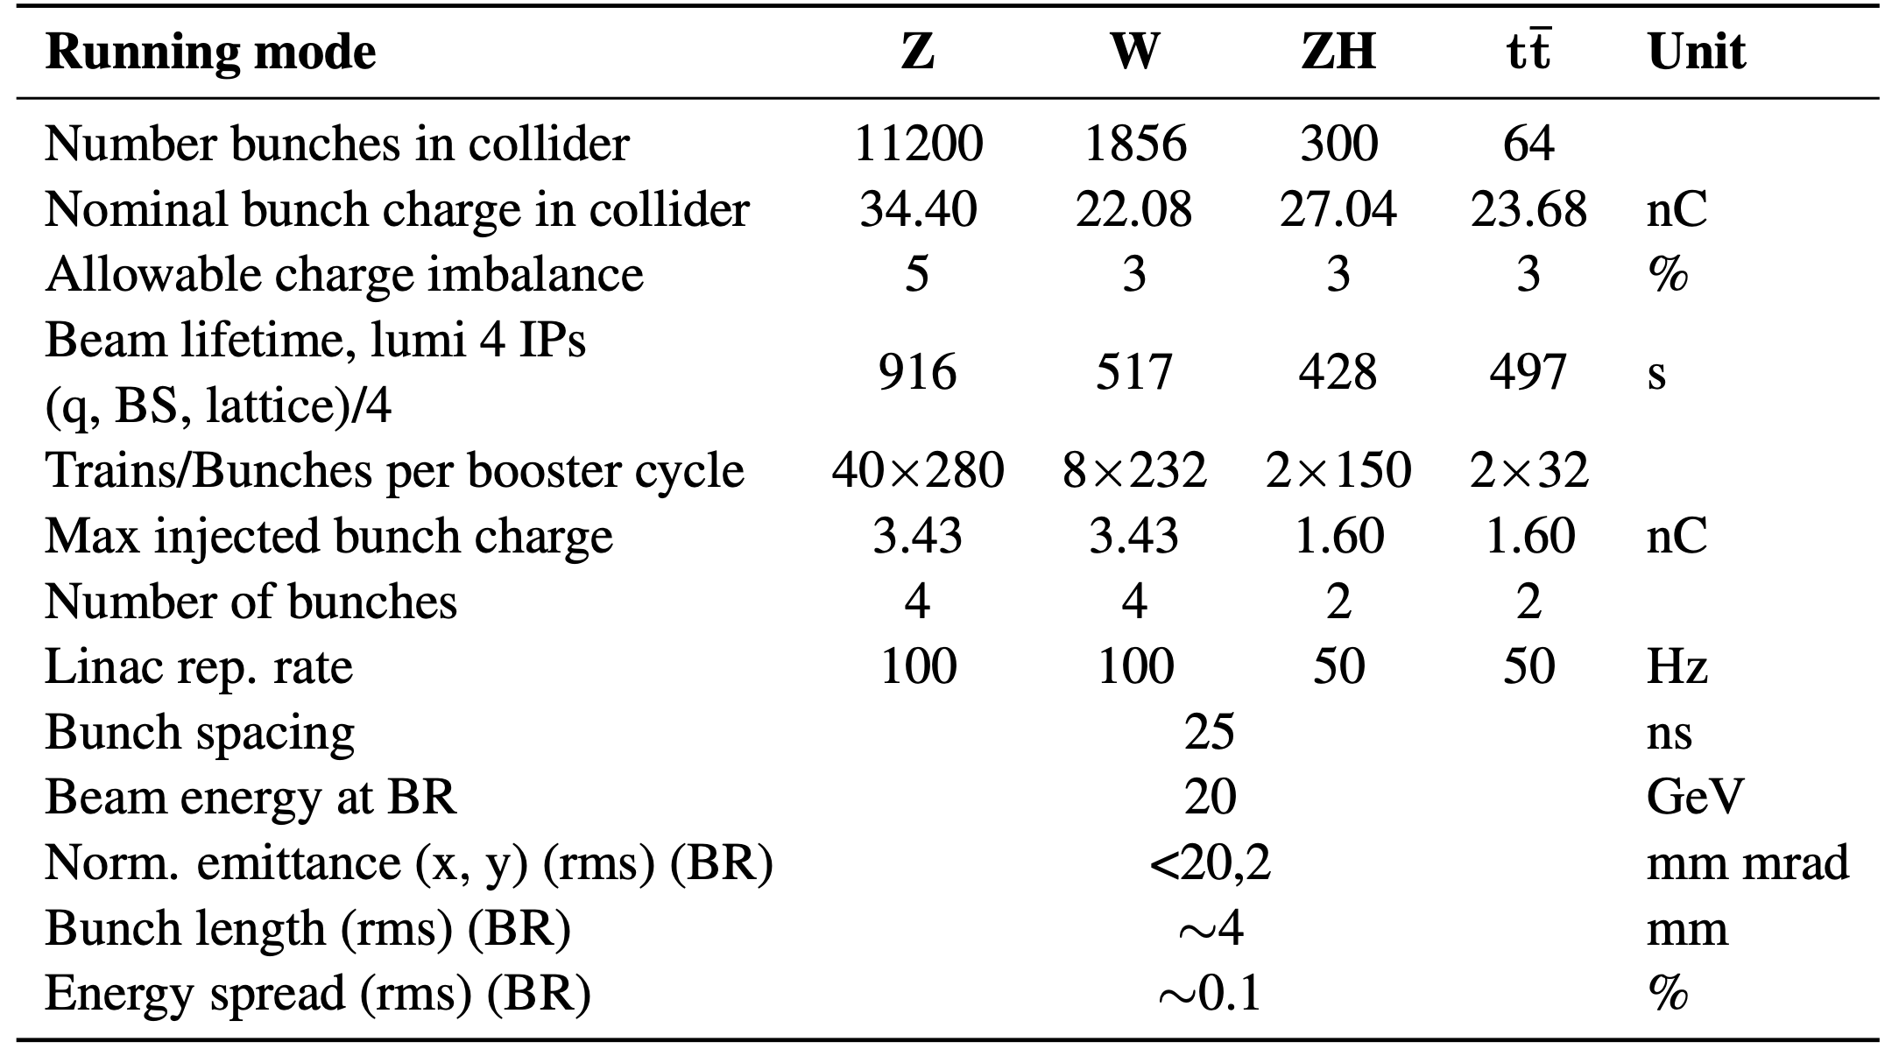
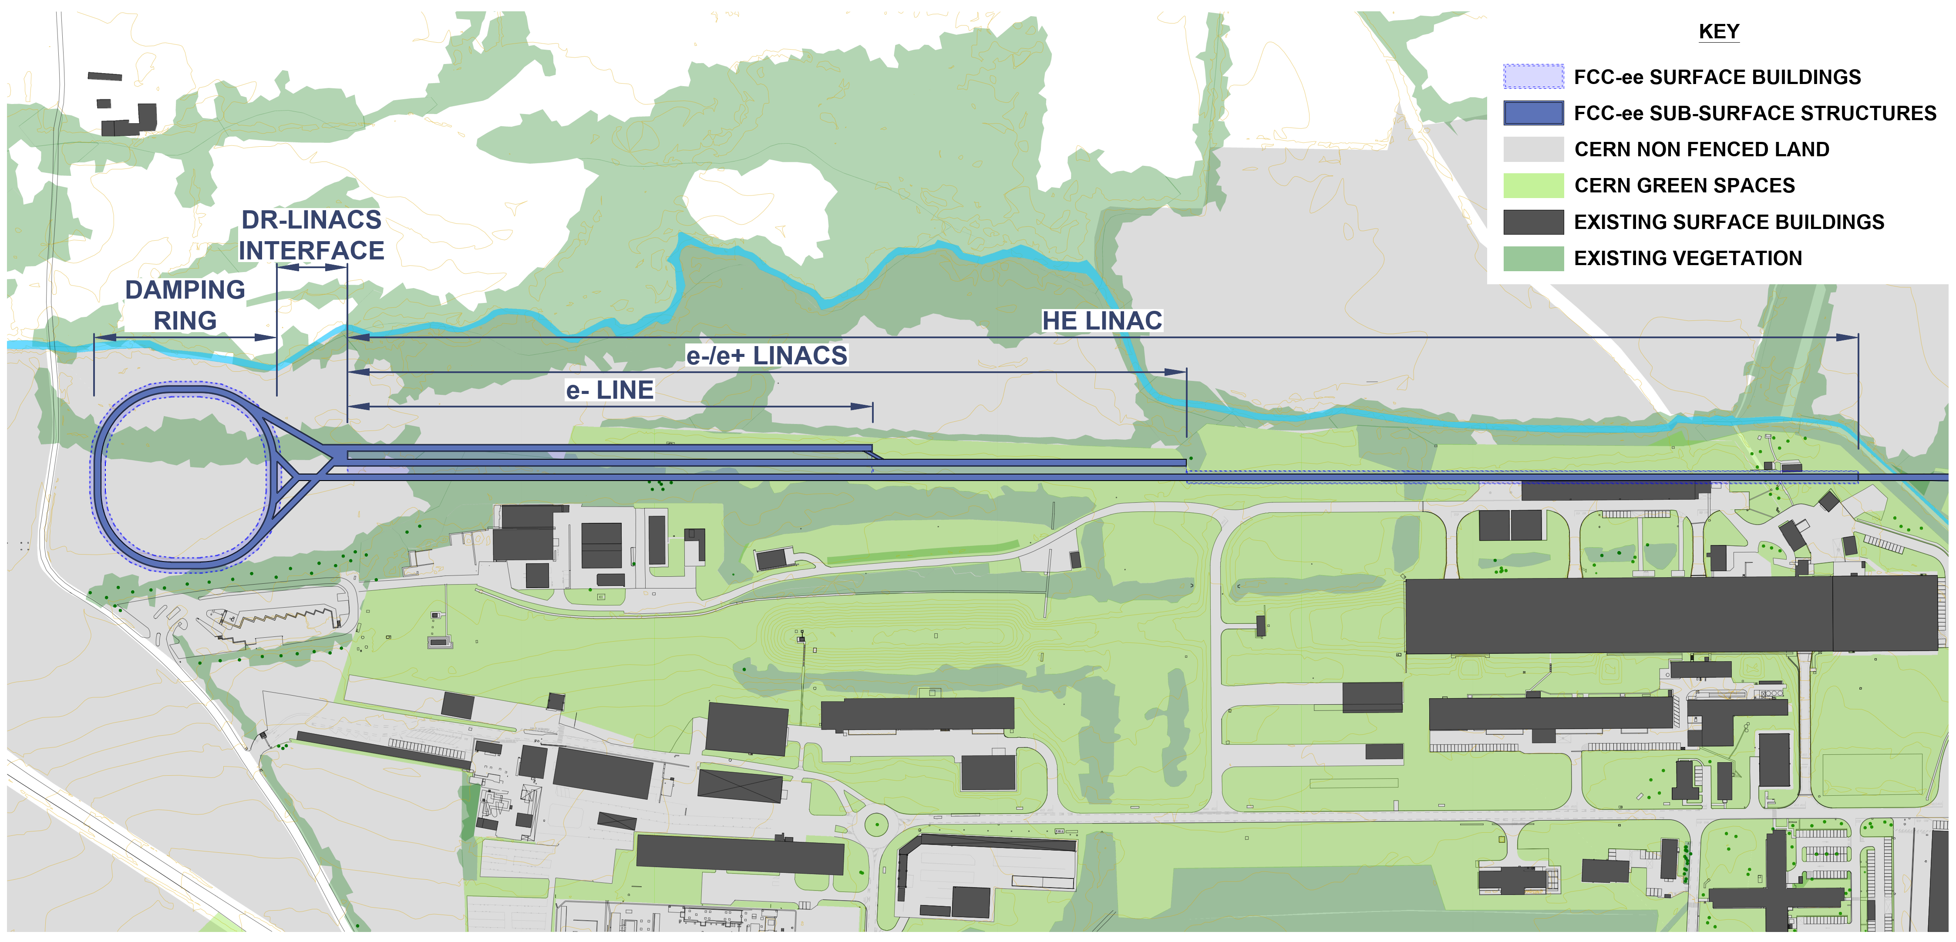
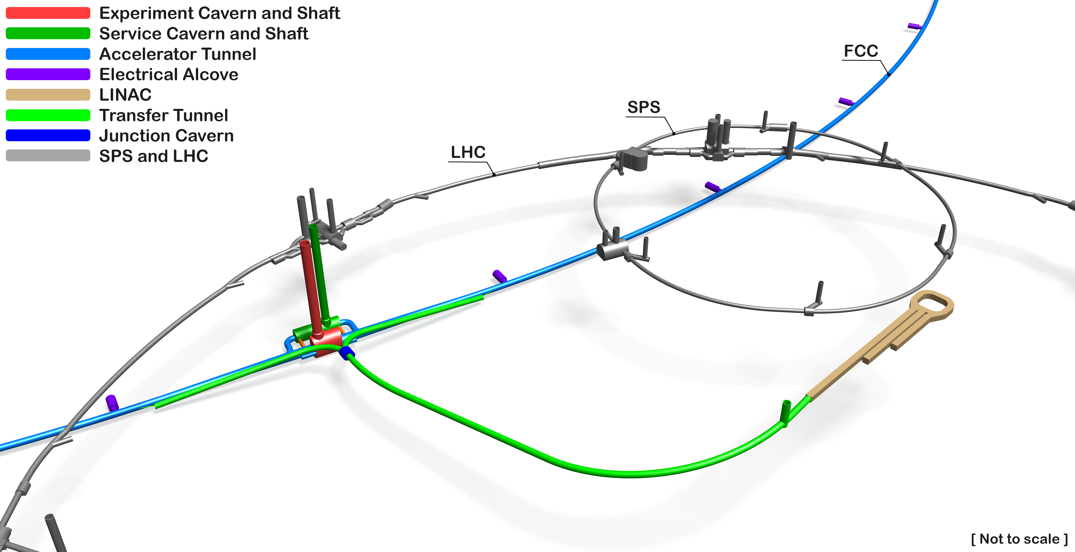
FCC-ee Injector Layout: Optimized Concept
4 bunches (25 ns), 100 Hz
Collider and booster parameters used as specifications for the injector design
FCC-ee injector with HE Linac on CERN Prévessin site
High-Energy Linac next to North Area and Beam Dump Facility
Courtesy T. Watson, W. Bartmann (CERN)

Slide 3

FCC-ee Positron Source: Current Requirements
The complete filling for Z running → Requirement ∼ 3 ⨯ 10¹⁰ e⁺/bunch (4.8 nC) at the linac end
or 5 nC accepted in the DR
Beam energy | 2.86 GeV
Bunch charge | ∼5 nC (max)
Bunch length | 1 mm
Bunch transverse size | ≳ 0.5 mm
Nb of bunches per pulse | 4
Bunch separation | 25 ns
Repetition rate | 100 Hz
Beam power | ∼5.7 kW (max)
e⁻ drive beam
N_{e-}/bunch ⨯ η^{e+}_{Accepted} ≥ 5 nC/bunch ⨯ 2.6
~ 13 nC
*A safety margin of 2.6 is currently applied for the whole studies (losses for injection in the DR + losses along the e+ pre-injector)
with N_{e-}~5 nC (max) ➔ η^{e+} ≳ 2.6 N_{e+}/N_{e-}
➜ positron flux of ∼1.2⨯10¹³ e⁺/s (⨯2.6). Demonstrated at SLC (a world record for existing accelerators): ∼ 6 ⨯10¹² e+/s

Slide 4
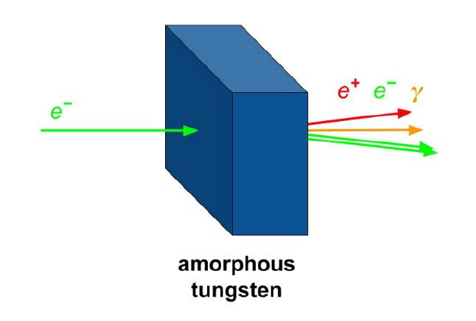
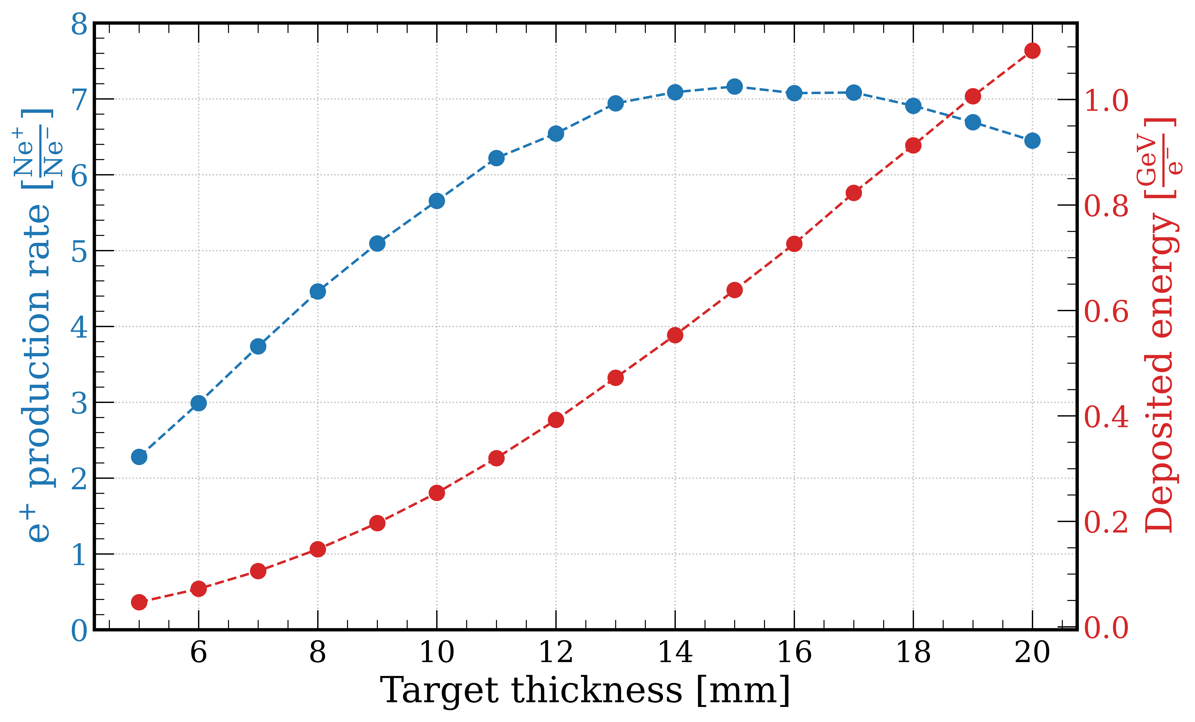
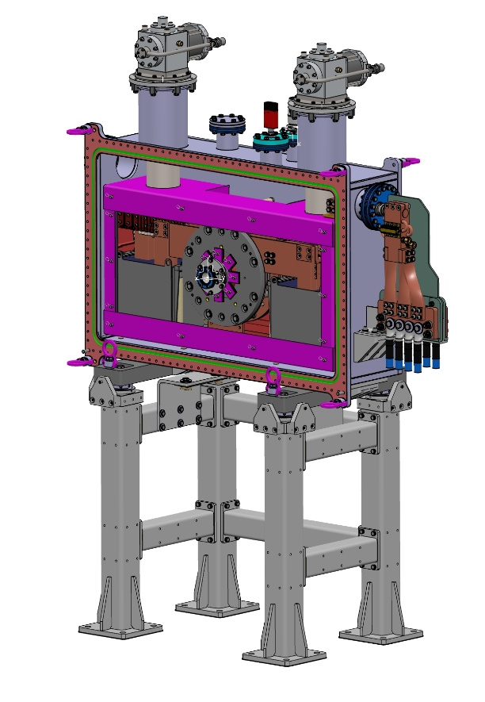
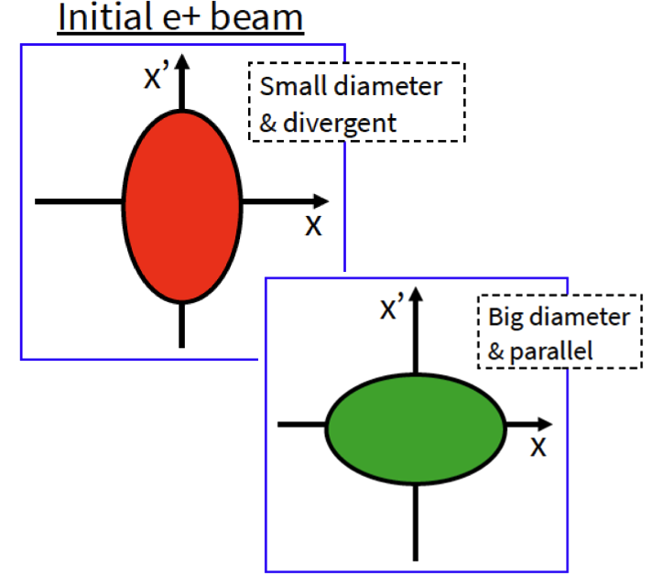
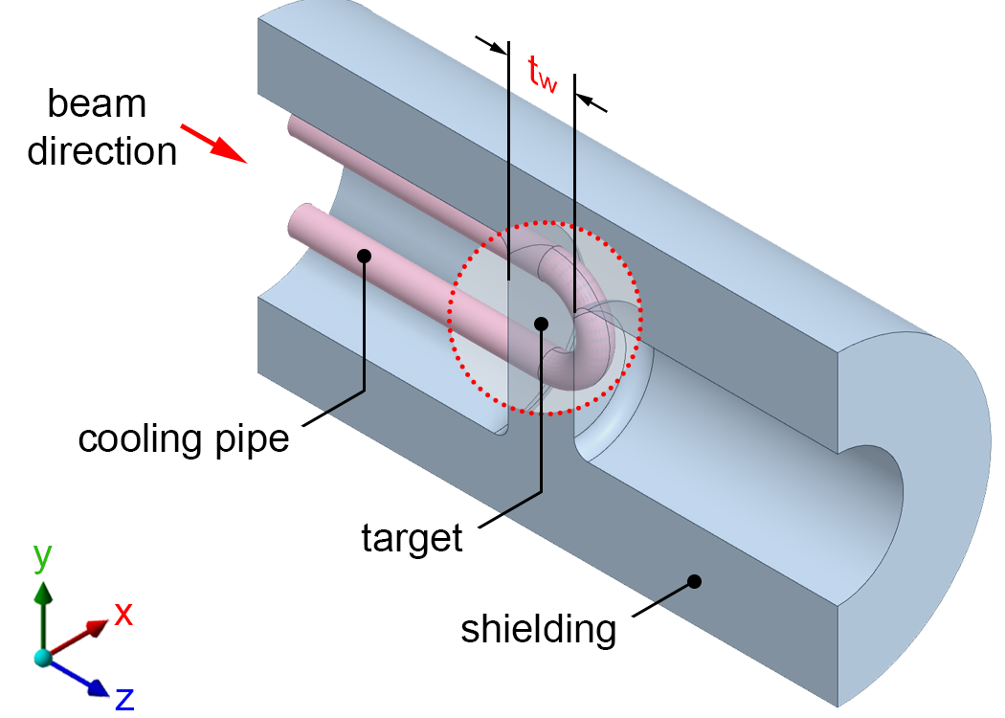
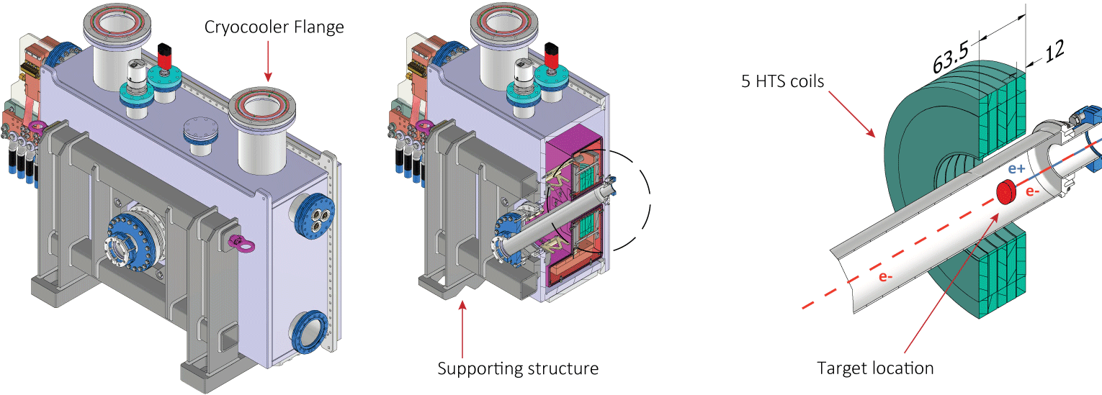
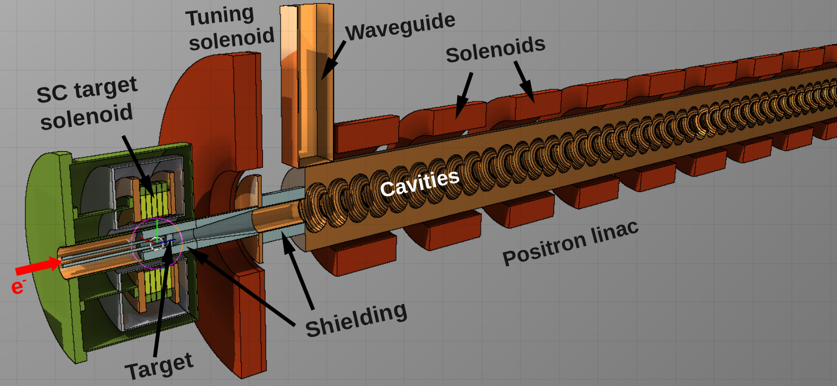
Positron Production @FCC-ee: Design Choices
TL + ESC to DR
2.86 GeV
DR
T
MD
CL
CH
PL1
MS
PL2
15 mm-thick W target-converter
Matching Device (MD) → phase space rotation
Talk by M. Duda (PSI)
2.86 GeV
Capture Linac and Positron Linac
L-band large-aperture acc. structures
NC solenoid channel
B_{z} = 0.5 T
FODO lattice
MD: HTS solenoid
Transfer Line + Energy Compression System + Damping Ring
Large acceptance/short damping time DR
Design studies in progress
2 GHz RF structures
(2a = 60 mm)

Slide 5
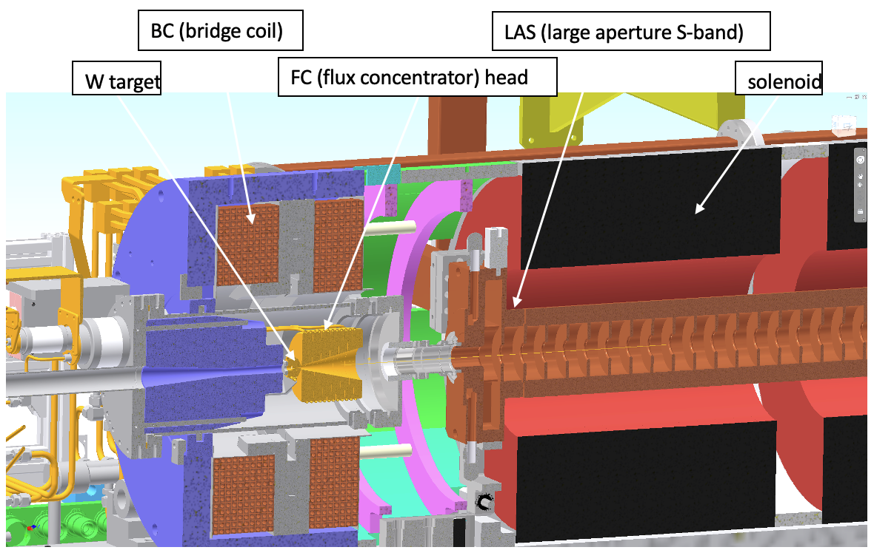
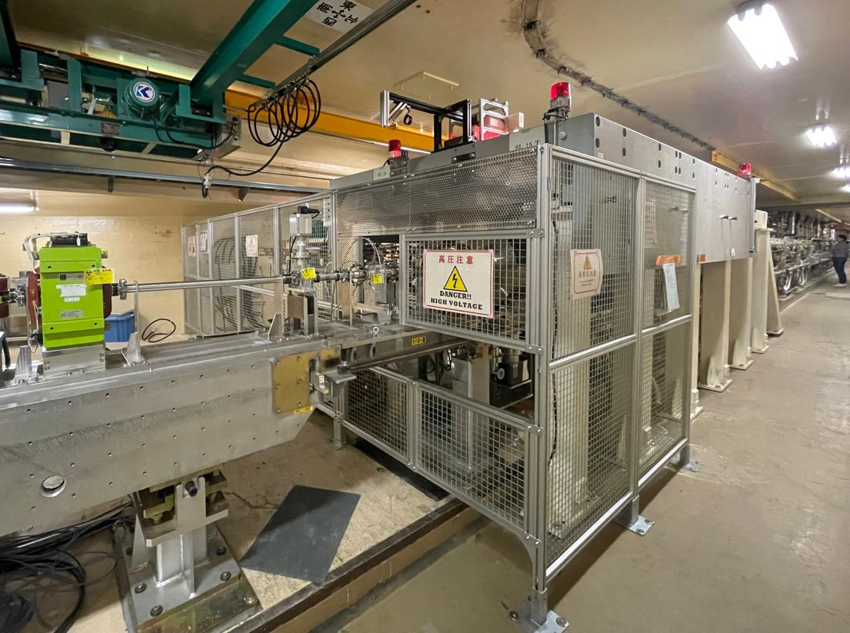
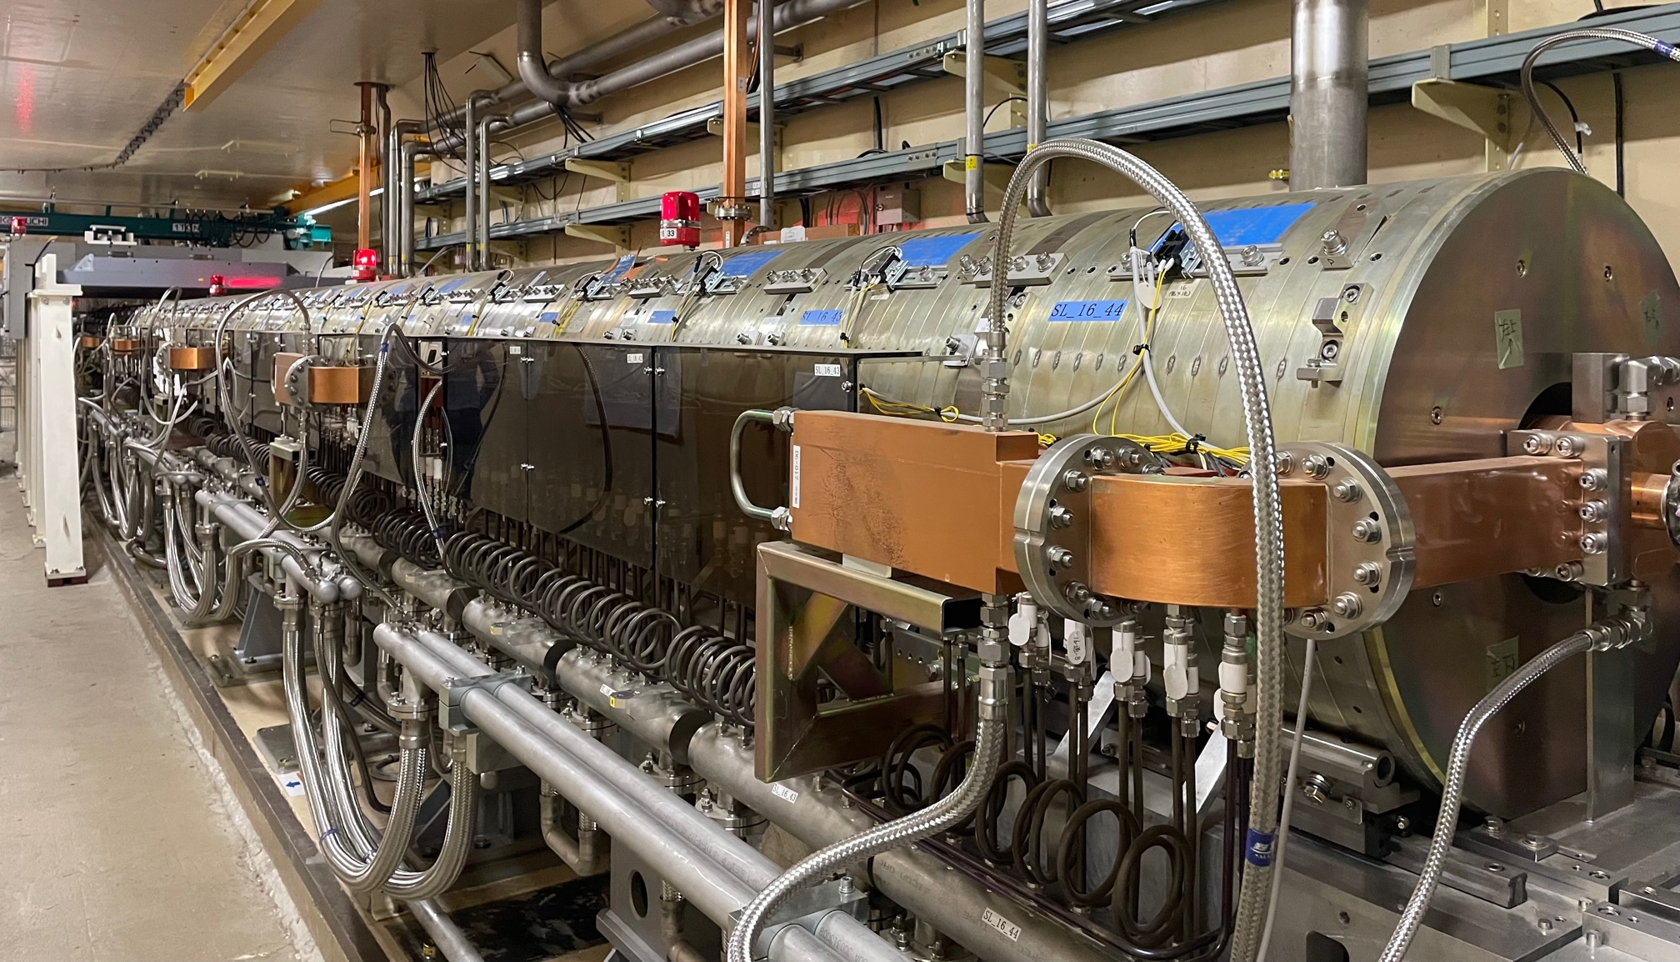
Validation of the FCC-ee Positron Source Design Framework
Start-to-end model: Geant4 + RF-Track
Benchmarked against other tools (EGS5+GPT, Geant4+ASTRA)
Validated with SuperKEKB experimental data. Excellent agreement: meas. yield (0.603 ± 0.003) vs. simulated 0.603.
→ Framework ready for FCC-ee design optimization
e⁻ beam energy | 2.9 GeV
Rep. rate | 25 Hz
Number of bunches | 2
Bunch charge | ∼10 nC
Beam size | ~0.5 mm
e⁺ yield after chicane | 0.6 N_{e+}/N_{e-}
e⁻ beam position scan on the target
Positron capture system
Magnetic field scan in the capture system
Positron source
F. Alharthi et. al.,"Modeling of the positron sources: an experiment-based benchmarking", Phys. Rev. Accel. Beams (Sept. 2025)

Slide 6
Positron Production: Capture System
E = 2.86 GeV
Q = 13 nC (considering 60% losses for transport, collimation and injection into DR)
2.86 GeV electron beam
from e- linac
Capture linac 2 GHz, 13.3 MV/m
100 Hz, 6 RF structures
Positron linac 2 GHz, 13.3 (12.8) MV/m
100 Hz, 20+52 RF structures
Positron/Electron
Separation at 170 MeV
Target & cryostat
DC solenoid
Injection section
E = 2.86 GeV
Q = ~3.8 nC
Damping Ring
E = 2.86 GeV
Q_{b} = 5 nC
DC solenoid
Electron/Photon dumps
Energy collimator
and compressor
Capture system (~ 20 meters)
Dedicated FLUKA model is developed for the target and e⁺ capture section
→ no showstoppers regarding thermal load or radiation damage
509.5 mm
105 mm
72 mm
3000 mm
200 mm
240 mm
346 mm
Positron production : conventional scheme (e- beam size on target = 1 mm rms ). Target exit located at 40 mm w.r.t. HTS solenoid peak field.
Matching device is based on the SC solenoid (5 HTS coils, 72 mm bore, ∅ 60 mm including shielding)
Capture linac is based on the 6 L-band TW RF structures ( 2 GHz, ∅ 60 mm, 3-m long)
NC solenoid B = 0.5 T (realistic conventional design based on the short coils B = 0.31 T) + short “tuning” solenoid B = 0.25 T before the 1st RF structure

Slide 7
Positron Production: Capture System
TL + ECS to DR
2.86 GeV
DR
T
MD
CL
CH
PL1
MS
PL2
Capture section is based on the conventional NC solenoid technology.
The first RF structure operates in deacceleration phase improving bunching and longitudinal phase space.
~ 33% e⁺ losses occur between the AMD and the first RF structure and ~ 9% additional losses at the chicane.
Talk by Y. Wang (IJCLab)

Slide 8
Positron Production: Positron Linac
E = 2.86 GeV
Q = 13 nC (considering 60% losses for transport, collimation and injection into DR)
2.86 GeV electron beam
from e- linac
Capture linac 2 GHz, 13.3 MV/m
100 Hz, 6 RF structures
Positron linac 2 GHz, 13.3 (12.8) MV/m
100 Hz, 20+52 RF structures
Positron/Electron
Separation at 170 MeV
Target & cryostat
DC solenoid
Injection section
E = 2.86 GeV
Q = ~3.8 nC
Damping Ring
E = 2.86 GeV
Q_{b} = 5 nC
DC solenoid
Electron/Photon dumps
Energy collimator
and compressor
Positron linac (~ 280 meters)
Separator chicane : Rectangular beampipe and hor./vert. collimators, Dipole peak field: ~0.2 T
Section 1 : up to ~ 930 MeV. Same RF structure as that of the Capture Linac (CL). 20 structures. G = 13.3 MV/m
Matching section : 5 quadrupoles (0.4 m long)
Section 2 : up to 2.86 GeV. Same RF structure as that of the CL. 52 structures. Quadrupole (0.4 m long), 2 structures per FODO cell. G = 12.8 MV/m
Capture Chicane Positron linac - Section 1 Matching section Positron linac - Section 2
section
3000 mm
200 mm
400 mm
400 mm

Slide 9
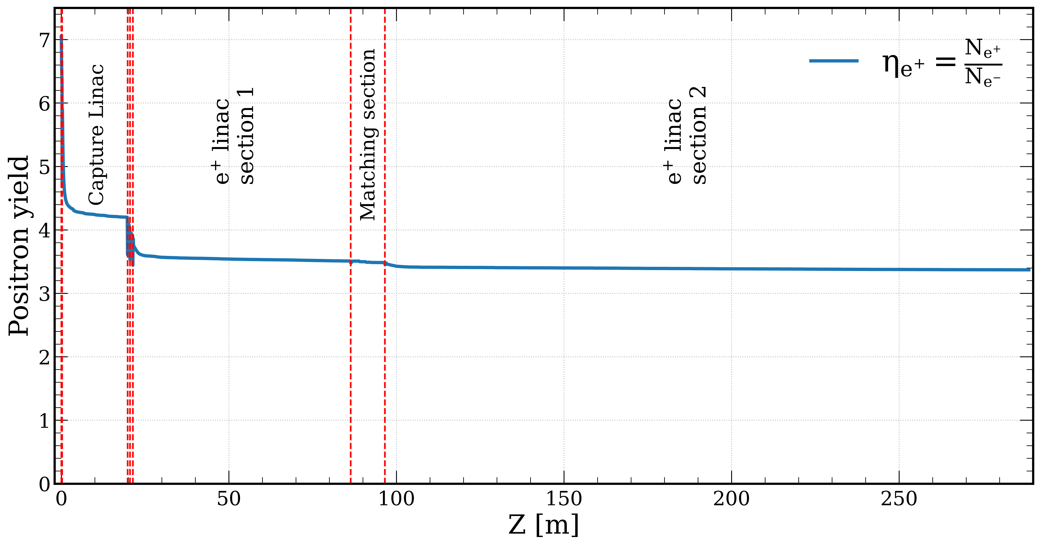
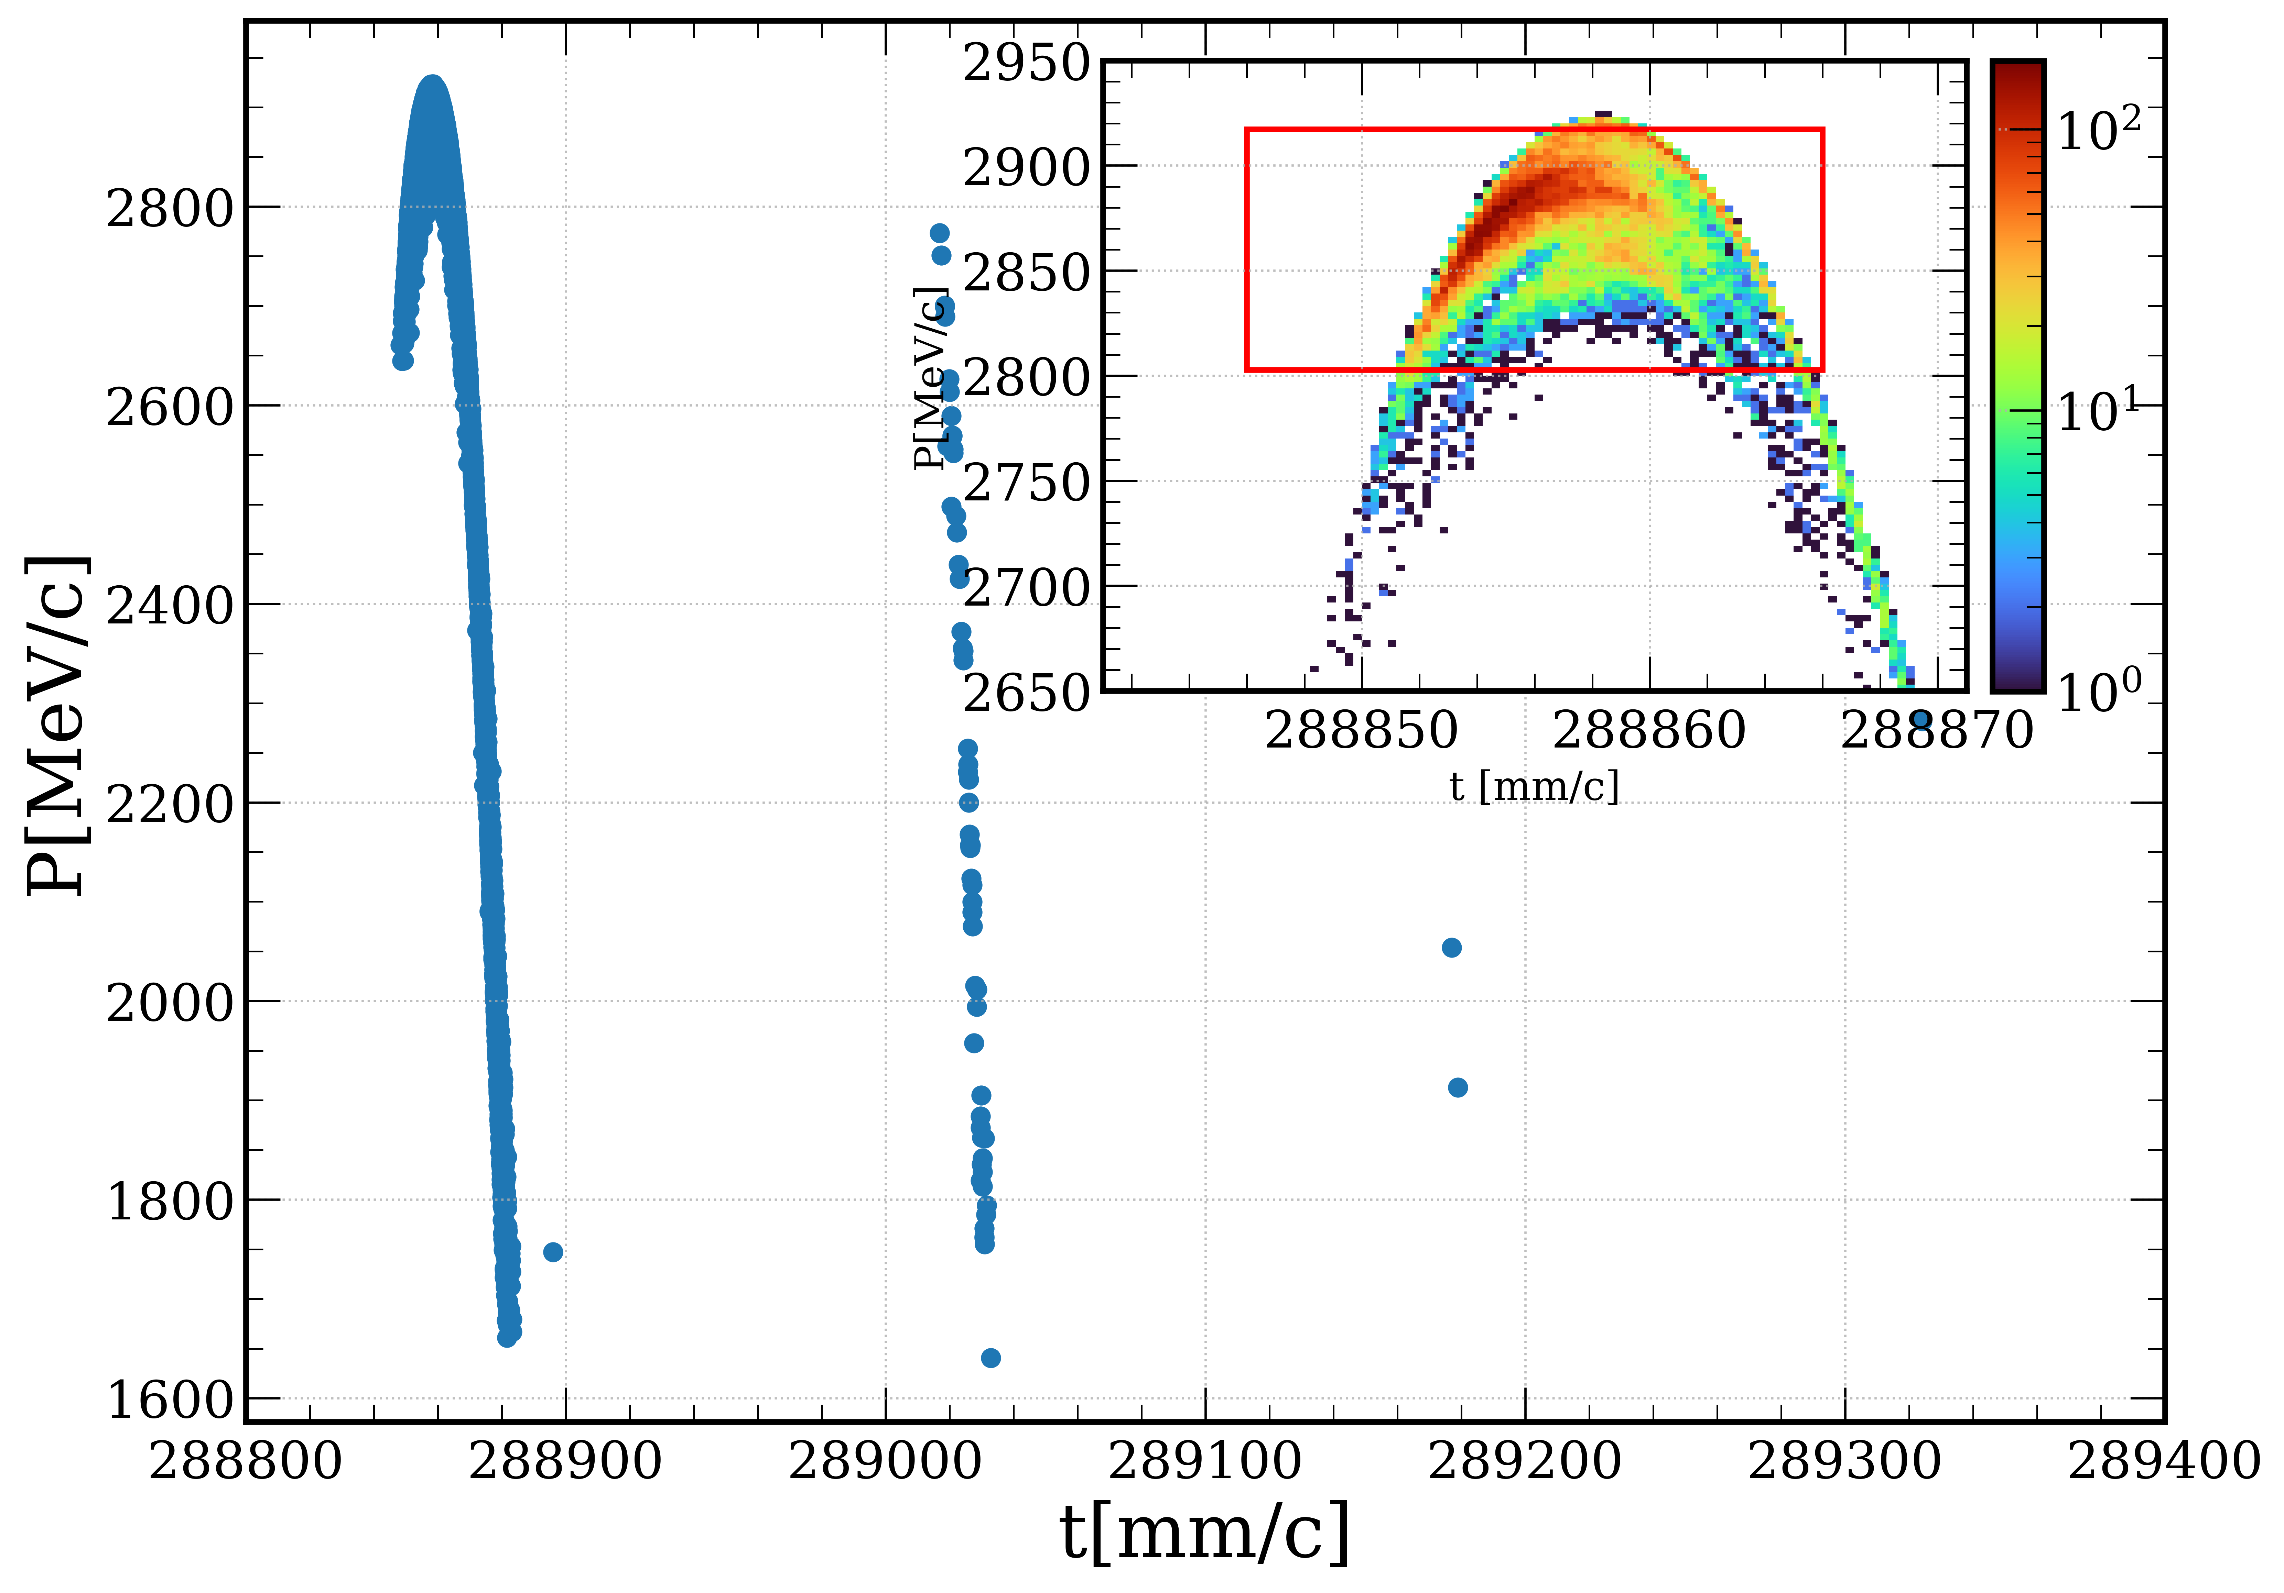
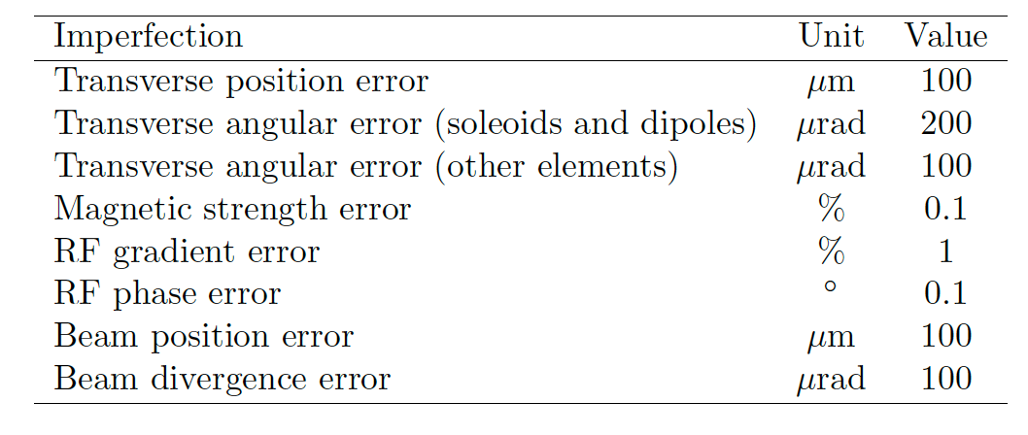
Positron Capture and Linac Overall Efficiency
TL + ECS to DR
2.86 GeV
DR
T
MD
CL
CH
PL1
MS
PL2
e⁺ yield ~ 3.4 (≳ 2.6)
Accepted yield @ DR ~ 3.0
(ΔE: ±2%, Δt: 20 mm/c)
*Simulations include collective effects
(space charge and short-range wakefield)
Start-to-end simulation (from target to the DR)
Design ensures reliable e⁺ production and meets the requirements set by FCC-ee (Z-pole) with the safety margins
The impact of these imperfections is found to be negligible: e⁺ yield ↓1.3%, emittance x/y ↓0.4/0.8 %

Slide 10
Summary of the Simulation Results
e⁻ Drive beam
Target-converter
Beam energy [GeV] | 2.86
Repetition rate [Hz] | 100
Number of bunches | 4
Bunch charge [nC] | 3.8
Bunch length [mm] | 1
Beam size @Target [mm] | 1
Beam power [kW] | 4.3
Thickness [mm] | 15
Production rate [N_{e+}/N_{e-}] | 7.07
Deposited power [kW] | 1
PEDD [J/g] | 5.8
e⁺ Linac
Average energy [GeV] | 2.87
Positron yield [N_{e+}/N_{e-}] | 3.4
Accepted positron yield @DR [N_{e+}/N_{e-}] | 3
Bunch length [mm] | 16 (2.8)
Energy spread [%] | 5 (0.9)
Spots size [mm] | 5.3/2.8
Normalized emittance [mm∙rad] | ~13
e⁺ Capture system
≳ 2.6 N_{e+}/N_{e-}
FS design
AMD peak field [T] | 15 (12)
Solenoid strength [T] | 0.5
AMD/CS aperture [mm] | 60
Average energy [MeV] | 173
Positron yield [N_{e+}/N_{e-}] | 4.2

Slide 11
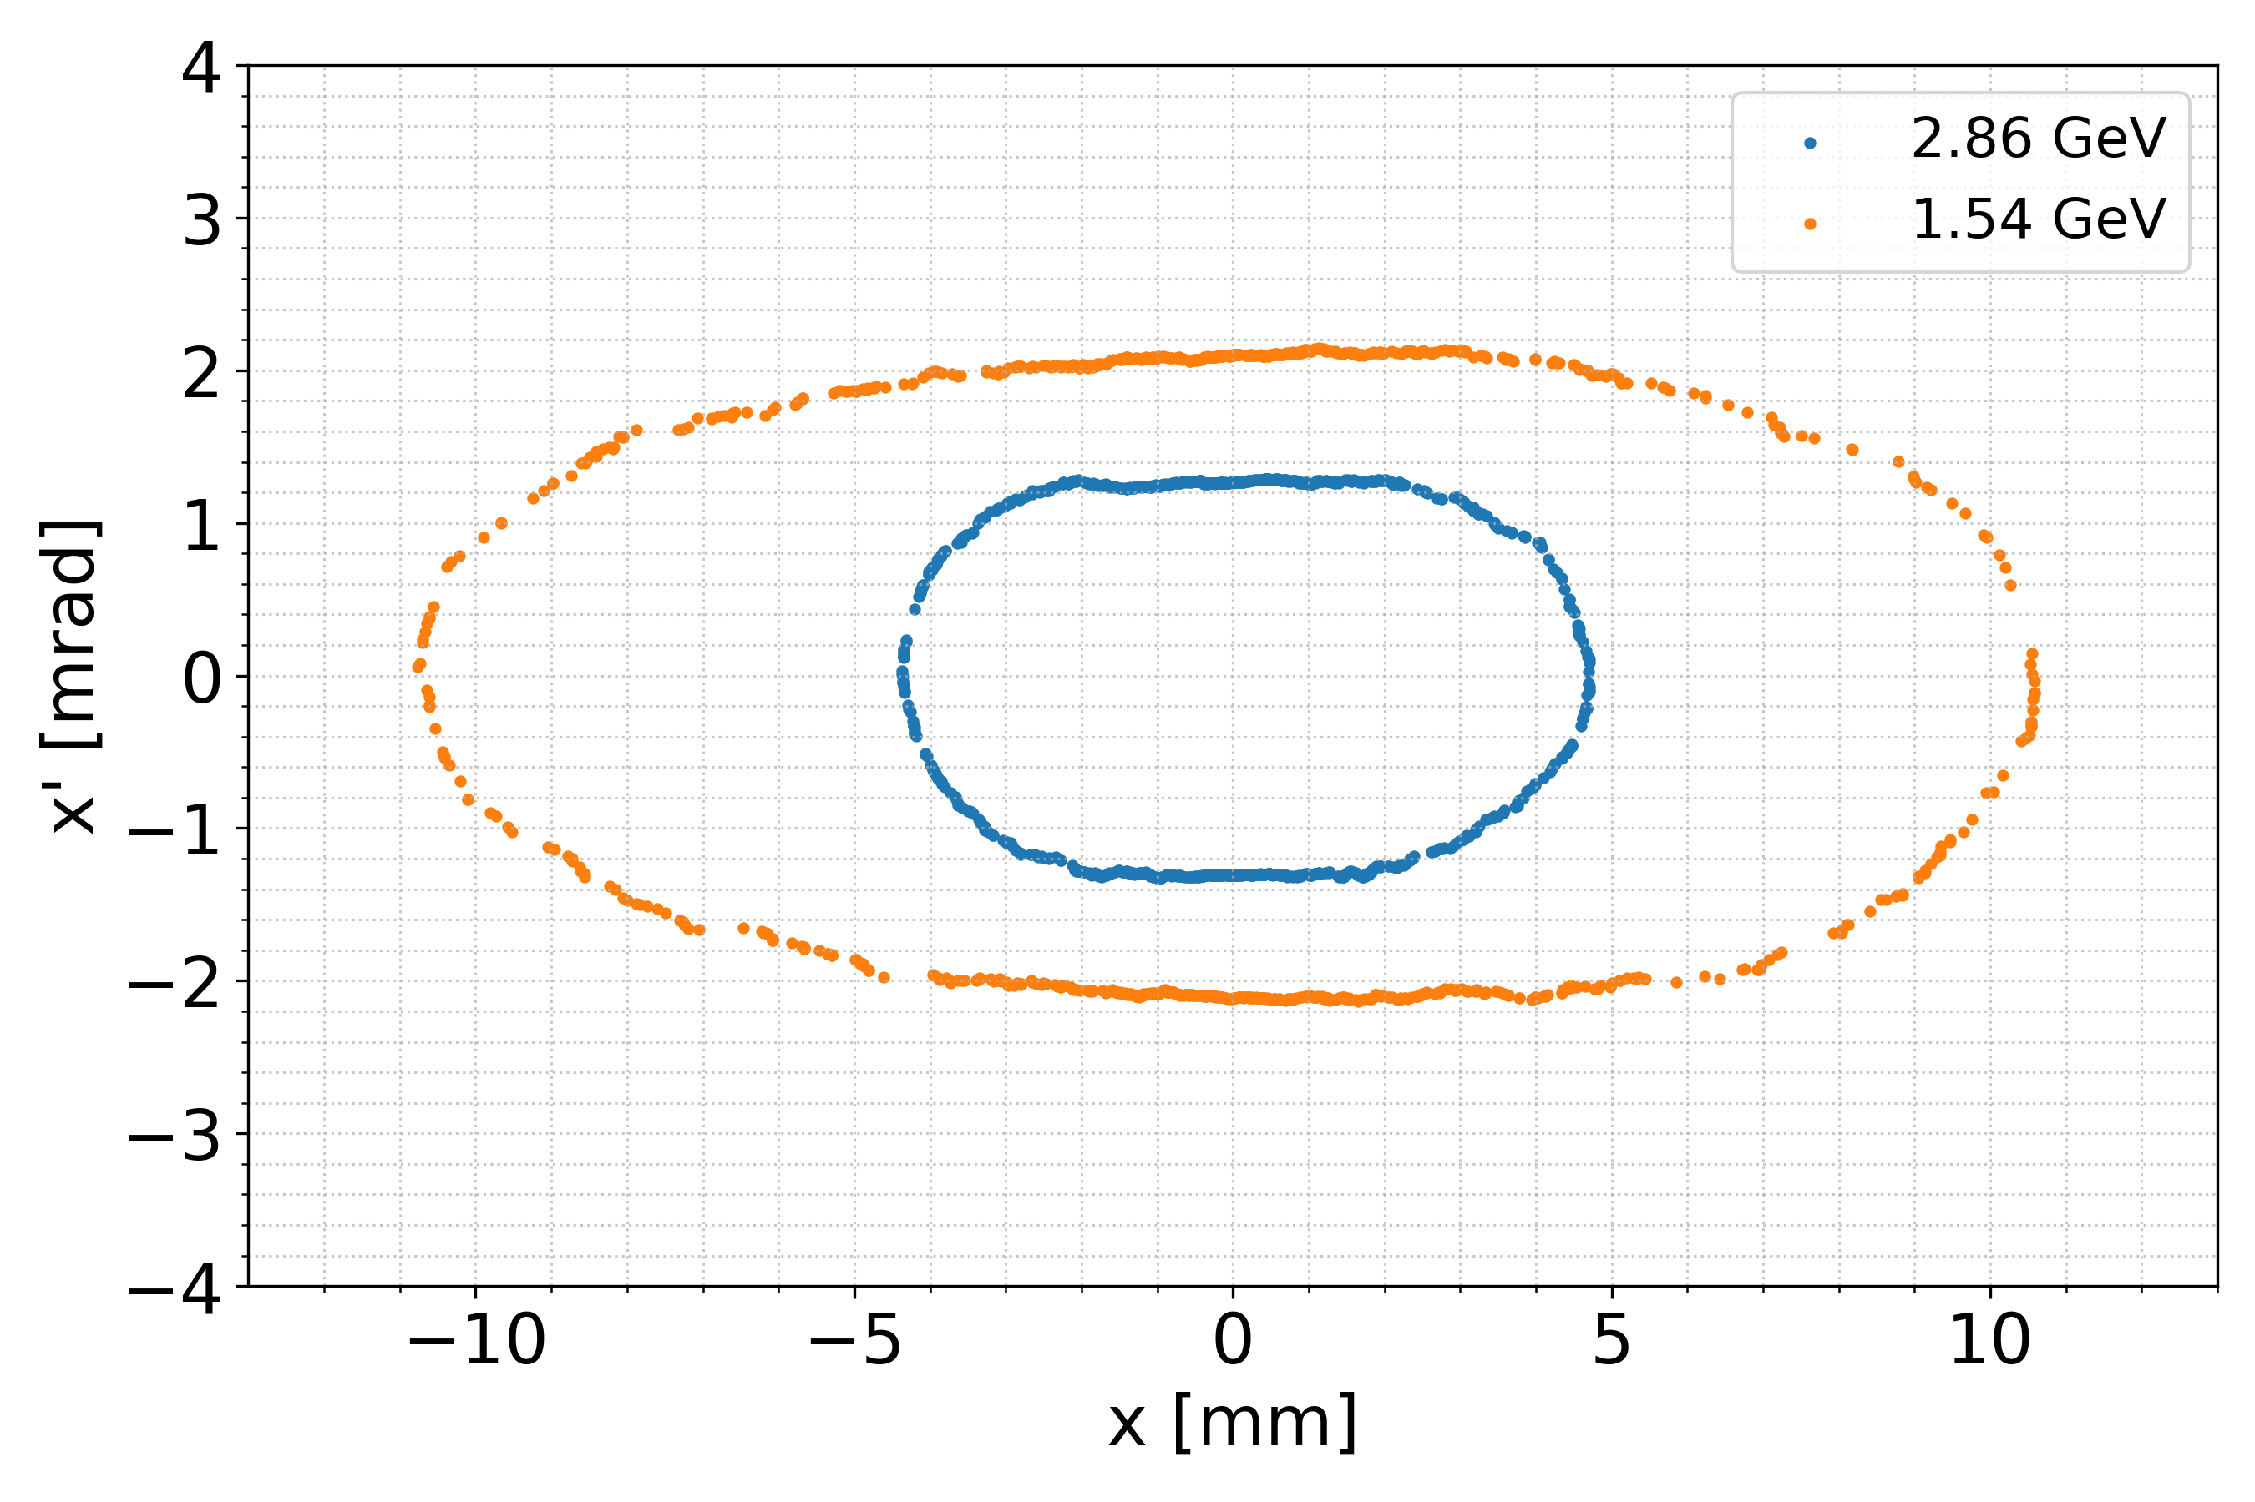
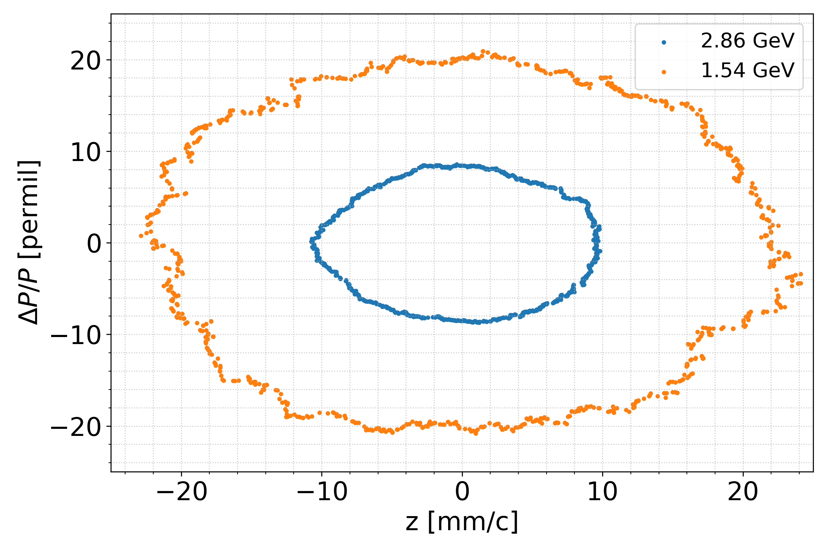
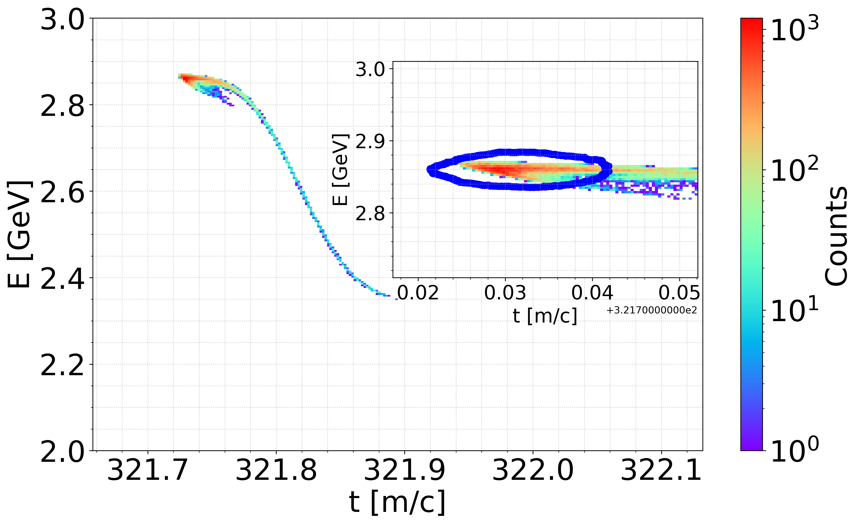
Positron Production with 6D Damping Ring Acceptance (ongoing)
http://dx.doi.org/10.17181/CERN.EBAY.7W4X
Start-to-end simulation including the DR (FS design @2.86 GeV)
The DR acceptance is based on the linear tracking without errors. Work in progress.
Damping Ring acceptance /A. Latina (CERN)
Longitudinal phase-space after the ECS and TL
(preliminary, work in progress)
The first studies made on the current DR @2.86 GeV (FS design) → the accepted e+ yield of ~1.1 N_{e+}/N_{e-} (~32 % inj. eff.)
Next step: quantify room for improvement in DR acceptance @2.86 GeV → final accepted e+ yield
The previous DR design @1.54 GeV is also under evaluation now.
Work in progress to evaluate the losses in transverse and longitudinal planes

Slide 12
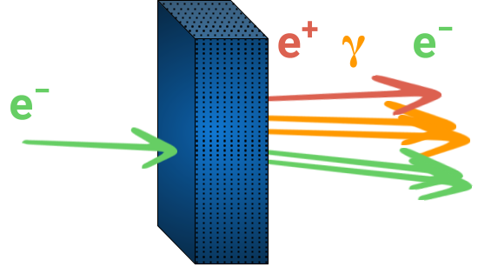
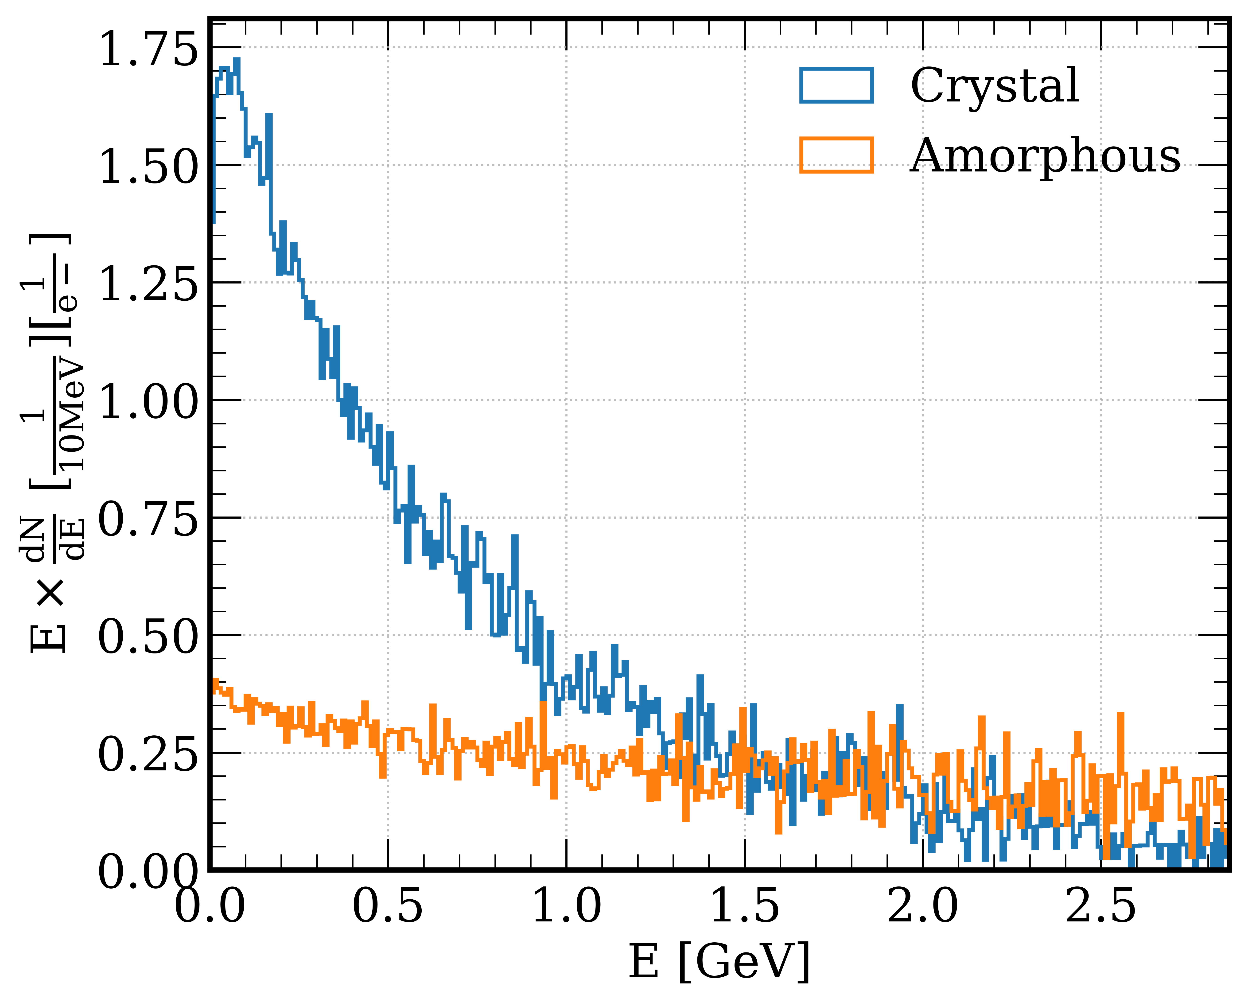
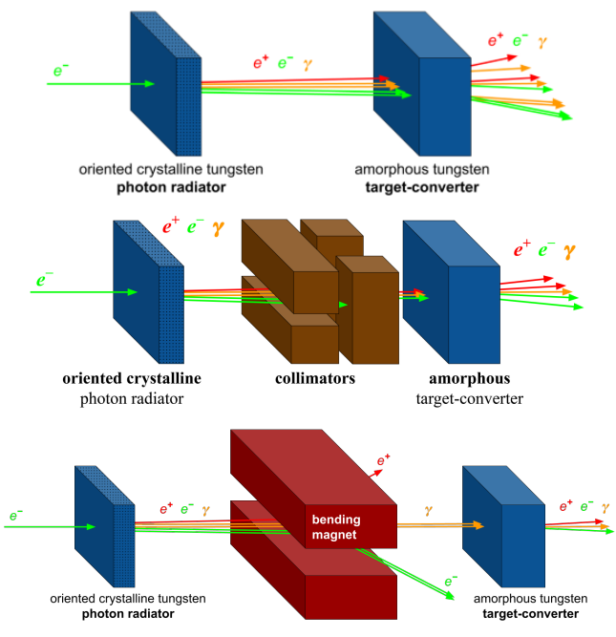
Crystal-Based Positron Source for FCC-ee
Originally proposed by R. Chehab, A. Variola, V. Strakhovenko and X. Artru
oriented crystalline
target
R. Chehab et al., in Proc. of the 1989 IEEE Particle Accelerator Conf., 1989, pp. 283–285
Use of lattice coherent effects in oriented crystals: channeling and over barrier motion
→ typical angular range ∼a few mrad at 6 GeV for <111> axis in W
Several experiments: Orsay, WA103@CERN and KEK (in the 1 – 10 GeV region)
2.86 GeV e⁻ beam on
1 mm-thick W target
Several options were considered for FCC-ee
Novel production scheme for positron sources
Enhancement of photon generation in oriented crystals → enhancement of pair production / positron charge
Lower energy deposit and PEDD in target → lower heating and thermo-mechanical stress (target reliability)

Slide 13

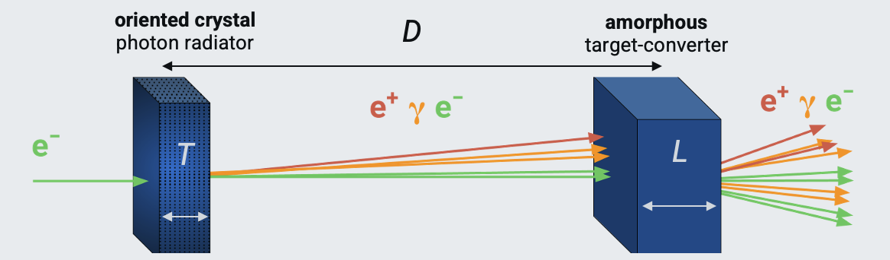
Crystal-Based Positron Source for FCC-ee (towards conceptual design)
The simulation environment was benchmarked/validated with experiments at energies of interest for positron sources of future colliders → optimization studies for the FCC-ee
L. Bandiera et al., Eur. Phys. J. C (2022) 82:699
Simulation studies converge to a total W thickness of about 10 - 12 mm
→ need D∼0 (2 targets) or 1 thick single-crystal
The whole setup was simulated through Geant4 toolkit taking advantage of GeantG4ChannelingFastSimModel, which is based on CRYSTALRAD code
A. Sytov et al. JKPS 83 (2023)

Slide 14
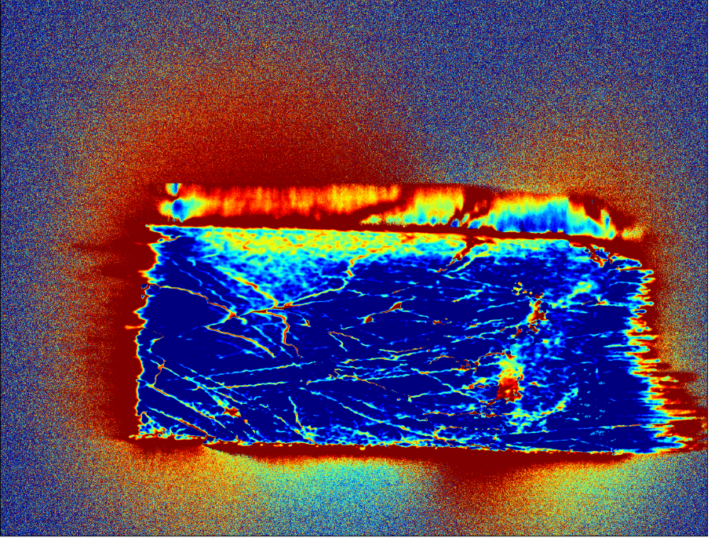

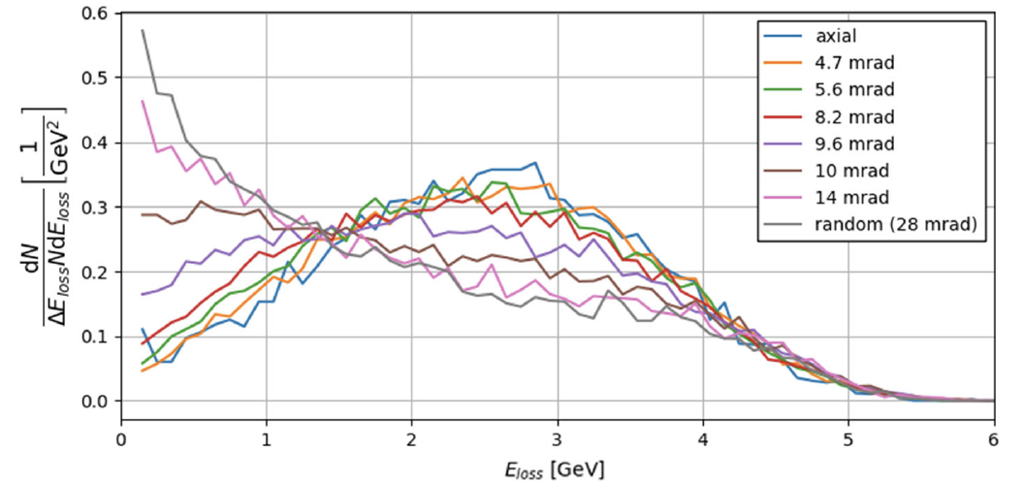
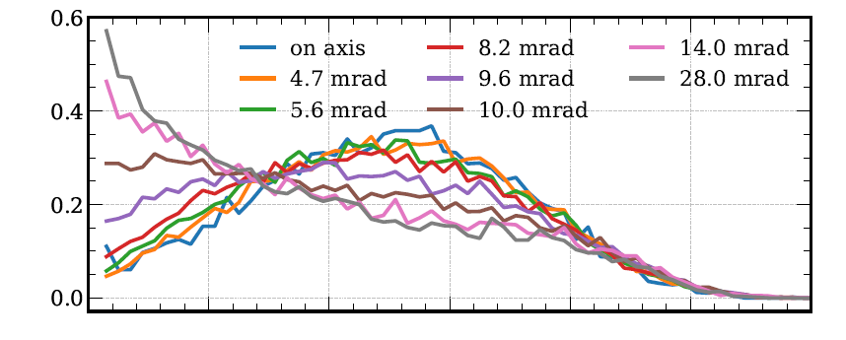
Integration and Operation of the Crystal Target
Crystal heating The photon yield remains stable up to ∼500 ⁰K
Crystal alignment No goniometer. The typical precision of the pre-alignment procedure ∼1 mrad Margins for improvement.
Crystal quality The crystalline quality of 10 – 12 mm thick W sample is lower than for a thin sample → lower yield, but larger acceptance angles
Misalignment w.r.t. desired axis <111> of 12 mm-thick W crystal @500 ⁰K
Beam test at the DESY TB 21 with 5.6 GeV
Imaging of the sample mosaicity measured at BM05 beamline
of ESRF for 10 mm thick W
Spectra of E_{loss} at various angular configurations
2.25 mm thick W crystal
Experimental studies and validation are needed !
(tests @MAMI, DESY, CERN, potential target design validation at P³)
Courtesy of Thu Nhi Tran Caliste (INFN)
At local level: mosaicity is contained within 0.2 – 0.4 mrad
At larger scale: separate crystal domains (on 10x10x10 mm³, total angular distribution of all the crystals domains is within 8.7 mrad)

Slide 15
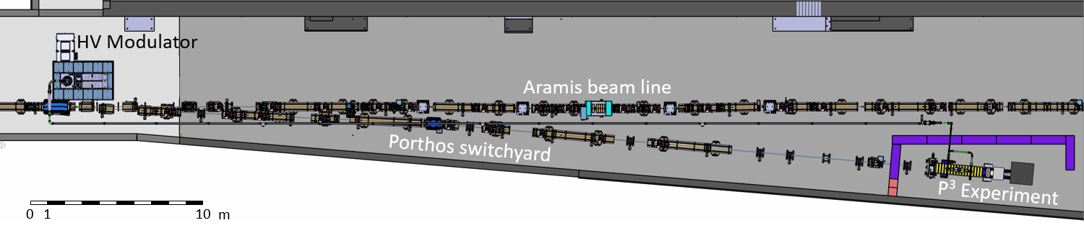

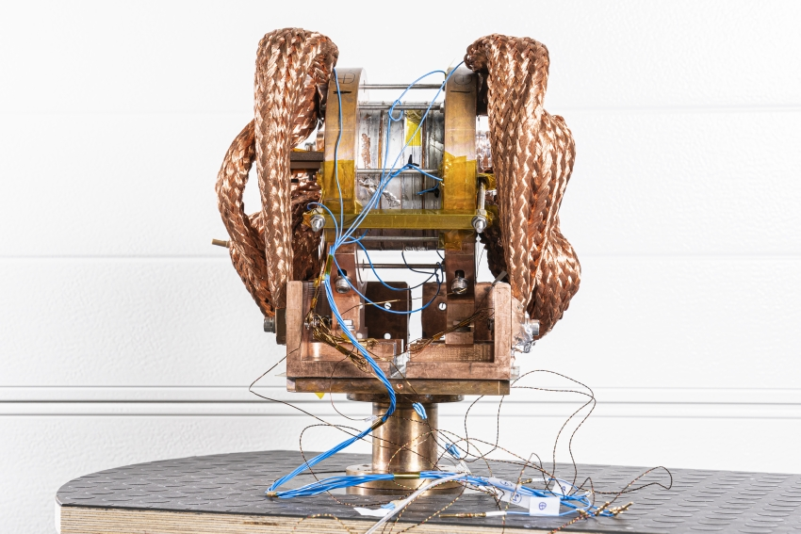
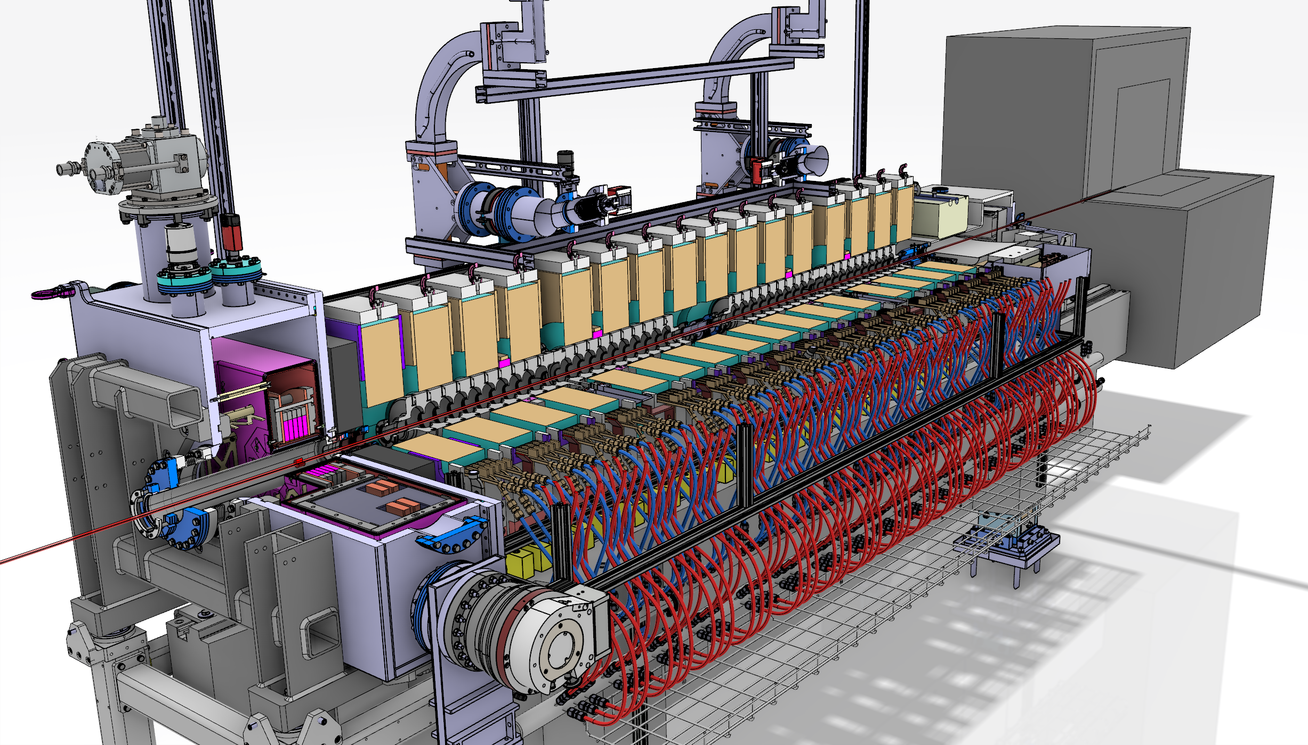
PSI Positron Production experiment: P³ or P-cubed
Key Technology: High-Temperature Superconducting (HTS) solenoid to deliver high field near the target exit.
HTS solenoid integrated in the cryostat (M. Duda et al.)
Peak magnetic field: 12 T (tested up to 18 T)
Demonstrator for positron production and capture using the 6 GeV linac of the SwissFEL facility at PSI will be realized to validate the proposed concept for the FCC-ee positron source
The installation works at SwissFEL are progressing smoothly
Based on the current progress, the major part of the installation work is expected to conclude by the end of 2025, making it possible to start the operation in 2026
P³ Layout
N. Vallis et al., Phys. Rev. Accel. Beams 27, 013401 – 2024
Talk by M. Duda (PSI)

Slide 16
Towards the pre-TDR
The current design assumes L-band 2 GHz RF frequency → limited availability of the power sources
Strong recommendation: investigate the feasibility of adopting “commercial” S-band frequency for the positron capture and linac.
Choice of RF frequency 3.006 GHz (e+ linac) and 2 GHz and 1.504 GHz (capture linac). Further investigations on NC vs. SC solenoid focusing, solenoid vs. quadrupole focusing for positron linac, e⁻ driver parameters ☞ impact on overall performance, layout, cost and power consumption.
Start-to-end simulations and optimizations including the TL, Energy Compressor and tracking in the Damping Ring
Detailed misalignment/error studies and tolerances. Hardware specs. Diagnostics.

Slide 17
Summary and outlook
Feasibility Study Report published on 31 March 2025
submitted for publication to EPJ (Springer-Nature)
Vol. 2: Accelerators, Technical Infrastructures, Safety Concepts
FS baseline design relies on the HTS solenoid. The e⁺ yield is ~3.4 N_{e+}/N_{e-} in the end of linac. Simulations with ECS + TL + DR in progress. Proof-of-principle with P³ experiment @PSI starting from 2026. Next: pre-TDR phase.
The very first studies to investigate the feasibility of 3 GHz RF frequency in the e⁺ capture and 2.86 GeV linac started. Final choice of RF frequency: simulated performance, injector integration and overall cost.
Conceptual design studies of the crystal-based positron source for the FCC-ee are well advanced and ongoing. Next steps: finilize the conceptual design, integration studies and beam tests with potential proof-of-principle at P³ experiment 2nd phase.

Slide 18
Credits
PSI | B. Auchmann, I. M. Besana, S. Bettoni, P. Craievich, M. Duda, R. Fortunati, H. Garcia-Rodrigues, D. Hauenstein, R. Ischebeck, P. Juranic, J. Kosse, F. Marcellini, U. Michlmayr, G. L. Orlandi, M. Pedrozzi, J.-Y. Raguin, S. Reiche, R. Rotundo, S. Sanfilippo, M. Schär, N. Strohmaier, N. Vallis, M. Zykova, R. Zennaro, H.H. Braun, M. Seidel all the technical groups involved in the P3 experiment
IJCLab | F. Alharthi, I. Chaikovska, R. Chehab, V. Mytrochenko, Y. Wang
CERN | W. Bartmann, H. Bartosik, M. Calviani, S. Doebert, Y. Duthell, J. L. Grenard, A. Grudiev, B. Humann, A. Kurtulus, A. Latina, A. Lechner, R. Mena Andrade, A. Perillo Marcone, K. Oide, Y. Zhao, F. Zimmermann, Z. Vostrel, M. Benedikt
SLAC | T. Raubenheimer
KEK | Y. Enomoto, K. Furukawa, F. Miyahara
INFN-LNF | C. Milardi, A. De Santis, O. Etisken, S. Spampinati
and L. Bandiera, N. Canale, A. Mazzolari, G. Paternò, M. Romagnoni, A. Sytov (INFN/Ferrara), A. Bacci, M. Rossetti Conti (INFN/Milano) | A. Bacci, M. Rossetti Conti, L. Bandiera, D. Boccanfuso (INFN Naple) , N. Canale, O. Lorio (INFN Naple), A. Mazzolari, R. Negrello, G. Paternò, M. Romagnoni, M. Soldani, A. Sytov
This work was done under the auspices of CHART (Swiss Accelerator Research and Technology) Collaboration, https://chart.ch - CHART Scientific Report 2022: https://chart.ch/reports/
FCCIS: 'This project has received funding from the European Union's Horizon 2020 research and innovation programme under the European Union's Horizon 2020 research and innovation programme under grant agreement No 951754.'

