Slide 1

Optimization of the positron capture section at FCC-ee
Yuting WANG
Laboratoire de Physique des 2 Infinis Irène Joliot-Curie (IJCLab), CNRS, Université Paris-Saclay
On behalf of the FCC-ee injector study collaboration

Slide 2
Outline
FCC-ee positron source
Simulation tools and positron capture system (baseline)
Possible options for RF structures operating at 3 GHz
6D acceptance approach for accepted e+ yield
Summary and conclusion

Slide 3
FCC-ee positron linac - baseline
Capture linac 2 GHz, 13.3 MV/m
6 RF structures
Solenoid-based focusing
RF: 2 GHz, 13.3 MV/m
20 RF structures
Quadrupole-based focusing
RF: 2 GHz, 12.3 MV/m
52 RF structures
E = 2.86 GeV
Q = 13 nC (considering 60% losses for transport, collimation and injection into DR)
Positron/Electron
Separation at 170 MeV
Target & cryostat
DC solenoid
Damping Ring V
Q_{b} = 5 nC
DC solenoid
Matching section
e⁻ 2.86 GeV
Q = ~3.8 nC
Transfer line
DC solenoid
Electron/Photon dumps
DC solenoid
Energy collimator
and compressor
Target-converter
Capture system (~ 20 meters)
Thickness [mm] | 15
Production rate [N_{e+}/N_{e-}] | 7.07
Deposited power [kW] | 1
PEDD [J/g] | 5.8
509.5 mm
105 mm
72 mm
3000 mm
200 mm
240 mm
346 mm
Positron production : conventional scheme (e- beam size on target = 1 mm rms) . Target exit located at 40 mm w.r.t. HTS solenoid peak field.
Matching device is based on the SC solenoid (5 HTS coils, 72 mm bore, ∅ 60 mm including shielding)
Capture linac is based on the 6 L-band TW RF structures ( 2 GHz, ∅ 60 mm, 3-m long)
NC solenoid B = 0.5 T (realistic conventional design based on the short coils B = 0.31 T) + short “tuning” solenoid B = 0.25 T before the 1st RF structure

Slide 4
Outline
FCC-ee positron source
Simulation tools and positron capture system (baseline)
Possible options for RF structures operating at 3 GHz
6D acceptance approach for accepted e+ yield
Summary and conclusion

Slide 5
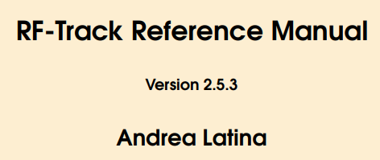


Simulation tools
The start-to-end simulation requires:
  beam-matter interaction
  Beam dynamic simulation
  Optimizing parameters
Capture system (~ 20 meters)
509.5 mm
105 mm
72 mm
3000 mm
200 mm
240 mm
346 mm
Particle-matter interaction for positron production.
https://geant4.web.cern.ch/
Novel tracking code developed for the optimization of low-energy linacs.
Been tested successfully in several cases (CLIC, DEFT facility, Linac4 and etc.)
https://gitlab.cern.ch/rf-track
Flexible optimization of arbitrary problems in Python.
DOI: 10.1103/PhysRevAccelBeams.27.084801

Slide 6
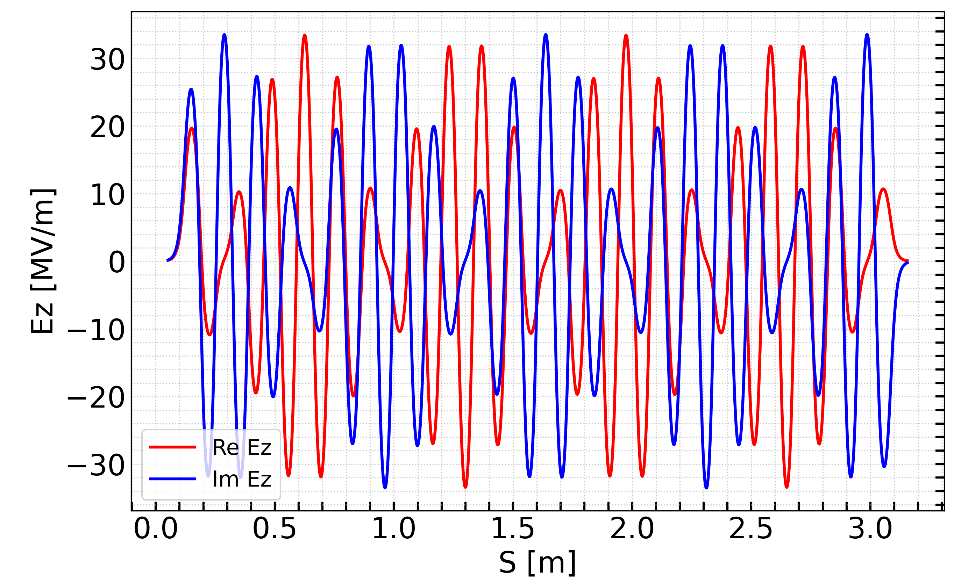
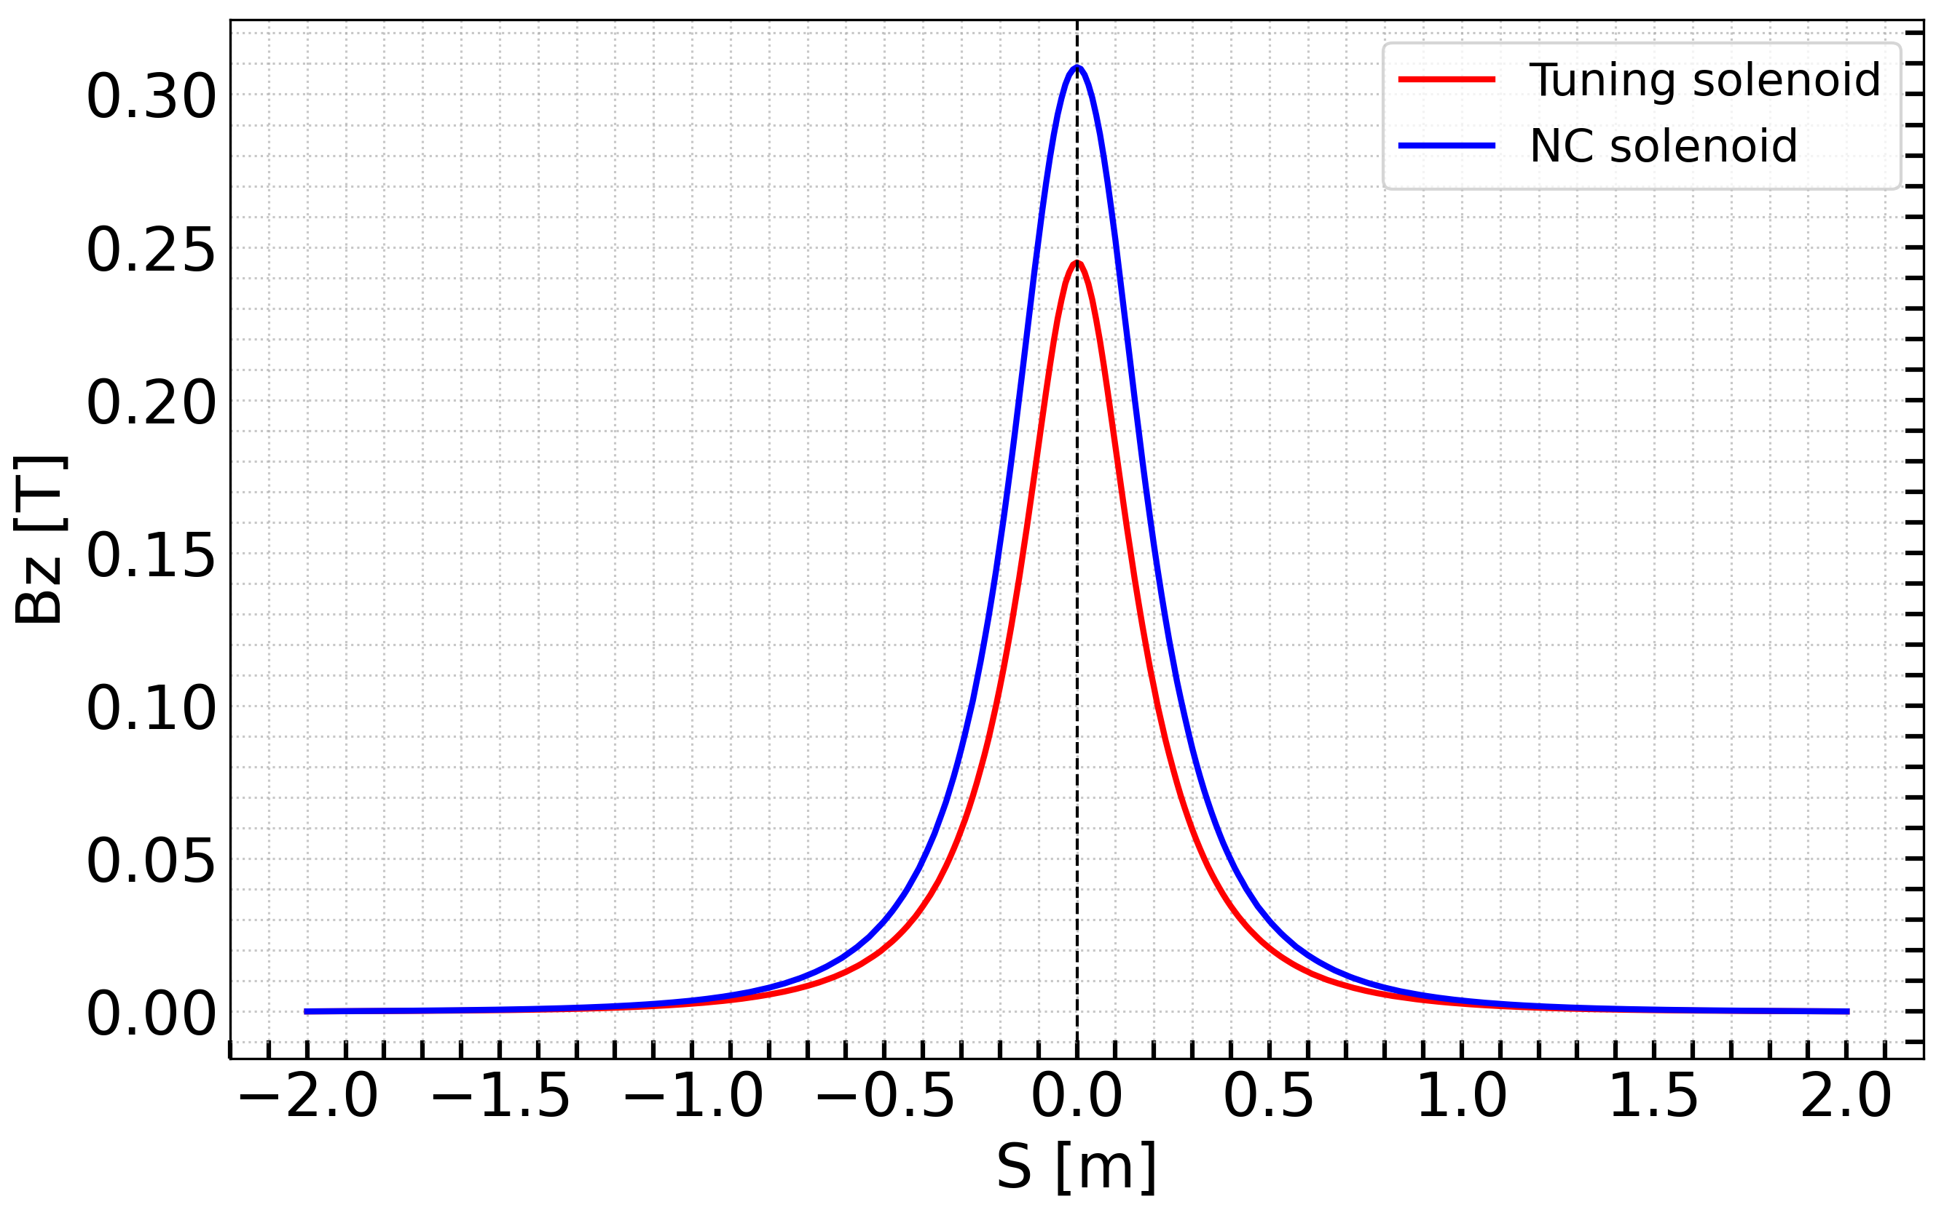
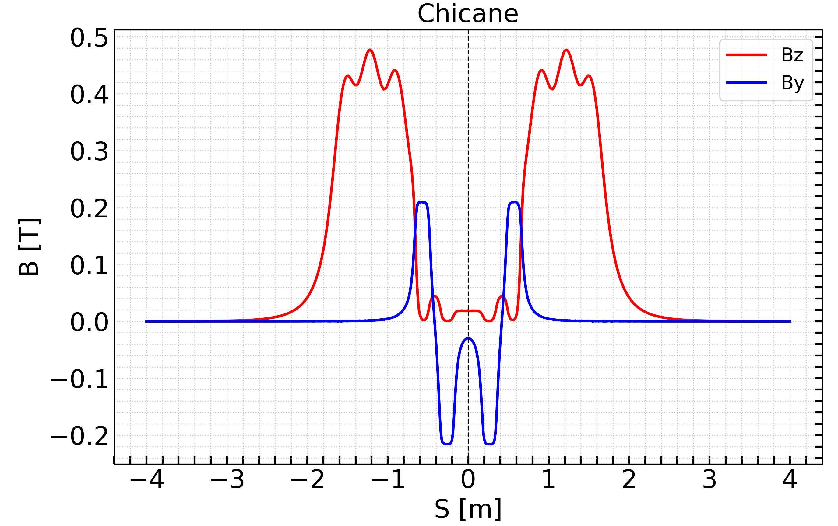
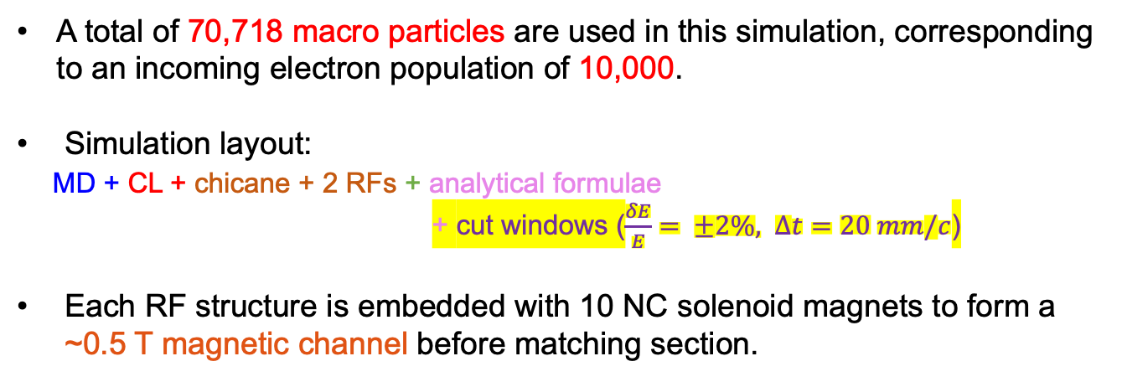
Elements modeled using field maps
A total of 70,718 macro particles are used in this simulation, corresponding to an incoming electron population of 10,000.
Simulation layout:
MD + CL + chicane + 2 RFs + analytical formulae
+ cut windows ($\frac{δE}{E}= ±2\%, ∆t=20 mm/c$)
Each RF structure is embedded with 10 NC solenoid magnets to form a ~0.5 T magnetic channel before matching section.
- RF structures: 2GHz L-band with aperture (2a) = 60mm , 3m long and 13.3 MV/m.
- Solenoids: 10 NC short solenoids surrounding each RF structure to create 0.5 T magnetic channel.
- Chicane: 4 dipoles (0.2T) to separate e- and e+, with electron stopper at the middle.

Slide 7
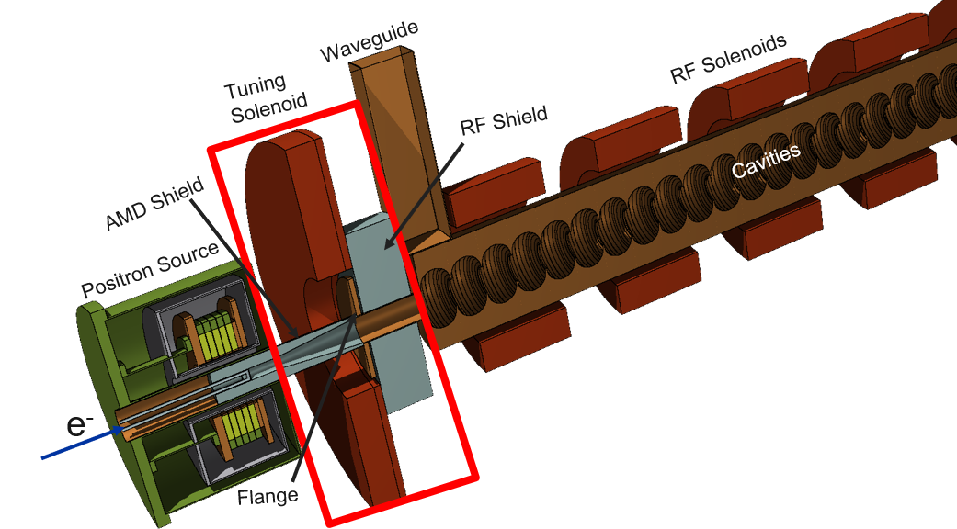
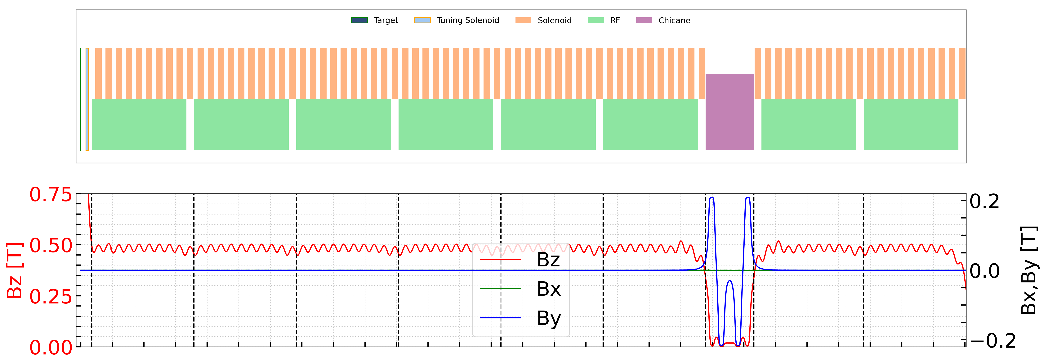
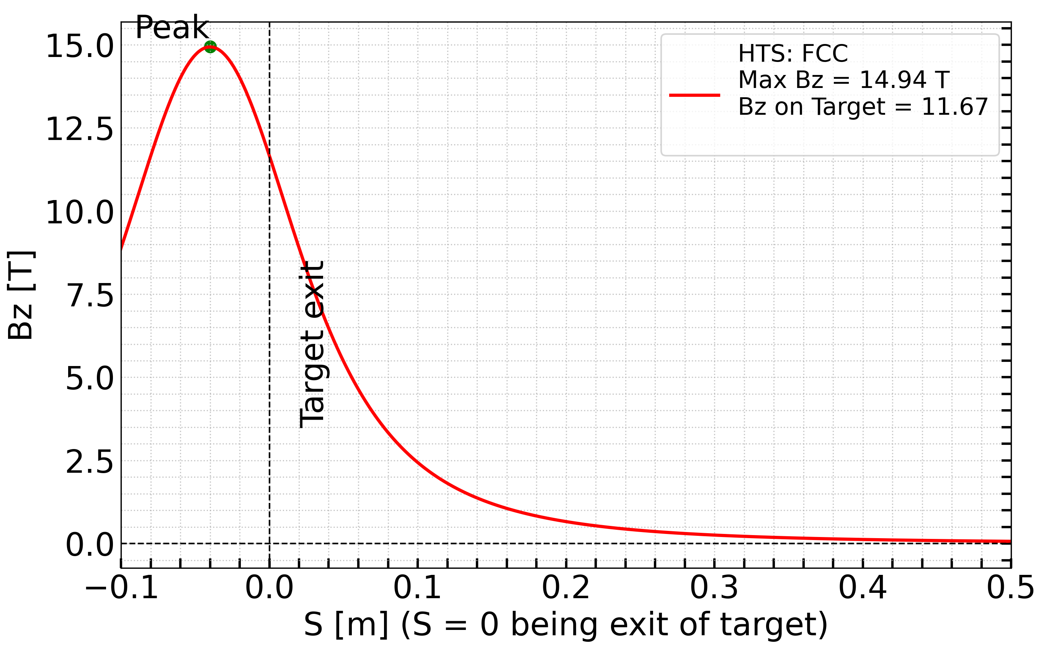
Positron capture system
High-Temperature Superconducting (HTS) solenoid designed by PSI
(Baseline - FCC Feasibility Study Report)
Matching device (MD)
  HTS solenoid (2D field, B0~14,94)
  Target exit position: 40 mm (w.r.t. HTS B0)
Matching solenoid
  L = 72 mm (3D field map)
Shielding
  Tapered aperture
Capture linac (CL)
  RF structures length: 3 m. Iris radius: 30 mm
  6 RF structures
  Regular solenoids: L = 200 mm (3D field, B0 ~ 0.31 T)

Slide 8
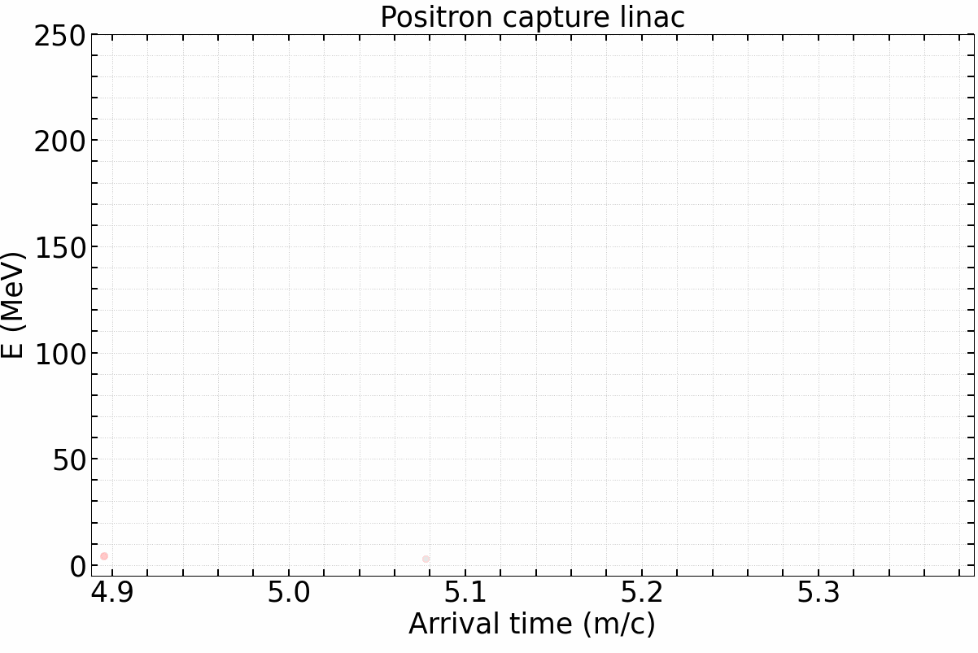
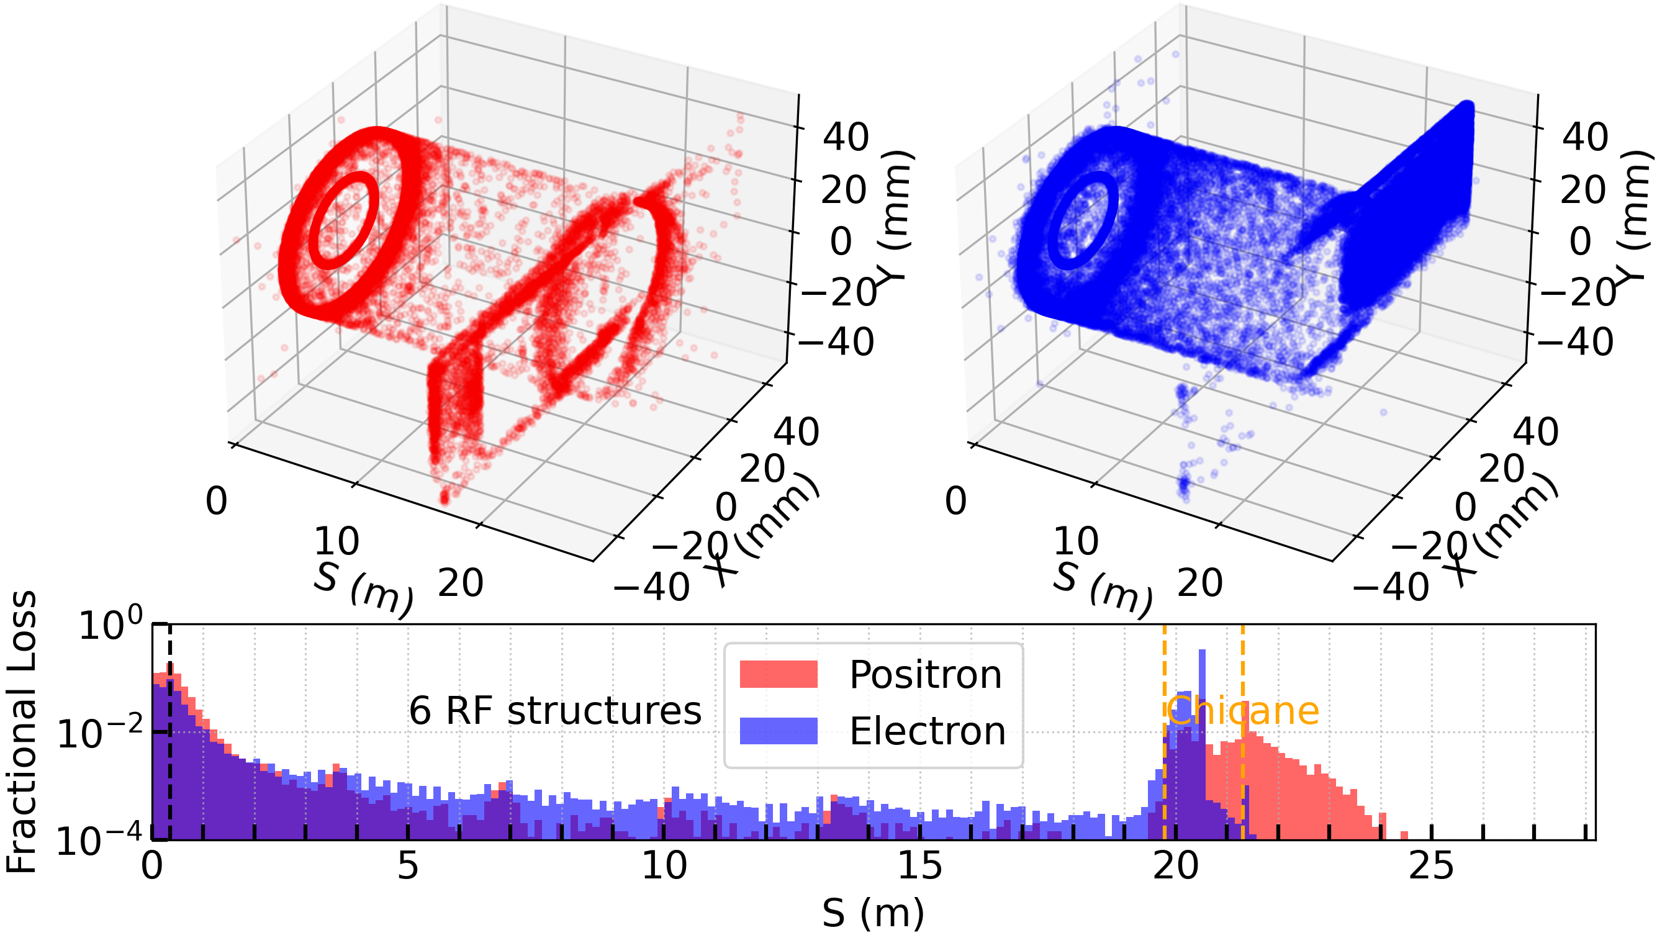
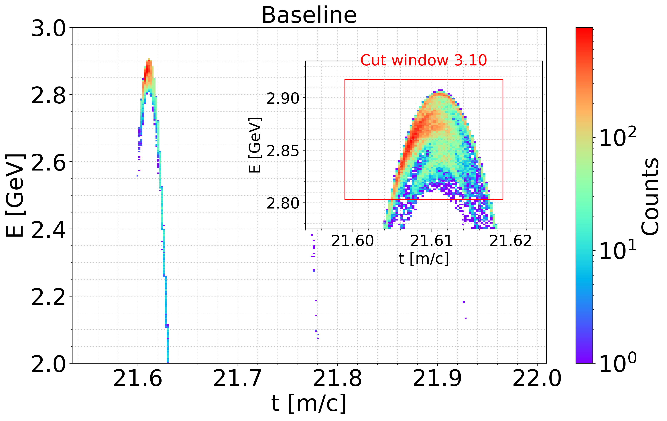
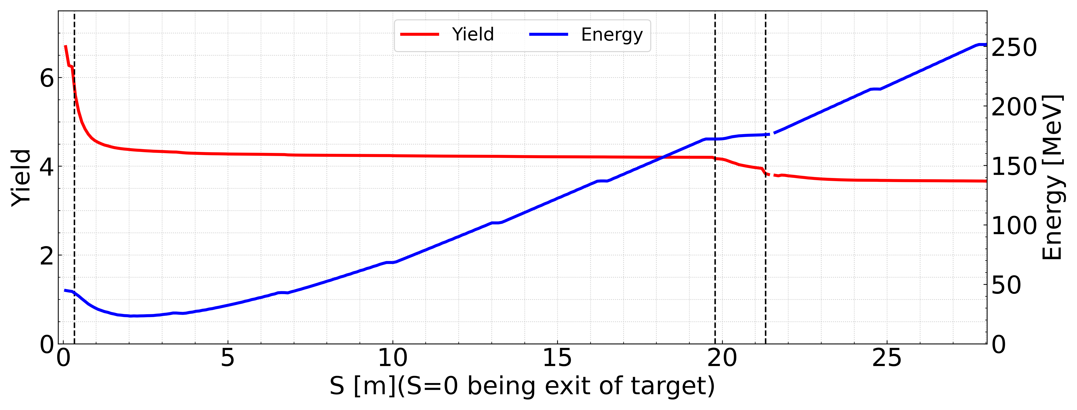
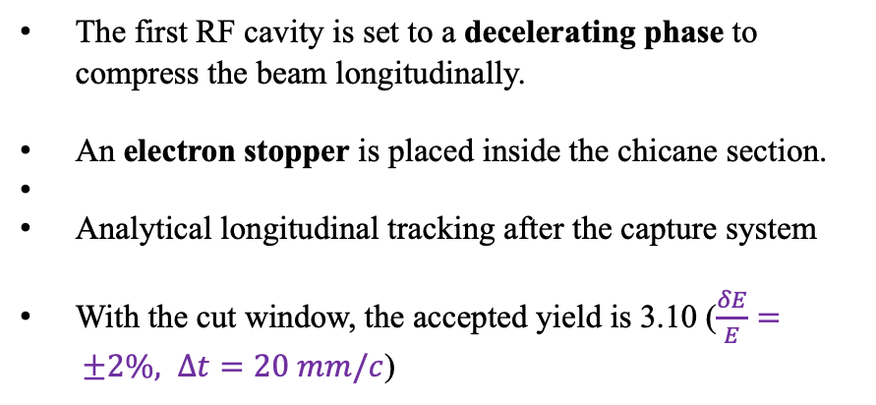
Beam dynamic (baseline)
Alive particles
The first RF cavity is set to a decelerating phase to compress the beam longitudinally.
An electron stopper is placed inside the chicane section.
Analytical longitudinal tracking after the capture system
With the cut window, the accepted yield is 3.10 ($\frac{δE}{E}= ±2\%, ∆t=20 mm/c$)

Slide 9
Outline
FCC-ee positron source
Simulation tools and positron capture system (baseline)
Possible options for RF structures operating at 3 GHz
6D acceptance approach for accepted e+ yield
Summary and conclusion

Slide 10
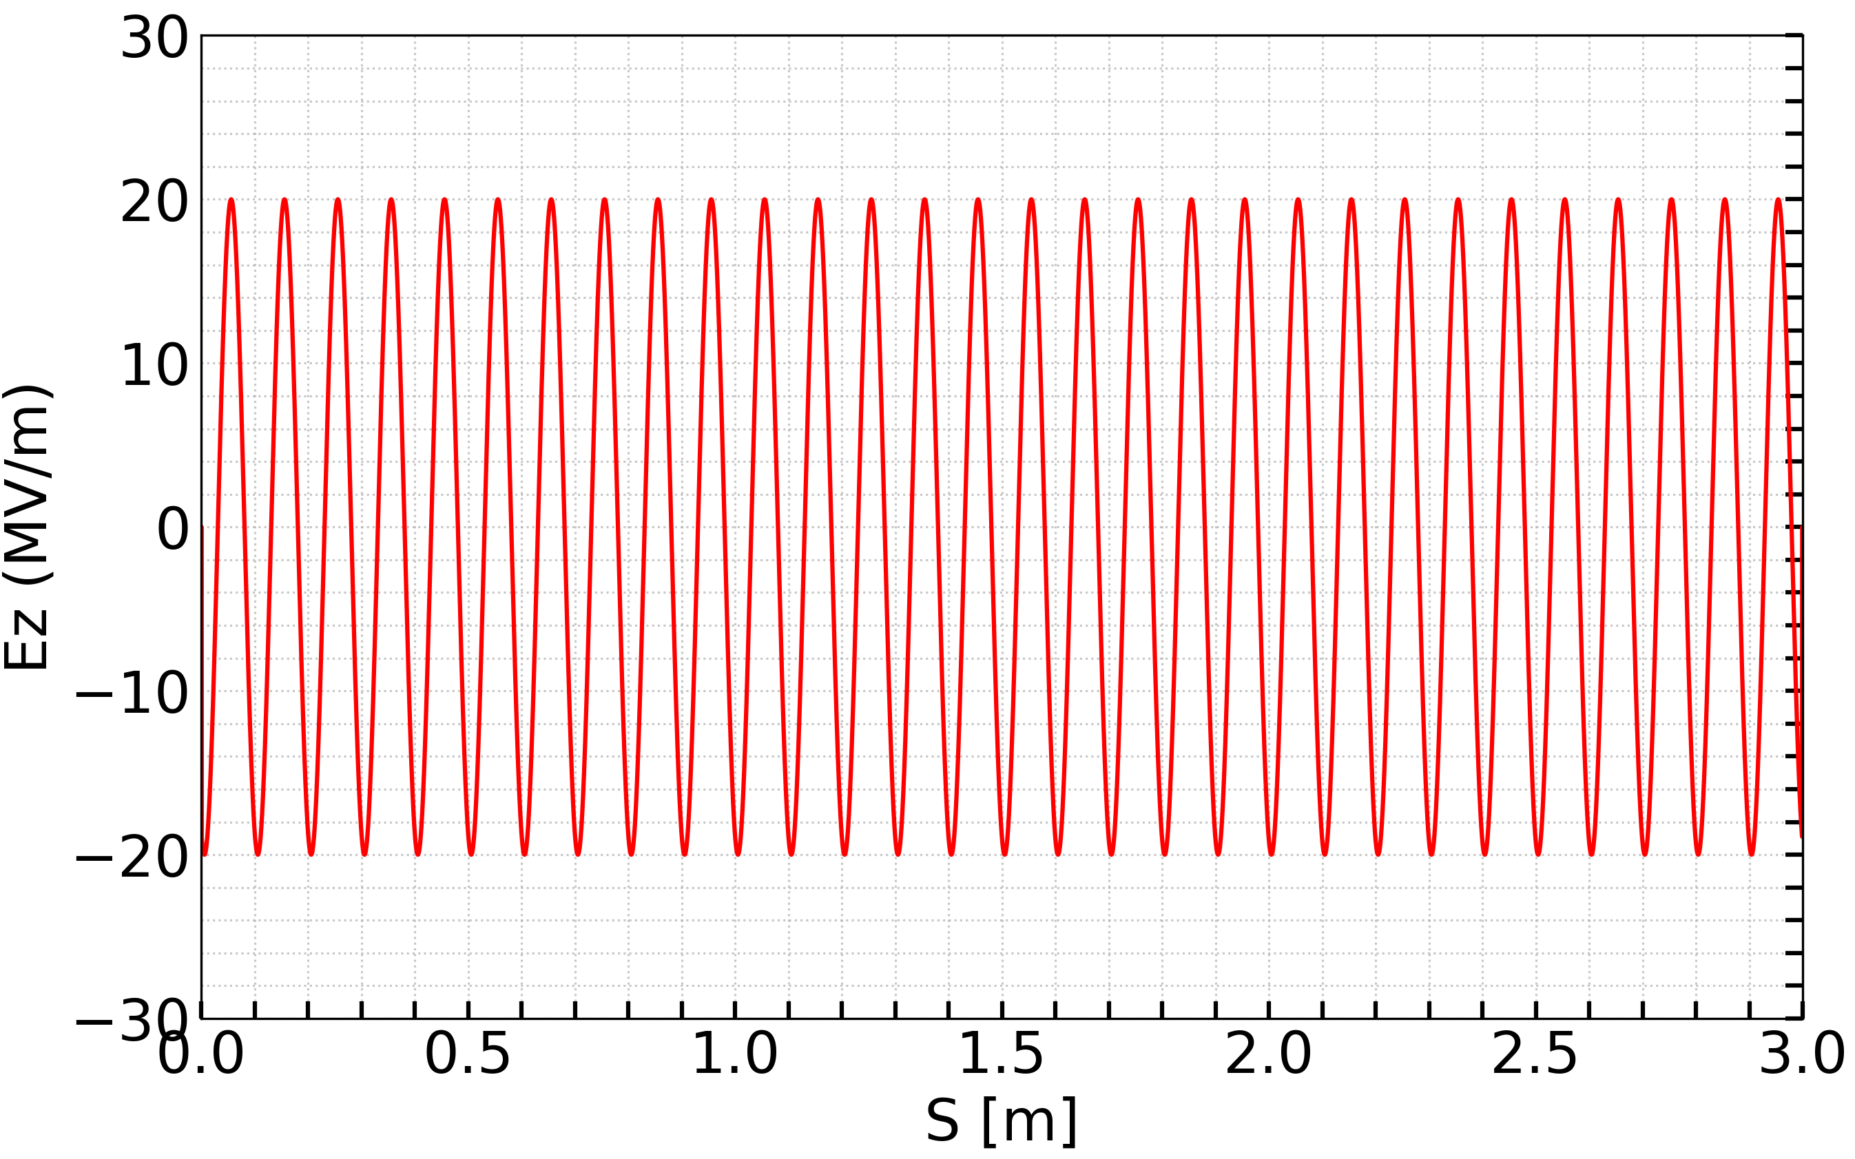
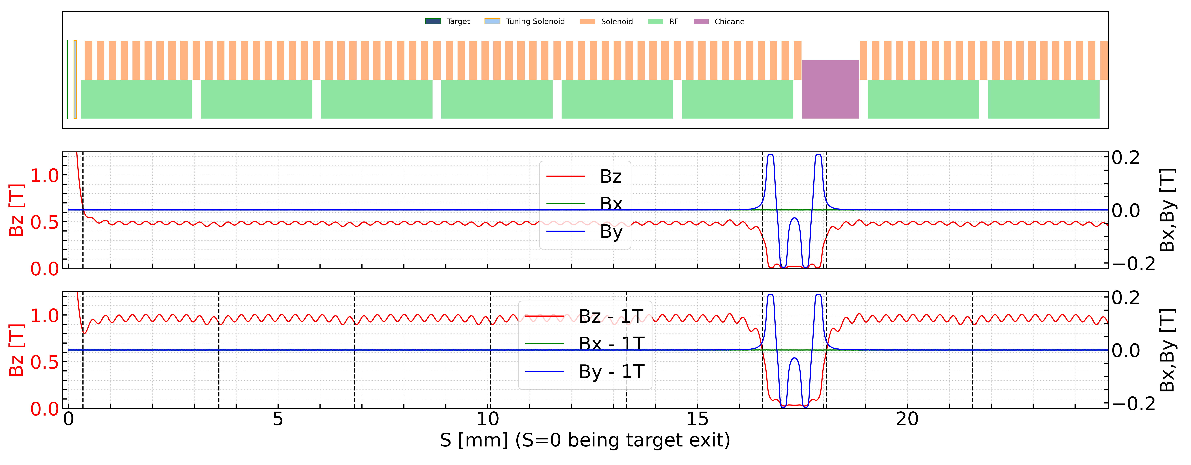
Possible options for RF structures operating at 3 GHz
Following the least design recommendations, a revised capture system operating at 3 GHz is investigated.
TW_Structure is applied to the current simulation. TW_Structure allows the simulation of the TM_{01n} modes in a travelling-wave structure using an analytic description of the field.
Two magnetic channel before matching section are considered (0.5 T and 1 T)
Define a TW_Structure in RF-Track
0.5 T magnetic channel
RF Parameters
Frequency | 3 GHz
Number of cells | 90
Phase advance | 2π/3
Length | ~ 3 m
Iris radius | 20 mm
1 T magnetic channel

Slide 11
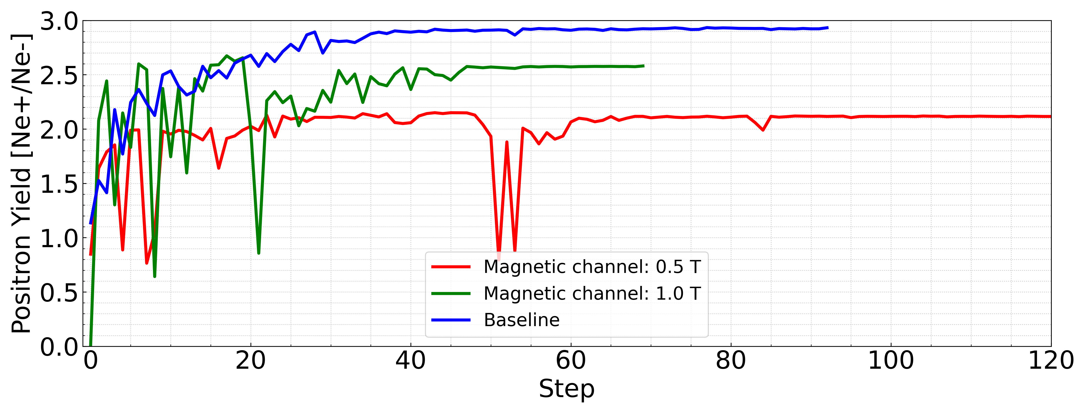
Optimization
The RF phases are optimized using Xopt with the Bayesian Upper Confidence Bound algorithm. After several steps, the yield converges to a stable value.
Stop optimization at S1 → apply analytical formulas + cut window
Simulation time: < 10 min per run.

Slide 12
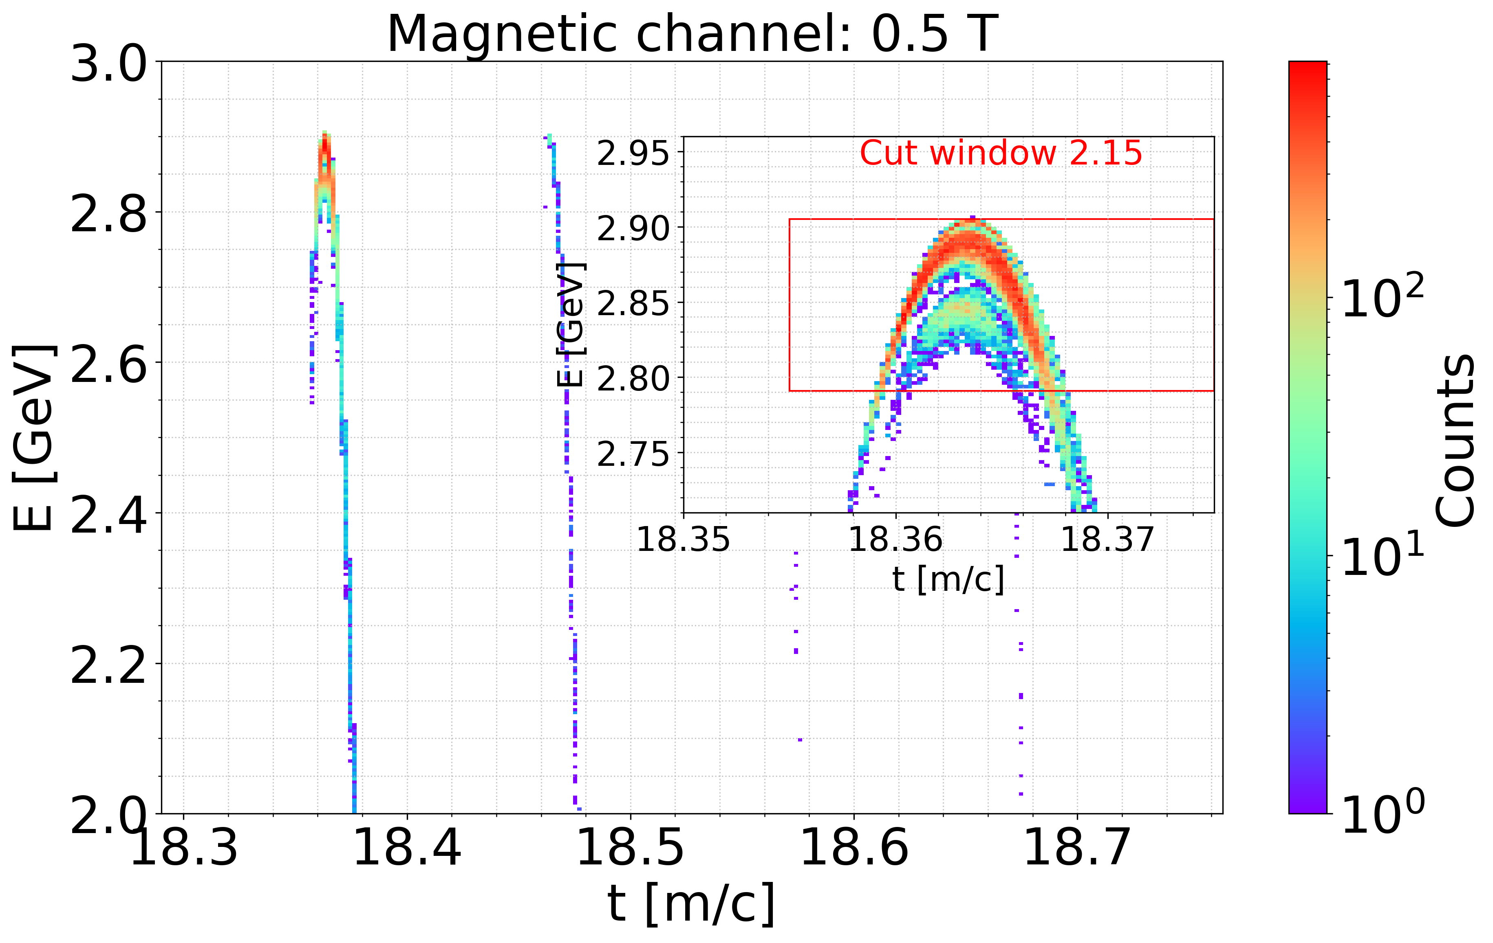
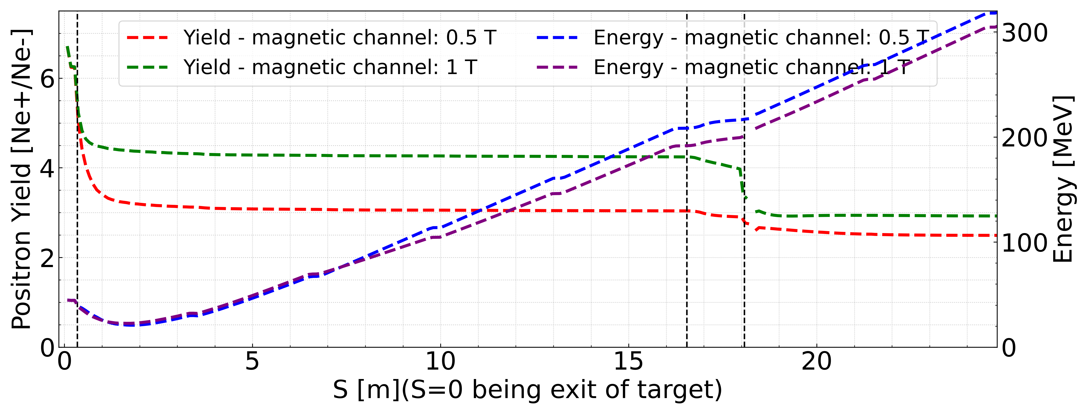
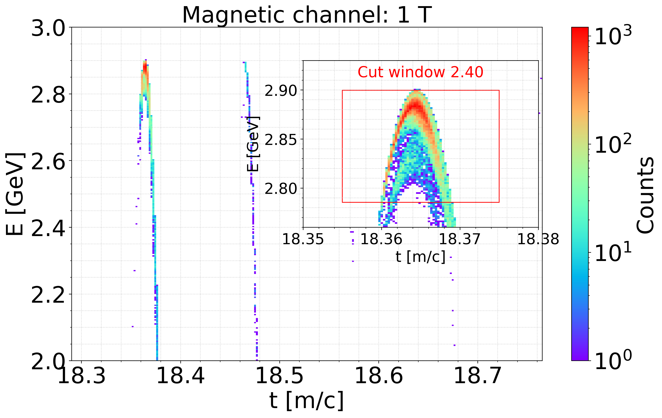
Beam dynamic (operation at 3 GHz)
Magnetic channels (approximately 0.5 T and 1 T) have a significant impact on the performance of both the capture linac and Section 1.
The chicane is optimized for the baseline configuration. Noticeable beam losses are observed in the chicane and Section 1 for two cases. In particular, severe beam loss occurs at the entrance of the first RF structure when the magnetic channel field is 0.5 T.
In Section 1, the positron transfer efficiencies for the two magnetic field cases are comparable.
Due to aperture

Slide 13
Detailed Comparison Table
Parameters | Baseline | RF 3GHz – solenoid 0.5 T | RF 3GHz – solenoid 1 T
Yield @ before chicane/ after chicane / S1* | 4.20 / 3.81 / 3.66 | 3.04 / 2.75 / 2.49 | 4.24 / 3.57 / 3.31
Energy (full beam) @ CL / S1 [MeV] | 172.1 / 176.05 / 251.6 | 208.3 / 217.3 / 317.8 | 172.18 / 191.6 / 186.54
Yield (cut window) | 3.10 | 2.15 | 2.40
Beam size x/y [mm] | 10.95/9.6 | 7.8/7.3 | 8.15 / 7.68
Normalized Emittance x/y [mm.rad] | 16.2 / 9.2 | 9.34/6.39 | 16.43/10.86
Geometry Emittance x/y [um] | 2.9 / 1.6 | 1.7 / 1.1 | 2.9 / 1.9
Energy spread [%] | 0.8 | 1.0 | 1.0
Bunch length [mm] | 2.5 | 2.0 | 1.8
* The yield represents the total beam output. The S1 ends after two RF accelerating cavities in Section 1.
Notes:
Plus minus 2 % and 20 mm/c

Slide 14
Outline
FCC-ee positron source
Simulation tools and positron capture system (baseline)
Possible options for RF structures operating at 3 GHz
6D acceptance approach for accepted e+ yield
Summary and conclusion

Slide 15

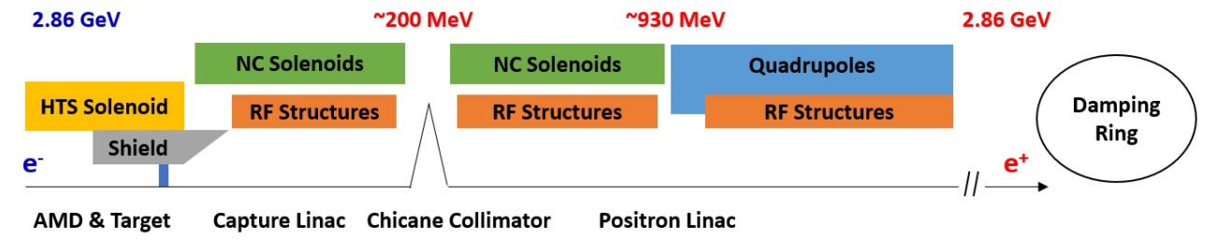

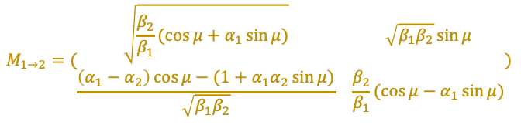
Full positron linac, Transfer Line and ECS
$$M_{1→2}=(\begin{matrix}\sqrt{\frac{β_{2}}{β_{1}}(\cos{μ}+α_{1}\sin{μ})} & \sqrt{β_{1}β_{2}}\sin{μ} \\ \frac{\left(α_{1}−α_{2}\right)\cos{μ}−(1+α_{1}α_{2}\sin{μ})}{\sqrt{β_{1}β_{2}}} & \frac{β_{2}}{β_{1}}(\cos{μ}−α_{1}\sin{μ})\end{matrix})$$
$$L= L_{0}(1+α_{c}δ)$$
After CL:
  Section 1: Same structures and solenoids as Capture Linc. Average energy (beam core) at exit: ~930 MeV
  Section 2: Periodic FODO cells. 2 structures per FODO cell. FODO phase advance: 76.345°
  Matching section: used to match the beam parameters between Section 1 and Section 2.
At present, the transport line is represented by using an analytical ECS together with a TransferLine element, instead of an actual designed section
The TransferLine element can be used to transport a beam through an entire beamline without having to specify each element individually, only by giving pairs of Twiss parameters [1].
[1] https://gitlab.cern.ch/rf-track

Slide 16
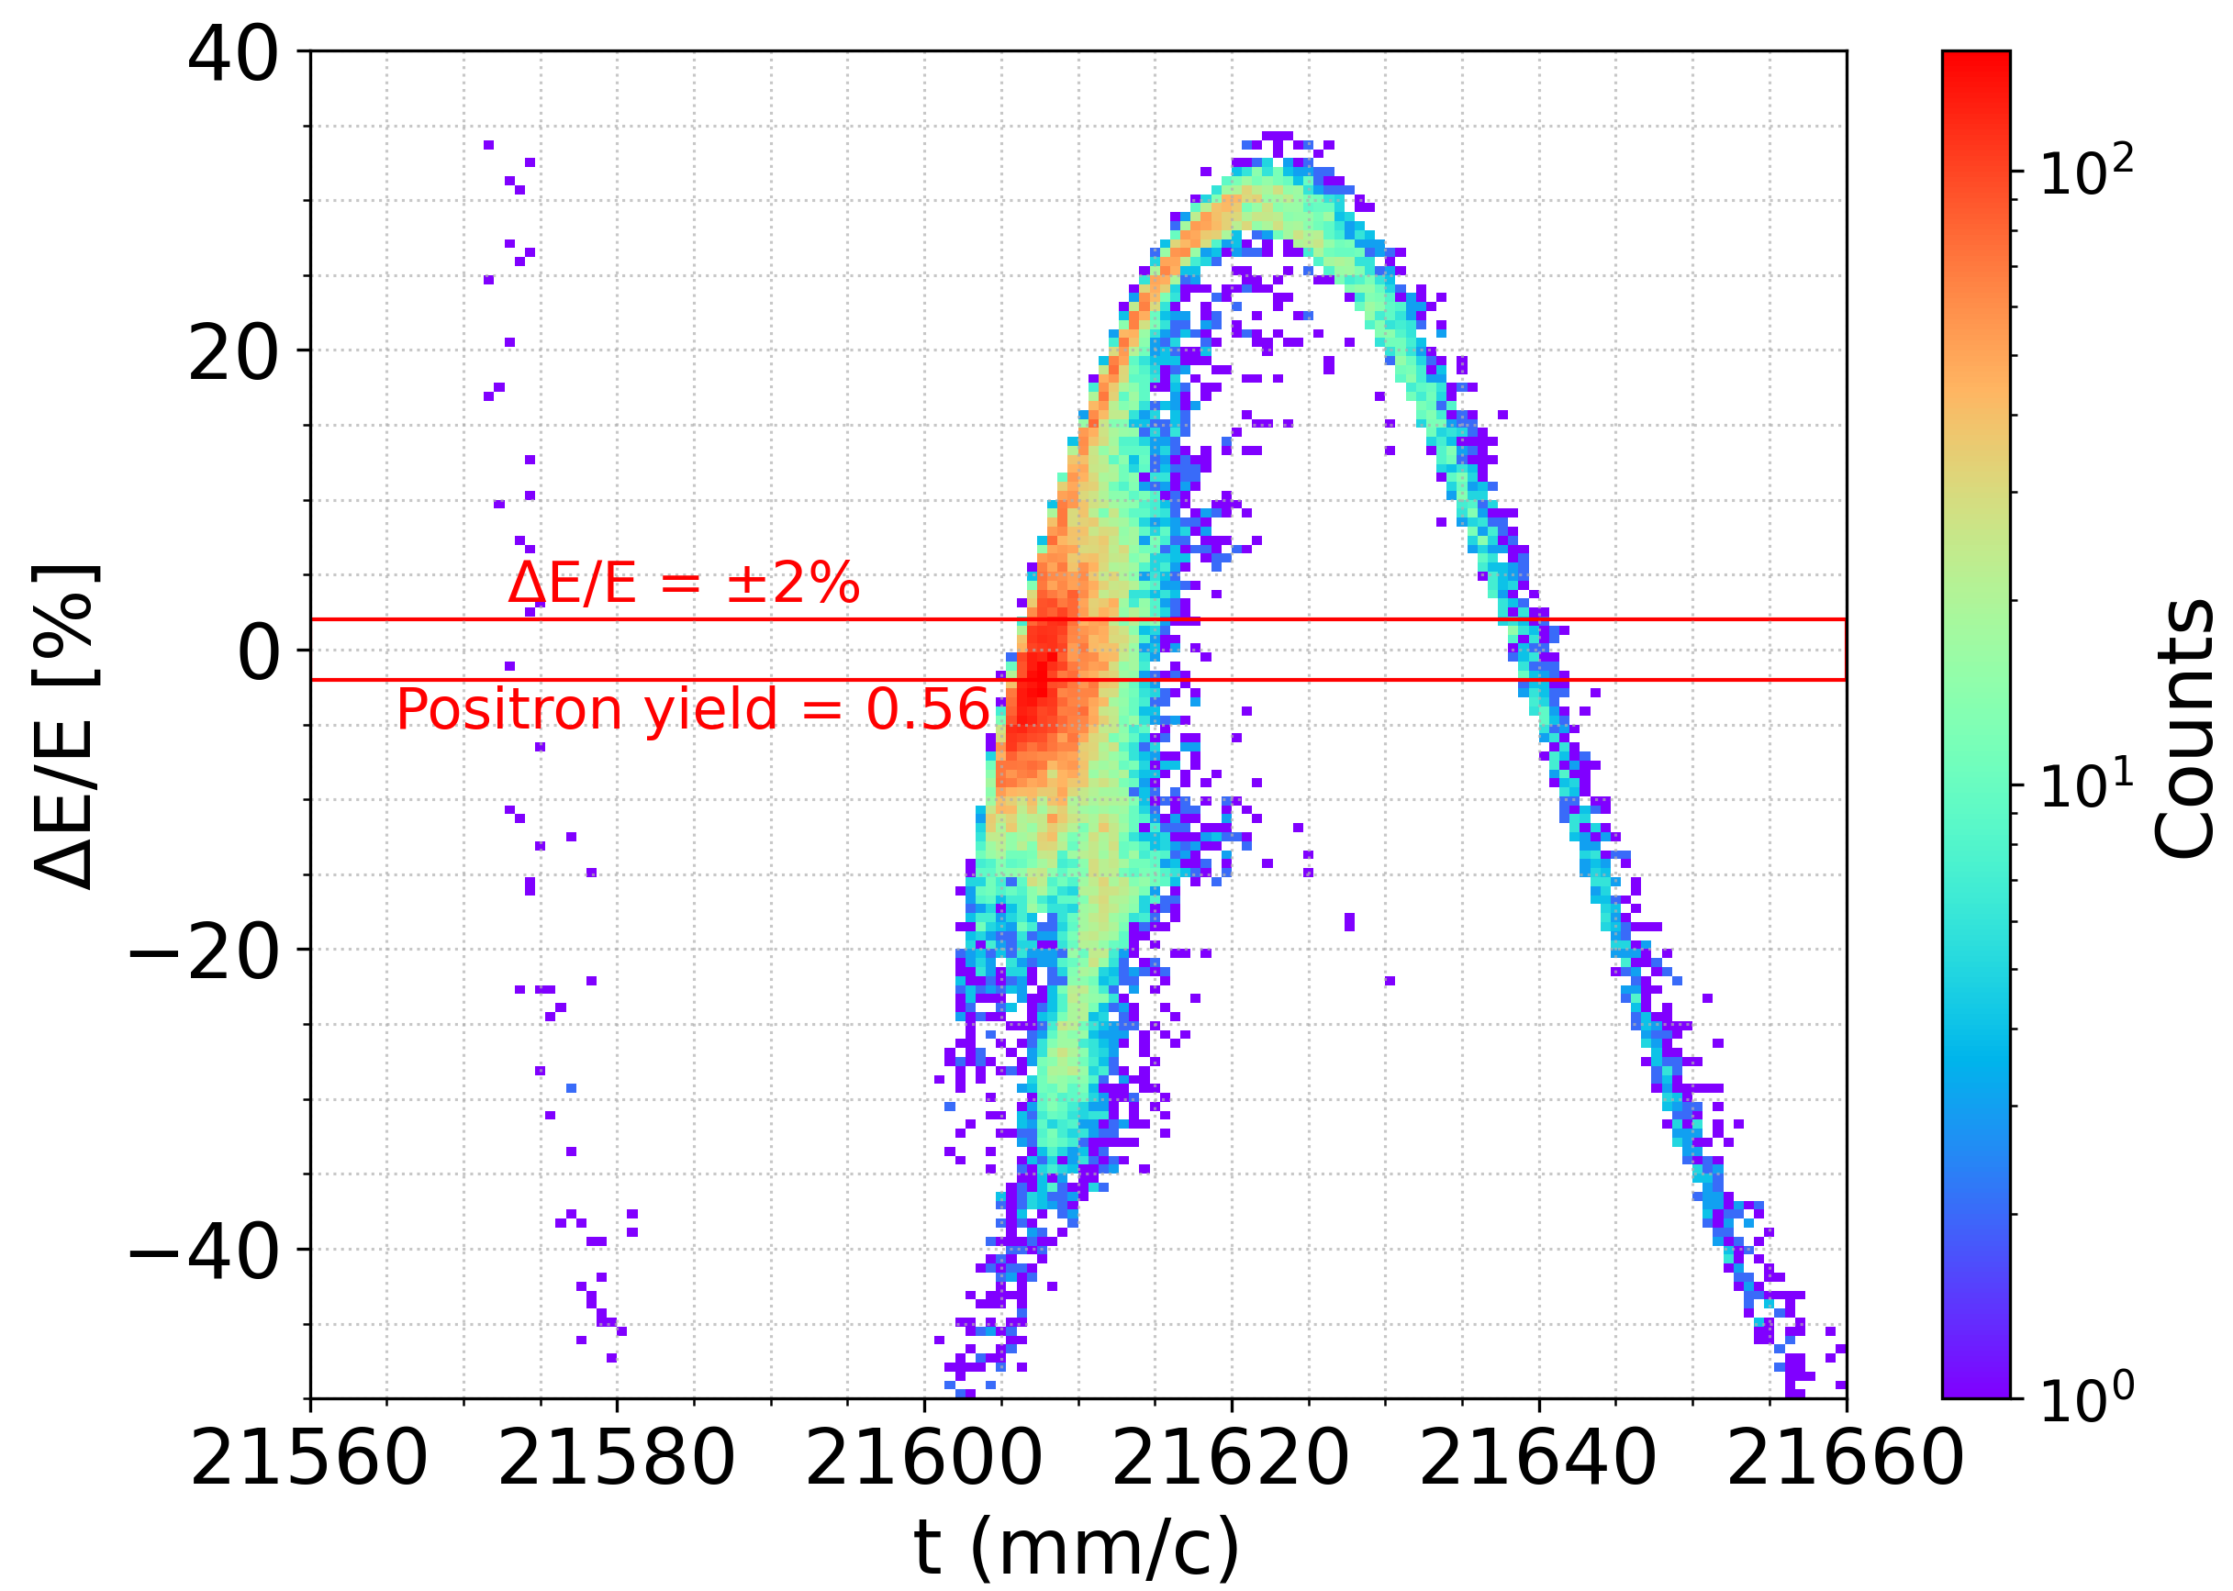
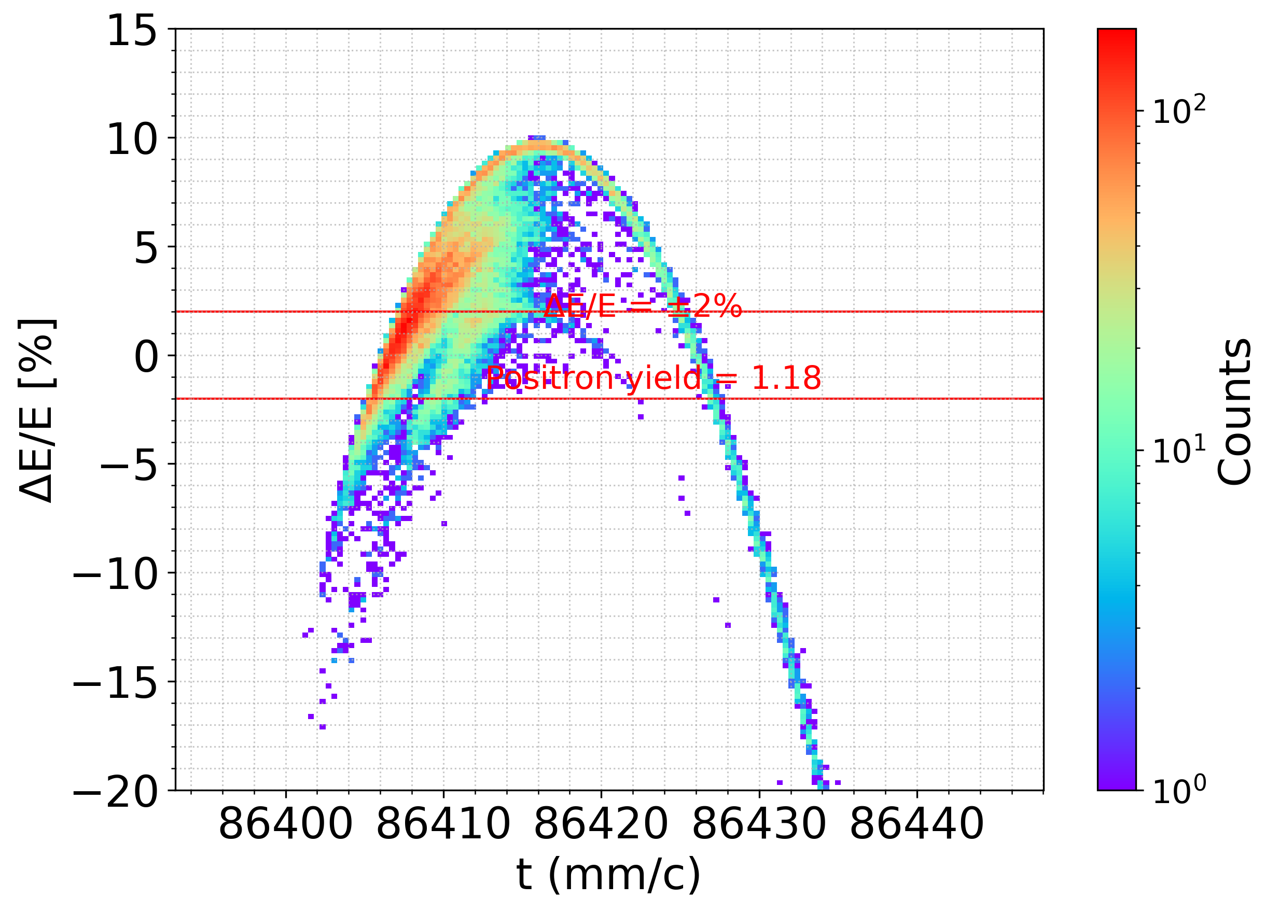
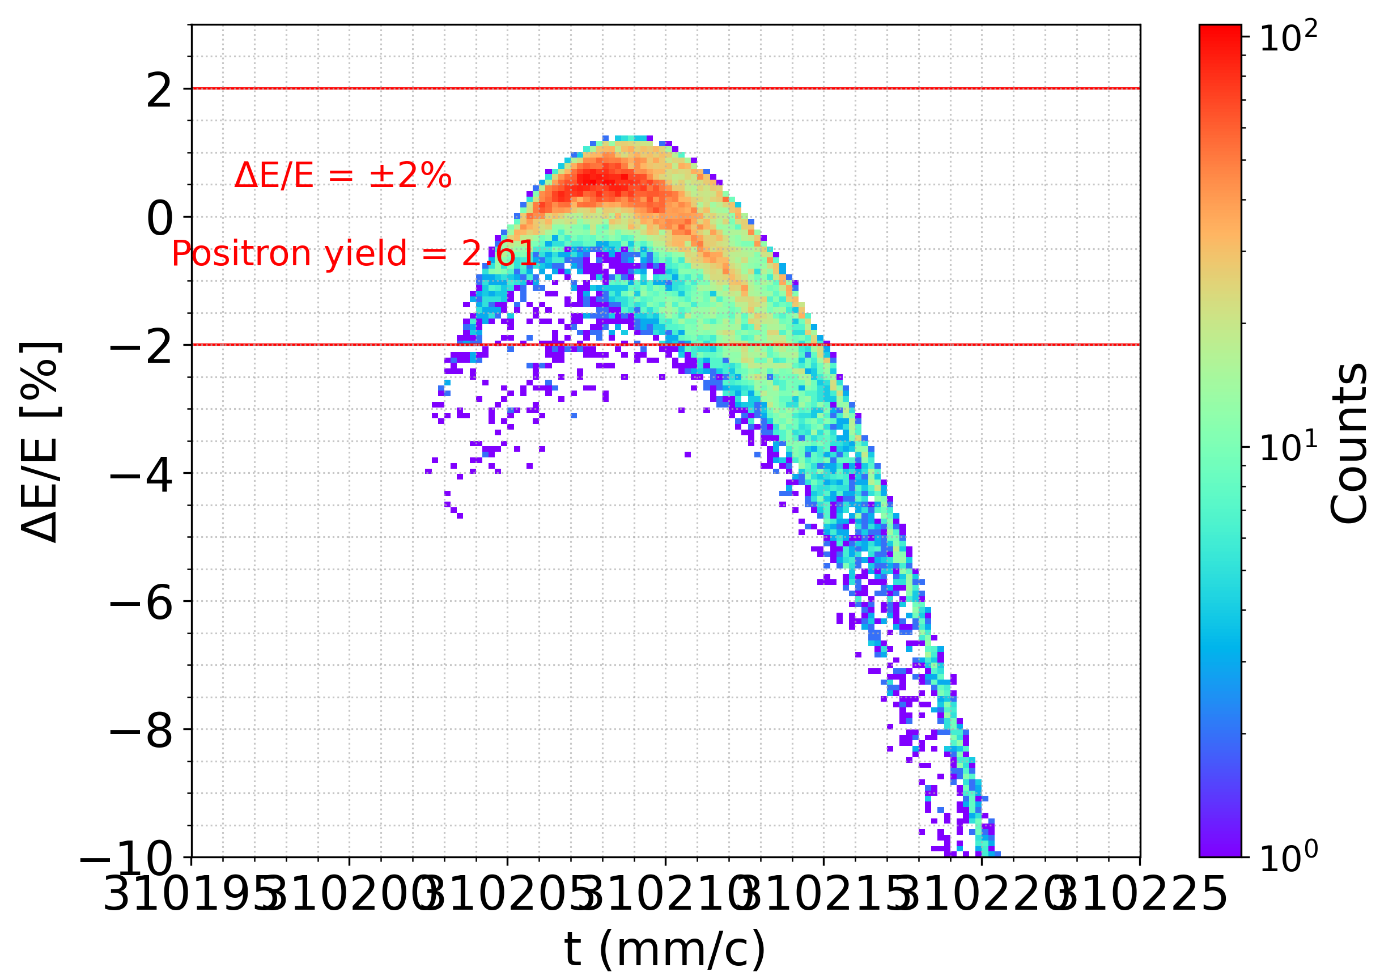
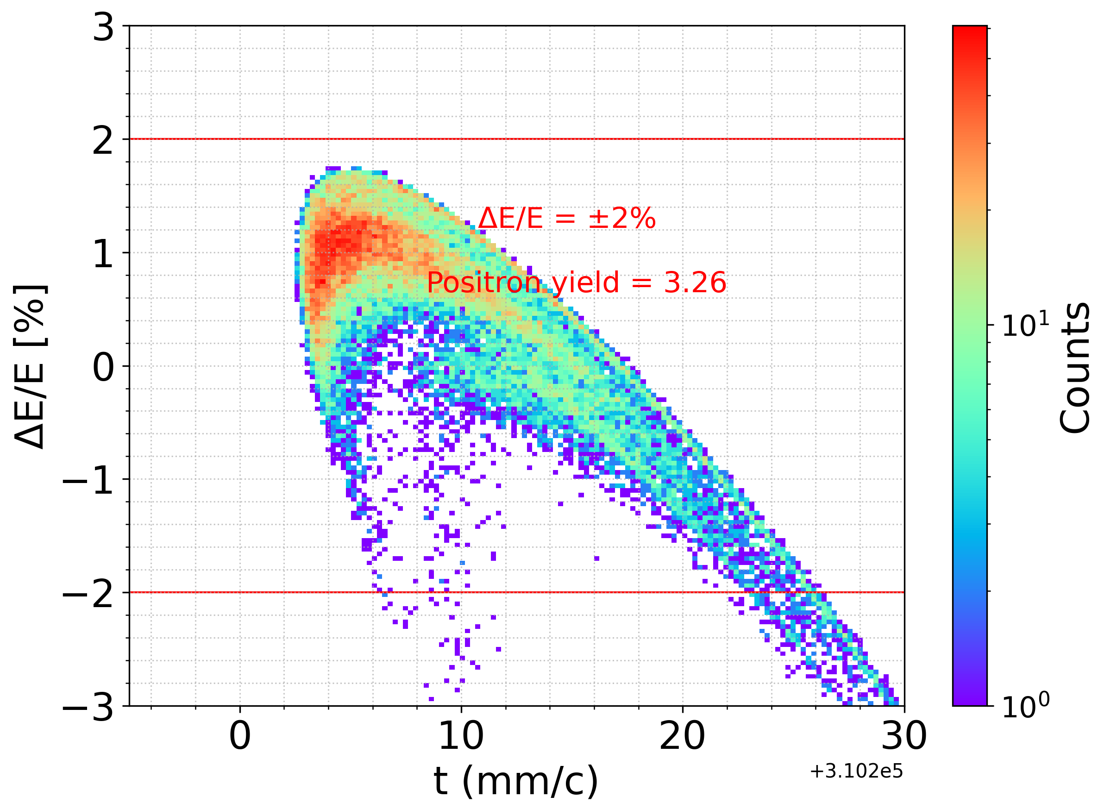
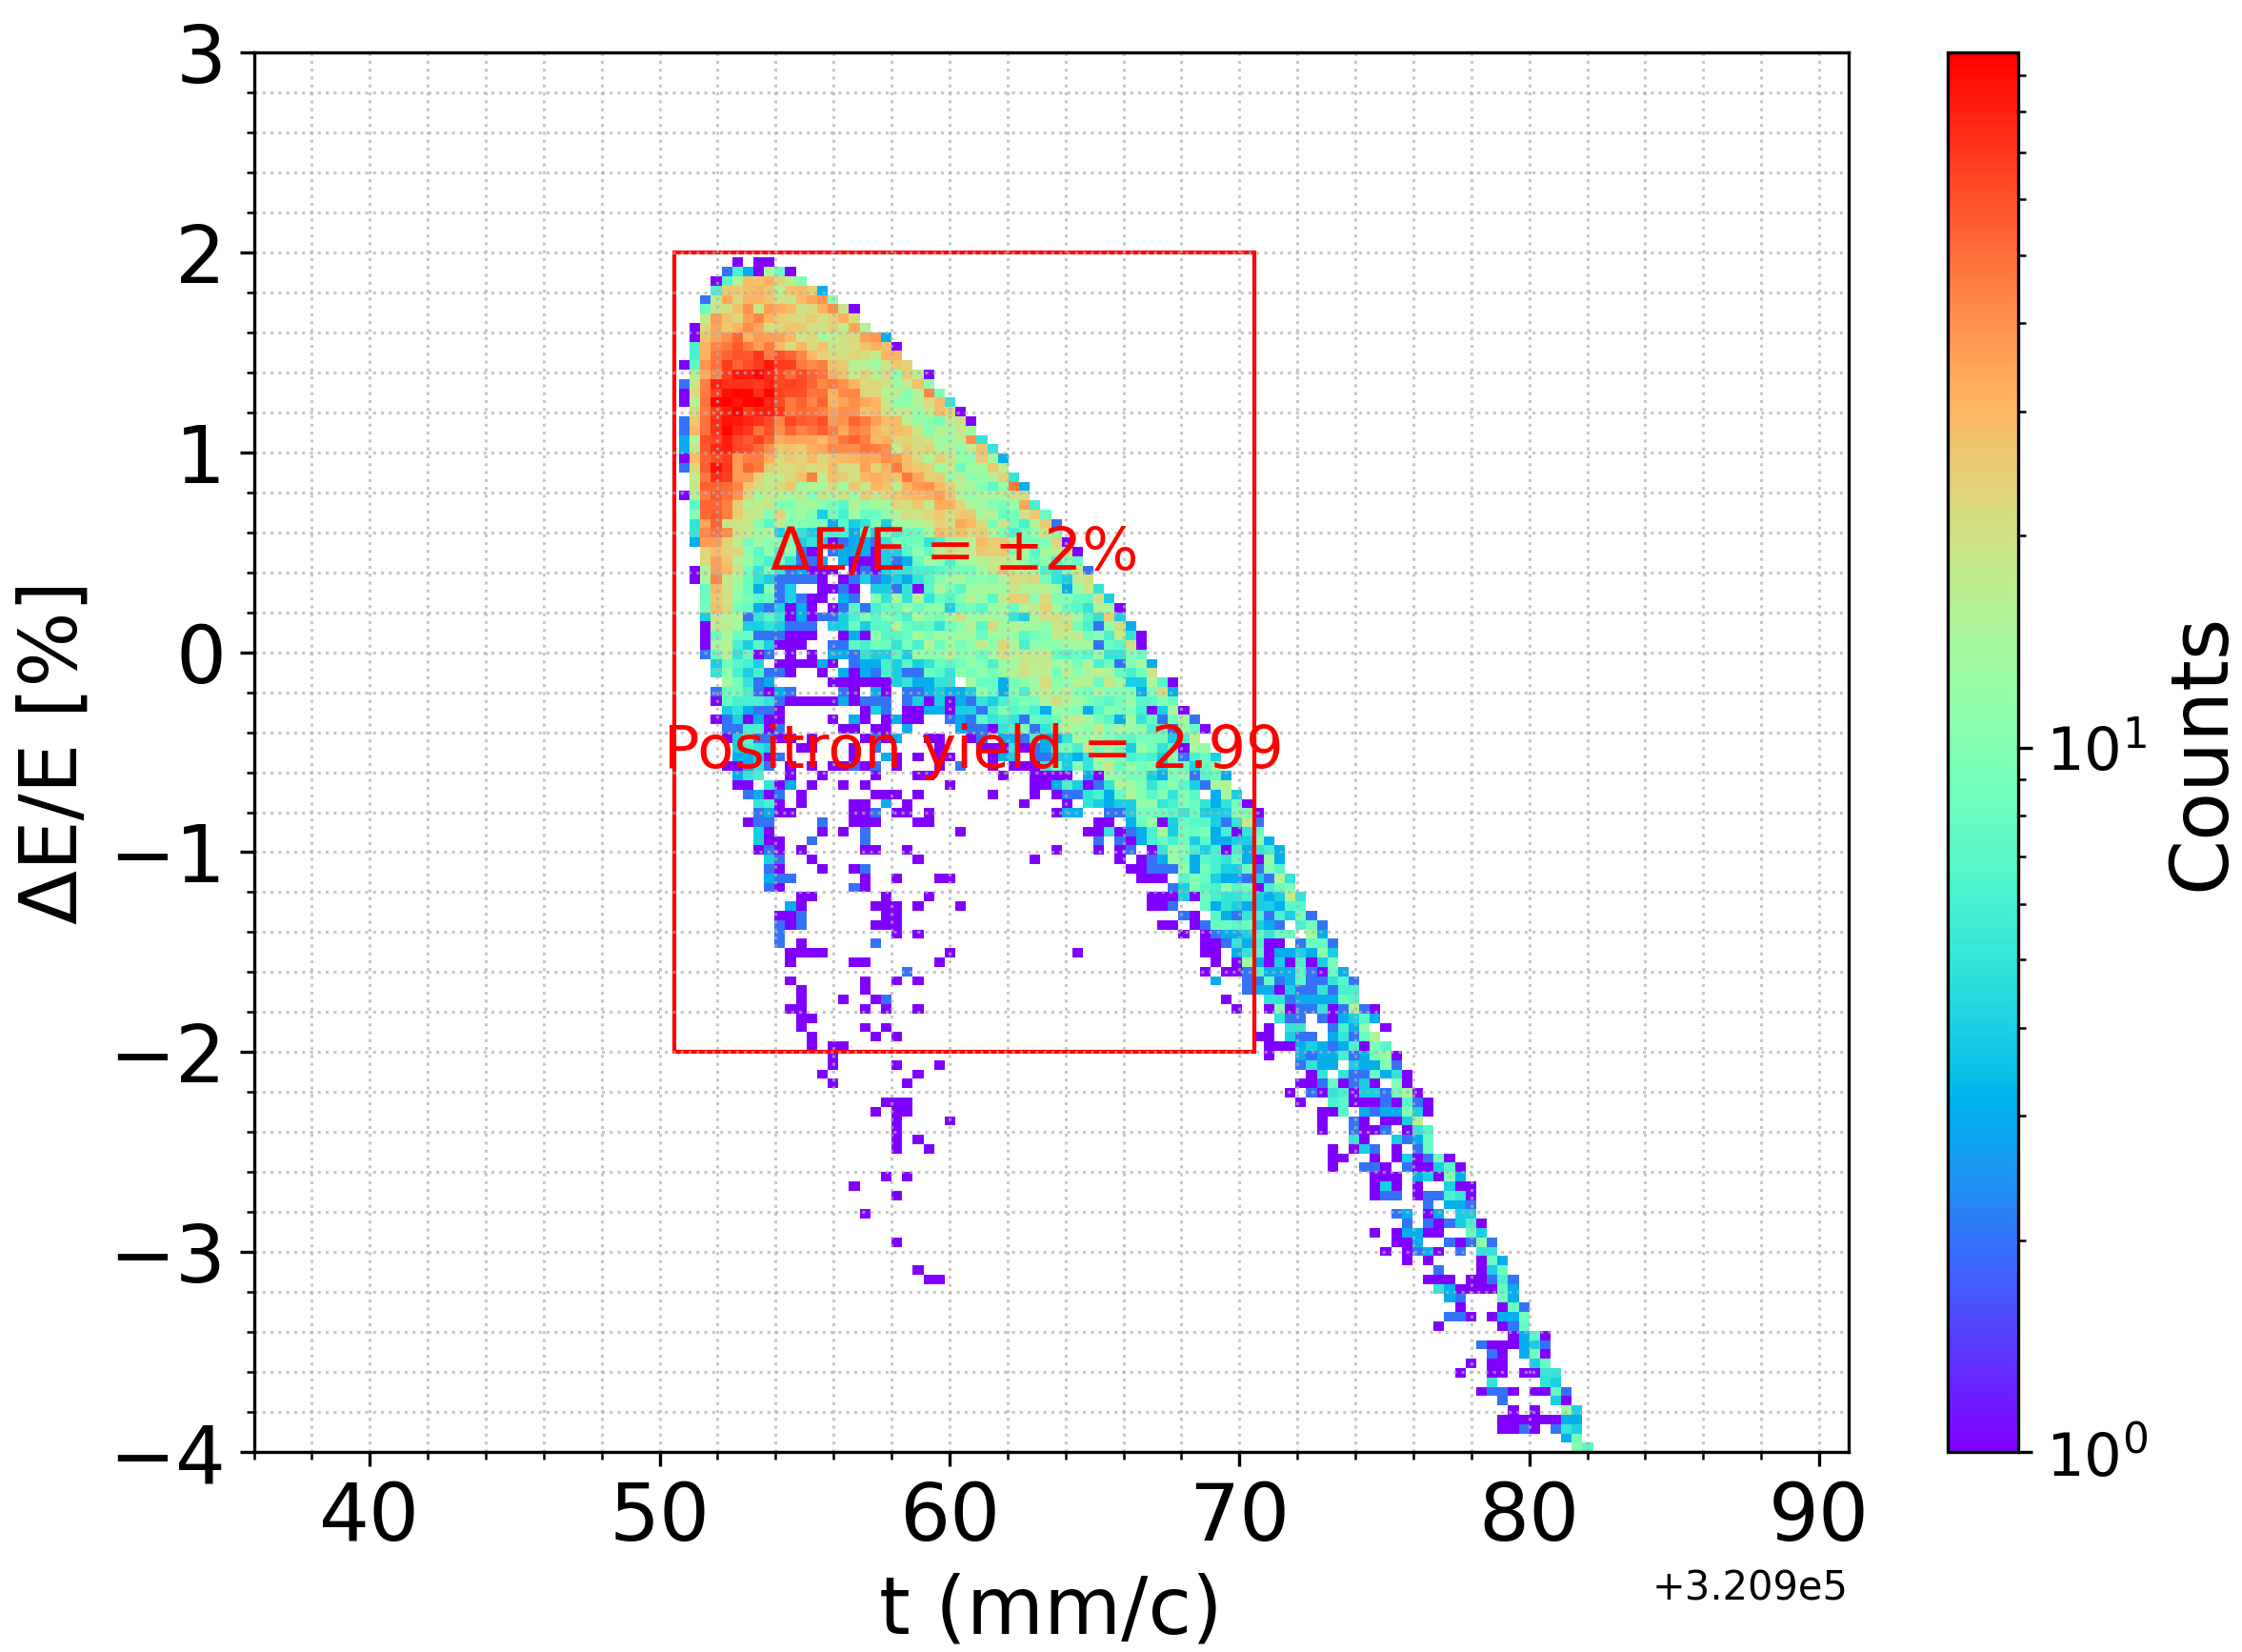
Full positron linac – baseline (start-to-end simulation)
Capture linac 2 GHz, 13.3 MV/m
6 RF structures
Solenoid-based focusing
RF: 2 GHz, 13.3 MV/m
20 RF structures
Quadrupole-based focusing
RF: 2 GHz, 12.3 MV/m
26 RF structures
E = 2.86 GeV
Q = 13 nC (considering 60% losses for transport, collimation and injection into DR)
Positron/Electron
Separation at 170 MeV
Target & cryostat
DC solenoid
DC solenoid
Matching section
e⁻ 2.86 GeV
Q = ~3.8 nC
DC solenoid
Electron/Photon dumps
DC solenoid
Transfer line
Energy collimator
and compressor
CL
S1
S2
ECS
Damping Ring
E = 2.86 GeV
Q_{b} = 5 nC
TL
Parameters in CL and transfer line are optimized by Xopt to maximize the accepted positrons.
With the longitudinal cut window, the acceptance of 3 is achieved with the cut window (δE/E = ±2 % and Δt = 20 mm/c).

Slide 17
Comparison with full simulation
 | Analytical formulae | Start-to-end simulation
Yield (cut window) | 3.10 | 2.99
Beam size x/y [mm] | 10.95/9.6 | 3.15/2.48
Normalized Emittance x/y [mm.rad] | 16.2 / 9.2 | 13.5/12.8
Energy spread [%] | 0.8 | 1
Bunch length [mm] | 2.5 | 4.6
For both cases, the final accepted yields are comparable when the transverse phase space is neglected.
To some extent, analytical formulas are an efficient tool for optimizing parameters in the capture linac.

Slide 18
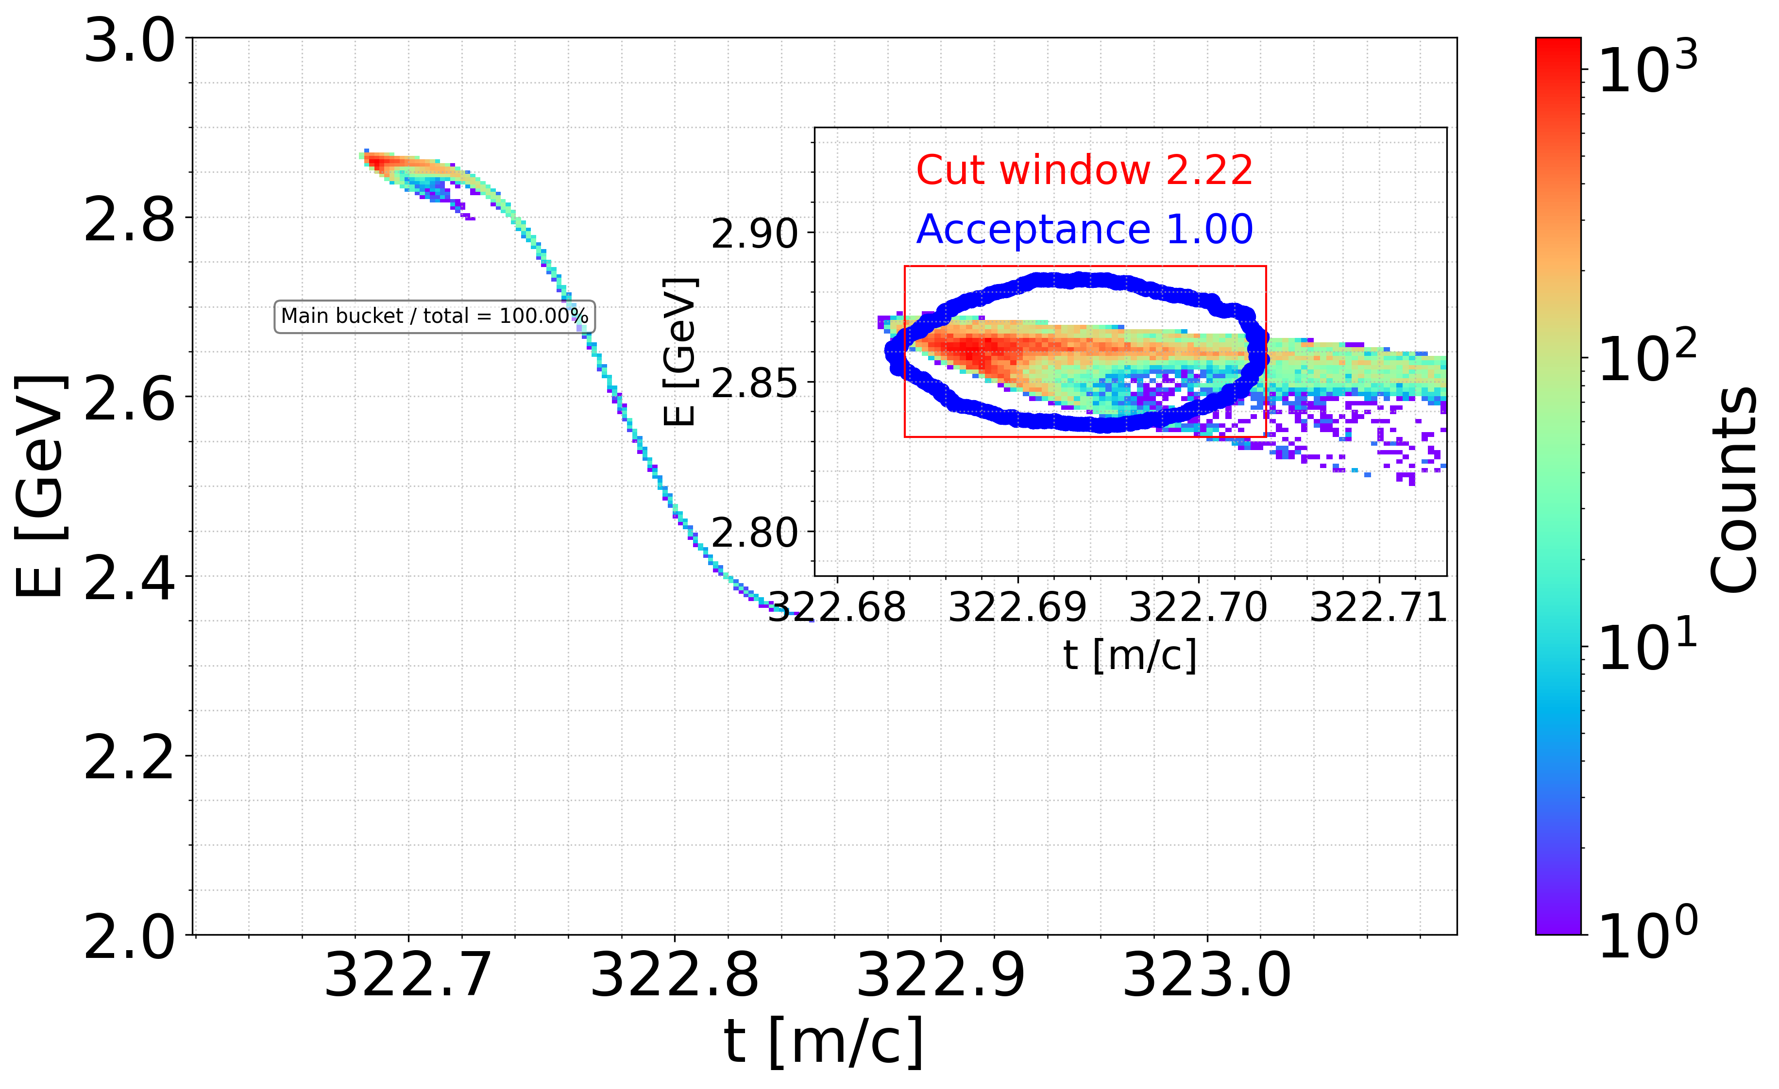
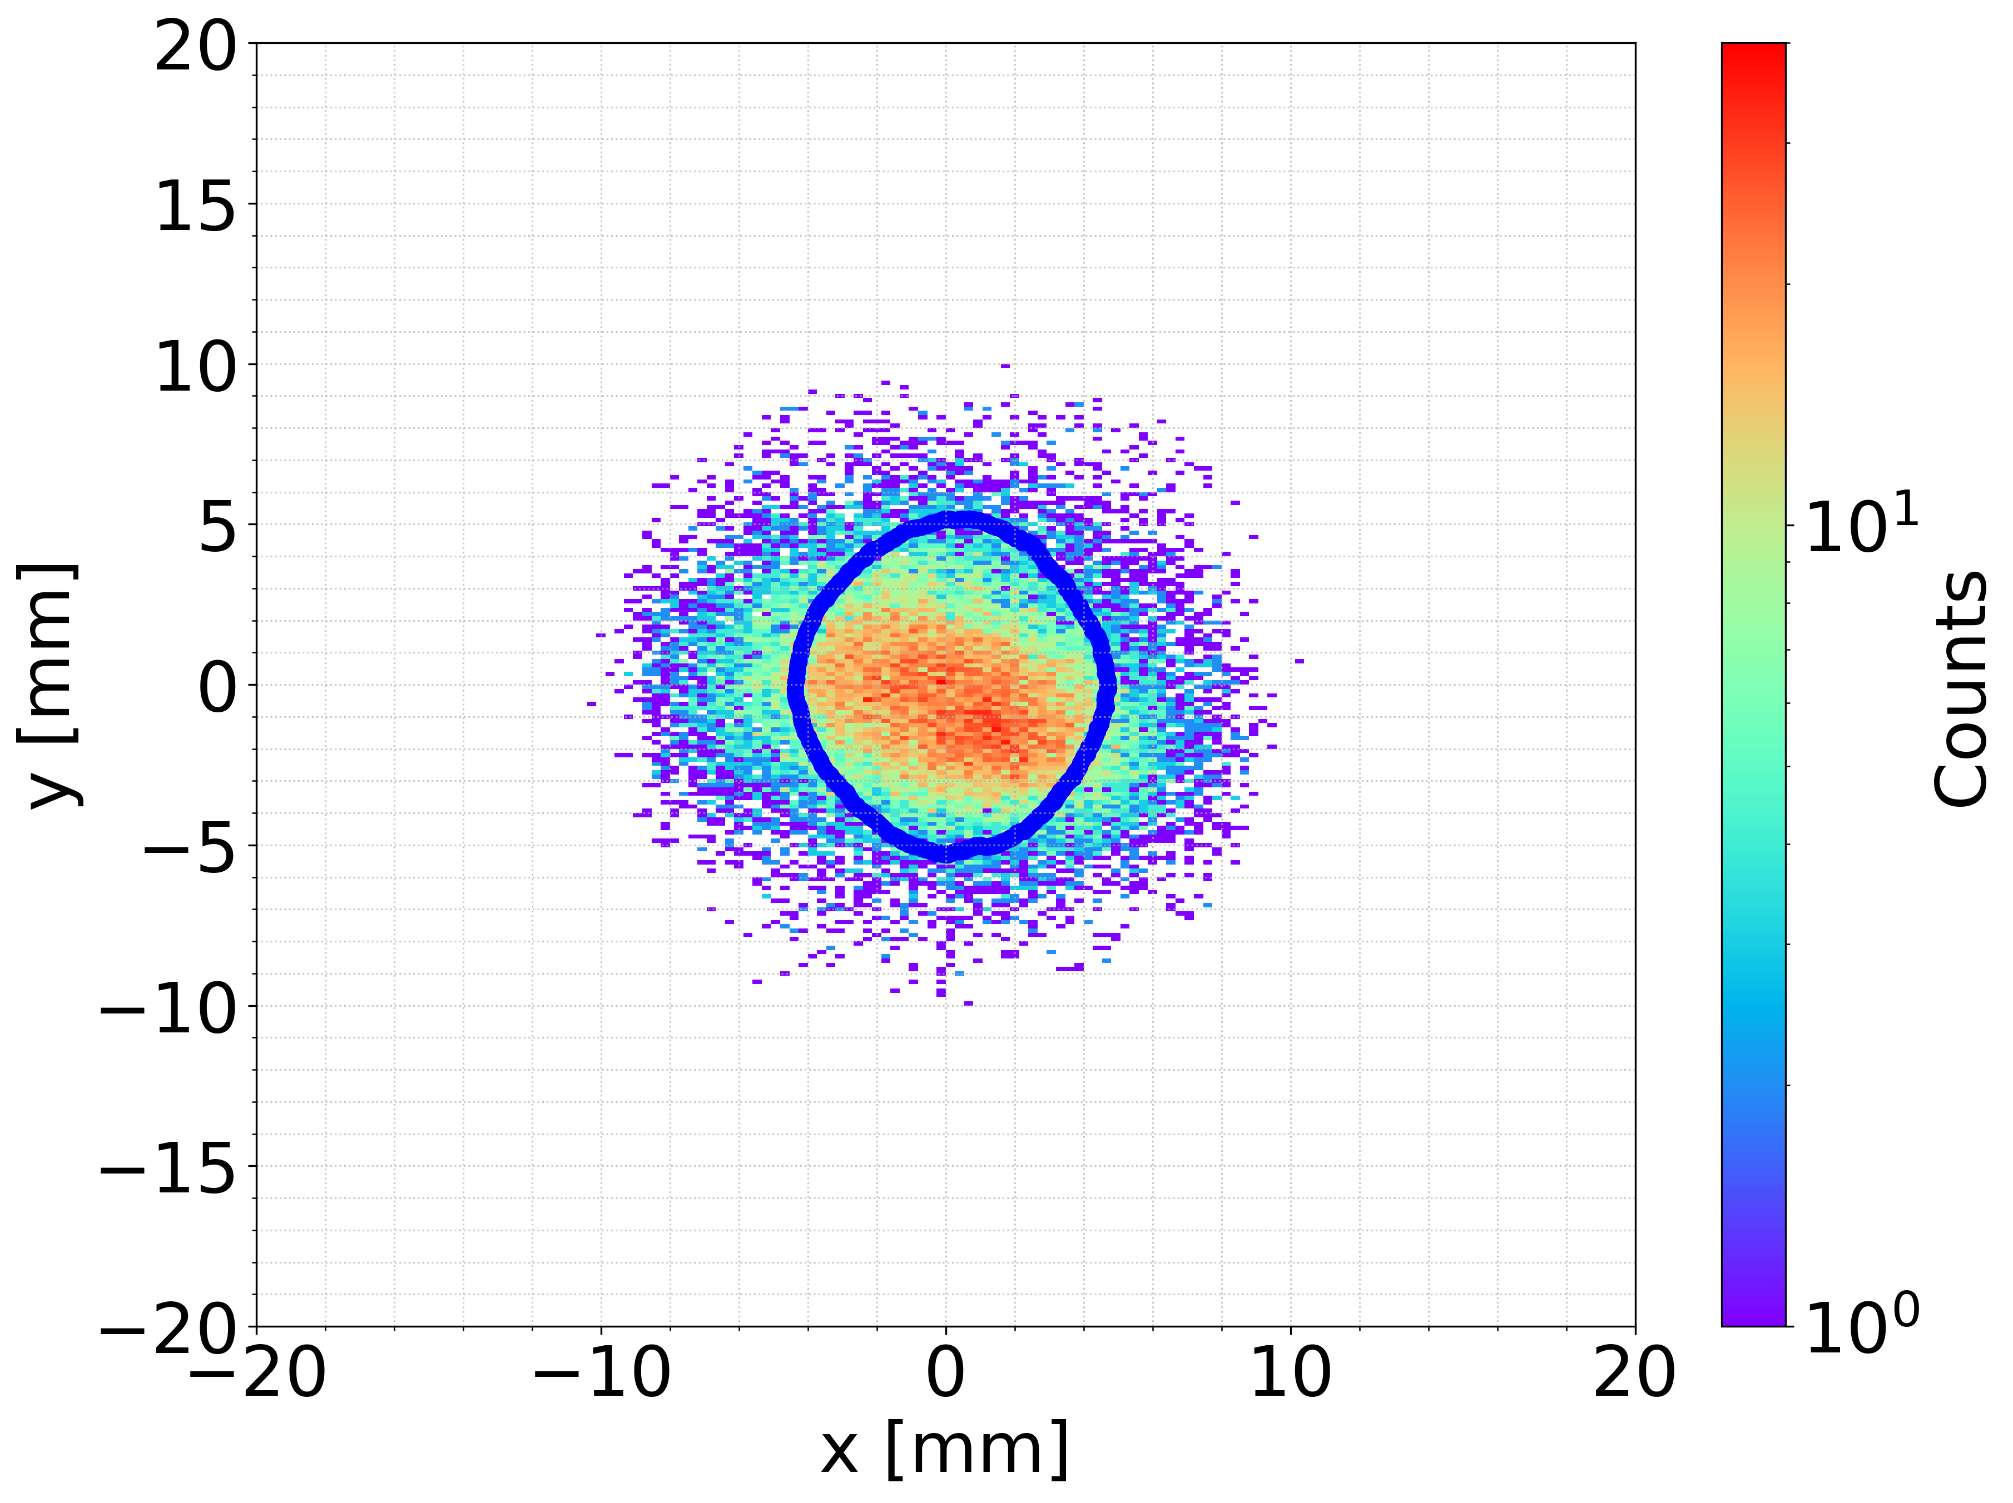
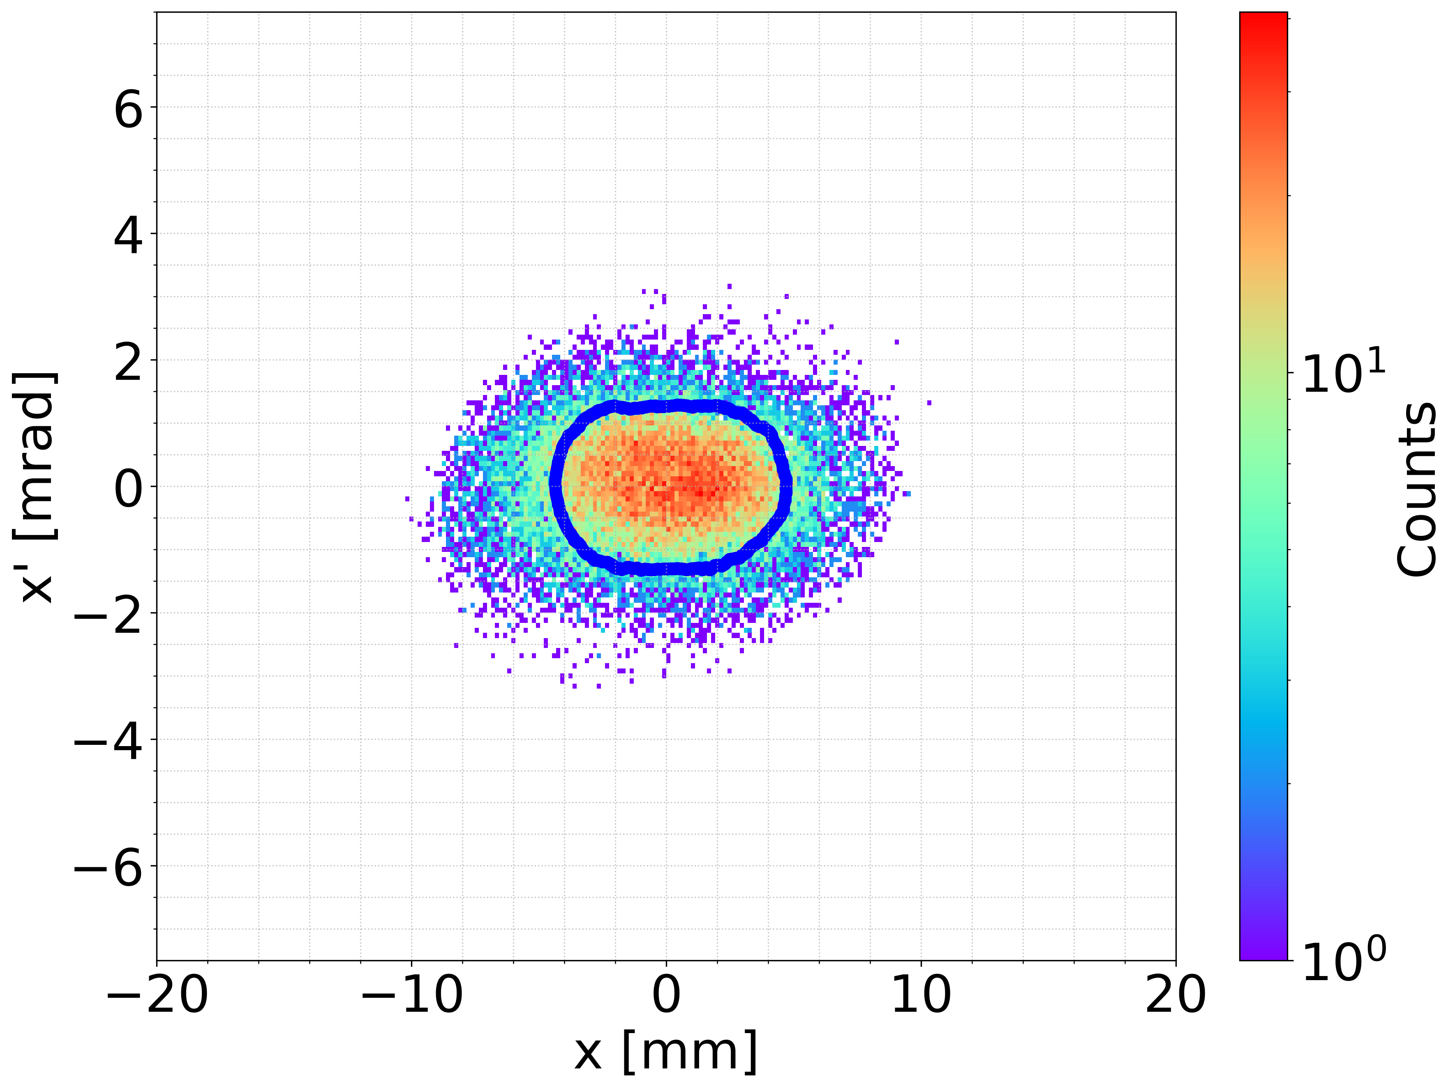
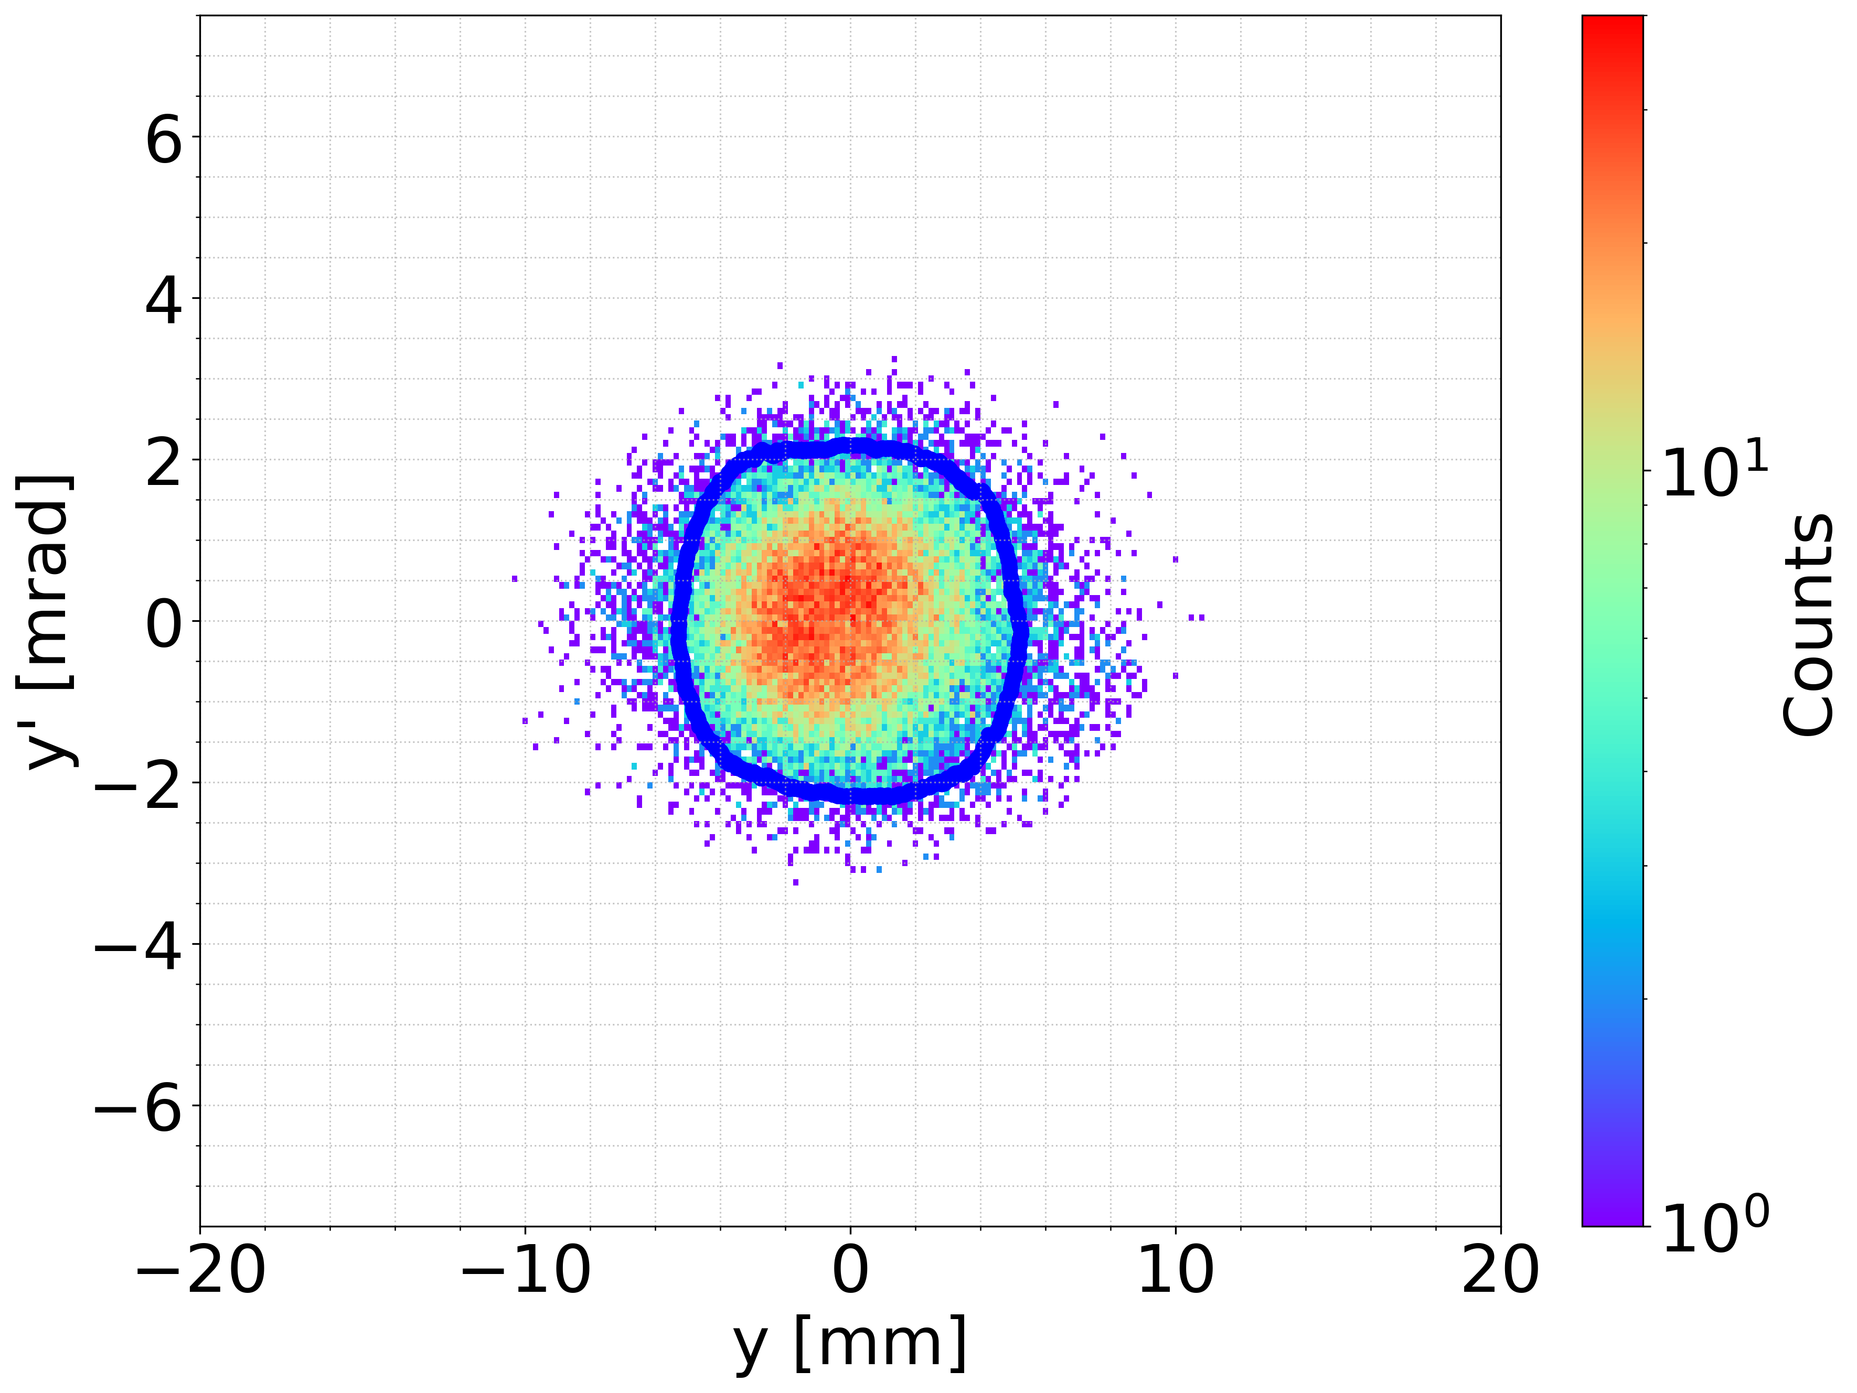
6D DR acceptance approach – (preliminary result)
The selection of the damping ring has not yet been finalized, and the results presented here should be considered preliminary.
6D DR acceptance approach to estimate the accepted e+ yield: the surviving particles identified by particle ID after damping ring tracking are used to define a 6D hypersphere, enabling survival prediction without full DR tracking [1].
With the 6D acceptance approach, the current positron linac design yields an DR acceptance of 1. Further validation and optimization studies are in progress to enhance its performance.
[1] Andrea Latina, “RF-Track acceptance surface,” WP4 - Damping ring and transfer lines, Jun. 27, 2025. https://indico.cern.ch/event/1563670/

Slide 19
Summary
The FCC-ee capture section is essential part of the e+ production chain defining its final performance. The FS baseline fulfils the FCC-ee injector requirements.
Compared with the analytical formula approach and the start-to-end simulation, the accepted yields are comparable when the transverse plane is neglected.
Using Xopt together with analytical formulas, the optimization of both the capture linac and the downstream sections becomes more efficient.
The performance of the RF operating at 3 GHz requires further understanding and more detailed optimization to achieve improvement.
The 6D acceptance approach represents a more advanced method for optimizing the positron linac, although its validation is still ongoing. In addition, machine learning techniques are being considered and compared with the current 6D acceptance approach.

Slide 20

Credits
PSI | B. Auchmann, I. M. Besana, S. Bettoni, P. Craievich, M. Duda, R. Fortunati, H. Garcia-Rodrigues, D. Hauenstein, R. Ischebeck, P. Juranic, J. Kosse, F. Marcellini, U. Michlmayr, G. L. Orlandi, M. Pedrozzi, J.-Y. Raguin, S. Reiche, R. Rotundo, S. Sanfilippo, M. Schär, N. Strohmaier, N. Vallis, M. Zykova, R. Zennaro, H.H. Braun, M. Seidel all the technical groups involved in the P3 experiment
IJCLab | F. Alharthi, I. Chaikovska, R. Chehab, V. Mytrochenko, Y. Wang
CERN | W. Bartmann, H. Bartosik, M. Calviani, S. Doebert, Y. Duthell, J. L. Grenard, A. Grudiev, B. Humann, A. Kurtulus, A. Latina, A. Lechner, R. Mena Andrade, A. Perillo Marcone, K. Oide, Y. Zhao, F. Zimmermann, Z. Vostrel, M. Benedikt
SLAC | T. Raubenheimer
KEK | Y. Enomoto, K. Furukawa, F. Miyahara
INFN-LNF | C. Milardi, A. De Santis, O. Etisken, S. Spampinati
and L. Bandiera, N. Canale, A. Mazzolari, G. Paternò, M. Romagnoni, A. Sytov (INFN/Ferrara), A. Bacci, M. Rossetti Conti (INFN/Milano) | A. Bacci, M. Rossetti Conti, L. Bandiera, D. Boccanfuso (INFN Naple) , N. Canale, O. Lorio (INFN Naple), A. Mazzolari, R. Negrello, G. Paternò, M. Romagnoni, M. Soldani, A. Sytov
This work was done under the auspices of CHART (Swiss Accelerator Research and Technology) Collaboration, https://chart.ch - CHART Scientific Report 2022: https://chart.ch/reports/
FCCIS: 'This project has received funding from the European Union's Horizon 2020 research and innovation programme under the European Union's Horizon 2020 research and innovation programme under grant agreement No 951754.'

Slide 21
Thanks

